Slide 1
OOI Lab Manual v2.0 Overview

Slide 2
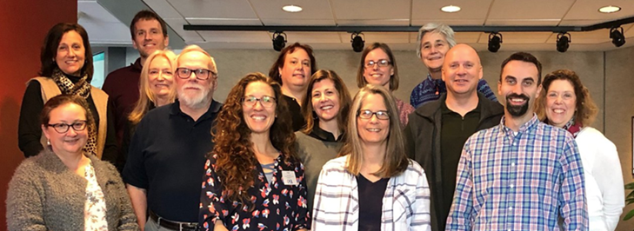
Inspiration for the OOI Lab Manual
Wouldn’t it be great to have a lab manual of OOI data activities aligned to our oceanography classes?
Dr. Sid Mitra
(East Carolina U)

Slide 3
Goals of the manual
Build data literacy and critical thinking skills in undergraduate students using authentic (“messy”) scientific data
Engage students with data activities that reinforce student confidence in scientific questioning, data analysis, and synthesis
Provide a real-world context for key concepts in oceanography

Slide 4
Lab manual audience
Provide instructors, with varying science backgrounds, data activities that are online and ready for implementation
Appropriate for a variety of Introductory Oceanography (or similar geosciences) courses at 2YC or 4YC for majors or non-majors
Follow a typical oceanography course sequence but can be used as stand-alone modules
Flexible for use in F2F, online or hybrid lecture or lab courses

Slide 5
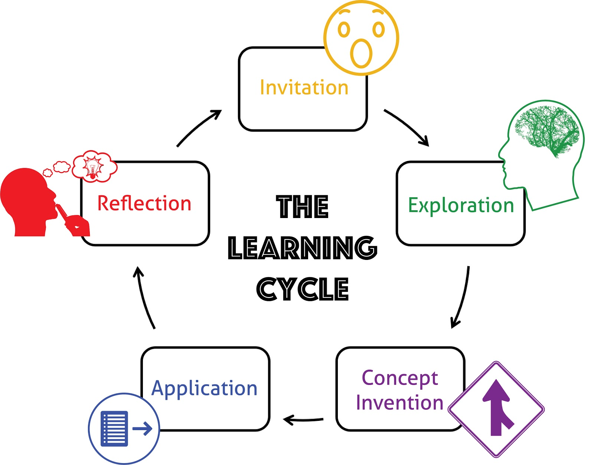
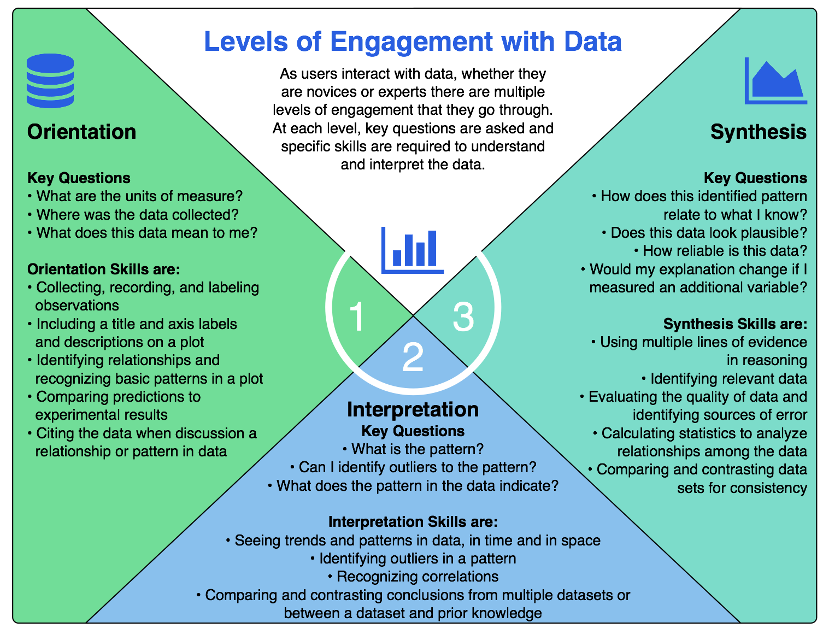
Design of data activities
Based in learning science:
University of California Lawrence Hall of Science
Hotaling et al. (2019)
Notes:
Not necessary to review the learning cycle if already covered by Janice/Sage; focus on adapted levels of engagement

Slide 6
Orientation
First carefully examine a novel dataset or visualization:
data source
variables and units
graph axes (including scales)
maxima and minima
gaps and outliers

Slide 7
Interpretation
Interpret data (without speculation):
variability
trends
correlation

Slide 8
Application
Apply prior knowledge:
recognize correlation vs. causation
compare to known pattern
develop hypothesis or conclusion, supported by evidence from the data

Slide 9
Reflection (and synthesis)
Reflect on the meaning:
Analyze data limitations
Relate to known phenomenon
Evaluate implications of trends or patterns
Connect to practical applications

Slide 10
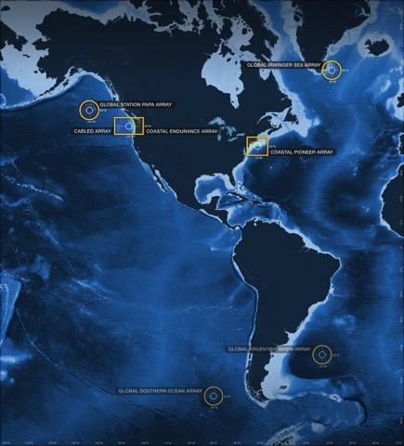
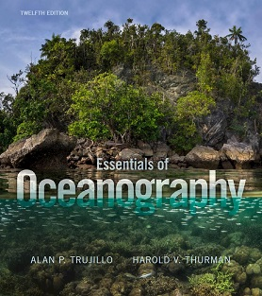
Alignment to Intro Oceanography curriculum
OOI science themes
and data availability
common Oceanography textbooks
Lab Manual chapters

Slide 11
Alignment to Intro Oceanography curriculum
Topic | Chapter
Ocean geography | Lab 1: Introduction to the OOI, the collection of oceanographic data
Ocean technology | Lab 1: Introduction to the OOI, the collection of oceanographic data
Data skills for oceanography | Lab 2: Building data skills
Marine Geology | Lab 3: Plate tectonics and the seafloor Lab 4: Seafloor changes in a volcanically active setting
Ocean Chemistry | Lab 5: Investigating density stratification
Physical Oceanography | Lab 6: Waves generated by large storms
Biological Oceanography | Lab 7: Primary production Lab 8: Anoxic events

Slide 12
Peer review – Fall 2020 pilot implementation
Sample responses:
“The interactive graphics were excellent. It allowed students to explore the dataset and to see how the variability changes as you view the data over different time periods.”
“[students] were curious and surprised, and engaged. I think the unit actually set a tone of curiosity that persisted through the term”
Revisions based on pilot tester feedback:
Additional scientific background and definitions of key terms
Recalibration to meet needs of introductory courses
Increased focus on asynchronous online (while supporting other modalities)
Seeking additional pilot testers for Fall 2021…more on this later

Slide 13
Lab Manual structure
Each chapter contains:
Introductory page
Hook, brief background, key terms
3-4 data activities
follow orientation-interpretation-application-reflection model
scaffolded to increase in complexity
based around interactive data “widgets”
Instructor guide
learning objectives, additional scientific background, teaching tips, links to related resources

Slide 14
Walk through of Lab 1
https://datalab.marine.rutgers.edu/ooi-lab-exercises/lab-1-the-collection-of-oceanographic-data/

Slide 15
Meet with Lab Authors/Implementers
(Breakout Rooms)

Slide 16
Breakout Rooms:
Room “Lab 2”
Lab 2 – Building Data Skills
Room “Labs 3&4”
Lab 3 – Geology – Plate Tectonics and the Seafloor
Lab 4 – Geology – Sea Floor Changes in a Volcano
Room “Labs 5&6”
Lab 5 – Ocean Chemistry – Density and Stratification
Lab 6 – Ocean Physics – Waves Generated by Large Storms
Room “Labs 7&8”
Lab 7 – Biological Oceanography – Primary Production
Lab 8 – Anoxic Events – Solve the mystery of the dying crabs
Table of Contents: https://datalab.marine.rutgers.edu/ooi-lab-exercises/
Instructions:
Click Breakout Rooms in your meeting controls.
Hover your pointer over the number to the right of breakout room you wish to join, click Join, then confirm by clicking Join.
Participants not joined with the desktop or mobile app (version 5.3.0 or higher) will not be able to self-select a breakout room. The host will need to facilitate moving these participants manually.

