Slide 1
Contouring a vertical section
Contouring data, such as salinity or temperature, collected in the ocean reveals the structure of the water column

Slide 2
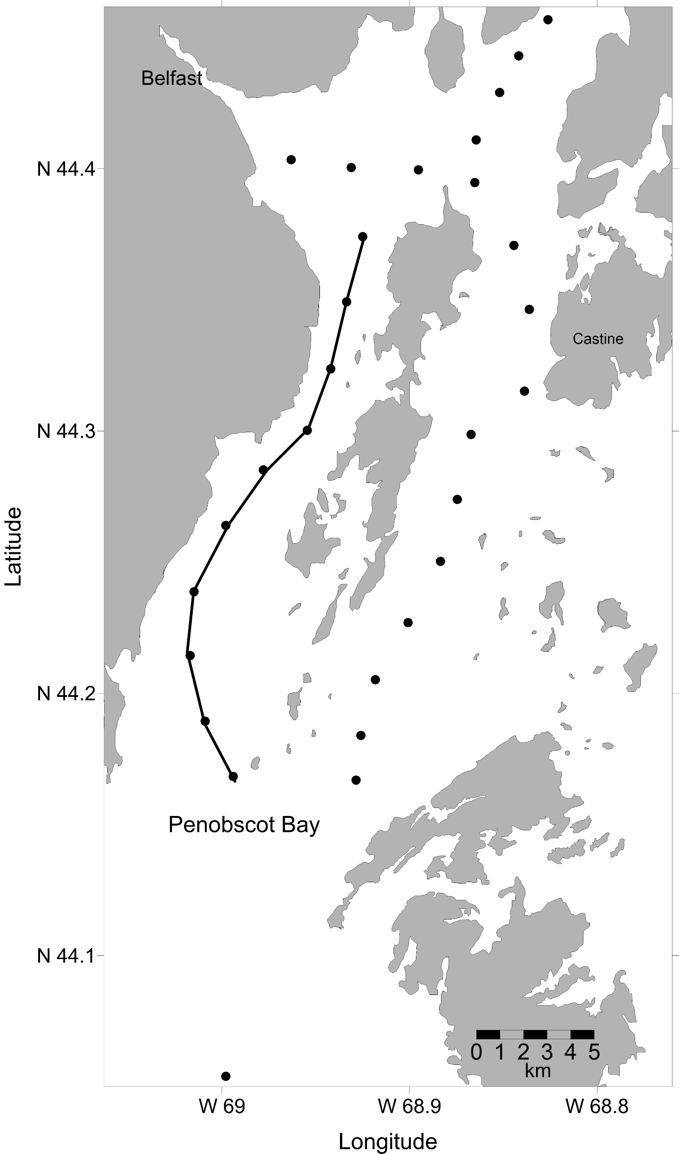
In a study of Atlantic Salmon migration oceanographic stations were occupied in Penobscot Bay to see if environmental conditions such as salinity or temperature controlled migration.
The dots on this map show the station locations, and the line shows the line along which the vertical section in this exercise was taken.

Slide 3
The same rules that are used to contour bathymetry data are used to contour a vertical section. The slide on the next page has salinity data collected in Penobscot Bay, Maine. Draw in the following contour lines to reveal the structure in the water column: 28, 29, 30 and 31

Slide 4
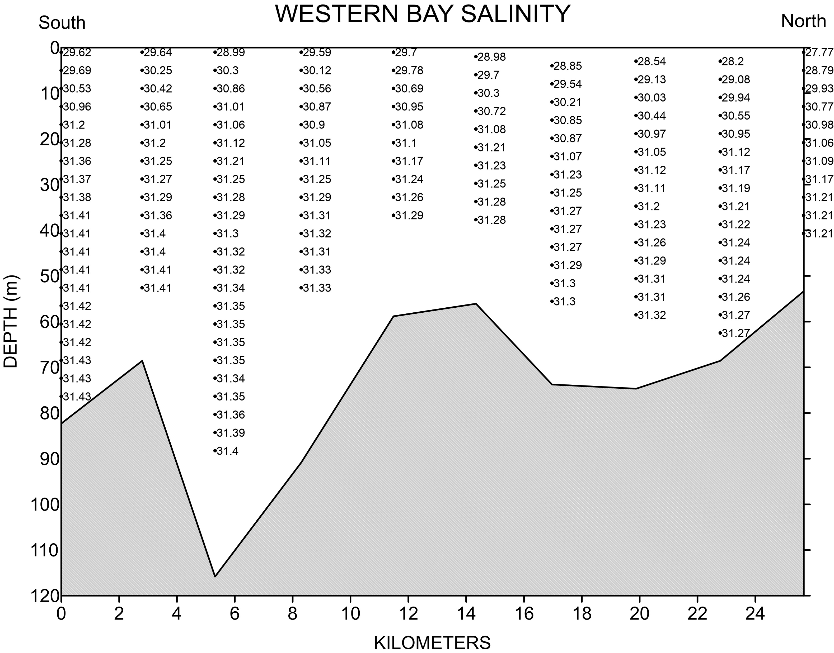

Slide 5
29
28
30
29
31
Notes:
Once students have contoured the data they may add color to illustrate color contouring. Choose a different color to use between each pair of contour lines.

Slide 6
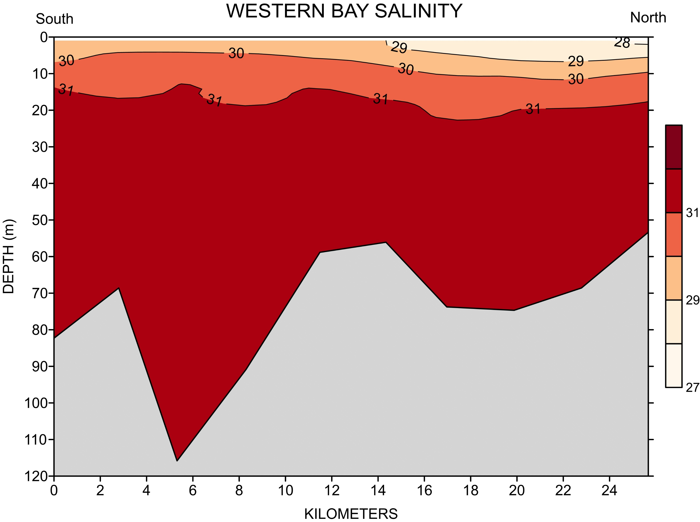
The vertical section you contoured, and this color version of the same data set, clearly shows that the lower salinity river plume floats on top of the saltier ocean water.

Slide 7
The slide on the next page may be printed out and given to students to practice contouring

