Slide 1
How Does Temperature and Air Pressure Vary Between
Guam, Puerto Rico, and Rhode Island?
Margot Chisholm
Nikko Galanto
Patricia Vidal

Slide 2
Background
Three students living in three distinct coastal regions of the U.S.
Does temperature and air pressure along these coasts reflect those distinctions? How so?
Will these regions show any common trends?
Puerto Rico
Guam
Rhode Island
Notes:
We knew that

Slide 3
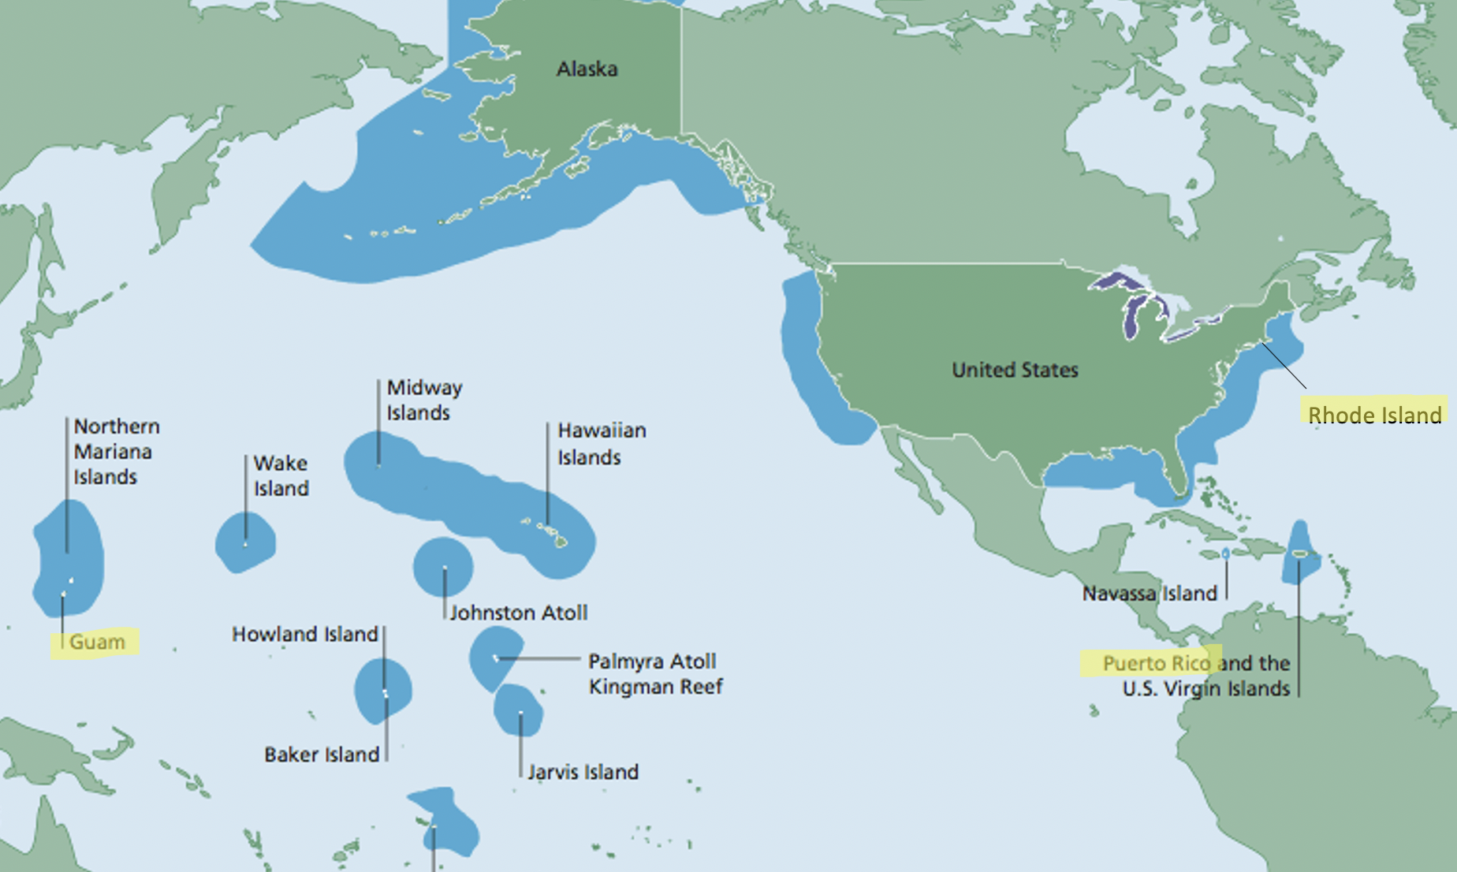

Slide 4
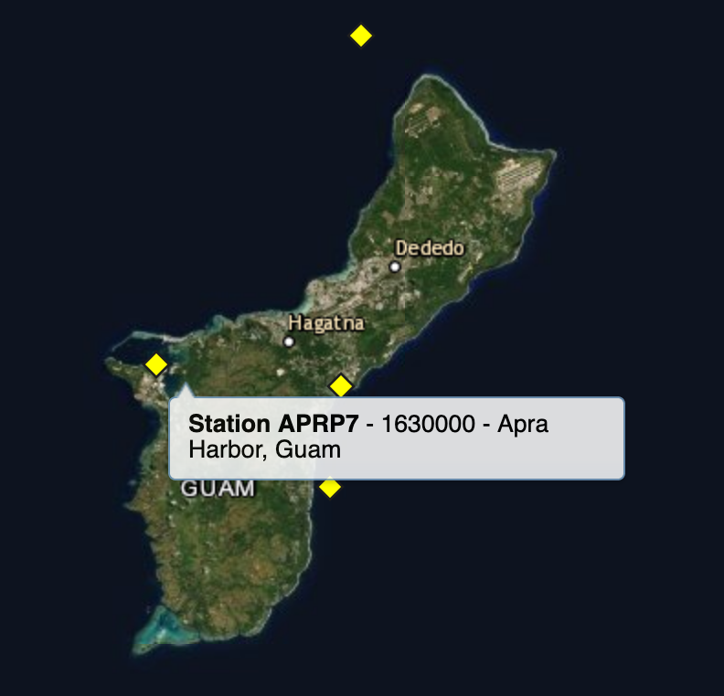
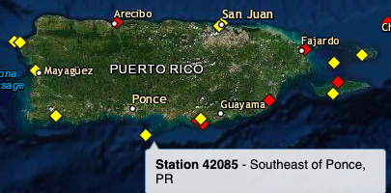
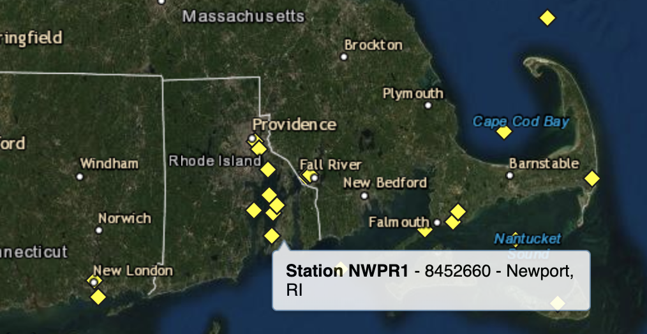
Datasets Used

Slide 5
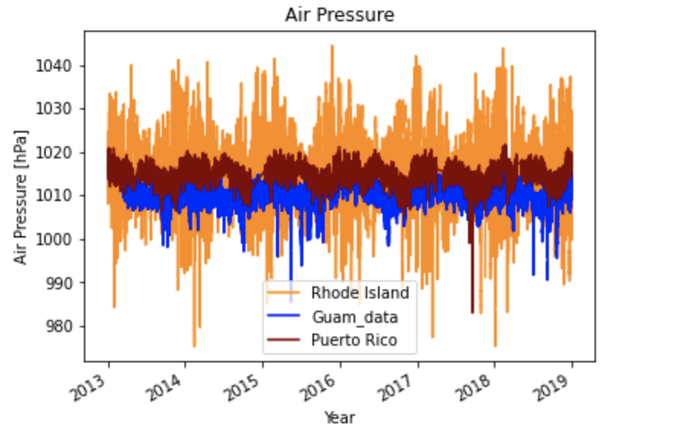
Air Pressure over 6 Years
Notes:
Mention the outliers (ex: Guam’s drop mid 2015 = Typhoon Dolphin; pretty devastating)

Slide 6
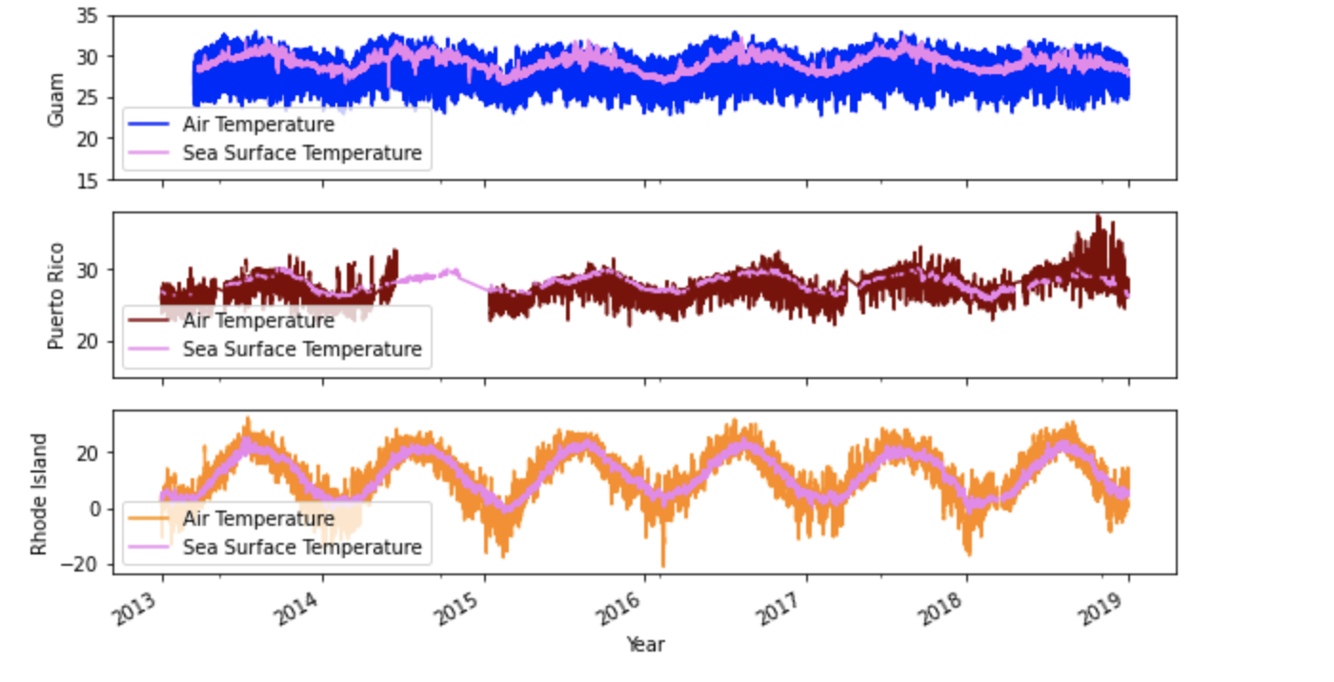
Air Vs. Sea Surface Temperature
Notes:
Make sure to start by orienting

Slide 7
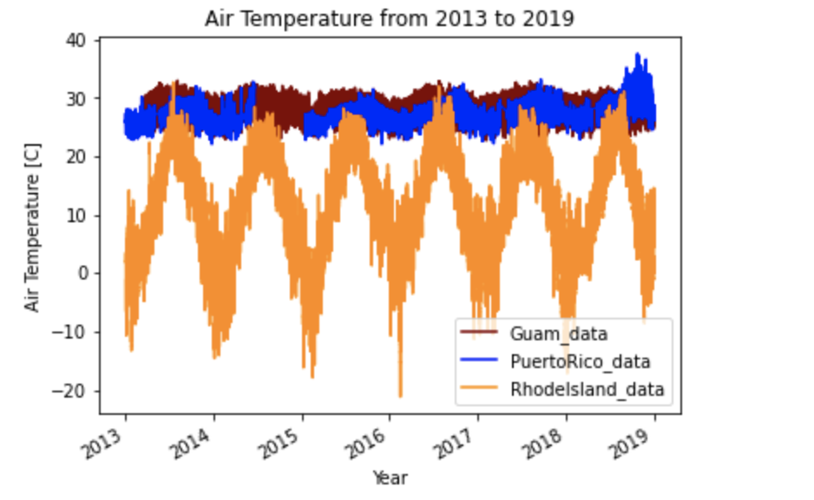
Air Temperature over 6 years
Notes:
Air temp is the most commonly measured weather parameter
Air temperature affects:
the rate of evaporation
relative humidity
wind speed and direction
precipitation patterns and types, such as whether it will rain, snow, or sleet.

Slide 8
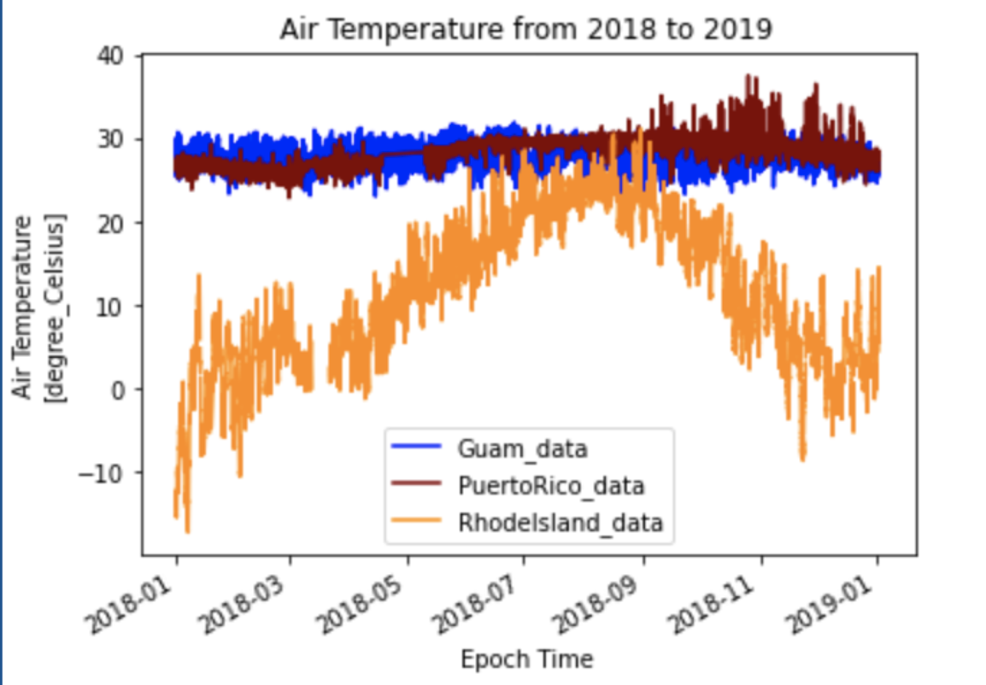
Air Temperature of 1 year
Notes:
Guam and Puerto Rico show similarities due to the same tropical seasonal patterns
Rhode Island shows more seasonal variation and showcases the four seasons

Slide 9
Conclusion
Guam and Puerto Rico have the same seasonal behavior.
Seasonality is visible in Rhode Island data.
Guam and Puerto Rico have more similarities because they are closer to the equator compared to Rhode Island.

Slide 10
Implications for the Future
See data from 20 or 30 years ago to see if climate change is visible.
See Ocean Data

Slide 11
References:
https://www.ndbc.noaa.gov/
https://www.ndbc.noaa.gov/station_history.php?station=aprp7
https://www.ndbc.noaa.gov/station_page.php?station=nwpr1
https://www.ndbc.noaa.gov/station_history.php?station=42085

Slide 12
Acknowledgments:
Janine Barr
Sage Lichtenwalner
Dr. Richard Dixon

