Slide 1
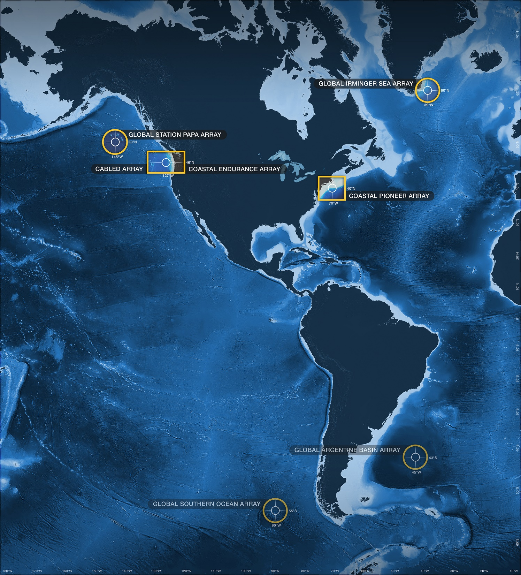
Discrete vs. Continuous Data
Ocean Data Labs
Rutgers University
datalab.marine.rutgers.edu

Slide 2
Discrete Data
Let’s take a look at a few snapshots of data…

Slide 3
1/8

Slide 4
2/8

Slide 5
3/8

Slide 6
4/8

Slide 7
5/8

Slide 8
6/8

Slide 9
7/8

Slide 10
Return to beginning
8/8

Slide 11
Continuous Data
Now let’s see what really happened!

Slide 13
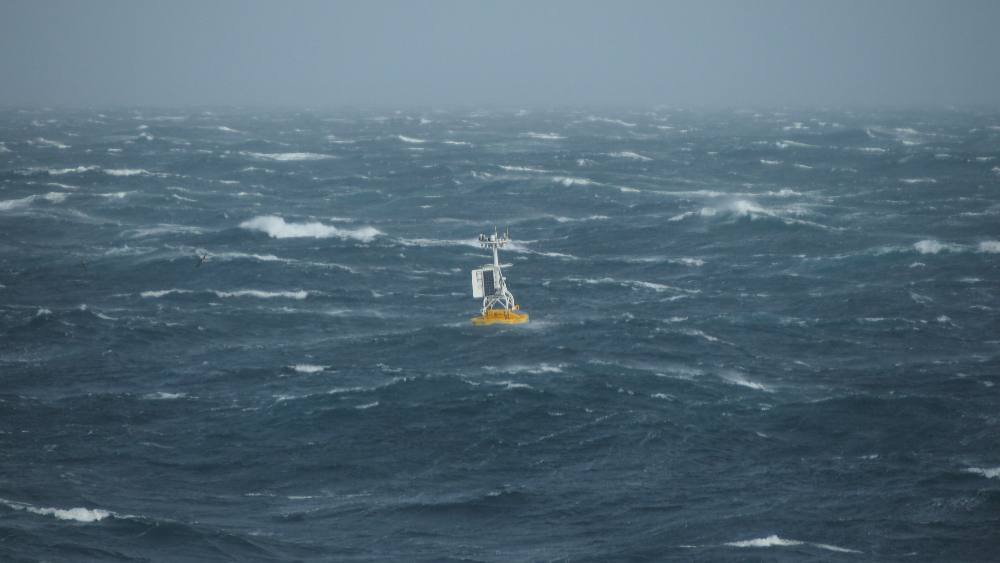
Ocean Observing Systems
Real-time
High-resolution
Long-term
No seasickness

