Slide 1
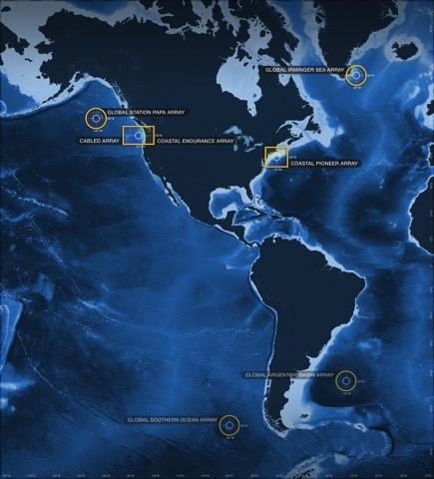
Ocean Data Labs
Dax Soule
Ocean Data Labs Workshop
0SM 2024
datalab.marine.rutgers.edu

Slide 2
Catalyst Question
Wanted: One shovel ready project that delivers a sustained, research-driven, ocean observing capability.
What should such a system be comprised of?
Notes:
Global, regional, and local climate change and impacts
coastal hazards
ecosystem-based management
the relationship between the ocean and human health

Slide 3
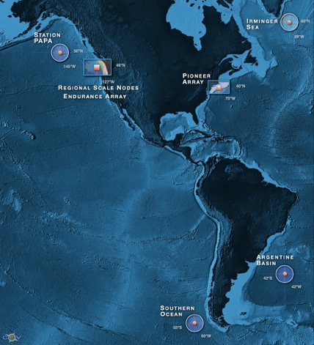
What and where was OOI built?
A distributed network of fully open access data for sustained periods open to anyone with open access to the web the democratization of oceanography
Ability to characterize the importance of episodic versus seasonal, annual variability over eddy, shelf and plate scales
>800 unique sensors deployed at any given time on the network
A network capable of absorbing new sensors as they are developed by the wider scientific community
A scalable cyber infrastructure providing a service orientated architecture
A system that provides web service data management with visualization
An integrated education and public engagement suite of tools that can be directly integrated into undergraduate education modules

Slide 4
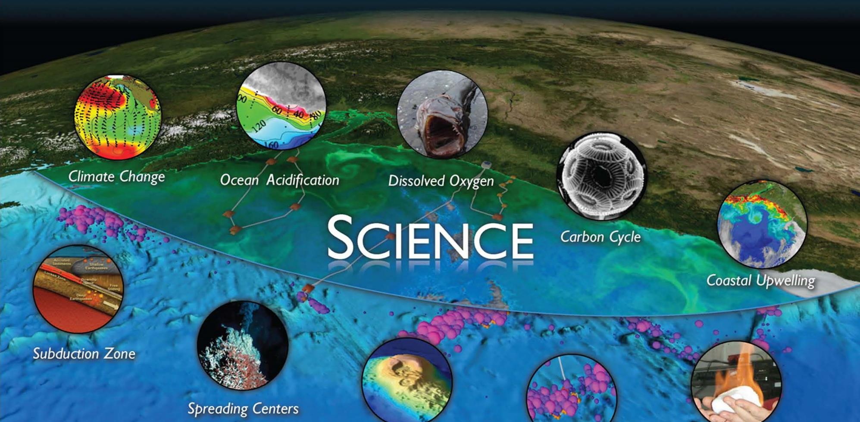
WHY?
UW CEV Graphics
Global Biogeochemistry and Carbon Cycling Ocean-Atmosphere Exchange
Ocean Circulation, Mixing and Ecosystems Climate Variability and Ecosystems
Coastal Ocean Dynamics and Ecosystems - Hypoxia on Continental Shelves
Coastal Ocean Dynamics and Ecosystems - Shelf/Slope Exchange
Notes:
Overarching themes:
Forcing and exchange at the boundaries
Dynamics of the boundary regimes
Dynamics and variability of the ocean volume

Slide 5
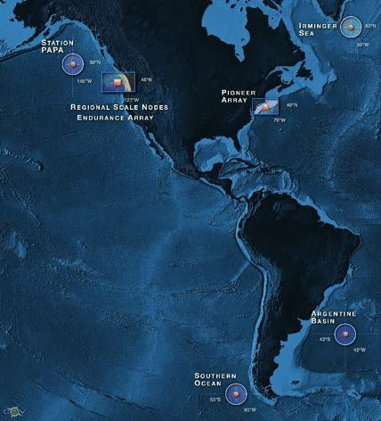
OOI By the Numbers
7
57
33
1227
>2500
>100K
Arrays
4 Global, Pioneer, Endurance, Cabled
Sites
Moorings, Profilers, Nodes
Mobile Assets
Gliders, AUVs
Instruments
Science Data Products
Science/Engineering Data Products
Notes:
Greater than 2500 data products
Some stream in from the cable
Some are telemetered….things like gliders will dump periodic data when it comes to the surface.
Different latencies with the different data types.
If you include the engineering streams you have over 100K separate data streams at anyone time. The scale of this is a huge data problem.
It is especially difficult because of the diversity of the data streams. If you use the national weather service as a comparison, they deal with a similar amount of data,,, but they are only measuring a few key parameters, so you can build a driver once and it will be usable by a third of the network. With OOI they had to build individual drivers for each sensor. This has been a process… not everything worked the first time, but at every step we have tried to seek and be responsive to community feedback.
We are the goal… NSF and the OOI wants this system to work for you.

Slide 6
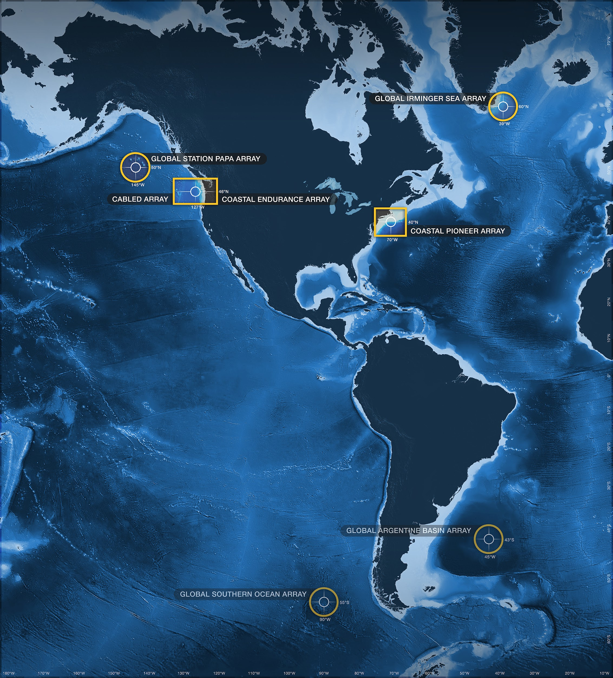
OOI Components
4 (3) High Latitude Global Sites
Regional Plate-scale Cable
2 Coastal Dynamics Arrays
Data Management System
Ocean Education Portal
Notes:
These different components reflect how the OOI was funded.
Huge cohort of coastal oceanographers
Huge cohort of deep sea oceanographers
Huge cohort of seafloor volcanism group with Neptune.

Slide 7
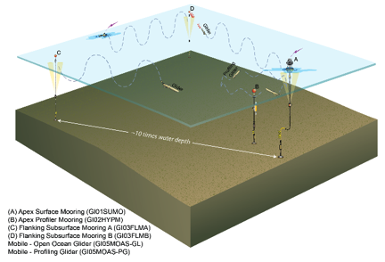
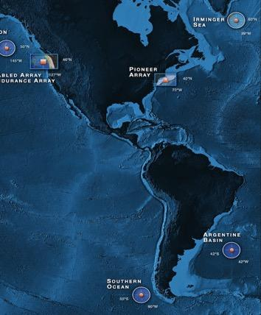
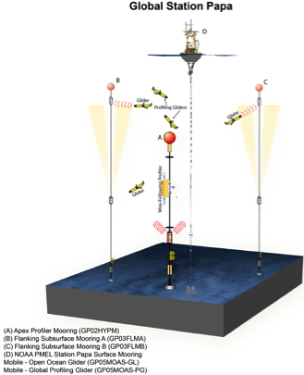
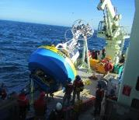
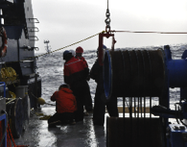
OOI Components: Global Array
Four Global Sites
Flanking Moorings
Profiler Mooring
Surface Mooring
Gliders (5)
Bio-Acoustics
Telemetered & recovered data
Notes:
The deep sea thing is an array of moorings filled in with gliders and the spacing is optimized to be able to resolve the EDDIE covariances that flow through the network.
Placed in areas where you have very extreme weather, like the Southern Ocean
What you will notice is that the network components are often components of larger experiments.
From a proposal standpoint, you can write a proposal that leverages all of this infrastructure to answer your science questions.

Slide 8
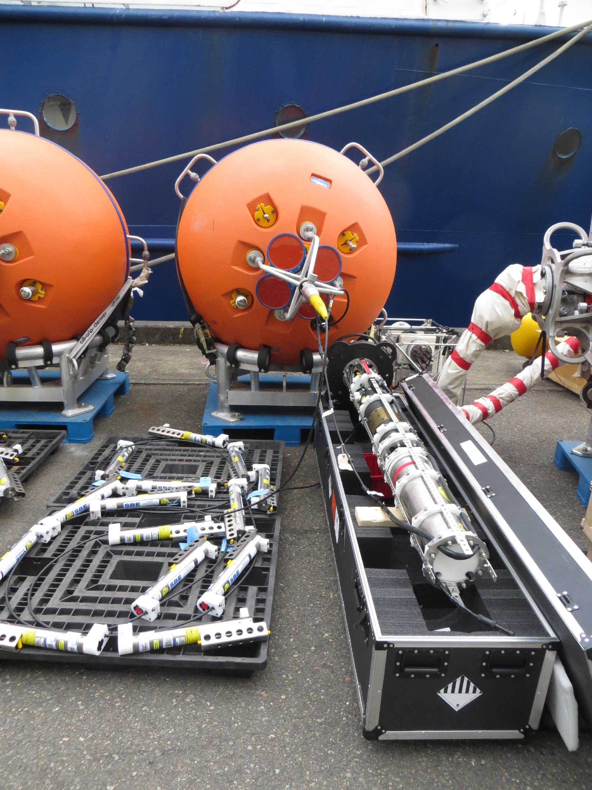
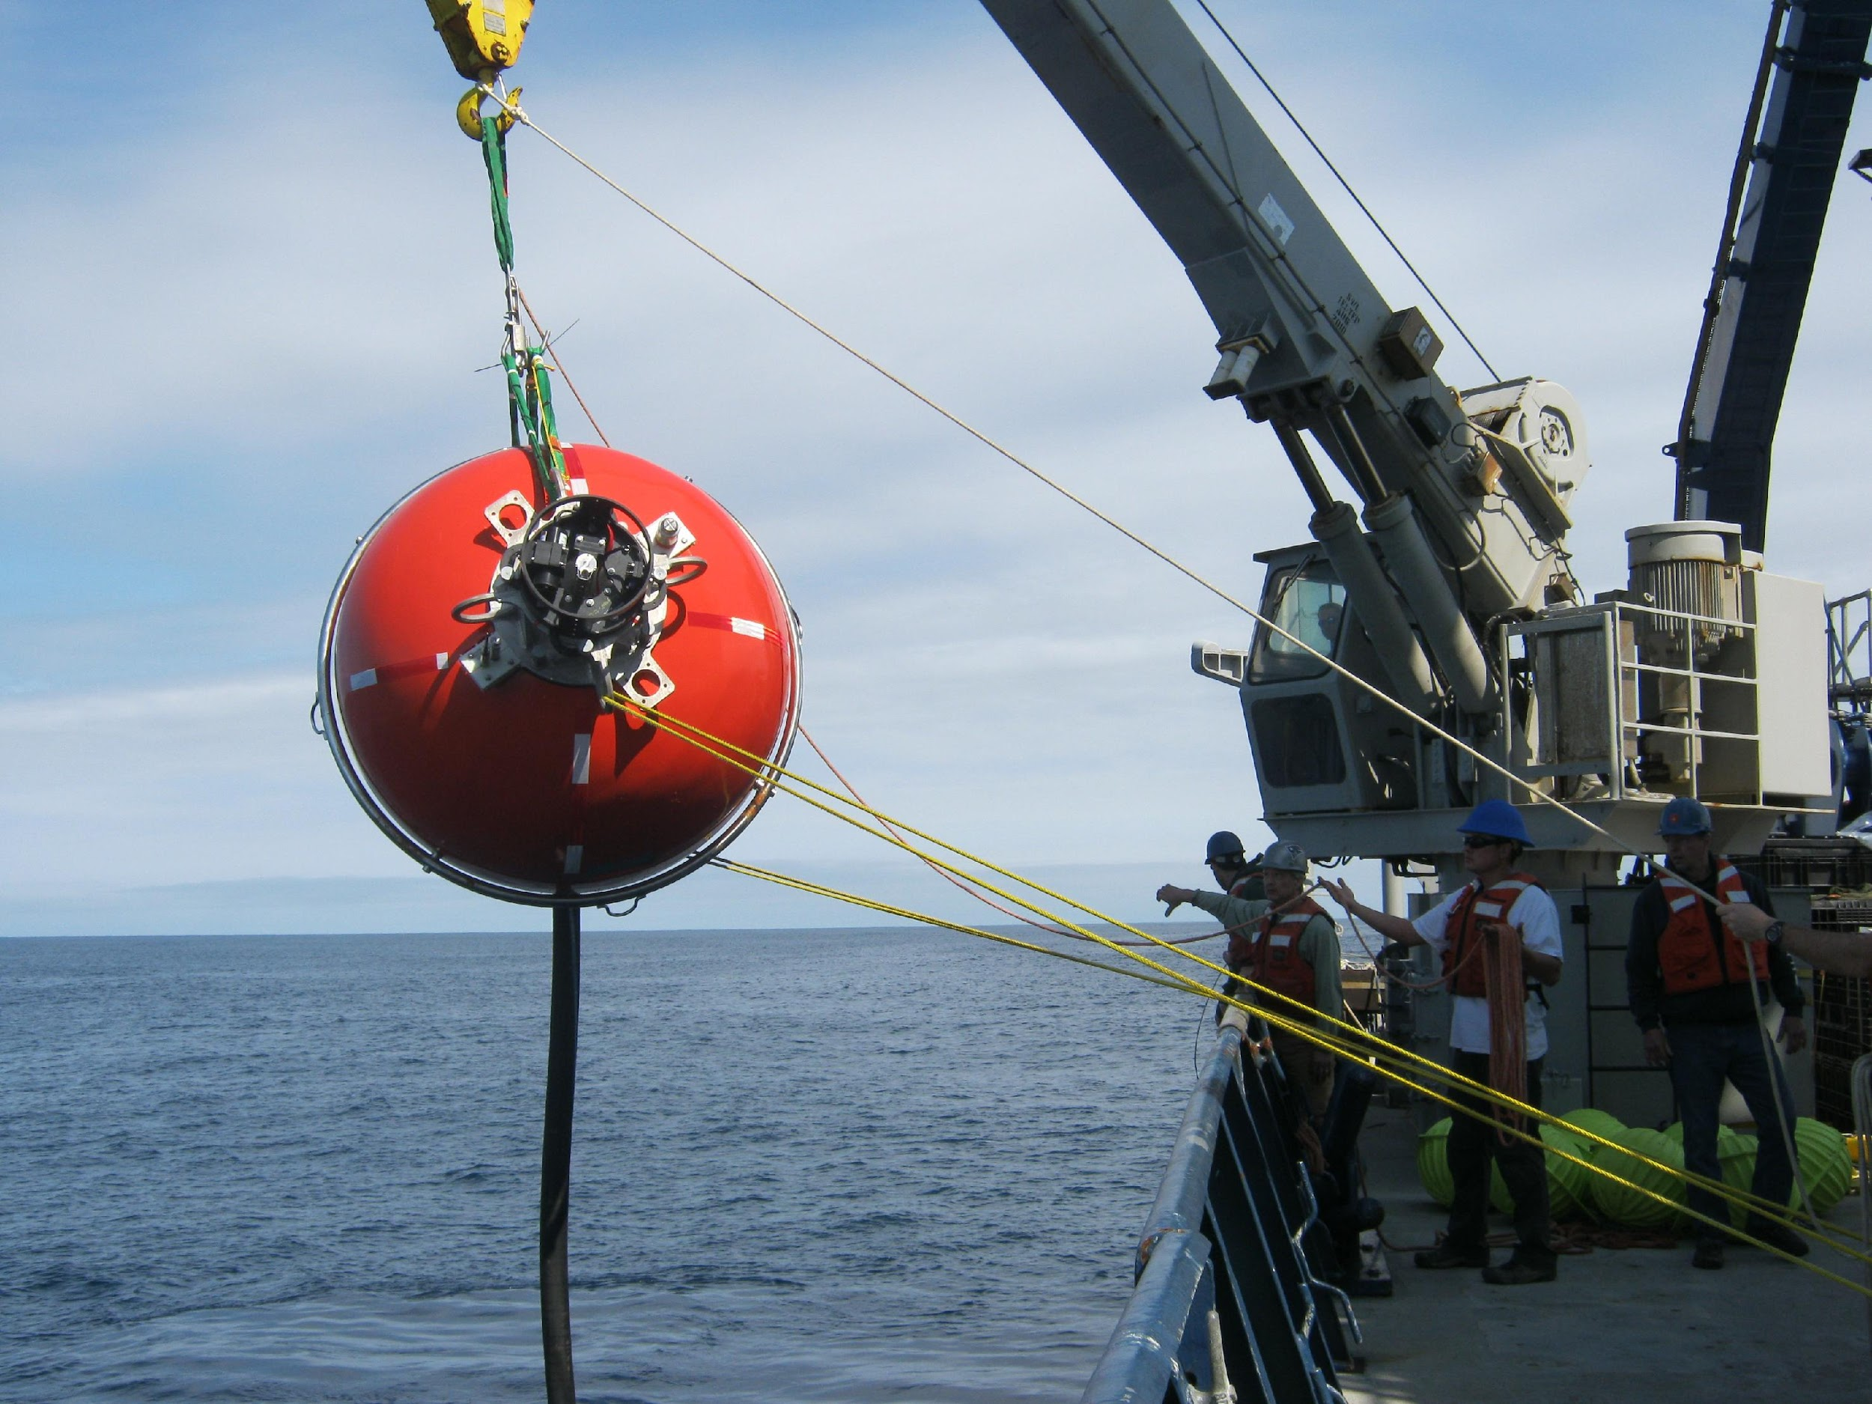
Global Flanking Moorings

Slide 9
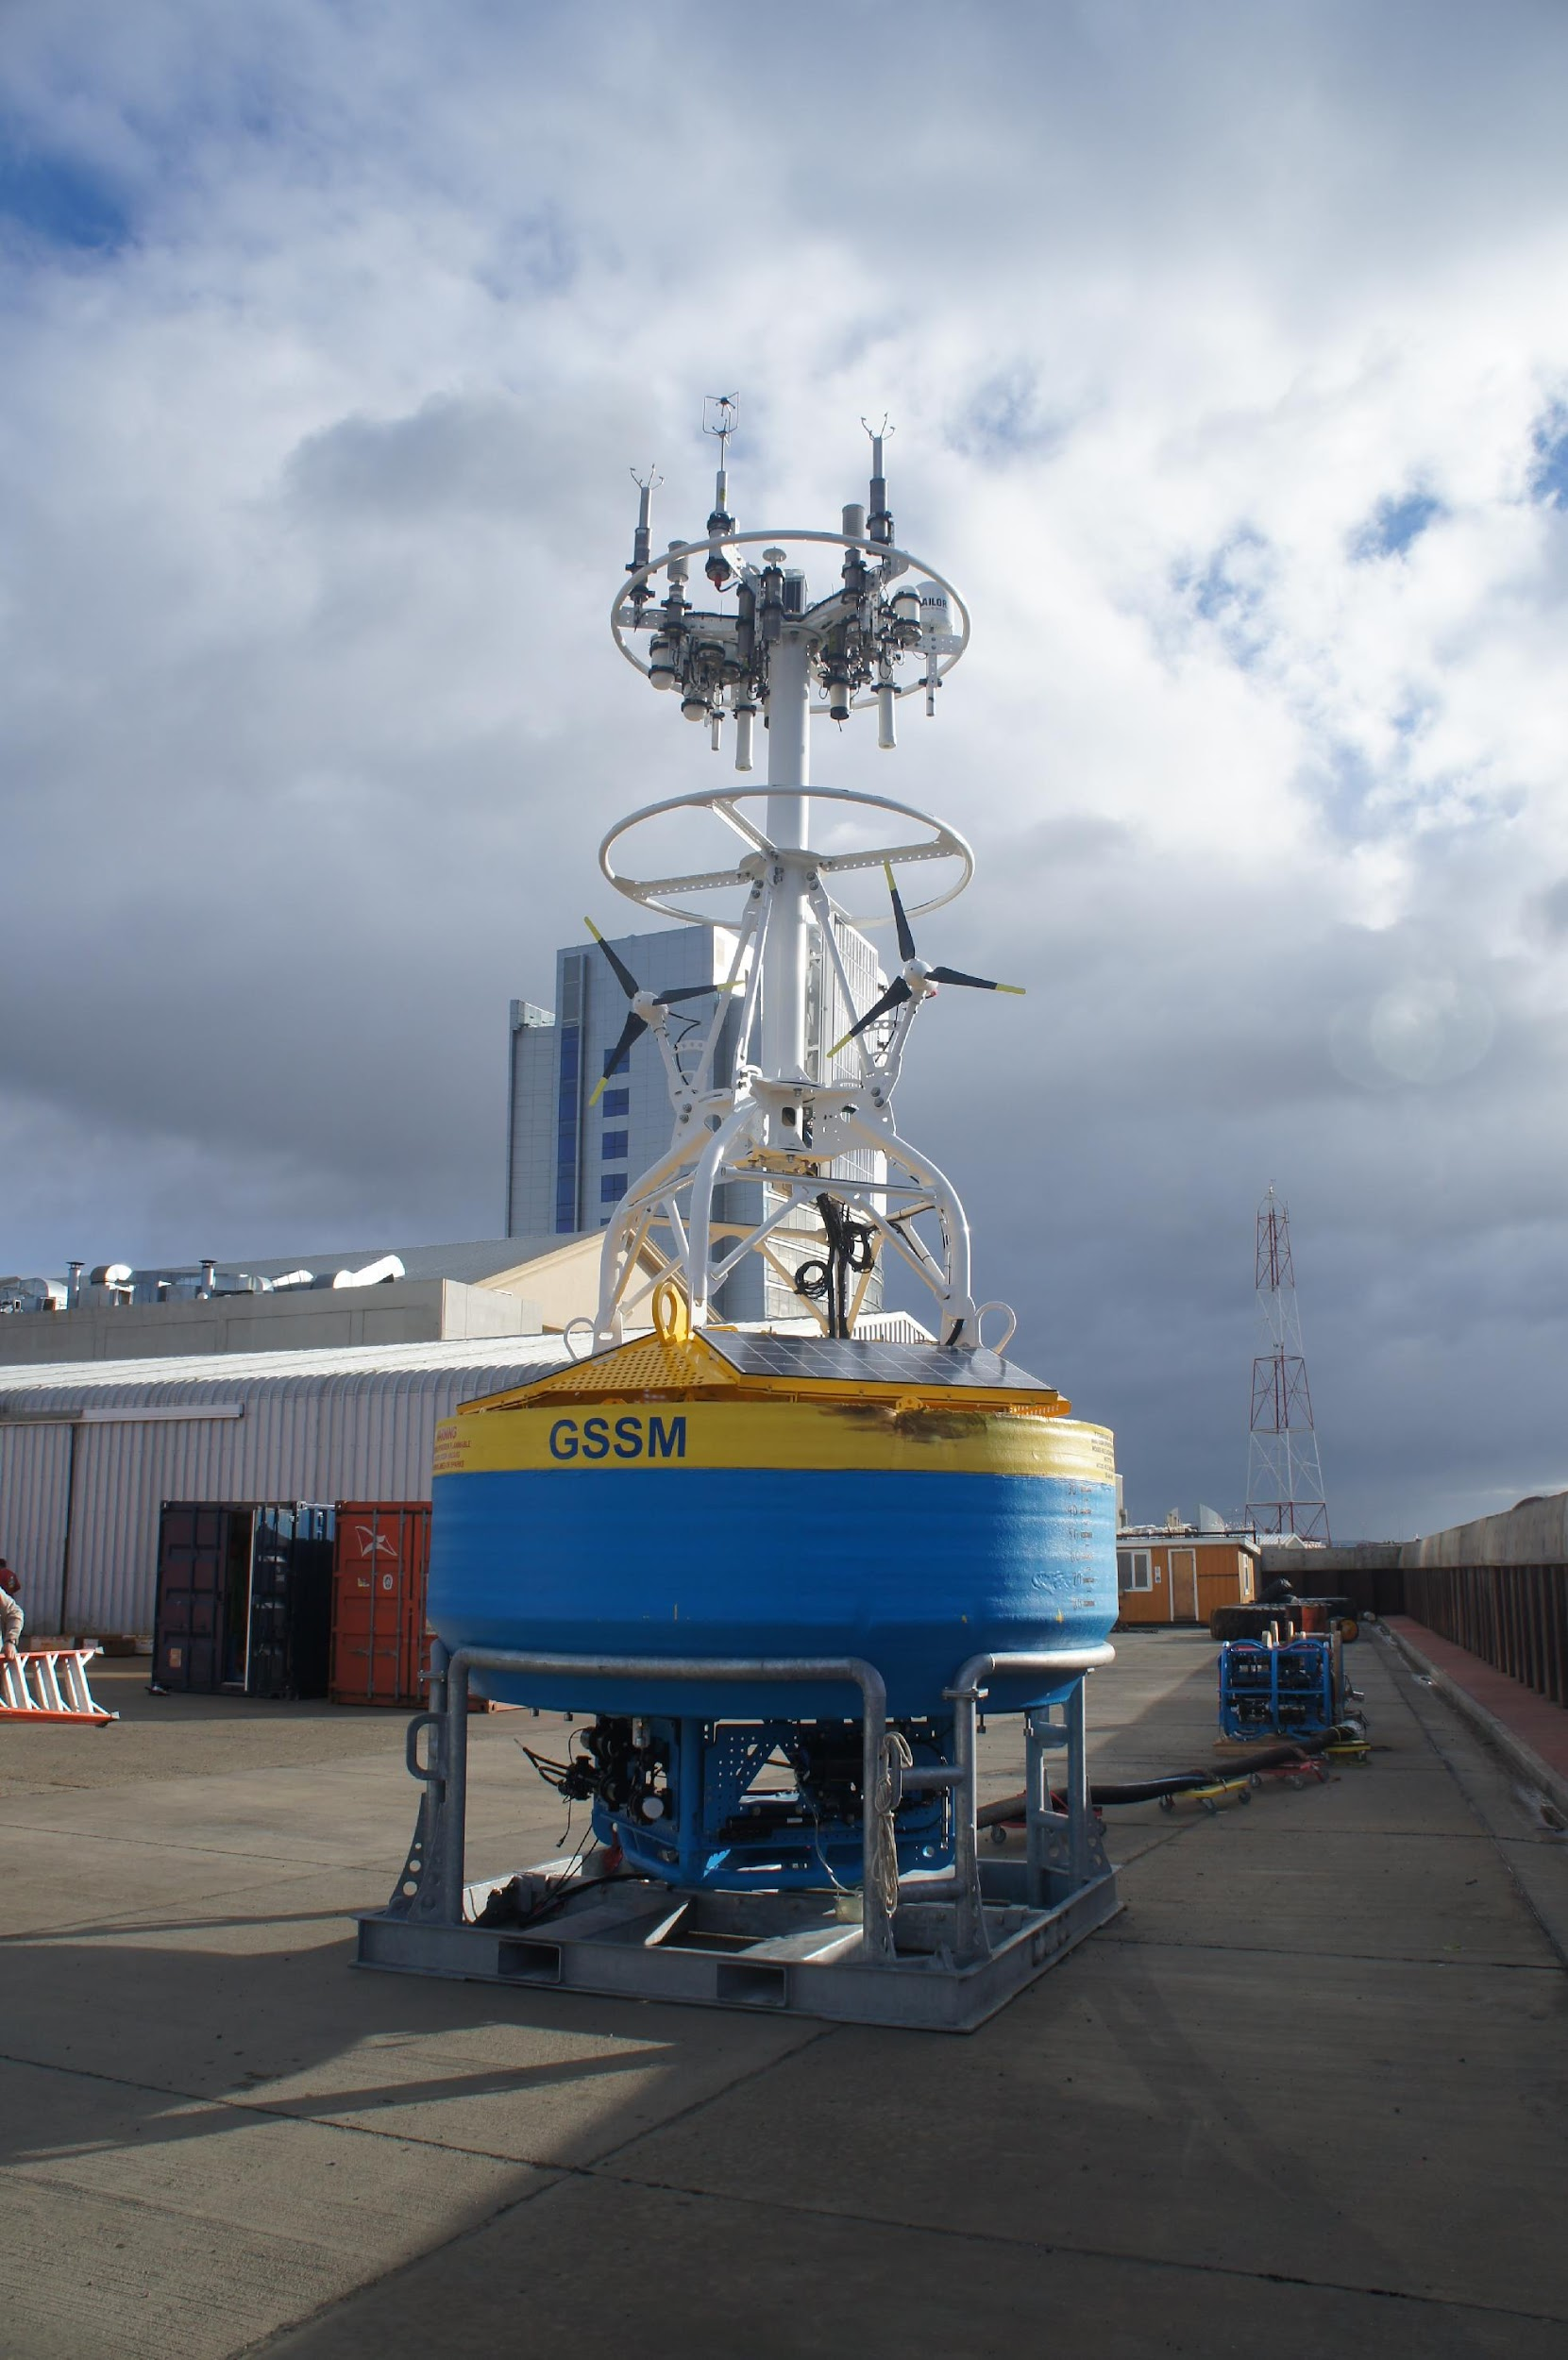
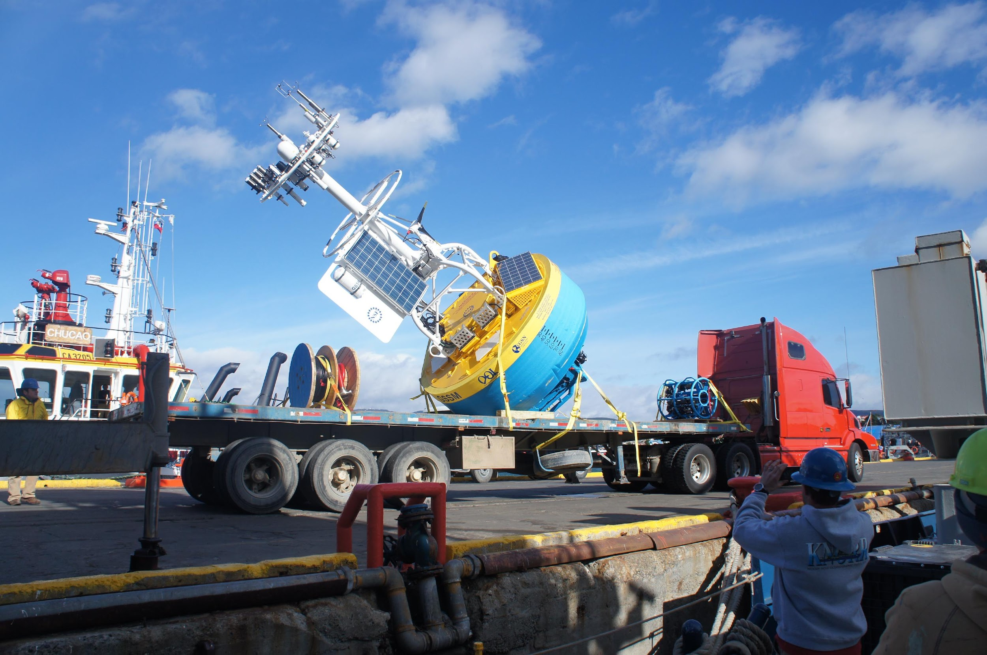
Global Surface Mooring

Slide 10
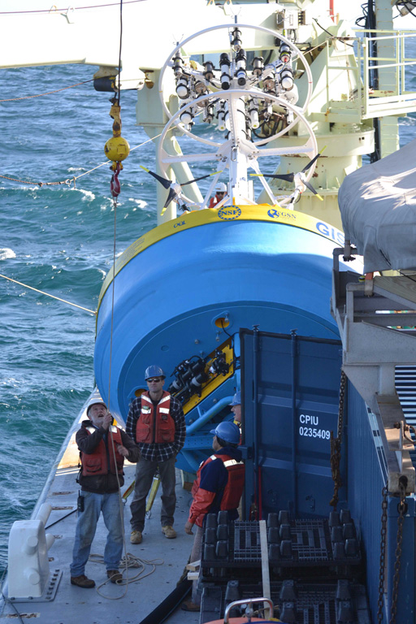
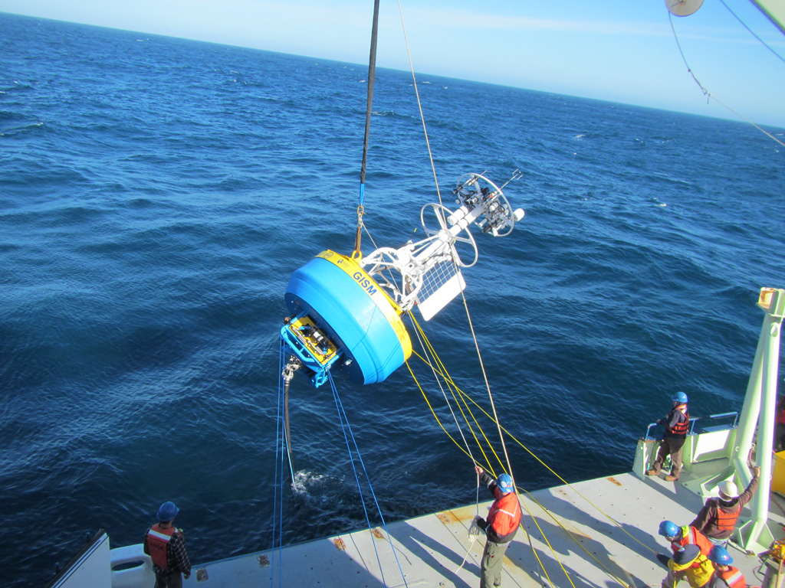
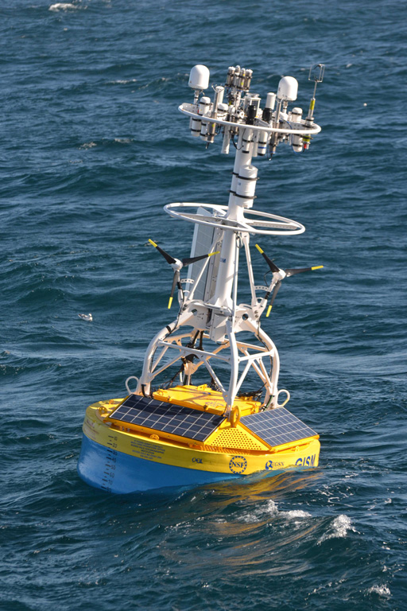
Irminger Sea Deployment, Sept. 2014

Slide 11
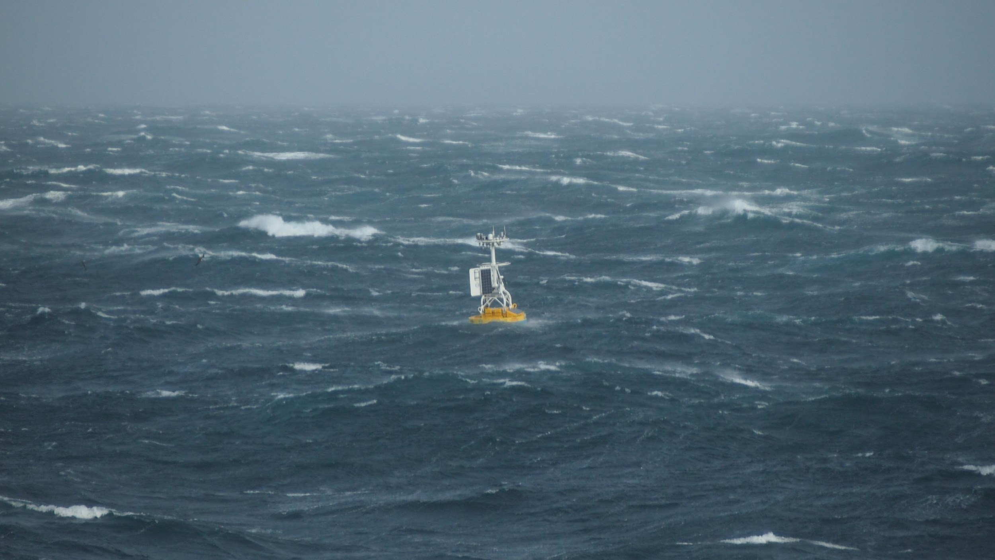

Slide 12
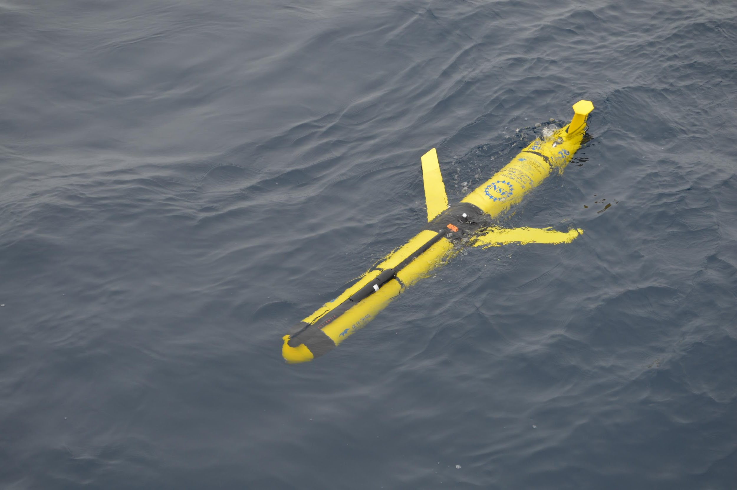
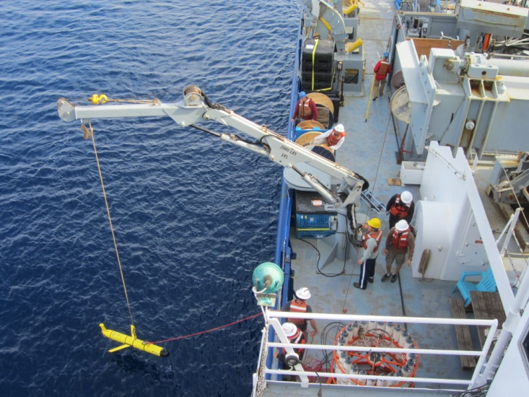
Global Gliders

Slide 13
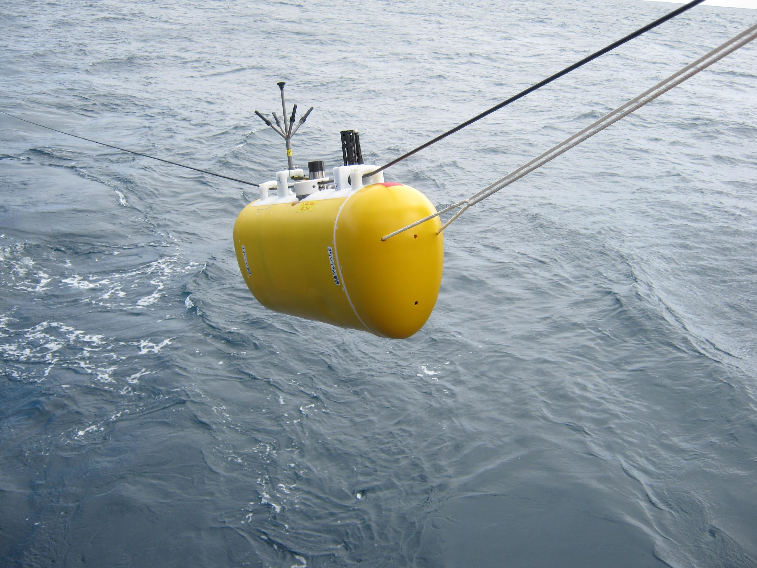
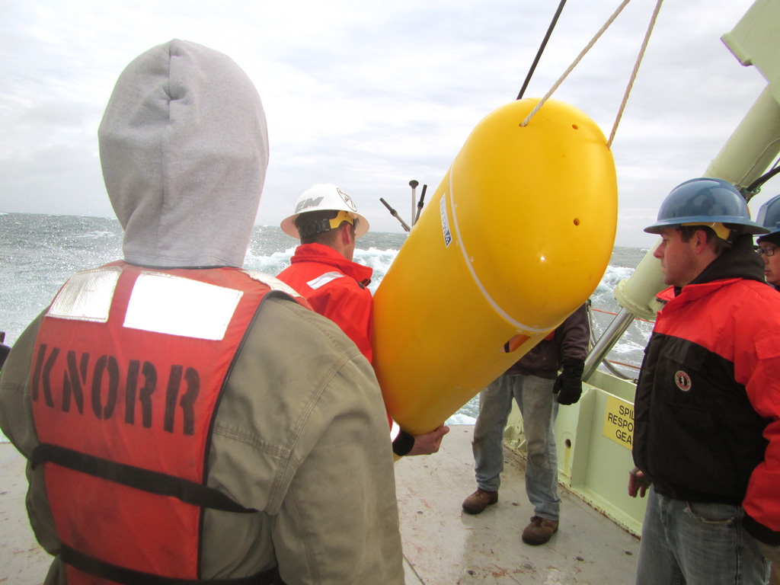
Global Wire Following Profiler

Slide 14
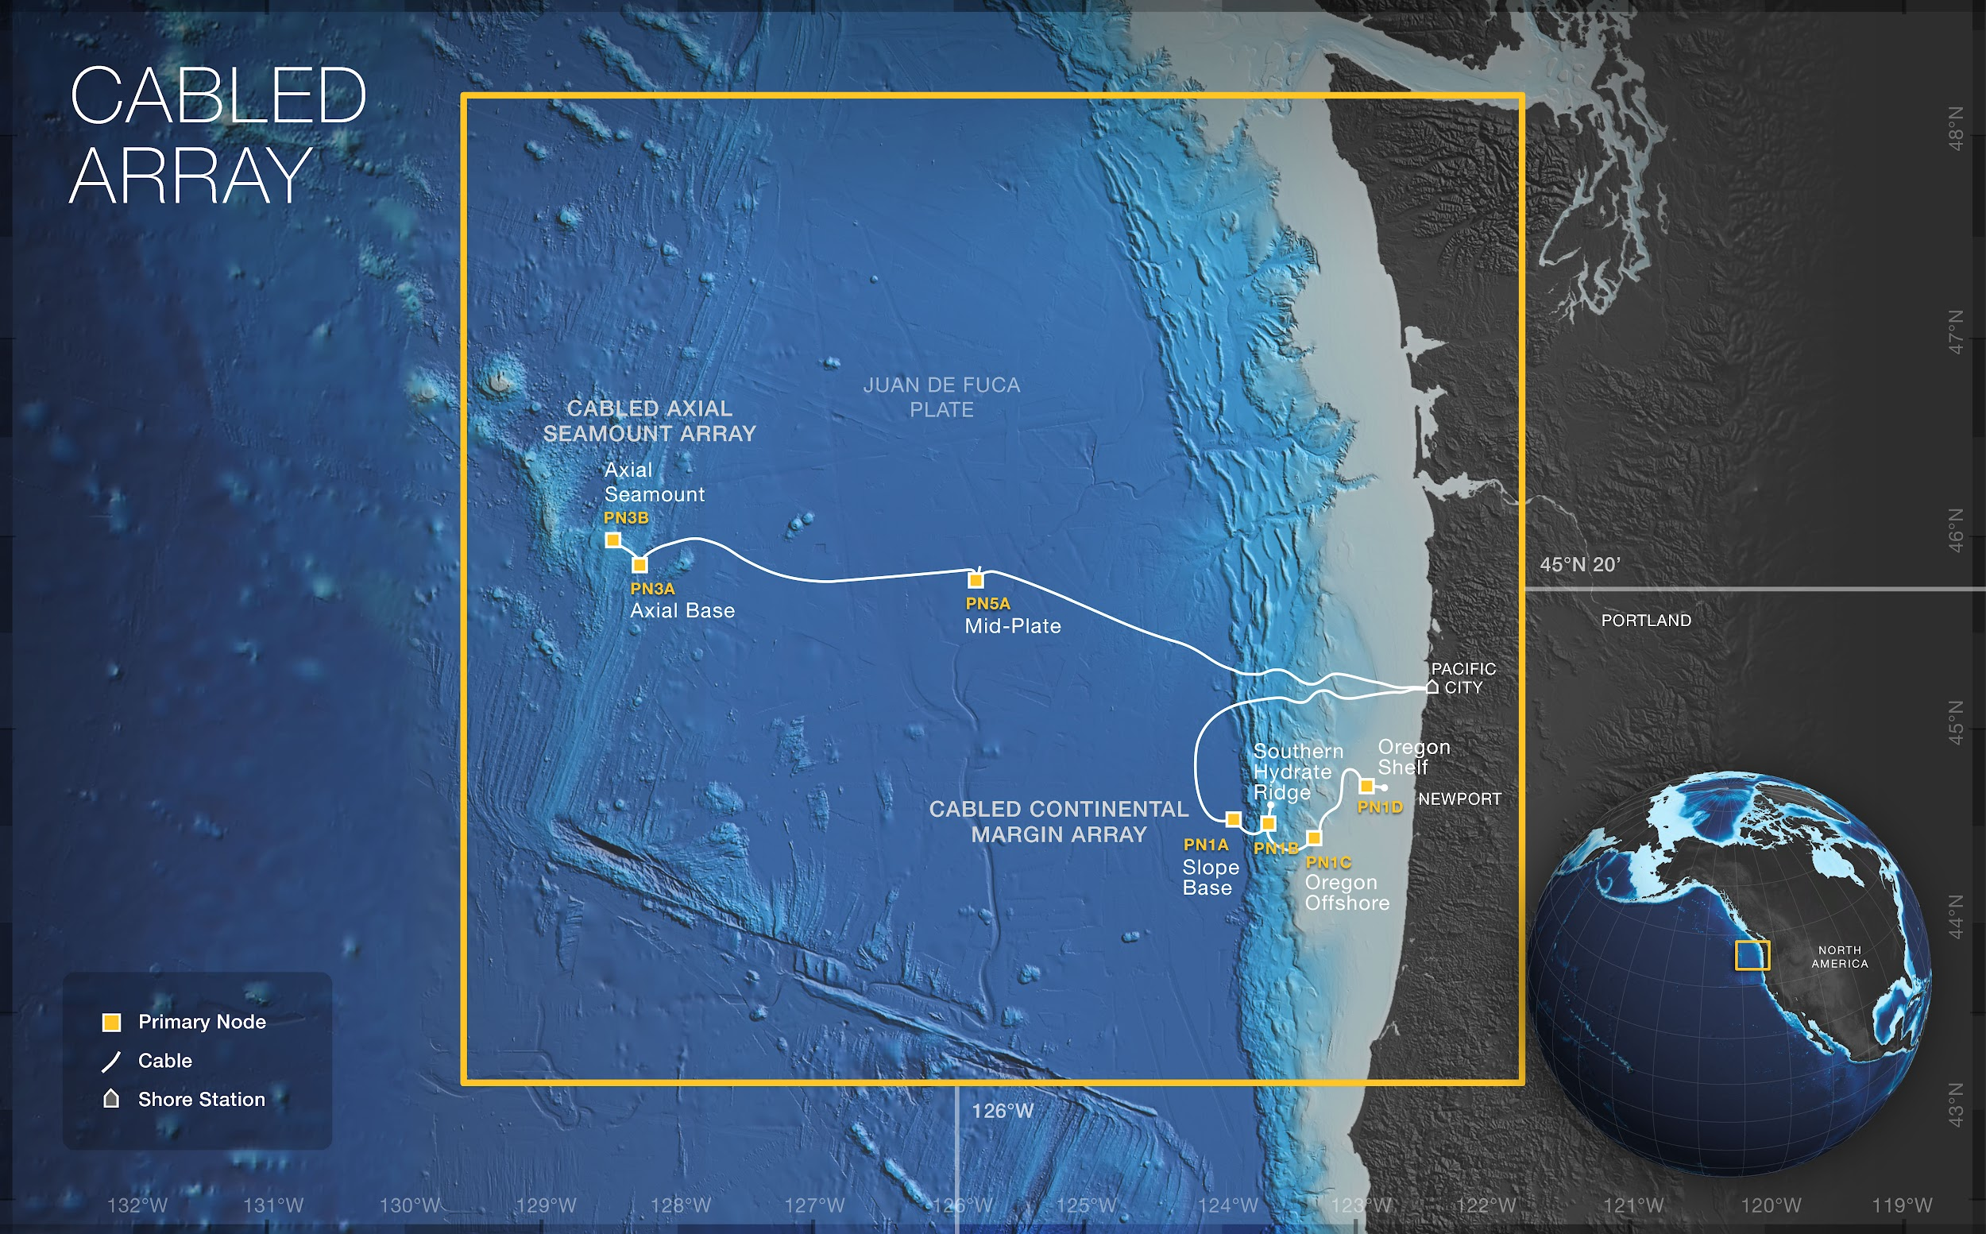
Moorings
Profilers
HD Video
Hydrophones
Seismic
Cable allows for high frequency sampling and quick delivery

Slide 15
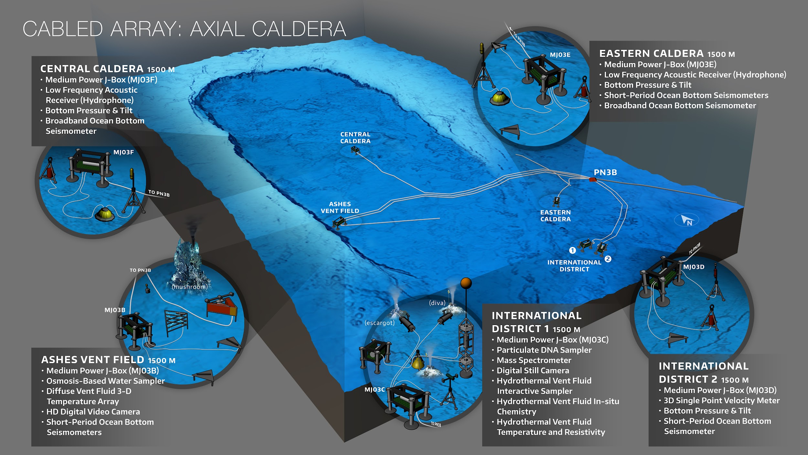

Slide 16
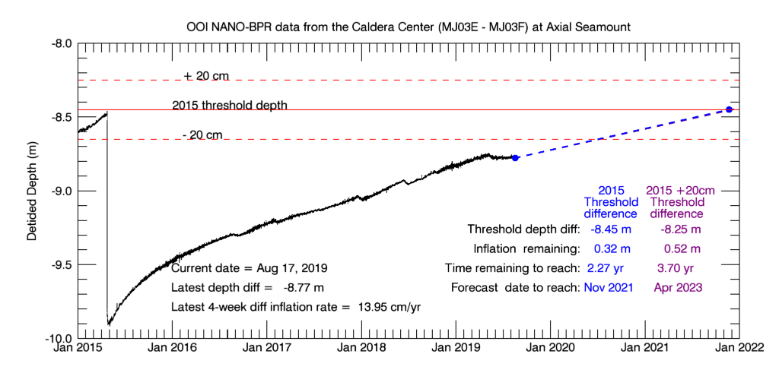

Slide 17
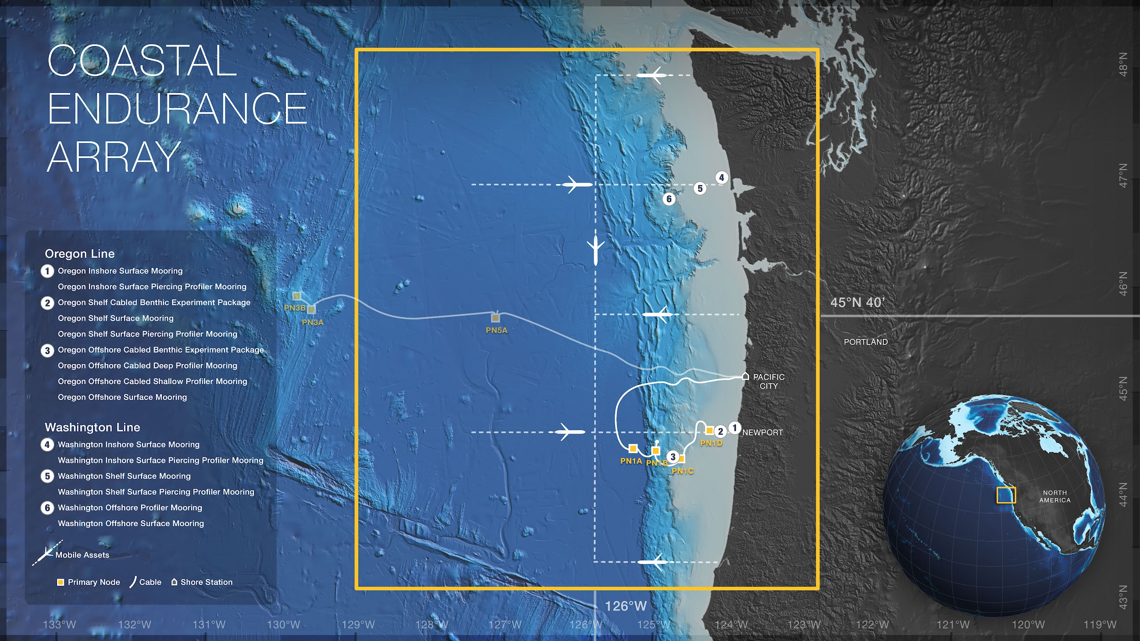
Glider AUVs
Moorings
Profilers
Meta data
Telemetered & recovered
Notes:
There are two coastal arrays… One is called the Endurance array. And the idea was that in one coastal area we should have a fixed timeseries The choice was to sample the evolution of the California current.
Examining the structures of the ecosystems along the western seaboard.
Fixed arrays with moorings and profilers
Different types of data latency based on your real time framework.
Sampling volumes with the glider.

Slide 18
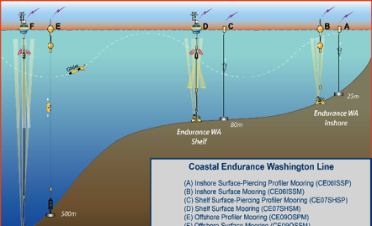
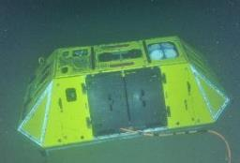
‹#›

Slide 20
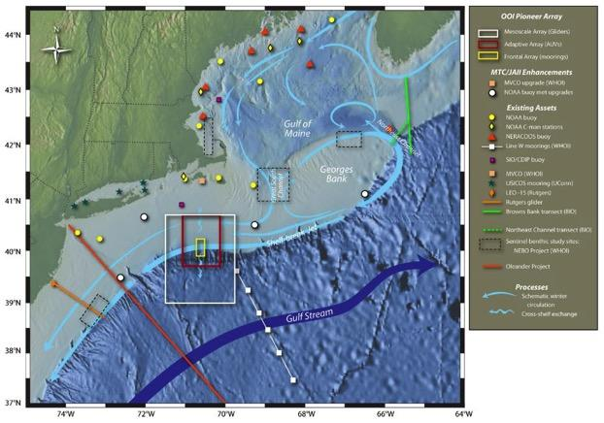
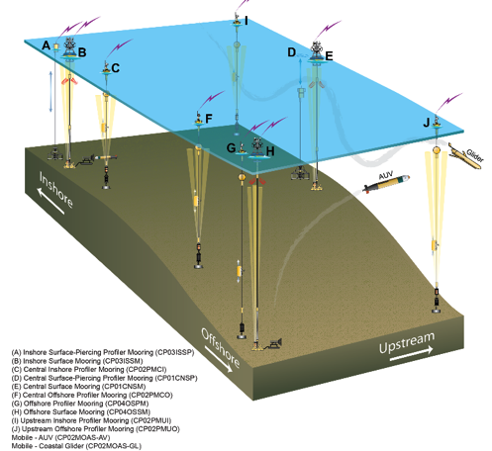
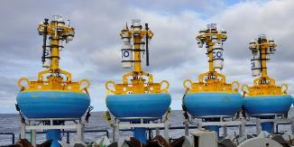
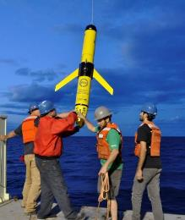
OOI Components: Pioneer Array
Glider AUVs
Moorings
Profilers
Met Data
REMUS AUV (late 2016)
Telemetered & recovered
Notes:
Located right here on the edge of the continental shelf.
The winning idea for this one
Look at exchanges of energy and nutrients across the shelf’s whole front.
The structure of the ecosystem here
The key concept is that it is recompeted… it could be moved.
The next deployment might be the Gulf of Mexico or perhaps the mouth of the Columbia.
This is in contrasted to the Endurance

Slide 21
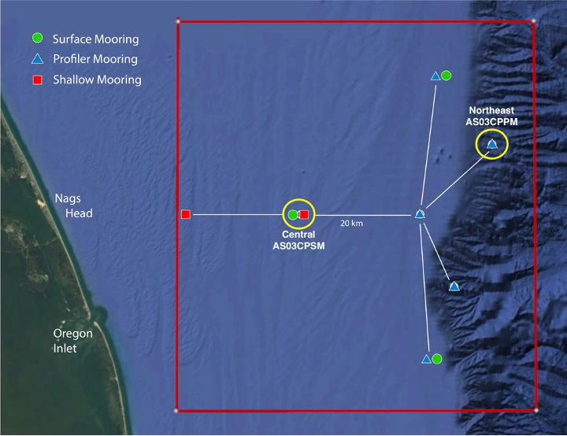
Pioneer MAB

Slide 22
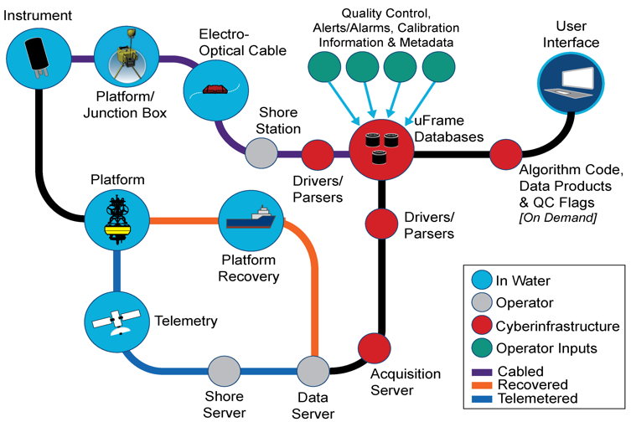
Data Flow Chart
Data types:
Telemetered Data
Recovered Data
Streamed Data
Shipboard Data
Metadata (CF 1.6)
Data product levels:
Raw, L0, L1, L2
Notes:
The overarching guts is called Uframe.
It should give you QC
Alarms
The ability of annotate
The user interface is changing.
There is a variety of ways to get to the data.
Raw comes off the instrument. L0 (many instruments do not send L0), L1 (science product), L2 (derived parameters)

