Slide 1
Use of Data Explorations and Lab Manual in online modality
Dr. Melissa Hicks, Onondaga Community College

Slide 2
AES 105 and 105L—ONLINE
Fall and Spring Semesters
Students can take lecture only
24 Max enrollment
Non-science Majors
General Elective with no math prerequisite
Online lecture and lab using D2L Brightspace

Slide 3
Use of Data Explorations and Ocean Data Labs for ONLINE lecture and labs.
Online Lecture
Online Lab
Plate Boundary Features Exploration
Lab 5.2 Density and Stratification
Lab 1: OOI Introduction and collection of data
Dynamic Air-Sea interactions Exploration
Thermohaline Exploration
Lab 4: Geology-Sea floor changes
Lab 8: Anoxic Events

Slide 4
Set up is very important when Asynchronous
Tutorial Videos
Fill-in work sheets
Always start by having the student characterize the graph
Use of checks as part of the worksheet

Slide 5
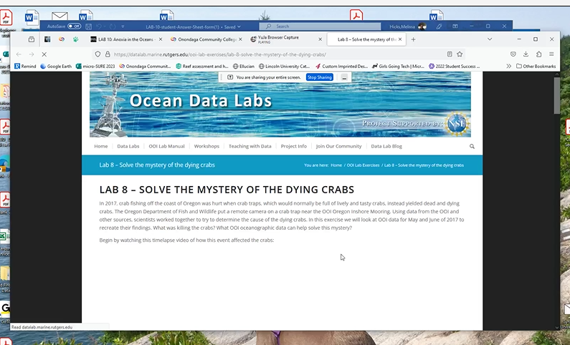
Video tutorial

Slide 6
OOI data Labs are online lab life savers!
Please ask me any questions—OOI users are a community!
Thanks!
Melissa Hicks
m.hicks@sunyocc.edu

