Slide 1
Engaging Students with OOI Ocean Data Labs
Jean R. Anastasia
anastaj@sunysuffolk.edu
(631)451-4923
Suffolk County Community College
Selden, NY

Slide 2
Target Audience & Implementation
An introductory oceanography class at a community college.
Students are freshman or sophomore non-science majors.
-24-48 students
Need more step-by-step guidance
Traditional Classroom
2 hour laboratory in a computer classroom
-work in pairs
Lecture activity coupled with Poll Everywhere
Asynchronous Online
instructional videos were made to guide students.
face-to-face setting is preferred so instructor can intervene and guide students

Slide 3
OOI Resources
EXPLORING THE OCEAN WITH OOI DATA – 2ND EDITION
Lab 2 Building Data Skills: Display of Oceanographic Data
2.1 Reading a Time Series Graph
nice introduction to graphing in general
2.4 Station Profiles
love this to show importance of axes scales
Lab 3 Geology: Plate Tectonics and the Seafloor
3.2 Plate Tectonics Settings
DATA EXPLORATION:
Factors Affecting Primary Productivity Data Exploration
address the misconception that temperature is most important factor
Link to my Blog
Link to Webinar with Matt Iacchei from Hawaii Pacific University

Slide 4
Extra Guidance in Primary Production Lab: Sample Student Worksheet Question
Now examine the different parameters that you can select on the bottom graph. Start by leaving “Water Temperature” selected.
During what month does phytoplankton production reach its peak?
During what month is temperature the highest?
c) Does the peak of phytoplankton production correspond to the warmest temperature?
d) Now put all of this information together and compare the patterns of primary productivity and
temperature. Summarize and explain any relationships that you see:

Slide 5
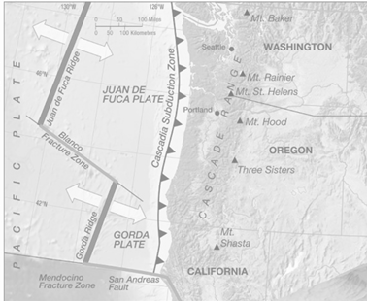
Extra Guidance in Plate Tectonic Lab: Overlay Picture Provided

Slide 6
Summary:
Students enjoy the labs
visual, interactive, and current
Data labs teach oceanography AND transferable skills
There is a community of colleagues to help
Reach out anytime:
Jean Anastasia
anastaj@sunysuffolk.edu
(631)451-4923

