Slide 1
Welcome
Link to Agenda
OCEAN DATA LABS WORKSHOP:
Engaging students in oceanography
with authentic datasets

Slide 2
Workshop Goals
Learn about the OOI program and the key science questions it addresses.
Access existing tools and resources designed to integrate OOI data into teaching.
Learn how to effectively incorporate OOI Data Labs into your classes.
Network with other professors interested in using oceanographic data in undergraduate classrooms.

Slide 3
OOI Data Labs Project Goals
Address the challenges of teaching with data & support opportunities for professors and undergraduates to become more expert users of authentic ocean data.
Increase student engagement and understanding of core concepts through use of OOI data
http://datalab.marine.rutgers.edu

Slide 4
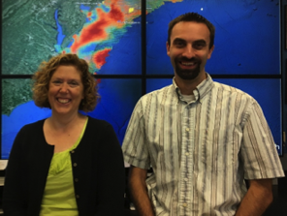
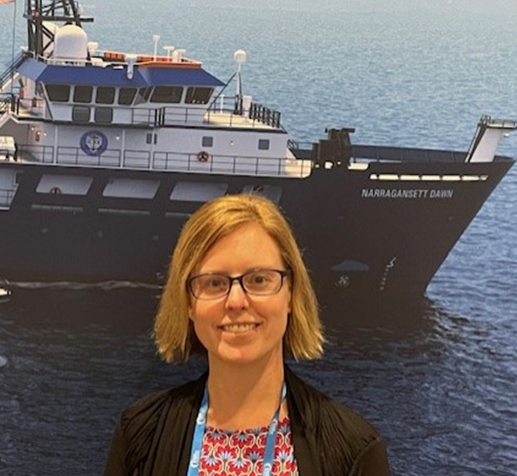
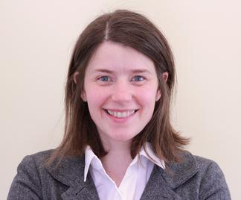
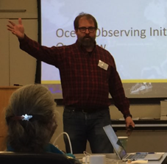
Data Labs Project Team
Janice McDonnell, Sage Lichtenwalner
Rutgers University
Anna Pfeiffer-Herbert
Stockton University
Denise Bristol
Hillsborough Community College
Dax Soule
Queens College CUNY
Kristin O’Connell
SERC

Slide 5
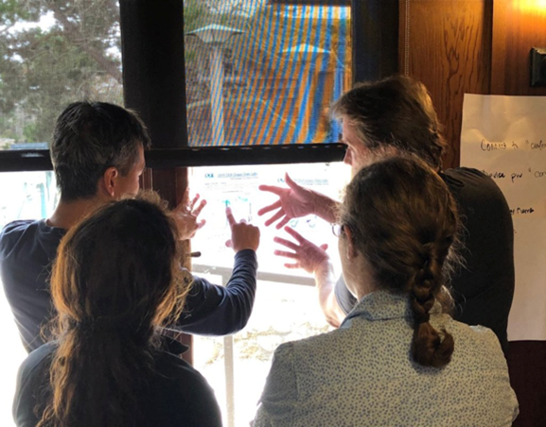
Data Labs Community of Practice
By providing sustained professional development opportunities and support in facilitating communication and the sharing of ideas and teaching practice, we are building an OOI focused Community of Practice for teaching with data

Slide 6
Introductions
Turn and Talk
What piqued your interest for this workshop?
What do you hope to get out of today?

Slide 7
Teaching with Data Activity

Slide 8
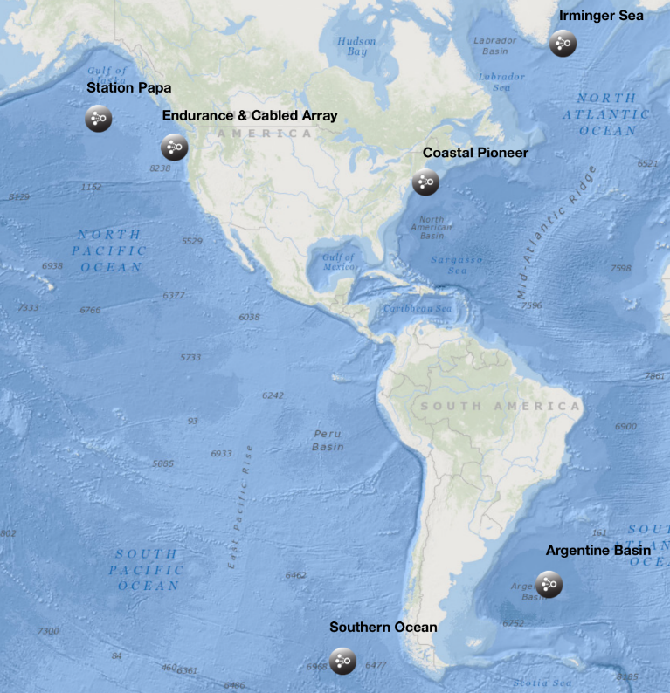
What is the Ocean Observatories Initiative?
Dax Soule
Notes:
Go to Dax’s Slide Deck

Slide 9
Catalyst Question
What are the barriers for
using large datasets in teaching?

Slide 10
Translating OOI data into educational resources
Identify Target Scientific Concepts & Skills
Match with Research Results
Find Available Instrument Data
Cleanup the Dataset
Make Interactives & Visualizations
Add Educational Surrounds (Context)
Resource collection created by the community through
curricular workshops, fellows, pilot testers and more…

Slide 11
Online Data Labs Resource Collection
Want a series of lab activities with built-in student assessments?
Want a ready-made lesson plan incorporating OOI datasets?
Want a modular set of activities that you can adapt?
Want to start from scratch using curated OOI datasets?
Want to introduce coding notebooks with OOI datasets?
Data Lab Manual
Lesson Plans
Data Explorations
Data Nuggets
Python Notebooks
OOI Data Explorer – Direct Data
Notes:
I removed the QR code from this slide since participants won’t explore until after the lightning talks

Slide 12
Lightning talks:
Teaching examples by authors of lab chapters/data explorations
Rich Dixon
Melissa Hicks
Claire Condie
Jean Anastasia

Slide 13
Exploring OOI
Data Labs Collection

Slide 14
Online Data Labs Resource Collection
Want a series of lab activities with built-in student assessments?
Want a ready-made lesson plan incorporating OOI datasets?
Want a modular set of activities that you can adapt?
Want to start from scratch using curated OOI datasets?
Want to introduce coding notebooks with OOI datasets?
Data Lab Manual
Lesson Plans
Data Explorations
Data Nuggets
Python Notebooks
Explore the collection
OOI Data Explorer – Direct Data

Slide 15
Lunch
Please write on flip charts:
Any questions you have
Topics or activities you want to talk about

Slide 16
Ocean Data Labs
LAB MANUAL
EXPLORING THE OCEAN WITH OOI DATA
2ND EDITION

Slide 17
What did you notice about the structure of the resources you explored?

Slide 18
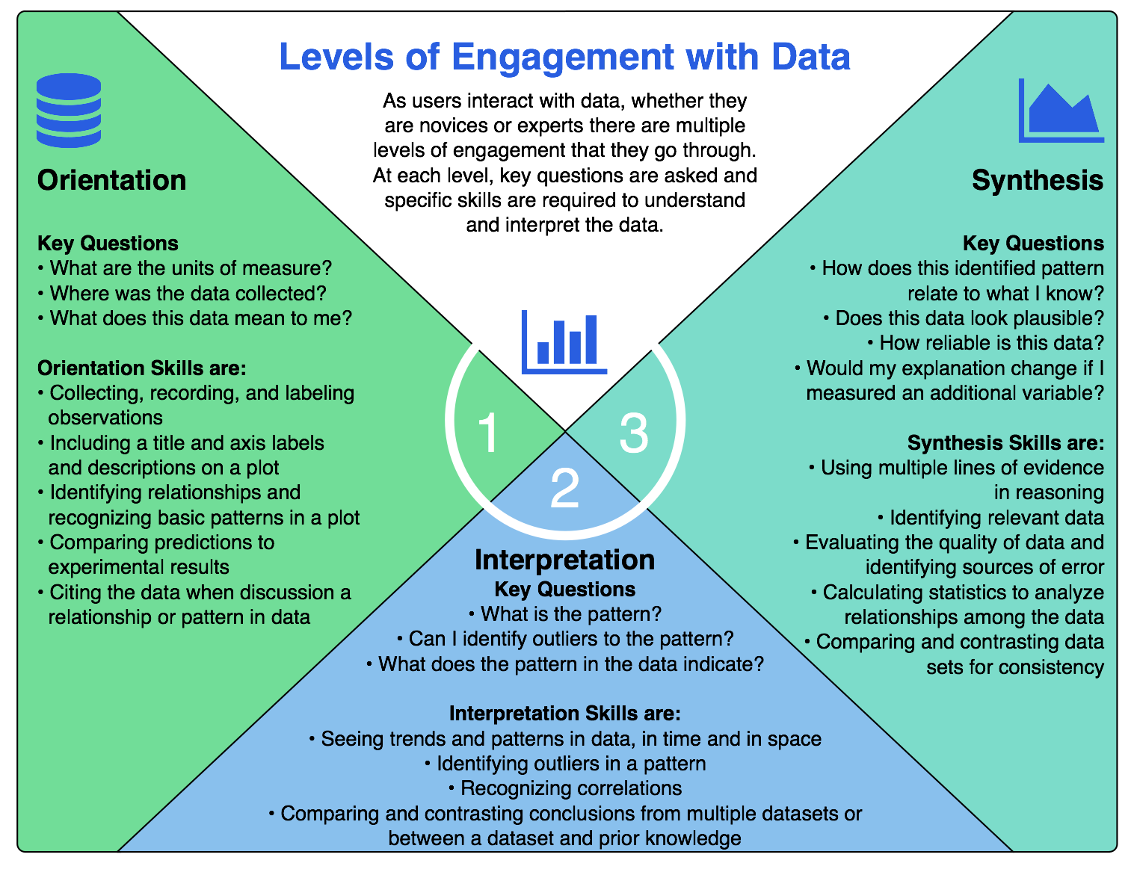
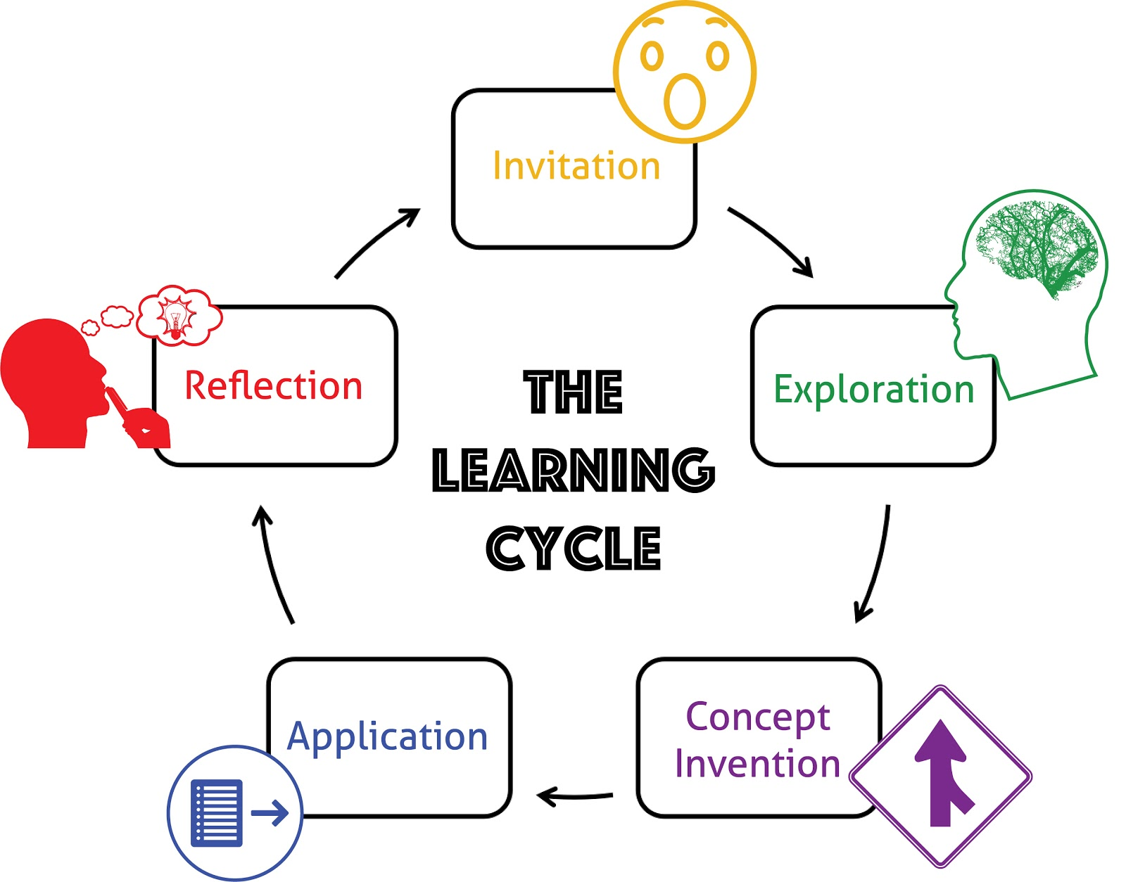
Design of data activities
Based in learning science:
University of California Lawrence Hall of Science
Hotaling et al. (2019)
Notes:
focus on adapted levels of engagement

Slide 19
Orientation
First carefully examine a novel dataset or visualization:
data source
variables and units
graph axes (including scales)
maxima and minima
gaps and outliers

Slide 20
Interpretation
Interpret data (without speculation):
variability
trends
correlation

Slide 21
Application
Apply prior knowledge:
recognize correlation vs. causation
compare to known pattern
develop hypothesis or conclusion, supported by evidence from the data

Slide 22
Reflection (or synthesis)
Reflect on the meaning:
Analyze data limitations
Relate to known phenomenon
Evaluate implications of trends or patterns
Connect to practical applications

Slide 23
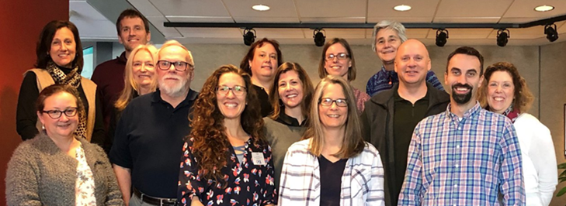
Inspiration for the OOI Lab Manual
Wouldn’t it be great to have a lab manual of OOI data activities aligned to our oceanography classes?
Dr. Sid Mitra
(East Carolina U)

Slide 24
Goals of the manual
Build data literacy and critical thinking skills in undergraduate students using authentic (“messy”) scientific data
Engage students with data activities that reinforce student confidence in scientific questioning, data analysis, and synthesis
Provide a real-world context for key concepts in oceanography

Slide 25
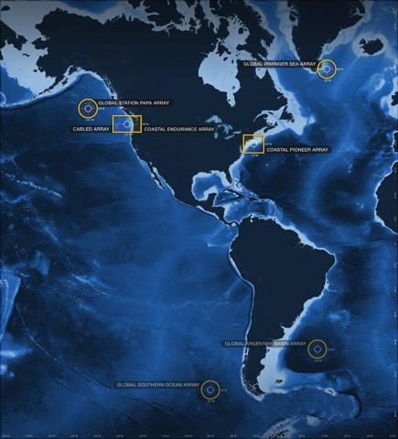
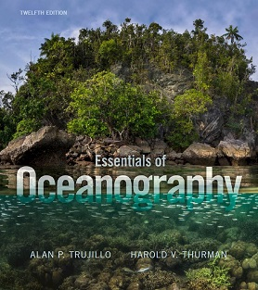
Alignment to Intro Oceanography curriculum
OOI science themes
and data availability
Topic | Chapter
Ocean geography Ocean technology | Lab 1: Introduction to the OOI, the collection of oceanographic data
Data skills for oceanography | Lab 2: Building data skills
Marine Geology | Lab 3: Plate tectonics and the seafloor Lab 4: Seafloor changes in a volcanically active setting
Ocean Chemistry | Lab 5: Investigating density stratification
Physical Oceanography | Lab 6: Waves generated by large storms
Biological Oceanography | Lab 7: Primary production Lab 8: Anoxic events
Lab Manual chapters
common Oceanography textbooks

Slide 26
Lab Manual Structure
Each chapter contains:
Introductory page
Hook, brief background, key terms
3-4 data activities
follow orientation-interpretation-application-reflection model
scaffolded to increase in complexity
based around interactive data “widgets”
Instructor guide
learning objectives, additional scientific background, teaching tips, links to related resources
Student answer forms
By Request: Instructor Key

Slide 27
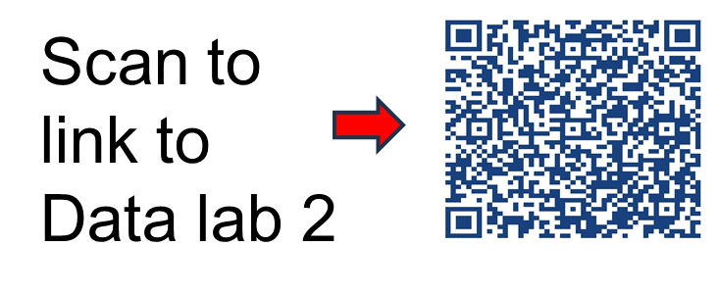
Lab 2: Building Data Skills Complete vs Modular Implementation

Slide 28
What Students Think after Lab 2!
“Just the large amount of different graphs and having in-depth questions about them really helped me to get the hang of how to interpret them better.”
“For me, the guiding questions honestly allowed me to get better primarily because they allowed me to know where to look for what in the graphs, and gave me a better understanding of them.”
“Vertical line graphs and understanding topography graphs were completely new to me, but the information and learning activities helped me learn about them quickly and I feel much more confident about reading these kinds of graphs in the future.”

Slide 29
What Students Think after Lab 2!
“I appreciated the lab because it allowed me to go through each of the different graphs and identify what data was being provided. The videos explaining the data were very helpful”
“Just the large amount of different graphs and having in-depth questions about them really helped me to get the hang of how to interpret them better.”
“I really like how everything is taught to you beforehand and can be used as a reference to make my own graph or answers certain questions. The practice questions are also very useful.”
“Vertical line graphs and understanding topography graphs were completely new to me, but the information and learning activities helped me learn about them quickly and I feel much more confident about reading these kinds of graphs in the future.
“I really liked the way the questions were worded, how each one lead into the other. I thought it was helpful that for the most part you had to get the previous question correct in order to understand the next one.”
“For me, the guiding questions honestly allowed me to get better primarily because they allowed me to know where to look for what in the graphs, and gave me a better understanding of them.”
“Vertical line graphs and understanding topography graphs were completely new to me, but the information and learning activities helped me learn about them quickly and I feel much more confident about reading these kinds of graphs in the future.”

Slide 30
End-of-semester student comment
“The most important skill I learned from this class was reading and analyzing graphs. In every class, homework, and test, [professor] included graphs and taught us how to analyze them. I notice in my other science classes that it is so much easier for me to analyze graphs, and I can do it lightning quick too.”

Slide 31
Group Reflection

Slide 32
Questions for reflection
How will you use OOI data into your classes, activities, and/or undergraduate research?
What are the challenges you have experienced or anticipate for working with students on data literacy?
What other opportunities do you see to enrich your teaching with OOI data? (e.g. your research, student research, data science / programming skill building)
Notes:
Jamboard link: https://jamboard.google.com/d/1gf6fFaeHB2CoDptAlD-u1dNUEq9Ee7kqxHeOr80tl5I/edit?usp=sharing

Slide 33
Implementation Planning
Link to Agenda
Use the worksheet provided on the workshop agenda website to plan how you will incorporate a data activity into one of your courses

Slide 34
Reflection and Evaluation

Slide 35
Next Steps: Data Labs 2023-2025
Project Goals
Continue to build and support the OOI educator community
Especially MSI, 2YC, PUI and R2
Special focus on the Mid Atlantic
Develop “next level” activities
Fill in gaps in the existing OOI Data Labs manual
Domain-specific and level-appropriate programming notebook-based activities

Slide 36
Workshop Evaluation
Check your email for evaluation link from Qualtrics or Kristen O’Connell
We thank you for your participation in the workshop today!

