Slide 1
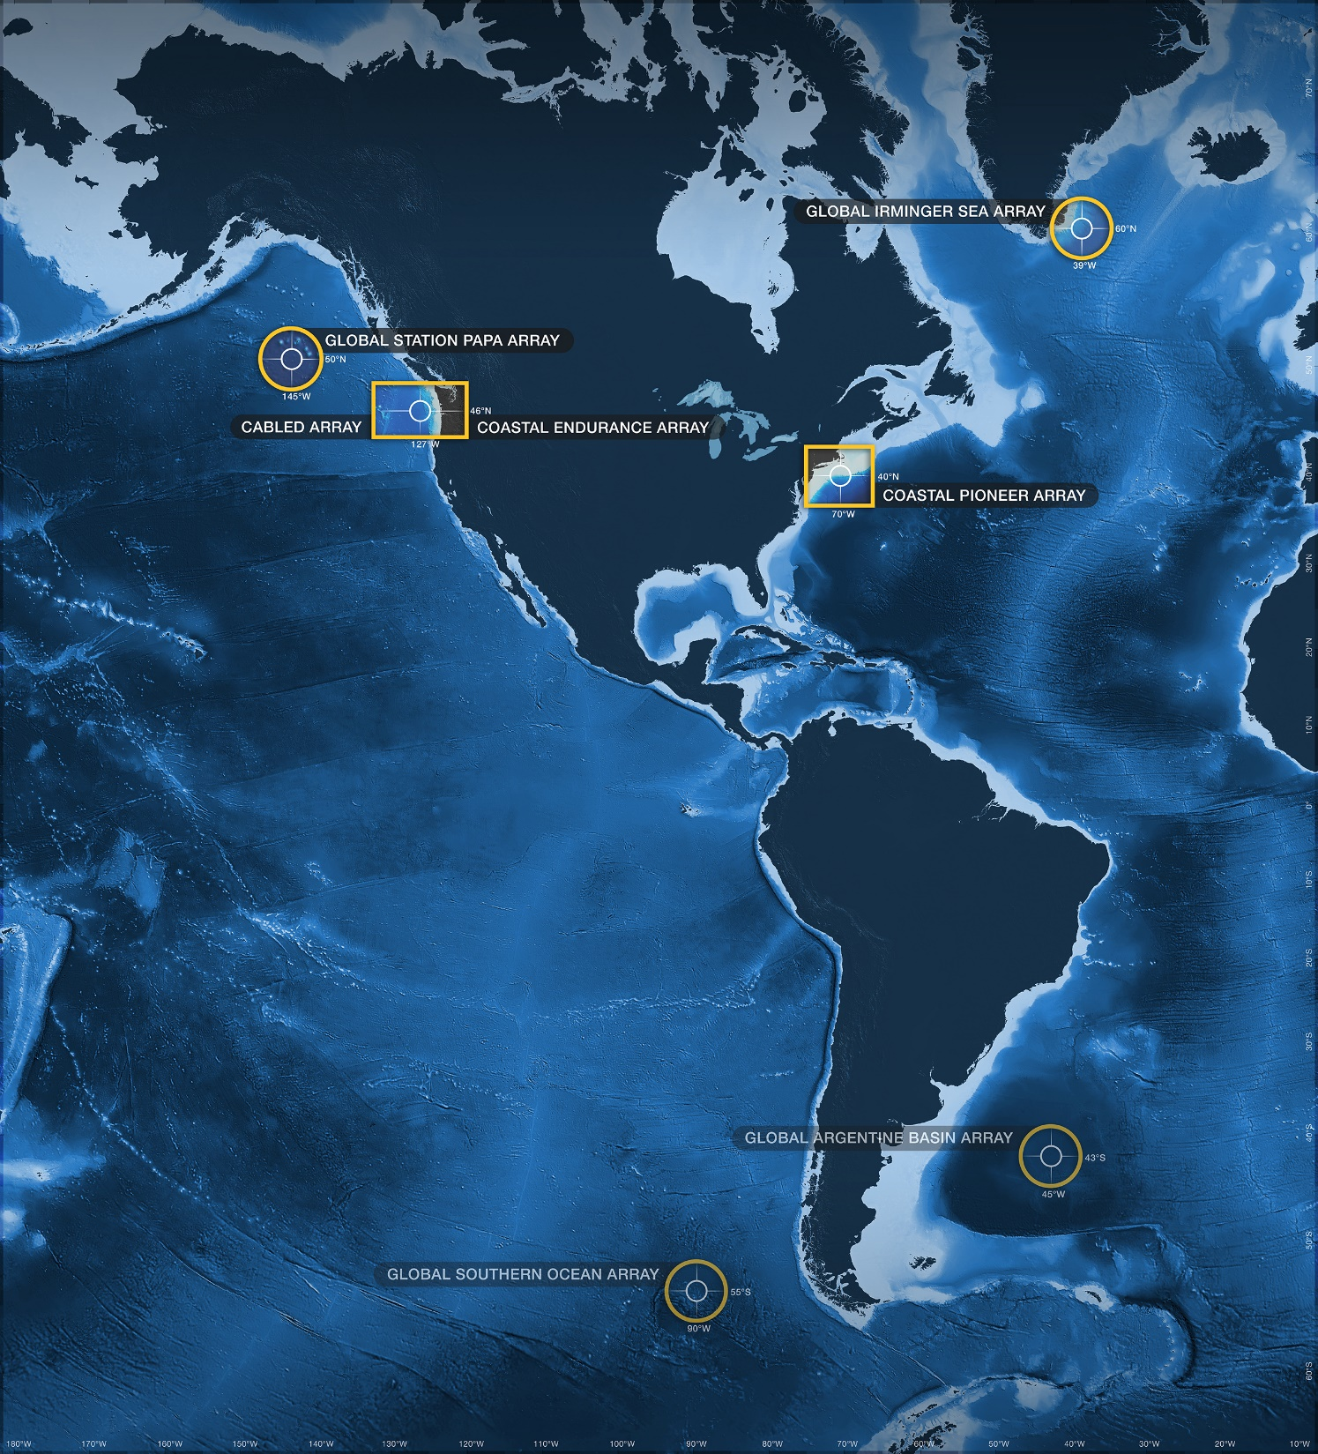
Where does OOI data fit in my teaching?
Anna Pfeiffer-Herbert & Denise Bristol
OOI Data Labs Workshop
Ocean Sciences Meeting—February 16, 2020
datalab.marine.rutgers.edu

Slide 2
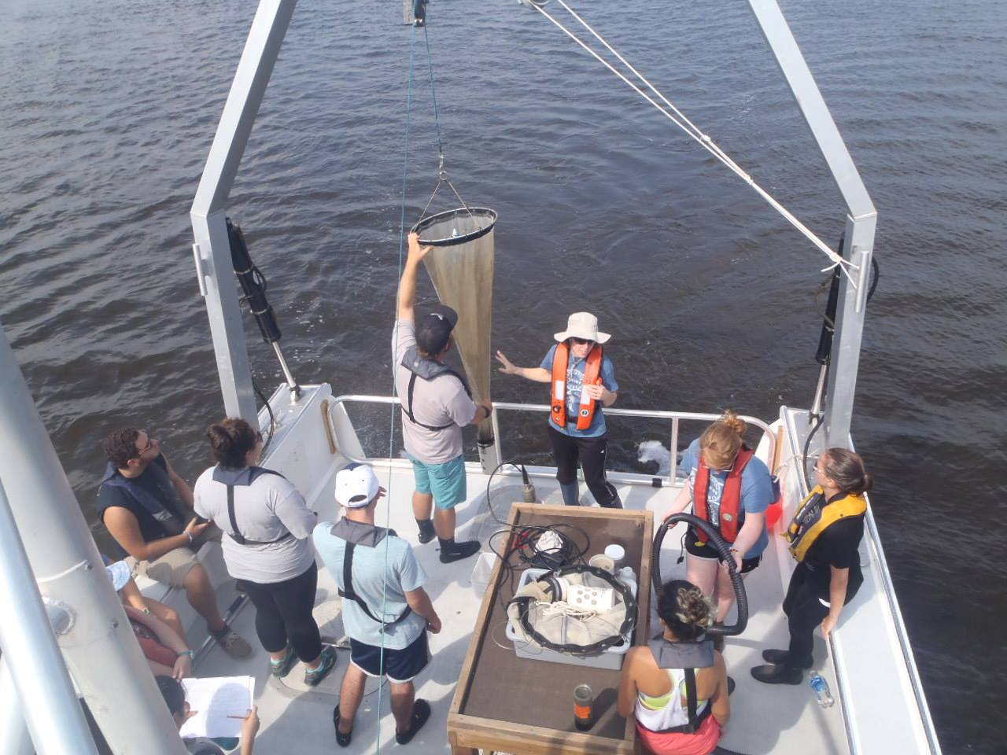
Case study: Primary production data activity
Enduring idea: Primary production, the fuel for marine food webs, is not constant over time or across all ocean basins
How to provide a sense of patchiness in time and space in a (non-lab) classroom?

Slide 3
Learning goals
Know: Primary production varies over time and by location
Understand: Changes in primary production relate to changes in the limiting factors for phytoplankton growth
Be able to: Interpret graphs of chlorophyll, connect variations in chlorophyll to changes in the amount of primary production

Slide 4
Activity context
Introduction to Oceanography course
30-40 students
mix of majors/non-majors
Biological Oceanography unit
last third of semester
after photosynthesis/respiration lesson
In computer lab or regular classroom with student-owned laptops

Slide 5
Before activity, students should know
Definition of primary production
Limiting factors for primary production in ocean
Main primary producers = photosynthetic phytoplankton
abundance measured by chlorophyll concentration
Assessed by homework questions due before class

Slide 6
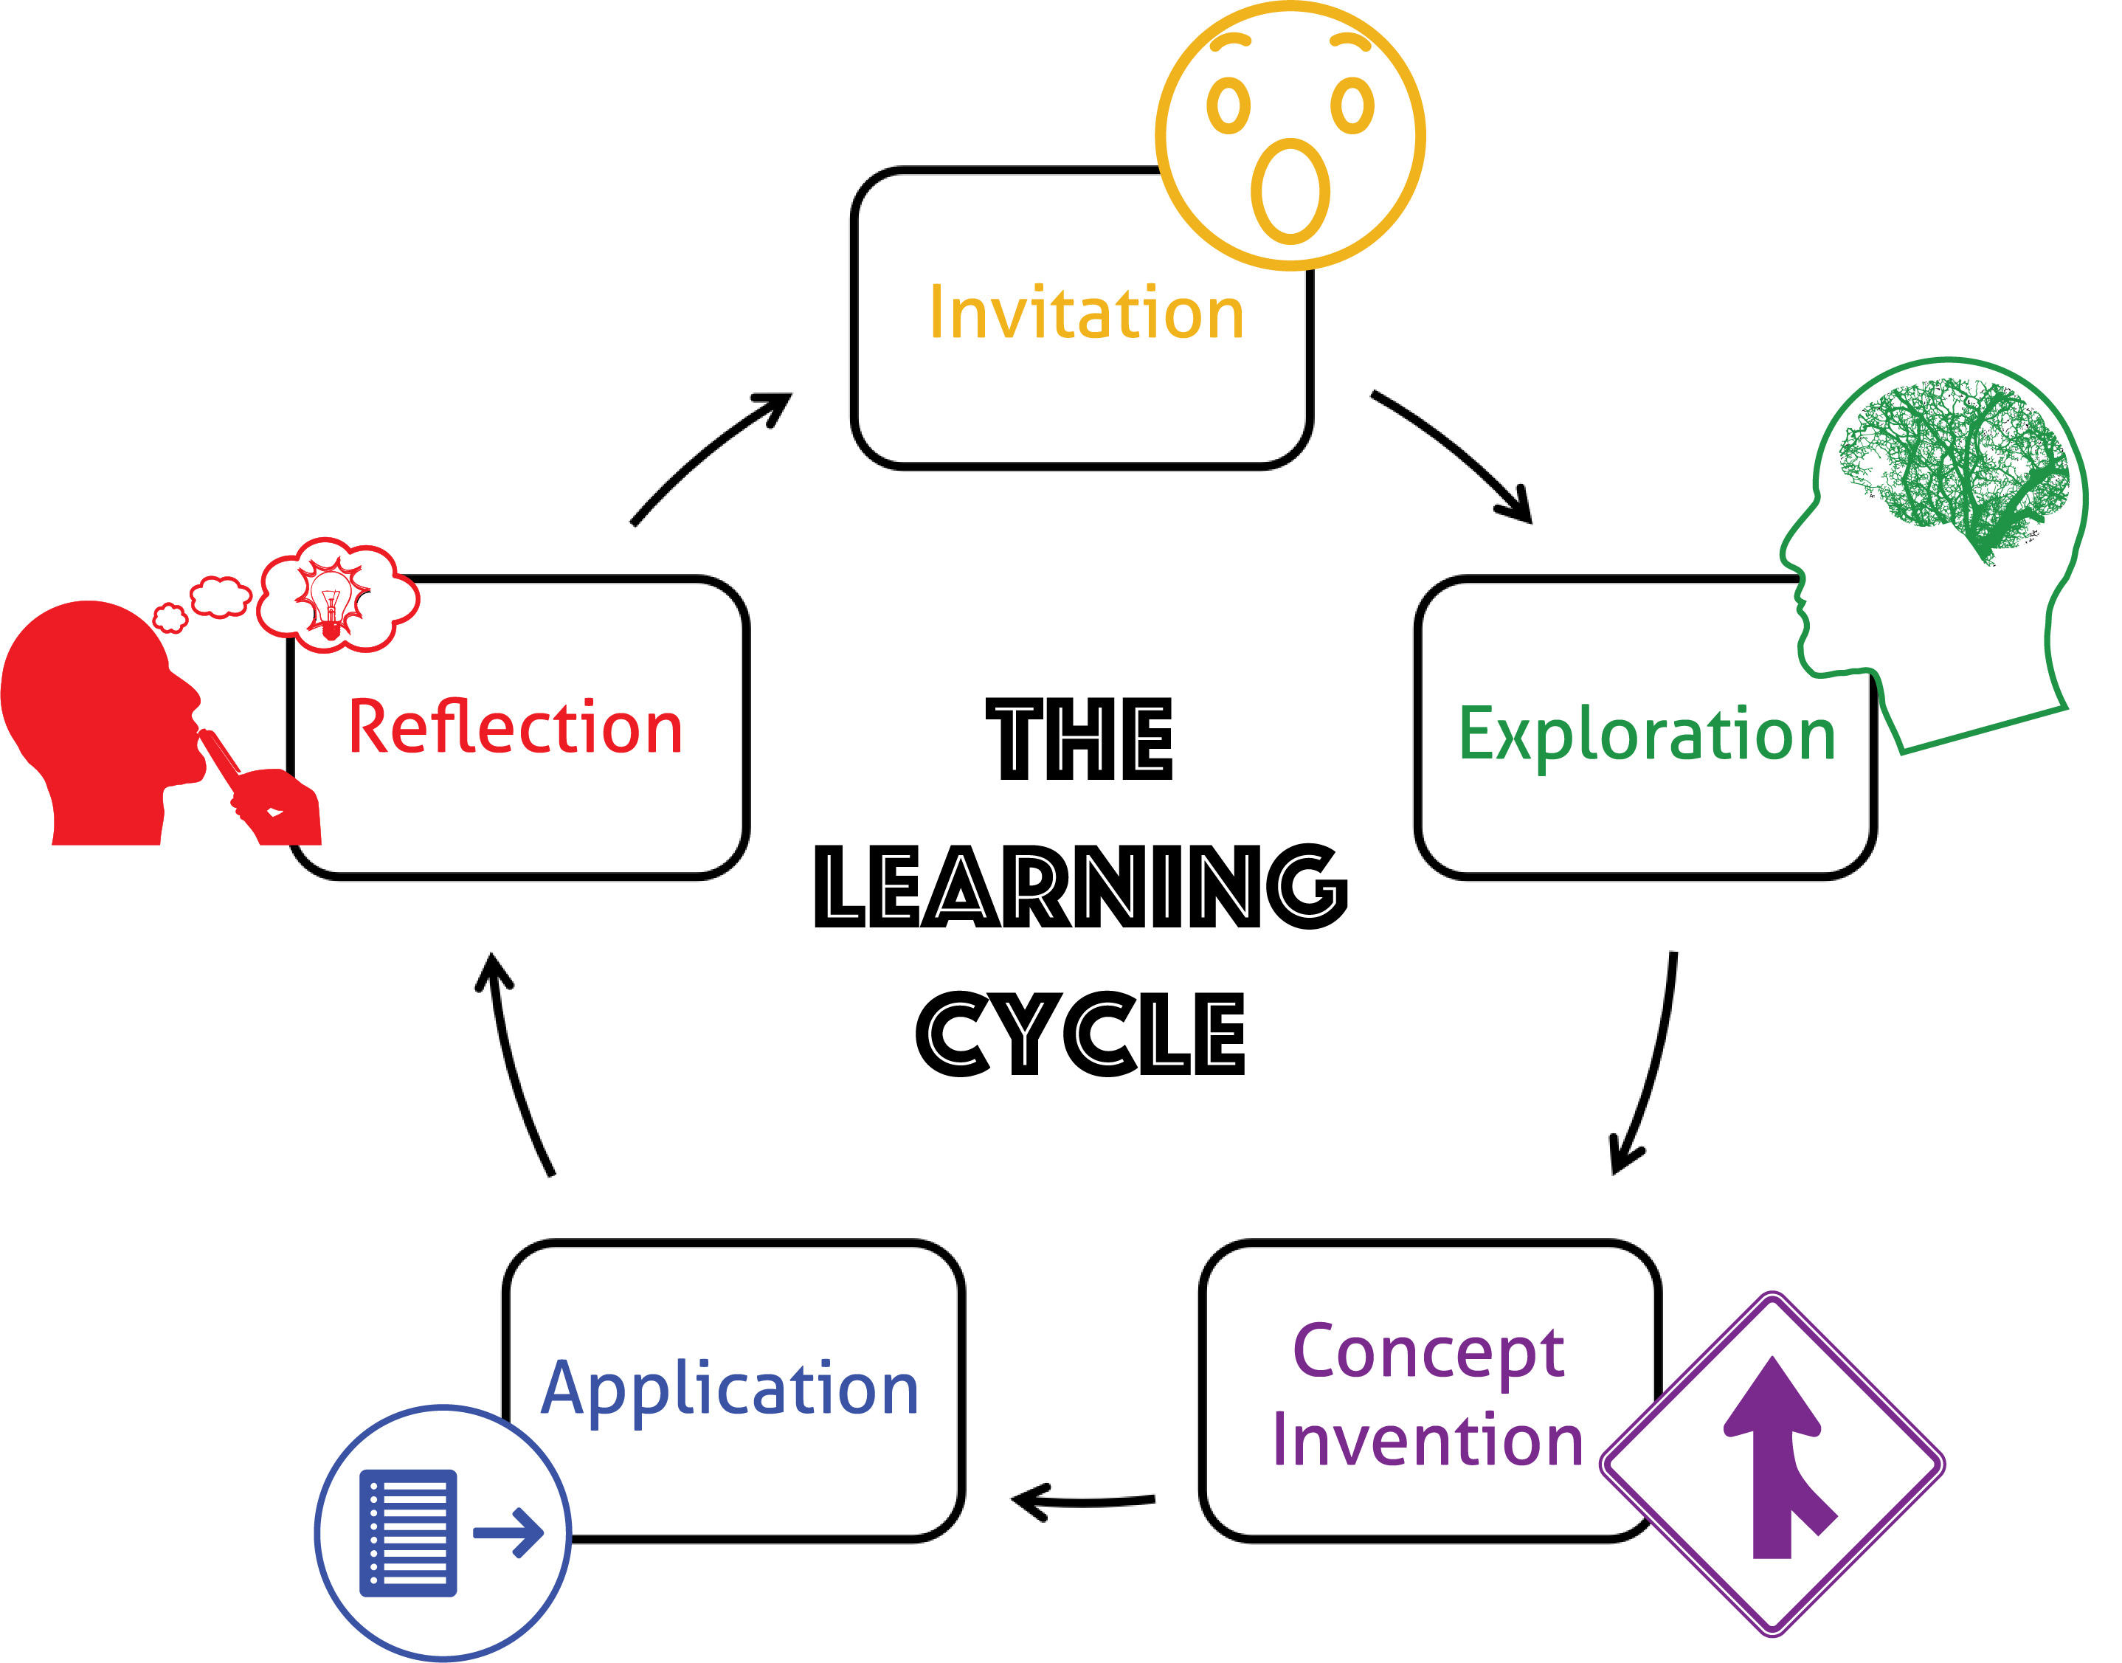
Think-pair-share question challenges learners to recall physical and chemical factors that affect primary productivity
Lawrence Hall of Science, Univ. California Berkeley

Slide 7
Sample TPS Question
Why are more phytoplankton growing along the equator than 15° north and south?
[pick the most important factor]
More sunlight at equator
Warmer water at equator
More nutrients at equator
15°N
0°
15°S

Slide 8
In pairs, students examine chlorophyll concentration over a year in either temperate or high latitude locations

Slide 9
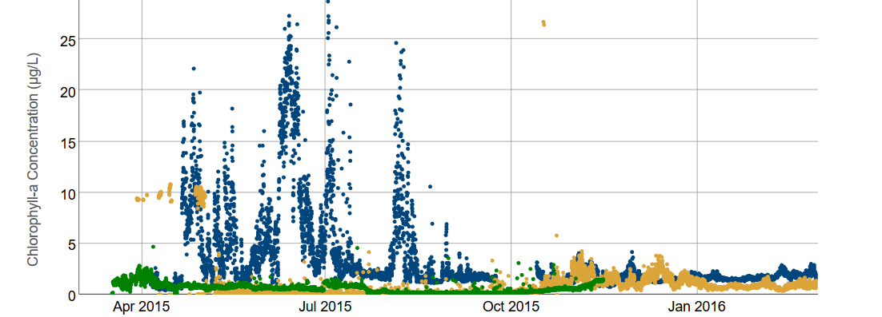
Exploration: Primary production in temperate vs. polar latitudes
Graph orientation: How did chlorophyll vary over time?
Describe: Evidence of a pattern over time?
Inquire: What questions do you have about this pattern?
Notes:
https://datalab.marine.rutgers.edu/explorations/productivity/activity4.php?level=exploration

Slide 10
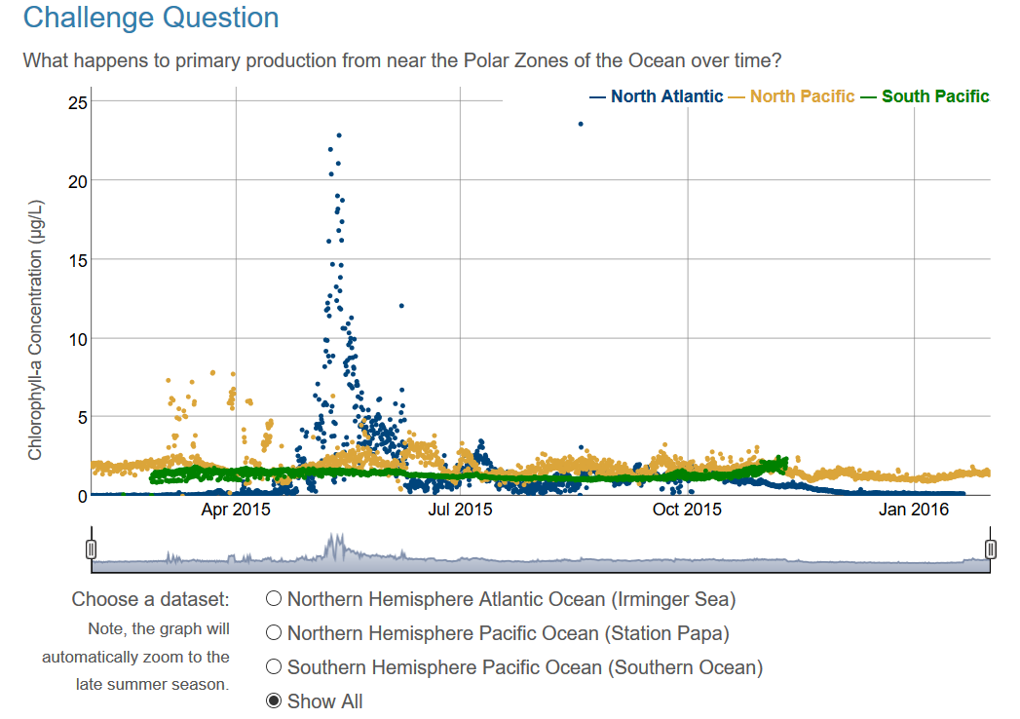
Notes:
https://datalab.marine.rutgers.edu/explorations/productivity/activity5.php?level=exploration

Slide 11
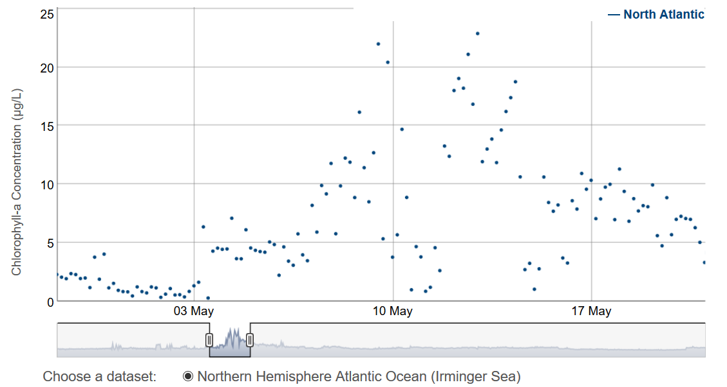
Zoom in

Slide 12
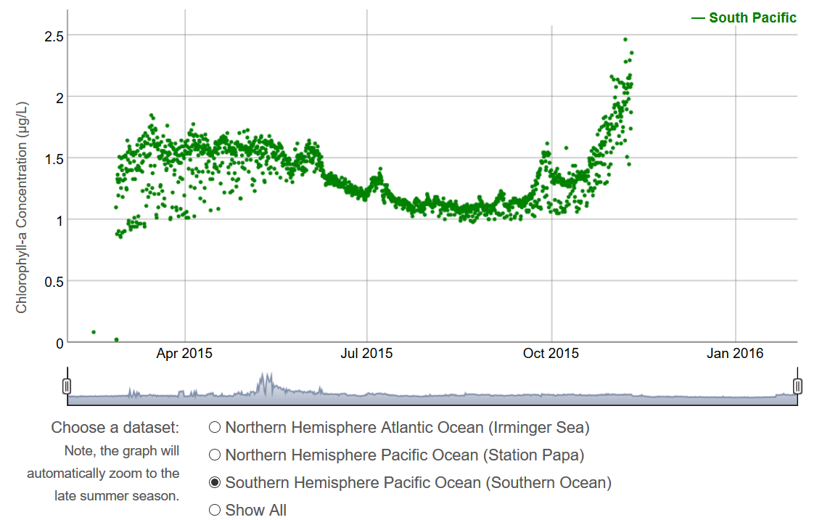
Change in scale
Select

Slide 13
Students notice
Near-polar zone:
“Generally, chlorophyll concentration lingers at very low numbers for most of the year. In the northern Atlantic Ocean, however, the concentration spikes very steeply at the end of spring/beginning of summer. The Northern Pacific Ocean experiences a much smaller but more widespread jump in concentration as Spring kicks in.”

Slide 14
Students ask
Why are there peaks and valleys in chlorophyll data within a season?
Why do the North Pacific and South Pacific not spike like the North Atlantic?
Why does the data cut off for the South Pacific?

Slide 15
Class discussion of seasonal patterns, comparing temperate and polar patterns, evidence and questions

Slide 16
Students apply concepts of seasonal variability and primary production limiting factors to data from neighboring continental shelf moorings

Slide 17
Application: Primary production in inshore vs. offshore areas of continental shelves
Compare two time series of chlorophyll
Assess: Is there a relationship between the time series?
Apply prior knowledge:
Why do you think that relationship exists?
Does it agree with what you previously knew about primary production?

Slide 18
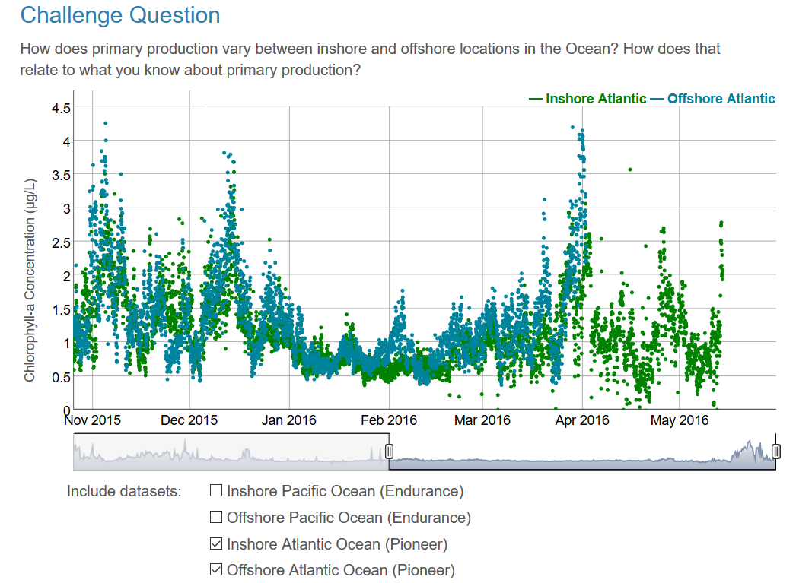

Slide 19
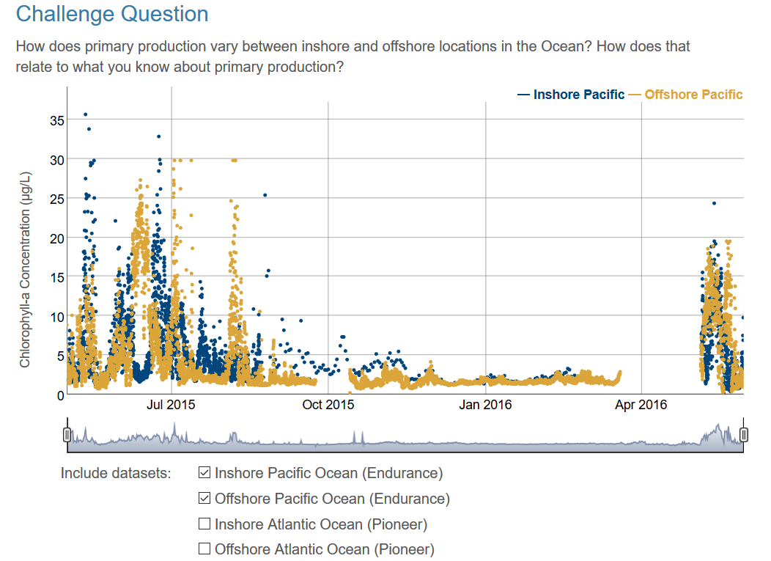

Slide 20
Students notice
Atlantic shelf: “There is more chlorophyll inshore during the spring season. The pattern persists until mid-fall, where the amount of chlorophyll inshore and offshore are about the same.”
Pacific shelf: “Both follow pattern of spiking high and then immediately followed by a large decline before spiking again. Alternating pattern of high-low between May and August.”
Pacific shelf: “I originally thought that inshore production would always be higher due to potentially higher nutrient levels vs. the deep ocean. However the primary production rates inshore & offshore are pretty even.”

Slide 21
Students ask
Why is there more primary production in the Pacific than in the Atlantic?
How is it that there are inconsistencies in locations so close together?

Slide 22
Discuss patterns observed in the data and compare to the textbook picture of seasonal primary productivity cycles

Slide 23
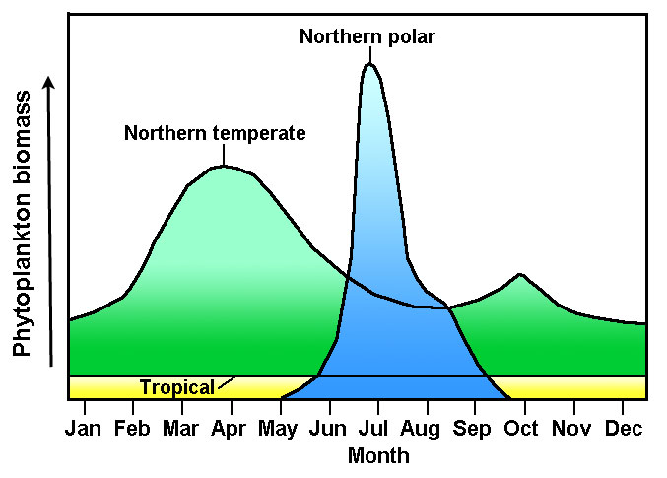
Follow-up discussion for reflection
Textbook explanation of seasonal primary productivity
Do OOI data agree with this graph?

Slide 24
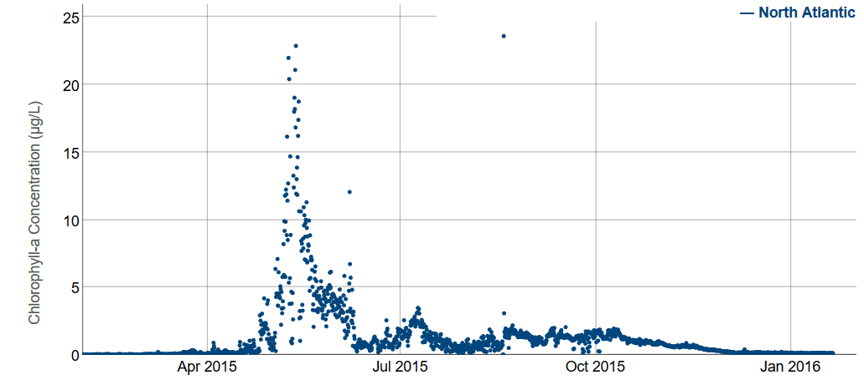
Irminger Sea: Single large bloom in late spring/early summer
Washington coast: Frequent shorter blooms throughout spring-summer

Slide 25
Challenges
“I would like no gaps in my data.
Is a complete year too much to ask for?”

Slide 26
Challenges
Resistance to uncertainty
applies to students and instructors
Computer access
Range of data skills
Interpreting graphs, understanding data gaps and outliers
Next level: Producing graphs (Excel, etc.)
Class size
Class time

Slide 27
Benefits
Students “think like scientists”
Curiosity
Developing hypotheses, testing prior knowledge
Exploring the unknown
Generates dynamic discussion
Students better prepared to work with data in upper-level classes
Confidence in pattern recognition, uncertainty

Slide 28
OOI Data Lab Notebook
Open source lab activities
COMING SOON!
2020
datalab.marine.rutgers.edu

Slide 29
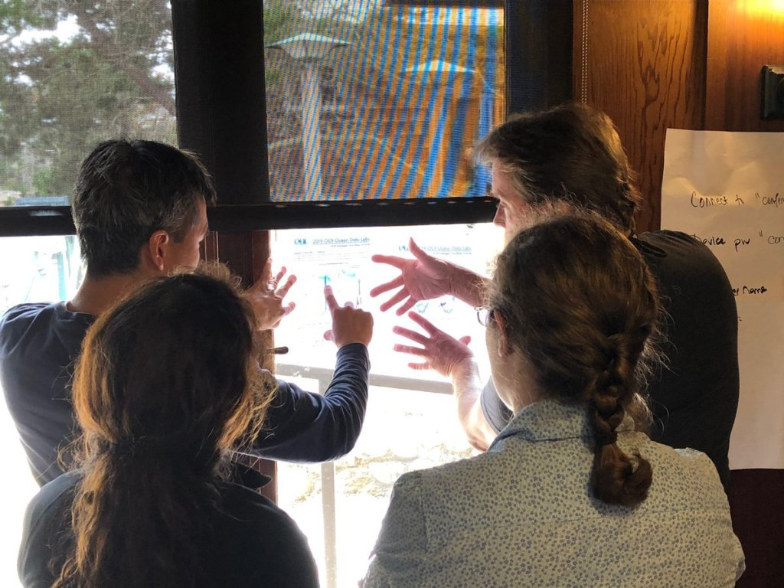
Lab Notebook Goals
‘Plug and Play’ version of widgets that is accessible to Instructors with a variety of backgrounds
Can be used in a variety of Introductory Oceanography (or similar) courses.
Ensure that each activity and widgets are properly scaffolded to be accessible to students from a variety of backgrounds.
Teach basic data skills and reinforce those skills within each lab activity
Lab notebook activities may be used together or as stand alone
Teach students about authentic very messy scientific data vs ‘cleaned-up’ textbook examples

Slide 31
Lab notebook 4 Components
Student Manual- 5 Chapters
Background information
Hook to engage students
Student activities
2-3 Scaffolded labs/widgets
Instructors Guide
Student activity mapped to outcomes
Materials needed
Pre and post lab assessment
Instructors Activity Notes
Additional links or activities
Background material

Slide 32
Chapters
Data skills – Introduce OOI, Sensors/underwater technology and Introduce common graphs oceanographers use. Sets up students for success in later chapters
Biological oceanography- Primary production and influencing factors
Chemical oceanography – Temperature, salinity, depth, stratification and relationship to ocean circulation
Geological oceanography – Plate tectonics and seafloor features
Physical oceanography – Local wind speed and waves

Slide 33
Interested in the Lab Notebook?
Trials coming soon!
Apply to test the manual out in your classes Fall 2020

