Slide 1
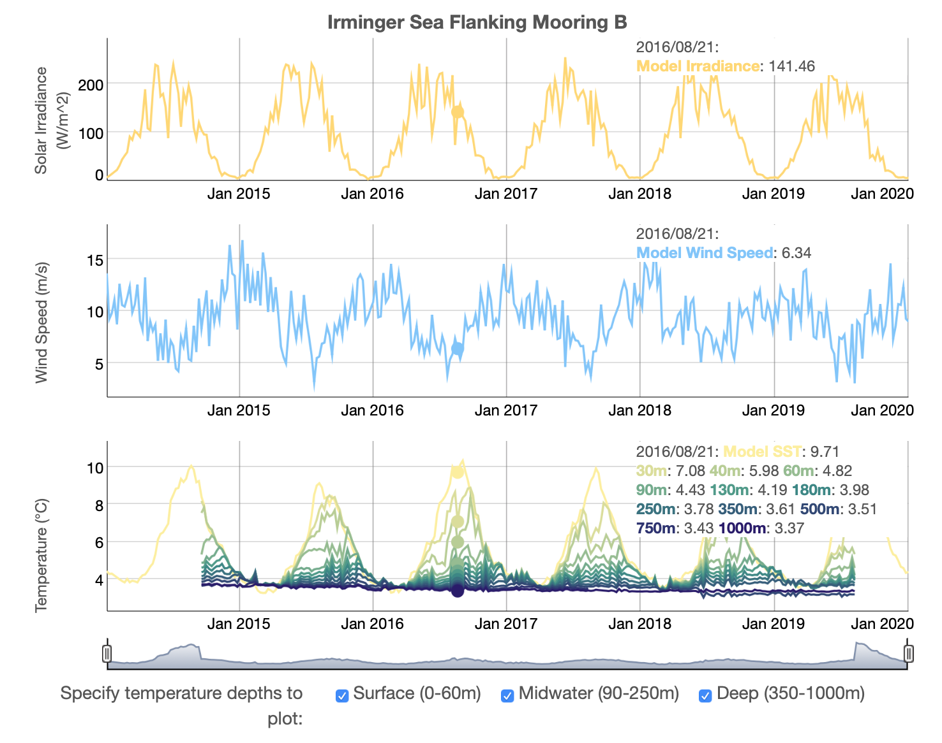
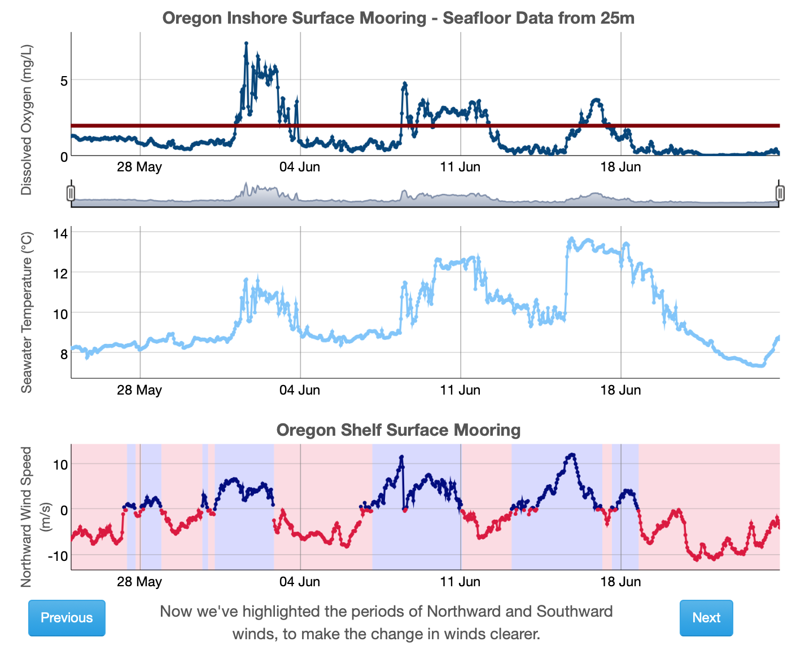
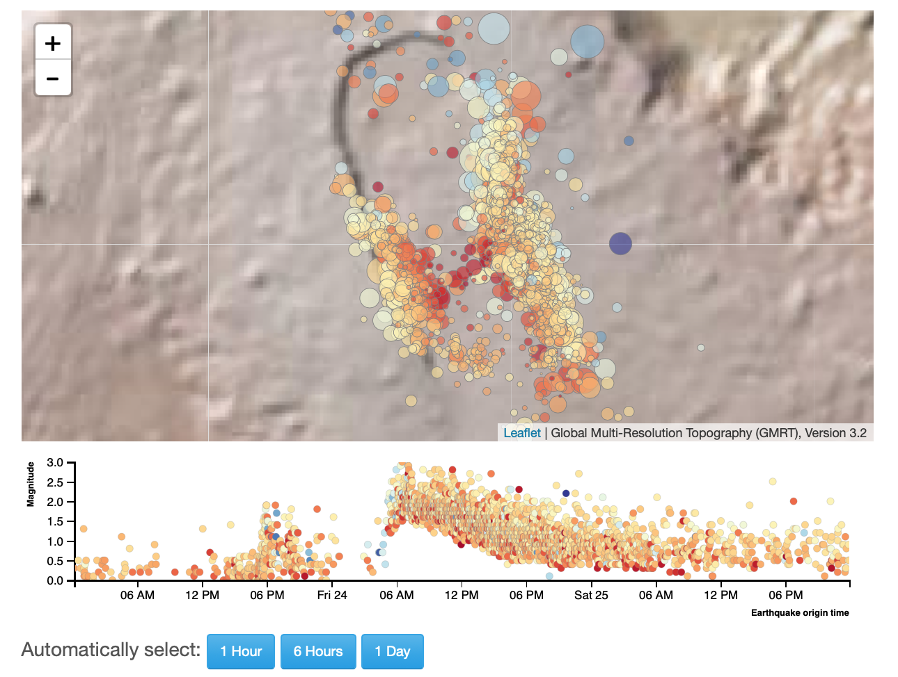
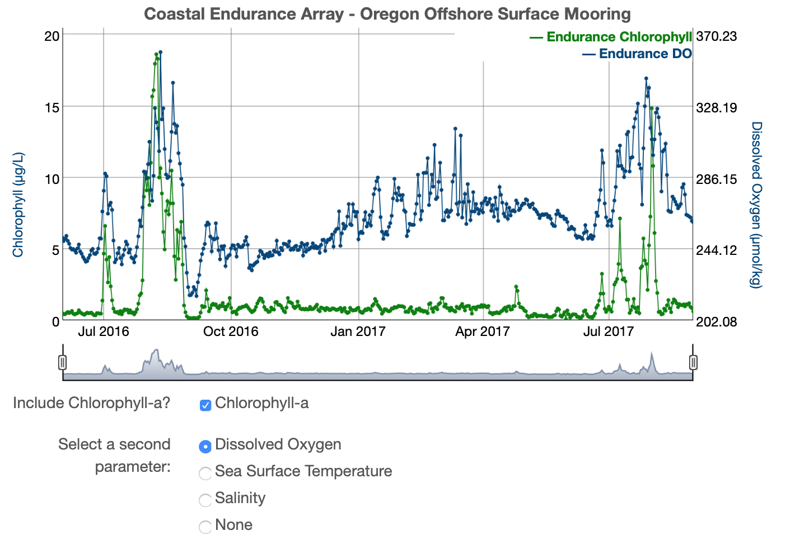
OOI Data Explorations: A Collection of Online Data Visualization Activities to Engage Introductory Undergraduate Students
ED21A-06
Sage Lichtenwalner, Rutgers University
Janice McDonnell, Catherine Halversen, Dax Soule, Anna Pfeiffer-Herbert, Kristin Hunter-Thomson
February 18, 2020
datalab.marine.rutgers.edu

Slide 2
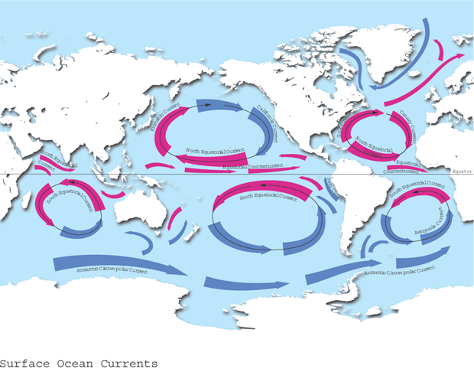
What We Teach
6ish Ocean Gyres
+ Thermohaline

Slide 3
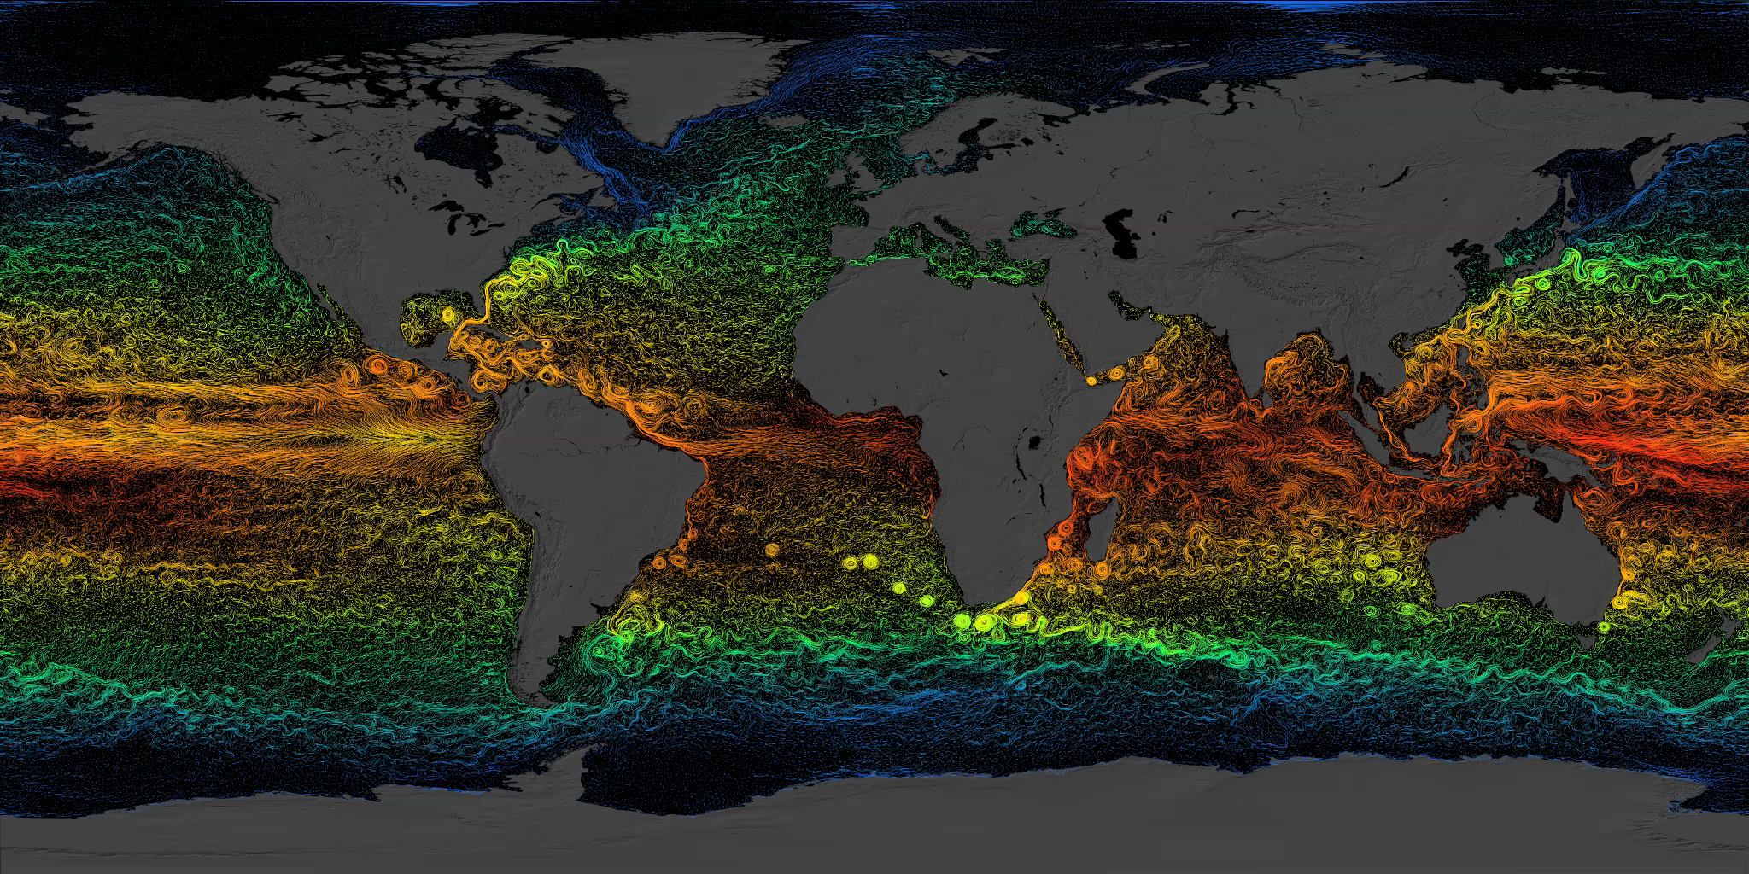
What the World Ocean really looks like
Complex circulation defines the Ocean Gyres

Slide 4
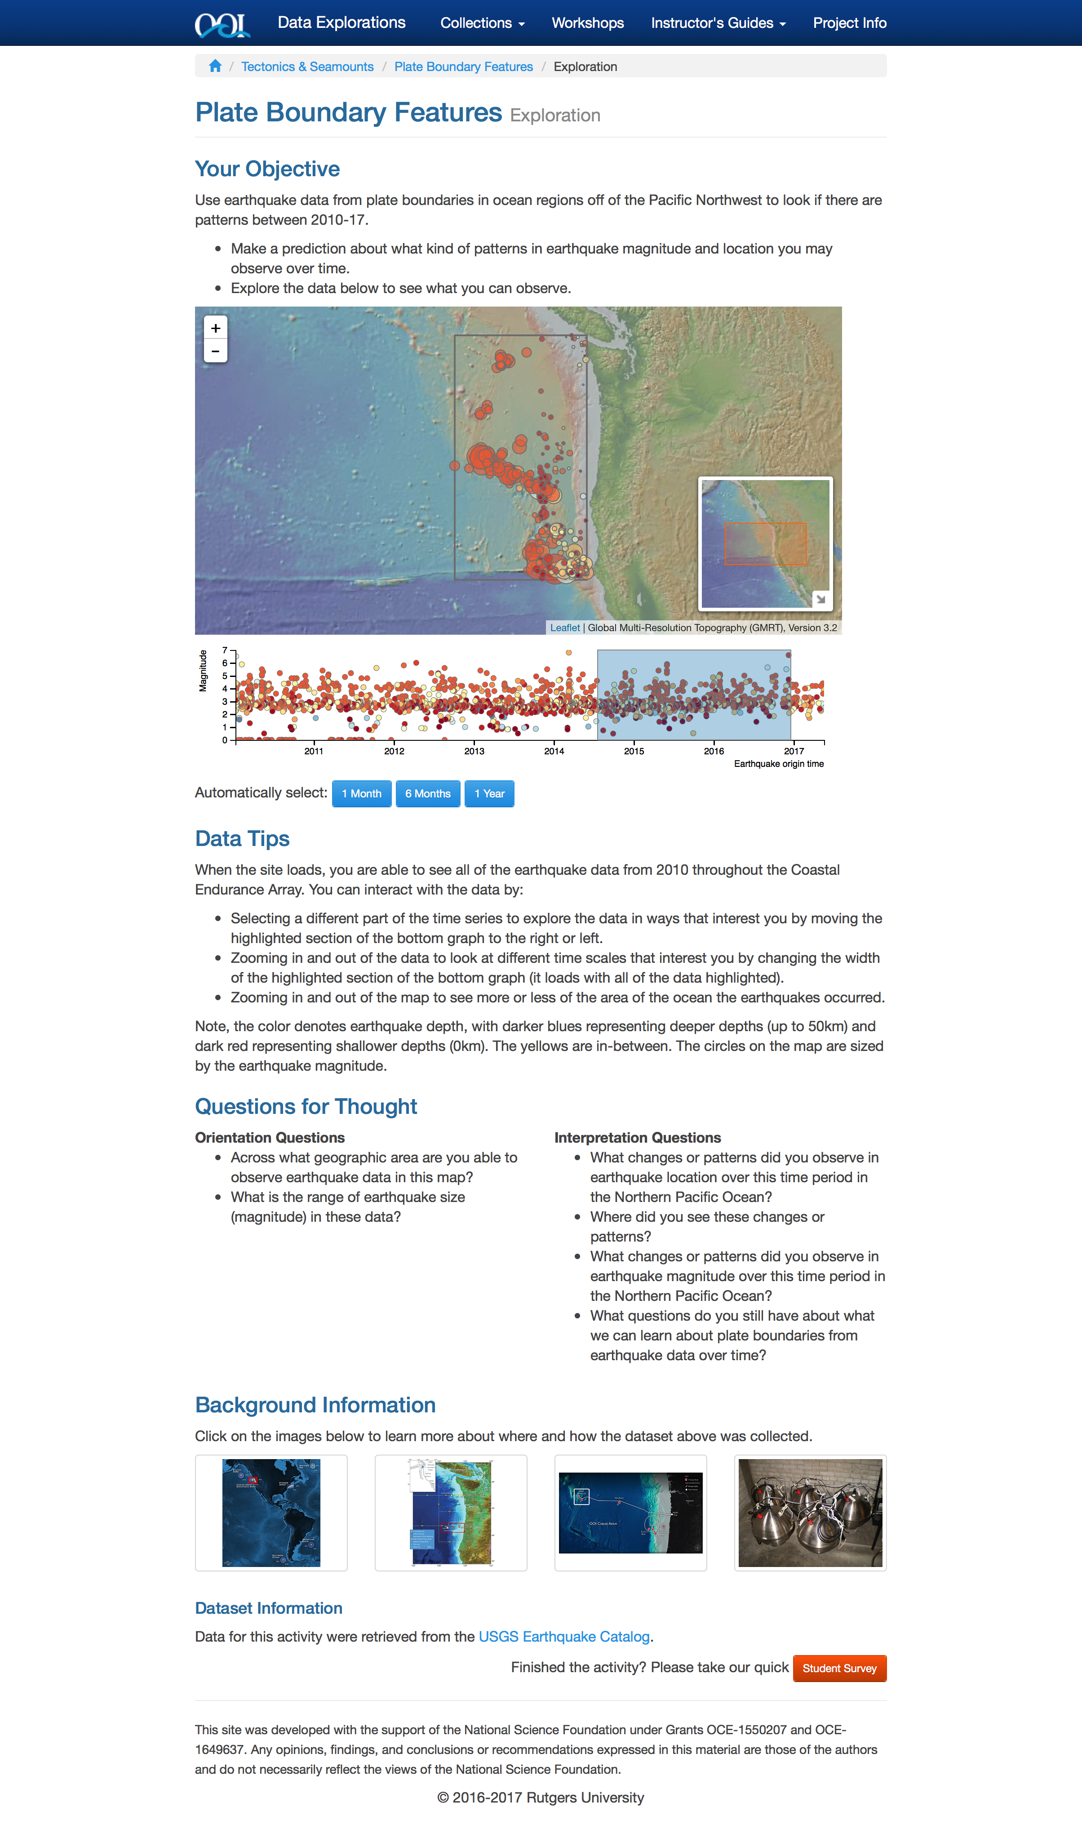
What is a Data Exploration?

Slide 5
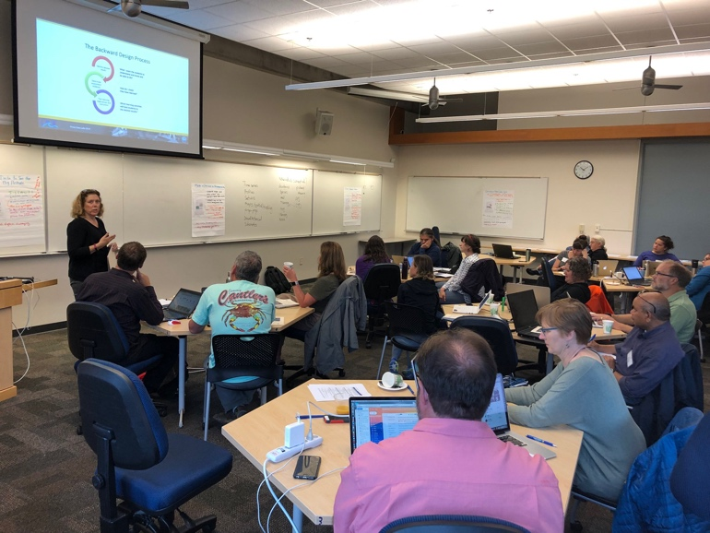
OOI Data Labs Project
Key Goals
Build a Community of Practice of undergraduate educators, interested in using OOI data with their students
Create and pool tools to OOI data more accessible to educators and students

Slide 6
What is Data Labs trying to accomplish?
OOI
Data + Science
Data Science
Coding/Python
Education
Data
Explorations
Data
Workshops
?
Data Sci
Bootcamps

Slide 7
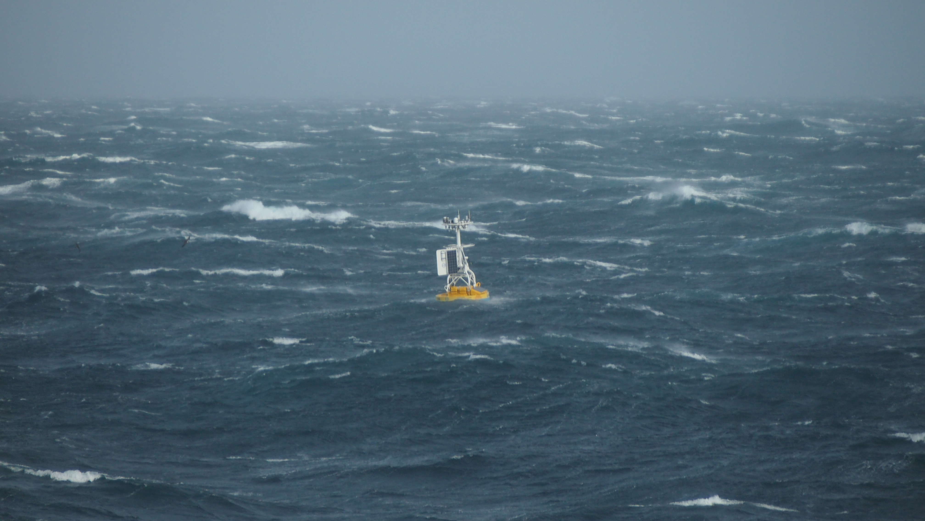
Measurement Complexity
1,327 Instruments
36 Instrument Types
Hundreds of science parameters
Fixed / Profiling / Gliding Platforms
Temporal/Spatial resolution
Big Headaches:
  Instrument Issues
  So much data to choose from

Slide 8
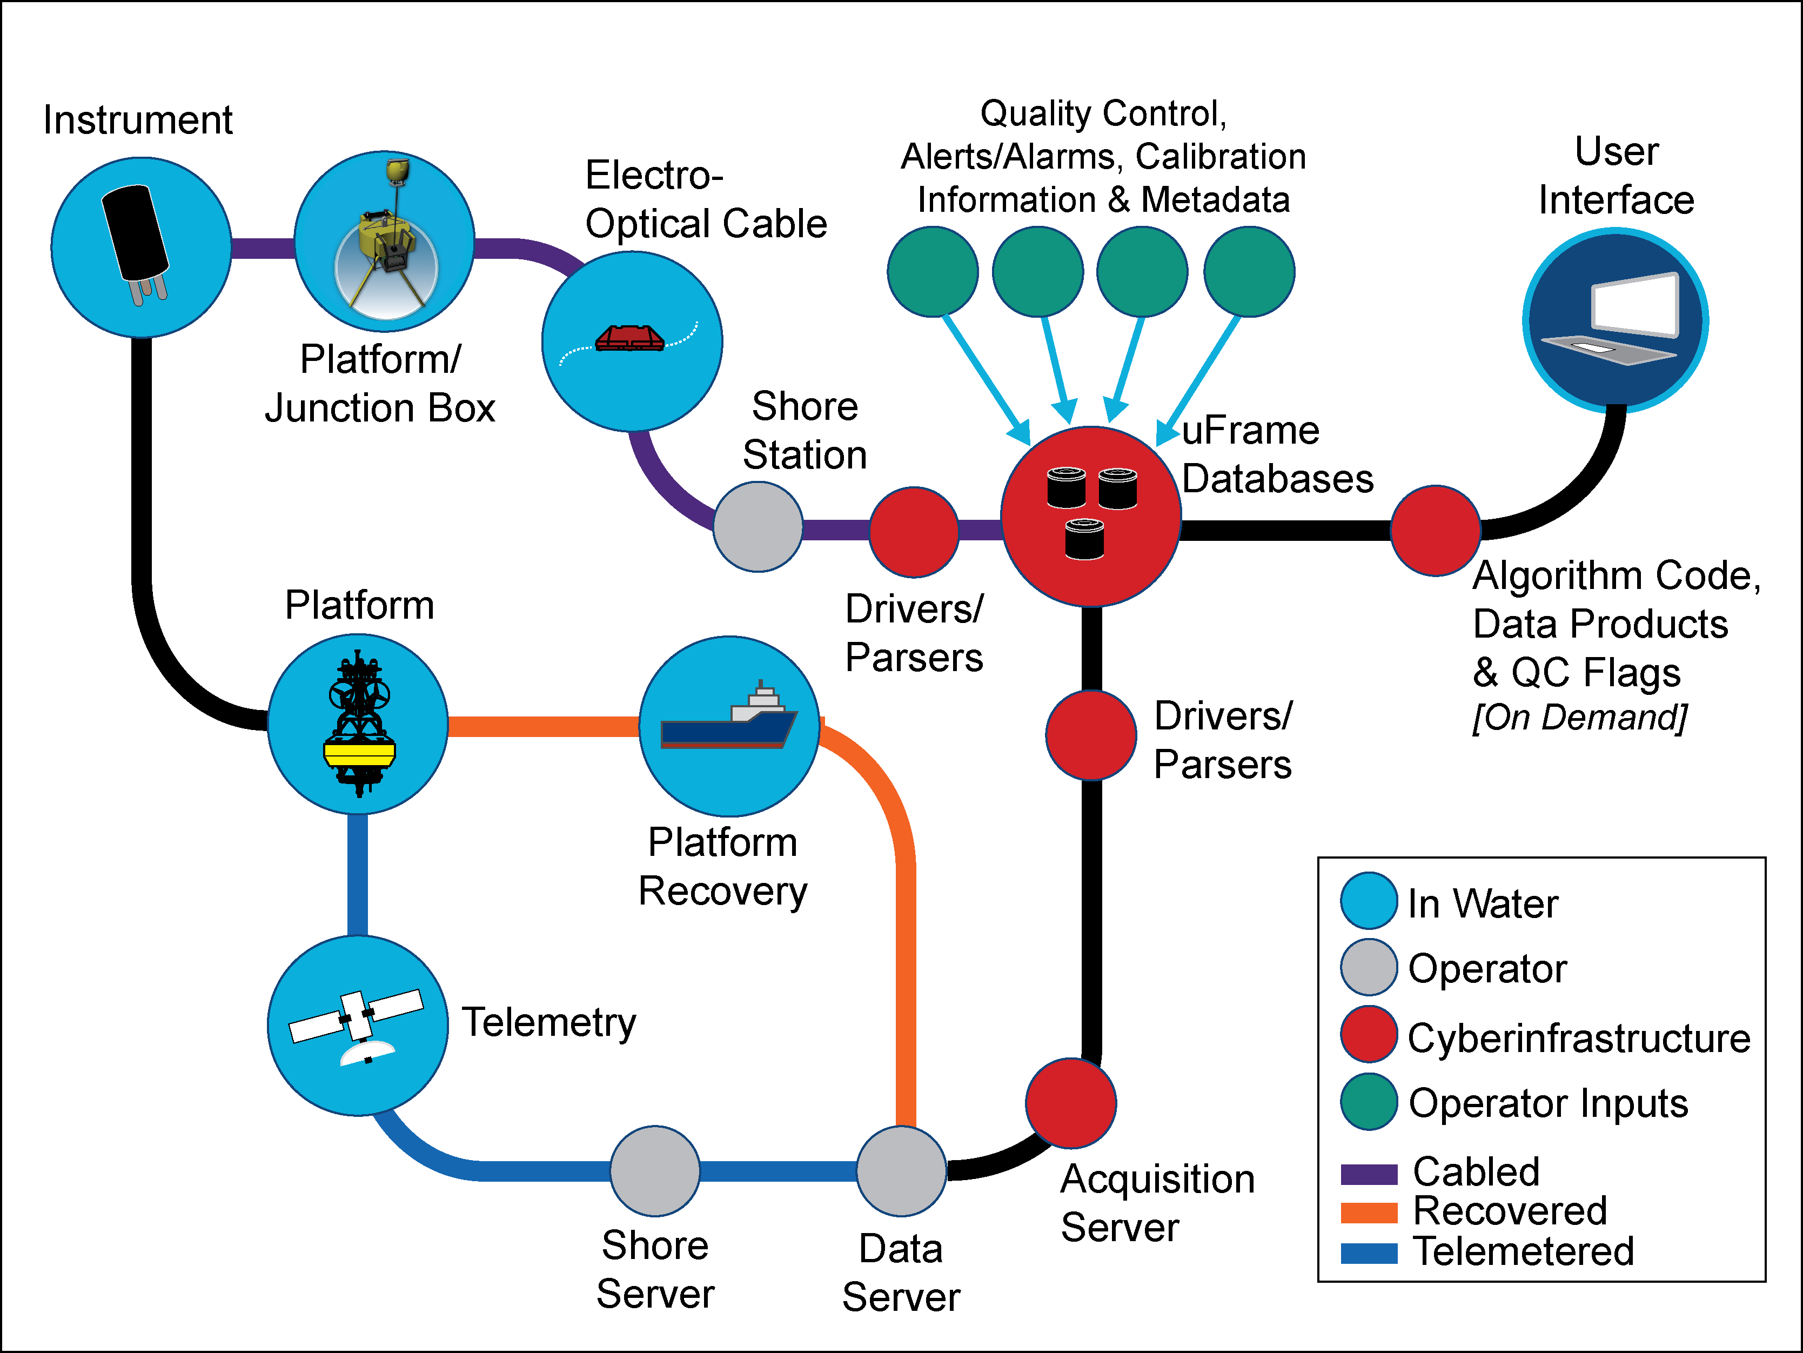
Data System Complexity
Customized API
Multiple variable names
Large Files
Data formats
Real-time / Recovered
Big Headaches
  System Issues
  Complex User Interfaces

Slide 9
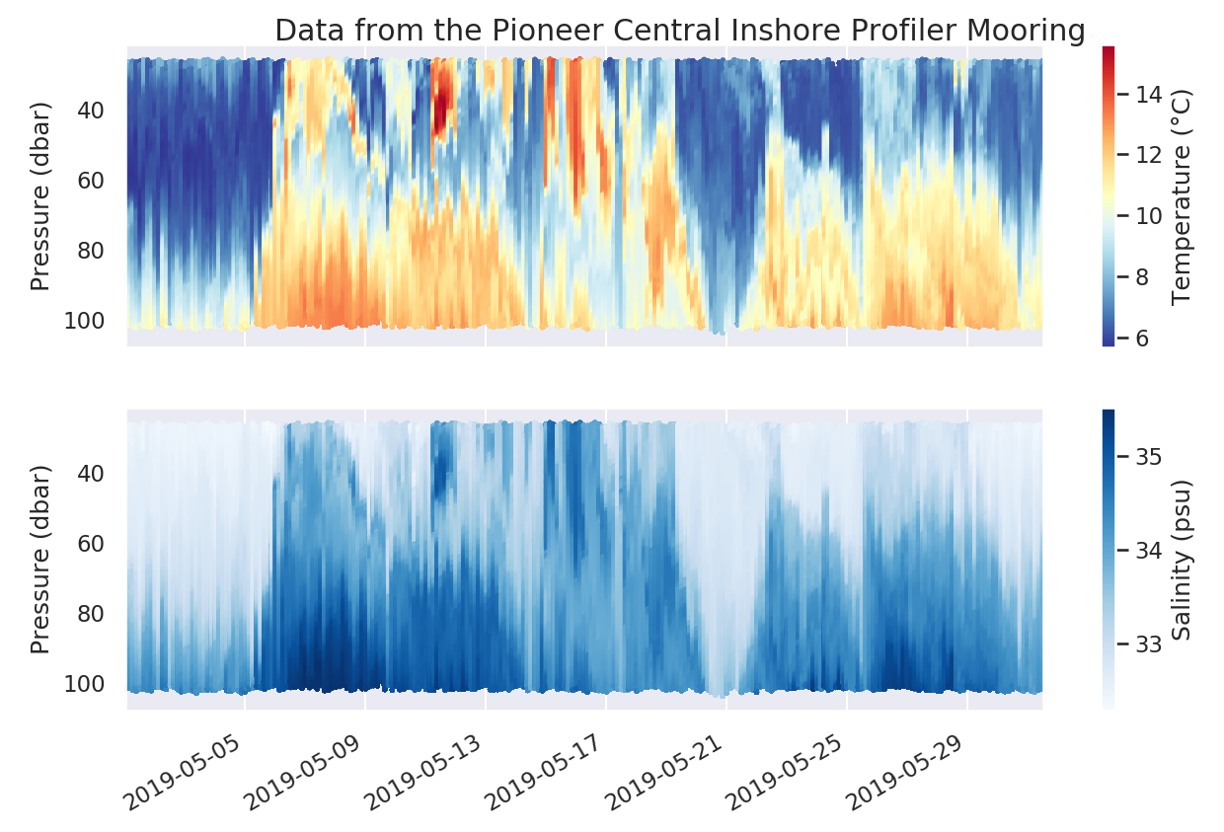
Natural System Complexity
Seasonal Cycles
Spatial/temporal resolution
Internal Waves
Eddies, Gulf Stream Rings
Bio-Physical Interactions
Big Headaches:
  Figuring out what’s ”real”
  What does it mean?

Slide 10
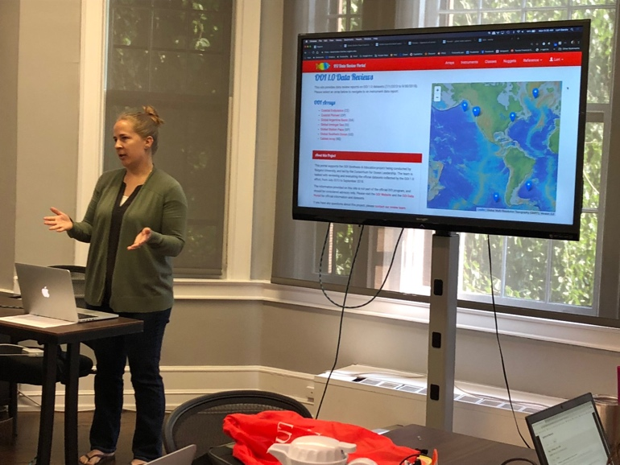
The Data Explorations – Design Process
Identify Target Scientific Concepts & Skills
Match with Research Results
Find Available Instrument Data
Cleanup the Dataset
Add Educational Surrounds (Context)
Make Interactives & Visualizations
Faculty Development Workshops
Science Papers
e.g. OOI Special Issue
“Nuggets” from
OOI 1.0 Data Review
https://datareview.marine.rutgers.edu/nuggets
Guidance from the Lawrence Hall of Science
Active Learning
The Learning Cycle

Slide 11
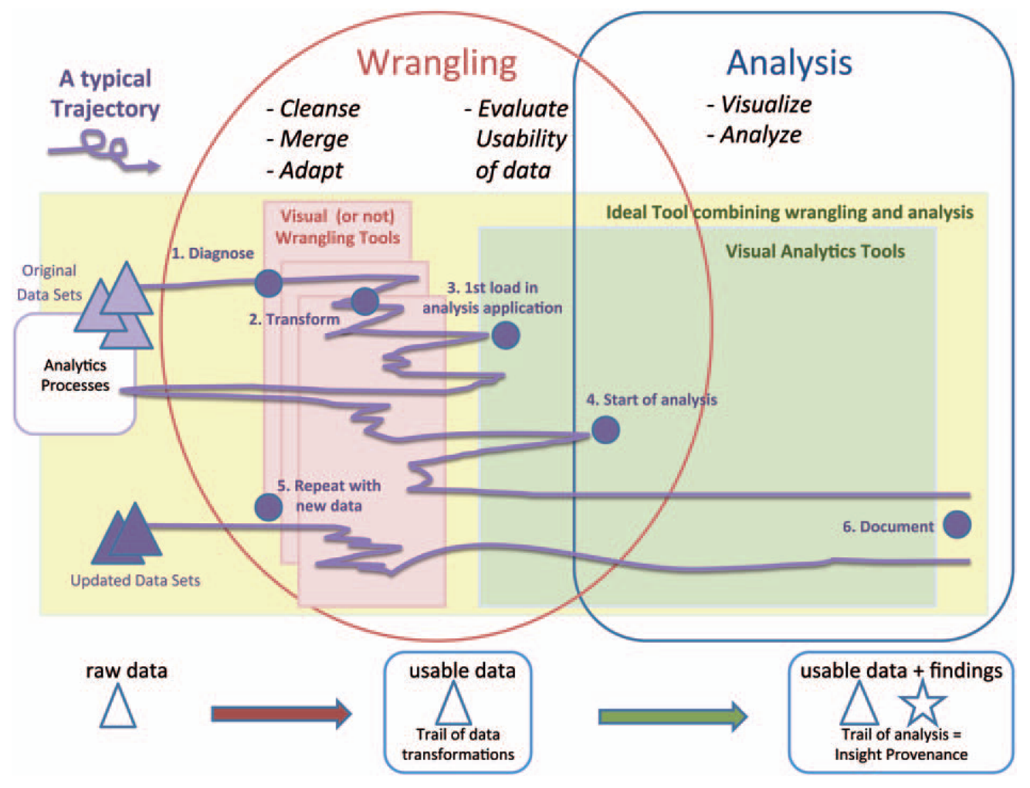
Cleaning Data
A ”linear” process?
Kandel, S., et al (2011), Research directions in data wrangling: Visualizations and transformations for usable and credible data, Inf. Vis., 10(4), 271–288.

Slide 12
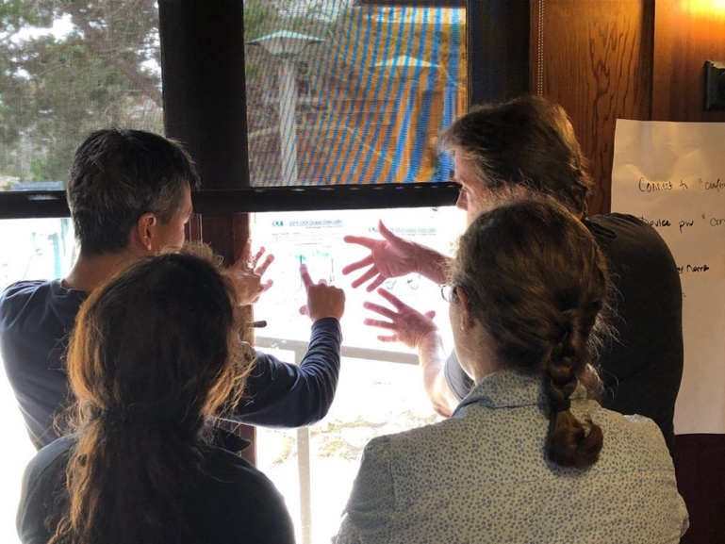



Approach 1 – Handmade Interactive Widgets
18 Pilot Data Explorations (from 2016-2017)
13 New Data Explorations from 2019 Workshops
  Many have 2-3 variants
Development Tools:
dygraphs.js – Used for most time-series widgets
d3.js – More complex widgets, including profiles
Leaflet.js - Spatial maps

Slide 13
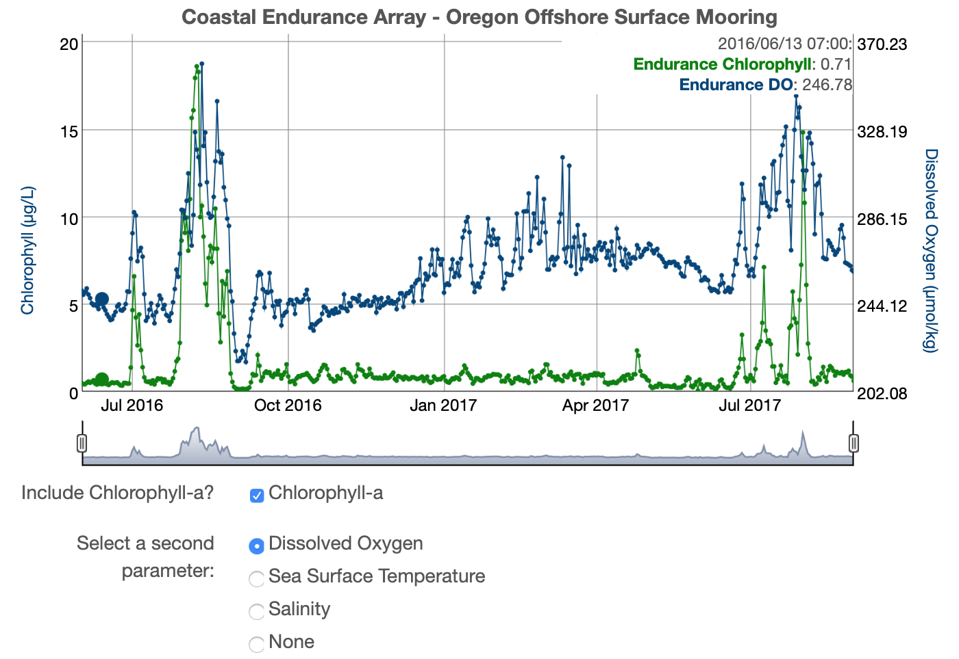
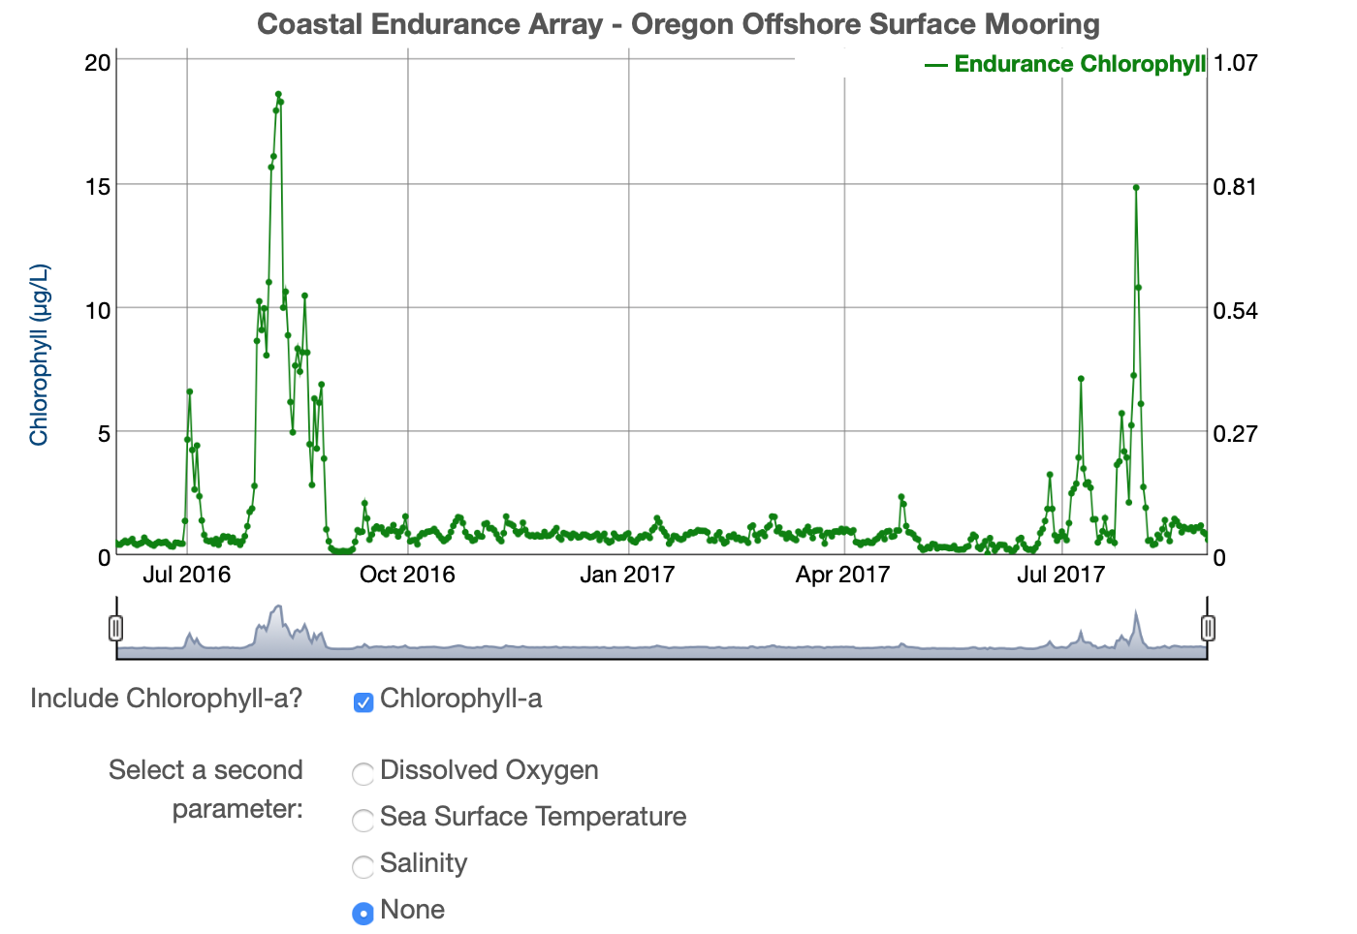
Exploring Data
Chlorophyll-a in
Upwelling and
Stratified Temperate
Regions
Karen Baker, Orange Coast College
Claire Condie, Middlesex County College
Robert Ellis, Orange Coast College
Colleen Petrik, Texas A&M University

Slide 14
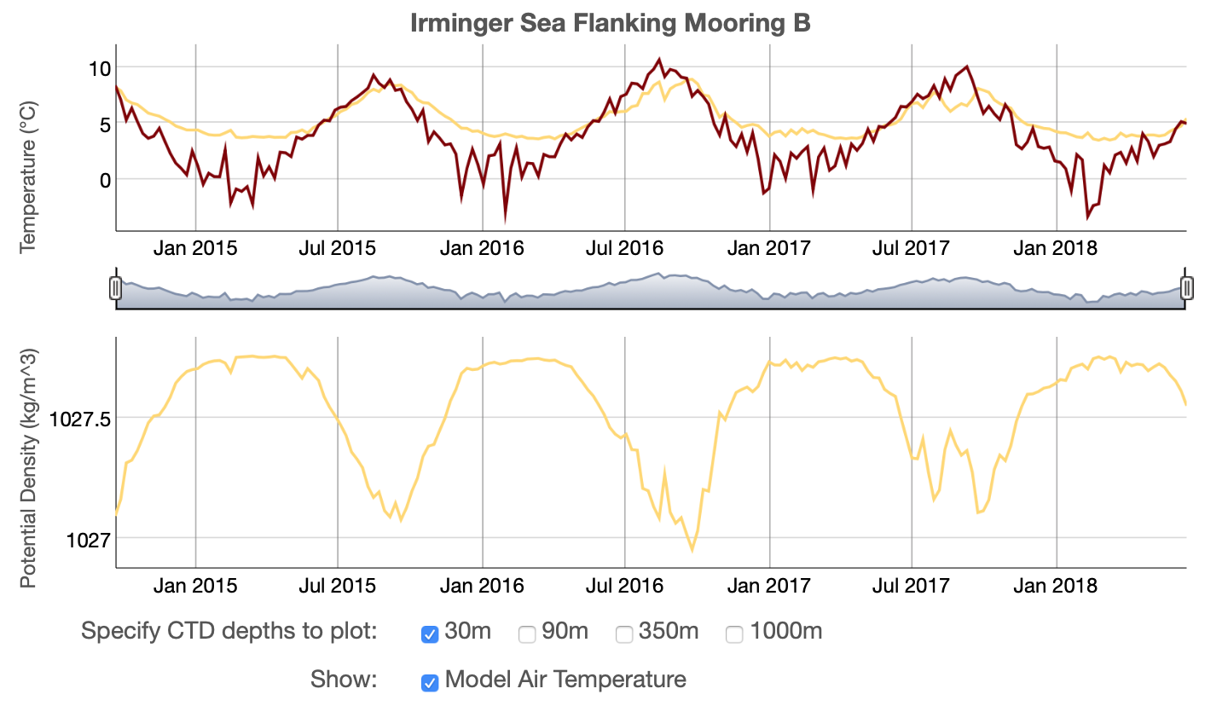
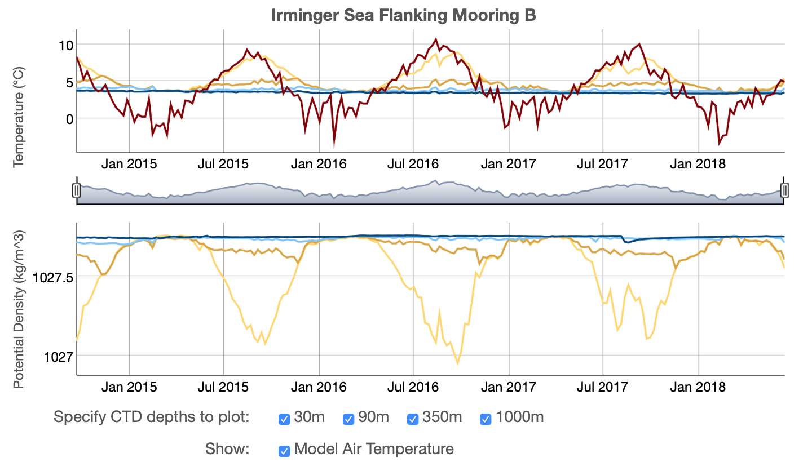
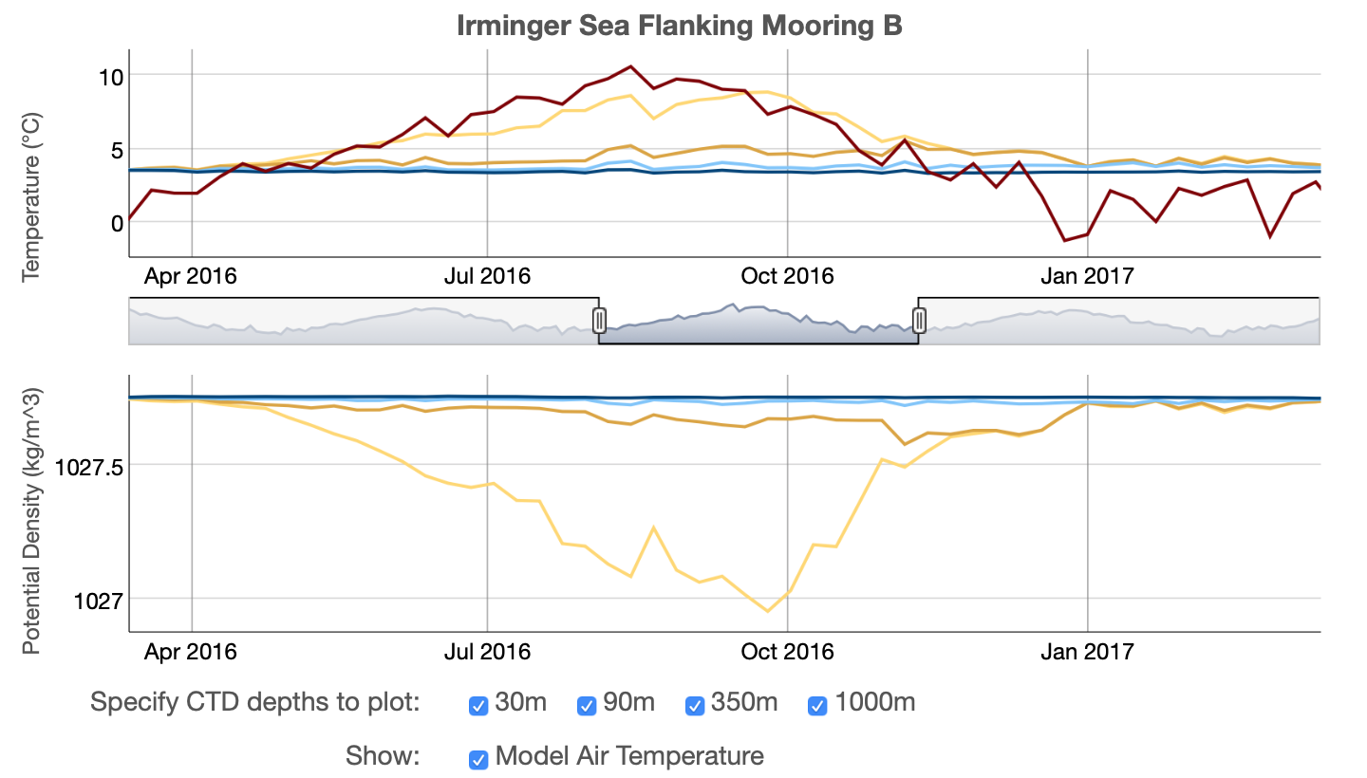
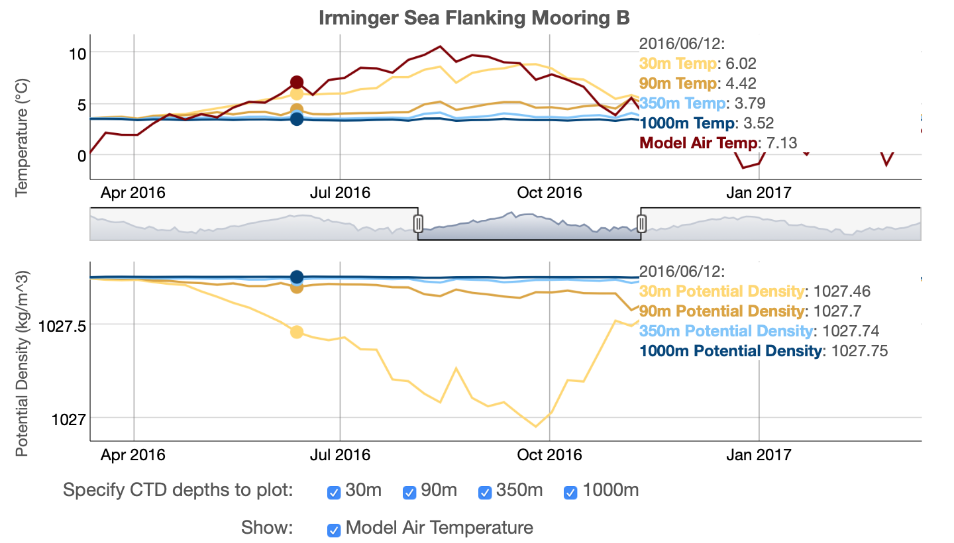
Focus + Context
Thermohaline
Circulation
Rich Dixon, Texas State University
Nicholas Beaird, Rutgers University

Slide 15
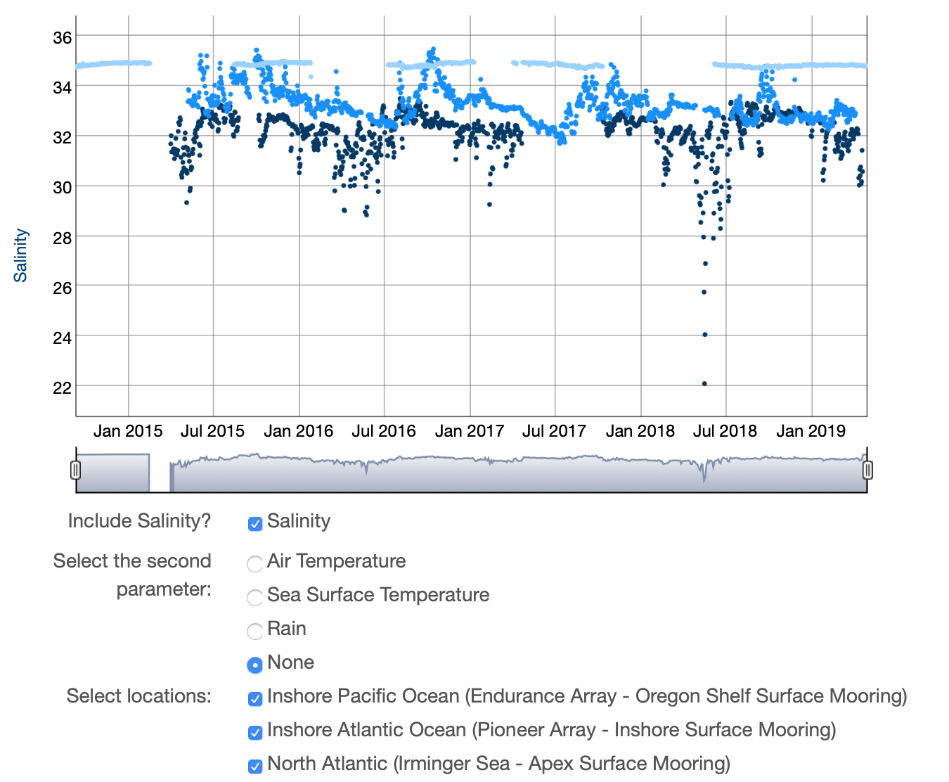
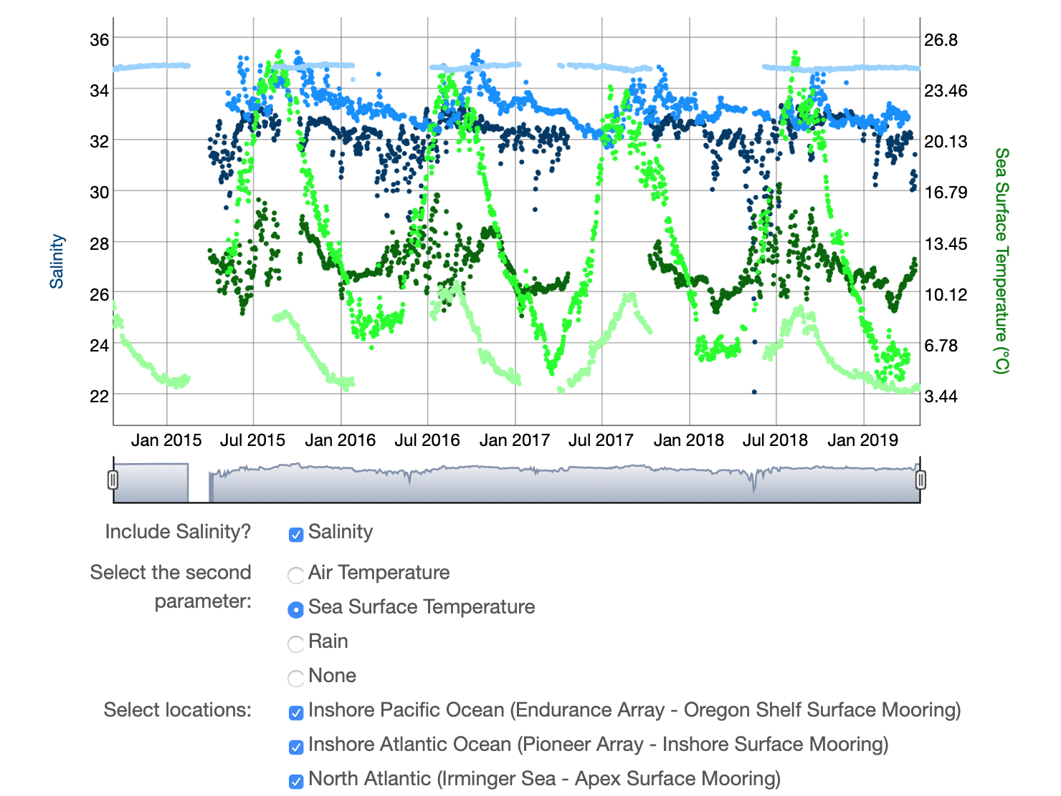
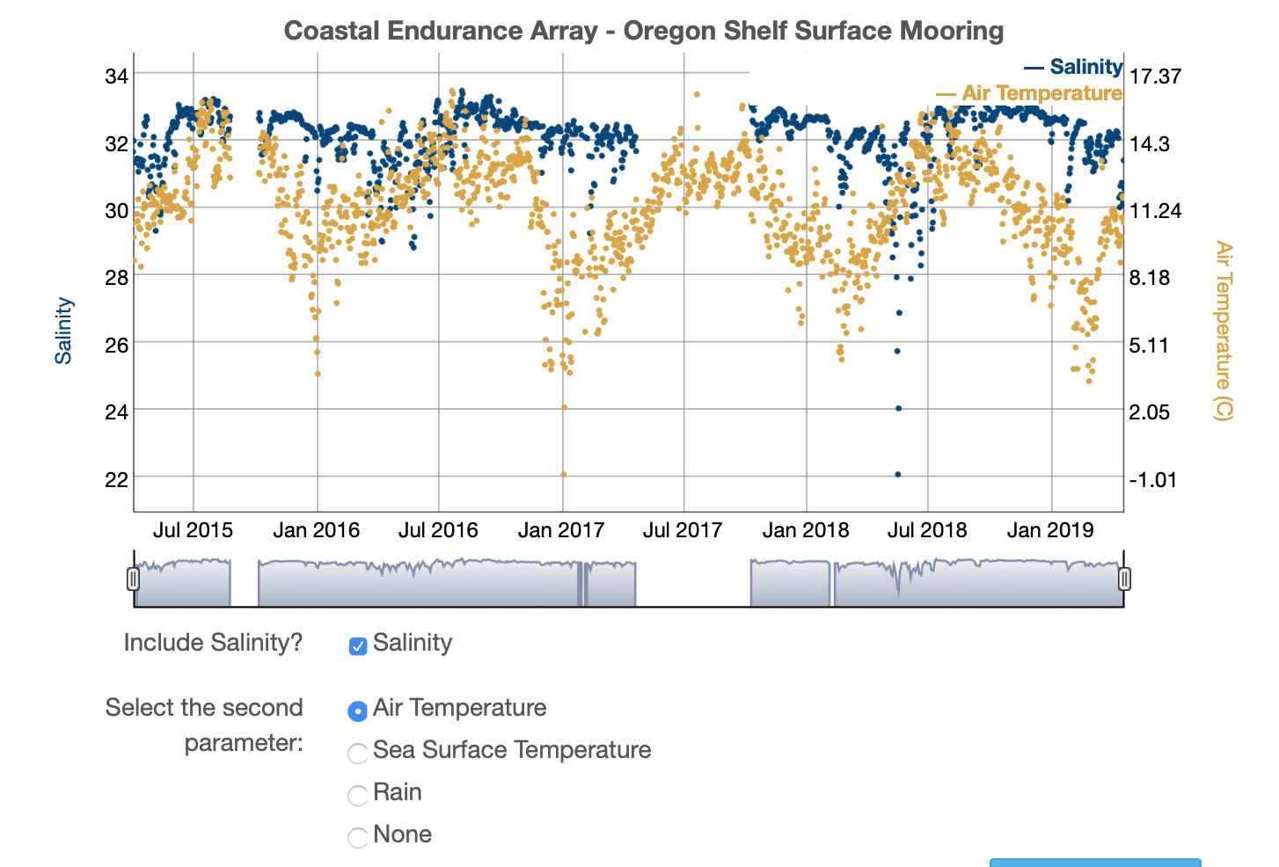
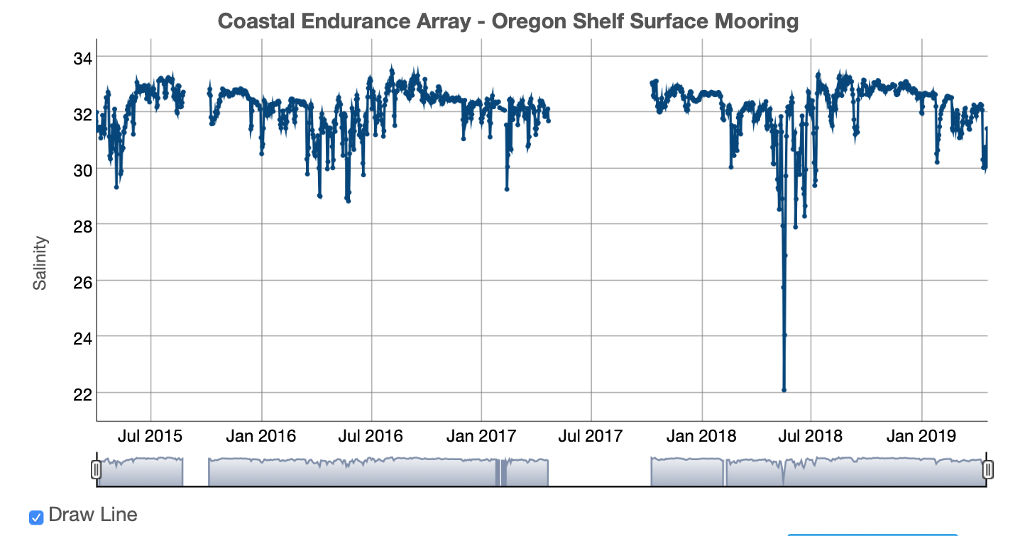
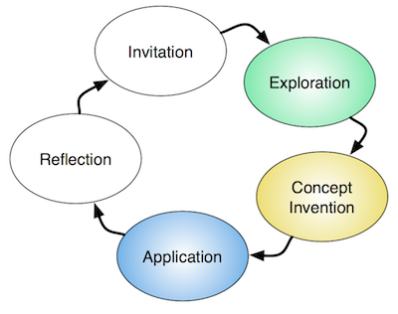
Compare Variables and Locations
Changes in Salinity
Michael Phillips, Illinois Valley Community College
Karen Helgers, SUNY Ulster
Jessica Olney, Hillsborough Community College
Matthew Semcheski, Florida Keys Community College

Slide 16
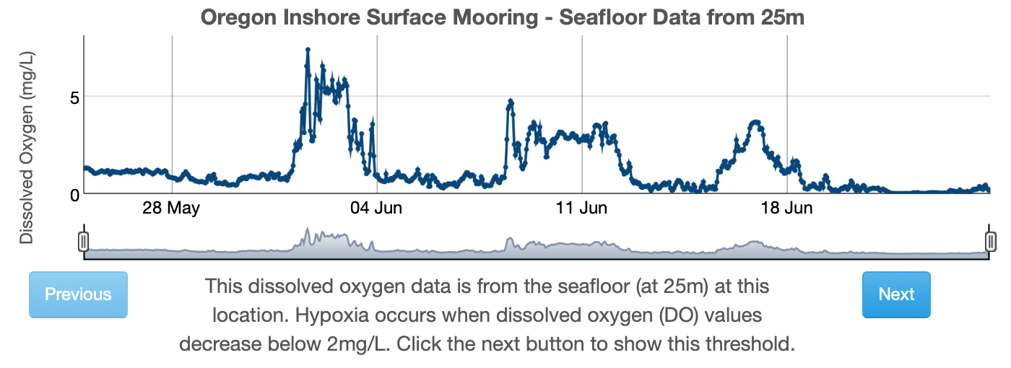
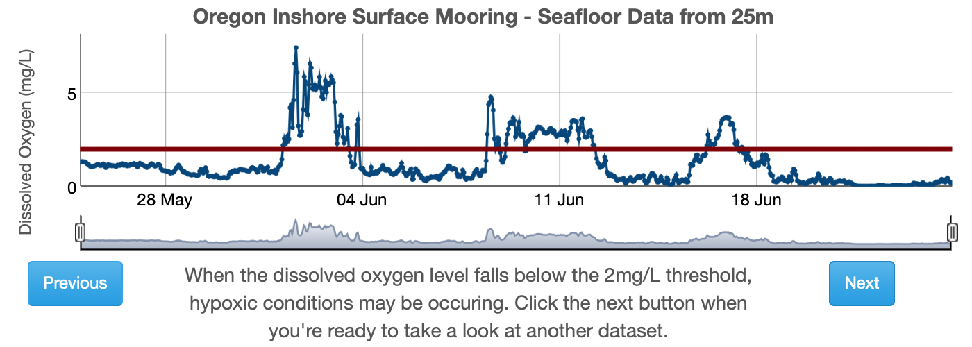
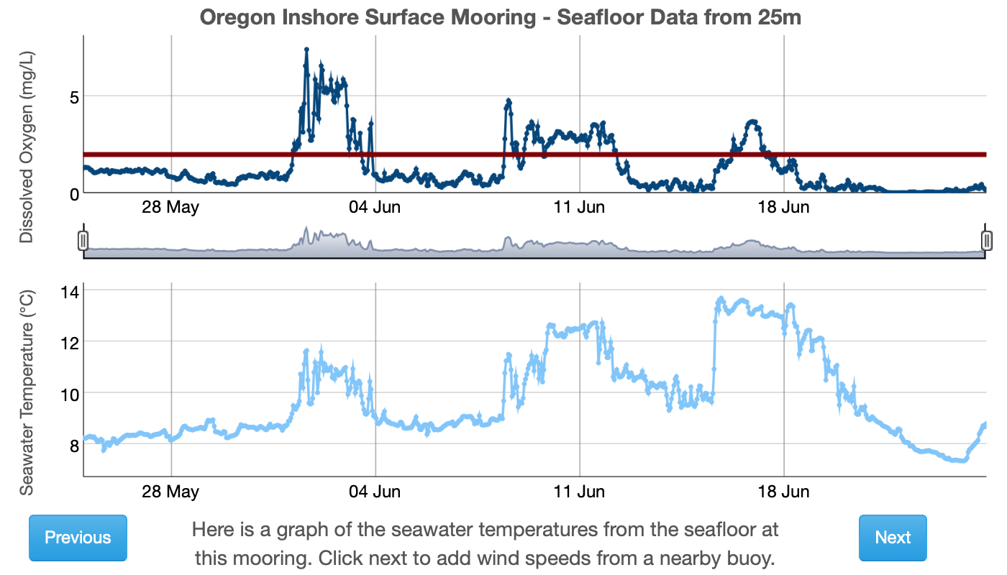
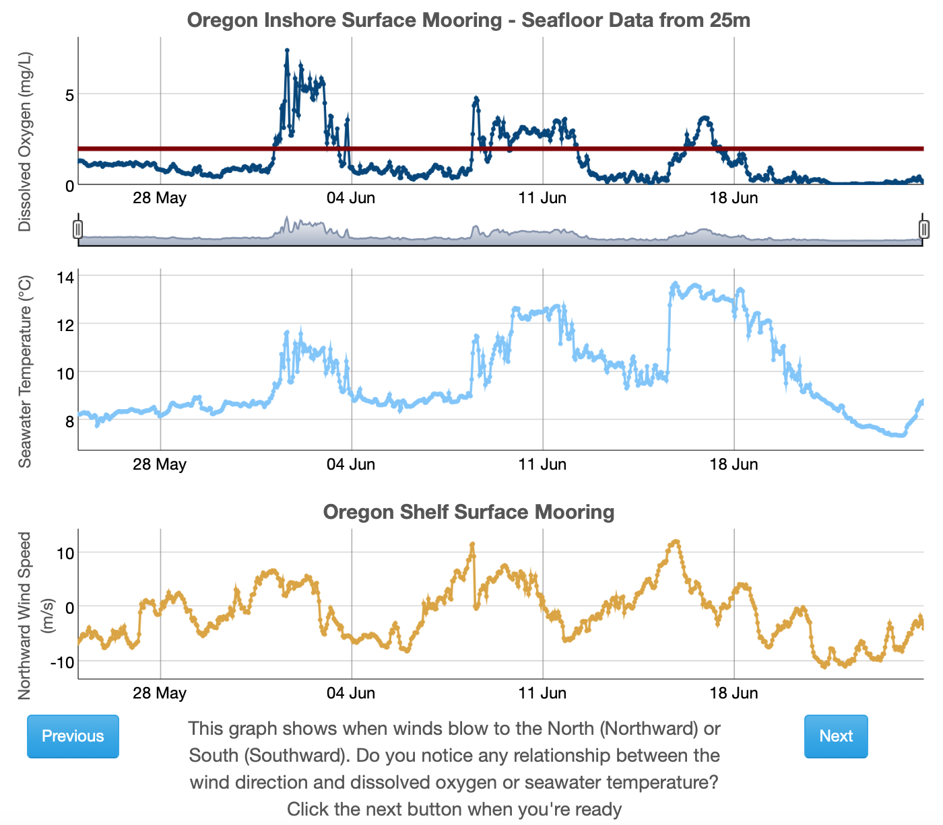
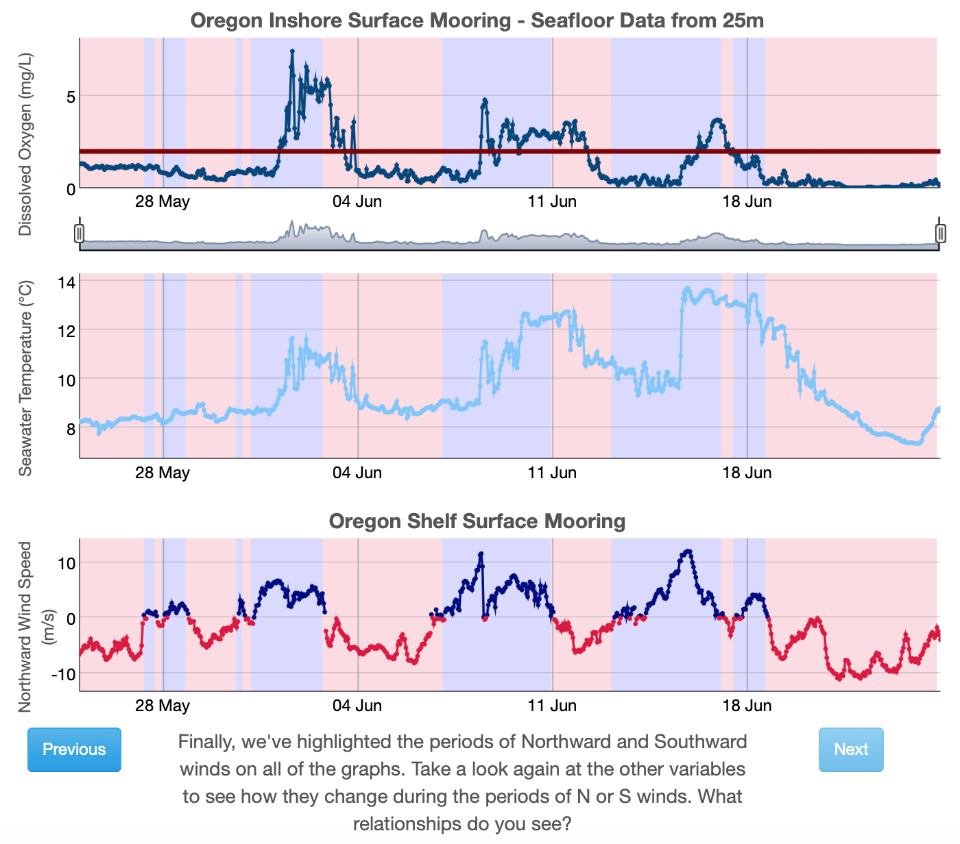
Guided Learning
Anoxic Events
Kathy Browne, Rider University
Lauren Sahl, Maine Maritime Academy
Rebecca Freeman, University of Kentucky
Gabriella Smalley, Rider University
Carol White, Southern Maine Community College

Slide 17
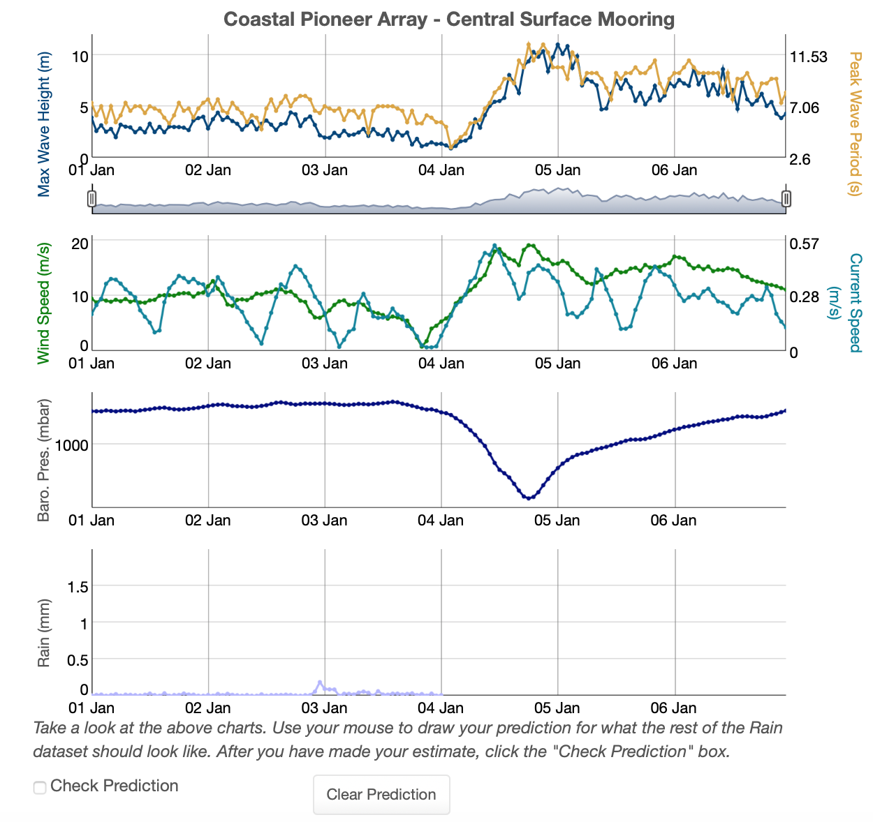
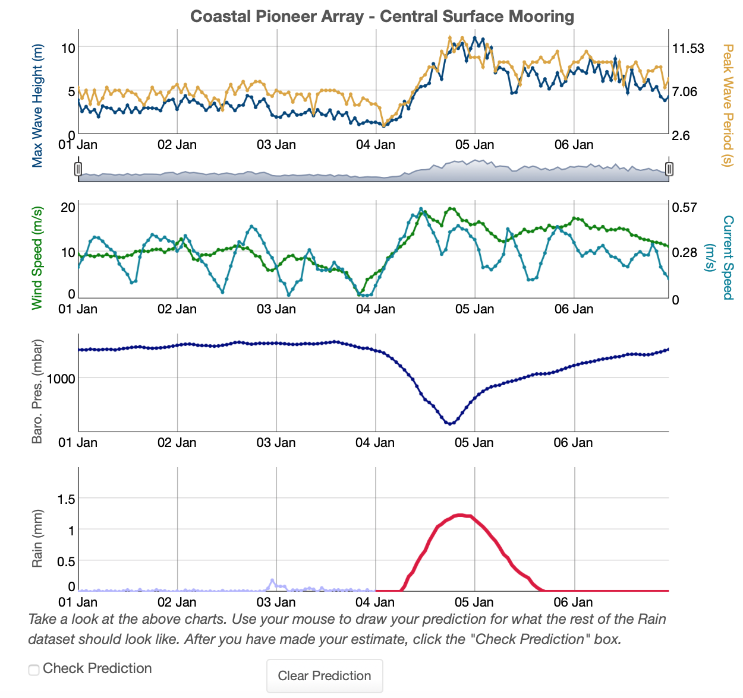
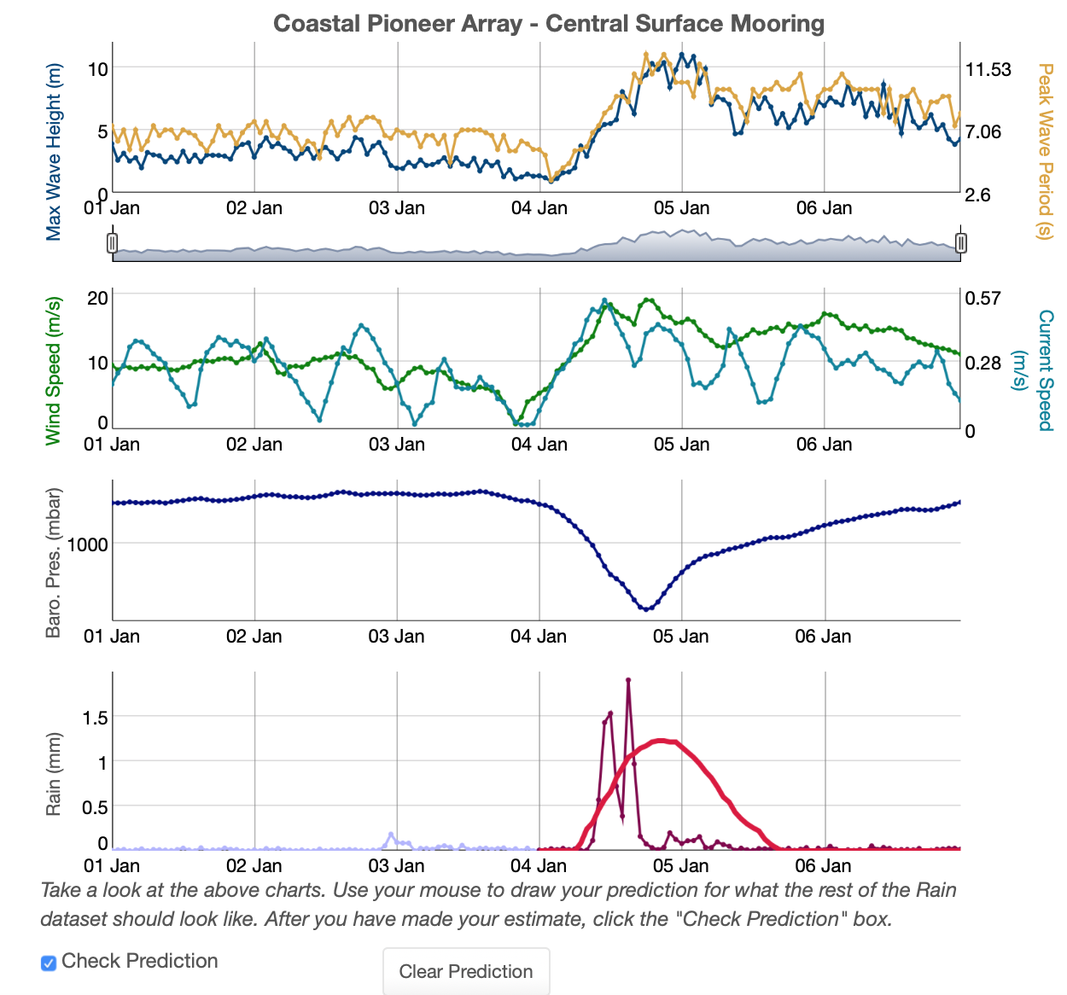
Student Predictions
Dynamic Air-Sea Interactions
Jacqui Degan, Cape Fear Community College
Melissa Hicks, Onondaga Community College
Siddhartha Mitra, East Carolina University
Paul Webb, Roger Wiliams University

Slide 18
Approach 2 – Python/Matlab/R Notebooks
Notebooks can be used for:
Tutorials
Exercises/practice (in-class or out)
Guided discovery
Self-directed inquiry (aka research projects)
Enables Community Driven interactive datasets, lessons and research
31 Example OOI Data Processing Notebooks to date
  https://github.com/ooi-data-lab/data-lab-workshops
4 “Data Labs Fellows” working on Educational notebooks
New visualization libraries enable interactive exploration
  Altair
  HoloViz

Slide 19
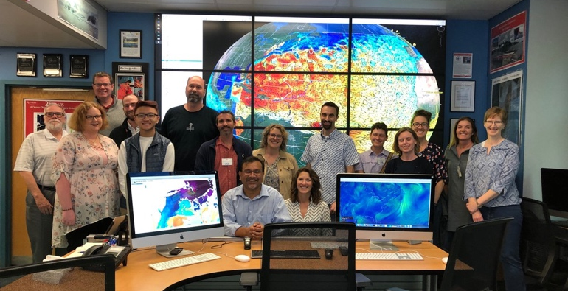
Notable Professor Quotes
“When I asked the students if they wanted to continue this; they overwhelmingly said ‘yes.’”
“I was so excited about the data portal and the new data labs that my students and I look at either OOI data or some other data portal every single day in class.”
“The data set is fantastic. One thing I would like to tell [project leaders] is that this gives the oceanography students the kind of skills which they can take even if they don't want to continue in the oceanography field”
“We had some really good discussions. It was one of the best weeks of the semester where students were engaged, they put the work in, and they really thought about the questions I was asking them.”

Slide 20
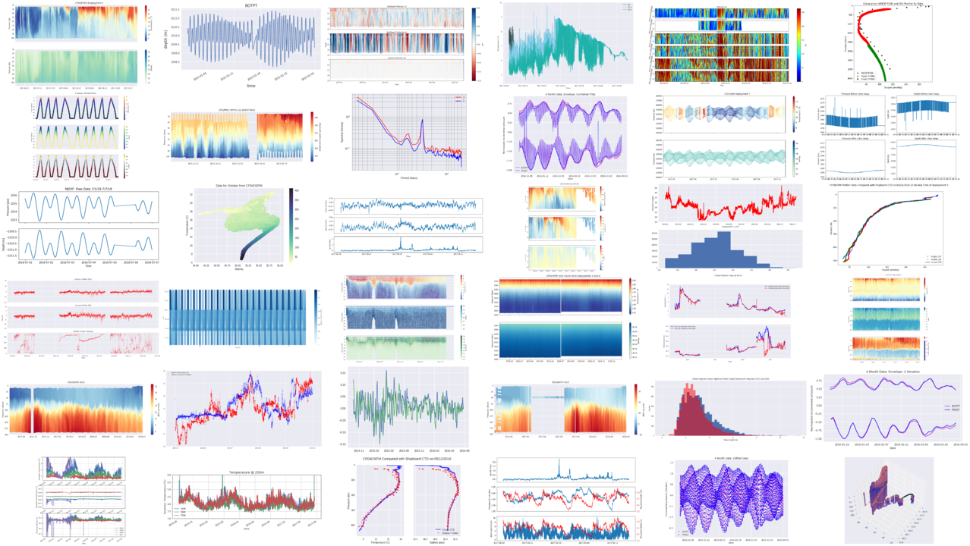
Start your Data Exploration!
Data Explorations
Python Notebooks
Blog / Tutorials
Webinar recordings
Join our mailing list
https://datalab.marine.rutgers.edu
sage@marine.rutgers.edu
@visualocean

Slide 21
FIN

Slide 22
Additional Data Explorations at OSM20
Seasonal Variability In The Mixed Layer – Rachel Eveleth ED24D-3628
Factors affecting Primary Production – Dina DiSantis ED24D-3633
CO2 Exchange Between Air and Sea – Robert Rhew ED24D-3630
Plate Tectonics and the Seafloor – Benjamin R Jordan
And more!

Slide 23
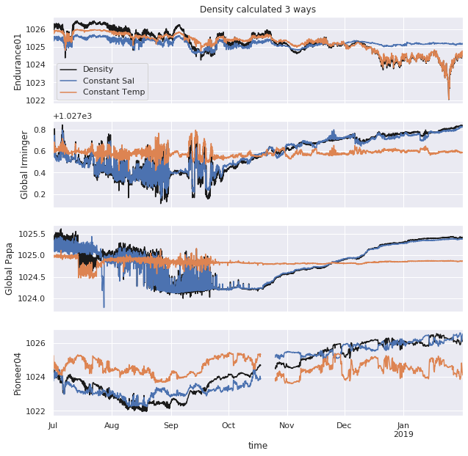
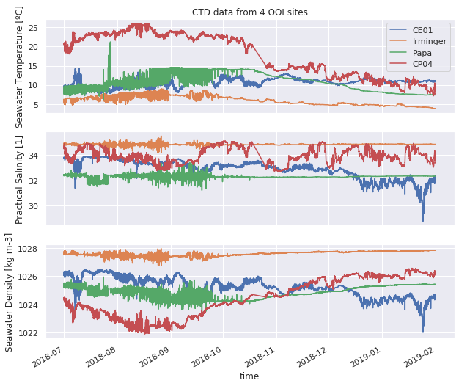
Drivers of Seawater Density
Goal: Observe how temperature, salinity influence density at three locations

Slide 24
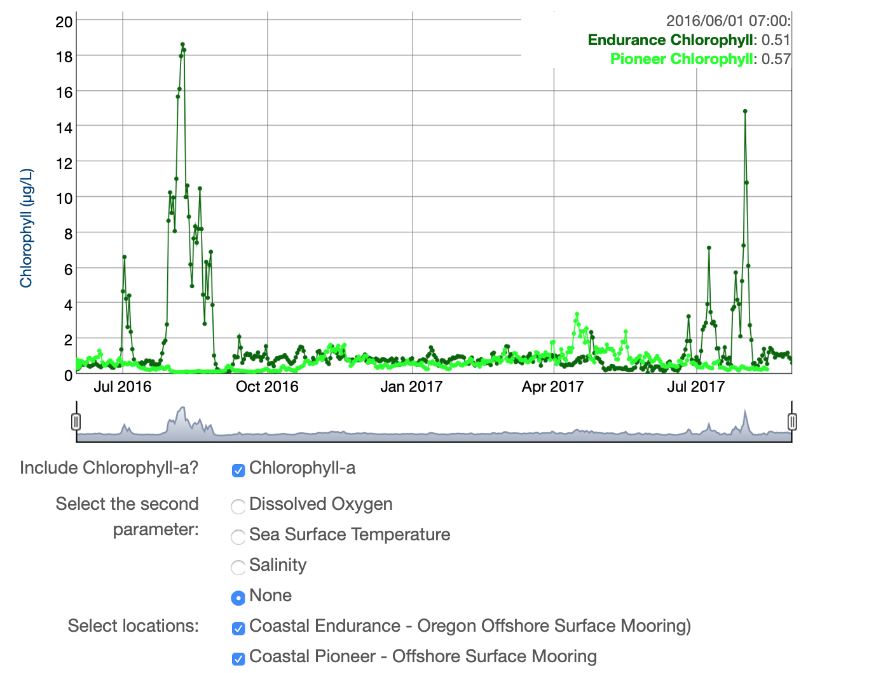
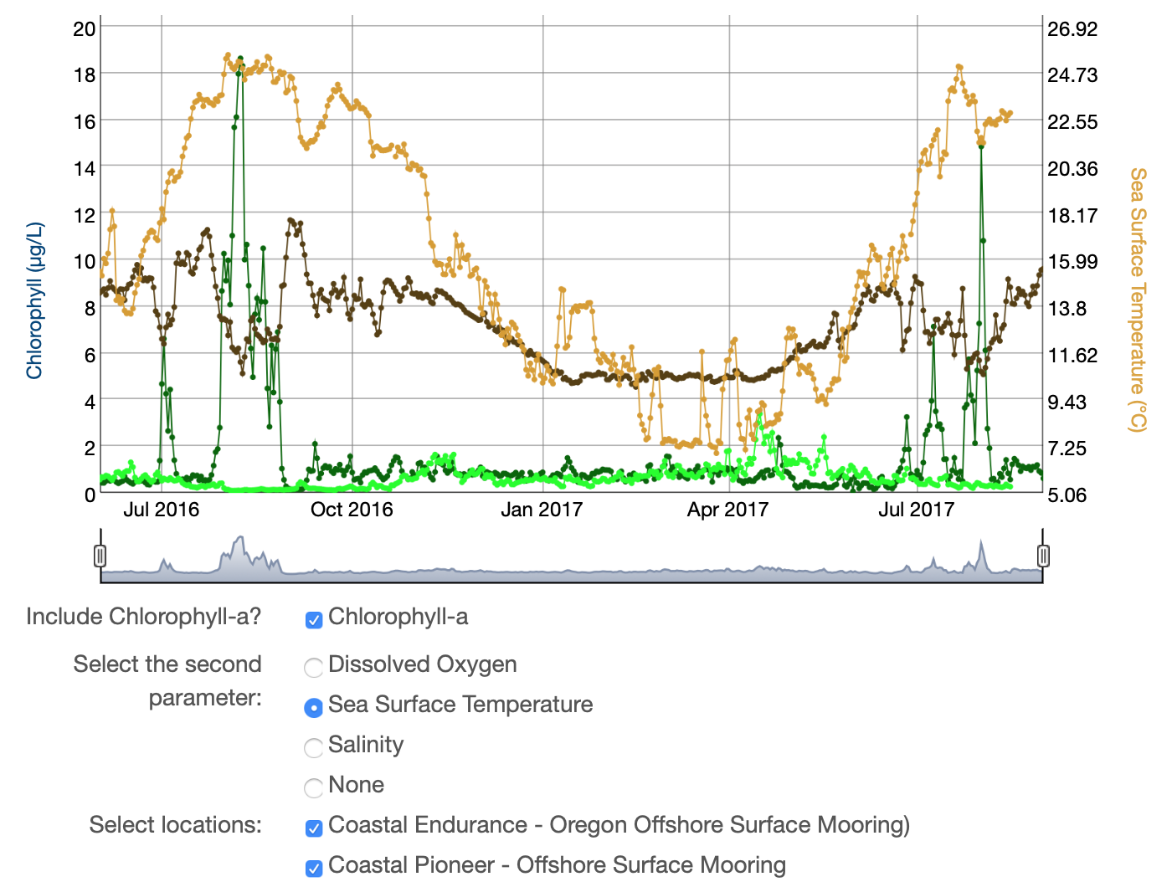
Exploring Data
Chlorophyll-a in
Upwelling and
Stratified Temperate
Regions
Karen Baker, Orange Coast College
Claire Condie, Middlesex County College
Robert Ellis, Orange Coast College
Colleen Petrik, Texas A&M University

