Slide 1
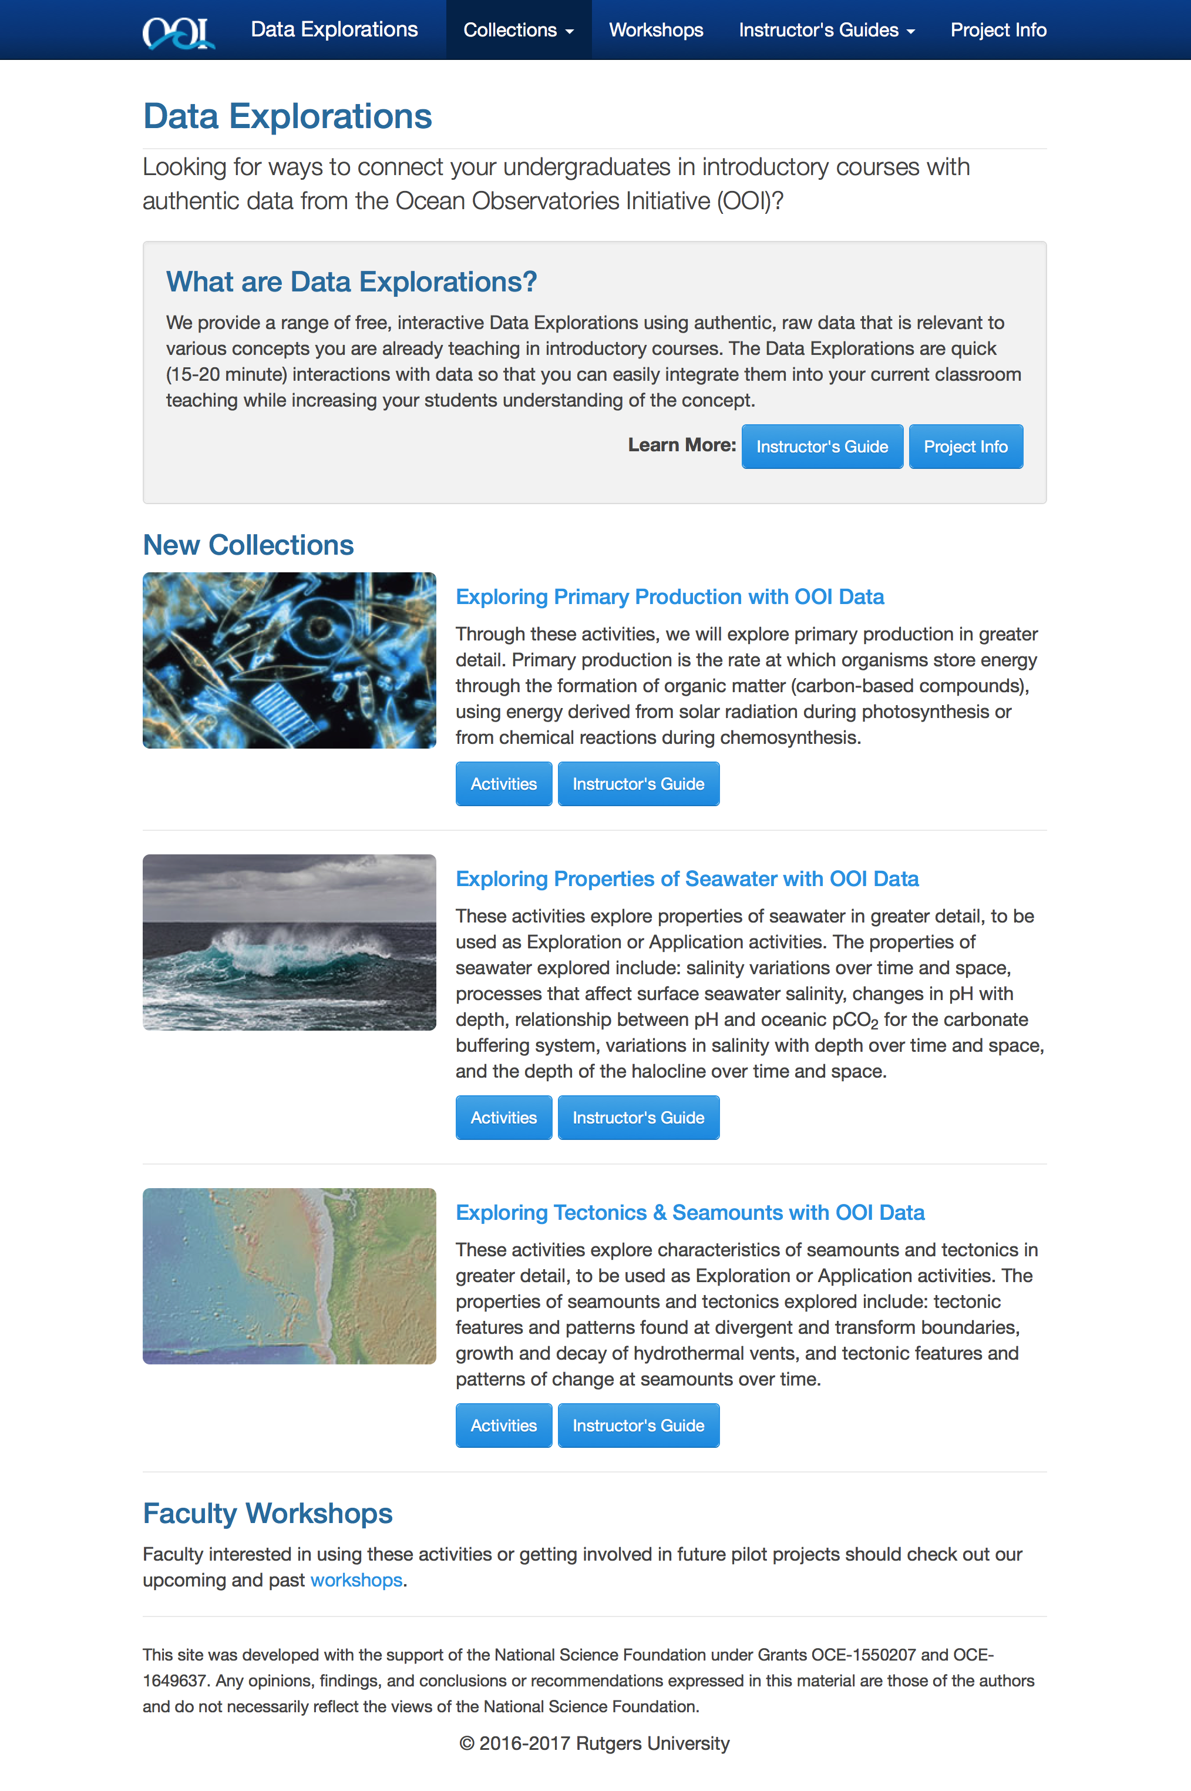
Engaging Introductory Undergraduate Students with Online Data Explorations
ED41A-07
Sage Lichtenwalner, Janice McDonnell, Kristin Hunter-Thomson, & Catherine Halversen
February 15, 2018
http://explorations.visualocean.net

Slide 2
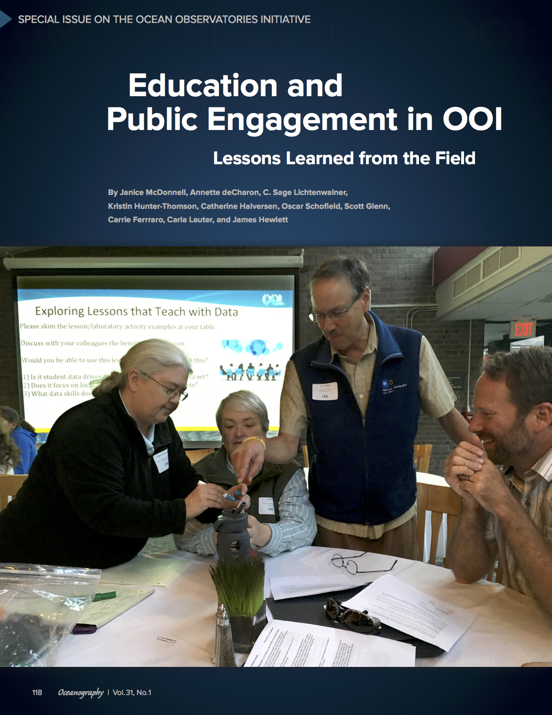
Exploring Explorations
TL;DR
http://explorations.visualocean.net
For more…
Hunter-Thomson et al. Incorporating Observatory Data into Oceanography Courses. EOS 12/8/17
McDonnell et al. Education and Public Engagement in OOI: Lessons Learned from the Field. Oceanography (Special issue this month!)
Poster today: ED44C-2483 Julie Masura. Integrating Ocean Observatories Initiative Data into Undergraduate Introductory Courses.
Notes:
How this all started
The evolution of the idea
What is a Data Exploration?
The Design/Development Process
Quick Results

Slide 3
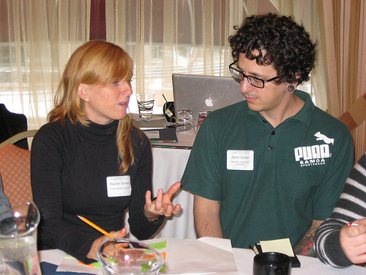
Claims, Evidence, and Reasoning
2010 K. Kastens. Oceans of Data Institute.

Slide 4
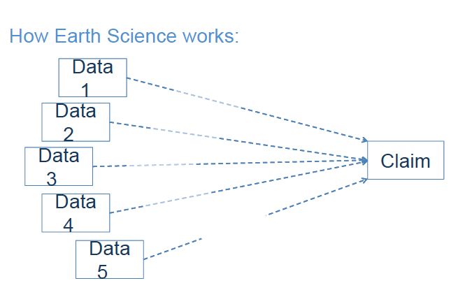
Claims, Evidence, and Reasoning
Many claims in Earth Science are based on the preponderance of the evidence from multiple lines of data-based reasoning

Slide 5
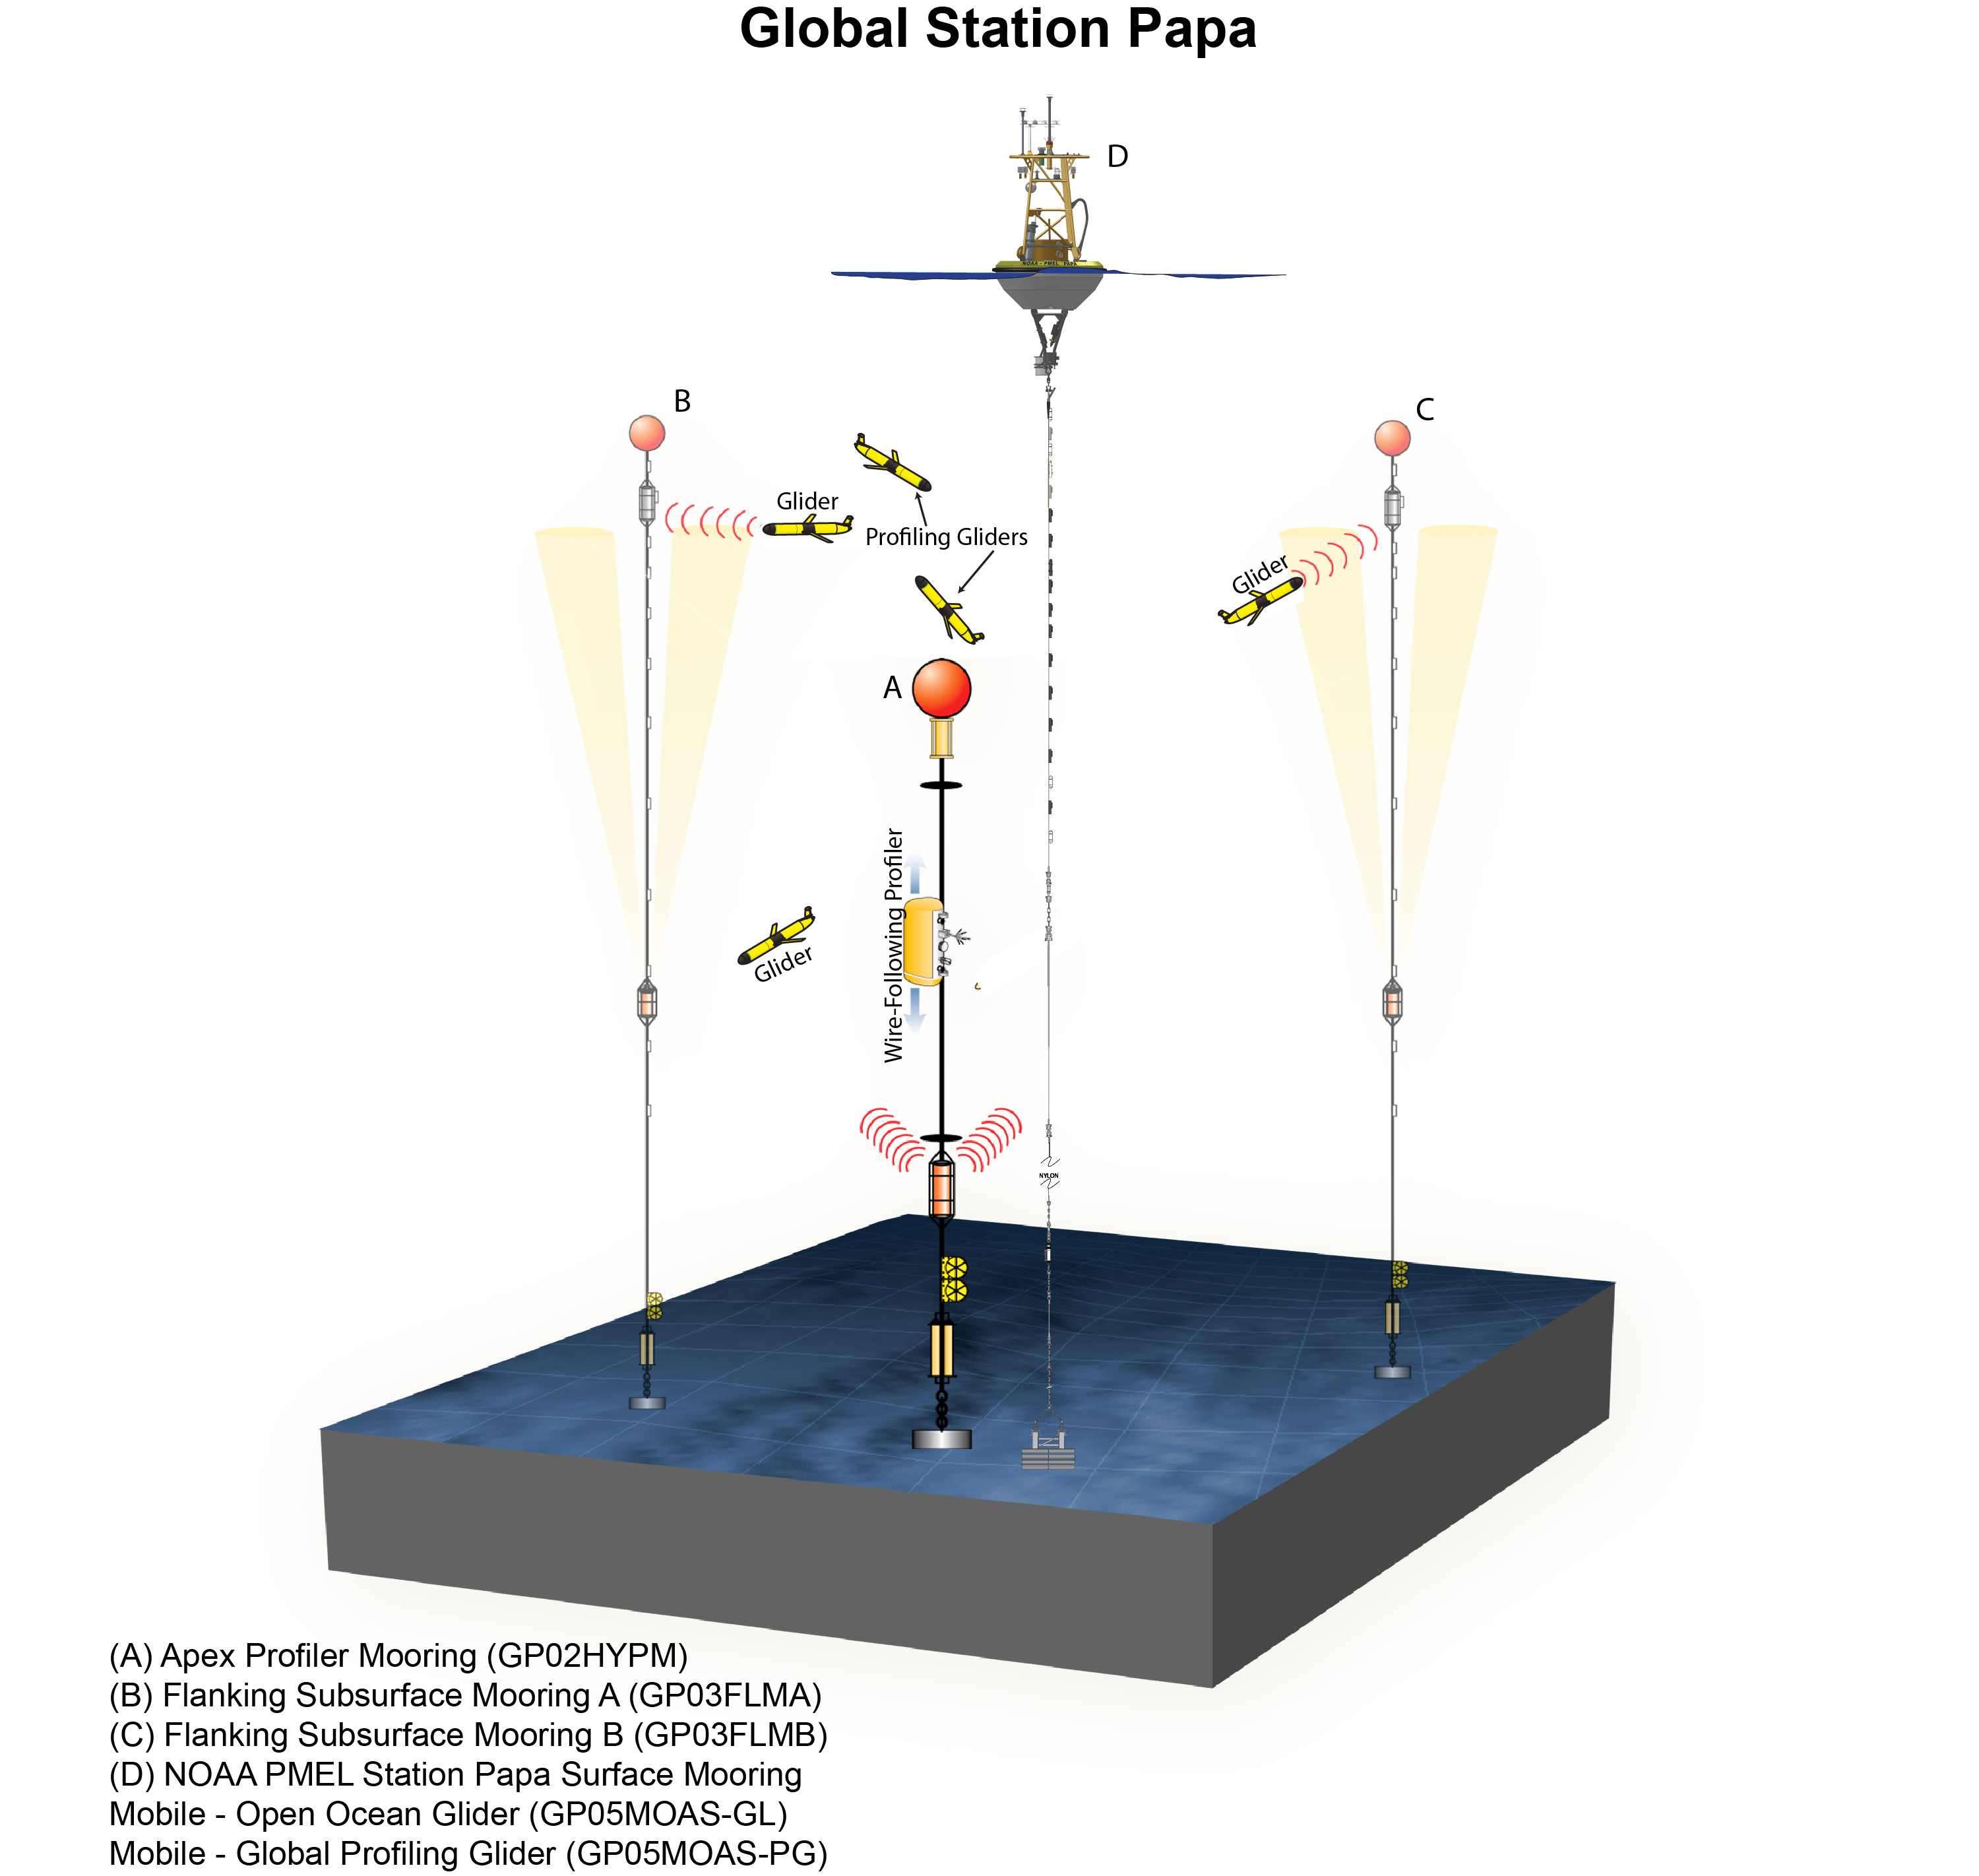
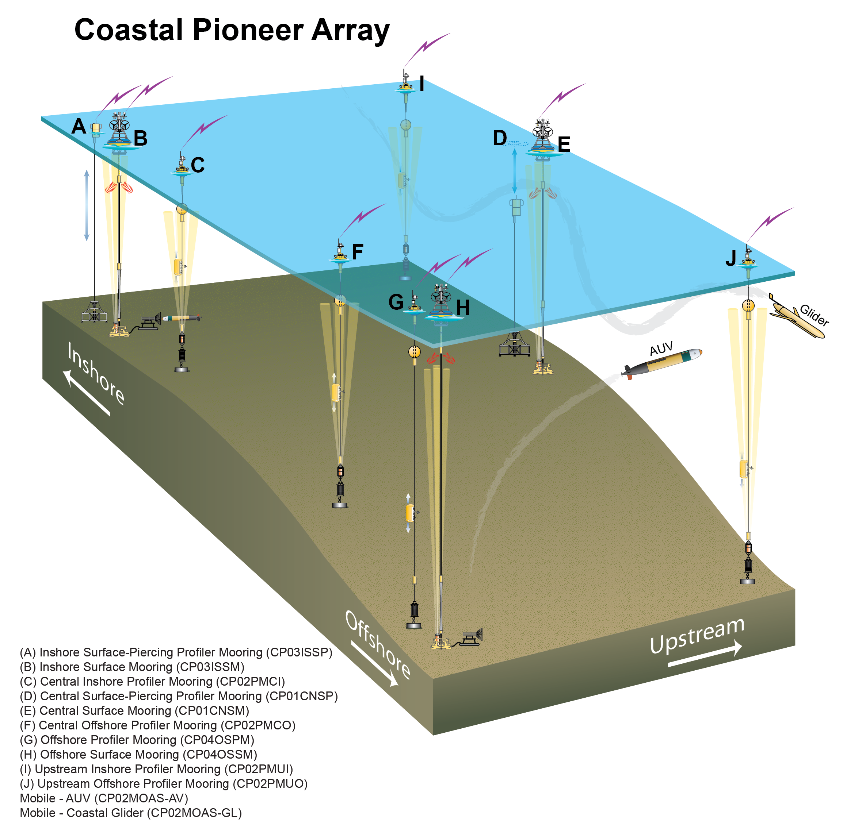
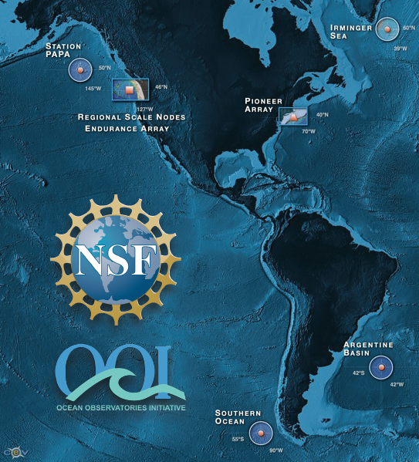
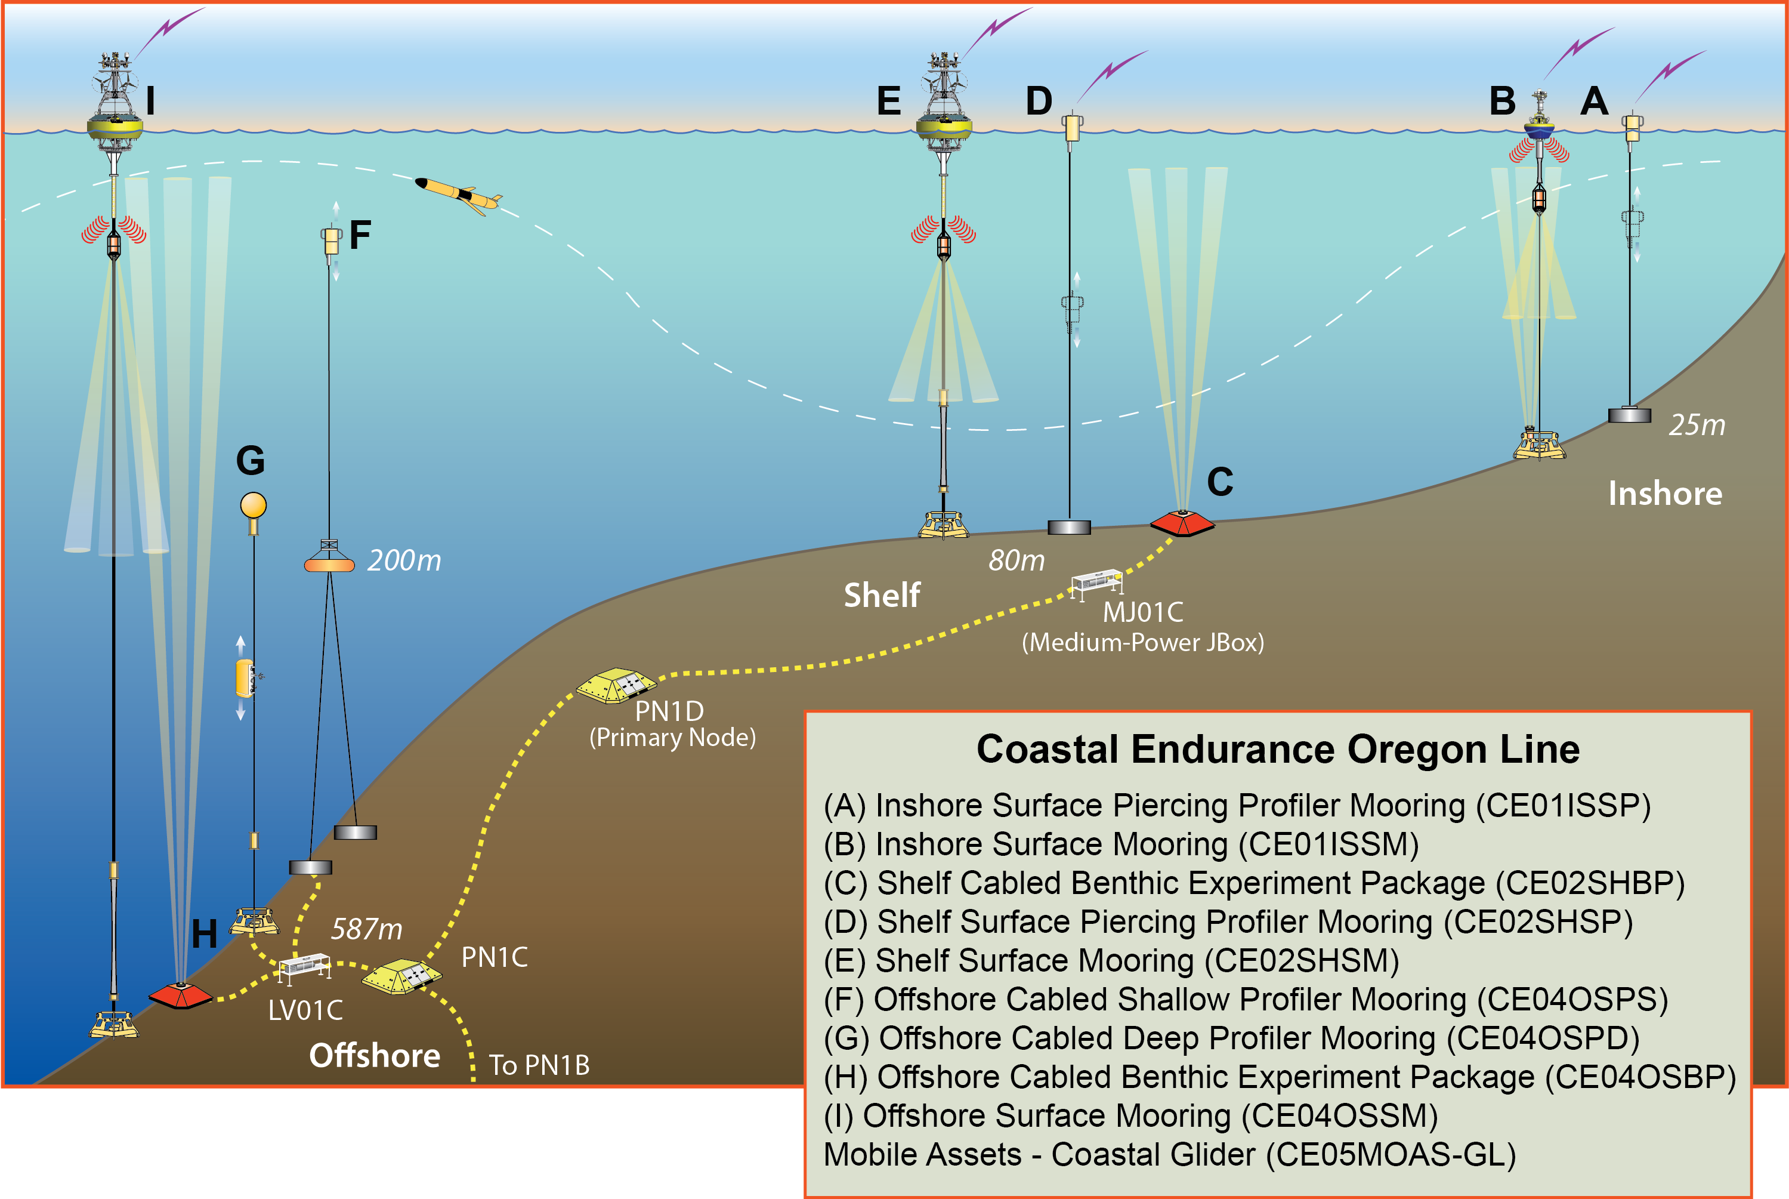
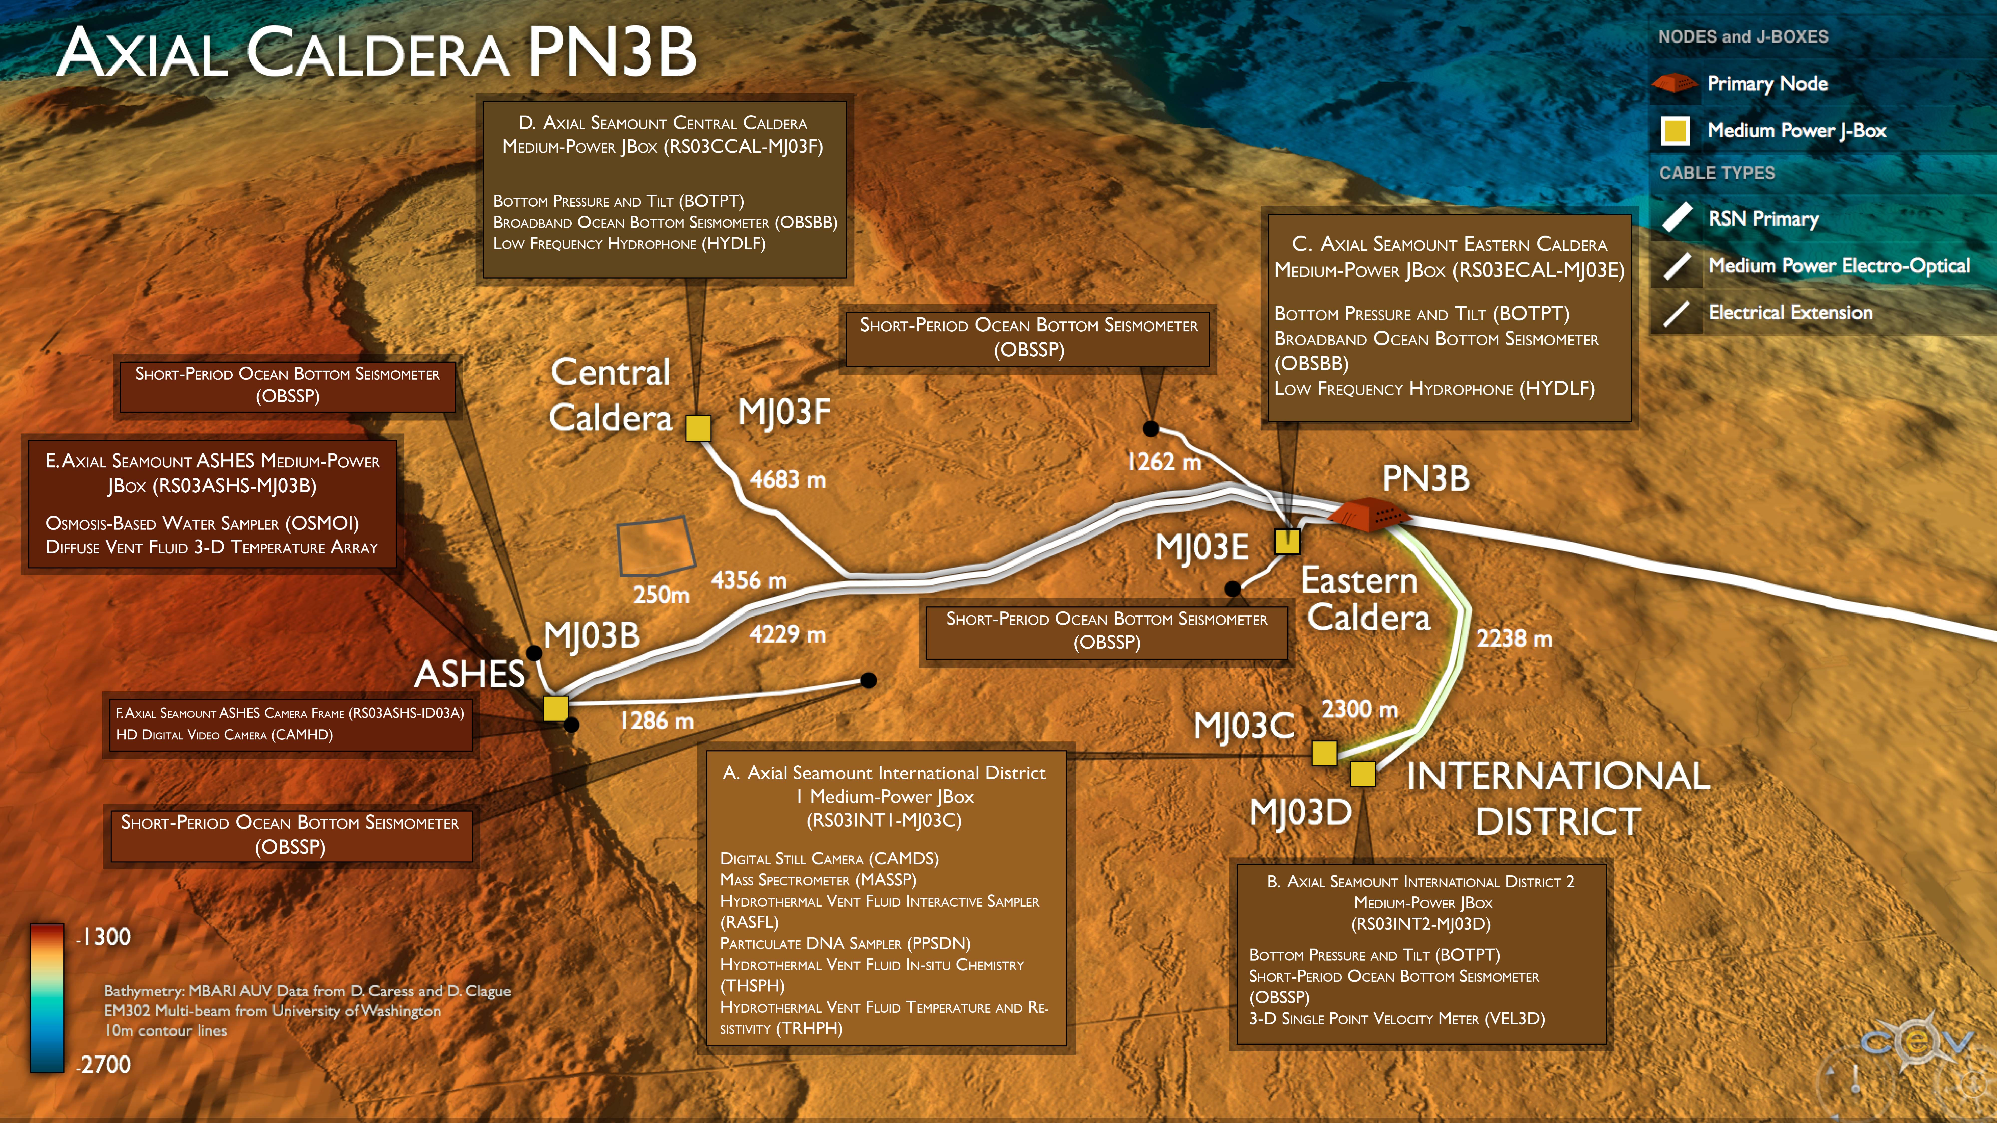
The Ocean Observatories Initiative

Slide 6
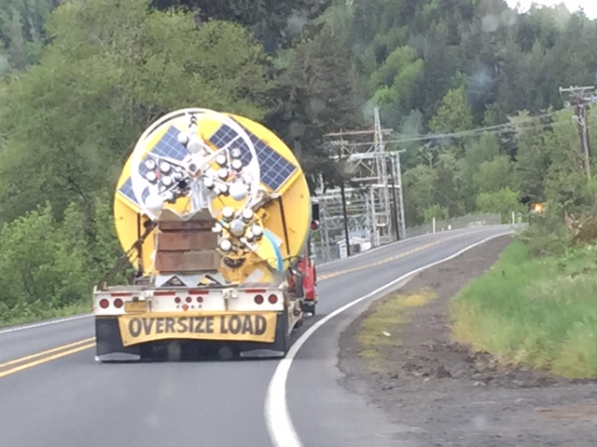
OOI by the Numbers
7
58
34
56
1,313
9,557
153,589
Arrays
(2 suspended)
Stable Platforms
Moorings, Profilers, Nodes
Regularly Planned Mobile Assets
Gliders, AUVs
Instrument Types
Instruments (~850 deployed)
Science Data Products
Science/Engineering Data Products
As of 2/9/18

Slide 7
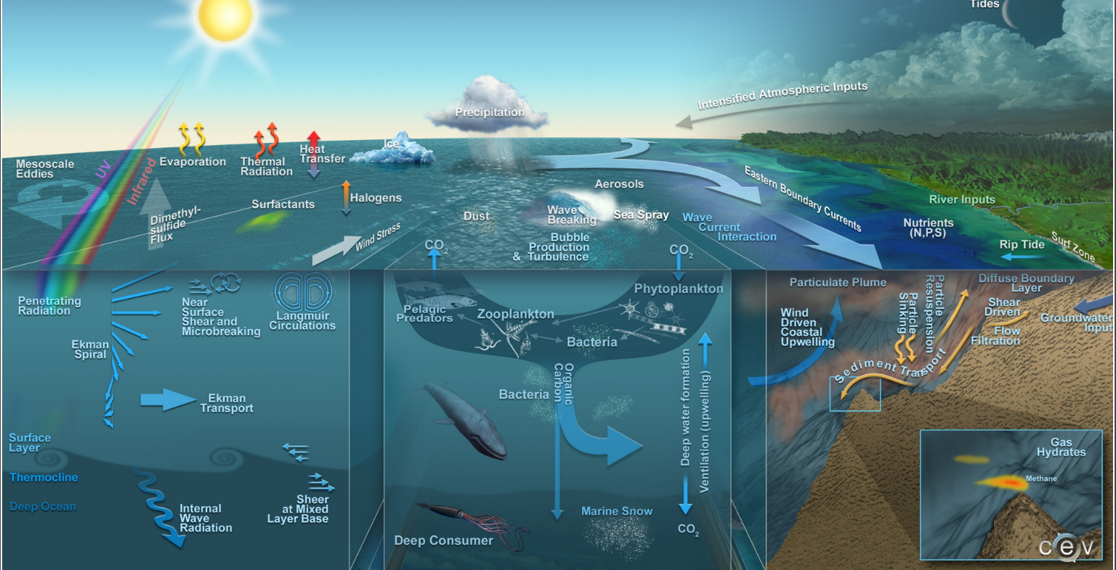
OOI Science Themes
Crossing time & spatial scales
Ocean-Atmosphere Exchange
Climate Variability, Ocean Circulation, Ecosystems
Turbulent Mixing and Biophysical Interactions
Coastal Ocean Dynamics & Ecosystems
Fluid-Rock Interactions & Sub-seafloor Biosphere
Plate-scale Geodynamics
Overarching: Climate Change, Carbon Cycle, Acidification, Ecosystem Health

Slide 8
What Do Educators Want?
Top requested features:
Data visualization tools (ability to graph, map, chart data)
Inquiry-based lessons/activities
Lesson plans for teaching science concepts with RTD
Locally relevant data sets
Map interfaces
Stories or case studies that show how scientists use real-time data.
Middle-school teachers were more likely to have students use:
Computers at school as part of their lessons
The Internet/websites at school as part of their lessons
Real-time data (mostly student-collected data) as part of their lessons
NERRS Real-Time Data Needs Assessment 2006
COSEE NOW Educator Survey 2008
Notes:
Educator Survey:
Q3: What characteristics are important when you teach using RTD? Data presented visually 4.3 (#3/11)
Q8: What RTD related activities are you likely to engage in? Finding data in visual formats 73%
This study’s results show a gap between stakeholders’ views that high-school should be the primary target and teachers’ and other data that indicate that middle-school would be the better primary target, especially for NERRS. Although more high-school teachers attended the focus groups than middle-school teachers (56% vs. 43% respectively), in comparing the two groups’ responses to the online survey we found that middle-school teachers were more likely to:
have student use computers at school as part of their lessons
have students use the Internet/websites at school as part of their lessons
have students use real-time data (mostly student-collected data) as part of their lessons (see the full report).
Main point: middle school students are more likely to collect their own data, while high school students will spend more time on data analysis.

Slide 9
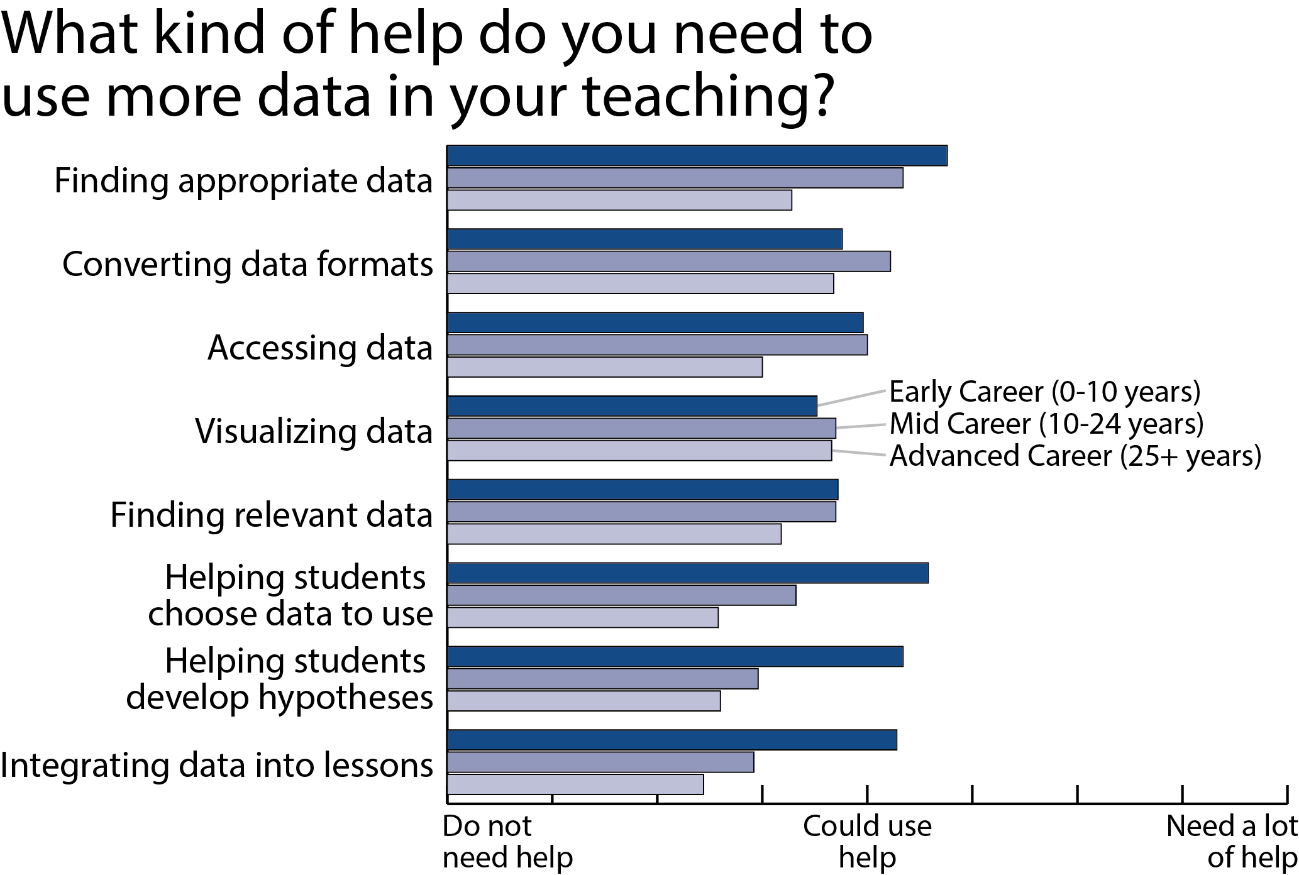
2012 Undergraduate Educator Survey
n=179

Slide 10
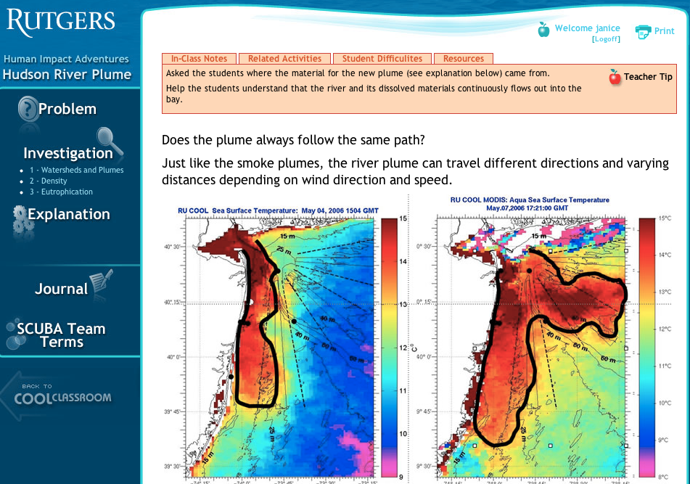
Idea 1: The Cool Classroom
A problem-based learning approach
Notes:
Going back to Claims, Evidence Reasoning…
This is how we developed the idea of trying to use data with a Problem based learning approach.

Slide 11
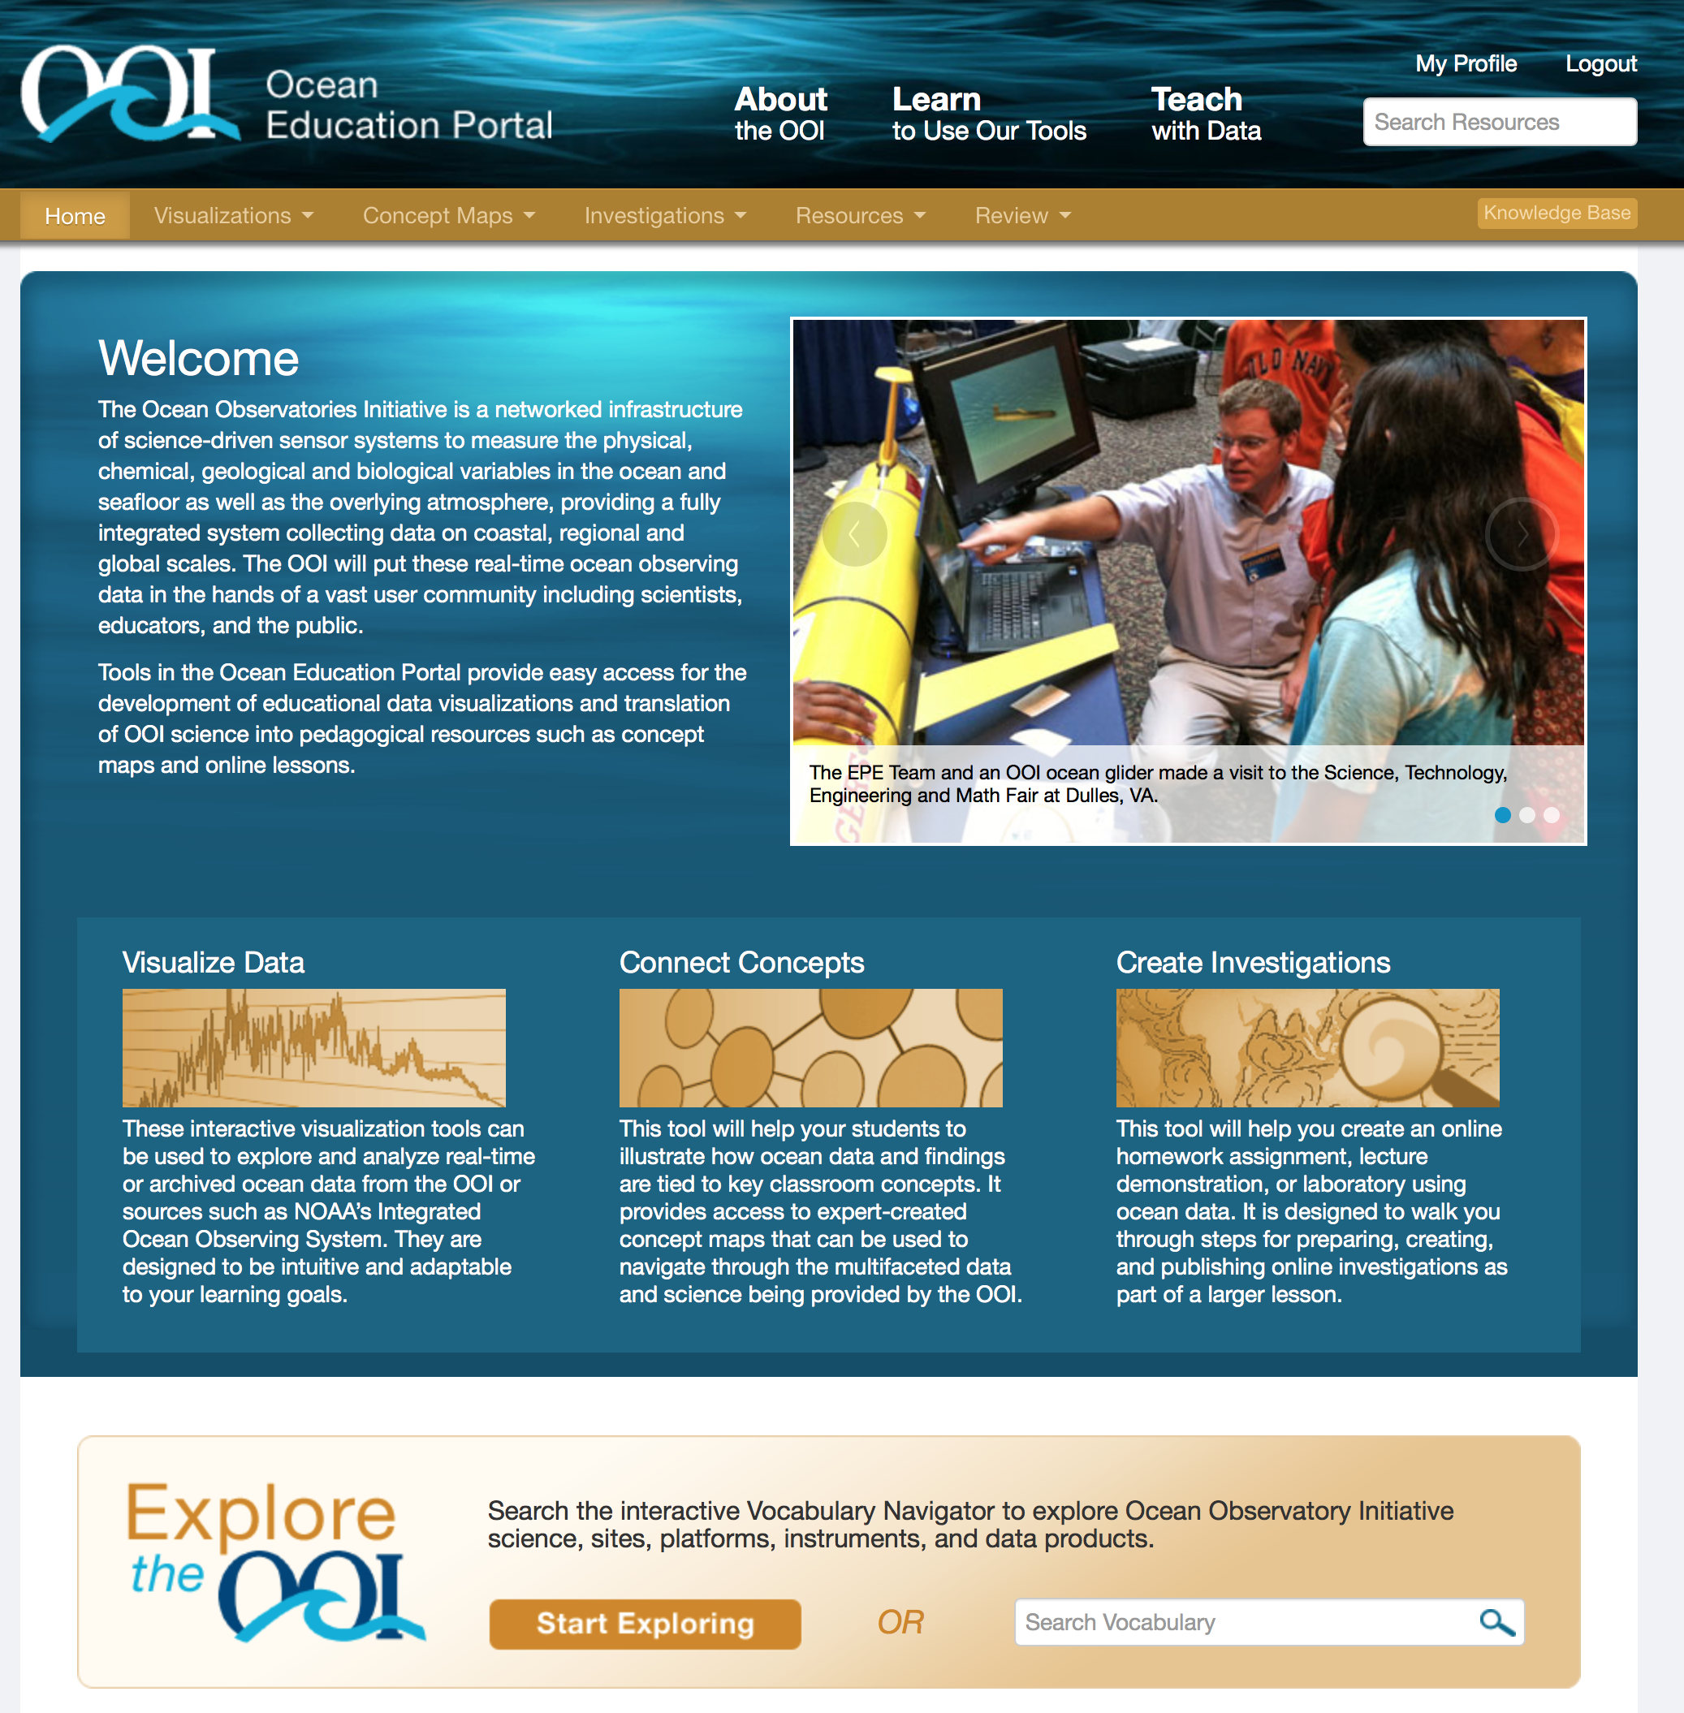
Idea 2: OOI Ocean Education Portal
Education Tools
Concept Map Builder
Investigation Builder
Visualization Tools
Vocabulary Navigator
Resource Database
Developed 2011-2015
http://education.oceanobservatories.org

Slide 12
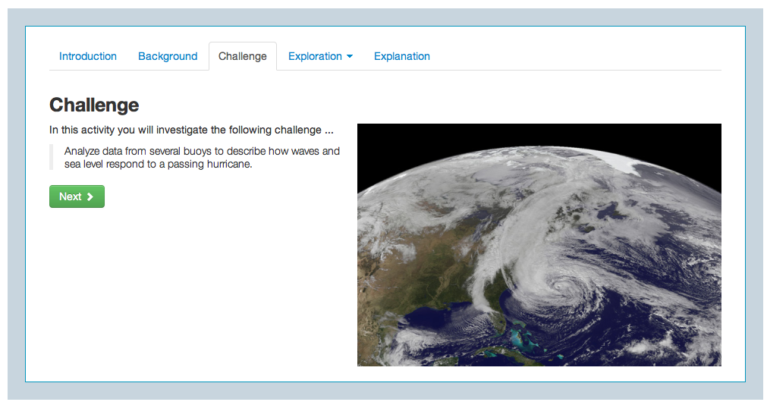
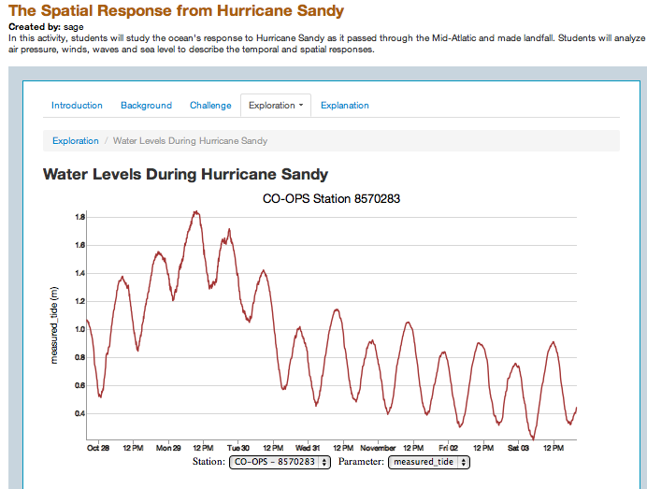
The Data Investigation Builder
Knowledge centered
Learner centered
Assessment centered
Backwards Design Wizard
1999 Bransford, Brown & Cocking. NRC: How People Learn.
Notes:
With the DIB we figured out how to operationalize and standardize lesson development to support CER.
Knowledge Centered
- Inquiry-based and organized around questions/problems
- Data driven activities.
- Investigations conclude with the development of a scientific explanation
Student Centered
- Initial questions serve to surface students‘prior knowledge
- Investigation help students build understandings of the core concepts
- There are opportunities to reflect on learning and compare initial ideas to final ideas
Assessment Centered
- Formative assessment is critical for learning
- Supports professors in tailoring instruction to meet students’ needs
Backwards Design
- Driven by end goals- what we want students to be able to do (performance oriented)
- Strength is in the focus on creating greater coherence and alignment between goals, learning experiences, and assessments

Slide 13
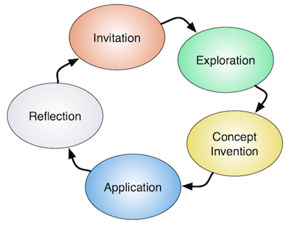
Idea 3: Data Explorations
“Authentic” raw OOI data relevant to course concepts
Adapts Learning Science research on how people learn
Follows a framework for supporting novice users interacting with data
Utilizes best practices of user experience design
The Learning Cycle
Notes:
Now that we have data framed the right way,
We emphasized the pedagogical approaches: learning cycle, data framework

Slide 14
Levels of Engagement with Data
Orientation
Using data is very new to learners; they need a lot of guidance from the educator(s).
Interpretation
Learners have basic data skills, and are practicing applying data to what they are studying about a topic.
Synthesis
Learners are skilled at “reading” data, and can proceed to using it as evidence to construct conclusions about the science.
2018 Hotaling et al. Educating with Data (In print).

Slide 15
What is a Data Exploration?

Slide 16
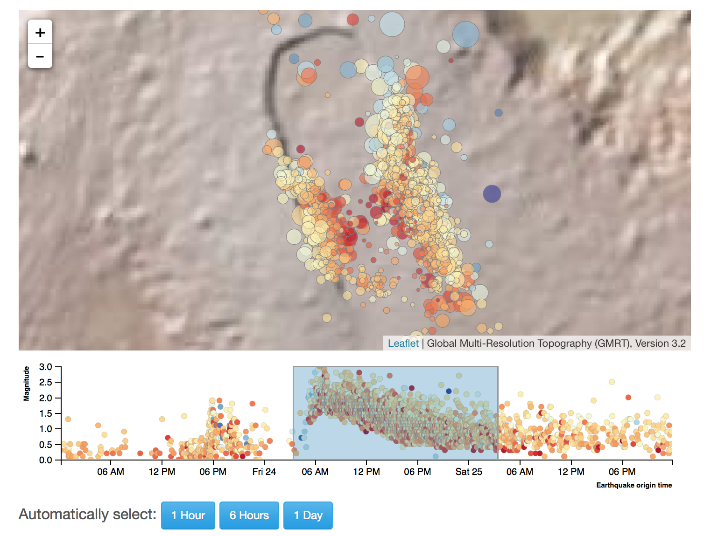
Seismic Features at a Seamount Application
Objective
Use earthquake data from Axial Seamount in April 2015 to determine when the diking-eruptive event occurred.
Data from Wilcock et al. 2015

Slide 17
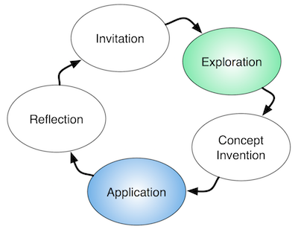
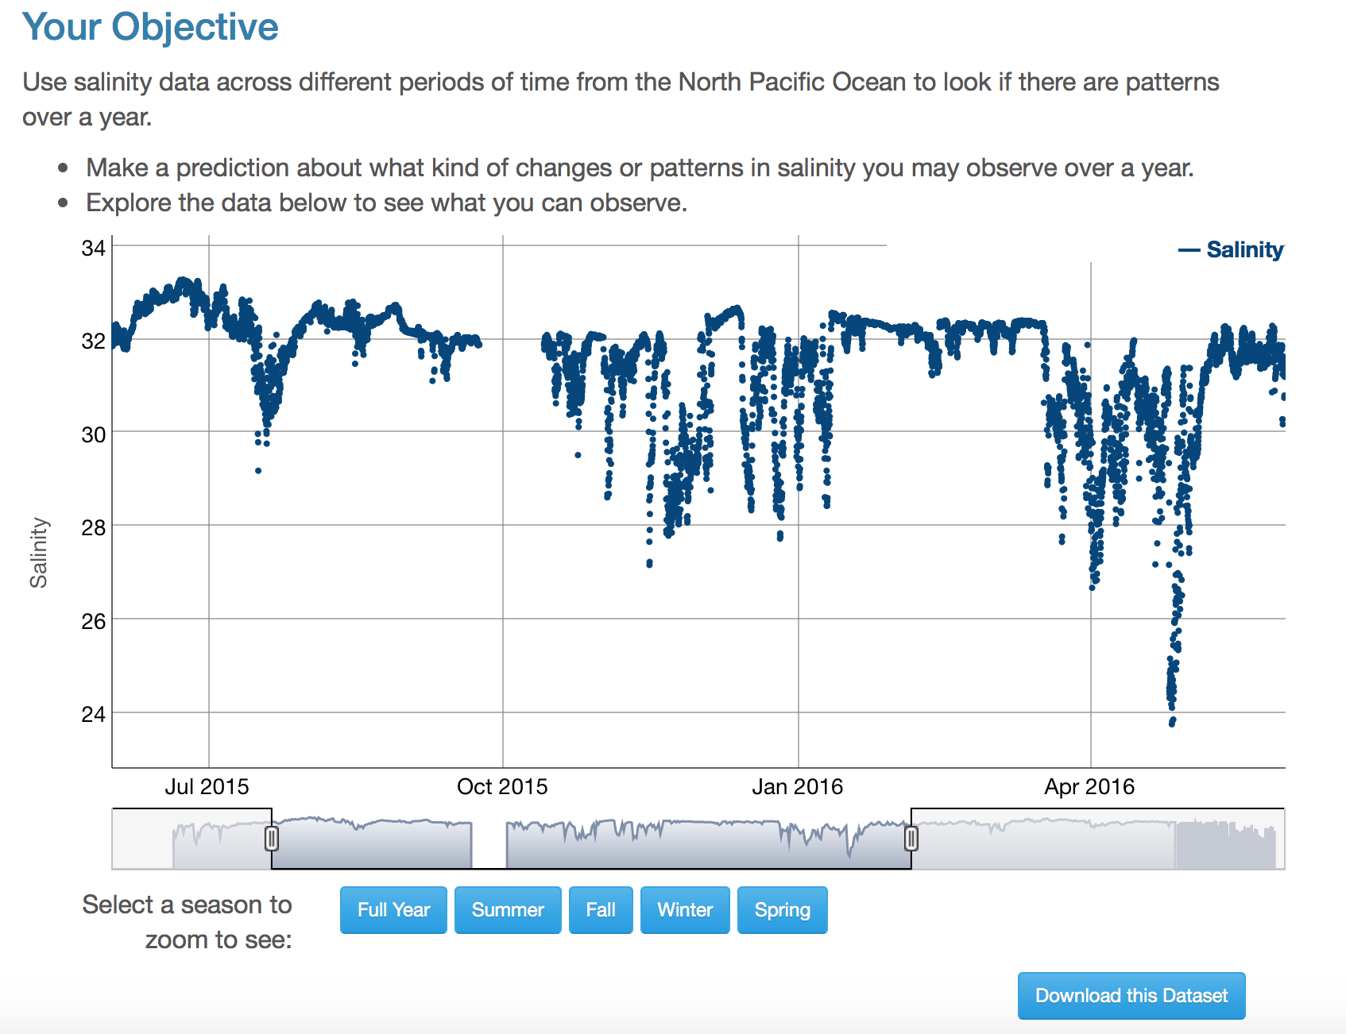
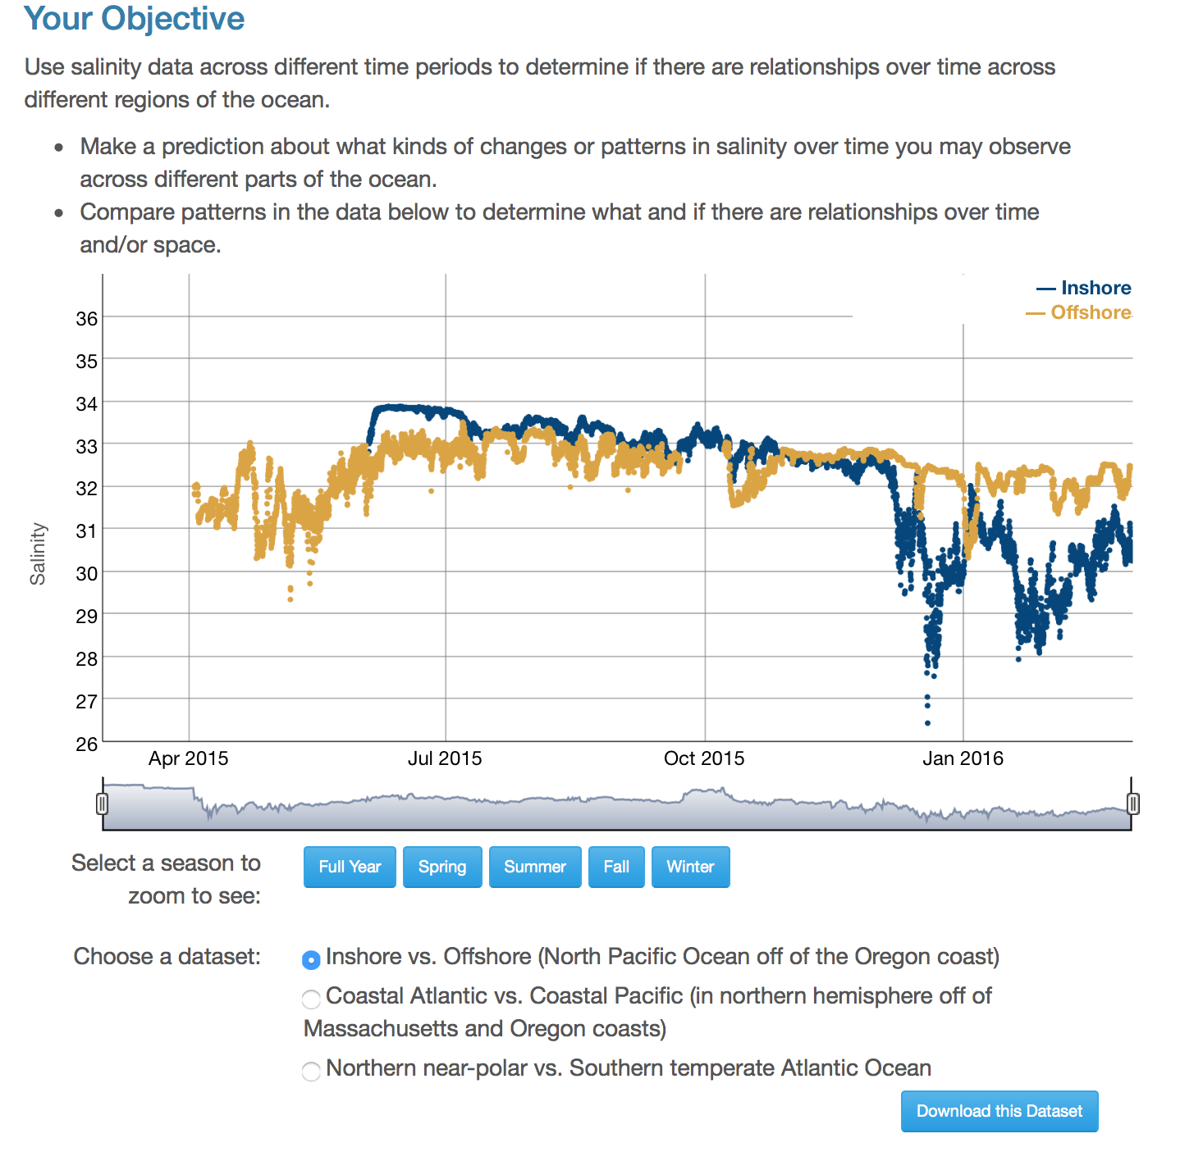
Learning Cycle Variations Seasonal Variation of Surface Salinity
Exploration
Application
Notes:
Ability to interpret in different concepts

Slide 18
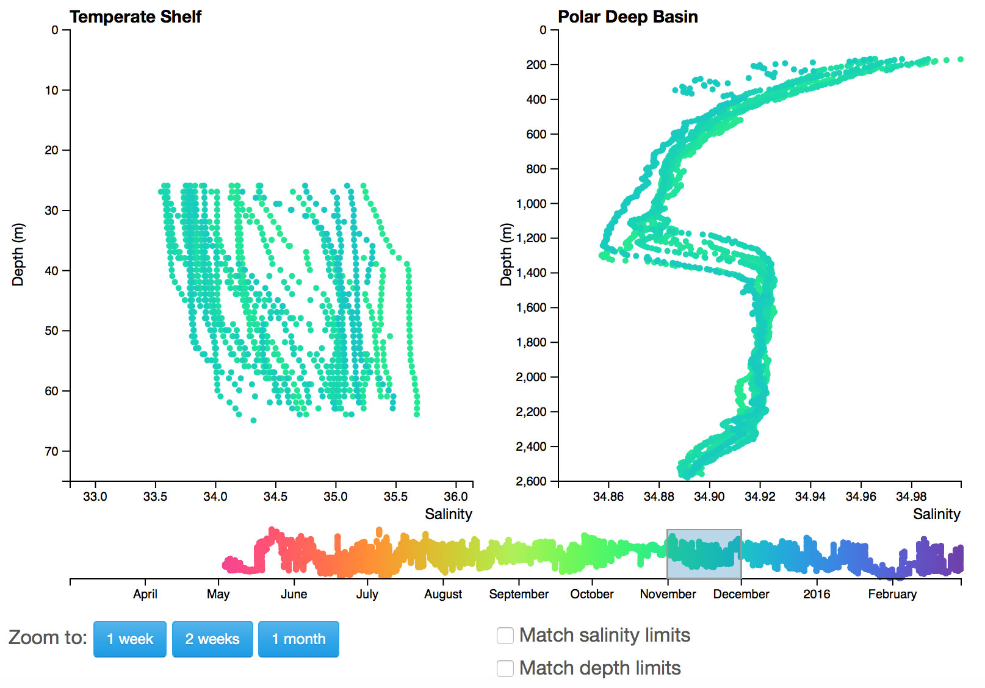
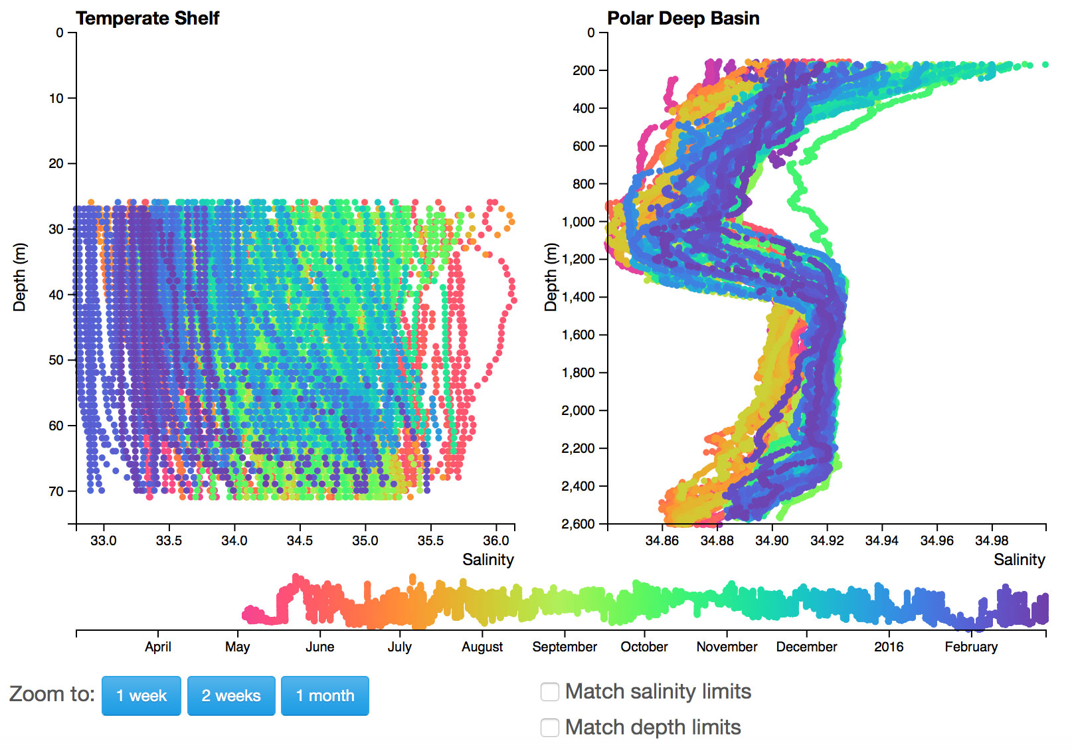
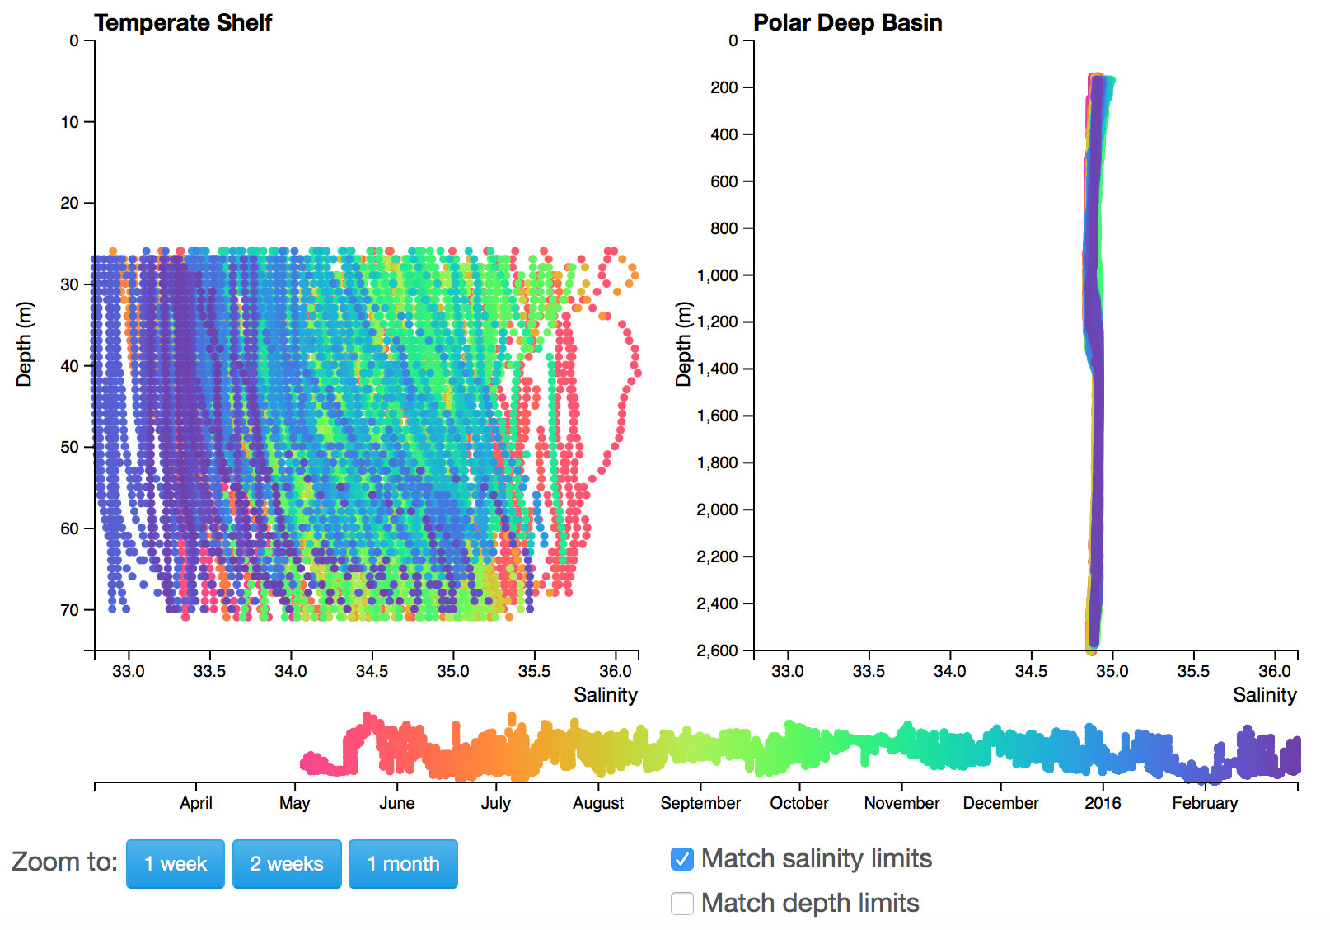
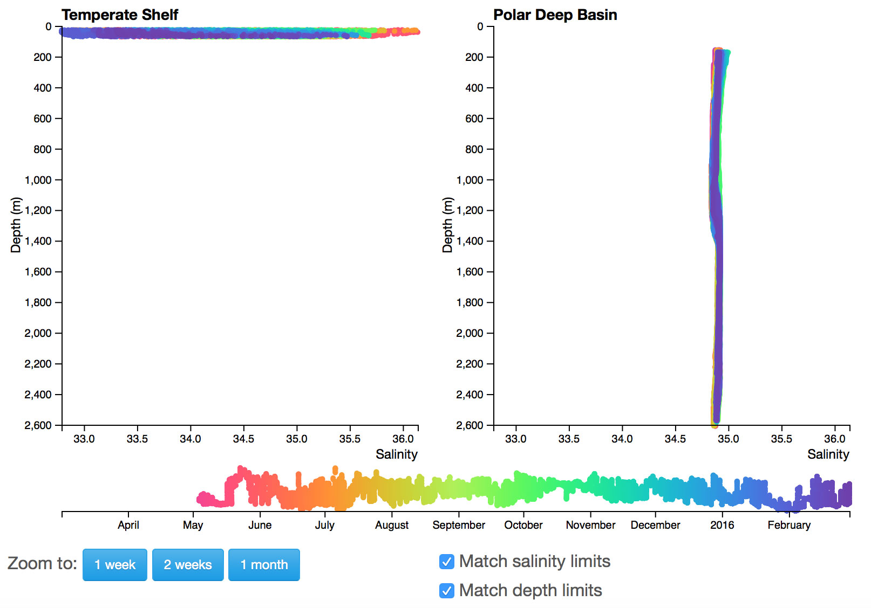
Interactive Exploration Changes in Salinity with Depth

Slide 19
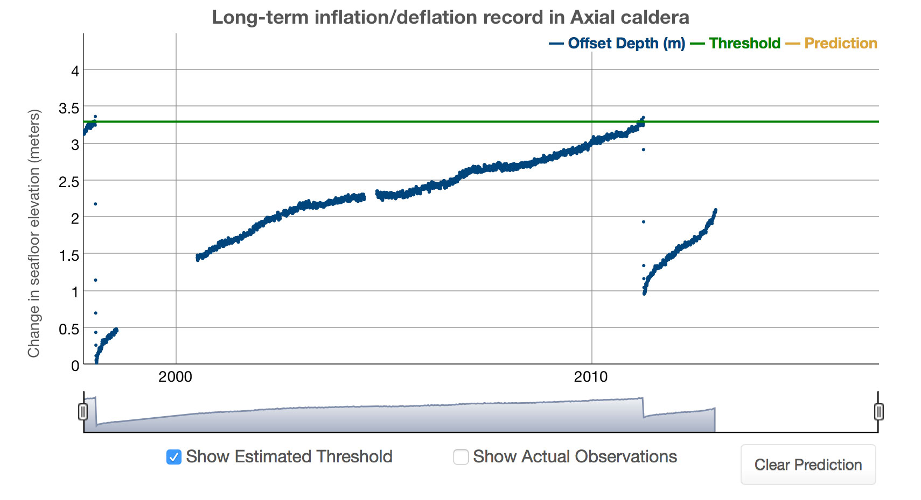
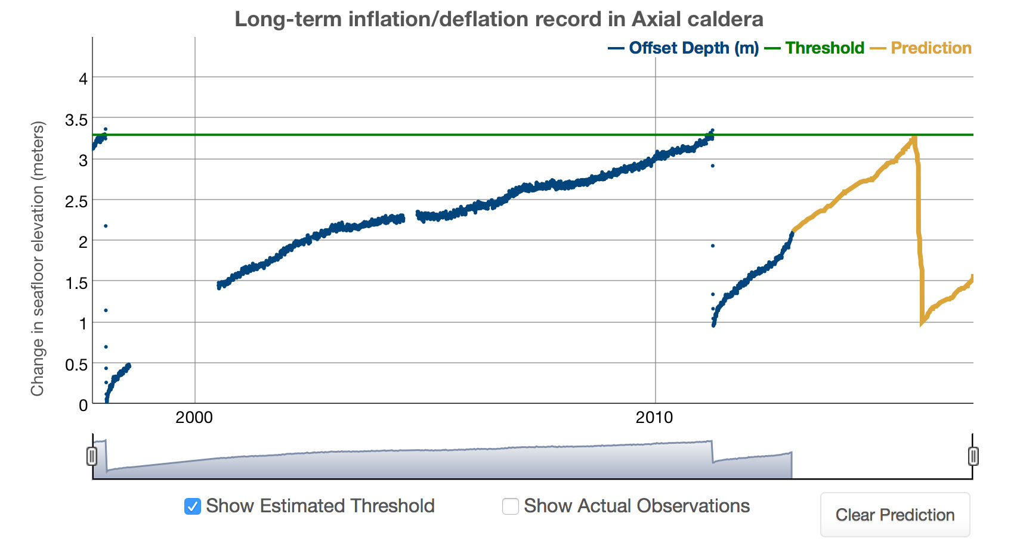
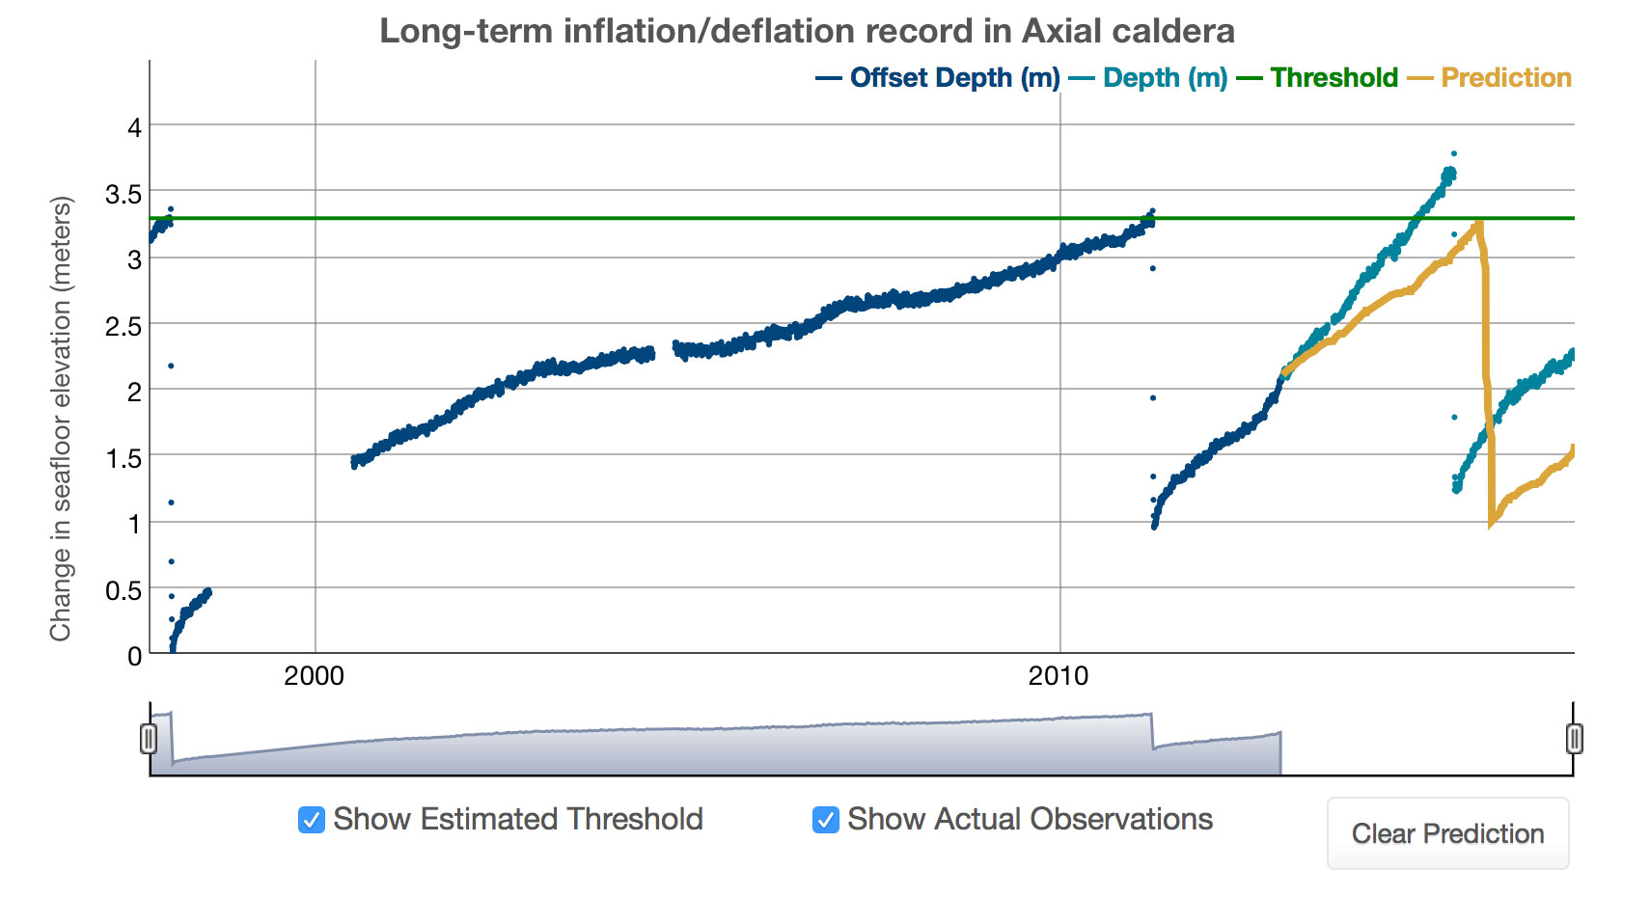
Interactive Student Predictions Seamount Diking-Eruption Event Science
Data from Nooner and Chadwick 2016

Slide 20
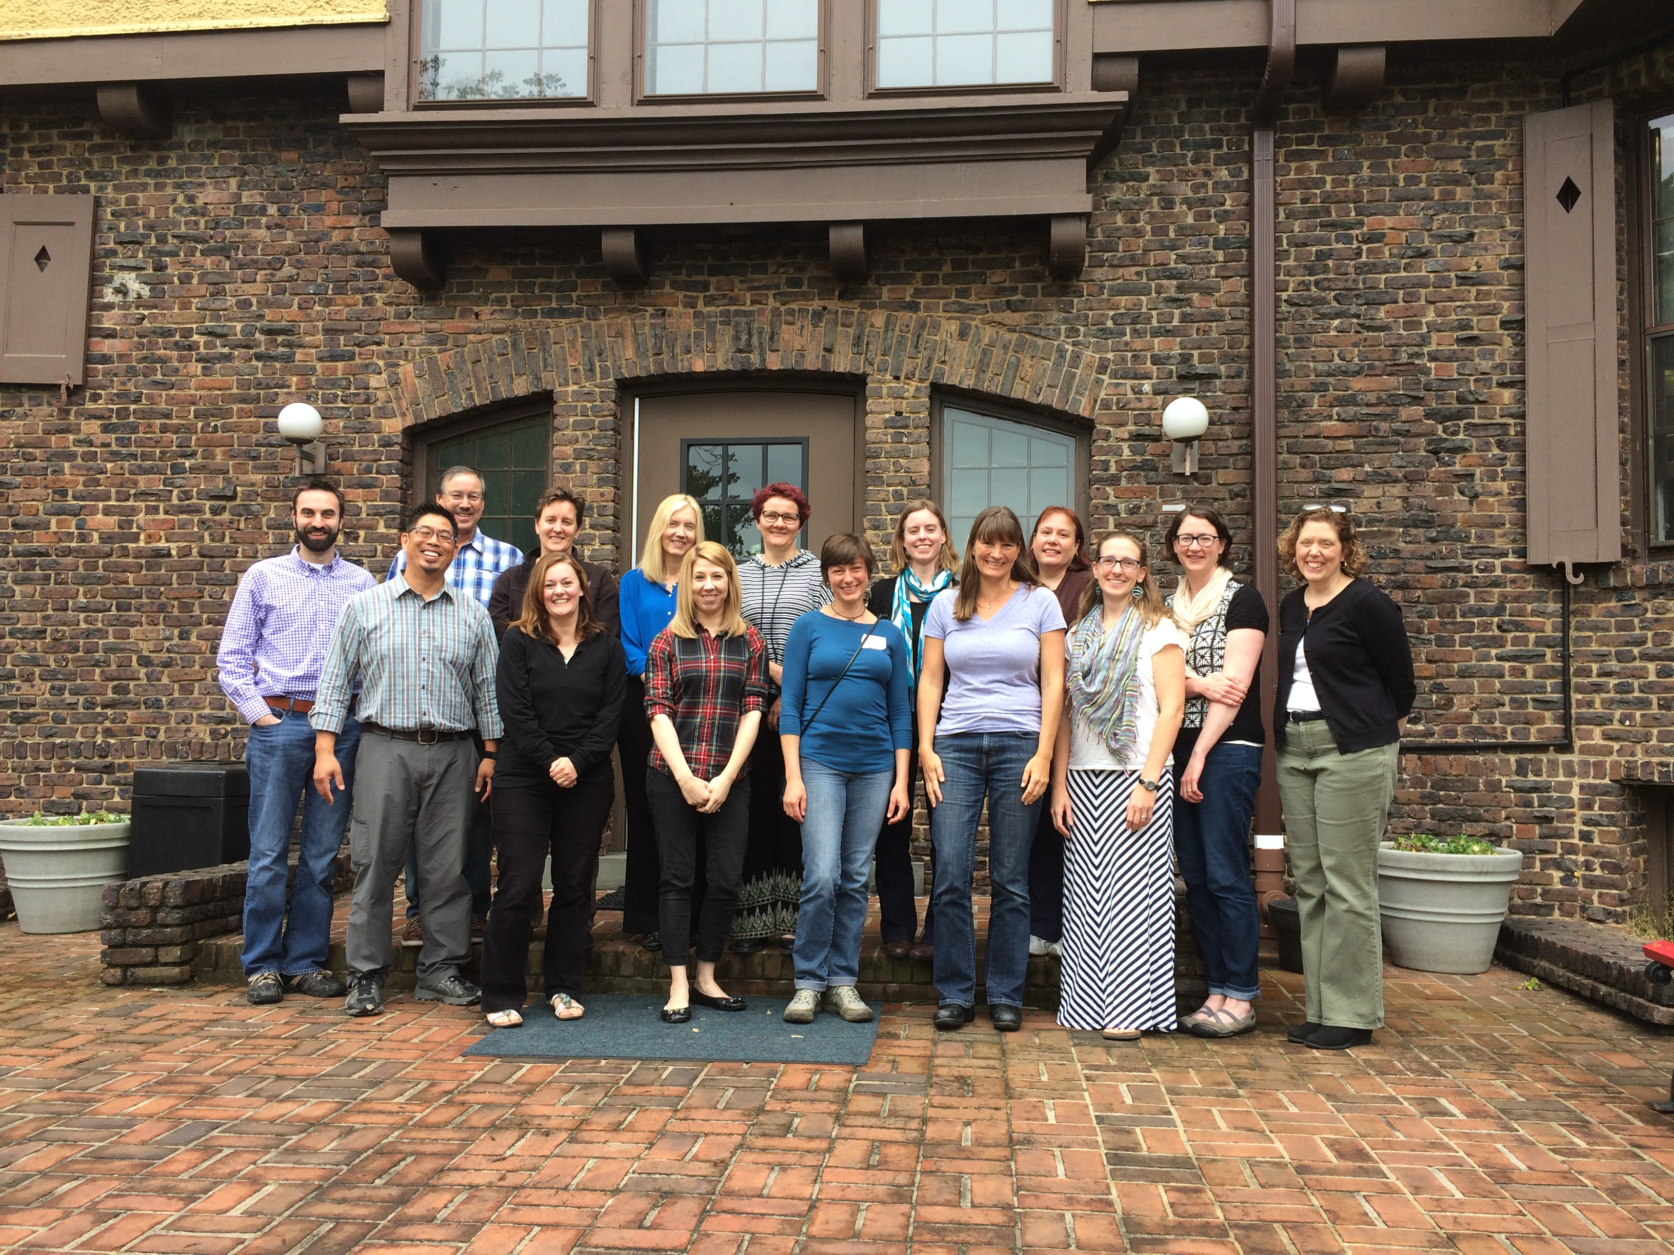
Workshop Objectives
Crosswalk OOI Science themes with introductory oceanography textbooks
Review sample activities using OOI data/data viz tools
Discuss strategies to incorporate into curriculum
Build long-term working relationships and collaborations on data investigation development
Productivity Workshop 2016
Notes:
Aands-on workshops focused on developing effective teaching with data practices using OOI

Slide 21
The Data Explorations Design Process
Identify Target Scientific Concepts & Skills
Match with Research Results
Find Available Instrument Data
Cleanup the Dataset
Add Educational Surrounds (Context)
Make Interactives & Visualizations
Design
Build
Test

Slide 22
2017 Results: Professor Adaptations
Assigned as Homework
Assigned as Class/Lab Activity (individual or group)
Assigned as Online Activity
Handout or Worksheet Provided
Discussions (table or class)
Group presentations
Compiled Introductory Material (as lecture and/or handout)
Provided one-on-one help
Further analysis, comparisons, or stats calculations
Presented alongside other activities or experiments

Slide 23
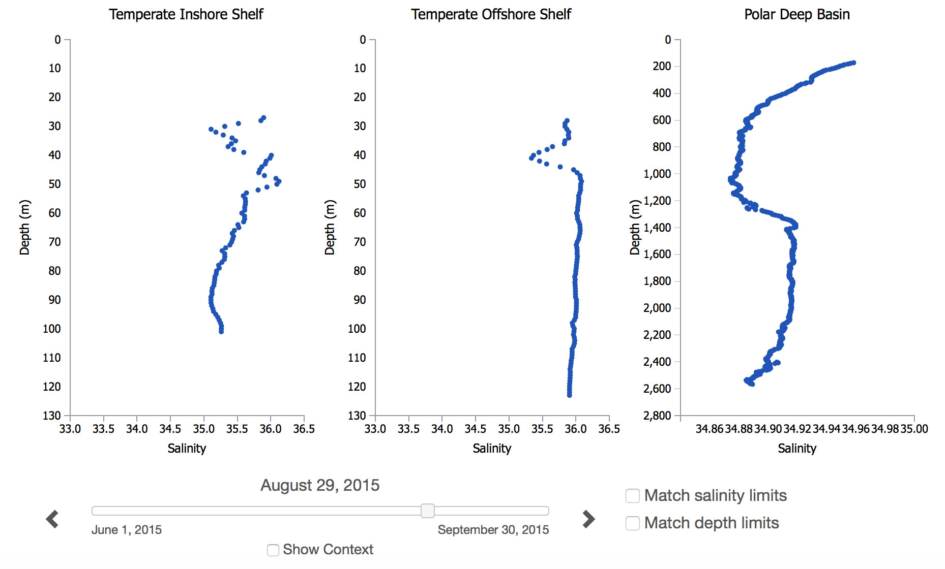
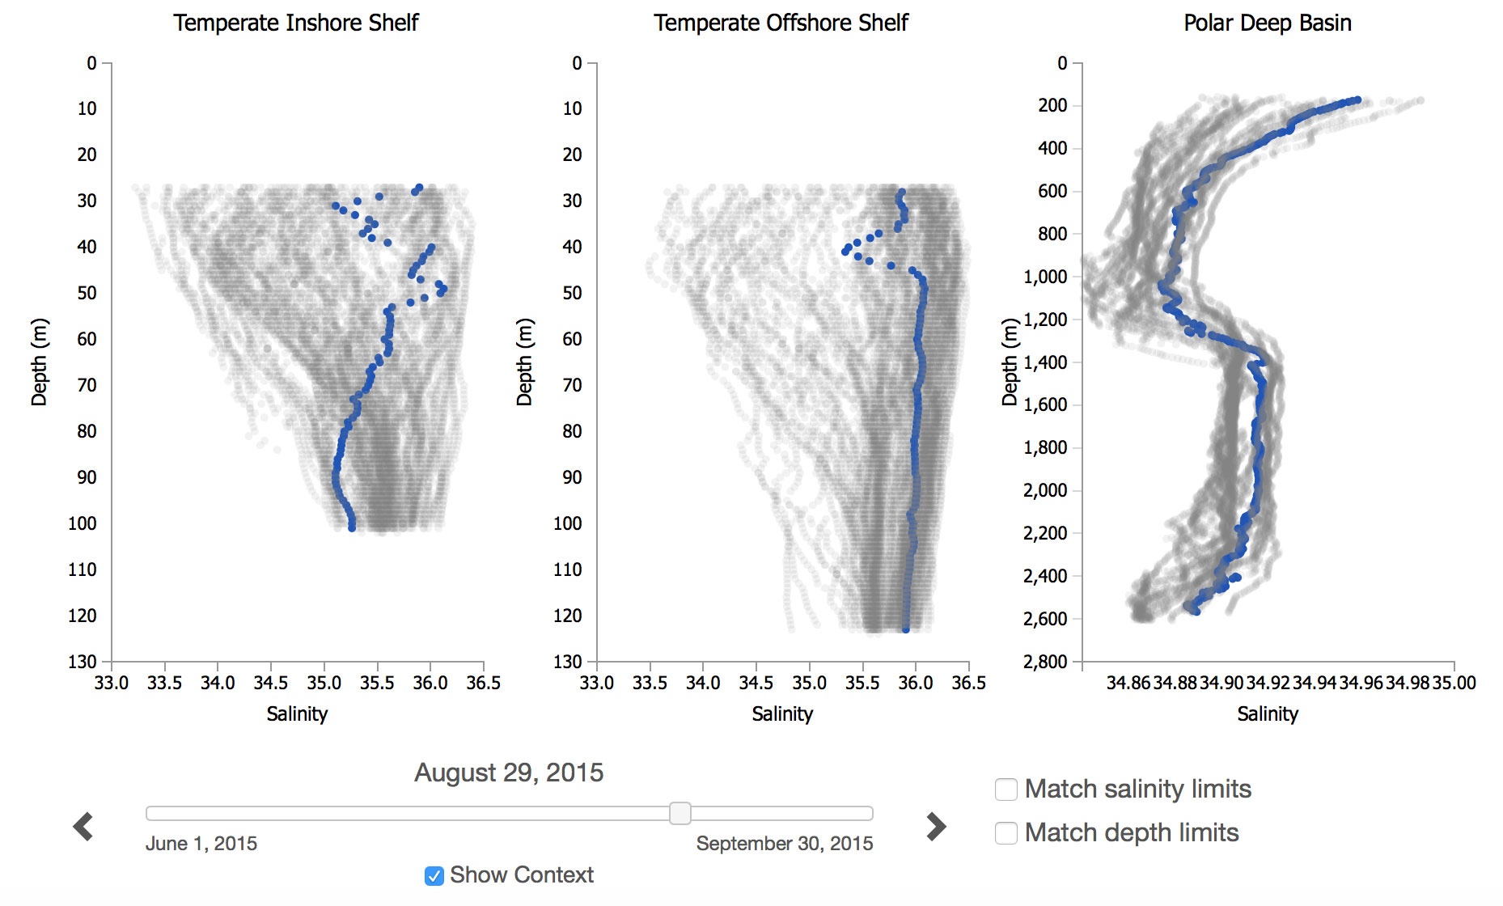
Context is Key Data, Science, Educational

Slide 24
Notable Professor Quotes
“The questions really did reveal that students were looking at the exact things that we want them to look at: desperately looking for correlations. So this was very revealing in a very good way about what was going on in the students’ minds.”
“They wondered where there was a gap in the data which led to a nice discussion about the need for servicing instruments, how data ‘failures’ occur, and the realities of authentic data.”
“Overall, the students expressed that they really liked this exercise; they realized the data were messy but thought it was really cool to have been able to look at real data.”

Slide 25
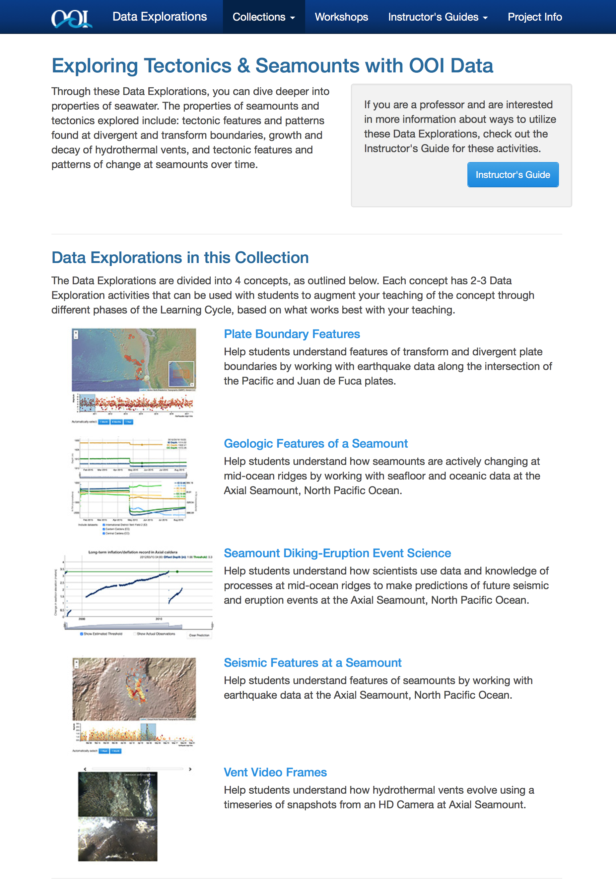
Start your Data Exploration!
Current Collections
Primary Production
Properties of Seawater
Tectonics & Seamounts
Stay tuned for more
http://explorations.visualocean.net

Slide 26
FIN

Slide 27
The Design Process
Identify Topics
Develop initial Exploration ideas
Instrument to Topics
Then Analysis Goals. Questions, patterns, LC
Investigate available data
Find data
Quick look plots
Select datasets (date ranges and instrument)
Identify vis / interactive needs
Draft Vis
Draft Lesson Content
Revise tool / Content
Identify Instruments
Download Initial Datasets
Scratch Plots
Select Datasets (Kristin)
Process Final Dataset
Draft Visualization Tool
Draft Page Content
Background Images
Update Visualization Tool
Update Page Content
Finalize Page

Slide 28
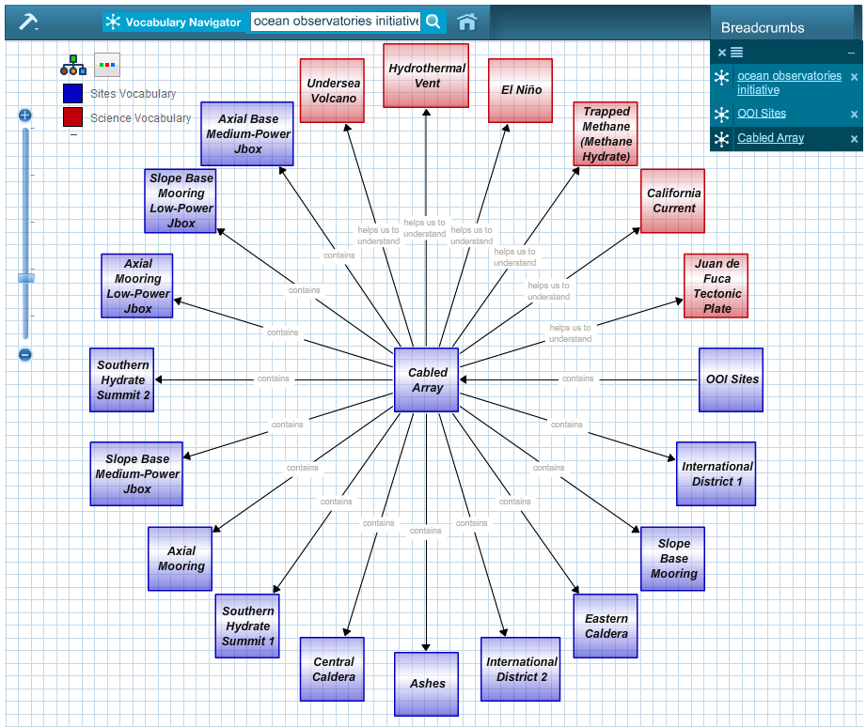
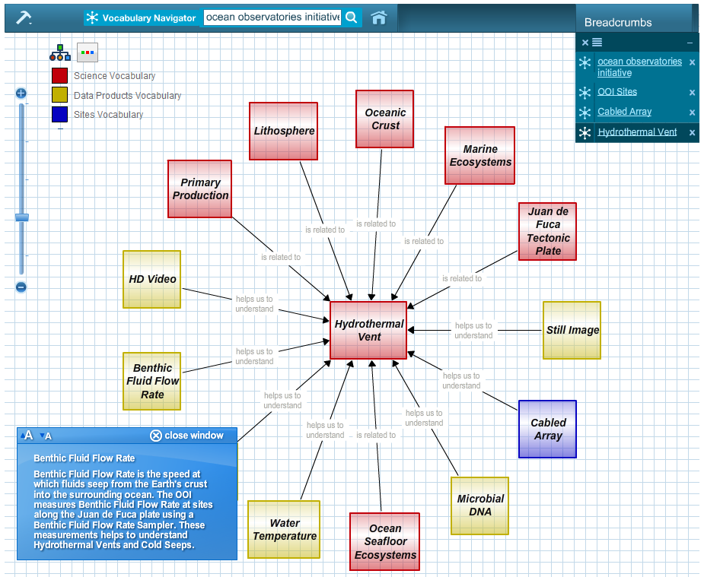
Concept Mapper: OOI Vocabulary Navigator
Concept Map Builder (create & edit) and Viewer
Concept & linking phrase suggestions (ontologies)
Embedded content resources such as descriptions, data visualizations, photos & videos from OOI & outside resources

Slide 29
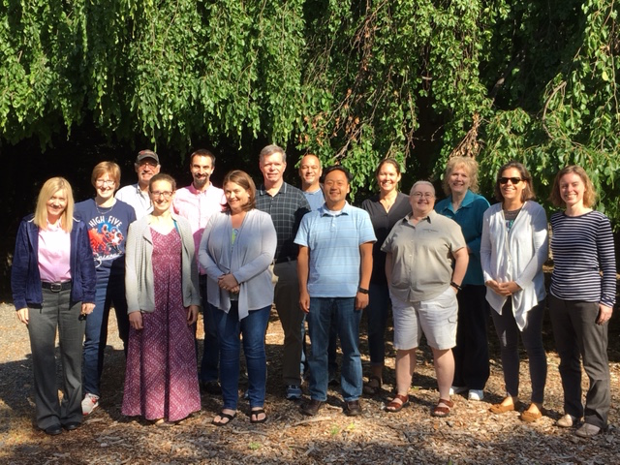
Workshop Format
Friday
Welcome/Icebreaker
Introduction to the OOI and Undergraduate Teaching
Strategies for Teaching With Data
Goals & Expectations
Saturday
Introduction Learning Cycle
Data Explorations Review
Science Background
Reflections
Sunday
Additional Data Explorations
Foundational Ideas of Learning
Quick intro to OOI Data Access
Implementation Planning
Chemistry Workshop 2016

Slide 30
Visualization Design Process
Ben Fry’s seven stages to visualizing data:
Acquire
Parse
Filter
Mine
Represent
Refine
Interact

Slide 31
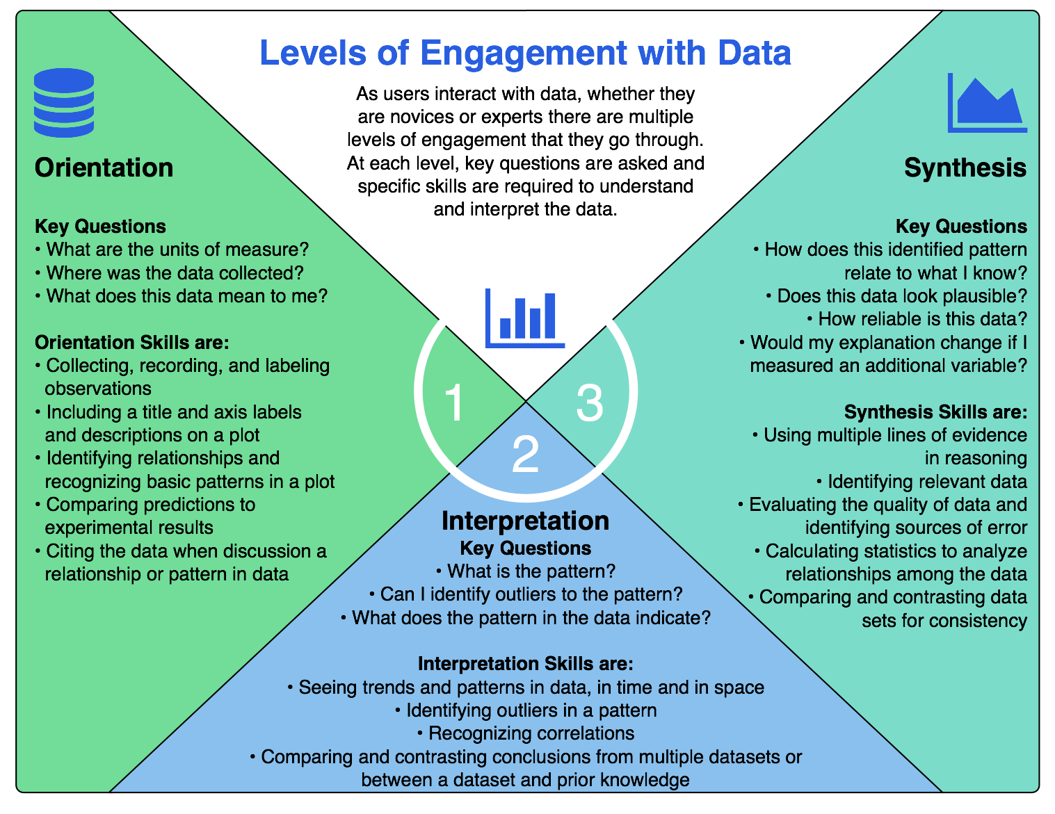
2018 Hotaling et al. Educating with Data (In print).

Slide 32
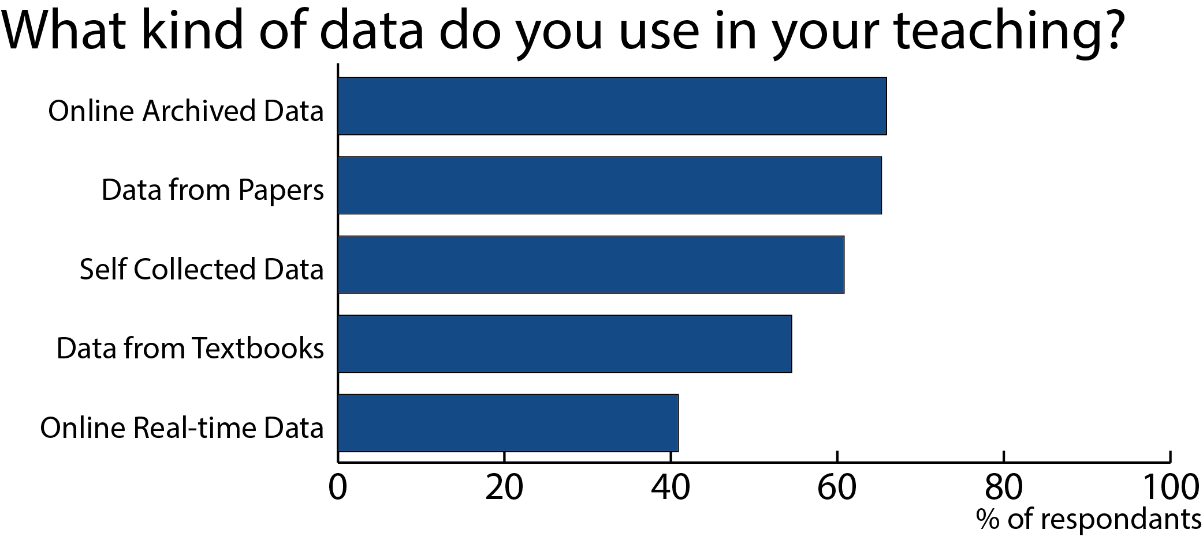
2012 Undergraduate Educator Survey
n=179
2015 McDonnell et al. MTS Journal.

