Slide 1
Examples of Currently Used Exemplary Labs
OOI Data Lab Notebook Workshop - January 6 - 9, 2020

Slide 2
Kathleen Browne
Rider University, Lawrenceville NJ

Slide 3
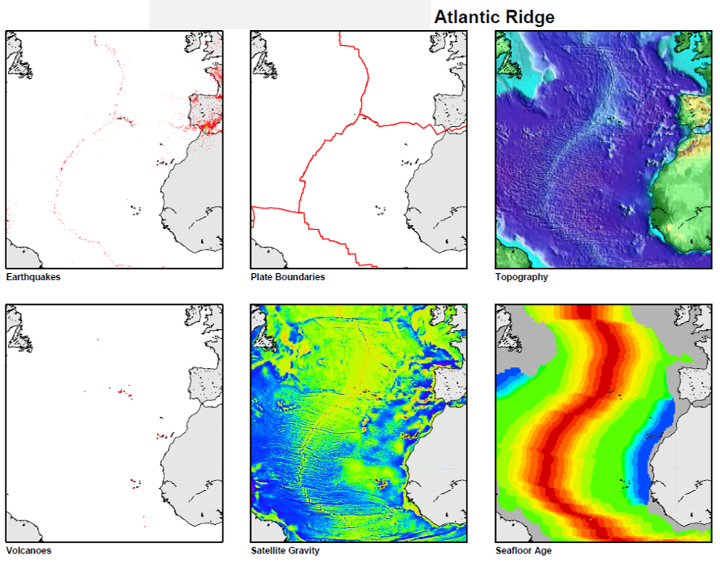
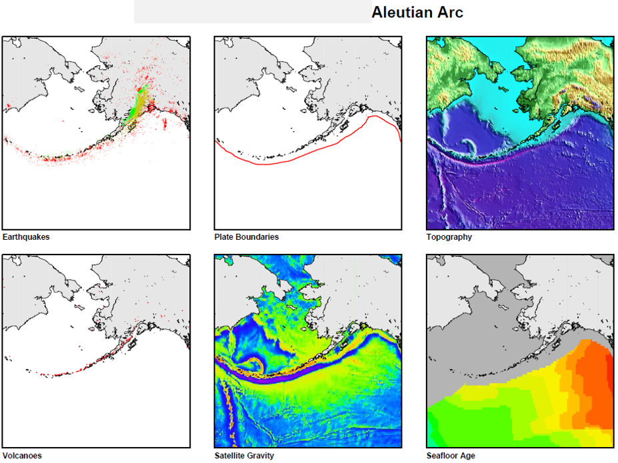
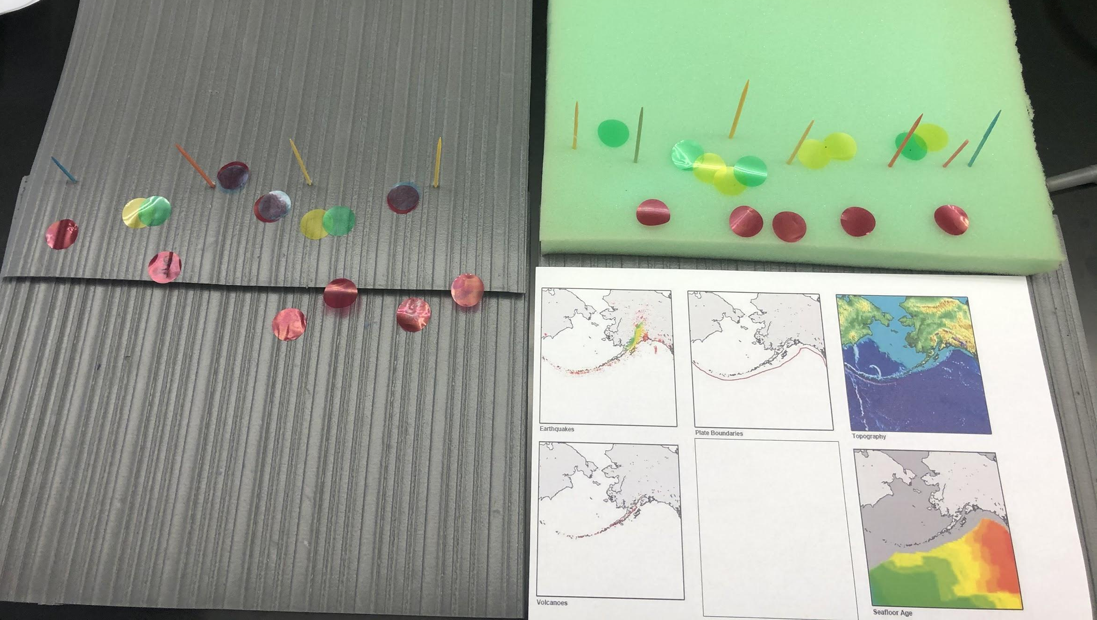
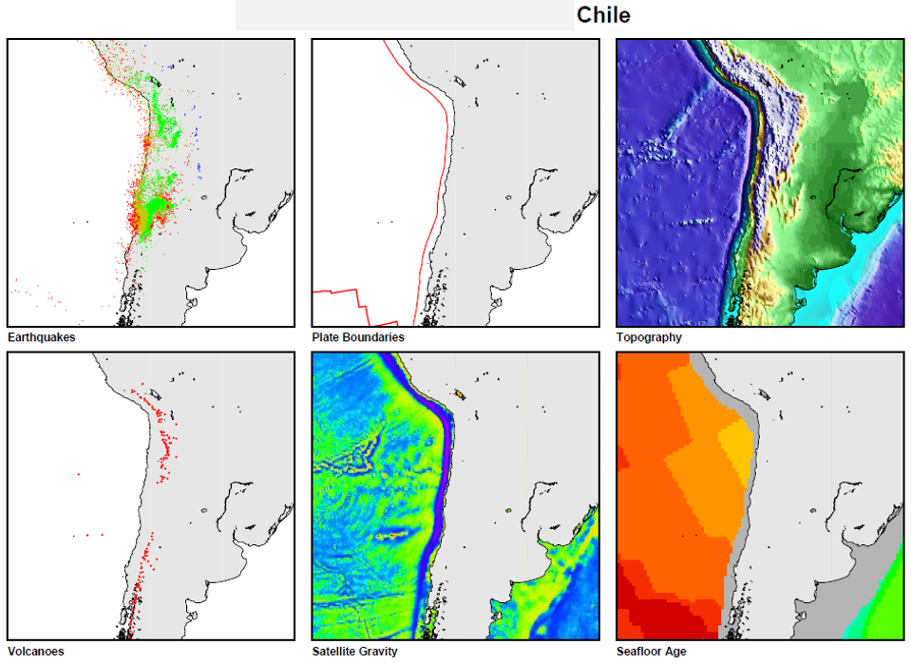
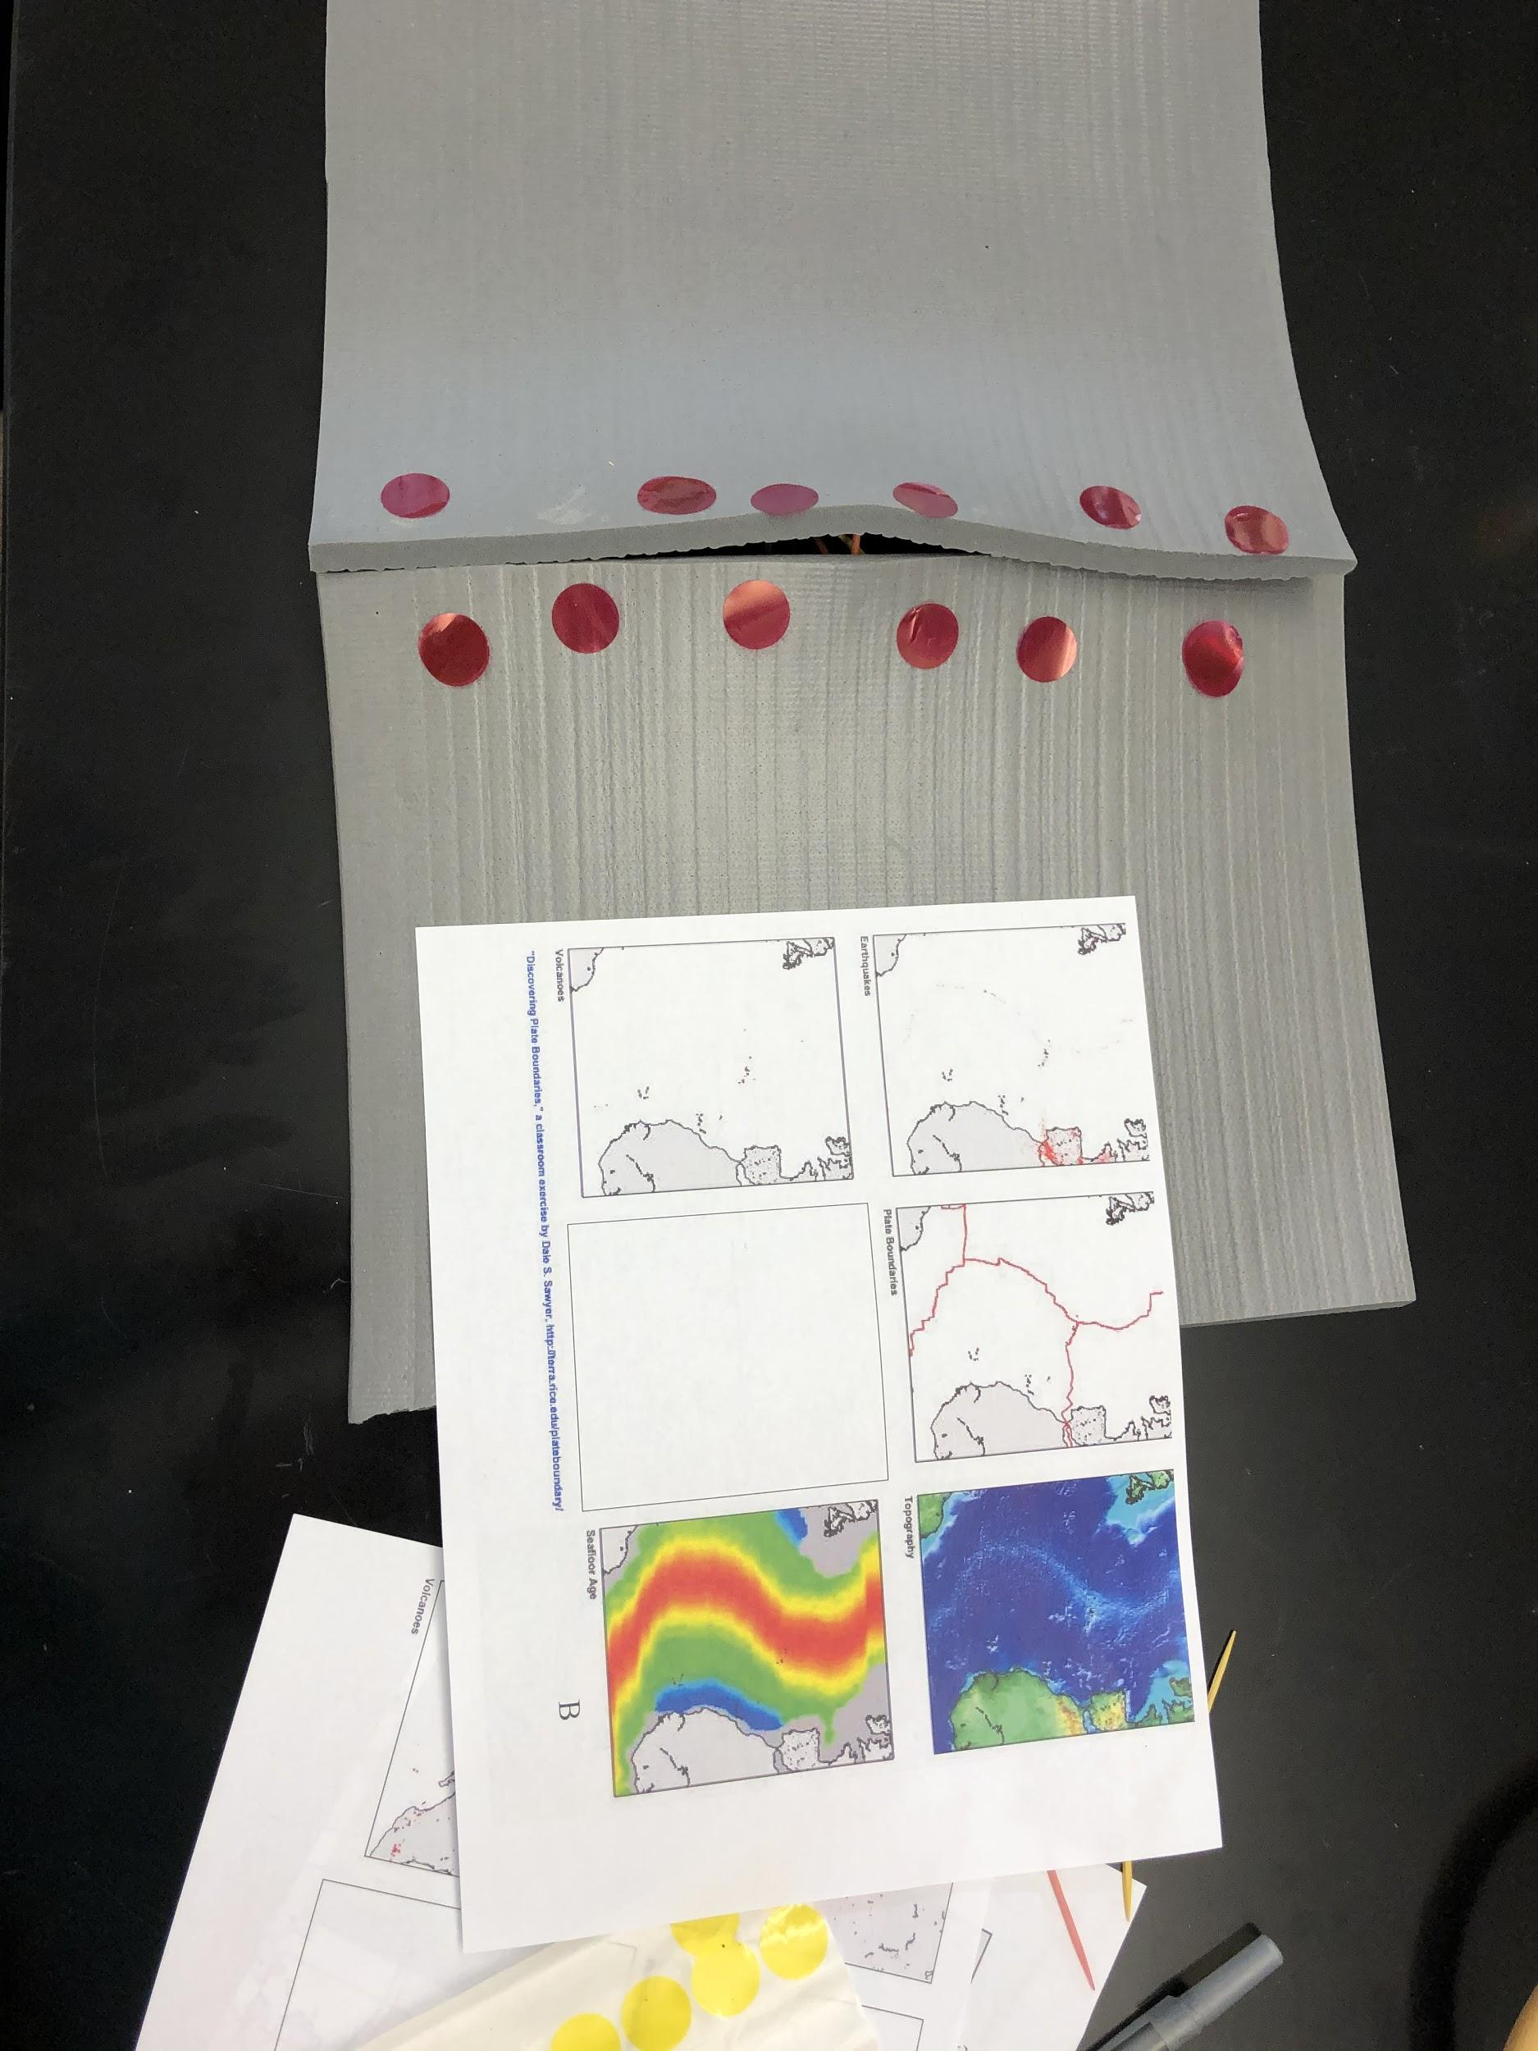
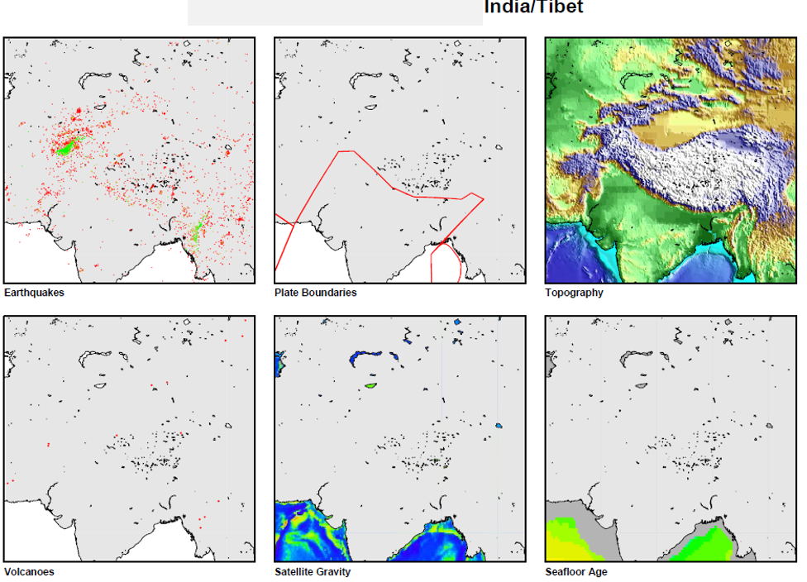
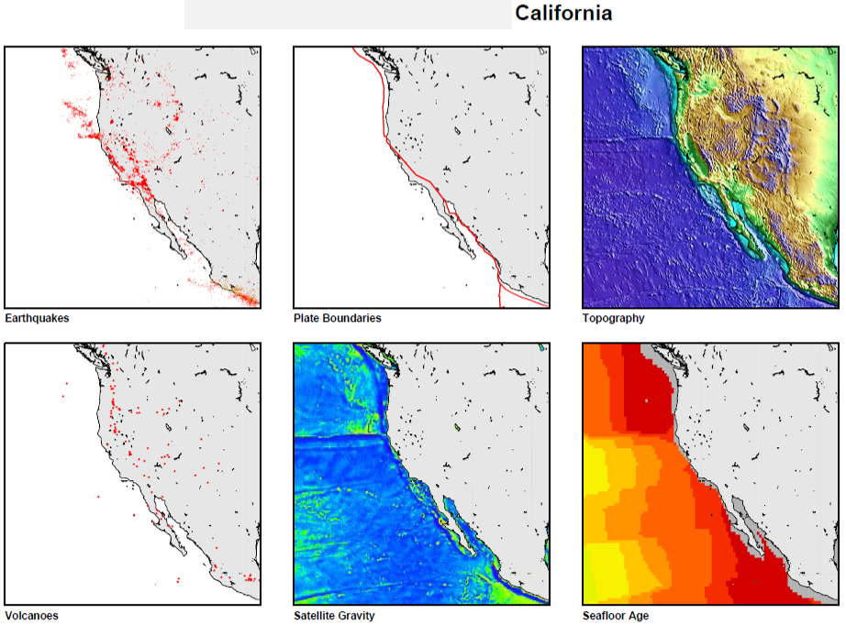
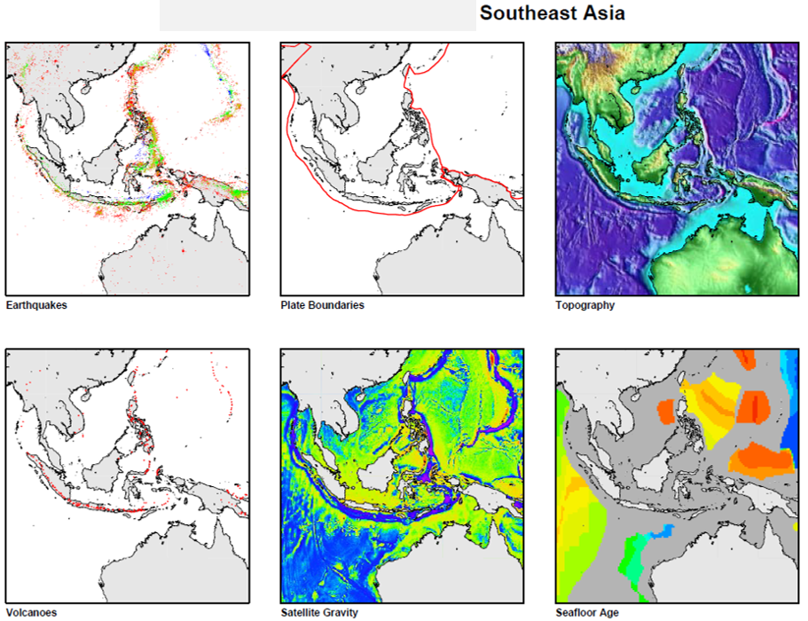
Plate Tectonics Boundary Exercise
Following an introduction to Plate Tectonics and some of the evidence that supports the theory
Determine the plate boundary at sites assigned using data set from http://plateboundary.rice.edu/
Construct a model to show the plate margin you concluded and add representation of data that supports your conclusion.
Review other models and help others improve them.
Likes
Utilize multiple steps in the scientific process.
Requires multiple levels of thinking and consideration of different perspectives.
Reveals understandings that can be addressed
Dislikes
Time consuming and prohibits further studies in this topic.
Describe patterns in data sets
Determine evidence that supports your conclusion
Use your understanding of scientific principles and evidence to support your conclusion in an explanation
Feedback provided

Slide 4
Benjamin Jordan
Brigham Young University, Laie HI

Slide 5
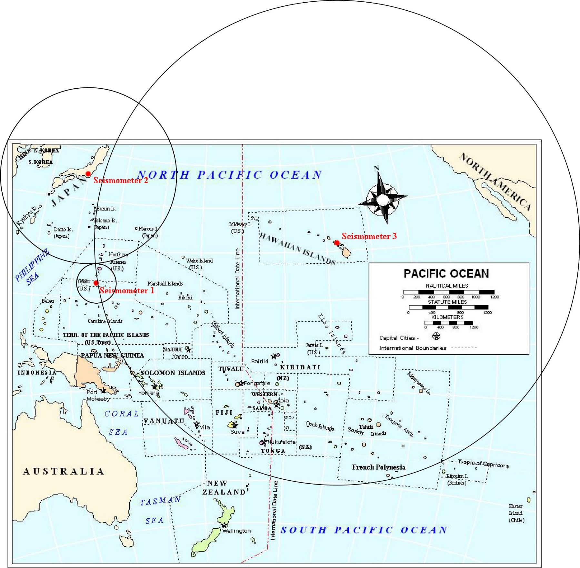
Earthquakes and Tsunamis
LIKES:
Students learn to work with maps, including using scales.
Students gain an understanding of the process of triangulation.
Students see the connection between earthquake epicenter location and the travel time of tsunamis.
Epicenter
DISLIKES:
It is a challenge for most students to do digitally.
The map needs to be cleaner and maybe show seafloor bathymetry.

Slide 6
Denise Bristol
Hillsborough Community College, Tampa FL

Slide 7
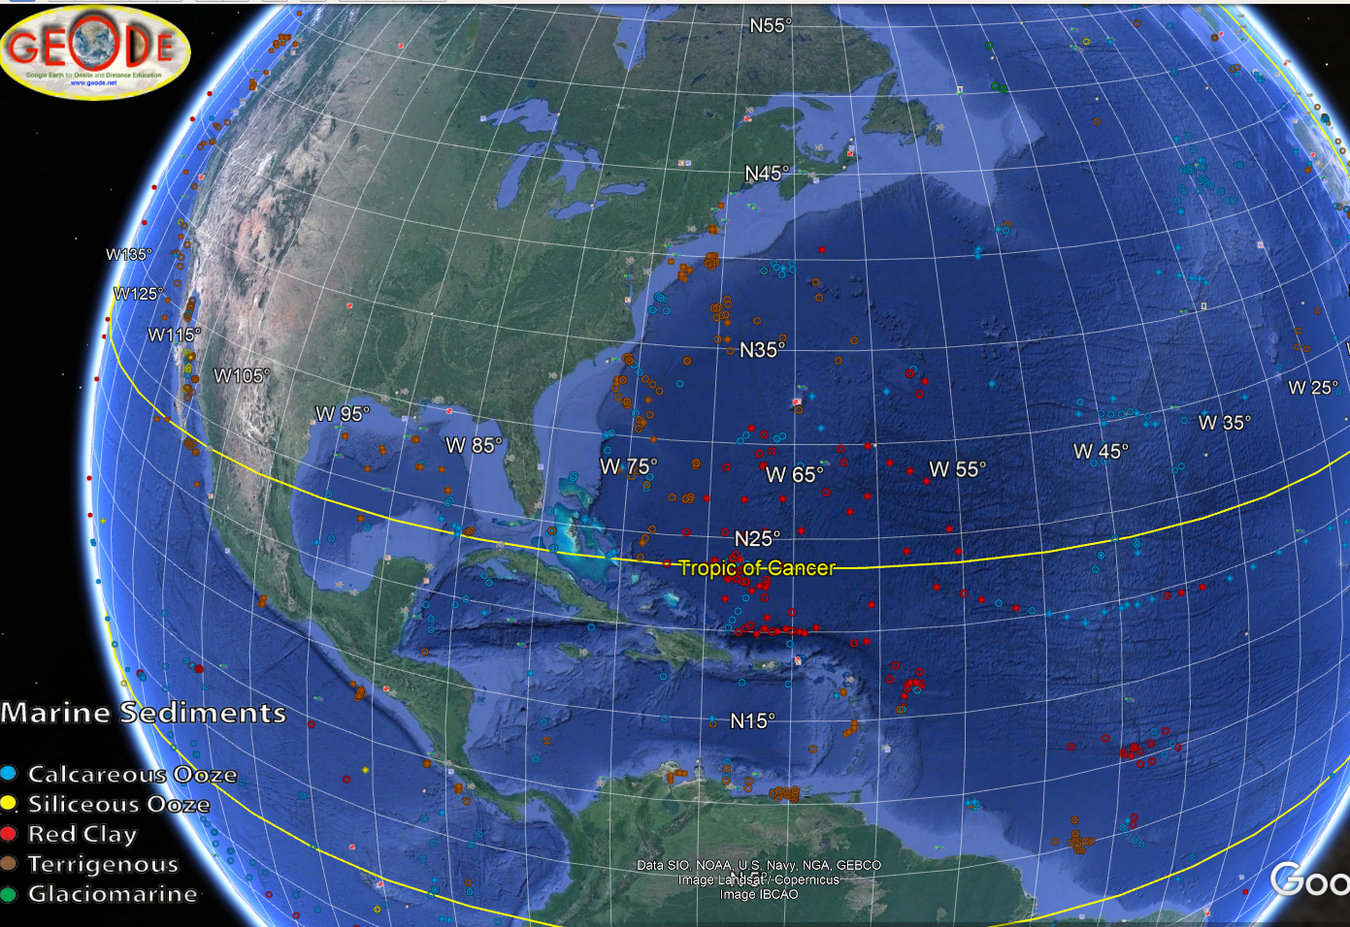
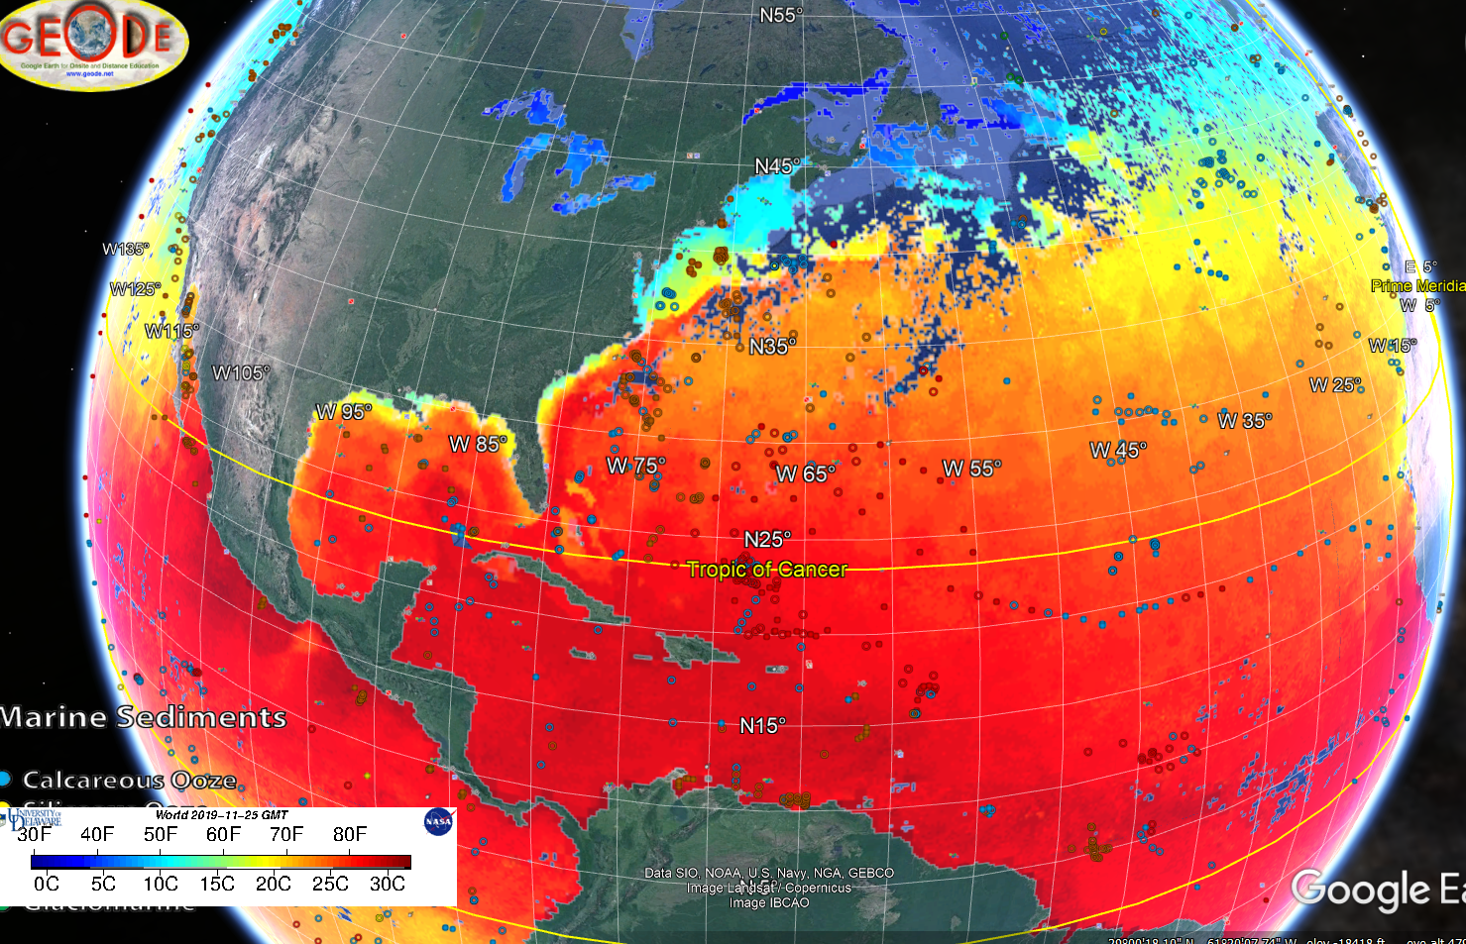
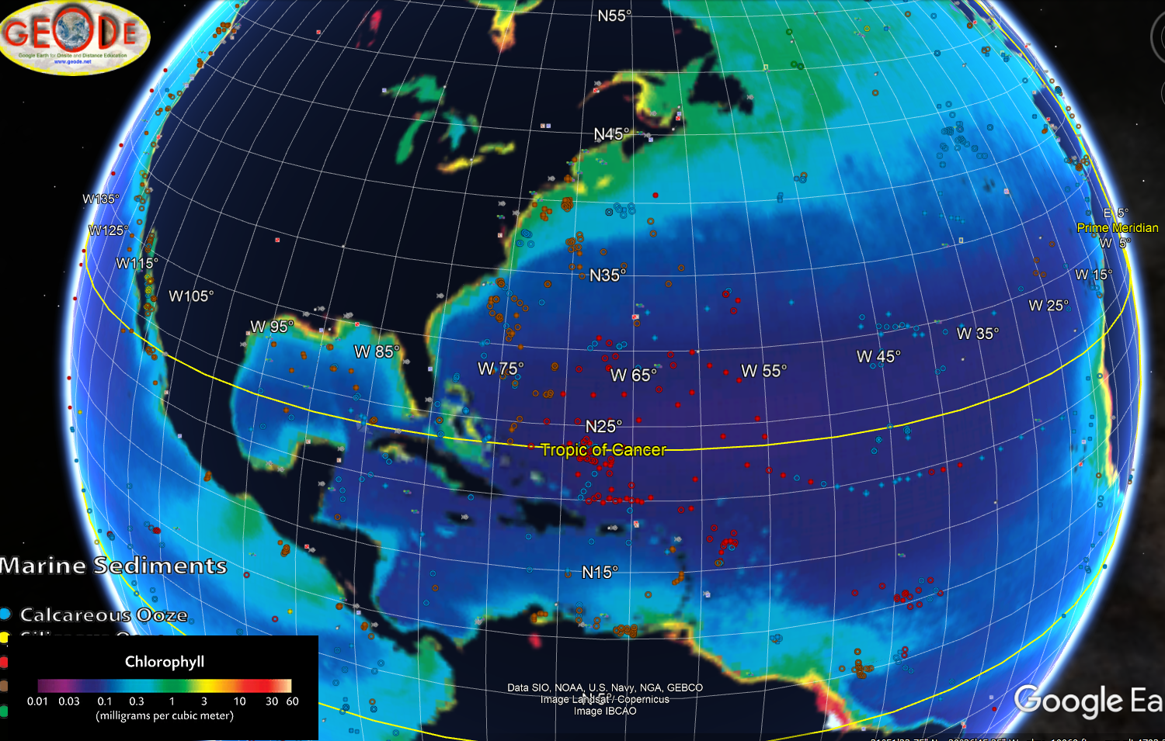
Marine Sediments in Google Earth– Introductory Course mostly Non-majors & DL
Likes
Google earth is free
Visualization of IODP core sites with data
Reinforces sediment types with location, SST, and PP
Reinforces R/V deep sea drilling & sampling equipment/methods
Observational data interpretation
Dislikes & solutions
Only 1.5 hr lab – had to separate components into discrete labs
Problems w/downloading and using GE – added intro to GE lab w/ screenprints
Problems w/Internet access in FTF classes

Slide 8
Lauren Sahl
Maine Maritime Academy, Castine ME

Slide 9
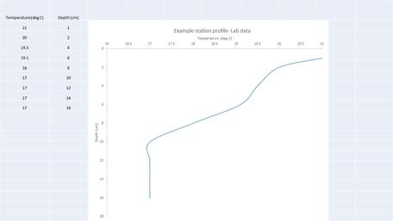
Build a circuit with sensor
Modify computer code
Building a temperature sensor
Build a thermocline and take data
Calibrate the sensor
Plot the data
Notes:
This is best done as two lab activities, one as an introduction to circuit building, Arduino and coding.
The other as an application, students build a circuit with a temperature sensor, calibrate it then take some data in a layered water column in a graduated cylinder.
In the first part of the lab students are walked through building a circuit and changing computer code to make the circuit work. This lab is done with LEDs in the circuit, a quick check to make sure the circuit is properly wired, and fun when the code is changed to make the lights blink in a different way. I like this part of the lab because my students have never built a circuit or even looked at a computer code so this opens there eyes to new information.
The science happens in the second lab. Students reinforce what they learned in the first lab by following directions to build a circuit with a temperature sensor in it. They then use an ice water bath and boiling water bath to make a two point calibration curve. From this point on when students take measurements they correct them with their calibration curve.
Finally, students build a two layered system in a graduated cylinder, floating colored hot water on top of different colored cold water. They then use the temperature probe as a mini-ctd and take depth versus temperature data. The data are plotted in excel, using the oceanographic convention with depth increasing down. And students identify the thermocline.
Students really enjoy these two labs and they fit well into 2 3 hour lab sessions.

Slide 10
Jacqui Degan
Cape Fear Community College, Wilmington NC

Slide 11
Dittmar’s Principle - The Principle of Constant Proportions
Objective: Determine salinity using the Principle of Constant Proportions with random, made-up data
Likes: - MATH - Can be done as demonstration, in groups, or individually in face-to-face or online classes
Dislikes: - Lack of real-time data - No big picture applications
OOI Data Idea*: - Utilize seawater ion measurements from data arrays to calculate seawater salinity - Compare calculations to actual salinity measured by OOI array
*Not sure if possible (depends on availability of seawater ion data)

Slide 12
Mikelle Nuwer
University of Washington, Seattle WA

Slide 13
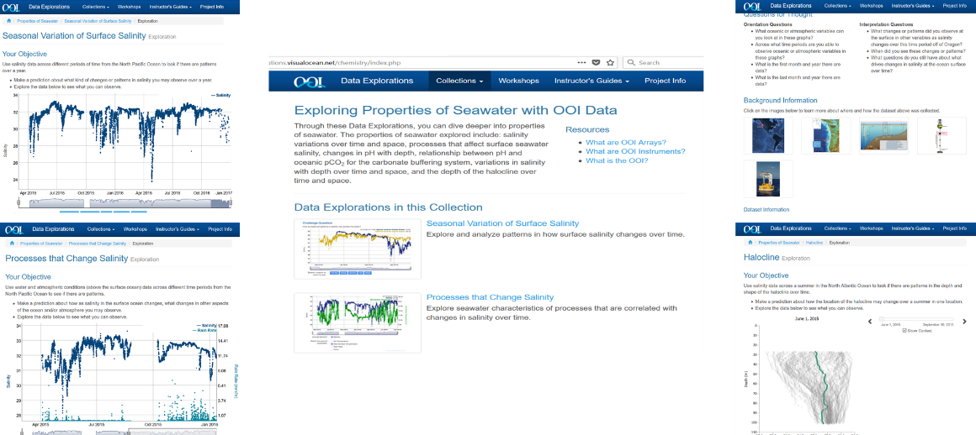
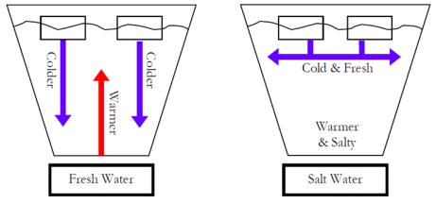
Exploring Salinity, density and stratification with OOI Data Labs
Course: Introductory Oceanography (OCEAN 101)
Traditional lecture course with weekly 2-hour lab
~ 100 students (~ half first-year students)
OOI Education Portal
http://explorations.visualocean.net/
Salinity Widgets
Two-part lab with worksheet:
Qualitative hands-on exercise at beginning to explore stratification - ice in salt and fresh water.
Exploration & Application of 3 OOI salinity widgets (on personal devices) developed by Rutgers:
- Seasonal Variation of Surface Salinity
- Processes that Change Salinity
- Halocline
Pre and post multiple-choice test of knowledge concepts
Qualitative student survey
Pros:
Combination of group and individual work
Students work at own pace
Students report liking work with real world data
Students report lab helped learn concepts
Cons:
Students confused by visualizations/graphs
Students needed to be stepped through lab

Slide 14
OOI Education Portal
http://explorations.visualocean.net/
Salinity Widgets

Slide 15
Anna Pfeiffer-Herbert
Stockton University, Galloway NJ

Slide 16
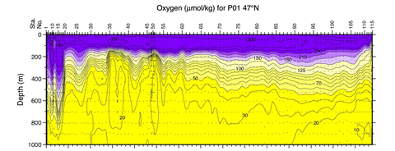
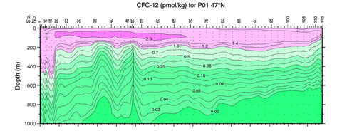
Interpreting chemical patterns in the ocean with WOCE contour plots
Goals:
•Correctly interpret rate of change vs. distance on contour graphs
•Identify similarities and differences in temperature, salinity, oxygen and nutrient concentrations by latitude and longitude
•Describe unusual patterns in North Atlantic and in CFC profiles (revisit in P.O. unit on thermohaline circulation)
Likes:
•The interpolated WOCE data is relatively easy to read, lots of options for sections and chemical parameters
•Once students get over the hurdle of reading contours, groups are able to come to clear consensus on basin similarities/differences
•CFC data adds an interesting story
Dislikes:
•Excessive amount of time on reading contour graphs, not enough left for synthesis
•Requires computer access, challenges to reading PDFs on small screens
•Students find it fairly dry compared to other data activities

Slide 17
Richard Dixon
Texas State University, San Marcos TX

Slide 18
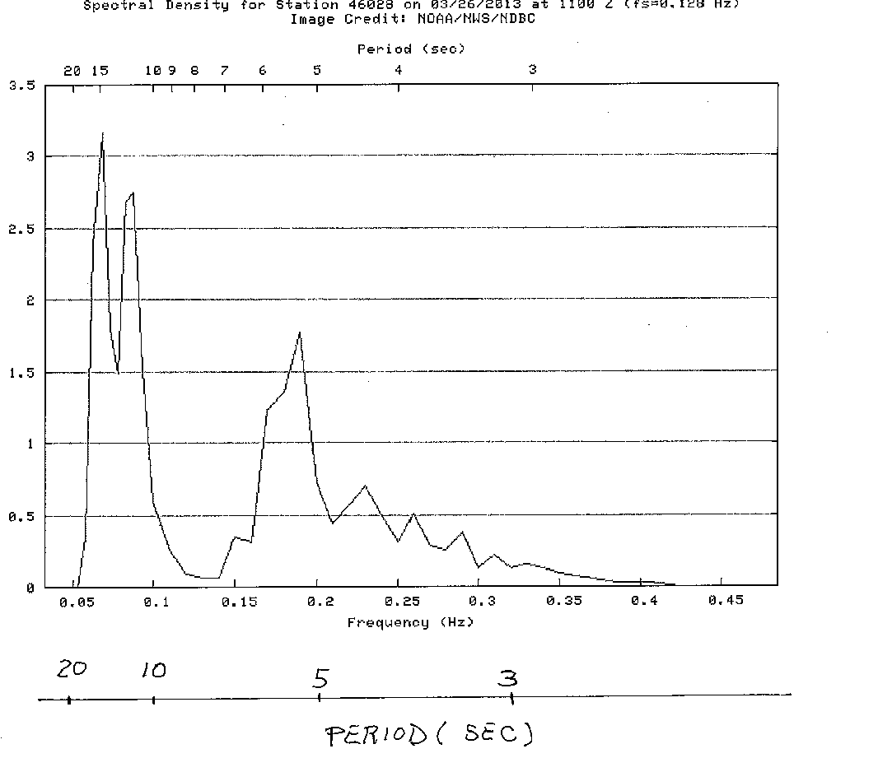
Wave Characteristics Exercise
Calculate the frequency, wavelength, phase speed and group speed for the three different deep-water wave trains indicated on the spectral plot.
LIKES: Allows students to exercise knowledge of governing equations. Can also expand into a discussion of sea vs swell and likely generation area for swell. Helps to introduce my later wave dispersion exercise.
DISLIKES: Students often forget to include units with answers and express results of calculations to an unrealistic number of digits.
Rich Dixon; Texas State University
GEO 3335 Oceanography
Class is taught for upper division physical geography and marine biology majors.

Slide 19
Joseph Long
University of North Carolina, Wilmington NC

Slide 20
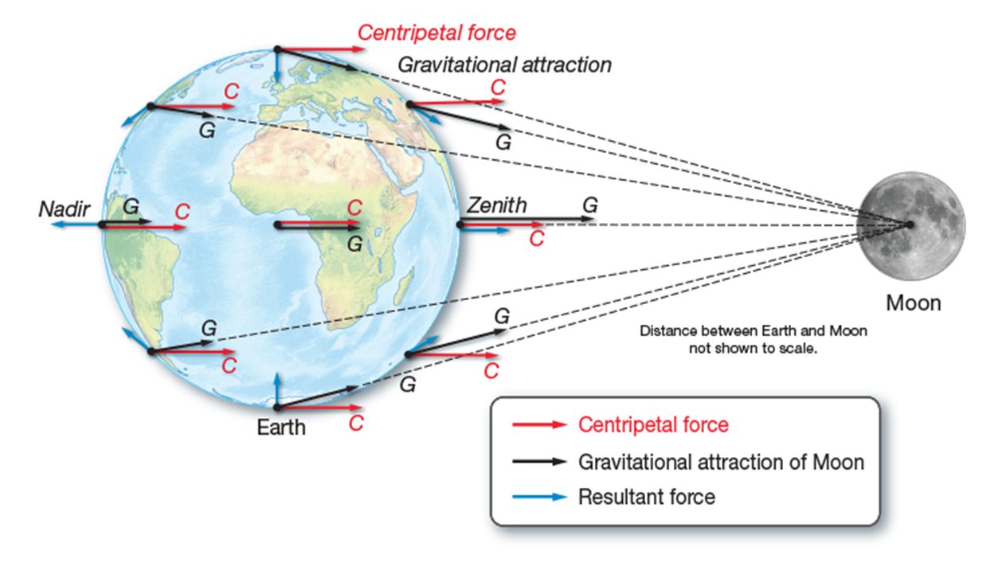
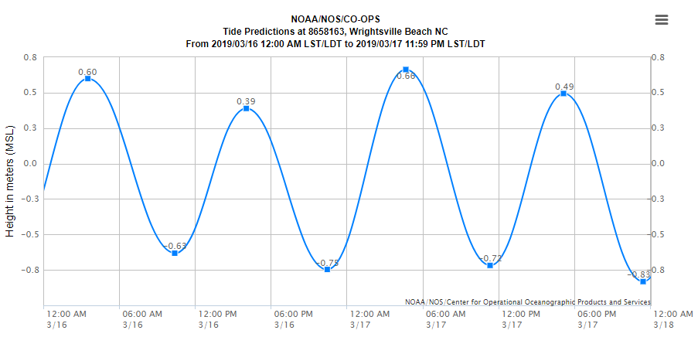
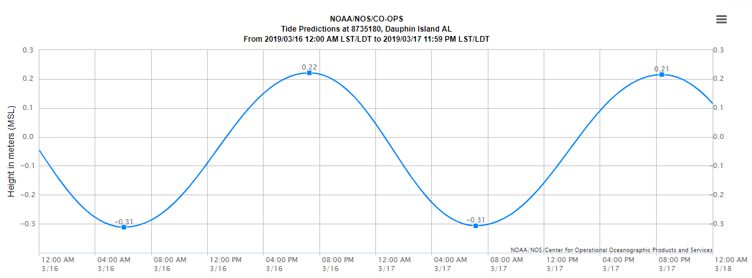
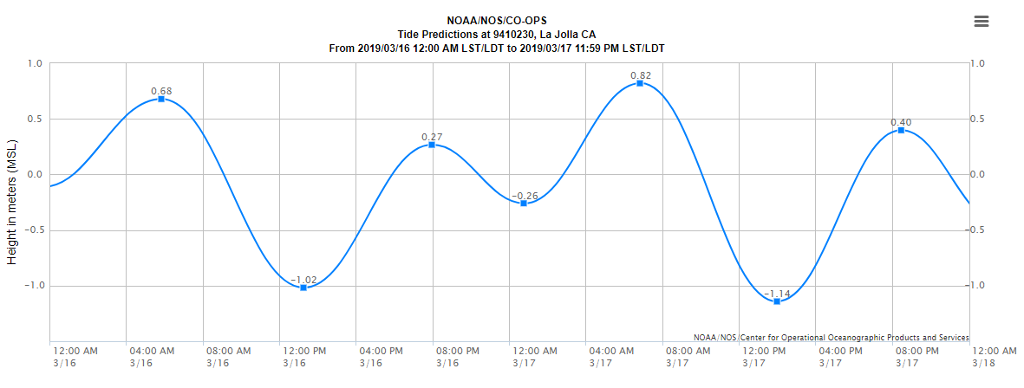
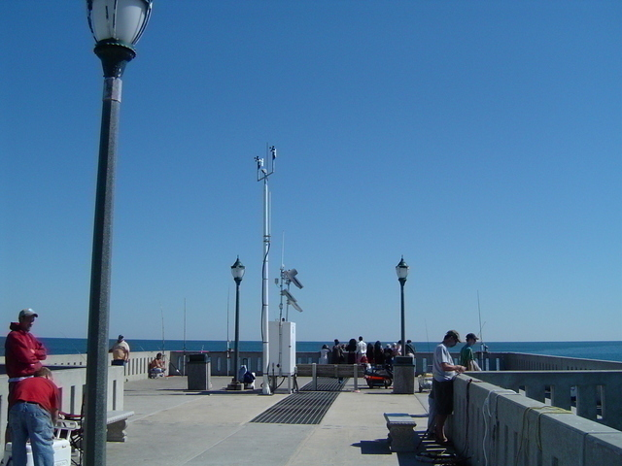
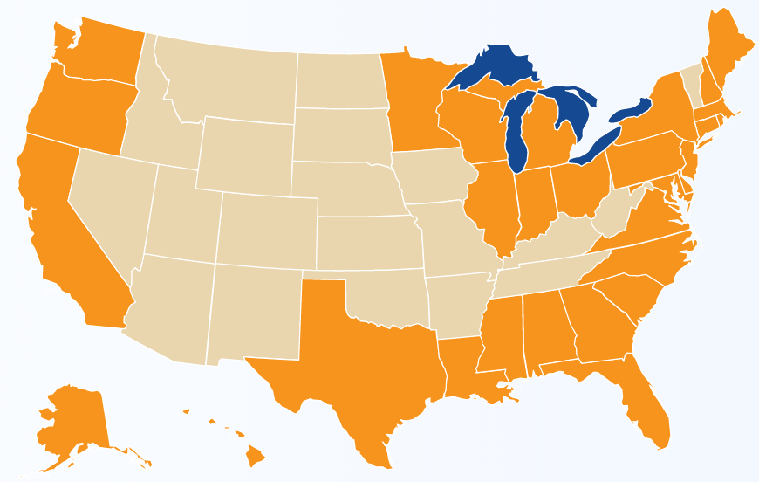
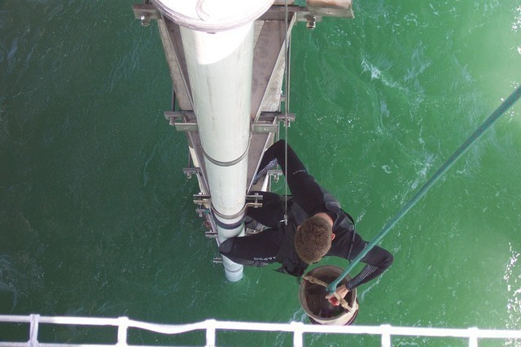
Introduction: lecture/discussion about forces that generate tides
Guide students to different locations to investigate tide characteristics:
different coastlines
open coast vs. estuarine
spring/neap variations
Students work together to predict tidal period, timing of high tide from day-to-day, etc.
Discuss how and where we measure tides
Pros:
Students explore and test assumptions
Leads to discussion about why tides are ‘simple’
Work in groups to practice identifying tide range, period, etc.
Cons:
Worksheet-based
(I kill a lot of trees)
Students struggle with mixed vs. semi-diurnal when looking at data
https://tidesandcurrents.noaa.gov/

Slide 21
Gabriela Smalley
Rider University, Lawrenceville NJ

Slide 22
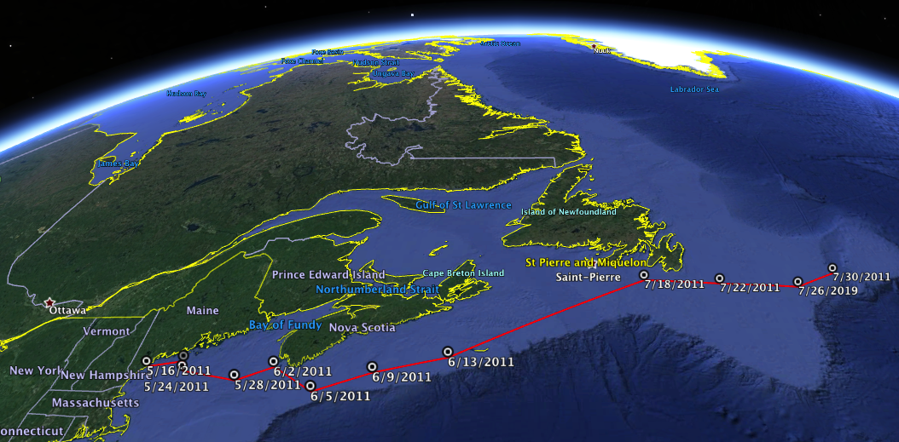
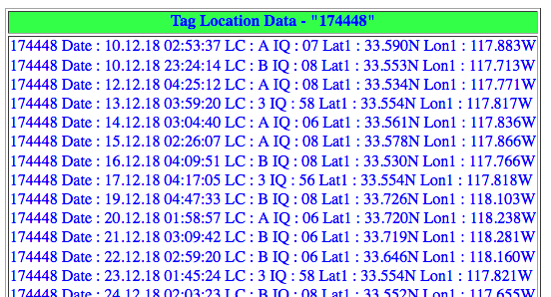
Tracking Marine Mammals and Reptiles
Students will:
Collect tracking information for a specific animal including latitude and longitude (Whalenet.net)
Generate a map of animal’s tracking data
Manipulate tracking data using Excel to get information on distance, speed, and depth
Explain the animal’s movements using background information and claim/evidence/reasoning
Like:
Students are more willing to work with data because it’s a cute animal they actually care about
Create, use, and interpret maps in a different context
Practice claim/evidence/reasoning
Don’t like:
Struggle to help some students with data, software, calculations, etc.
Students select individual data points instead of using all available data; also missing larger picture/questions
Data descriptions and claim/evidence/reasoning often unsatisfactory

Slide 23
Rebecca Freeman
University of Kentucky, Lexington KY

Slide 24
Using Google Earth and Google Earth Streetview to understand coral reef problems
Rebecca Freeman, University of Kentucky (Class: large auditorium intro class for non-science majors; no lab!)
Learning Outcomes
1. You will distinguish healthy reefs from unhealthy ones.
2. Using real-time ocean data you will identify links between ocean conditions and reef health.
Google Earth streetview
Google Earth Streetview
NOAA Coral Reef Watch:
https://coralreefwatch.noaa.gov/satellite/ge/index.php
Stressed coral reefs
Sea Surface Temperature Anomalies
Checking on individual reefs

