Slide 1
Building Data Literacy Skills in Undergraduate Oceanography Education
Integrating Python Exercises with OOI Data Lab on Primary Production
Mikelle Nuwer & Kathy Qi
University of Washington
Amanda Kaltenberg
Savannah State University

Slide 2
Why Data Literacy Matters
The oceans are changing rapidly
Understanding these changes requires strong data literacy skills
Essential for analyzing large, complex datasets
Critical thinking to understand & address environmental challenges
Enhances career readiness in aquatic sciences
Notes:
Teaching data literacy in oceanography is essential for advancing the field and preparing students for the data-rich realities of modern marine science.
Oceanography generates vast amounts of data through advanced technologies like remote sensing, autonomous vehicles, and ocean monitoring systems.
Data literacy equips students with the skills to analyze, interpret, and make sense of this information, enabling them to uncover new insights and contribute to future discoveries AND prepares students for STEM careers in a rapidly evolving workforce, where data-driven decision-making is critical.

Slide 3
The ooi education opportunity
The Ocean Observatories Initiative (OOI) provides a valuable resource for authentic oceanographic data that can be leveraged for educational purposes & as an onramp to data literacy
Authentic Data Source
Real-World Complexity
OOI Data Lab Manual
Foundation for Python Activities
Notes:
Authentic datasets, such as those from the Ocean Observatories Initiative (OOI), are invaluable for developing these skills in undergraduate education.
Authentic Data Source: OOI provides extensive time series data from diverse marine environments.
Real-World Complexity: Data includes gaps, outliers, and noise, simulating real-world challenges.
OOI Data Lab Manual: Offers structured activities connecting oceanography topics with data literacy skills.
Lab 7 Focus: Explores factors controlling primary production, including chlorophyll and seasonal cycles.
Foundation for Python Exercises: Existing framework supports introduction of Python-based data analysis activities.

Slide 4
ADD-ON python ACTIVTIES
Introduce students to programming & Guide students through progressively complex data analysis tasks
Create Python notebooks that enable all students to:
Utilize (and edit) Python scripts for data analysis
Create plots to explore trends and patterns
Formulate data-driven questions
OOI Data Lab 7
Python Activity
Scaffolded design to gain deeper understanding of concepts & build data literacy

Slide 5
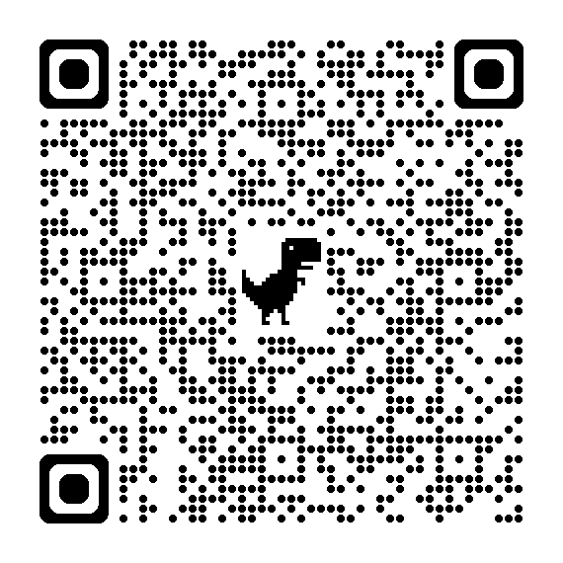
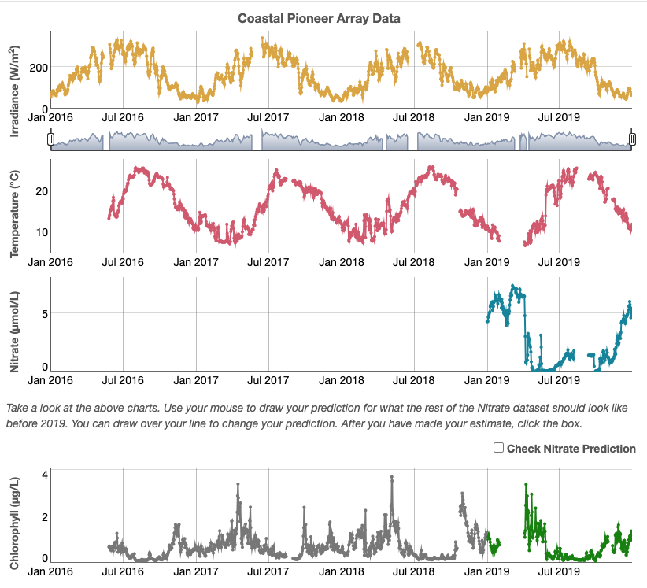
OOI DATA LAB 7 Overview
IDENTIFY FACTORS THAT CONTROL PRIMARY PRODUCTION IN THE WESTERN TEMPERATE ATLANTIC OCEAN
LEARNING OUTCOMES (LO)
Describe patterns in data sets and correlations between the different data types presented
Interpret data and hypothesize about how these variables influence each other and why
Explain the relationship between variables using evidence and relevant scientific concepts to support the hypotheses
Predict patterns over multiple years using data

Slide 6
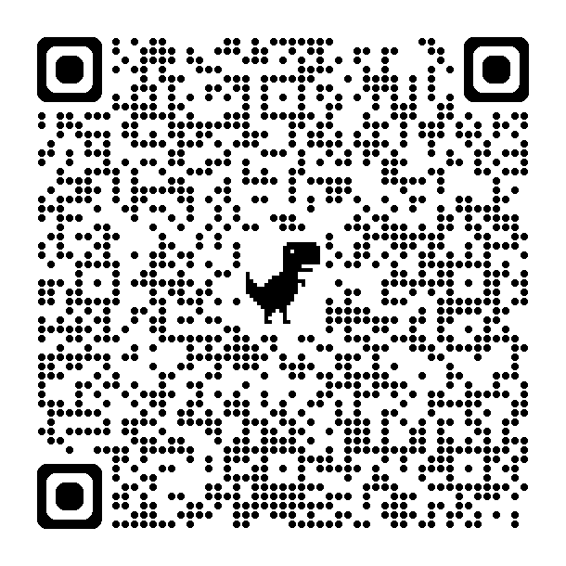
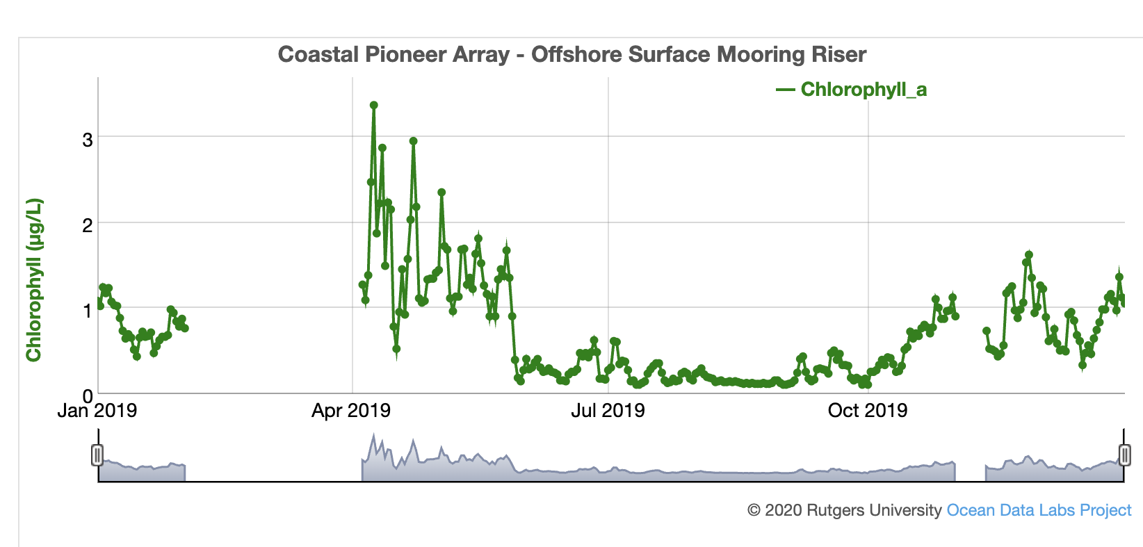
OOI DATA LAB 7.1
How does the abundance of phytoplankton vary over the course of a year?
Fundamental Concept:
Describe seasonal pattern in chlorophyll a concentration over a year
Proxy for Primary Production
Connect to marine food web & abundance of Right whales
Time to complete: 45 minutes
Data skills: Analyzing Time series

Slide 7
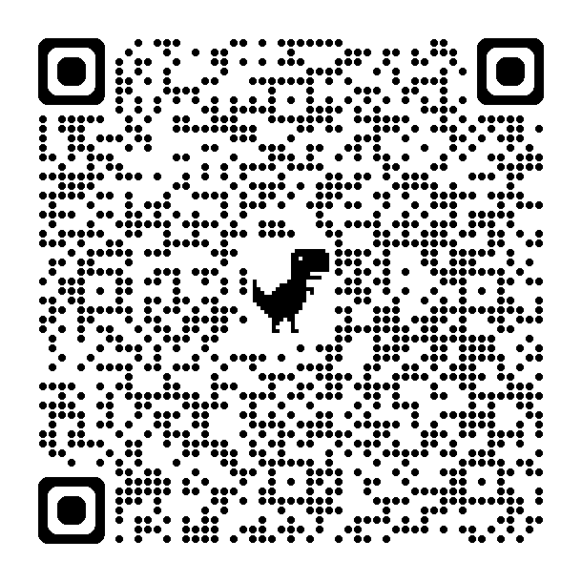
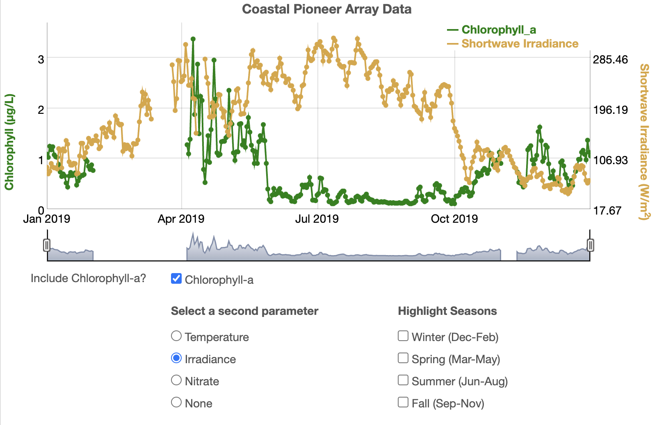
OOI DATA LAB 7.2
What is the relationship between chlorophyll and other abiotic variables?
Fundamental Concept:
Interpret the relationship between primary production, nitrate concentration, irradiance, and surface water temperature
Time to complete: 45-6o minutes
Data skills: Analyzing Time series

Slide 8
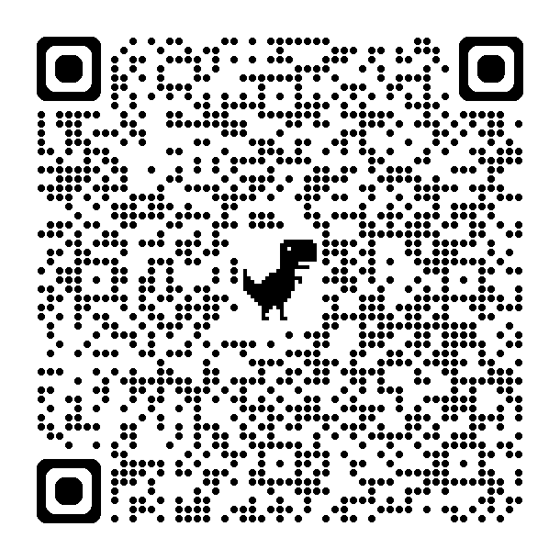
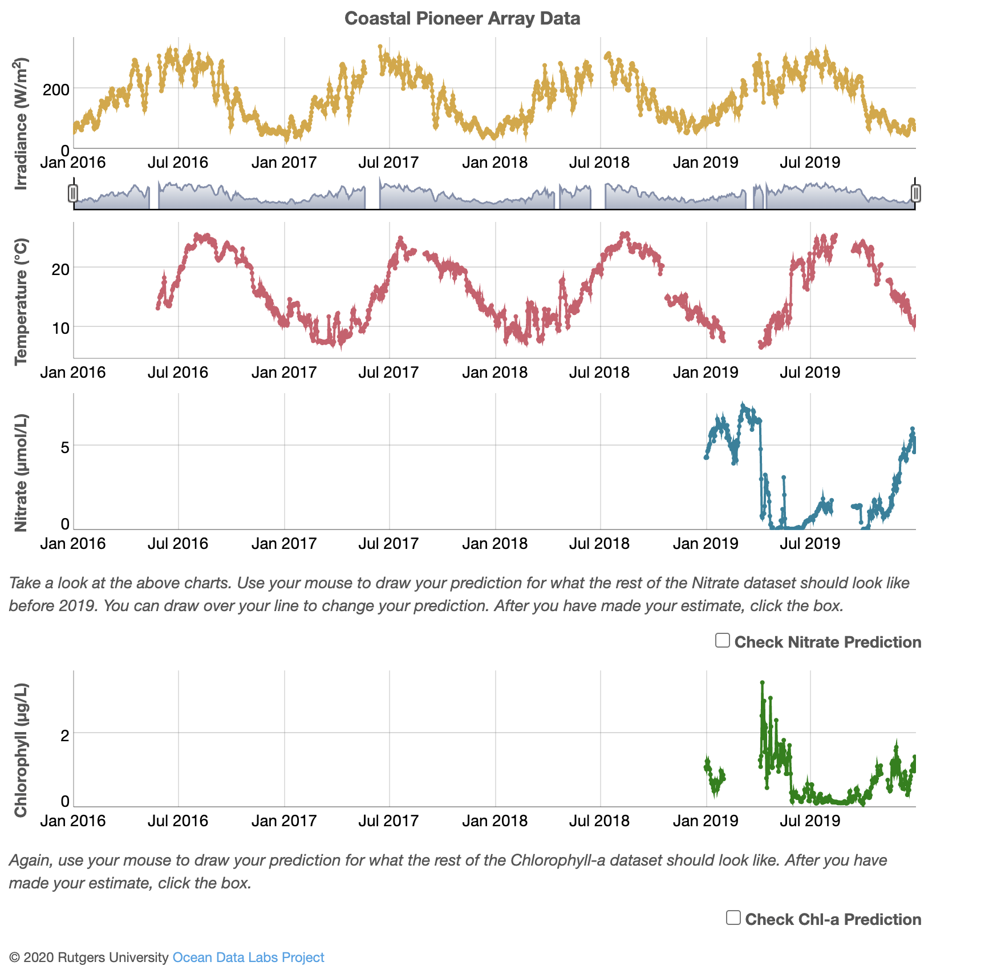
OOI DATA LAB 7.3
Can you make predictions for patterns of variation for other years?
Fundamental Concept:
Apply interpretation of one year of data to predict patterns over multiple years
Time to complete: 45 minutes
Data skills: Analyzing Time series

Slide 9
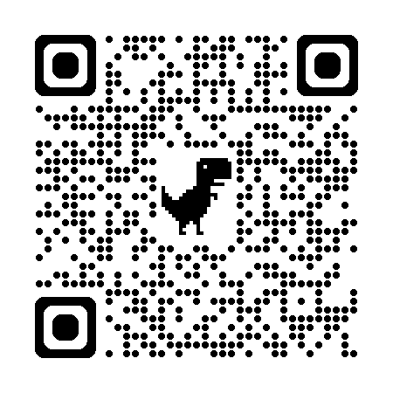
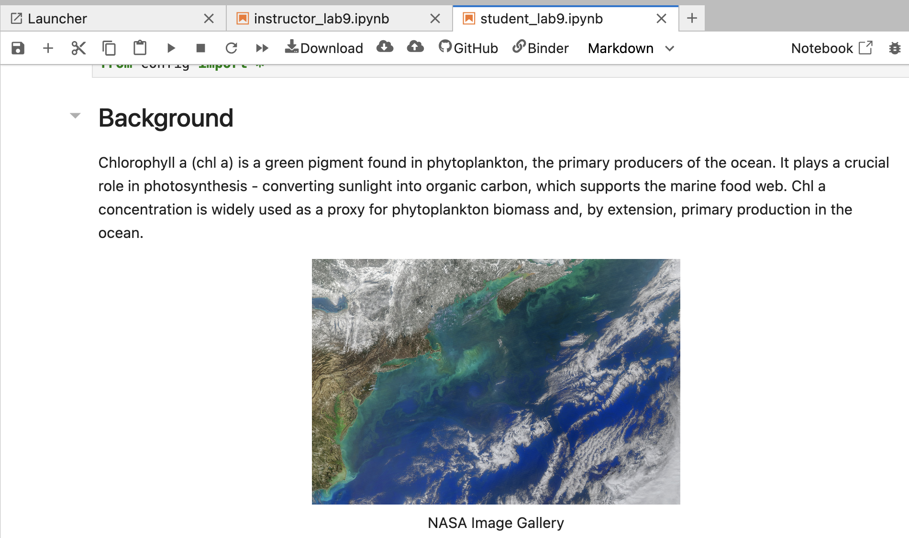
Exploring Primary production python activity
Explore & Compare the timing & magnitude of phytoplankton blooms at different locations
Learning outcomes:
Analyze Spatial and Temporal Patterns in Phytoplankton Blooms
Evaluate Environmental Drivers of Bloom Dynamics
Time to complete: 15+ minutes
Data Skills:
Utilize Python Libraries for Data Visualization Analysis
Visualize Data for Insights & Explanations
VIDEO

Slide 10
Python ACTIVITY overview
Video shows how to access and run Python activities
Instructor & student guides
Students build interactive widgets
Load data sets
Push play to run cells, OR
Edit code
Create interactive plots (widgets from OOI Data Labs)

Slide 11
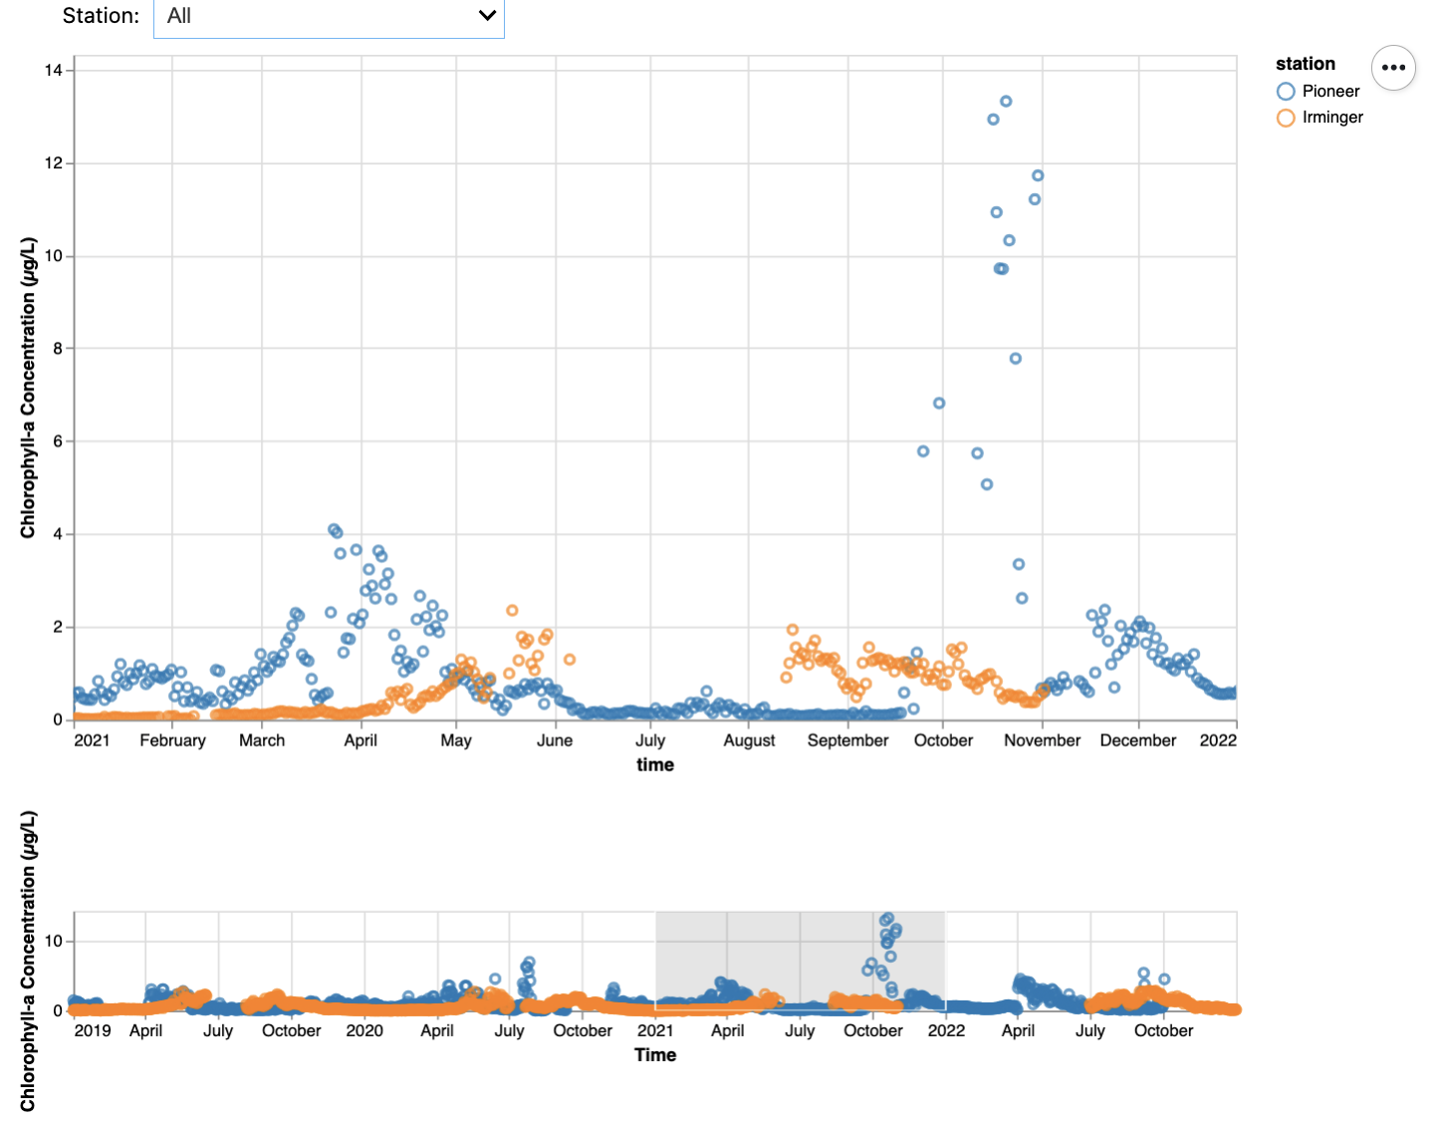
Python activity LO1
Compare & contrast seasonal patterns in primary production at different Latitudes
Plot the chlorophyll time series for Pioneer
Step 1: Generate chl a plot from Lab 7.1
Compare Pioneer & Irminger time series
Step 2: Generate chl a plot for Irminger Sea
Step 3: Generate chl a plot with both locations
Interpretation & Analysis questions
Formulate testable hypothesis/es based on knowledge from OOI Lab 7
Screenshot or VIDEO

Slide 12
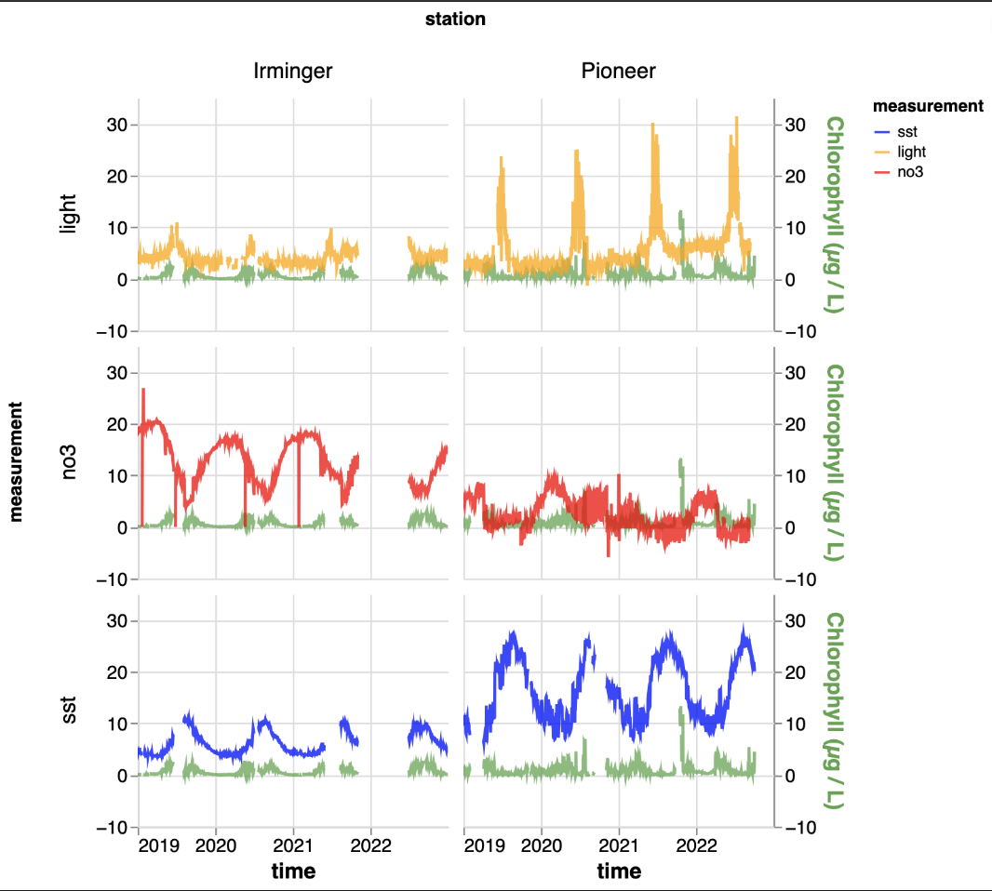
python activity l02
explain differences in timing and/or magnitude of bloom between two latitudes
Visualize, analyze and interpret multiple environmental datasets
Step 4: Generate plots to explore how temperature, light and nitrate change with chl a
Draw evidence-based conclusions about differences
Screenshot or VIDEO

Slide 13
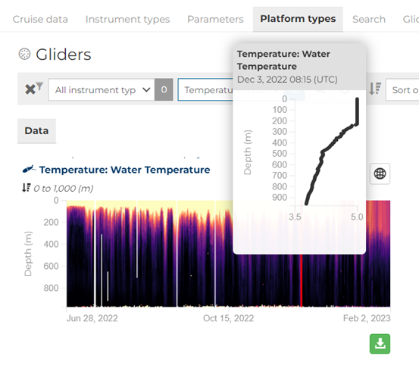
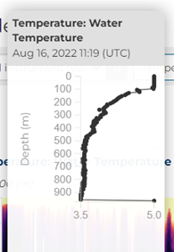
Python Activities to come
Explore & compare the timing & magnitude of phytoplankton blooms at different locations
Latitudes
Onshore & offshore
Explore connection between mixed-layer depth and timing of bloom at different locations

Slide 14
Questions & suggestions?
Many thanks OOI DATA Labs team & community
Denise Bristol (Hillsborough Community College)
Janice McDonnell (Rutgers University)
Sage Lichtenwalner (Rutgers University)
Anna Pfeiffer-Herbert (Stockton University)
Dax Soule (Queens College)

