Slide 1
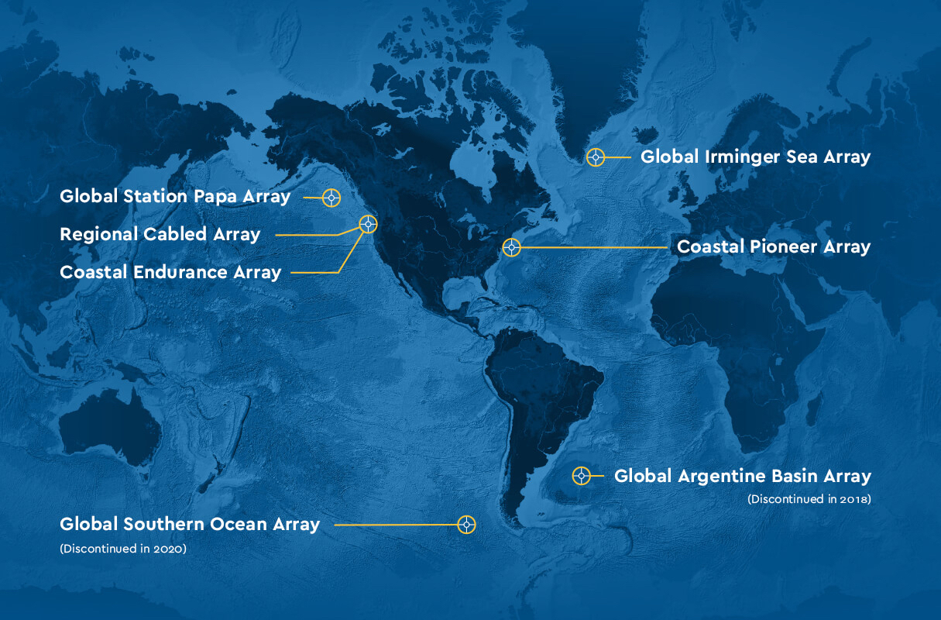
Data Labs Design Workshop
2025
Grand Hotel
Cape May, NJ
datalab.marine.rutgers.edu

Slide 2
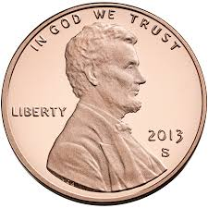
Welcome and Introduction
Introduce yourself (name, institution, and what you teach)
Tell us something about yourself in your penny year!

Slide 3
Workshop Goals:
During the workshop, participants will:
Learn about the OOI program and how to effectively incorporate OOI datasets into your classes.
Learn how to support data literacy skills development by using the learning cycle to structure your lessons.
Review and pilot test a new collection of data-focused lab activities.
Share your favorite hands-on activities and develop a compilation to support OOI Data Labs activities.
Network with other professors interested in using oceanographic data in undergraduate education.

Slide 4
Sunday, May 18 – Day 0: Welcome
3:00 pm Check In at The Grand Hotel of Cape May
4:00 pm Welcome and Introduction
4:45 pm Introduction to the Learning Cycle
Learn about various Learning Cycle frameworks and how it can be used to plan lessons and develop students’ skills.
Quick Reflection
6:30 pm Welcome Group Dinner at the Hotel
8:00 pm Conclude for the Evening

Slide 5
Monday, May 19 - Day 1: Data Skills Development
7:30 am Breakfast Available at the Hotel
8:30 am Welcome and Announcements. Review schedule and goals for the day.
8:45 am Teaching with Data
Highlight and discuss the challenges of teaching with authentic data. Introduce how OOS and the OOI can help.
10:00 am Teaching with Observatory Data
Discuss challenges in working with ocean datasets, and brainstorm strategies for proactively addressing student resistance to quantitative tasks.
10:30 am Coffee Break

Slide 6
10:45 am The OOI Today - An introduction to the history, composition and goals of the OOI and the science it supports.
12:15 pm Lunch
1:00 pm The OOI Data Explorer - Explore the data provided by the OOI Data Explorer, including the data platforms, instrumentation, and data delivery methods.
2:30 pm Data Explorer Exploration and Activity Development - Explore the Data Explorer and design their own Data Exploration-like activity to engage their students in a scientific concept and data skills using the Learning Cycle.
3:00 pm Break
3:15 pm Data Explorer Exploration and Activity Development (continued)
Introduction to Implementation Planning
Review the implementation worksheet to guide planning.
4:15 pm Data Exploration Activity Brainstorm Share Out
4:45 pm Reflection and Feedback
5:00 pm Dinner on Your Own

Slide 7
Tuesday, May 20 - Day 2: Application of the Learning Cycle
7:30 am Breakfast Available at the Hotel
8:30 am Welcome and Announcements - Review schedule and goals for the day.
Review road check comments.
Review OOI QFT questions from yesterday.
8:45 am Pilot Test #1 - Ocean Acidification- Review and pilot test the new Ocean Acidification activity as your students would.
10:00 am Leave for the Rutgers Aquaculture Innovation Complex (AIC)
10:30 am Tour of the Rutgers AIC - Explore ideas on how Ocean Acidification and aquaculture science can support OOI-based activities.
12:15 pm Boxed Lunch at Cape May Point or Hotel Beach

Slide 8
1:30 pm Wildfires and Ocean/Estuary Connections feat. Dr. Matt Olson (Stockton University)
Learn about recent research on wildfires and potential connections and impacts with the ocean.
2:15 pm Pilot Test #2 - Wildfire Impacts on the Ocean - Review and pilot test the new Wildfires activity as your students would.
3:00 pm Break
3:15 pm Introduction to the OOI Data Lab Manual- Review the content, structure, and goals of the OOI Data Labs manual and how it can be integrated into Learning Cycle based teaching.
3:30 pm Lab Manual Activity Review #1 - Meet in small groups to provide an "expert review" of one of the other new Lab Manual activities.
4:45 pm Reflection and Feedback
5:00 pm Daily Wrap Up
6:00 pm Group Reception at the Hotel
7:00 pm Dinner on Your Own

Slide 9
Wednesday, May 21 - Day 3: Hands-On Activities & Share-A-Thon
7:30 am Breakfast available at the Hotel
8:30 am Welcome and Announcements - Review schedule and goals for the day.
Review road check comments.
8:45 am Lab Manual Activity Review #2 - Split up into small groups to review and provide feedback on the other new and revised activities.
10:30 am Break
10:45 am Hands-On Round Robin - Share and review suggested hands-on activities that could potentially support concepts covered in the OOI Data Labs Manual.

Slide 10
12:15 pm Lunch
1:00 pm Hands-On Activity Development - Write up hands-on activities to complement Lab Manual chapters.
2:00 pm Implementation Planning - Work on personal implementation plans to incorporate OOI activities into your teaching.
3:00 pm Break
3:15 pm Share-A-Thon Presentations - Share your reflections and plans and provide feedback to others.
4:30 pm What’s Next? Review the many ways we can use OOI in teaching.
4:45 pm Final Reflection - Review and reflect on what we did together. Complete Final Survey.
5:15 pm Break
6:00 pm Group Farewell Dinner at the Hotel

Slide 11
Turn and Talk
How might these ideas apply to you as an educator?
• Learning is an active process to construct understanding.
• Learning builds on prior knowledge.
• Learning occurs in a complex social environment and is a social activity.
• Learning should be situated in an authentic context.
• Learning is affected by motivation and cognitive engagement.

Slide 12
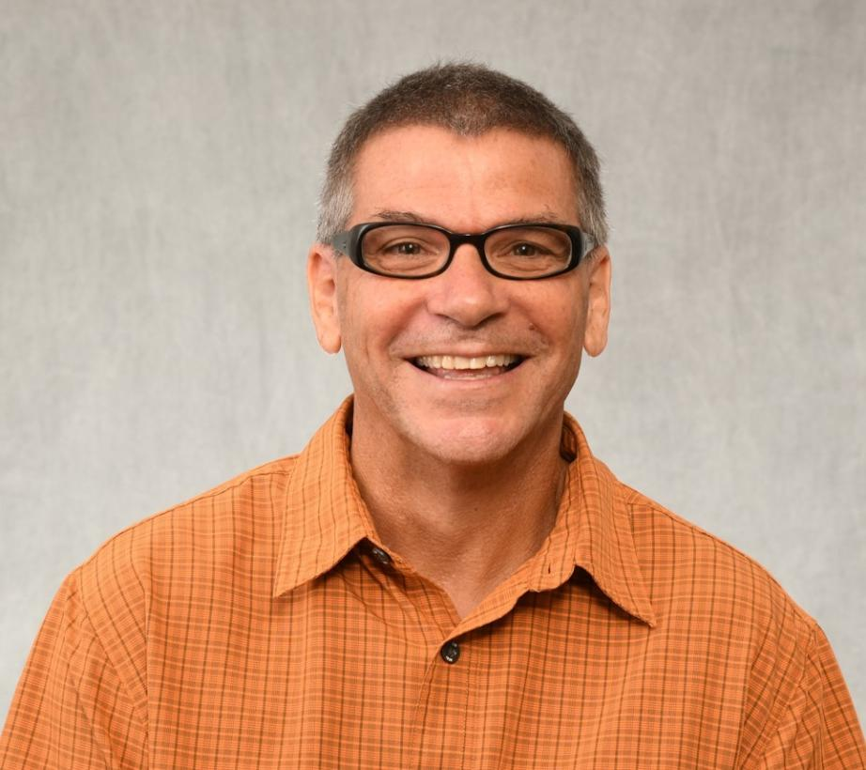
Introducing Dr. Paul Jivoff
Behavioral Ecology, Animal Behavior, Marine Biology
Paul is interested in the influence of sexual competition on courtship and mating behavior, particularly in the blue crab, Callinectes sapidus. He is also interested in the potential impacts of fishing on blue crab reproduction. Currently, he assesses the population structure (e.g., abundance, size distribution, sex ratio) and various measures of reproductive potential (e.g., sperm stores of both sexes, brood production and fecundity of females) of adult blue crabs in Barnegat Bay.

Slide 13
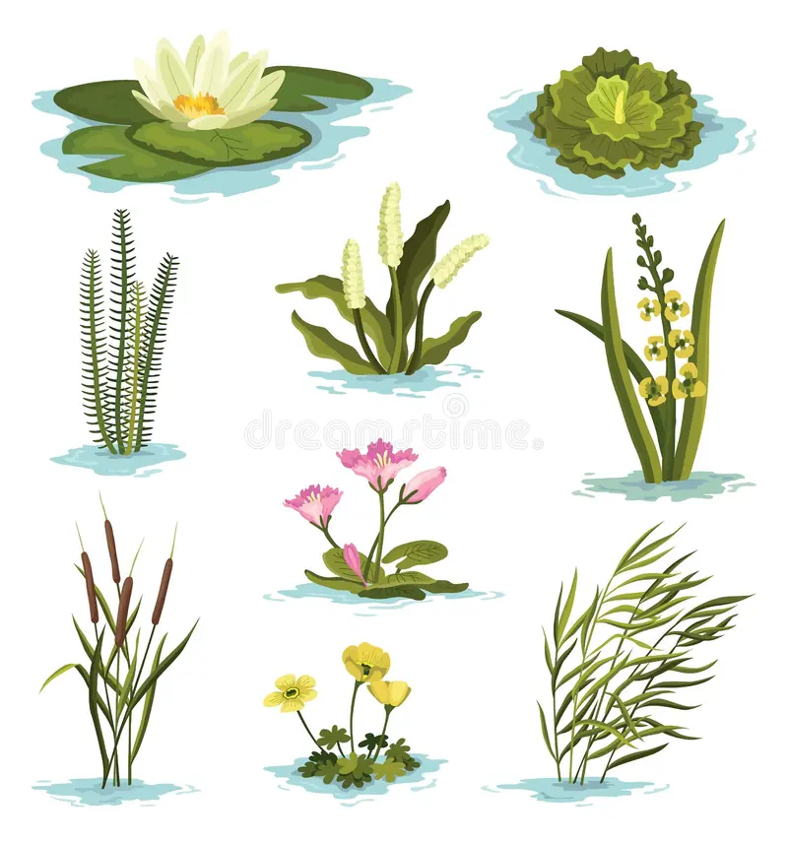
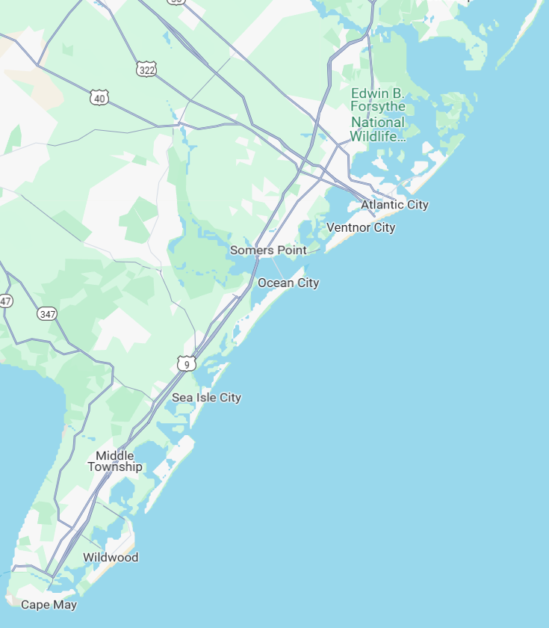
Physical aspects of Marine Environments….OR
Controlling features of Marine Environments
A
B
A
B
C
A
B
Features
Salinity
Temperature
Dissolved Oxygen
pH
?1
C
C
?3
A
B
What characteristic do all of these share?
C
?2
Components of Community Structure
Abundance
Distribution
Species Diversity

Slide 14
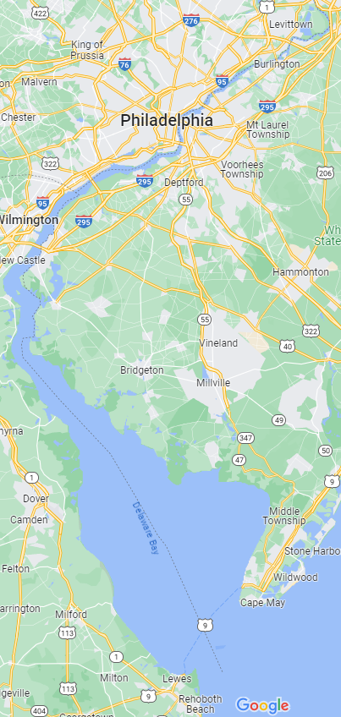
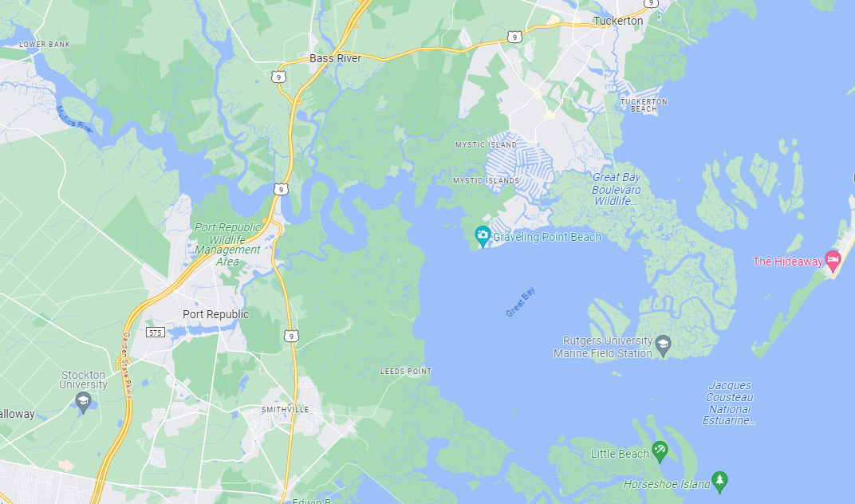
What ARE these places?
Why are they good for seeing salinity variation?
ocean
ocean

Slide 15
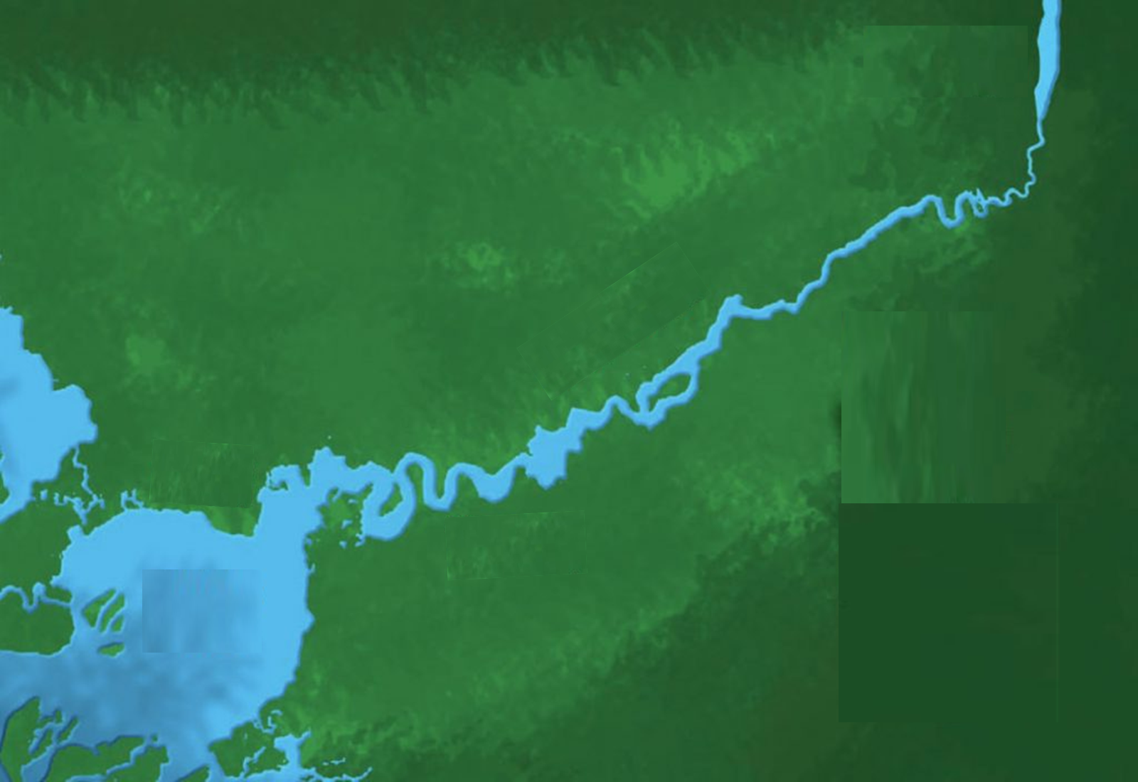
Salinity Variation
Based on these…
what’s going on?
A
B
C
35º/oo
25º/oo
15º/oo
5º/oo
Great Bay-Mullica River
? 2
C
? 1
B
A

Slide 16
Salinity Variation
A
B
C
What’s the difference?
or
What factor creates
variation in salinity?
A
B
C
How is the crab effected?
What do you need to know
to answer?
Salinity Tolerance
25-35º/oo

Slide 17
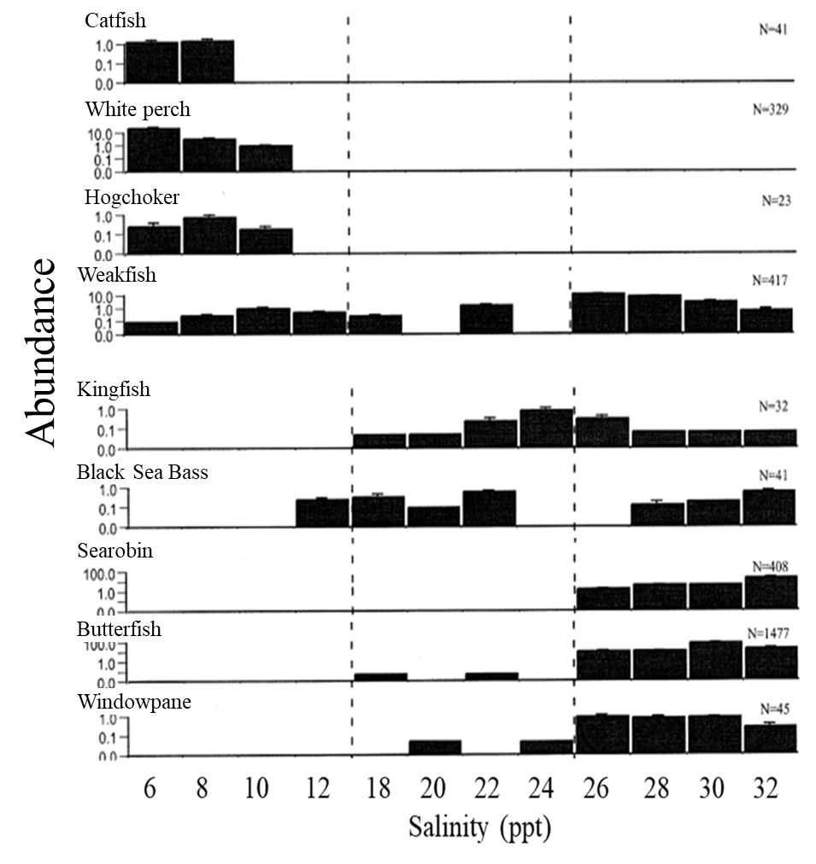
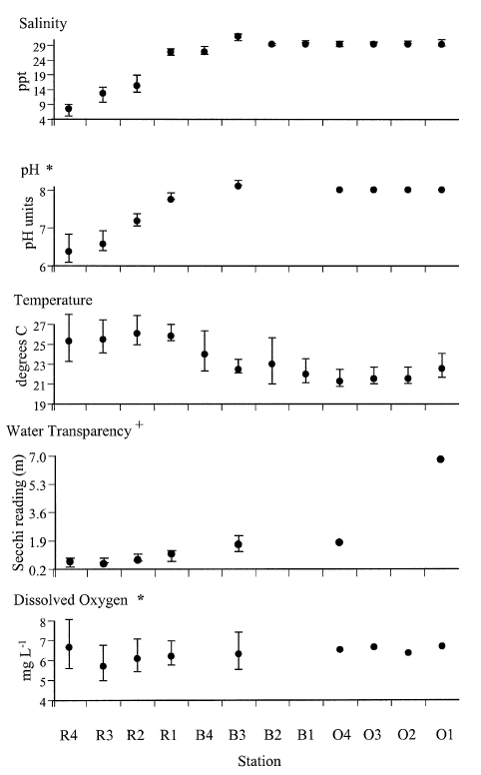
Which aspects of fish community structure are influenced by salinity?
How do you know?
Talk with your neighbors!

Slide 18
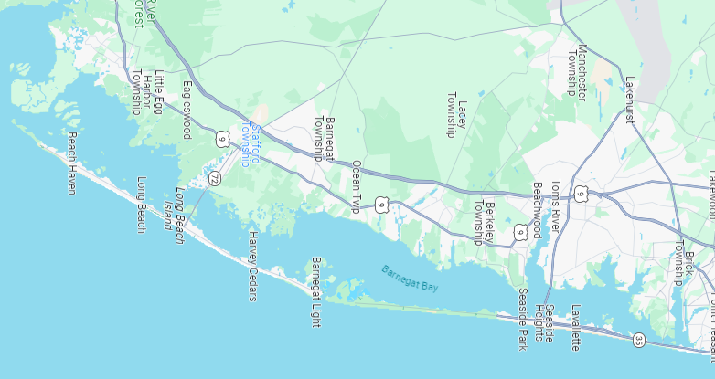
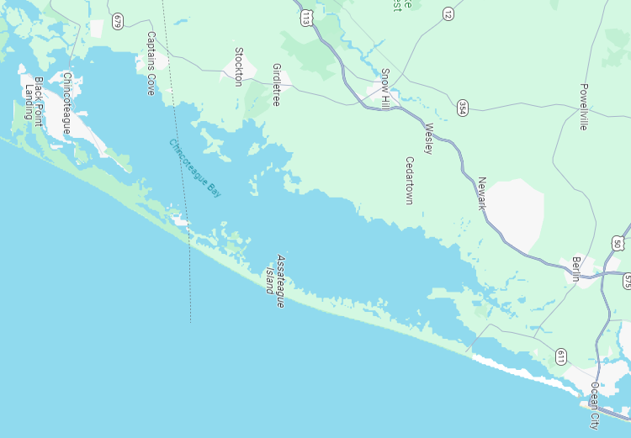
DO ESTUARIES VARY?
26
inlet
26
26
26
Salinities?
24
20
16
What does Barnegat Bay have…
inlet
26
26
26
inlet
26
26
26
26
that Chincoteague Bay does NOT?
inlet

Slide 19
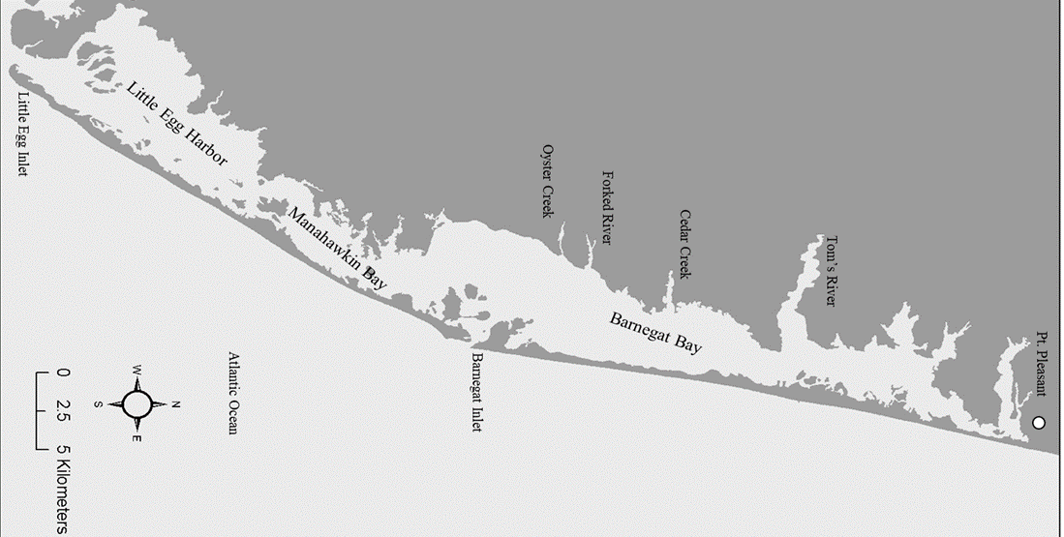
Adult Blue Crab Abundance
10
Challenge Question…
with your tablemates…..
Hypothesize….where do blue crab larvae develop?
Lagoonal Estuary
Drowned-River Estuary
Little Egg Harbor & Manahawkin Bay
Barnegat Bay
9
8
25.6
7
24.6
6
25.7
25.0
23.2
Catch per Unit Effort
21.4
Abundance
17.4
5
Males
4
Females
3
2
1
0
1 2 3 4 5 6 7
Sampling Location
Tuckerton
West Creek
Manahawkin
Waretown
Forked River
Bayville
Silverton

Slide 20
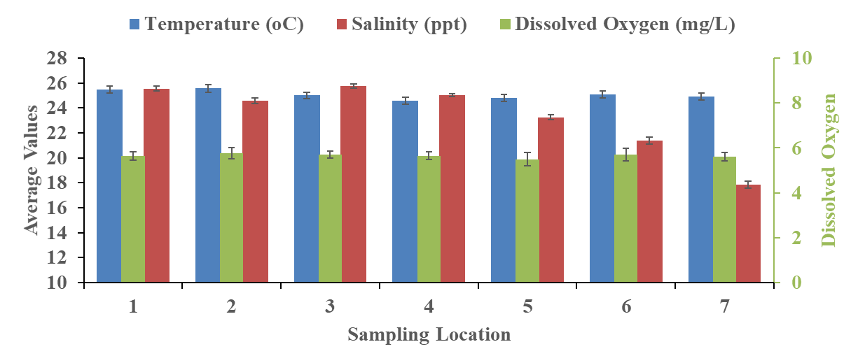

Slide 21
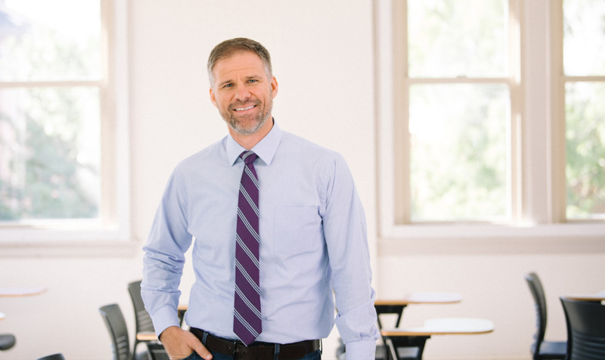
Introducing Dr. Troy Sadler
Troy Sadler conducts research related to how students negotiate complex socio-scientific issues and how these issues may be used as contexts for science learning.
He is interested in how issues-based learning experiences can support student learning of science and development of practices essential for full participation in modern democratic societies.
Sadler’s work has been funded by the National Science Foundation, the Institute of Education Sciences, the US Department of Education, the Howard Hughes Medical Institute as well as local foundations and state agencies.

