Slide 1
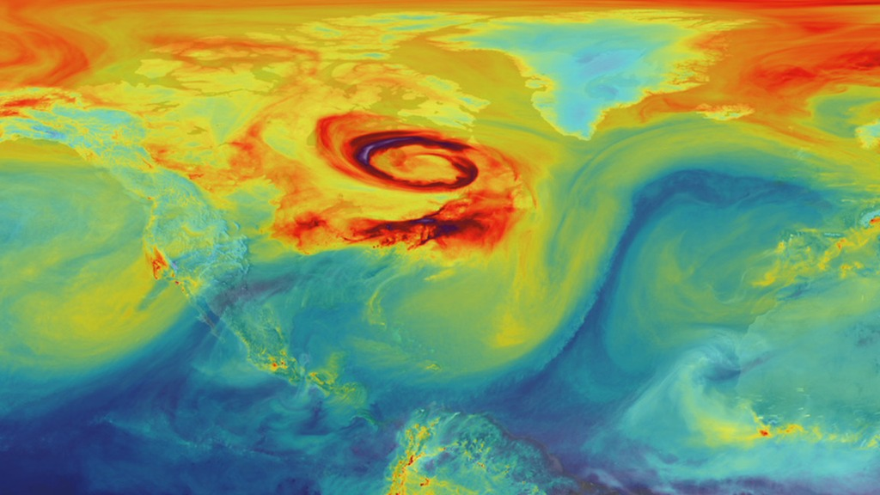
Uncovering the Drivers of CO₂ in the Ocean

Slide 2
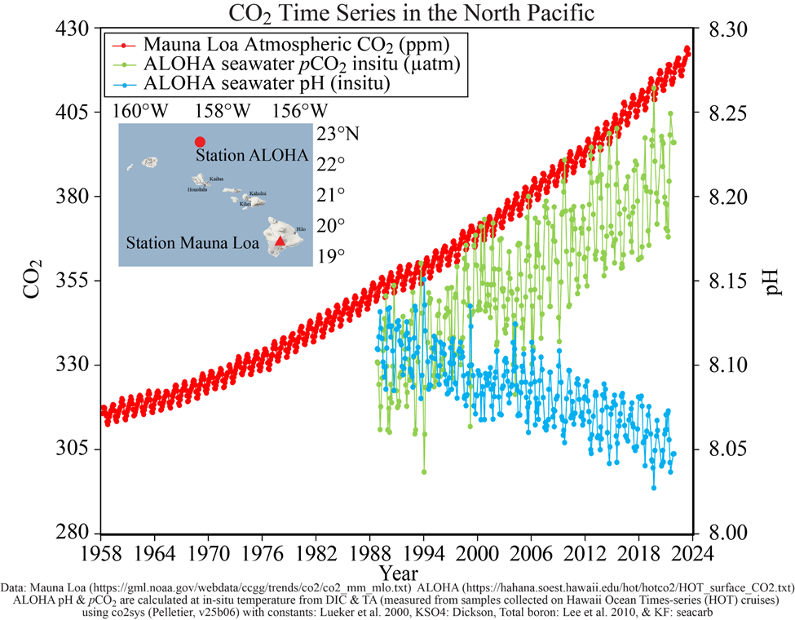
Why has ocean pH declined over time?

Slide 3
05/20/2025 ABC: Let's use the scientific method to investigate what happens when lemon juice meets antacid tablets. Your task: Use your white board to record the following steps with your lab partners.
Ask a question ( What do you want to find out?)
Do Background Research
What is lemon juice?
What are antacid tablets used for?
Form a hypothesis; let's write it as an if / then statement
Test Your Hypothesis by Doing an Experiment
Place an antacid tablet in a small dish.
Pour water onto the tablet so that it almost submerged.
Observe what happens
Repeat the experiment but this time squeeze lemon juice onto the tablet.
5. Record and Analyze Data
What did you see, hear, or smell in each experiment?
6. Draw a Conclusion
Was your hypothesis correct? What does your result tell you about acids?
Compare both the tablet sitting in water and the tablet sitting in lemon juice.
7. Communicate Your Results : Share your findings on the white board.

Slide 4
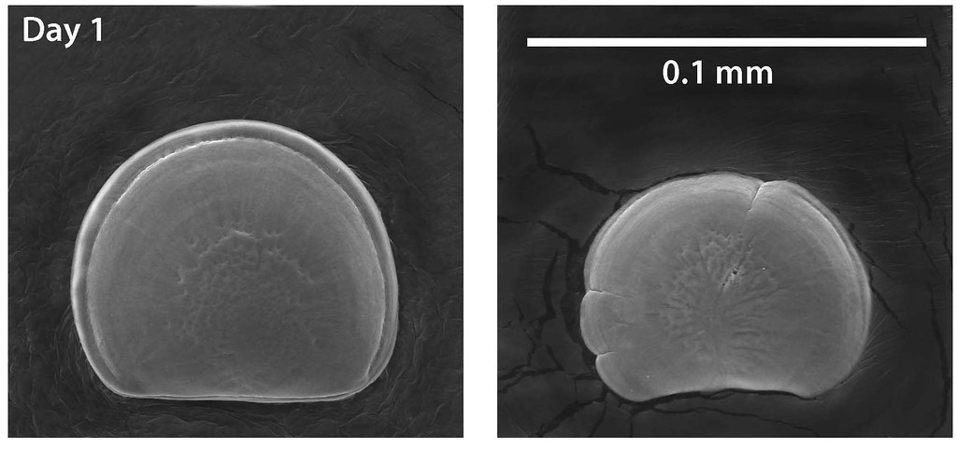
What does this mean for marine life?

Slide 5
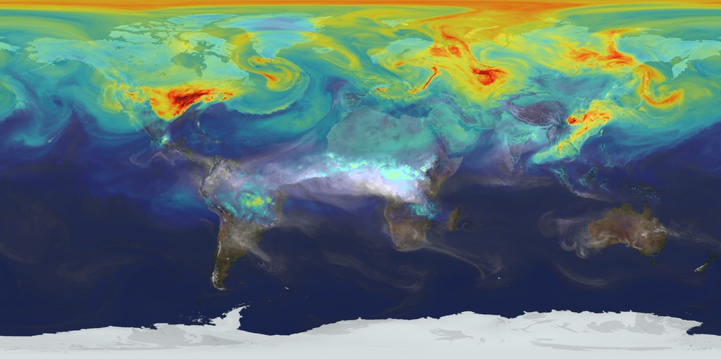
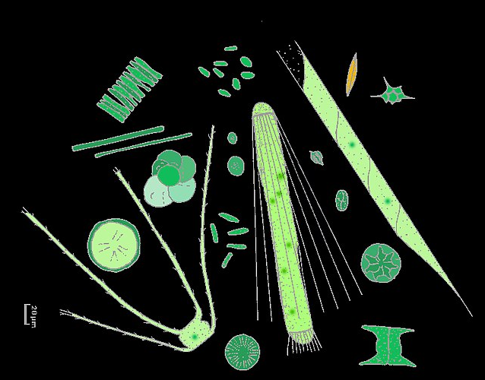
A Year in the Life of Atmospheric CO₂
Notes:
What you’re looking at is a supercomputer model of carbon dioxide levels in the Earth’s atmosphere. The visualization compresses one year of data into a few minutes. Carbon dioxide is the most important greenhouse gas affected by human activity. About half of the carbon dioxide emitted from fossil fuel combustion remains in the atmosphere, while the other half is absorbed by natural land and ocean reservoirs. In the Northern Hemisphere, we see the highest concentrations are focused around major emission sources over North America, Europe and Asia. Notice how the gas doesn’t stay in one place. The dispersion of carbon dioxide is controlled by the large-scale weather patterns within the global circulation. During spring and summer in the Northern Hemisphere, plants absorb a substantial amount of carbon dioxide through photosynthesis, thus removing some of the gas from the atmosphere. We see this change in the model as the red and purple colors start to fade. Meanwhile, in the Southern Hemisphere, we see the release of another pollutant—carbon monoxide. This is a gas that’s both harmful to the environment and to humans. During the summer months, plumes of carbon monoxide stream from fires in Africa, South America and Australia, contributing to high concentrations in the atmosphere. Notice how these emissions are also transported by winds to other parts of the world. As summer transitions to fall, and plant photosynthesis decreases, carbon dioxide begins to accumulate in the atmosphere. Although this change is expected, we’re seeing higher concentrations of carbon dioxide accumulate in the atmosphere each year. This is contributing to the long-term trend of rising global temperatures.
Plumes of carbon dioxide in the simulation swirl and shift as winds disperse the greenhouse gas away from its sources. The simulation also illustrates differences in carbon dioxide levels in the northern and southern hemispheres and distinct swings in global carbon dioxide concentrations as the growth cycle of plants and trees changes with the seasons. The carbon dioxide visualization was produced by a computer model called GEOS-5, created by scientists at NASA Goddard Space Flight Center’s Global Modeling and Assimilation Office. The visualization is a product of a simulation called a “Nature Run.” The Nature Run ingests real data on atmospheric conditions and the emission of greenhouse gases and both natural and man-made particulates. The model is then left to run on its own and simulate the natural behavior of the Earth’s atmosphere. This Nature Run simulates January 2006 through December 2006.

Slide 6
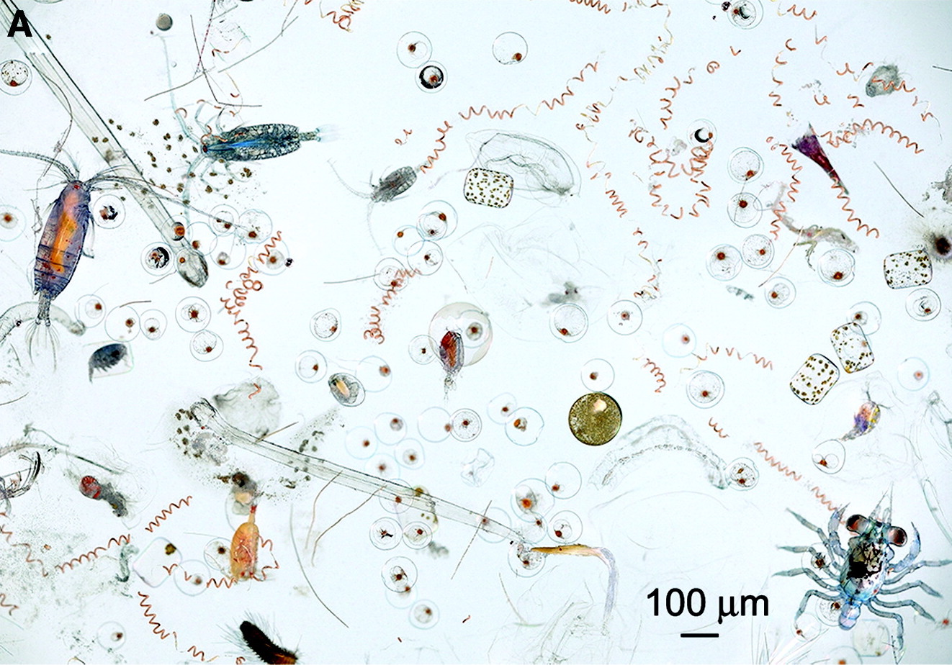
Two Key Biological Processes
Photosynthesis
Carbon Dioxide + Nitrate + Phosphate + Energy → Organic Matter + Oxygen
Respiration
Organic Matter + Oxygen → Carbon Dioxide + Nitrate + Phosphate + Energy
Notes:
Photosynthesis
Fixes carbon from CO₂ into biomass (organic matter)
Energy into the system (from light)
Consumes nutrients
Produces O₂
Respiration
Consumes organic matter
Energy is released from the organic matter
Releases nutrients
Consumes O₂

Slide 7
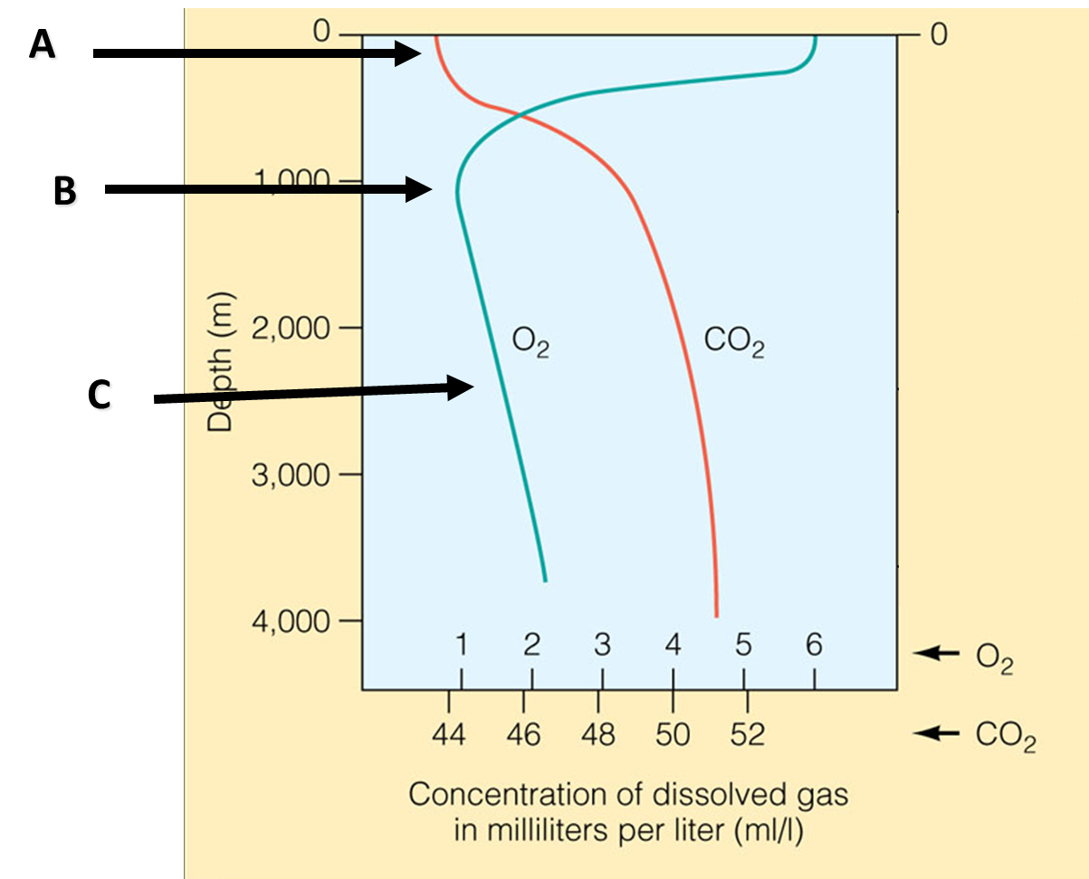
What are the dominant processes?
Notes:
Surface – o2 high and co2 low due to photosynthesis; uptake of gasses from the atmosphere
Mid depth – o2 decrease and co2 increase from decomposition and respiration
Deep – fewer organisms to use o2 & oxygen rich polar water – co2 increases due to higher pressure and lower temperature increasing solubility

Slide 8
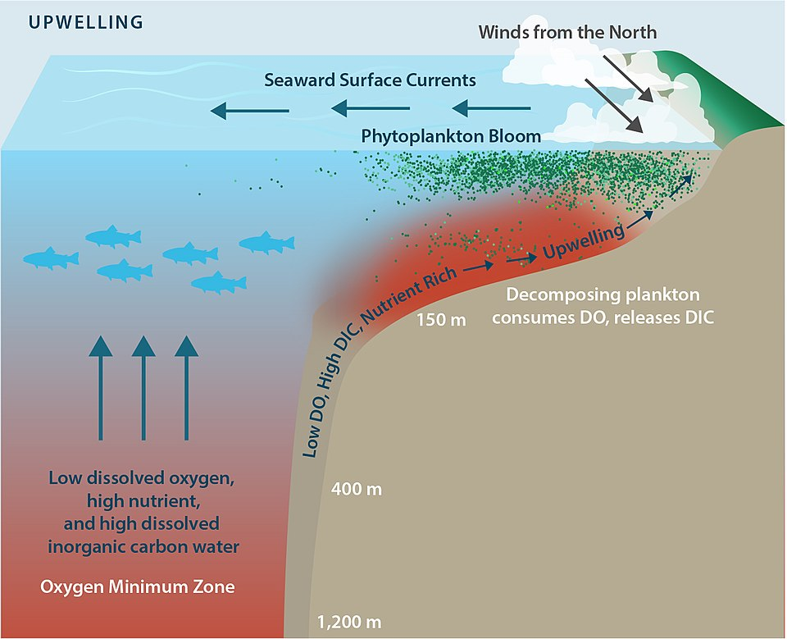
Upwelling: Nutrients from the Deep
Notes:
Surface – o2 high and co2 low due to photosynthesis
Mid depth – o2 decrease and co2 increase from decomposition and respiration
Deep – fewer organisms to use o2 & oxygen rich polar water – co2 increases due to higher pressure and lower temperature increasing solubility

Slide 9
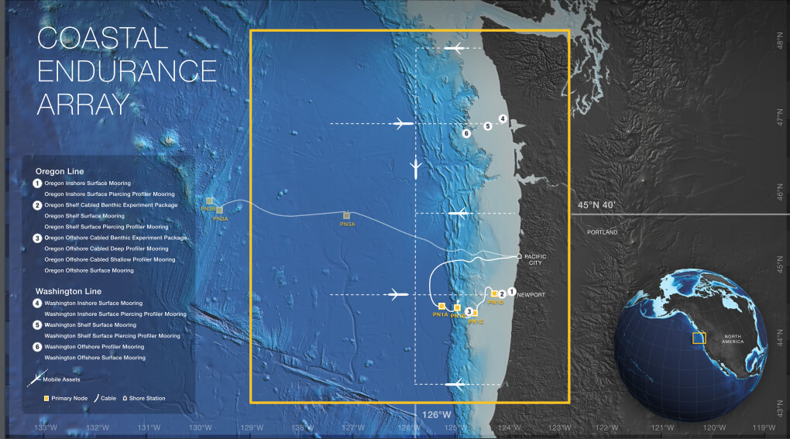
Upwelling: Nutrients from the Deep
Notes:
Surface – o2 high and co2 low due to photosynthesis
Mid depth – o2 decrease and co2 increase from decomposition and respiration
Deep – fewer organisms to use o2 & oxygen rich polar water – co2 increases due to higher pressure and lower temperature increasing solubility

Slide 10
Solving a West Coast Mystery
Notes:
Play half of it to show things are changing
Stop at 3:08

