Slide 1
OOI Overview for Ocean Data Labs Workshop
Dax Soule, Chair OOIFB
May 19, 2025

Slide 2
The Facility Board
The U.S. National Science Foundation (NSF) Ocean Observatories Initiative Facility Board (OOIFB) provides independent input and guidance regarding the management and operation of the U.S. National Science Foundation Ocean Observatories Initiative (NSF OOI).

Slide 3
Catalyst Question
Historically, where have we studied Oceanography?

Slide 4
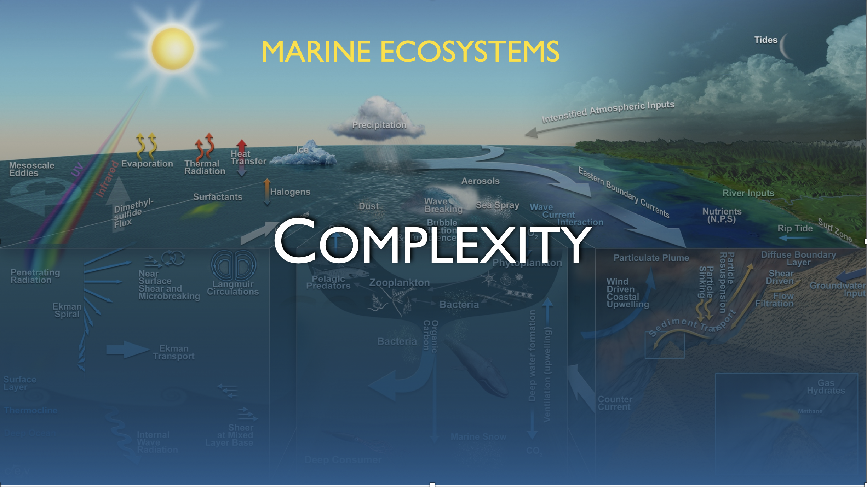
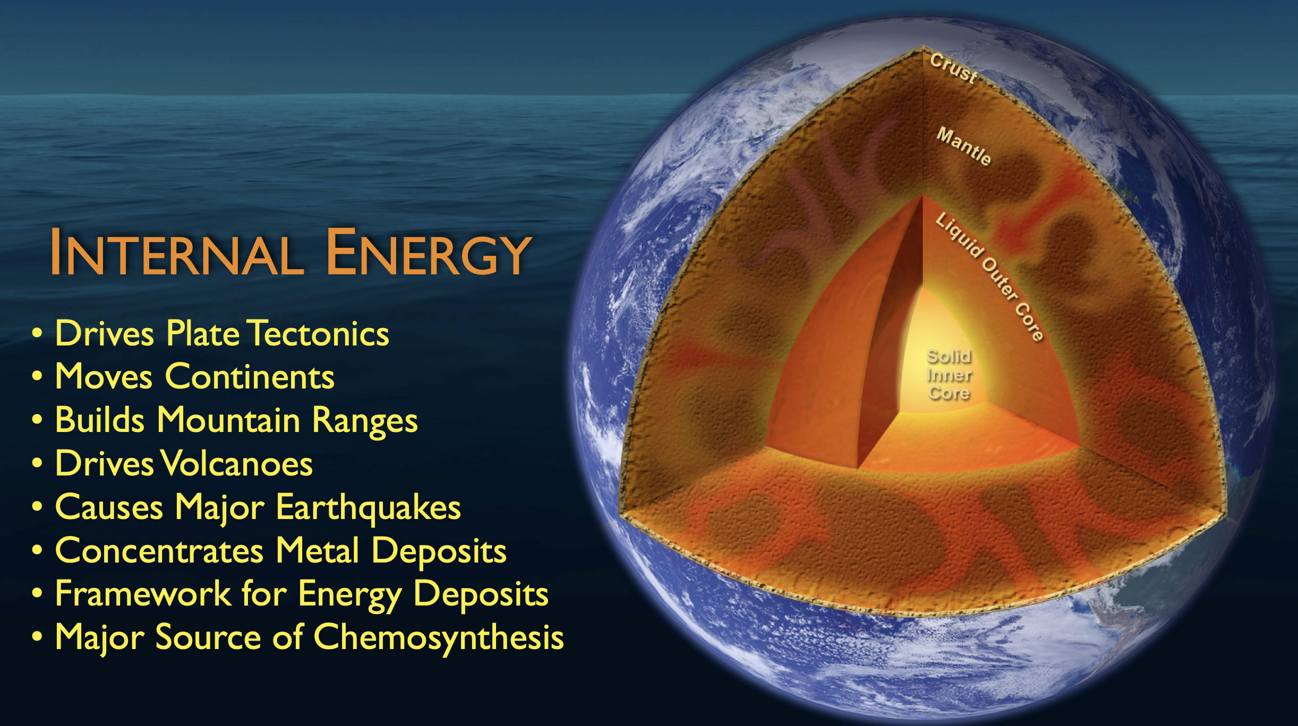
Key Points
Wanted: One shovel ready project that delives a sustained, research-driven, ocean observing capability.
What should such a system be comprised of?
Notes:
Interactions between

Slide 5
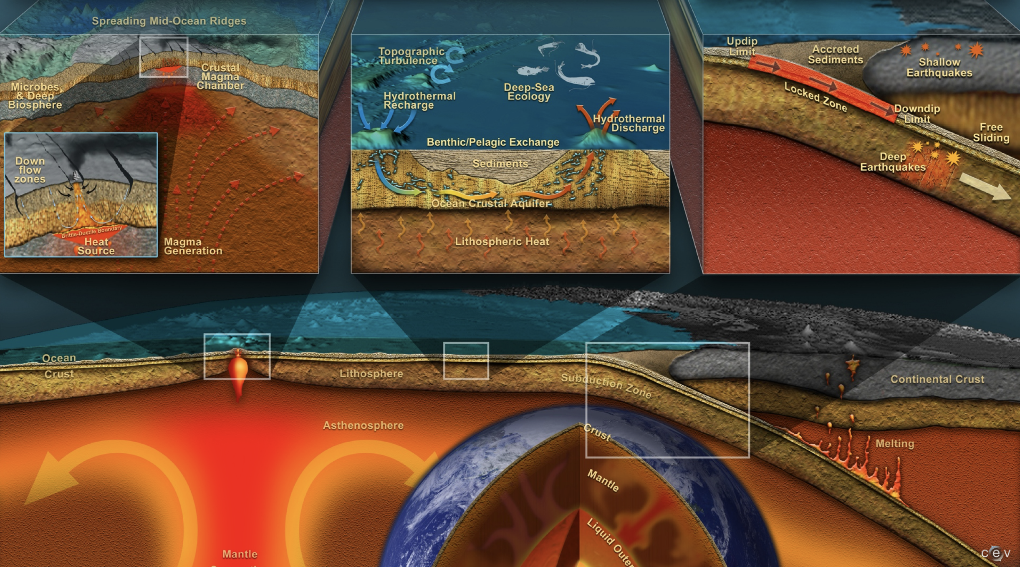
Key Points
Wanted: One shovel ready project that delives a sustained, research-driven, ocean observing capability.
What should such a system be comprised of?

Slide 6
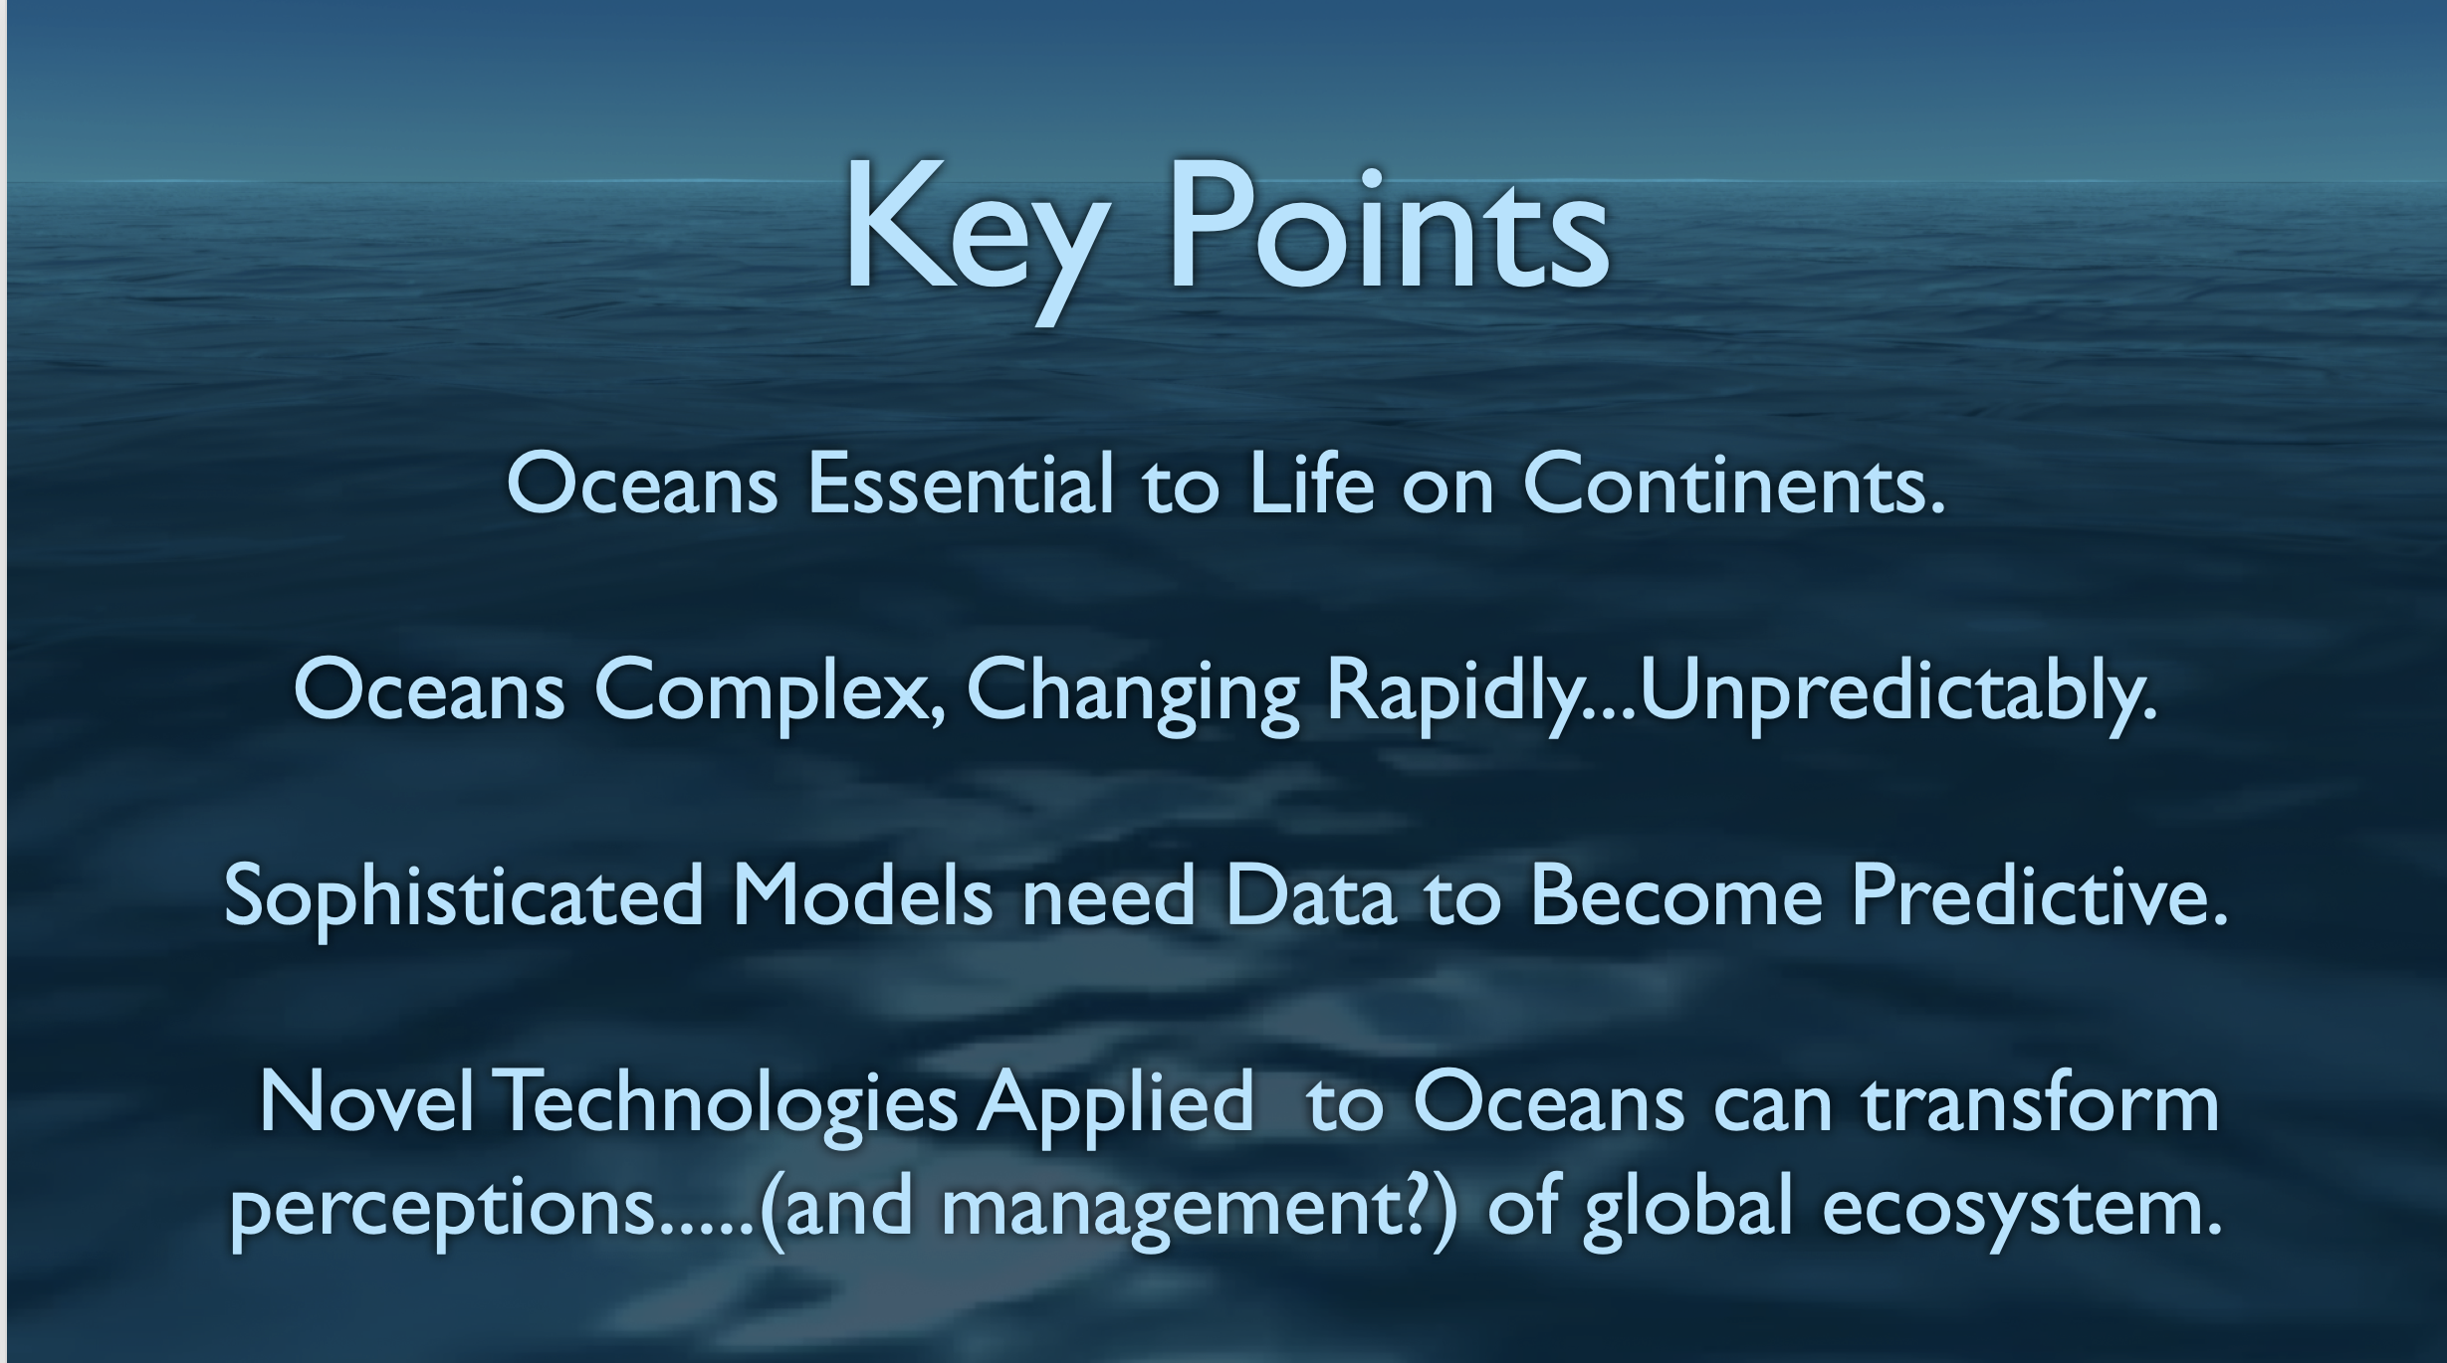
Key Points
Wanted: One shovel ready project that delivers a sustained, research-driven, ocean observing capability.
What should such a system be comprised of?

Slide 7
Wanted: One shovel ready project that delivers a sustained, research-driven, ocean observing capability.
What should such a system be comprised of?

Slide 8
A System of Systems Designed by the oceanographic community
Five active arrays united by a common cyberinfrastructure
Sensors measuring physical, chemical, geological and biological variables in the atmosphere, ocean, and seafloor
Fully integrated system collecting data on coastal, regional and global scales.
Short-term (episodic) & climate scale data (~30yrs)
Notes:
130 White Papers

Slide 9
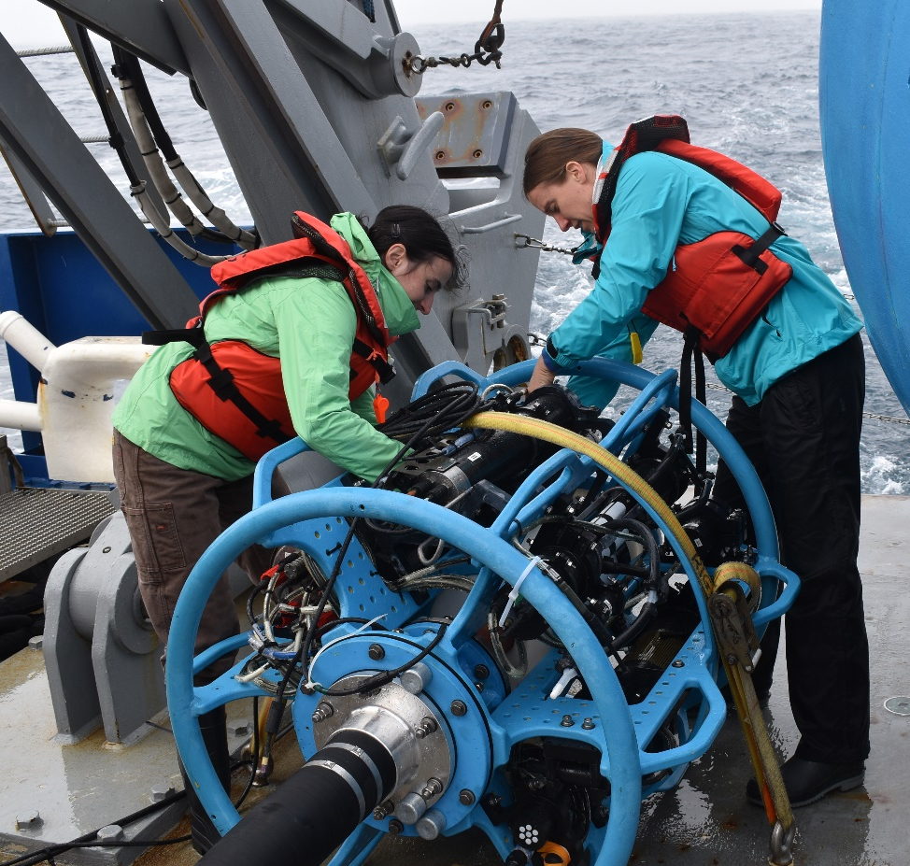
Our Mission
The OOI does not conduct research, the OOI provides research quality data to the user community (scientists, educators, and the public).

Slide 11
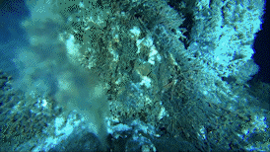
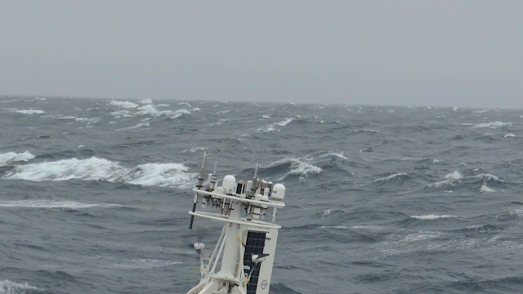
OOI operates & maintains sophisticated instrumentation in demanding locations
Hydrothermal Vents
Atmosphere Ocean Exchange

Slide 12
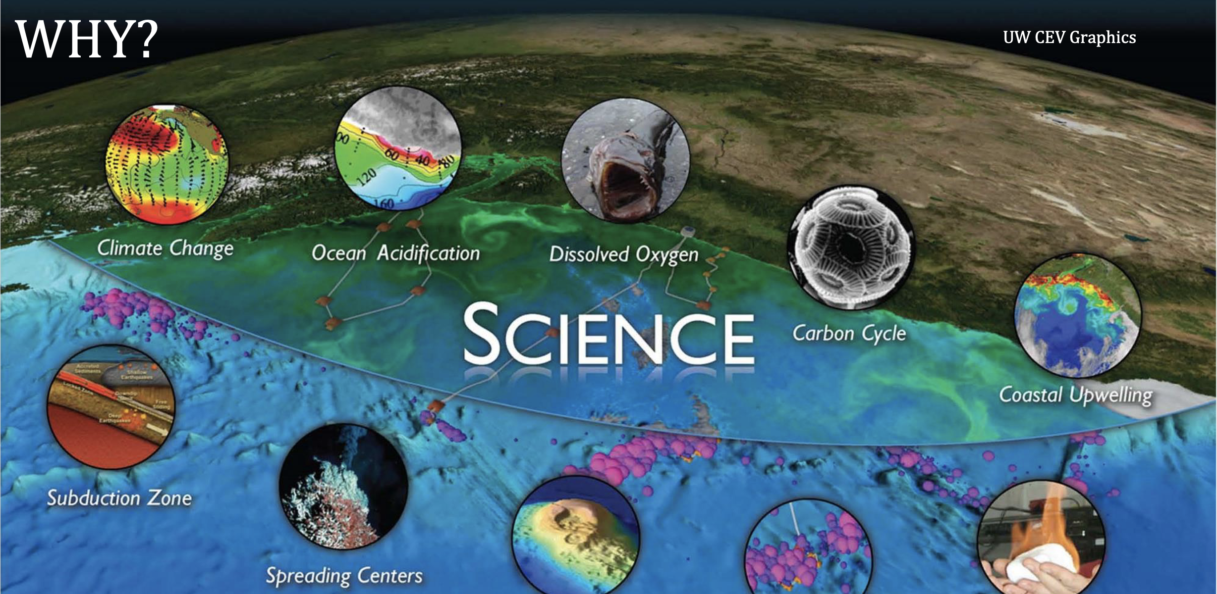

Slide 13
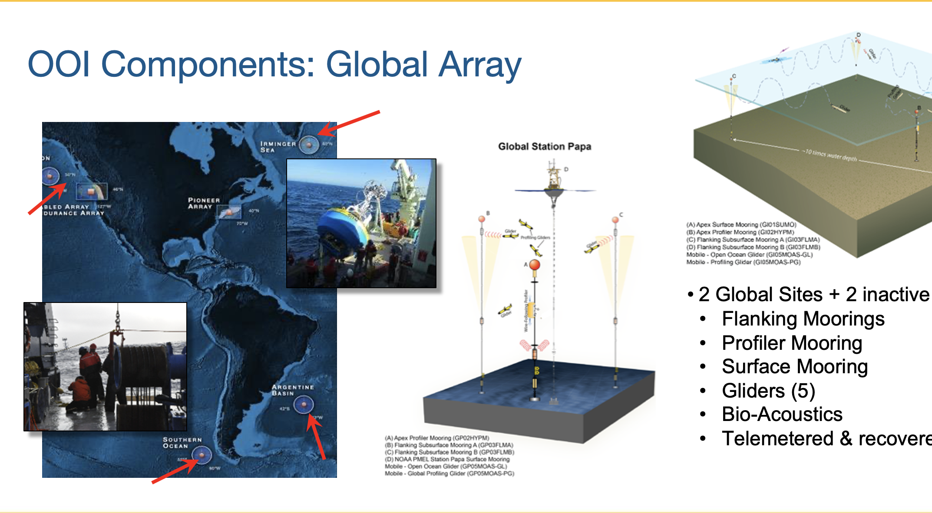
Notes:
Coastal Global Scales Node (CGSN) team heads to the Global Station Papa Array site. Papa is in the Gulf of Alaska, which is about 620 nautical miles from Seward, Alaska. This location is already occupied by the Ocean Station Papa surface mooring deployed by NOAA’s Pacific Marine Environmental Laboratory last month. This will be the 11th time the subsurface array will be refreshed so it continues to provide ocean data from a critical region of the northeast Pacific with a productive fishery subject to ocean acidification, low eddy variability, and impacted by the Pacific Decadal Oscillation.

Slide 14
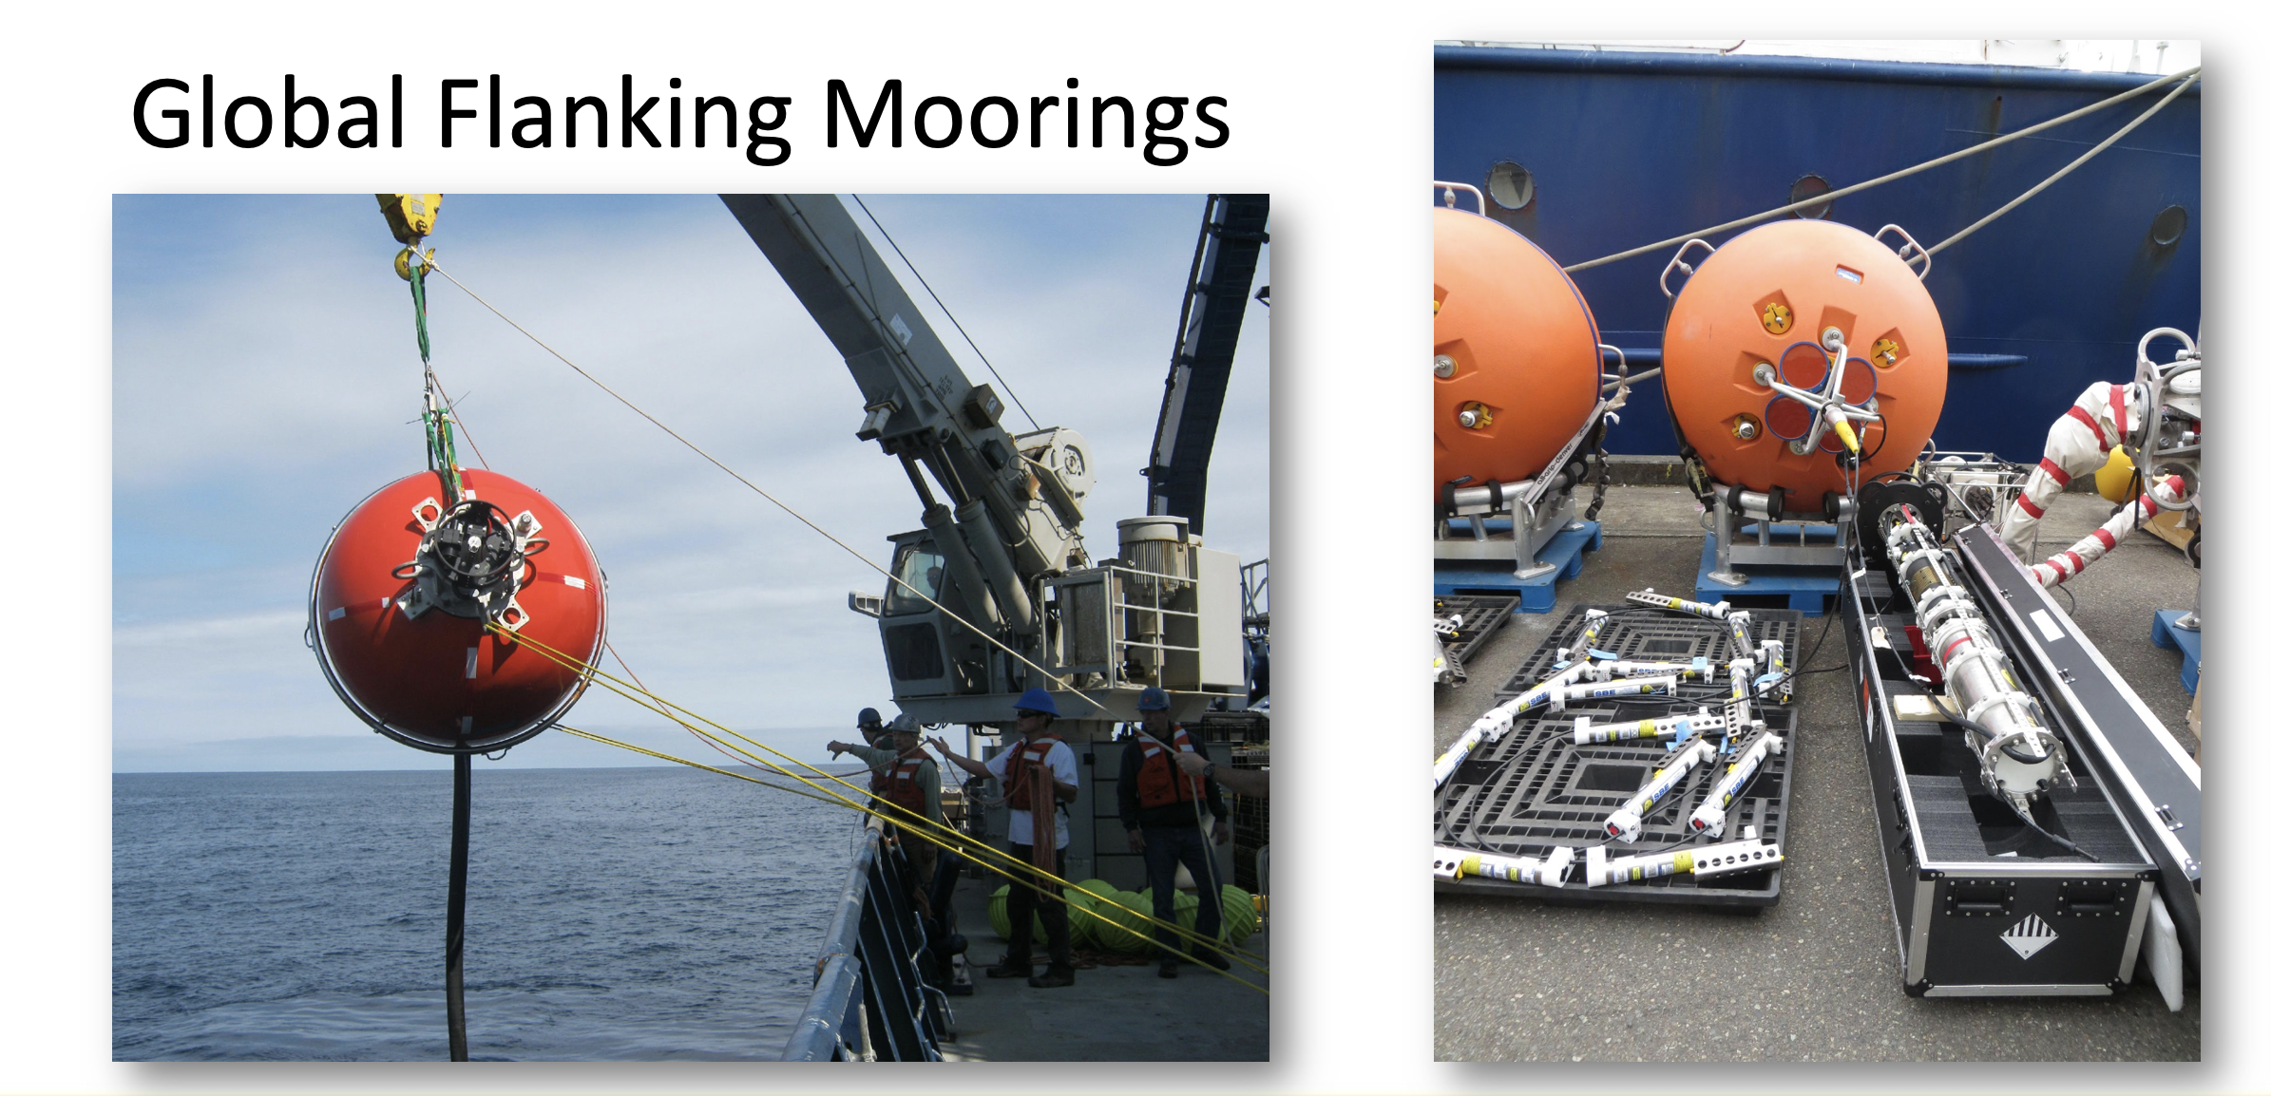

Slide 15
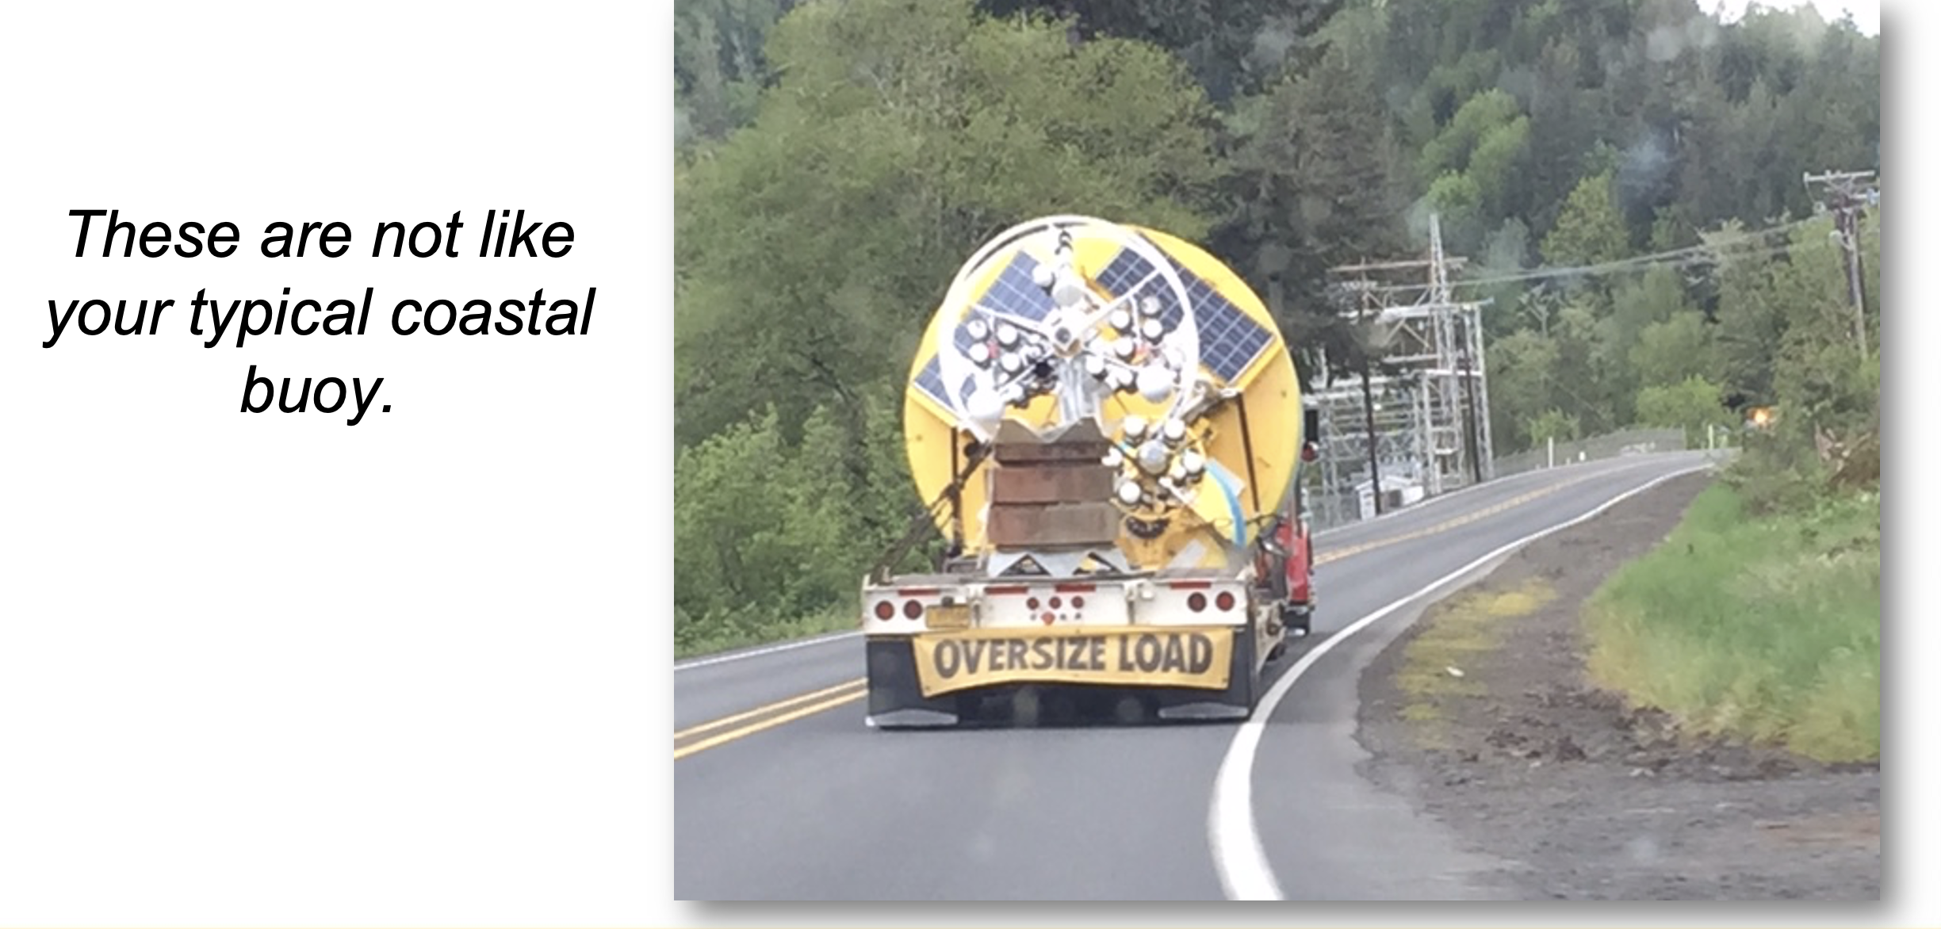
Notes:
The surface and subsurface elements of the array are in a region with high wind and large surface waves; strong atmosphere-ocean exchanges of heat, momentum, energy and gases; carbon dioxide sequestration; high biological productivity; and an important fishery. It is one of the few places on Earth with deep-water formation that feeds the large-scale thermohaline circulation.

Slide 16
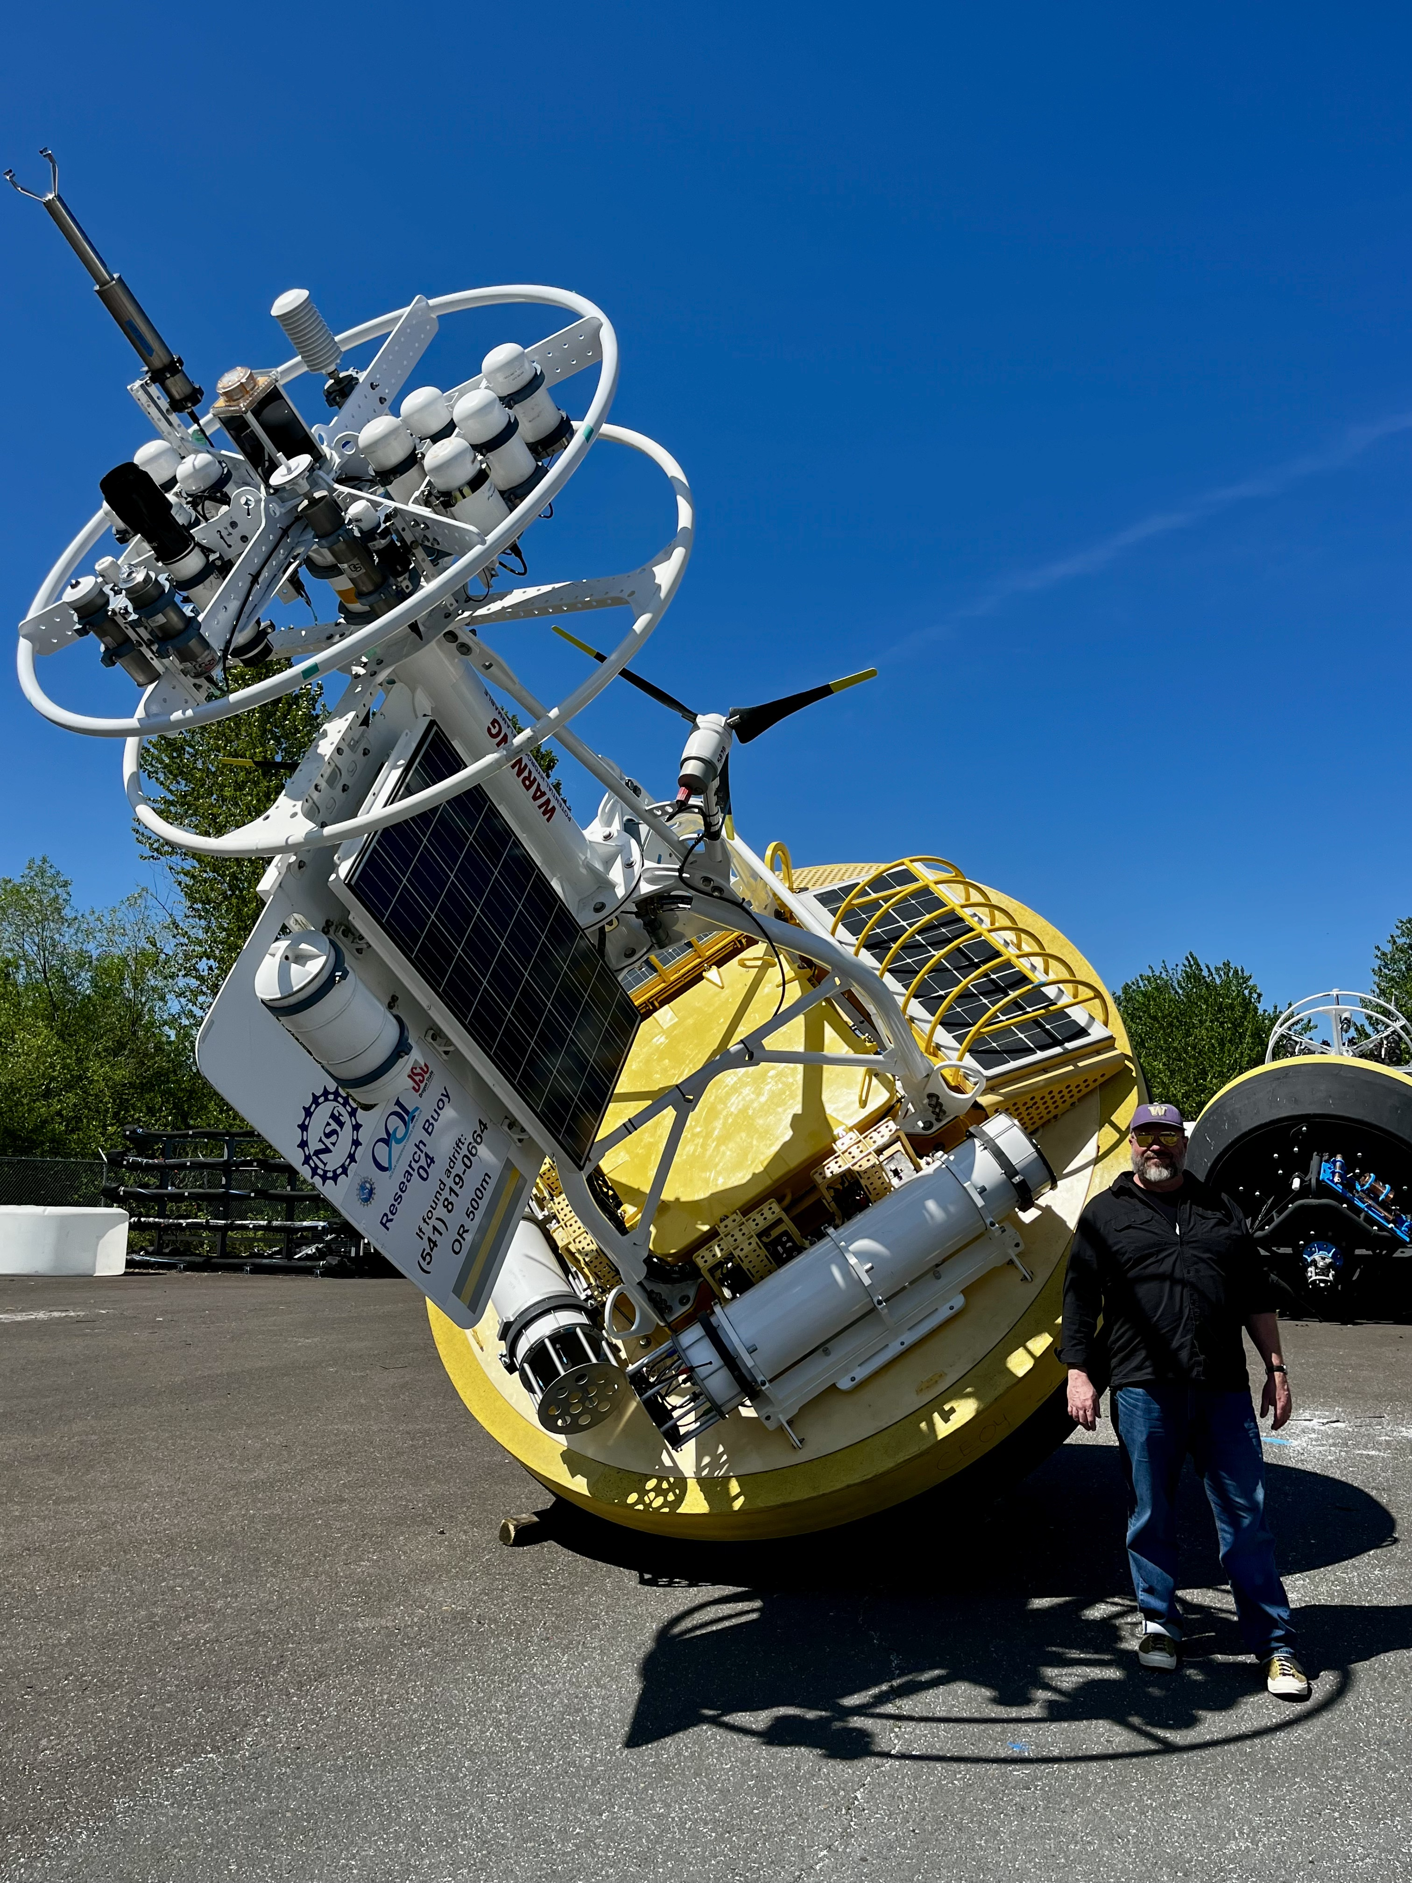
They are Big!

Slide 17
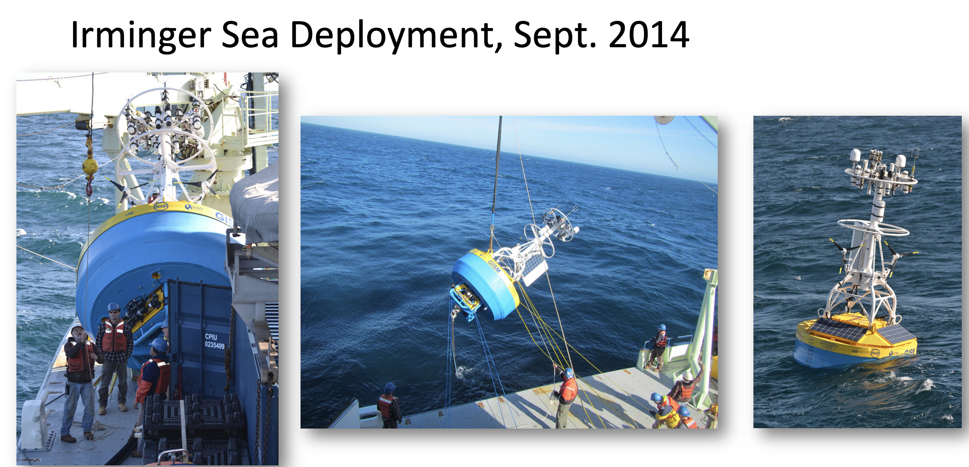

Slide 18
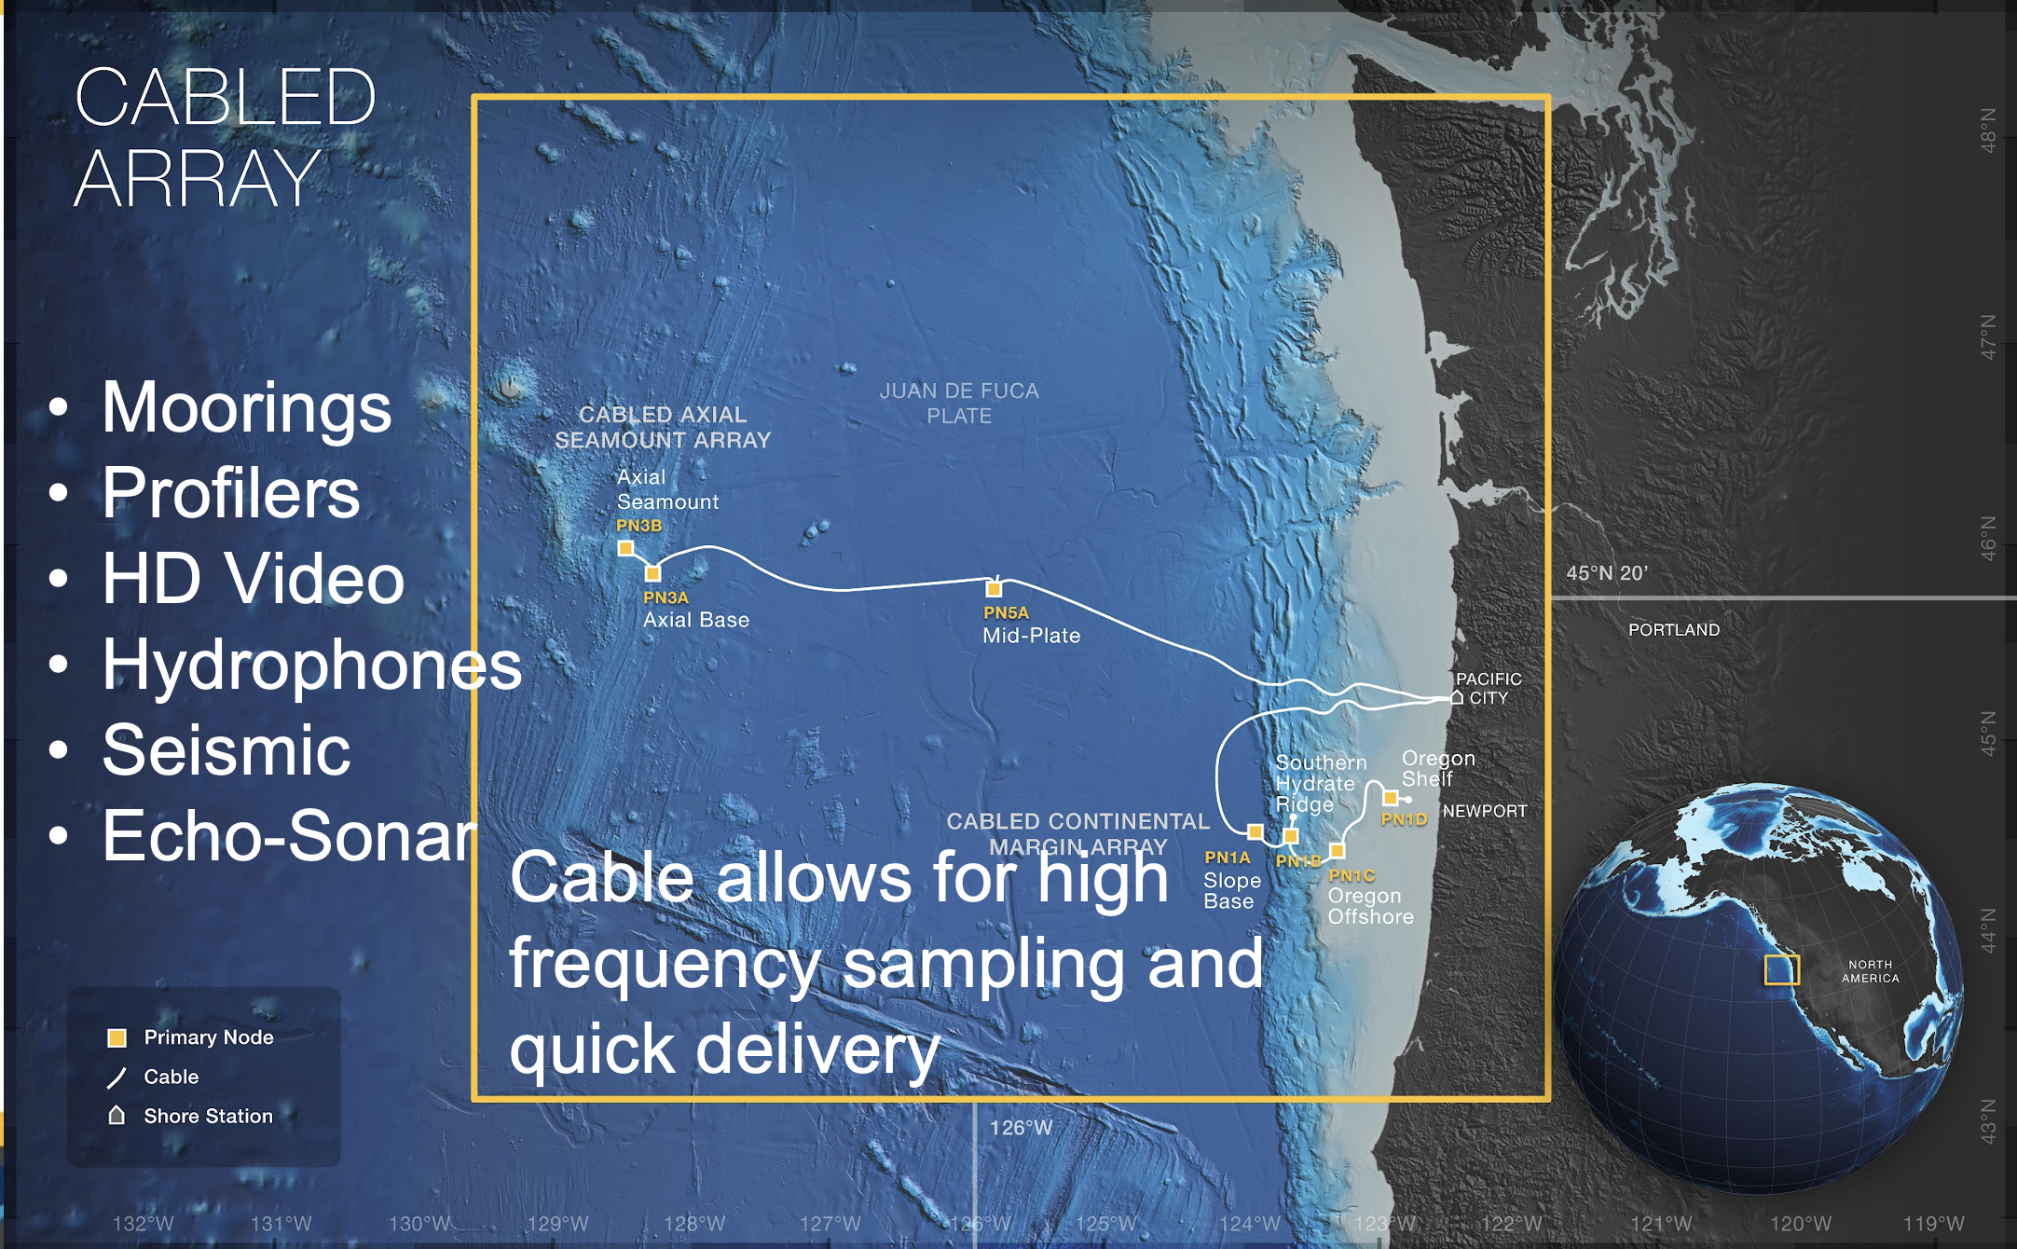

Slide 19
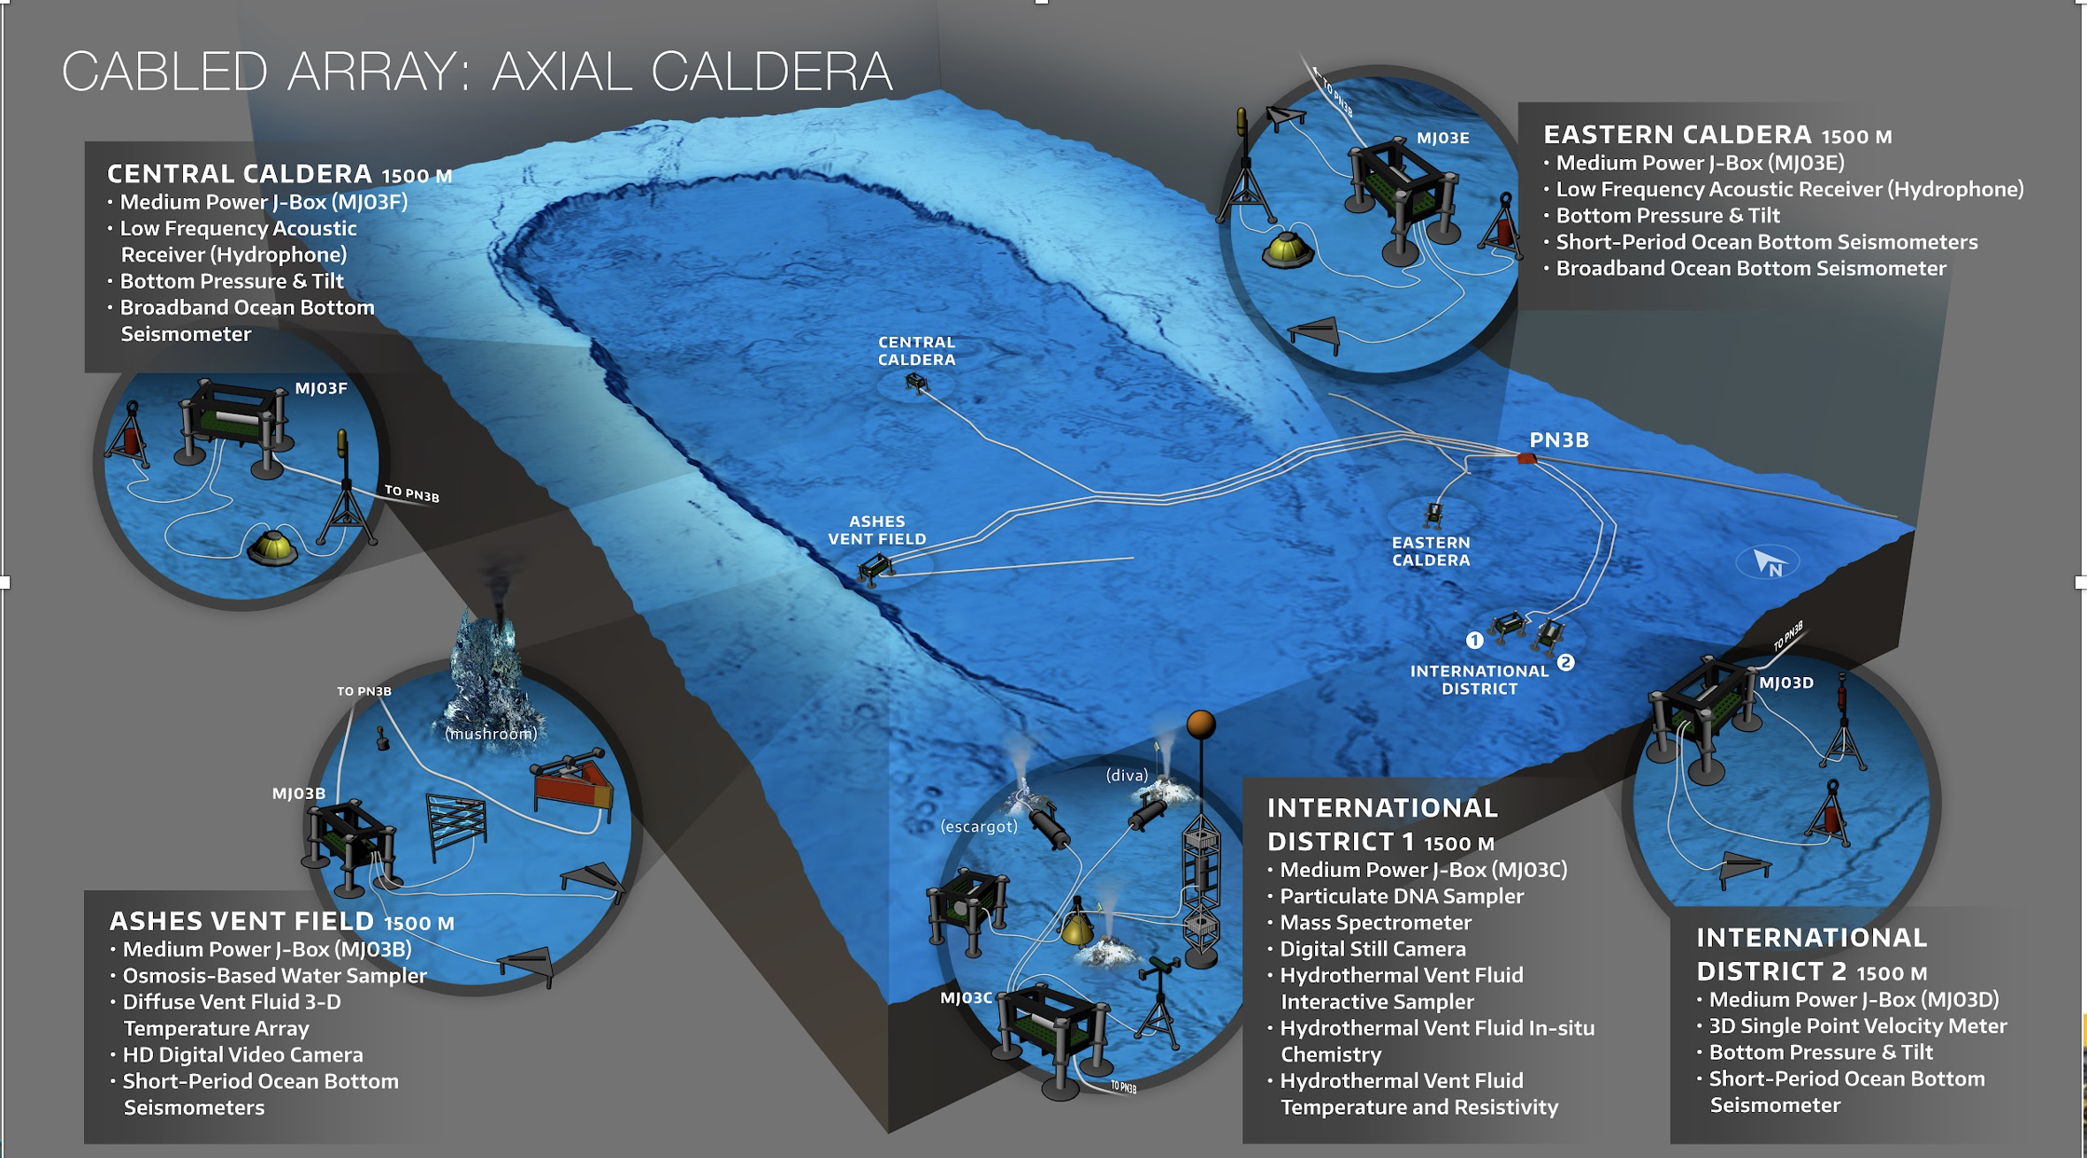

Slide 20
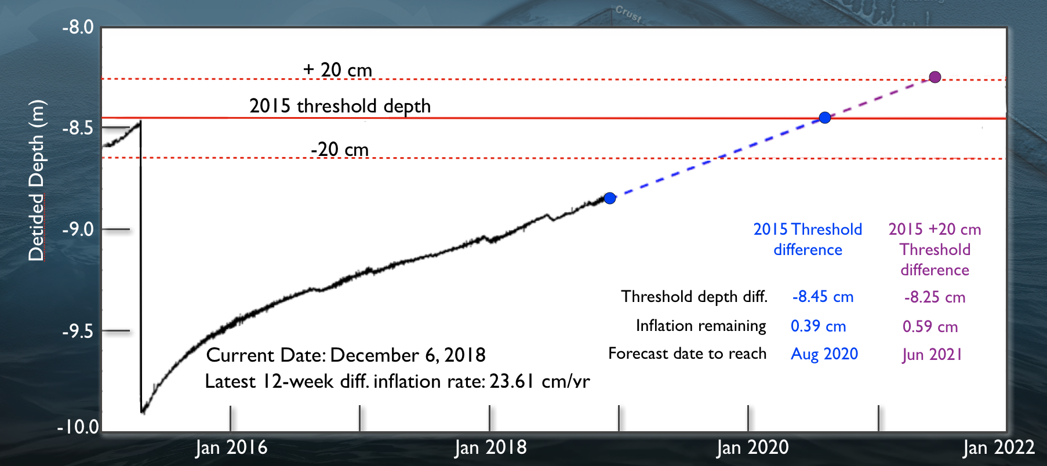
Axial Seamount Prediction
First place in world ocean where a submarine eruption can be predicted and tested.

Slide 21
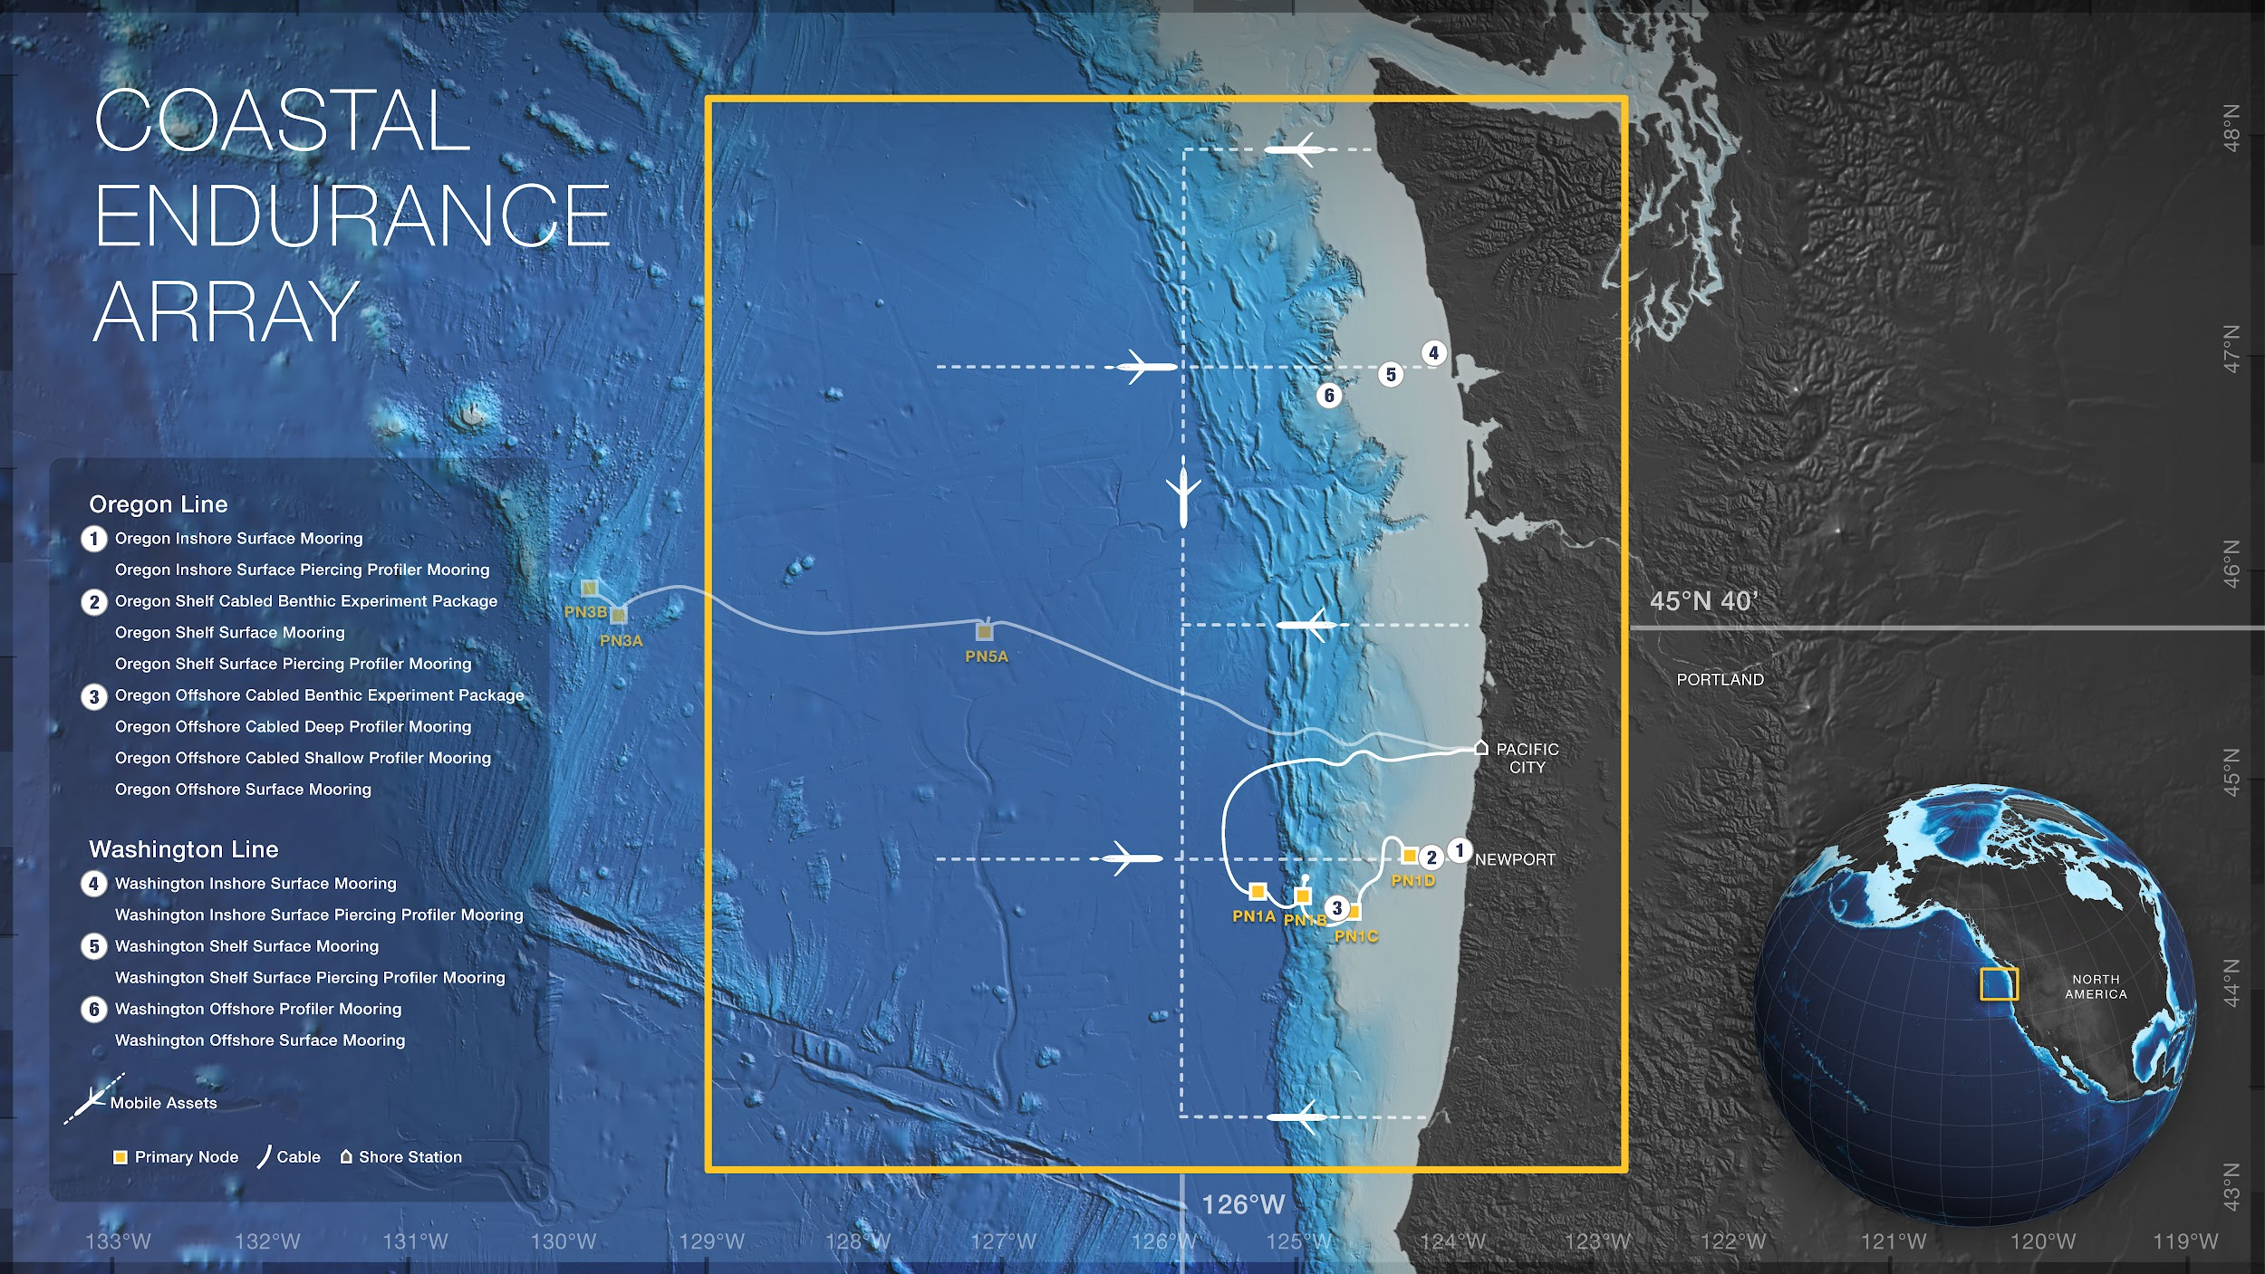
Glider AUVs
Moorings
Profilers
Meta data
Telemetered & recovered
Notes:
There are two coastal arrays… One is called the Endurance array. And the idea was that in one coastal area we should have a fixed timeseries The choice was to sample the evolution of the California current.
Examining the structures of the ecosystems along the western seaboard.
Fixed arrays with moorings and profilers
Different types of data latency based on your real time framework.
Sampling volumes with the glider.

Slide 22
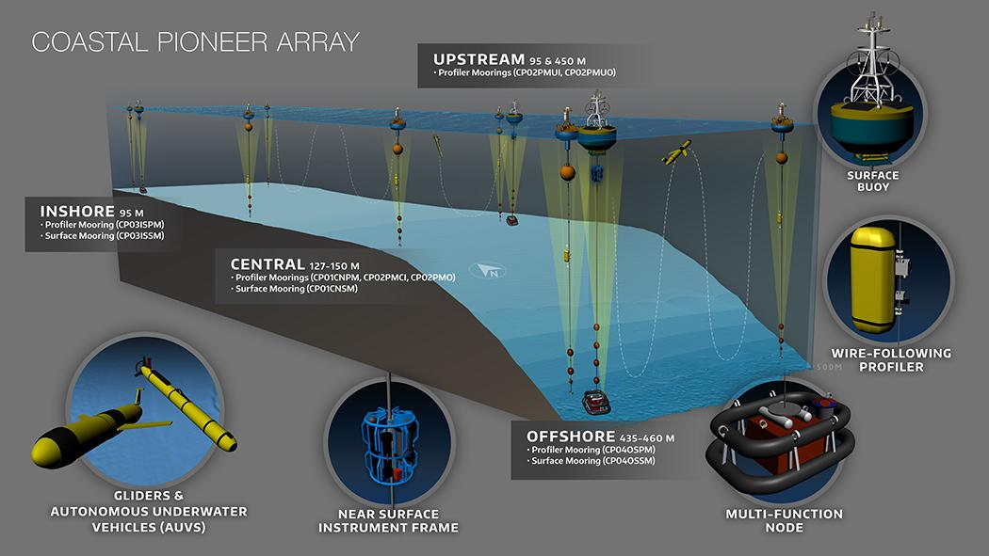

Pioneer MAB/ NES
The Pioneer Array was conceived within OOI as a re-locatable, coastal array suitable for moderate wave and current regimes on the continental shelf and upper slope.
Deployed on the New England Shelf 2016-2022
Relocated to the southern MAB offshore of North Carolina in April 2024
A community workshop will be held in Sep 2024 to inform and engage users.
Notes:
That’s the whole story in one slide!
I will provide more details on the process, timeline, and array design
*Initially deployed late 2013, but not full array. 7 year run from 2016-2022

Slide 23
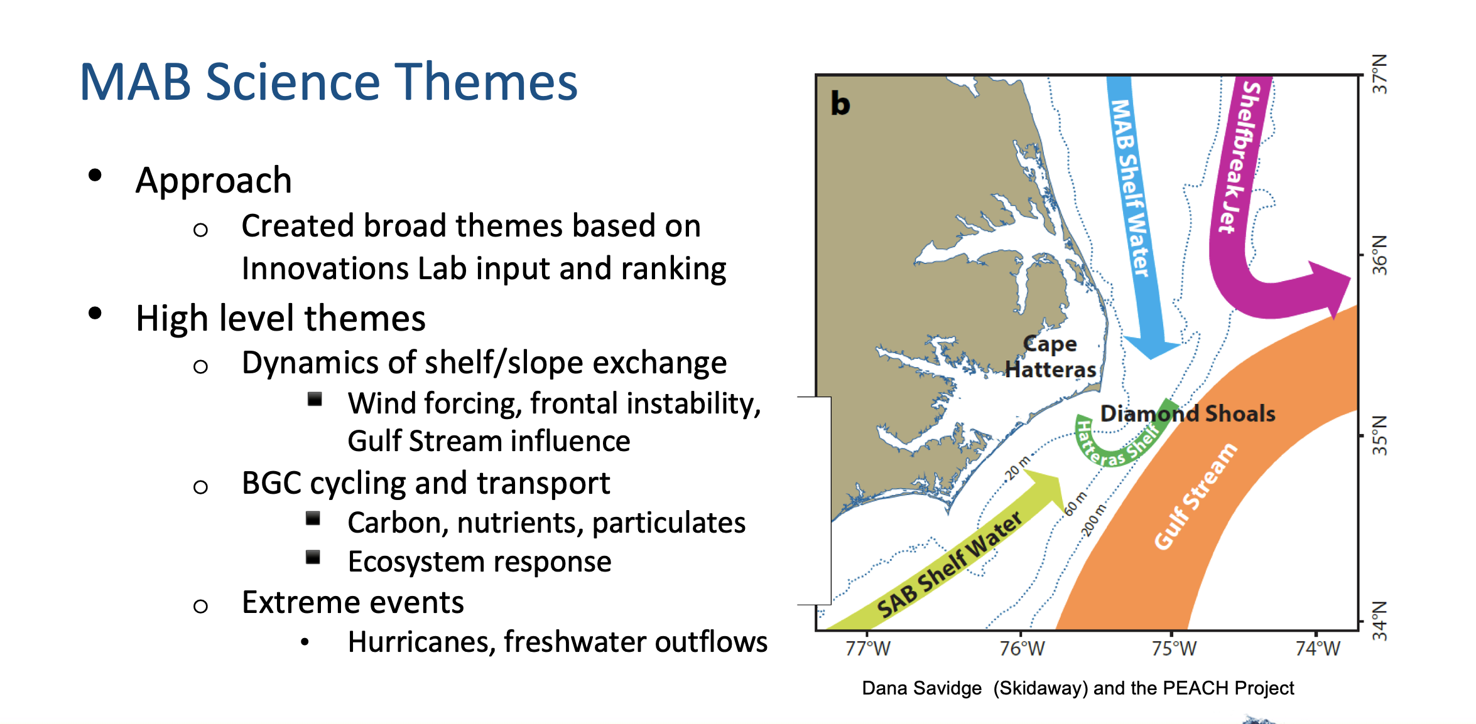

Slide 24
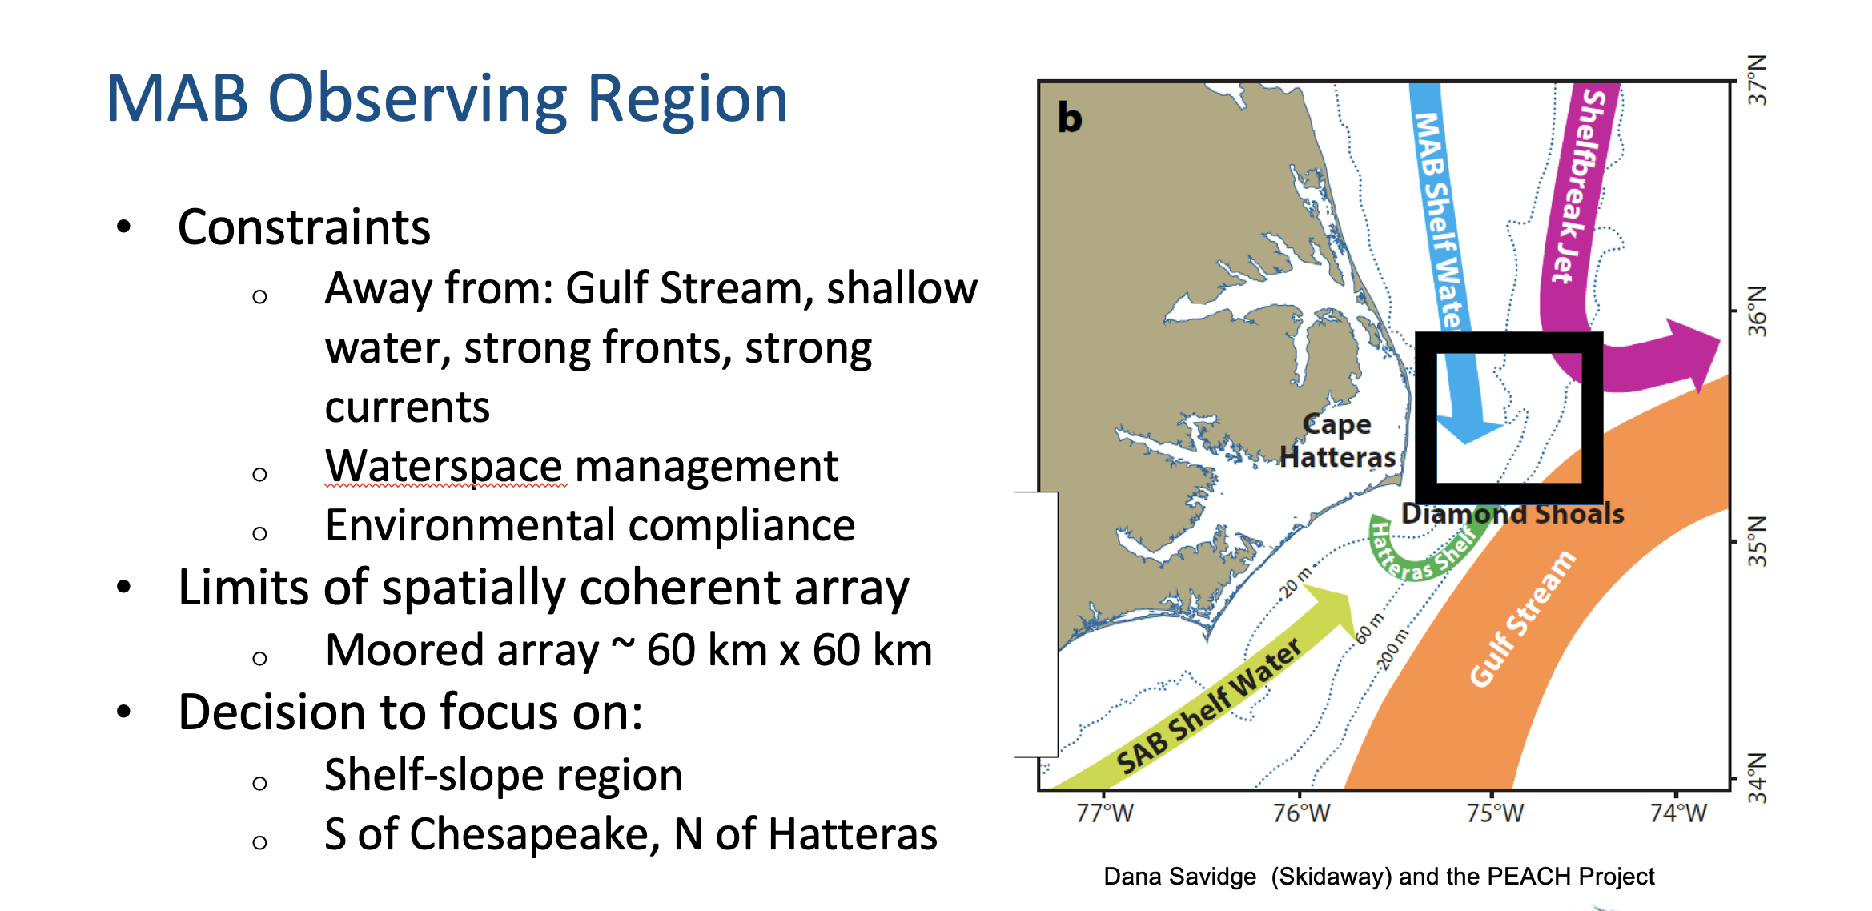

Slide 25
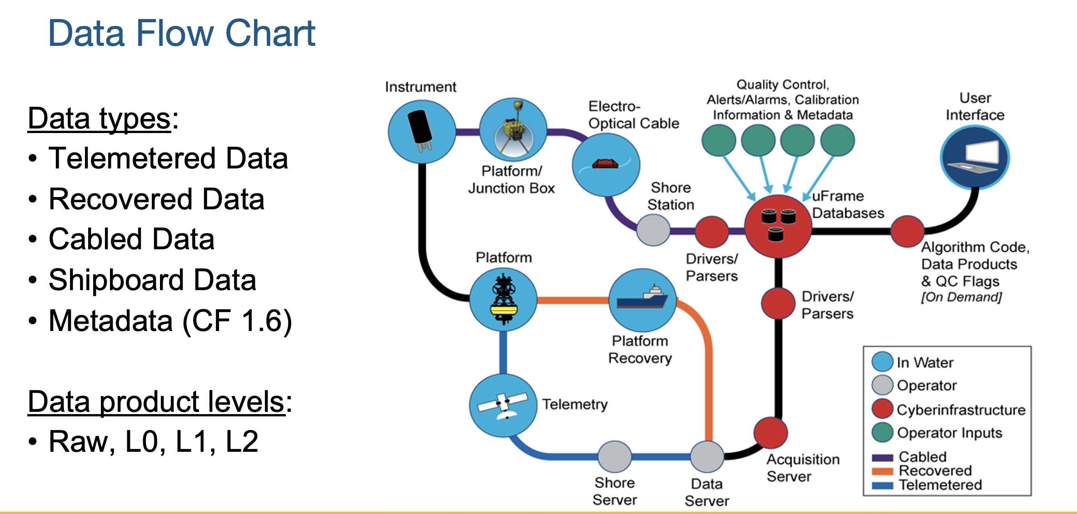

Slide 26
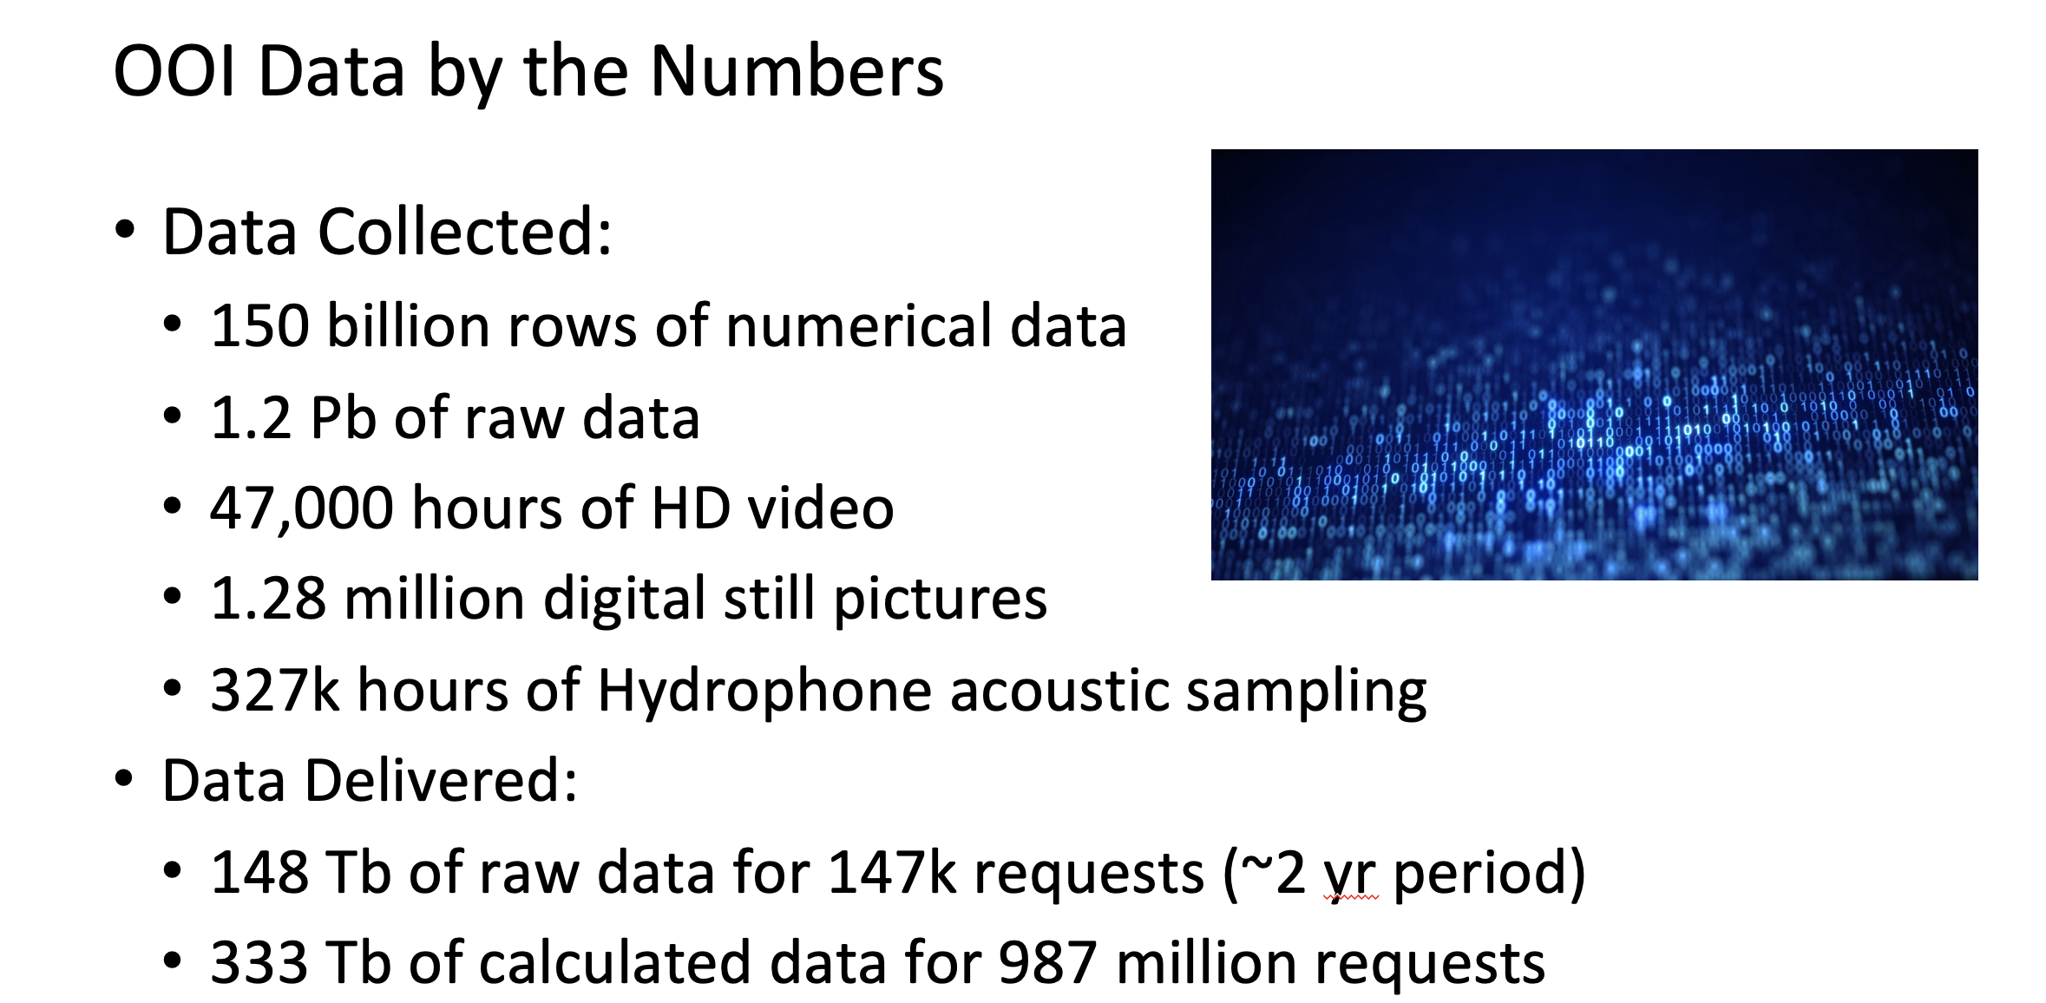

Slide 27
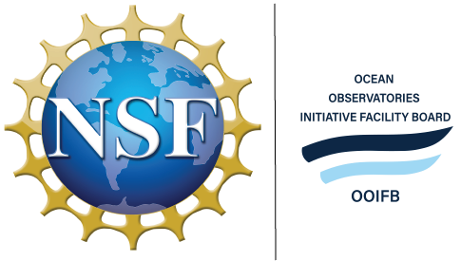
OOIFB - Engaging the Observing Community
Update/Discussion: IFCB Community Focus Group, June 2025 (UNC Wilmington)
  Pioneer MAB Community Workshop Follow-up Event
  June 18-20, 2025
  20-25 new/experienced IFCB users
  Goal(s):
    Demonstrate/show an onramp to OOI-IFCB data
    Work through use-case scenarios (what does/doesn’t work)
    Have a conversation about community expectations for OOI, and OOI expectations for the community

Slide 28
Engaging the Observing Community
Update/Discussion: July 2025 Summer School on Acoustics (U Washington)
  Dates: July 14-18, 2025
  Co-chairs: Shima Abadi and Wu-Jung Lee
  Focus: passive and active acoustics. 25 participants to finish the 5-day program with:
    A high level understanding of how sound propagates under water and the main factors influencing propagation.
    An awareness of passive and active acoustic instruments deployed through NSF OOI (e.g. hydrophones and echosounders) and the data sets available.
    The ability to navigate NSF OOI data portals to access and download acoustic and oceanographic data products.
    Basic processing methods for acoustic data (including coding, and working with data in JupyterHub environments).
    A comprehensive understanding about what scientific questions can be addressed using NSF OOI data.
    Connections to a network of professionals who are using or planning to use NSF OOI data in their research and education activities.

Slide 29
Engaging the Observing Community
Update: AGU 2025 (New Orleans, LA)
  December 15-19, 2025 (abstract submitted; hear back in June if accepted, scheduled in October)
  Axial Seamount focus (keynote presentation[s] and potential lightning talks)
      Title: Inevitable Eruption? An Ocean Observatories Initiative Facility Board (OOIFB) Town Hall to Discuss the Status of Axial Seamount
  Potential for an ECS style luncheon event (no offsite TH sessions)
Future plans/ideas for Early Career Scientist (ECS) engagement?

Slide 30
Engaging the Observing Community
Update: OSM 2026 (Glasgow, Scotland)
Special Session and TH abstracts due by May 28, 2025
Town Hall: broad observatory focus (Q&A session with scientists from diff observatories- have a conversation about challenges and opportunities)
Special Session: thematic to ocean observing in the North Atlantic
Potential collaborations:
Discussion: other engagement opportunities (scientific and engineering communities)?

Slide 31
Questions?

