Slide 1
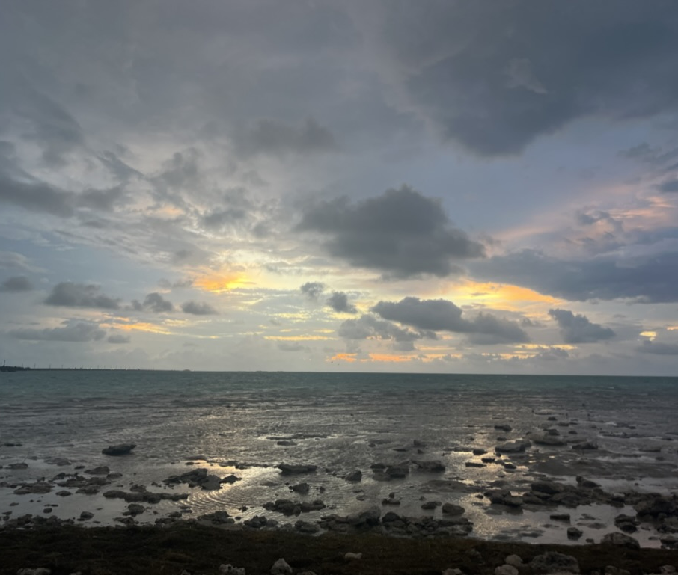
Learning Cycles
Troy Sadler, Thomas James Distinguished Professor of Experiential Learning, University of North Carolina -Chapel Hill

Slide 2
Learning Cycles—Key Points
Instructional strategy—focuses on sequencing
Based on research about how people learn
Big ideas:
Learners explore ideas or phenomena before formal instruction
Learners have opportunity to apply what they learn in a new context

Slide 3
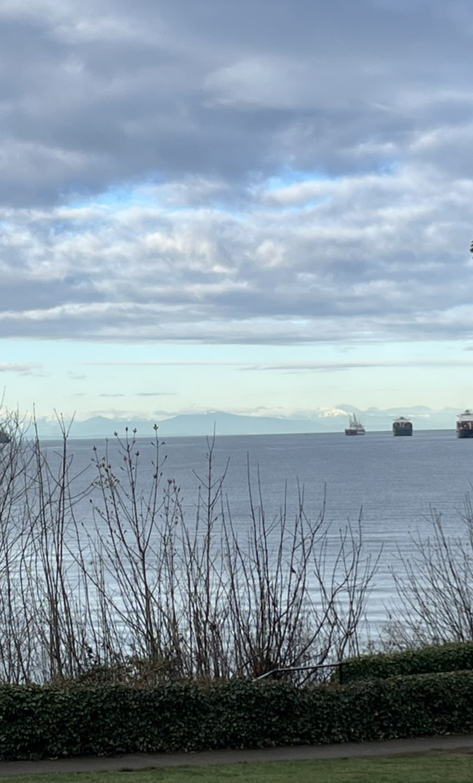
Learning Cycles—Background Info
Developed in 1950s
Several versions have been developed
Popularized in 1980s/90s by BSCS: 5E Model
Stage model for sequencing instruction
Stage variation
3-6
Could have more
Must have at 3

Slide 4
Learning Cycle—Basic
Learners explore an idea, concept, system or situation. They are challenged to figure something out.
Ex (HS): learners take apart an owl pellet with very limited directions.
Ex (UG): Read two contrasting article on benefits/concerns associated with nuclear power
Nonexample: Teaching basic concepts and then letting students explore
1- Explore
2- Explain/Introduce ideas/ Formalize concepts
3- Learner Application

Slide 5
Learning Cycle—Basic
Instructor works with learners to identify & explain concepts, new terms, issues, processes, etc.
Ex (HS): Teacher identifies owl pellets. Students use bone sorting chart. Introduce food web as a way to explain pellet.
Ex (UG): Students categorize benefits & risks of nuclear power. Instructor explains nuclear power generation
Consideration: Instructor & learners work together to build meaningful explanations.
1- Explore
2- Explain/Introduce ideas/ Formalize concepts
3- Learner Application

Slide 6
Learning Cycle—Basic
Learners use the ideas/concepts in a new way that forces them to apply their understandings.
Ex (HS): learners create a food web for an different ecological community.
Ex (UG): learners develop a plan for distribution of energy generation strategies for their state.
Nonexample: Answer questions about the exploration activity
1- Explore
2- Explain/Introduce ideas/ Formalize concepts
3- Learner Application

Slide 7
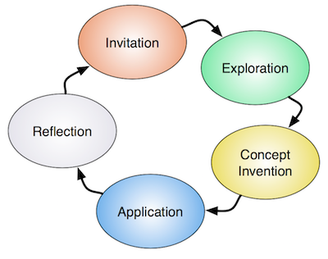
From OOI Learning Cycle Page
Explore
Invitation
Exploration
Concept Invention
Application
Reflection
Explain
Apply
https://datalab.marine.rutgers.edu/teaching-with-data/the-learning-cycle/

Slide 8
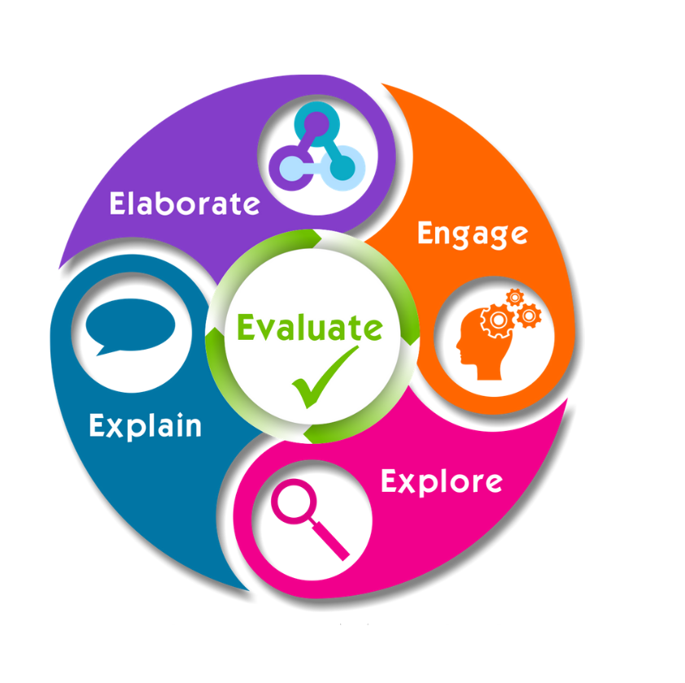
5E Learning Cycle
Engage
Explore
Explain
Extend
Evaluate

Slide 9
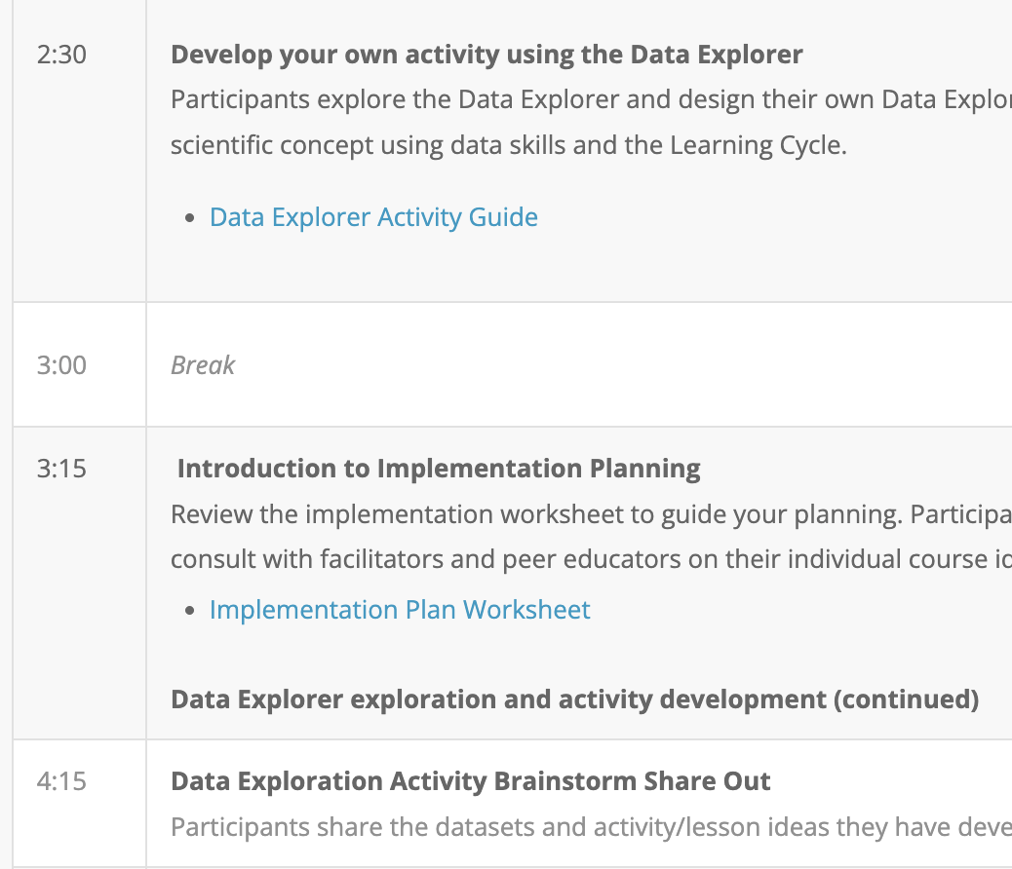
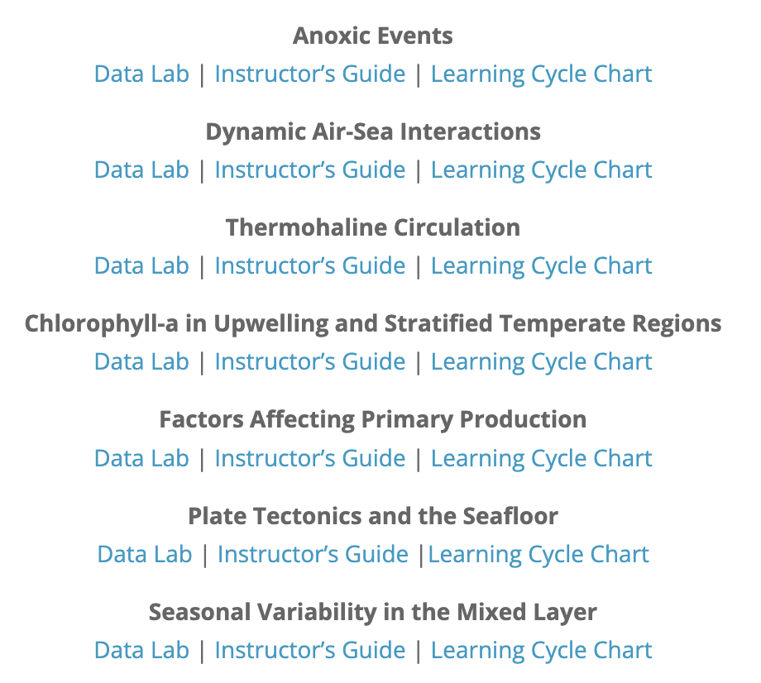
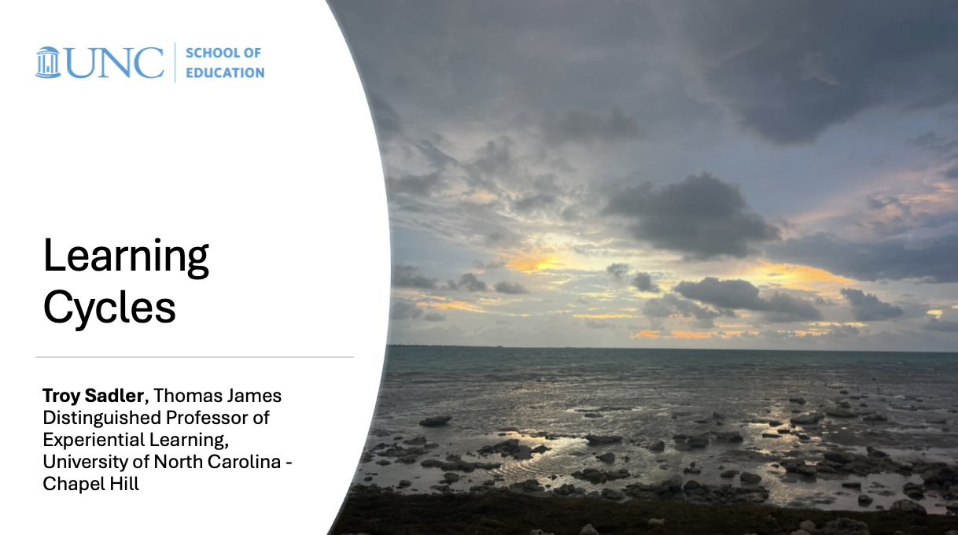
Learning cycle about learning cycles…
Explore OOI lessons structured as learning cycles
Introduce/explain learning cycles
Use the data explorer to create a learning cycle lesson for your students

Slide 10
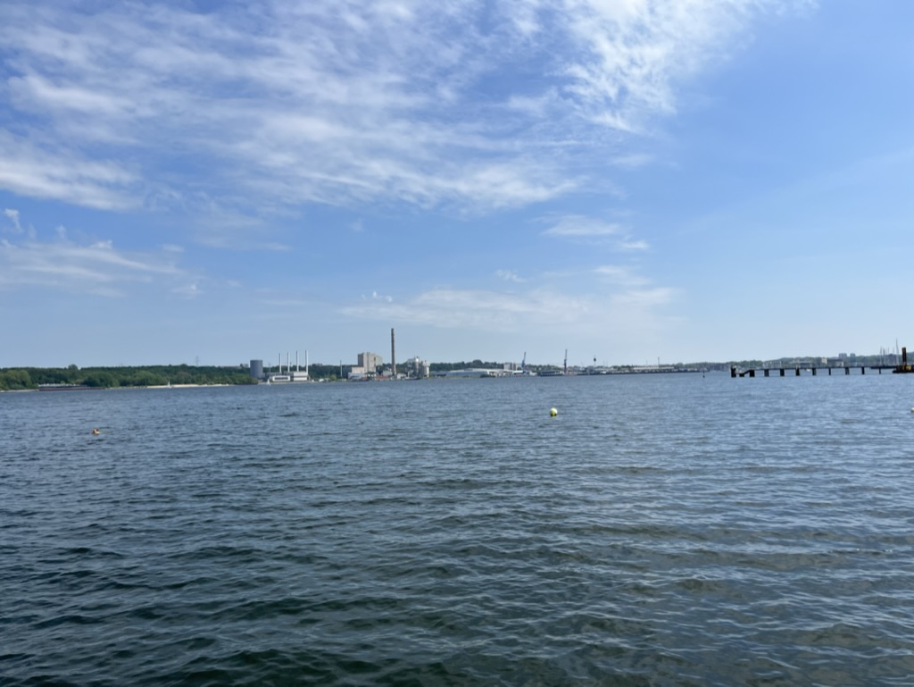
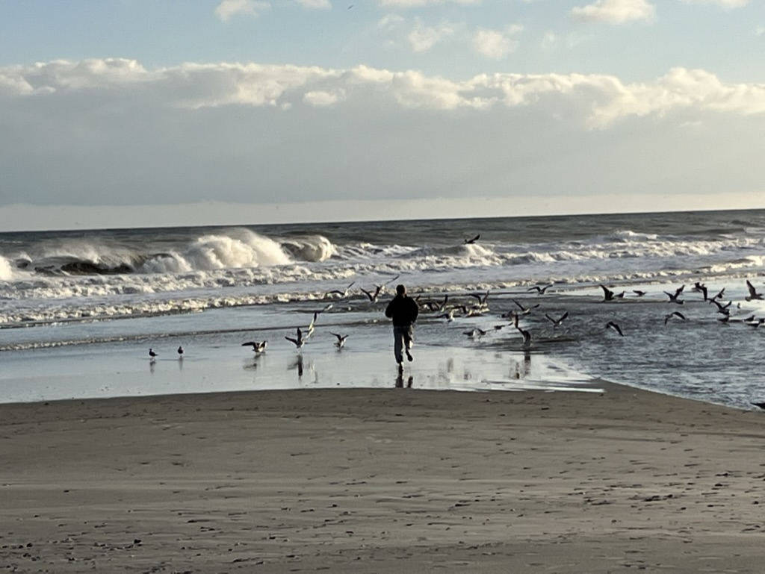
Thanks
tsadler@unc.edu

