Slide 1
Goals of the lab manual
Build data literacy and critical thinking skills in undergraduate students using authentic (“messy”) scientific data
Engage students with data activities that reinforce student confidence in scientific questioning, data analysis, and synthesis
Provide a real-world context for key concepts in oceanography

Slide 2
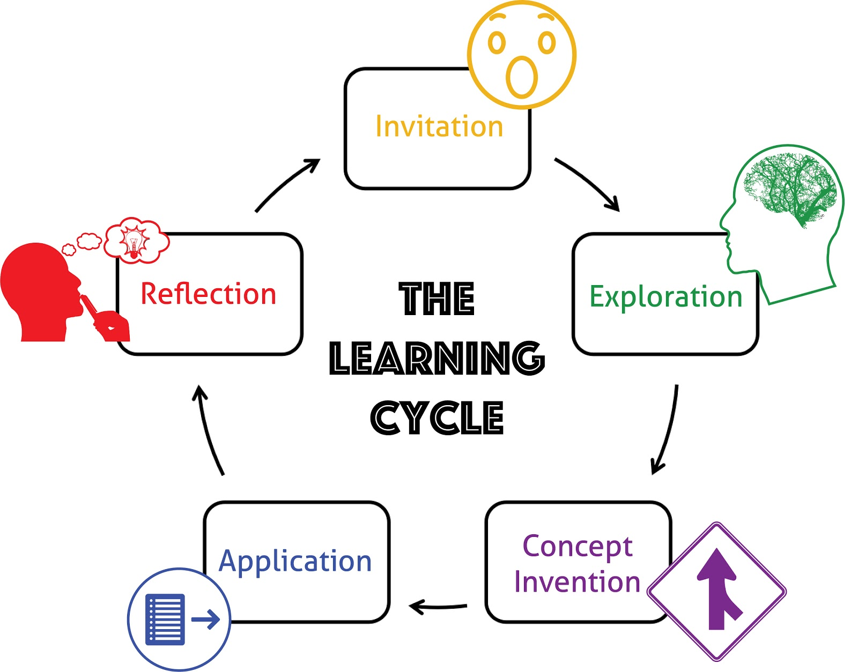
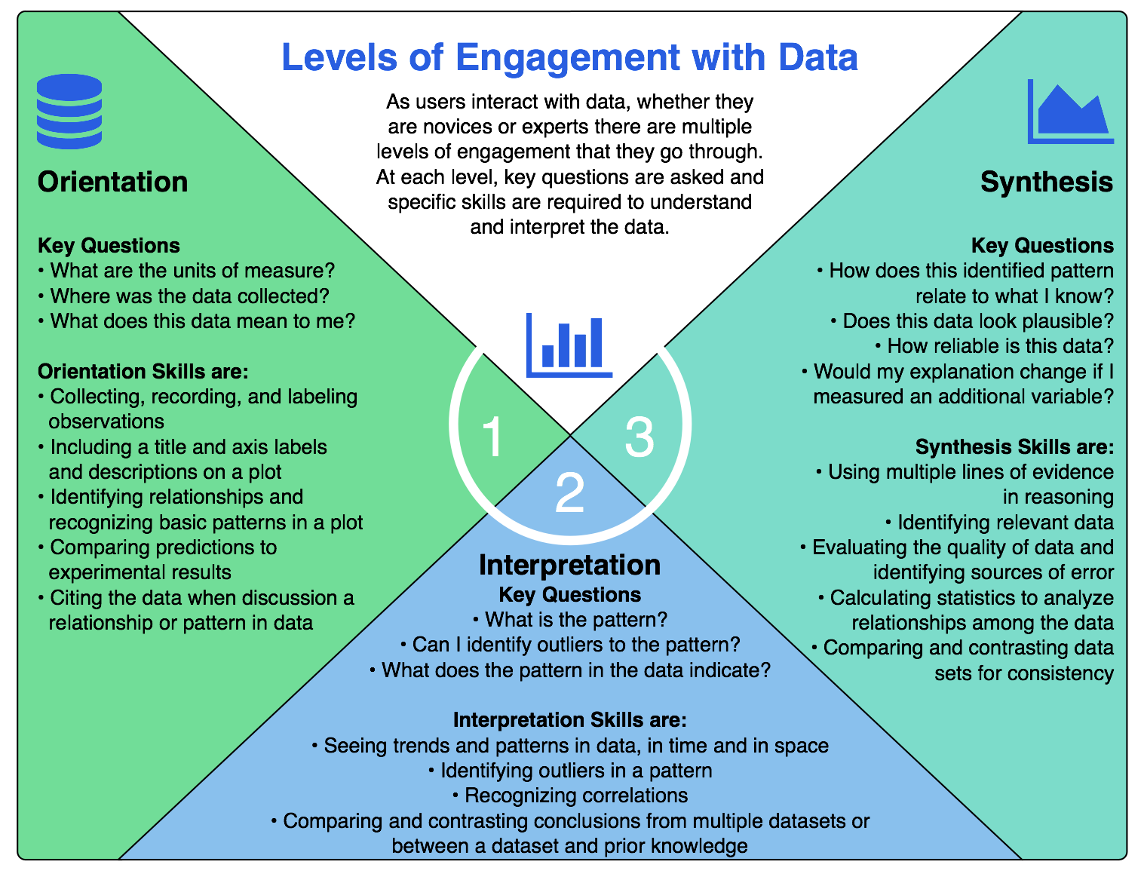
Design of data activities - Based in learning science:
University of California Lawrence Hall of Science
Hotaling et al. (2019)
Notes:
focus on adapted levels of engagement

Slide 3
Ocean Data Lab Manual Structure
Explore/ Engage
Invitation
Reflection
Orientation
Application
Interpretation

Slide 4
Invitation
Sets the context of the activity
Overarching authentic scientific ‘hook’ or concept story to catch students’ attention and pique interest
Helps to incorporate prior knowledge
Motivation for students – anticipation and attention for activity

Slide 5
Orientation
Guiding the novice data user by questions that mimic how experts view the data
Introduce data visualizations with review of data skills:
data source
variables and units
graph axes (including scales)
maxima and minima
gaps and outliers

Slide 6
Interpretation
Guided questions to describe the data and identify trends and relationships
Interpret data (without speculation):
identify patterns
trends
correlation

Slide 7
Application
Apply knowledge of key concepts to the data, make conclusions and explanations
Apply concept knowledge from textbook
recognize correlation vs. causation
compare to known pattern
develop hypothesis or conclusion, supported by evidence from the data

Slide 8
Reflection
Elaborate the greater implications of the data to other scientific phenomenon or real-world scenarios
Analyze data limitations
Relate to known phenomenon
Evaluate implications of trends or patterns
Connect to practical applications
Relate to other scenarios

Slide 9
Lab manual chapters
Lab 1 - Intro to OOI & science | Lab 7 - Water masses
Lab 2 - Charts and mapping | Lab 8 - Storm and waves
Lab 3 - Data skills (graph types) | Lab 9 - Primary productivity*
Lab 4 - Plate tectonics | Lab 10 - Anoxic events
Lab 5 - Volcanic eruptions | Lab 11 - Ocean acidification*
Lab 6 - Density stratification | Lab 12 - Forest fires*
*Python activities in development

Slide 10
Instructions
Move to one of the four topic tables
~4 new participants per table
~2 authors per table
Find your lab chapter link in the workshop agenda
Discuss the activity flow and content
Add your comments to the Lab Feedback Form

