Slide 1
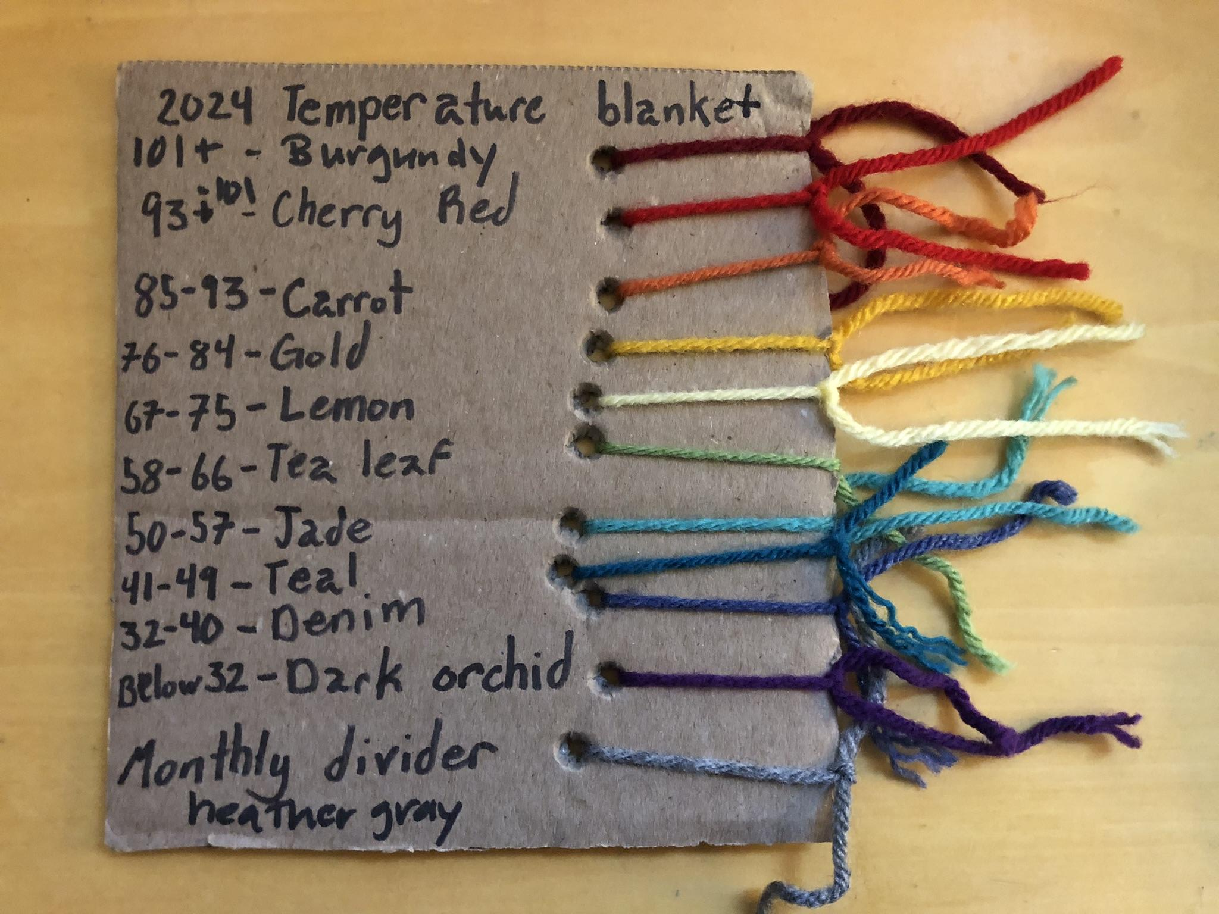
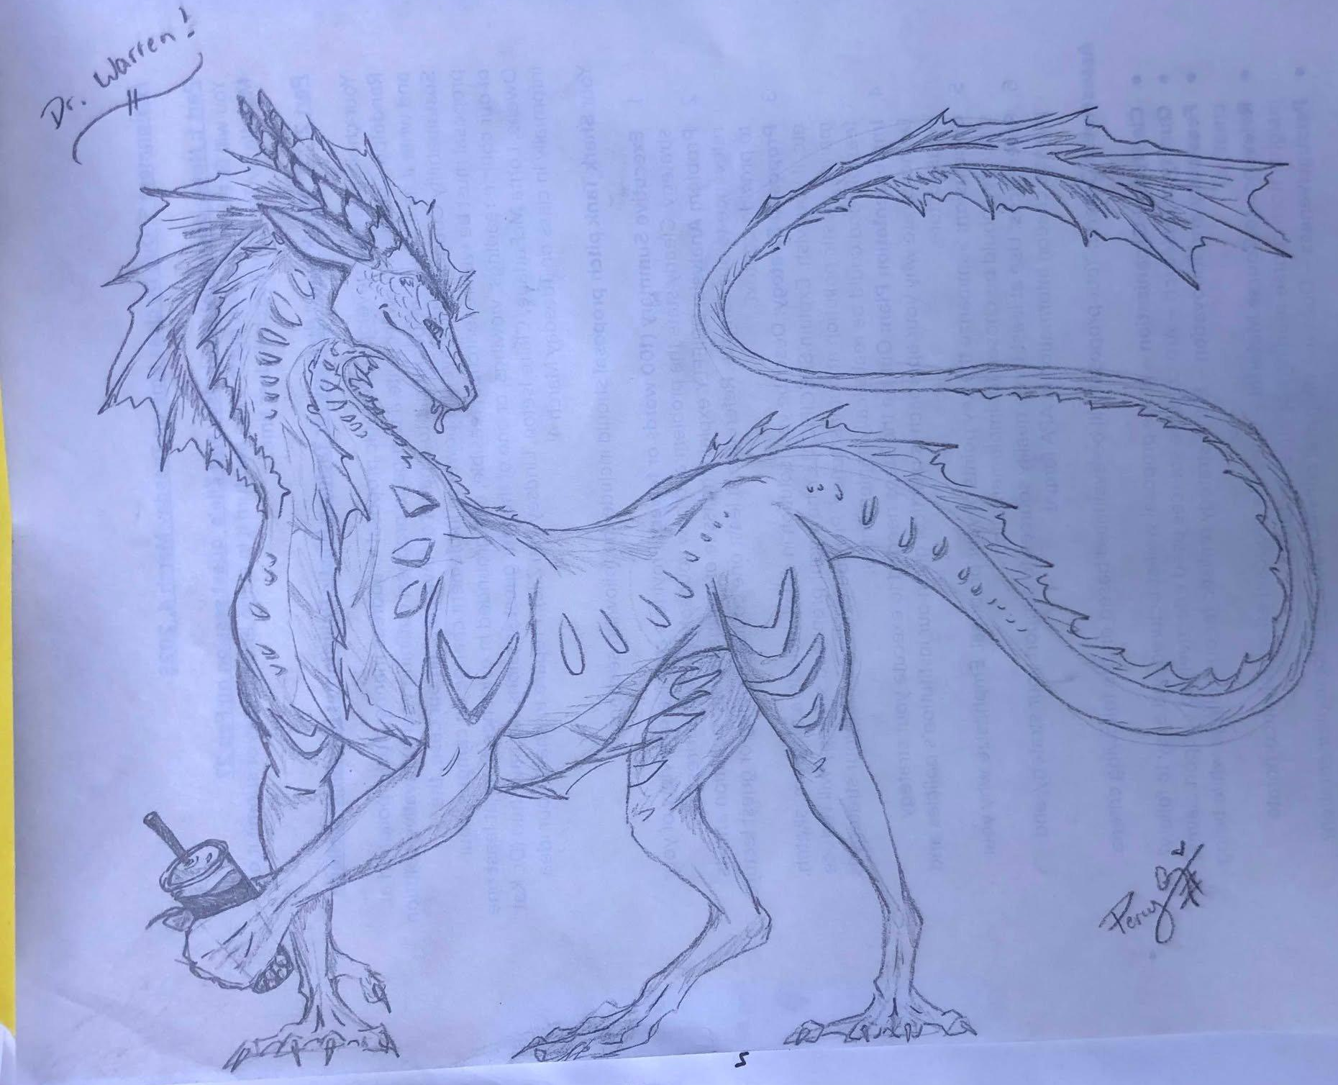
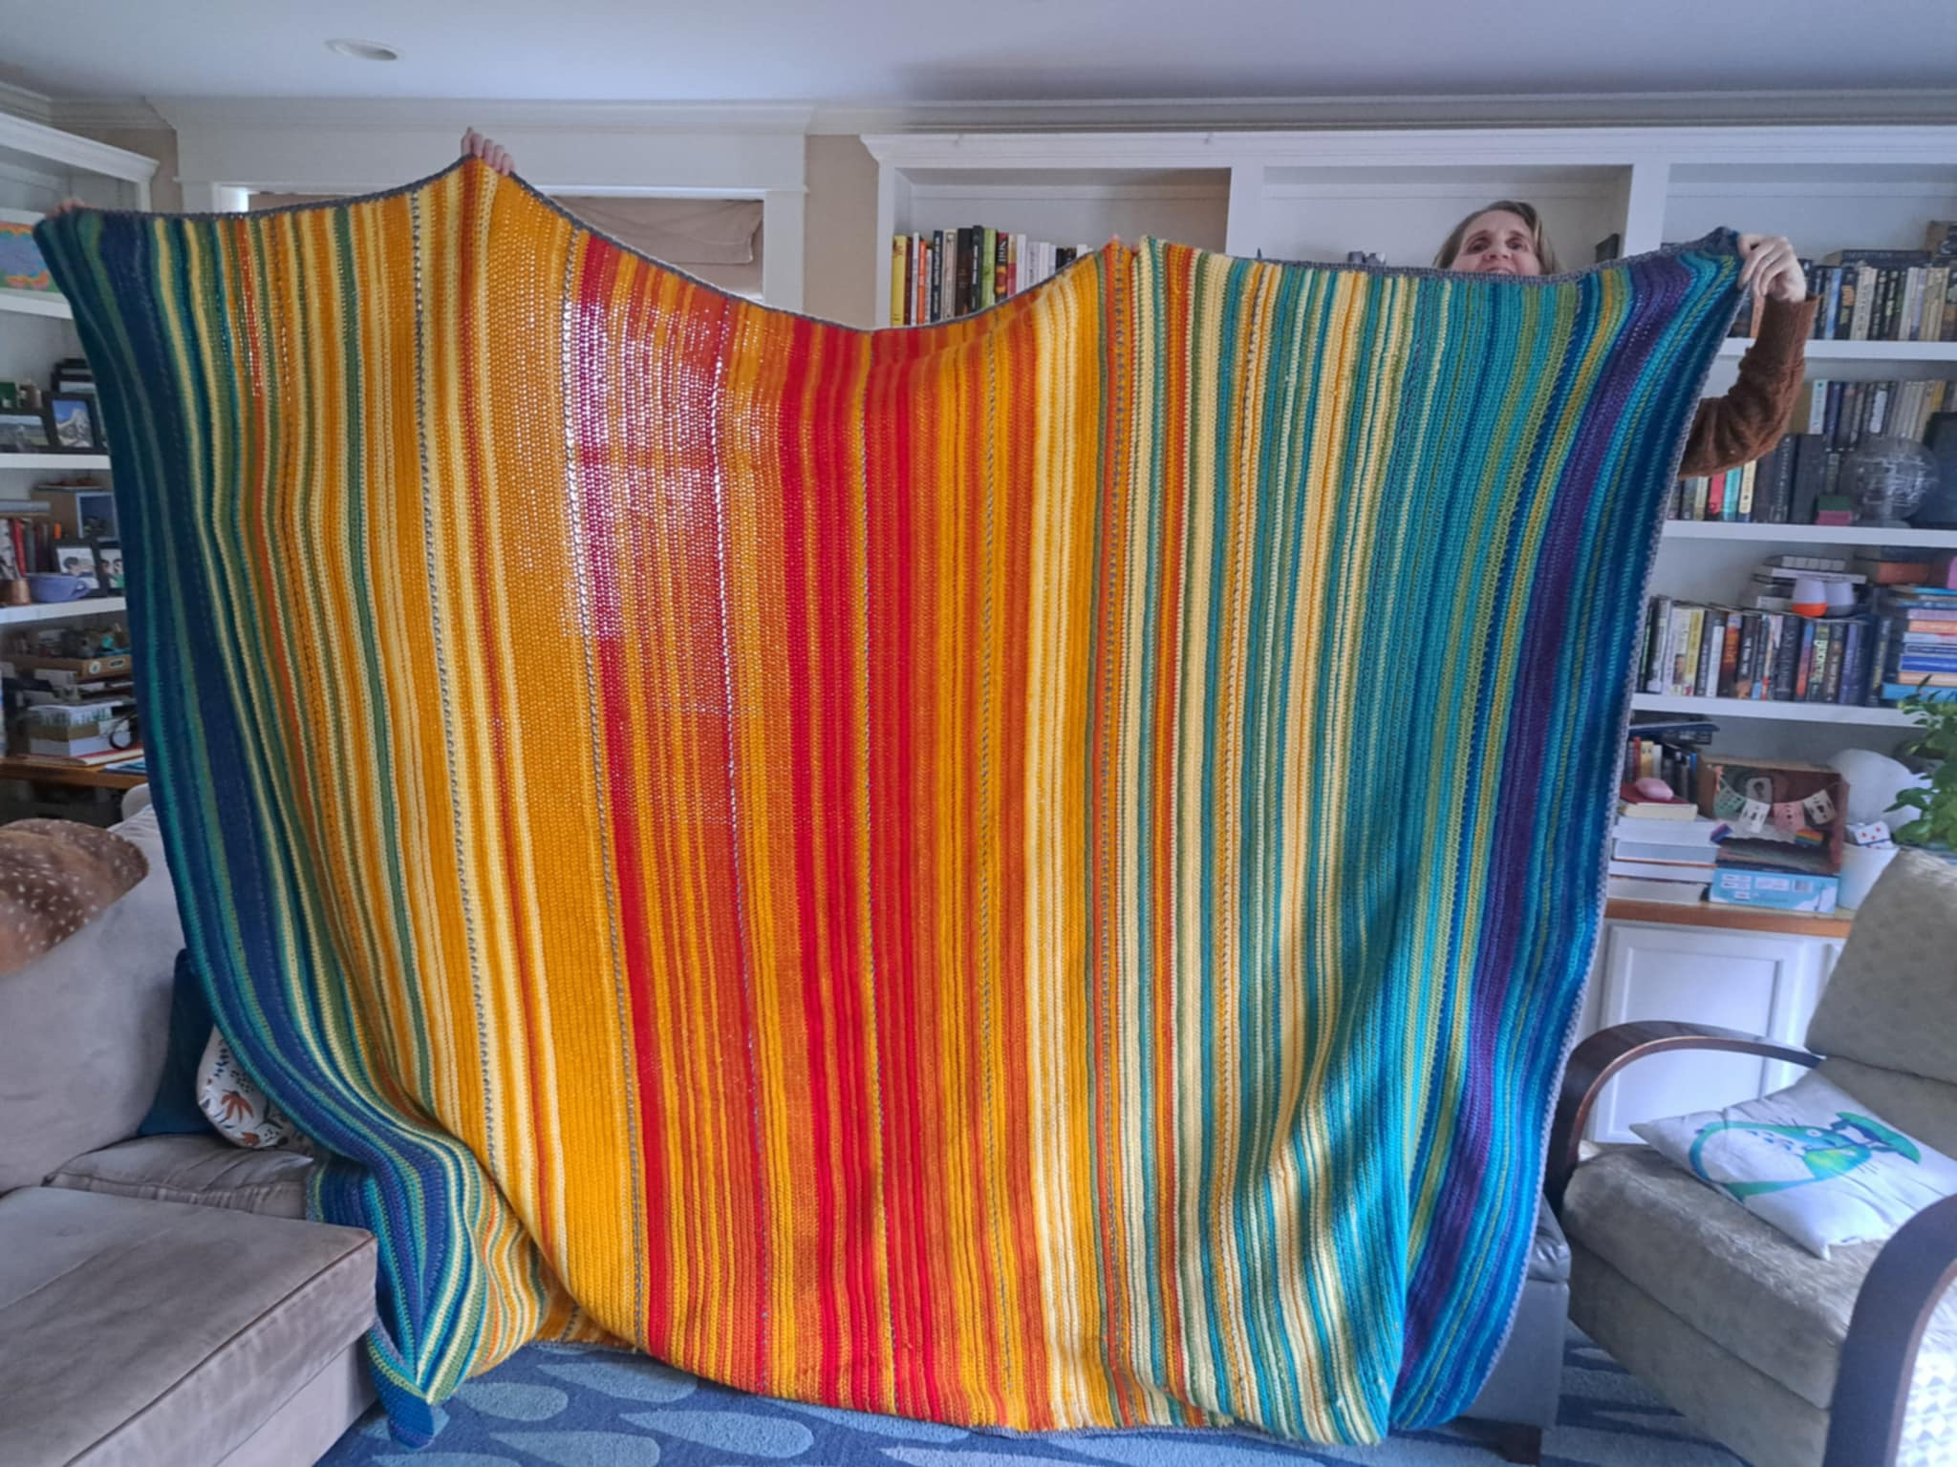
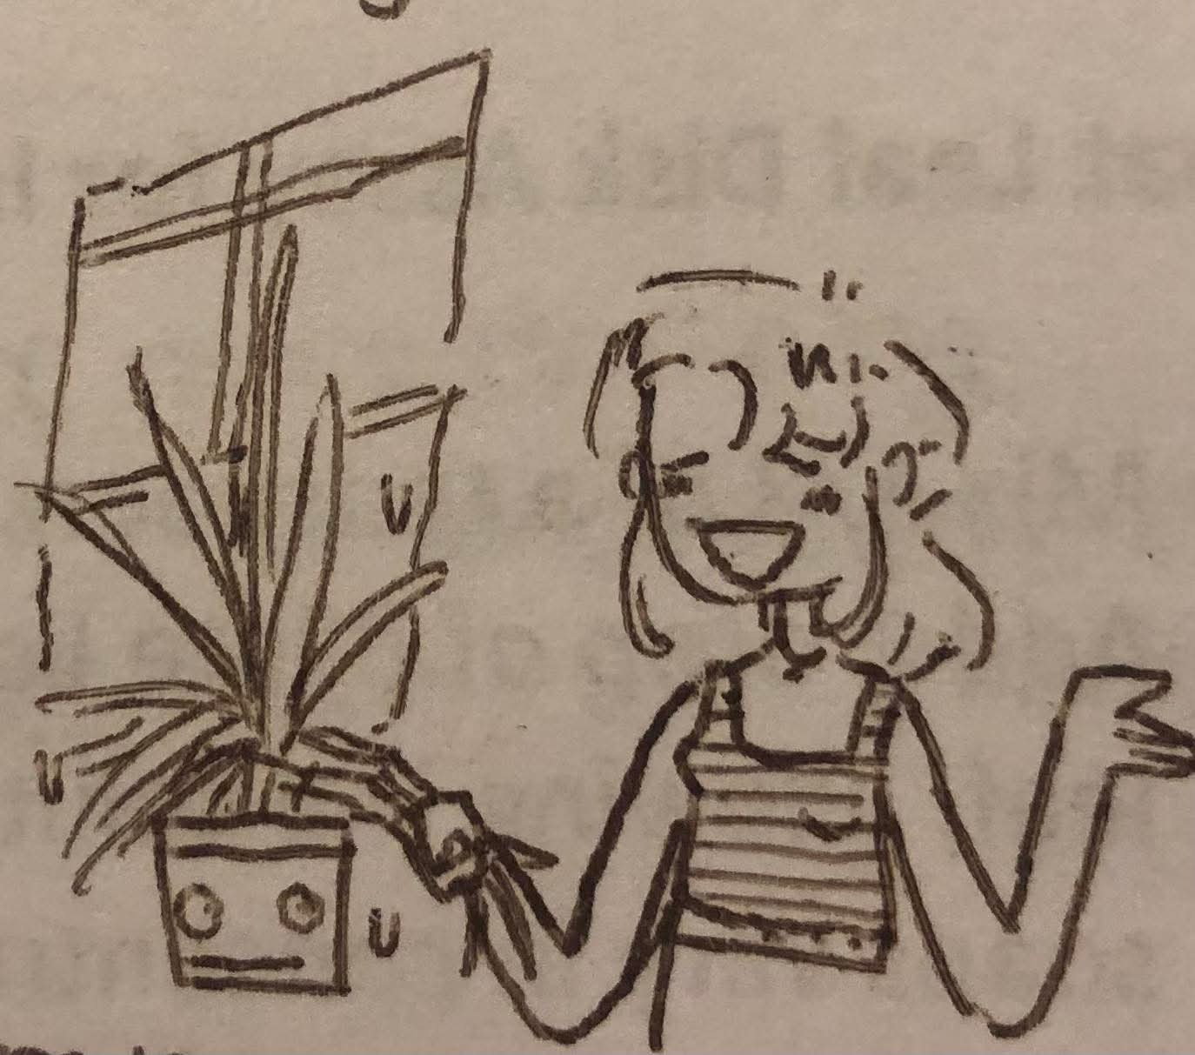
Hands-on activities and projects to support concepts in the OOI Data Labs Manual Karin Warren, Randolph College
Original artwork by Nella Pepelko
Original artwork by Elizabeth Parsons

Slide 2
Overview:
Value of hands-on activities
Examples
Large and small
Share-a-thon!

Slide 3
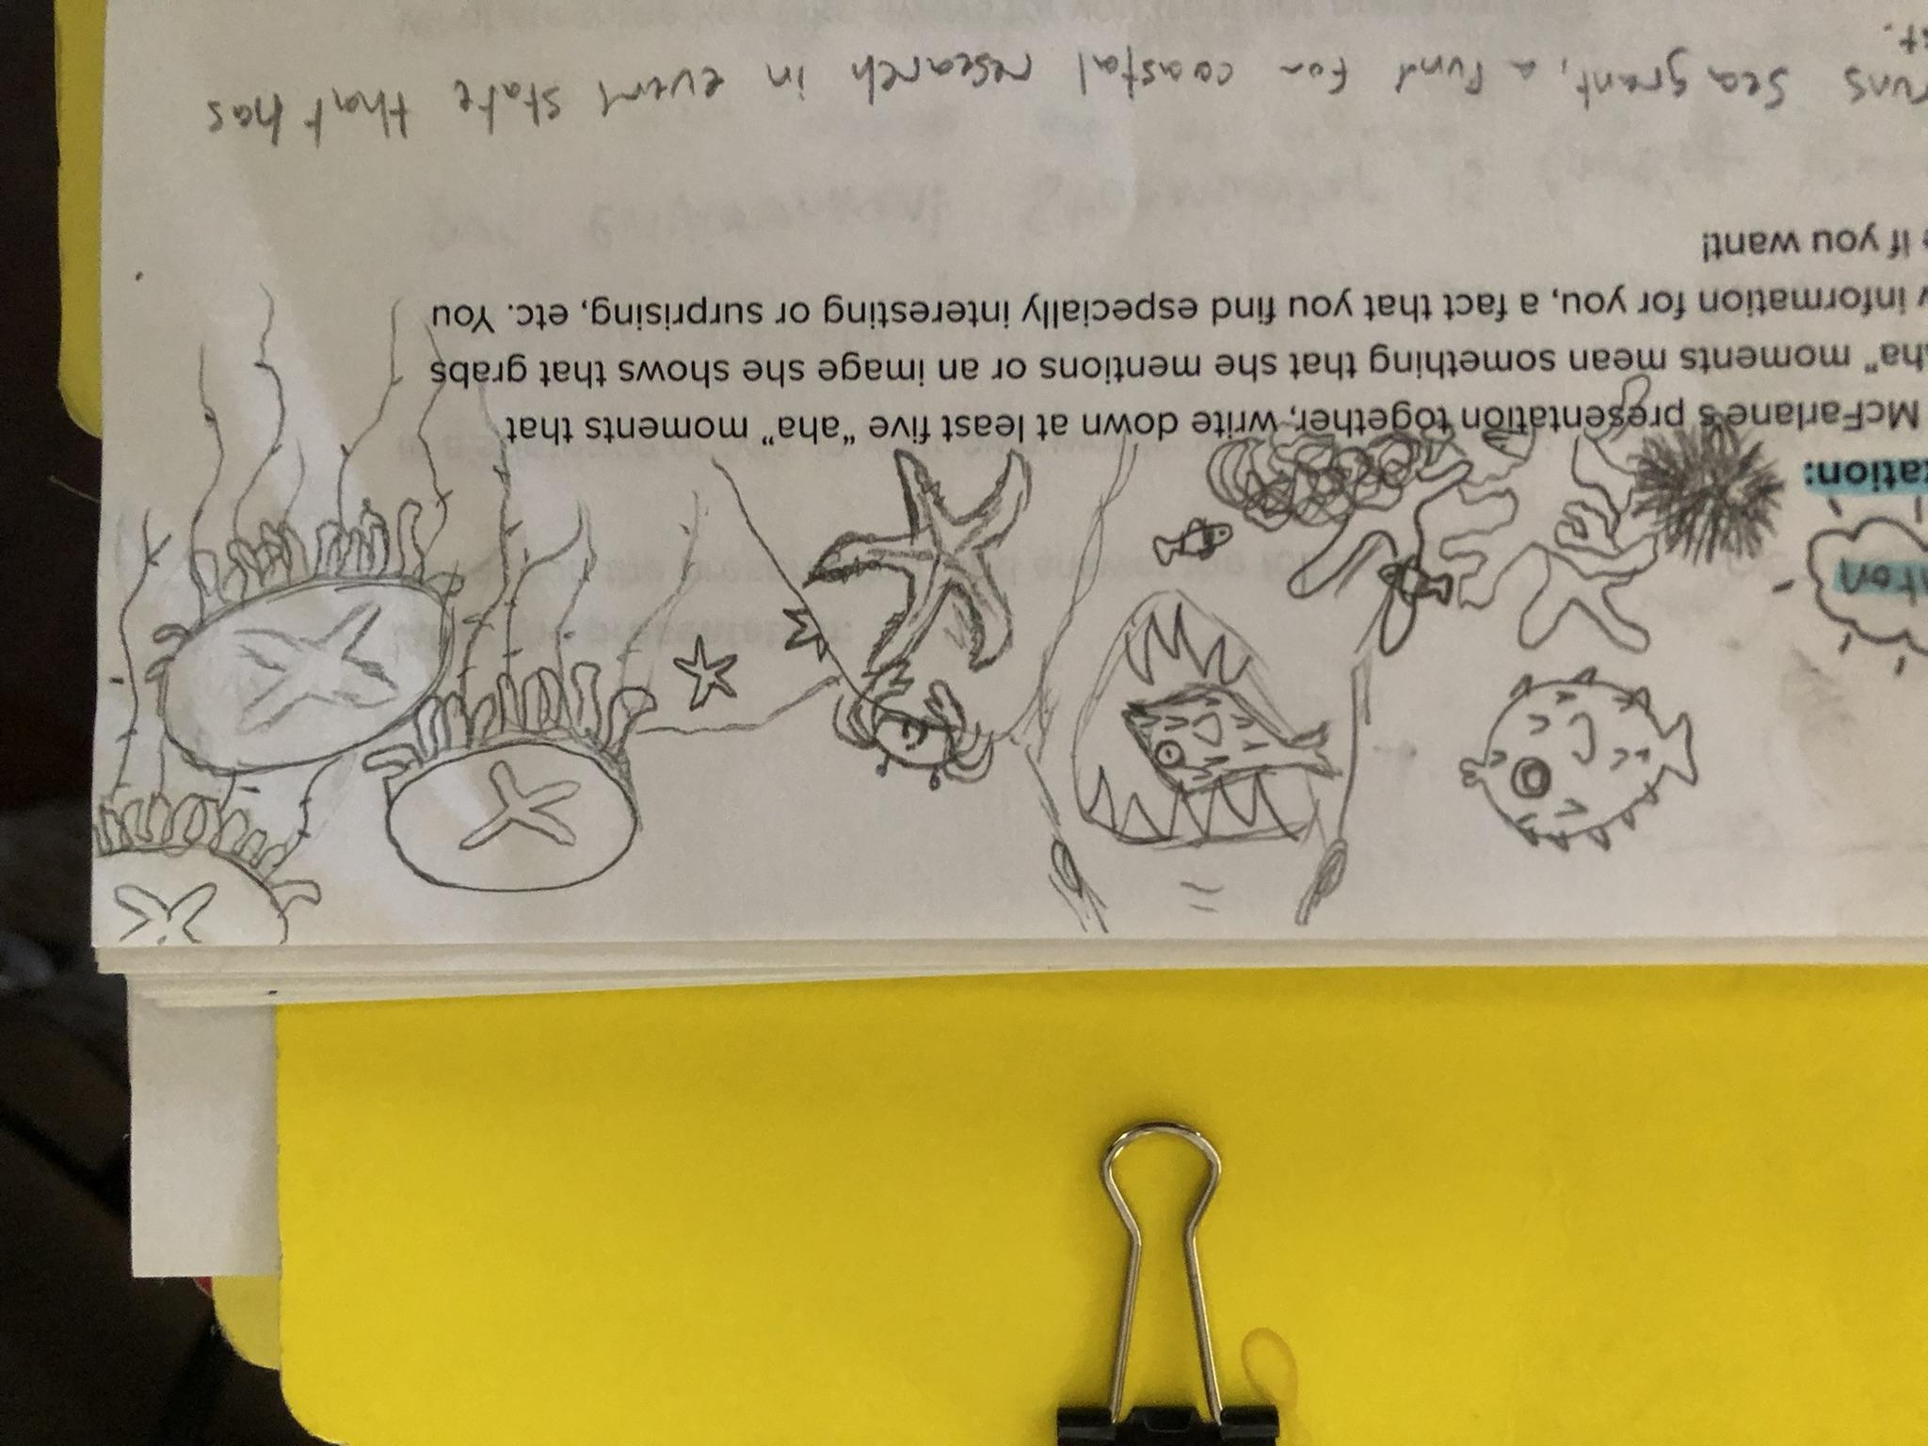
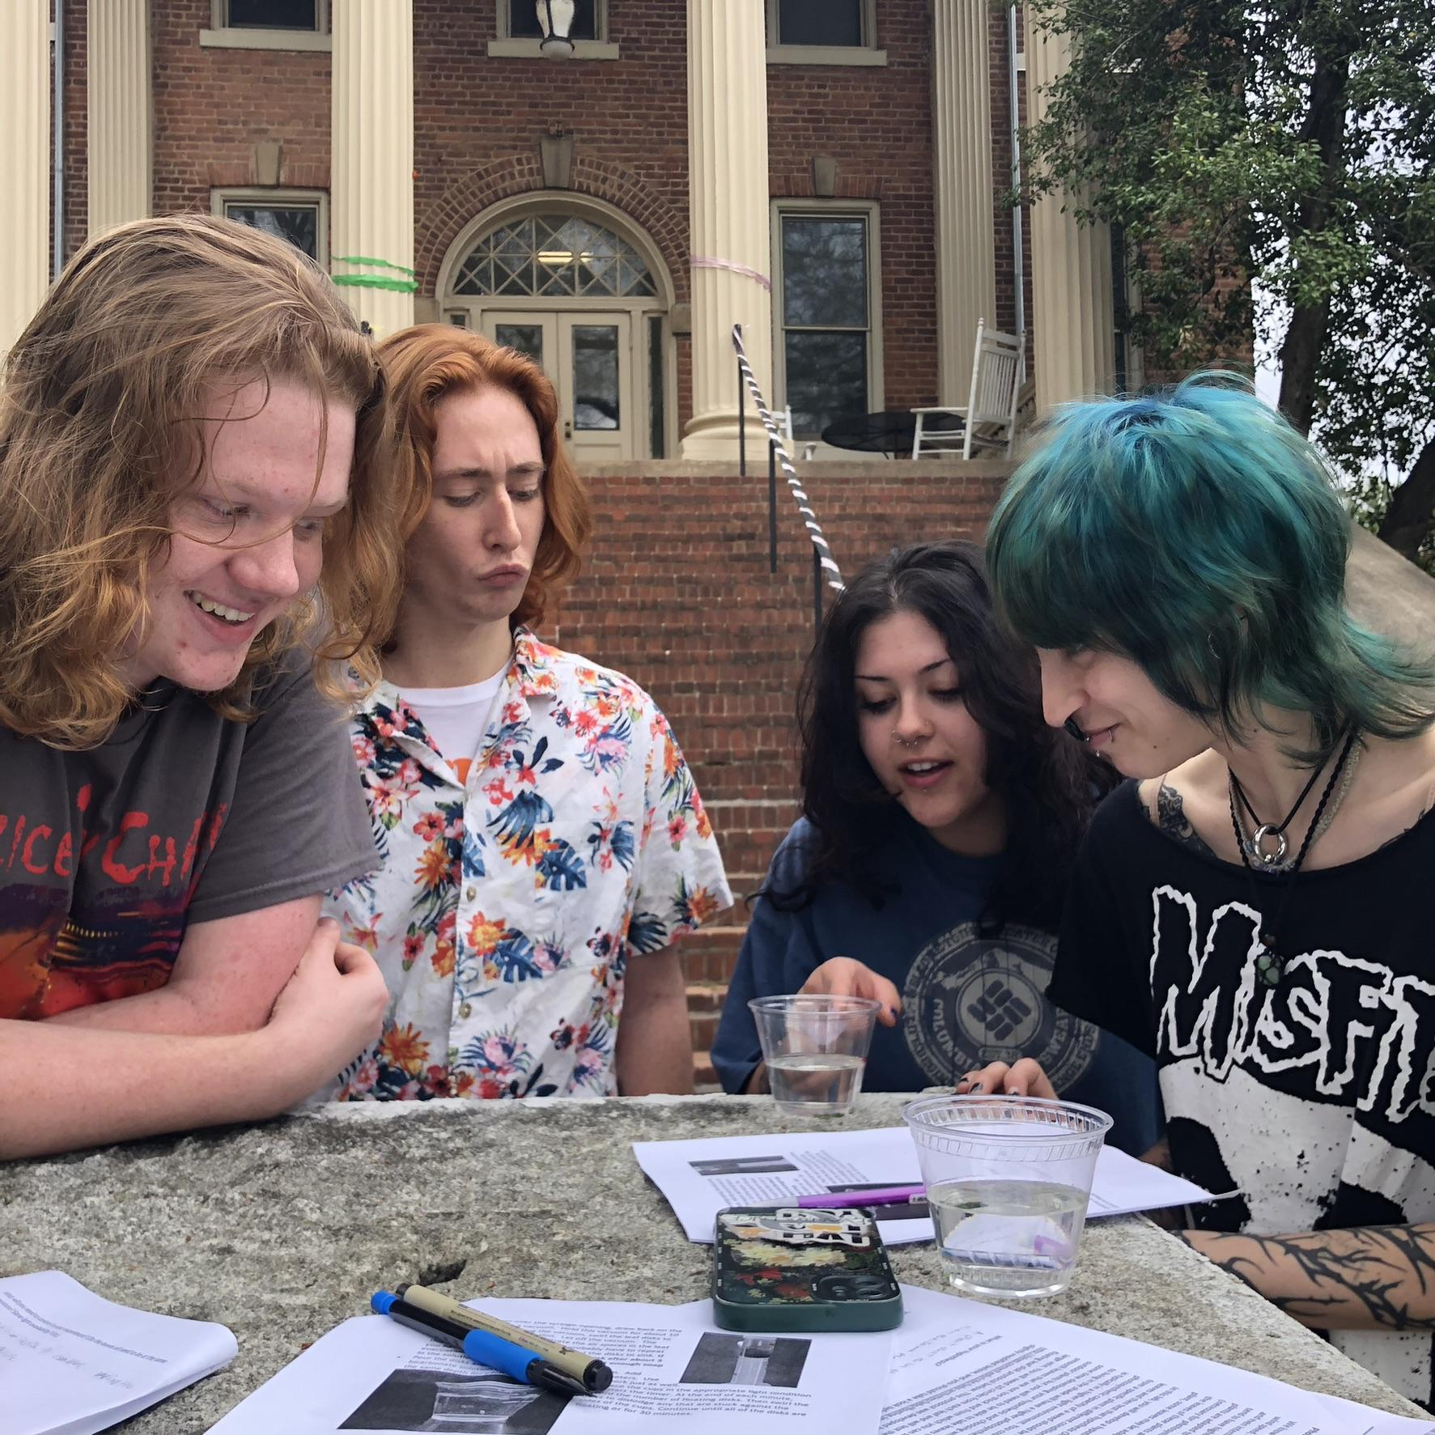
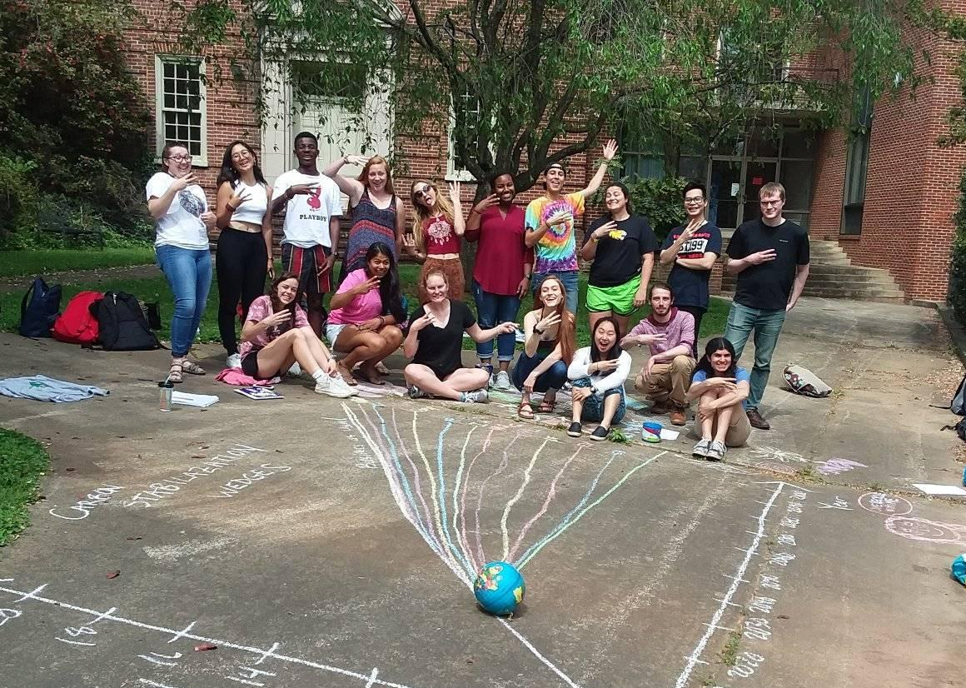
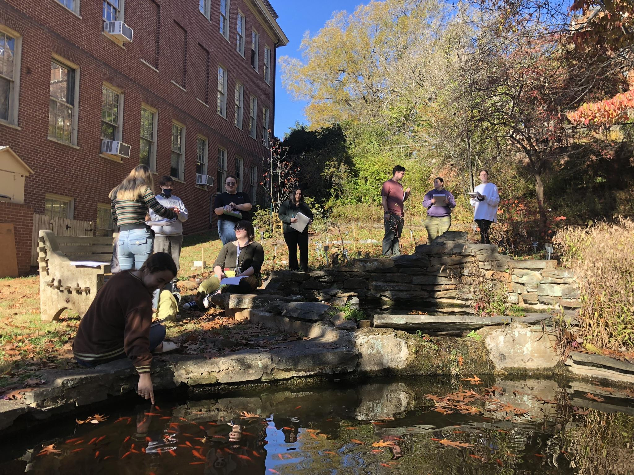
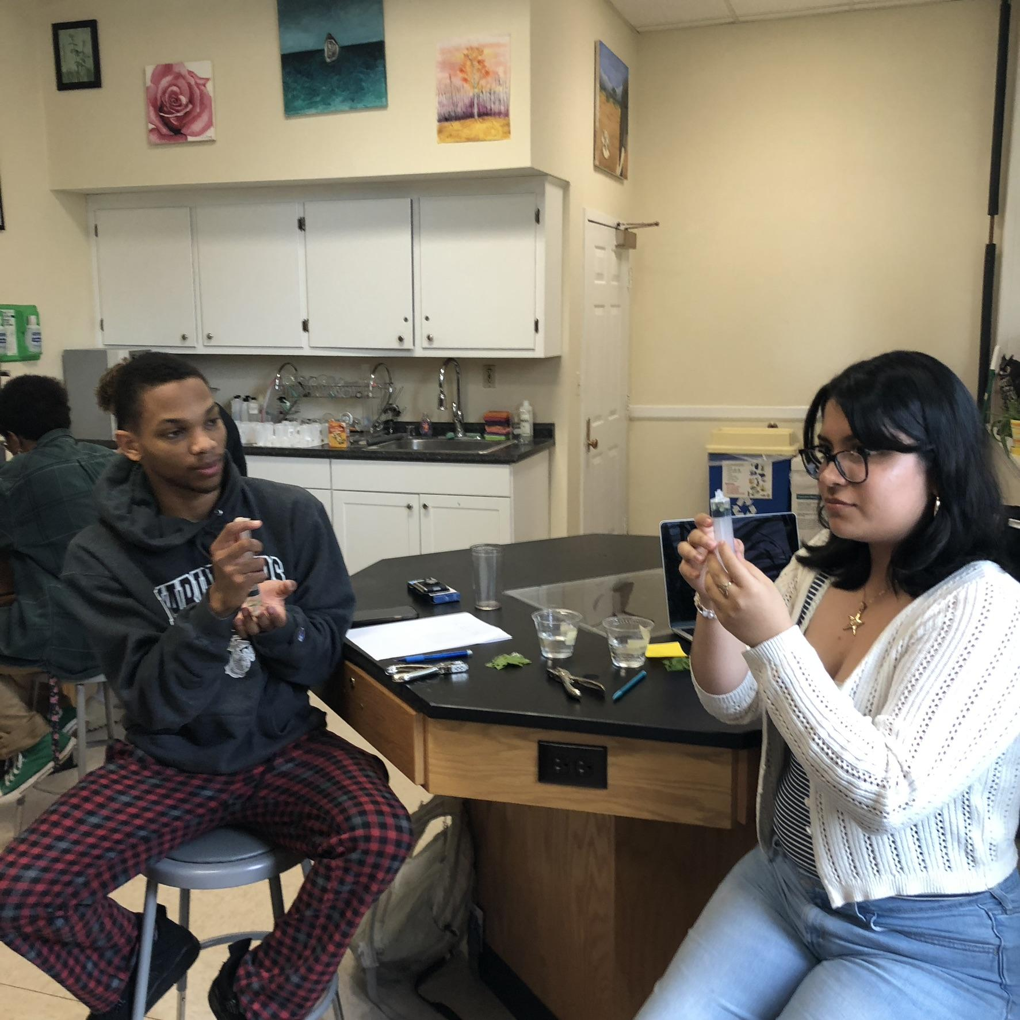
The value of hands-on learning, contemplative practice, and movement
Hands-on activities increase understanding and retention of STEM concepts
Students benefit from moving around, improves learning and retention, reduces stress
Hands-on activities encourage curiosity and practical application of theoretical knowledge
Embodied cognition research shows that the body must first be interacting with the world to activate and open up the mind for learning. (Hrach, 2021)
Can be especially effective for engaging those who are anxious about math, data, stats, graphs, etc.
Merging STEM instruction with contemplative methods can bring student-centered reflection into the classroom (Sundstrom et al, 2024)
Notes:
S. Hrach, 2021, “Minding Bodies”: How Physical Space, Sensation, and Movement Affect Learning”, West Virginia University Press
Sundstrom, Ramos, Zastavker, and Venkatesh, 2024, WIP: Contemplative Practices' Effects on Compassion, Belonging, and Self-Empowerment in Undergraduate Engineering Experiences, 2024 IEEE Frontiers in Education Conference (FIE), 10.1109/FIE61694.2024.10893487

Slide 4
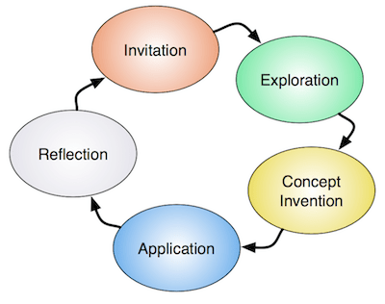
The Learning Cycle

Slide 5
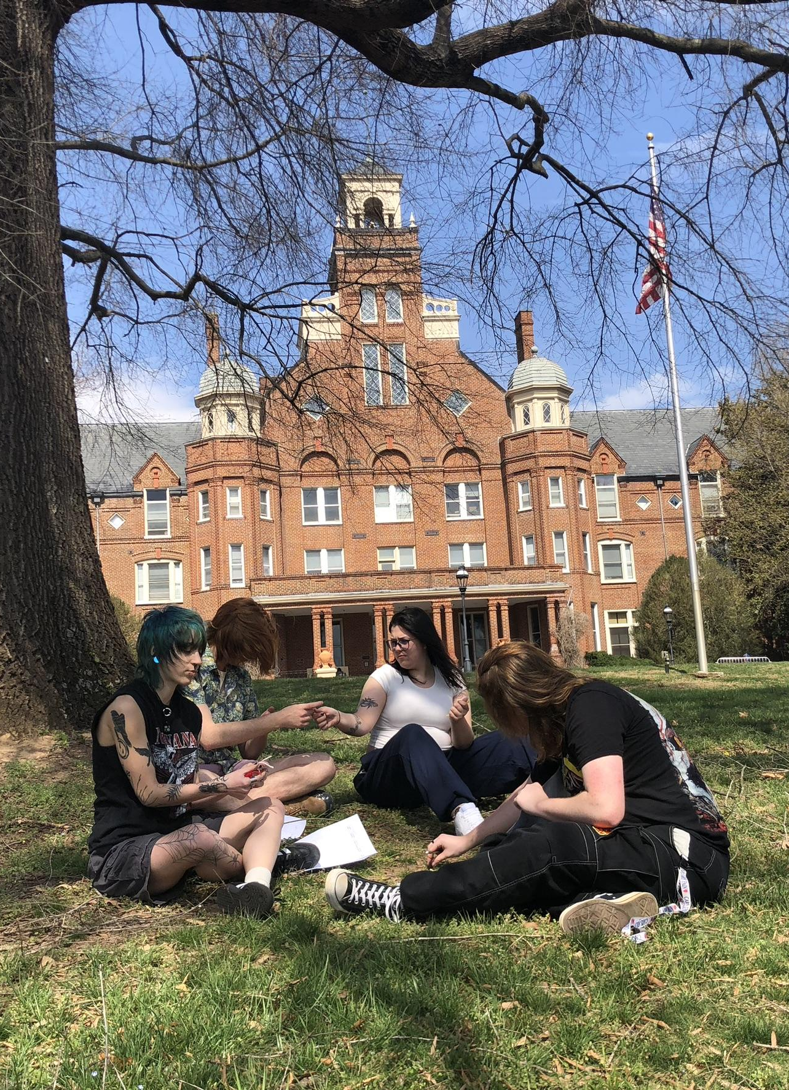
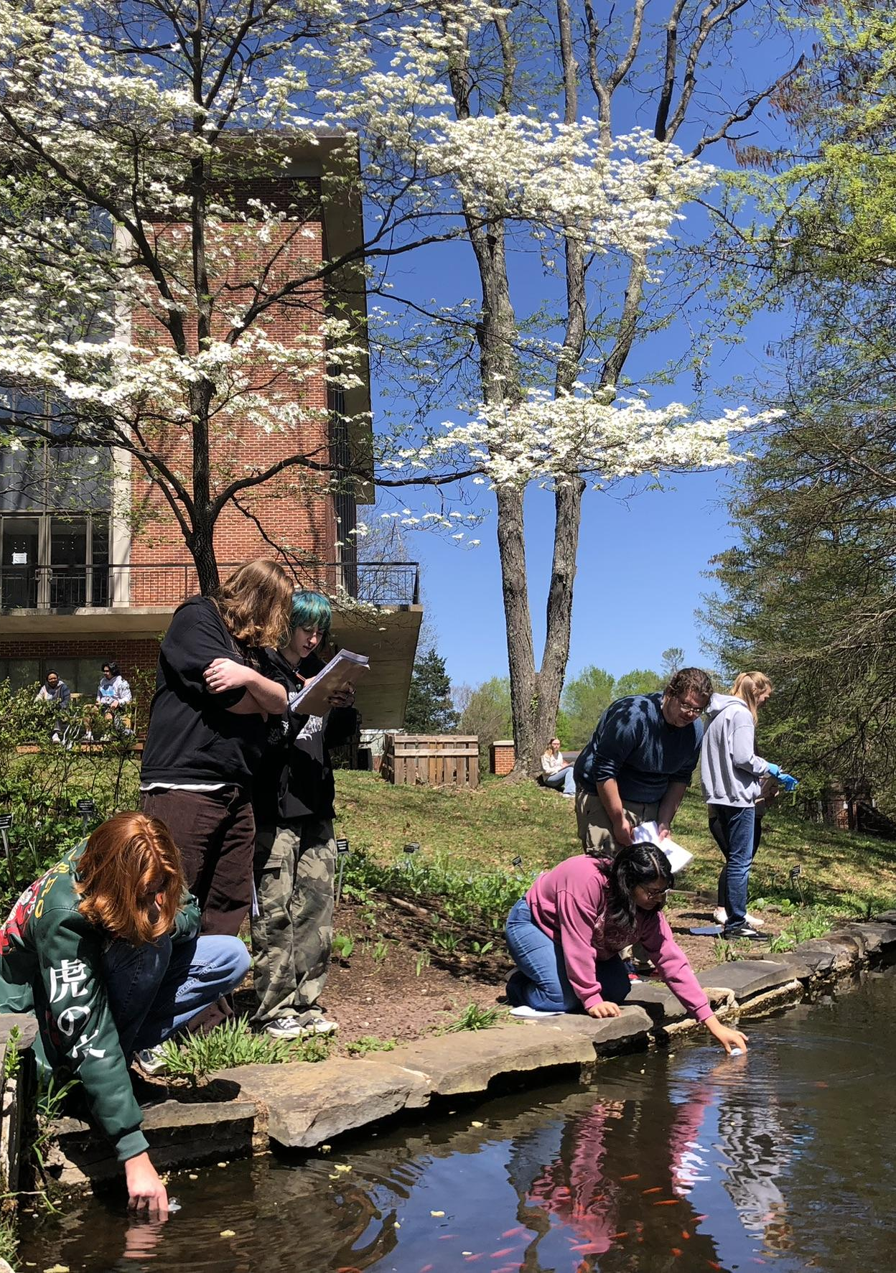
Consider: Time Space Resources
What can work for hybrid classes and fully online classes?
Can you use simple, inexpensive materials?
Modify existing ideas!
Demos vs. Activities
Build/make something and use it
Incorporate movement
Take it outside when you can
Term projects can reinforce several concepts throughout the term
Field trips & place-based opportunities
Campus/home/community as a living laboratory

Slide 6
Term Projects and 1-2 hour activities

Slide 7
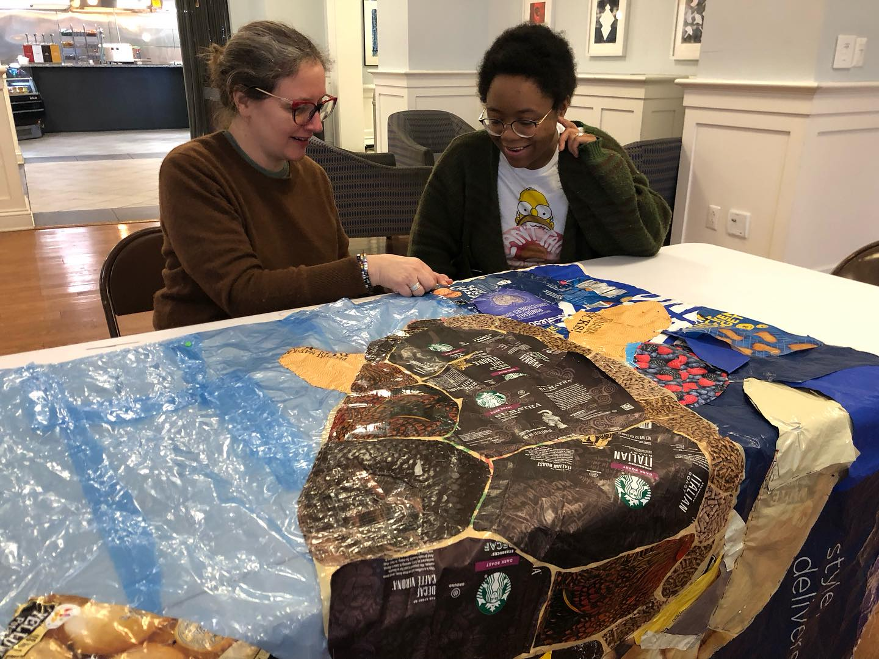
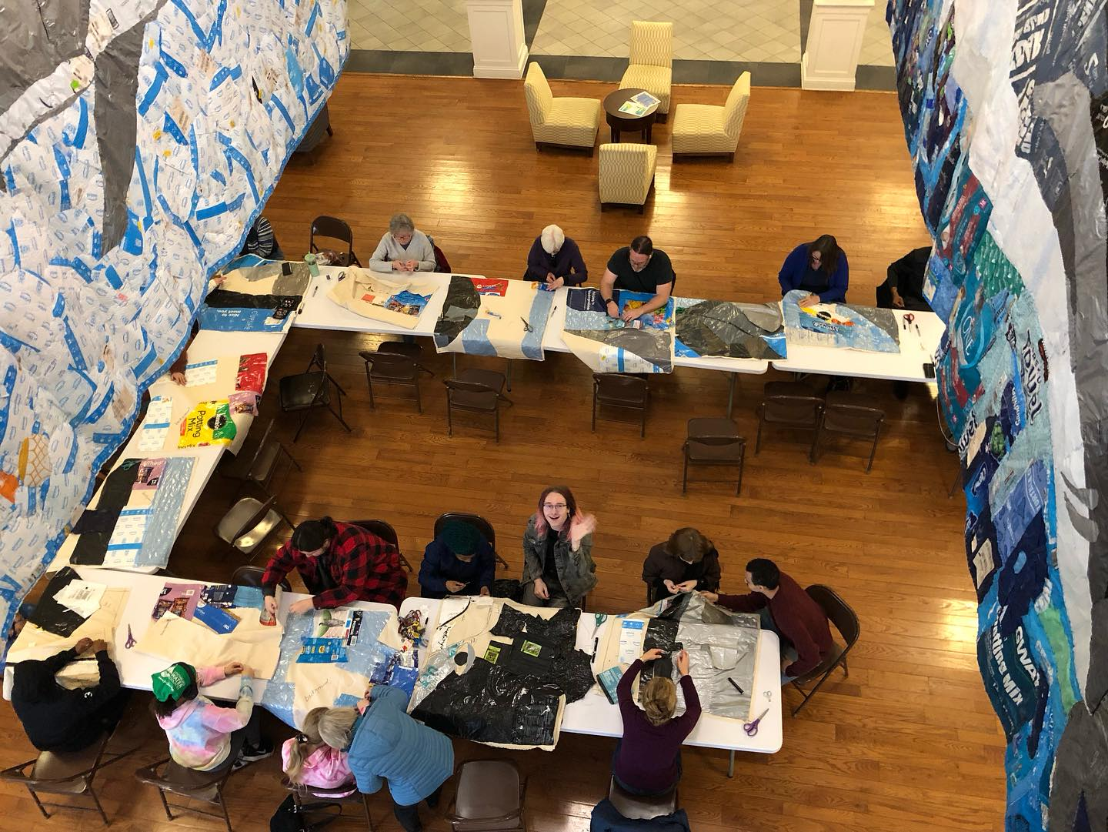
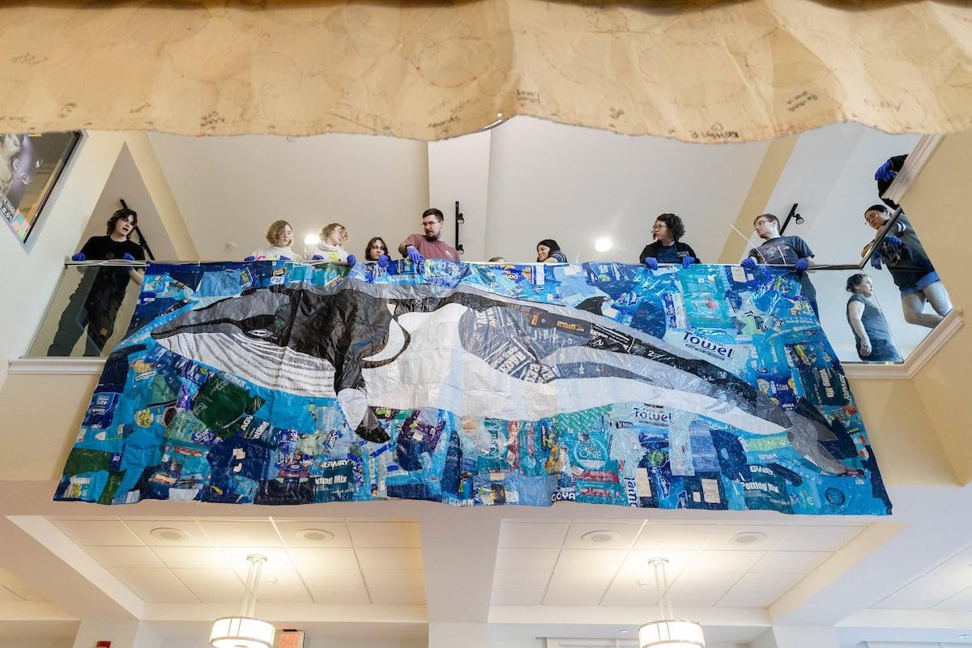
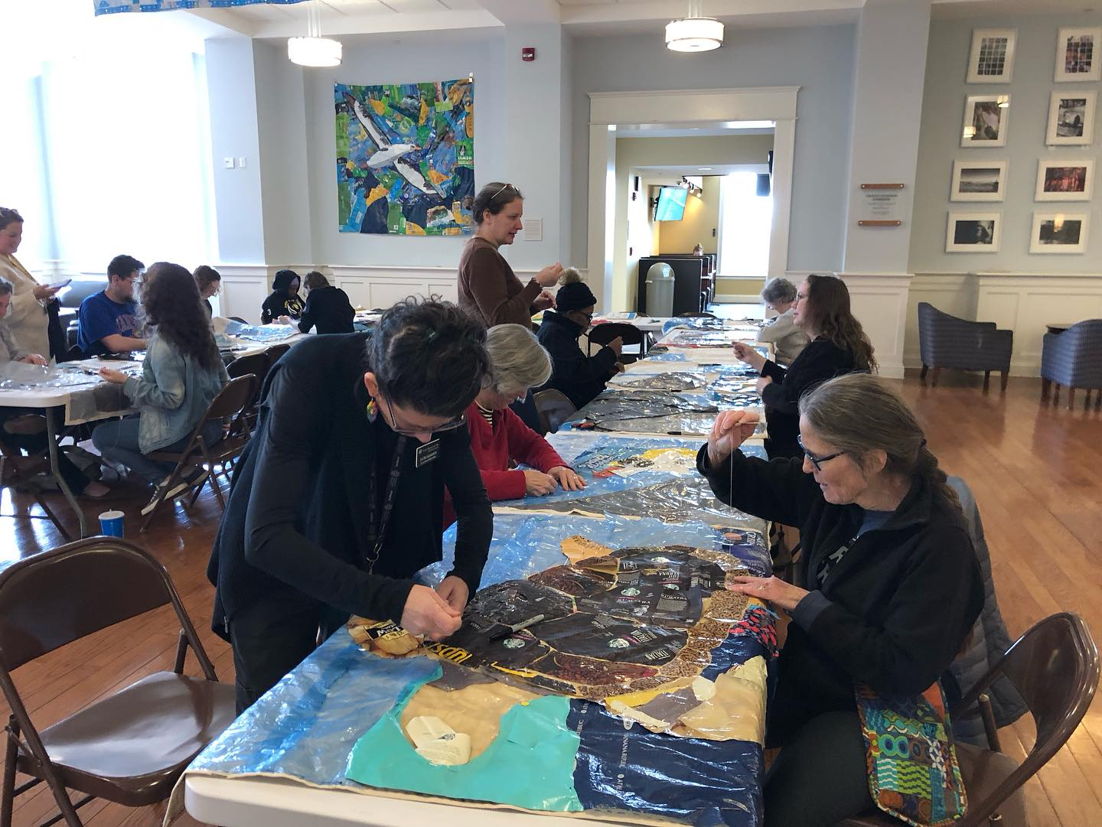
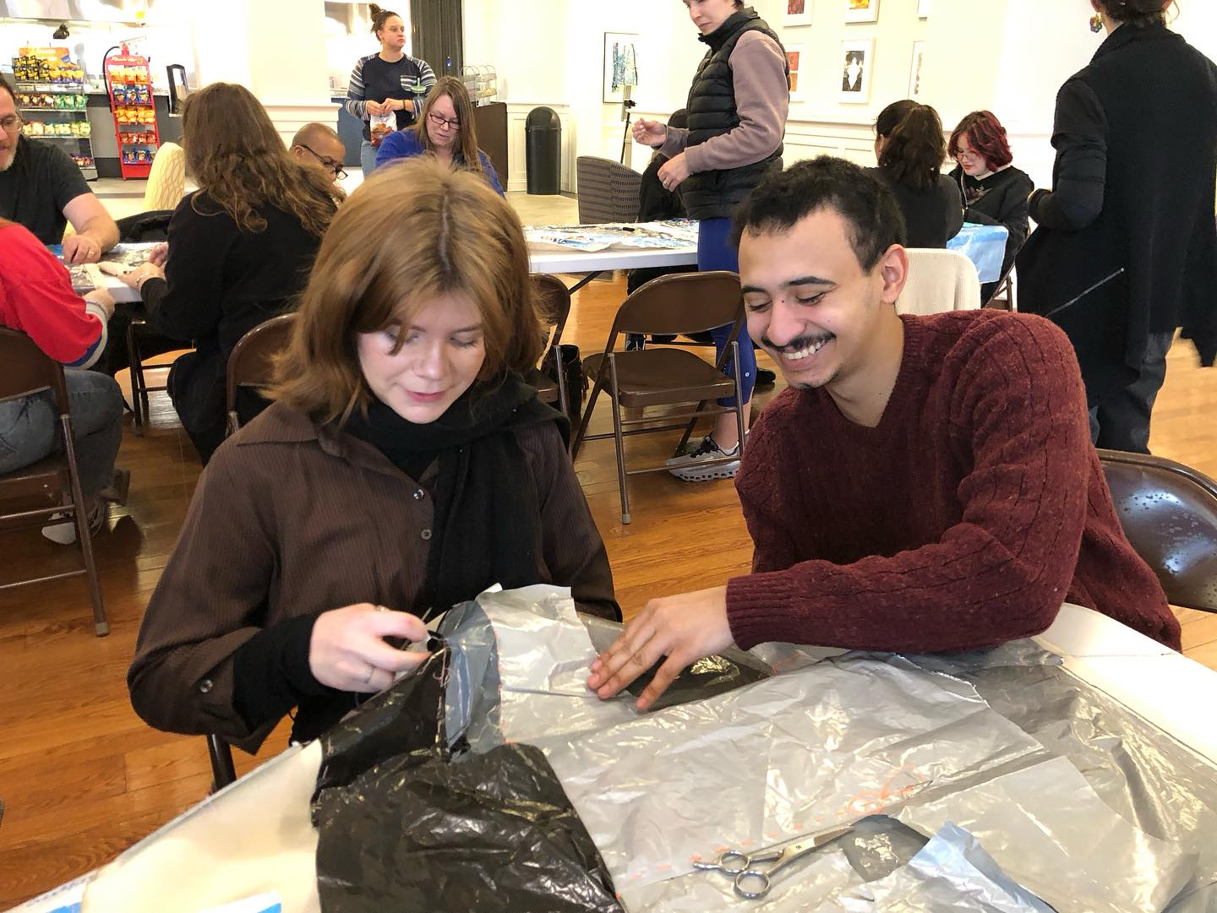
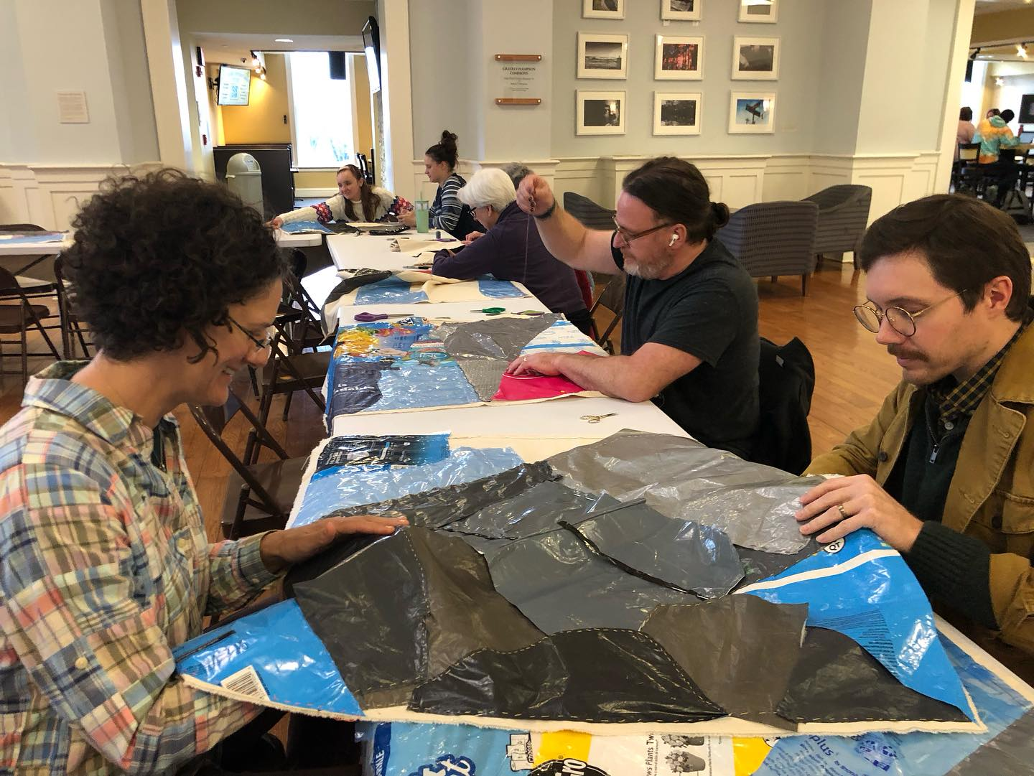
Example Term Project: Plastic Film Waste “Craftivism” Collages A project inspired by Dr. Kat Owens, katowens.com

Slide 8
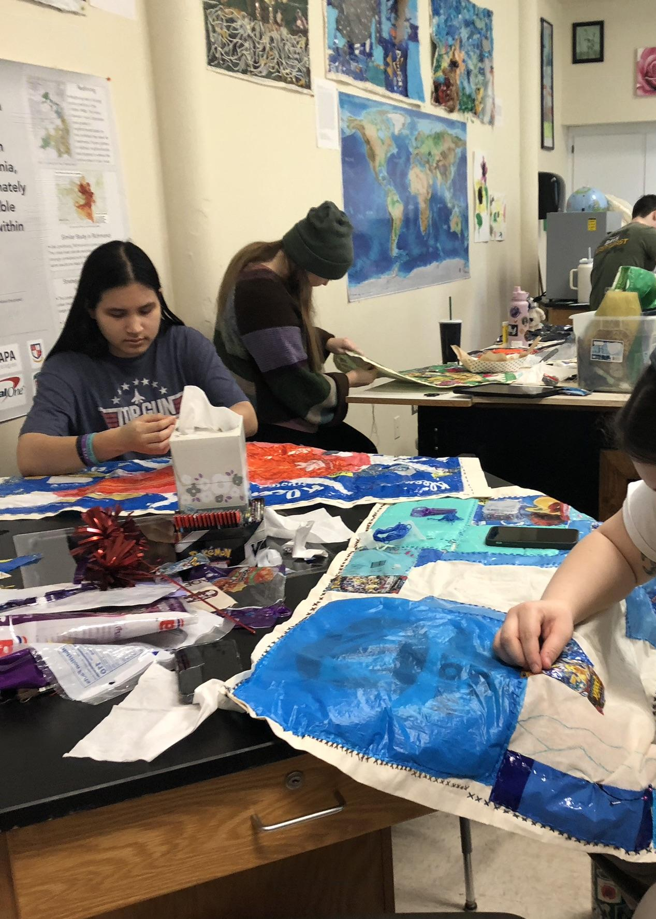
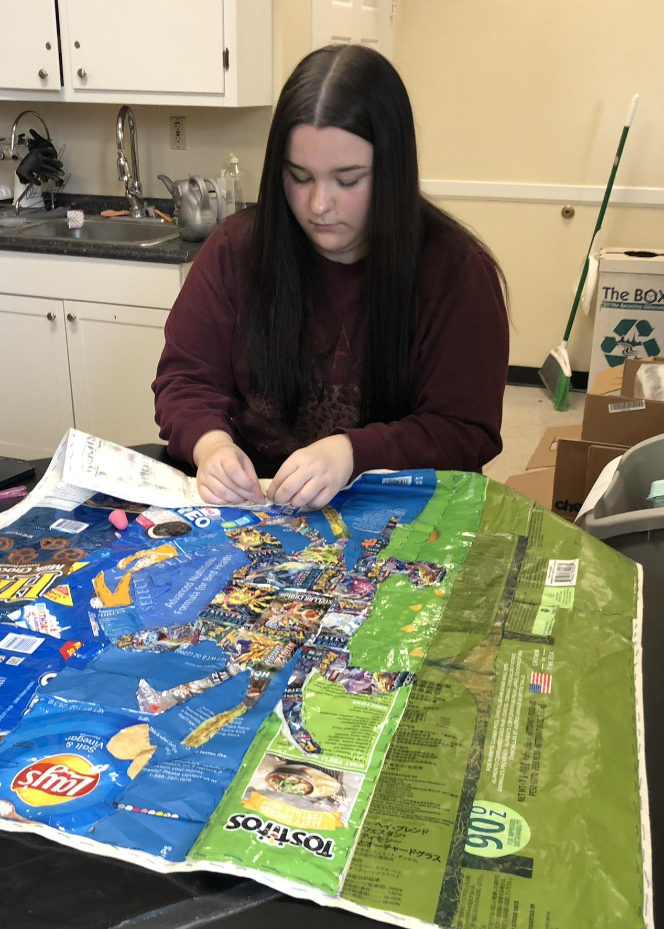
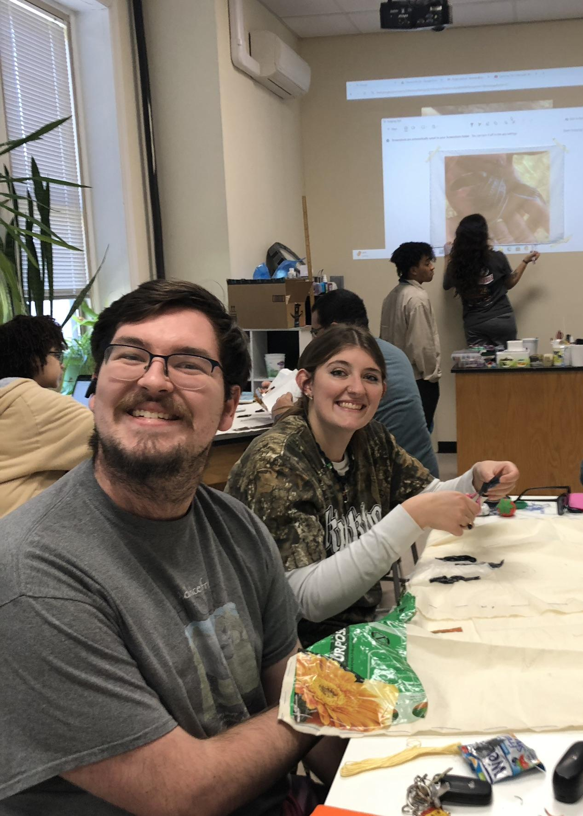
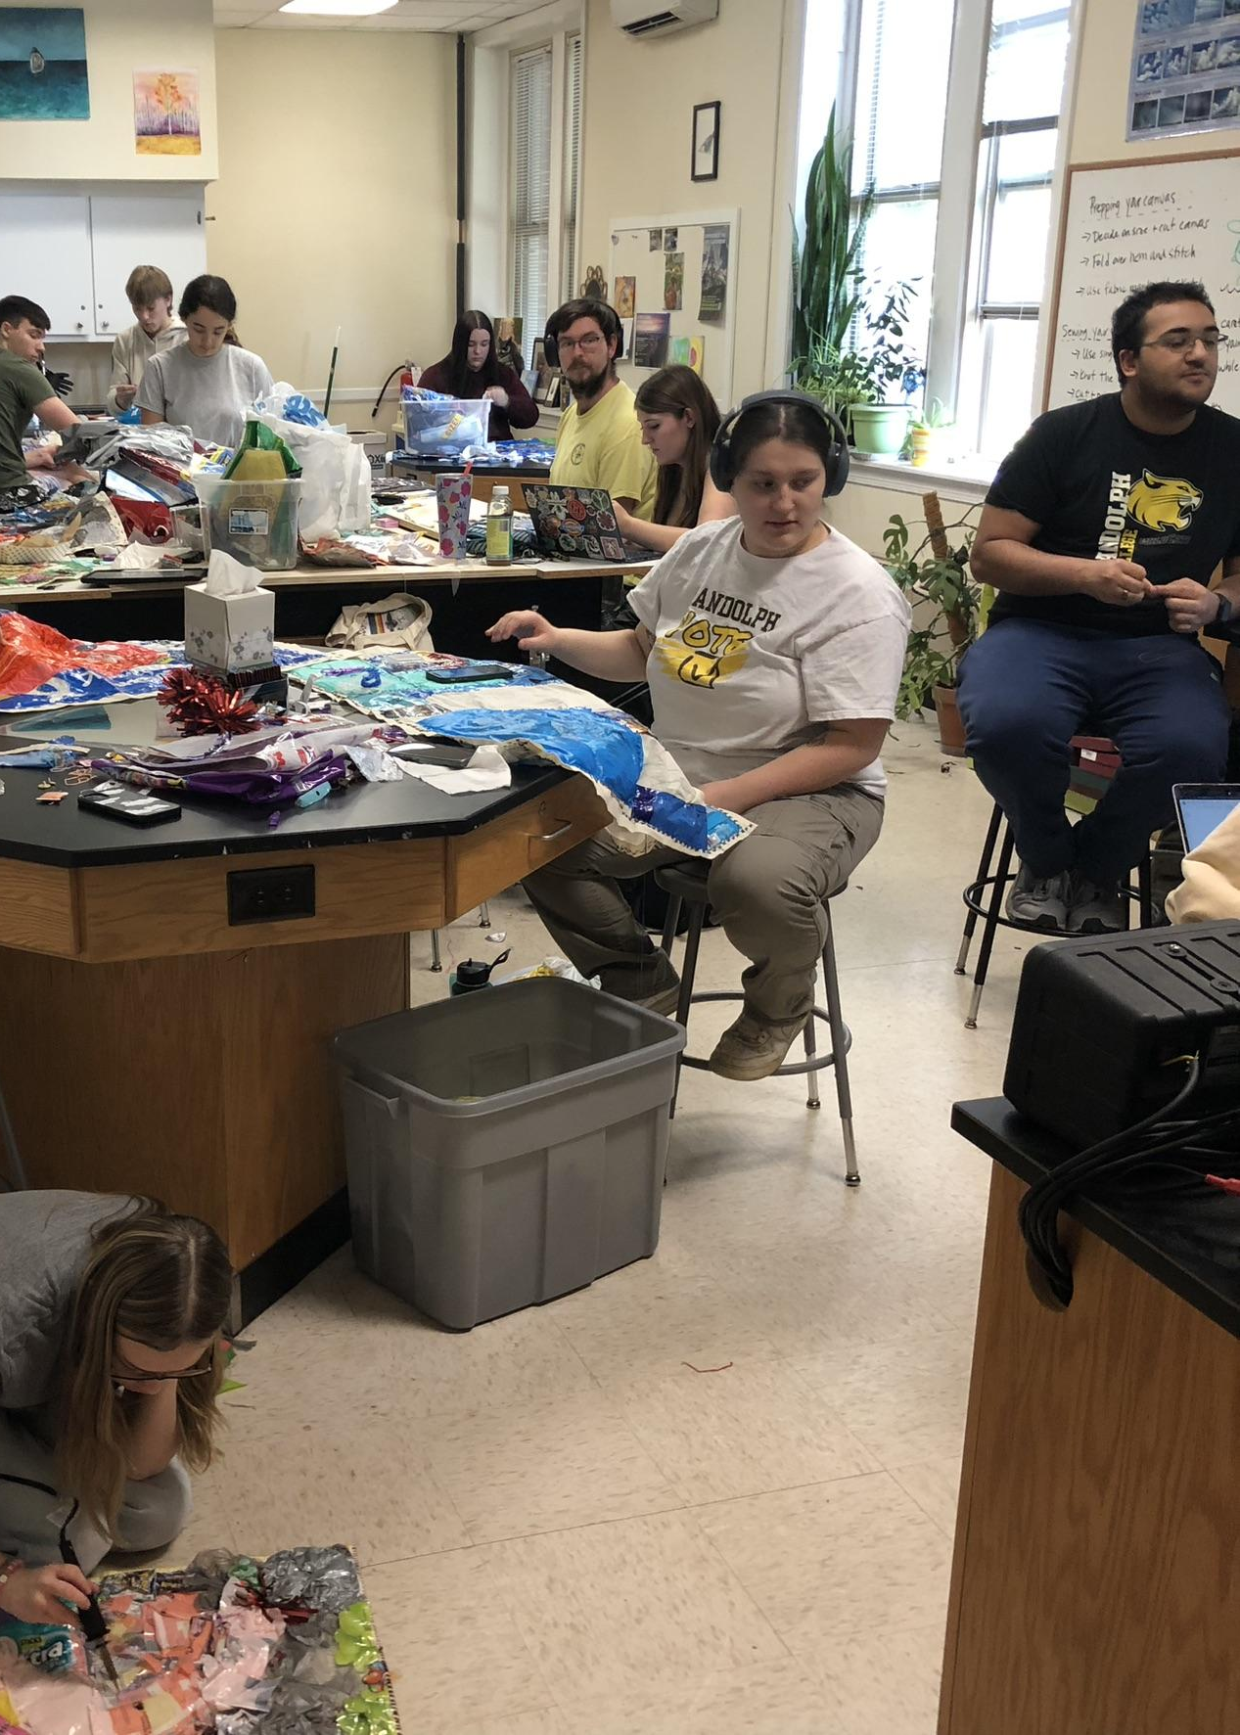
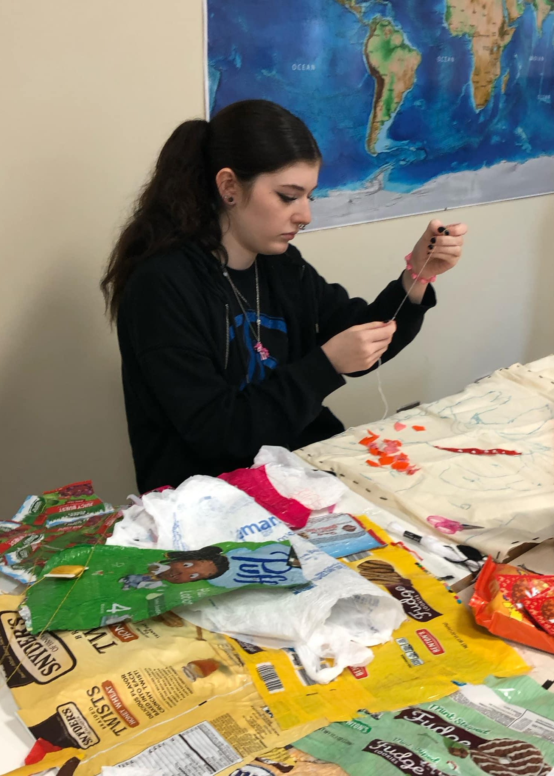
Plastic film waste collages Concepts: Plastic waste, solid waste management, environmental justice, life cycle, marine pollution,ocean circulation/gyres, ecosystem and organism impacts Can connect to: Lab 9 Anoxic events, Lab 10 Primary Production

Slide 9
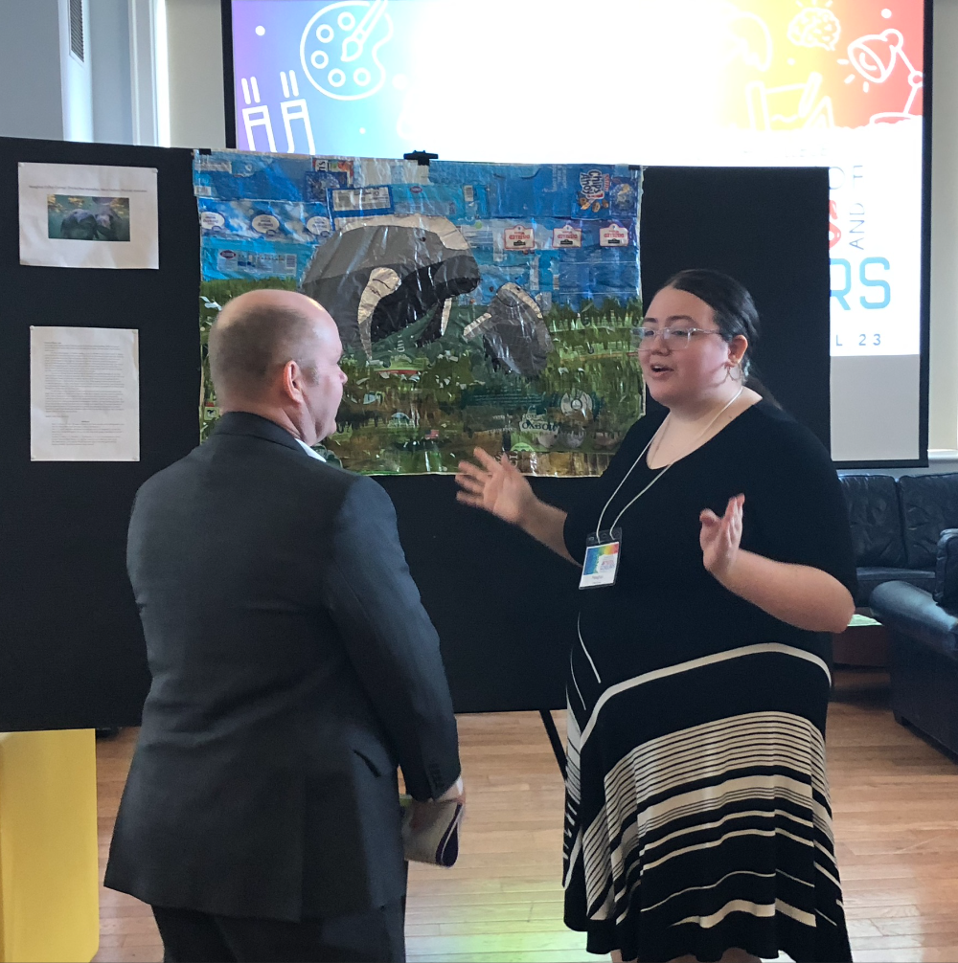
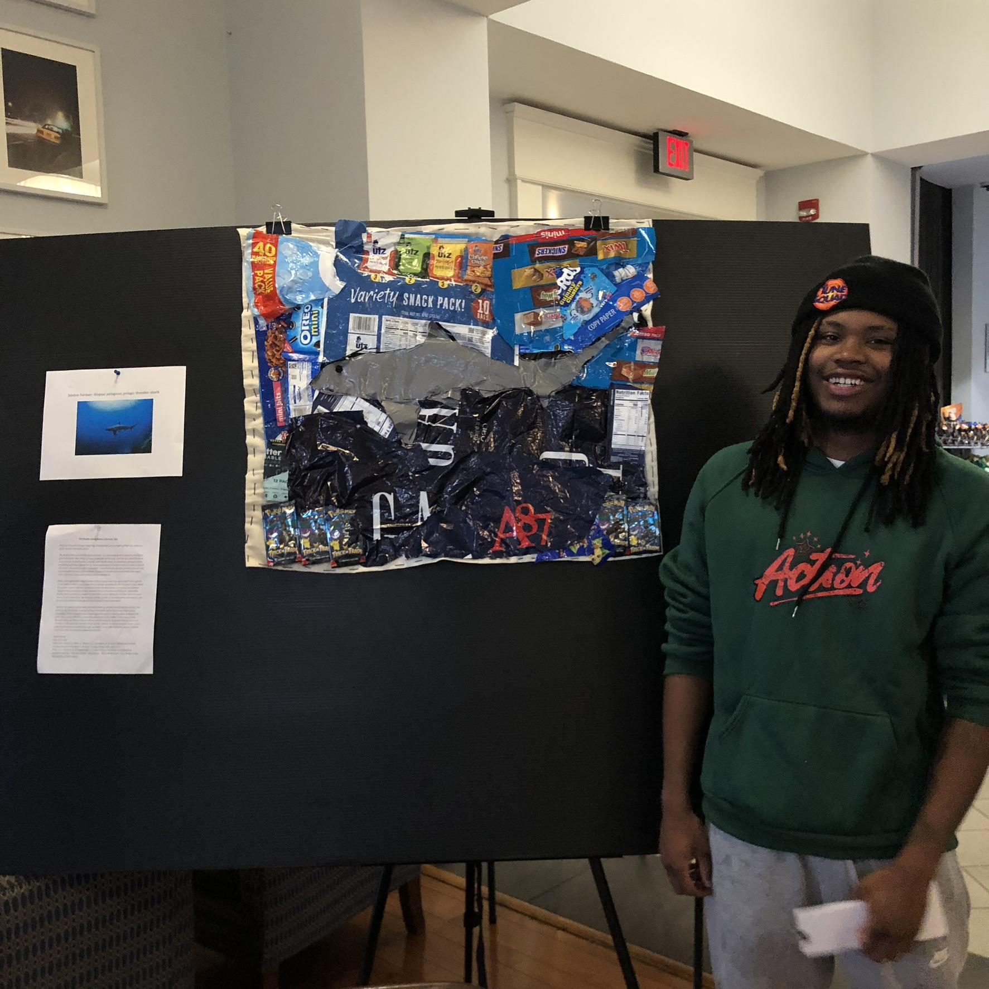
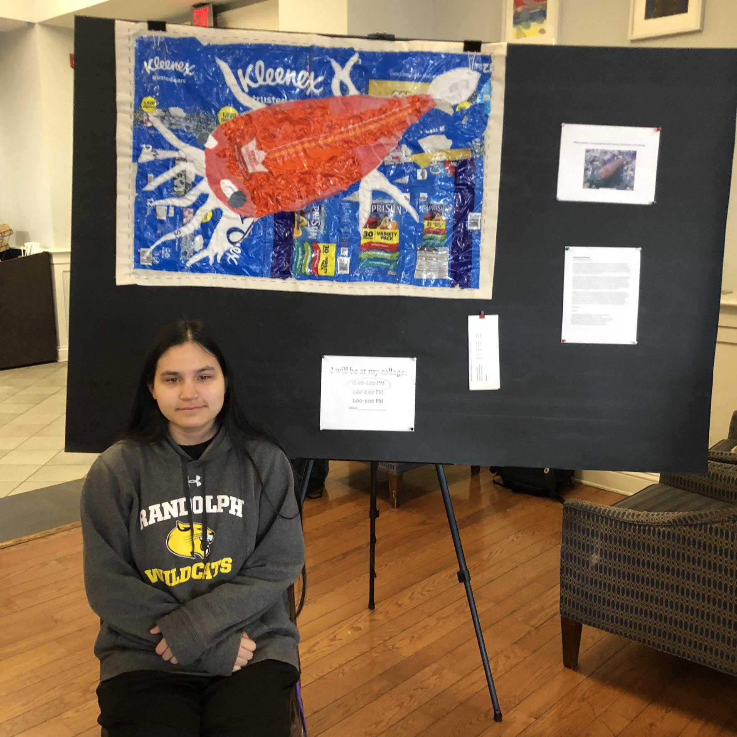
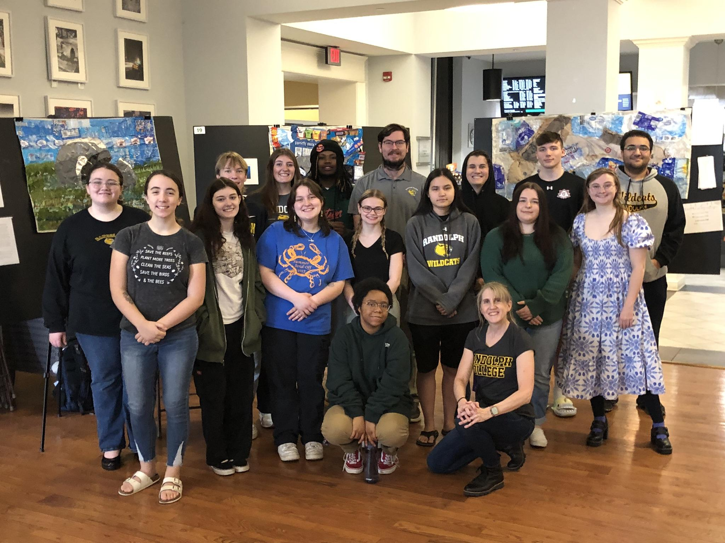
Plastic film waste collages: Outcomes

Slide 10
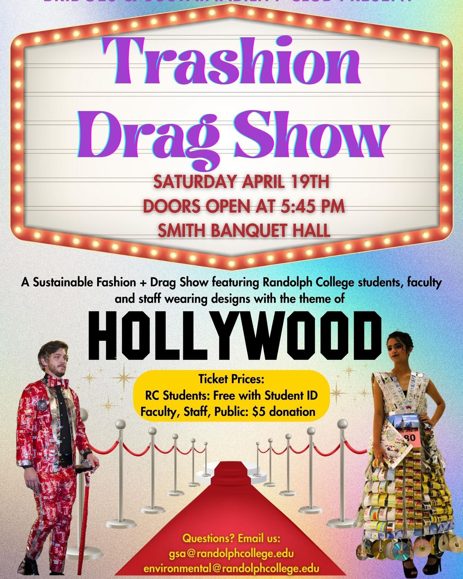
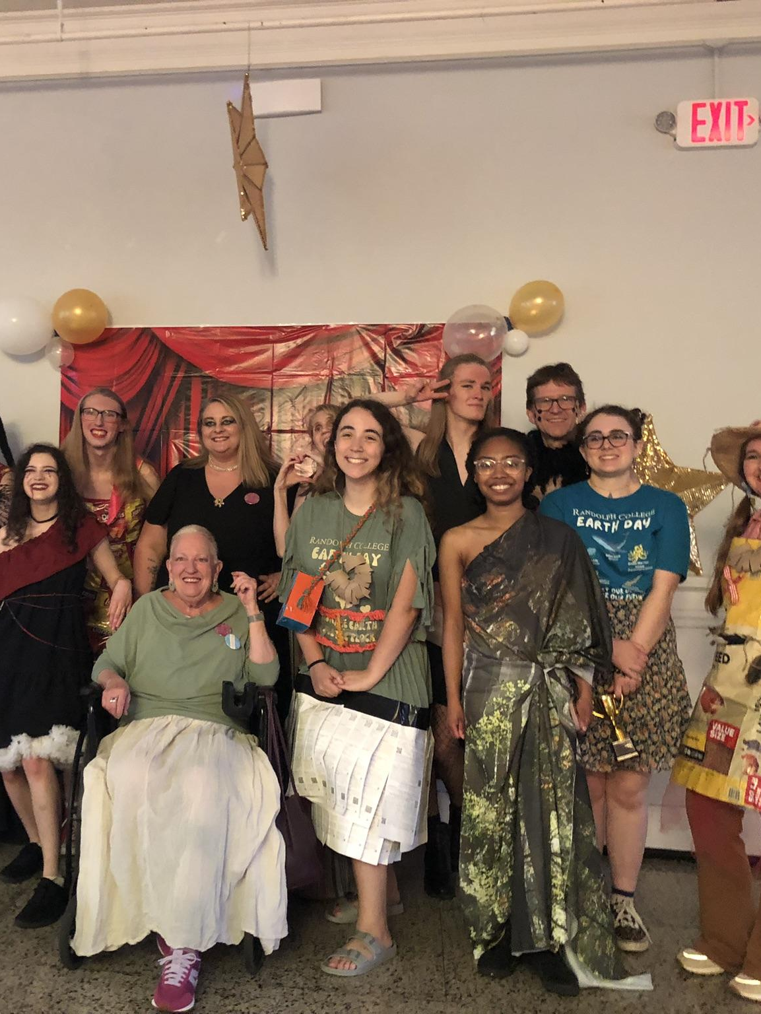
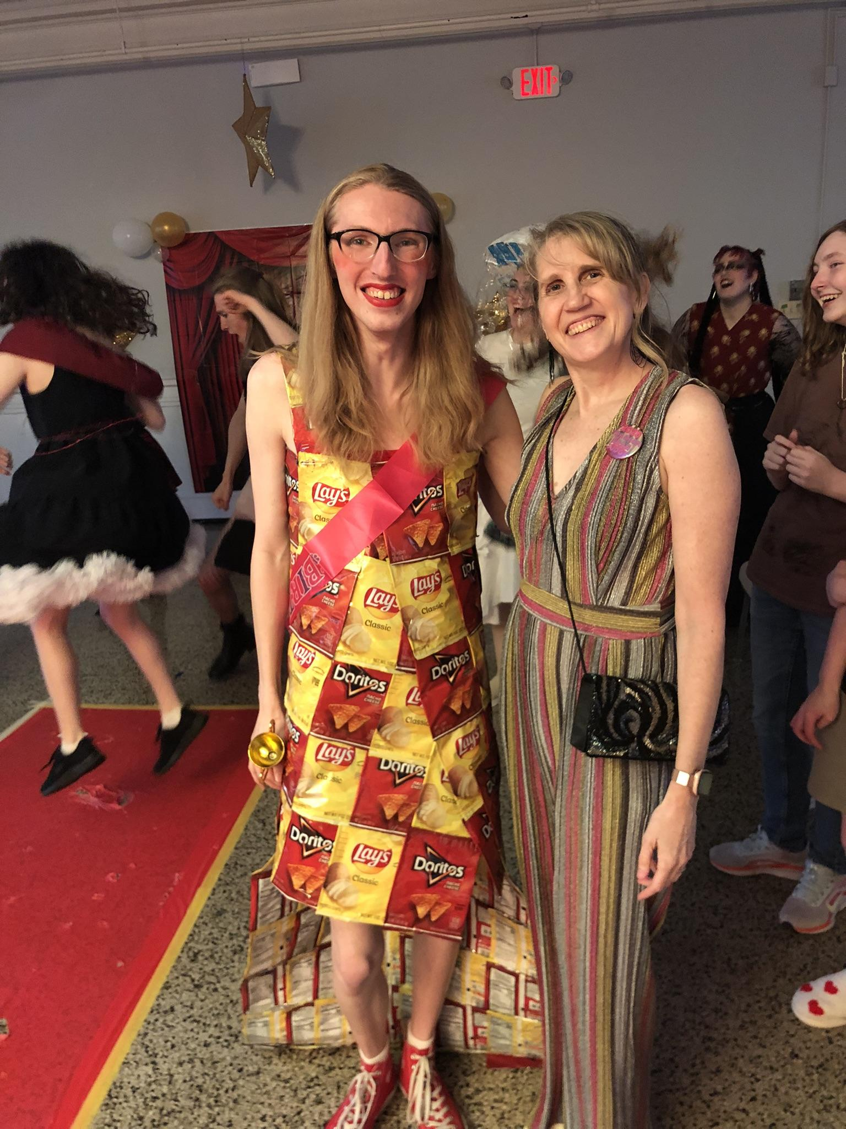
Project: “Trashion” Show (a student club-run event that can be modified for a class) Concepts: Waste management, life cycle, upcycling, fast fashion, environmental justice, marine pollution Can connect to: Lab 9 Anoxic events, Lab 10 Primary Production

Slide 11
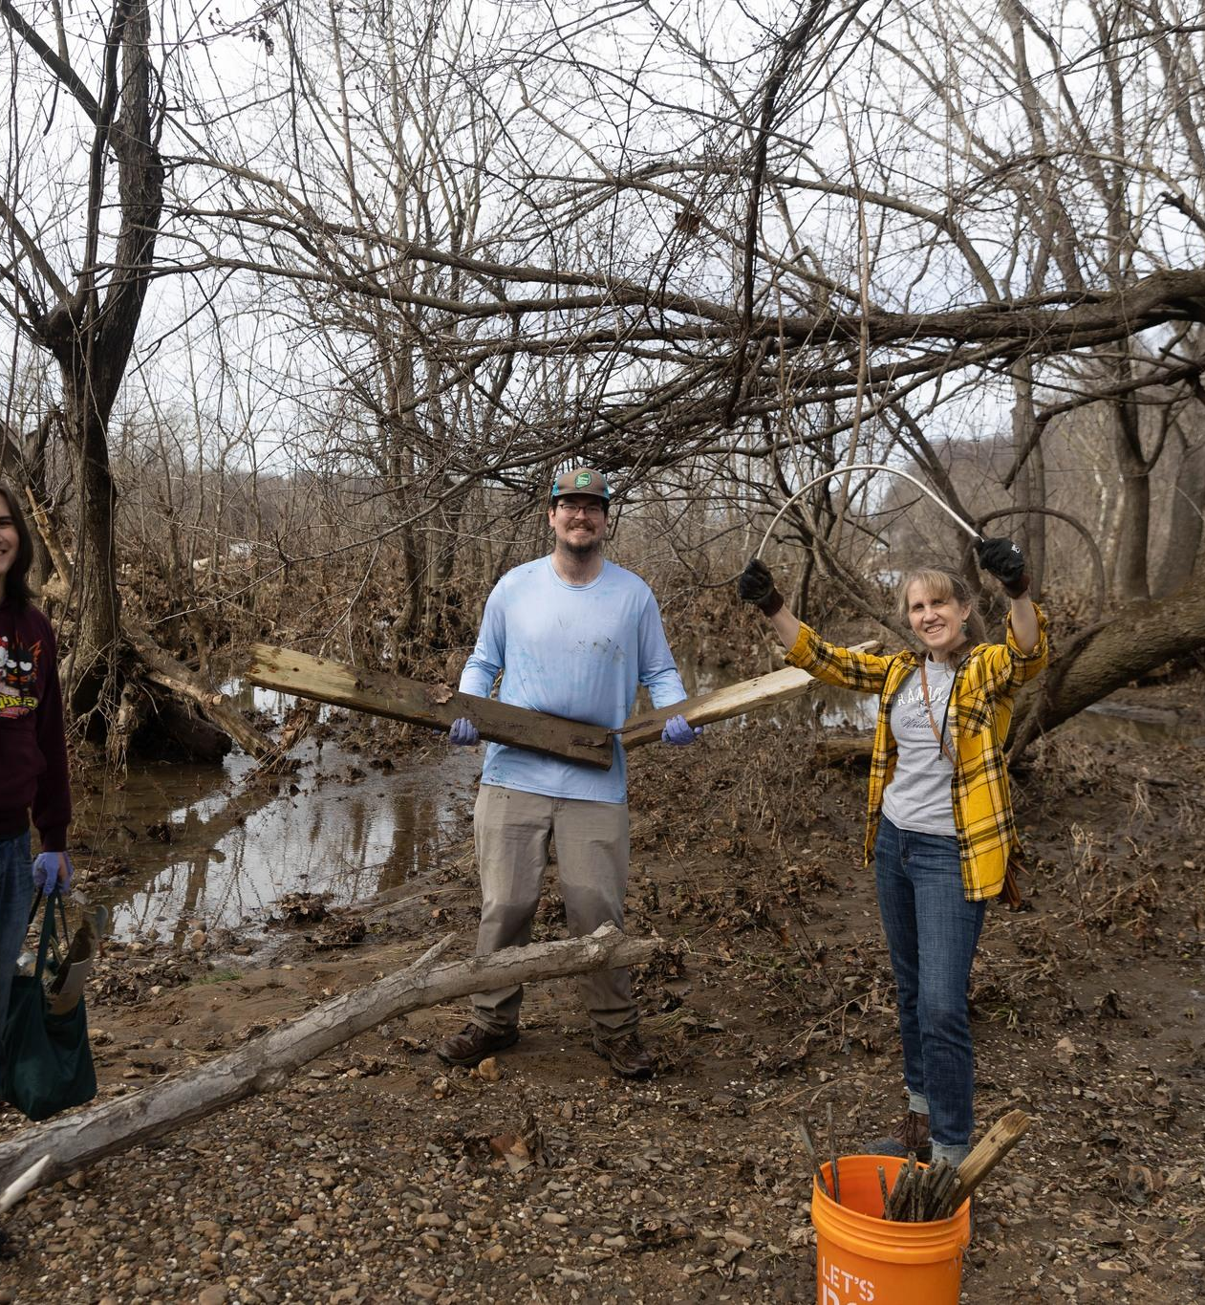
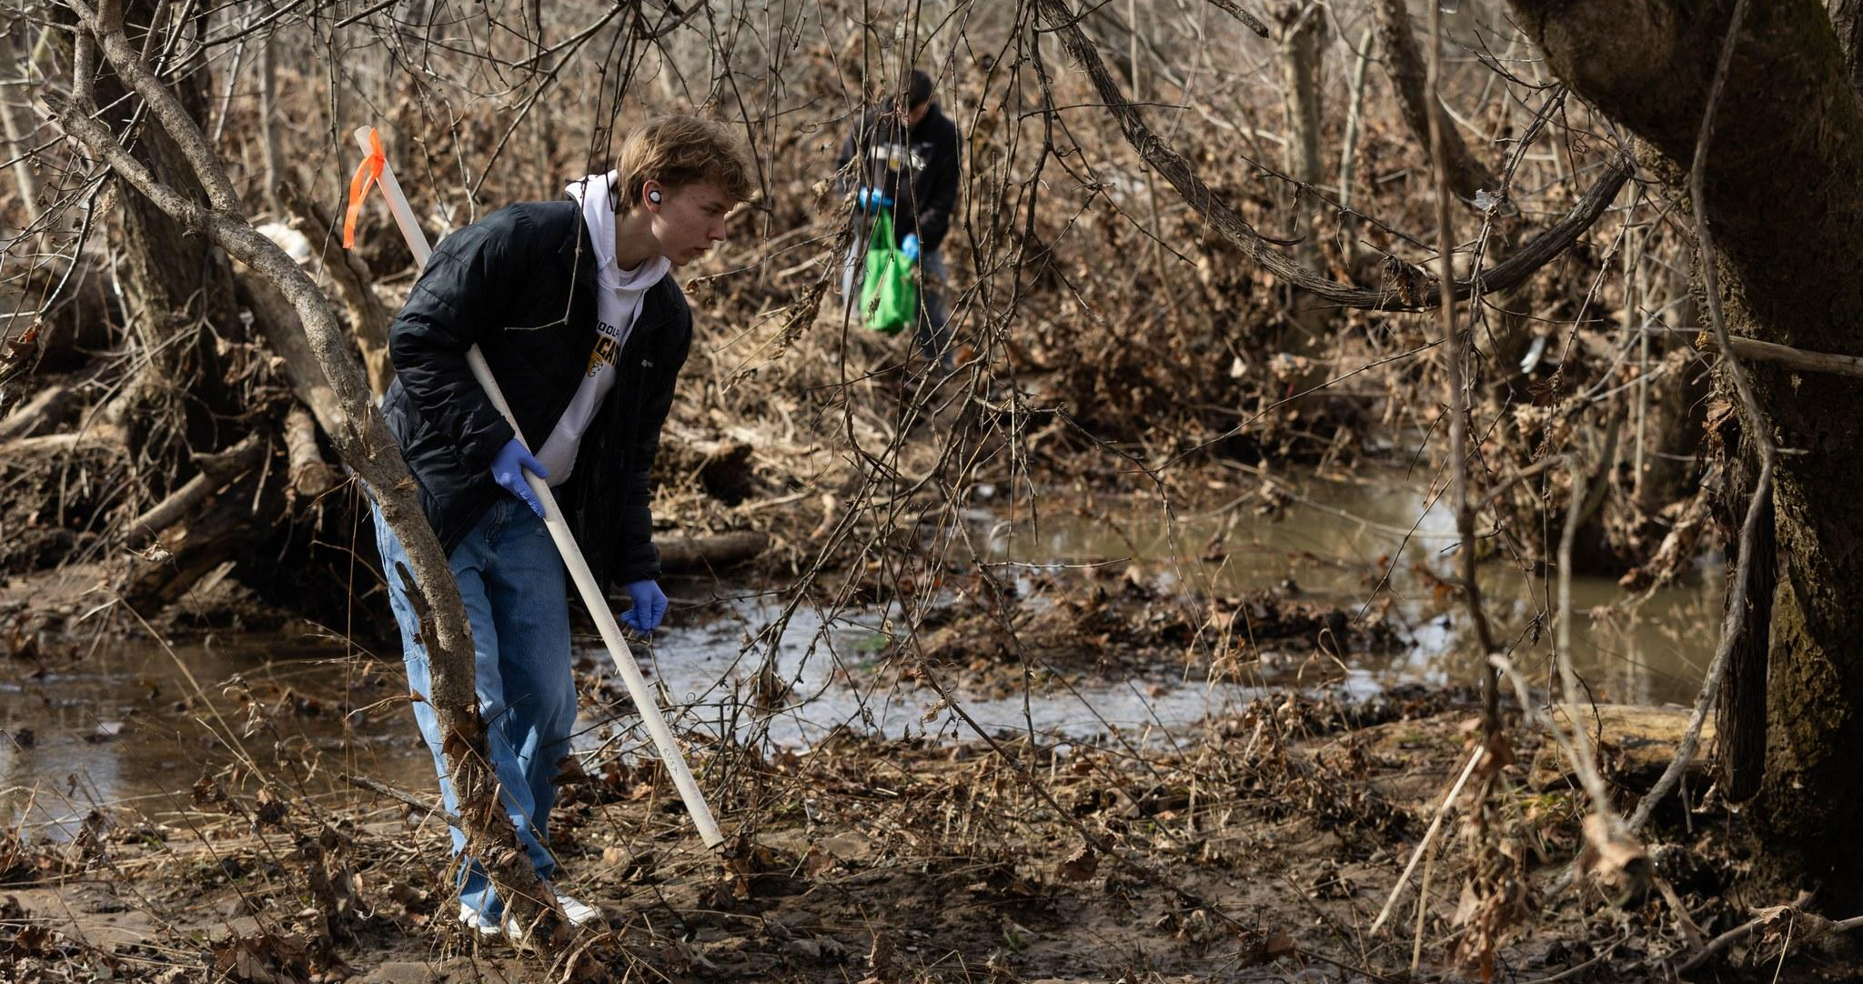
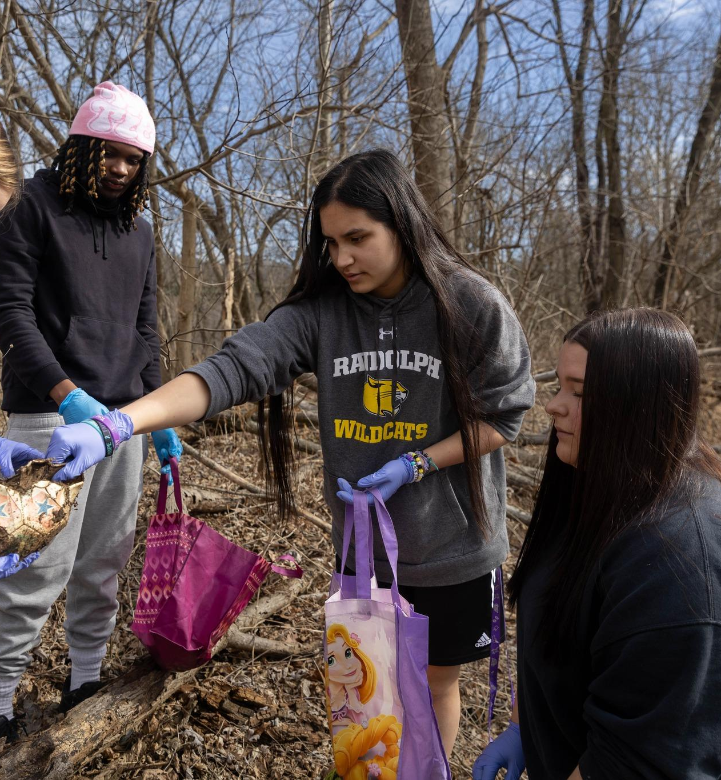
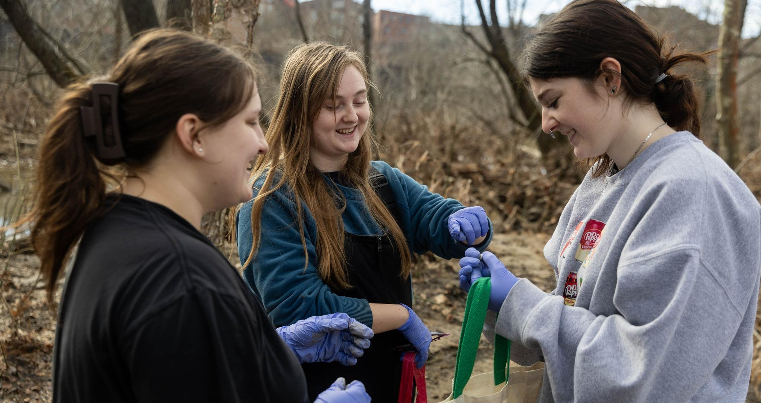
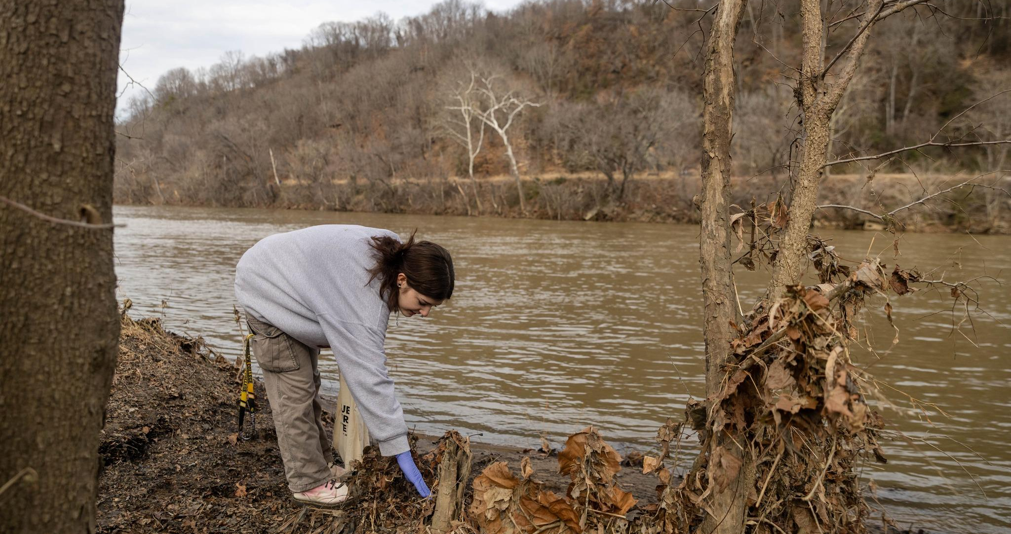
Marine/river debris collection 1-2 hours for collection, 1 hour sorting and inventory and graph construction Modified from Owens, Sarasamma et al., 2022

Slide 12
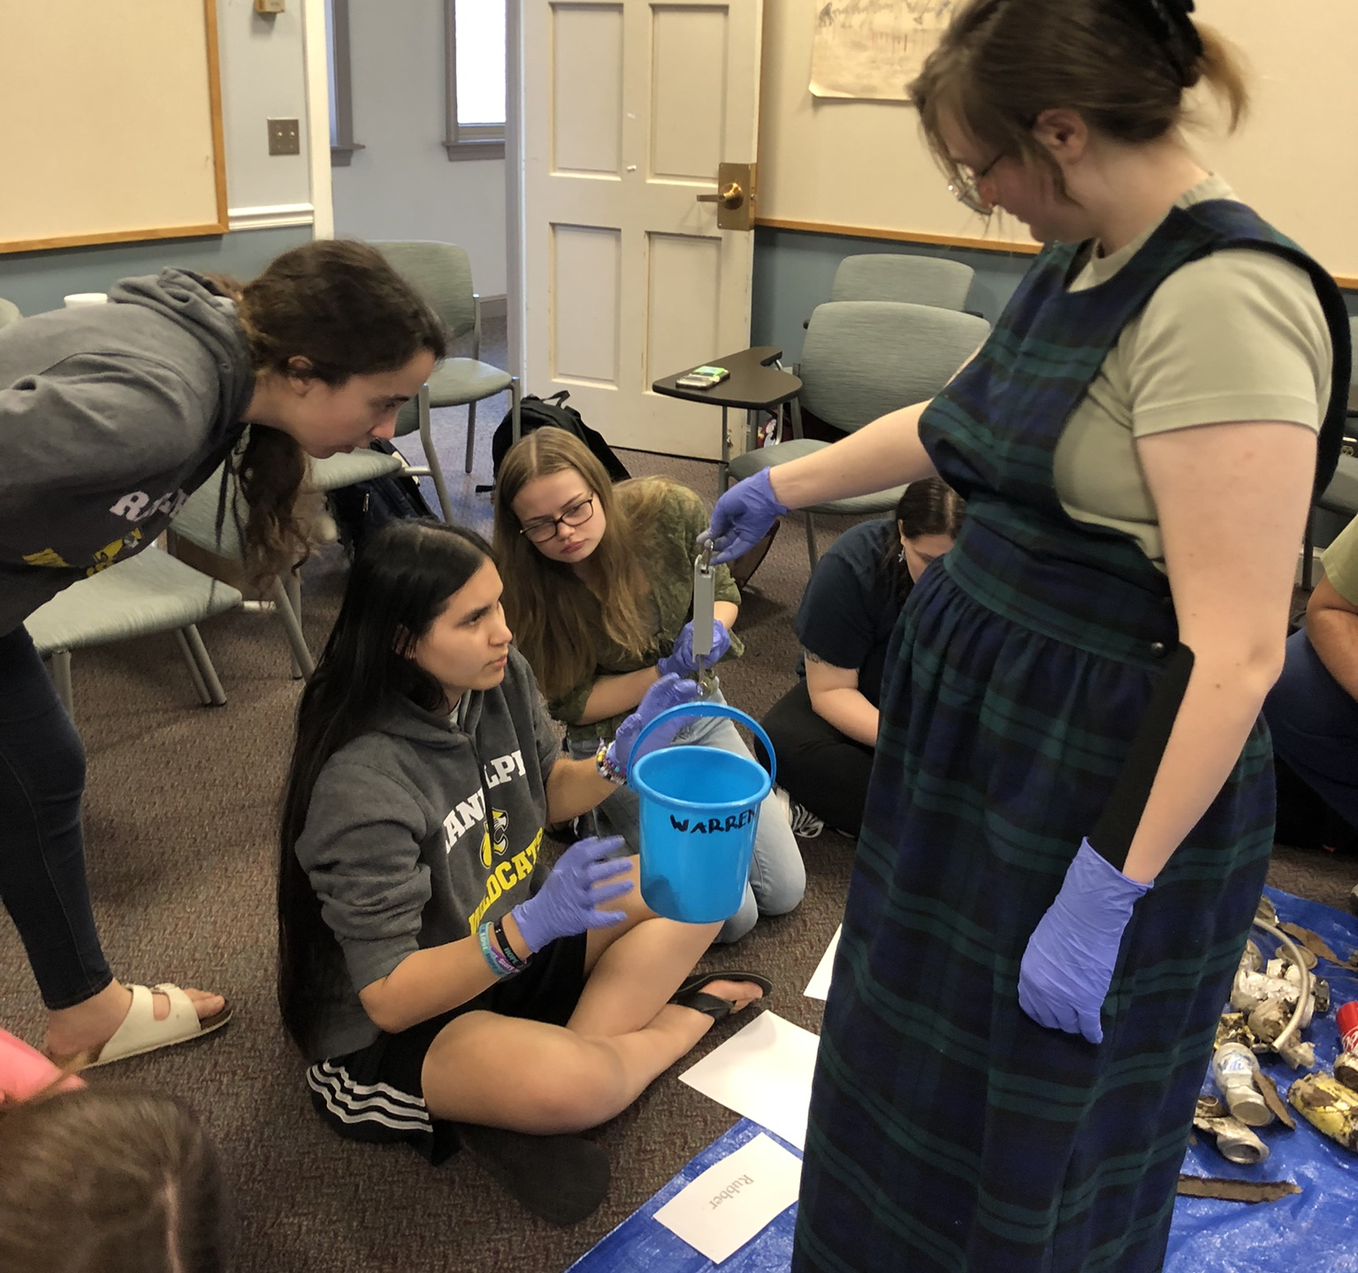
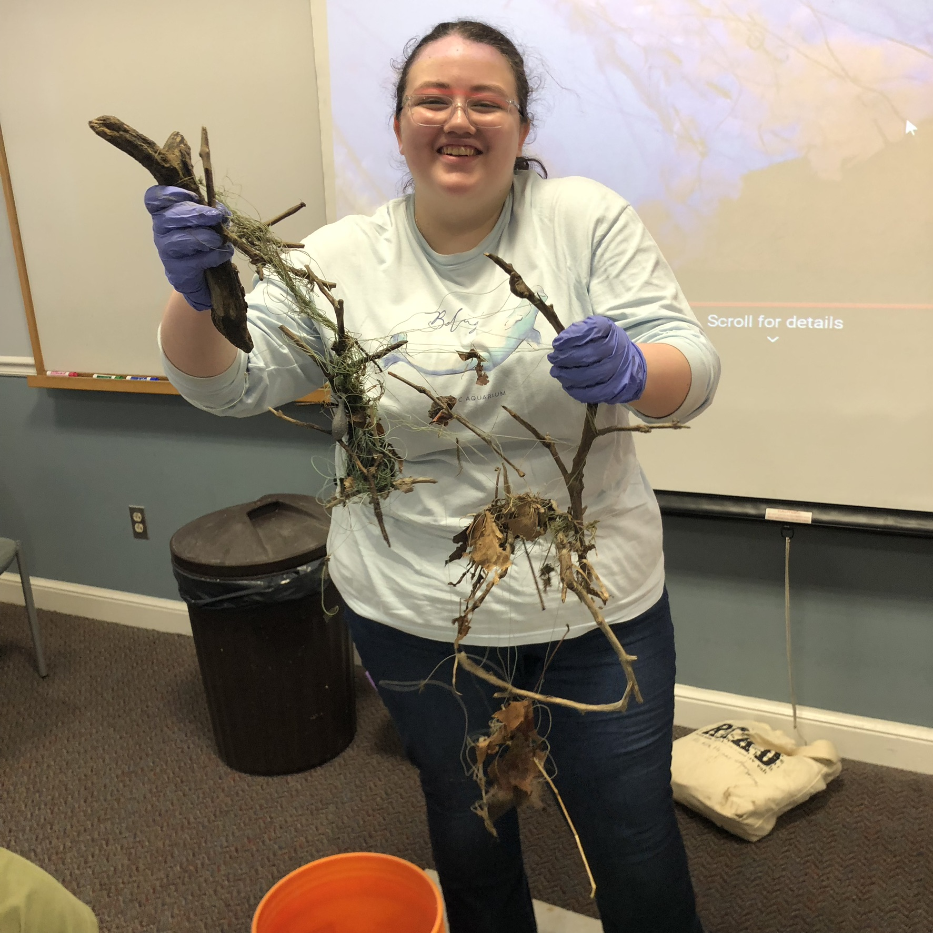
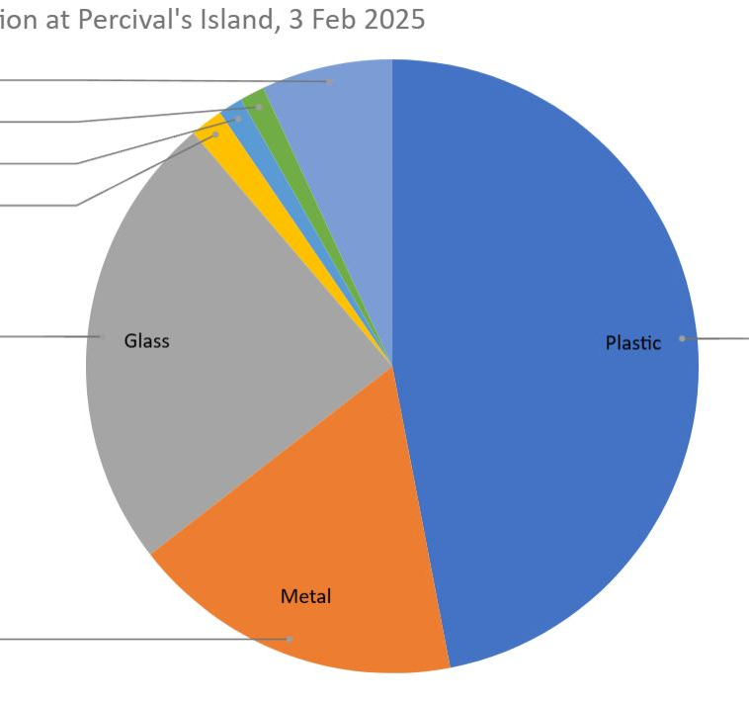
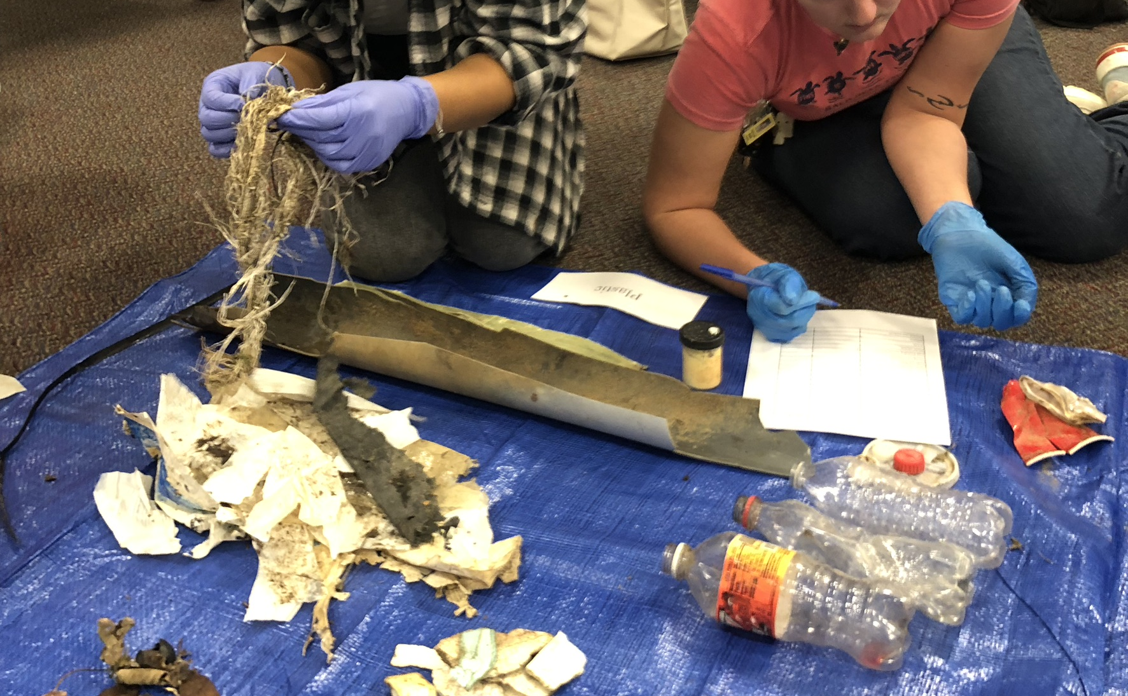
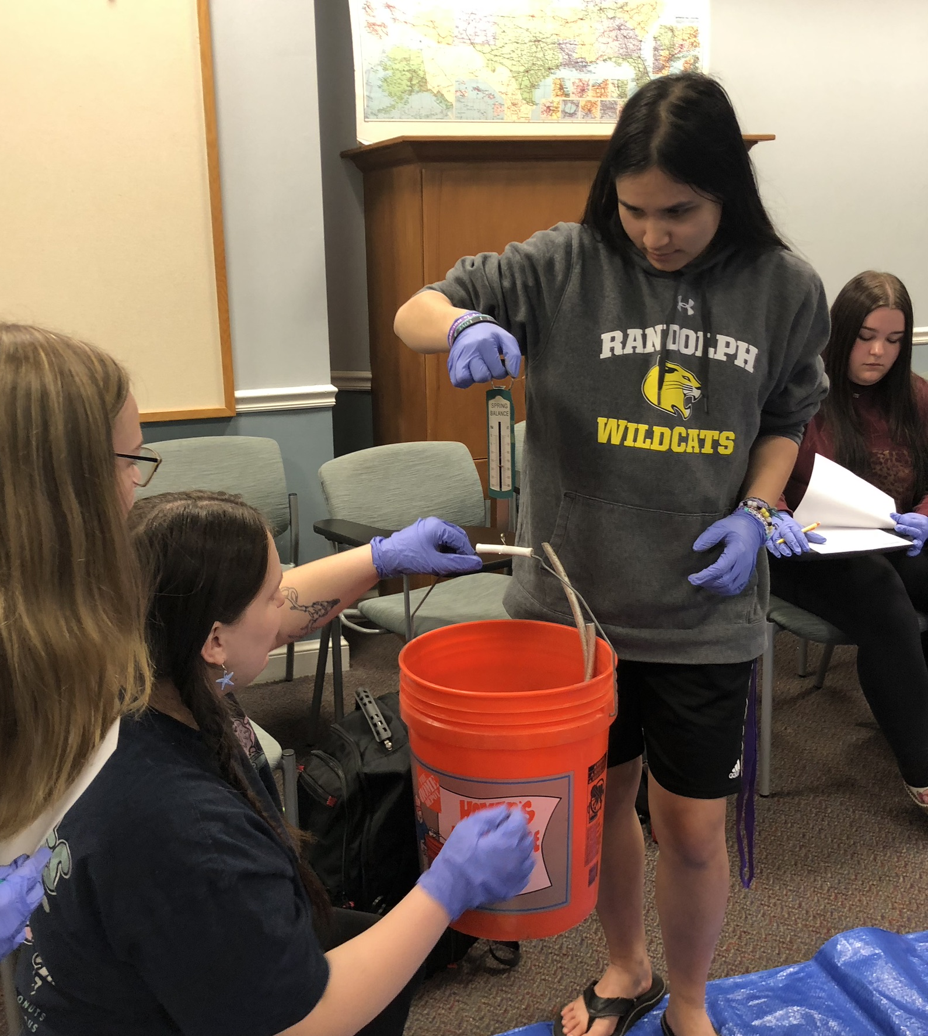
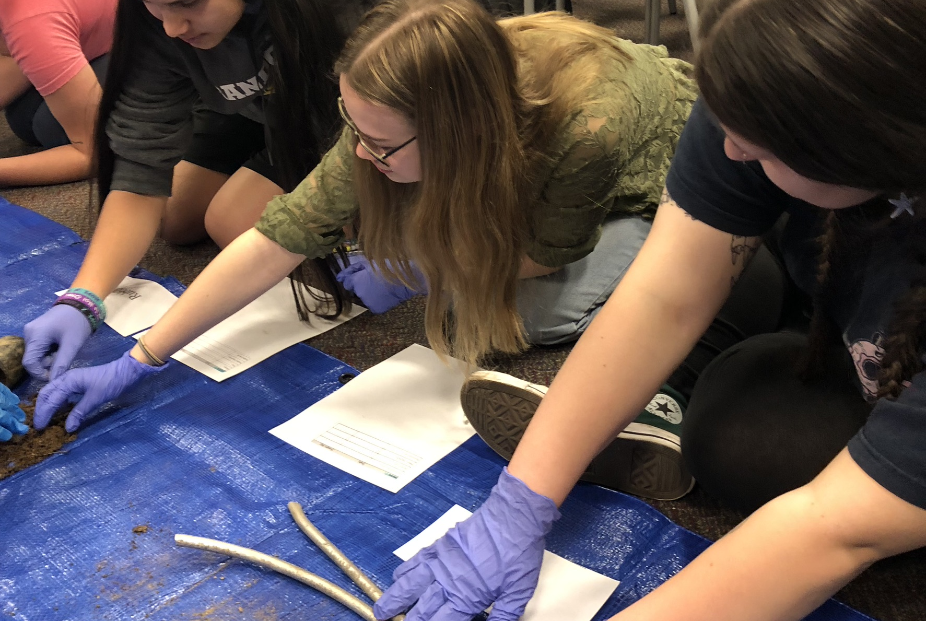
Project example (cont.) Debris Collection and analysis
Concepts:
Watersheds, pollution types & transport, data collection methods and analysis, ecosystem and organism impacts
Can connect to:
Lab 2 Building Data Skills
Lab 9 Anoxic events
Lab 10 Primary Production
Additional opportunity:
Share your data using the Marine Debris tracker app (open data citizen science project)

Slide 13
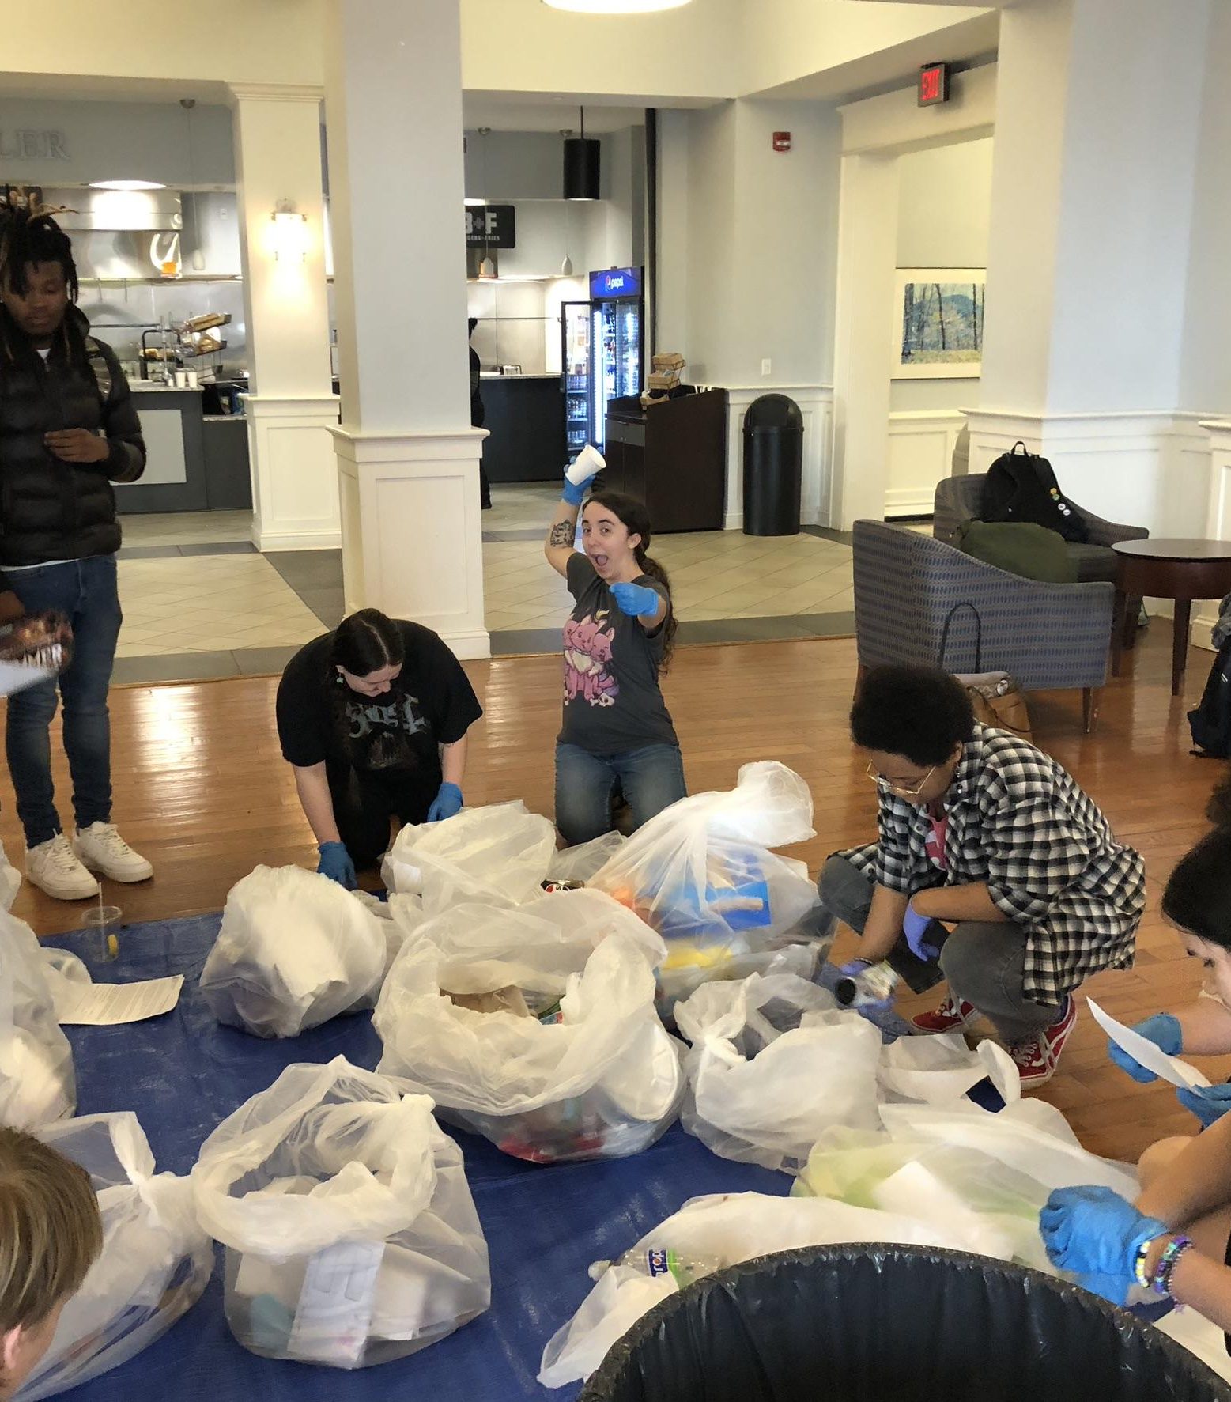
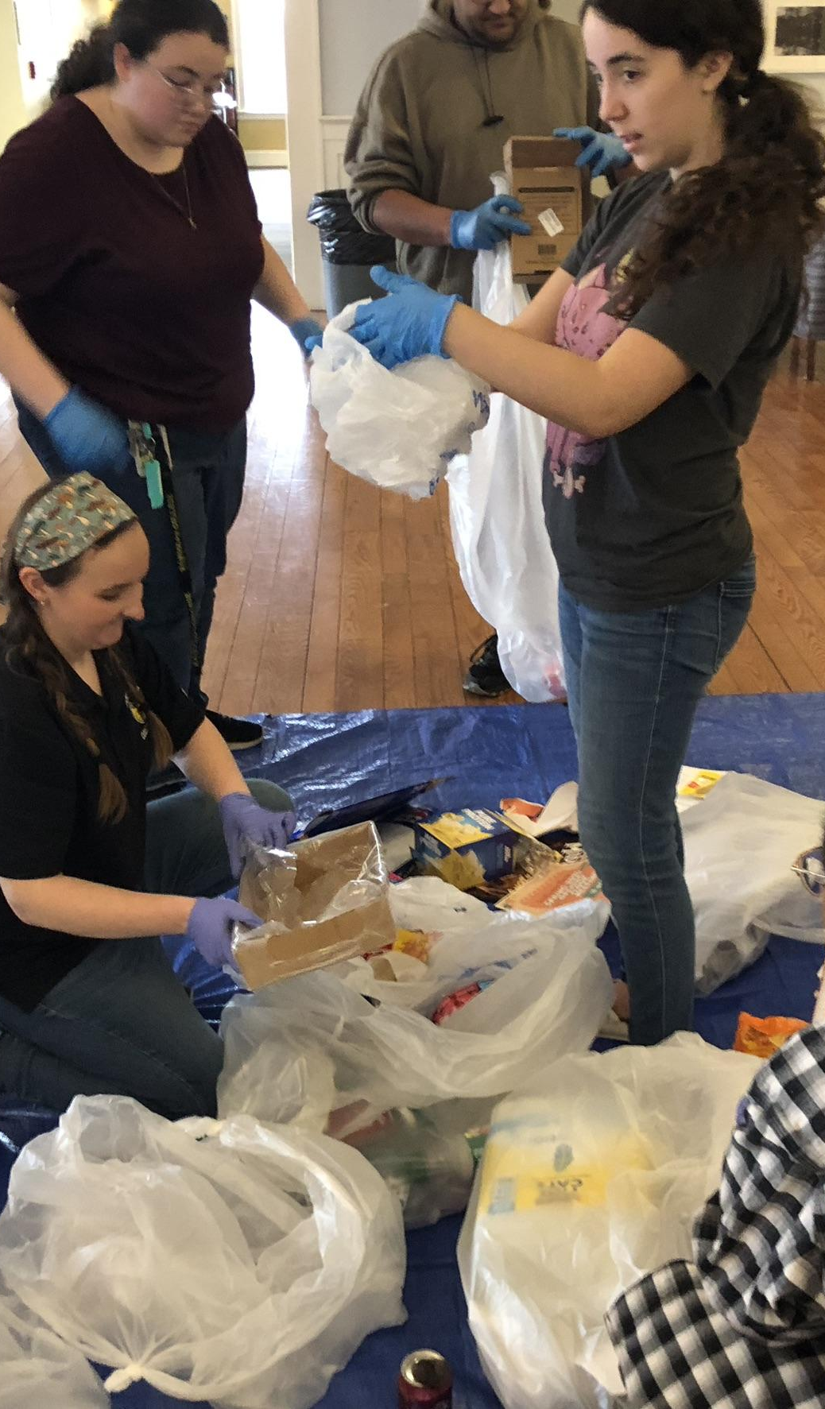
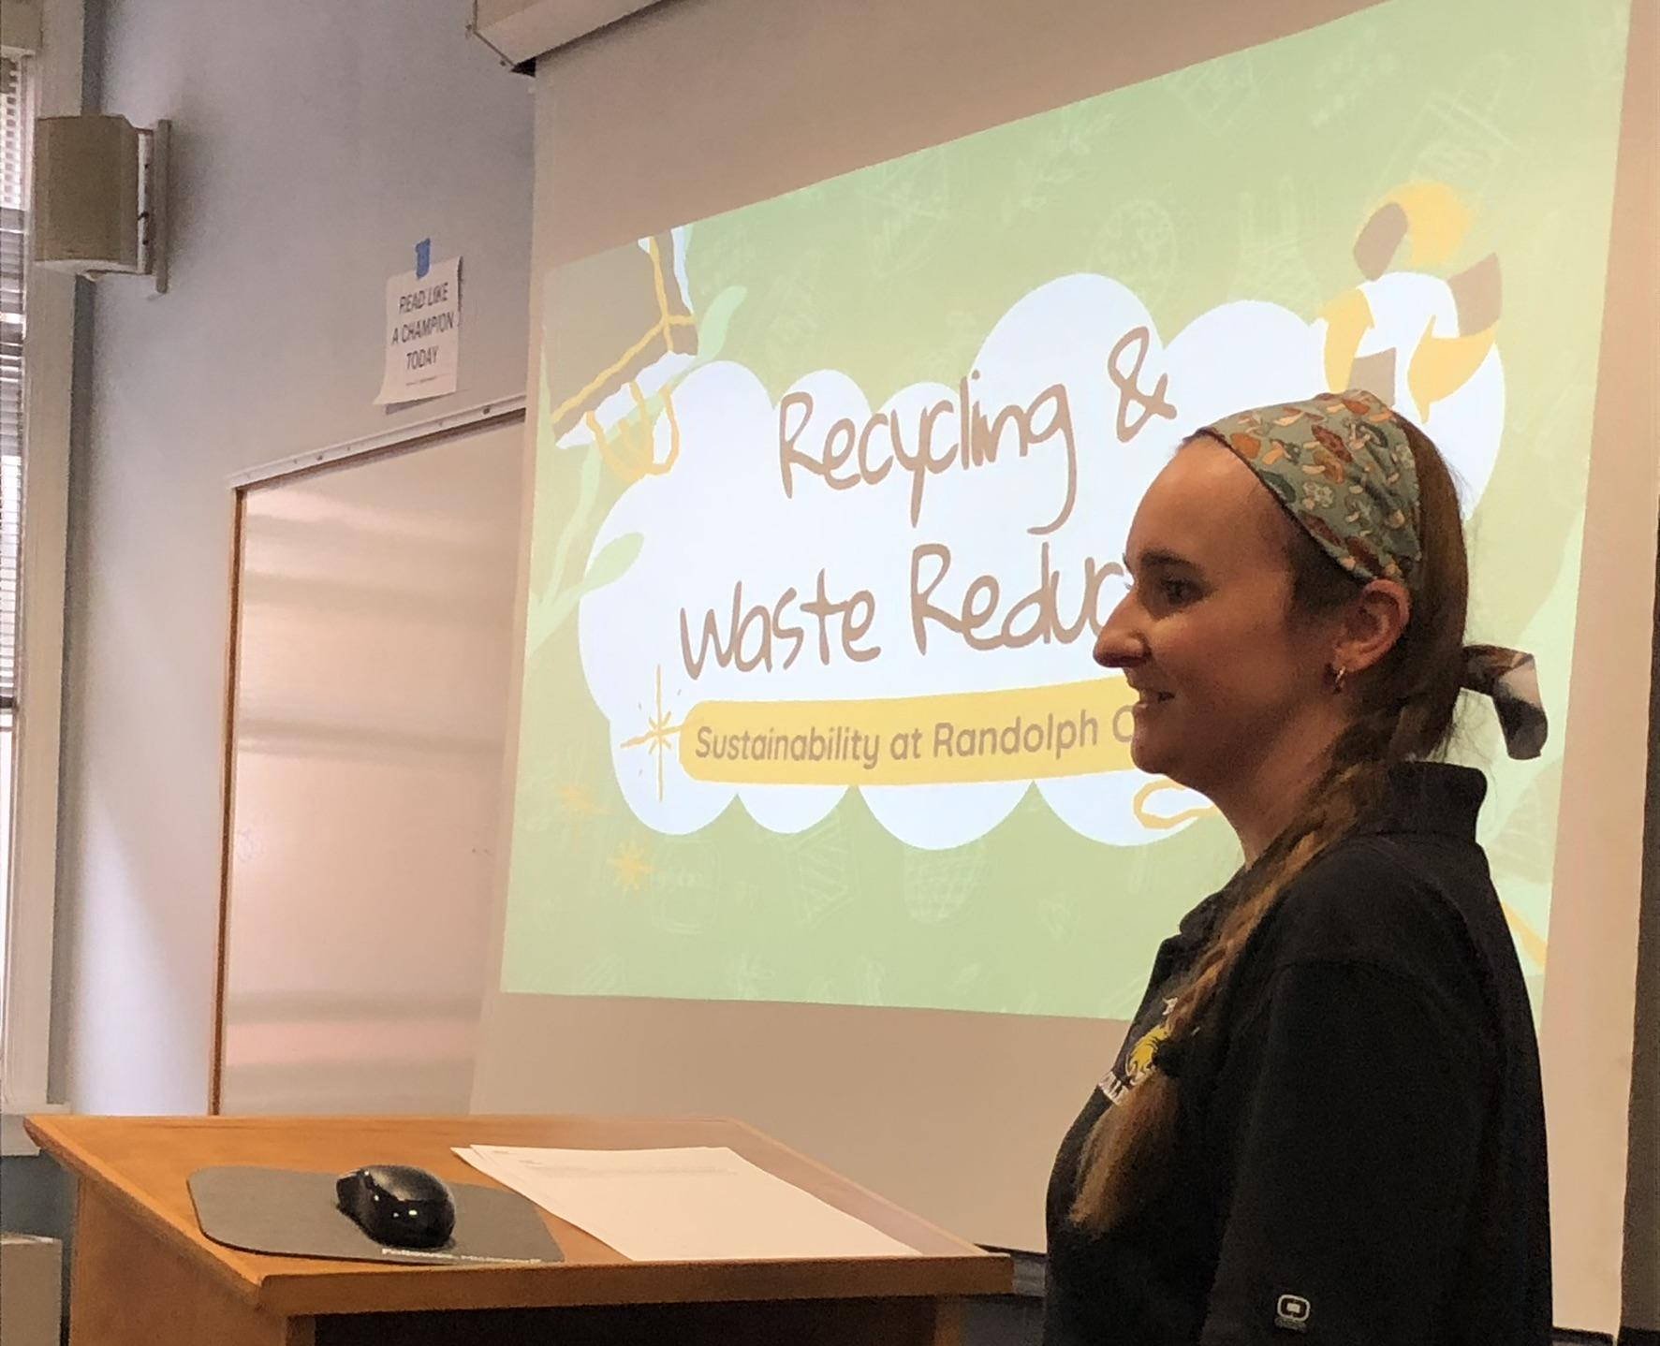
Class example activity: Campus recycling sampling Time: 60-75 minutes Concepts: Solid waste generation and management, water pollution, marine pollution Can connect to: Lab 2 Building Data Skills Lab 9 Anoxic events Lab 10 Primary Production

Slide 14
Demos and activities that take 5-20 minutes

Slide 15
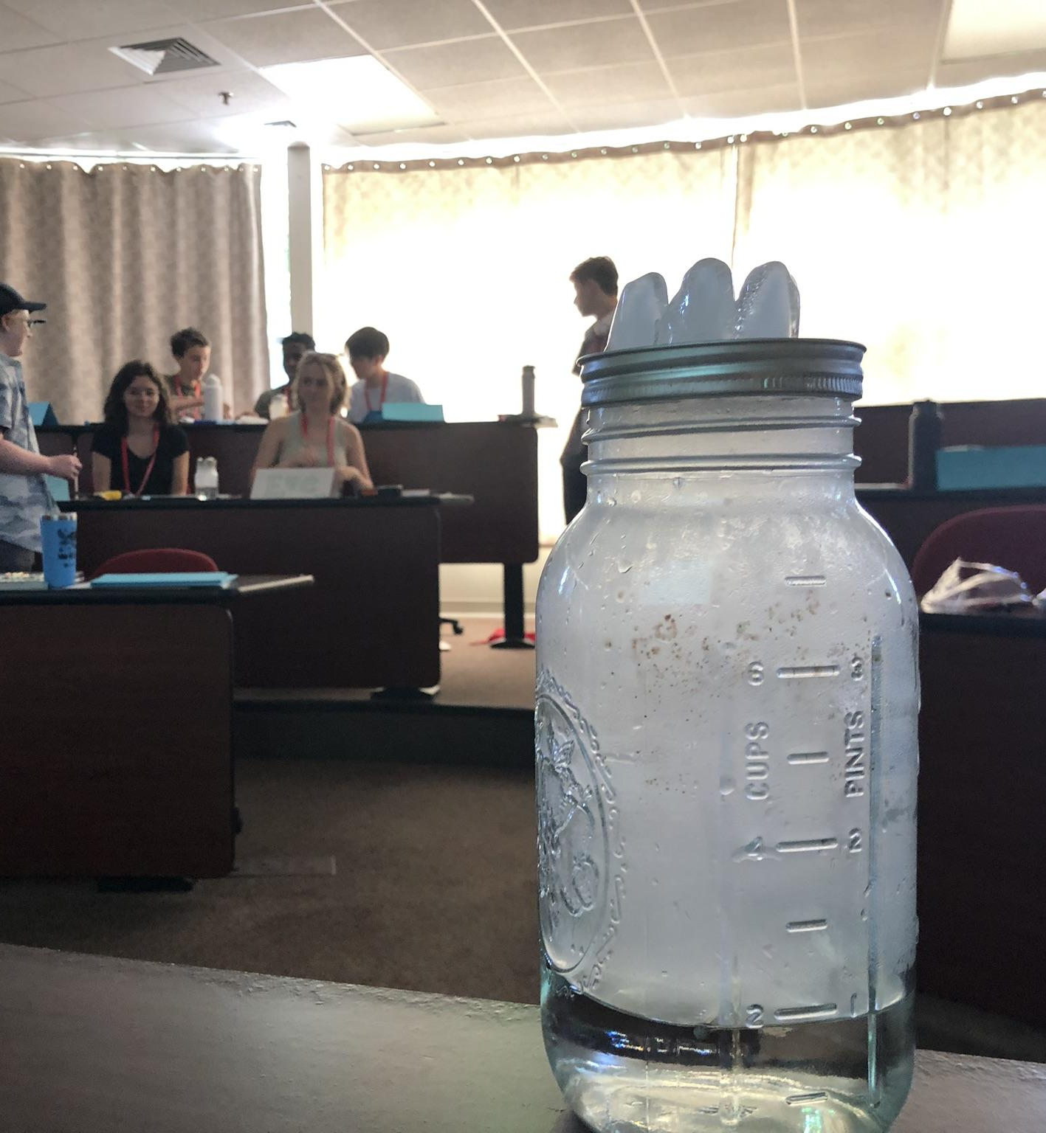
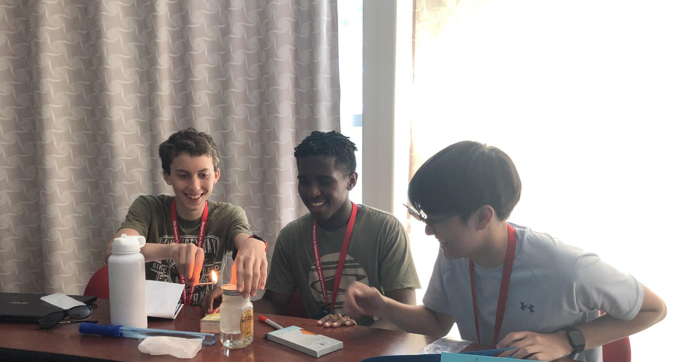
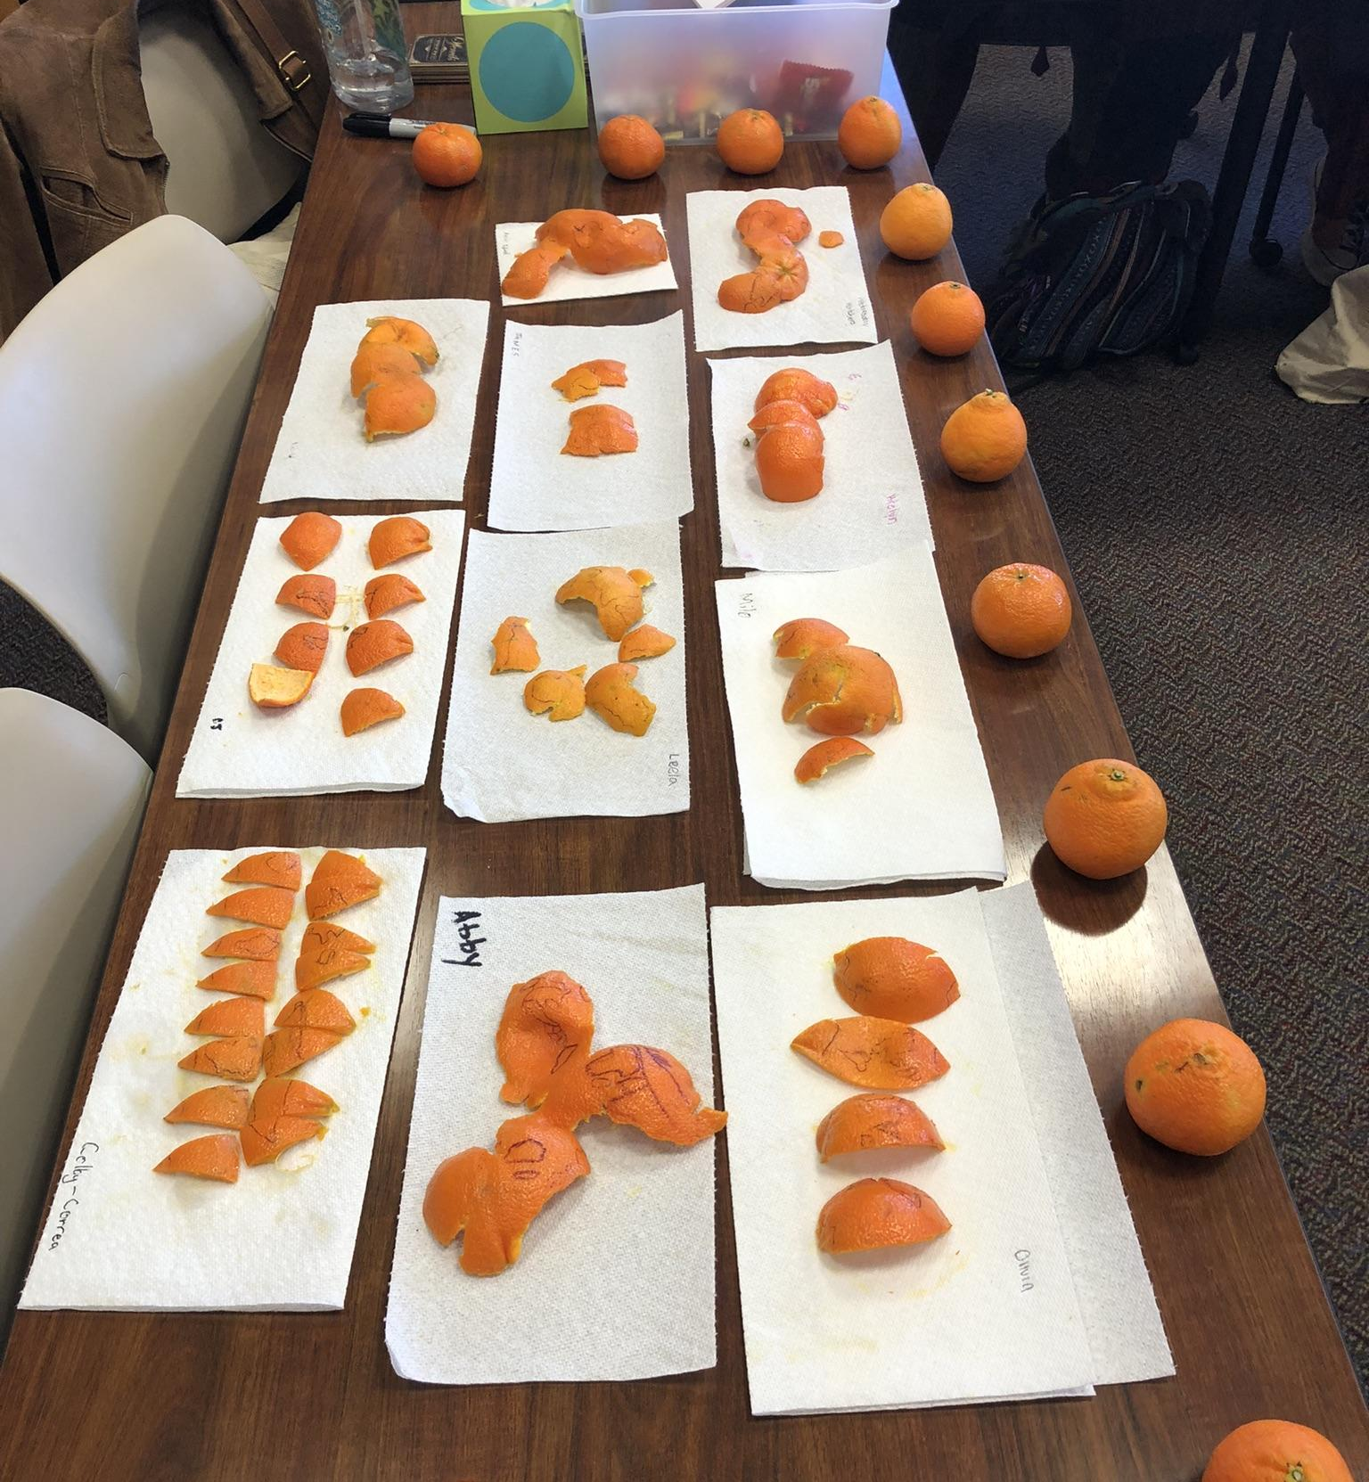
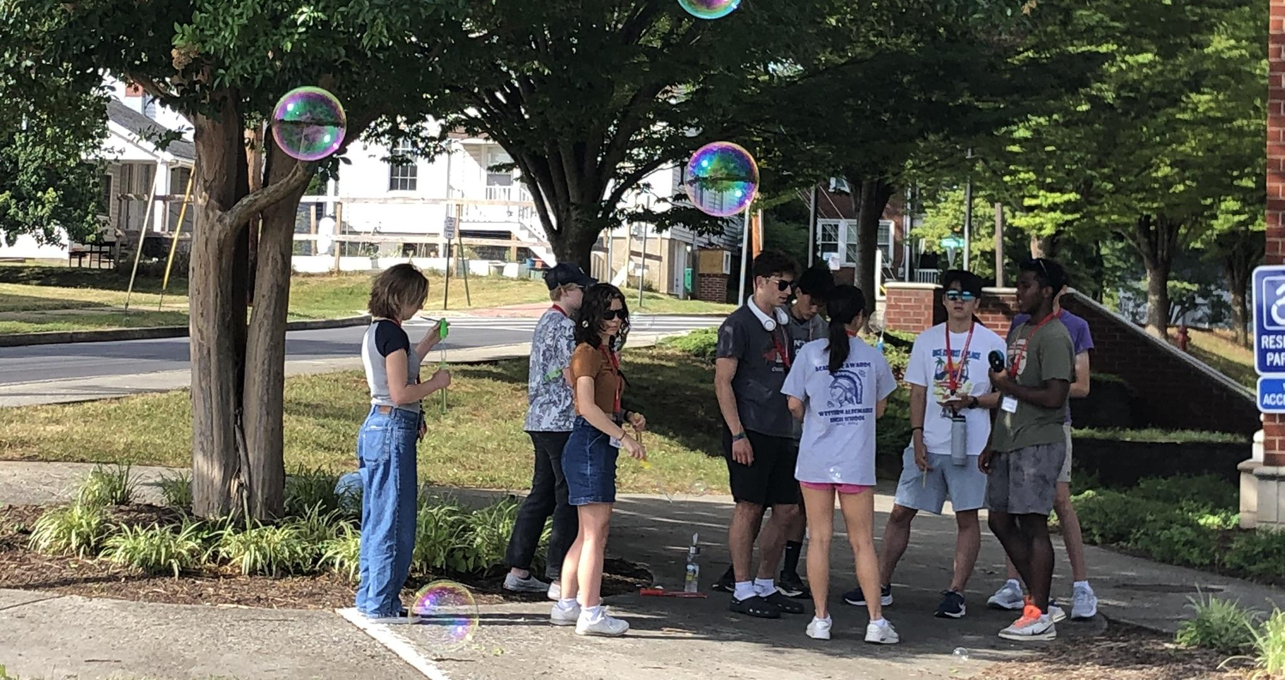
Class activities illustrating physical concepts and dynamics

Slide 16
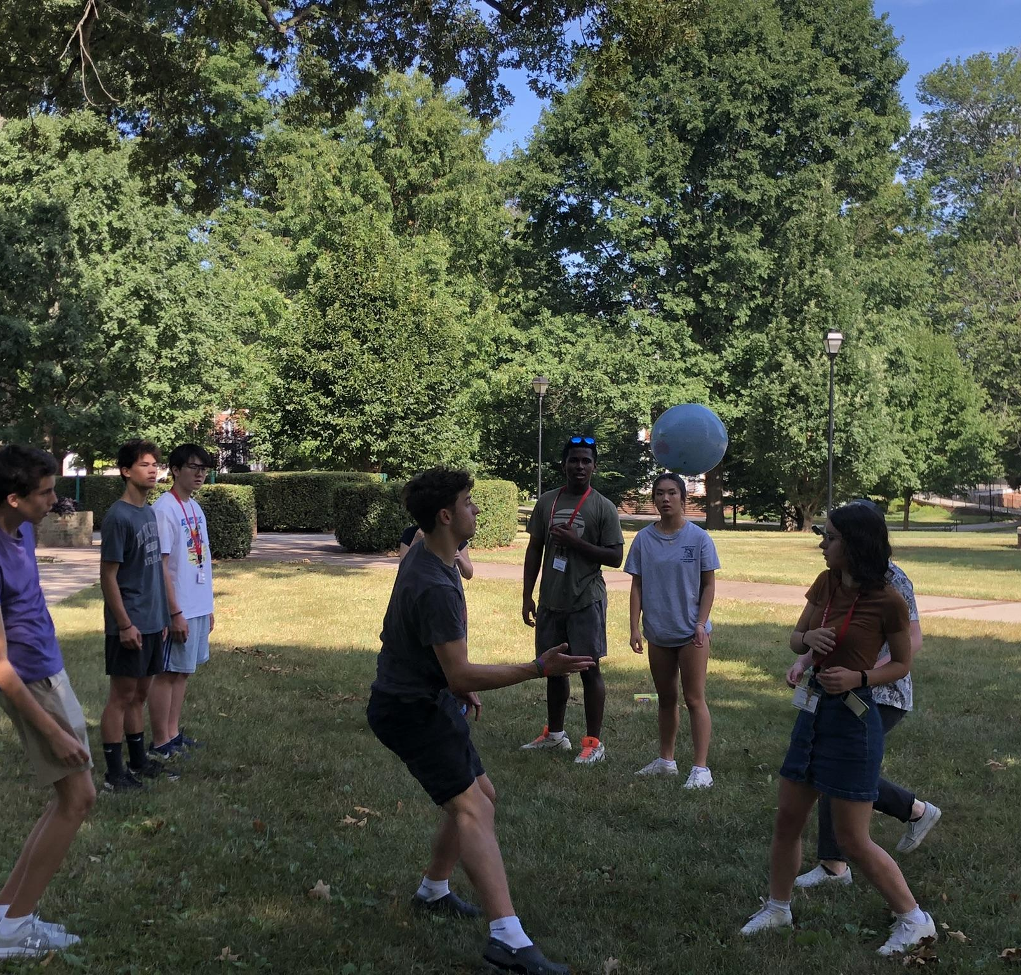
Physical activity examples: Systems Thinking and Dynamics
Dynamic Systems Dance
(source: Project Learning Tree)
Living Loops
(source: Sweeney and Meadows, “The Systems Thinking Handbook”)
Concepts:
Systems thinking, equilibrium, perturbations, system boundaries, characteristic times, positive and negative feedbacks
Can connect to:
Several data labs including Lab 11, 12

Slide 17
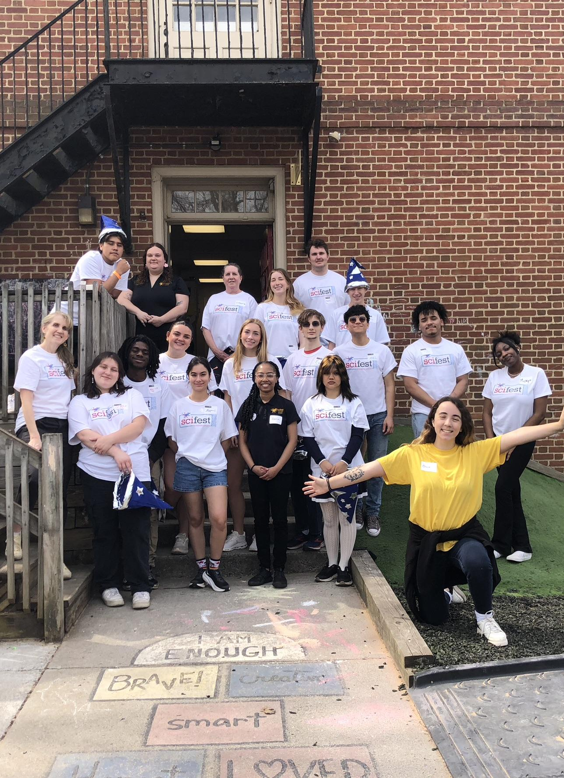
“Ocean in a Bottle”
Concepts: Density, stratification, wave action, gas dissolution, mixing, etc.
Can connect to: Lab 6 Density Stratification, Lab 7 Water Masses, Lab 8 Ocean Physics

Slide 18
Ocean in a Bottle Instructions
Materials
Clear Plastic Water bottle
Baby oil or vegetable oil
Blue food coloring
Small shells, glitter, small plastic ocean creatures
Funnel
Instructions
Fill each bottle halfway with water
Add a few drops of blue food coloring and shake to mix
Fill the rest of the bottle with oil, leaving a bit of air at the top
Drop in shells, glitter, or small plastic ocean creatures
Seal the cap tightly (you can hot glue it for extra security)
What can students explore with this model?

Slide 19
Share-a-Thon time!

Slide 20
Presenters and activities
Jean Anastasia Visualizing Ocean Currents | Anna Pfeiffer-Herbert Density stratification, thermohaline circulation
Jenna Lee Visualizing ocean thermal expansion | Denise Bristol Sea level rise: Glacier versus Iceberg
Tracy Quan Ocean acidification | Tim Macaluso Sea Water Analysis, Plankton, Density
Liz Sargent Moon Phases, Sinking Rates | Silke Severmann Density, Temperature and Salinity
Kari Benson Coriolis Effect, Wave Action | Kristen Coolbear Escape Room

Slide 21
Acknowledgements
Thank you to Dr. Katharine Owens, University of Hartford, katwowens.com, for plastic collage project inspiration/support and riverbank sampling resources and protocols
Original artwork by Elizabeth Parsons ’25 and Nella Pepelko ‘28
Dr. Laura-Henry Stone for recommending systems thinking exercises (Living Loops)
Dr. Sarah Sojka, Randolph College
Little Scientists Head Intern, Iyana Corbett ’26 (ocean in a bottle activity)
My undergraduate students at Randolph College and my HS students at the Virginia Summer Governor’s School for Science and Technology
All photos are from K. Warren, S. Sojka, or Randolph College photographer Jill Nance Waugh
References:
S. Hrach, 2021, “Minding Bodies”: How Physical Space, Sensation, and Movement Affect Learning”, West Virginia University Press
Owens, K. , J. Sarasamma, Sustainability 2022, 14(3), 1928; https://doi.org/10.3390/su14031928
Sundstrom, Ramos, Zastavker, and Venkatesh, 2024, WIP: Contemplative Practices' Effects on Compassion, Belonging, and Self-Empowerment in Undergraduate Engineering Experiences, 2024 IEEE Frontiers in Education Conference (FIE), 10.1109/FIE61694.2024.10893487
Sweeney, L. and D. Meadows, The System Thinking Playbook, Chelsea Green Publishing 2010

Slide 22
Some resources
SREC, https://serc.carleton.edu/sp/carl_ltc/teaching_resources/index.html
Project Learning Tree, https://www.plt.org/
Teaching physical concepts in oceanography: an inquiry-based approach https://tos.org/oceanography/assets/images/content/teaching_phys_concepts.pdf
NASA Global Climate Change teaching resources, https://climate.nasa.gov/for-educators/

