Slide 1
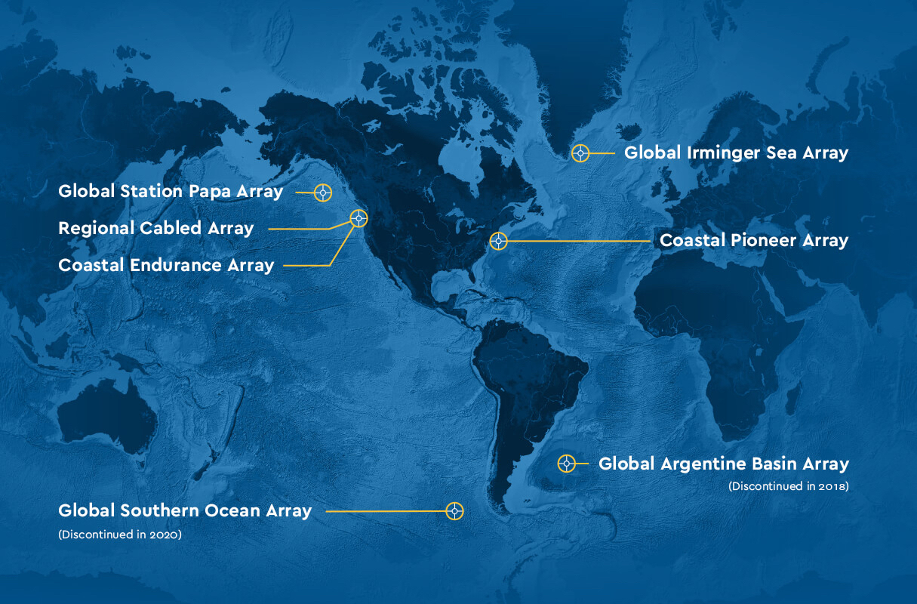
Data Labs Design Workshop
2025
Grand Hotel
Cape May, NJ
datalab.marine.rutgers.edu

Slide 3
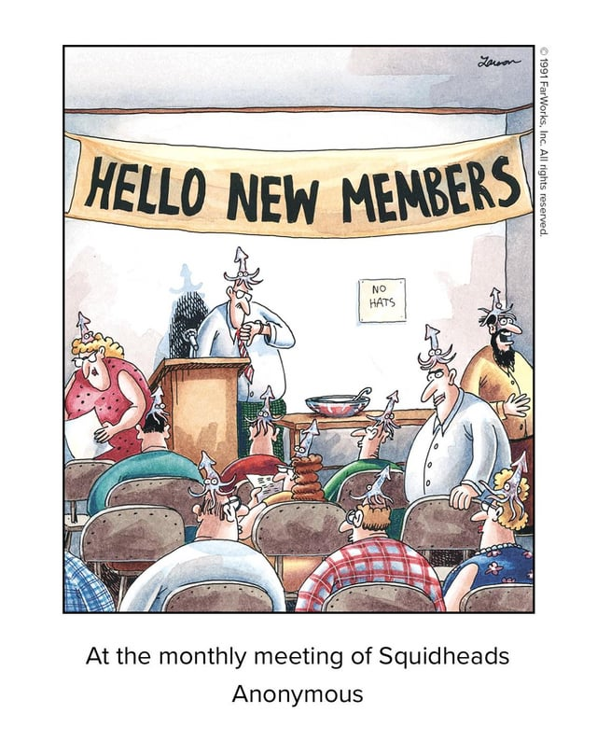
Welcome Friends…
Old and New

Slide 4
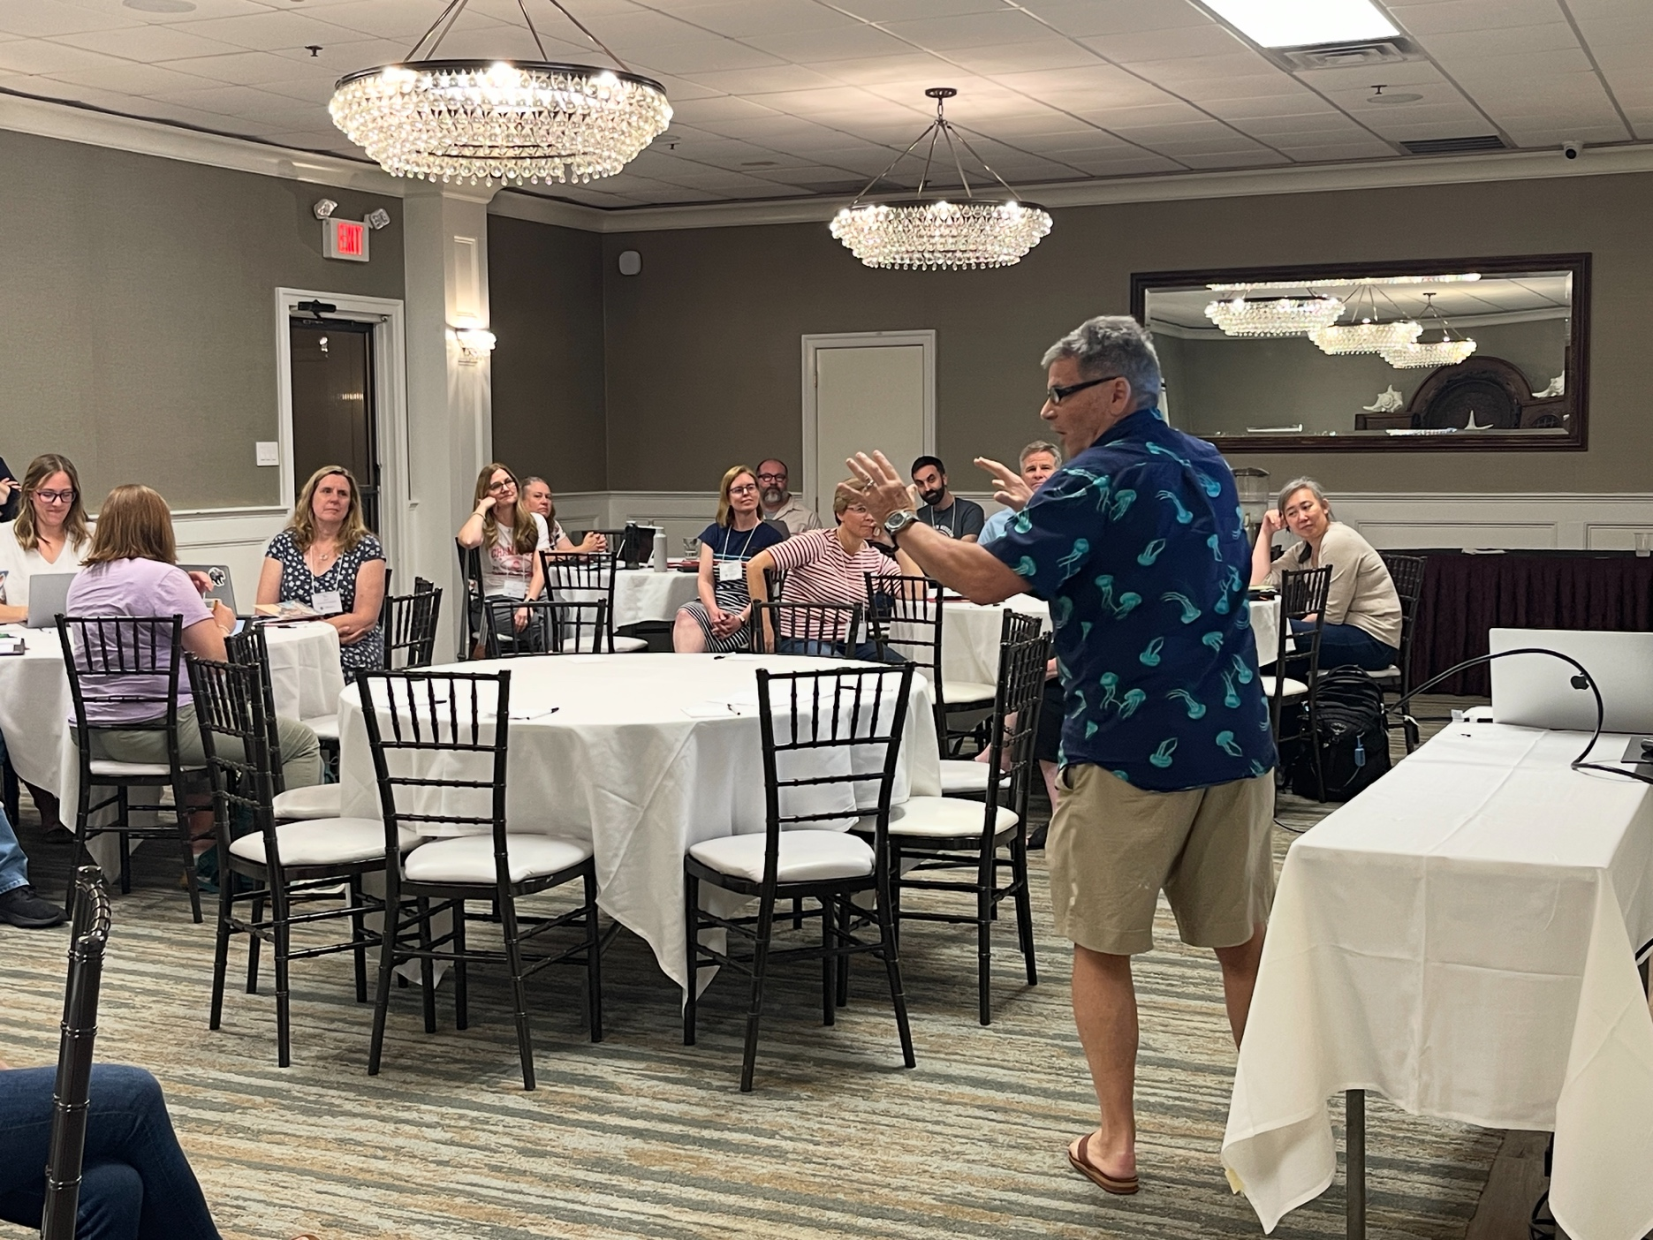
What did we accomplish?
Sunday Day 0
Exploring Learning Cycles
Thank you Paul and Troy!

Slide 5
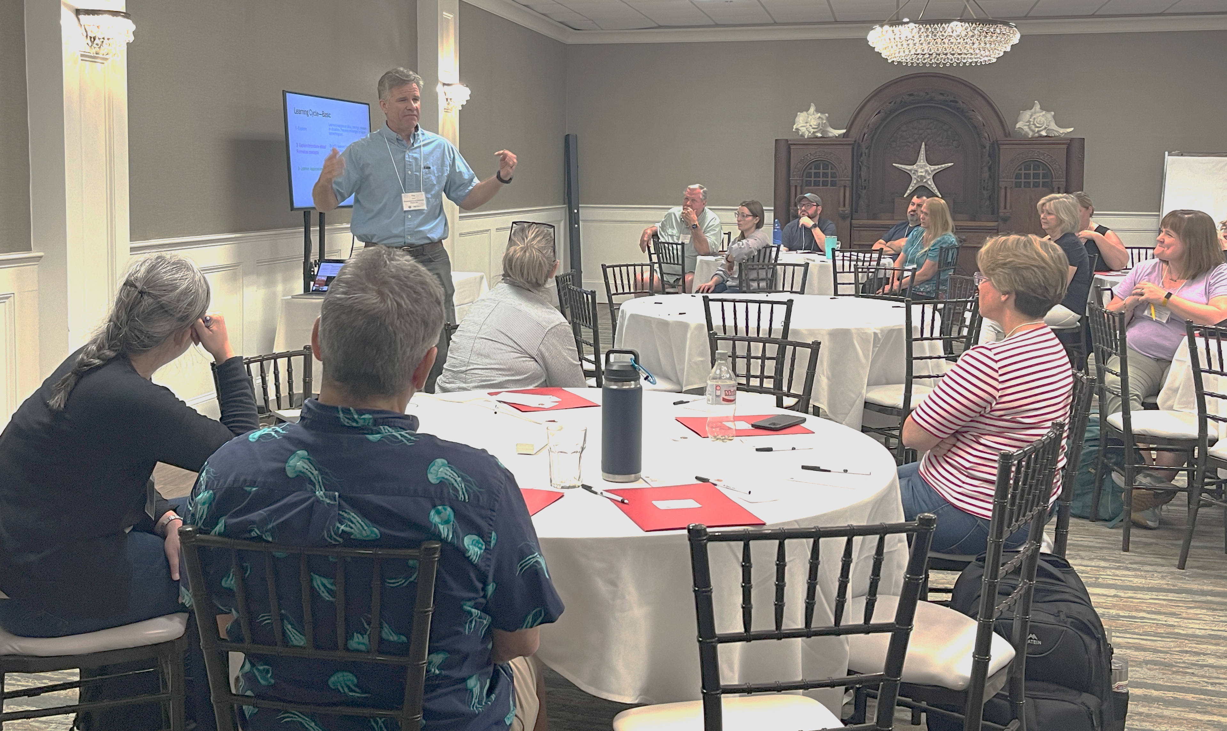
TROY HERE

Slide 6
Monday Day 1 – Divide and Conquer
Authors were off to edit and collaborate!

Slide 7
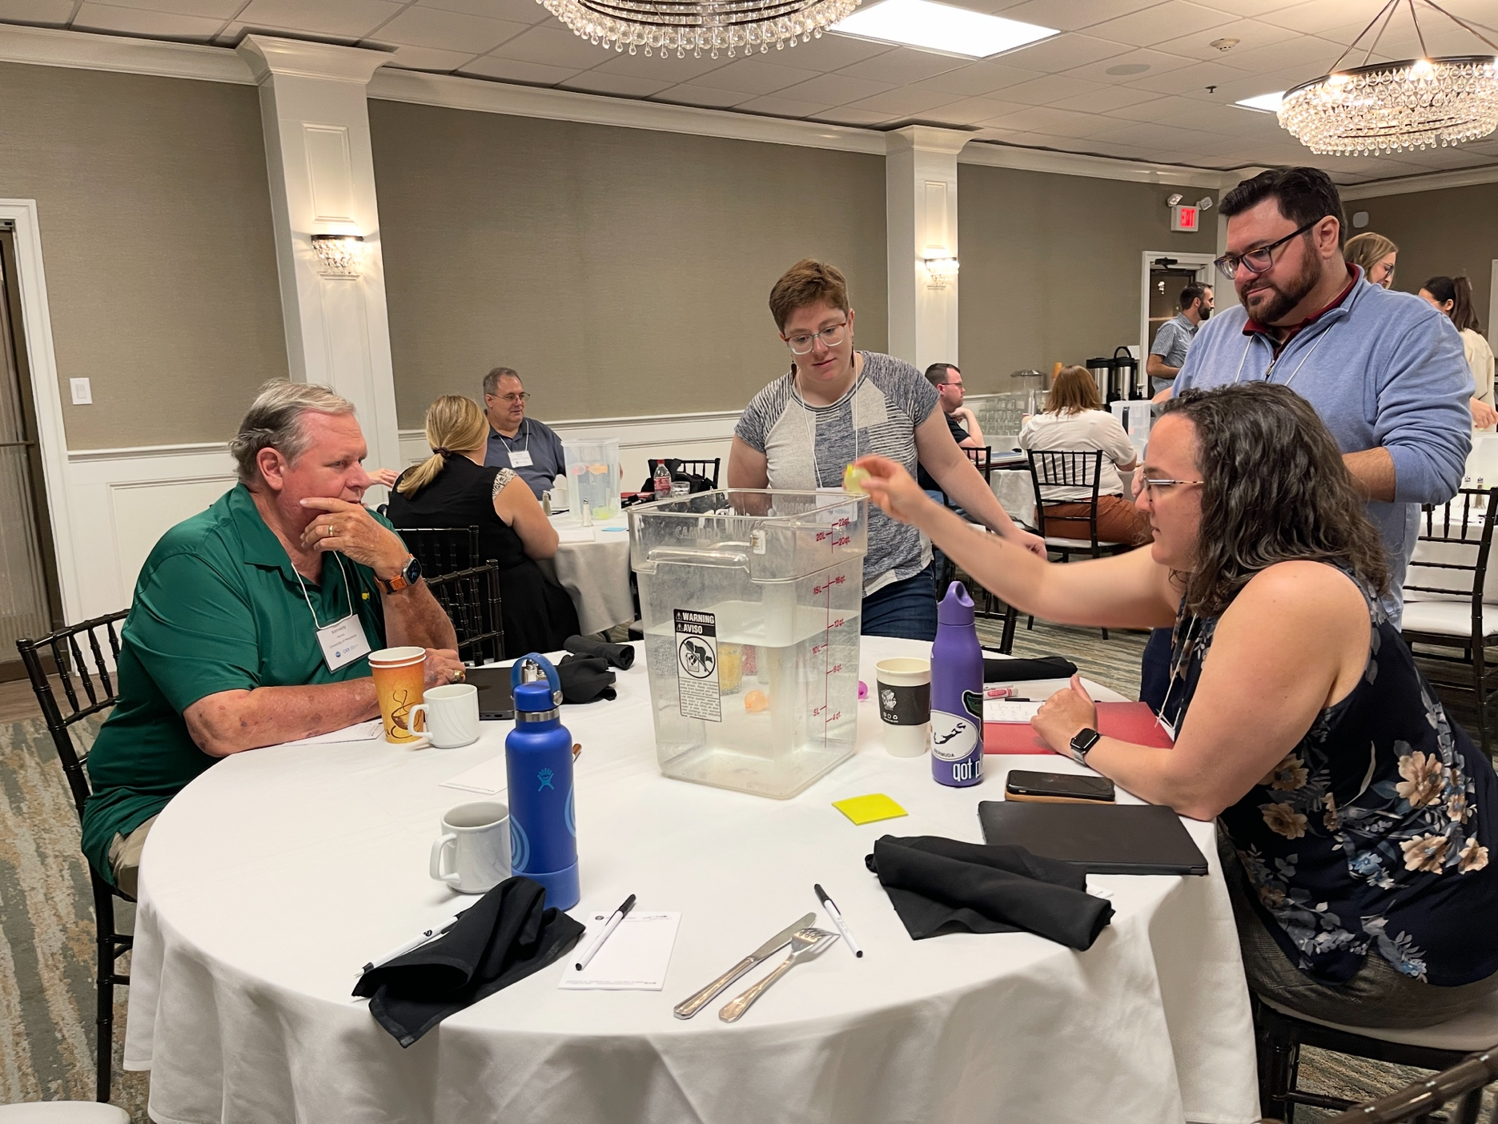
Explored what it was like to be a student learner
Nonsense Data
2. Explore Learning Cycles
Salinity explorations
3. Asking questions
QFT

Slide 8
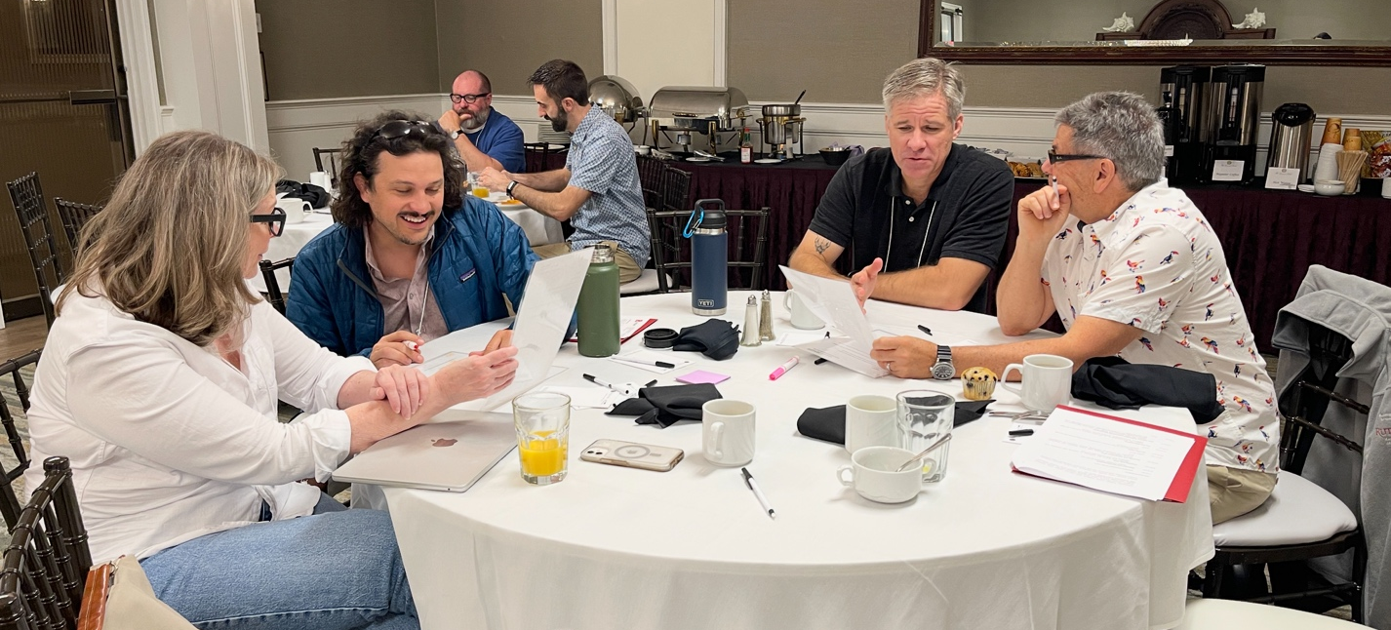
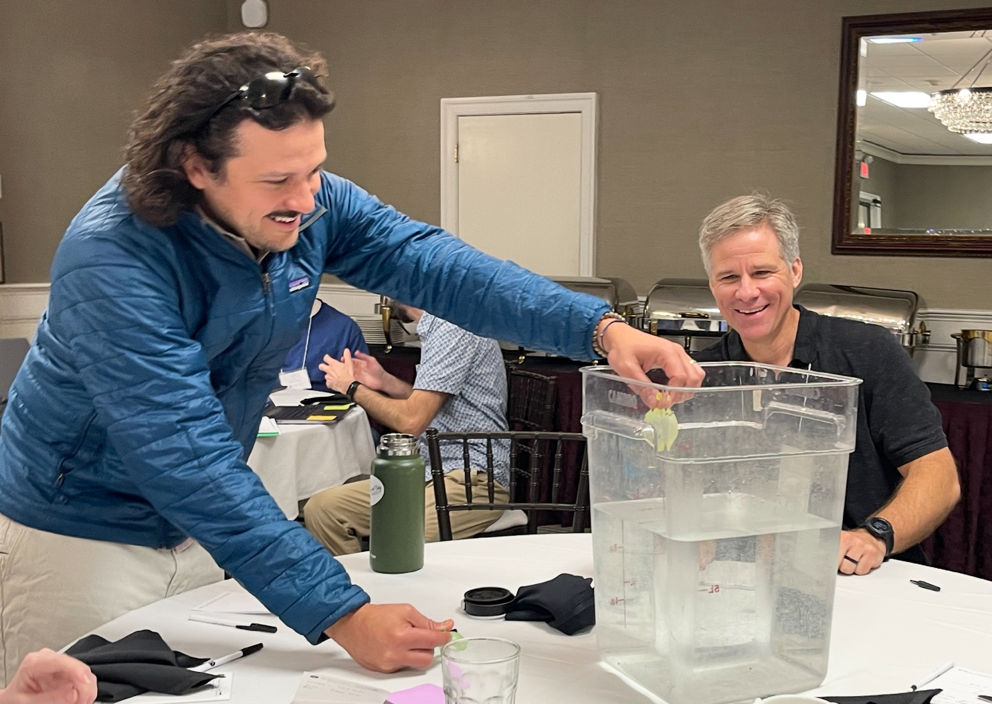
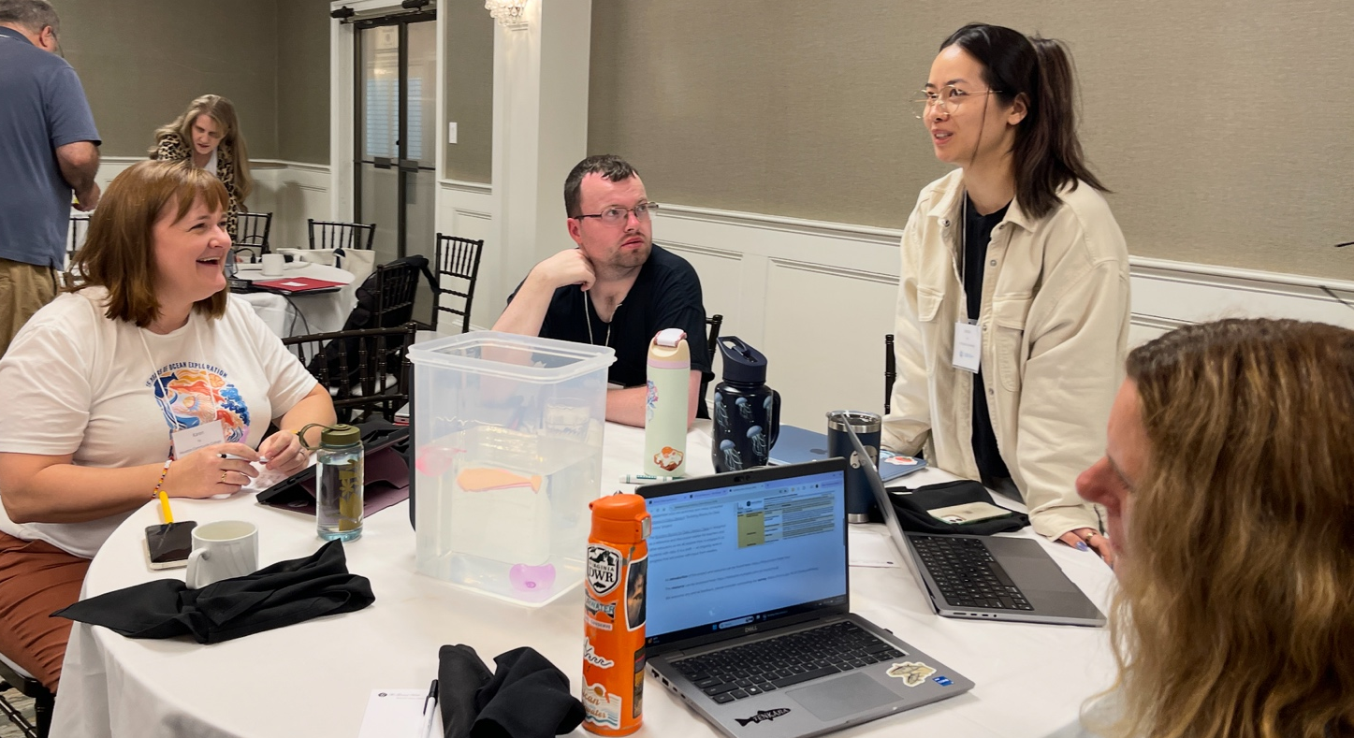

Slide 9
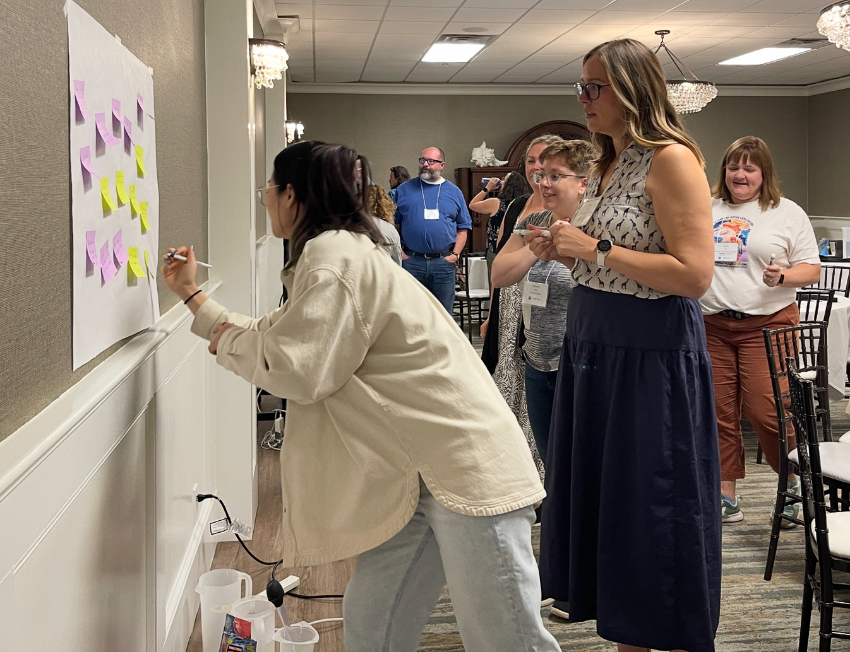
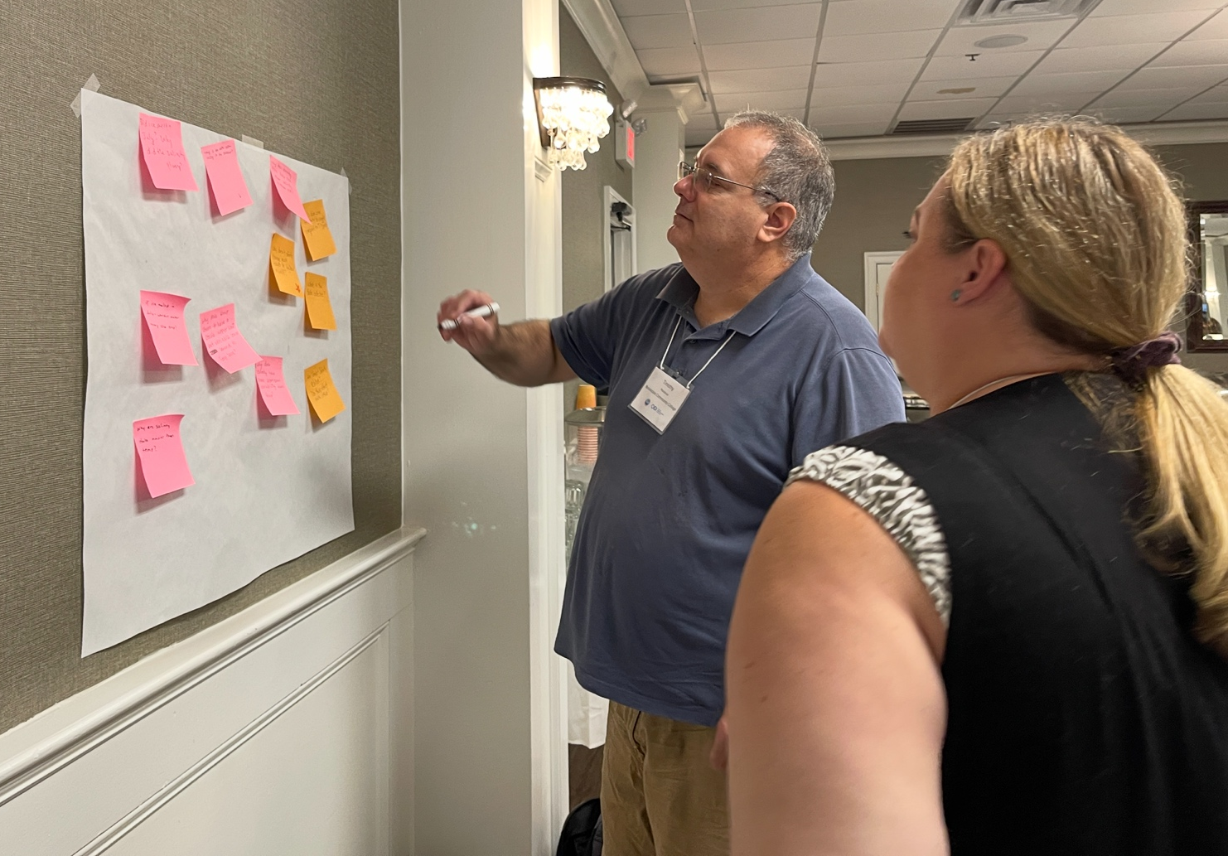
QFT

Slide 10
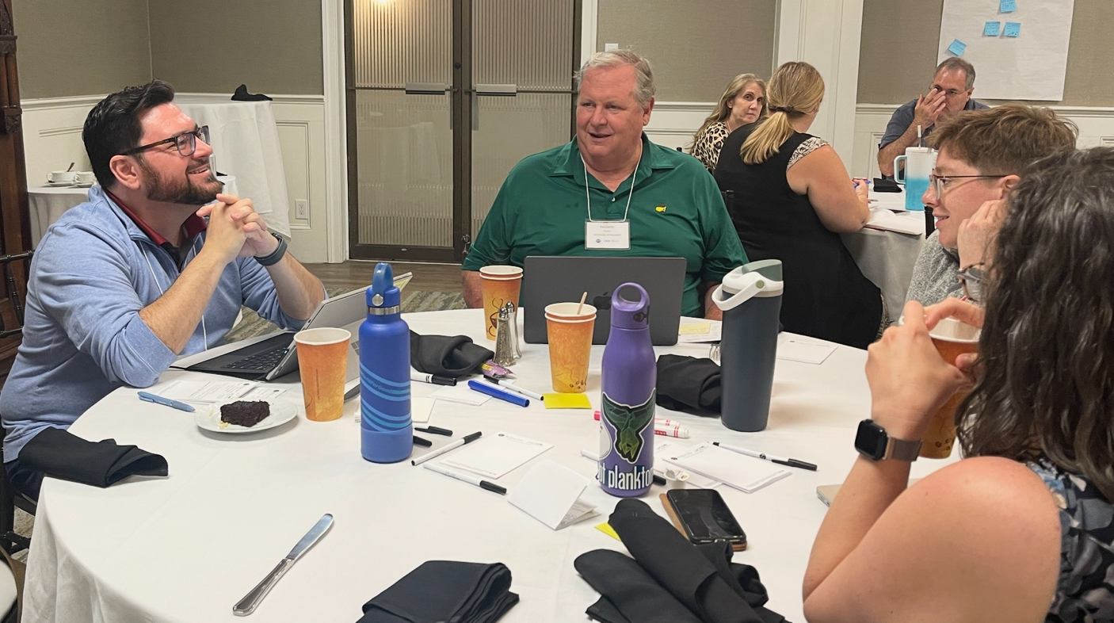
Data Explorer

Slide 11
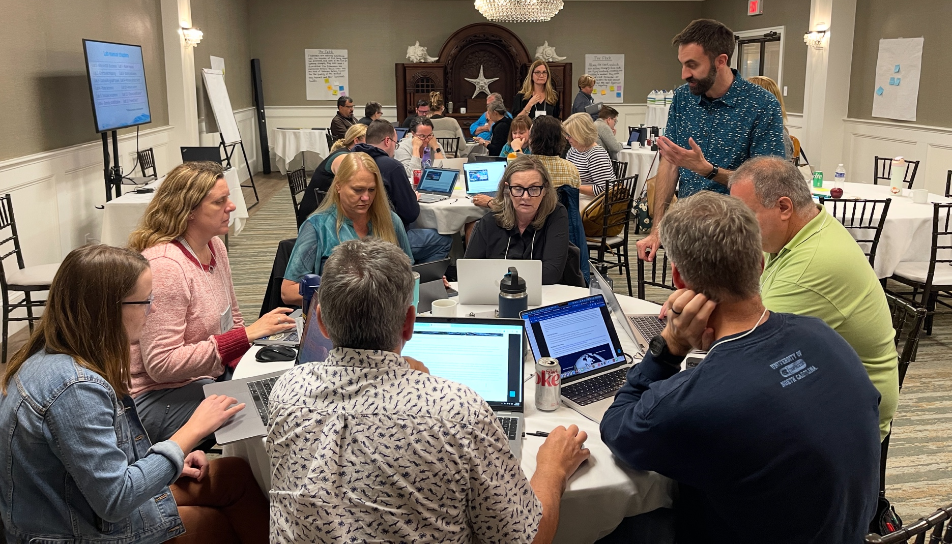
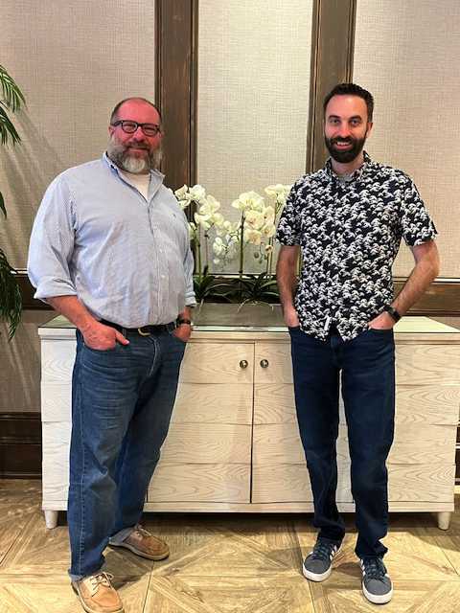
Dax HERE

Slide 12
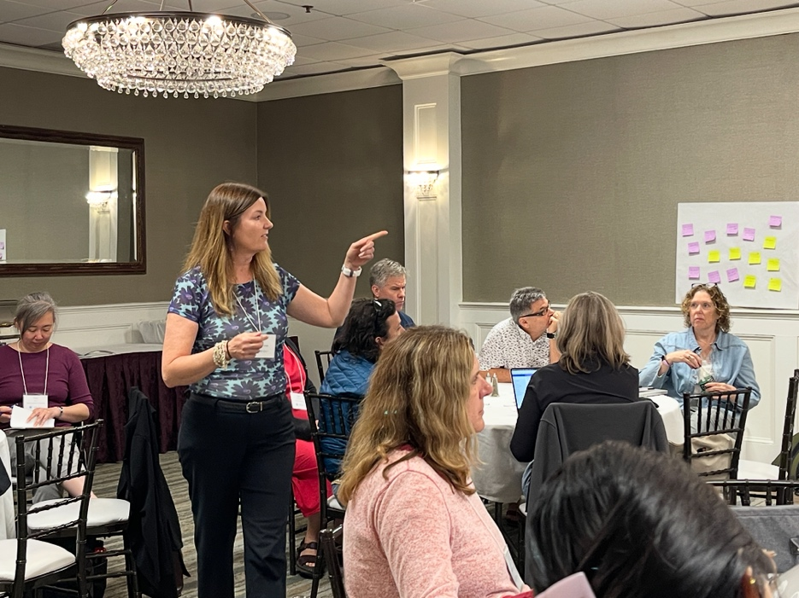
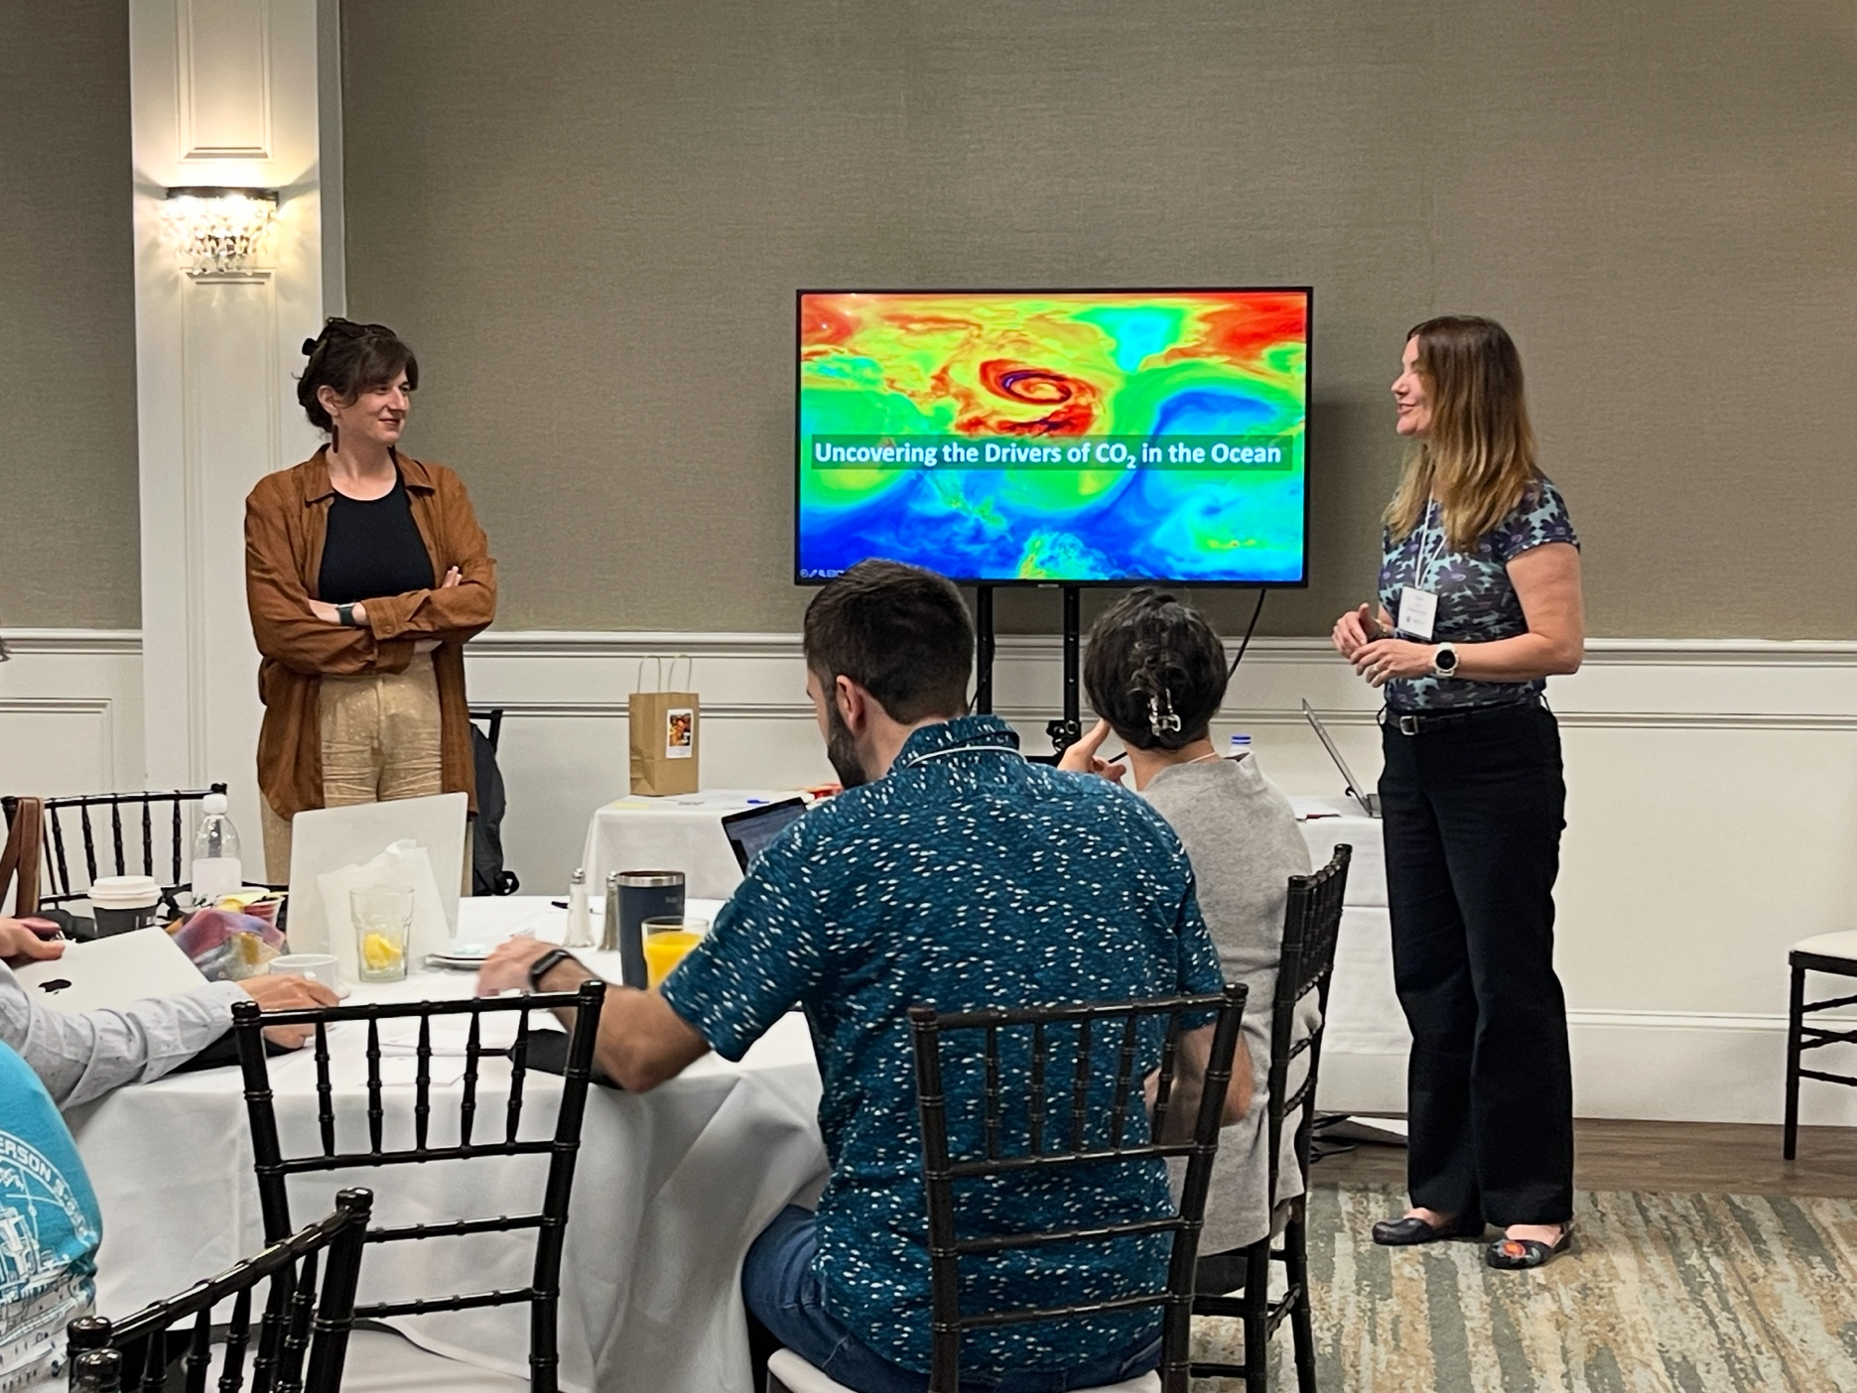
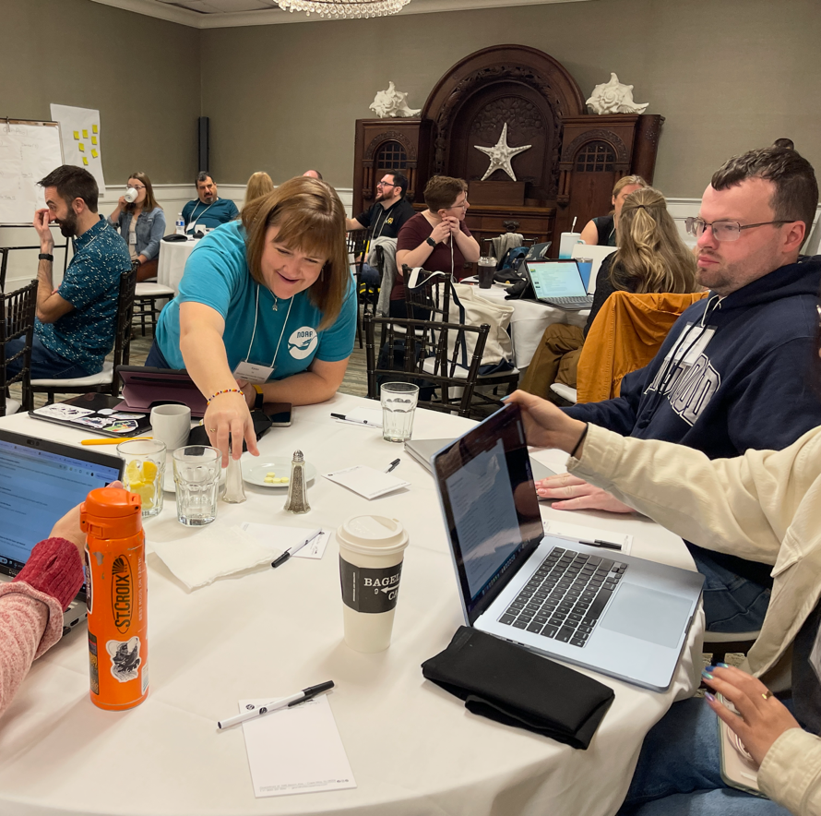
Day 2 – New DL Lessons!

Slide 13
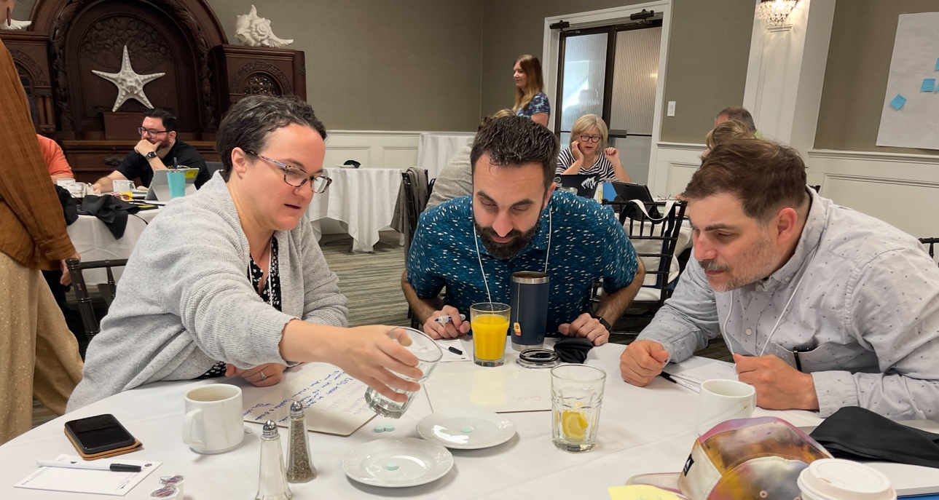
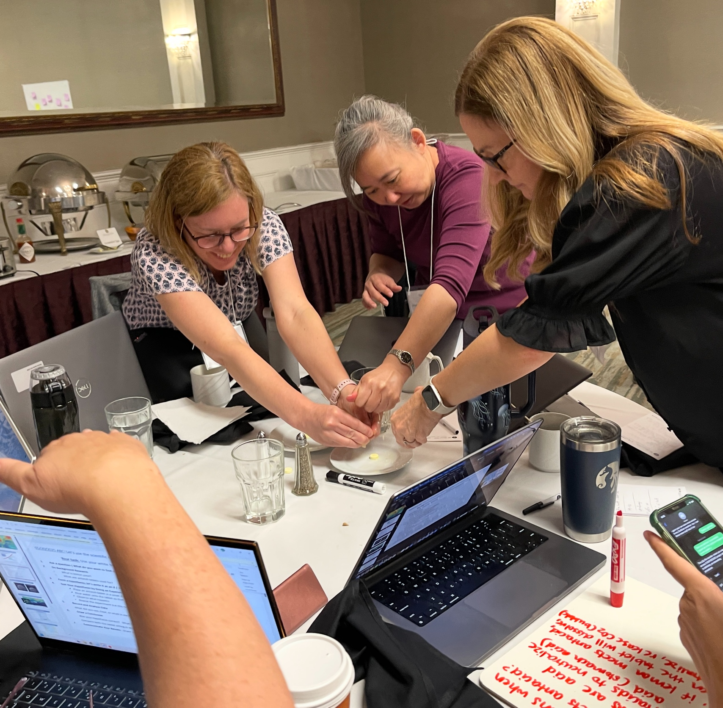
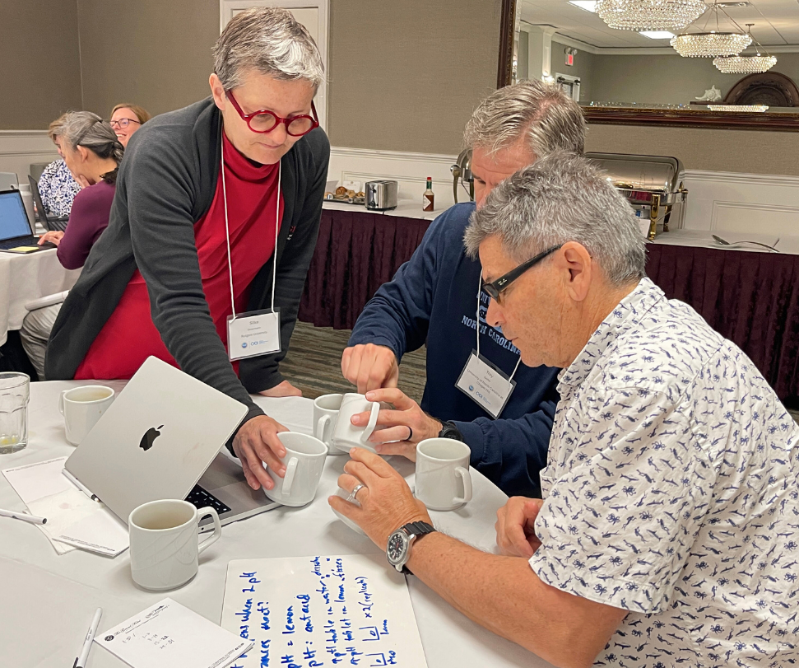

Slide 14
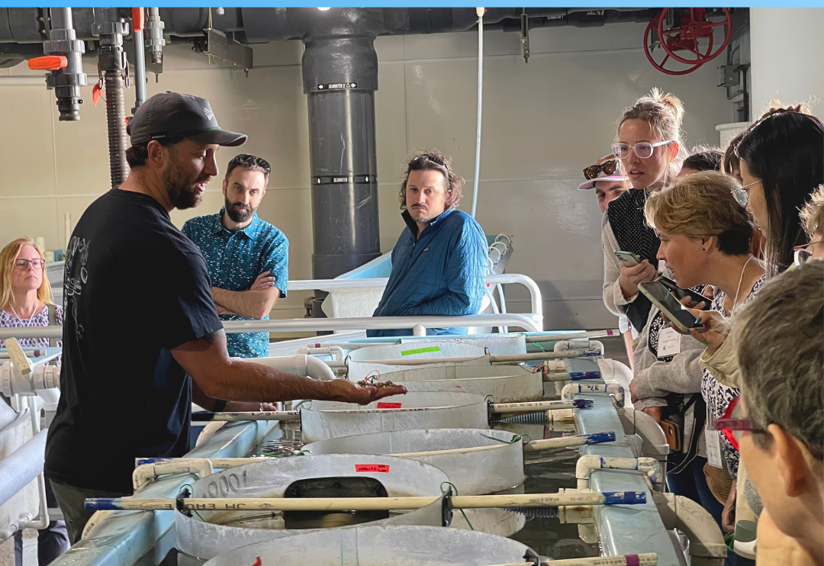
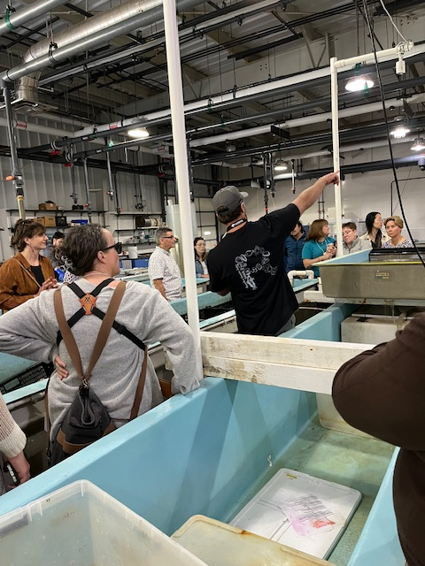
Field Trip!

Slide 15
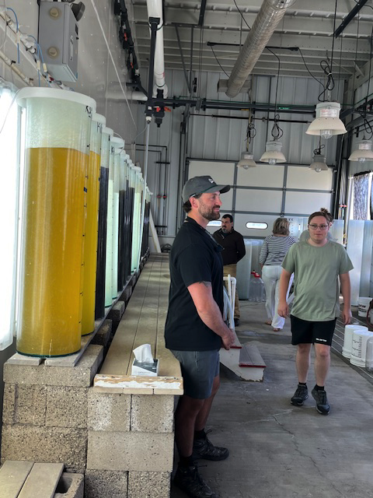
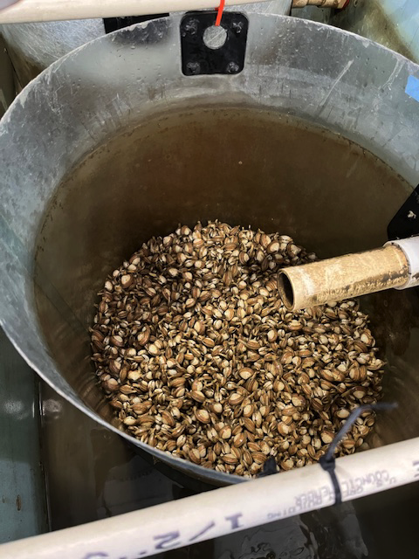

Slide 16
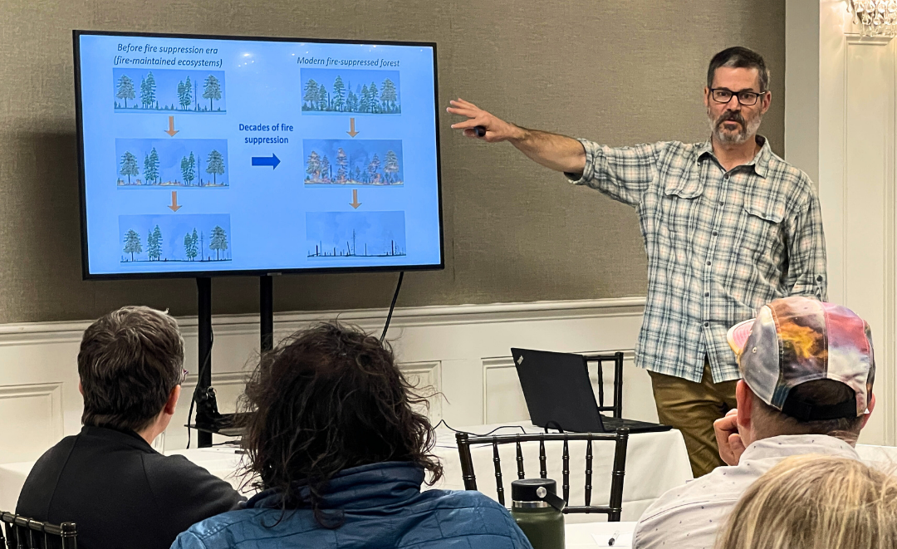

Slide 17
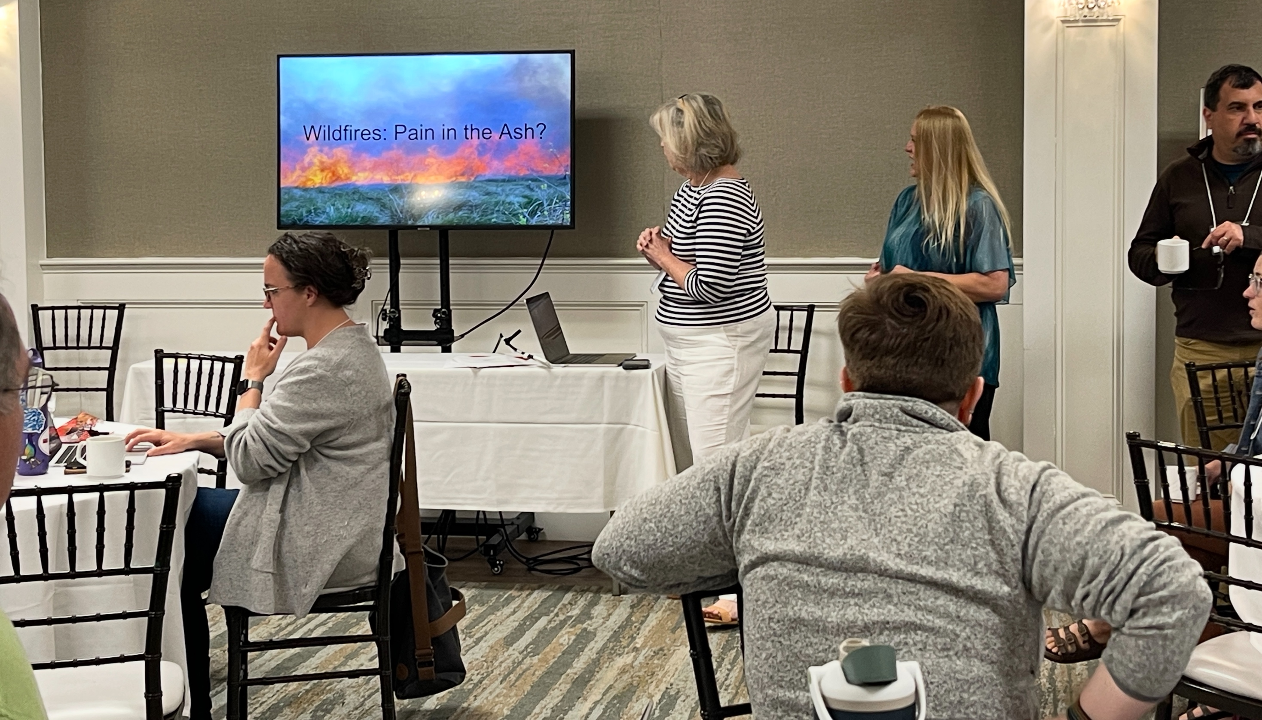

Slide 18
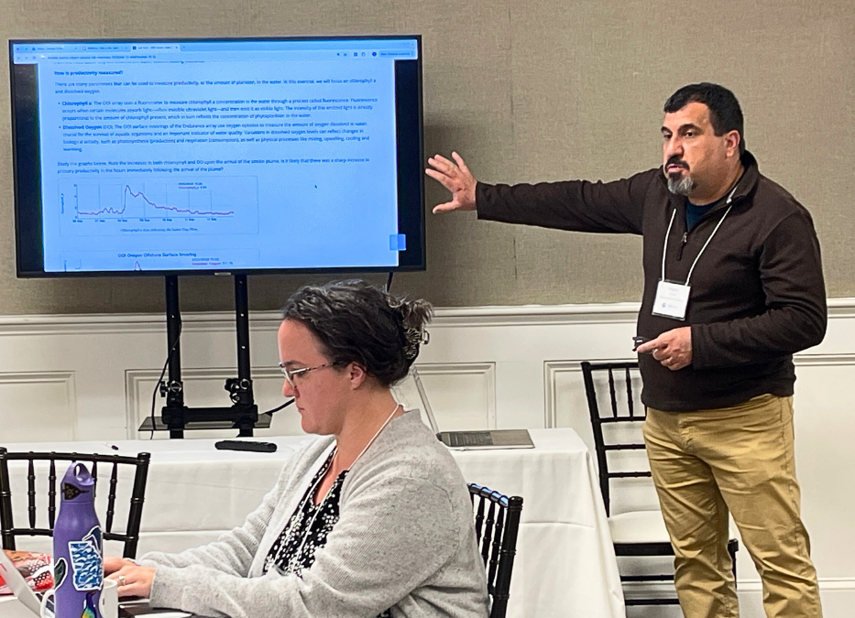

Slide 19
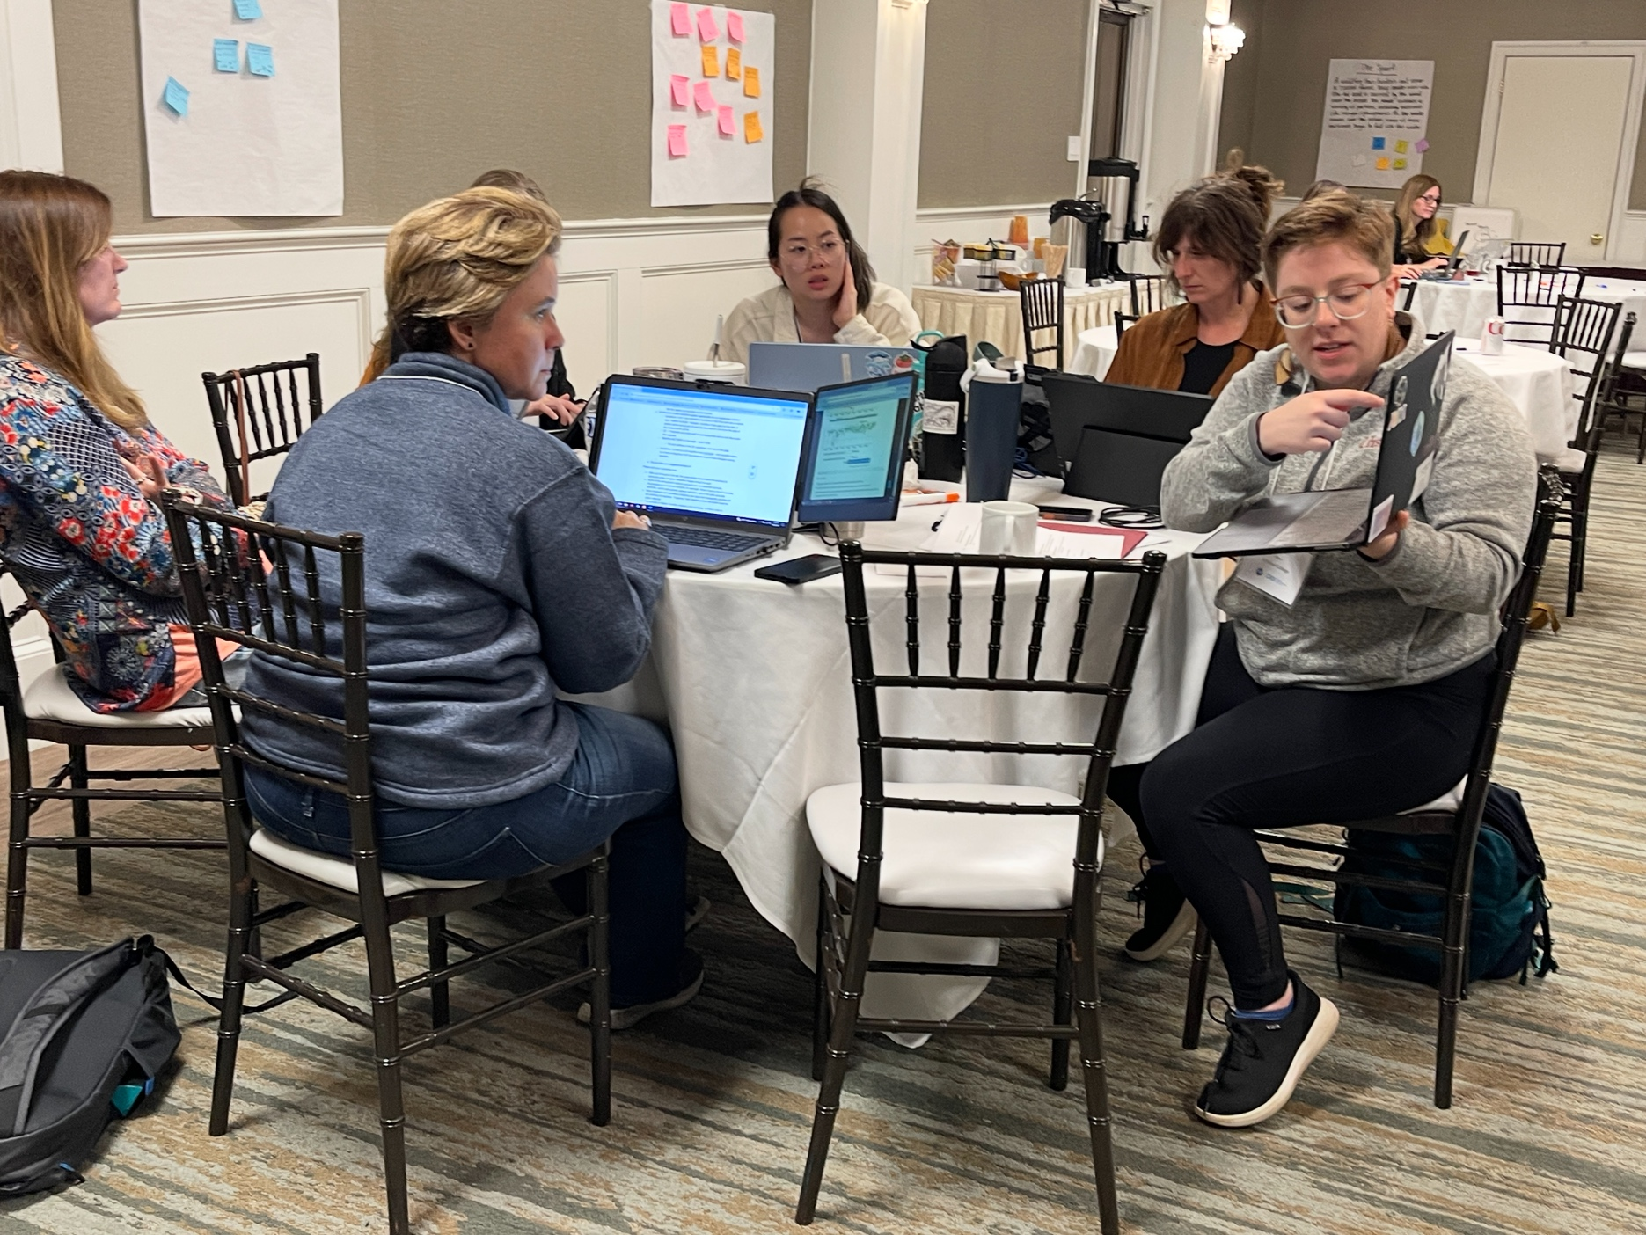
Discuss philosophy, content, modalities, and alignment with oceanography curriculum.
Explore OOI Data Labs resources
Understand how the OOI can be integrated into undergraduate teaching.
Peer faculty presentations/Field Trip/Guest Speakers

Slide 20
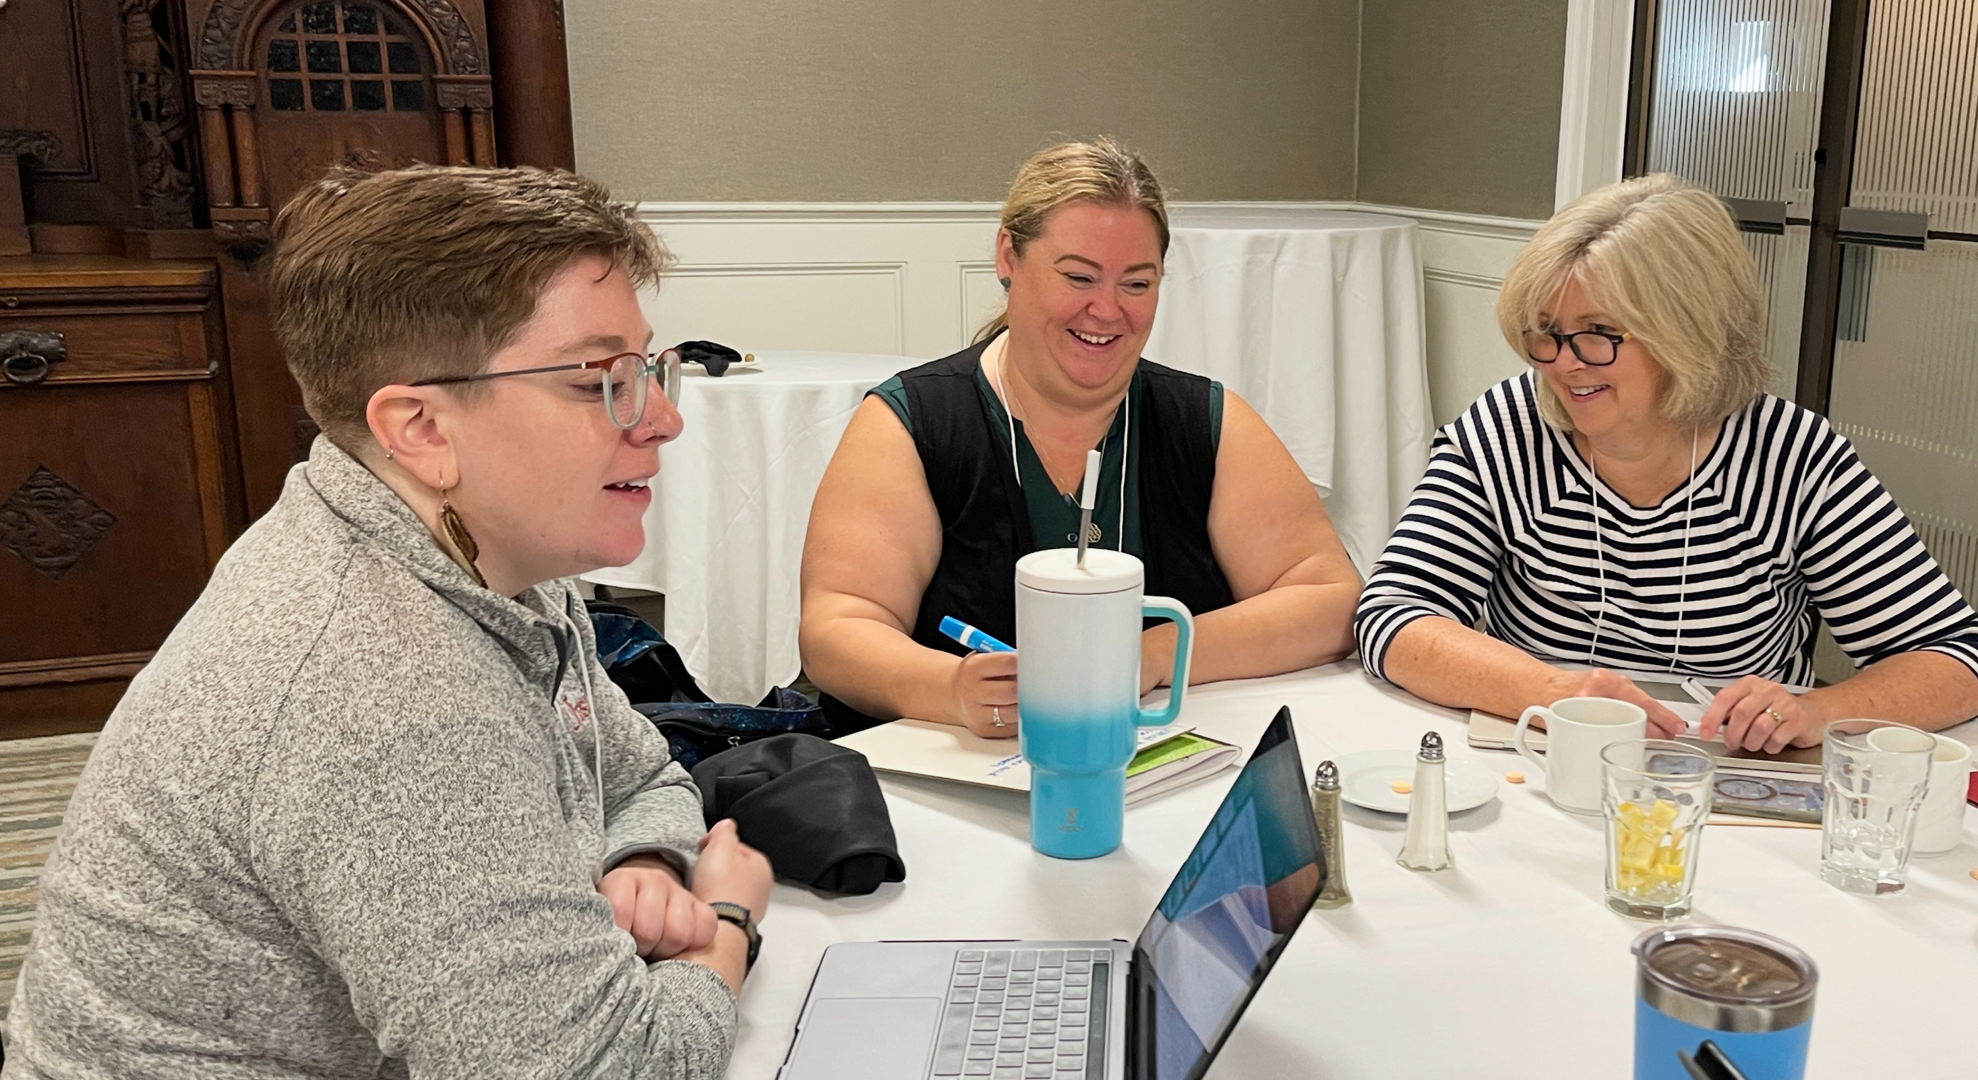

Slide 21
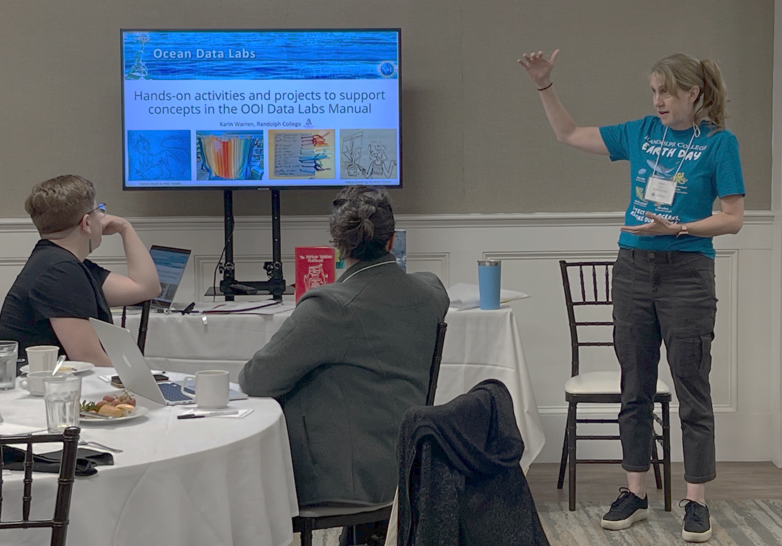
Day 3 – Hands-ON!

Slide 22
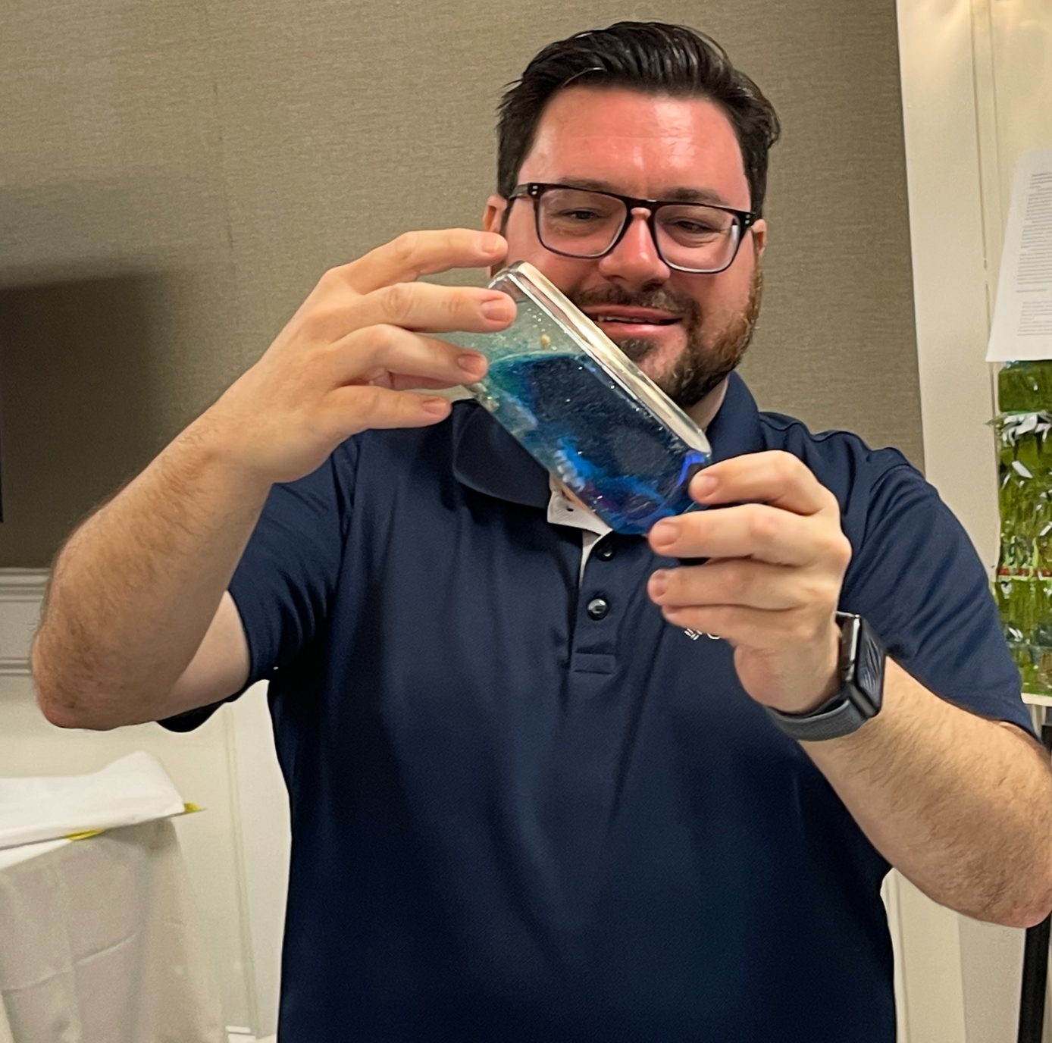
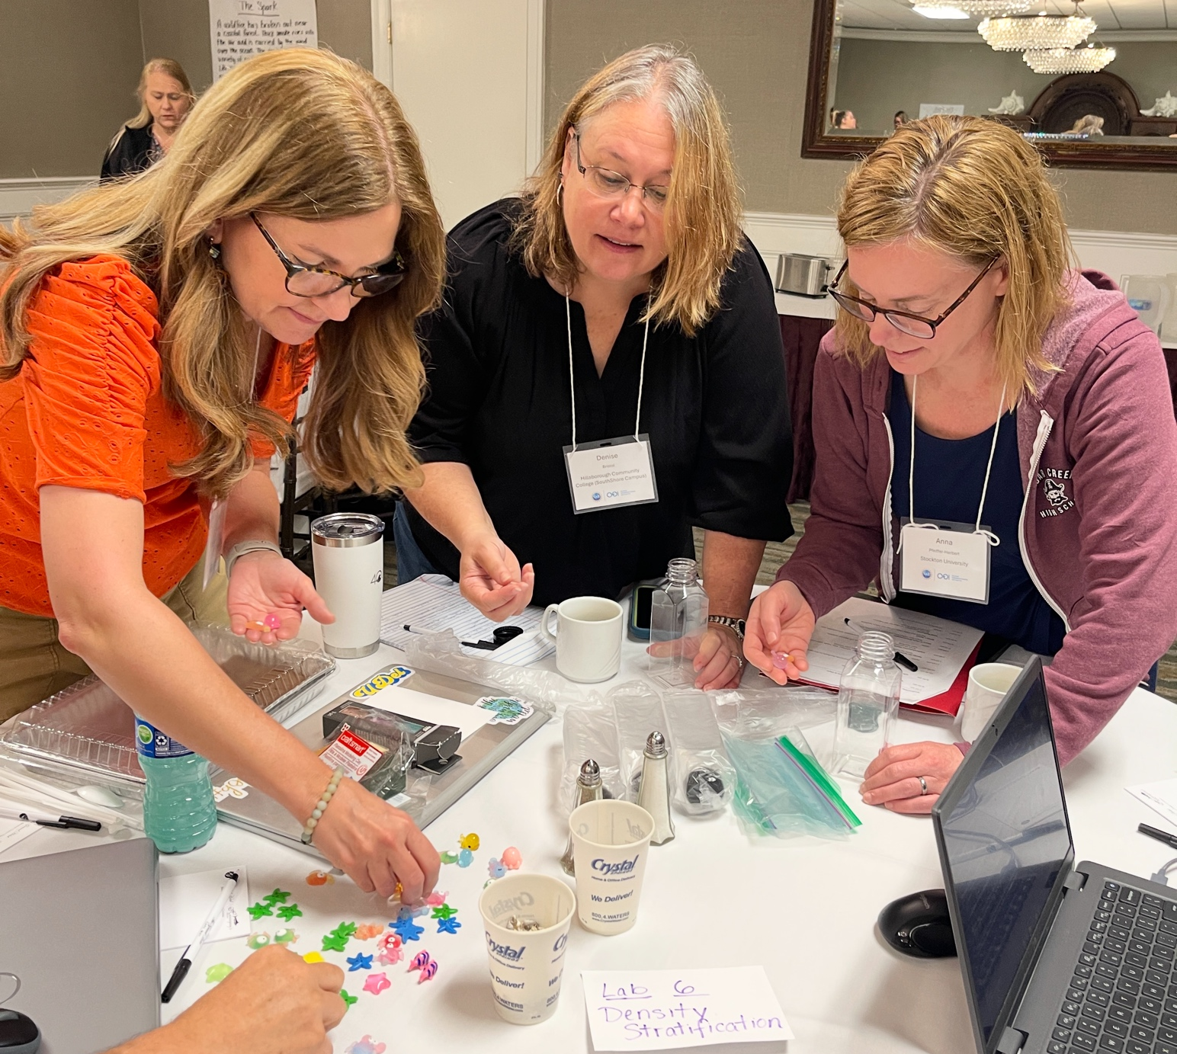

Slide 23
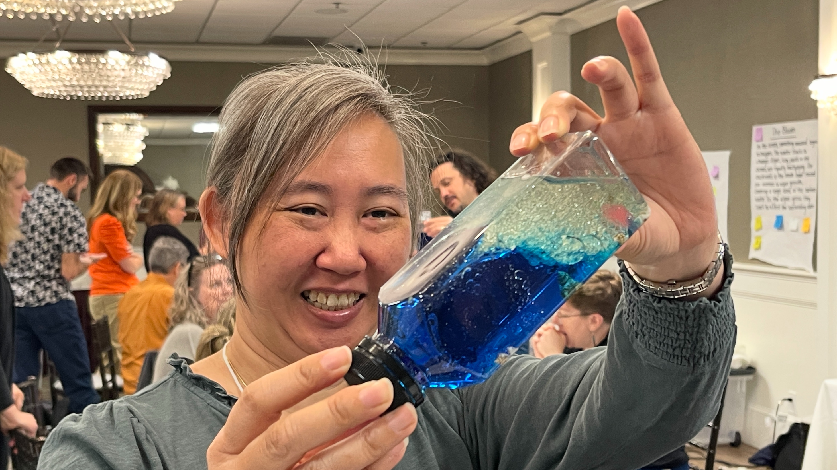

Slide 24
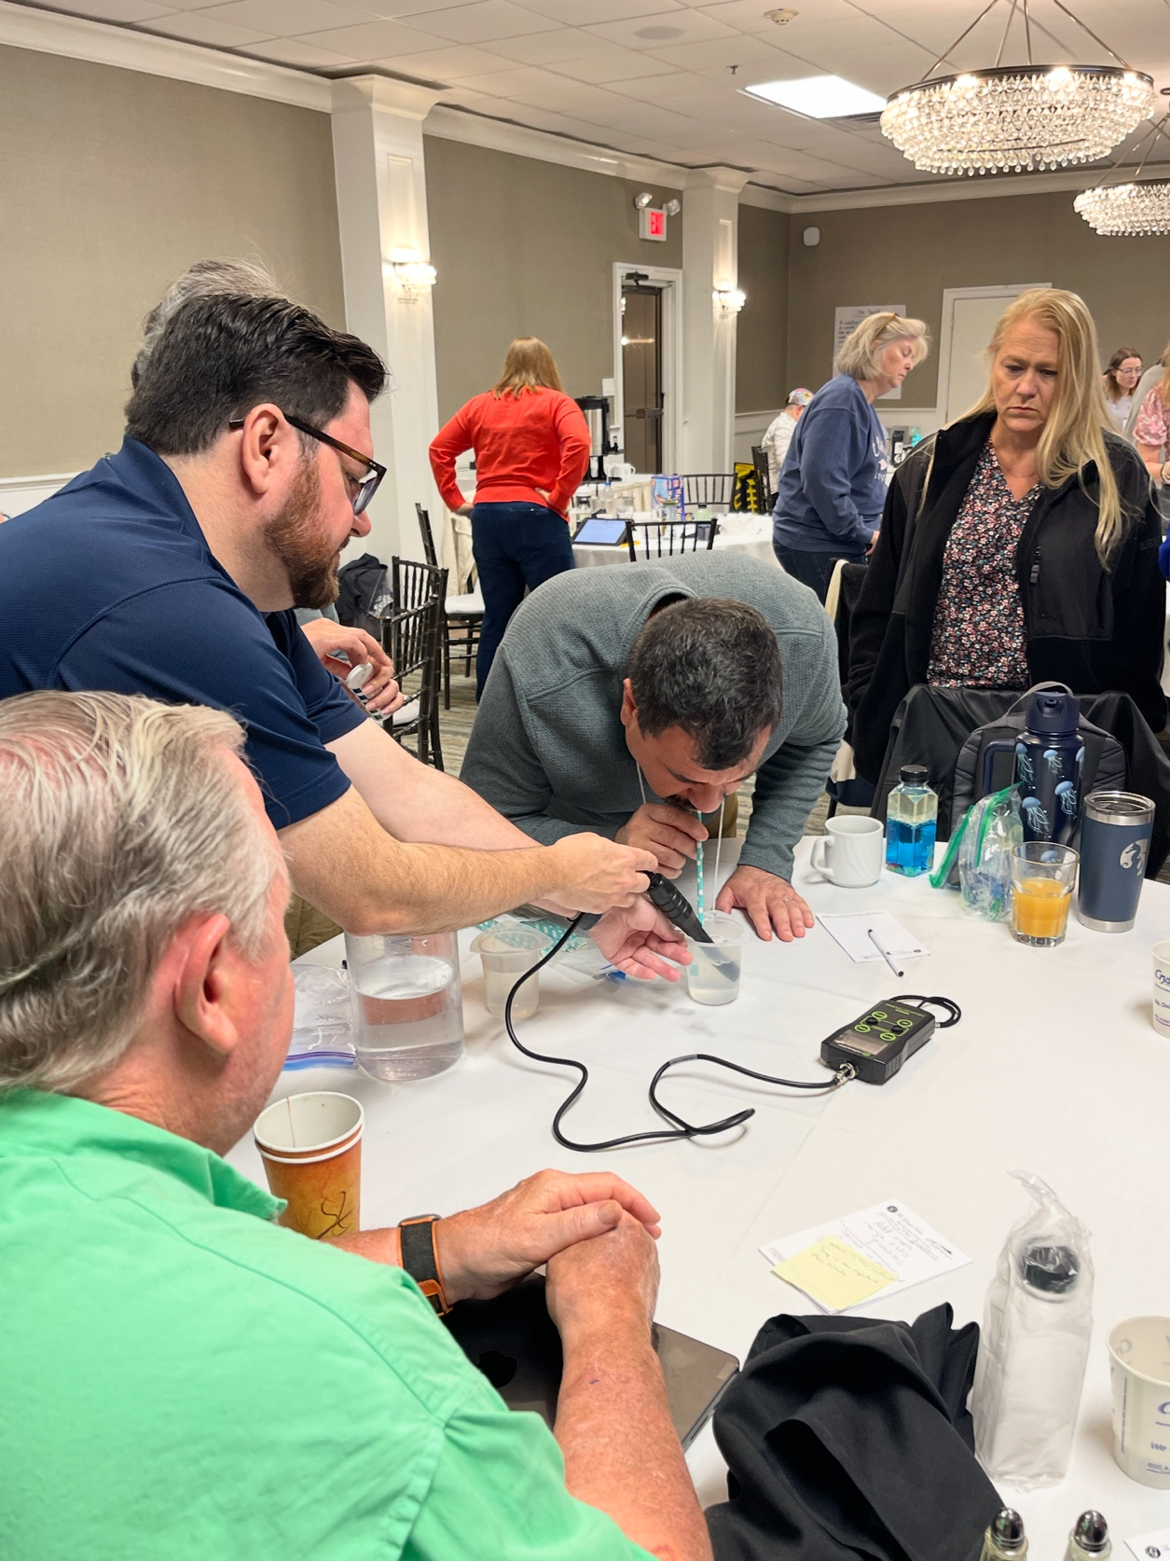
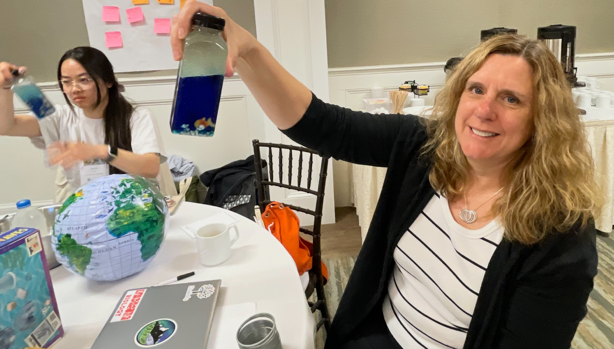
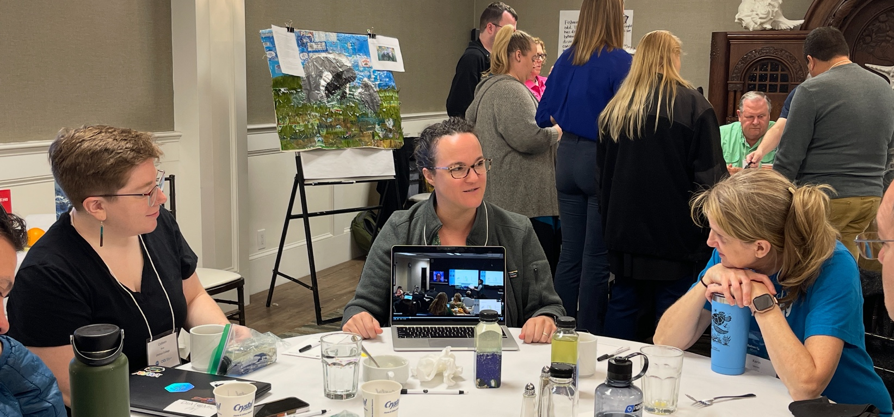

Slide 25
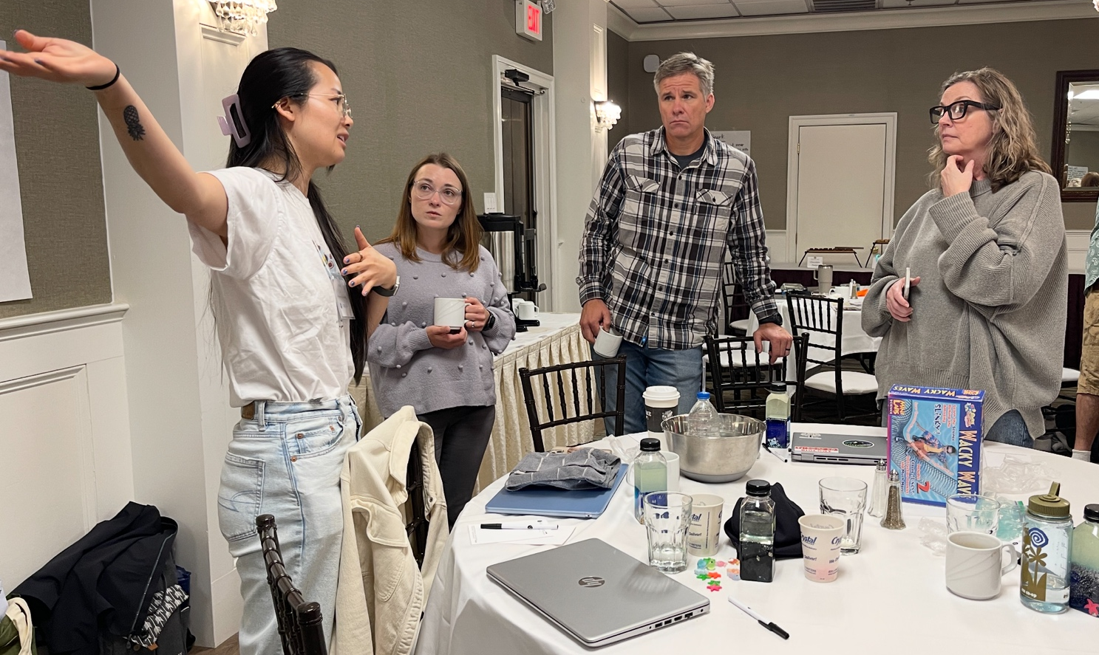
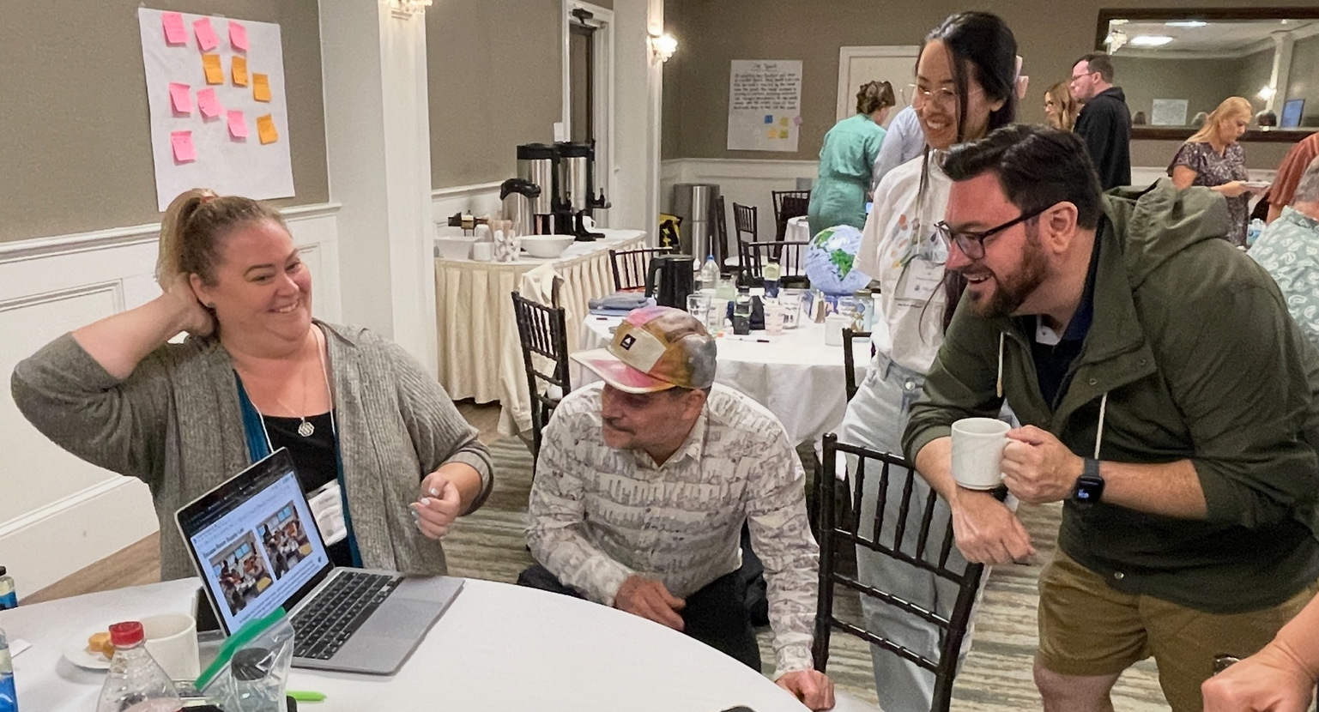

Slide 26
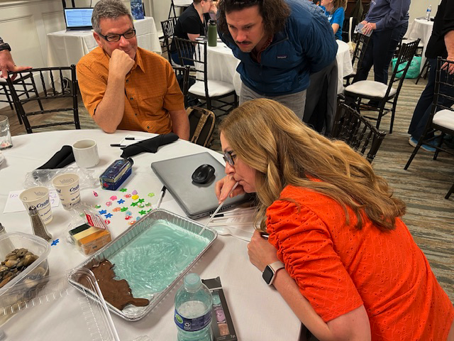

Slide 27
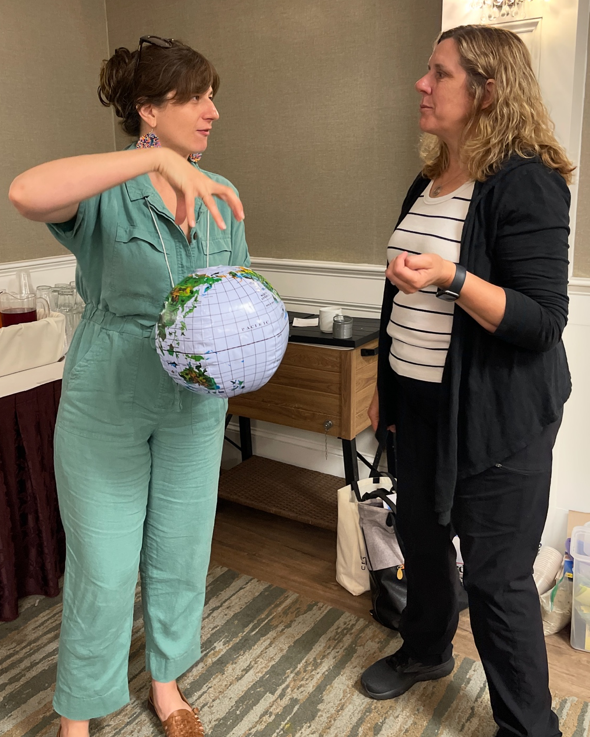
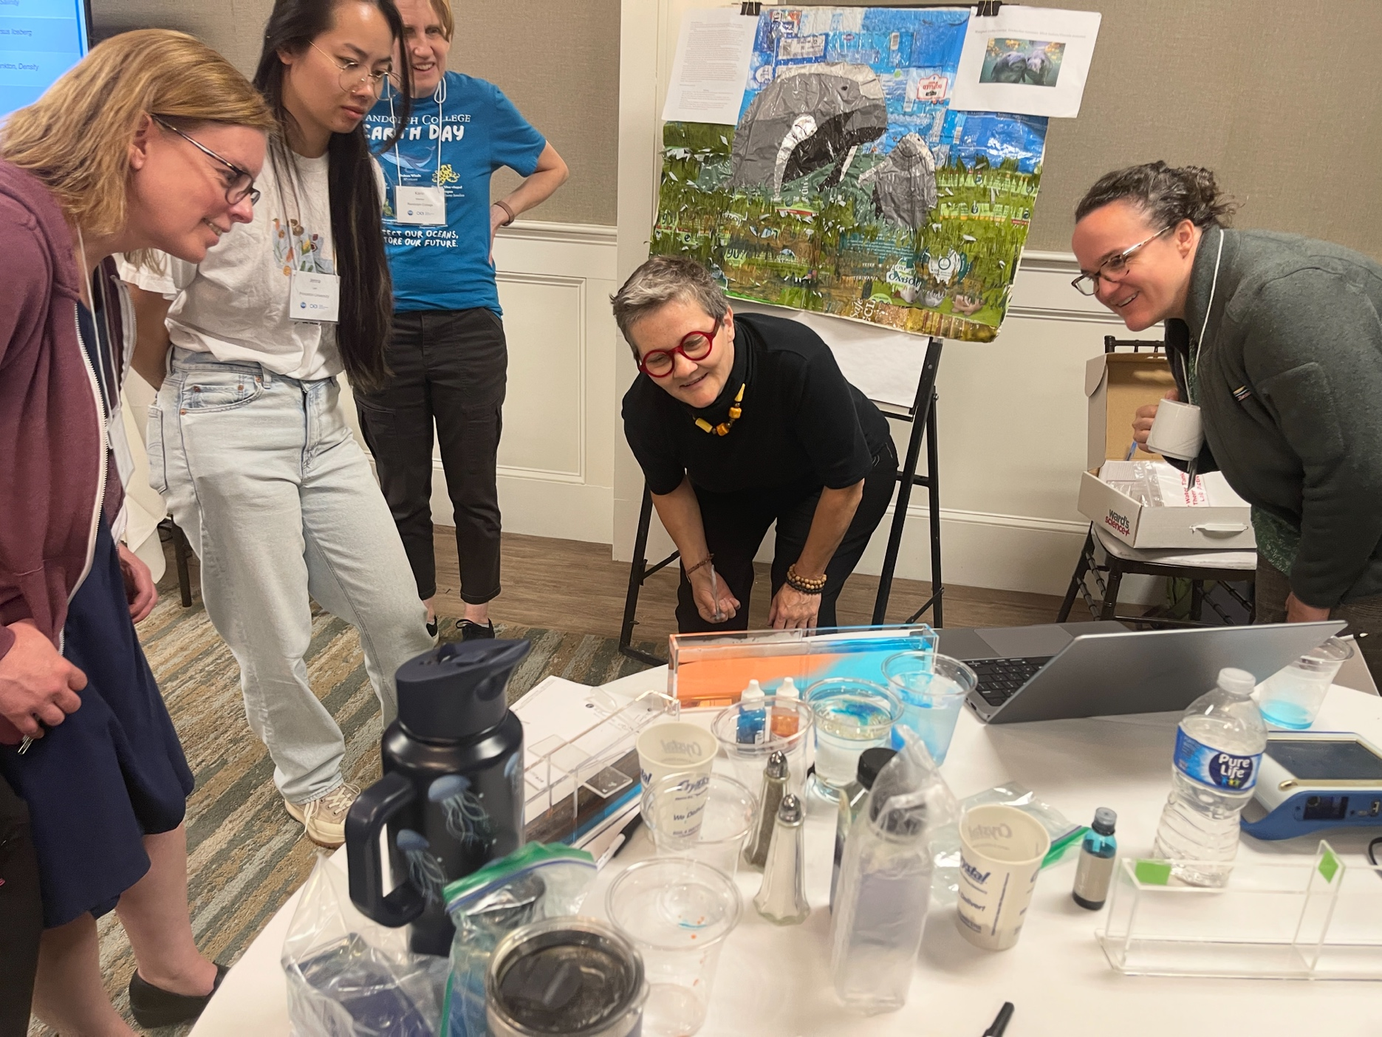

Slide 28
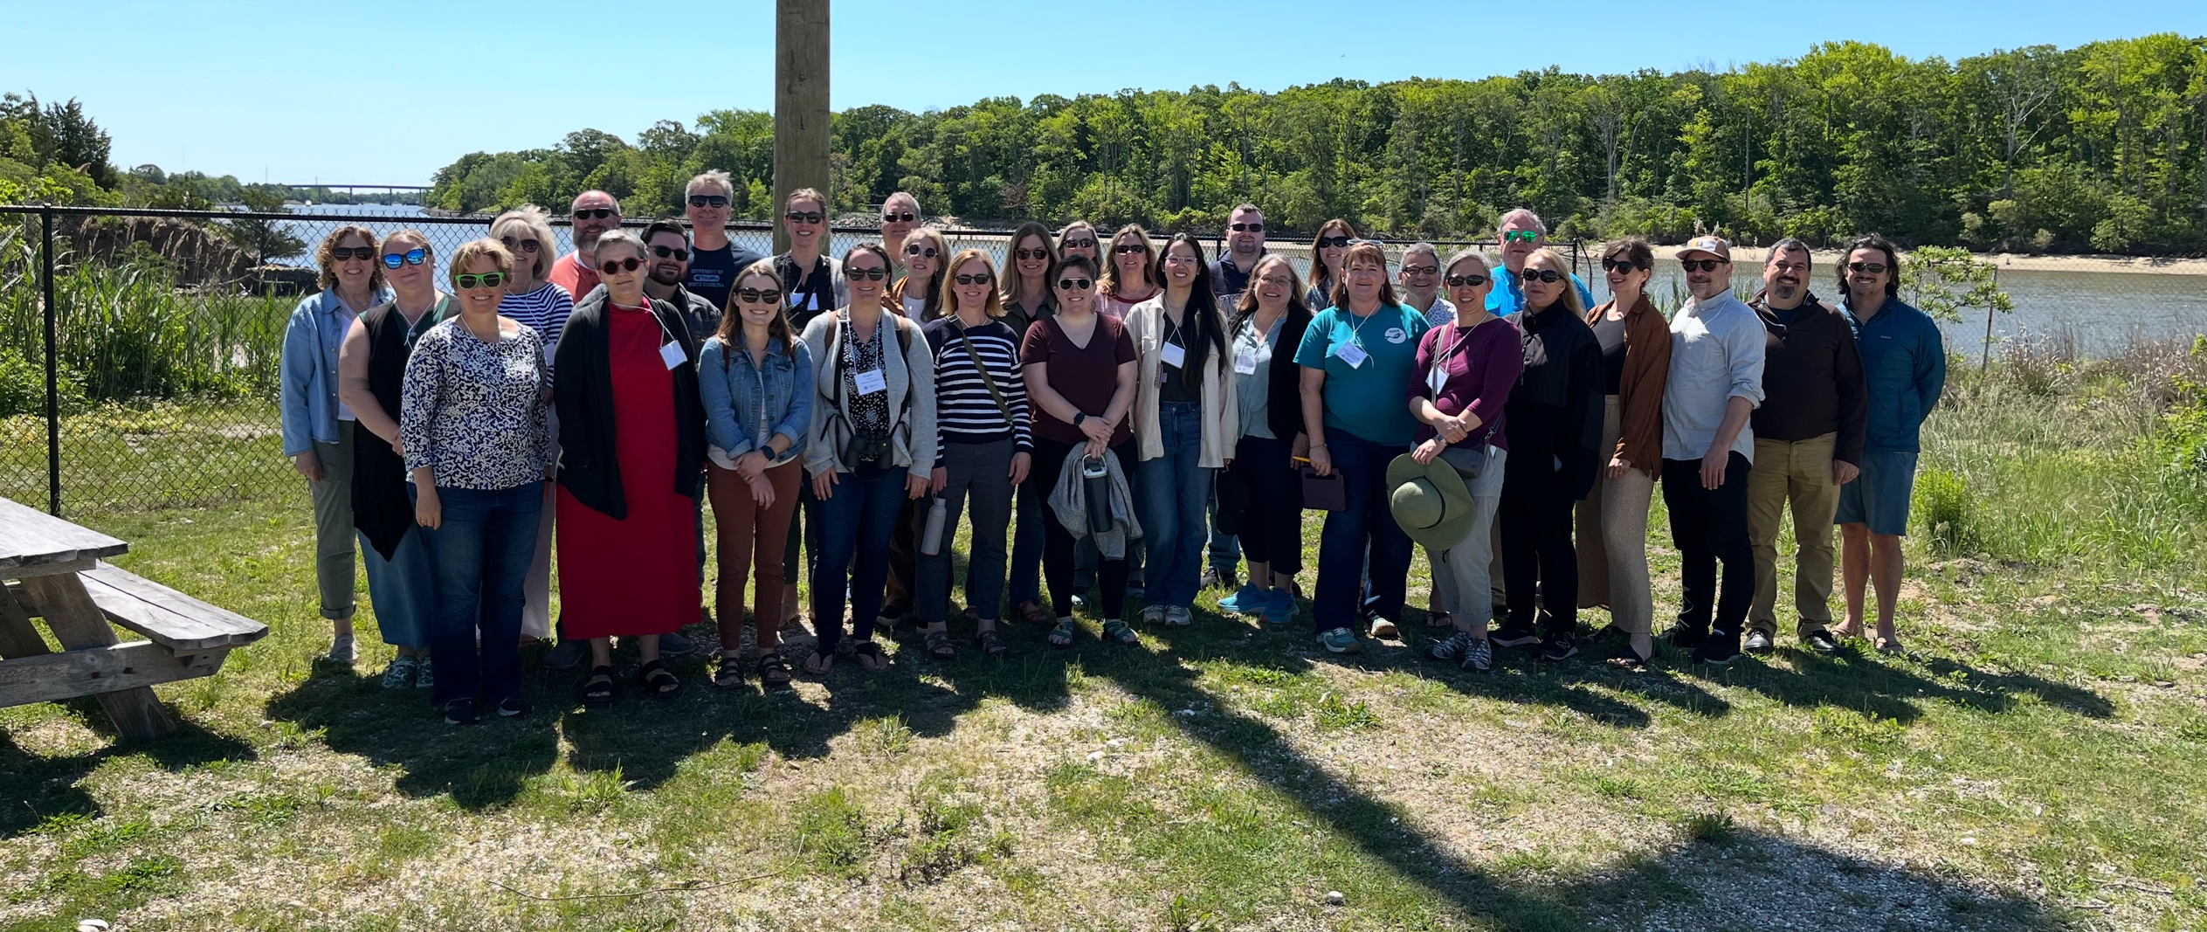
Thank you!

Slide 29
Thank you!

Slide 30
Next Steps, Action Items and House Keeping
Communications
Dean letters
Moving forward how do we communicate?
Newsletter
Workshops, Meetings and Webinars
Timing
Location
Additional Resources
Assessment
Coding/Python

