Slide 1
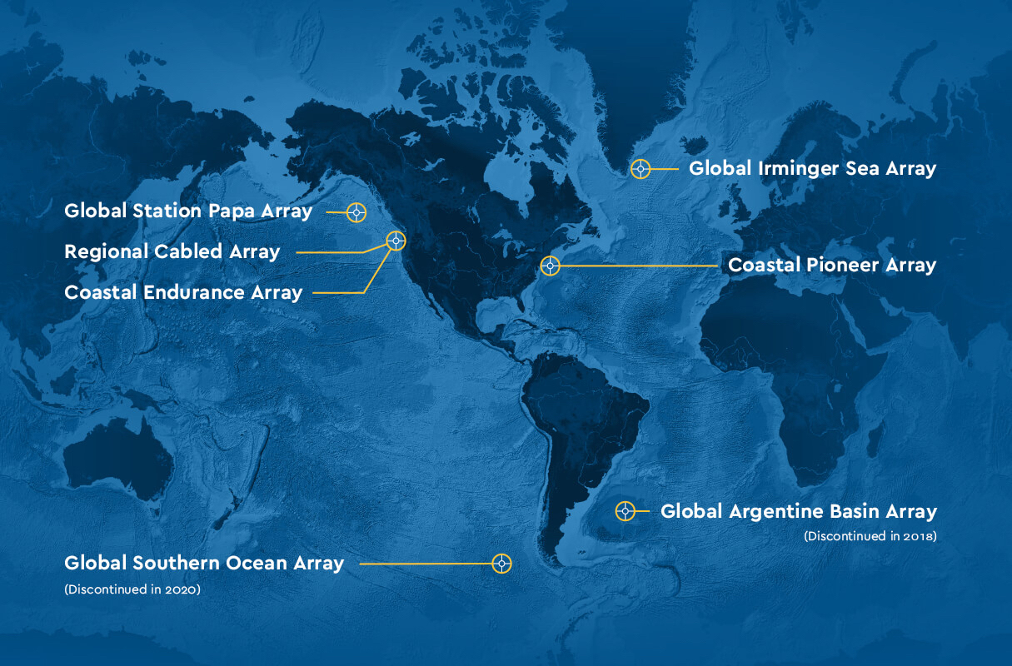
Data Labs Design Workshop
2025
Grand Hotel
Cape May, NJ
datalab.marine.rutgers.edu

Slide 2
Welcome to Monday May 19th

Slide 3
Welcome: Let’s look at some data…
Note what skills you are using to answer the questions.
Think about what you are paying attention to
Reflect on how you arrive at your answers
Think about what you can/cannot answer

Slide 4
Group A
How much pagbo was there at vanni?
Is 74sts a normal amount of pagbo for inu? Why or why not?

Slide 5
Group B
How many c/d wolide had the system reached after 5 minutes?
Describe the relationship between roshest and wolidein this system.

Slide 6
Group C
Where are the most eemp found?
What causes the change in eemp moving from west to east (or, from Awm toward madisdays)?
Notes:
Nonsense Data Activity

Slide 7
Turn and Talk: Share out
Were you able to answer the questions on Handout A
What about the questions on Handout B
Were the questions easy or difficult?
Where did you find the information you needed?
What skills did you use to answer the questions?
What information would you need to answer your unanswered questions?

Slide 8
Reflection
How did this activity make you feel? What did you find surprising? What implications could this activity have on how you teach with data?

Slide 9
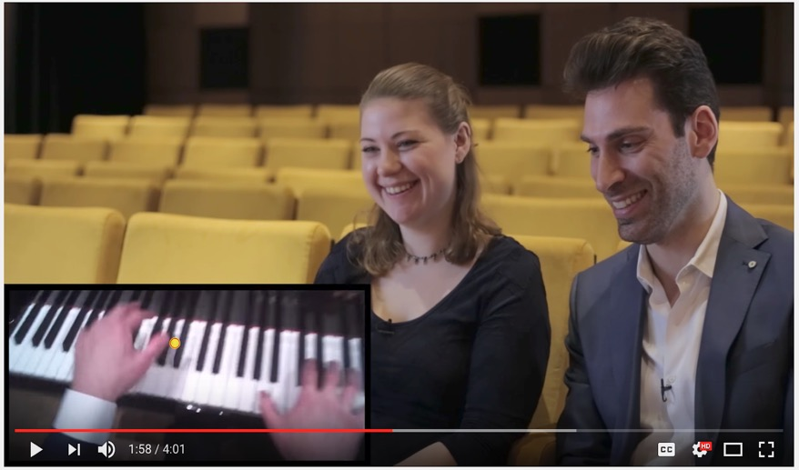
Novices ≠ Experts with Data
https://www.youtube.com/watch?v=GVvY8KfXXgE
Notes:
We are going to watch a short video and immerse ourselves in the world of music.
Play the video (https://www.youtube.com/watch?v=GVvY8KfXXgE).
So let’s think about how this would show up with our students when we are asking them to interpret data in our oceanography and other courses.

Slide 10
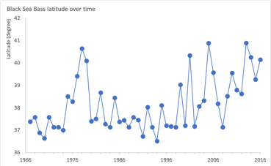
Novices ≠ Experts with Data
Adapted from slide developed by Catherine Halverson (UC-Berkeley)
Experts | Novices | Data Example
Notice features and meaningful patterns, often not noticed by novices. | Often focus on surface attributes.
Notes:
It turns out that there are some key differences for how our brains work when we are working on a problem as an expert versus as a novice.
First, when we are experts we notice features and meaningful patterns in what we are looking at or working with. Whereas, when we are novices we often focus on surface attributes.
You may have experienced this when working with your students with data. For example, if you are having them look at a timeseries (here I am presenting data on the average latitudinal location of the Black Sea Bass population along the eastern seaboard, Latitude is on the y-axis and for those of you that do not think in latitude as a reference New York City is at about 40 degrees North, and time from the mid-1960s to the mid-2010s is along the x-axis) you may ask your students what pattern they see in the data. And this is where it gets interesting, right? While you and I see a general increasing trend across these data, more often than not our students will report that the pattern is that the data ”go up and down”. Argh! Well, turns out this is a great example of them looking at the surface attribute and us seeing the meaningful pattern.
OK, let’s look at another one…

Slide 11
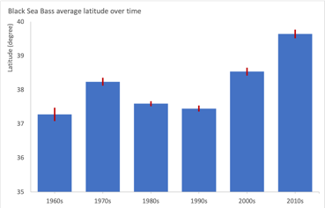
Novices ≠ Experts with Data
Adapted from slide developed by Catherine Halverson (UC-Berkeley)
Experts | Novices | Data Example
Notice features and meaningful patterns, often not noticed by novices. | Often focus on surface attributes.
Knowledge organized around “big ideas” that guide thinking. Problems approached with focus on concepts and rationale for why they apply. | Don’t “chunk information.” Knowledge is memorized in lists of facts & laws, and so problem solving requires searching for correct formulas, equations, and rules to plug & manipulate.
Notes:
Part of why when we are experts with the material that we notice these features and patterns is that we have organized knowledge about the topic area around big ideas in our brain. This organization helps us approach our thinking to working with more information about the topic area. However, when we are novices we haven’t yet chunked the information and instead we basically have just memorized disparate pieces of information. So instead of have an organized way to look at the new information, as novices we need to keep in essence scrolling through all of that information, whether relevant or not, before we find the piece that can help us. This is what I like to think of as the “rolodex effect”, which then makes me laugh as I don’t think many of our students even know what a rolodex is anymore. But it is as if there brain is just spinning the rolodex trying to find the right card to use.
When it comes to working with data, a really common way that we see this manifest itself is when it comes to making choices about what graph to use. As individuals comfortable with making and working with different graph types we have organized our experiences around the big ideas in terms of the graph type we choose is related to what question we are asking and what data we have. However, our students are often novices when working with data so they make choices on what graph types to used based off of factors like: what is easiest, what they are most comfortable making (i.e., bars and line charts), what they think looks the most complicated and thus will impress the instructor, etc. So you may get a bar chart for timeseries data when it doesn’t at all match the question they have of the data.
There is one other final piece I want to discuss with you…

Slide 12
Novices ≠ Experts with Data
Adapted from slide developed by Catherine Halverson (UC-Berkeley)
Experts | Novices | Data Example
Notice features and meaningful patterns, often not noticed by novices. | Often focus on surface attributes.
Knowledge organized around “big ideas” that guide thinking. Problems approached with focus on concepts and rationale for why they apply. | Don’t “chunk information.” Knowledge is memorized in lists of facts & laws, and so problem solving requires searching for correct formulas, equations, and rules to plug & manipulate.
Flexibly & selectively retrieve important and relevant aspects of their knowledge. | They are less likely to know the conditions under which specific knowledge is applied.
Notes:
Finally, because when we are an expert on a topic area we have organized the information around these big ideas, it also means that we can easily flexibly and collectively retrieve the specific information that we need in the moment to work with the new piece of information. In essence we know what to use from our memory and what to ignore. But when we are novices we can’t make these executive level decisions of what to use/recall and what to leave where it is. This makes it really hard to work with data, because in science when we are working with data we are asking our students to do three major things at once to connect the content, with the actual data, through the visualization of the data to make meaning from it that relates to other information they know about the topic area. If you do not know what information you need to approach that multi-level problem, it can get really overwhelming really quickly for you as a novice.
We will talk about this more later in the week, but an important aspect to remember is that to accomplish a state in which a more complex mental model is accessible from your long-term memory to use in a situation to solve a problem (aka make sense of data to make an inference supported by the evidence in the data and connect it to larger concepts/phenomena) TAKES TIME AND PRACTICE!
We need to provide the practice (A LOT) so that our novices can move from disparate ideas in long-term memory without knowing how to connect them…
So we need to provide more opportunities, to make more connections, to have more opportunities to trigger pulling from their long-term memory in ways that helps them make sense of the task at hand

Slide 13
Data literacy is the ability to read data, work with data, and communicate about data by putting it in proper context.

Slide 15
https://dataspire.org/building-blocks-for-data-literacy
Notes:
We worked with a Data Literacy consultant – Kristin Hunter Thomson of Dataspire to hone in on the data skills we really wanted to teach in this program. This is a subset of skills she has identified over the K-12 continuum

Slide 16
Three Levels of Engagement with Data Visualizations …once you have the data in a data table and/or ﬁgure OR you have the model output…

Slide 17
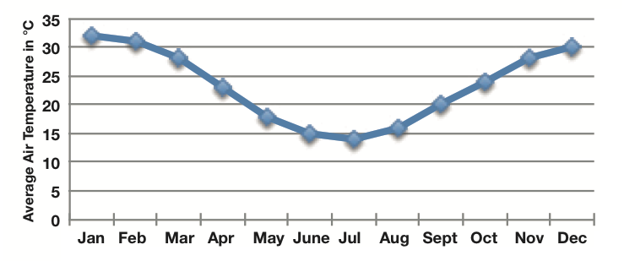
What helps us make sense of data?

Slide 18
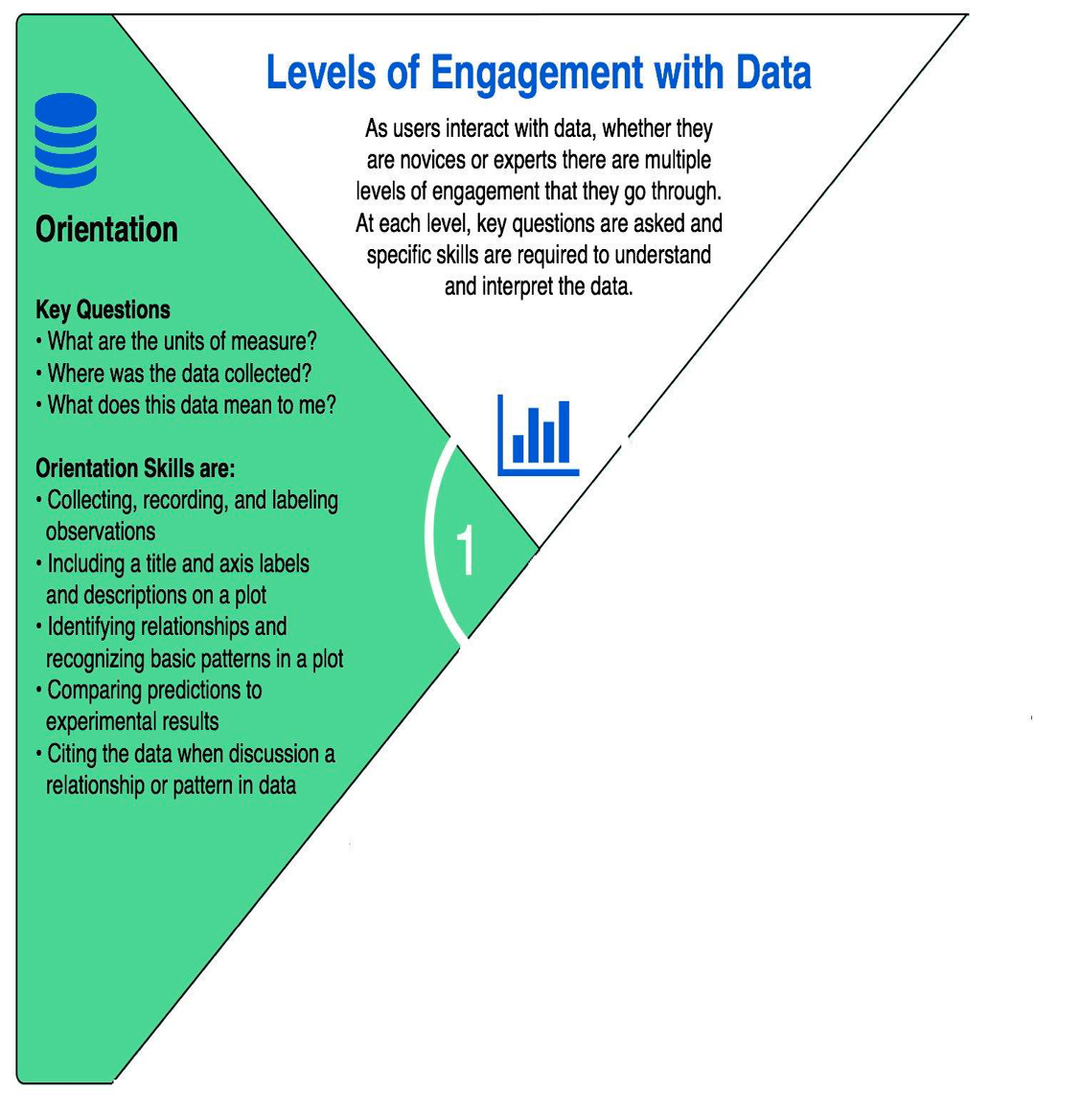
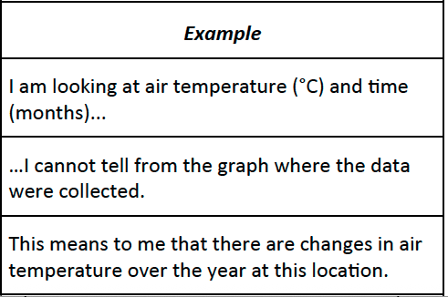
Orientation – What is there on the page?

Slide 19
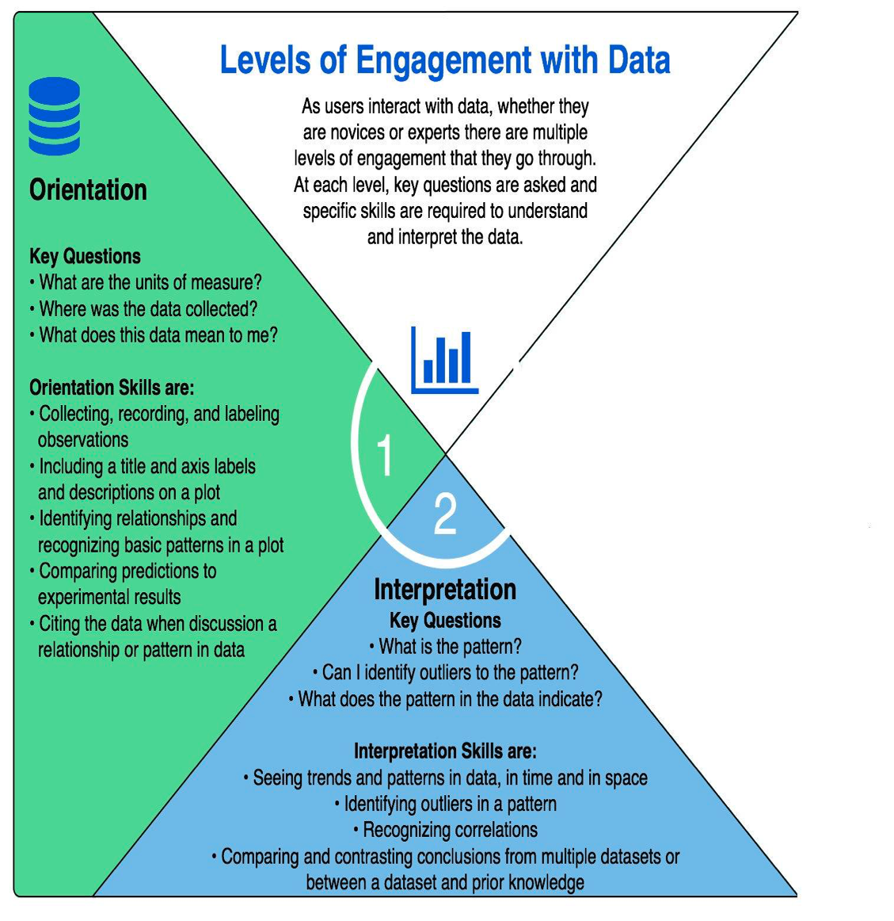
Interpretation -­‐ What does the data show?

Slide 20
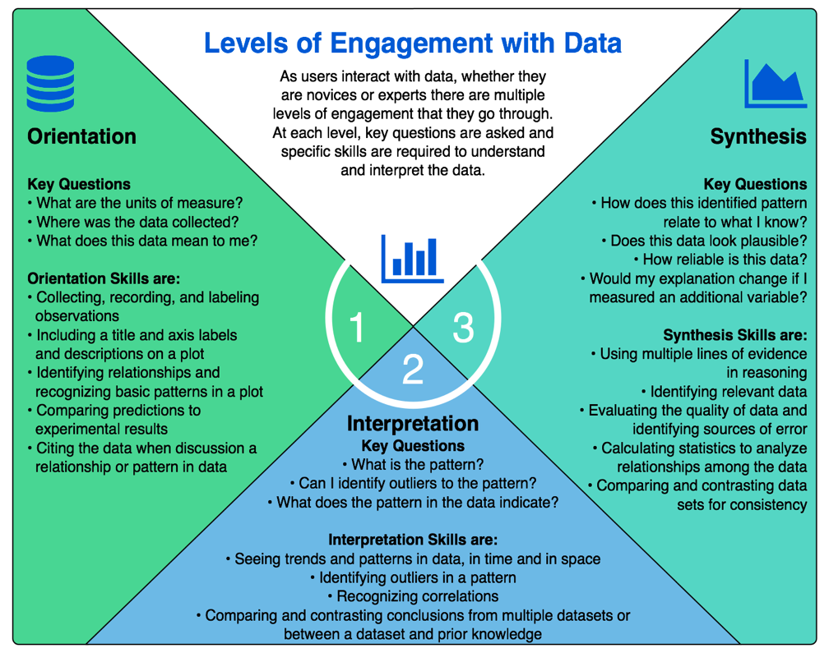
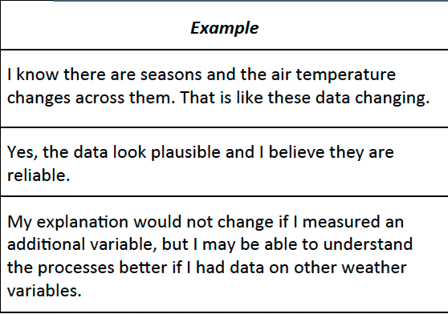
Synthesis – What does the data pattern allow me to explain about what is not on the page?

Slide 21
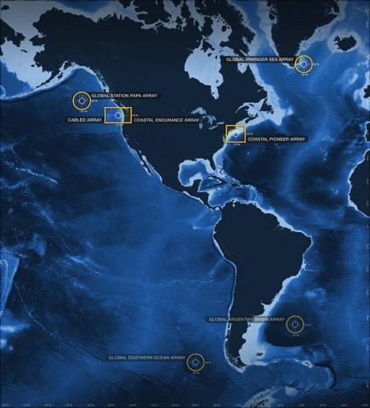
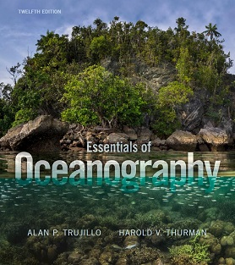
Alignment to Intro Oceanography curriculum
OOI science themes
and data availability
Data Skills Building Blocks
PDF
common Oceanography textbooks

Slide 22
Break 10:30 am

Slide 23
Hands-on
Provide a shared experience for everyone to think about learning and teaching.
Engage fully as a learner.
Give space for your friends to mess with the ideas.
Go deeper into your own understanding & bring your friends along.
Inquiry-learning may lead students to question and to share solutions, to extract valid conclusions from hands-on experiments, to formulate questions, to work with peers and to apply the usual research techniques (Lederman & Lederman, 2012; Scharfenberg & Bogner, 2013).

Slide 24
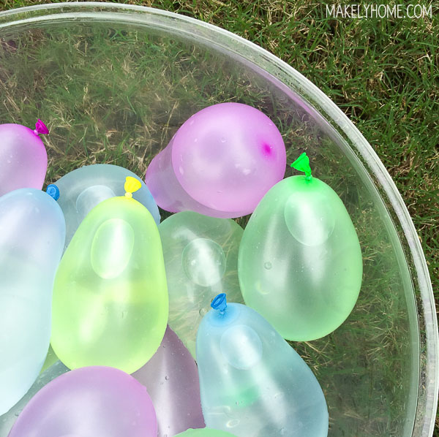
Exploring Ocean Density
Let’s get started. 3-4 people to each table
Fill five balloons as instructed.
Make a prediction and then collect evidence.
Notes:
Table 1- Blue Balloon (hot fresh)
Table 2- Yellow Balloon (cold saltwater)
Table 3- Green Balloon (room temp fresh)
Table 4- Red Balloon (cold freshwater – frozen in advance)
Table 5- Purple Balloon (hot freshwater)

Slide 25
Instructions
Place your balloons in the test tank (1-5).
After 30 seconds, record where the balloon ends up and draw it on a tank diagram.
Write why you think the balloon is responded in that way.
Indicate with arrows the how the position of the balloon changes as you you doing the investigation.

Slide 26
Ponder this…
What did you discover?
What kinds of balloons sank, and what kinds of balloons floated?
How could you explain what happened?

Slide 27
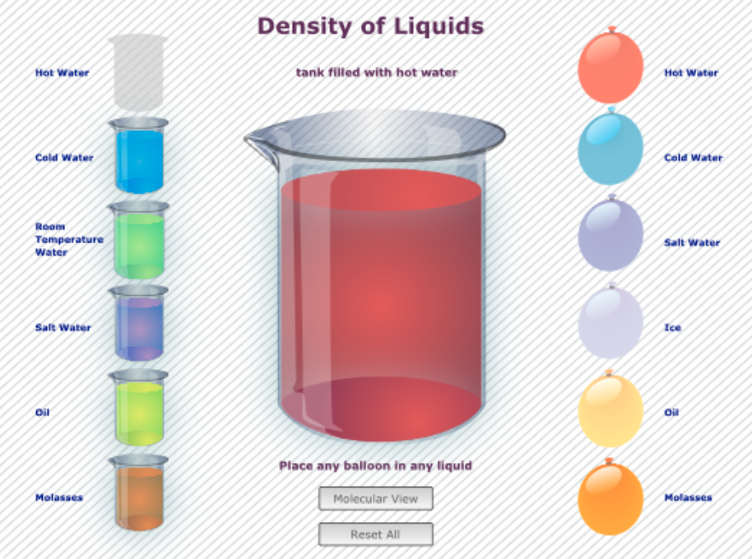
Elaborate: Why are some liquids denser than others?
https://go.rutgers.edu/wmqbu4vm
Notes:
https://mare.lawrencehallofscience.org/guiding-question-why-are-some-liquids-denser-than-others/
https://mare.lawrencehallofscience.org/guiding-question-why-are-some-liquids-denser-than-others/

Slide 28
Results
Hot fresh water
Room temp fresh
Cold fresh water
Room temp salt water
Cold salt water

Slide 29
The Question Formulation Technique (QFT)

Slide 30
Data Exploration

Slide 31
View undergraduate student work:
https://padlet.com/mcdonnel/using-the-question-formulation-technique-qft-to-analyze-ooi--gp7ozzde0f6wp9hp

Slide 32
Denser substances sink below substance that are less dense.
Density is mass/volume and plays a crucial role in driving ocean currents
The density of seawater is influenced by two main factors: temperature (thermo) and salinity (haline). Cold water is denser than warm water, and salty water is denser than fresh water.
When water at the surface becomes cold (e.g., near the poles) or when it gains salinity (e.g., due to evaporation), it becomes denser and sinks. This creates a downward movement of water.
The sinking cold, salty water is replaced by warmer water from lower latitudes, which then moves along the surface. This movement creates a global movement of ocean currents that helps distribute heat around the planet.
BIG ideas

Slide 33
Reflection
Turn & Talk

Slide 35
Five Foundational Ideas on Learning
Learning is an active process.
Learning builds on prior knowledge.
Learning that is authentic to the learner is more memorable.
Learning occurs in a complex social environment.
Learning requires motivation and cognitive engagement.

Slide 36
Synthesis of Discussion
People construct understanding of complex ideas over a long-period of time
Learners don’t acquire concepts simply by having someone tell them the content, or even by doing hands-on activities.
Learners must encounter multiple learning experiences that encourage them to:
Question their assumptions
Engage in discussion about their ideas
Make connections and build on prior knowledge
Apply their understanding in different contexts.

Slide 37
Learning Cycle (Akins and Karplus 1962)
Tanner (1987) Using the 5 E’s to Align Teaching with How People Learn
References
Notes:
Educators J. Myron Atkin and Robert Karplus argued in 1962 that effective learning cycles involve three key elements: exploration, term introduction, and concept application. “In their scheme, exploration allowed the learners to become interested in the subject at hand, raise questions, and identify points of dissatisfaction with their current understanding. Introduction of new ideas and terms, primarily by the instructor, but negotiated by both instructor and students, followed. Finally, concept application provided learners with opportunities within the classroom to apply their new ideas, try out their new understandings in novel contexts, and evaluate the completeness of their understanding,” according to Kimberly D. Tanner in the article “Order Matters: Using the 5E Model to Align Teaching With How People Learn.”

Slide 38
Alignment to Intro Oceanography curriculum
OOI science themes
and data availability
Revisit Data Skills Building Blocks PDF
common Oceanography textbooks

Slide 39
Placeholder for Dax

