Slide 1
Introduction to the
OOI Data Explorer
Sage Lichtenwalner
2025 OOI Data Labs Workshop
Based on slides from Stace Beaulieu, OOI CGSN Data Team
Notes:
“Review how to discover instruments and interesting datasets, bookmarking datasets via Data Views, Erddap download links, time series and profile graphs, notable “raw” datasets, etc.”
This material is based upon work supported by the Ocean Observatories Initiative (OOI), which is a major facility fully funded by the National Science Foundation under Cooperative Agreement No. 2244833.

Slide 2
Today’s session
Live demonstration
  Use Data Explorer to discover and plot datasets
  Compare datasets and share links via Data Views
  Download from (or link to) Data Explorer ERDDAP
Hands-on activity
  Data Explorer Web Quest! Explore the Data Explorer in pairs.
15 min re-group to share
Notes:
OOI Infrastructure: Introduction to the OOI Data Explorer and Data Access
Explore and expand on data platforms, instrumentation, data discovery and access. Explore the Data Explorer in pairs to discover what’s there and how to use it.

Slide 3
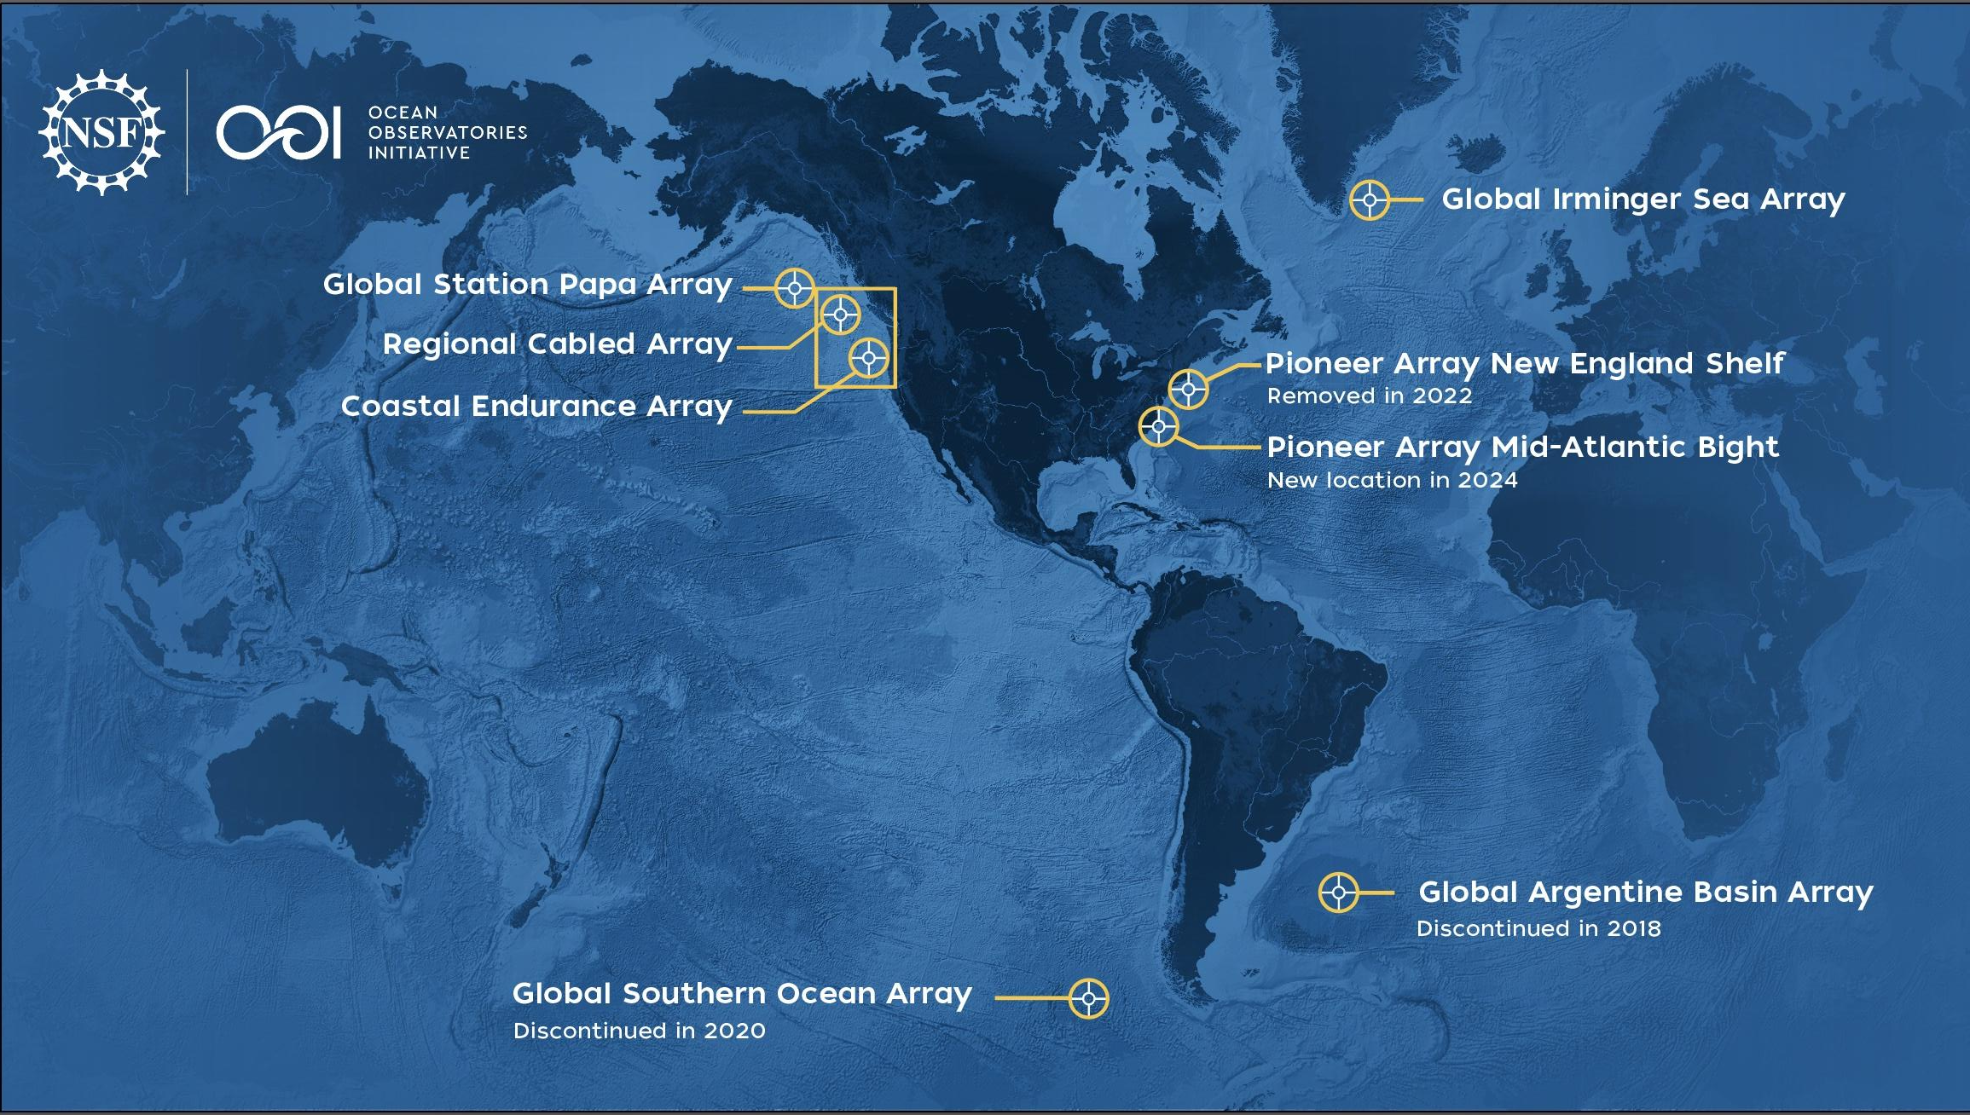
The NSF Ocean Observatories Initiative (OOI) delivers (near-)real-time data from a wide variety of instruments deployed at several ocean arrays
Notes:
NSF is U.S. National Science Foundation
https://oceanobservatories.org/
https://oceanobservatories.org/about-ooi/
I added the (near-) for the telemetered data

Slide 4
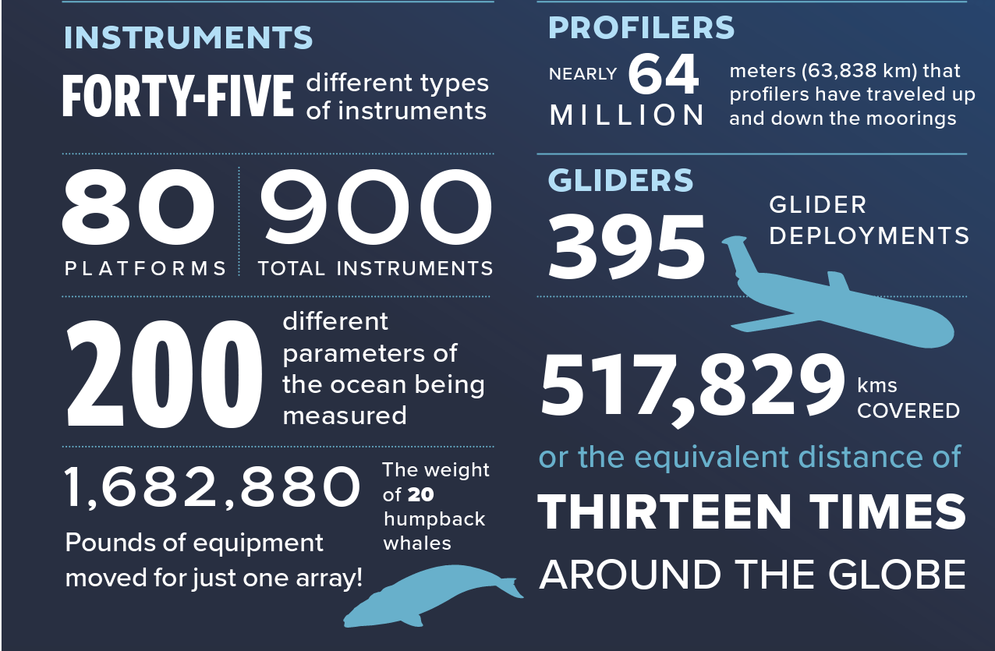
Infrastructure…
More than 900 instruments of almost 50 different types mounted onto moored or mobile platforms
Collecting physical, chemical, geological, and biological data from the air-sea interface to the seafloor
https://oceanobservatories.org/ooi-infrastructure/
Notes:
Frm infrastructure webpage: A variety of infrastructure — platforms, nodes, instruments, and sensors — comprise the arrays designed to provide a continuous stream of ocean data to the user community.
Text from 2024 brochure:
Facilities on east and west coast that deliver data from more than 900 instruments
fixed moorings, AUVs
https://oceanobservatories.org/about-ooi/
there were 45 different instruments as of 2023, and I think MAB adds 4 new
link to Andrew Reed’s slides used in JP Instrumentation course Nov 2023: https://docs.google.com/presentation/d/1Q9B4oX2w2wVikB4J3KbSkmFRjsCFJBCf/edit?usp=sharing&ouid=117776208155316584403&rtpof=true&sd=true

Slide 5
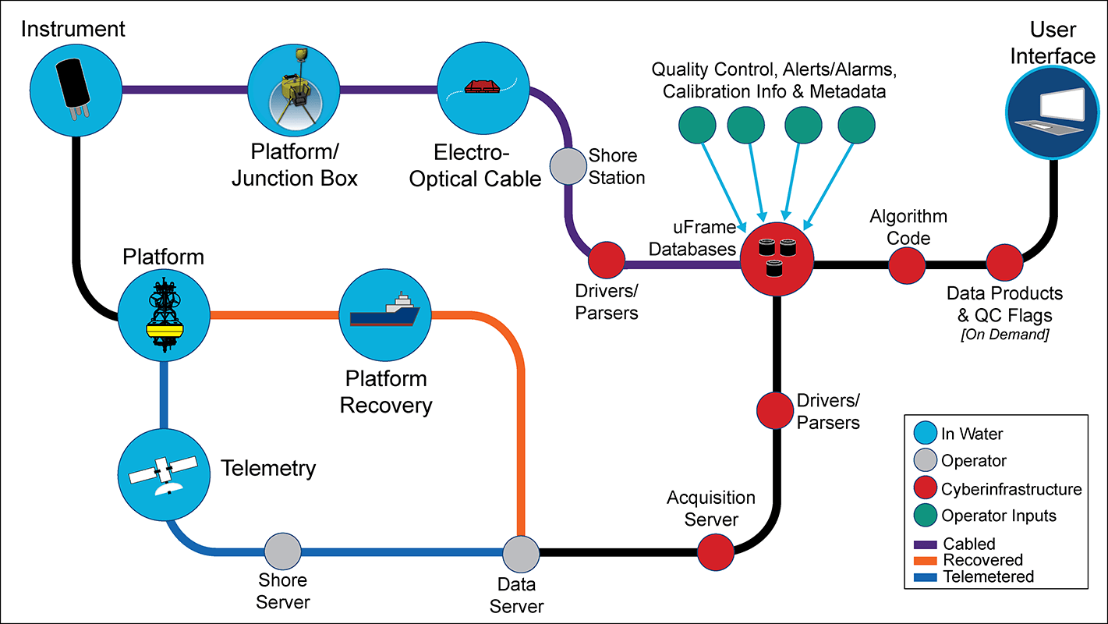
Infrastructure… includes cyberinfrastructure!
https://oceanobservatories.org/cyberinfrastructure/
Notes:
https://oceanobservatories.org/ooi-infrastructure/
“Relaying the data captured by this complex network of infrastructure is accomplished by an equally complex integrated cyberinfrastructure that receives, stores, and transmits ocean data to all those who request it.”
OOI is comprised of four entities: three Marine-Implementing Organizations (WHOI, Oregon State, University of Washington) and the Program Management Office (PMO) which oversees the three MIOs and the CyberInfrastructure (CI) which is responsible for the data delivery/web UI/etc).

Slide 6
Science Goal: Let’s investigate offshore bottom salinity and DO from the new Pioneer Mid Atlantic Bight (MAB) array to see how the seafloor ecosystem changes over time.

Slide 7
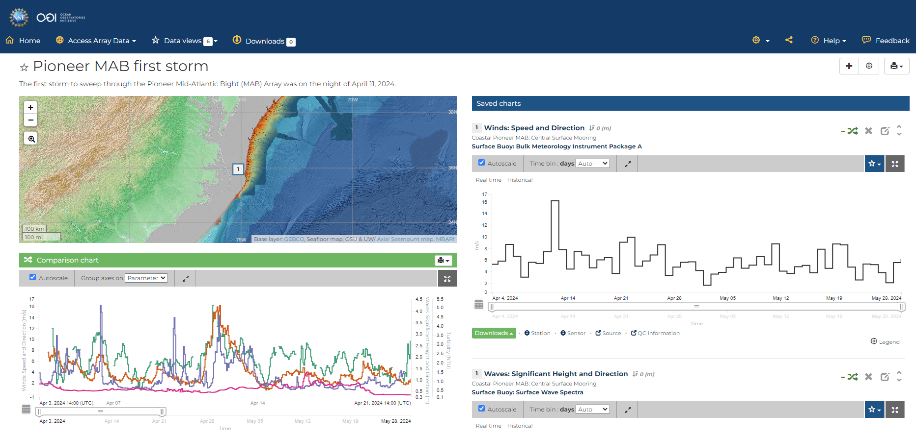
Our Objective: Create a Data View
What is a Data View?
A collection of datasets that can be visualized together for comparison.
See examples in the Menu.
This one was created to show the first storm to sweep through the Pioneer MAB Array.
Notes:
This was the Data View created for the June 2024 Data Labs MAB Workshop, slides available at https://datalab.marine.rutgers.edu/workshops/2024-mid-atlantic-workshop/#tab-id-2
This would fulfill the 1st 2 goals of today’s demo (except does not include profiler data)
Target 'data story' for wind, waves, and turbidity at OOI Pioneer MAB Central Site (30-m water depth), about 25 miles offshore the Outer Banks:
Here's Data View showing Apr 11 wind, max sig wave height, and MFN turbidity highest so far at CN, followed a couple days later by highest so far NSIF turbidity. (I don't know how to explain the NSIF turbidity, but I am curious...)
new: https://dataexplorer.oceanobservatories.org/?ls=xKnA_DDf#data/default
[old, also shares other data views: https://dataexplorer.oceanobservatories.org/?ls=OsGoQAe8#data/5.1]
zoom in, on the comparison chart, to about 2 weeks (Apr 7-21).
Anna Pfeiffer-Herbert “storms/coastal hazards is one of the areas we are hoping to further develop in the Data Lab manual with new Pioneer data”
Dax mentioned “event detection” - note in longer time series at other Arrays one can use the min/max or seasonal stats or QARTOD to identify events of interest, but in this case the Array is too new

Slide 8
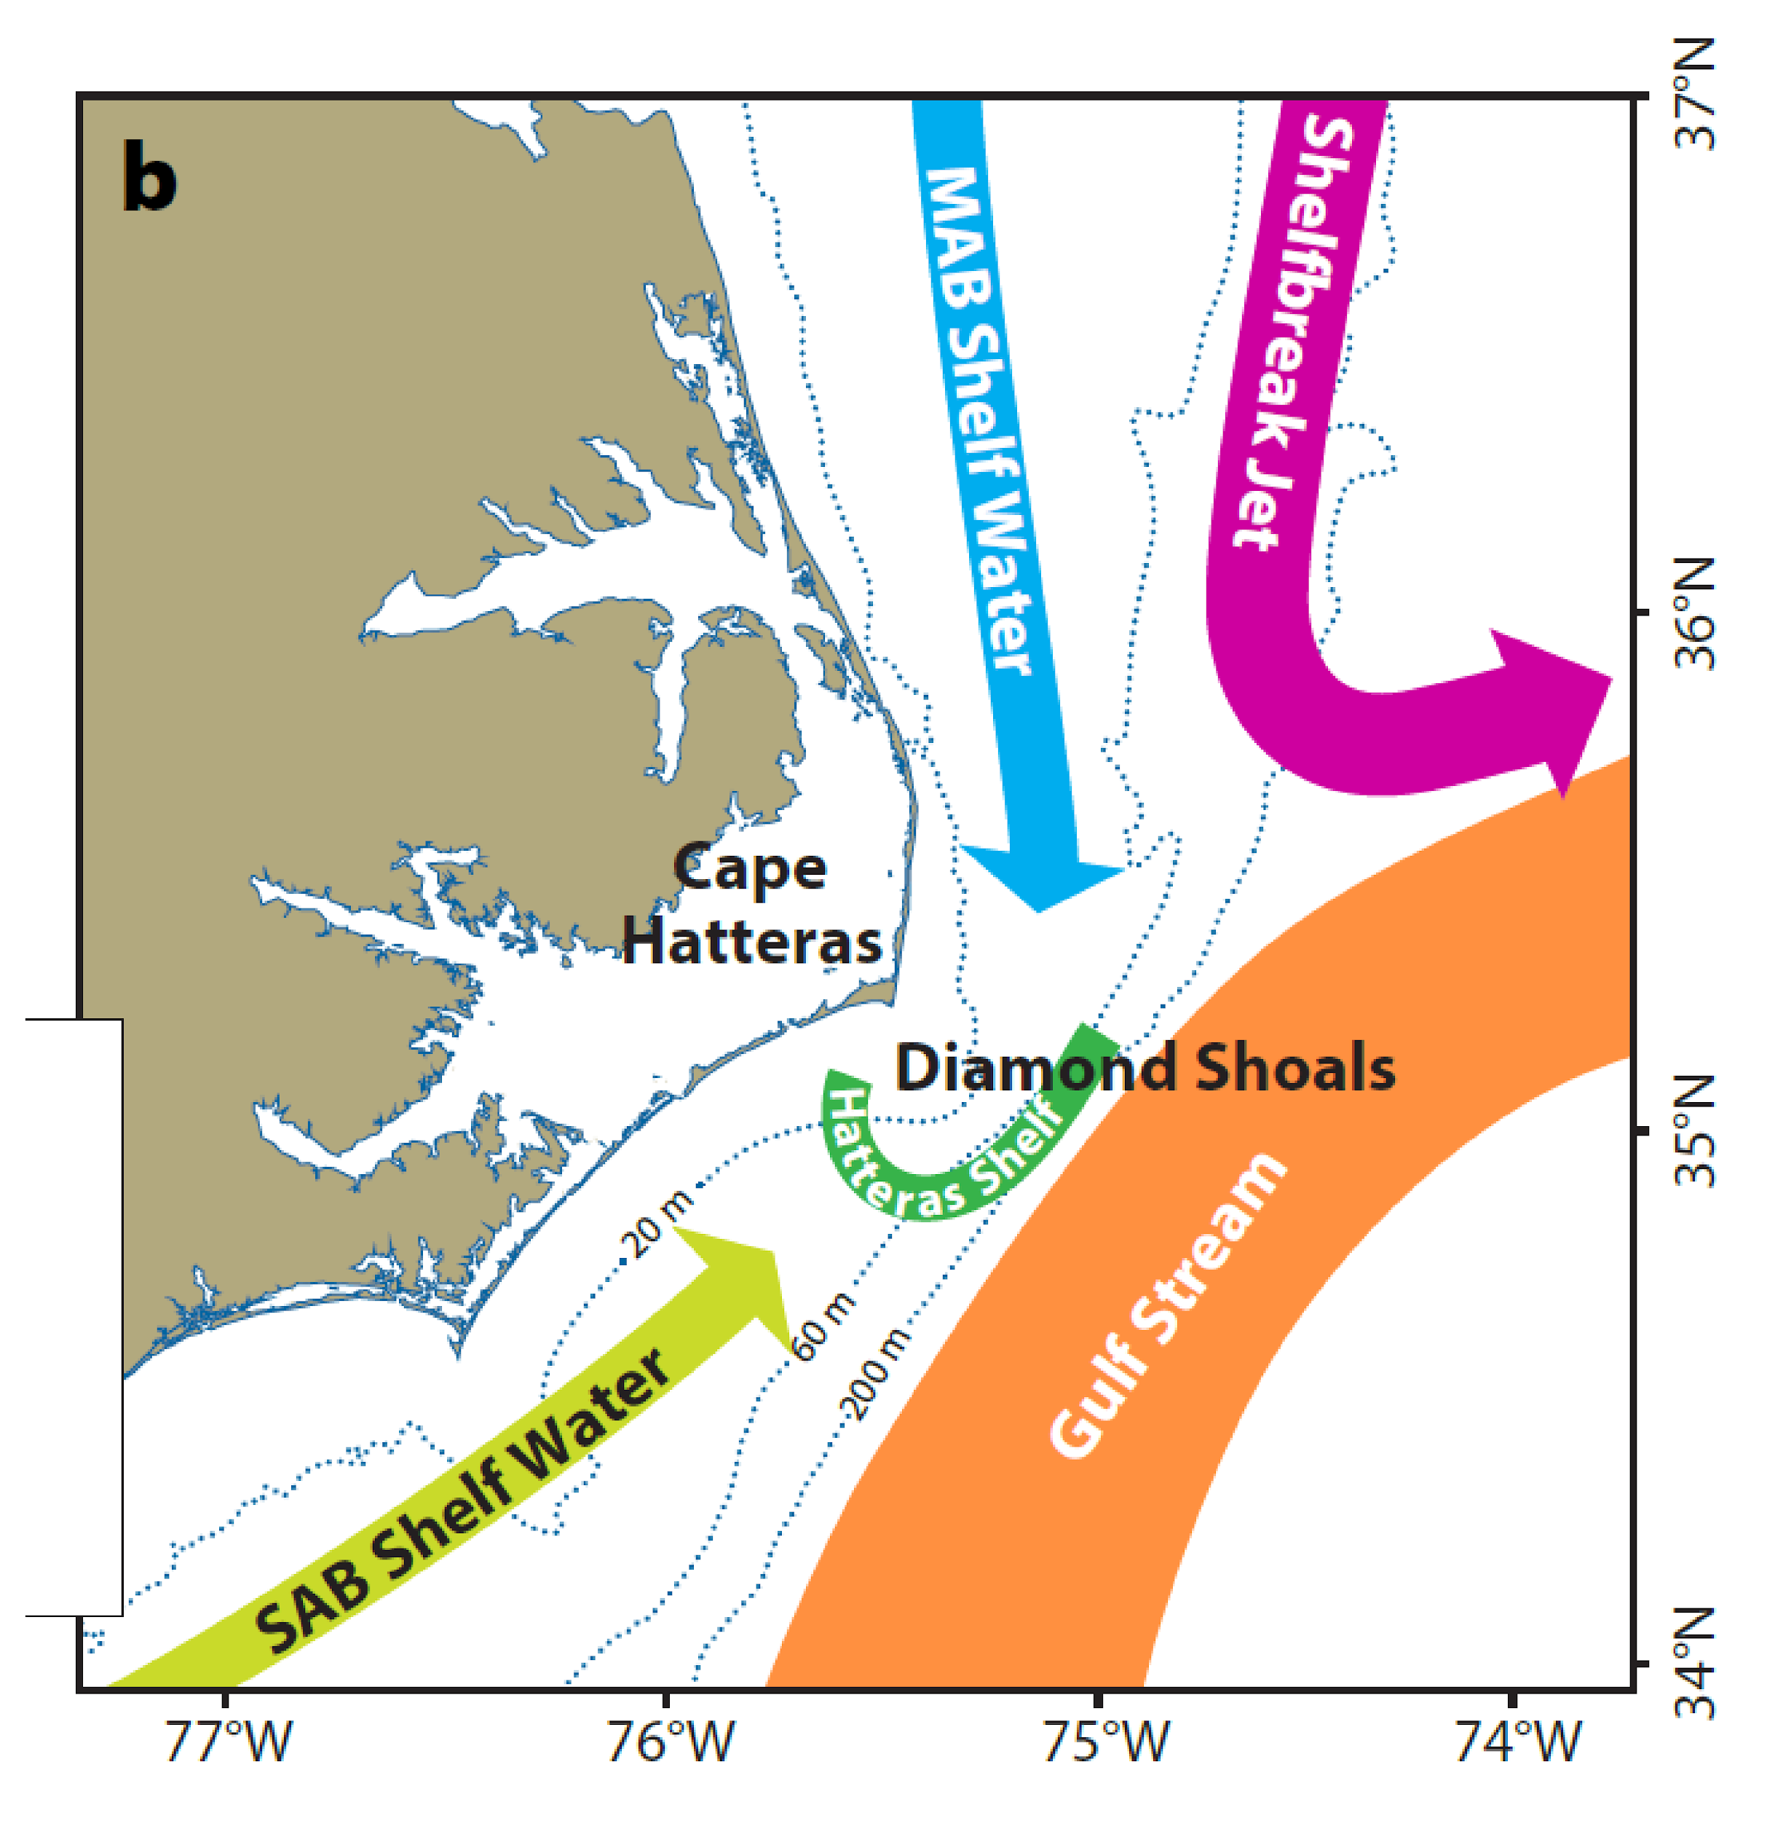
MAB science themes
  Dynamics of shelf/slope exchange
    Wind forcing, frontal instability, Gulf Stream influence
  BGC cycling and transport
    Carbon, nutrients, particulates
    Ecosystem response
  Extreme events
    Hurricanes, freshwater outflows
Approximate location
Southern Surface and Profiler Moorings
Seim et al. (2022)
Notes:
MAB science themes as context for today’s data story
https://oceanobservatories.org/2024/04/pioneer-array-operational-at-mab/
slide from Al Plueddemann, slightly modified
Complex region with multiple processes of interest (schematic of circulation from PEACH).
PEACH = Processes driving Exchange At Cape Hatteras
Extreme events: Hurricanes, freshwater outflows

Slide 9
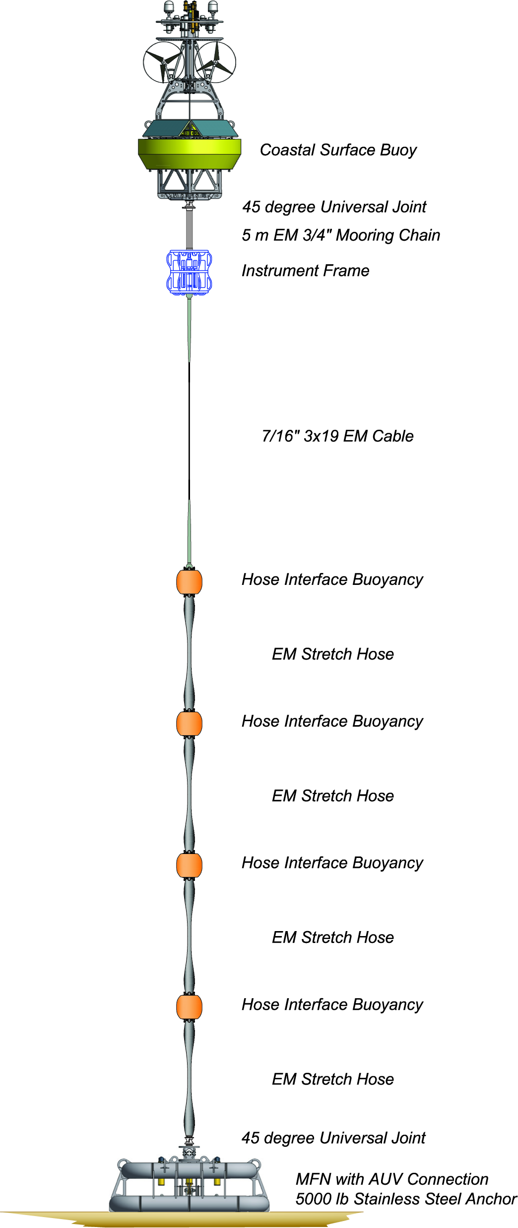
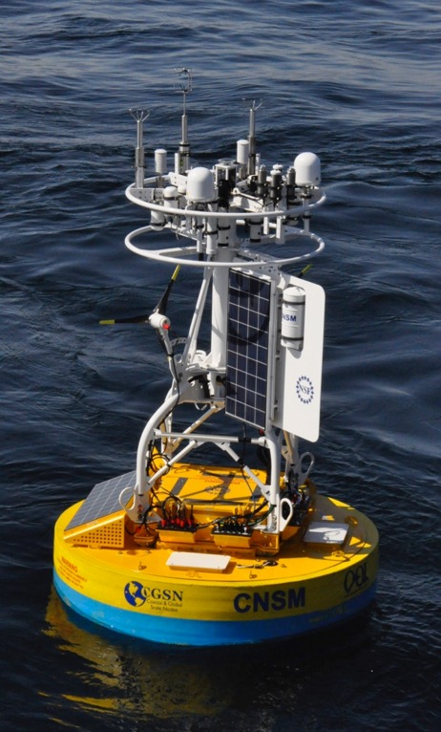
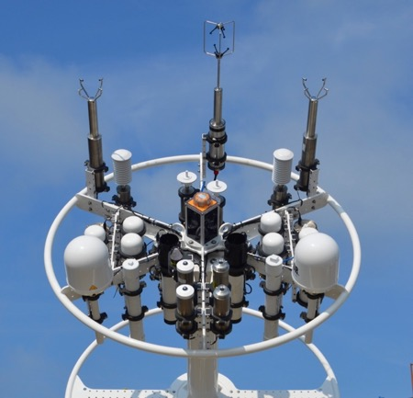
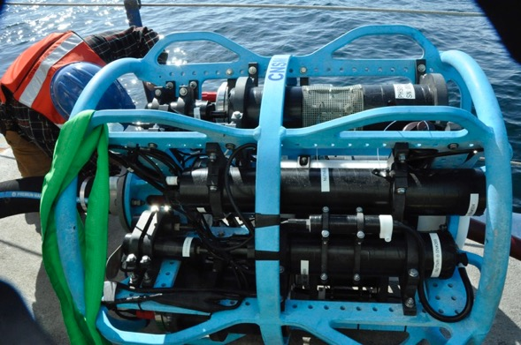
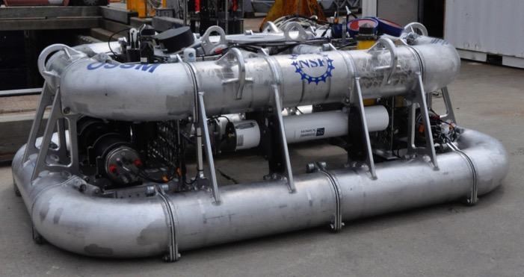
Coastal Surface Moorings
Notes:
Slide from Andrew Reed’s JP class presentation
https://docs.google.com/presentation/d/1Q9B4oX2w2wVikB4J3KbSkmFRjsCFJBCf/edit#slide=id.p8
Power Generation
Near-real-time communications
Instruments from buoy (Meteorology) to seafloor
9

Slide 10
Deploying the
surface moorings
Videos on OOI’s LinkedIn:
https://www.linkedin.com/posts/ocean-observatories-initiative_nsffunded-activity-7181747248966324224-k5uY
https://www.linkedin.com/posts/ocean-observatories-initiative_nsffunded-activity-7181293576352362496-Z4c-
Lots of infrastructure under the surface too…
Notes:
get a feel for the physical infrastructure (size, weight) and environment
News article for Pioneer MAB deployment:
https://oceanobservatories.org/2024/03/first-deployment-of-the-pioneer-array-in-the-mab/
Expedition blog post describing components of MAB surface moorings:
https://www2.whoi.edu/site/ooi-expedition/hoses-galore-hold-moorings-together/

Slide 11
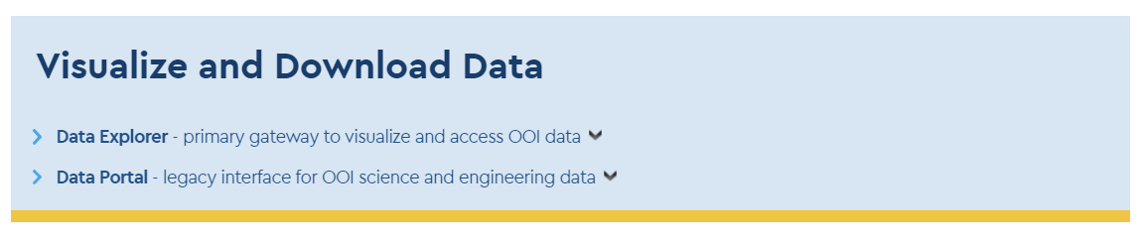
https://oceanobservatories.org/data-access/
Notes:
Today’s focus on these subheaders on Data Access webpage but we are happy to answer questions about all other listings on this webpage

Slide 12
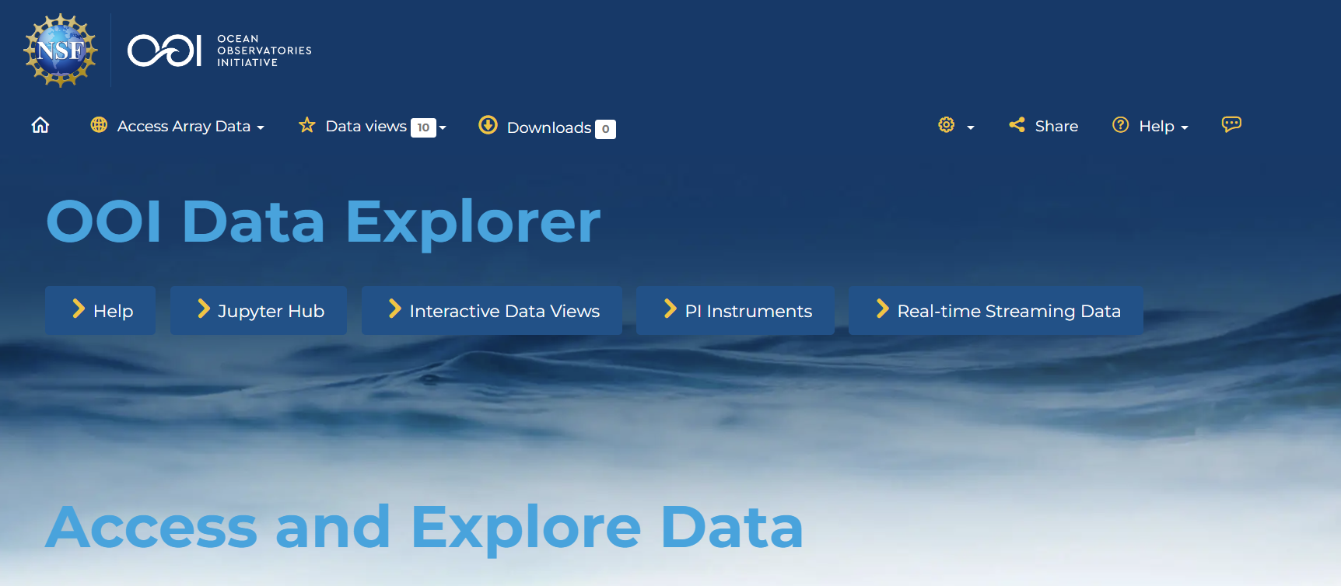
OOI Data Explorer:
Primary gateway to visualize and access OOI data
https://dataexplorer.oceanobservatories.org/
* for best results use Chrome or Firefox web browser
Notes:
You can access OOI data in many ways, with the Data Explorer as primary gateway
(don’t open yet bc next slide)

Slide 13
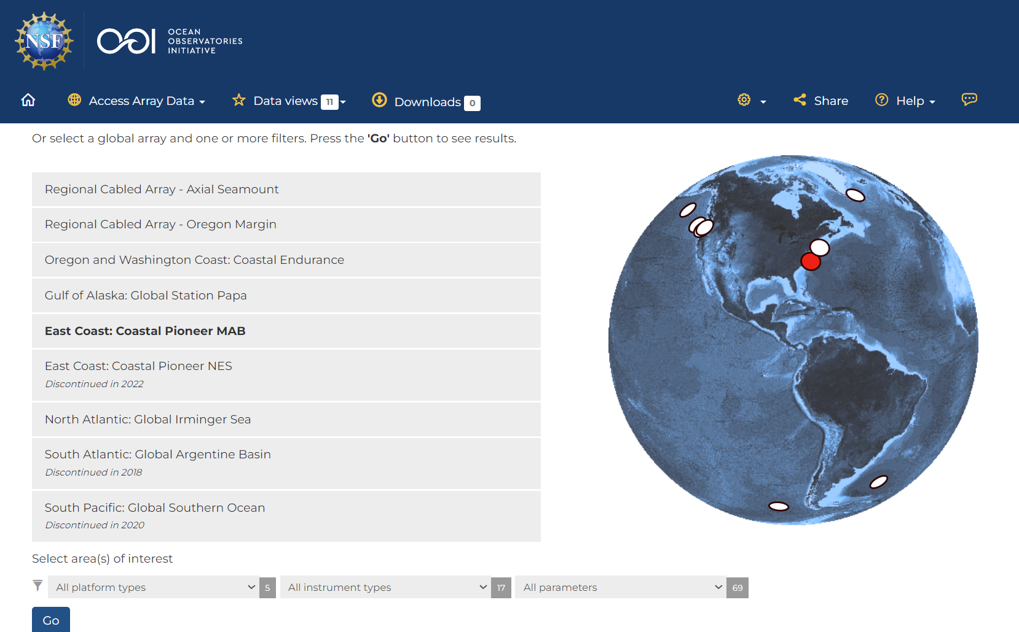
Let’s start by selecting the Pioneer MAB Array and the parameter for barometric pressure
https://dataexplorer.oceanobservatories.org/
Notes:
https://dataexplorer.oceanobservatories.org/
open it up here, it may take a few seconds
stop for a moment to orient participants to the interface
I want the data to “tell me” when there is a significant storm event. I want to see all the barometric pressure available to me at the MAB Array, and then eyeball a dataset to dive into.

Slide 14
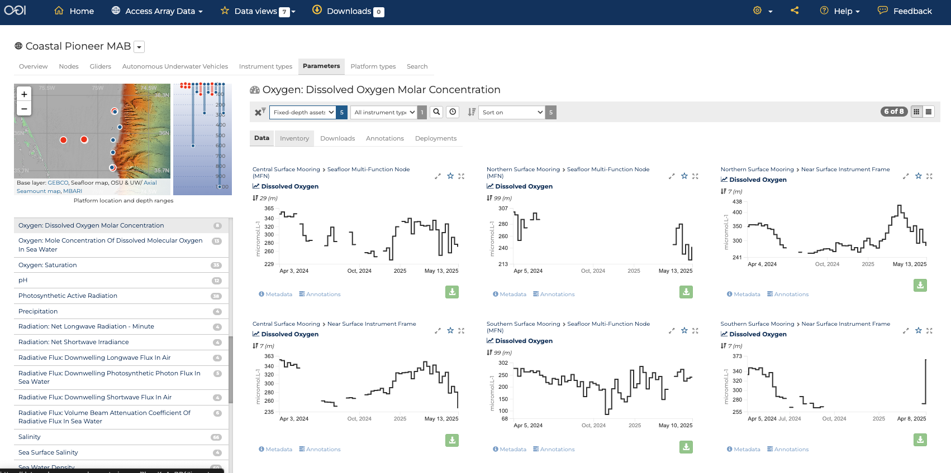
https://dataexplorer.oceanobservatories.org/?ls=xKnA_DDf#ooi/array/CP1/parameter/35/data

Slide 15
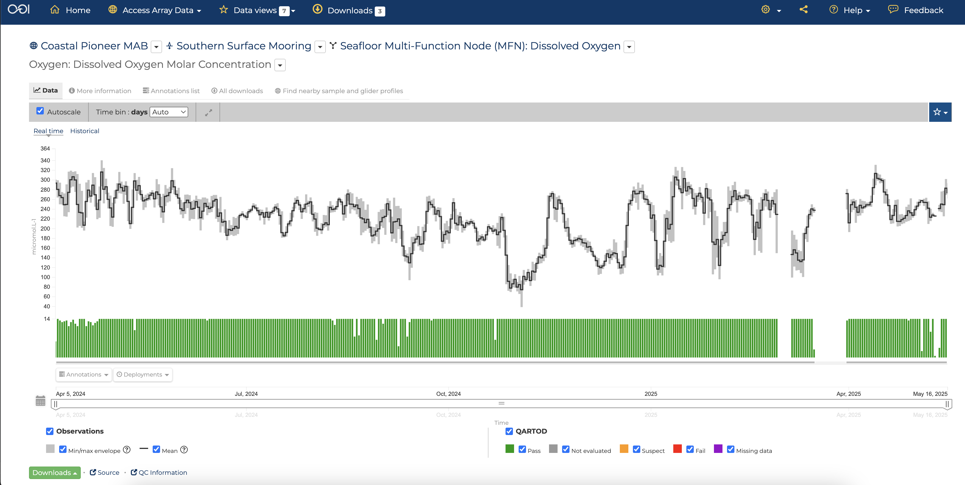
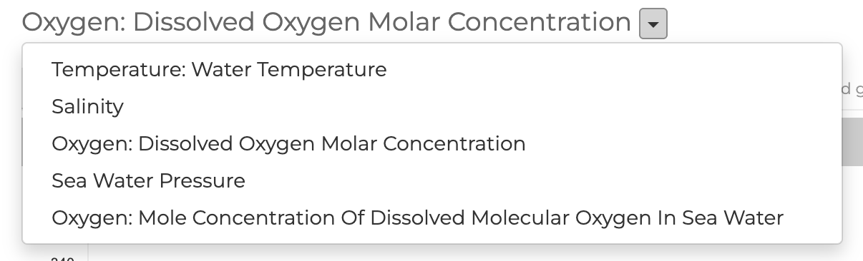
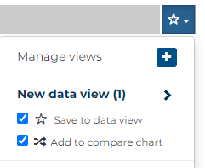
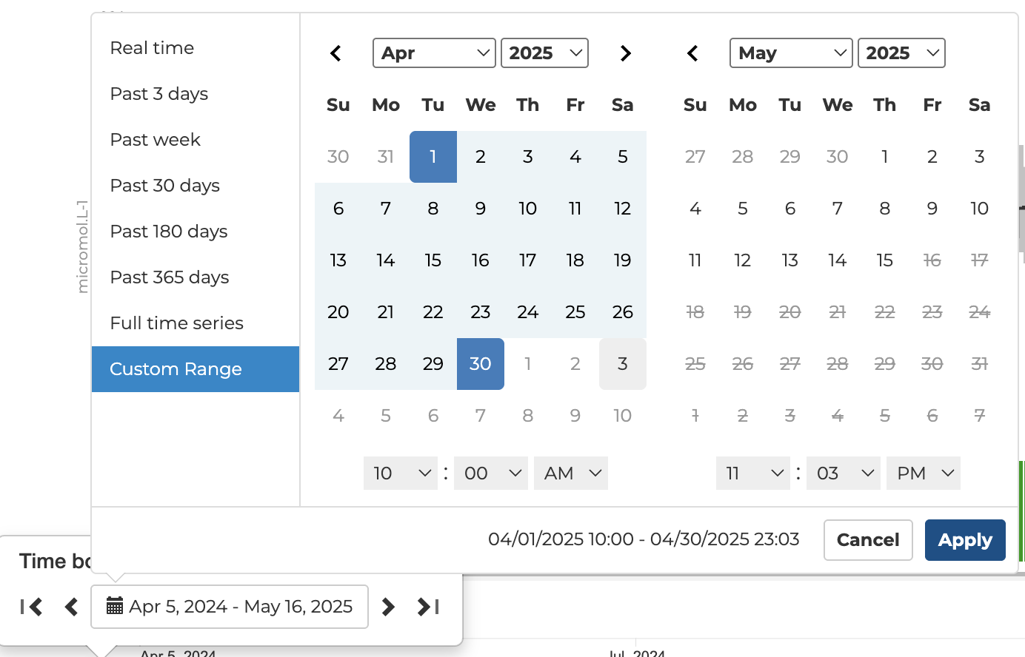
https://dataexplorer.oceanobservatories.org/?ls=xKnA_DDf#metadata/110959/station/35/sensor/data?start=2025-04-01T14:00:00Z&end=2025-05-01T00:03:00Z&leg_clim_max=false&leg_clim_min=false&leg_minmax=false
Notes:
Zoom in to April 2025
Create and add to new data view and comparison chart
Many instruments have several available parameters. Use drop-down to select salinity

Slide 16
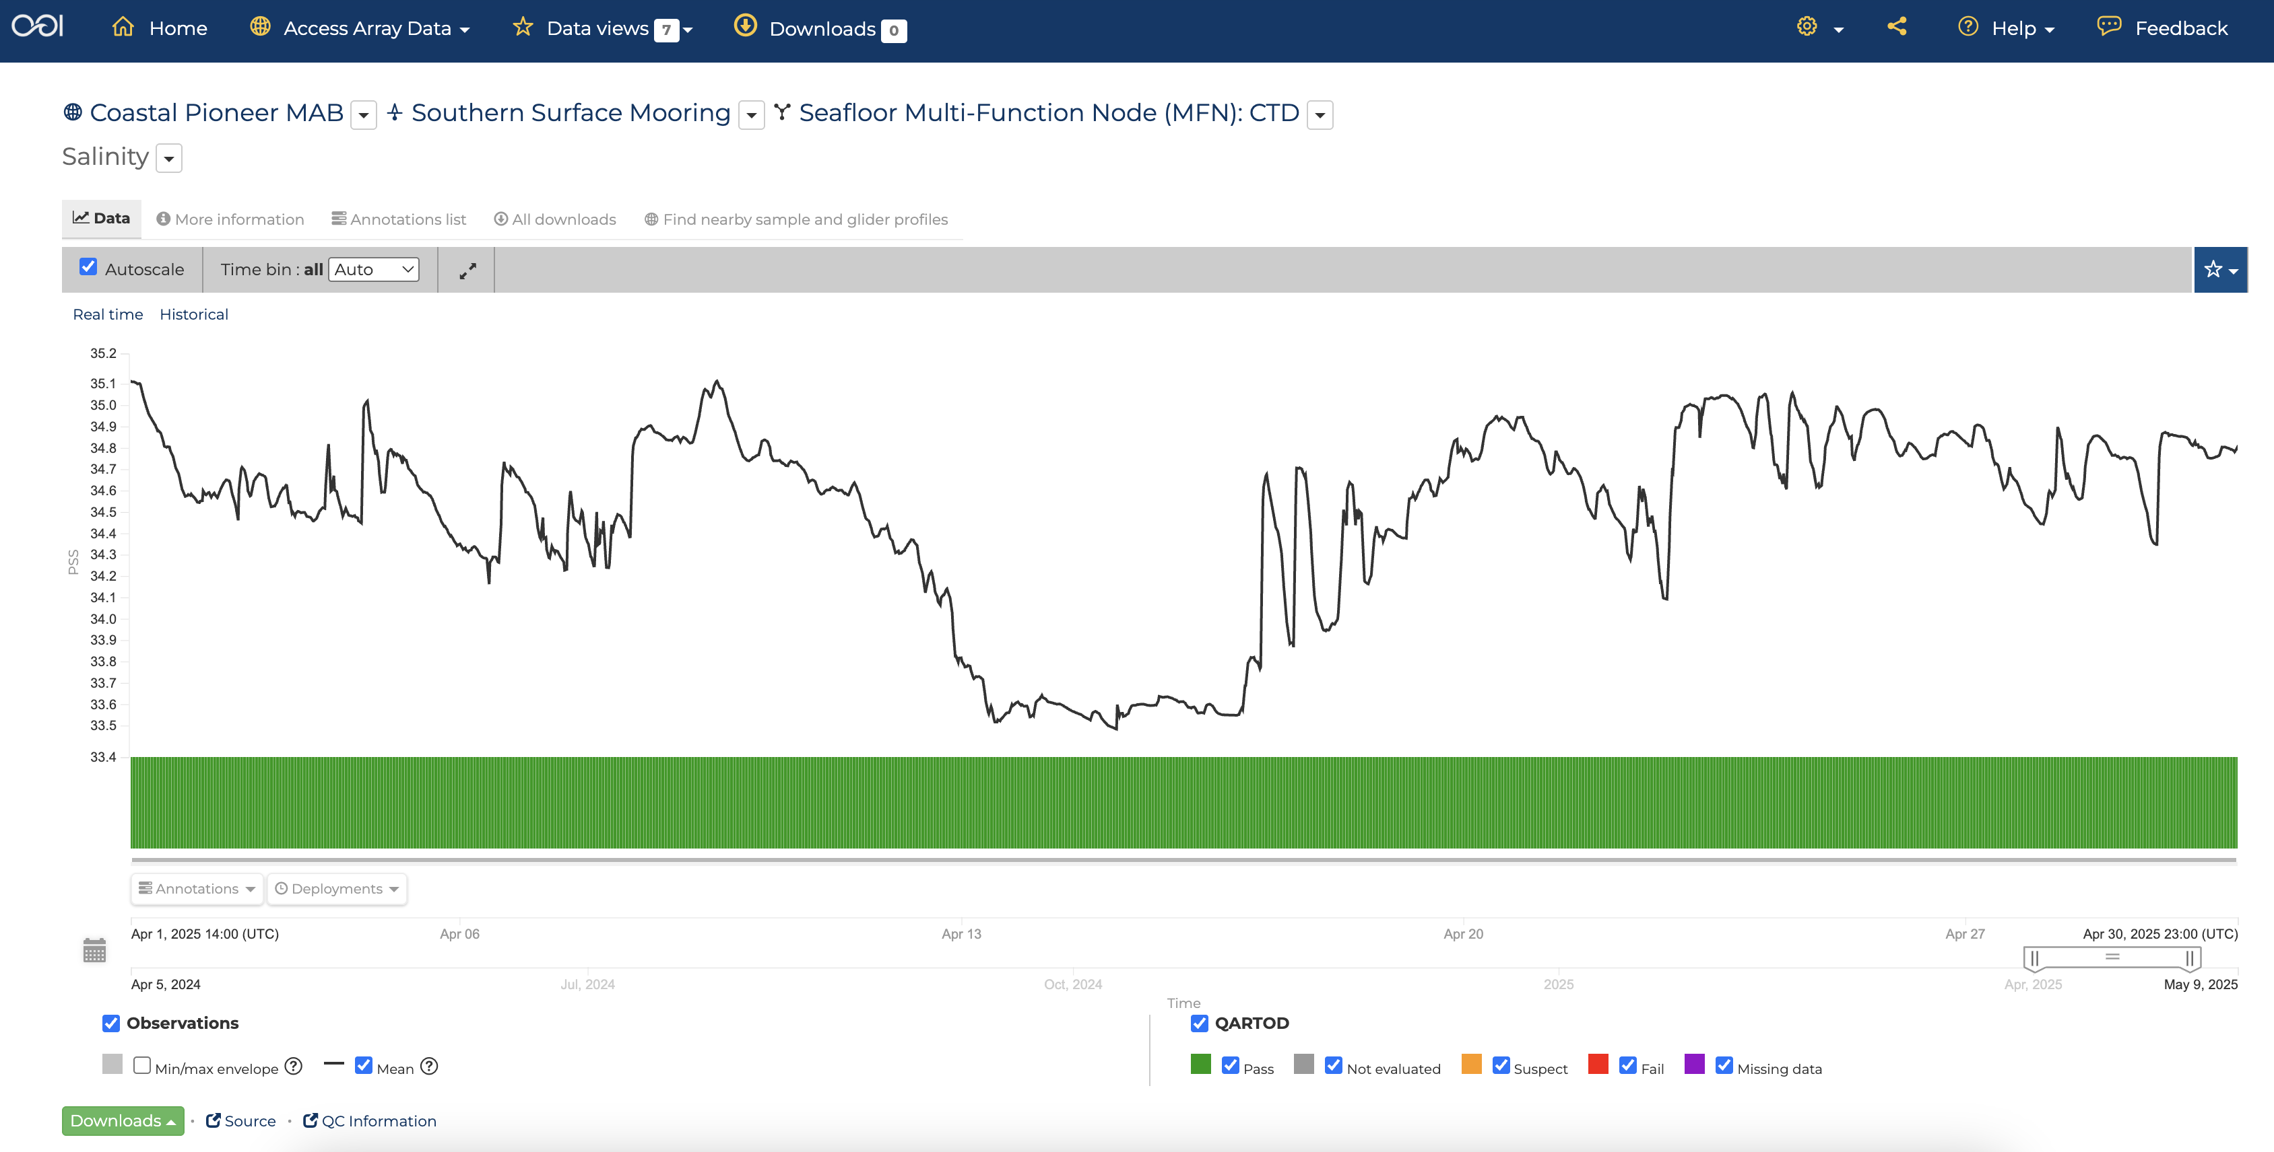
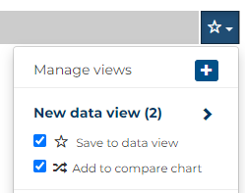
https://dataexplorer.oceanobservatories.org/?ls=xKnA_DDf#metadata/110958/station/14/sensor/data?start=2025-04-01T14:00:00Z&end=2025-04-30T23:15:00Z&leg_minmax=false&leg_clim_max=false&leg_clim_min=false
Notes:
Change from Auto time bin to hours
Add to new data view and comparison chart

Slide 17
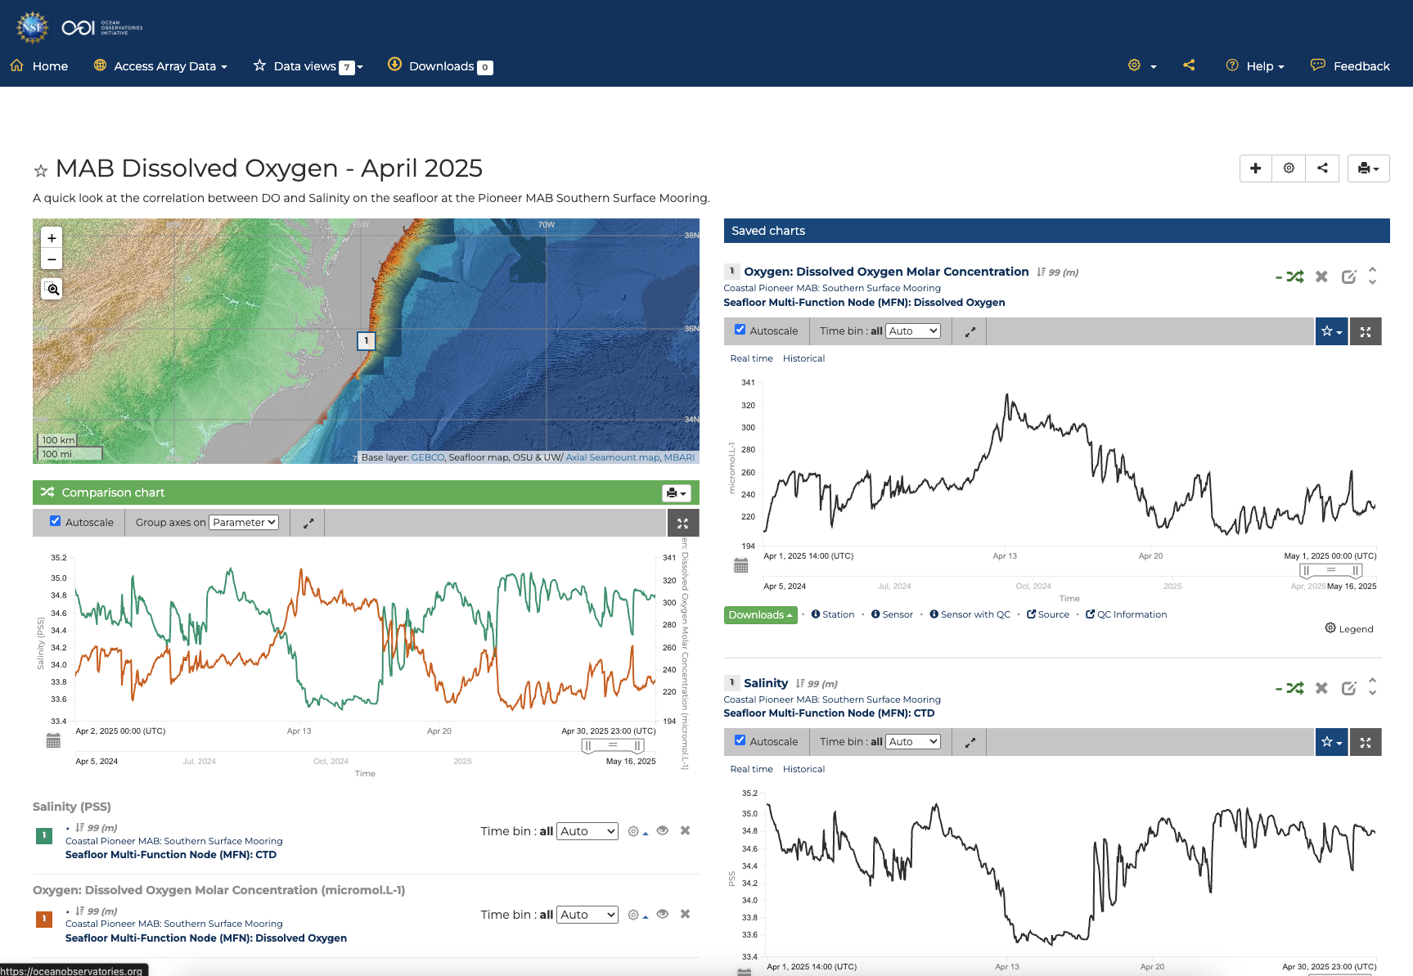
Create share link:
https://dataexplorer.oceanobservatories.org/?ls=xKnA_DDf#add-data-view/BkkFlJdB/1
Notes:
New data view comparison chart opens to most recent week by default
Change the time range in the comparison chart

Slide 18
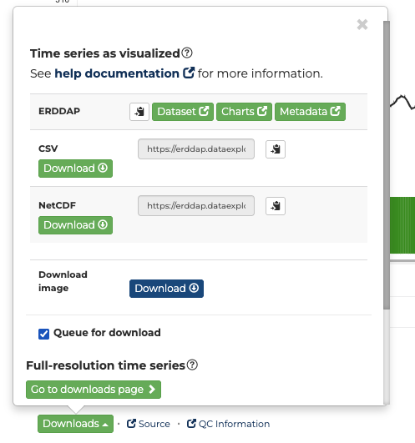
Queue for Download
https://dataexplorer.oceanobservatories.org/#add-data-view/o0Km_08S/1
Notes:
Add to download queue
End this example with Download data: queue these 2, note they are from same instrument so same ERDDAP link,
Show how to change the time range in ERDDAP to create the URL table, then csv output (or other)

Slide 19
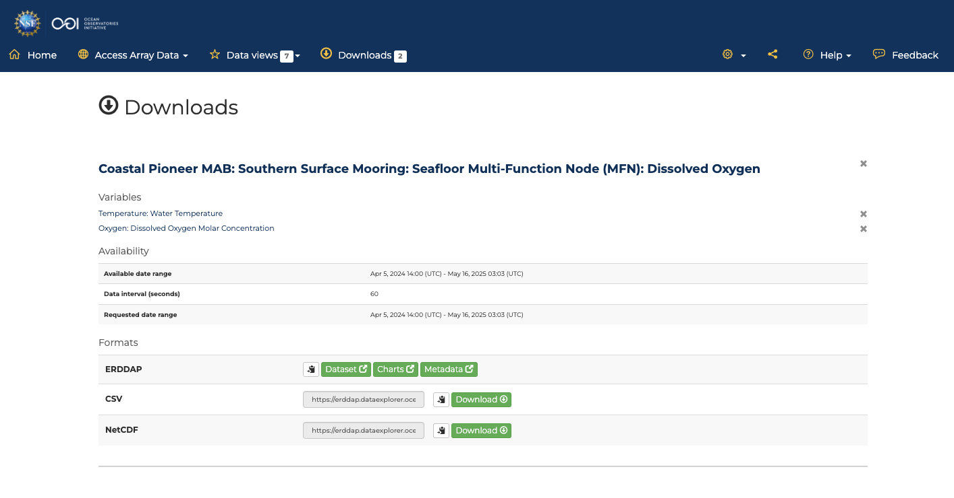
Notes:
Show the ERDDAP Data Access Form with the 2 parameters selected: https://erddap.dataexplorer.oceanobservatories.org/erddap/tabledap/ooi-cp11sosm-sbd11-06-metbka000.html?time%2Cwind_speed%2Cair_pressure%2Cz
Show the file types (csv and NetCDF)
Then back to the Queue to show the URLs for csv and NetCDF

Slide 20
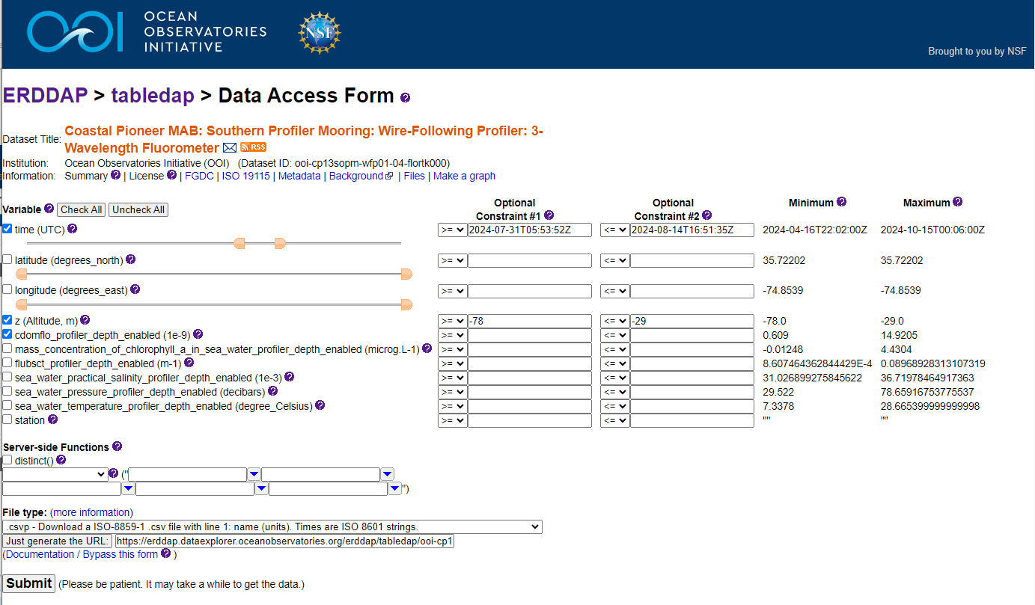
ERDDAP Data Access
ERDDAP is a common oceanographic data portal and good to learn your way around.
You can easily select different variables and date ranges.
Downloads are available in lots of formats.
Notes:
Show how to generate URL

Slide 21
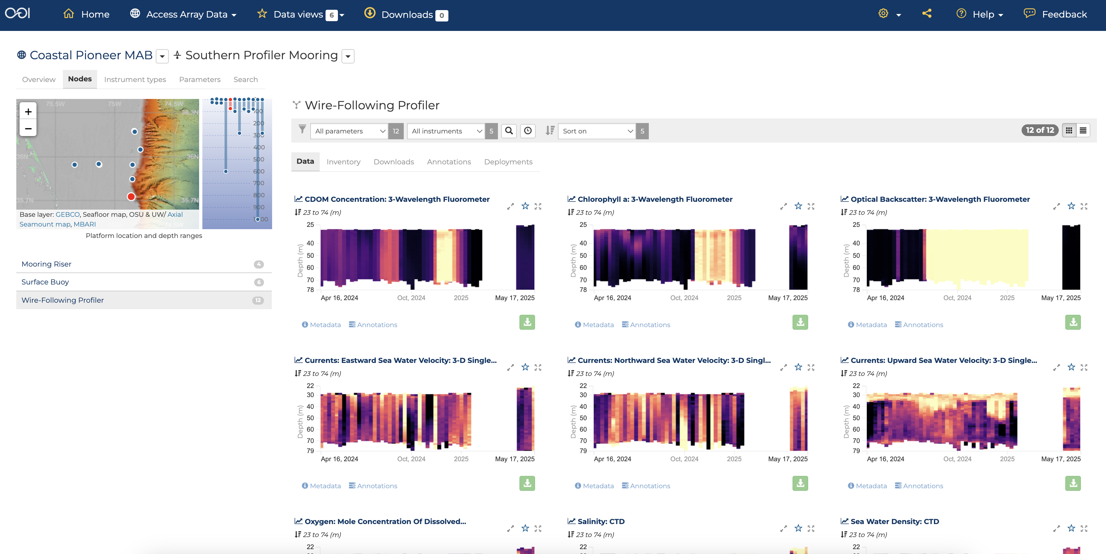
A quick look a profiler data
https://dataexplorer.oceanobservatories.org/#ooi/array/CP1/subsite/CP13SOPM/node/CP13SOPM-WF/data
Notes:
story in the MAB data for Data Labs demo.
From Al: “if it is a water column mixing event the optical backscatter might also show something. If it’s fresh water, the salinity signal from the buoy and NSIF might have a signal”
could we look for indicator of freshwater outflow? What parameters do we have for Southern Profiler Mooring? Navigate into Southern Profiler Mooring > WFP > CDOM really changed after 1st week August
We could explore the salinity although around august 8 appears influenced by Gulf Stream because values near surface are 36
find indications in CDOM profiles. line up CDOM with barometric pressure on August 8.

Slide 22
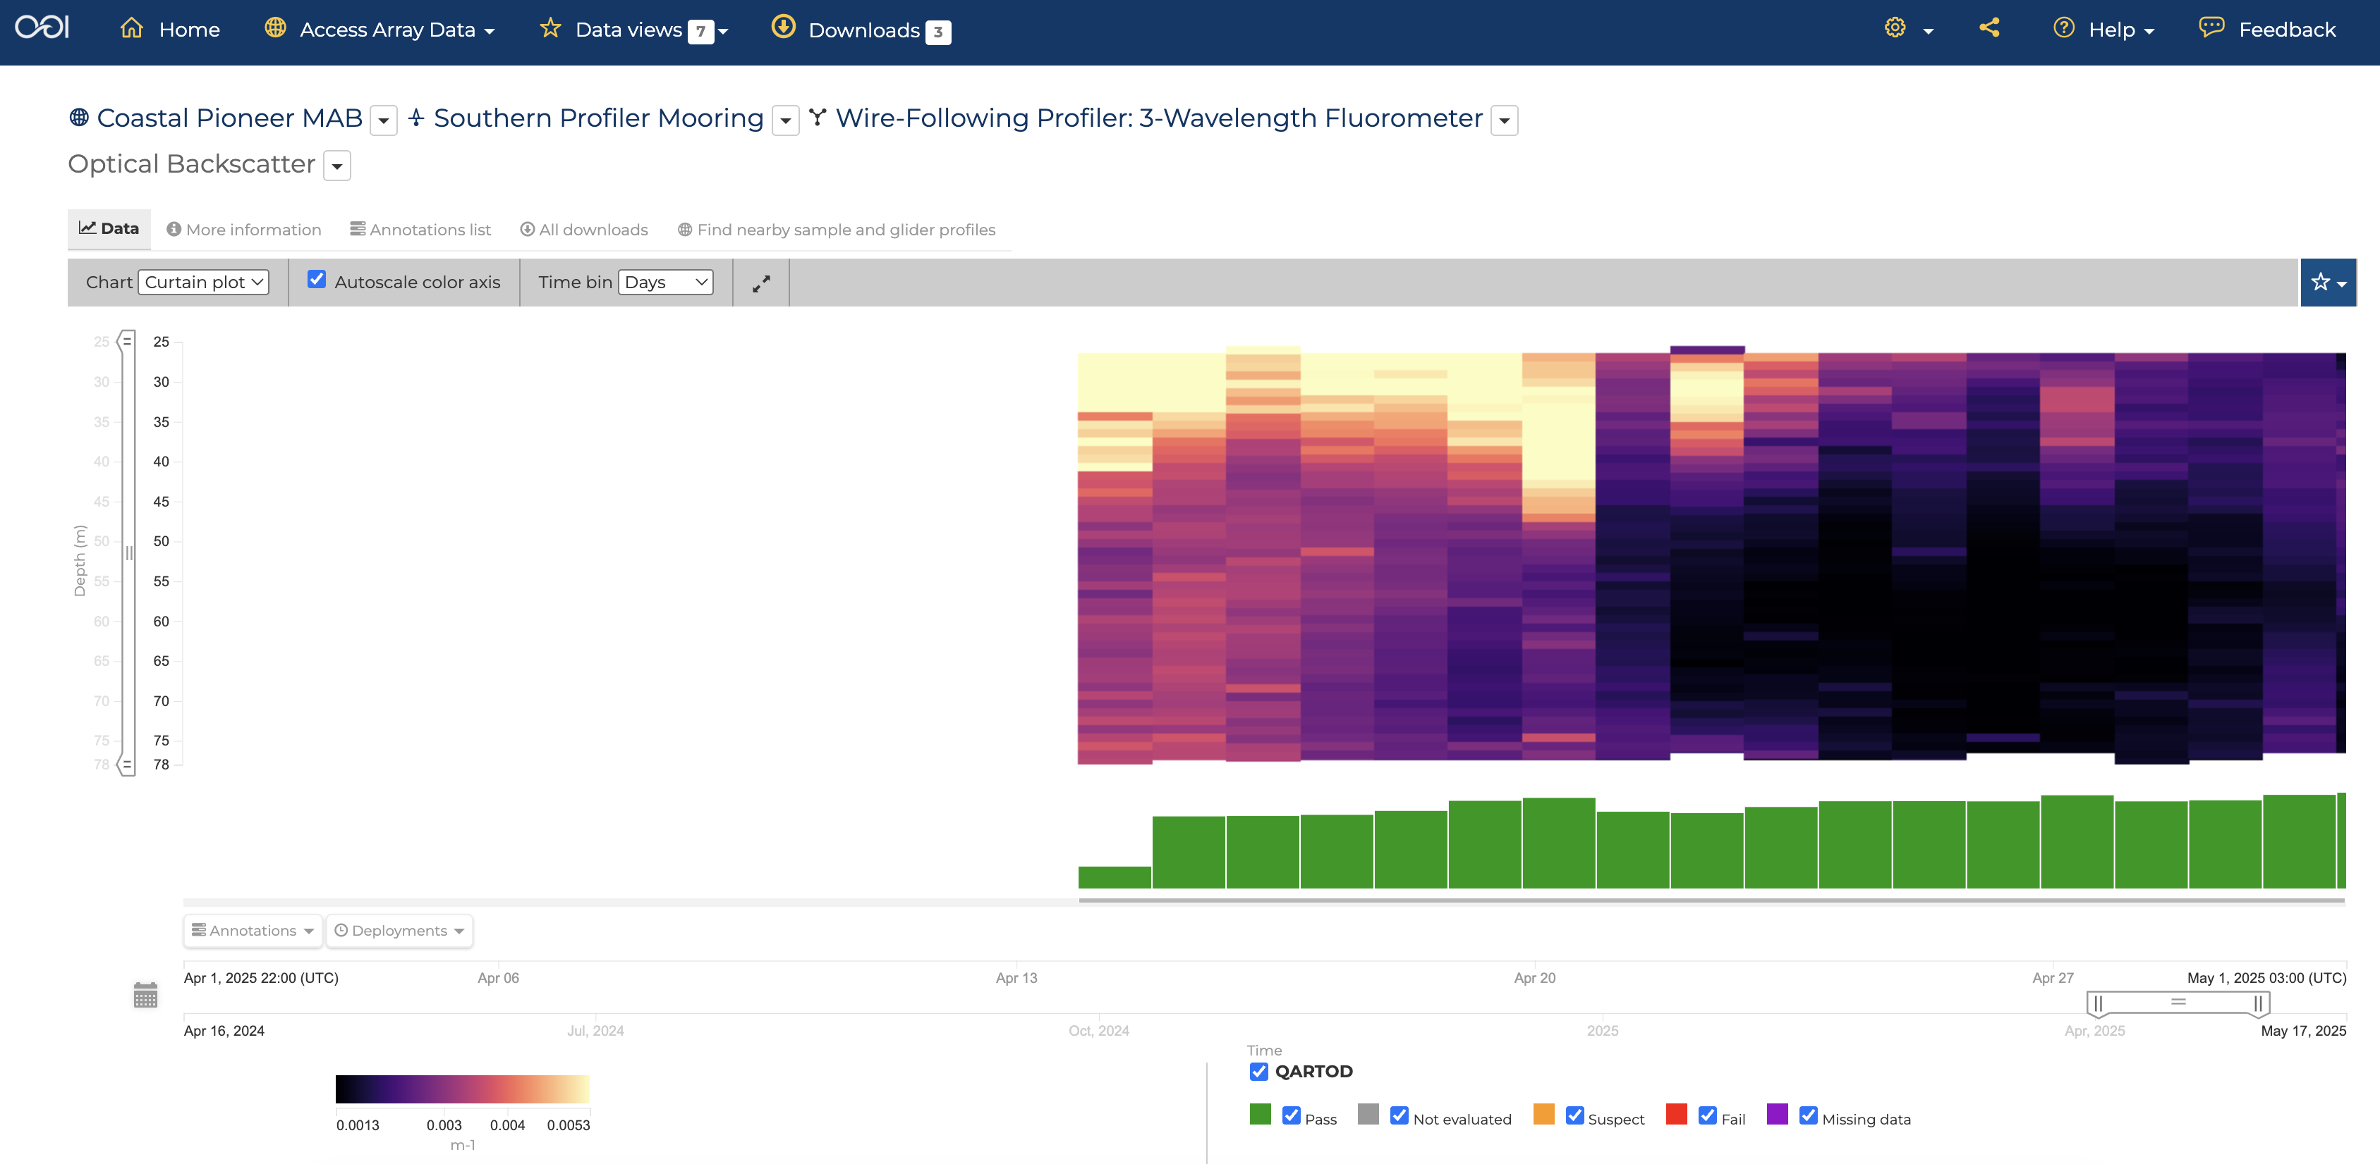
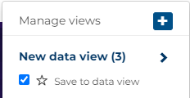
https://dataexplorer.oceanobservatories.org/#metadata/111005/station/2002/sensor/data?start=2025-04-01T22:02:00Z&end=2025-05-01T03:06:00Z&bin=days&leg_clim_max=false&leg_clim_min=false&leg_minmax=false
Notes:
Does the backscatter give us another view of what could be going on?
Here we changed selected the time range for April 2025. Looks lie the first part of the month is missing – likely do to the redeployment of the mooring.
We changed the Time Bins to days so the graph fills in a bit more than just the small dots used when Auto or Hour is selected.
Looks like the bottom has a lot less sediment after the 20th. Perhaps correlated with offshore waters coming onshore?
Could look at other variables (like temperature and water currents) to see.

Slide 23
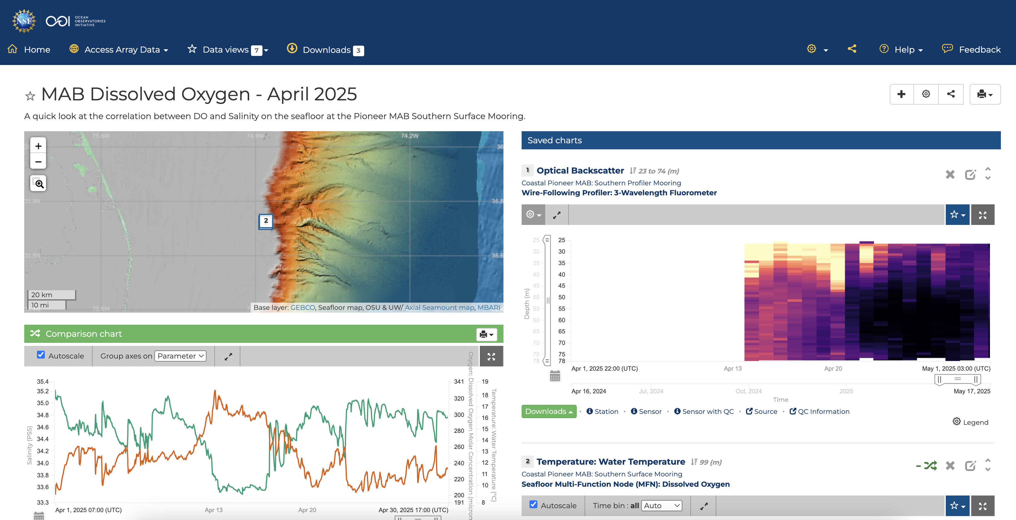
Notes:
Note, profiles can not be added to the Comparison chart. The can only be shown as individual plots on the right.
Also, keep in mind, the current Data View tool has separate time selectors for every chart. If you want them to all match, you will need to make sure they do.

Slide 24
Ready to explore?
Explore the Data Explorer in pairs using the Web Quest worksheet.
Your Quest is to:
Find more datasets to show how the bottom ecosystem changes over time
Add more datasets to a Data View, and
Create a sharable URL
Notes:
Walk thru the handout
explain ultimate Goal: add to a Data View and share URL link
Learning objectives for Quest:
Familiarity with OOI infrastructure as listed in Data Explorer:
Arrays
Platforms (and Nodes on the Platforms)
Instruments
Parameters
Bonus: reference designator for ERDDAP and JupyterHub demo
Familiarity with OOI Data Explorer as a tool, corresponding to step-by-step guide https://oceanobservatories.org/2023/09/four-part-series-on-using-data-explorer/ :
Find & visualize time-series data (at fixed depth)
Compare time-series data
Annotations as part of human-in-the-loop (HITL) quality control (QC) [https://dataexplorer.oceanobservatories.org/help/how-to/ooi/data-charts/data-charts-annotations.html]
Bonus: Find & visualize profiler data
Bonus: Mobile Assets (as of 2024-05-30 Gliders and AUVs not yet available for MAB in Data Explorer)
Familiarity with OOI Data Access as provided by Data Explorer:
Download* a CSV (or NetCDF) file for a “Time series as visualized” (* we will learn the next day about ways to access these data without having to download)

Slide 25

Questions?
Stace Beaulieu (stace@whoi.edu)
Feel free to use the Feedback button on Data Explorer
OOI Discourse HelpDesk https://discourse.oceanobservatories.org/
Notes:
This material is based upon work supported by the Ocean Observatories Initiative (OOI), which is a major facility fully funded by the National Science Foundation under Cooperative Agreement No. 2244833.

Slide 27
GI03FLMA-RIS01-03-DOSTAD000
  Array: Global Irminger Sea
  Instrument Type:
  Dissolved Oxygen
  Site: Flanking Mooring A
  Node: Mooring Riser
Important Notes:
Reference Designators effectively denote a physical deployment location in the OOI.
Asset IDs represent the serial-numbered instruments that are swapped in-and-out at each spot.

Slide 28
OOI Data Delivery Methods
How was the data collected and ingested into the system?
Telemetered Data
  Data received through a transmission medium over distance (e.g. surface buoy to satellite, glider to satellite, acoustic modem); may be decimated
Recovered Data
  Data offloaded directly from an instrument or data logger; usually by connecting the instrument to a computer after the instrument has been recovered and writing to files, often onboard the recovery vessel
Streamed Data
  Data received via transmission over electro-optical cable. Streaming data are provided at full temporal resolution and near-real time.

Slide 29
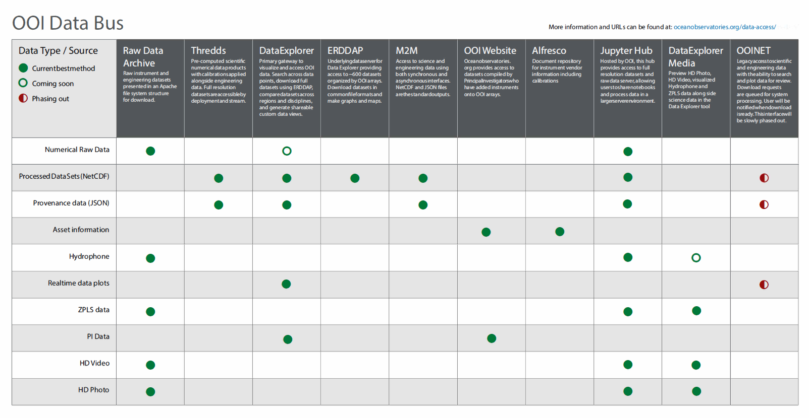
+ NEW: IFCB Dashboard
Notes:
Additional data access points
Data Bus shows 10 User Interfaces
Plus: https://ifcb-data.oceanobservatories.org/dashboard
Ask if anyone interested in quick demo of any other access points depending on data type.

Slide 30
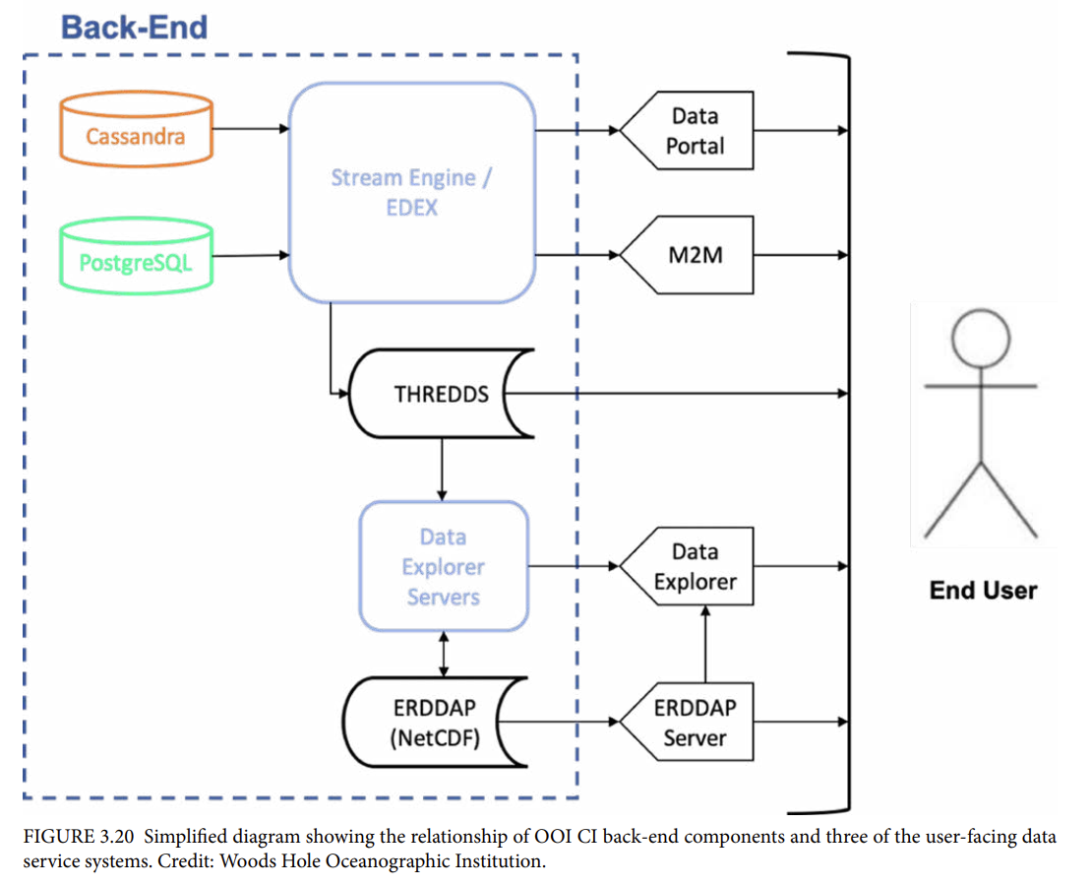
OOI Science Plan
Section 3.C.
OOI Data Delivery System
Notes:
This figure indicates 5 of the User Interfaces

Slide 31
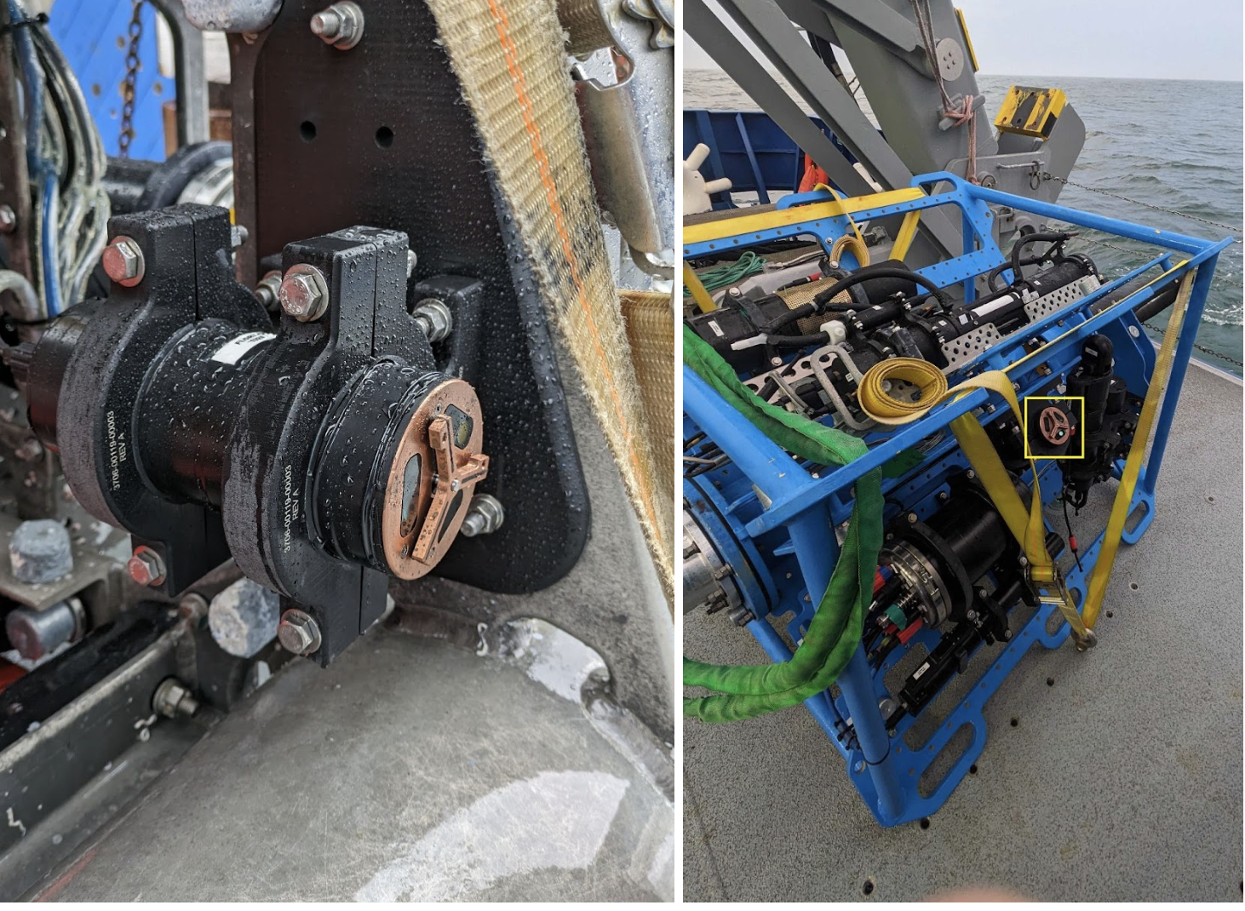
Pioneer MAB Providing Turbidity from Fluorometers
https://oceanobservatories.org/2024/05/pioneer-mab-providing-turbidity-from-ooi-core-fluorometers/
Fluorometers on the:
(left) Seafloor Multi-Function Node
(right, yellow box) Near-Surface Instrument Frame
The copper-covered “Y” is a wiper blade that prevents growth and marine debris from accumulating over the oval sensor windows.
Photos by Sawyer Newman © WHOI
Notes:
The one instrument (fluorometer ECO triplet-w) provides 4 parameters (chlorophyll a, CDOM, optical backscatter, and turbidity).
Note that the Data Explorer chart title for Turbidity does not follow the norm because the reference designator (dataset ID) does not include prefix FLORT but rather TURBD.
I might mention somehow that there is another/new parameter (total volume concentration) that also measures "how much sediment or other particles are in the water" https://dataexplorer.oceanobservatories.org/#ooi/array/all/parameter/2075/data

Slide 32
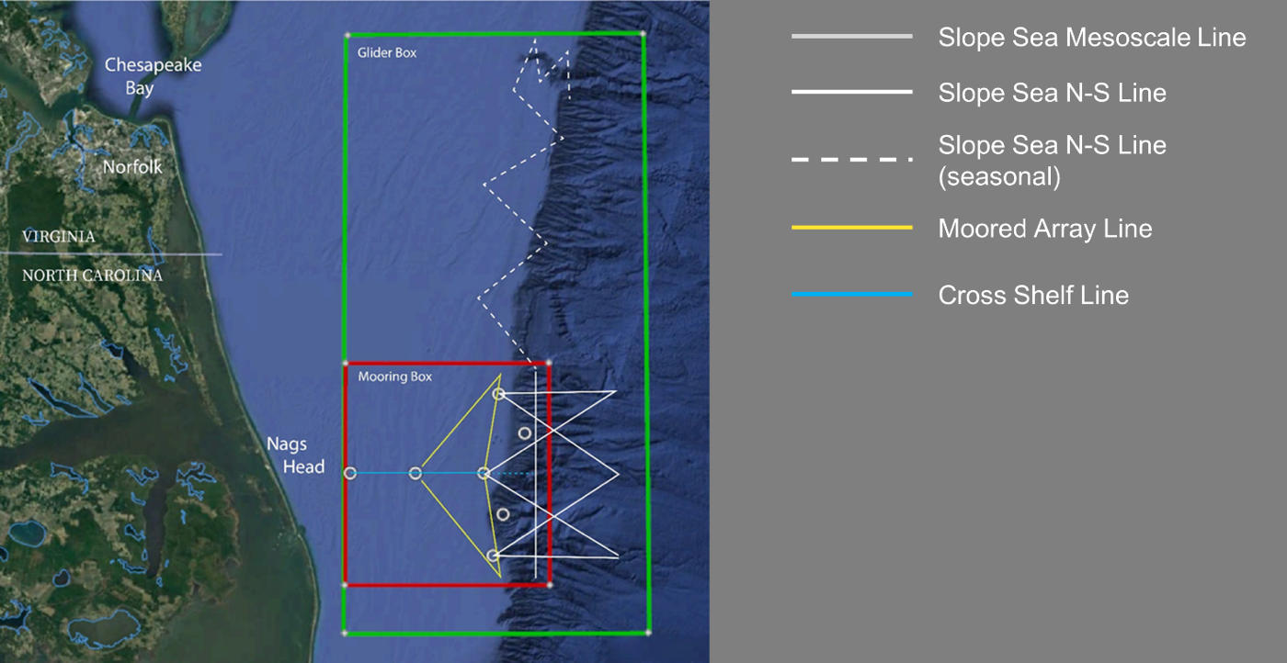
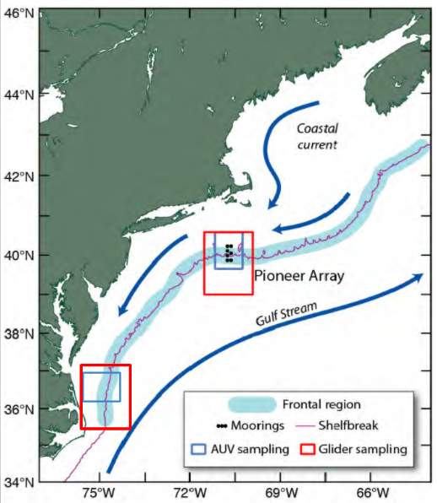
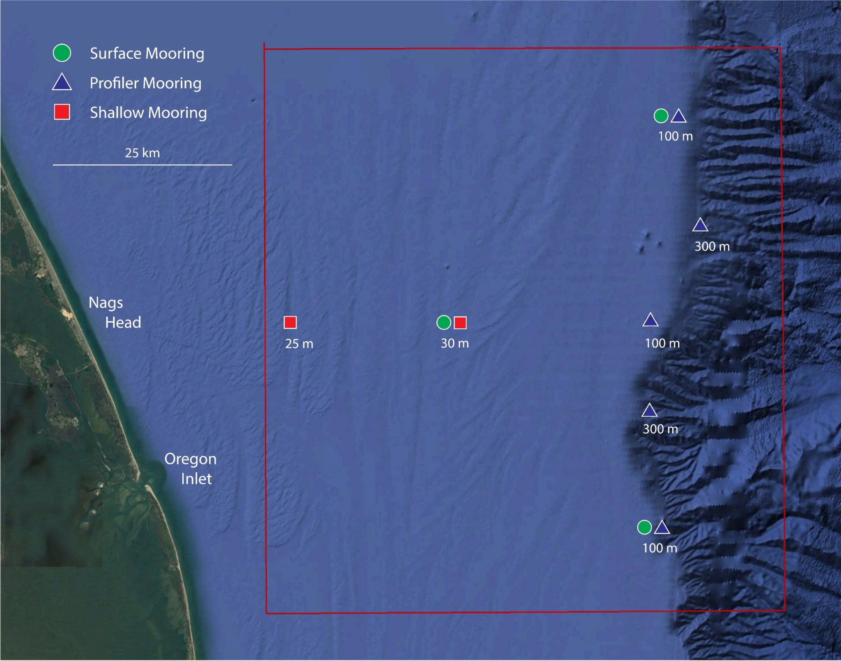
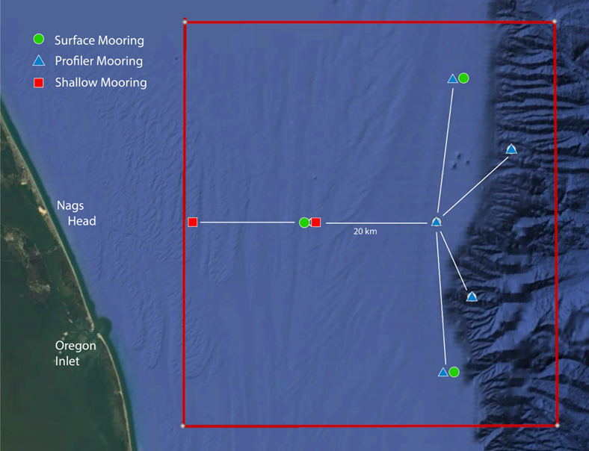
Coastal Pioneer Array – Mid Atlantic Bight
First deployment: April 2024
Notes:
Slide from Andrew Reed’s JP class presentation https://docs.google.com/presentation/d/1Q9B4oX2w2wVikB4J3KbSkmFRjsCFJBCf/edit#slide=id.p8
with updated map from https://oceanobservatories.org/array/coastal-pioneer-mid-atlantic-bight-array/
The “T” part of the layout along the ~100 m isobath with a total separation (north-south) of ~50 km
The “stem” part from West to East is ~45 km
32

