Slide 1
Creating Activities with the OOI Data Portal
Sage Lichtenwalner
OOI Data Labs
2025 Pilot Testing and Pedagogy Workshop

Slide 2
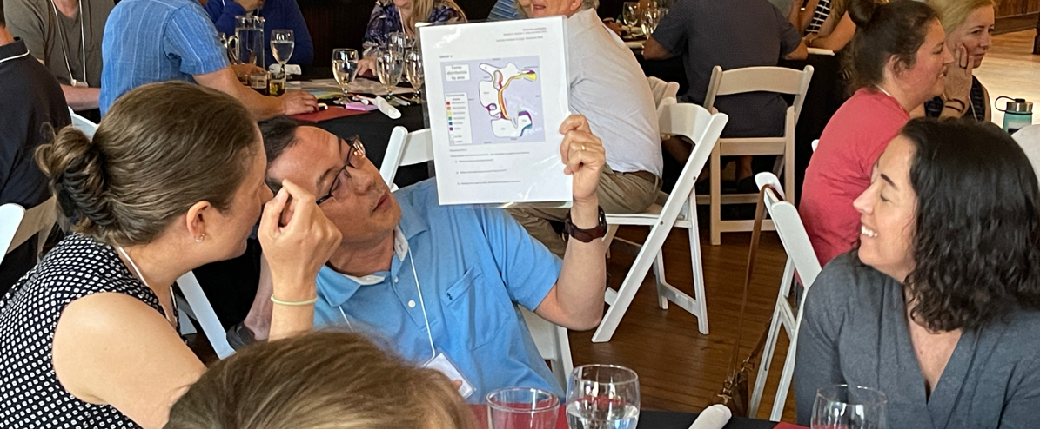
How do we make ocean data accessible to educators and students?

Slide 3
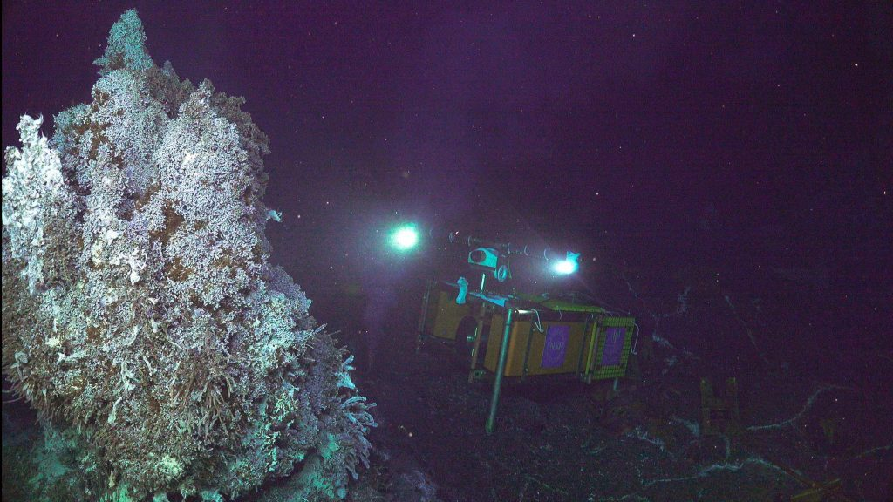
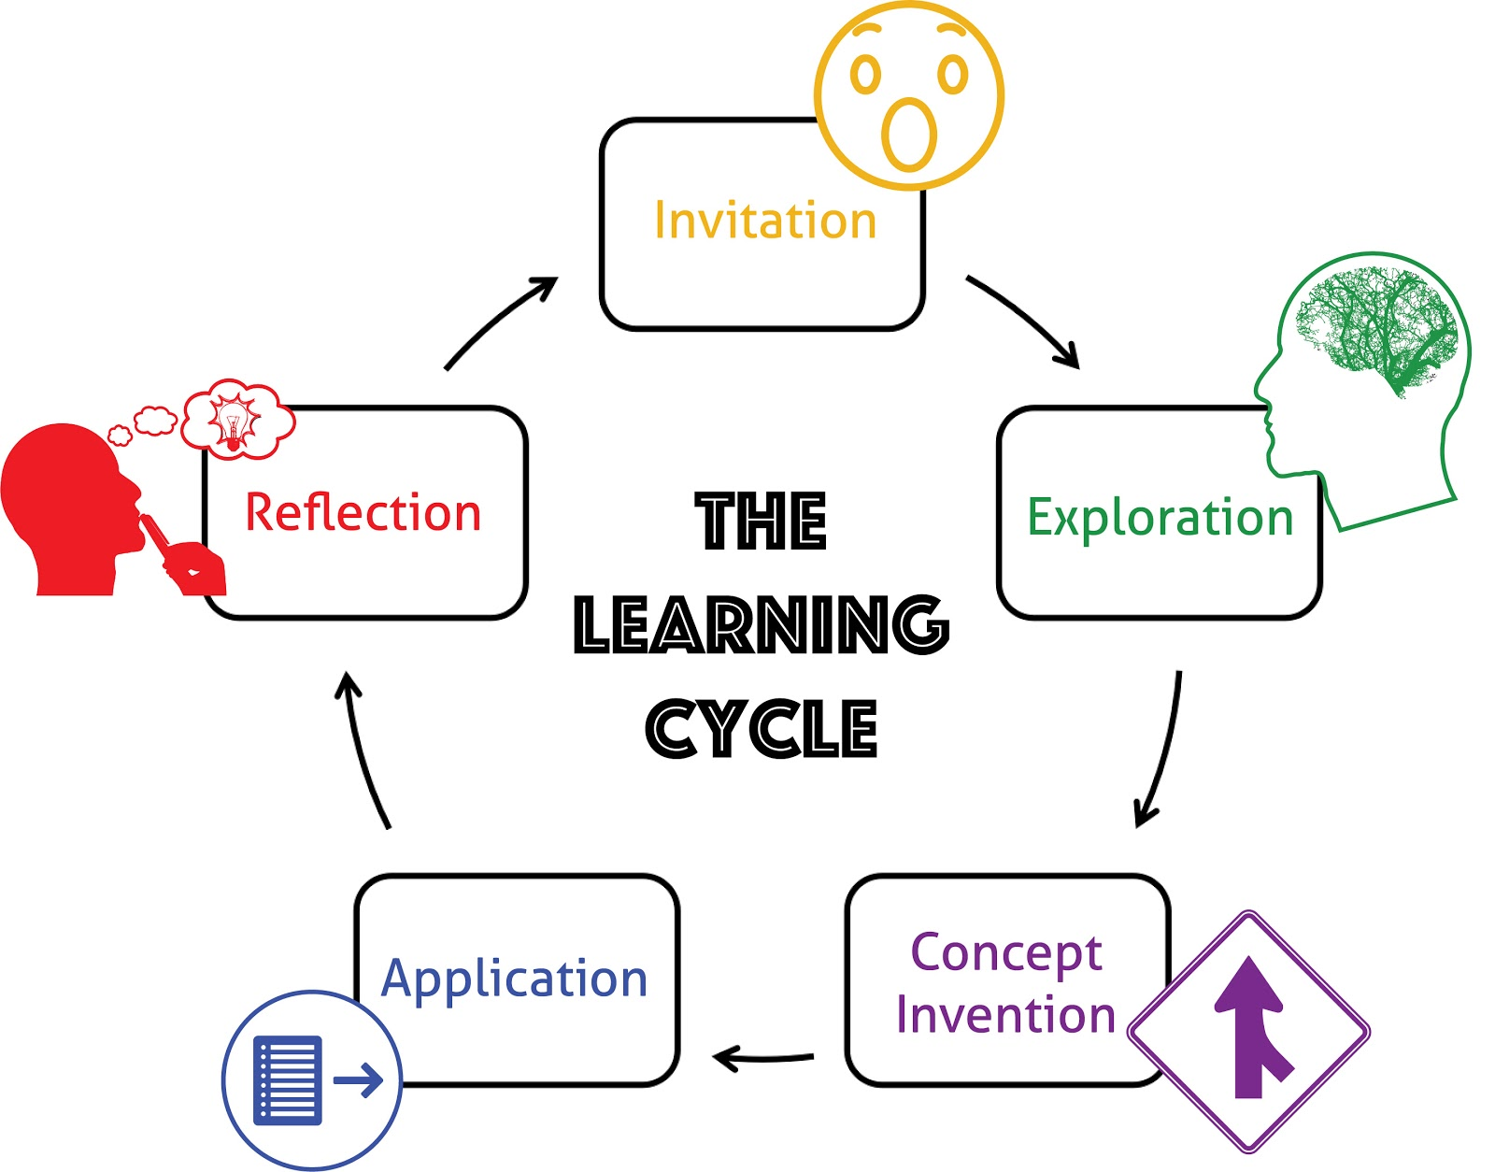
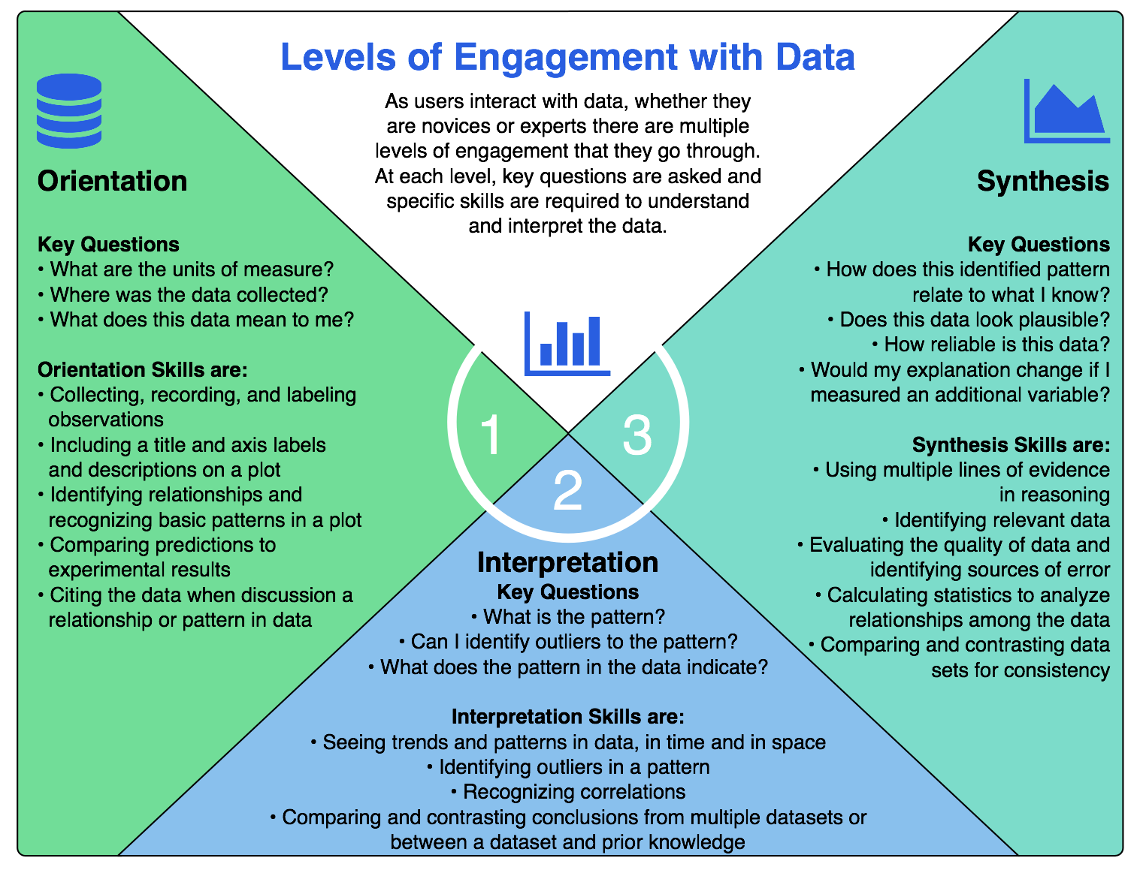
Workshop Design Approach
OOI Science
Data Explorer Demo
Data Exploration Activities
OOI Data + Science
(content)
Educational Pedagogy
(methods)
Data Literacy (skills)
Lawrence Hall of Science
Learning Cycle (implementation planning)
Active Learning Strategies (hands-on learning)
Question Formulation Technique (QFT)
Backwards Design (activity development)
Hotaling et al. (2019)
Data Skills Building (Data Literacy)
Data/Graph Interpretation (Levels of Engagement)
Coding/Python Intro (PRIMM Model)

Slide 4
Design Process – Lessons Learned
Identify Target Scientific Concepts & Skills
Match Educational Goals with Instrumentation
Find Available Instrument Data
Cleanup the Dataset
Add Context & Educational Surrounds
Build Interactive Visualizations
Takes time and effort – The process is highly iterative (esp. 3&5)
Process helps everyone stay on track and divide tasks
Educators can help with content identification and development
With better data portals, they can also help with data and visualizations
Matching goals and finding appropriate datasets to use in educational settings was most challenging, especially for a new OOS like OOI

Slide 5
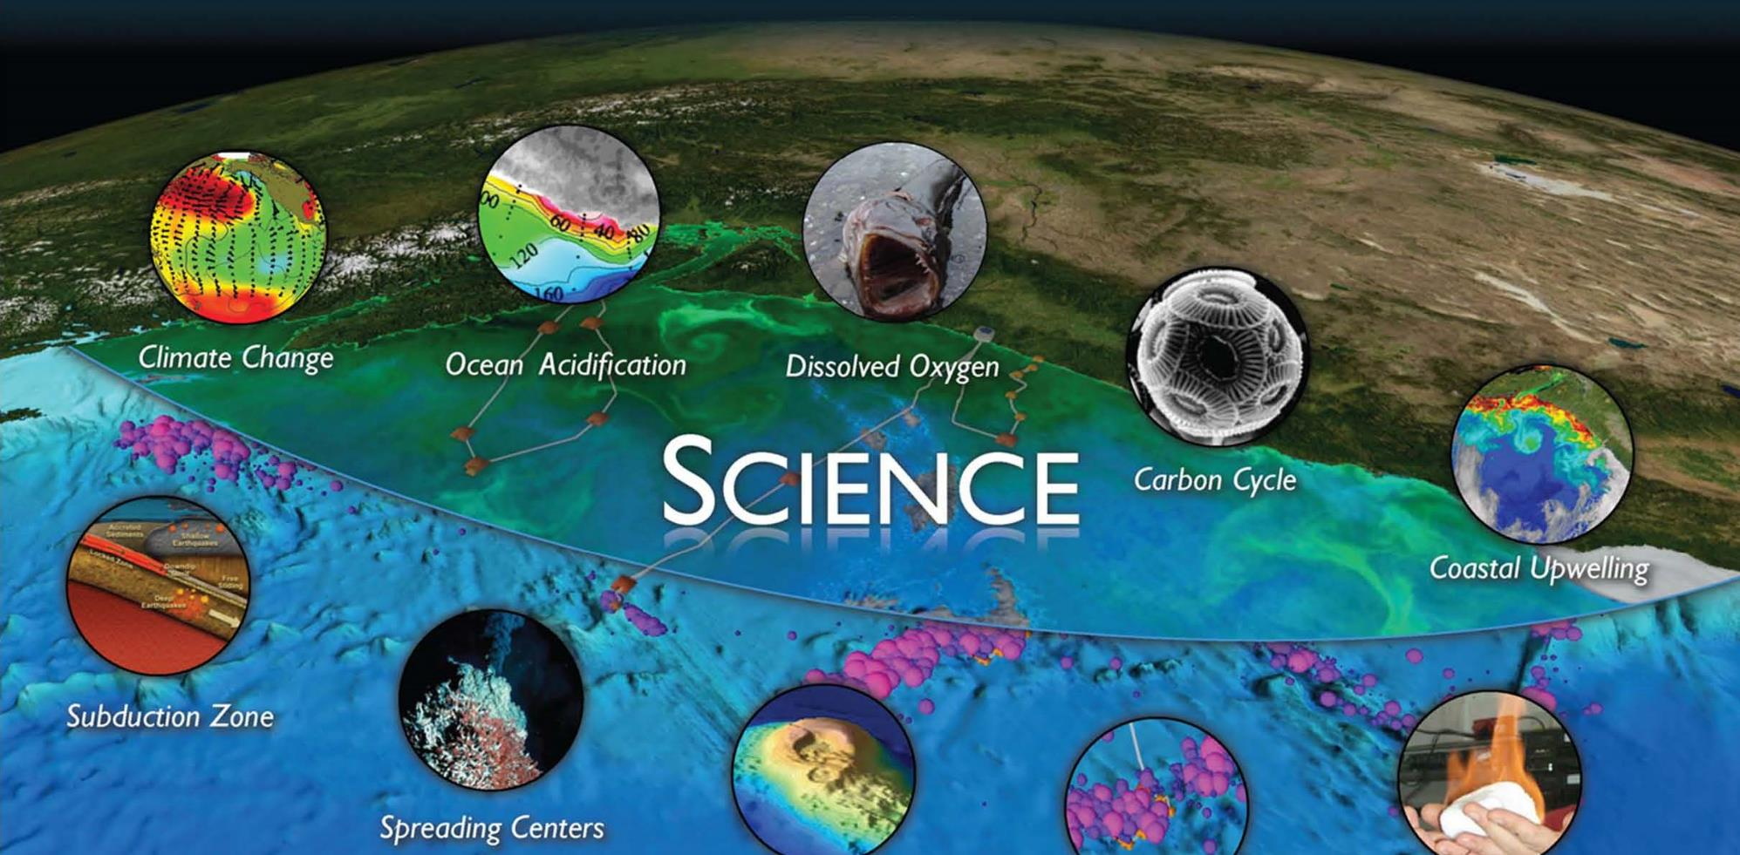
Step 1: Identify Your Goals (Scientific Concepts & Skills)
Crosswalk
Climate variability, Ocean Food Webs, and Biogeochemical Cycles
Ocean-Atmosphere Exchange
Coastal Ocean Dynamics and Ecosystems
Turbulent Mixing and Biophysical Interactions
Global and Plate-scale Geodynamics
Fluid-Rock Interactions & Sub-seafloor Biosphere
Core Concepts from
Introductory Oceanography
OOI Science Themes & Research Questions

Slide 6
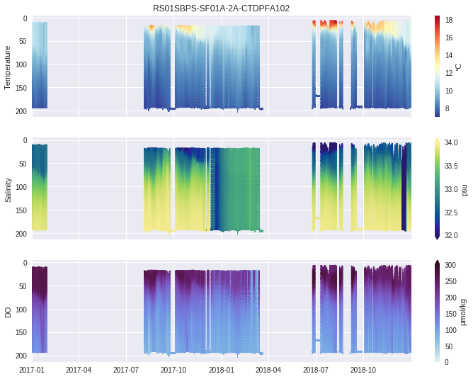
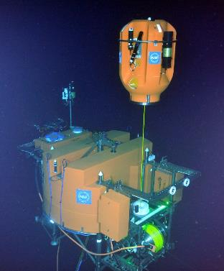
Step 2: Find Some Useful Data

Slide 7
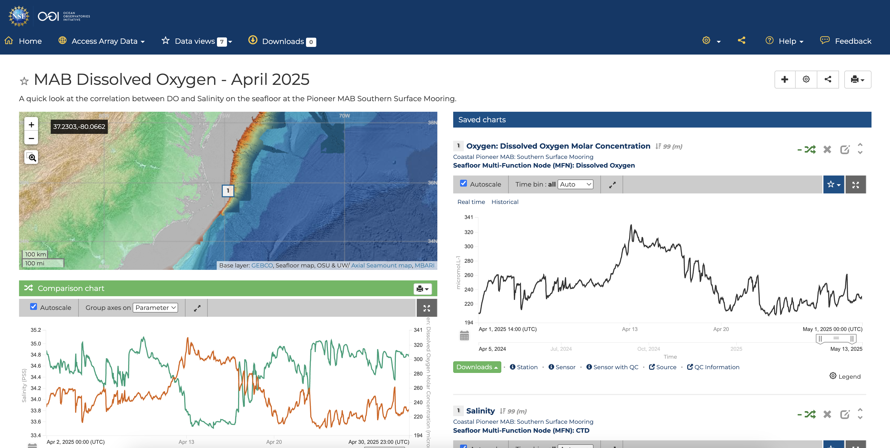
Step 3: Define your Objectives & Make Some Charts
Define your Student Learning Objective(s)
Create a “challenge question” or “claim” you would like them to address.
Create and export your graphs, Data View, or other instructions.

Slide 8
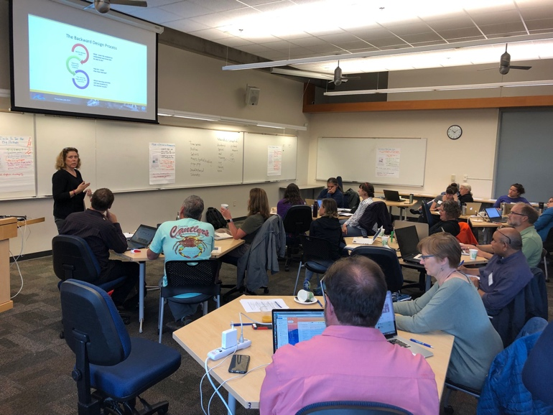
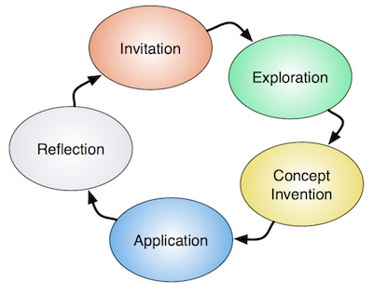
Step 4: Add Context and Educational Surrounds
Guiding Questions
Orientation
Interpretation
Synthesis
Data Tips
Background Info/Images
Instructor’s Guide
Assessment
Active Learning Strategies
Related Activities based on the LHS Learning Cycle
The Learning Cycle
Lawrence Hall of Science

Slide 9
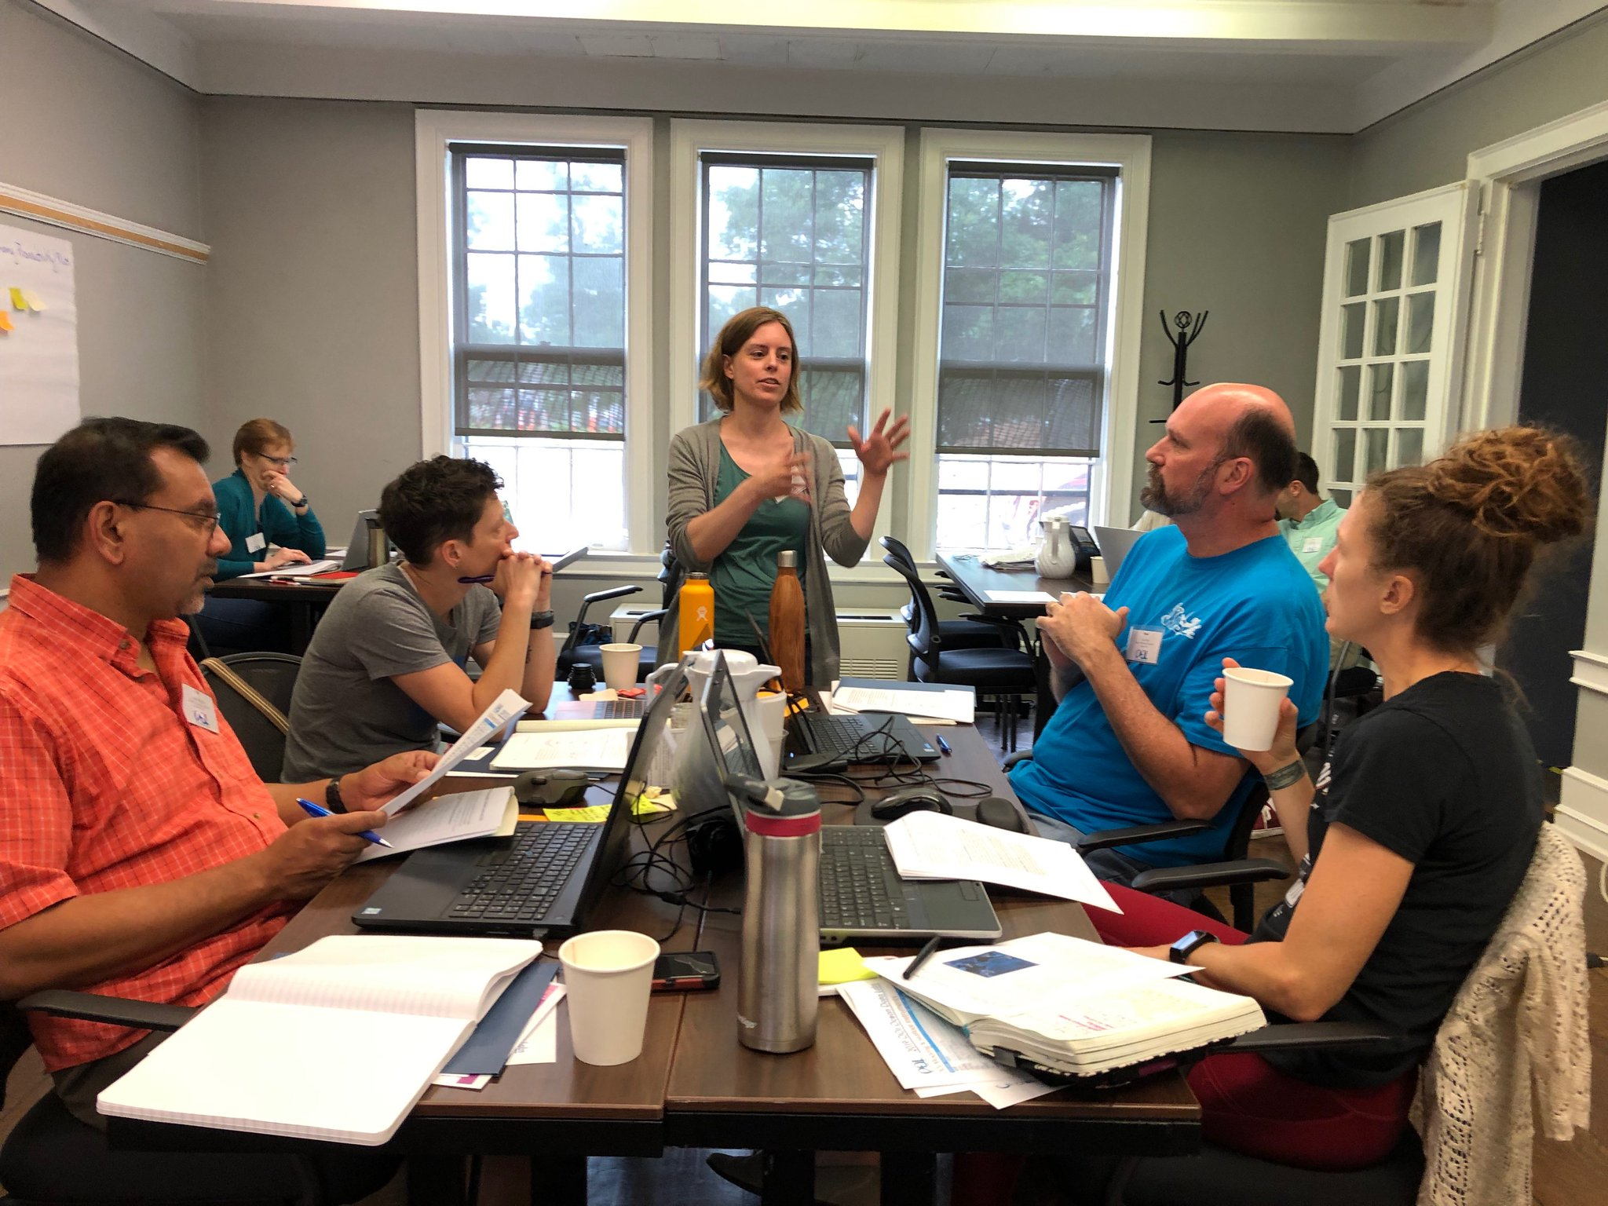
How to Translate OOI data into Educational Resources
Identify Target Scientific Concepts & Skills
Match Educational Goals with Instrumentation
Find Available Instrument Data
Cleanup the Dataset
Add Context & Educational Surrounds
Build Interactive Visualizations
Use the OOI Data Portal!
Step 1
Step 2
Step 3
Step 4
From Lichtenwalner 2021

Slide 10
Caution: Limit your Data Activity Dimensions
Time
Single event
Specific Date Range (year, quarter, month, week, day)
Several cycles (interannual, annual, seasonal, monthly, weekly, daily)
Compare cycles (e.g., winter vs. summer)
Depth
Fixed / Single Point
Multipoint
Full Profile
Spatial
Fixed (lat, lon)
Multipoint
Vertical Slice (depth transect)
Horizontal Slice (spatial map)
Variables/Parameters
Raw
Calculated: Averaged, Filtered or Smoothed
Derived (e.g., anomaly or model)

Slide 11
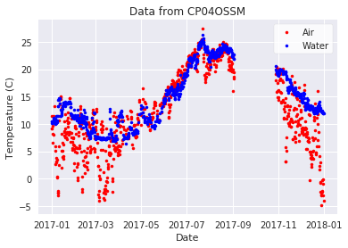
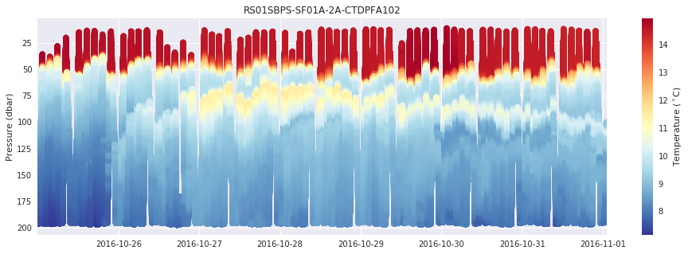
OOI Datasets Types
What types of data are available?
Point Timeseries
Profiles
Wire Following
Glider
ADCP
Multi-point Timeseries Profiles
And others…
Seismic/Earthquake
Hydrophones
Sonar
Camera
Optical OPTAA/SPIKR

Slide 13
Design of data activities - based in learning science:
University of California Lawrence Hall of Science
Hotaling et al. (2019)

Slide 14
Scientific Evidence
Evidence is a clue that helps answer a question or explain something.
Evidence can come from
Our own investigations
Other people’s investigations
Evidence includes reasoning about WHY or HOW the data help answer the question or explain something
Scientific explanations are based on evidence
What makes a good scientific explanation?
The evidence supports the explanation
The evidence is based on carefully collected data and information, not just casual observation
The evidence is from a reliable source

