Slide 1
Good morning and welcome!
Today’s schedule…
Notes:
Janice will cover this part

Slide 2
[QFT recap]
Notes:
Janice will cover this part?

Slide 3
What are your experiences with using real-world data in the classroom?
Jot down individually
Top 3 challenges as an instructor? (experienced or anticipated)
Top 3 challenges as a student? (observed or anticipated)
Positive experiences?
Find a partner and share your thoughts
What did you have in common?
What were major differences?
Join another pair and discuss your common themes
Record your themes on posterboards
Notes:
Think: 2-3 min; Pair: 2-3 min; Square: 2 min; Share: 1-2 min {8-10 min}
Posterboards and post-its/pens; mentors to summarize

Slide 4
Ways we use data
Reinforcing known phenomena
Generating new knowledge

Slide 5
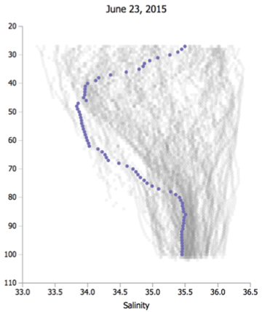
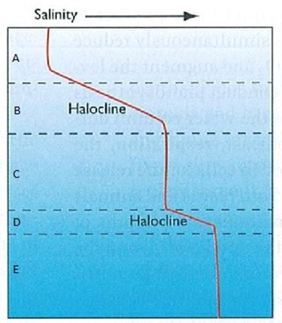
Types of data we use
Real-world (messy) data
Idealized patterns

Slide 6
Four aspects of using data in teaching
Real-world (messy) data
Labs/demos with
authentic data
Professional observations and models
Reinforcing known phenomena
Generating new knowledge
Textbook data
visualizations
Models of theory
Idealized patterns

Slide 7
Menti…
Notes:
Ask Janice

Slide 8
Ways data are generated or collected
Benefits | Limitations
Personal connection to the data, understanding of collection methods, small datasets | Limited in types of data and temporal/spatial scale, time consuming to collect, may not follow consistent protocols
Learner-generated data
e.g., lab experiments, field trip observations

Slide 9
Ways data are generated or collected
Benefits | Limitations
Personal connection to the data, understanding of collection methods, small datasets | Limited in types of data and temporal/spatial scale, time consuming to collect, may not follow consistent protocols
Larger temporal and spatial scales, consistent collection protocols, focus on interpretation and analysis | Time consuming to locate, may be challenging to access, usually noisy, does not always show clear patterns
Learner-generated data
e.g., lab experiments, field trip observations
Professionally-collected data
e.g., Ocean observatories, Traditional Ecological Knowledge

Slide 10
Data skills learning curve
Challenging transition
(A) Unstructured observation with human senses
(B) Student-collected small datasets
Challenging transition
(C) Professionally collected large datasets, well-structured problems
(D) Professionally collected large datasets, ill-structured problems
Challenging transition
Modified from Figure 1 in Kastens et al., 2015, The Science Teacher 82(5):25-31
Notes:
Transition from B-C: focus of Data Labs (but some participants may work with their upper-level students on C-D)

Slide 11
Why are professionally collected data challenging for learners?
Novices and experts approach novel data with substantially different thought processes…

Slide 12
https://youtu.be/GVvY8KfXXgE?si=h4eYe_KPxddWosG5

Slide 13
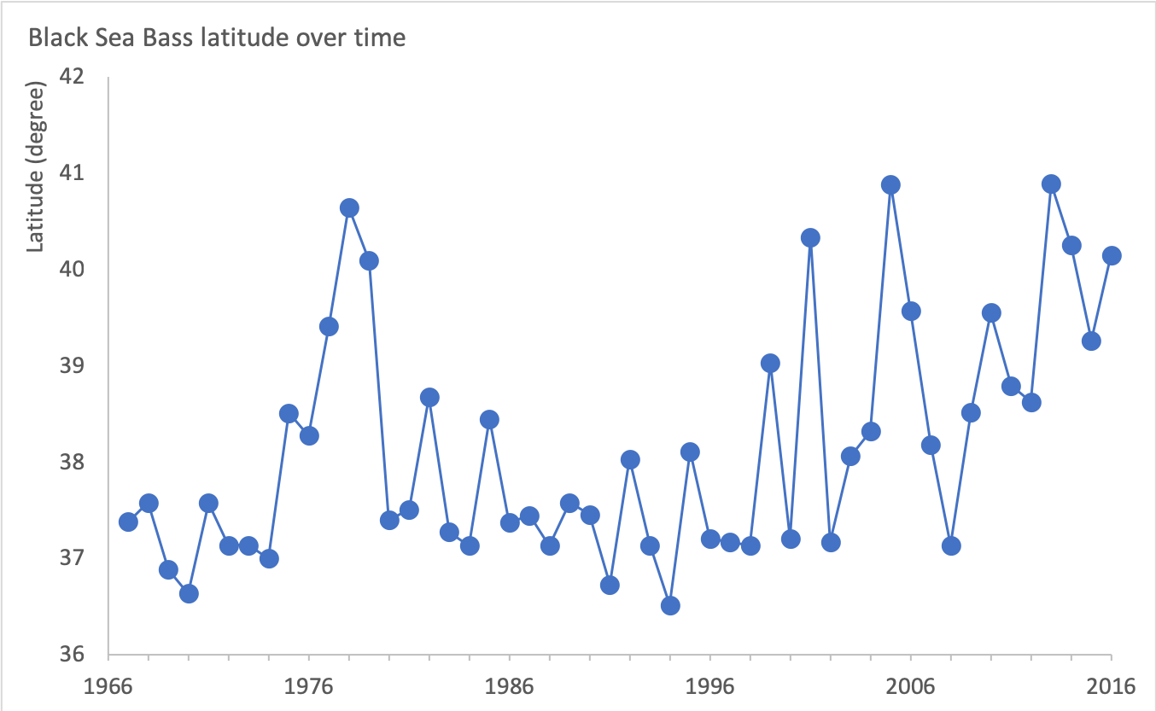
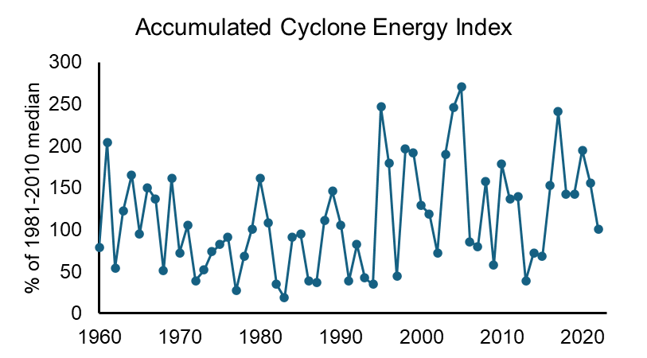
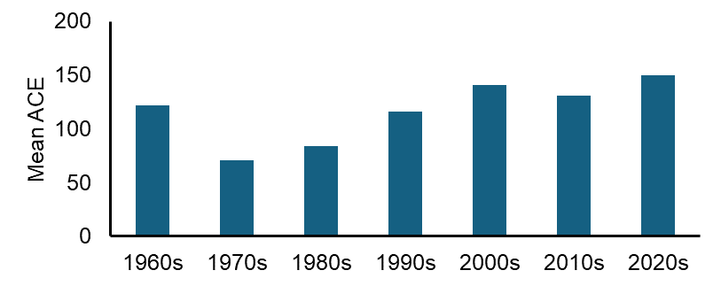
What experts and novices see in oceanographic data
Experts | Novices | Data Example
Notice features and meaningful patterns | Often focus on surface attributes
Knowledge organized around “big ideas” that guide thinking. Problems approached with focus on concepts and rationale for why they apply. | Knowledge is memorized in lists of facts & laws; problem solving requires searching for correct formulas, equations, and rules.
Flexibly & selectively retrieve important and relevant aspects of their knowledge. | Less likely to know the conditions under which specific knowledge is applied.
Catherine Halverson, Lawrence Hall of Science

Slide 14
Pause to reflect
How do the challenges we identified this morning connect to the needs of our students as they transition toward expert skills?
Notes:
“minute paper” reflection

Slide 15
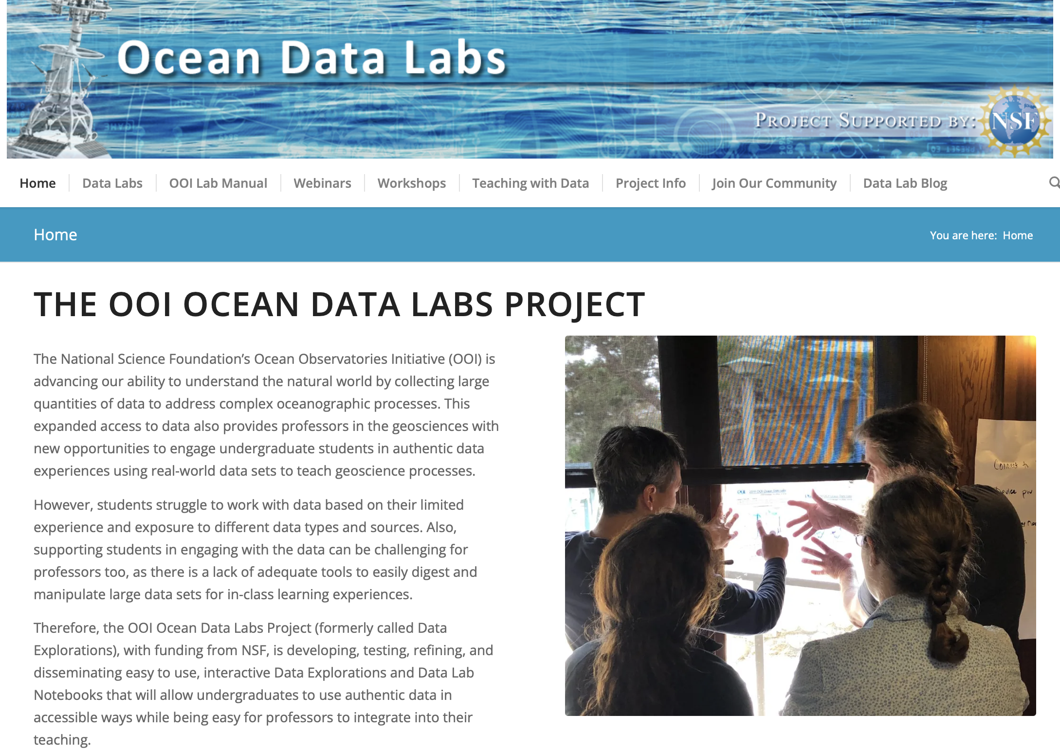
OOI Data Labs Project Goal
Bring professionally collected data from the Ocean Observatories Initiative to oceanography classrooms with structure supporting learners and instructors

Slide 16
OOI Data Labs Resource Collection
Want a series of lab activities with built-in student assessments?
Want a ready-made lesson plan incorporating OOI datasets?
Want a modular set of activities that you can adapt?
Want to start from scratch using curated OOI datasets?
Want to introduce coding notebooks with OOI datasets?
Data Lab Manual
Lesson Plans
Data Explorations
Data Nuggets
Python Notebooks
OOI Data Explorer Direct access to data
Notes:
Add animated boxes highlighting Data Lab Manual and Data Explorations

Slide 17
Jigsaw activity: Step 1
Explore the Collection:
See websites at table
Each table will explore a different data exploration or lab manual chapter
Discuss:
What structure or pedagogy do you notice in the activities?
Data Exploration | Data Lab Manual
Anoxic Events | Chapter 8
Plate tectonics and the seafloor | Chapter 3
Dynamic air-sea interactions | Chapter 6
Factors affecting Primary Production | Chapter 7
Notes:
8 tables for round 1, each has one item from exploration or lab manual (put pairs next to each other)

Slide 18
Jigsaw activity: Step 2
Join with the group next to you who reviewed the same topic
Discuss:
Similarities and differences in structure/ pedagogy between data explorations and lab manual activities?
How do you imagine using the activities in a class?
Data Exploration | Data Lab Manual
Anoxic Events | Chapter 8
Plate tectonics and the seafloor | Chapter 3
Dynamic air-sea interactions | Chapter 6
Factors affecting Primary Production | Chapter 7
Notes:
matching lab/exploration: Swap half of each table with adjacent table

Slide 19
Jigsaw activity: Step 3
Share out
What structure or pedagogy do you notice in the activities?
Similarities and differences between data explorations and lab manual activities?
Data Exploration | Data Lab Manual
Anoxic Events | Chapter 8
Plate tectonics and the seafloor | Chapter 3
Dynamic air-sea interactions | Chapter 6
Factors affecting Primary Production | Chapter 7
Notes:
(one observation per table)

Slide 20
Take a break!

