Slide 1
OOI Overview for Ocean Data Labs Workshop
Dax Soule, Chair OOIFB
June 2, 2024

Slide 2
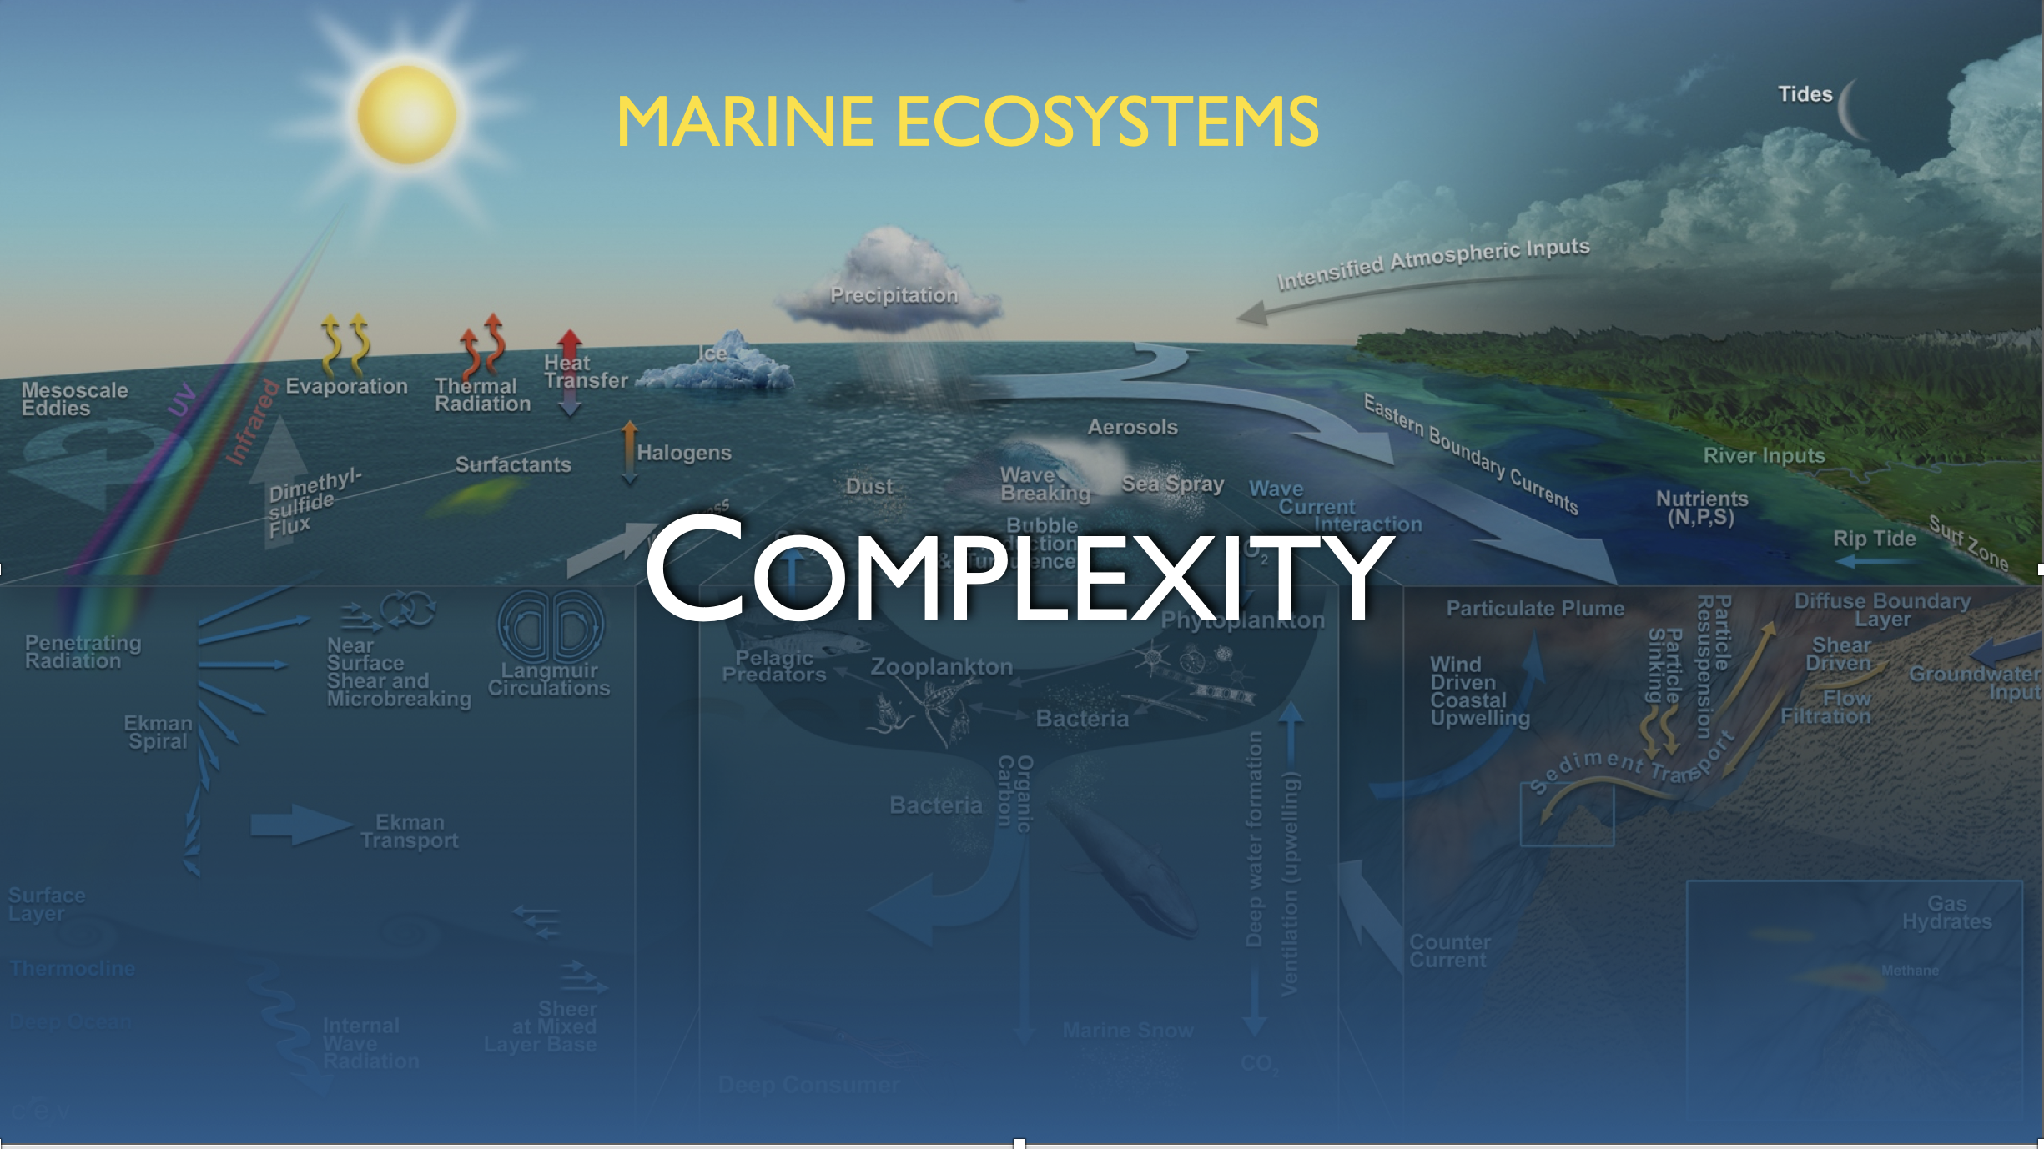
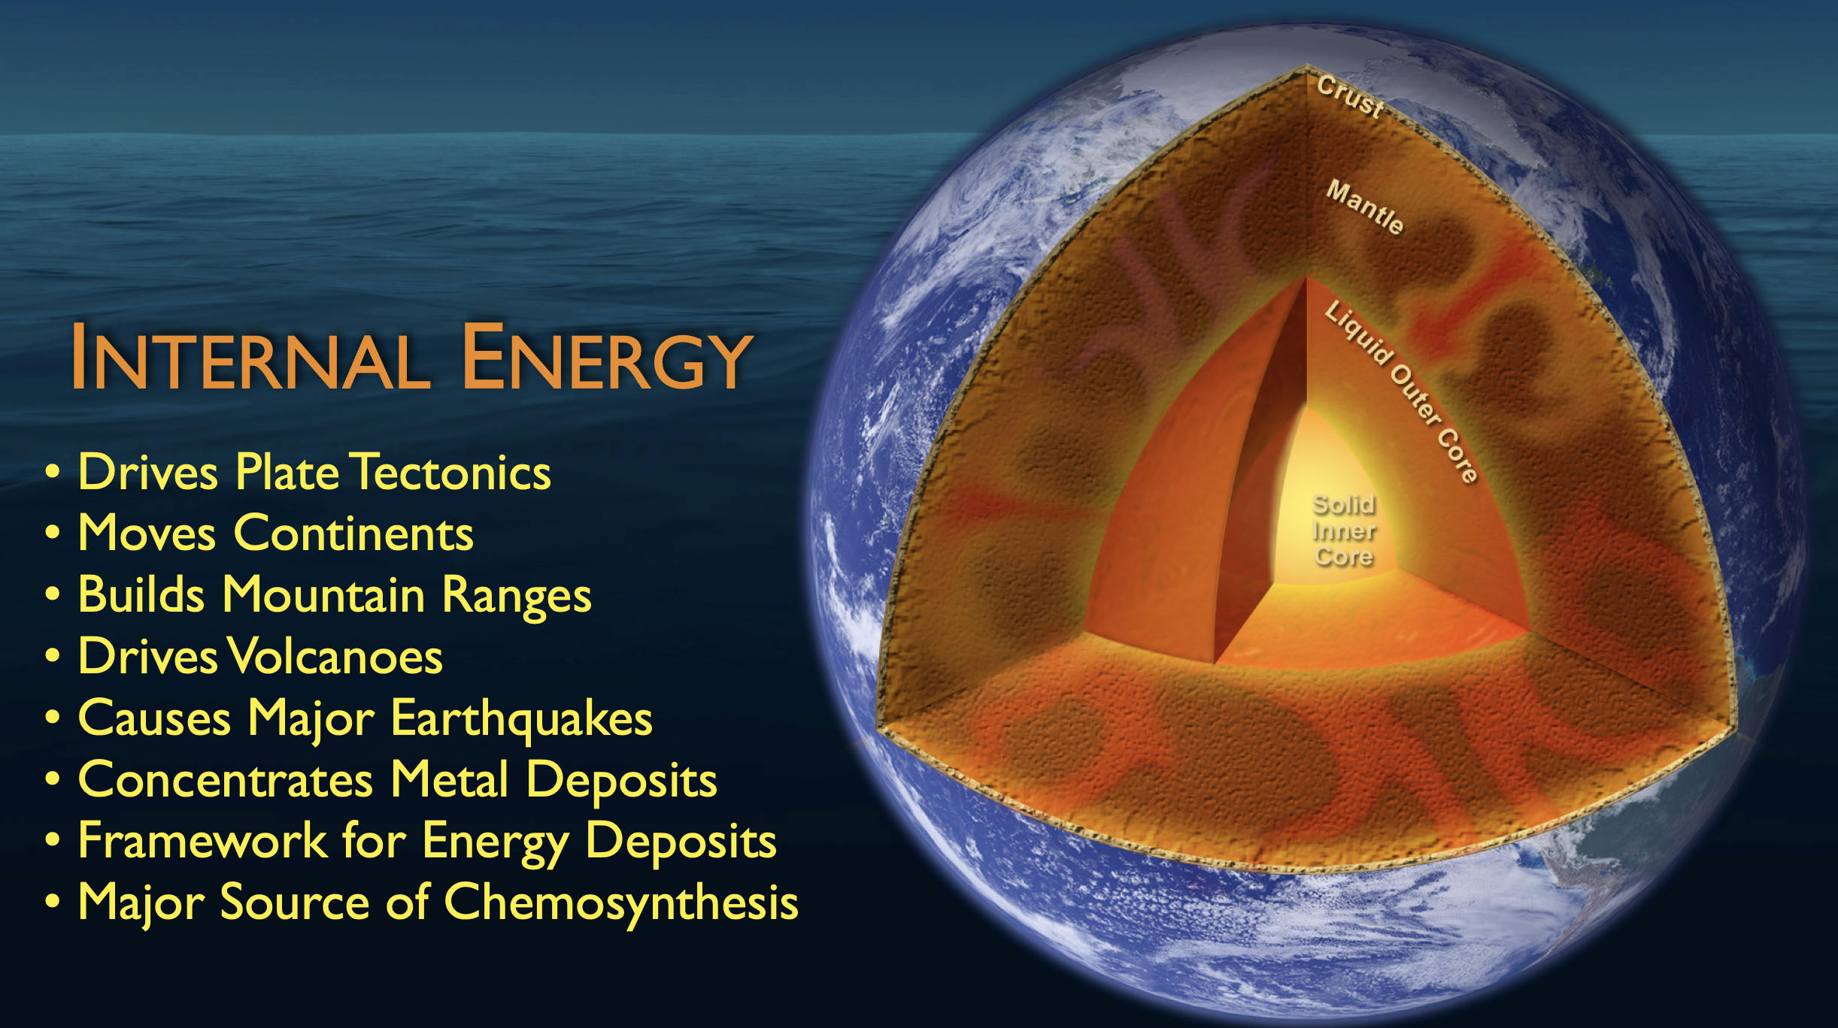
Key Points
Wanted: One shovel ready project that delives a sustained, research-driven, ocean observing capability.
What should such a system be comprised of?

Slide 3
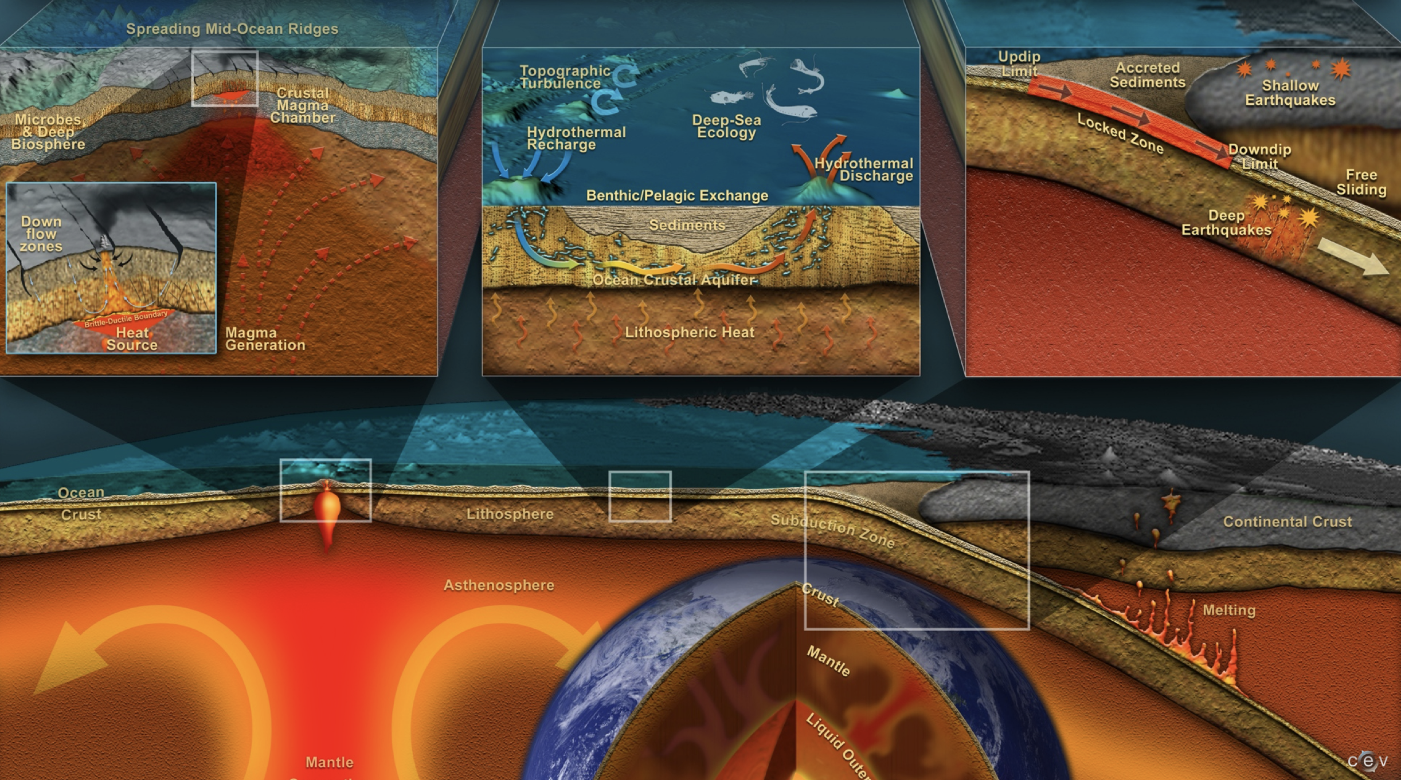
Key Points
Wanted: One shovel ready project that delives a sustained, research-driven, ocean observing capability.
What should such a system be comprised of?

Slide 4
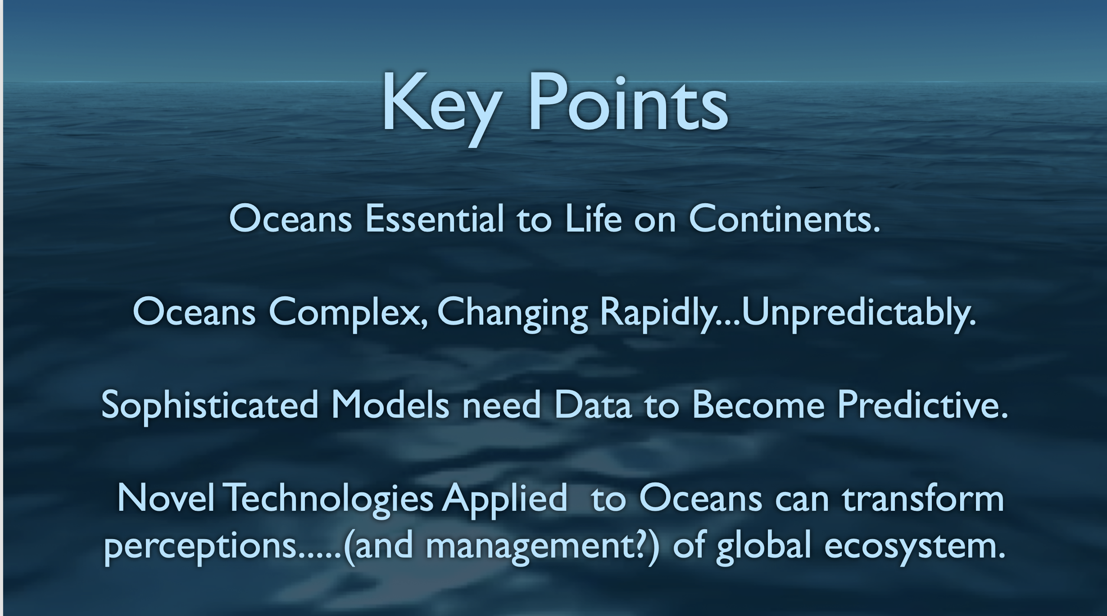
Key Points
Wanted: One shovel ready project that delivers a sustained, research-driven, ocean observing capability.
What should such a system be comprised of?

Slide 5
Wanted: One shovel ready project that delivers a sustained, research-driven, ocean observing capability.
What should such a system be comprised of?

Slide 6
A System of Systems
Five arrays united by a common cyberinfrastructure
Sensors measuring physical, chemical, geological and biological variables in the atmosphere, ocean, and seafloor
Fully integrated system collecting data on coastal, regional and global scales.
Short-term (episodic) & climate scale data (~30yrs)
Notes:
130 White Papers

Slide 7
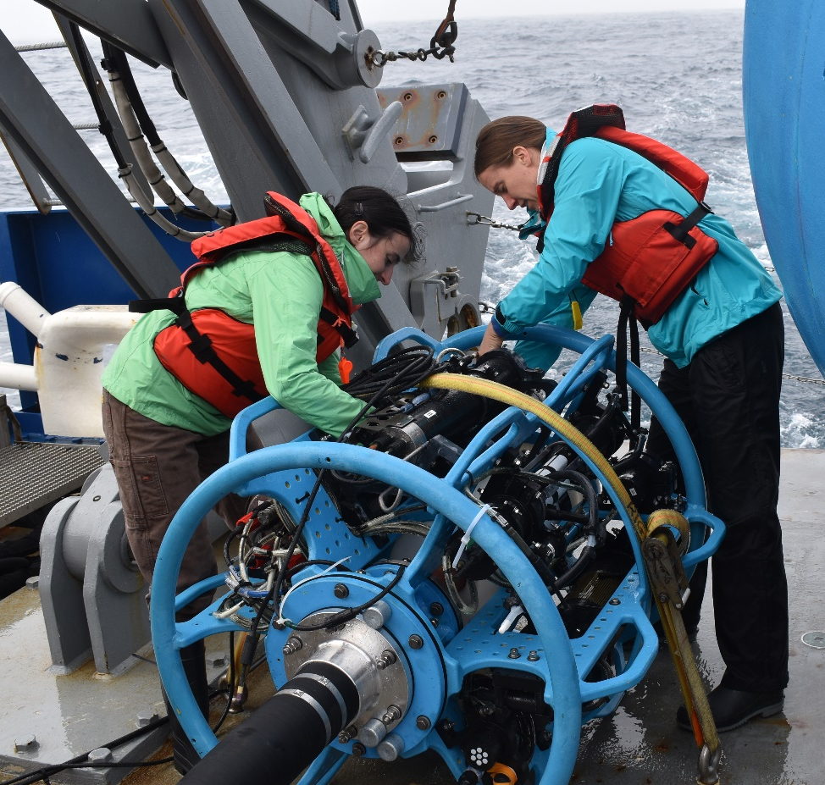
Our Mission
The OOI does not conduct research, the OOI provides research quality data to the user community (scientists, educators, and the general public).

Slide 9
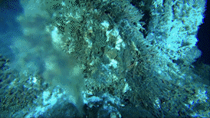
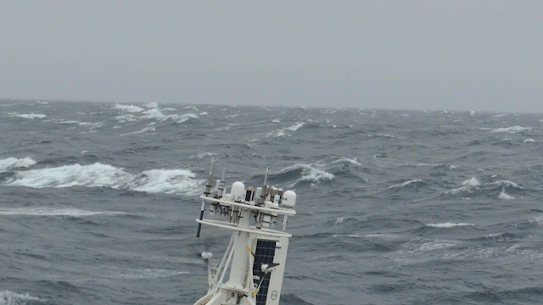
OOI operates & maintains sophisticated instrumentation in demanding locations
Hydrothermal Vents
Atmosphere Ocean Exchange

Slide 10
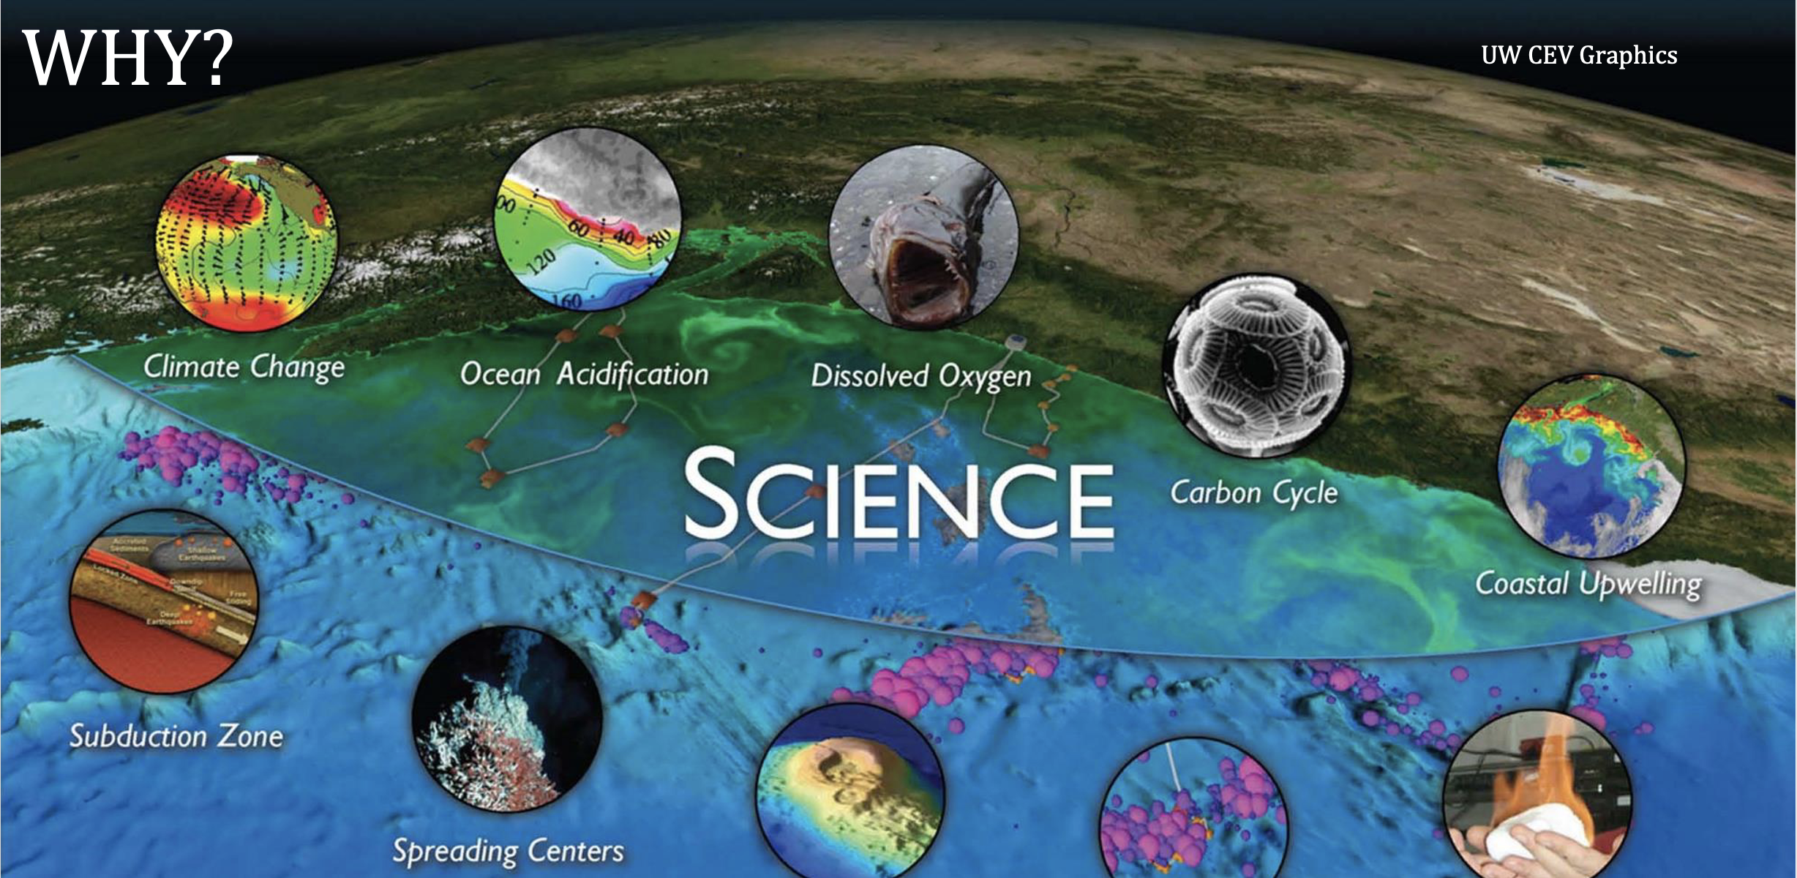

Slide 11
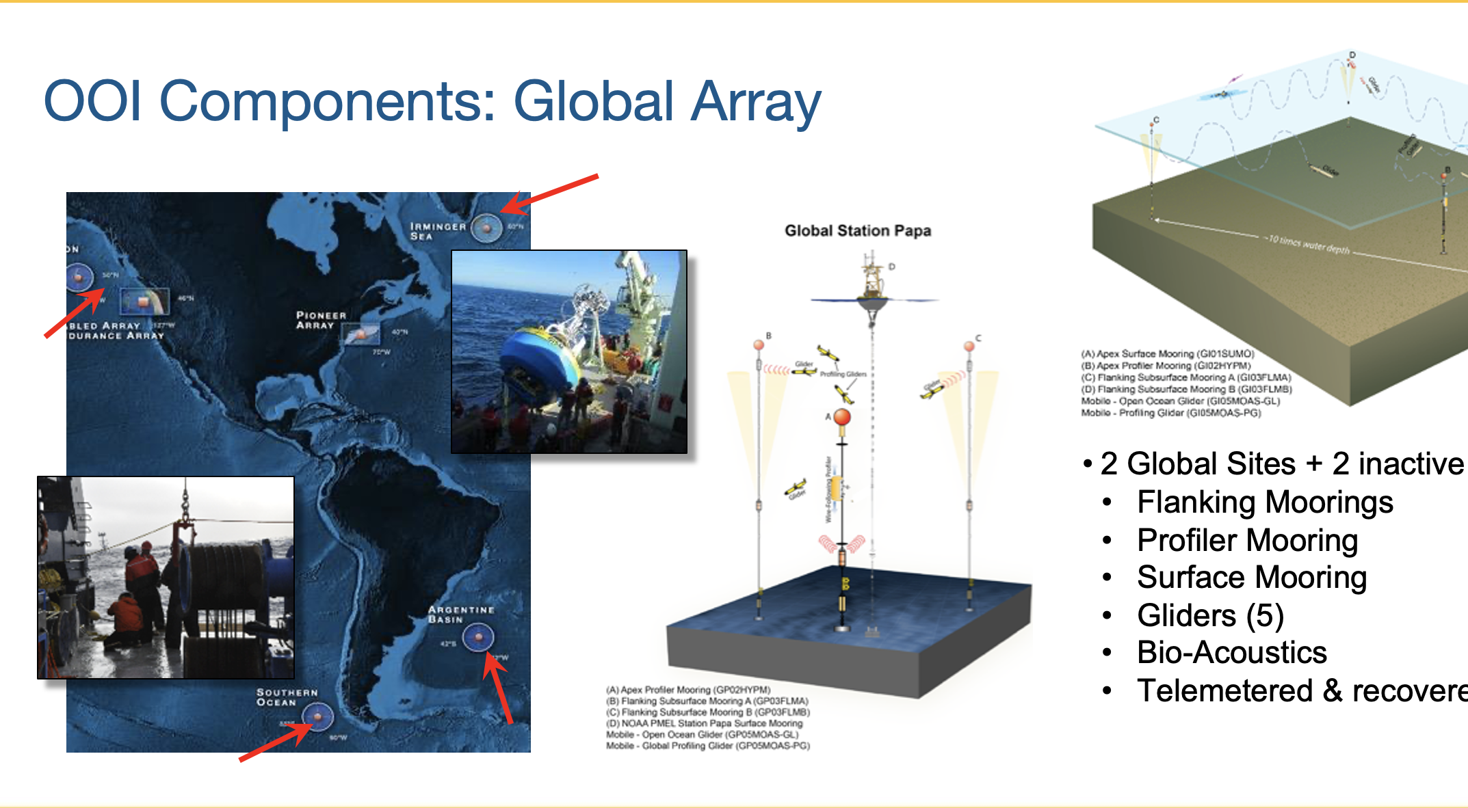
Notes:
Coastal Global Scales Node (CGSN) team heads to the Global Station Papa Array site. Papa is in the Gulf of Alaska, which is about 620 nautical miles from Seward, Alaska. This location is already occupied by the Ocean Station Papa surface mooring deployed by NOAA’s Pacific Marine Environmental Laboratory last month. This will be the 11th time the subsurface array will be refreshed so it continues to provide ocean data from a critical region of the northeast Pacific with a productive fishery subject to ocean acidification, low eddy variability, and impacted by the Pacific Decadal Oscillation.

Slide 12
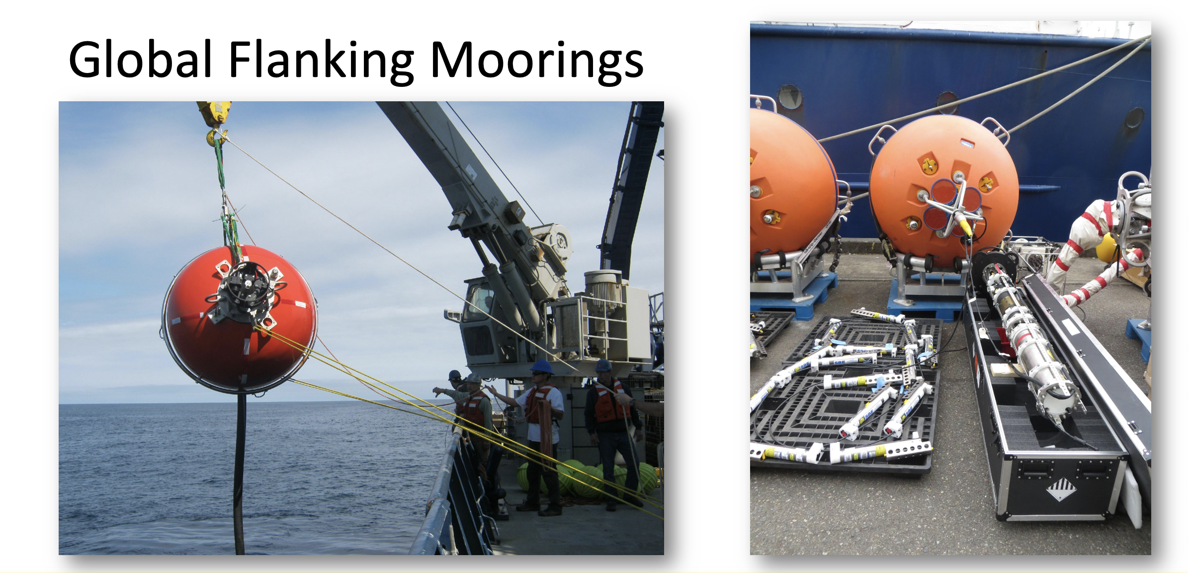

Slide 13
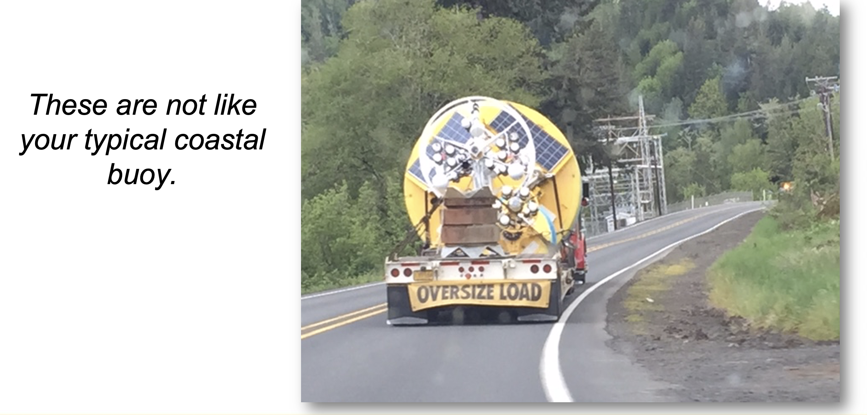
Notes:
The surface and subsurface elements of the array are in a region with high wind and large surface waves; strong atmosphere-ocean exchanges of heat, momentum, energy and gases; carbon dioxide sequestration; high biological productivity; and an important fishery. It is one of the few places on Earth with deep-water formation that feeds the large-scale thermohaline circulation.

Slide 14
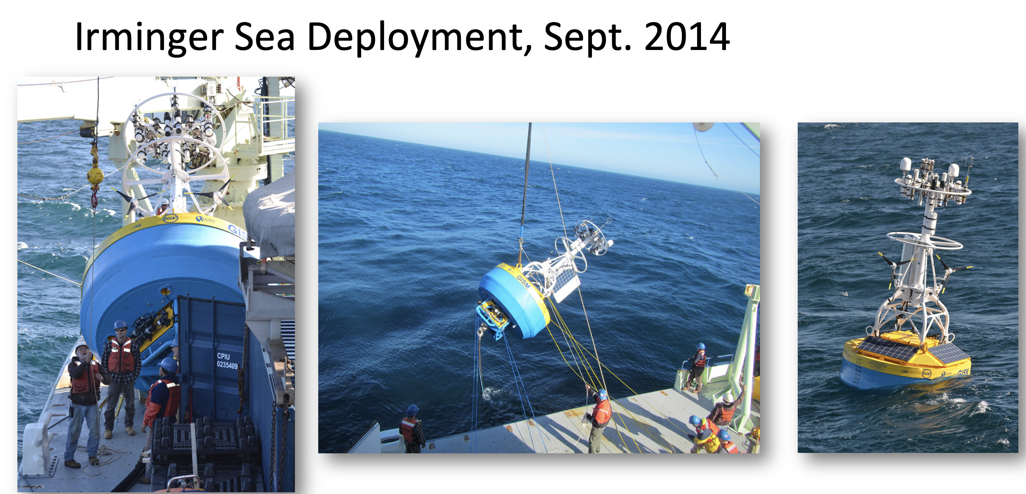

Slide 15
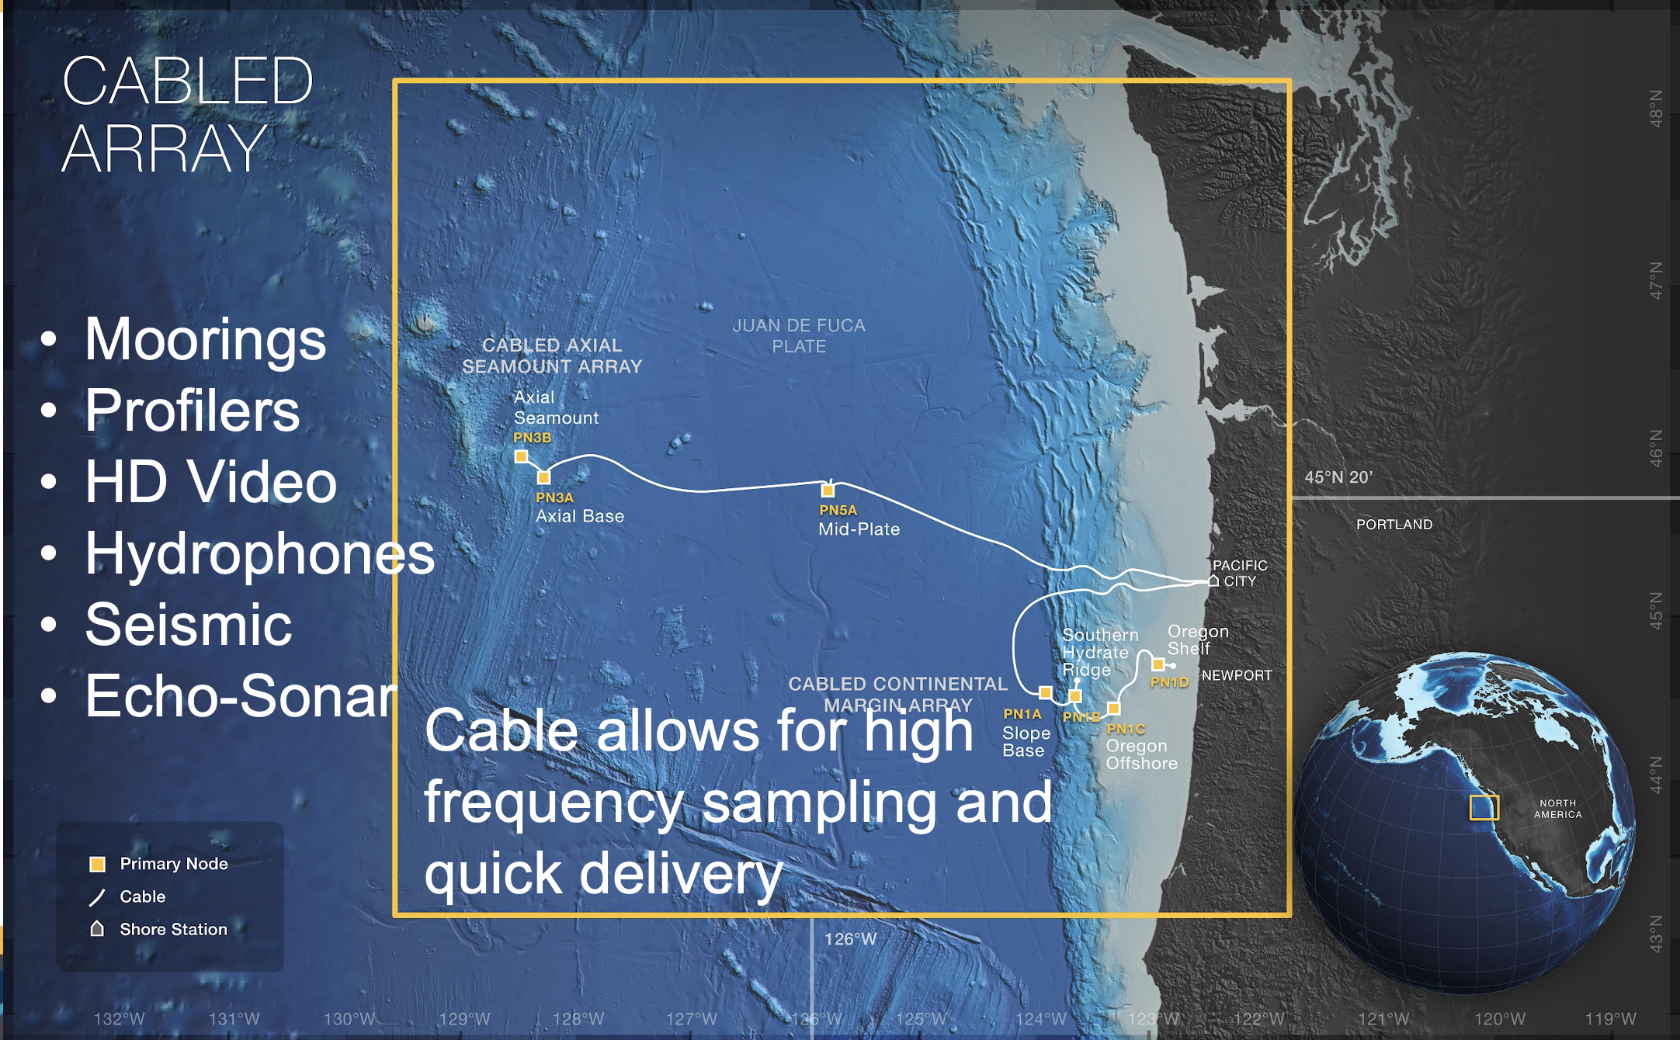

Slide 16
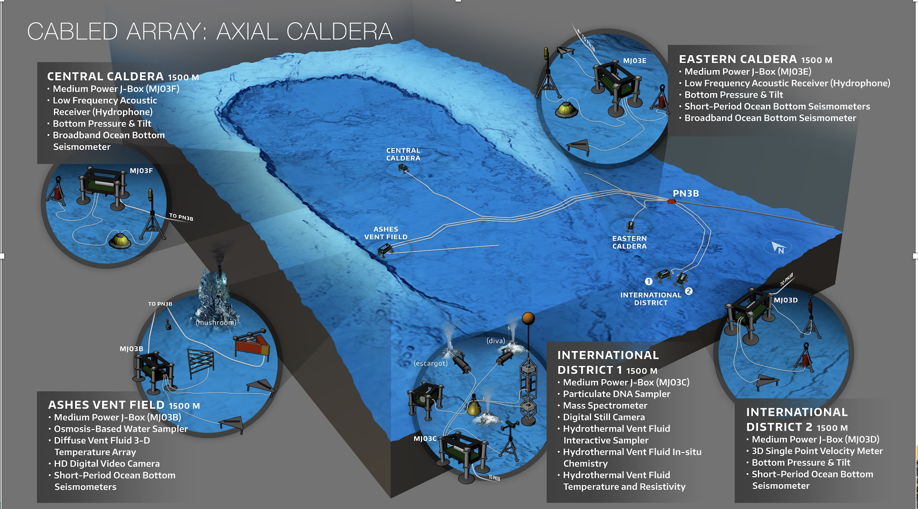

Slide 17
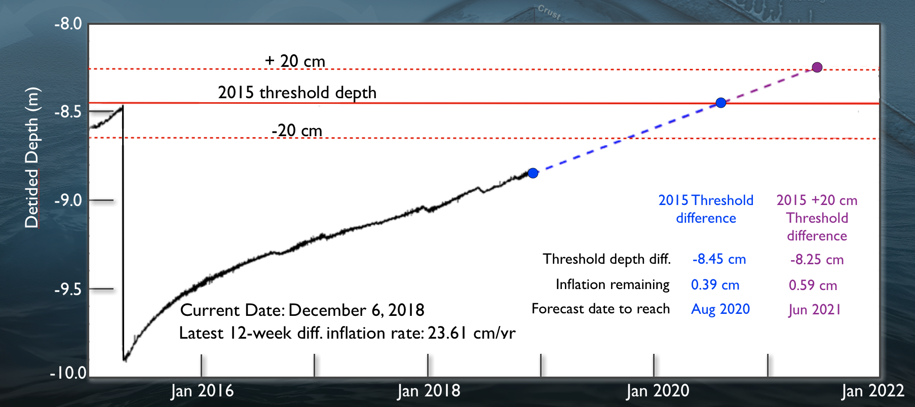
Axial Seamount Prediction
First place in world ocean where a submarine eruption can be predicted and tested.

Slide 18
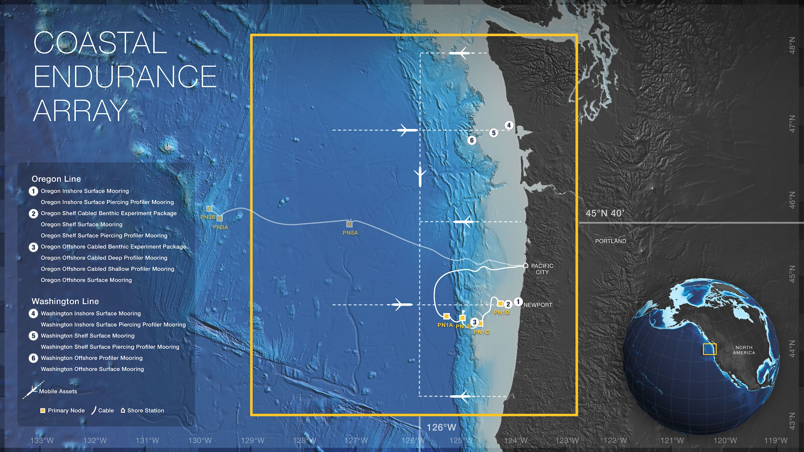
Glider AUVs
Moorings
Profilers
Meta data
Telemetered & recovered
Notes:
There are two coastal arrays… One is called the Endurance array. And the idea was that in one coastal area we should have a fixed timeseries The choice was to sample the evolution of the California current.
Examining the structures of the ecosystems along the western seaboard.
Fixed arrays with moorings and profilers
Different types of data latency based on your real time framework.
Sampling volumes with the glider.

Slide 19
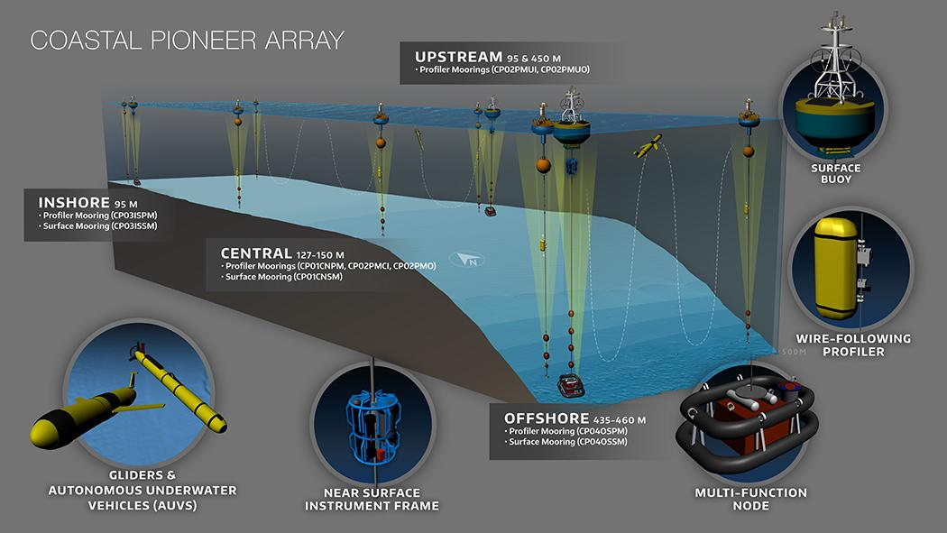

Pioneer MAB/ NES
The Pioneer Array was conceived within OOI as a re-locatable, coastal array suitable for moderate wave and current regimes on the continental shelf and upper slope.
Deployed on the New England Shelf 2016-2022
Relocated to the southern MAB offshore of North Carolina in April 2024
A community workshop will be held in Sep 2024 to inform and engage users.
Notes:
That’s the whole story in one slide!
I will provide more details on the process, timeline, and array design
*Initially deployed late 2013, but not full array. 7 year run from 2016-2022

Slide 20
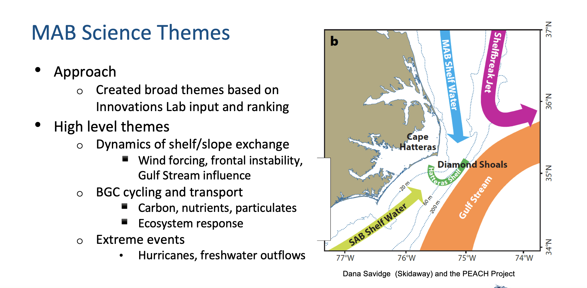

Slide 21
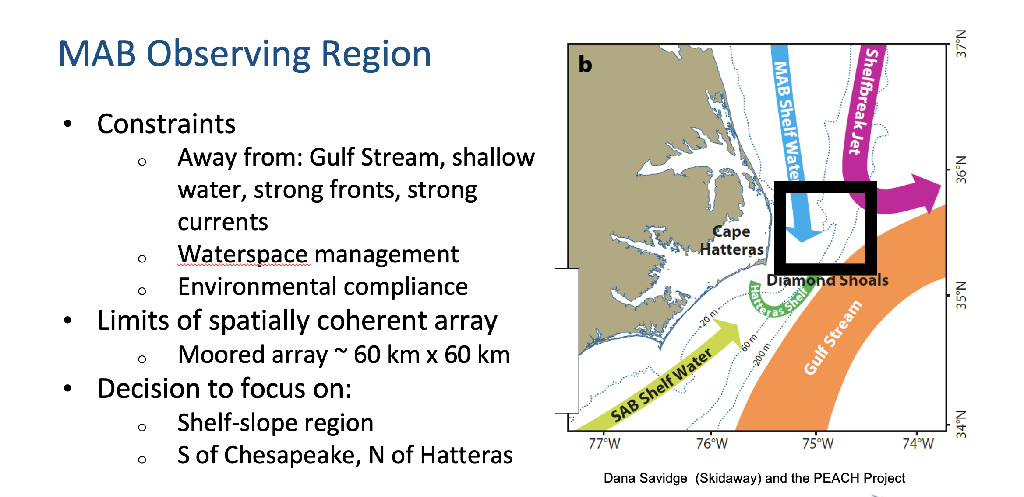

Slide 22
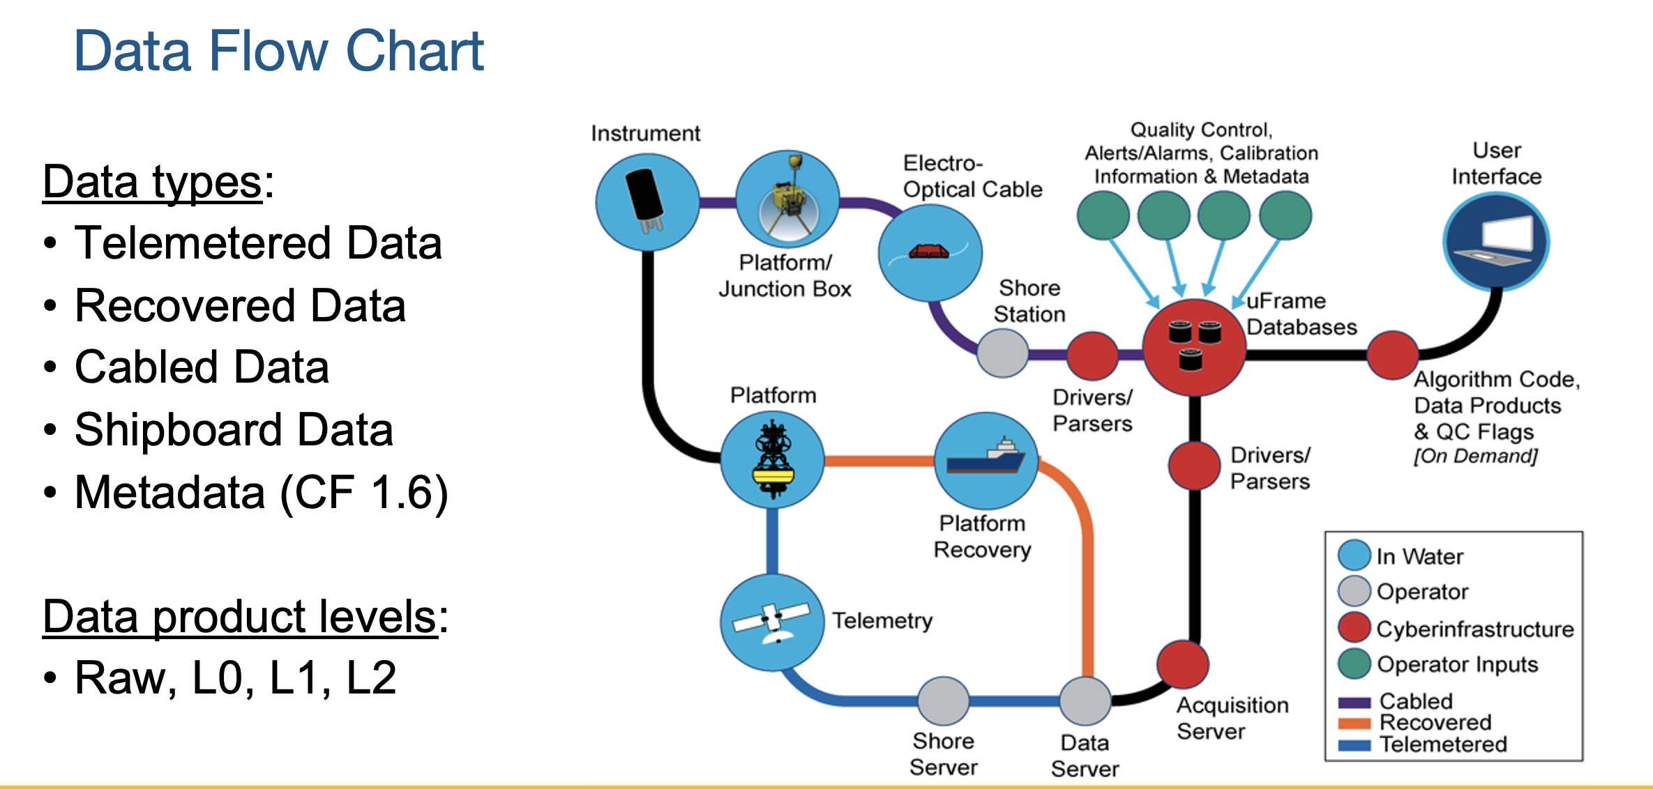

Slide 23
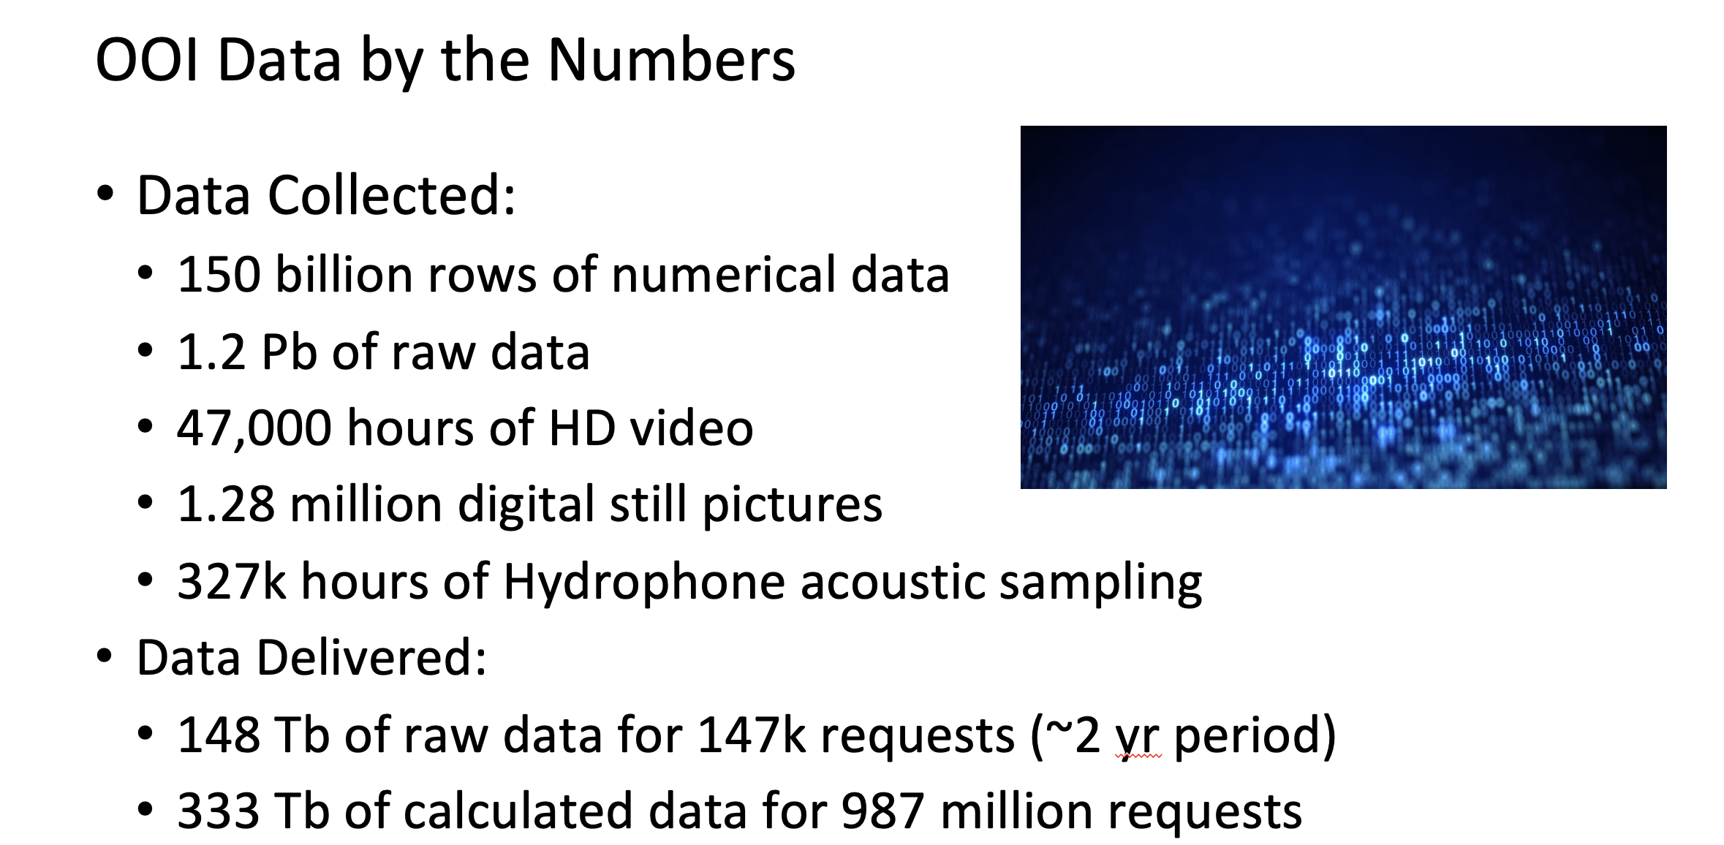

Slide 24
Questions?

