Slide 1
Introduction to
OOI Data Explorer
and Data Access
Stace Beaulieu, OOI CGSN Data Team
OOI Data Labs 2024 Mid-Atlantic Workshop
3 June 2024
Notes:
https://datalab.marine.rutgers.edu/workshops/2024-mid-atlantic-workshop/#tab-id-2
3:00 - 4:15pm “OOI Infrastructure: Introduction to the OOI Data Explorer and Data Access
Explore and expand on data platforms, instrumentation, data discovery and access. Explore the Data Explorer in pairs to discover what’s there and how to use it.”
This material is based upon work supported by the Ocean Observatories Initiative (OOI), which is a major facility fully funded by the National Science Foundation under Cooperative Agreement No. 2244833.

Slide 2
Today’s session
30 min presentation with live demonstration:
You’ll learn about OOI Infrastructure while I explore with the Data Explorer.
30 min hands-on activity:
Data Explorer Quest! You’ll explore the Data Explorer in pairs.
15 min re-group to share
Notes:
Presentation will start after a 15-min break
Next session will roll into 4:15 pm Reflection and Feedback
OOI Infrastructure: Introduction to the OOI Data Explorer and Data Access
Explore and expand on data platforms, instrumentation, data discovery and access. Explore the Data Explorer in pairs to discover what’s there and how to use it.

Slide 3
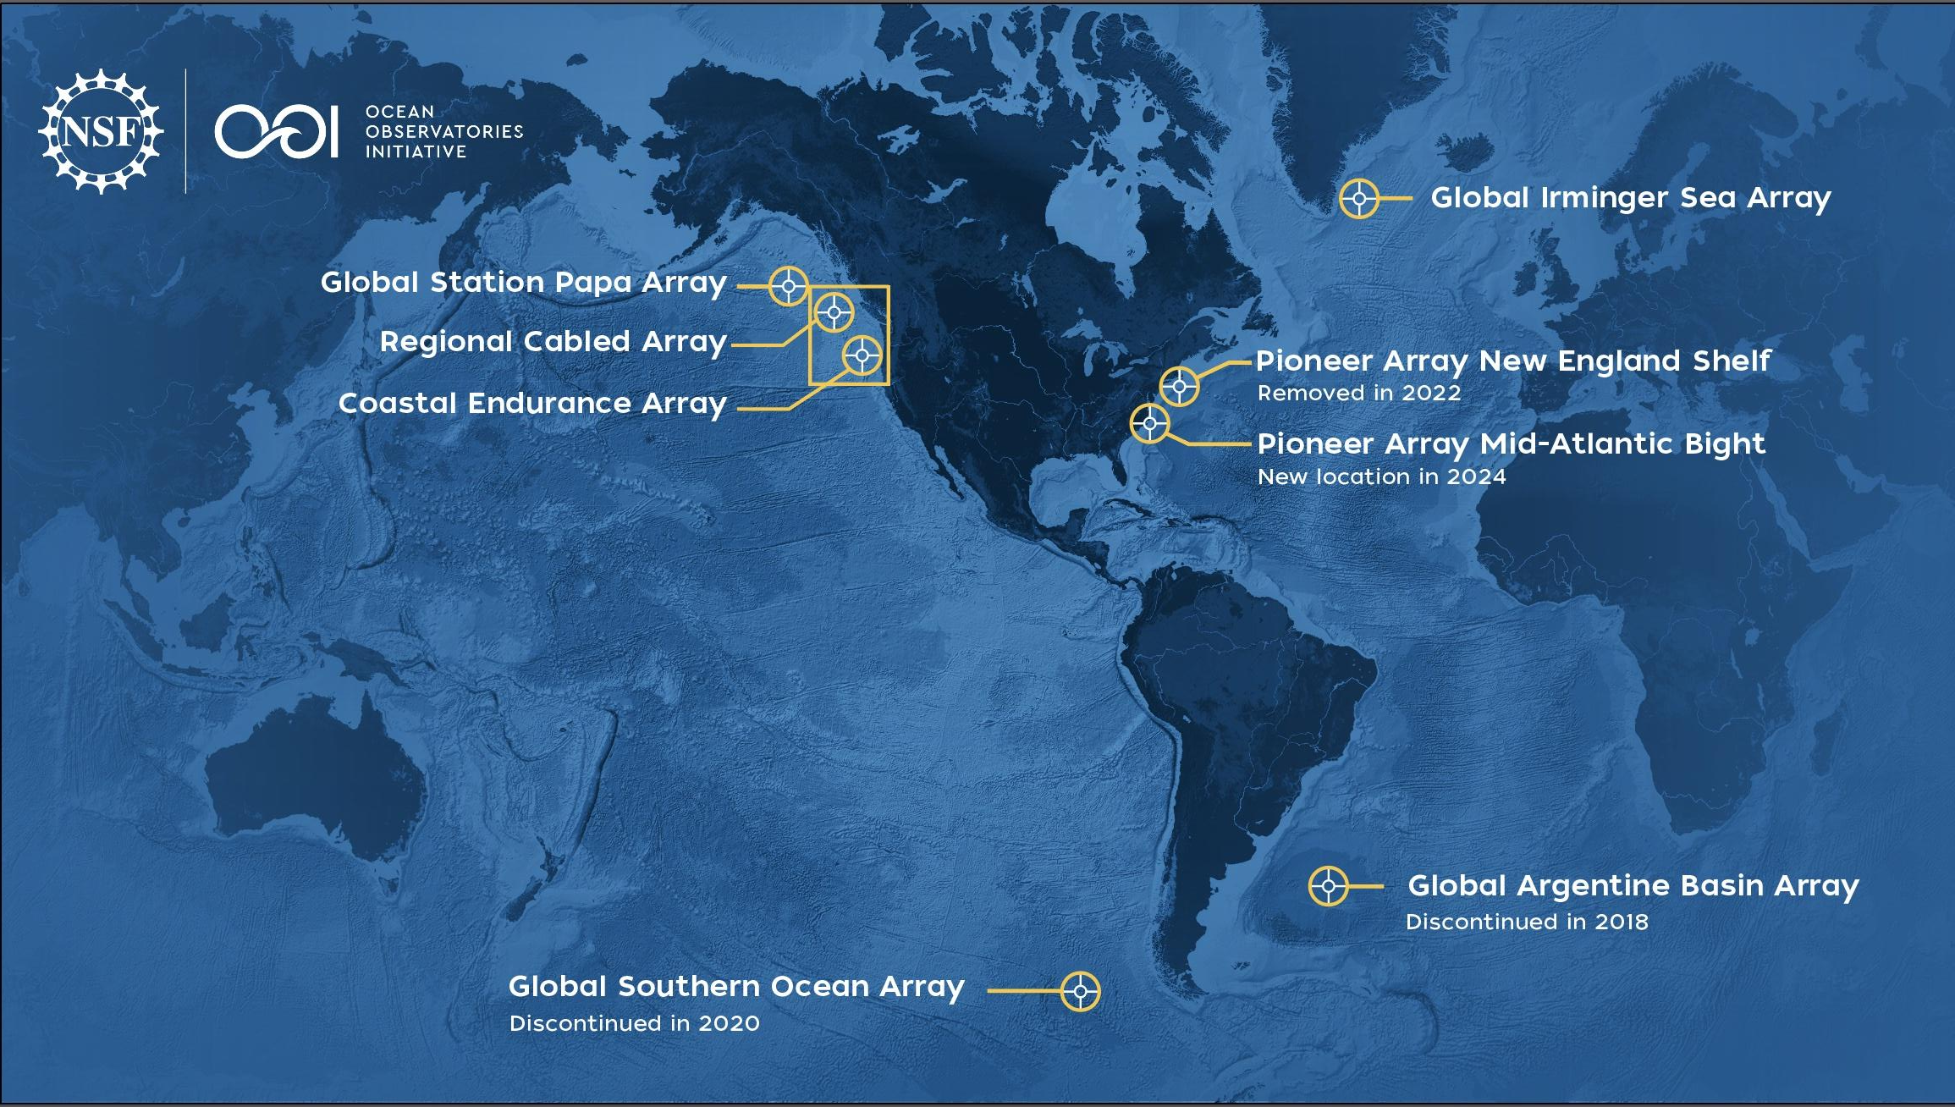
The Ocean Observatories Initiative (OOI) delivers (near-)real-time data from a wide variety of instruments deployed at several ocean arrays
Notes:
relate back to dax’s talk yesterday
https://oceanobservatories.org/
https://oceanobservatories.org/about-ooi/
I added the (near-) for the telemetered data

Slide 4
Infrastructure…
More than 900 instruments of almost 50 different types mounted onto moored or mobile platforms
Collecting physical, chemical, geological, and biological data from the air-sea interface to the seafloor
https://oceanobservatories.org/ooi-infrastructure/
Notes:
Frm infrastructure webpage: A variety of infrastructure — platforms, nodes, instruments, and sensors — comprise the arrays designed to provide a continuous stream of ocean data to the user community.
Text from 2024 brochure:
Facilities on east and west coast that deliver data from more than 900 instruments
fixed moorings, AUVs
https://oceanobservatories.org/about-ooi/
there were 45 different instruments as of 2023, and I think MAB adds 4 new
link to Andrew Reed’s slides used in JP Instrumentation course Nov 2023: https://docs.google.com/presentation/d/1Q9B4oX2w2wVikB4J3KbSkmFRjsCFJBCf/edit?usp=sharing&ouid=117776208155316584403&rtpof=true&sd=true

Slide 5
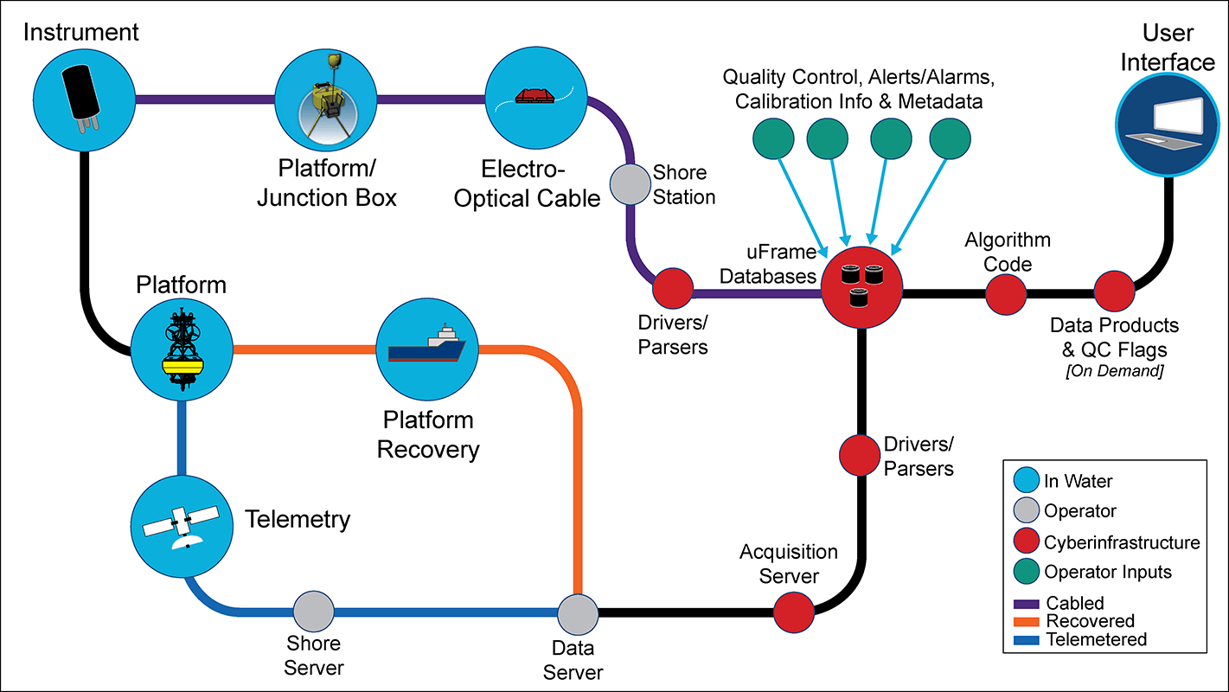
Infrastructure… includes cyberinfrastructure!
https://oceanobservatories.org/cyberinfrastructure/
Notes:
https://oceanobservatories.org/ooi-infrastructure/
“Relaying the data captured by this complex network of infrastructure is accomplished by an equally complex integrated cyberinfrastructure that receives, stores, and transmits ocean data to all those who request it.”
OOI is comprised of four entities: three Marine-Implementing Organizations (WHOI, Oregon State, University of Washington) and the Program Management Office (PMO) which oversees the three MIOs and the CyberInfrastructure (CI) which is responsible for the data delivery/web UI/etc).

Slide 6
Data access
OOI provides users with direct, continuous, and free access to data
https://oceanobservatories.org/data-access/
Today: Visualize and Download Data
Tomorrow: Access Datasets Using Scripts
Notes:
Text from 2024 brochure
Mention ERDDAP and JupyterHub for tomorrow

Slide 7
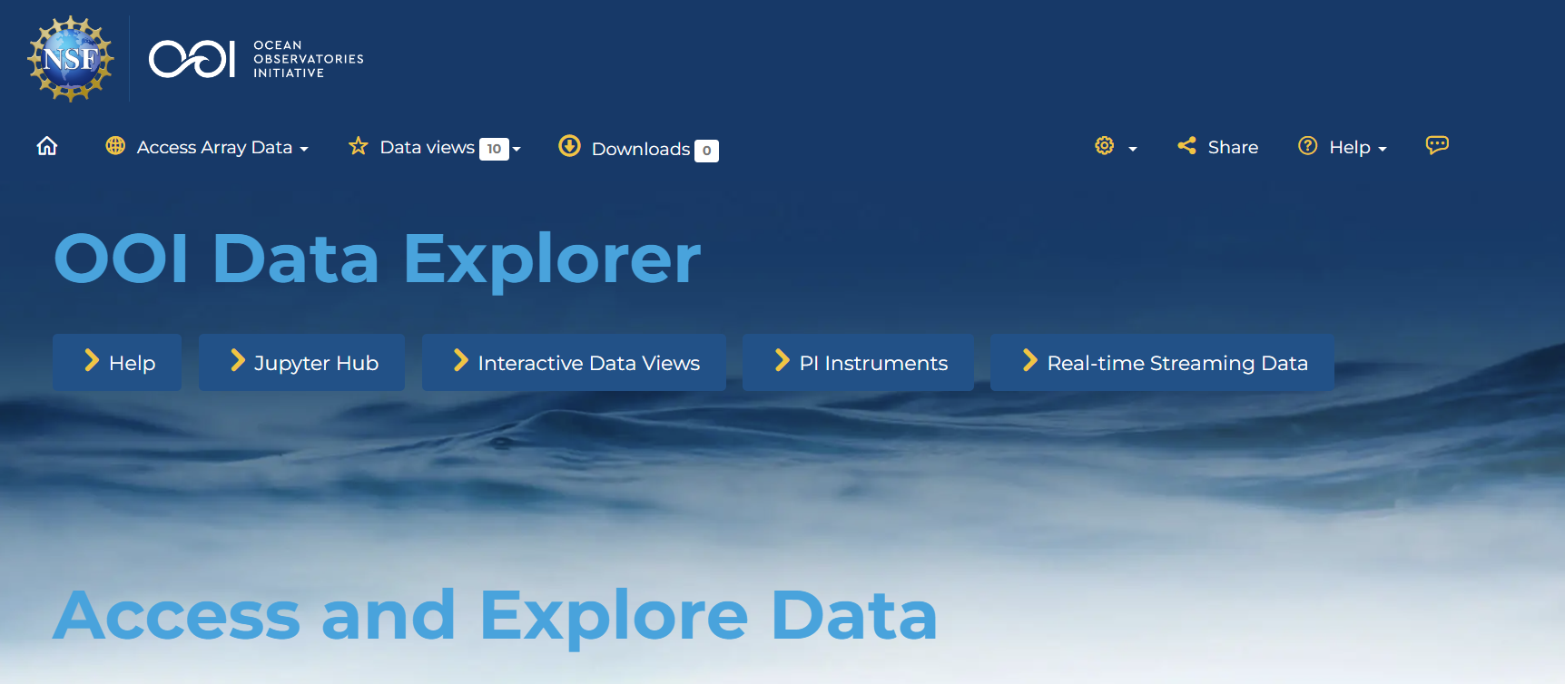
OOI Data Explorer:
Primary gateway to visualize and access OOI data
https://dataexplorer.oceanobservatories.org/
* for best results use Chrome or Firefox web browser
Notes:
You can access OOI data in many ways, with the Data Explorer as primary gateway…
open it up here, it may take a few seconds
stop for a moment to orient participants to the interface

Slide 8
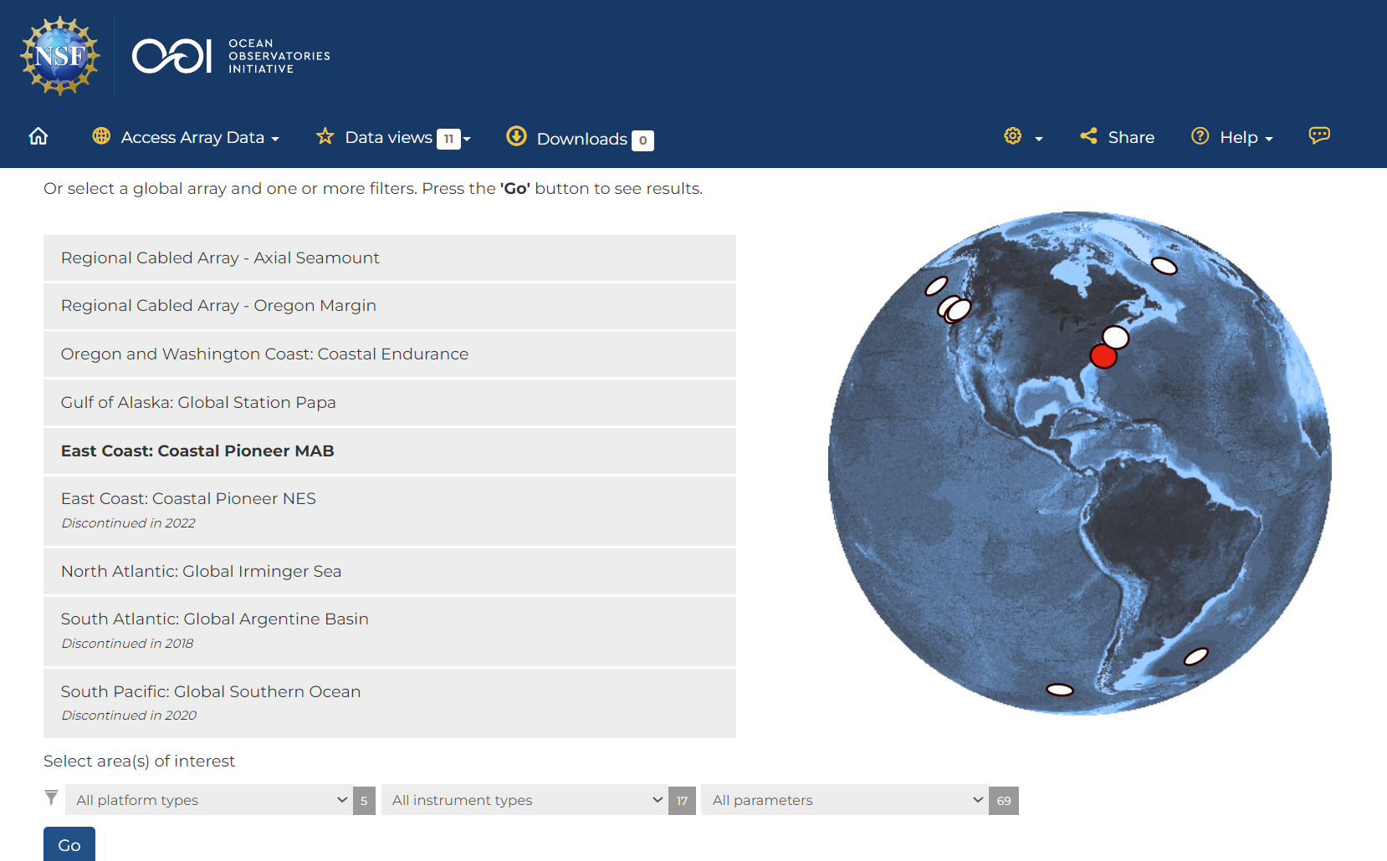
Let’s start by selecting an Array to dive into today
https://dataexplorer.oceanobservatories.org/
Notes:
https://dataexplorer.oceanobservatories.org/
Click on Go without selecting any ‘area(s) of interest’ (applying no filters)

Slide 9
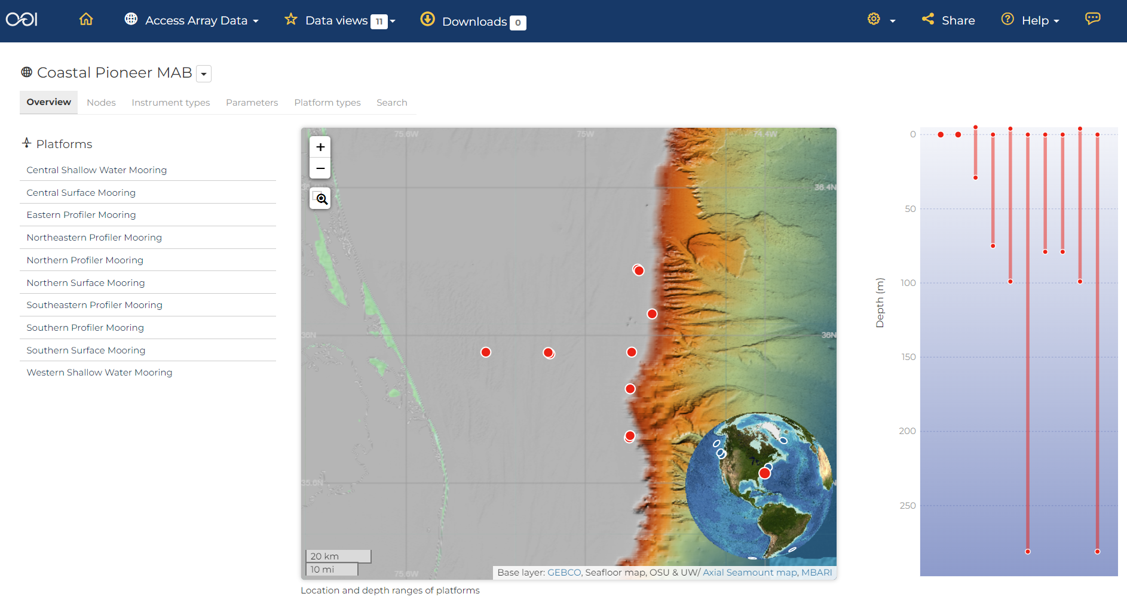
Let’s select a central location within the Array
https://dataexplorer.oceanobservatories.org/#ooi/array/CP1?search=
Notes:
Hover over list showing how depth bars far right and map symbols highlight
Hover over Central Surface Mooring
Note: the Overview information is not populated yet

Slide 10
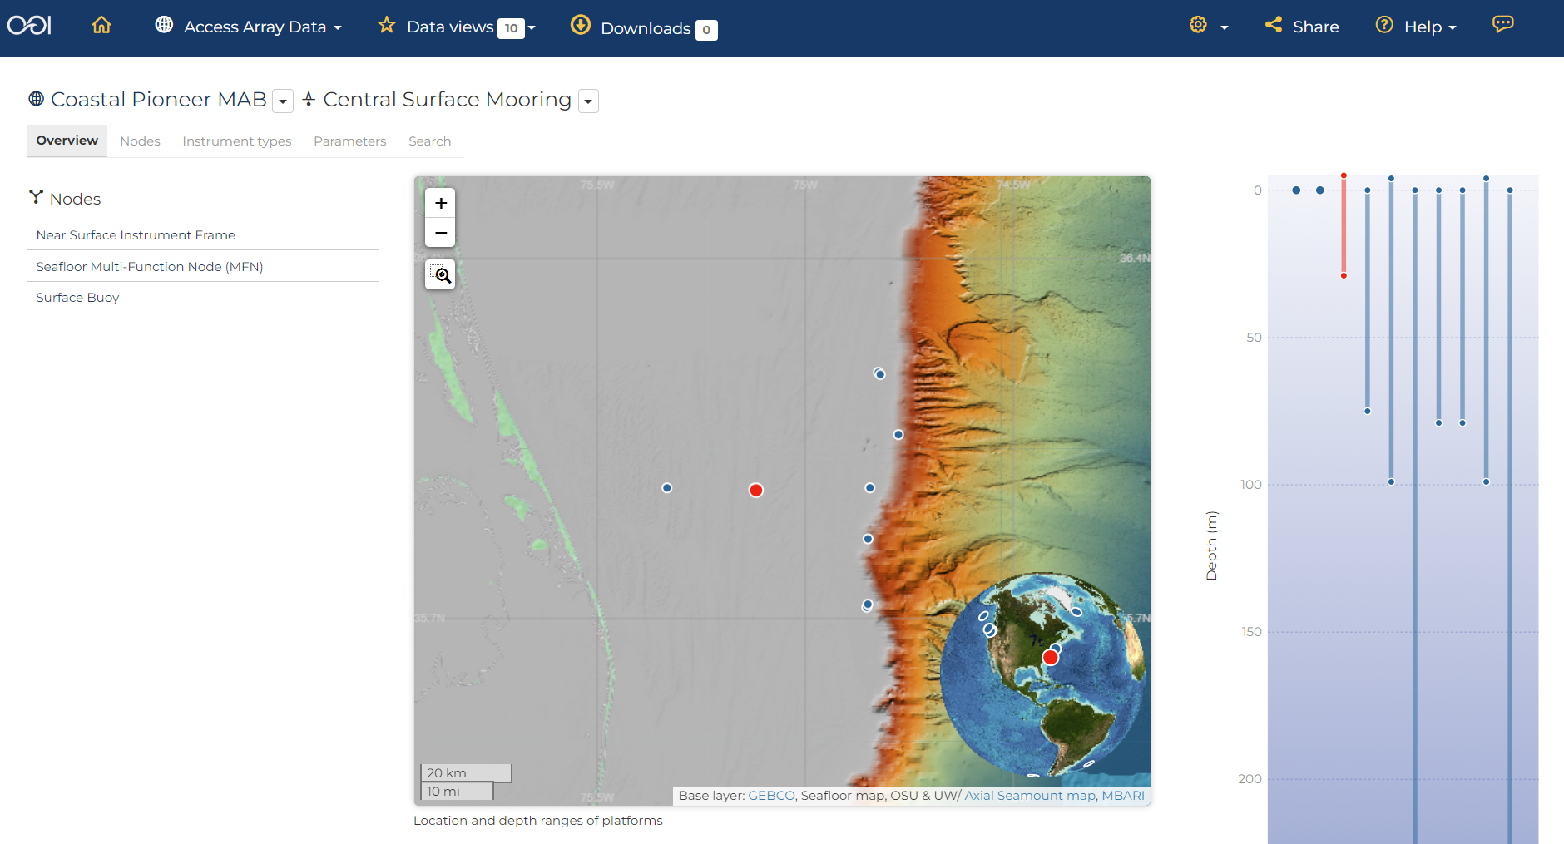
Coastal Pioneer MAB: Central Surface Mooring
https://dataexplorer.oceanobservatories.org/#ooi/array/CP1/subsite/CP10CNSM
Back to slides…
Notes:
note the physical infrastructure: nodes
go back to the slides to better explain terminology

Slide 11
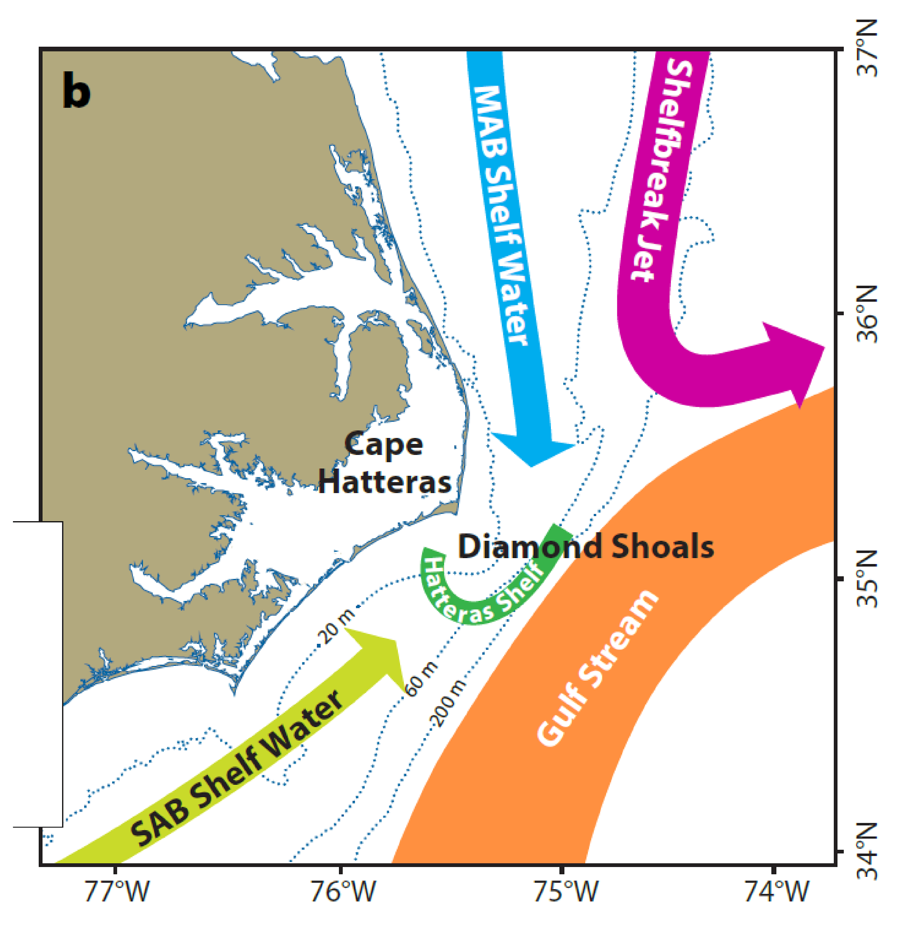
MAB science themes
Dynamics of shelf/slope exchange
Wind forcing, frontal instability, Gulf Stream influence
BGC cycling and transport
Carbon, nutrients, particulates
Ecosystem response
Extreme events
Hurricanes, freshwater outflows
Approximate locations
Wilmington, NC, and Central Surface Mooring
Dana Savidge (Skidaway) and the PEACH Project
Notes:
MAB science themes as context for today’s data story and quest
https://oceanobservatories.org/2024/04/pioneer-array-operational-at-mab/
slide from Al Plueddemann, slightly modified (removed top portion of text:
Approach
Created broad themes based on Innovations Lab input and ranking
High level themes)
Wilmington 34.2104° N, 77.8868° W
Hurricanes linked to relevant Wired news story posted 2 May 2024 https://www.wired.com/story/monster-hurricane-season-summer-2024-atlantic-tropical-storm/
Complex region with multiple processes of interest (schematic of circulation from PEACH).
Innov Lab input included >120 science topics; 23 highly ranked ideas
(ecosys response = primary production to marine mammals)
PEACH = Processes driving Exchange At Cape Hatteras

Slide 12
Deploying the
surface moorings
Videos on OOI’s LinkedIn:
https://www.linkedin.com/posts/ocean-observatories-initiative_nsffunded-activity-7181747248966324224-k5uY
https://www.linkedin.com/posts/ocean-observatories-initiative_nsffunded-activity-7181293576352362496-Z4c-
Lots of infrastructure under the surface too…
Notes:
get a feel for the physical infrastructure (size, weight) and environment
News article for Pioneer MAB deployment:
https://oceanobservatories.org/2024/03/first-deployment-of-the-pioneer-array-in-the-mab/
Expedition blog post describing components of MAB surface moorings:
https://www2.whoi.edu/site/ooi-expedition/hoses-galore-hold-moorings-together/

Slide 13
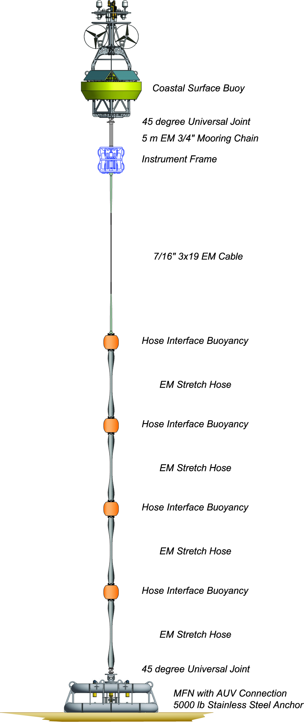
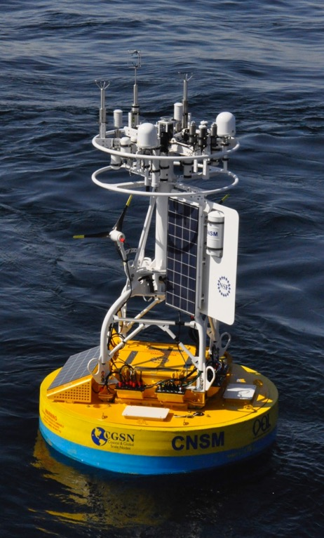
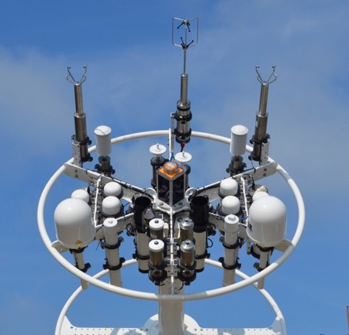
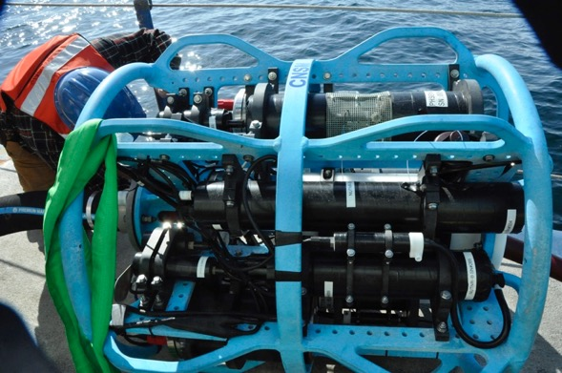
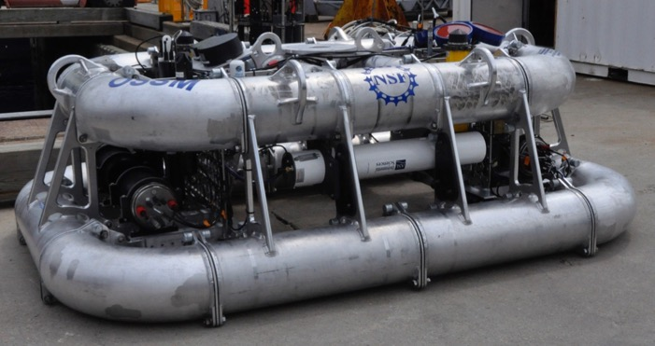
Coastal Surface Moorings
Notes:
Slide from Andrew Reed’s JP class presentation https://docs.google.com/presentation/d/1Q9B4oX2w2wVikB4J3KbSkmFRjsCFJBCf/edit#slide=id.p8
Power Generation
Near-real-time communications
Instruments from buoy (Meteorology) to seafloor
‹#›

Slide 14
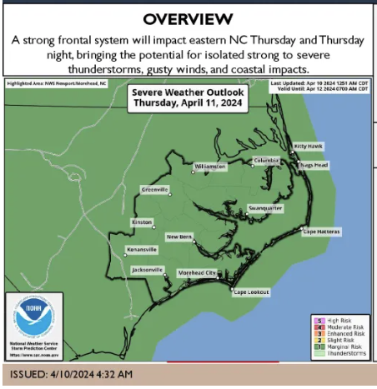
MAB science themes
Extreme events
Hurricanes, freshwater outflows
We know there have been recent storms
[example: April 11]
What types of instruments / data might be useful to detect a storm event at sea?
Back to demo…
Notes:
https://ocracokeobserver.com/2024/04/09/another-brief-storm-system-heading-our-way-thursday/
I confirm from historical weather on land: (see later in day on apr 11 high wind 27 kt from S) https://www.timeanddate.com/weather/@4470221/historic?month=4&year=2024
brainstorm before opening the Data Explorer list of instruments

Slide 15
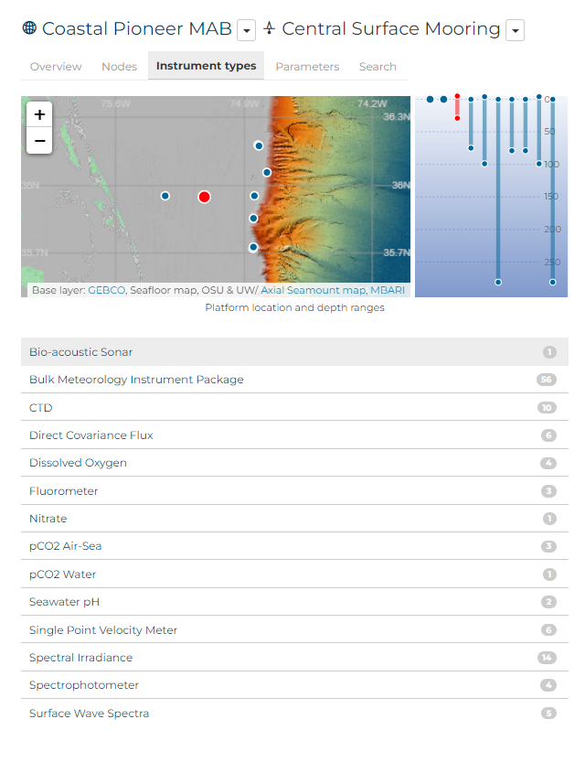
List Instrument types for Central Surface Mooring
https://dataexplorer.oceanobservatories.org/#ooi/array/CP1/subsite/CP10CNSM/instrument_type/
Select an instrument that might be useful to detect a storm event
Notes:
back to CNSM https://dataexplorer.oceanobservatories.org/#ooi/array/CP1/subsite/CP10CNSM
click on Instrument types
https://dataexplorer.oceanobservatories.org/#ooi/array/CP1/subsite/CP10CNSM/instrument_type/
select Bulk Meteorology
https://dataexplorer.oceanobservatories.org/#ooi/array/CP1/subsite/CP10CNSM/instrument_type/METBK/data?platform_id=fixed-depth-assets
note that by starting in the platform CNSM first, the total number of instruments in the list is less than the total available for the array as a whole
however if one starts at the Array level, then selects meteorology, there will be too many options because of the multiple Platforms. best to constrain to CNSM first

Slide 16
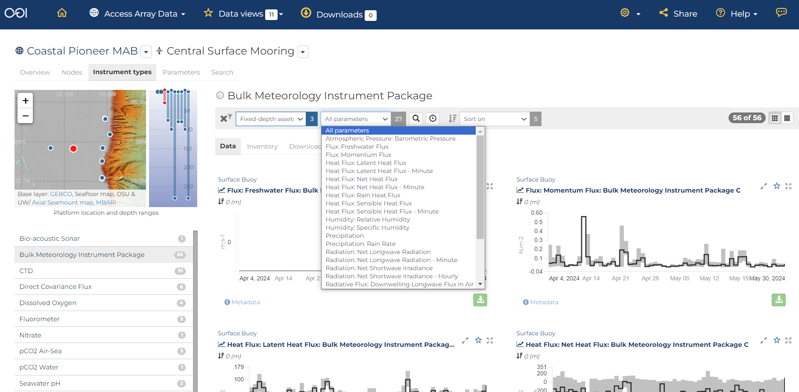
List Parameters for Bulk Meteorology Instrument Package
https://dataexplorer.oceanobservatories.org/#ooi/array/CP1/subsite/CP10CNSM/instrument_type/METBK
Notes:
56 options! But it’s not actually that many parameters - it’s that there is redundancy with two instruments each with 28
note 3 options for winds but might mention there was another instrument that measures winds in different way (they could select in their Quest)
select winds speed and direction* which I understand is calculated from the components plus an adjustment for height above the sea surface
there are 2 options, I want the “A” to match my provided Data View but it’s ok if select “C”.
* note I do not actually see direction provided in the ERDDAP. Is it actually not provided, or is it under an unexpected parameter name? Follow up with CI/Axiom.

Slide 17
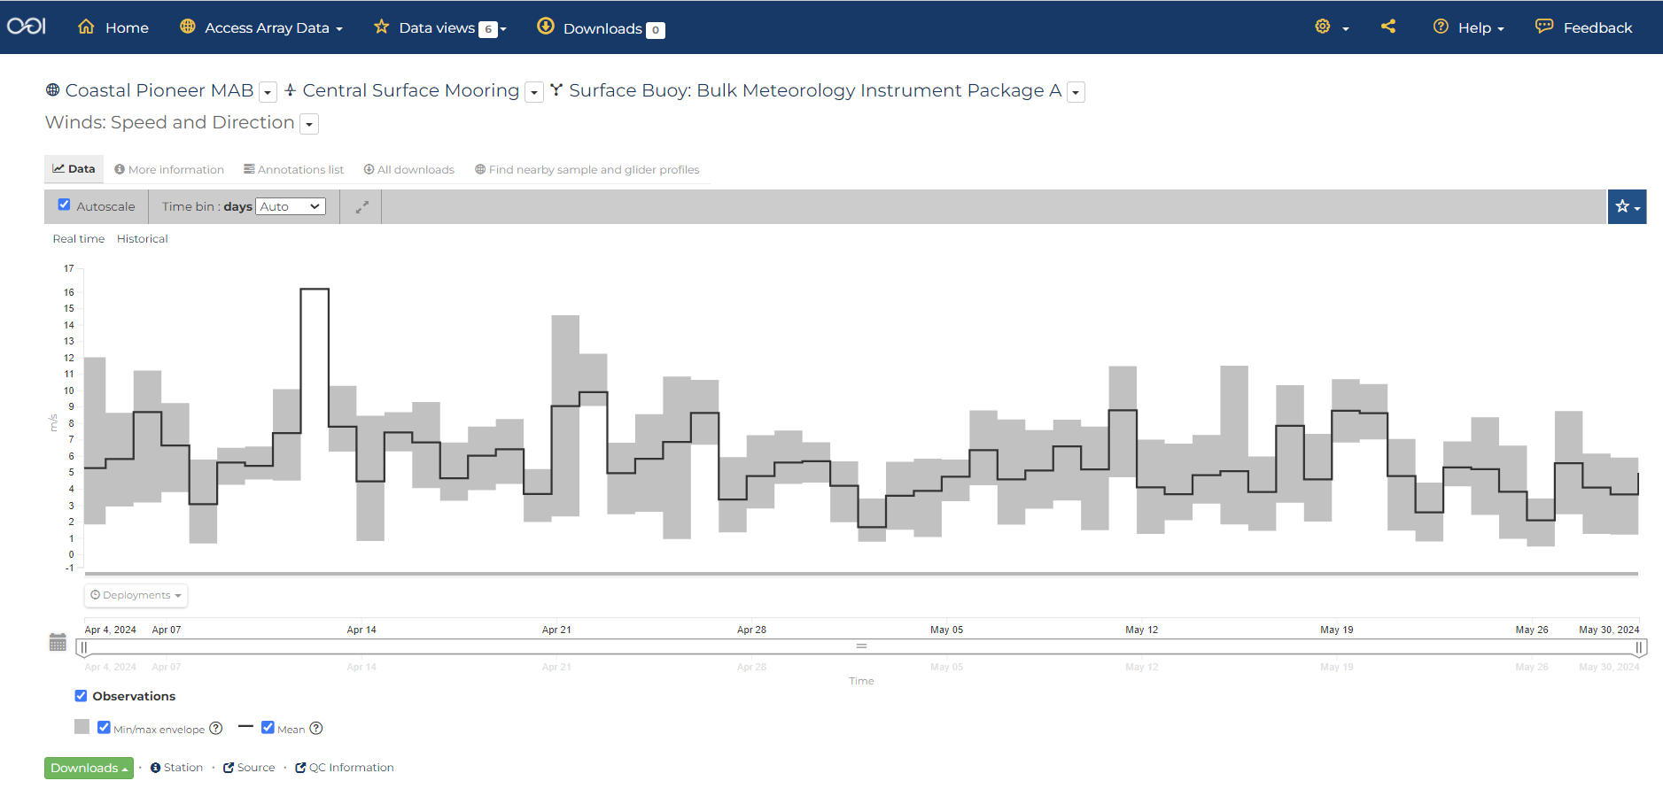
Display Parameter that might be useful to detect a storm event
Notes:
select wind speed
note there are 2 for redundancy
select the “A”
https://dataexplorer.oceanobservatories.org/#metadata/110925/station/8/sensor/data?start=2024-04-04T05:27:00Z&end=2024-05-30T00:34:00Z&leg_clim_max=false&leg_clim_min=false
turn off min/mix
zoom into the highest wind

Slide 18
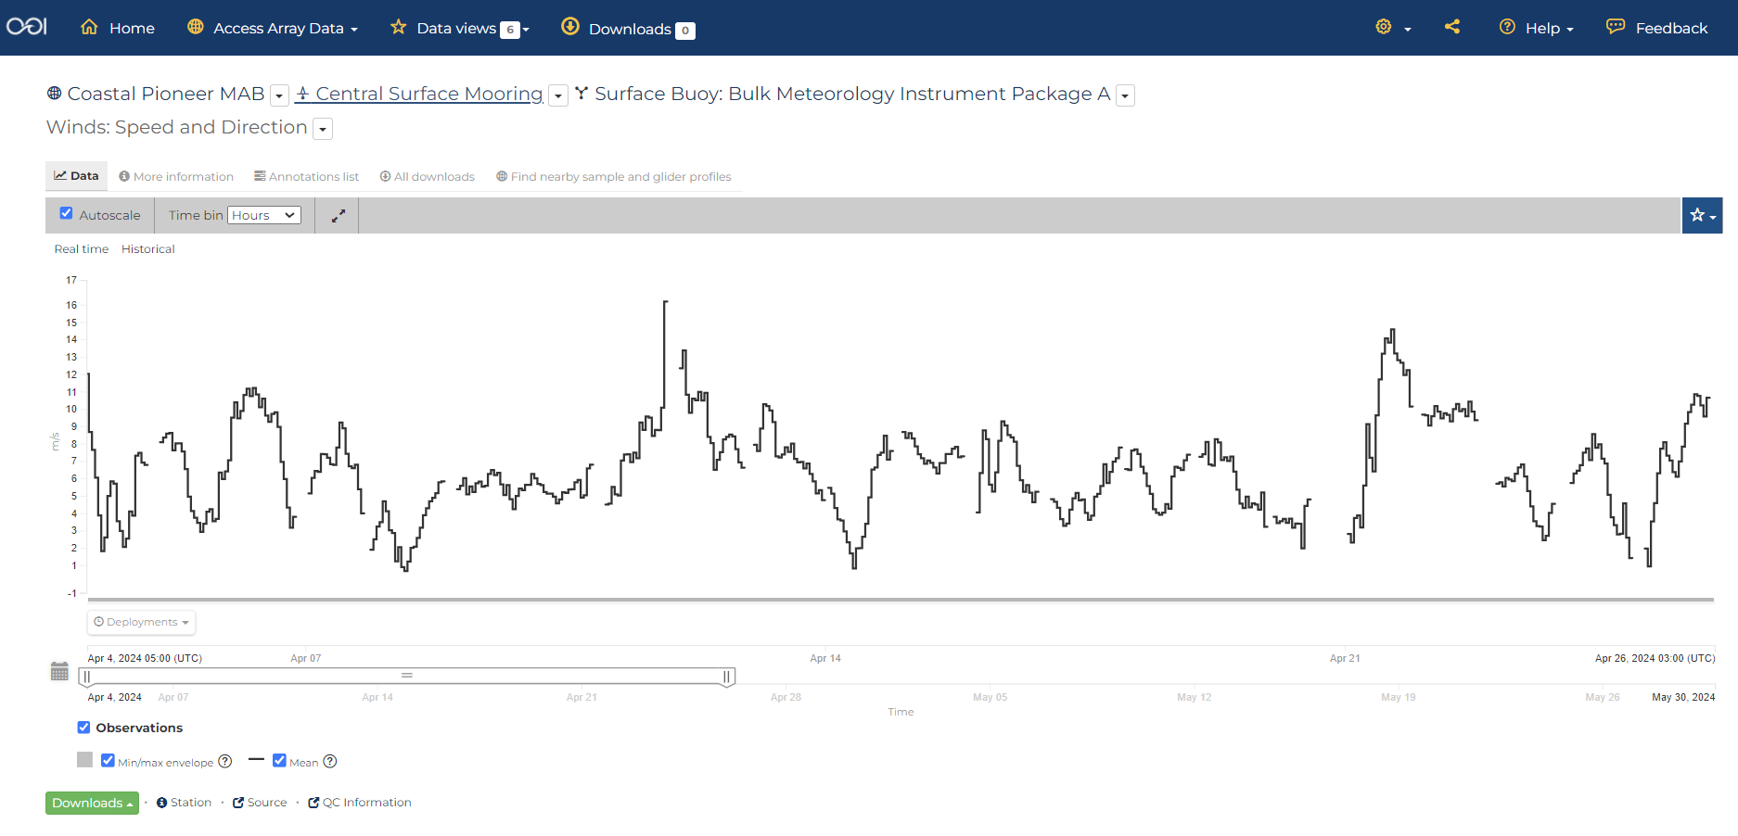
Let’s have a closer look the night of April 11
Notes:
https://dataexplorer.oceanobservatories.org/#metadata/110925/station/8/sensor/data?start=2024-04-04T05:27:00Z&end=2024-04-26T00:11:47Z&bin=hours&leg_clim_max=false&leg_clim_min=false
talk thru some of the visualization features such as min/max (longer time series will have seasonal), QARTOD (not evaluated for this particular dataset yet), time bin (note the data are telemetered so expect some small gaps especially if stormy)
When we get the recovered data… will we see even higher wind speeds?
no need to check the drop-down button to see if any other parameters available (there will be in the ERDDAP but the D.E. does not include in display for winds product)

Slide 19
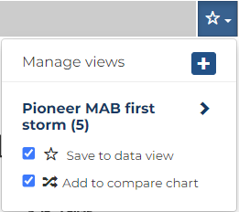
Let’s save this chart into a new Data View
Add new label
Notes:
save into Data View and Comparison Chart (I’ll have to do new bc it’s already saved to my Data View created for the workshop)
show how it increments the number in the top menu Data views, mention the other available default Data views have Data stories they could use for different subjects

Slide 20
What is a Data View? (in Data Explorer)
Click here for example Data Views
A Data View is a collection of datasets that can be visualized together for comparison
https://dataexplorer.oceanobservatories.org/help/overview.html#data-views-overview

Slide 21
Let’s find more data to add to our Data View
https://dataexplorer.oceanobservatories.org/#ooi/array/CP1/subsite/CP10CNSM/instrument_type/
Select another instrument that might be useful to detect a storm event
Notes:
next we’ll select another instrument
go back to the options for CNSM by clicking on the Platform label, then Instrument types
back to CNSM https://dataexplorer.oceanobservatories.org/#ooi/array/CP1/subsite/CP10CNSM
click on Instrument types
https://dataexplorer.oceanobservatories.org/#ooi/array/CP1/subsite/CP10CNSM/instrument_type/
select Surface Wave Spectra
https://dataexplorer.oceanobservatories.org/#ooi/array/CP1/subsite/CP10CNSM/instrument_type/WAVSS/data?platform_id=fixed-depth-assets

Slide 22
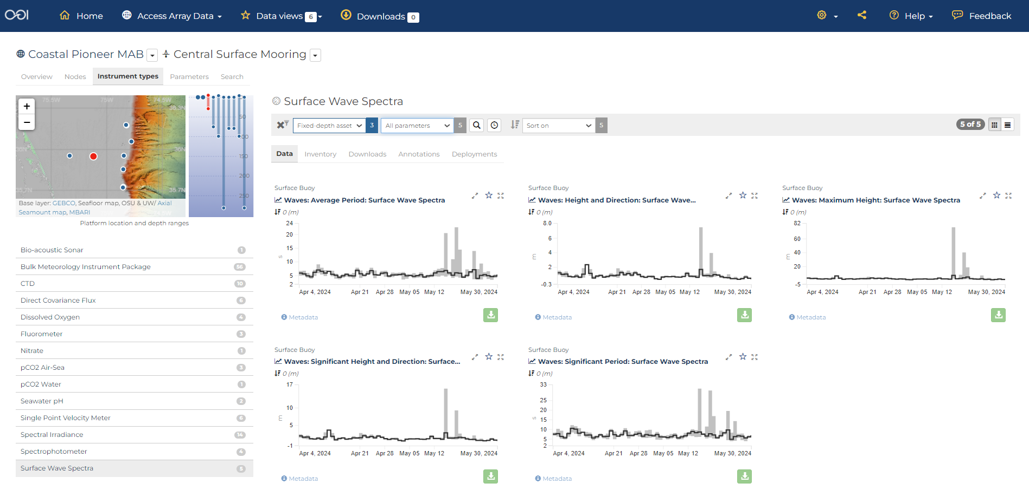
Where there are high winds there should be waves…
https://dataexplorer.oceanobservatories.org/#ooi/array/CP1/subsite/CP10CNSM/instrument_type/WAVSS/data
Notes:
https://dataexplorer.oceanobservatories.org/#ooi/array/CP1/subsite/CP10CNSM/instrument_type/WAVSS/data
height, maximum height, significant height…
choose significant height, and then use the parameter information for definition
https://dataexplorer.oceanobservatories.org/#metadata/110932/station/232/sensor/data?start=2024-04-04T00:23:00Z&end=2024-05-30T00:23:00Z&leg_clim_max=false&leg_clim_min=false
https://mmisw.org/ont/cf/parameter/sea_surface_wave_significant_height

Slide 23
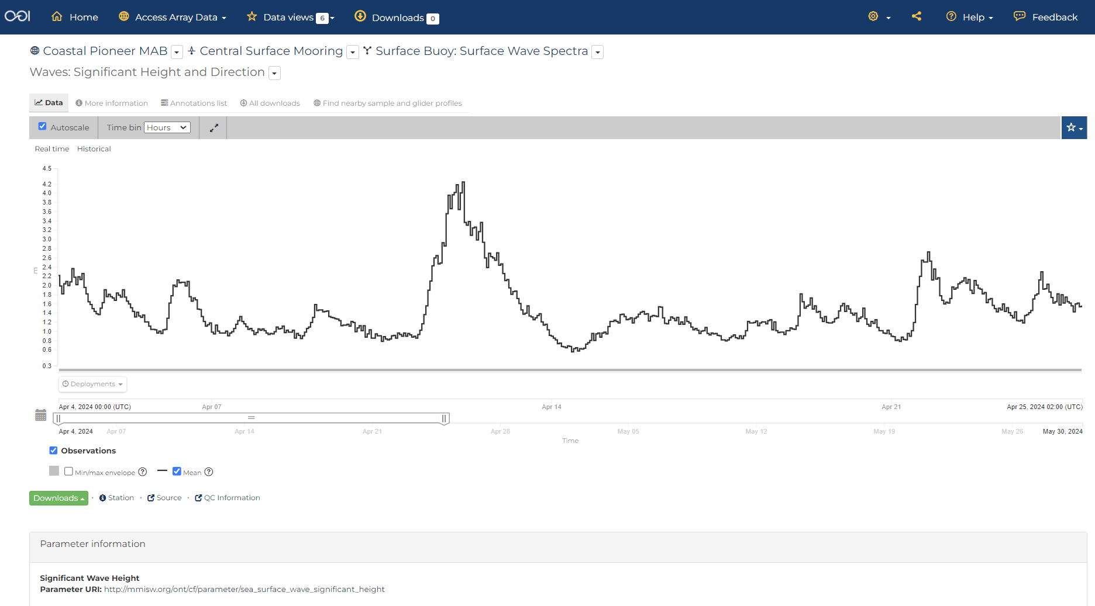
Let’s have a closer look
Notes:
https://mmisw.org/ont/cf/parameter/sea_surface_wave_significant_height
https://dataexplorer.oceanobservatories.org/#metadata/110932/station/232/sensor/data?start=2024-04-04T00:23:00Z&end=2024-04-25T02:32:33Z&bin=hours&leg_clim_max=false&leg_clim_min=false&leg_minmax=false

Slide 24
Let’s save this chart into our new Data View
New Data View
Notes:
show how the number increments indicating when added to the Data view
click open new Data view https://dataexplorer.oceanobservatories.org/#add-data-view/9T0tsodL/1

Slide 25
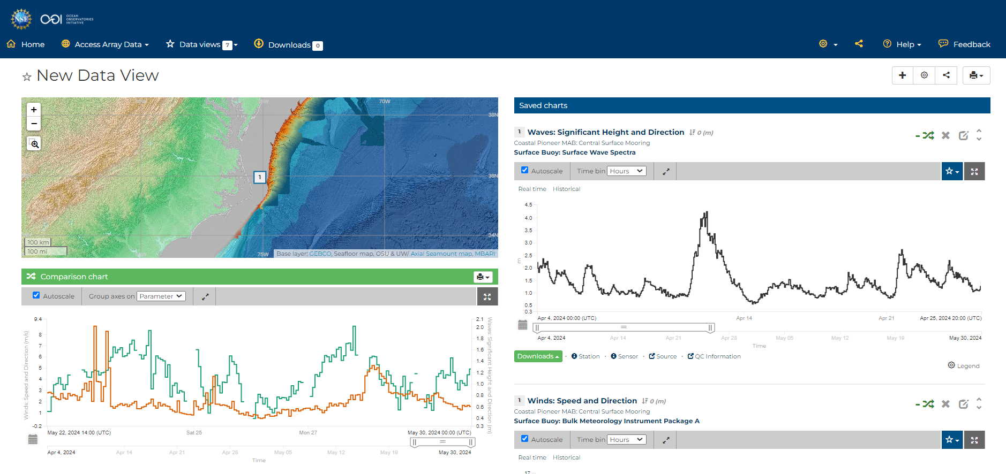
Let’s compare in our new Data View
https://dataexplorer.oceanobservatories.org/#add-data-view/9T0tsodL/1
Notes:
go over the layout and zoom into the April 11 event on the Comparison Chart

Slide 26
What sub-surface instruments might provide evidence for a storm event?
https://dataexplorer.oceanobservatories.org/#ooi/array/CP1/subsite/CP10CNSM/instrument_type/
Back to slides…
Notes:
to navigate out of the Data view, click into one of the Saved charts
then click the Platform Central Surface Mooring
“Turbidity” not listed as instrument. Would you think that a Fluorometer could provide evidence for a storm event?? Not if you just thought of chlorophyll. But this fluorometer actually enables sensing 4 types of parameters.

Slide 27
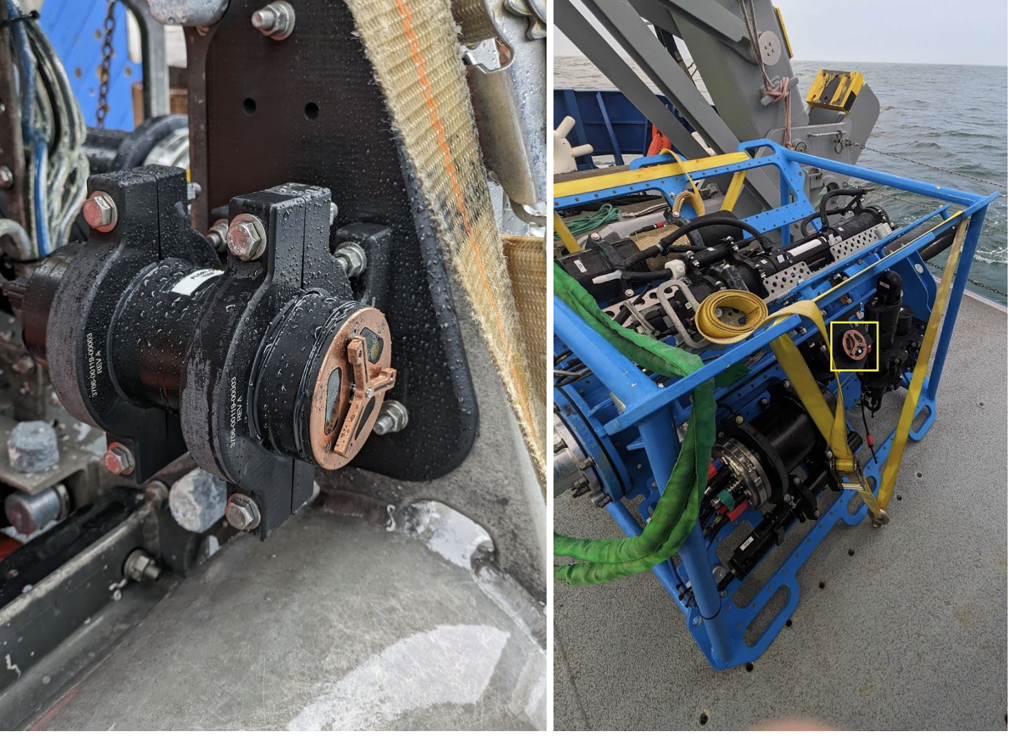
Pioneer MAB Providing Turbidity from Fluorometers
https://oceanobservatories.org/2024/05/pioneer-mab-providing-turbidity-from-ooi-core-fluorometers/
Fluorometers on the:
(left) Seafloor Multi-Function Node
(right, yellow box) Near-Surface Instrument Frame
The copper-covered “Y” is a wiper blade that prevents growth and marine debris from accumulating over the oval sensor windows.
Photos by Sawyer Newman © WHOI
Notes:
The one instrument (fluorometer ECO triplet-w) provides 4 parameters (chlorophyll a, CDOM, optical backscatter, and turbidity).
Note that the Data Explorer chart title for Turbidity does not follow the norm because the reference designator (dataset ID) does not include prefix FLORT but rather TURBD.
I might mention somehow that there is another/new parameter (total volume concentration) that also measures "how much sediment or other particles are in the water" https://dataexplorer.oceanobservatories.org/#ooi/array/all/parameter/2075/data

Slide 28
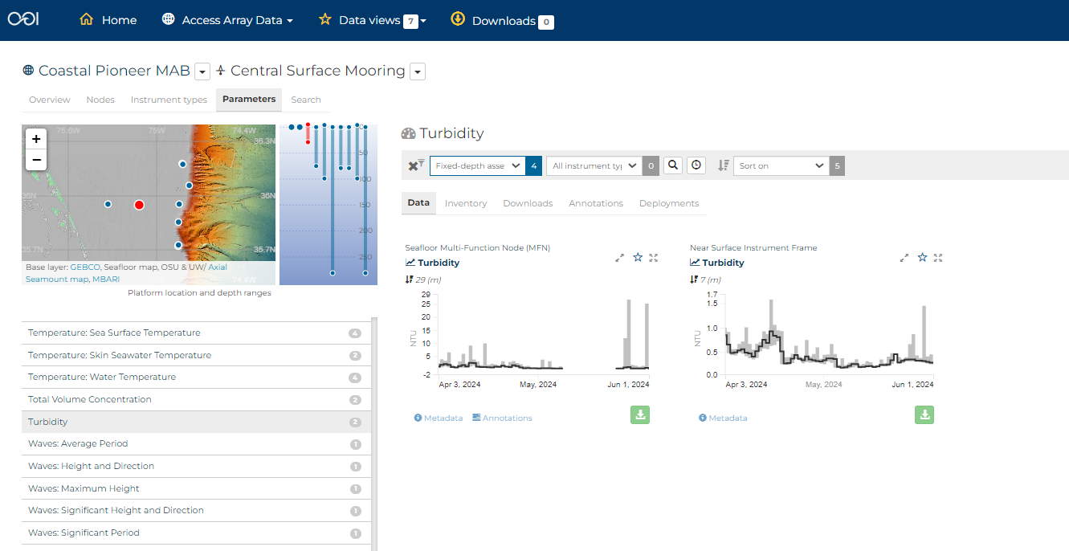
Turbidity might provide evidence for a storm event
https://dataexplorer.oceanobservatories.org/#ooi/array/CP1/subsite/CP10CNSM/parameter/37/data?platform_id=fixed-depth-assets
Notes:
it’s so new that “Turbidity” not listed yet as 4th parameter under Fluorometer.
click on Parameters ist for the Central Surface Mooring as a whole

Slide 29
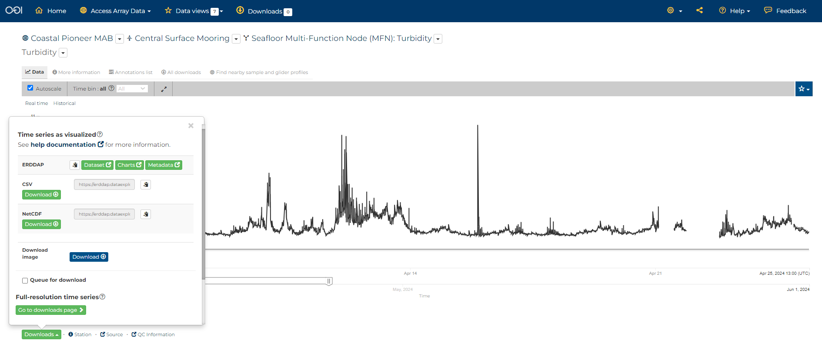
Let’s download data for further analysis
Back to slides…
Notes:
https://dataexplorer.oceanobservatories.org/#metadata/110983/station/37/sensor/data?start=2024-04-03T14:00:00Z&end=2024-04-25T13:37:48Z&bin=all&leg_clim_max=false&leg_clim_min=false&leg_minmax=false
We could add Turbidity to our Data view, but…
to conclude today’s demo…
Let’s download data for further analysis
end presentation by showing what’s behind the green Downloads button to connect to Sage’s demos tomorrow
note that sage uses “dataset ID” for reference designator
In order to download data from Erddap, we need to know the dataset ID. To find the ID, navigate to the instrument you want on the OOI Data Explorer, then click the green Download button, and select the Erddap Metadata option. This will bring up a page with the Dataset ID at the top. Here the the IDs we will need for Winds and Waves.
Central Surface Mooring, Surface Buoy: Bulk Meteorology Instrument Package A, Winds: Speed and Direction
ooi-cp10cnsm-sbd11-06-metbka000
Central Surface Mooring, Surface Buoy: Surface Wave Spectra, Waves: Significant Height and Direction
ooi-cp10cnsm-sbd12-05-wavssa000

Slide 30
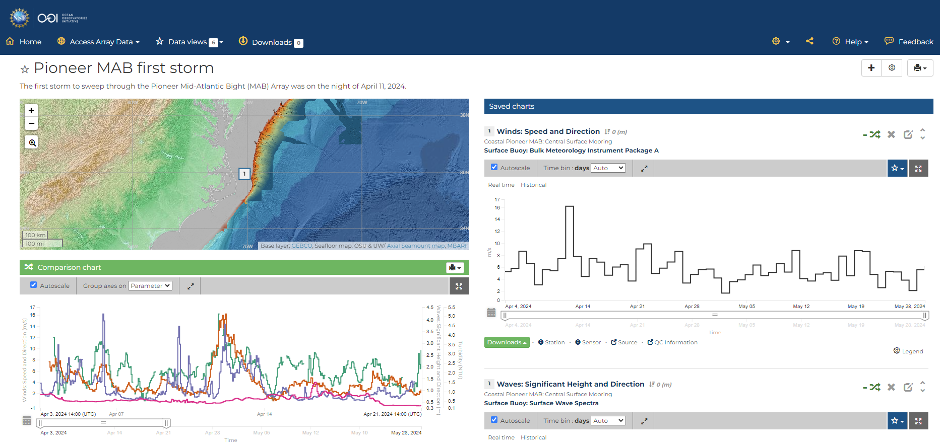
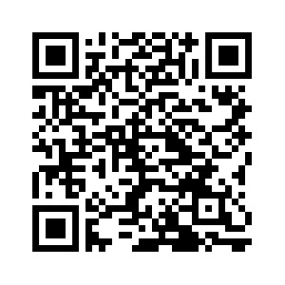
The first storm to sweep through the Pioneer MAB Array
https://dataexplorer.oceanobservatories.org/?ls=xKnA_DDf#data/default
Notes:
Target 'data story' for wind, waves, and turbidity at OOI Pioneer MAB Central Site (30-m water depth), about 25 miles offshore the Outer Banks:
Here's Data View showing Apr 11 wind, max sig wave height, and MFN turbidity highest so far at CN, followed a couple days later by highest so far NSIF turbidity. (I don't know how to explain the NSIF turbidity, but I am curious...)
new: https://dataexplorer.oceanobservatories.org/?ls=xKnA_DDf#data/default
[old, also shares other data views: https://dataexplorer.oceanobservatories.org/?ls=OsGoQAe8#data/5.1]
zoom in, on the comparison chart, to about 2 weeks (Apr 7-21).
Anna Pfeiffer-Herbert “storms/coastal hazards is one of the areas we are hoping to further develop in the Data Lab manual with new Pioneer data”
Dax mentioned “event detection” - note in longer time series at other Arrays one can use the min/max or seasonal stats or QARTOD to identify events of interest, but in this case the Array is too new

Slide 31
Ready to explore?
You’ll explore the Data Explorer in pairs [here]
Your Quest is to:
find more evidence for the storm offshore,
add to a Data View, and
share URL link
At 4pm we’ll re-group to share data views
Notes:
Walk thru the handout
explain ultimate Goal: add to a Data View and share URL link
Learning objectives for Quest:
Familiarity with OOI infrastructure as listed in Data Explorer:
Arrays
Platforms (and Nodes on the Platforms)
Instruments
Parameters
Bonus: reference designator for ERDDAP and JupyterHub demo
Familiarity with OOI Data Explorer as a tool, corresponding to step-by-step guide https://oceanobservatories.org/2023/09/four-part-series-on-using-data-explorer/ :
Find & visualize time-series data (at fixed depth)
Compare time-series data
Annotations as part of human-in-the-loop (HITL) quality control (QC) [https://dataexplorer.oceanobservatories.org/help/how-to/ooi/data-charts/data-charts-annotations.html]
Bonus: Find & visualize profiler data
Bonus: Mobile Assets (as of 2024-05-30 Gliders and AUVs not yet available for MAB in Data Explorer)
Familiarity with OOI Data Access as provided by Data Explorer:
Download* a CSV (or NetCDF) file for a “Time series as visualized” (* we will learn the next day about ways to access these data without having to download)

Slide 32
Re-group to share data views
Notes:
will we have a collaborative document to paste URLs?

Slide 33
Questions?
Stace Beaulieu (stace@whoi.edu)
Feel free to use the Feedback button on Data Explorer
OOI Discourse HelpDesk https://discourse.oceanobservatories.org/
Notes:
This material is based upon work supported by the Ocean Observatories Initiative (OOI), which is a major facility fully funded by the National Science Foundation under Cooperative Agreement No. 2244833.
Link to additional relevant presentation [here]:
Wild Ocean Data: Easily Within Reach
The Wild North Atlantic at Your Fingertips with the Data Explorer from the Ocean Observatories Initiative
Massachusetts Marine Educators Meeting 2022

Slide 34
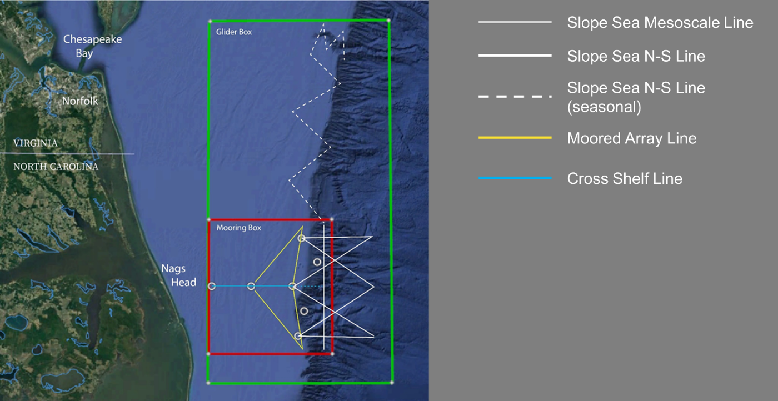
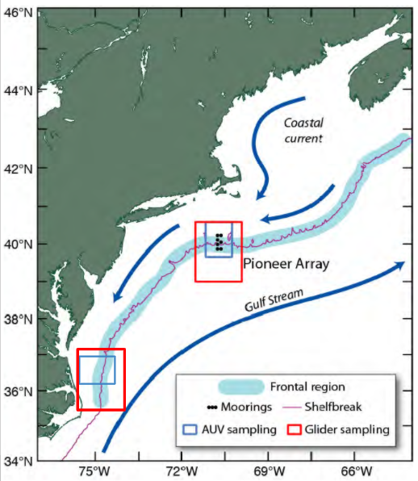
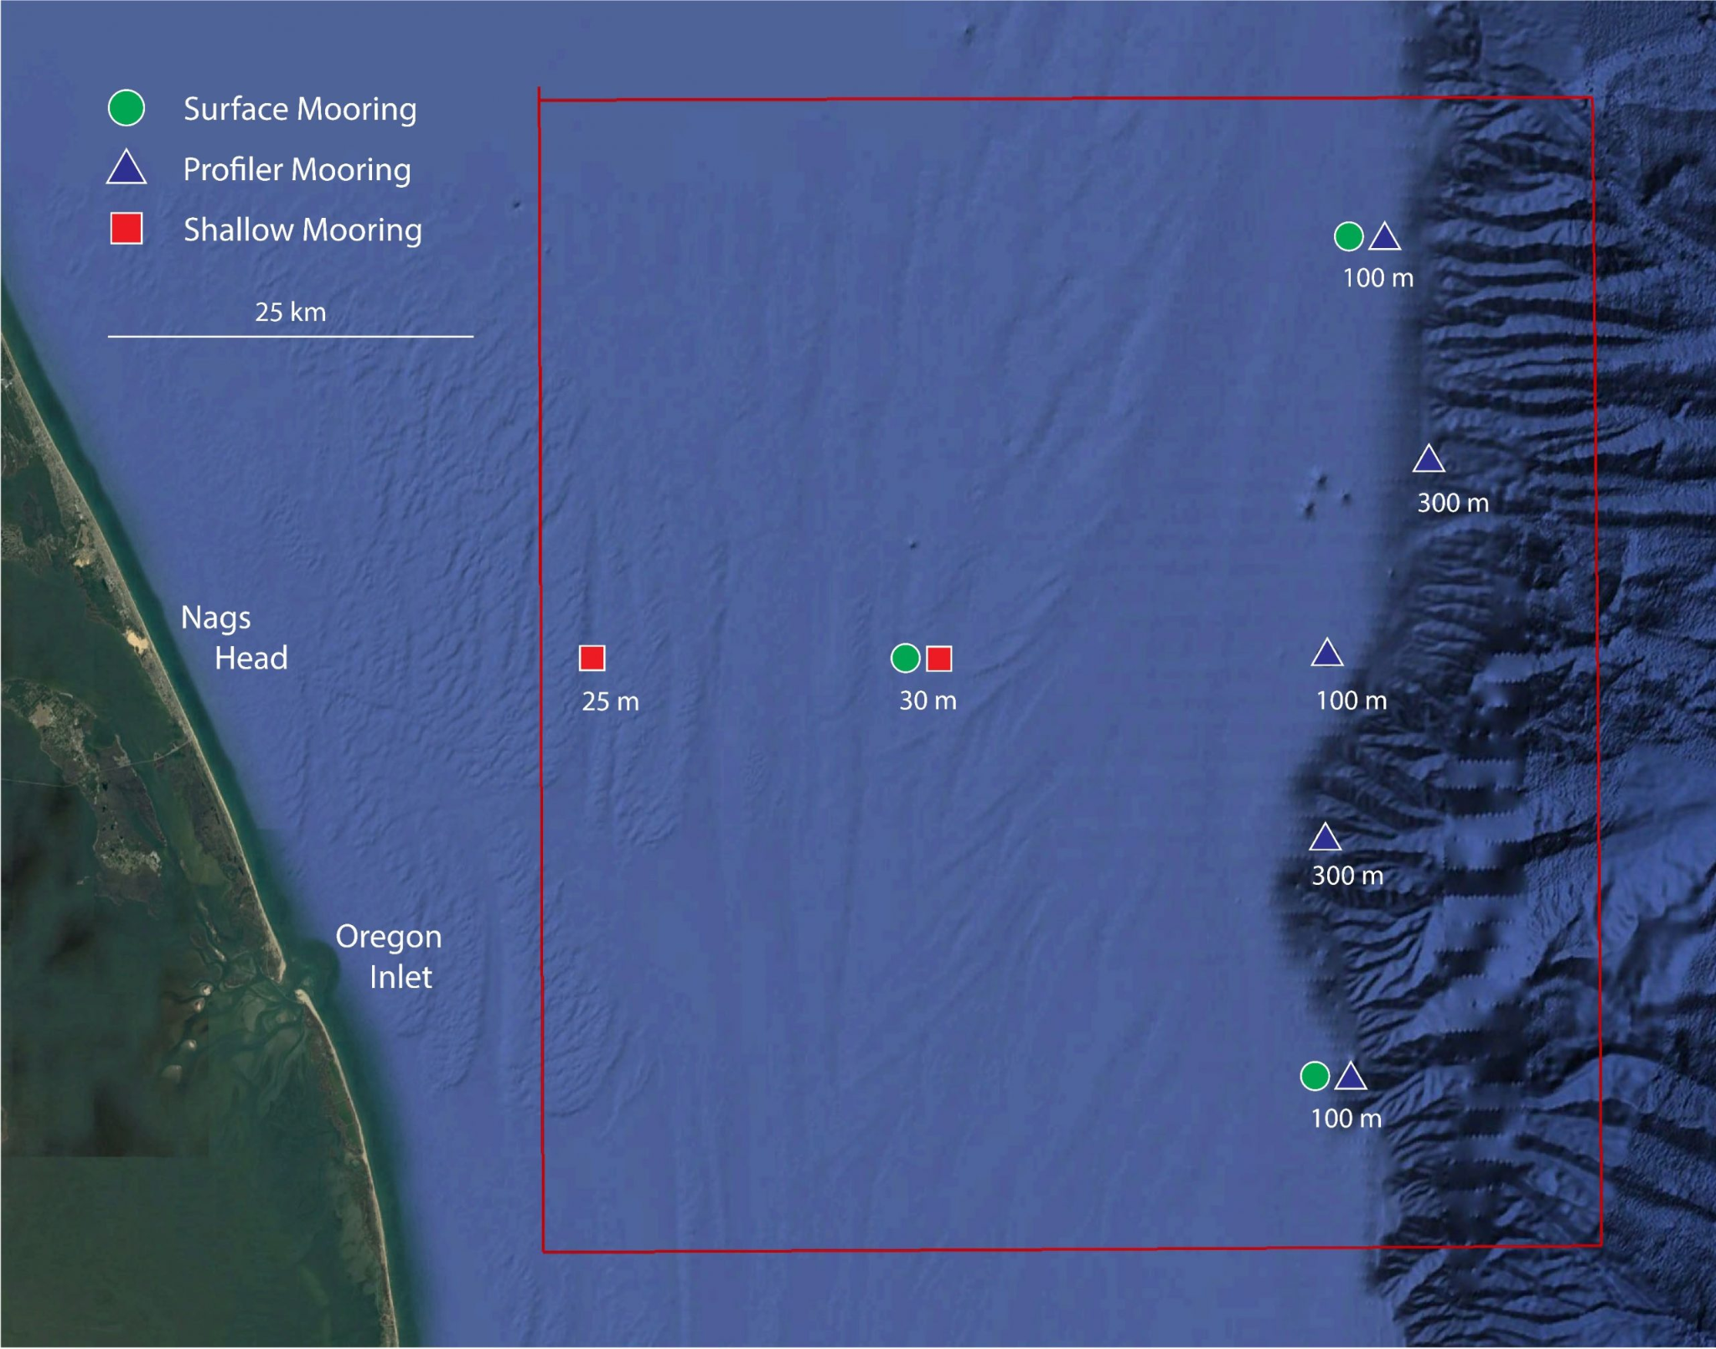
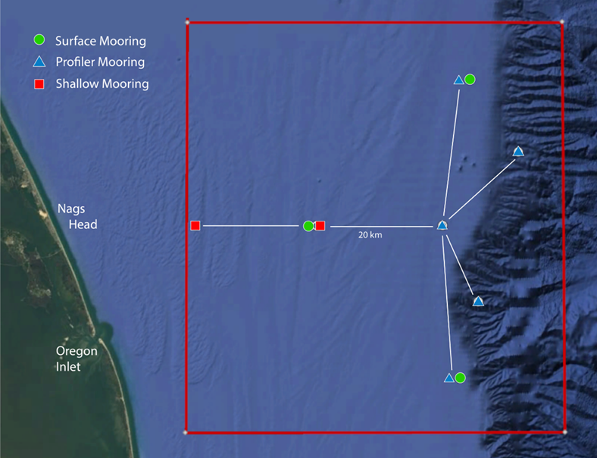
Coastal Pioneer Array – Mid Atlantic Bight
First deployment: April 2024
Notes:
Slide from Andrew Reed’s JP class presentation https://docs.google.com/presentation/d/1Q9B4oX2w2wVikB4J3KbSkmFRjsCFJBCf/edit#slide=id.p8
with updated map from https://oceanobservatories.org/array/coastal-pioneer-mid-atlantic-bight-array/
The “T” part of the layout along the ~100 m isobath with a total separation (north-south) of ~50 km
The “stem” part from West to East is ~45 km
‹#›

Slide 35
Notes:
This could be supplement to tomorrow’s Notebook activity (share with Dr. Mark Lammers, UNCW Data Science):
Let’s see if we can find and access data relevant to our ‘first storm event’ from
https://cormp.org/
https://uncw.edu/research/major-programs/aquaculture/media/pdf/highlights-cormp.pdf

