Slide 1
Transitioning Lessons from the OOI Lab Notebook to Upper Level Data-Focused Classes
Joe Long
longjw@uncw.edu

Slide 2
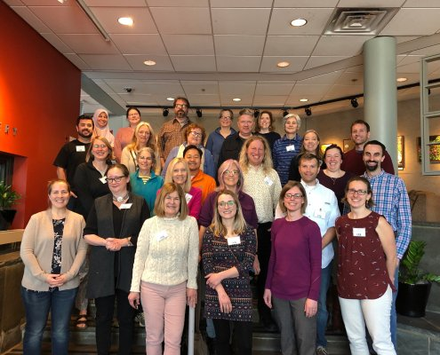
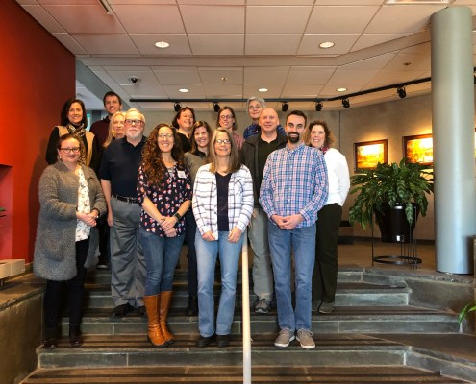
March 2019
Participated in March 2019 data lab and January 2020 lab notebook workshops
Entered with more of a background in coding than teaching!
Used labs 4 and 6 for remote assignments (Canvas) during pandemic:
January 2020
Transitioned to teaching upper level major-specific classes in Fall 2021, including a new field methods course where students collect, interpret, synthesize, and visualize various data they collect.
Continue to use elements of the OOI lab notebooks and overall structure to design new lab assignments

Slide 3
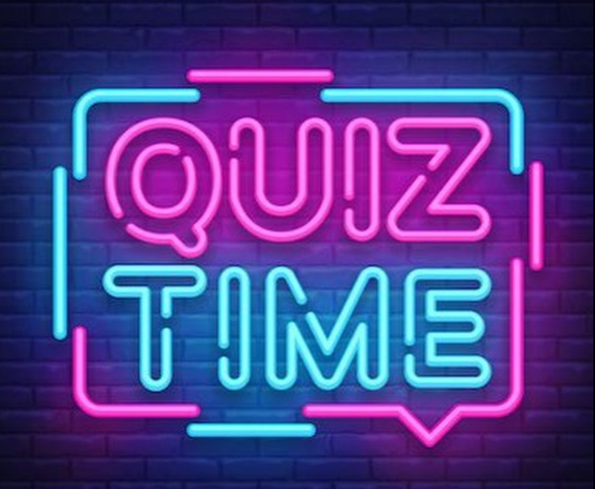
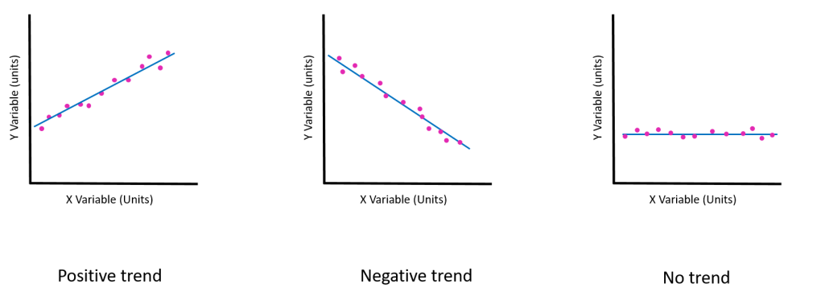
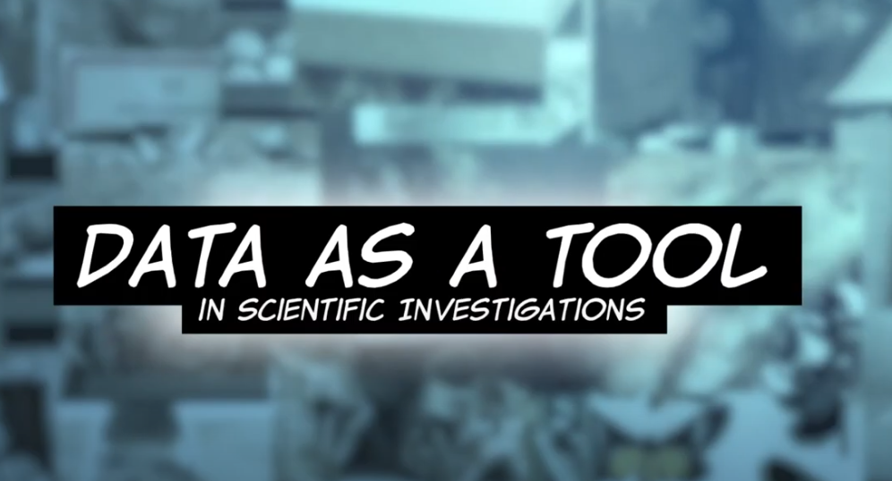
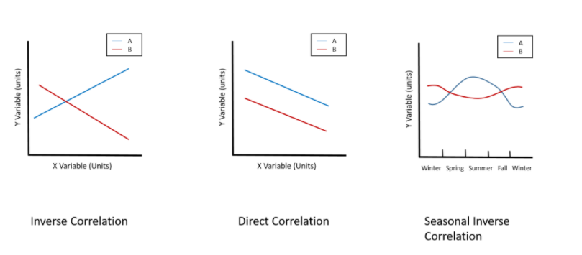
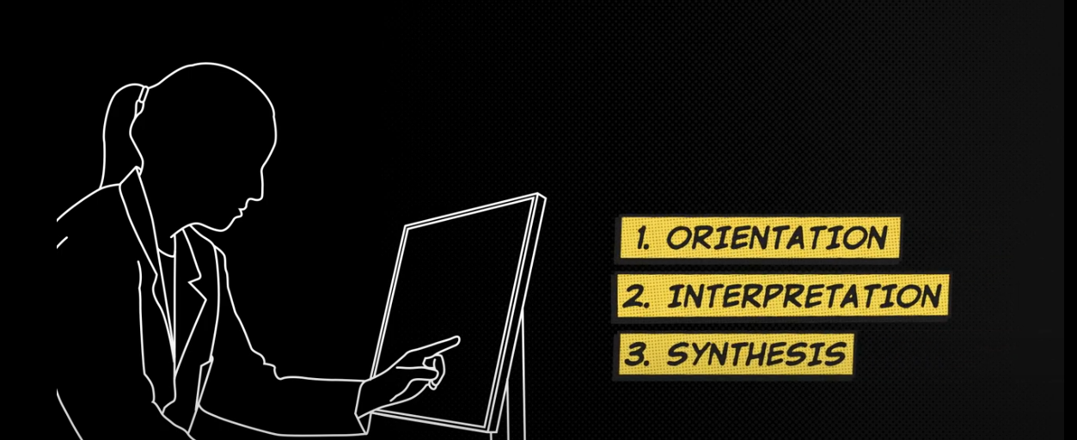
Introduction/Review: Day 1

Slide 4
Introduction/Review: Week 1-2
Administer parts of OOI Lab #2 on Canvas as assignments.
Great reminders on how graphs are presented and interpreted.
Talk about making sense of the mess and dealing with gaps in data into a few classes (consistent with some OOI themes)

Slide 5
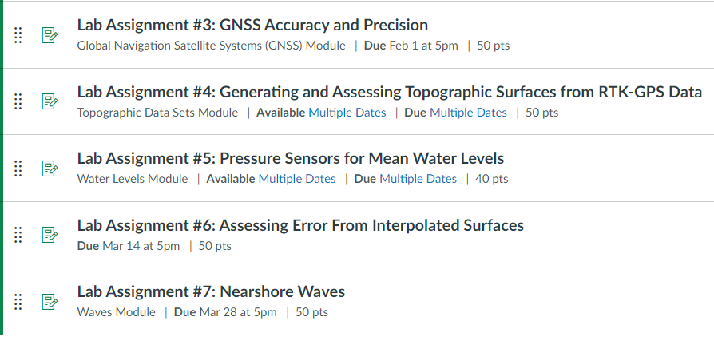
Course-Specific Labs
Scaffold the data collection (and code building) to develop competency in data analysis:
Survey benchmarks
Survey benchmarks + beach profiles
Survey benchmarks + beach profiles + waves
Survey benchmarks + beach profiles + waves + currents
Introduce some code functions through simple in-class examples and reinforce in lab assignments

Slide 6
Course-Specific Labs
Each lab has these three sections:
Orientation
Load and plot the data
Does it have the range of values that match your intuition (time, magnitude, etc.)
Is it in the right location?
What are the units?
Interpretation
What variability or pattern do you see?
Compare data from different sensors or locations
After filtering or interpolation or removing outliers, what signals do you see?
Synthesis
Do your observations of patterns match what you expect? Why or why not?
How would you change your sampling if you were to repeat the data collection?
What would the data look like if we sampled under a different condition?
Based on the known levels of instrument error what magnitude of signals can we detect?

