Slide 1
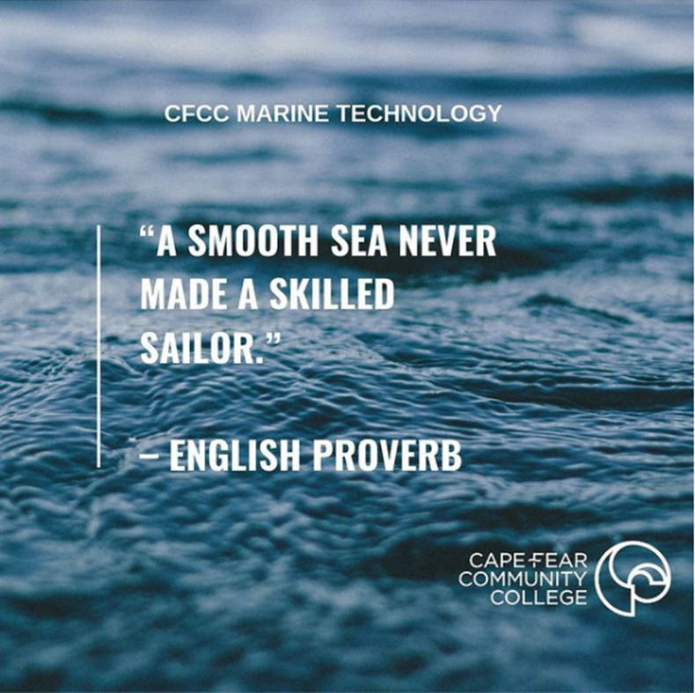
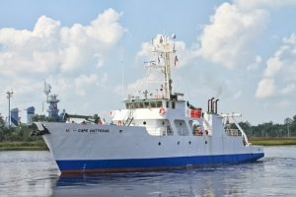
Target Audience
Cape Fear Community College
Marine Technology program (AAS)
Scientific Support
Critical Thinking
Quantitative Reasoning

Slide 2
OOI Workshops
Ocean Data Labs Development June 2019
Dynamic Air-Sea Interactions Data Exploration
Ocean Data Lab Notebook January 2020
Lab 5: Investigating Density and Stratification

Slide 3
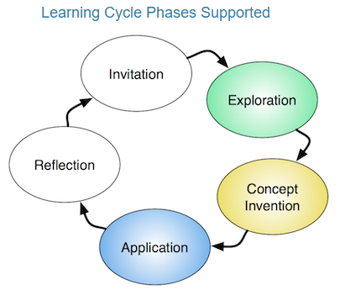
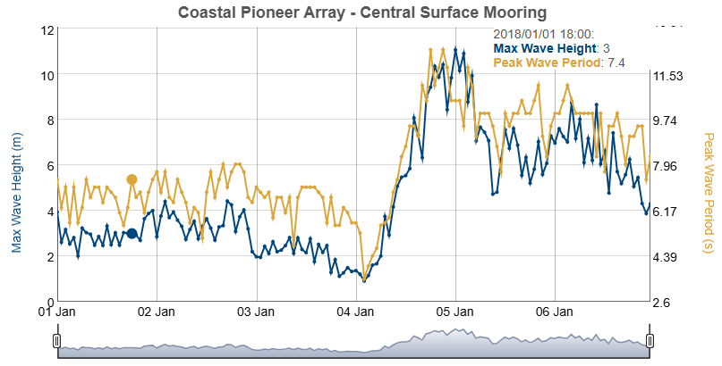

Slide 4
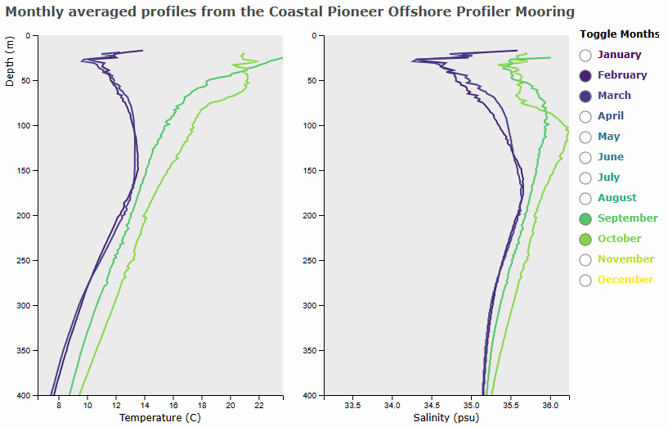

Slide 5
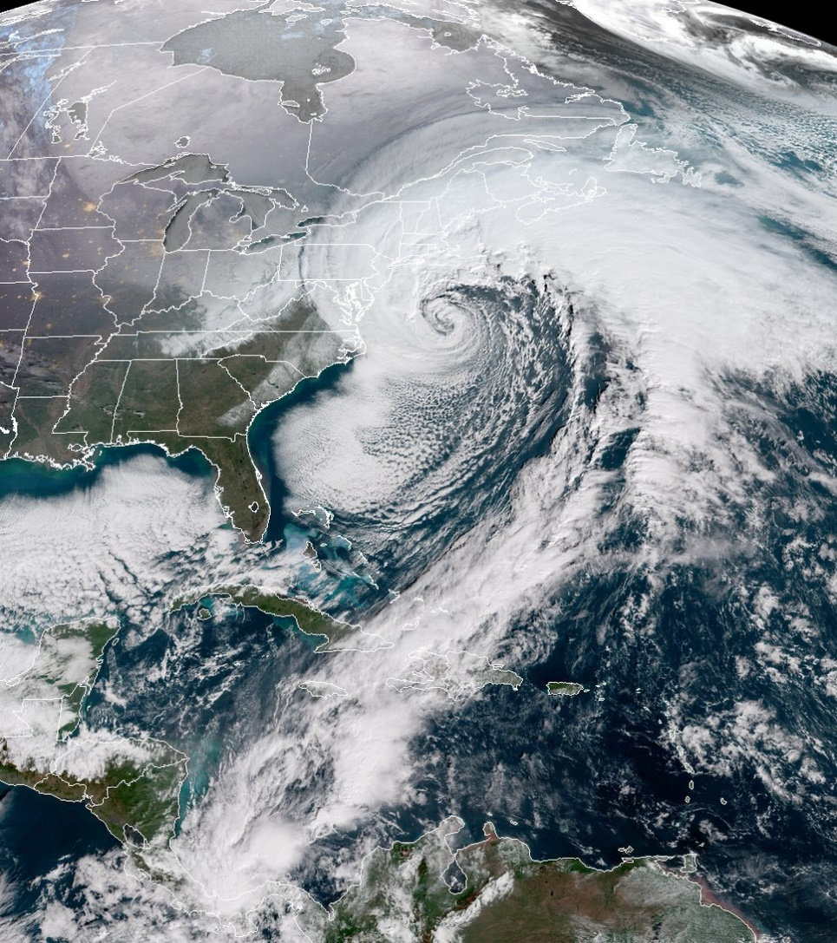
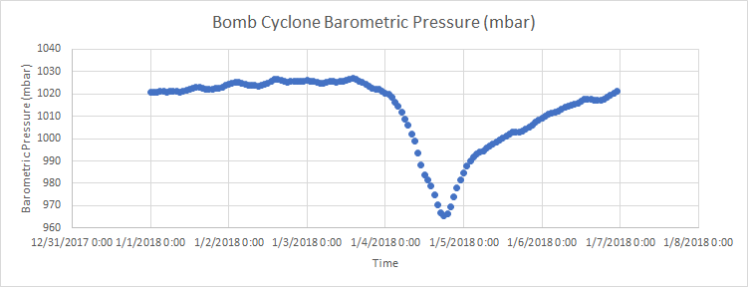
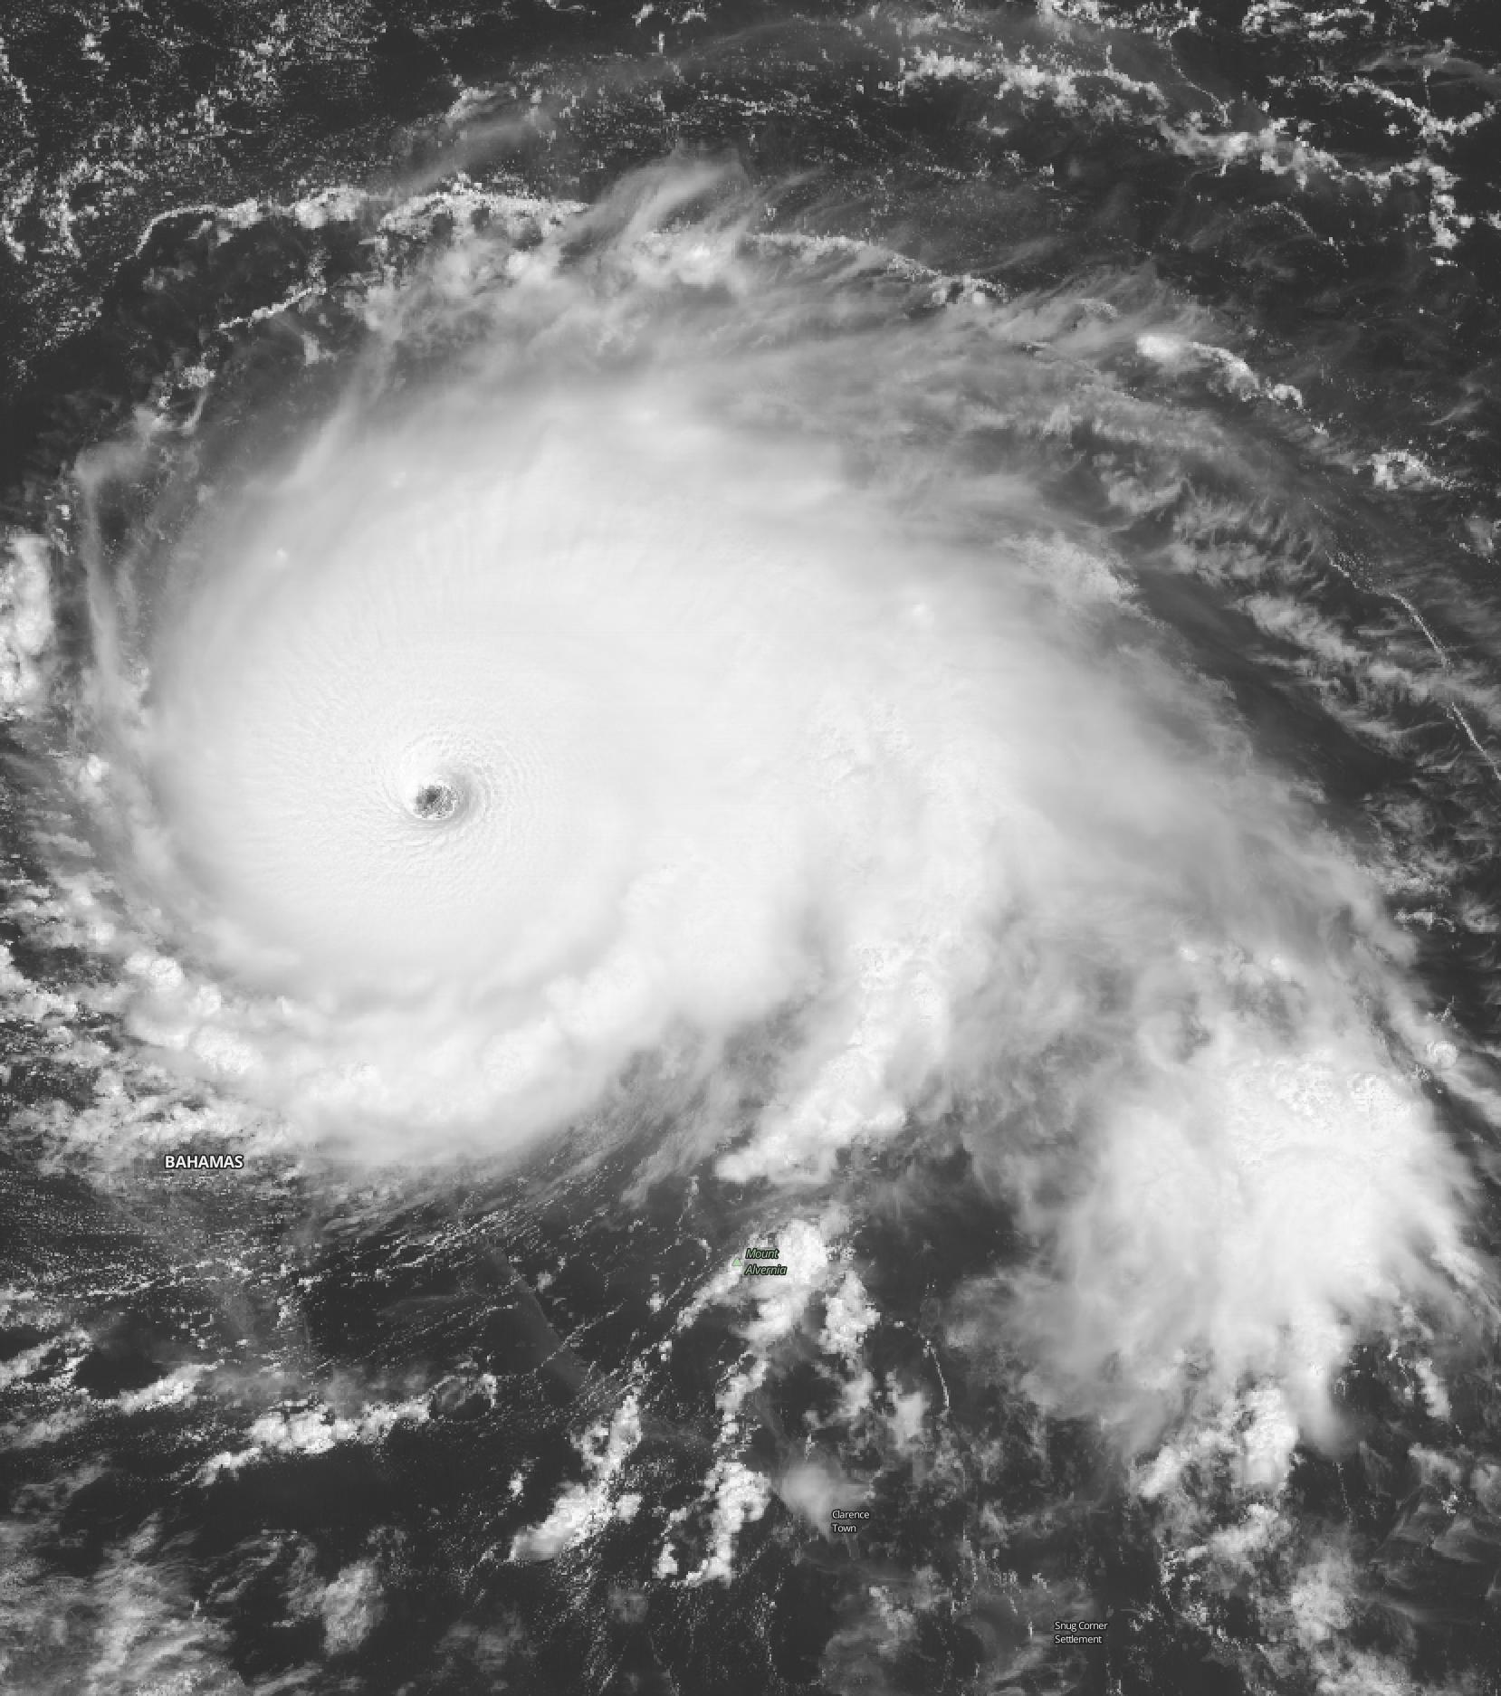
Bomb Cyclone 965 mb
Hurricane Dorian 962 mb

Slide 6
Implementation:
Introductory Oceanography
Face-to-face and asynchronous online
Class size 15-20; 3 sections
2-hour computer lab access weekly
Independent project
Successes:
Scaffolding Approach
Ease of use in LMS
Individuals & Groups
Roadblocks:
Technical Knowledge
“Messy” Data
Future Developments:
Increase use of Data Explorer
Adding Intro to Python

Slide 7
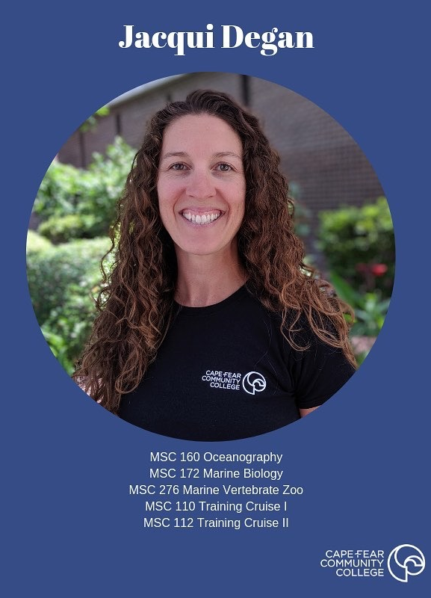
Questions?
Jacqui Degan
jdegan@cfcc.edu
(910) 362-7405

