Slide 1
OOI Labs In PHYS-121 Introductory Oceanography Lab
Karen Bridges
Howard Community College, Columbia, MD
kbridges@howardcc.edu

Slide 2
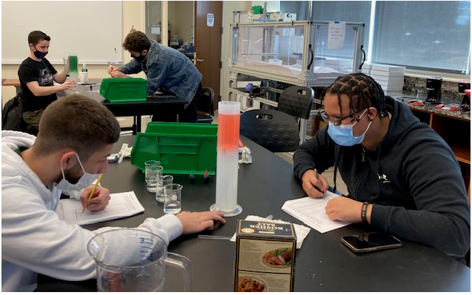
A Glance: Howard Community College & PHYS-121
Majority minority college
Average student 24 years old, 44% receive aid
13,000+ enrolled in 2023
Offered as a hybrid
1-credit GenEd science lab
Nearly all non-STEM majors
Used with Drivers of Seawater Density Exploration

Slide 3
In the beginning (FA 2021*)…
OOI Lab #3, Plate Tectonics and the Seafloor as an online lab
Put first two parts (seafloor features and plate tectonic settings) in Canvas as pages. Included interactives/quick check questions.
Made Canvas quizzes for open-ended Orientation/ Interpretation questions
*Class only had 7 students in it

Slide 4
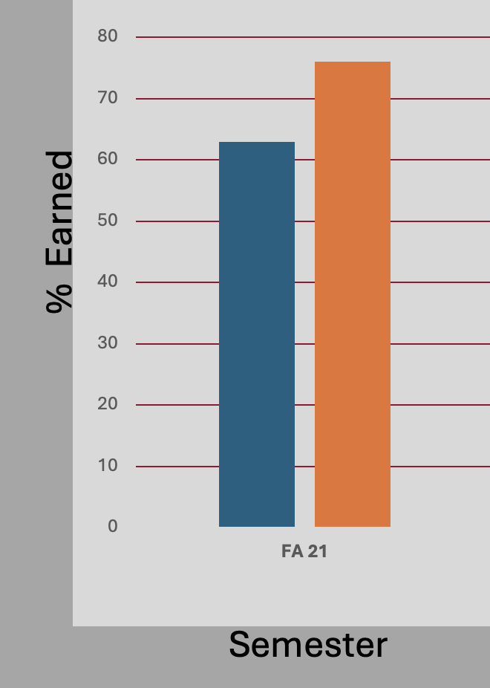
Lessons & Next Steps
Students were:
Afraid to guess
Uncomfortable with Plate Tectonic Theory
Didn’t understand all the questions
Thrown by an example that didn’t ”fit” (Pacific Northwest)
Not carefully reading the materials
Spring 2022:
Wrote a pre-lab assignment
Updated questions in my own voice
Added hints or encouragements to the questions
tectonic setting
seafloor features

Slide 5
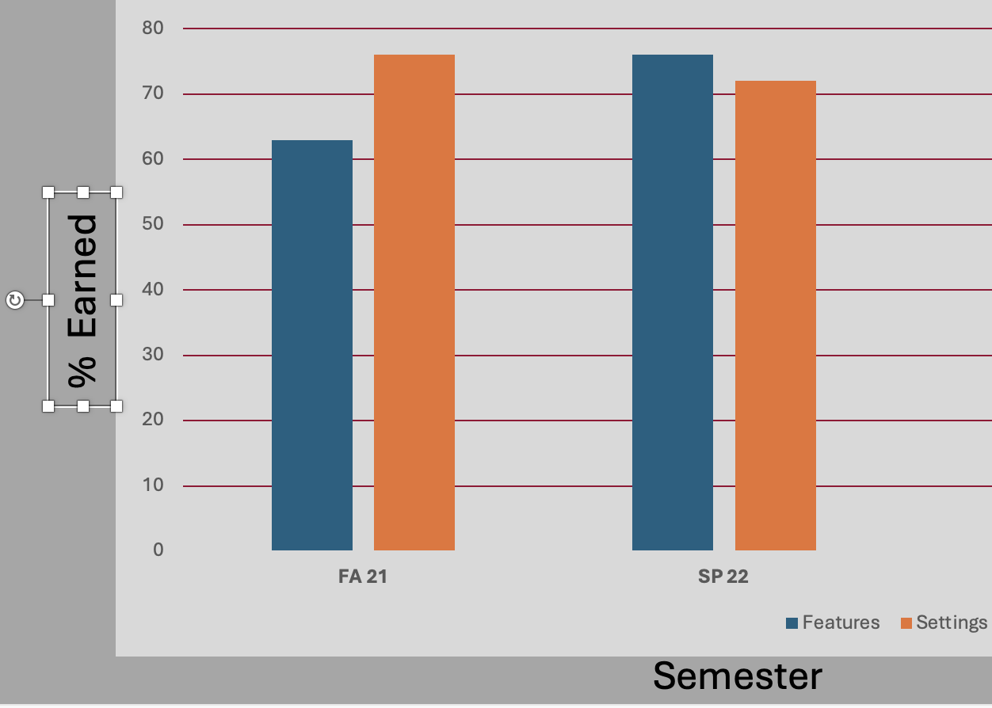
More Lessons & Next Steps
Continued redesign for fall 2022 and spring 2023:
Kept the pre-lab assignment
Ran the lab in-person
Reviewed tectonics together in lab based on pre-lab results
Had students work together
Worked through more challenging parts as a class, specifically the interpretation questions in the seafloor features section.

Slide 6
Outcomes
% Earned
Semester

Slide 7
Takeaways
Use the materials as a guide, adjust based on your own students’ strengths and weaknesses
Can combine data explorations with a fun hands-on activity in a face-to-face class (”sneaking in the data”)
Start small and keep making things more specifically address your own needs.

Slide 8
Thank you!
I’ve also used the following:
Lab 1. The Collection of Oceanographic Data (Part 3. lat/long exercise)
Former Lab 7. The Atmosphere and Wave Development
Lab 8. Mystery of the Dying Crabs
Data Exploration: Changes in salinity

