Slide 1
Data Labs 2024
June 2 - 5
Wilmington

Slide 2
Welcome!
Get into groups of 8!
Pick 2 cards that describe you and 1 that does not.
Take turns introducing yourselves and sharing your cards.
Image by bearfotos on Freepik

Slide 3
Your Facilitators
Janice McDonnell, Rutgers University
Sage Lichtenwalner, Rutgers University
Mitaali Taskar, Rutgers University
Dax Soule, Queens College SUNY
Kristin O'Connell, SERC, Carleton College
Mike Muglia, Coastal Studies Institute
Denise Bristol, Hillsborough Community College
Anna Pfeiffer-Herbert, Stockton University
Stace Beaulieu, Woods Hole Oceanographic Institution

Slide 4
Your Peer Presenters
Jean Anastasia, SUNY Suffolk Community College
Karen Bridges, Howard Community College
Jacqui Degan, Cape Fear Community College
Joe Long, UNC Wilmington

Slide 5
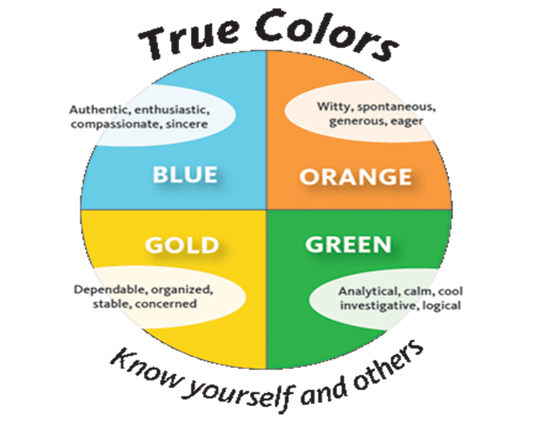
Notes:
Click to reveal

Slide 6
https://lifetickler.com/your-true-colors-test/
Notes:
Gold values family and tradition – follow rules and respect authority- faithful stable loyal and dependable.
Orange – witty, spontaneous and fun value independence and freedom - restless with routine/tradition
Blue – Warm compassionate, kind, value peace and flexibility – helping people and communication
Green – calm , cool collected, analytical – value perfection, conceptual and big thinking

Slide 7
Gold

Slide 8
Orange

Slide 9
Blue

Slide 10
Green

Slide 11
Four Corners
A
B
C
D

Slide 12
What method do you find most effective for teaching data literacy?
Hands on lab exercises using real-world datasets
Traditional lectures and theoretical discussions
Project based learning with real-world applications
Online tutorials and self paced learning modules

Slide 13
What are you hoping to get from this workshop?
Dedicated network of professors doing the same things
Experience with python/other software to analyze data sets
Curricula building pedagogical tools to use
Other

Slide 14
What data tool do you want your students to learn?
Excel, basic stats software
Specialized oceanographic software
Programming languages
Geographic Information Systems

Slide 15
How should data literacy be integrated into oceanography curriculum?
As a stand-alone course
Integrated into existing courses
Through workshops and seminars
Via collaborative research projects

Slide 16
Notes:
Break!

Slide 17
Key Workshop Objectives
During the workshop, participants will:
Learn about the OOI program and key science questions it addresses.
Explore how to use OOI Data Labs resources and effectively incorporate data-rich lessons into your classes.
Create a classroom Implementation plan that integrates OOI data into your teaching.
In addition, participants will:
Be introduced to methods for accessing and engaging students in OOI data directly (e.g. via the Data Explorer, Python notebooks, and ERDDAP) to support advanced data literacy skills building.
Network with other professors interested in using oceanographic data in undergraduate education.

Slide 18
Daily Agenda

Slide 19
June 2
Time | Topic
3:00 PM | Hotel Check In
4:00 PM | Welcome, Introductions
5:00 PM | Why Ocean Observatory Education?
5:45 PM | Dinner
6:45 PM | The OOI Today
8:00 PM | Back to the hotel!
Objective: Welcome & Introductions

Slide 20
June 3
Time | Topic
7:00 AM | Breakfast (Hotel)
8:30 AM | Cars Leave for UNCW
9:00 AM | Welcome, Announcements
9:15 AM | Teaching with OOI Data Labs
10:30 AM | Coffee Break
10:45 AM | Lightning Talks
12:00 PM | Lunch, Tour of UNCW Pier
Objective: Explore the Data Labs collection. Start building your classroom plan.

Slide 21
June 3
Time | Topic
1:30 PM | Intro to Implementation Planning
2:45 PM | Break
3:00 PM | OOI Infrastructure
4:15 PM | Reflection & Feedback
4:30 PM | Head to CFCC
5:00 PM | CFCC Tour
6:30 PM | Dinner
Objective: Explore the Data Labs collection. Start building your classroom plan.

Slide 22
June 4
Time | Topic
7:00 AM | Breakfast (Hotel)
8:30 AM | Cars Leave for UNCW
9:00 AM | Welcome, Announcements
9:15 AM | Tools for Visualizing OOI Data
10:45 AM | Coffee Break
11:00 AM | Pioneer Array Science
12:00 PM | Lunch, Tour at UNCW
Objective: Diving deeper to explore other ways to access OOI data for teaching.

Slide 23
June 4
Time | Topic
1:30 PM | Developing OOI Data Activities
3:00 PM | Break
3:30 PM | Implementation Planning
4:30 PM | Reflection and Feedback
6:00 PM | Dinner
Objective: Diving deeper to explore other ways to access OOI data for teaching.

Slide 24
June 5
Time | Topic
7:00 AM | Breakfast (hotel)
8:30 AM | Cars Leave for UNCW
9:00 AM | Share-a-thon
10:30 AM | Break
10:45 AM | Share-a-thon (cont.)
11:30 AM | Final Reflection & Feedback
1:00 PM | Box Lunches, Wrap Up
Objective: Reflection and looking forward! Educational share-a-thon on preliminary curriculum planning ideas.

Slide 25
Notes:
Break!

Slide 26
Let’s look at some data…
Note what skills you are using to answer the questions.
Think about what you are paying attention to
Reflect on how you arrive at your answers
Think about what you can/cannot answer

Slide 27
Group A
How much pagbo was there at vanni?
Is 74sts a normal amount of pagbo for inu? Why or why not?

Slide 28
Group B
How many c/d wolide had the system reached after 5 minutes?
Describe the relationship between roshest and wolidein this system.

Slide 29
Group C
Where are the most eemp found?
What causes the change in eemp moving from west to east (or, from Awm toward madisdays)?
Notes:
Nonsense Data Activity

Slide 30
Turn and Talk: Share out
Were you able to answer the questions on Handout A
What about the questions on Handout B
Were the questions easy or difficult?
Where did you find the information you needed?
What skills did you use to answer the questions?
What information would you need to answer your unanswered questions?

Slide 31
Reflection
How did this activity make you feel?

Slide 32
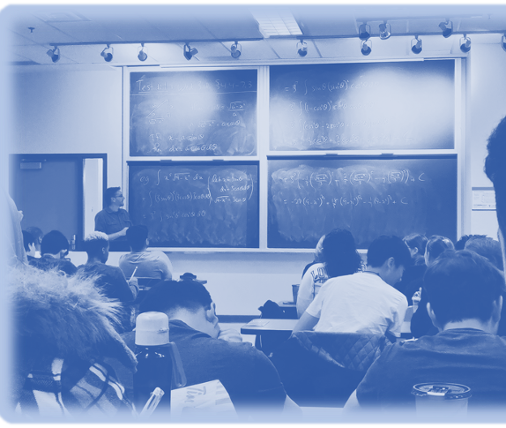
Fear and misrepresentation has replaced apathy as the number one enemy of data …

Slide 33
Data literacy is the ability to read data, work with data, and communicate about data by putting it in proper context.

Slide 34
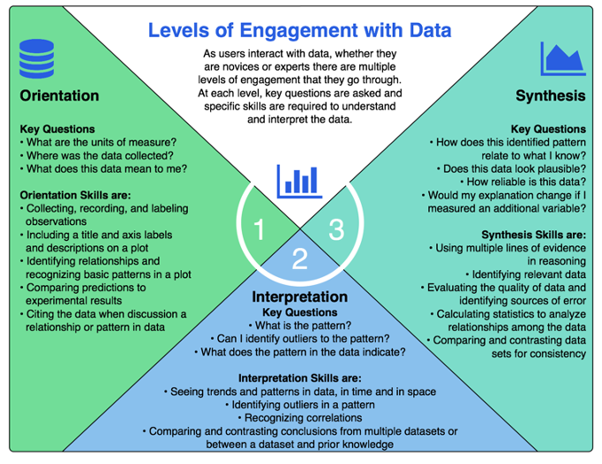
We need to help our students...
•Know where to start looking (orientation)
•how to make sense of what they see (interpretation)
•how to relate it to other concepts (synthesis)

Slide 35
The Question Formulation Technique (QFT)

Slide 36
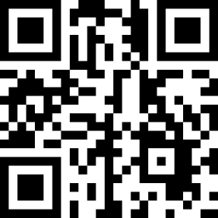
Changes in Salinity with Depth
https://go.rutgers.edu/lnnu3miv

Slide 37
Step 4- Improve your question(s).
Review the questions that you asked. Find at least one to label “C” for closed-ended or and at least one to label “O” for open-ended.
Closed-ended: can be answered with “yes” or “no” or with one word.
Open-ended: require an explanation and cannot be answered with "yes”, “no”, or one word.
Then, edit your post it using the pencil symbol and in the "write something" section, next to your initials, label it C or O.
THINK: What are the advantages and disadvantages of asking each type of question? (optional)
Share an advantage or disadvantage you see for Open and/or Closed questions. Add your first and last initial after any comments that you make.

Slide 38
Step 5- Prioritize Questions.
Read through all of the questions that have been posted. Pick the three questions that you might want to research further.
Put a dot at the end of a post to "vote" for it as a priority question.
THINK: What were your reasons for selecting those three? Share your rationale and reflect on your choices.

Slide 39
Further Investigation.
If you were going to answer your three priority questions right now, what are some possible next steps or avenues for investigation and further exploration?

Slide 40
Reflection
What did you learn?
How did you learn it?
What are you now wondering about?

Slide 41
What did we accomplish?
Identify as a learner what it is like to work with unfamiliar data
Nonsense Data Activity
Explore ways to identify common experiences and misconceptions about data
Four Corners
Experience scientific inquiry and asking questions like scientists
QFT

Slide 42
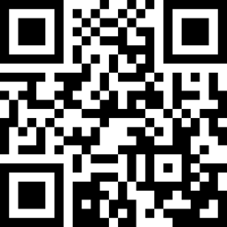
Homework
Watch this video and tell us tomorrow how this relates/does not relate to scientific inquiry and working with data.
https://go.rutgers.edu/xs5jy3nb

