Slide 1
Data Labs 2024
June 2 - 5
Wilmington

Slide 3
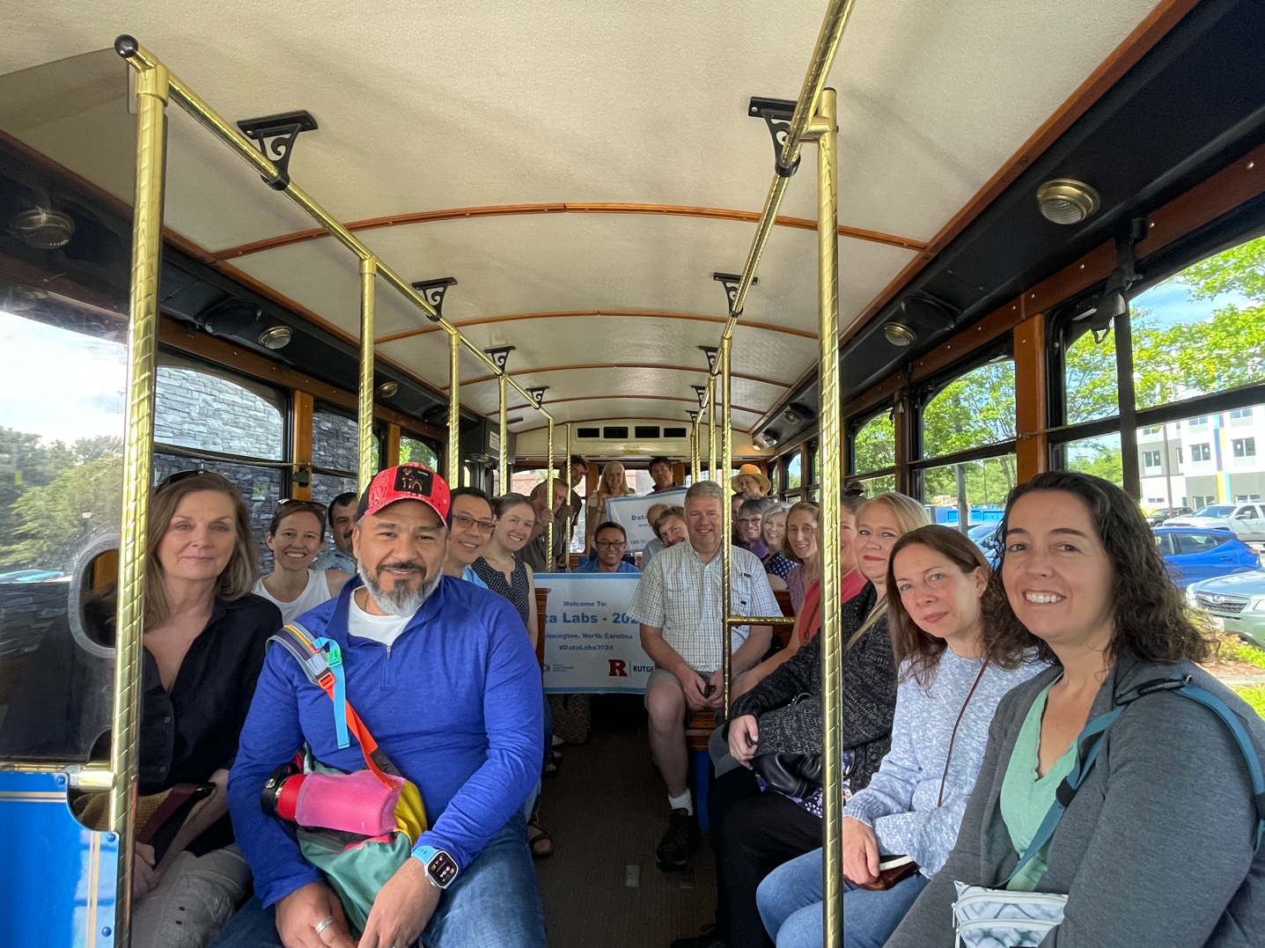

Slide 4
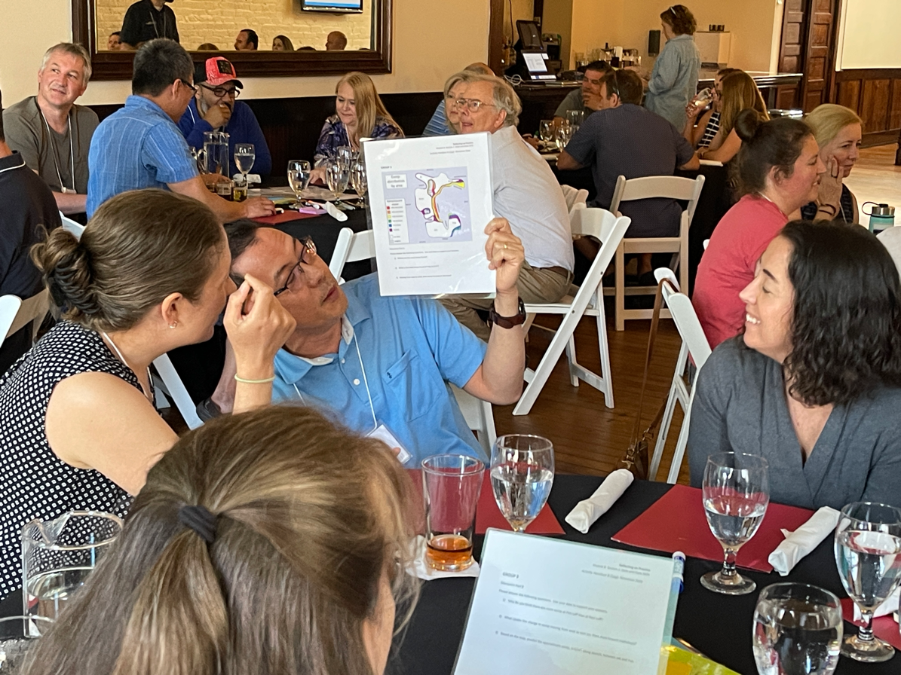
What did we accomplish?
Day 1
Identify as a learner what it is like to work with unfamiliar data
Nonsense Data Activity
Explore ways to identify common experiences around data
Four Corners
Experience scientific inquiry and asking questions like scientists
QFT

Slide 5
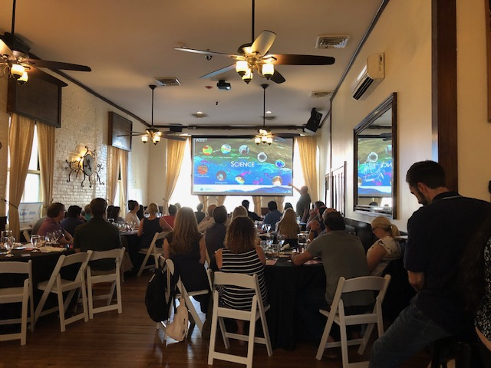
Learn about OOI with Dax!

Slide 6
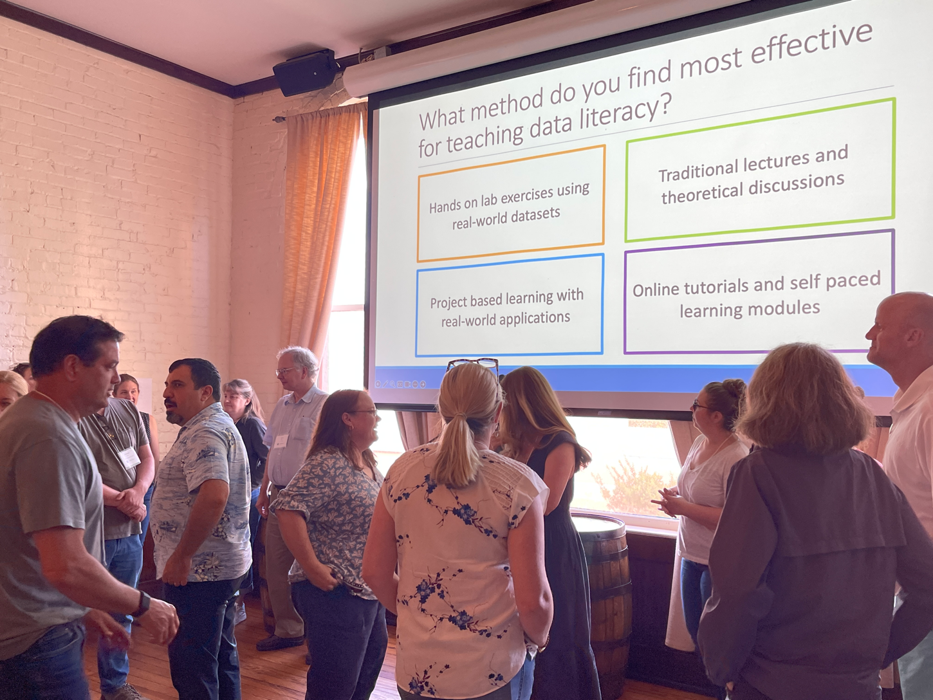

Slide 7
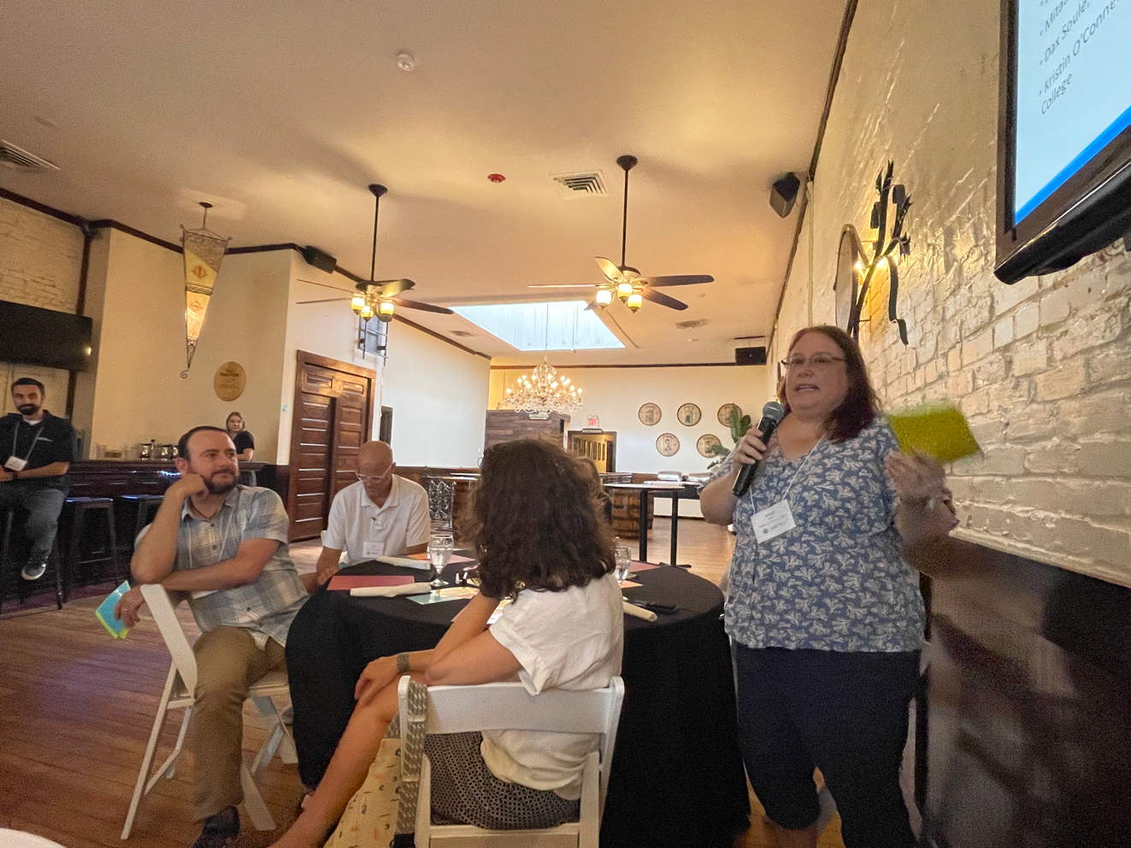
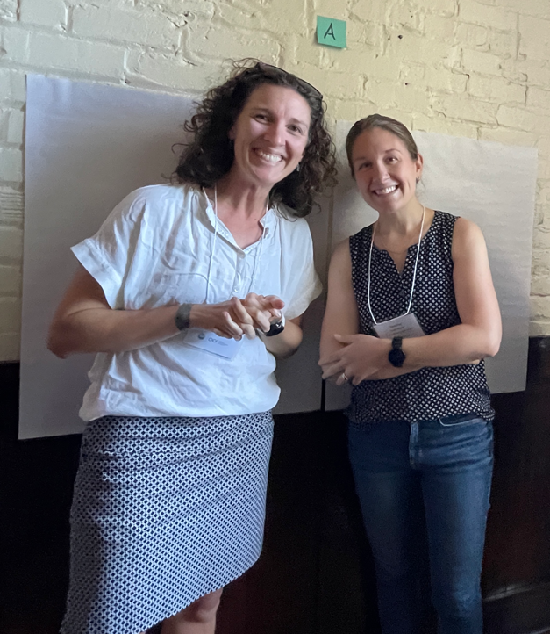

Slide 8
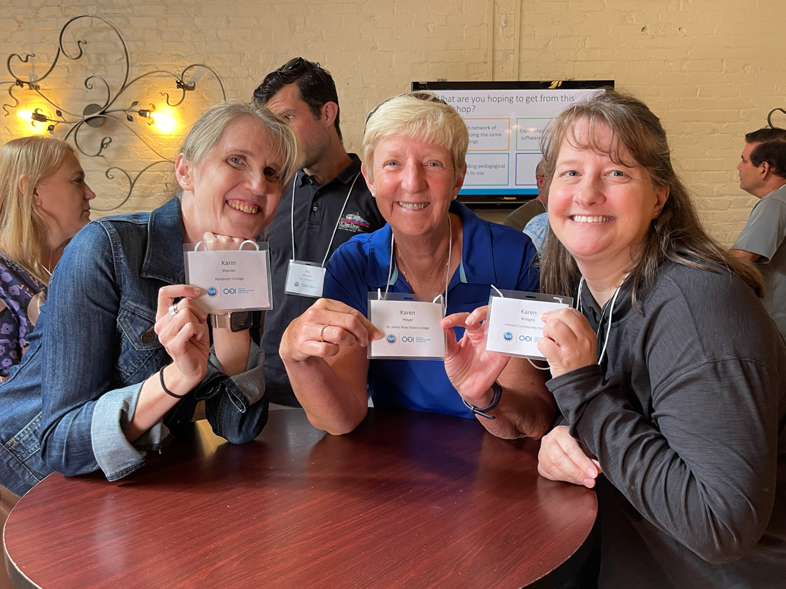
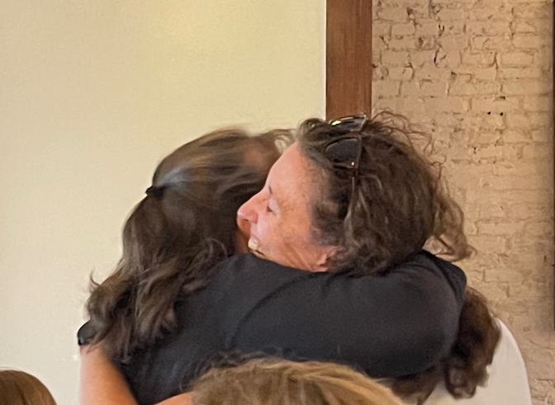

Slide 9
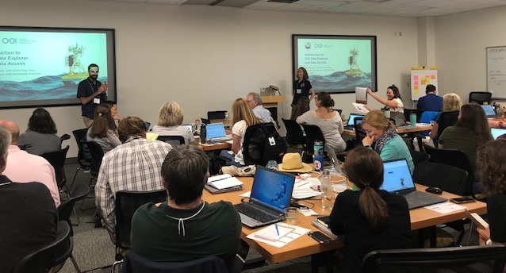
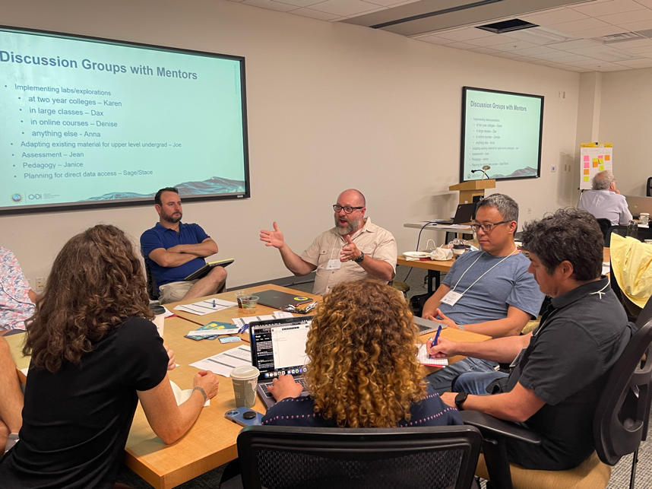
Day 2
Discuss philosophy, content, modalities, and alignment with oceanography curriculum.
Explore OOI Data Labs resources
Understand how the OOI can be integrated into undergraduate teaching.
Peer faculty presentations/lightening talks
Explore and expand on data platforms, instrumentation, data discovery and access.
Explore the Data Explorer
Tour of UNCW Pier and Cape Fear Community College and be impressed!

Slide 10
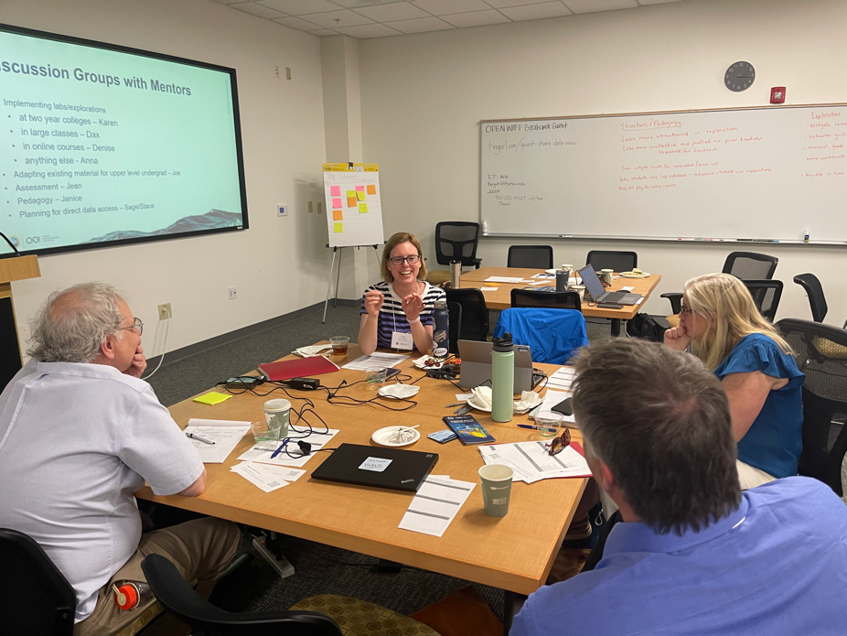
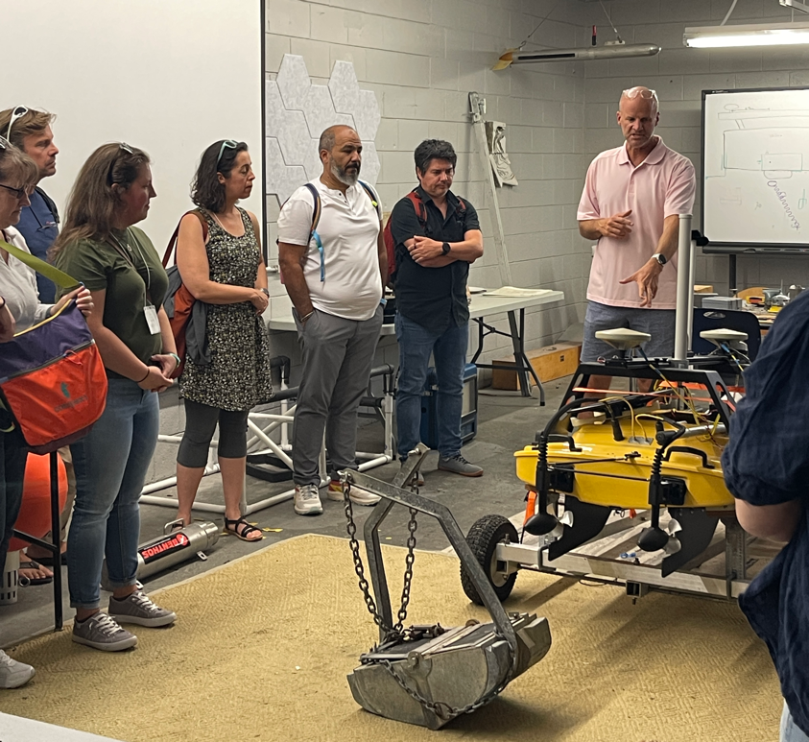

Slide 11
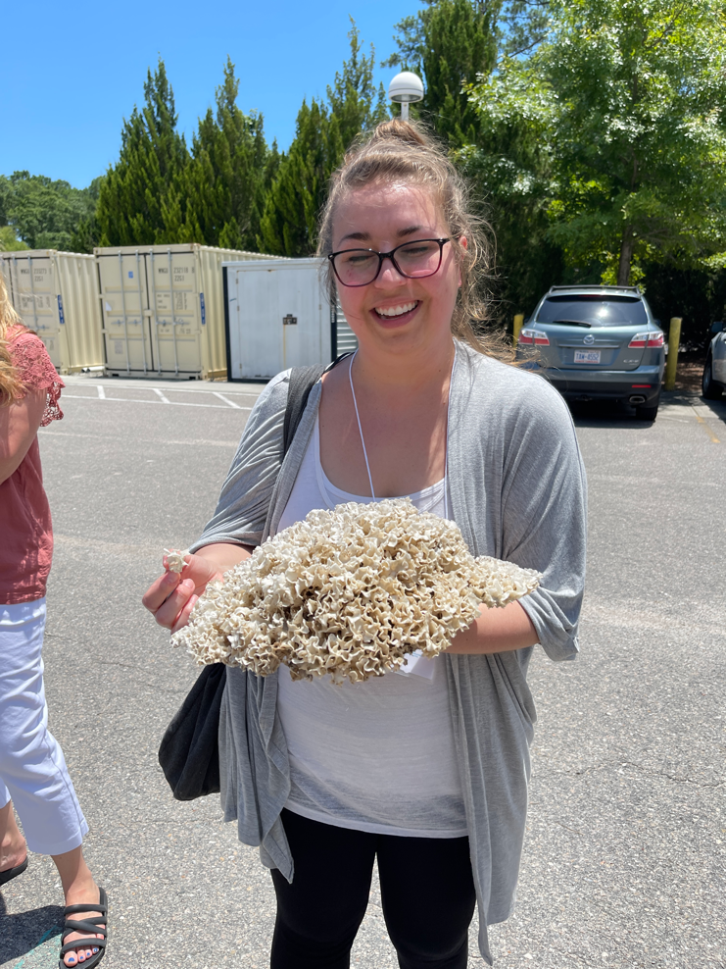
Day 3
Access and visualize OOI datasets
Explore the OOI ERDDAP server
Visualization OOI datasets for analysis, particularly from the new Pioneer MAB Array.
Introduction to how Python notebooks
Explore Pioneer Array science with Mike Muglia!
Implementation planning
Tour the instrumentation labs and be impressed!

Slide 12
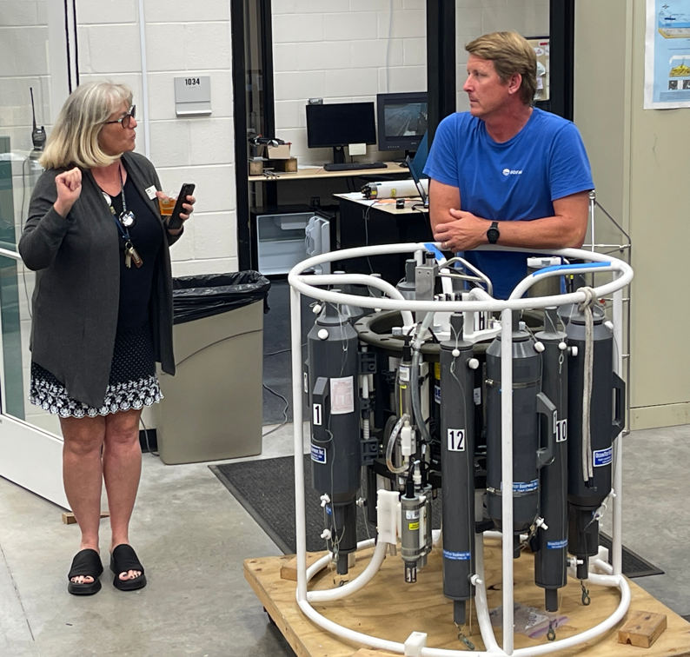
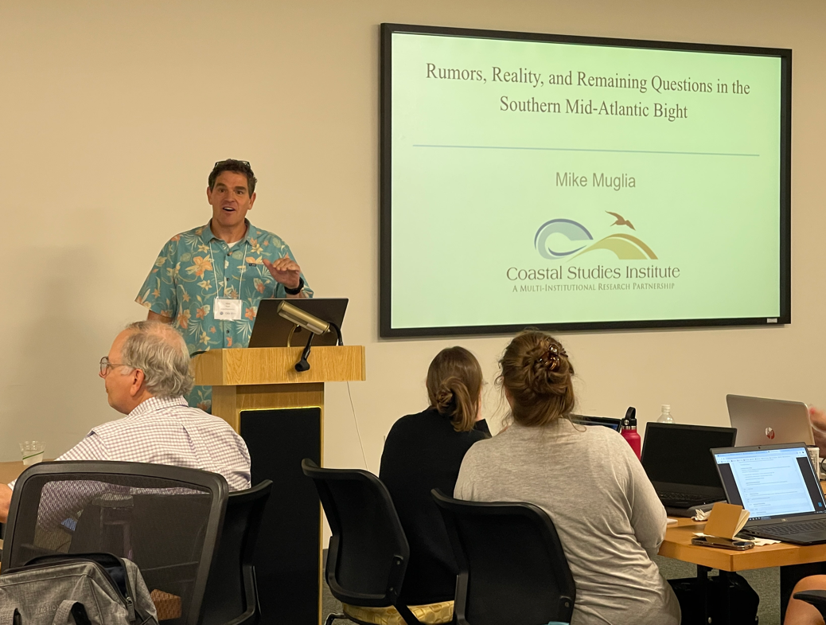

Slide 13
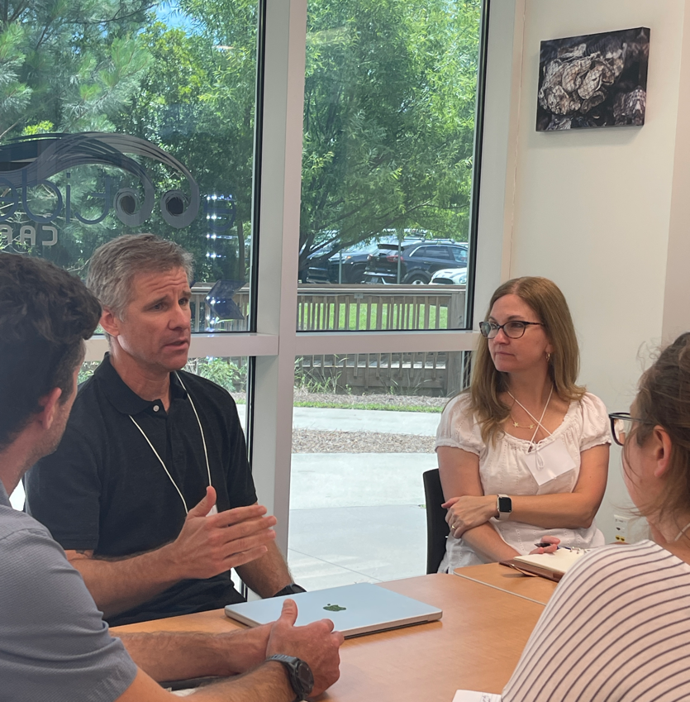
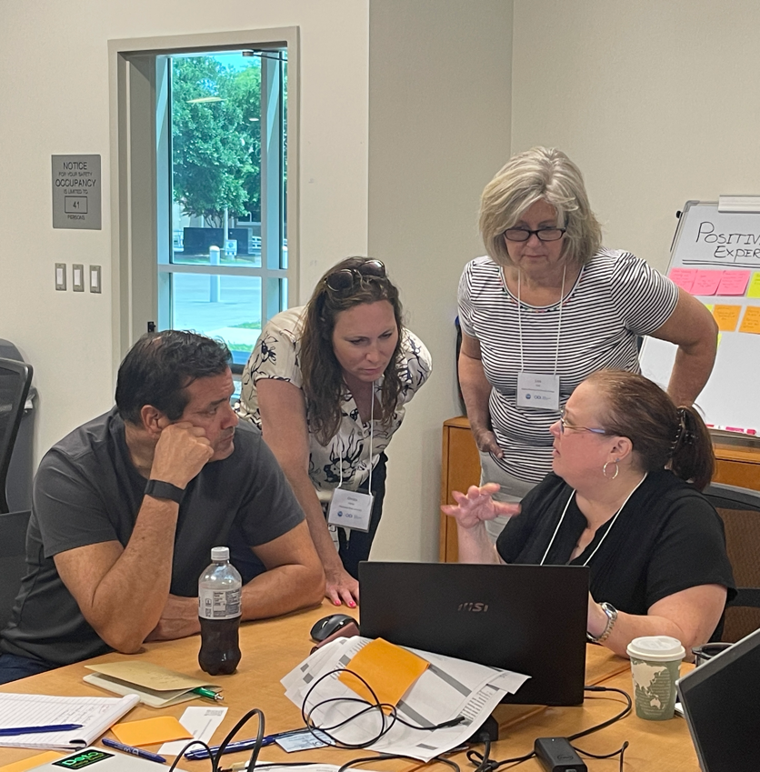

Slide 14
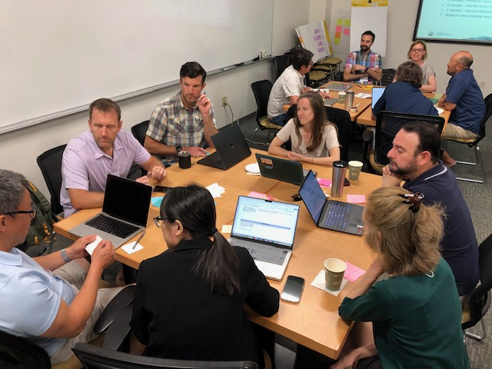
Day 4
Build a peer community and learn from each other
Sharathon

Slide 15
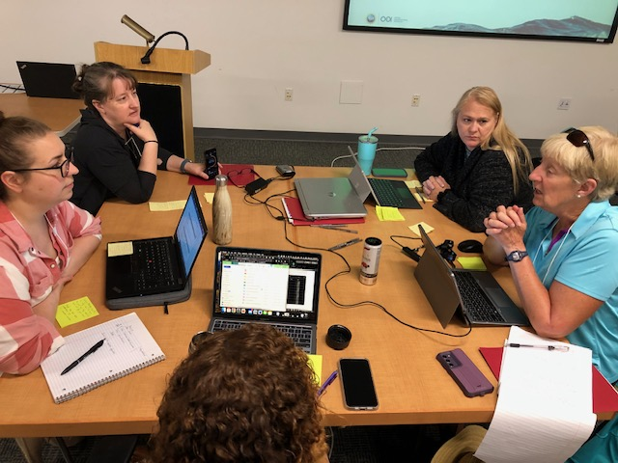

Slide 16
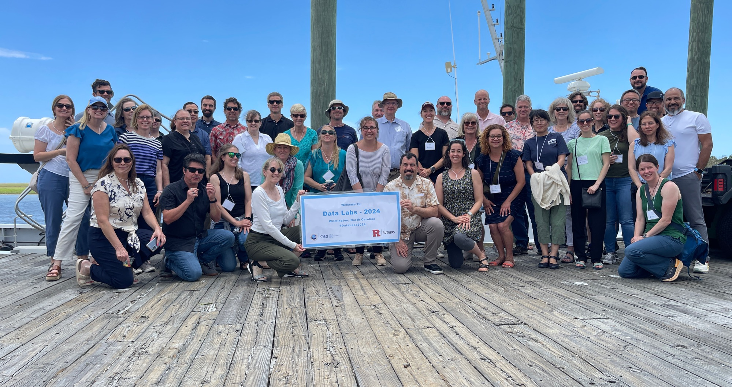
Thank you!

Slide 17
Next Steps, Action Items and House Keeping
Communications
Dean letters
Moving forward how do we communicate?
Newsletter
Workshops, Meetings and Webinars
Timing
Location
Additional Resources
Assessment
Coding/Python

