Slide 1
Advanced tools for Accessing and Visualizing OOI Data for Education
Sage Lichtenwalner & Dax Soule
OOI Data Labs Mid-Atlantic Workshop
June 4, 2024

Slide 2
Session Outline
Advanced data activities (10 min)
ERDDAP Data Servers (15 min)
Playing with Python (30 min)
OOI Jupyter Hub Demo (15 min)

Slide 3
Advanced Data Activities

Slide 4
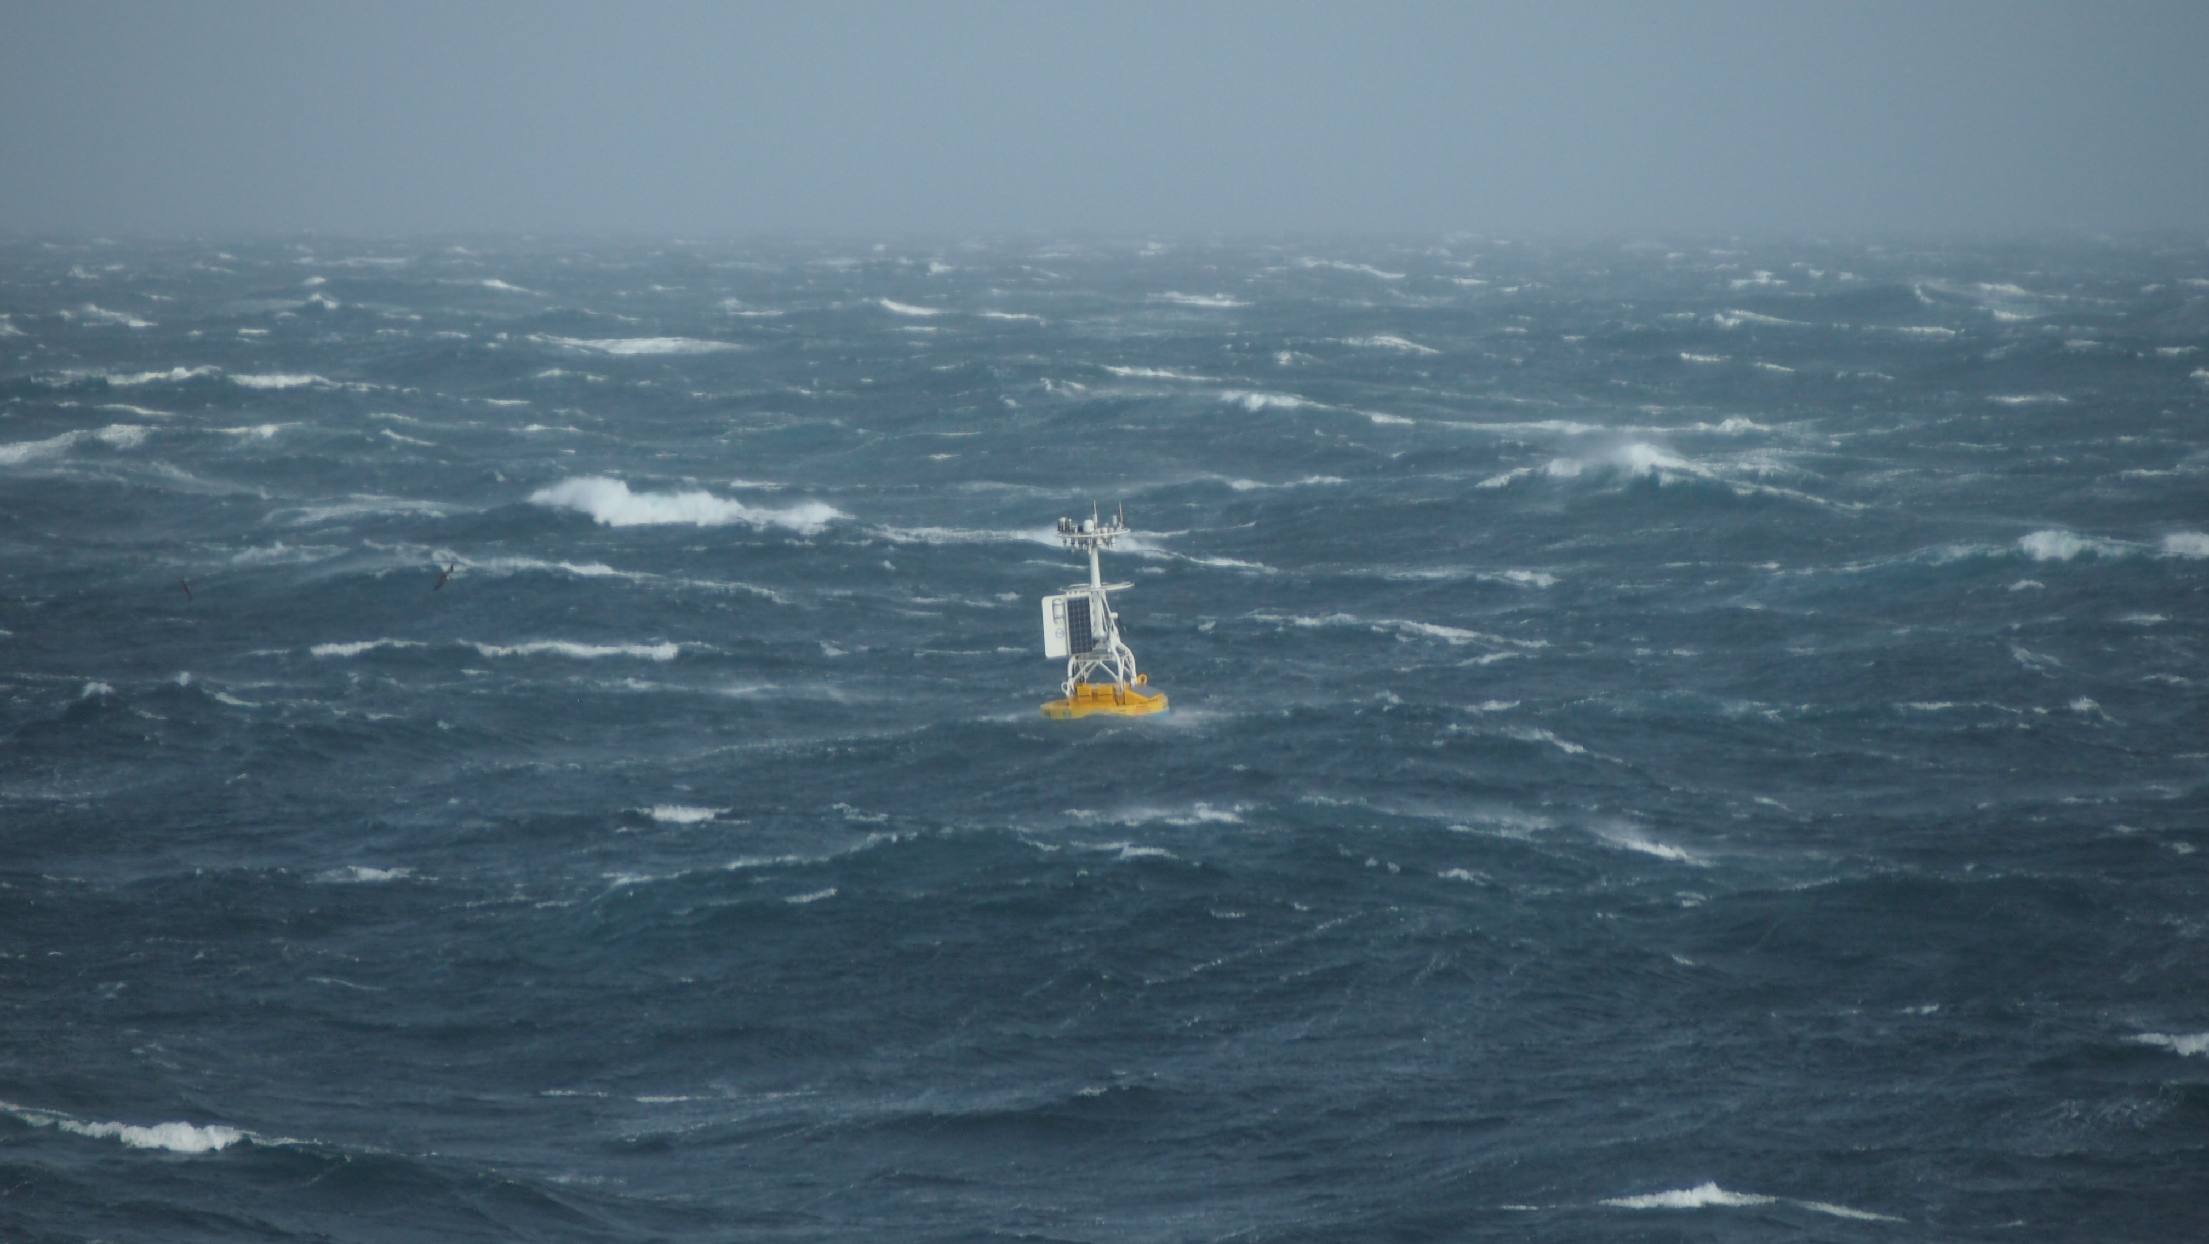
Figuring out the Ocean:
A Big Data Problem

Slide 5
Why do we have Observatories?
Is this real?
Observatories help us monitor events:
In real-time
With multiple instruments
From many perspectives and locations at once
They can also help us better understand the features and patterns we observe.
What happened here?

Slide 6
The Value of Comparing Data
Weather data shows the timing of a storm.
SST data shows a warm core ring

Slide 7
OOI Data Labs 2.0
OOI Data + Science
Data Science Coding/Python
Education
Data
Explorations
Data
Workshops
?
Data Sci
Bootcamps

Slide 8
Time for a programming therapy session
Notes:
Image from http://chatbots-agency.at/tintin_portfolio/eliza-chatbot/

Slide 9
How comfortable are you in incorporating oceanographic datasets into your teaching?

Slide 10
Survey Results

Slide 11
Pre-Survey: Research Experience

Slide 12
Pre-Survey: Teaching Experience

Slide 13
Data Labs Resource Collection
Want a ready-made lesson plan incorporating OOI datasets?
Want a series of lab activities with built-in student assessments?
Want a modular set of activities that you can adapt?
Want to start from scratch using curated OOI datasets?
Lesson Plans
Online Lab Manual
Data Explorations
OOI Nuggets
Ideal for introductory undergraduate majors or non-majors
Ideal for intermediate undergraduate majors or non-majors
Ideal for upper-level undergraduate majors or graduate level
More guided
More open-ended
Explore the collection: datalab.marine.rutgers.edu/data-labs/

Slide 14
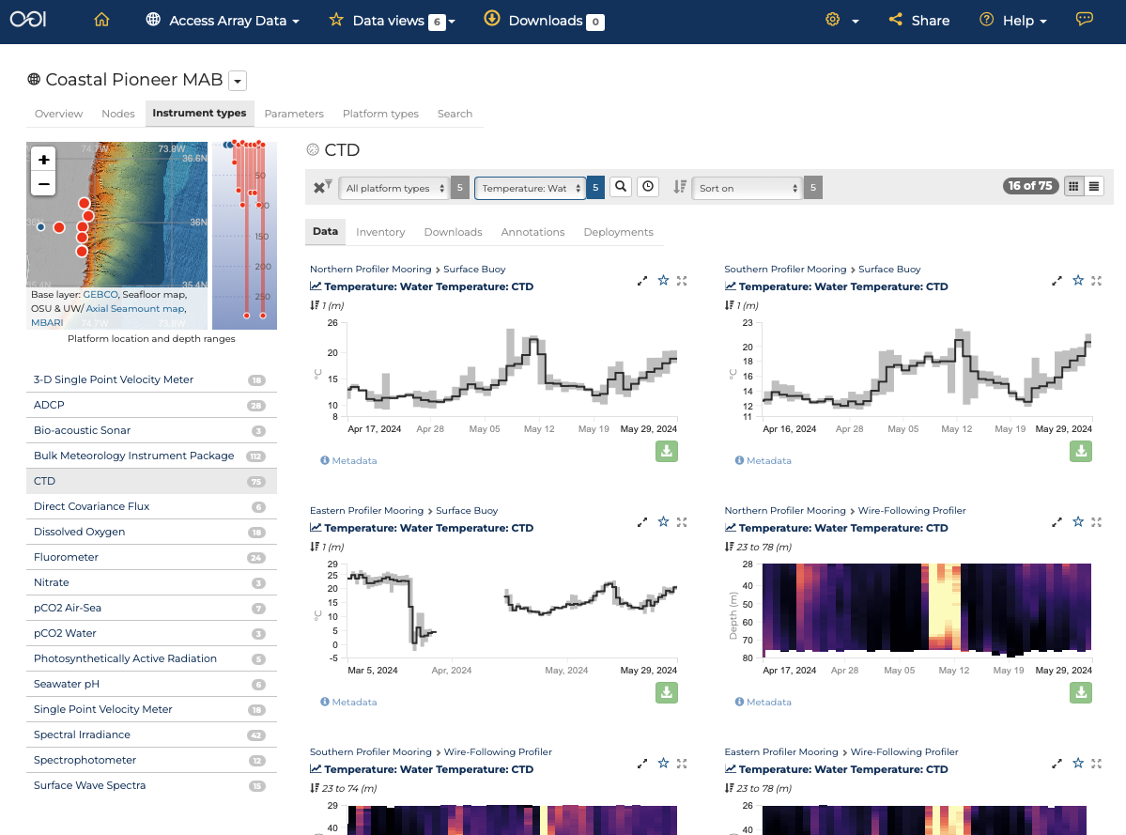
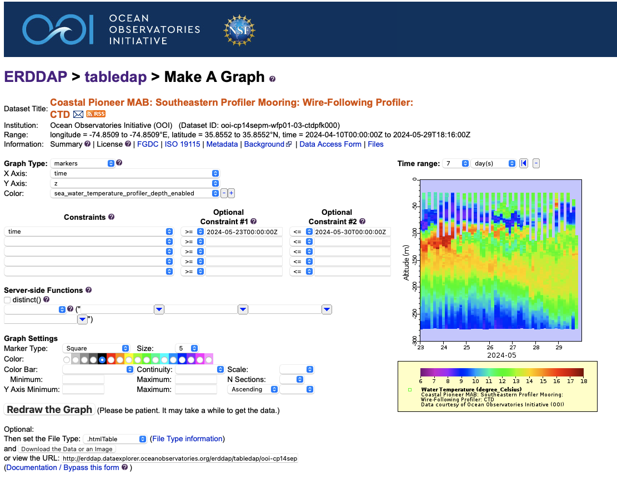
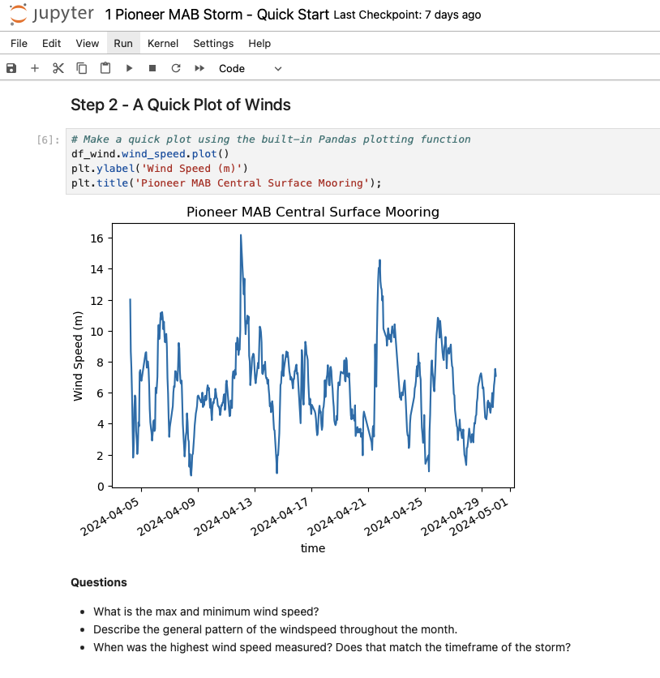
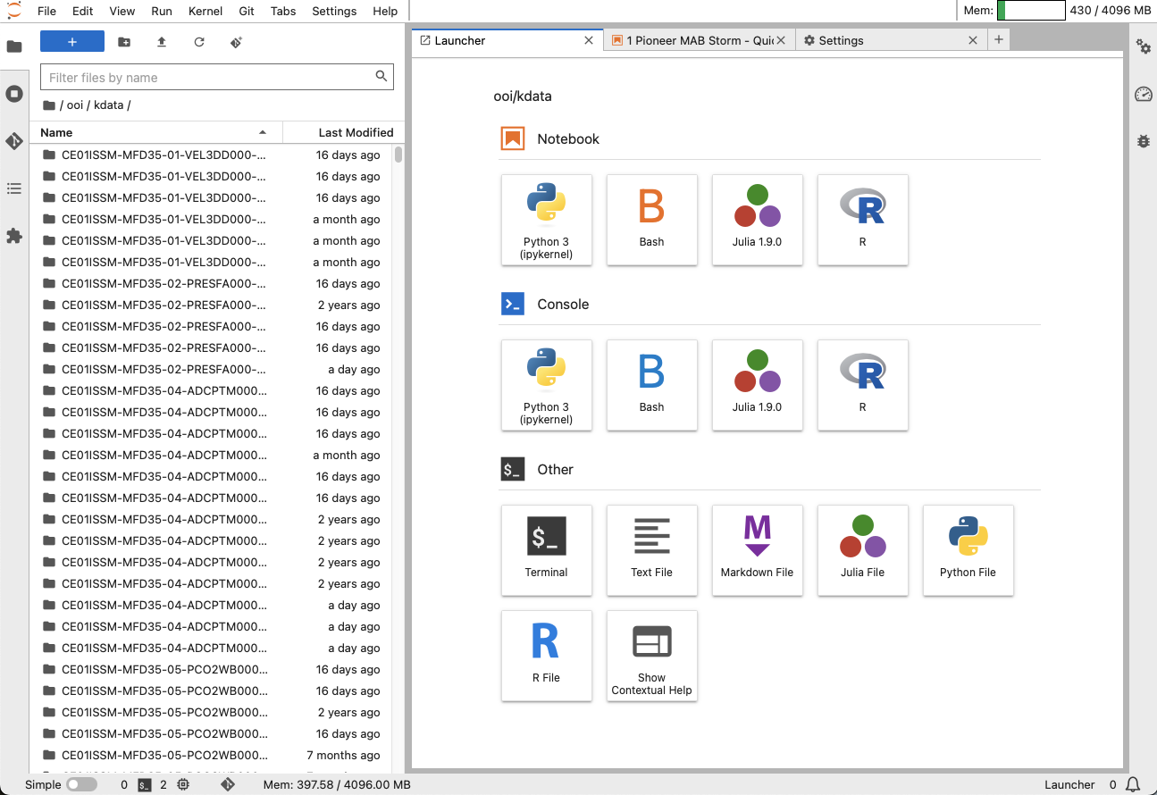
Advanced Data Tools
OOI Data Explorer
ERDDAP Data Servers
Coding Notebooks
OOI Jupyter Hub

Slide 15
Advantages of going further…
Educational Possibilities
Develop your own activities
Advanced activities allow students to gain experience
Working with data (Data Literacy)
Using data portals
Making their own graphs (Visualization Literacy)
Student can conduct their own research projects (Scientific Literacy)
Data Access Points
Data Explorer
Graphs, Downloads, Data Views
ERDDAP
Quick graphs, Data downloads
DIY Coding (R, Python, Matlab)
Custom graphs
Advanced data processing (averaging, correlations, anomalies, etc.)

Slide 16
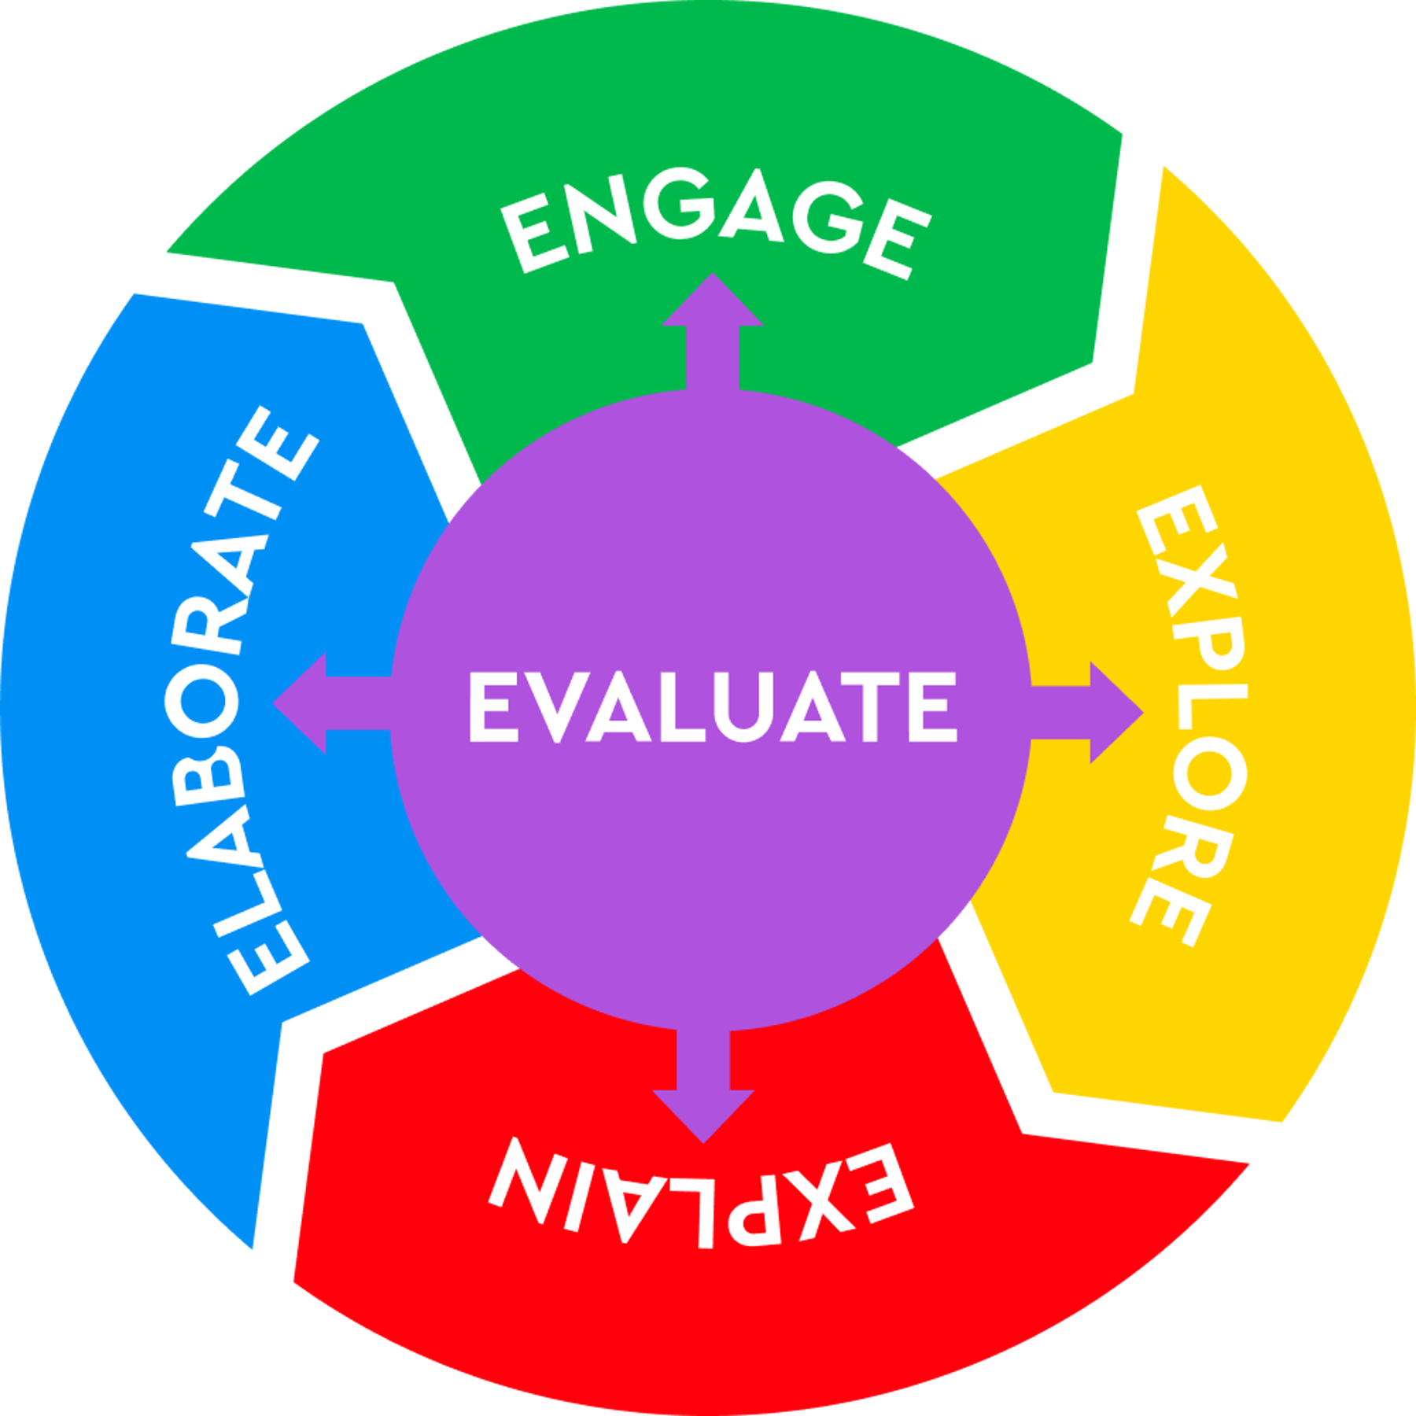
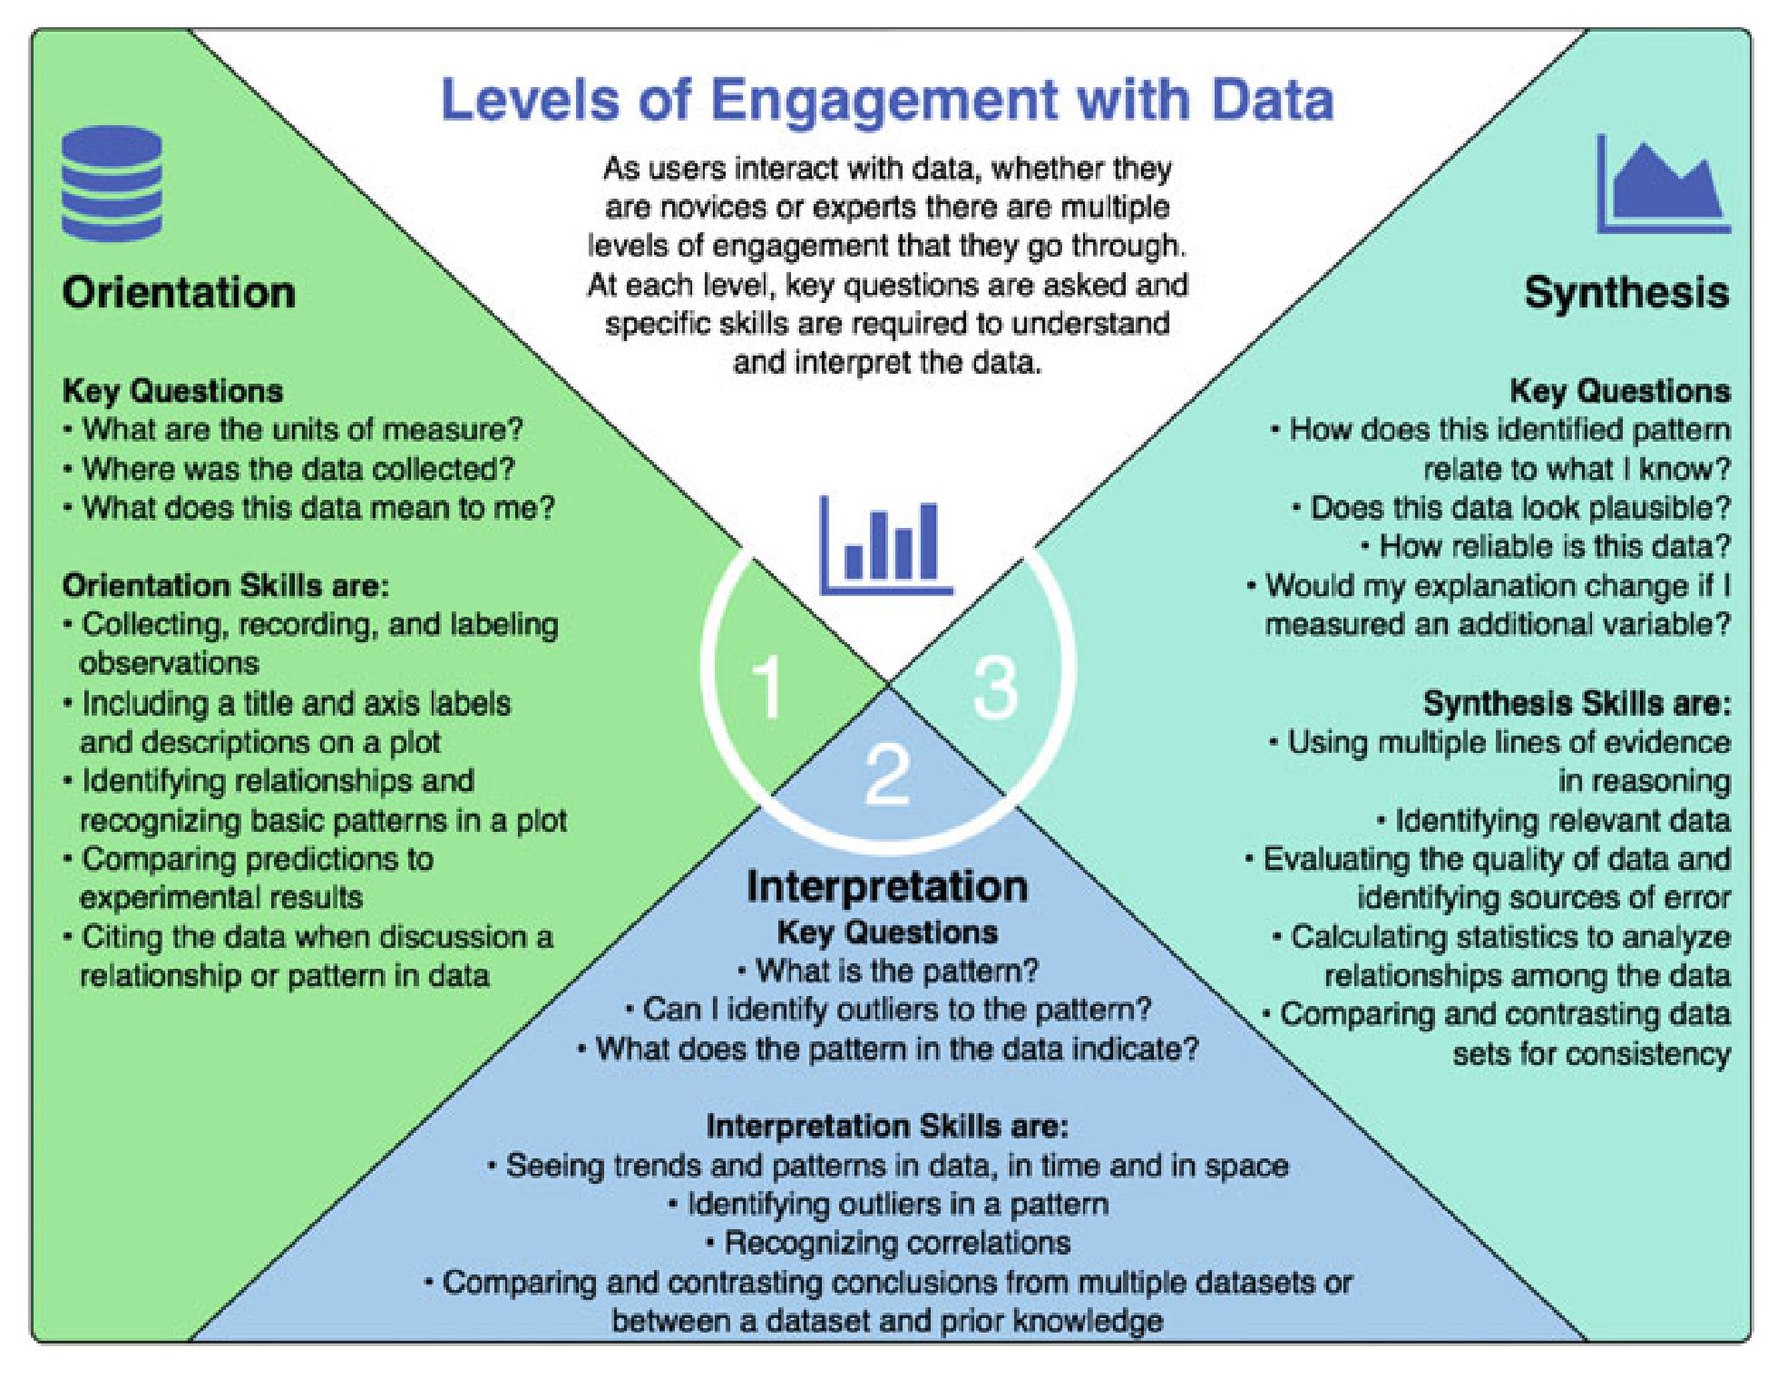
Pedological Approaches
Guided Inquiry, Constructivism
Learning for Use (Edelson 2001)
Motivate, Construct, Apply/Refine
Bybee 5E Instructional Model
Engage, Explore, Explain
Levels of Engagement (Hotaling 2019)
Orientation, Interpretation, Synthesis
PRIMM Teaching Model
Paired Programming

Slide 17
ERDDAP Introduction

Slide 18
Advantages of learning Erddap
Lots of oceanographic data servers use it!
Standardized access
Simple forms (once you get the hang of it)
Can design a human-readable and human-editable URL
Great for scripting or sharing links
Common data formats
NetCDF, CSV, .MAT
Quick images (though not great)

Slide 19
ERDDAP Resources
OOI Data
https://erddap.dataexplorer.oceanobservatories.org
Gliders, including OOI
https://gliders.ioos.us/erddap/
Pacific CoastWatch (includes NDBC data)
https://coastwatch.pfeg.noaa.gov/erddap/
And many others
https://github.com/ioos/erddapy/blob/main/erddapy/servers/erddaps.json
Coding Libraries
Rerddap https://docs.ropensci.org/rerddap
Erddapy https://ioos.github.io/erddapy

Slide 20
ERDDAP Demo
Index page
List of datasets
Search for “mab temperature”
Find Central METBK-A
Demo Graph Page
Overview: Dataset ID, Metadata Page
Make a time series graph of air temp – change to line – filter time
Download data option (html, csv, image) – Only one variable
Demo Data Page
Toggle variables. Time range filter. Select output format. Download or URL
Search for “mab profiler ctd”
Find Southeastern and demo profile plot – change markers, color scale, direction

Slide 21
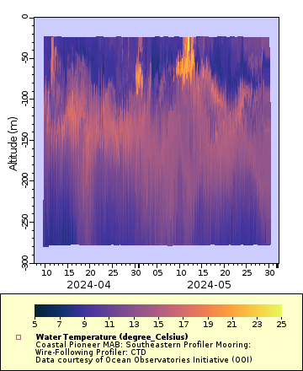
Your challenge…
Make a graph of some Pioneer MAB data you’re interested in
Send a link to sage@marine.rutgers.edu

Slide 22
“Jupyter” Notebooks
In Python, R and other languages

Slide 23
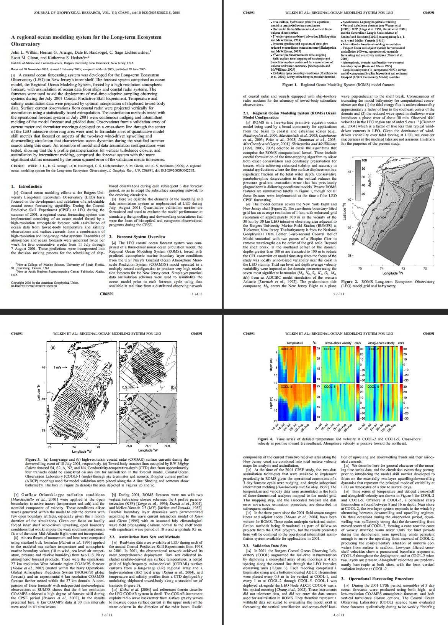
The Scientific Paper Is Obsolete. Here’s what’s next.
The Atlantic, 2018
https://www.theatlantic.com/science/archive/2018/04/the-scientific-paper-is-obsolete/556676/

Slide 24
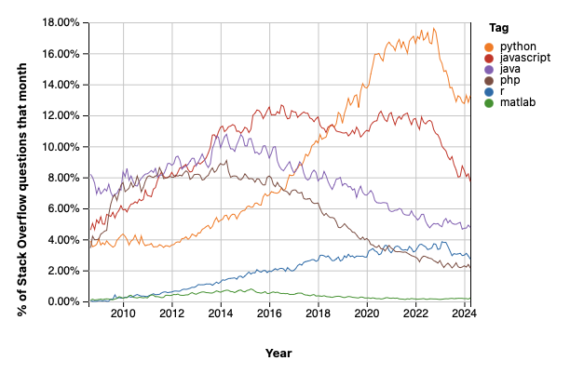
Why Python?
Stack Overflow Question Trends
Designed to be easy to use, learn, and understand
Very readable code
Flexible yet powerful programming language
Large community of support
Many scientific libraries
Open source – Free!
Named for Monty Python
Python is still on top! But ChatGPT is likely cutting into the search results.
https://insights.stackoverflow.com/trends

Slide 25
The Python Ecosystem
Python - The base language
Numpy - Arrays, fast operations on arrays
Scipy - higher level computational routines
Matplotlib - plotting
Pandas - data analysis
Xarray - Multi-dimensional arrays
Jupyter Notebooks
Notes:
Caption: The Python Data Stack. Source: Jake VanderPlas, “The State of the Stack,” SciPy Keynote (SciPy 2015).
From https://pangeo-data.github.io/about/

Slide 26
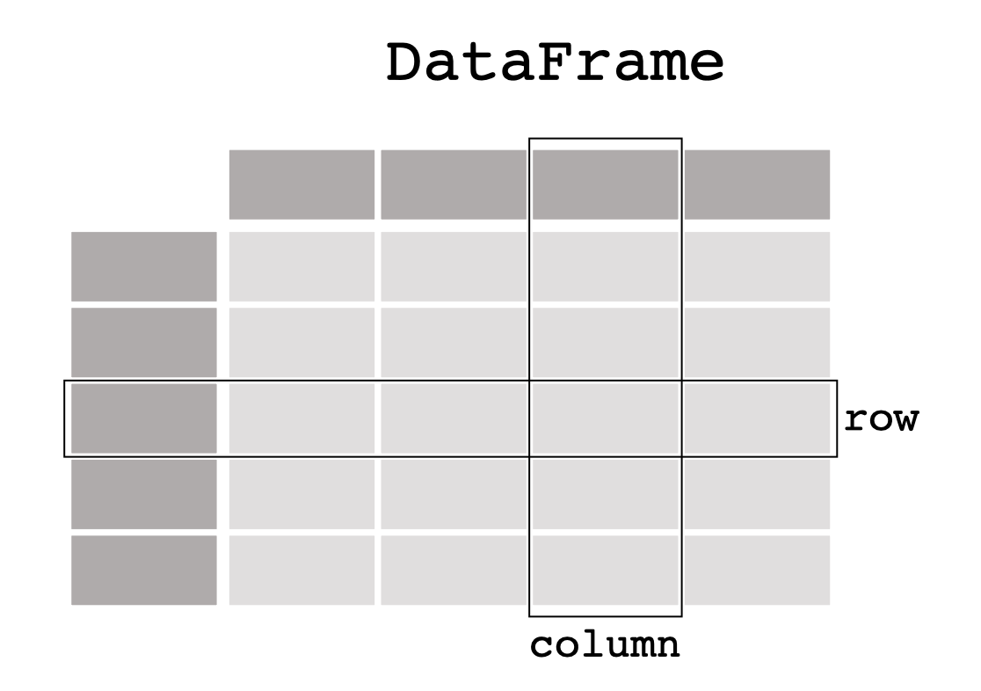
Pandas works with data in “spreadsheet” form
https://pandas.pydata.org/docs/getting_started/intro_tutorials/01_table_oriented.html

Slide 27
Xarray can handle complex data structures
http://xarray.pydata.org/en/stable/data-structures.html

Slide 28
Is Python Magic?
XKCD 353: Python
December 5, 2007

Slide 29
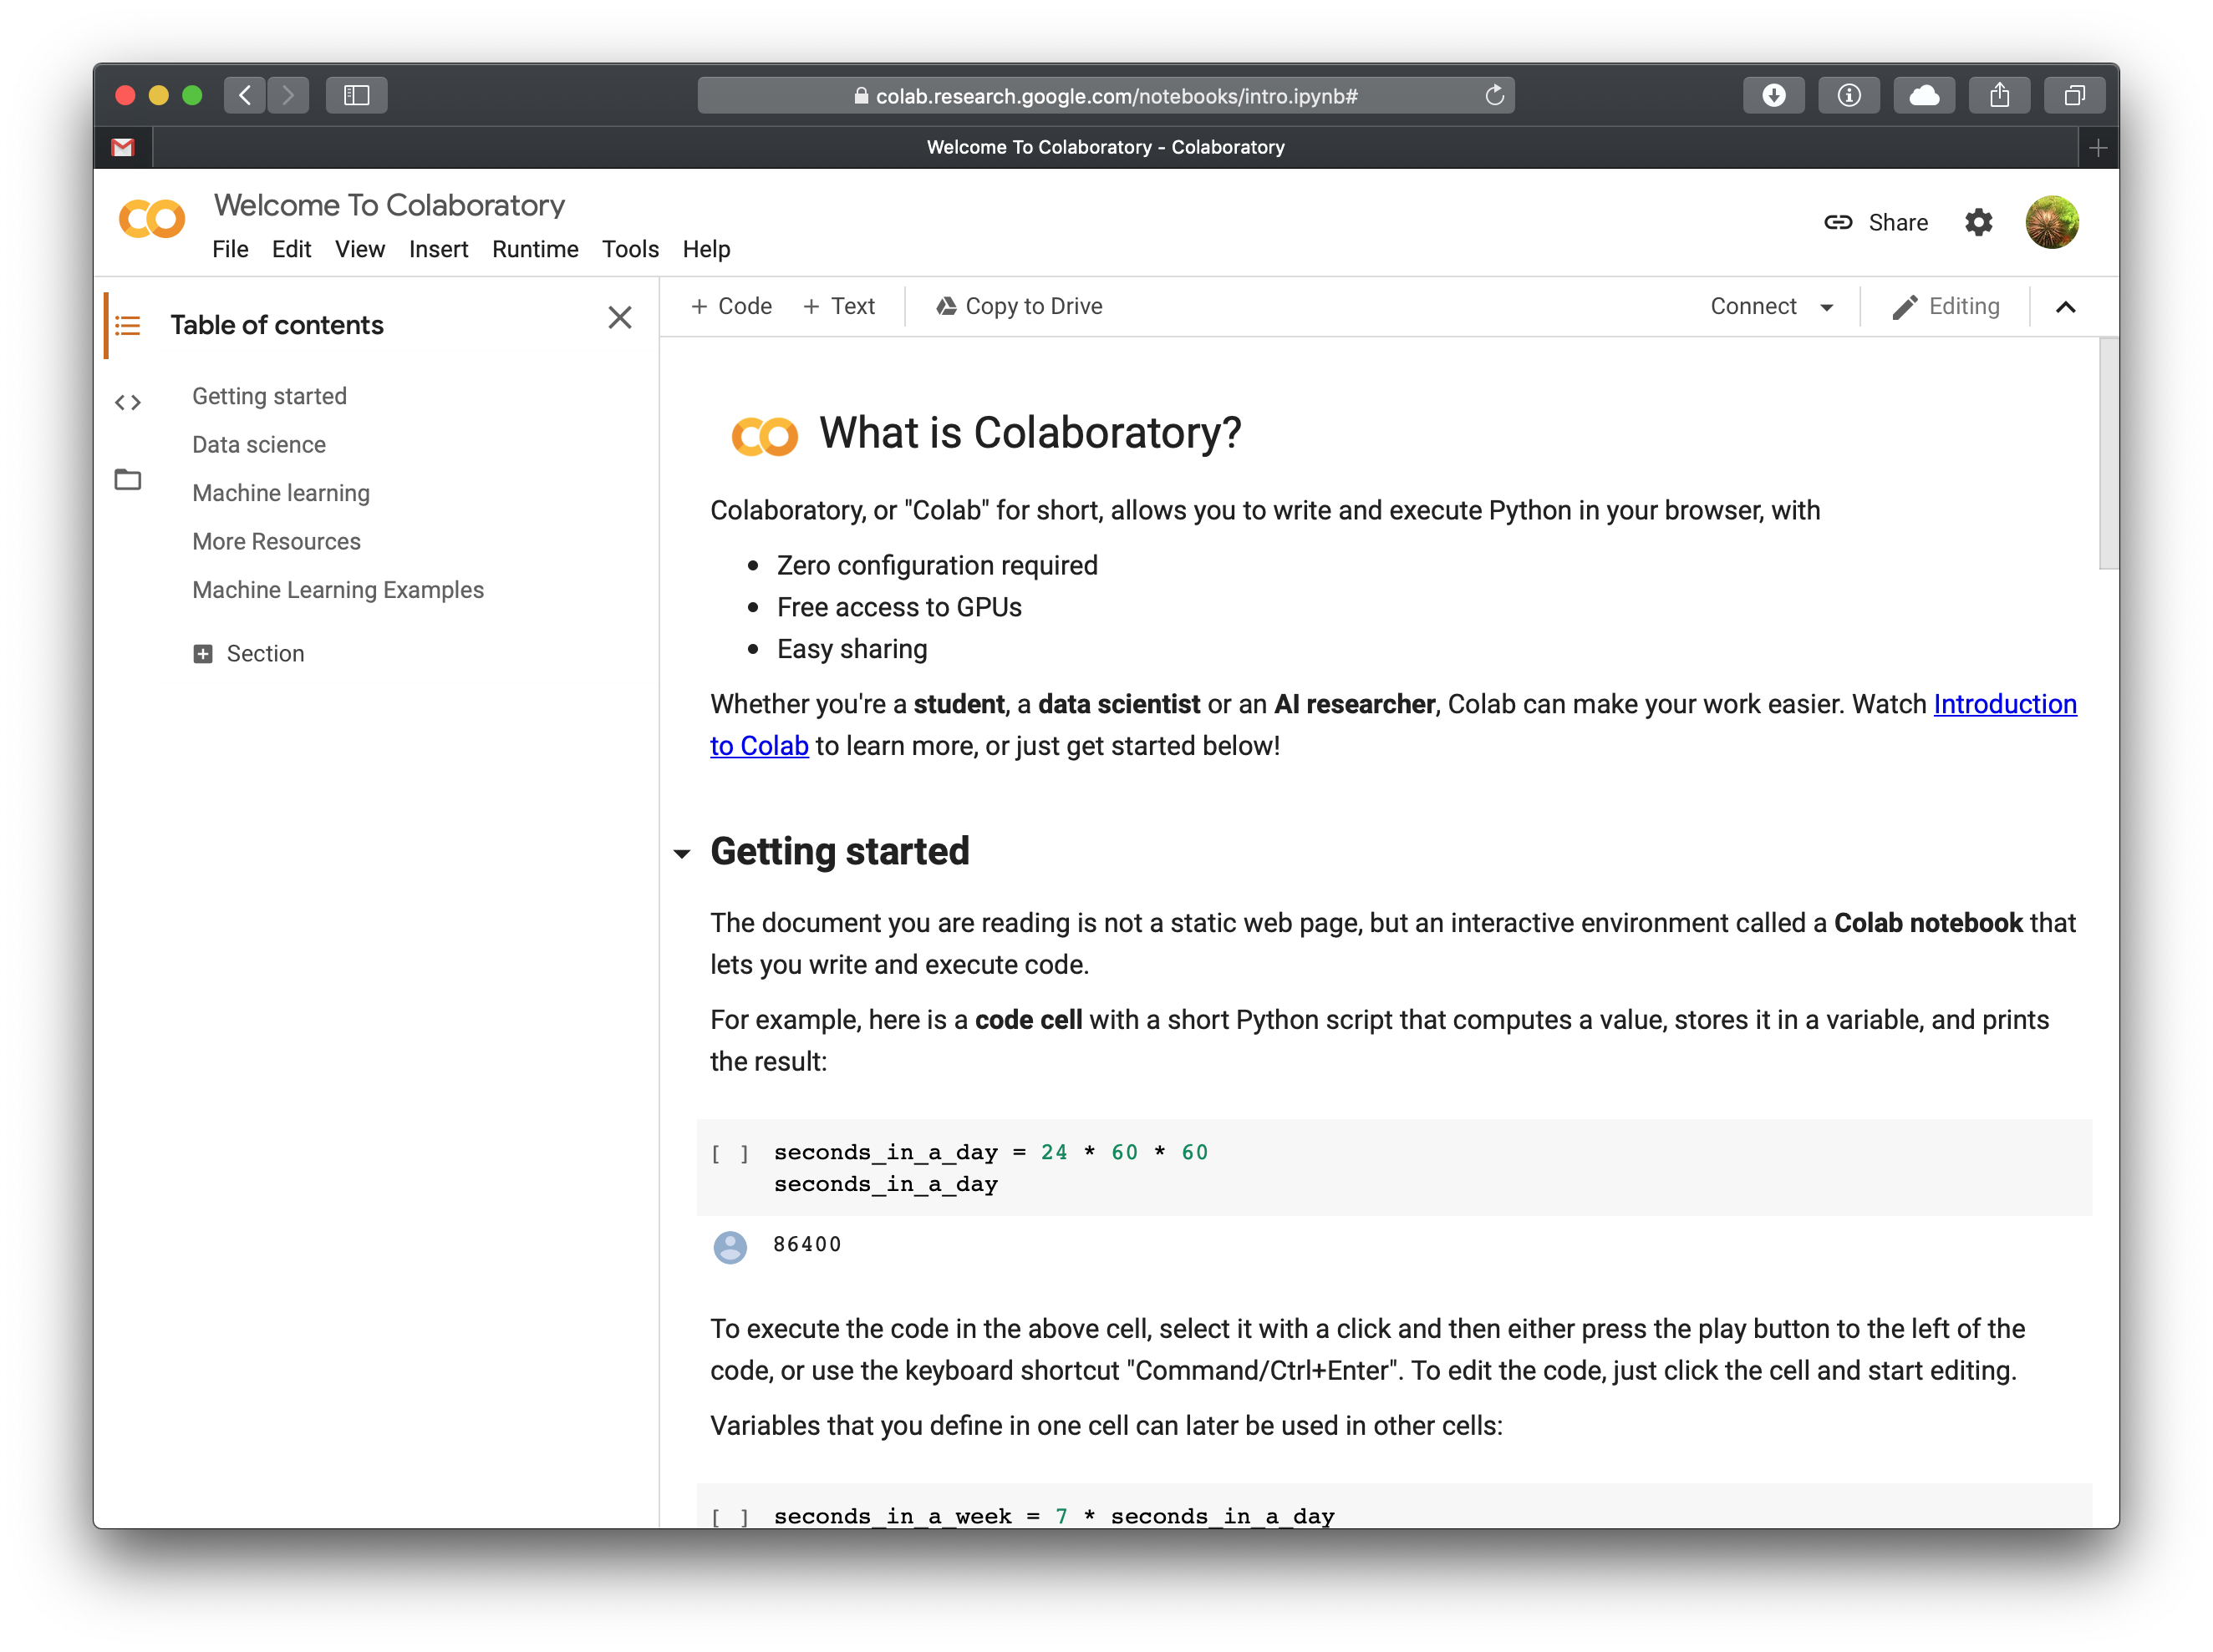
Notebook Environments
Personal computer
Install Jupyter with mini-conda
R Studio
Matlab
Google Colab (python only)
Simply go to your Google Drive and click New Google Colaboratory
Or go to https://colab.research.google.com
OOI Jupyter Hub

Slide 30
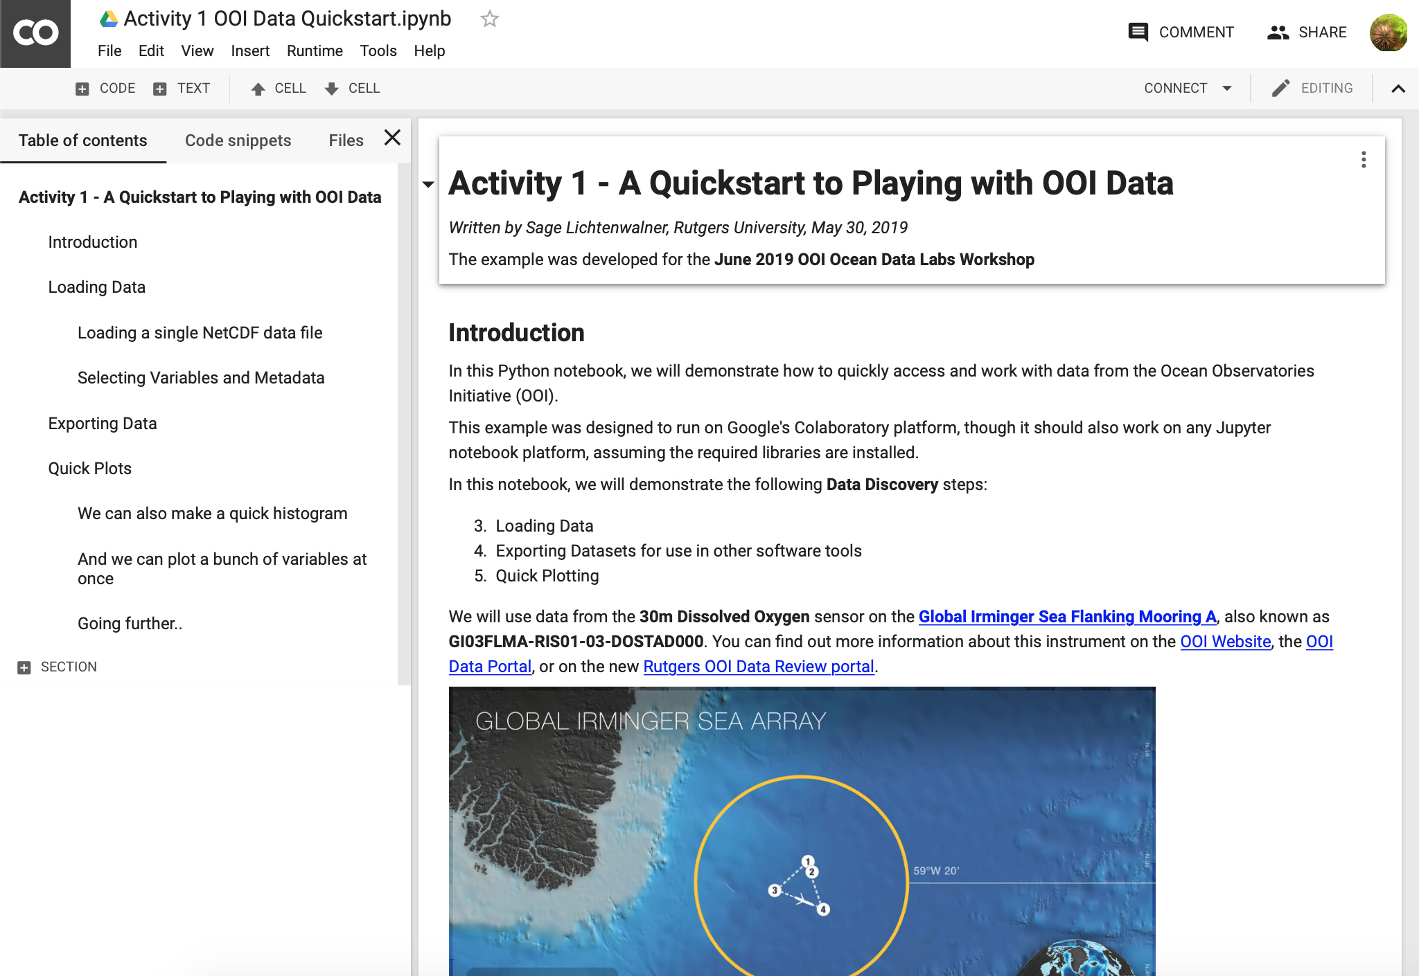
The Power of Coding Notebooks
A “linear” development approach
Code blocks can run independently
With an IDE you would have to use debug breakpoints
No need to download files
Files can be accessed and concatenated on the fly
Thanks to xarray and pandas we can easily run analysis functions
Notebooks are Sharable
via GitHub
In real-time with Colab
Easy to share examples
Data and Metadata Access
Requesting, loading, concatenating data
Various plot types
Color scales
Filtering and Splicing datasets

Slide 31
“Data Discovery” Process
Search / Discover datasets to use
Request and load data
Parse, filter, average and/or process (if needed)
Visualize
Analyze – Interpret plots and calculate statistics
Export for use in other tools (if needed)
Discover
Download
Plot
Analyze
Filter

Slide 32
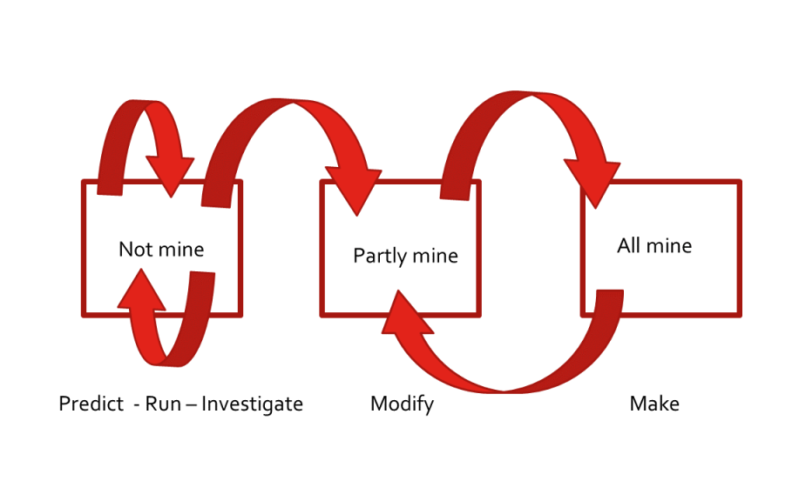
PRIMM Teaching Model
Predict
Run
Investigate
Modify
Make
Use with Paired Programming to spur discussions
http://primmportal.com

Slide 33
Let’s go to the notebook…

Slide 34
OOI Jupyter Hub

Slide 35
How to Access OOI Jupyter Hub
New Users need to register email address with OOI at: helpdesk@oceanoservatories.org
CILogon Service is in use to allow university Ids. You will first need to register that email.
Jupyter Hub is at https://jupyter.oceanobservatories.org
Help link is on front page
Link to register via email will be on front page
Link to Jupyter hub is also on the Data Explorer

Slide 36
Why use OOI Jupyter Hub?
It’s Available!
Single Computational Environment For Students.
JupyterLab is the latest web-based interactive development environment for notebooks, code, and data.
Its flexible interface allows users to configure and arrange workflows in data science, scientific computing, computational journalism, and machine learning.
A modular design invites extensions to expand and enrich functionality.
No locked doors.
It’s Flexible
Runs on OOI servers with access to a large number of CPU and Memory creating a Cloud-like environment.
Has access to both processed science data and raw data files – eliminating the need to download or move large data files.
Democratizes data access and processing requirements.
OOI wants to build a community of users and users sharing notebooks and ideas.

Slide 37
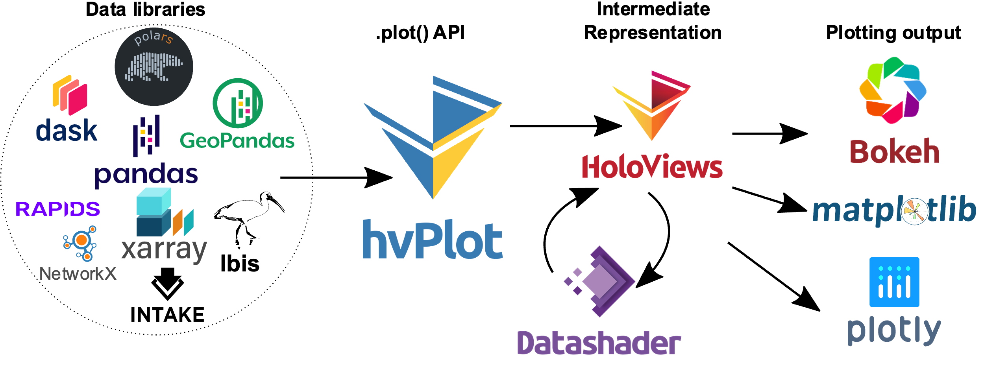
The Jupyter Hub Environment
It’s Customizable
Supports over 40 languages including Python, Java, R, Julia, Matlab, Octave, Scheme, and Scala
Use GitHub and the broader DataScience community to accelerate your learning curve
https://github.com/daxsoule
https://github.com/jakevdp
https://github.com/rabernat
https://github.com/jsignell
https://github.com/tjcrone
https://github.com/robfatland
It’s Powerful and No Downloading Data Required
As OOI continues to collect data, timeseries will continue to grow in size and processing power needs.

Slide 38
FIN

Slide 39
GI03FLMA-RIS01-03-DOSTAD000
Array: Global Irminger Sea
Instrument Type:
Dissolved Oxygen
Site: Flanking Mooring A
Node: Mooring Riser
Note:
Reference Designators effectively denote a physical deployment location in the OOI.
Asset IDs represent the individual serial-numbered instruments that are swapped in and out at each spot.

Slide 40
Methods
How was the data collected and ingested into the system?
Telemetered Data
Data received through a transmission medium over distance (e.g. surface buoy to satellite, glider to satellite, acoustic modem); may be decimated
Recovered Data
Data offloaded directly from an instrument or data logger; usually by connecting the instrument to a computer after the instrument has been recovered and writing to files, often onboard the recovery vessel
Streamed Data
Data received via transmission over electro-optical cable. Streaming data are provided at full temporal resolution and near-real time.

Slide 41
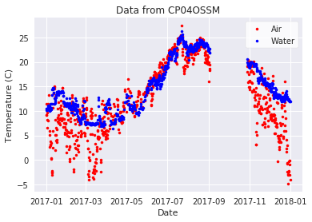
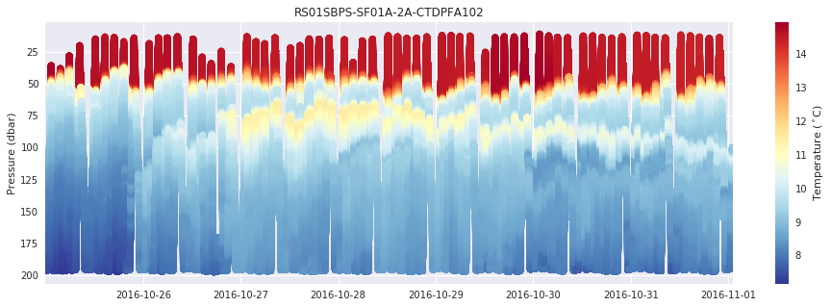
OOI Datasets Types
What types of data are available?
Point Timeseries
Profiles
Wire Following
Glider
ADCP
Multi-point Timeseries Profiles
And others…
Seismic/Earthquake
Hydrophones
Sonar
Camera
Optical OPTAA/SPIKR

Slide 42
Design Process – Lessons Learned
Lichtenwalner, 2021
Identify Target Scientific Concepts & Skills
Match Educational Goals with Instrumentation
Find Available Instrument Data
Cleanup the Dataset
Add Context & Educational Surrounds
Build Interactive Visualizations
Community Building – Defined process helps divide tasks and keep everyone on track
Takes time and effort – Development is highly iterative (esp. 3&5)
Educators can spearhead content selection and lesson development
Training is essential for new faculty to lean about the tools and instruments to find appropriate datasets, esp. those not familiar with OOI or using OOS.
With better data portals, they might also help with data and visualizations

Slide 43
Data Activity Dimensions
Time
Single event
Specific Date Range (year, quarter, month, week, day)
Several cycles (interannual, annual, seasonal, monthly, weekly, daily)
Compare cycles (e.g., winter vs. summer)
Depth
Fixed / Single Point
Multipoint
Full Profile
Spatial
Fixed (lat, lon)
Multipoint
Vertical Slice (depth transect)
Horizontal Slice (spatial map)
Variables/Parameters
Raw
Calculated: Averaged, Filtered or Smoothed
Derived (e.g., anomaly or model)

Slide 44
Possible Example Notebooks
MAB Storm – Winds, Waves and Turbidity
Engage, Explore, Make Meaning
PCO2 and Irradiance
Demonstrate the PRIMM inquiry framework
Hunga Tonga Tsunami
Pioneer Timeseries Averaging
MAB Profiler (CTD, DO, and/or Flort)
MAB Glider (CTD, DO, and/or Flort)
Erddapy: Search and Download
Others?
Air vs. Water Temp

Slide 45
Our Python Adventure
Discovering OOI Data to Use
Requesting OOI Data
Loading Data
Quick Plots
Basic Statistics and Analysis
Exporting Data for Use in Other Software

