Slide 1
Graduate & Undergraduate Student Engagement
Anna Pfeiffer-Herbert & Sage Lichtenwalner
OOI Pioneer MAB Community Workshop
September 12, 2024

Slide 2
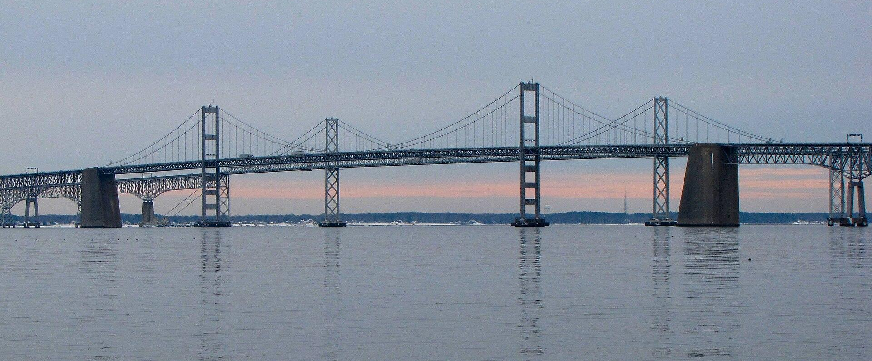
How do we effectively connect students to OOI data?
Challenges
OOI arrays sample oceanographically complex regions
Data curation requires time and expertise
Learners need scaffolded data skills
Opportunities
Broaden access to OOI data
Prepare students for STEM careers
Develop a data literate society
Instill curiosity and the excitement of discovery

Slide 3
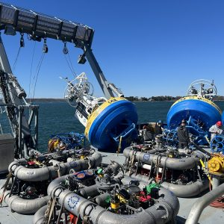
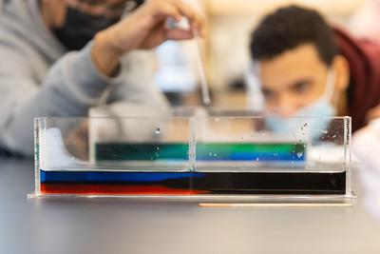
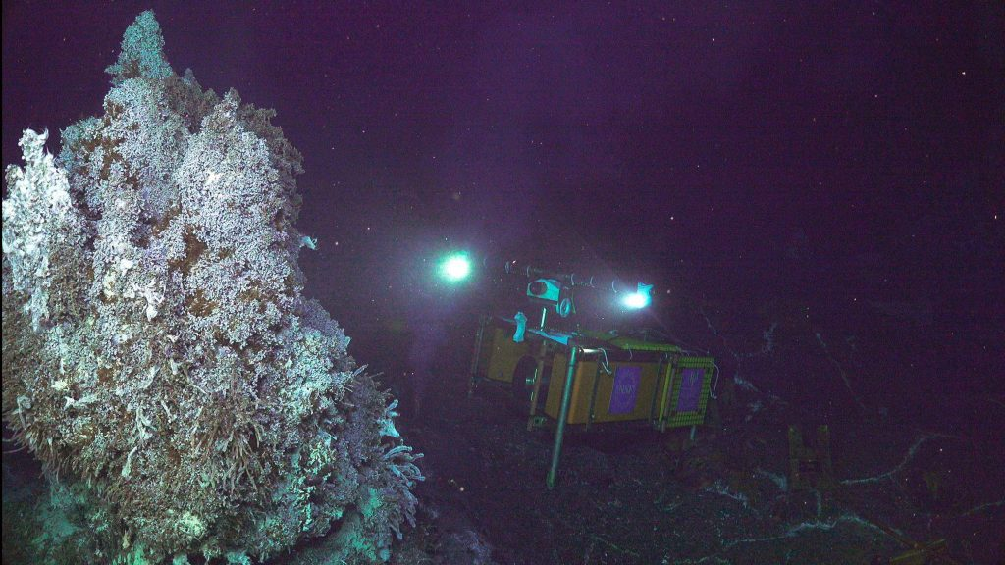
Ways we use data
D. Buffitt (WHOI)
Reinforcing known phenomena
Generating new knowledge
S. Allen (Stockton U)

Slide 4
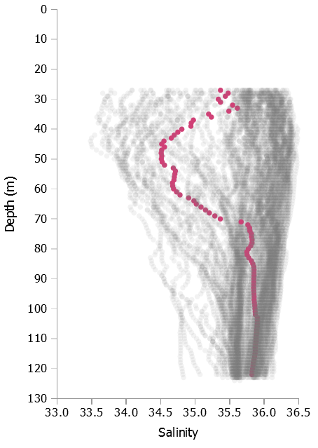
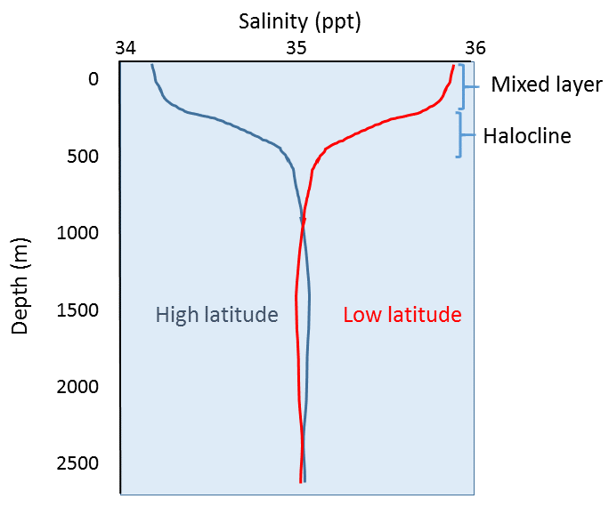
Types of data we use
Coastal Pioneer NES
Central Offshore Profiler
July 6, 2015
Real-world (messy) data
Idealized patterns
Webb (2023)

Slide 5
Four aspects of using data in teaching
Real-world (messy) data
Labs/demos with
authentic data
Professional observations and models
Reinforcing known phenomena
Generating new knowledge
Textbook data
visualizations
Models of theory
Idealized patterns

Slide 6
Data skills learning curve
Challenging transition
(A) Unstructured observation with human senses
(B) Student-collected small datasets
Challenging transition
(C) Professionally collected large datasets, well-structured problems
(D) Professionally collected large datasets, ill-structured problems
Challenging transition
Modified from Figure 1 in Kastens et al., 2015, The Science Teacher 82(5):25-31
Notes:
Transition from B-C: focus of Data Labs (but some participants may work with their upper-level students on C-D)

Slide 7
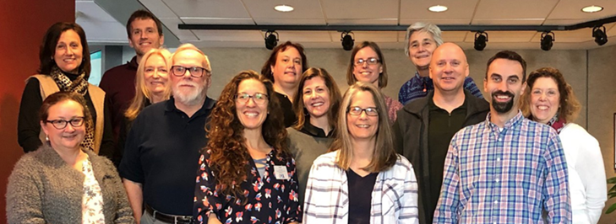
OOI Data Labs Project – Key Goals
Build a Community of Practice (CoP) of professors, interested in using OOI data with their undergraduate students.
Make OOI data more accessible to educators and students.

Slide 8
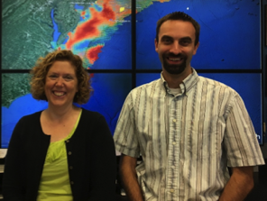
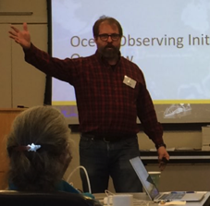
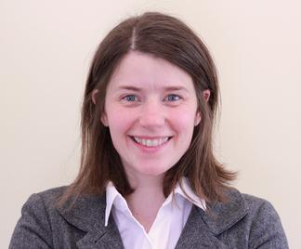
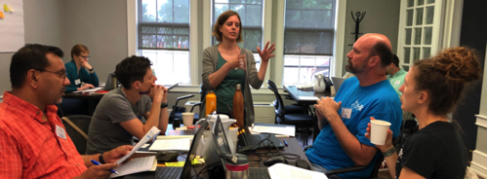
Project Team
NSF Grant #1831625
and # 2316075
Kristin O’Connell
SERC
Janice McDonnell, Sage Lichtenwalner
Rutgers University
Dax Soule
Queens College CUNY
Denise Bristol
Hillsborough CC
Anna Pfeiffer-Herbert
Stockton University

Slide 9
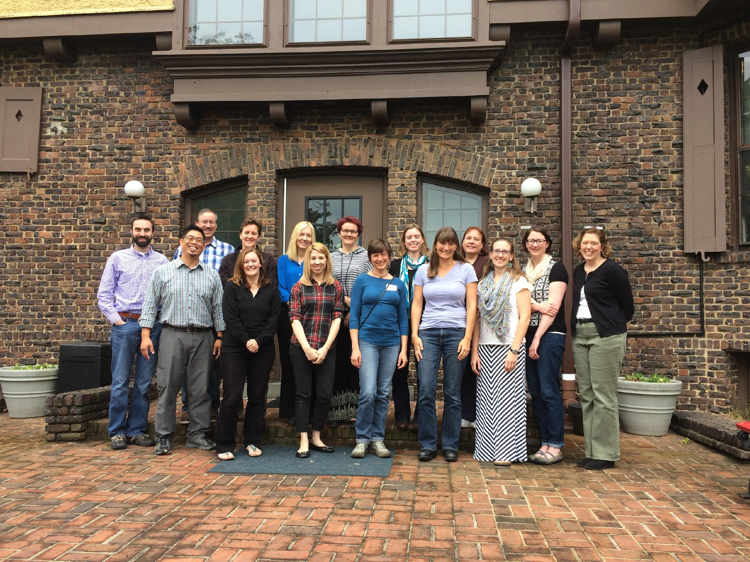
Data Labs Project History
Data Explorations Workshops
2016-2017
Undergrad Educators
OOI Early Career Data Workshops
2018
Research Graduate Students, Post-docs and pre-tenure faculty
Data Labs 1.0
2018-2021
Introductory Undergrad Educators
Esp. 2YC and PUI
Data Labs 2.0
2023-2025
Intro and Advanced Undergrad Educators
Focus on Python
And new MAB array

Slide 10
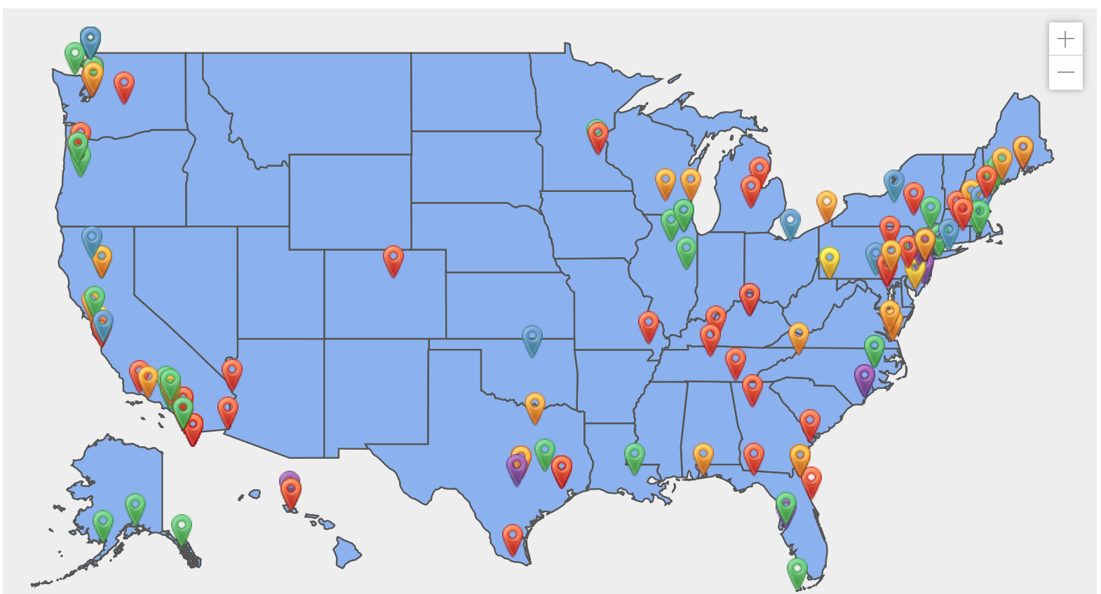
The growing Ocean Data Labs community!
Developer (green) Participated in one of our week-long development workshops in 2019
Piloter (orange) Attended one of our weekend pilot workshops in 2016-2017, or who have pilot tested our OOI Lab Manual.
Fellows (blue) 2020 implementation and dev cohorts
REU Mentors (yellow) Faculty who helped mentor our 2020 Virtual REU students
Leaders & Staff (purple) Members of the core project team
https://datalab.marine.rutgers.edu/community-map/

Slide 11
Translating OOI data into educational resources
Identify Target Scientific Concepts & Skills
Match with Research Results
Find Available Instrument Data
Cleanup the Dataset
Make Interactives & Visualizations
Add Educational Surrounds (Context)
Resource collection created by the community through
curricular workshops, fellows, pilot testers and more…

Slide 12
OOI Data Labs Resource Collection
Want a series of lab activities with built-in student assessments?
Want a ready-made lesson plan incorporating OOI datasets?
Want a modular set of activities that you can adapt?
Want to start from scratch using curated OOI datasets?
Want to introduce coding notebooks with OOI datasets?
Data Lab Manual
Lesson Plans
Data Explorations
Data Nuggets
Python Notebooks
OOI Data Explorer Direct access to data

Slide 13
Inspiration for the OOI Lab Manual
Wouldn’t it be great to have a lab manual of OOI data activities aligned to our oceanography classes?
Dr. Sid Mitra
2020 OOI Data Lab Manual Dev. Team

Slide 14
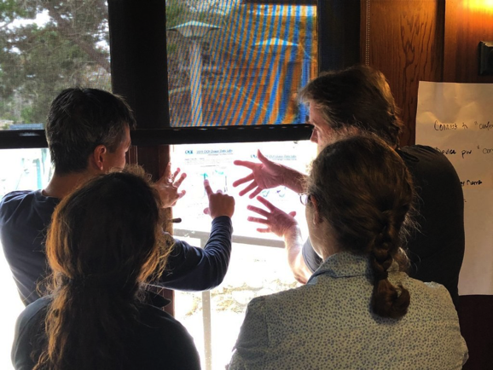
Goals of the OOI Lab Manual
Build data literacy and critical thinking skills in undergraduate students using authentic (“messy”) scientific data
Visualize data in a user-friendly, interactive and authentic way
Engage students with data activities that reinforce student confidence in scientific questioning, data analysis, and synthesis
Provide a real-world context for key concepts in oceanography

Slide 15
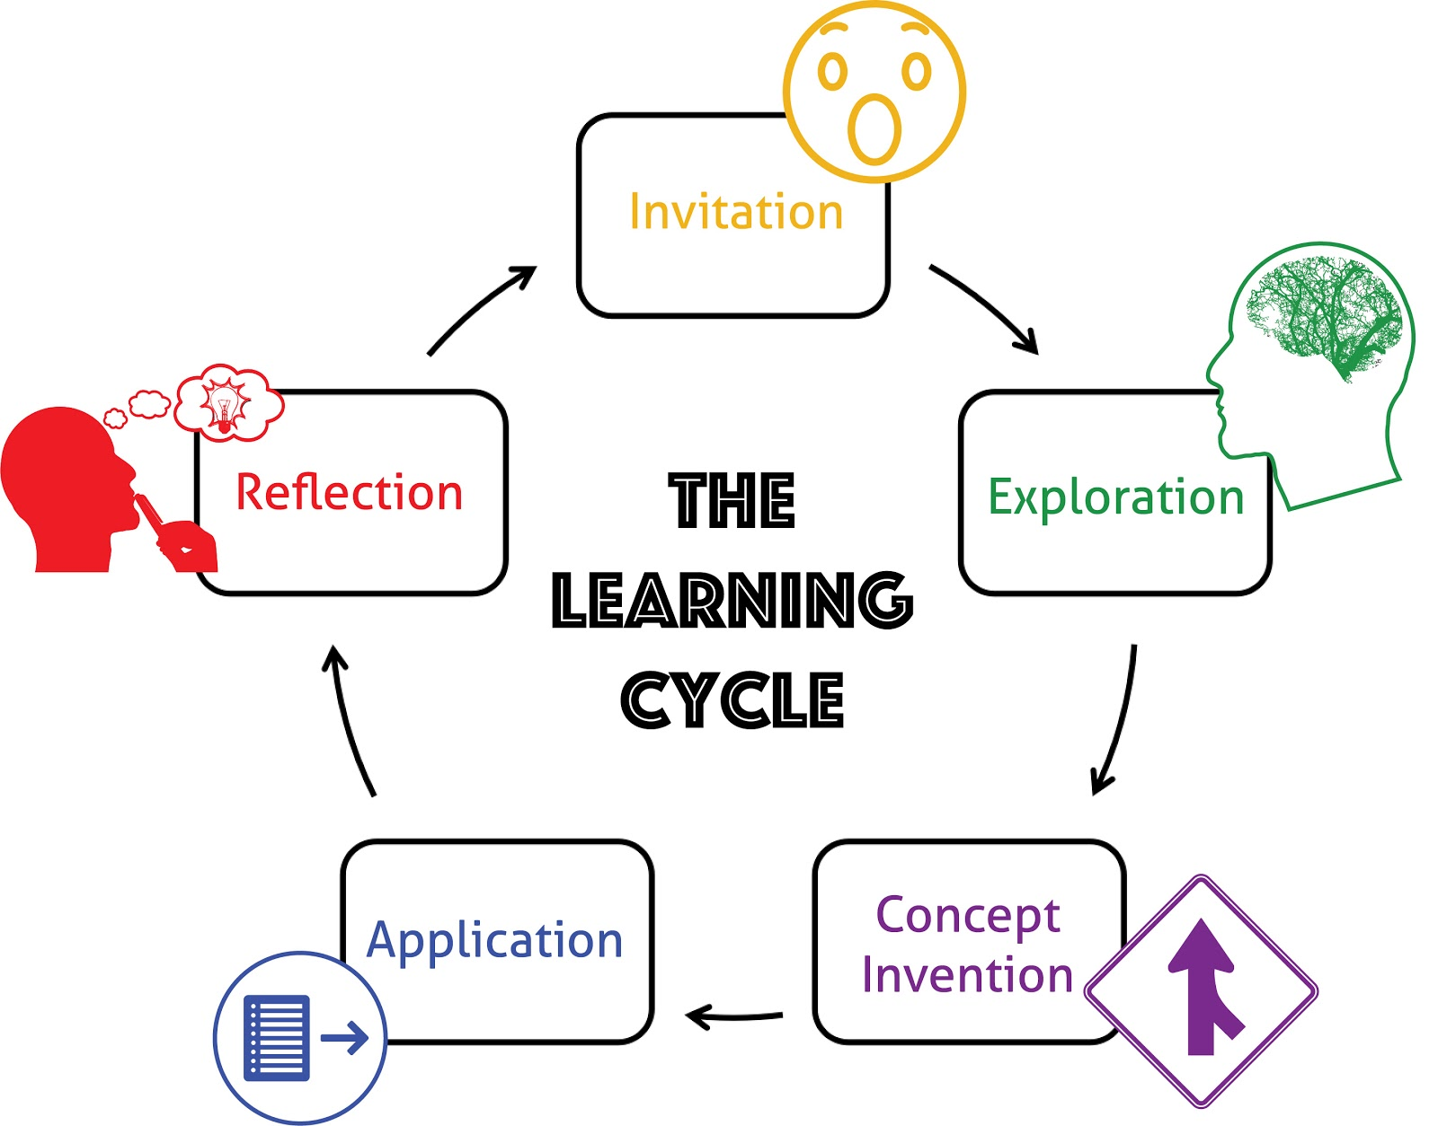
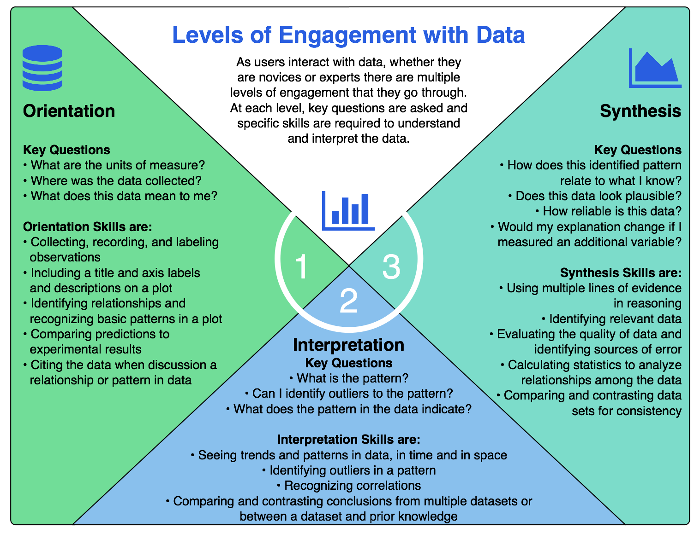
Design of data activities - based in learning science:
University of California Lawrence Hall of Science
Hotaling et al. (2019)

Slide 16
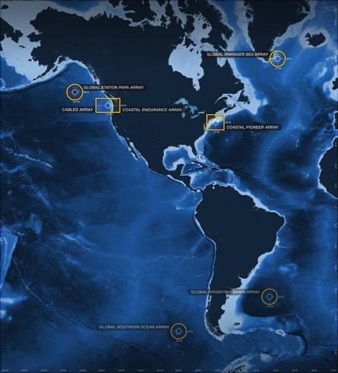
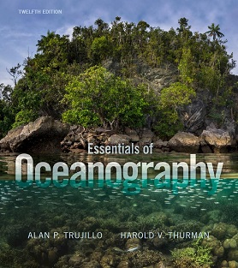
Alignment to Intro Oceanography curriculum
OOI science themes
and data availability
Topic | Chapter
Ocean geography Ocean technology | Lab 1: Introduction to the OOI, the collection of oceanographic data
Data skills for oceanography | Lab 2: Building data skills
Marine Geology | Lab 3: Plate tectonics and the seafloor Lab 4: Seafloor changes in a volcanically active setting
Ocean Chemistry | Lab 5: Investigating density stratification
Physical Oceanography | Lab 6: Waves generated by large storms
Biological Oceanography | Lab 7: Primary production Lab 8: Anoxic events
common Oceanography textbooks

Slide 17
A Quick Lab Example
https://datalab.marine.rutgers.edu/ooi-lab-exercises/

Slide 18
Design Process – Lessons Learned
Lichtenwalner, 2021
Identify Target Scientific Concepts & Skills
Match Educational Goals with Instrumentation
Find Available Instrument Data
Cleanup the Dataset
Build Interactive Visualizations
Add Context & Educational Surrounds
Community Building – Defined process helps divide tasks and keep everyone on track
Takes time and effort – Development is highly iterative (esp. 3&5)
Educators can spearhead content selection and lesson development
Training is essential for new faculty to lean about the tools and instruments to find appropriate datasets, esp. those not familiar with OOI or using OOS.
With better data portals, they might also help with data and visualizations

Slide 19
Evaluation & Impacts
Conducted by Dr. Ellen Altermatt, SERC at Carleton College
The purpose was to:
better understand current perceptions of and practices in using large, real-world oceanographic datasets in undergraduate classrooms,
assess levels of involvement in past and current OOI Ocean Data Labs initiatives,
examine the impact of participation in these initiatives on faculty teaching and perceptions of community belongingness, and
assess planned levels of future involvement and to understand how current resources might better meet community needs.

Slide 20
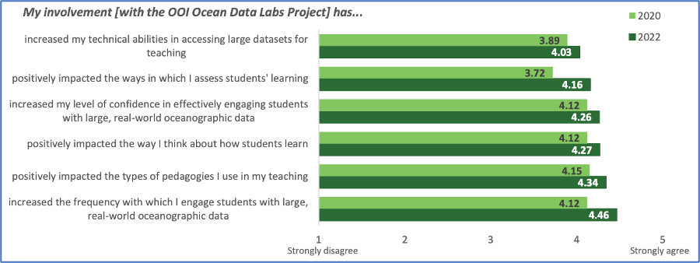
How has participants’ involvement in the OOI Data Labs Project influenced their teaching?
Notes:
Comparison between 2020 and 2022 mean ratings of the degree to which participants’ involvement with the OOI Ocean Data Labs Project has influenced their teaching. When asked to report the degree to which their involvement in the Data Labs project influenced their teaching and perception of themselves as instructors, participants reported positive impacts in engagement and confidence in using authentic datasets as well as other areas including teaching, thinking about how students learn. Means for all items > 4 on a scale of 1 (strongly disagree) to 5 (strongly agree).
Respondents, as a group, reported that involvement with the OOI Data Labs project had positive impacts on engagement and confidence in using authentic datasets as well as on other areas teaching (e.g., thinking about how students learn) with means for all items > 3.70.
The highest means emerged for two items tapping the degree to which respondents felt part of a community of educators interested in using OOI data in their teaching (mean = 4.20) and interested in changing how they teach to improve student outcomes (mean = 4.24).

Slide 21
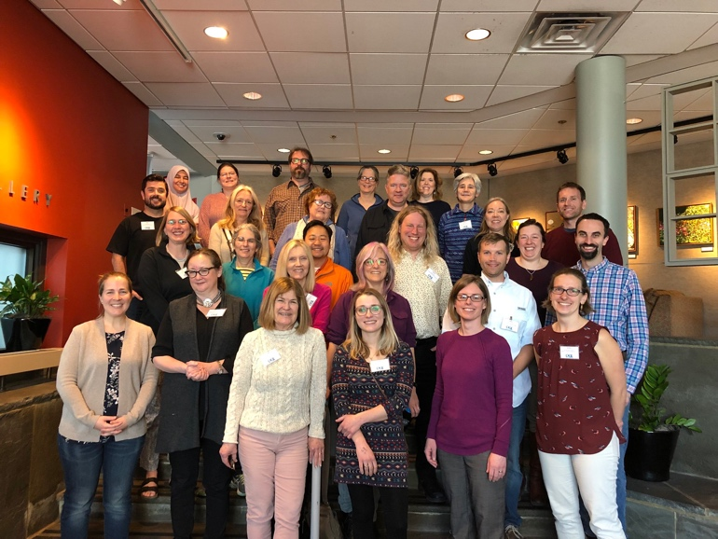
OOI Data Labs 2.0 (2023-2025)
Project Goals
Continue to build and support the OOI educator community
Especially MSI, 2YC, PUI and R2
Special focus on the Mid Atlantic
Develop “next level” activities
Fill in gaps in the existing OOI Data Labs manual
Domain-specific and level-appropriate programming notebook-based activities

Slide 22
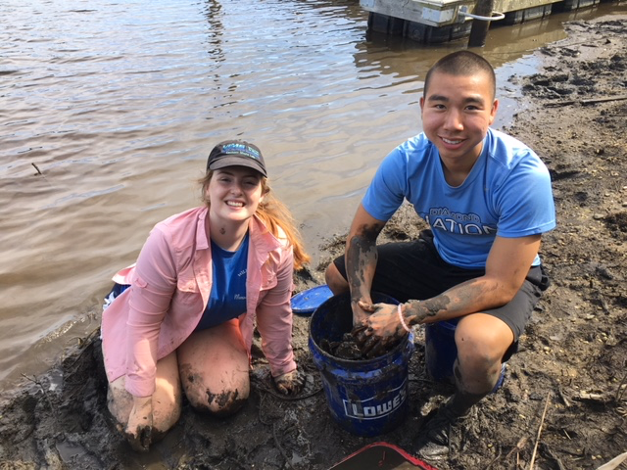
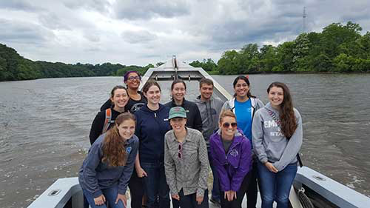
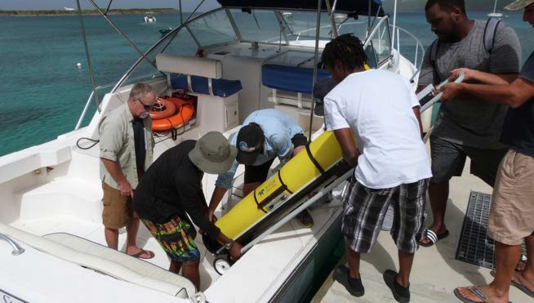
Existing Opportunities for Engaging Students
REU Sites
REU Project Supplements
Cruise Opportunities (e.g. Visions and CGSN)
Individual research projects with faculty mentors
Classroom Activities
Others?
https://marine.rutgers.edu/rios/

Slide 23
2020 Virtual REU Goals
Lichtenwalner, 2021 (MTS Oceans)
Introductory Workshop
2 weeks
Research Experience
6 weeks
Poster Presentation
Conference Presentation
(optional)
Develop and apply their data analysis skills using Python notebooks to access, analyze, and present ocean data.
Learn about the variety of ocean data collection methodologies and datasets available to oceanographers.
Participate in a variety of professional development sessions, including scientific question development, science communication, the graduate school process, and Diversity, Inclusion, and Research Ethics.
Have the opportunity to participate in Career and Graduate Student Panels.
Develop, carry-out, and summarize a research experience using an online dataset, under the guidance of a faculty mentor. (8-week participants only)

Slide 24
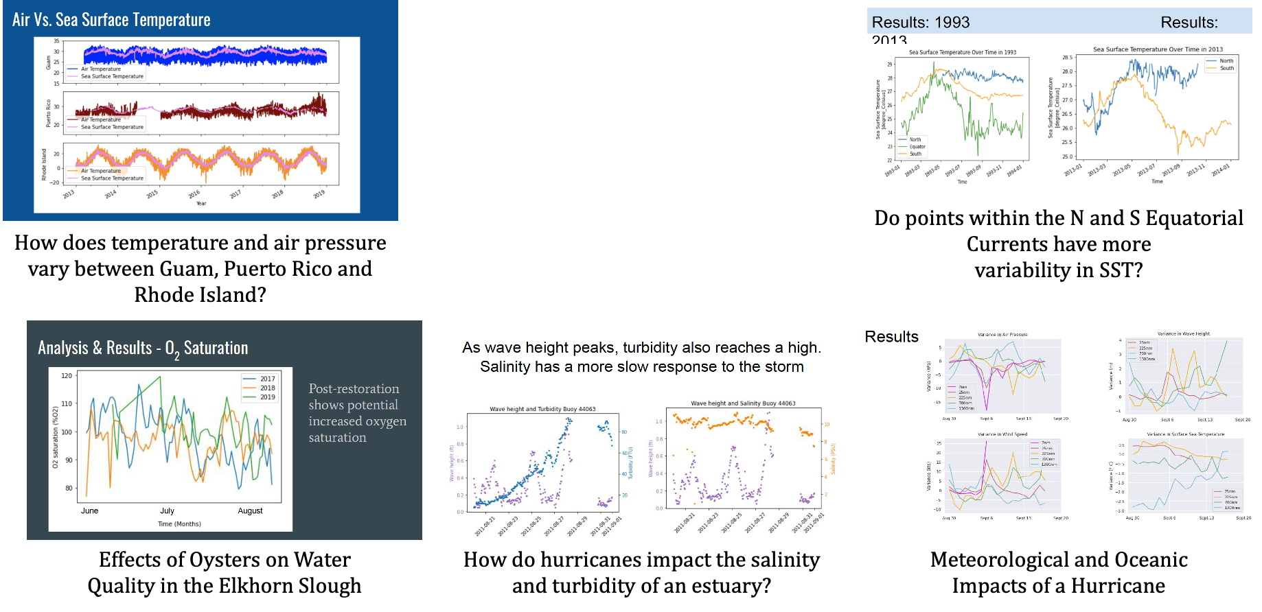
Virtual REU
Initial
Group Projects
A wide variety of data investigations in just 1.5 weeks of coding using NDBC data!

Slide 25
The OOI Data Labs 2.0
Research Challenge
OOI Data + Science
Data
Explorations
Data
Workshops
?
Education
Data Science Coding/Python
Data Sci
Bootcamps

Slide 26
Wilmington Workshop Participants… How comfortable are you in incorporating oceanographic datasets into your teaching?

Slide 27
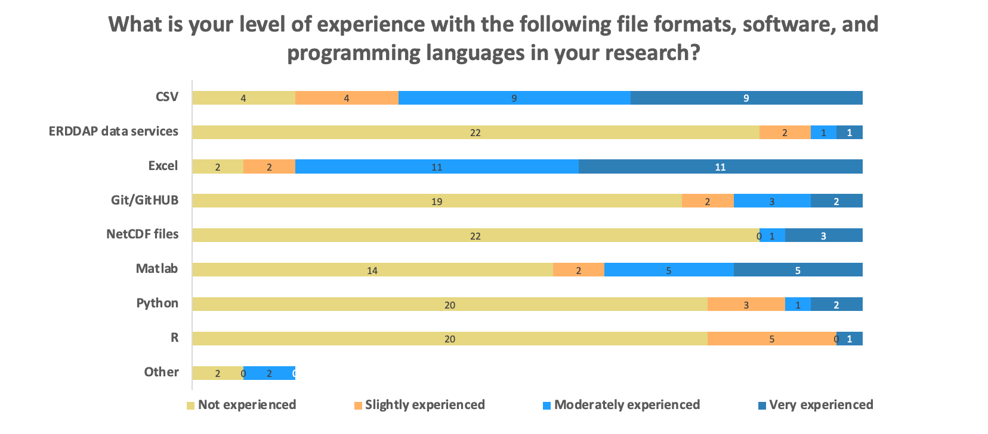
Pre-Survey: Research Experience

Slide 28
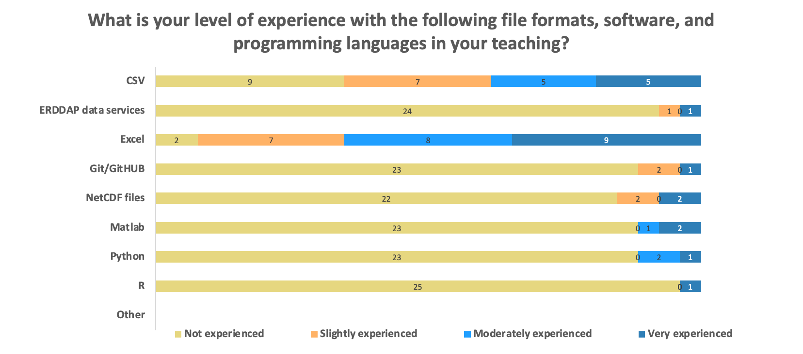
Pre-Survey: Teaching Experience

Slide 29
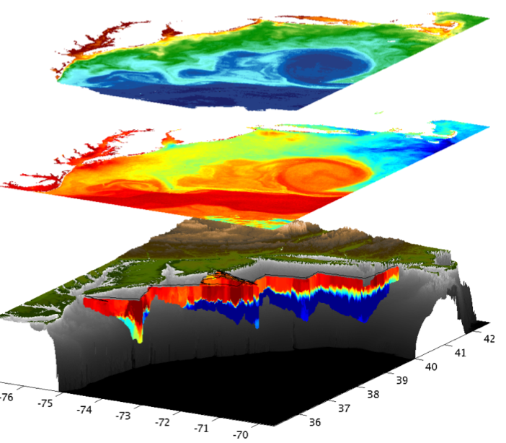
Ocean Observing Systems Potential for Education
Data already available “on the shelf”
Supports a wide variety of research questions, locations & instruments
Provides an opportunity to focus on programming, data analysis, and data visualization skills
Helps build data literacy and critical thinking skills using “real” data

Slide 30
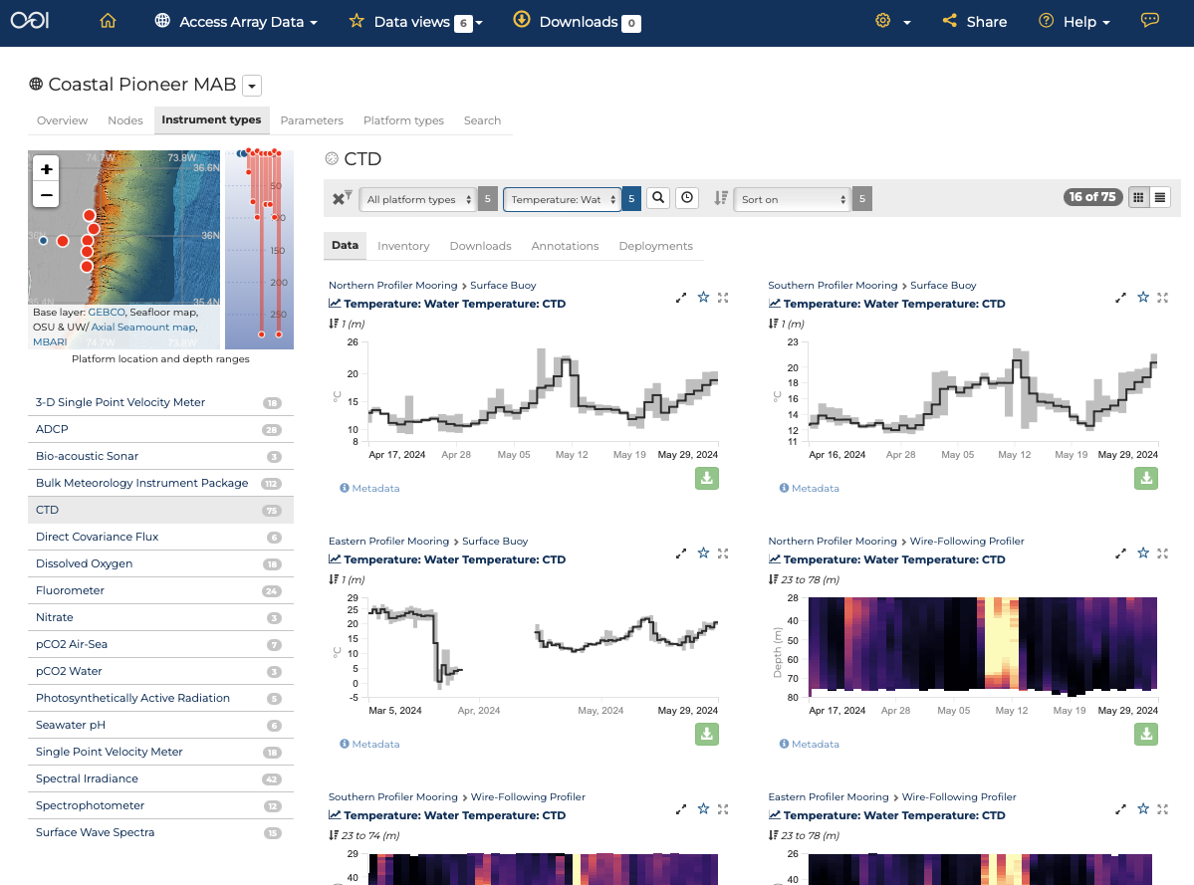
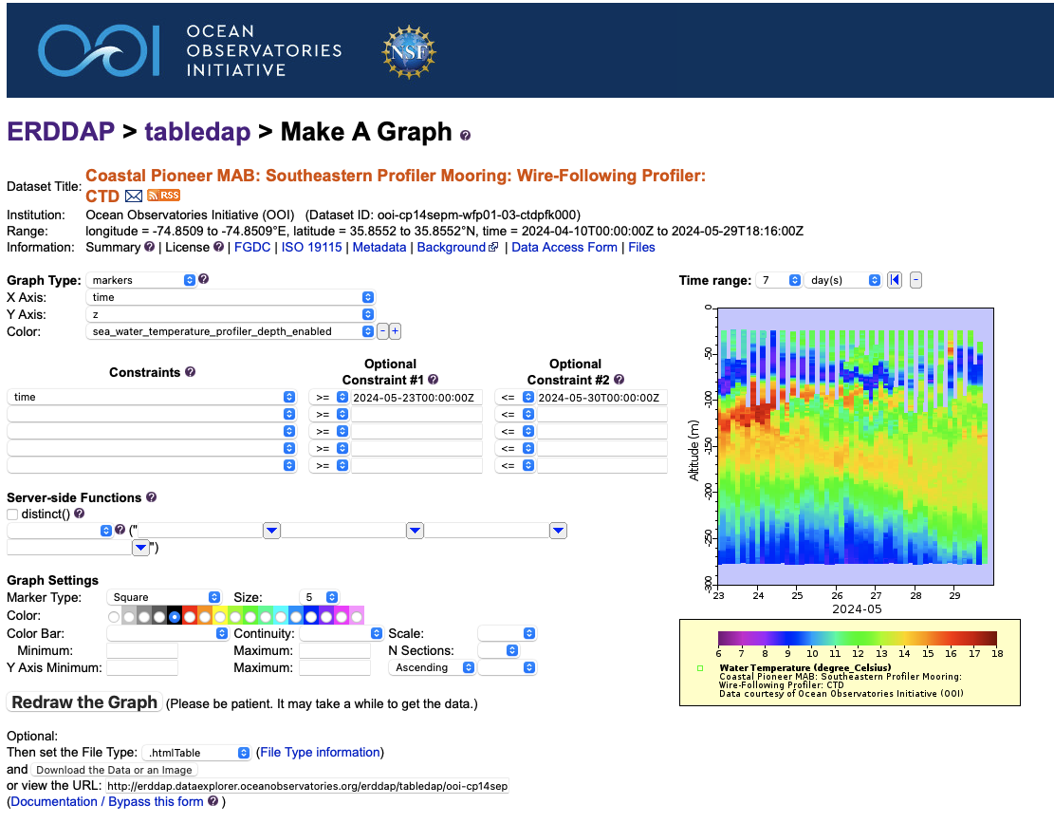
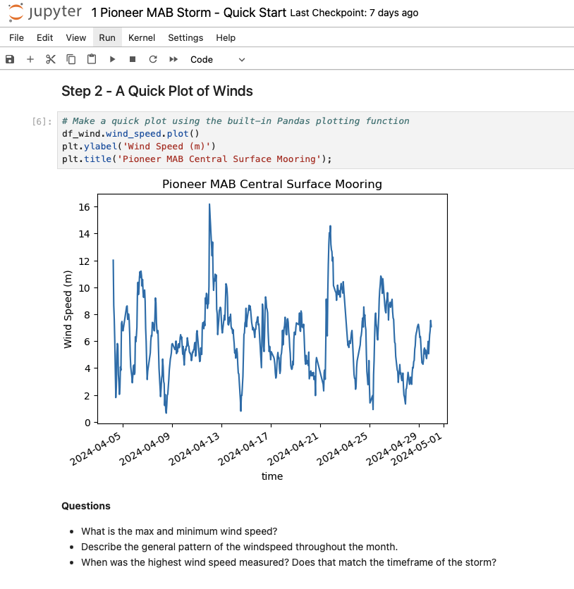
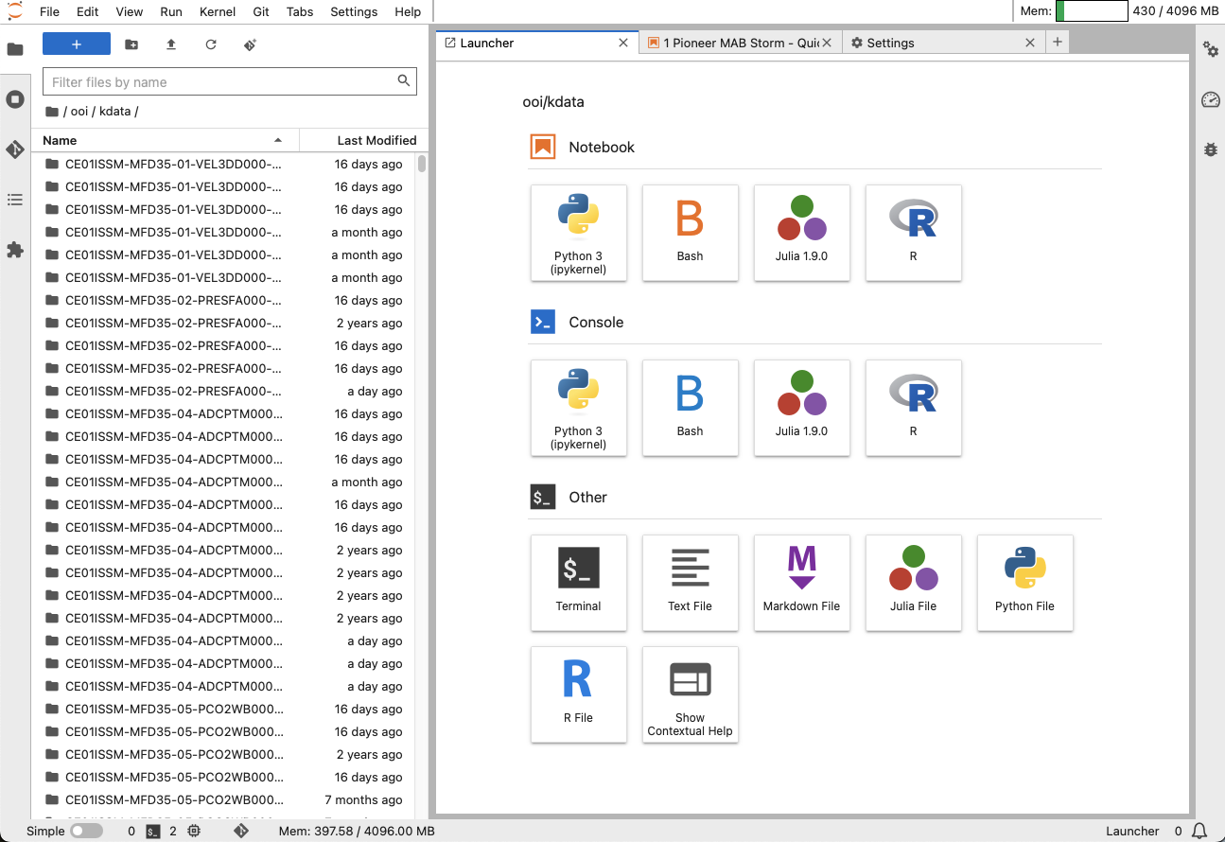
OOI’s Advanced Data Tools
OOI Data Explorer
ERDDAP Data Servers
Coding Notebooks
(in development)
OOI Jupyter Hub
New!

Slide 31
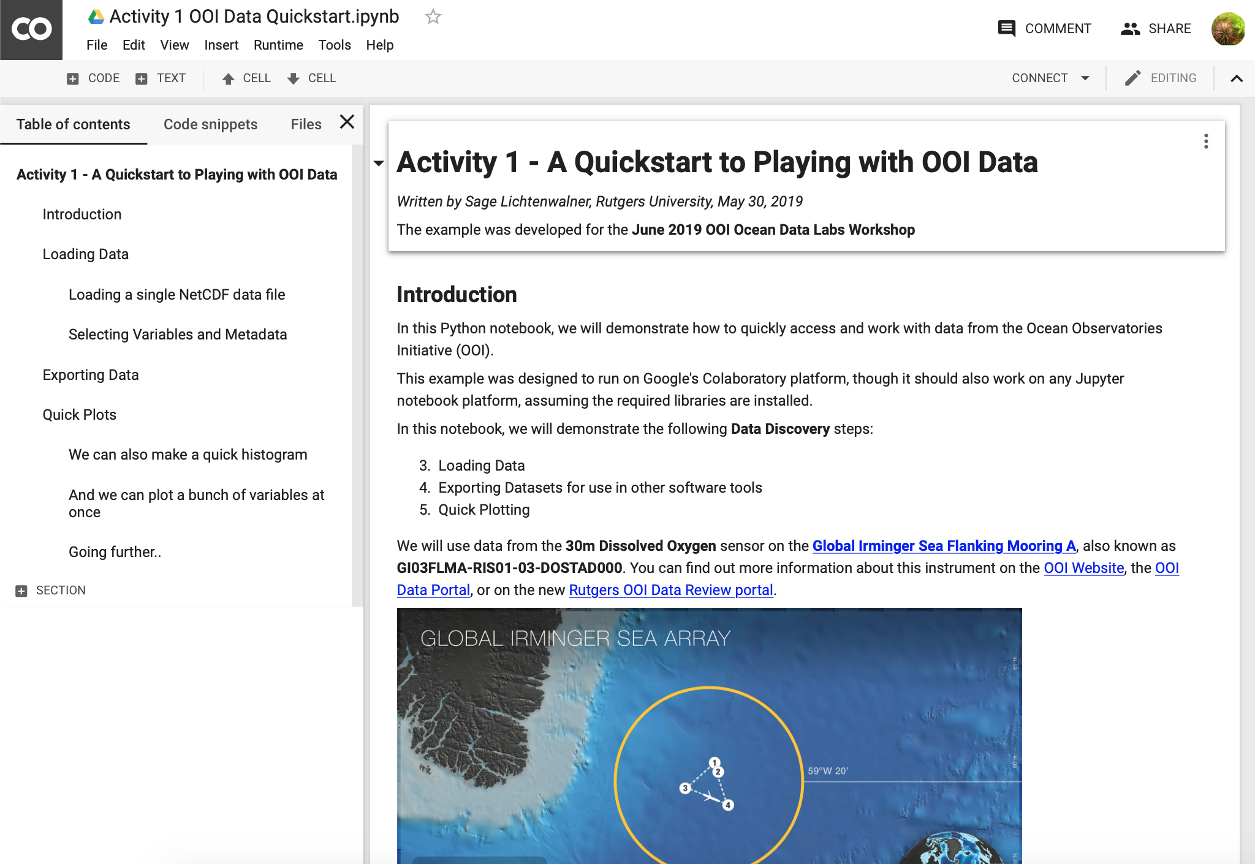
The Power of Coding Notebooks for Education
Low-to-No setup
Thanks to Google Colab, OOI JupyterHub, and other tools
Runs in your browser
A “linear” development approach
Easy(ish) to understand
Low bandwidth
No need to download data locally
Lots of datasets readily available
Sometimes co-located with server
Notebooks are Sharable
via GitHub
In real-time with Colab

Slide 32
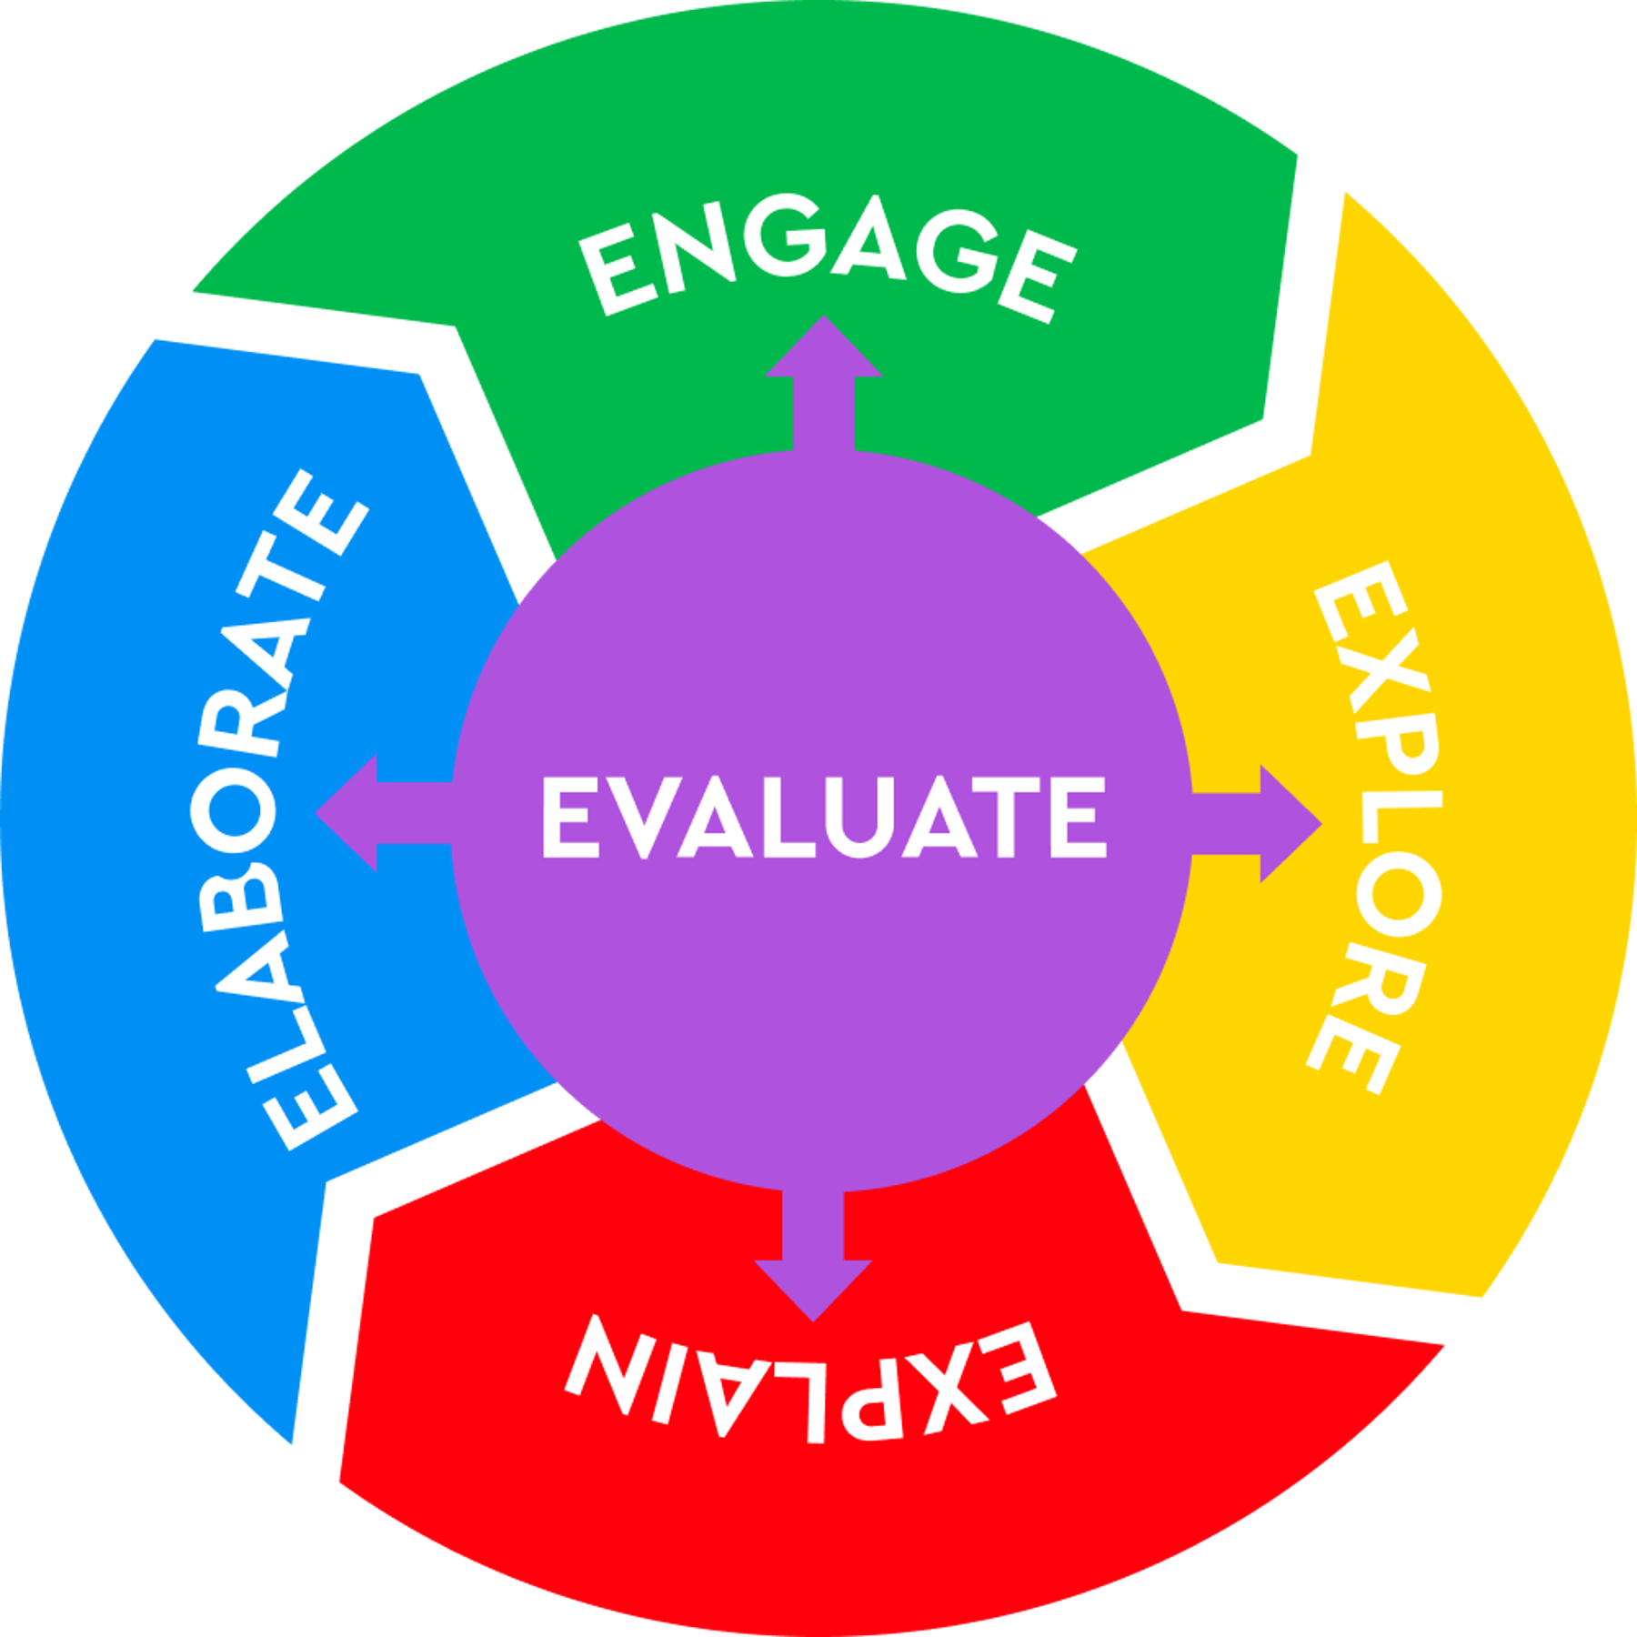
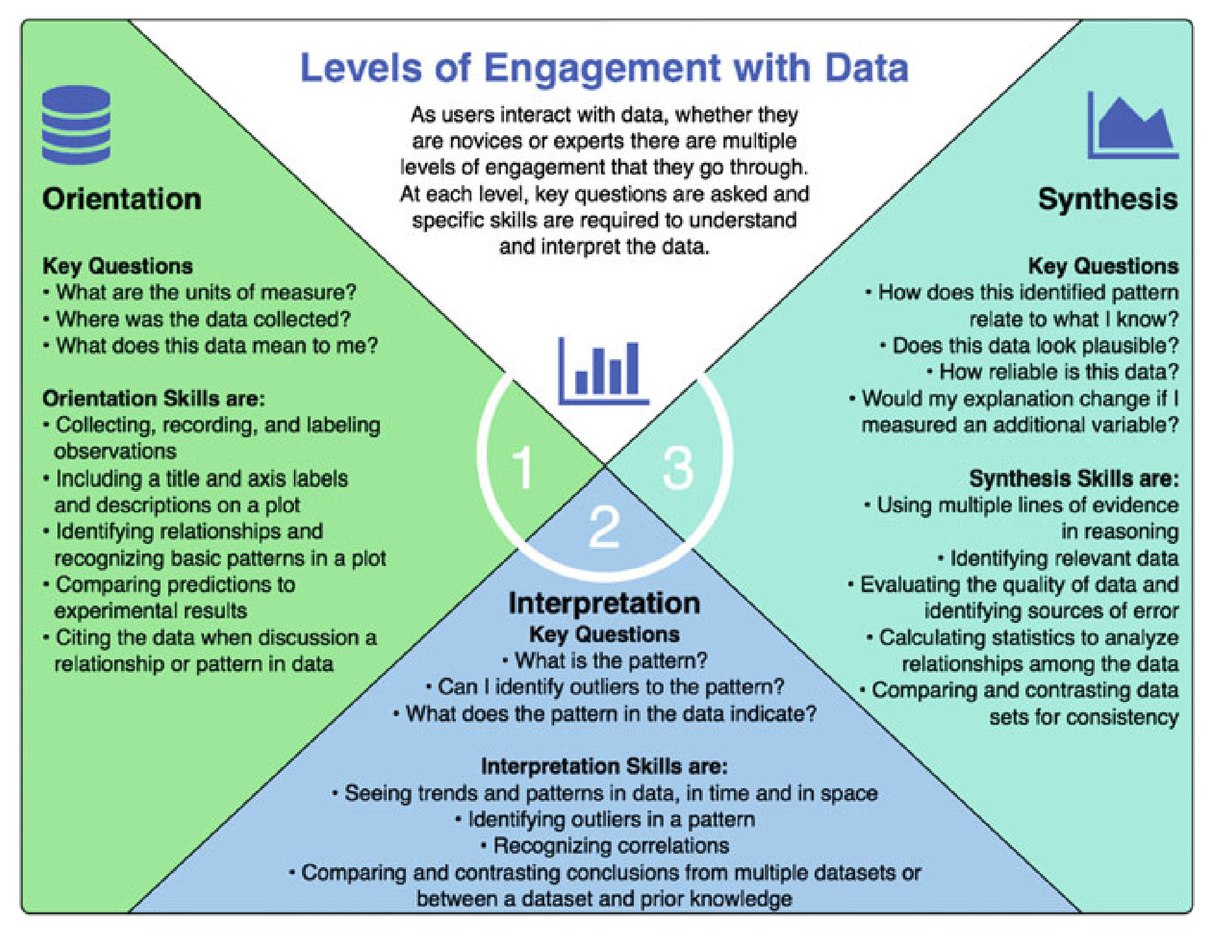
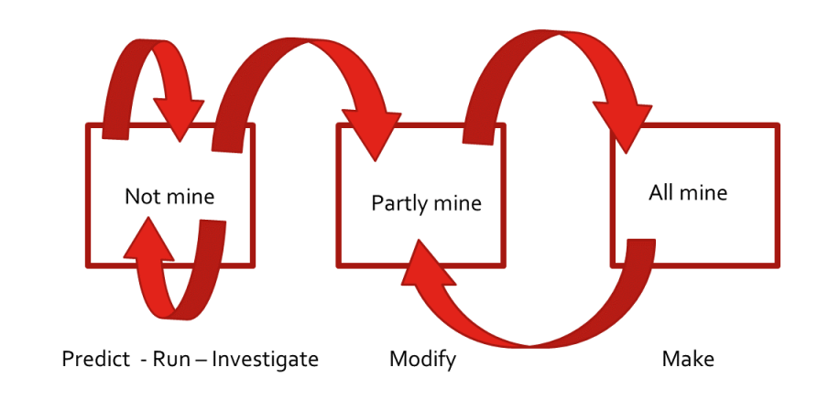
Pedological Approaches for Coding-based Activities
Structured/Guided Inquiry
Constructivism / PBL
Learning for Use (Edelson 2001)
Motivate, Construct, Apply/Refine
Bybee 5E Instructional Model
Engage, Explore, Explain
Levels of Engagement (Hotaling 2019)
Orientation, Interpretation, Synthesis
PRIMM Teaching Model
Paired Programming

Slide 33
Potential Advantages of Notebook-based Educational Activities
Educational Possibilities
Develop your own activities
Advanced activities allow students to gain experience
Working with data (Data Literacy)
Using data portals
Making their own graphs (Visualization Literacy)
Student can conduct their own research projects (Scientific Literacy)
OOI Tools for Skill Development
Data Explorer
Quick graphs
Data Downloads for additional analysis
Share custom Data Views
ERDDAP
Quick graphs & data downloads
DIY Coding (R, Python, Matlab) Notebooks & JupyterHub
Custom graphs
Advanced data processing techniques (averaging, correlations, anomalies, etc.)

Slide 34
Summary and Future Collaborations
All OOI Data Labs activities are designed to develop students’ Data Literacy, to engage them in the scientific process and help them develop a key workforce development skill.
The OOI Lab Manual and Data Explorations, are targeted to introductory courses that include majors and non-majors, focusing on data Orientation and Interpretation skills.
The Python notebook-based activities (in development) will guide students through the scientific process with OOI data to further support their data analysis skills.
The Future
Future Pioneer MAB scientific results can inspire future student activities!
Broader Impacts: OOI Data Labs provides several models for engaging faculty and students (undergrad and grad) in using OOI data

Slide 35
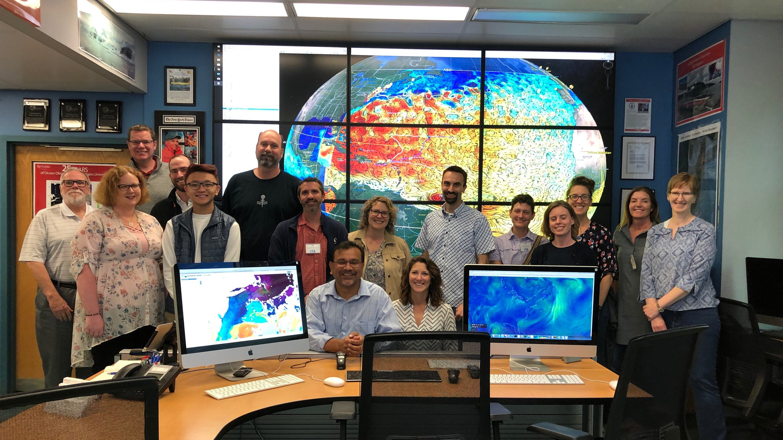
Thank you! datalab.marine.rutgers.edu

