Slide 1
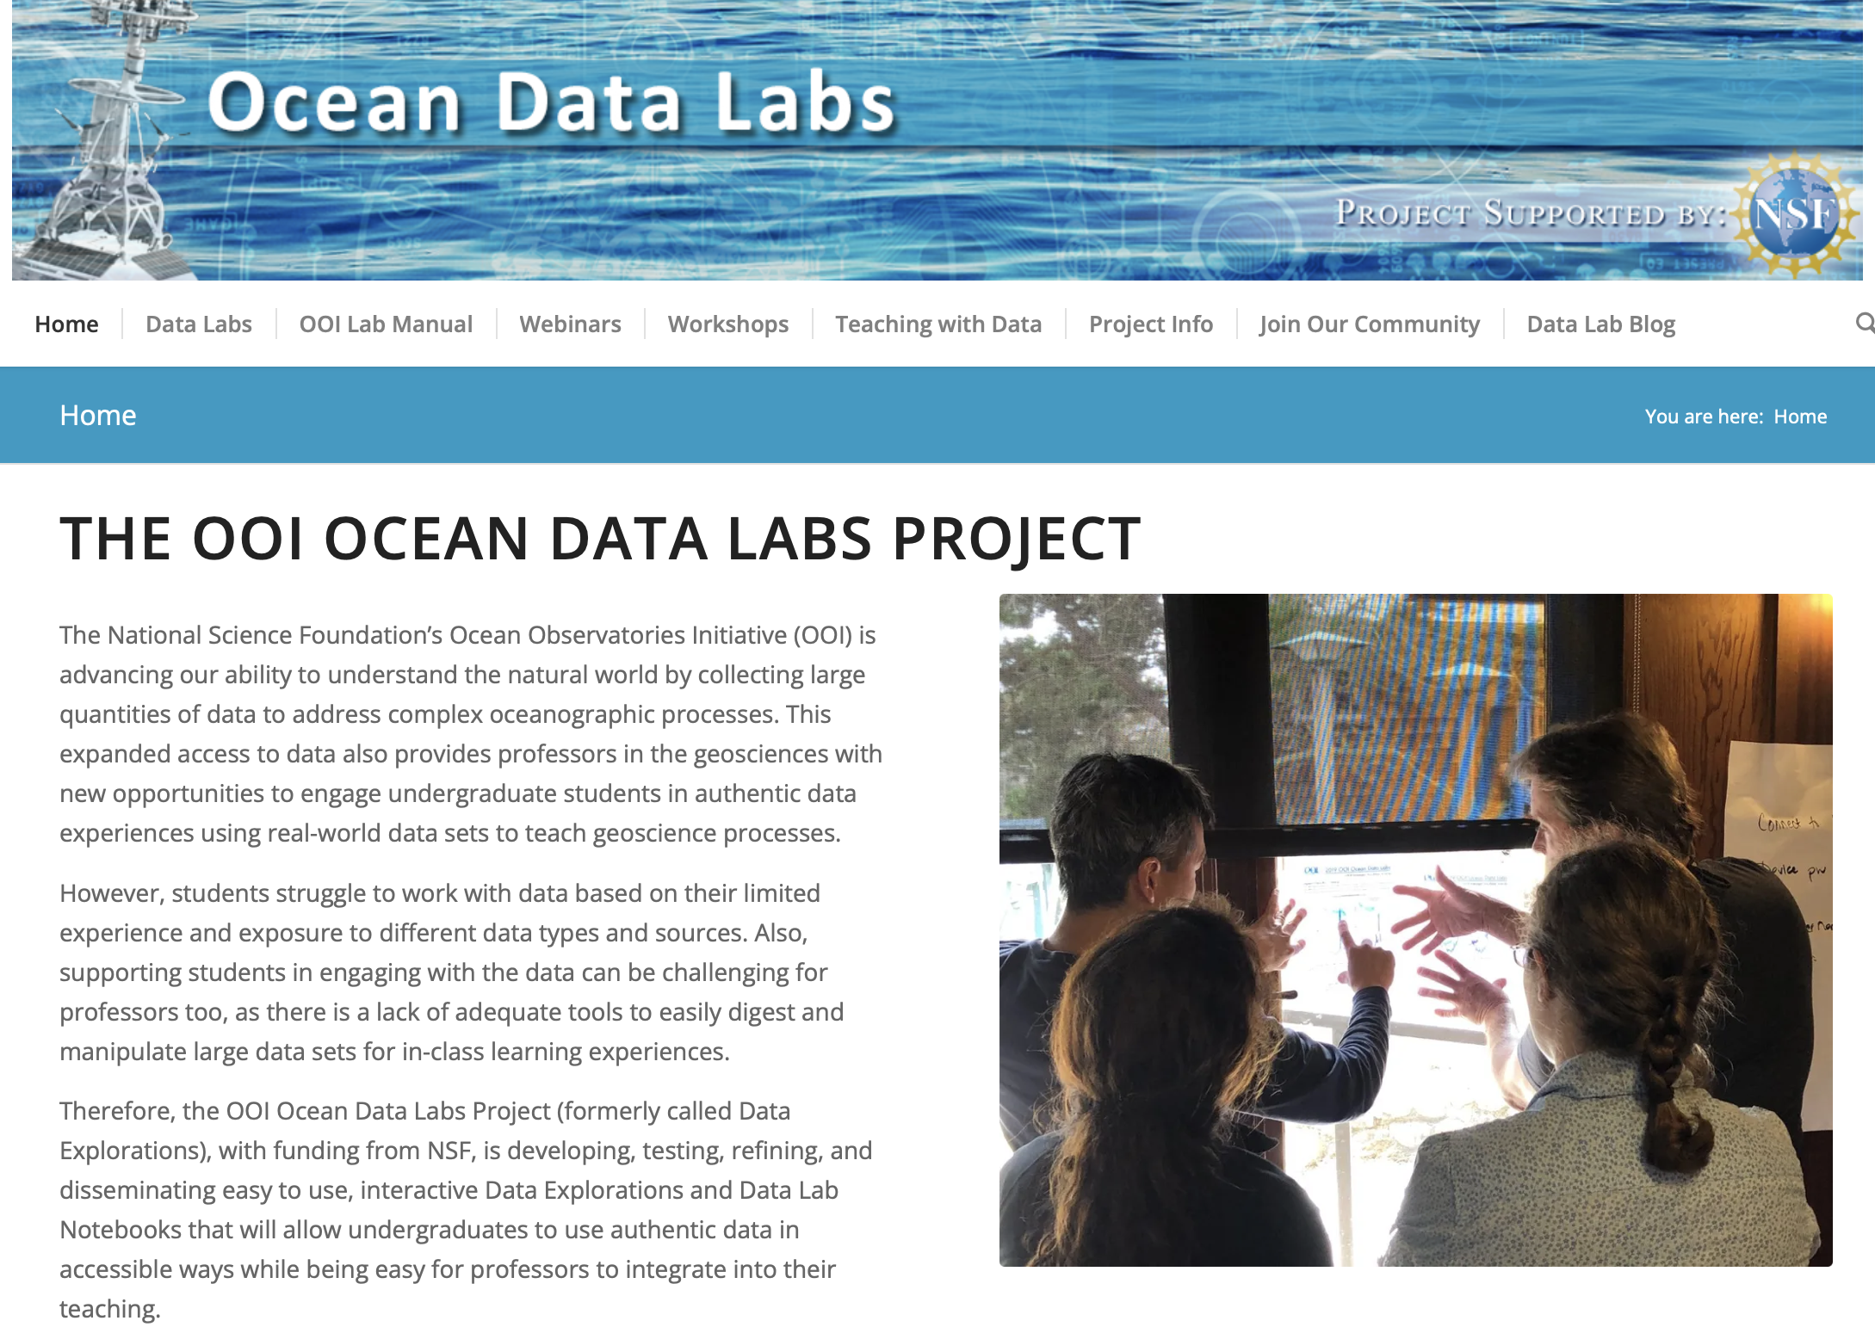
An Update on the OOI Data Labs Project
May 8, 2023
Janice McDonnell, Sage Lichtenwalner, Rutgers University
Dr. Anna Pfeiffer-Herbert, Stockton University
Denise Bristol, Hillsborough Community College
Dr. Dax Soule, Queens College
datalab.marine.rutgers.edu
Notes:
# of people who've participated; the community map graphic; anything to report from the REACH survey of interest
Lab Manual - a community-driven initiative; update on its development
Virtual REU - mentors from our community; 8 student posters at this meeting
Ways to join the community - upcoming Spring webinars; lab manual pilot #2

Slide 2
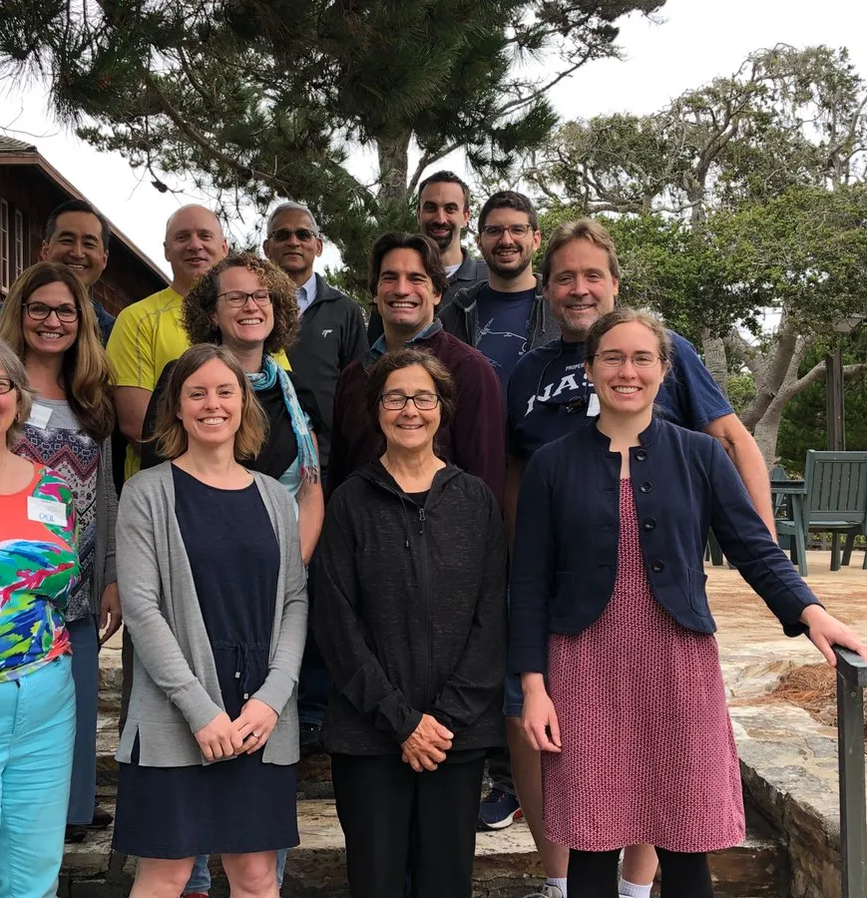
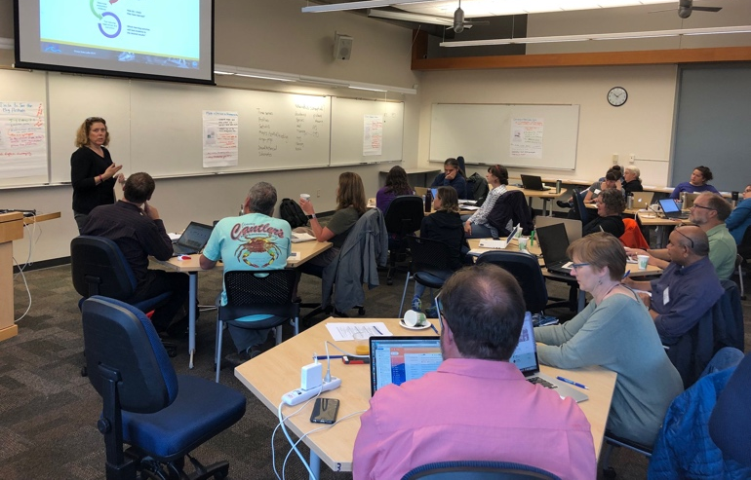
OOI Data Labs 2.0
Tasks
Engage a new community of faculty capitalizing on the Pioneer Array relocation
  Refresh our database of potential faculty
  ”Regional” workshop focused on Pioneer
Expand the collection of OOI education resources
  Development Workshop
Continue to support the community
  Two 1-day introductory workshops (e.g. OSM24)
  Sharing resources
Evaluation
  Needs Assessment to identify community needs
  Reach Survey to measure long-term impact

Slide 3
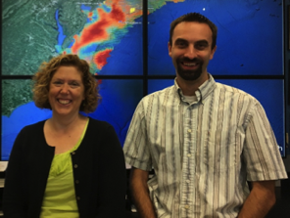
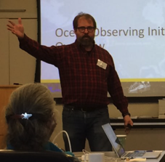
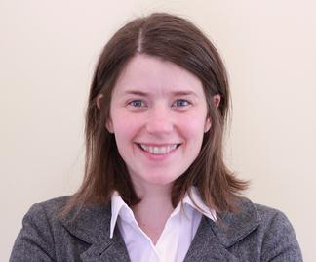


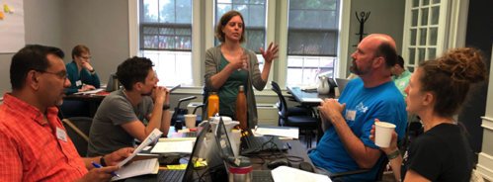
Project Team
NSF Grant #1831625
and # 2316075
Kristin O’Connell
SERC
Janice McDonnell, Sage Lichtenwalner
Rutgers University
Dax Soule
Queens College CUNY
Anna Pfeiffer-Herbert
Stockton University
Denise Bristol
Hillsborough CC

Slide 4
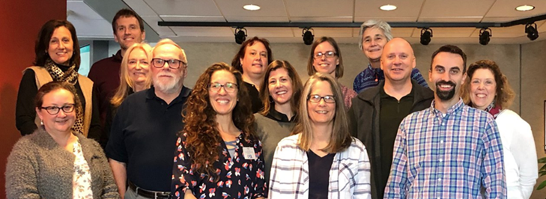
OOI
Data Labs
Project
Key Goals
Build a Community of Practice (CoP) of professors, interested in using OOI data with their undergraduate students:
Make OOI data more accessible to educators and students

Slide 6
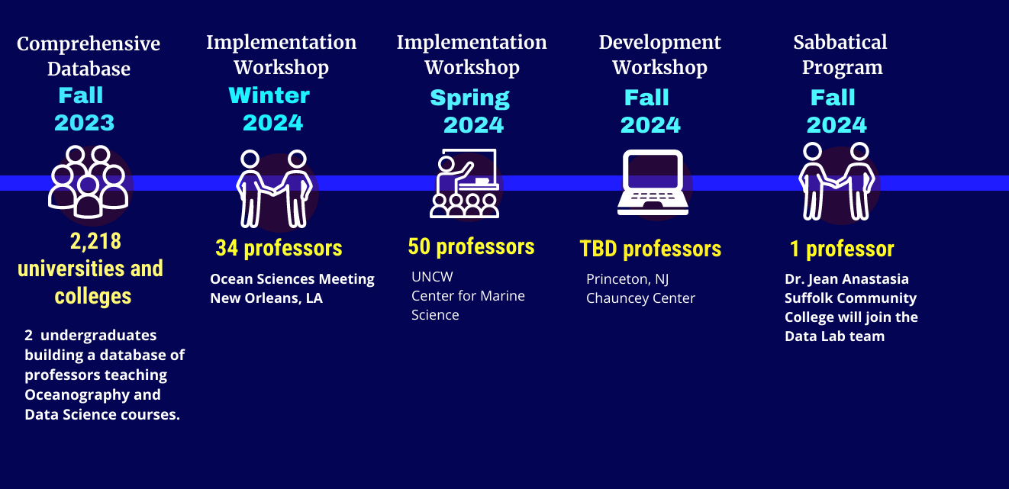
2023-24

Slide 7
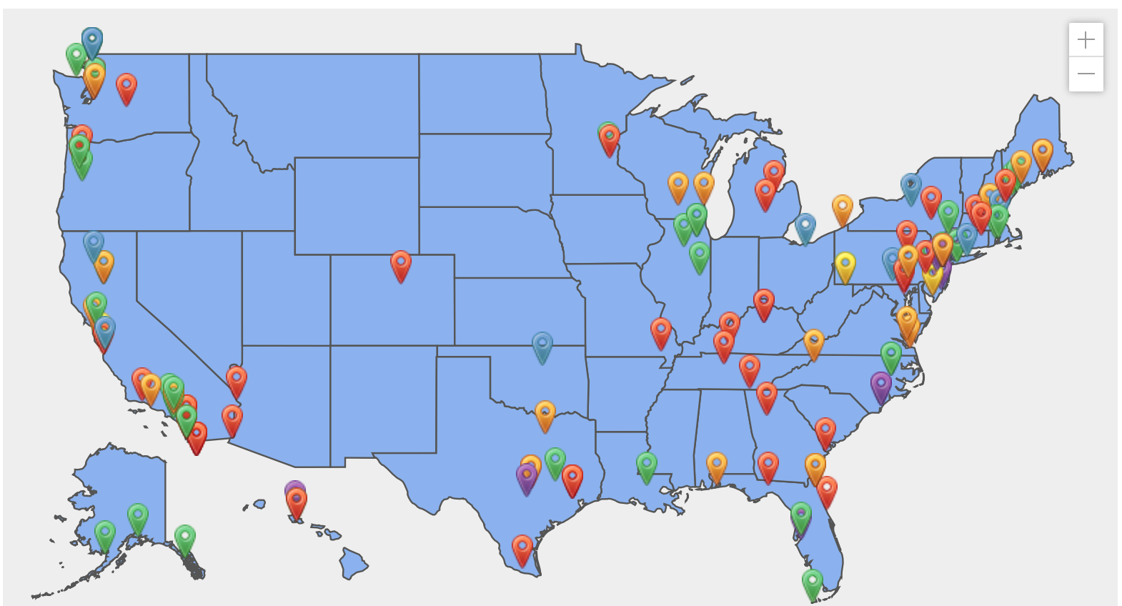
Community of Practice ~182 members
70% (n=133) involved in one or more Data Lab initiatives
** 60 Implementation workshop attendees (not pictured on map)
Notes:
Overall, 70.7% of 133 survey respondents indicated that they had been involved in one or more OOI Data Lab initiatives. As shown in Table 2, more than half indicated that they had visited that OOI Data Labs Project website, more than 1/3 indicated that they had joined the mailing list, roughly 1/5 indicated that they had used an OOI Data Exploration/Lab activity that they had created, and roughly 1/4 indicated that they had used an activity that someone else had created.

Slide 8
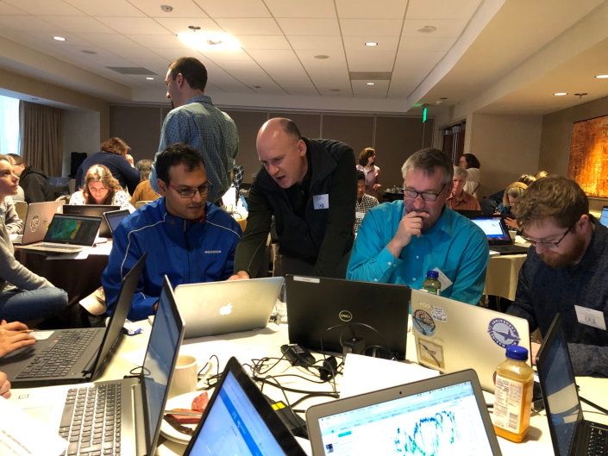
Data Labs workshop at OSM24
One day workshop during February 2024 Ocean Sciences Meeting in New Orleans
34 participants from a wide range of institutions
  two-year community colleges, 4-year PUI, R1/R2,…
Four previous curriculum developers returned as peer mentors

Slide 9
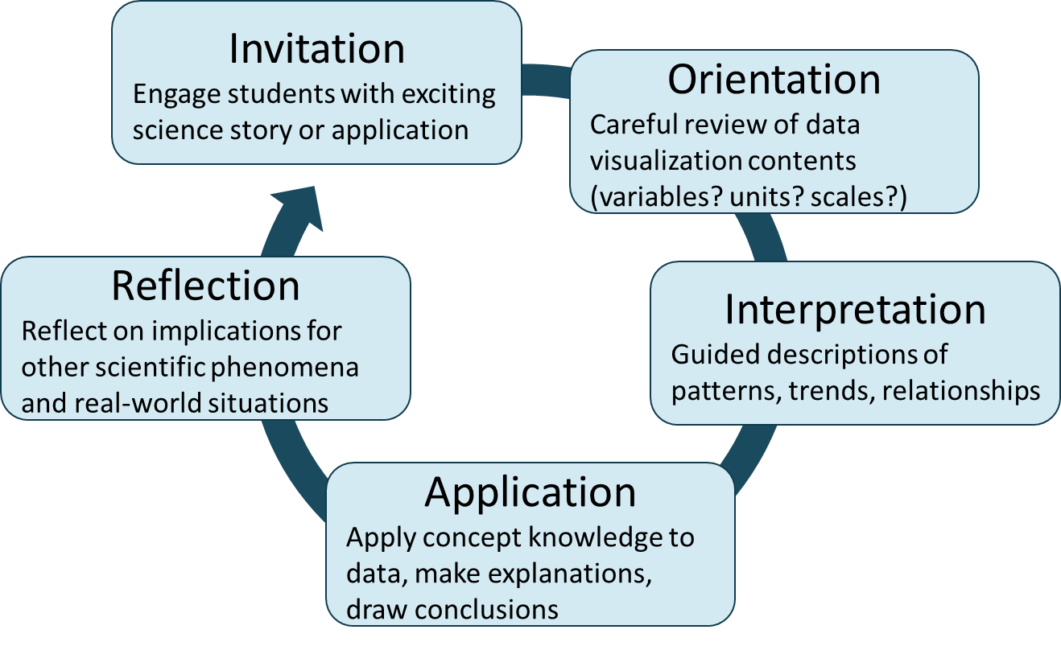
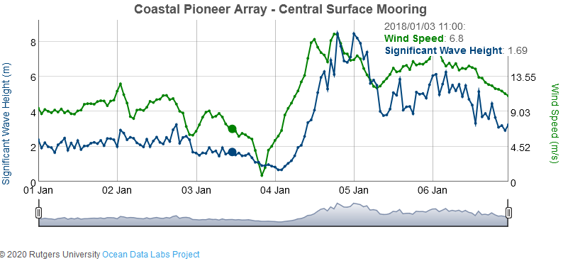
Data Labs workshop at OSM24
Introduced OOI project history
Reviewed existing Data Labs educational resources
Discussed challenges and recommendations for teaching with authentic data
Facilitated individual curricular planning
Invited participants to stay involved in the Data Labs community
Full workshop agenda: https://datalab.marine.rutgers.edu/ocean-sciences-2024-workshop/

Slide 10
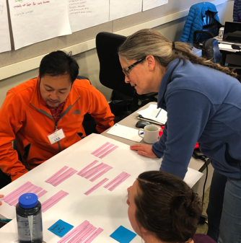
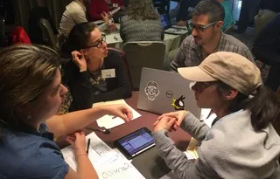
Data Labs workshop at OSM24
Feedback from participants (workshop evaluation by SERC):
  All respondents were satisfied (28%) or very satisfied (72%) with the workshop experience
  All respondents agreed or strongly agreed that the workshop goals were met, especially:
    Learn about the OOI program and key science questions it addresses
    Network with other professors interested in using oceanographic data
  80% plan to use OOI Data Labs in their classes within the next year

Slide 11
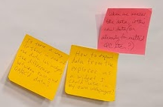
Data Labs workshop at OSM24
Observations from small group discussions…faculty need:
  well curated datasets
  scaffolded activities that are ready to implement
  examples from other professors
A subset of participants interested using OOI data for:
  undergraduate research or upper-level open-ended inquiry
  graduate student training in data science
  developing curricular tools using Jupyter Hub

Slide 12
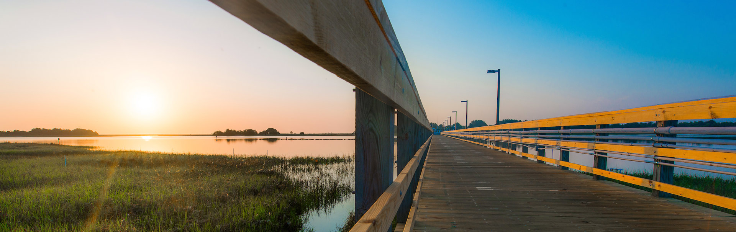
Upcoming: Mid-Atlantic Data Labs Workshop
June 1-5 at University of North Carolina Wilmington
Goals:
  Expand network of professors using OOI data in the classroom
  Introduce techniques for accessing OOI data
  Brainstorm development of new Pioneer array curriculum

Slide 13
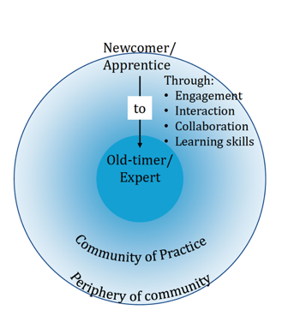
Building a Community of Practice
Of the 116 we worked intensively with in workshops:
19 delivered OOI DL webinars, presenting the DL they had developed during workshop
11 became DL Fellows
11 are designing and building the DL Notebook
9 became peer presenters at mini workshops
10 presented on OOI at Ocean Sciences Meeting in San Diego, CA
13 volunteered to be an OOI Virtual REU mentor
20 participated as Lab Manual testers
The community is growing!

Slide 14
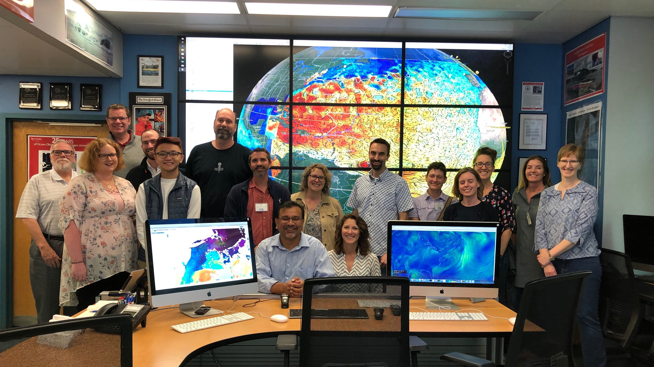
Thank you! mcdonnel@marine.rutgers.edu
Anna.Pfeiffer-Herbert@stockton.edu

