Slide 1
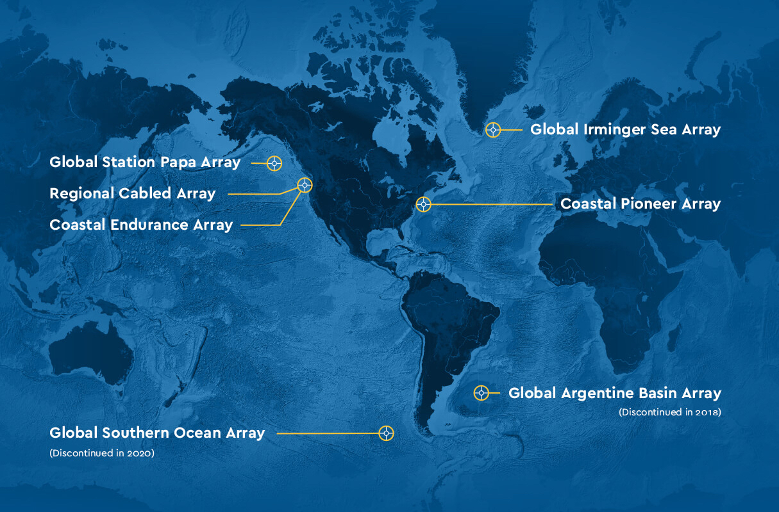
Data Labs Design Workshop
2024
datalab.marine.rutgers.edu

Slide 2
Welcome!
Goals for today’s call:
1- Review travel logistics for the workshop – what to expect/bring.
2- Expectations as a workshop participant.
3- Answer your questions/concerns.

Slide 3
Chauncey Center in Princeton NJ

Slide 4
Logistics
Fly into Newark – (Take NJ Transit to Princeton Junction and Uber/Lyft to Chauncey Center Princeton)
Fly into Phily – (Take Uber/Lyft to Chauncey Center, Princeton)
Travel will be reimbursed please save all receipts
Stipend $450 is provided for your participation in the workshop

Slide 5
What to Bring/Expect
Casual and comfortable clothes
Bring laptop if you have one
Syllabus/stories/worksheets/examples of how you have used Data Labs in the past
We will be going into Princeton on Friday October 18th for dinner and time to tour town. Please let us know if you will be joining us.
I will schedule car service to get you back to the airports on Sunday. Please let me know if you don’t want to be included in the car pool.

Slide 6
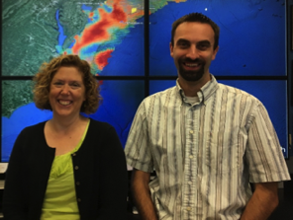
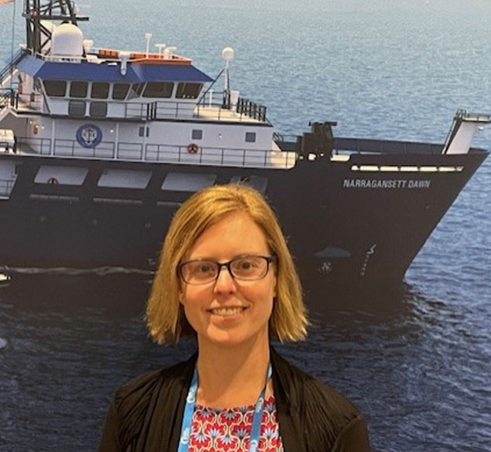
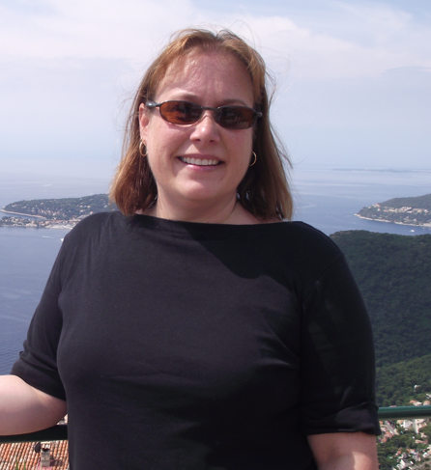
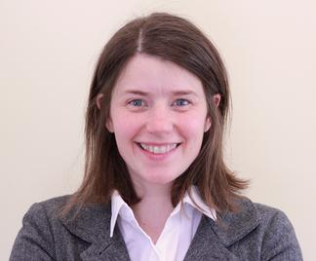
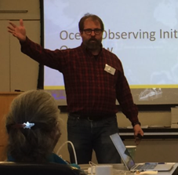
Data Labs Project Team
Janice McDonnell, Sage Lichtenwalner
Rutgers University
Anna Pfeiffer-Herbert
Stockton University
Denise Bristol
Hillsborough Community College
Dax Soule
Queens College CUNY
Kristin O’Connell
SERC

Slide 7
Workshop Goals:
Review OOI Data Lab Manual design structure and scaffolding
Discuss framework and audience for classroom activities using Python notebooks to access OOI data
Design 2-3 new Lab Manual chapters based on community needs assessment and update selected existing Lab Manual activities
Develop Python-based data analysis activities appropriate for novice programmers

Slide 8
OOI Data Lab Manual 3.0

Slide 9
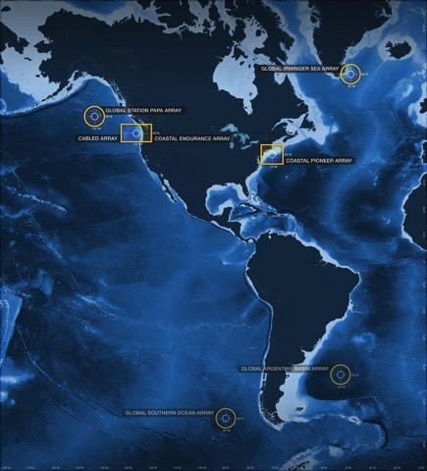
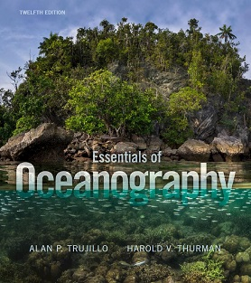
Alignment to Intro Oceanography curriculum
OOI science themes
and data availability
Topic | Lab Manual 2.0 Chapter
Ocean geography Ocean technology | Lab 1: Introduction to the OOI, the collection of oceanographic data
Data skills for oceanography | Lab 2: Building data skills
Marine Geology | Lab 3: Plate tectonics and the seafloor Lab 4: Seafloor changes in a volcanically active setting
Ocean Chemistry | Lab 5: Investigating density stratification
Physical Oceanography | Lab 6: Waves generated by large storms
Biological Oceanography | Lab 7: Primary production Lab 8: Anoxic events
common Oceanography textbooks

Slide 10
Lab Manual 3.0 Plan
Develop 2-3 new chapters
Define fundamental concepts
Locate relevant OOI data and design concept for interactive data visualizations
Write surrounding content to blend with the existing lab manual structure
Update existing chapters
Revise hooks, background information, or questions
Improve scaffolding
Update datasets

Slide 11
New topics suggested by needs assessment
Natural hazards
Storm events/impacts (e.g., Hurricane Debby passage near Pioneer array)
Wind, waves, temperature, precipitation
Detect land runoff at MAB Pioneer (estuarine plumes)
Coastal tide gauge data for storm surge detection
Fronts, eddies, water masses
Compare SST spatial data with OOI sensors
Water mass T-S characteristics (e.g., slope, shelf, and estuarine water masses near MAB Pioneer)
Tides
Shelf vs. NOAA coastal tide gauges (inshore estuaries, outer coast, offshore)
Interesting impacts of tides? (e.g., earthquake frequency, hydrothermal fluid flux at Axial Seamount)
Climate change - temperature
Long-term temperature trends at Station Papa
Compare OOI temperature data to climatologies (surface and subsurface)
Climate change - carbon
CO₂ air-sea flux and ocean acidification
Impacts on organisms and ecosystems
Other topics mentioned: Subduction zone processes, rip currents, tsunamis, rogue waves
Aiming for 2-3 new topics at most
Notes:
Mention that we are open to additional ideas! But we need some idea of the topics before the workshop so that we can start thinking about data sources

Slide 12
Topic | Lab Manual 3.0 Chapter
Ocean technology | Lab 1: Introduction to the OOI, the collection of oceanographic data Add: people and careers, more on technology
Geography and | Charts and Mapping – MAB setting, General geography, Lat/Long, Bathymetry, ocean floor features
Data skills for oce | Lab 2: Building data skills – add graph types
Marine Geology Tsunami | Lab 3: Plate tectonics and the seafloor – improve scaffolding
Volcanic eruptions | Lab 4: Seafloor changes in a volcanically active setting– improve scaffolding
Ocean Chemistry | Lab 5: Investigating density stratification
Physical Oce | Lab 6: Waves generated by large storms
Physical Oce- Fronts, Eddys, water masses | Compare SST spatial data with OOI sensors – use eddies/satellite Water mass TS characteristics (e.g., slope, shelf, estuarine water masses near MAB Pioneer)
Bio Oce | Lab 7: Primary production – update with new data
Physical/Bio Oce | Lab 8: Anoxic events– update with new data
Natural Hazards | Hurricanes – storm surge vs tide/ Coastal Tides vs. shelf Tsunamis, Coastal flooding,
Climate change | Ocean Acidification - CO2 air-sea flux and ocean acidification, Impacts to organisms, HAB’s Temperature trends

Slide 13
Python Activity Development

Slide 14
Python Activity Development Goals
During the workshop, we will develop a set of “next-level” python-based activities that…
Support upper-level undergraduate (or beginning graduate) oceanography courses.
Introduce students to accessing and visualizing OOI datasets using simple code blocks
Use real-world data that allows students to explore advanced oceanographic concepts and data analysis techniques
Incorporates appropriate scaffolding to ensure that neither instructors nor students are required to have prior coding experience to effectively implement the activities
Effectively engages students in data exploration and interpretation.
I.e. these activities should be more than a tutorial, but also not a coding textbook.

Slide 15
What it is NOT…
A full data analysis or data science “textbook.”
A few already exist.
Is there a need for an OOI or undergrad ocean-focused one? (If so, next project)
A set of python activities that extend existing “lab manual” chapters.
Labs may have similar topics, but the 2 manuals should be independent.
Notebooks to support the existing Data Labs manual
Nice idea, but how useful?
A basic data analysis guide or a full “how to access and use OOI data” using python (or another language) for upper-level undergrad research.
Finding the balance between tutorial and activity is key.

Slide 16
Draft Workshop Discussion Plan
Target Audience / Courses
Lab Manual Format
E.g. Jupyter Book
Overall Lab Manual Structure
Likely mirror the Inro book? (see right)
Activity Structure / Pedagogy
Topic Selection
Ocean Concepts
Data Analysis Skills
Events and Cool dataset
Proposed Structure
Lab Chapter 1
An introduction to exploring OOI data using Python Notebooks
Chapter 2
An intro to plotting oceanographic datasets
Chapter 3+
Assorted activities that delve into…
data processing techniques (e.g. averaging)
data skills (e.g. reading and interpreting graphs)
oceanographic concepts, events and stories.

Slide 17
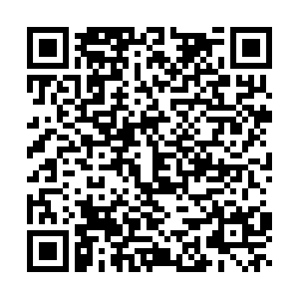
Roles for Design Fellows
Lab Manual Authors (~4 teams)
Revisions to existing chapters
Develop new chapters
Python Activity Authors (~4 teams)
Define scope and structure
Develop sample activities
Work in teams with Python and curriculum development expertise
Bridge: Contribute to Python activity design discussions, assist with locating data for lab manual activities
Fill out this form to let us know what role/topics you are most interested in:
https://docs.google.com/forms/d/e/1FAIpQLSexSZ-Asj2zanuFEvvXoPrI02GDpz14nxl3Vs6Zzpg0jrNCAg/viewform?usp=sharing

