Slide 1
Let’s create a collection of Python notebook activities to engage undergrads in OOI data!
Dax, Sage, & all of you!
2024 OOI Data Labs Design Workshop
October 17-20, 2024

Slide 2
Workshop Goals
Review OOI Data Lab Manual pedagogy, design, structure and scaffolding.
Design 2-3 new Lab Manual chapters and update selected existing Lab Manual activities based on community needs assessment feedback.
Outline a framework and target audience for classroom activities using Python notebooks to access OOI data.
Develop a collection of Python-based data analysis activities appropriate for novice programmers.
Ensure that activities and data widgets are properly scaffolded to be accessible to instructors and students from a variety of backgrounds

Slide 3
Python Notebook Development Goals
During the workshop, we will develop a set of “next-level” python-based activities that…
Support upper-level undergraduate (or beginning graduate) oceanography courses.
Introduce students to accessing and visualizing OOI datasets using simple code blocks.
Use real-world data that allows students to explore (advanced) oceanographic concepts and data analysis techniques.
Incorporate appropriate scaffolding to ensure that neither instructors nor students are required to have prior coding experience to effectively implement the activities.
Effectively engage students in data exploration and interpretation. I.e. these activities should be more than a tutorial, but also not a coding textbook.

Slide 4
What it is NOT… (we can debate this)
A full data analysis or data science “textbook.”
A few already exist.
Is there a need for an OOI or undergrad ocean-focused one? (If so, next project)
A set of python activities that extend existing “lab manual” chapters.
Labs may have similar topics, but the 2 manuals should be independent.
Notebooks to support the existing Data Labs manual
Nice idea, but how useful?
A basic data analysis guide or a full “how to access and use OOI data” using python (or another language) for upper-level undergrad research.
Finding the balance between tutorial and activity is key.

Slide 5
Big Questions / Discussion Plan
Big Questions
Target Audience / Courses
Final Format
Overall Content Structure
Activity Structure / Pedagogy
Topic Selection
Ocean Concepts
Data Analysis Skills
Events and Cool Datasets
Today’s Sessions
What should the end-product look like?
What topics/skills should the notebook collection include?
Notebook activity structure & pedagogy
How will we get there?

Slide 6
The OOI Data Labs 2.0
Research Challenge
OOI Data + Science
Data
Explorations
Data
Workshops
?
Education
Data Science Coding/Python
Data Sci
Bootcamps

Slide 7
Wilmington Workshop Participants… How comfortable are you in incorporating oceanographic datasets into your teaching?

Slide 8
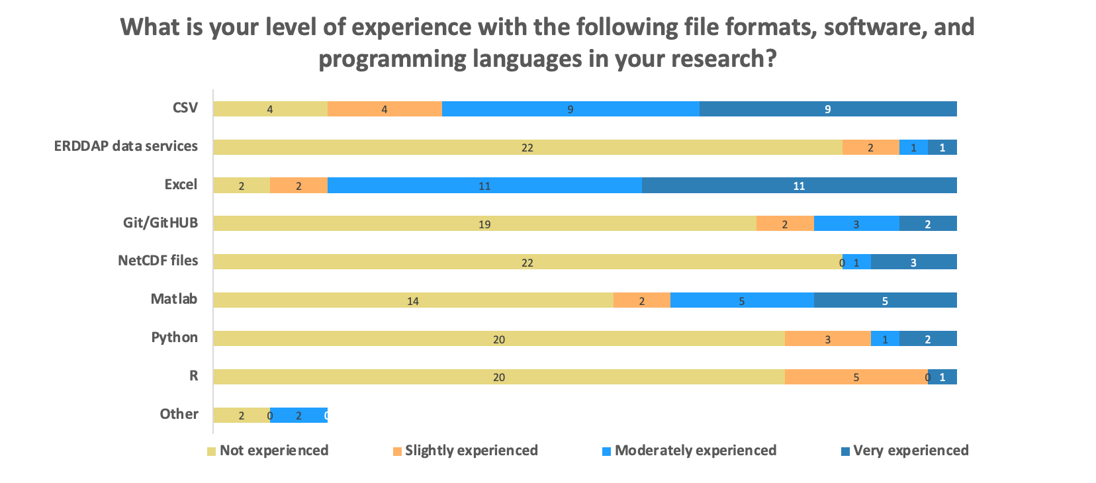
Pre-Survey: Research Experience

Slide 9
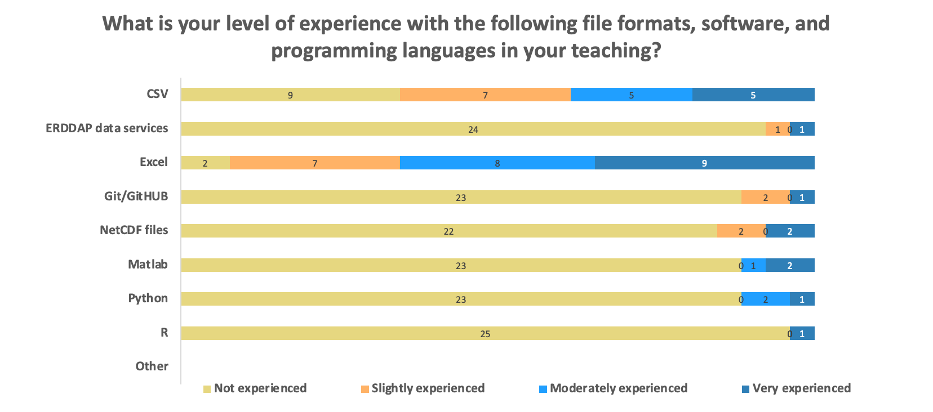
Pre-Survey: Teaching Experience

Slide 10
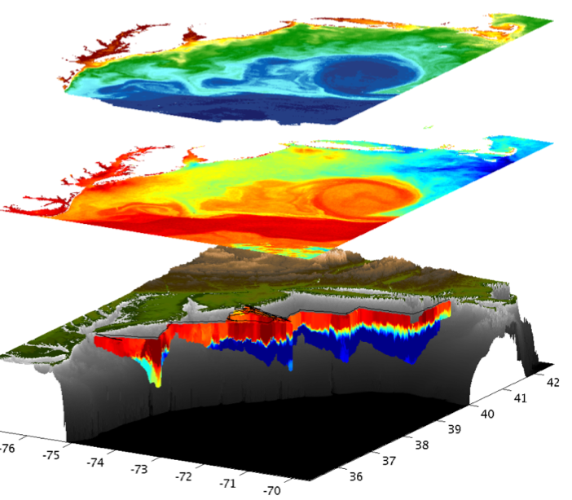
Ocean Observing Systems Potential for Education
Data already available “on the shelf”
Supports a wide variety of research questions, locations & instruments
Provides an opportunity to focus on programming, data analysis, and data visualization skills
Helps build data literacy and critical thinking skills using “real” data

Slide 11
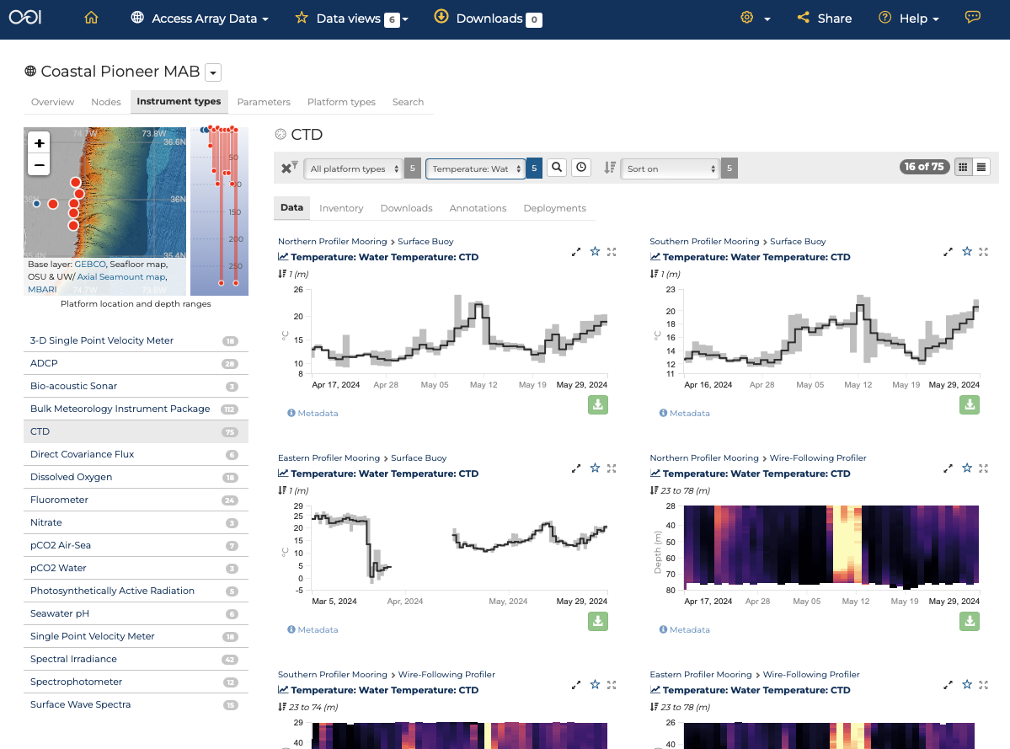
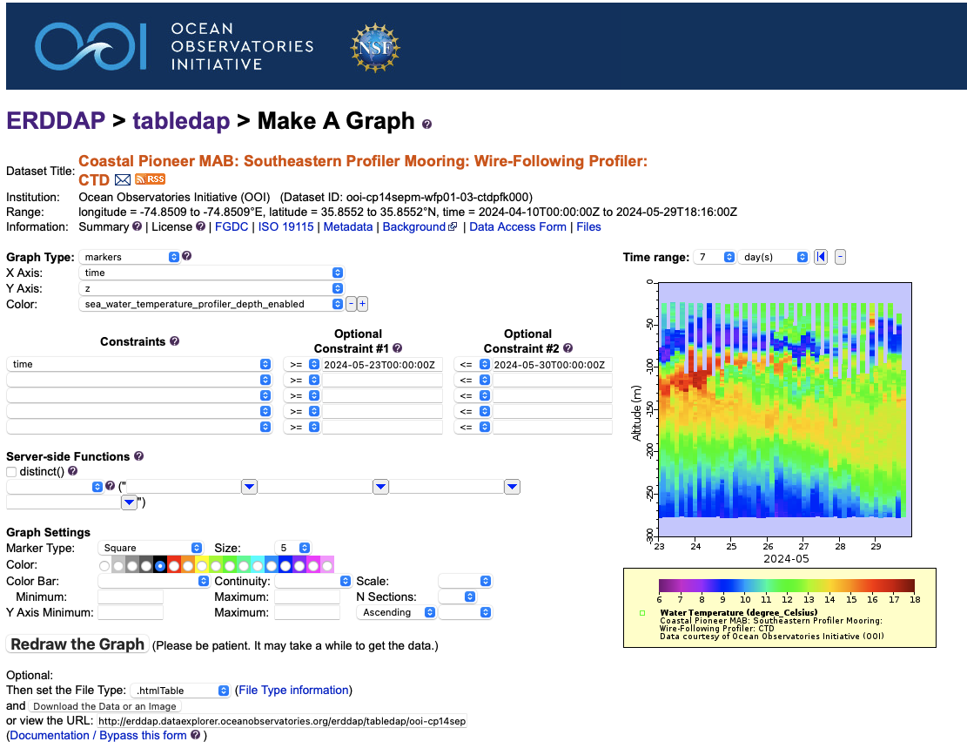
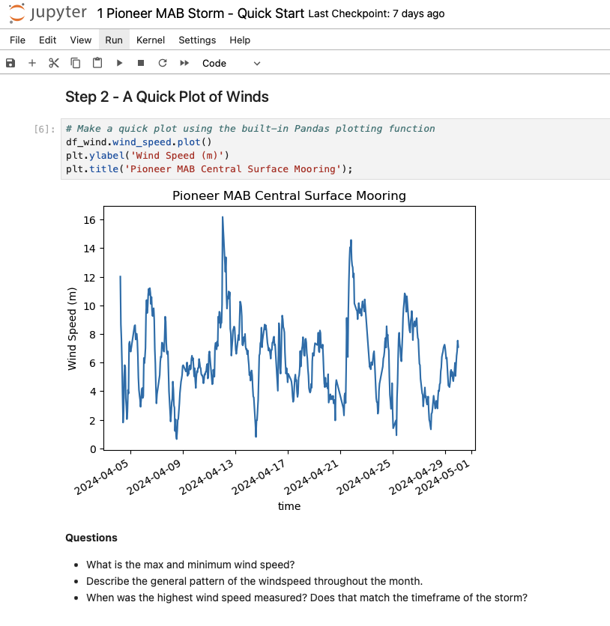
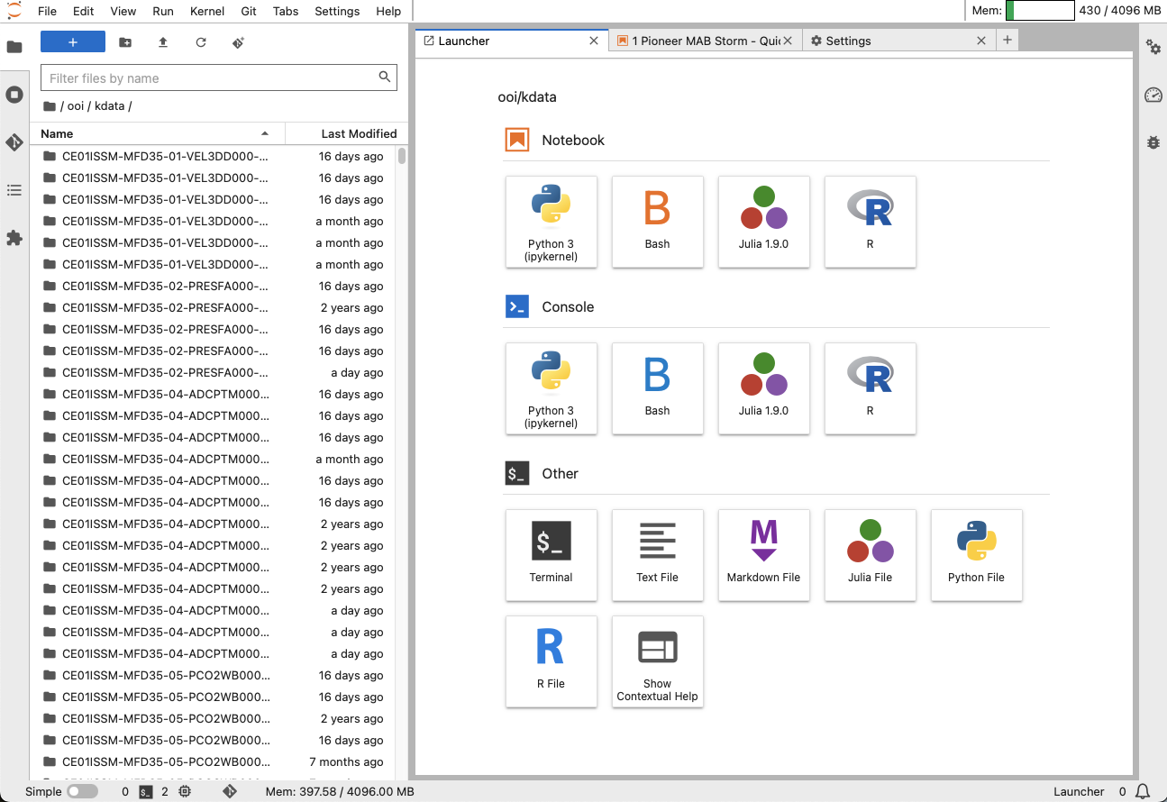
OOI’s Advanced Data Tools
OOI Data Explorer
ERDDAP Data Servers
Coding Notebooks
(in development)
OOI Jupyter Hub
New!

Slide 12
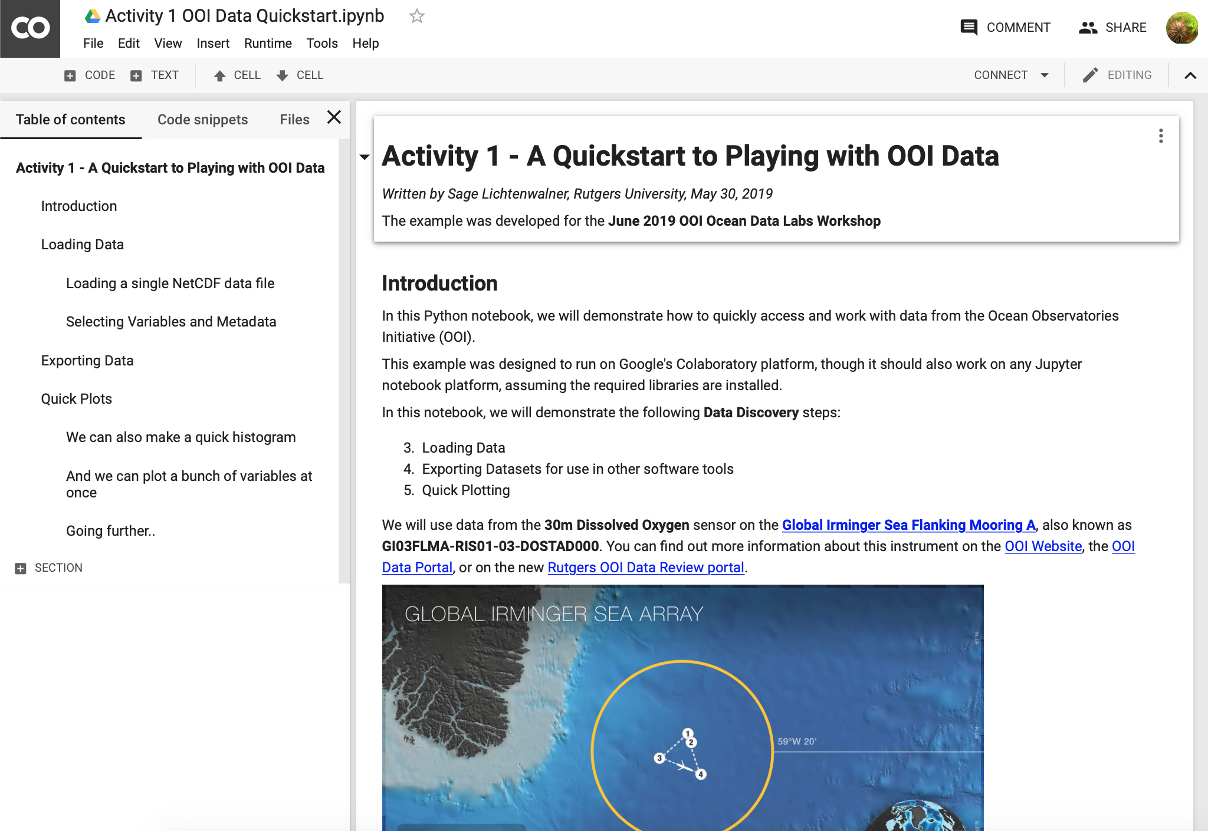
The Power of Coding Notebooks for Education
Low-to-No setup
Thanks to Google Colab, OOI JupyterHub, and other tools
Runs in your browser
A “linear” development approach
Easy(ish) to understand
Low bandwidth
No need to download data locally
Lots of datasets readily available
Sometimes co-located with server
Notebooks are Sharable
via GitHub
In real-time with Colab

Slide 13
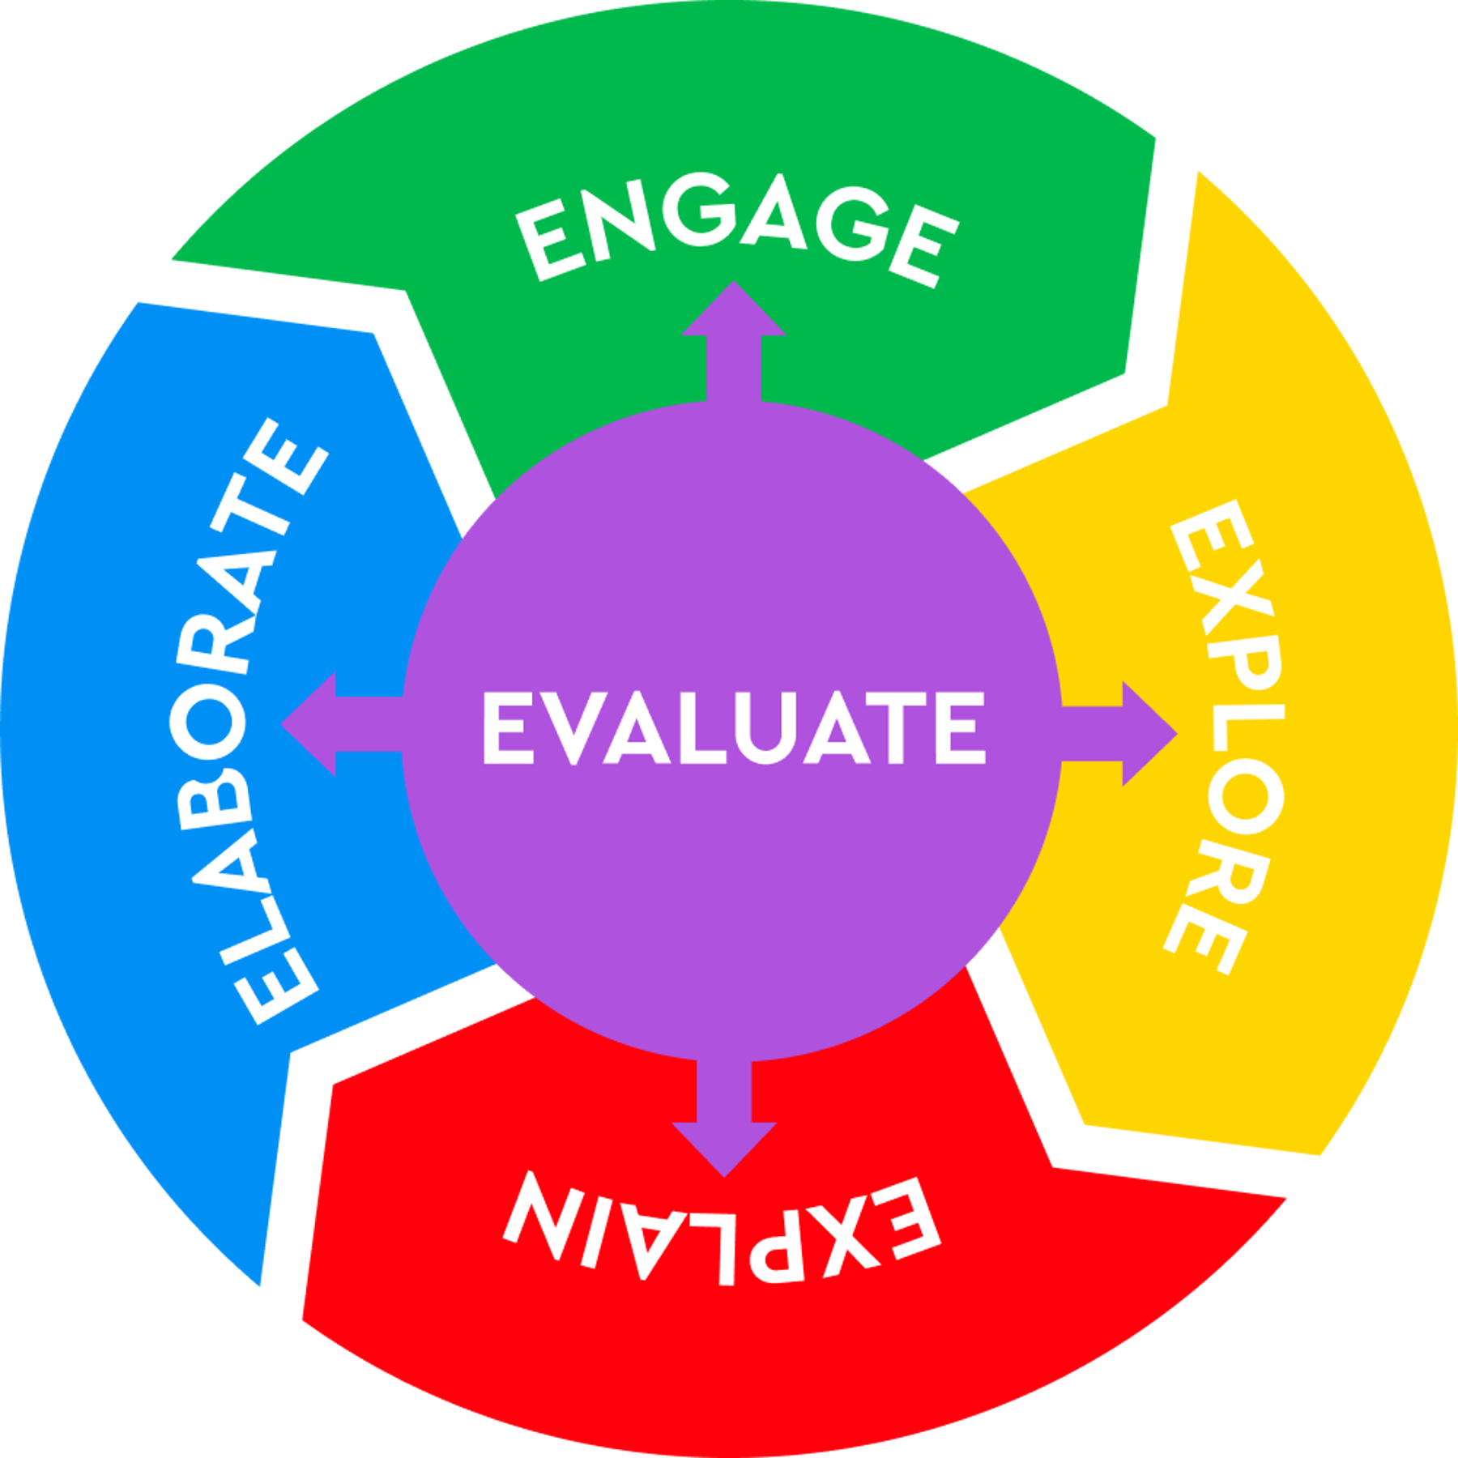
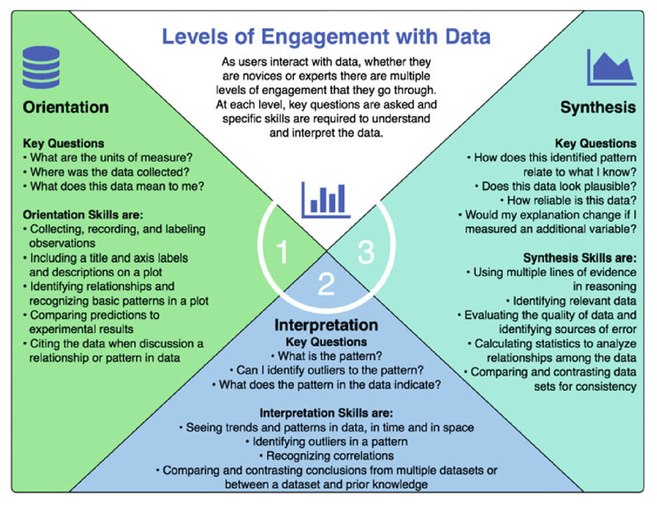
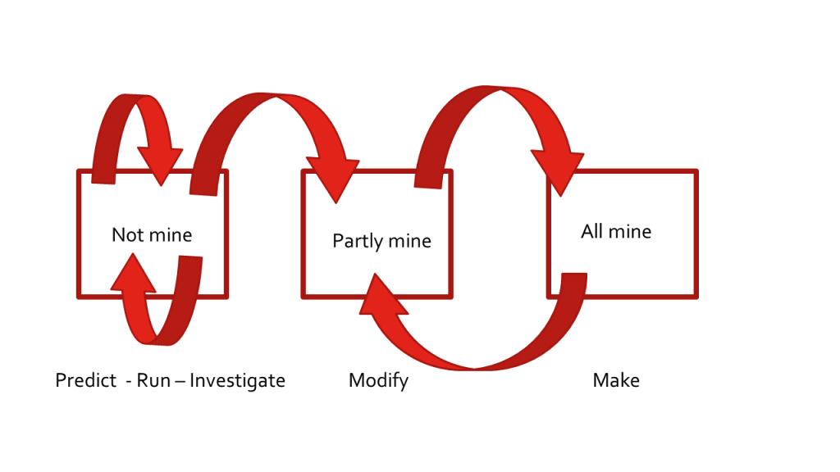
Pedological Approaches for Coding-based Activities
Structured/Guided Inquiry
Constructivism / PBL
Learning for Use (Edelson 2001)
Motivate, Construct, Apply/Refine
Bybee 5E Instructional Model
Engage, Explore, Explain
Levels of Engagement (Hotaling 2019)
Orientation, Interpretation, Synthesis
PRIMM Teaching Model
Paired Programming

Slide 14
Potential Advantages of Notebook-based Educational Activities
Educational Possibilities
Develop your own activities
Advanced activities allow students to gain experience
Working with data (Data Literacy)
Using data portals
Making their own graphs (Visualization Literacy)
Student can conduct their own research projects (Scientific Literacy)
OOI Tools for Skill Development
Data Explorer
Quick graphs
Data Downloads for additional analysis
Share custom Data Views
ERDDAP
Quick graphs & data downloads
DIY Coding (R, Python, Matlab) Notebooks & JupyterHub
Custom graphs
Advanced data processing techniques (averaging, correlations, anomalies, etc.)

Slide 15
Let’s go to the notebook… ???
Activity 0

Slide 16
Session 1

Slide 17
Session 1: What should the end-product look like?
Evaluate the design of existing Notebook exemplars
Decide on a format to publish in
Jupyter Book
Regular web pages
Something else?
Discuss overall lab manual structure
Do we mirror the Lab Manual?
Also, what do we call this thing?

Slide 18
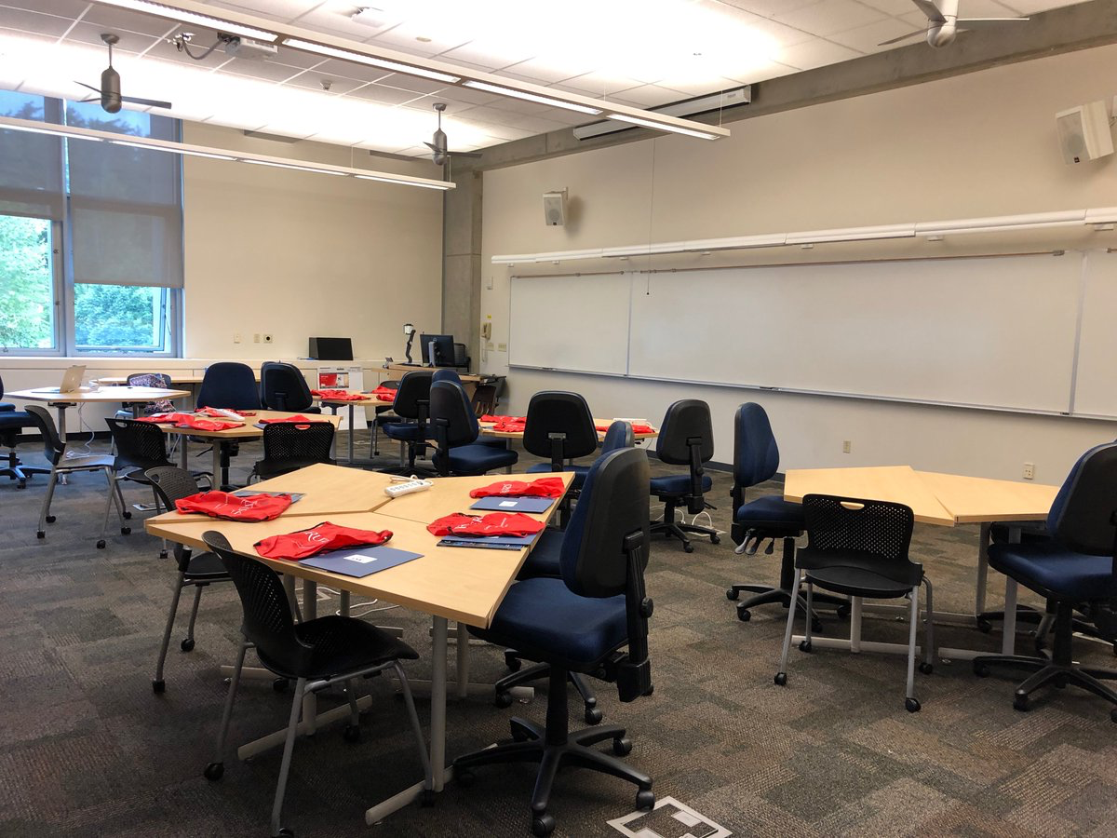
Who is our primary audience?
What are the outcomes for each audience?
Undergraduates
Professors
What are the backgrounds and needs for each?
Possible Vision for the Collection
Focus on Messy Data (for practice)
Make it Modular (can be used in pieces or together)
Dynamic Product (interactive, and not just paper based)
Highlight strengths of OOI

Slide 19
Book Review: Questions to Consider
Activity 1
What do you like about the resource?
What do you not like?
How is the model applicable to what we want to do?
What features (pedagogical or technical) do you like that we should incorporate into our notebooks?

Slide 20
Book Examples
Data Analysis Techniques in Marine Science (chapter 2.4)
An Introduction to Earth and Environmental Data Science
Python for Atmosphere and Ocean Scientists (chapter 4)
Data Analysis and Visualization in Python for Ecologists (chapter 9)
Introduction to Earth Data Science Textbook (chapter 4, lesson 3)

Slide 21
Overall Format and Structure Discussion
Activity 1b
Do we Mirror the Existing Lab Manual?
Lab Chapter 1
An introduction to exploring OOI data using Python Notebooks
Chapter 2
An intro to plotting oceanographic datasets
Chapter 3+
Assorted activities that delve into…
data processing techniques (e.g. averaging)
data skills (e.g. reading and interpreting graphs)
oceanographic concepts, events and stories.

Slide 22
Session 2

Slide 23
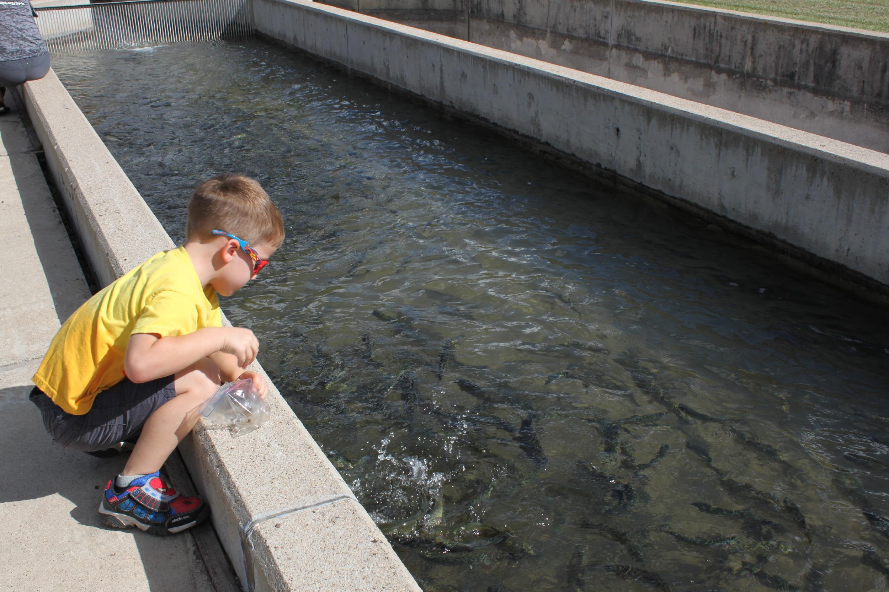
Session 2: What topics/skills should the notebook collection include?
Topic Selection
Ocean Concepts
Data / Analysis / Coding Skills
OOI instruments
Events and other known cool datasets/stories

Slide 24
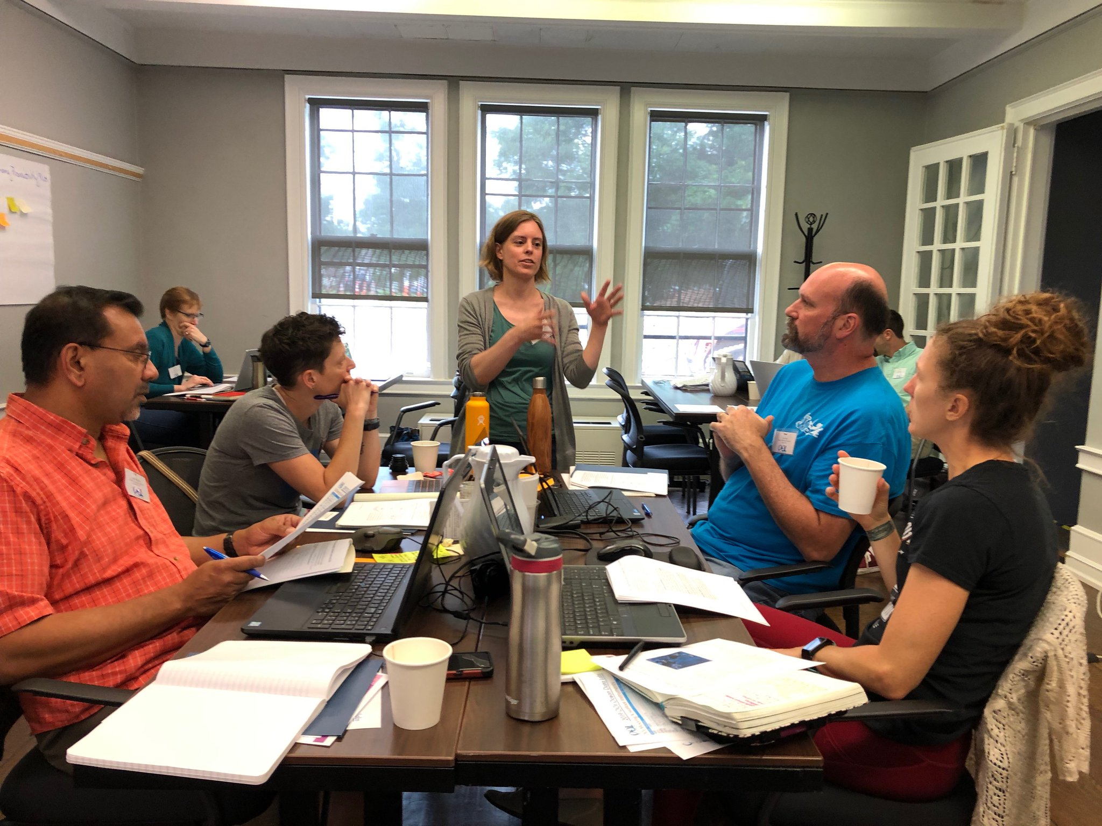
Data Exploration Design Process
Having an identified process helped us to standardize development and insure all aspects are appropriately thought through
It also allowed us to identify tasks that could be accomplished by different community members
Identify Target Scientific Concepts & Skills
Match Educational Goals with Instrumentation
Find Available Instrument Data
Cleanup the Dataset
Add Context & Educational Surrounds
Build Interactive Visualizations

Slide 25
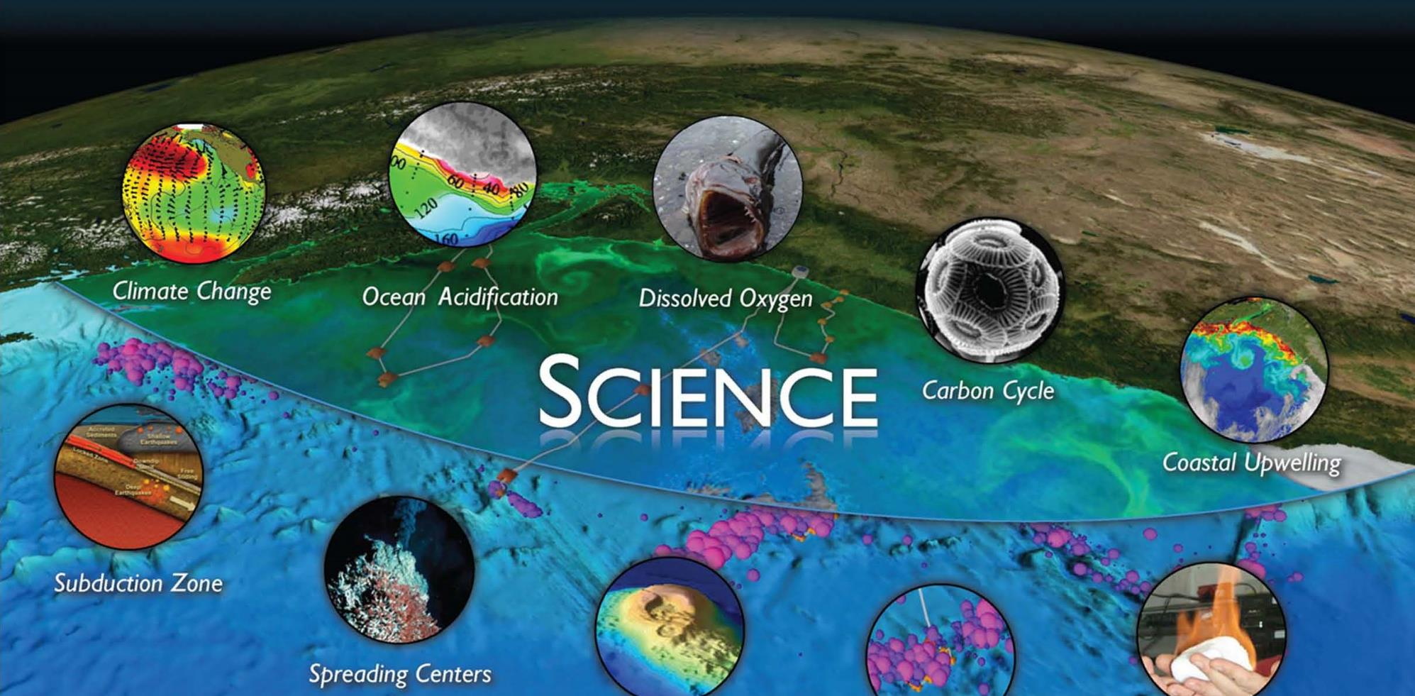
1. Identify Target Scientific Concepts and Skills
Crosswalk
Climate variability, Ocean Food Webs, and Biogeochemical Cycles
Ocean-Atmosphere Exchange
Coastal Ocean Dynamics and Ecosystems
Turbulent Mixing and Biophysical Interactions
Global and Plate-scale Geodynamics
Fluid-Rock Interactions & Sub-seafloor Biosphere
Core Concepts from
Introductory Oceanography
OOI Science Themes & Research Questions

Slide 26
2. Match Educational Goals with Instrumentation
7
58
34
56
1,313
9,557
153,589
Arrays
(2 suspended)
Stable Platforms
Moorings, Profilers, Nodes
Regularly Planned Mobile Assets
Gliders, AUVs
Instrument Types
Instruments (~850 deployed)
Science Data Products
Science/Engineering Data Products
As of 2/9/18
Notes:
Measurement Complexity
1,327 Instruments
36 Instrument Types
Hundreds of science parameters
Fixed / Profiling / Gliding Platforms
Temporal/Spatial resolution
Big Headaches:
Instrument Issues
So much data to choose from

Slide 27
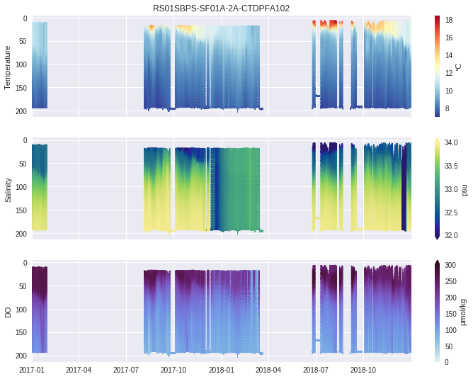
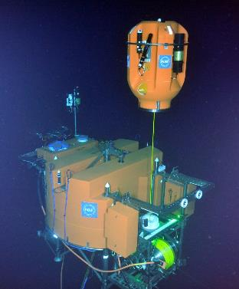
3. Find Available Instrument Data

Slide 28
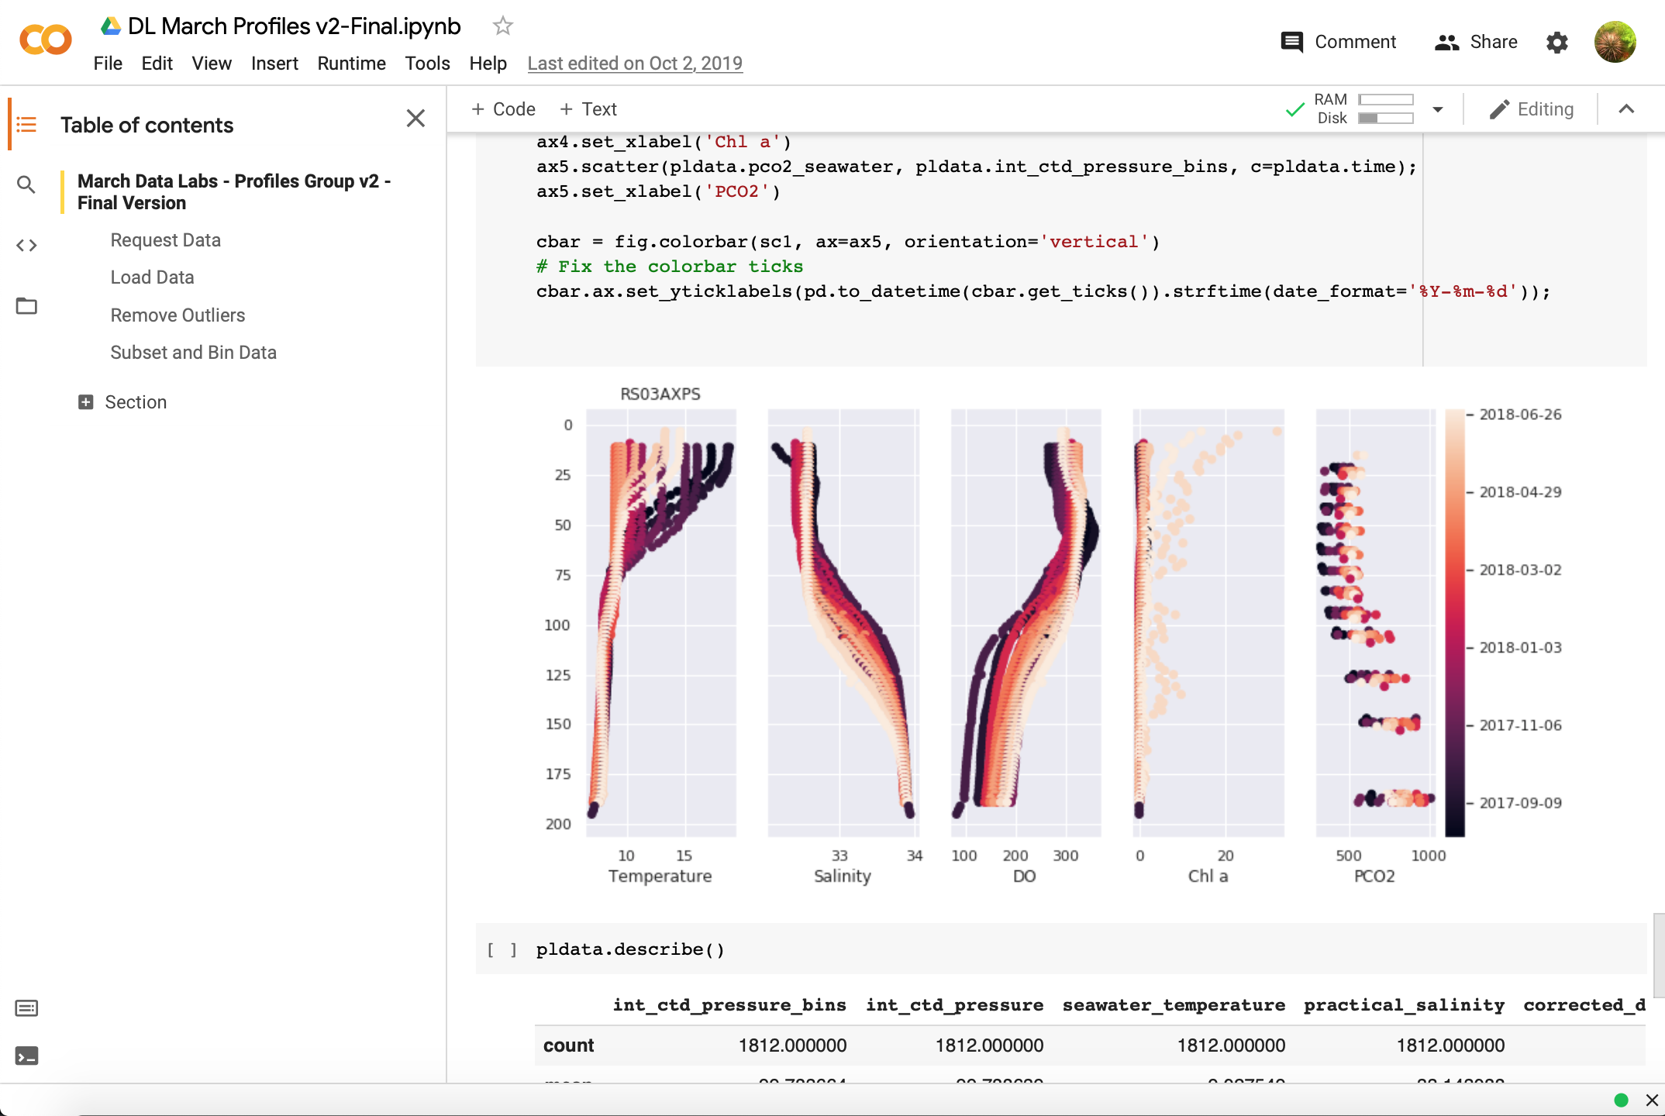
4. Cleanup the Dataset
Download datasets
Remove outliers
Average/Bin (if needed)
Merge instruments
Export as CSV
Our goal was to keep the final datasets as “true” to the look of the raw (authentic) data as possible.
Python Notebooks are available on GitHub for each activity, for those looking for extensions.

Slide 29
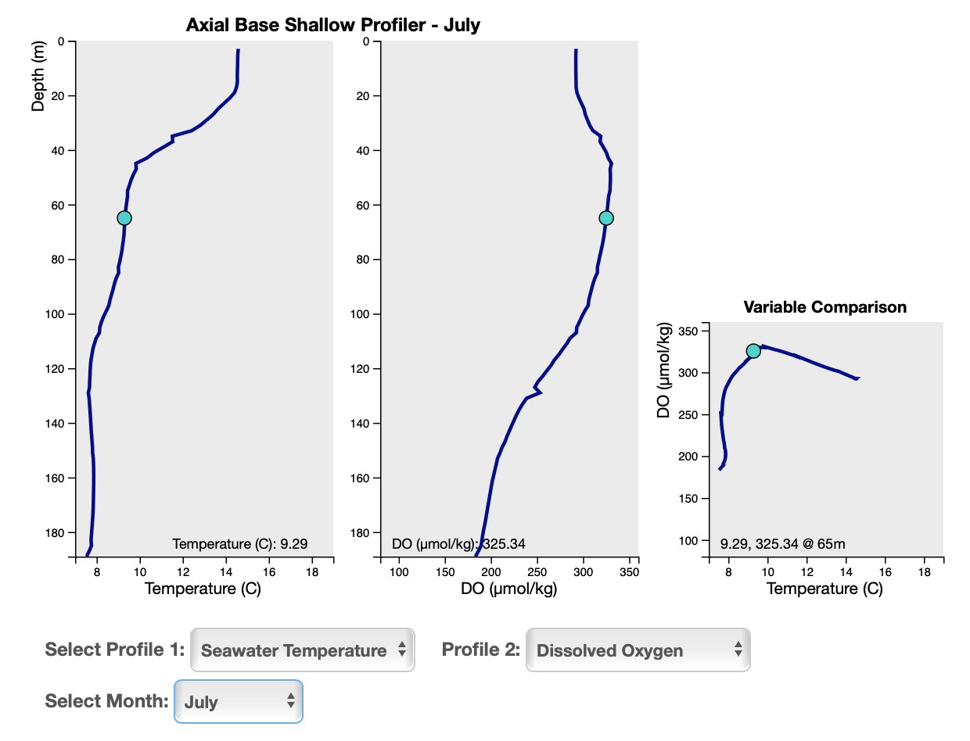
5. Build Interactive Visualizations
Development Tools
dygraphs.js Good option for time-series graphs
d3.js Custom/complex graphs, e.g. profiles
Leaflet.js Interactive spatial maps, e.g. earthquakes

Slide 30
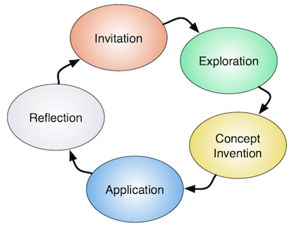
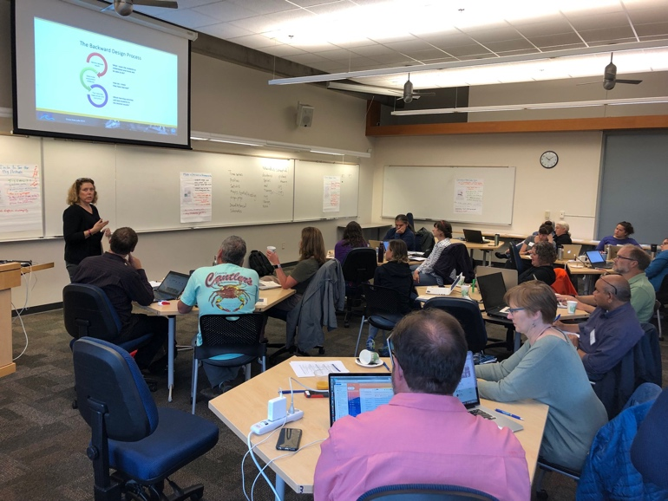
6. Add Context and Educational Surrounds
Questions
Data Tips
Background Info/Images
Instructor’s Guide
Assessment
Active Learning Strategies
Related Activities based on the LHS Learning Cycle
The Learning Cycle
Lawrence Hall of Science

Slide 31
Design Process – Lessons Learned
Identify Target Scientific Concepts & Skills
Match Educational Goals with Instrumentation
Find Available Instrument Data
Cleanup the Dataset
Add Context & Educational Surrounds
Build Interactive Visualizations
Takes time and effort – The process is highly iterative (esp. 3&5)
Process helps everyone stay on track and divide tasks
Educators can help with content identification and development
With better data portals, they can also help with data and visualizations
Matching goals and finding appropriate datasets to use in educational settings was most challenging, especially for a new OOS like OOI

Slide 32
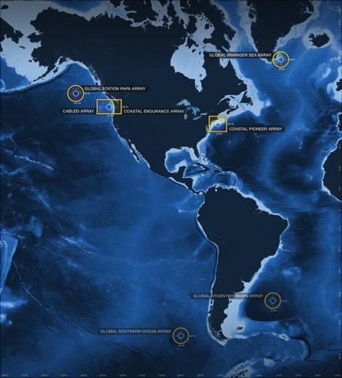
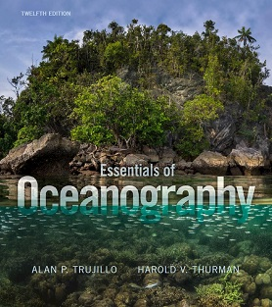
Alignment to Intro Oceanography curriculum
OOI science themes
and data availability
Topic | Chapter
Ocean geography Ocean technology | Lab 1: Introduction to the OOI, the collection of oceanographic data
Data skills for oceanography | Lab 2: Building data skills
Marine Geology | Lab 3: Plate tectonics and the seafloor Lab 4: Seafloor changes in a volcanically active setting
Ocean Chemistry | Lab 5: Investigating density stratification
Physical Oceanography | Lab 6: Waves generated by large storms
Biological Oceanography | Lab 7: Primary production Lab 8: Anoxic events
common Oceanography textbooks

Slide 33
New topics suggested by needs assessment
Natural hazards
Storm events/impacts (e.g., Hurricane Debby passage near Pioneer array)
Wind, waves, temperature, precipitation
Detect land runoff at MAB Pioneer (estuarine plumes)
Coastal tide gauge data for storm surge detection
Fronts, eddies, water masses
Compare SST spatial data with OOI sensors
Water mass T-S characteristics (e.g., slope, shelf, and estuarine water masses near MAB Pioneer)
Tides
Shelf vs. NOAA coastal tide gauges (inshore estuaries, outer coast, offshore)
Interesting impacts of tides? (e.g., earthquake frequency, hydrothermal fluid flux at Axial Seamount)
Climate change - temperature
Long-term temperature trends at Station Papa
Compare OOI temperature data to climatologies (surface and subsurface)
Climate change - carbon
CO₂ air-sea flux and ocean acidification
Impacts on organisms and ecosystems
Other topics mentioned: Subduction zone processes, rip currents, tsunamis, rogue waves
Aiming for 2-3 new topics at most
Notes:
Mention that we are open to additional ideas! But we need some idea of the topics before the workshop so that we can start thinking about data sources

Slide 34
Topic | Lab Manual 3.0 Chapter
Ocean technology | Lab 1: Introduction to the OOI, the collection of oceanographic data Add: people and careers, more on technology
Geography and | Charts and Mapping – MAB setting, General geography, Lat/Long, Bathymetry, ocean floor features
Data skills for oce | Lab 2: Building data skills – add graph types
Marine Geology Tsunami | Lab 3: Plate tectonics and the seafloor – improve scaffolding
Volcanic eruptions | Lab 4: Seafloor changes in a volcanically active setting– improve scaffolding
Ocean Chemistry | Lab 5: Investigating density stratification
Physical Oce | Lab 6: Waves generated by large storms
Physical Oce- Fronts, Eddys, water masses | Compare SST spatial data with OOI sensors – use eddies/satellite Water mass TS characteristics (e.g., slope, shelf, estuarine water masses near MAB Pioneer)
Bio Oce | Lab 7: Primary production – update with new data
Physical/Bio Oce | Lab 8: Anoxic events– update with new data
Natural Hazards | Hurricanes – storm surge vs tide/ Coastal Tides vs. shelf Tsunamis, Coastal flooding,
Climate change | Ocean Acidification - CO2 air-sea flux and ocean acidification, Impacts to organisms, HAB’s Temperature trends

Slide 35
Post-it Activity
Activity 2
Ocean Concepts
Data Analysis Skills & Techniques
Data Visualization / Data Literacy
Coding Skills & Techniques
OOI Instruments
Cool Events
Cool Datasets
Cool Stories

Slide 36
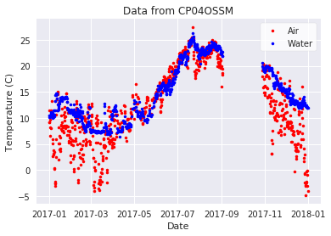
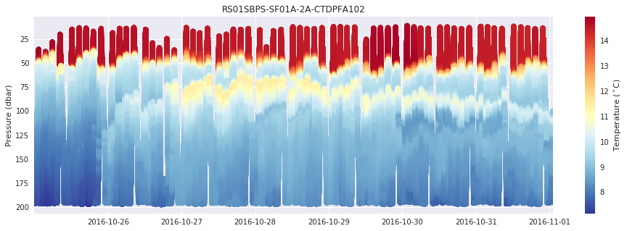
OOI Datasets Types
What types of data are available?
Point Timeseries
Profiles
Wire Following
Glider
ADCP
Multi-point Timeseries Profiles
And others…
Seismic/Earthquake
Hydrophones
Sonar
Camera
Optical OPTAA/SPIKR

Slide 37
Data Activity Dimensions
Time
Single event
Specific Date Range (year, quarter, month, week, day)
Several cycles (interannual, annual, seasonal, monthly, weekly, daily)
Compare cycles (e.g., winter vs. summer)
Depth
Fixed / Single Point
Multipoint
Full Profile
Spatial
Fixed (lat, lon)
Multipoint
Vertical Slice (depth transect)
Horizontal Slice (spatial map)
Variables/Parameters
Raw
Calculated: Averaged, Filtered or Smoothed
Derived (e.g., anomaly or model)

Slide 38
Session 3

Slide 39
Session 3: Notebook activity structure & pedagogy
Review possible pedagogical approaches to structuring labs
Activity structure
Pedagogical approaches to guiding student questions
Interactive Elements?
Develop a Lab Activity template
Identify additional background elements and content needed in each activity, as well as how to structure the Instructors Guide(s)

Slide 40
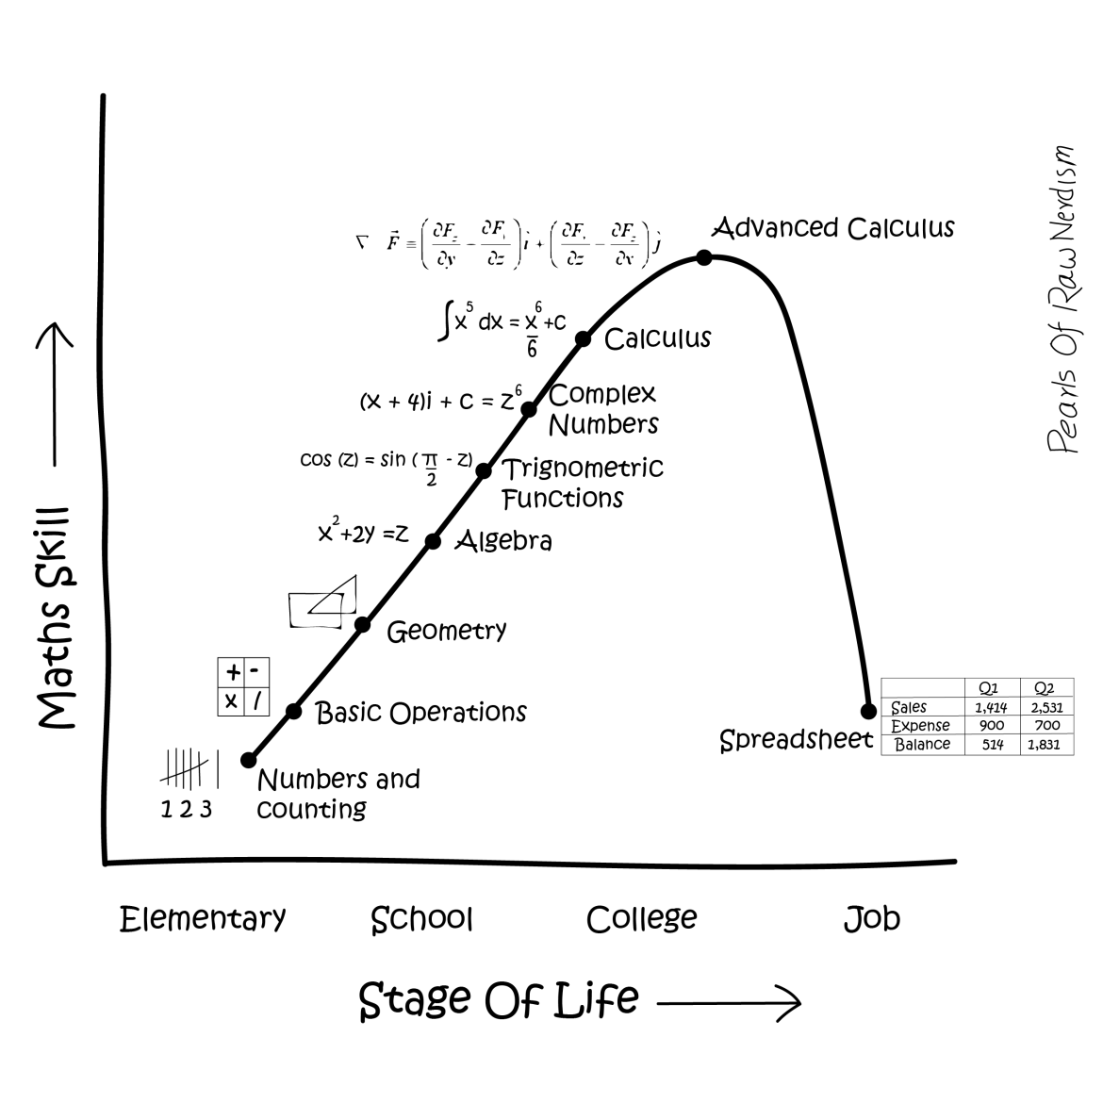
Notes:
https://pearlsofrawnerdism.com/?p=1252

Slide 41
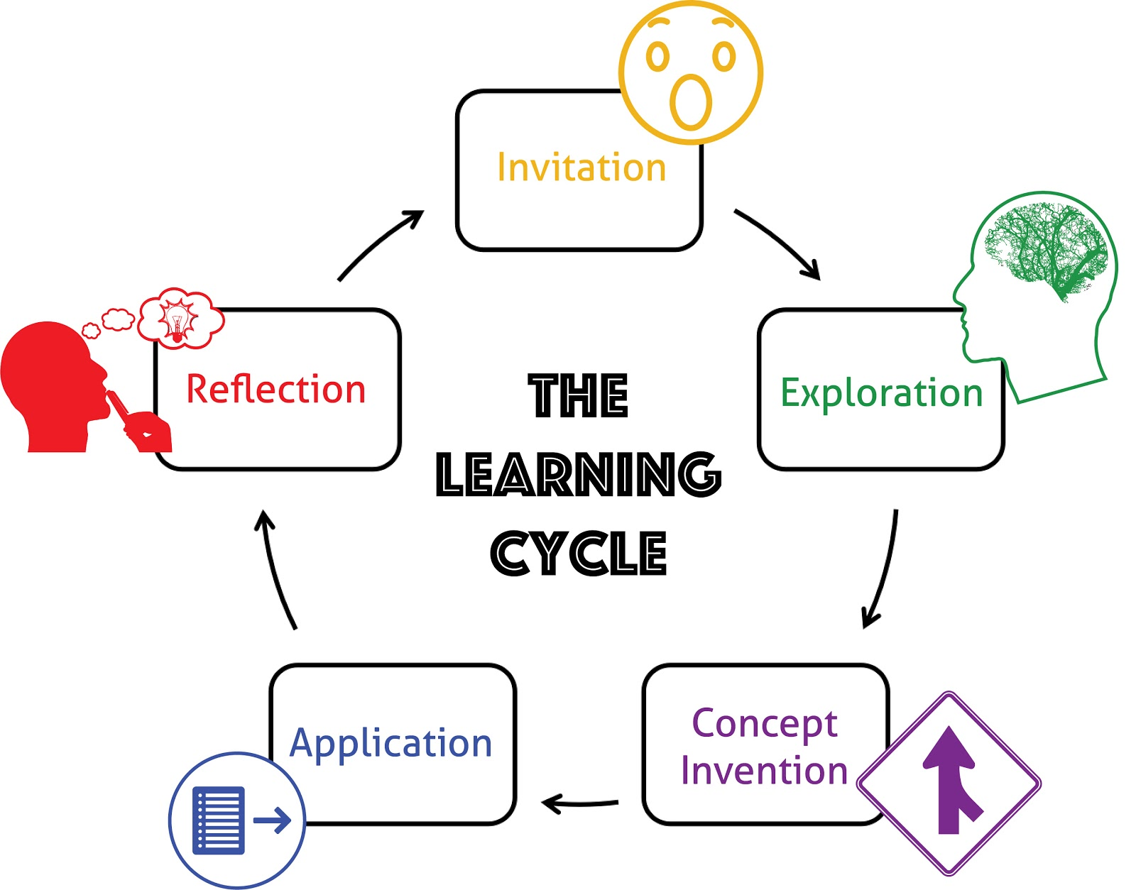
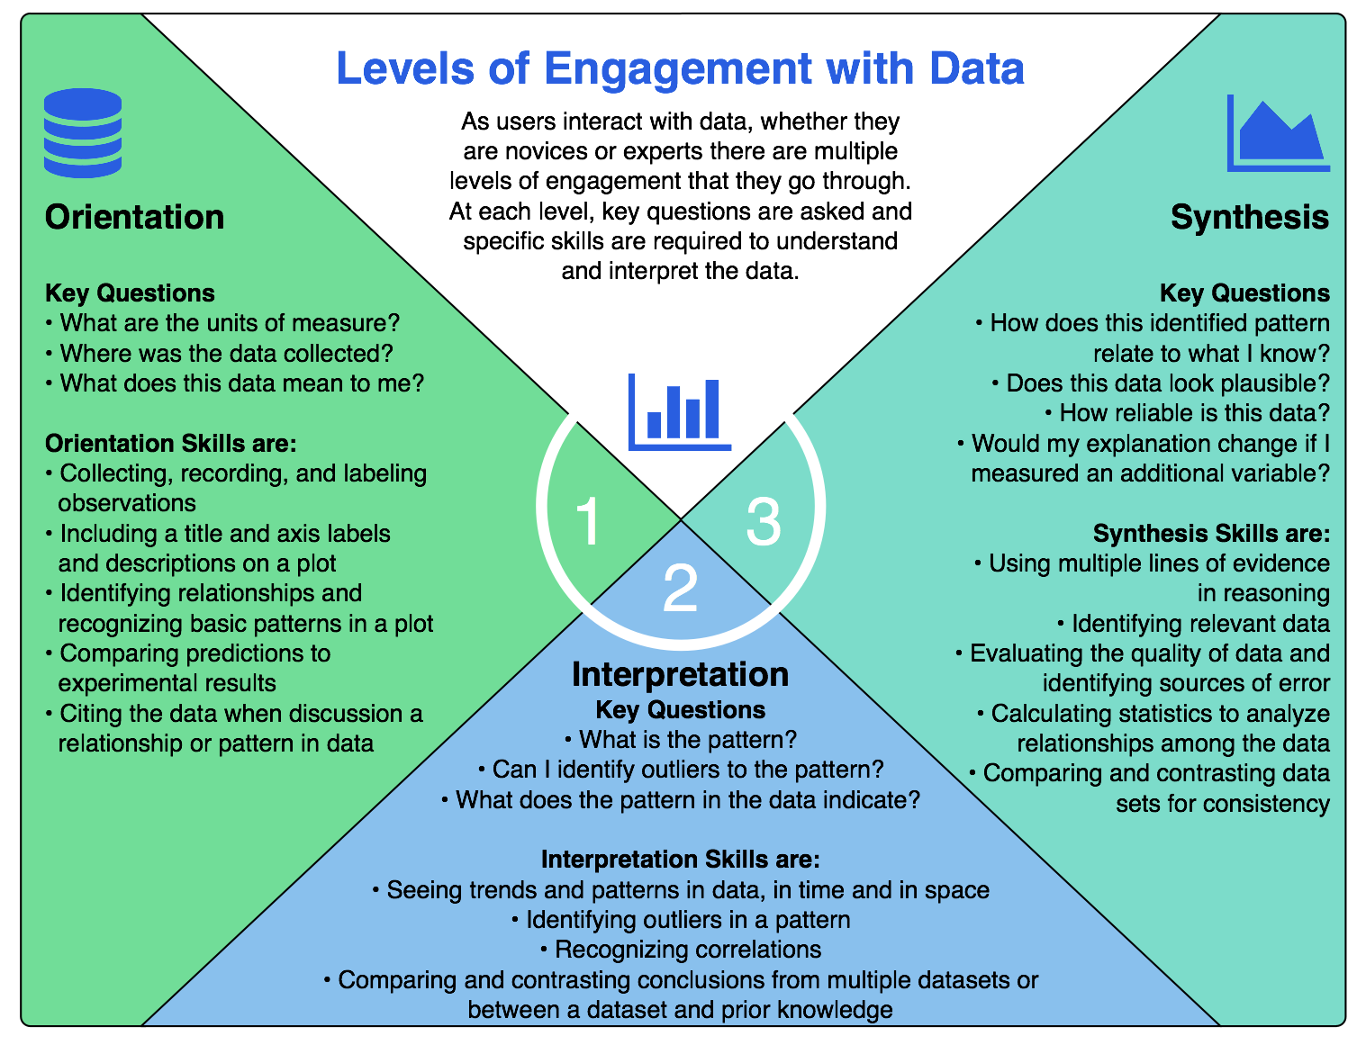
Design of data activities - based in learning science:
University of California Lawrence Hall of Science
Hotaling et al. (2019)

Slide 42
The Learning Cycle
The most popular educational framework may be the Learning Cycle. The following table summarizes and relates various terms used by different inquiry-based frameworks.
Edelson developed the Learning for Use model as a "description of the learning process that can be used to support the design of content-intensive, inquiry-based science learning activities." While the Learning Cycle is named for the activities students engage in, the terms used in Learning for Use are named for the role each step plays in the learning process.
Constructivist Model | Engage | Explore | Explain | Elaborate | Evaluate
Learning Cycle (from LHS COS) | Invitation | Exploration | Concept Invention | Application | Reflection
Learning Cycle (from Edelson) |  | Exploration | Invention / Term Introduction | Discovery
Learning for Use (from Edelson) | Motivate: Experience Demand Motivate: Experience Curiosity | Construct: Observe | Construct: Receive Communication | Refine: Apply | Refine: Reflect

Slide 43
Scientists and the Learning Cycle
Edelson also describes the Learning Cycle from the perspective of scientists, who use inquiry to conduct scientific research, and students, who use inquiry as a means to learn. The following table describes what each role does for each step in the inquiry process.
 | Scientists | Students
Exploration | Gather evidence | Gain experience to help understand scientific concepts, i.e. collect observations or measurements
Invention | Induce relationships and name concepts | Discuss findings and build explanations. Teacher introduces terms
Discovery | Use relationships and concepts to investigate other phenomena | Make additional observations to apply concepts to verify or identify limitations in their understanding
Edelson, D. C. (2001). Learning-For-Use: A framework for the design of technology-supported inquiry activities. Journal of Research in Science Teaching, 38(3), 355-385.

Slide 44
Levels of Inquiry
Brown et al. (2006) found that many college educators have a misguided view of inquiry, with many assuming that inquiry must be unstructured and student-directed. In truth there are in fact many levels of inquiry, summarized in the following table.
Inquiry Level | Question | Procedure | Solution
Confirmation | Provided | Provided | Provided | Students confirm previously observed or learned material.
Structured | Provided | Provided |  | Students are given the question and procedures, but generate their own explanations based on the evidence collected.
Guided | Provided |  |  | Students are given only the research question, but they plan the investigation, collect and organize their own data and make evidence-based conclusions. (This works best when students already have experience planning experiments and recording data.)
Open |  |  |  | Students form their own questions, plan their investigation, collect and organize their data and make evidence-based conclusions, and communicate their results.
Brown, P. L., et al (2006). College science teachers' views of classroom inquiry. Sci. Educ. 90, 784–802.

Slide 45
Uncookbooking
Leonard (1997) provides a method to "uncookbook" a traditional lab. He recommends that students should be provided with:
a question to explore,
knowledge of the materials and other resources available, including time,
a minimum set of general instructions to guide exploration—few enough so the student does not get bogged down in simply following directions to the point where they lose sight of both the question and the concept (although specialized technique instructions are fine),
a request to make predictions or construct hypotheses,
an opportunity to work in collaborative groups,
a requirement to collect data,
a set of questions which allows students to interpret and infer the desired concepts from their data, and
an opportunity to discuss in class among themselves and with the instructor the interpretation of their results.
Given the misconceptions on inquiry in the classroom, it's not surprising that Brow et al also found that many "faculty placed some value on traditional cookbook labs" finding them "more structured, more efficient, easier to plan and prepare and more accessible to nonmajors."
Leonard, William H (1997). How do college students learn science? Methods of Effective Teaching and Course Management, chapter 1.

Slide 46
“Data Discovery” Process
Search / Discover datasets to use
Request and load data
Parse, filter, average and/or process (if needed)
Visualize
Analyze – Interpret plots and calculate statistics
Export for use in other tools (if needed)
Discover
Download
Plot
Analyze
Filter

Slide 47
PRIMM Teaching Model
Predict
Run
Investigate
Modify
Make
Use with Paired Programming to spur discussions
http://primmportal.com

Slide 48
What should the Lab Notebook include?
Activity 3
What are the high-level elements/components we want to include in the lab notebook?
Discuss and revise a Lab Activity template
Define and outline chapters
Define instructors guide elements

Slide 49
Pedagogy Examples
OOI Data Lab Manual
Project Eddie Module Development Rubric
Integrate / SERC ActivitySheet
PRIMM
Paired Programming
The Carpentries
Timms
Flipped learning and scaffolded content.
Session outline in appendix
Rowe
Computational Guided Inquiry
Backwards Design
Student & Instructor Evaluation
Campbell
Flipped videos / active learning
Core concepts list
Multiple problems in each notebook
Think-pair-share to review results
Project rubric

Slide 50
Session 4

Slide 51
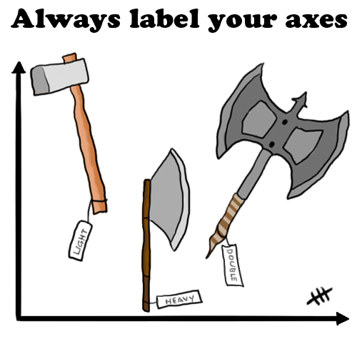
Session 4: How will we get there?
Decide on priority topics
Do we have all key topics covered?
Develop a notebook structure / outline.
Do we have the right sequence of activities?
Who can work on what?

Slide 53
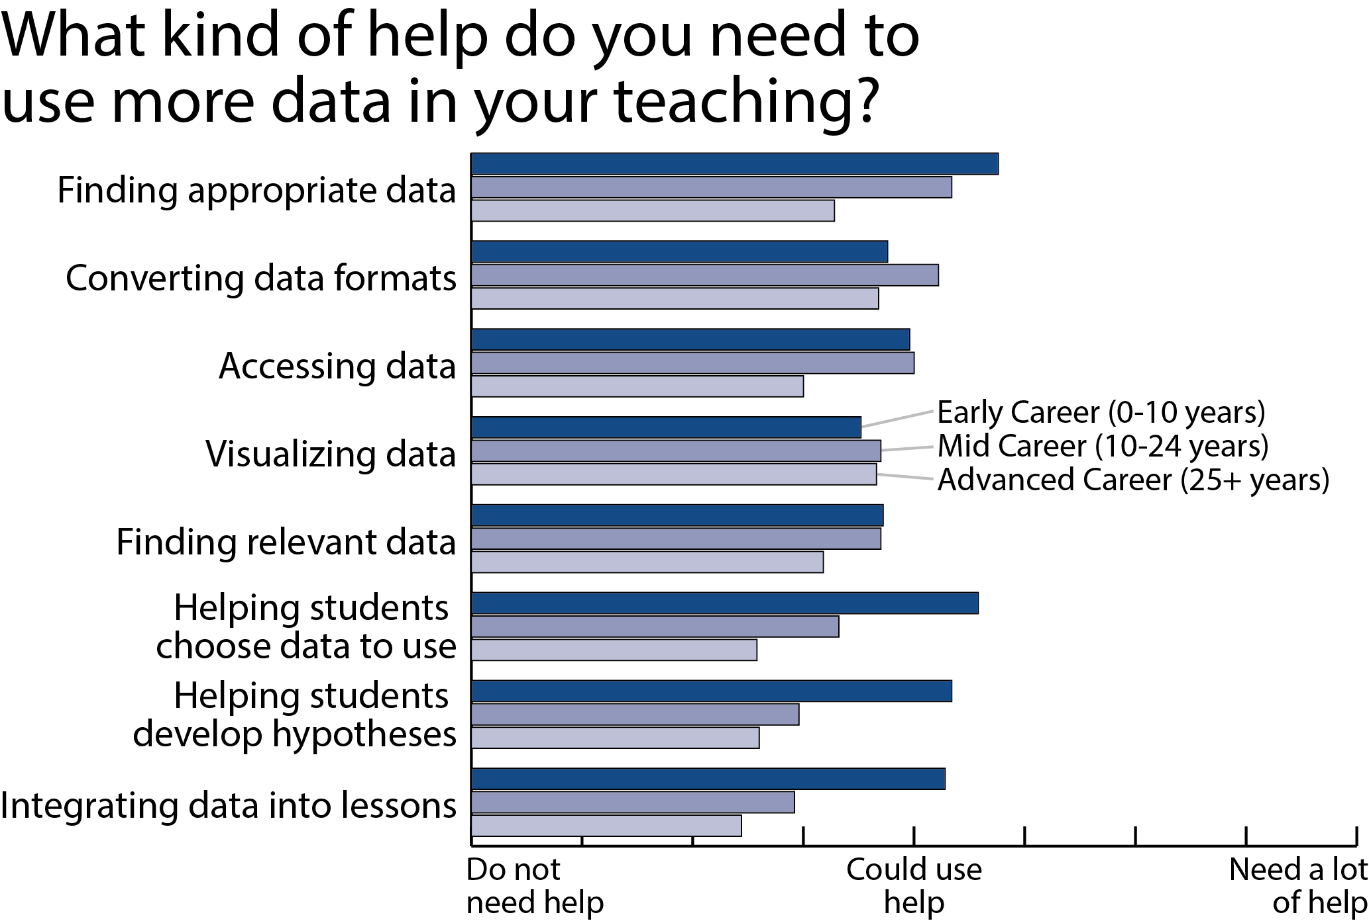
2012 Undergraduate Educator Survey
n=179

Slide 54
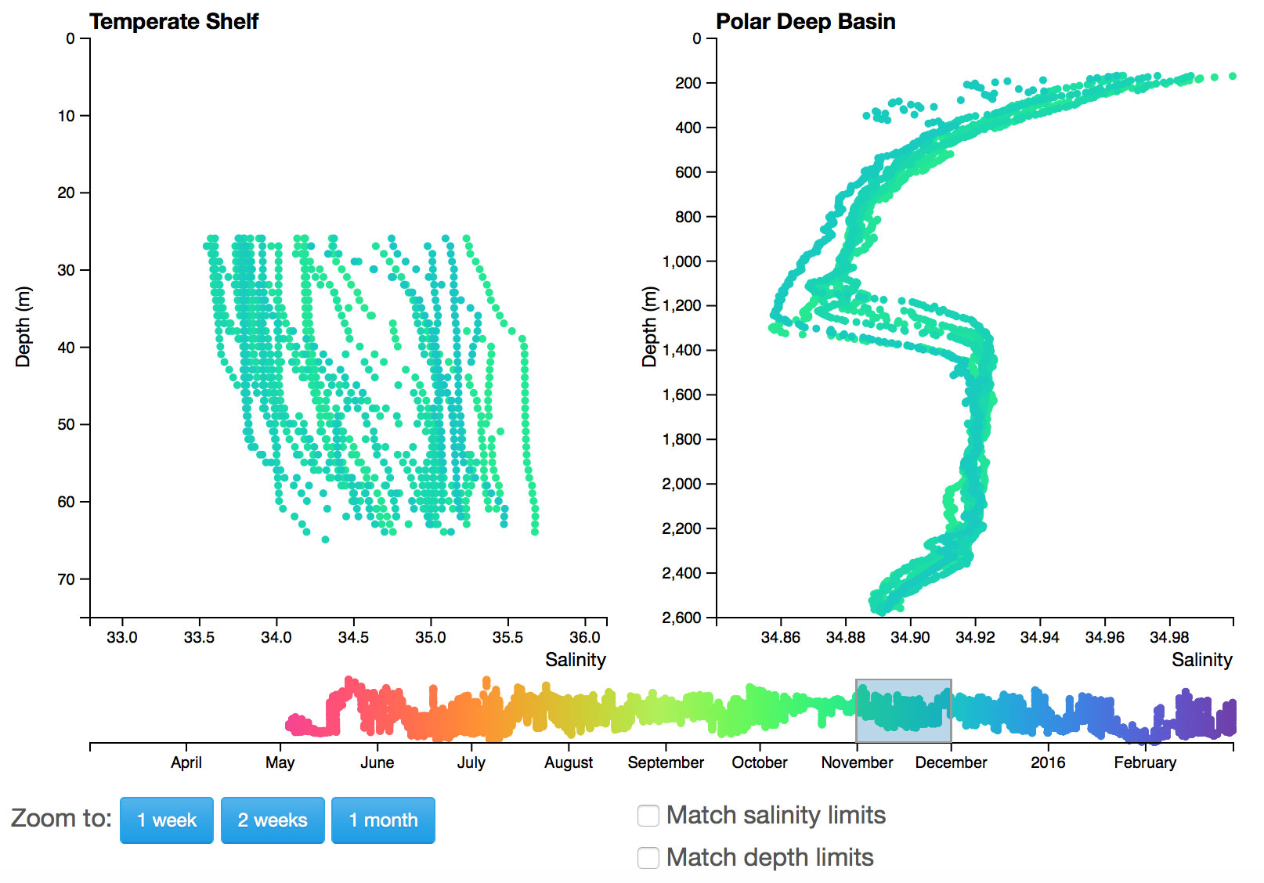
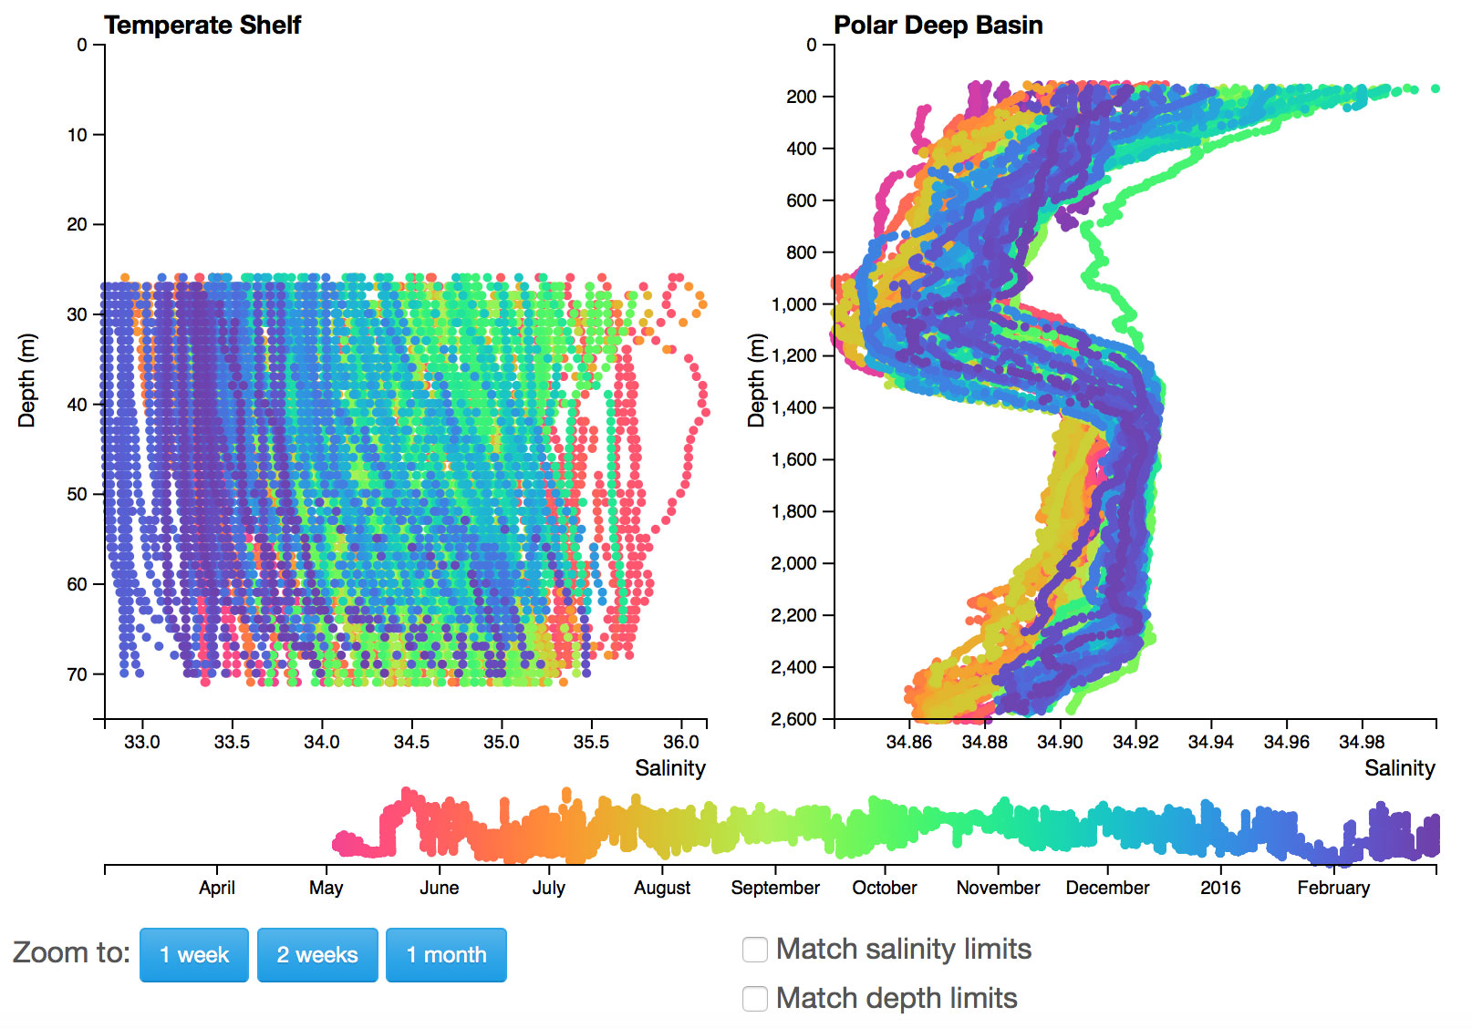
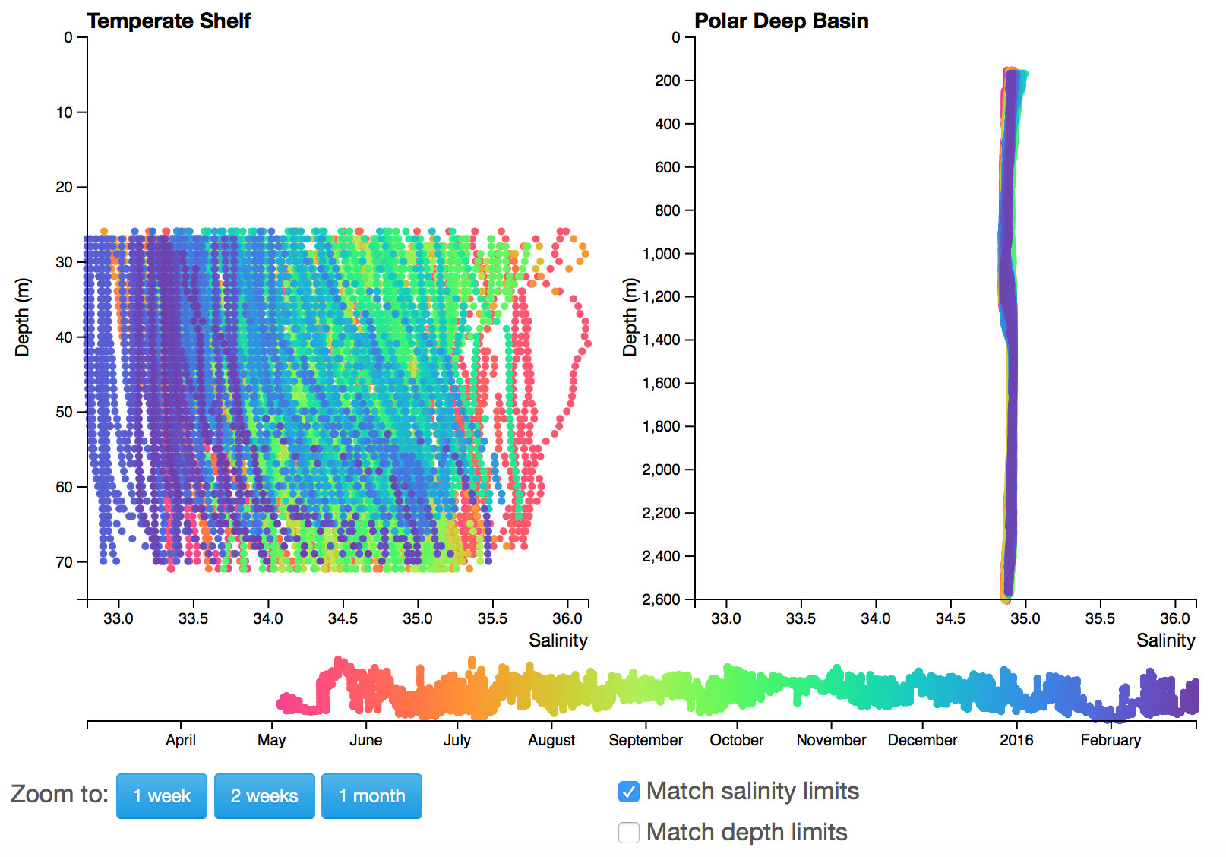
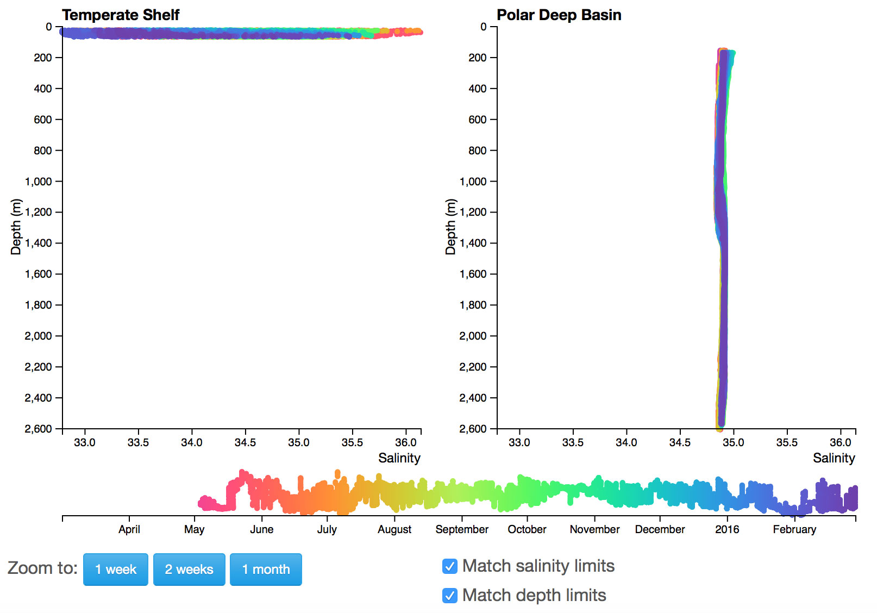
Interactive Exploration Changes in Salinity with Depth

Slide 55
Other topics
Streamlit – Simple Python Webapps
https://streamlit.io
Interactives in Jupyter Notebooks
https://jupyterbook.org/en/stable/interactive/interactive.html

Slide 56
Day 2

Slide 57
Feedback
This is hard. We all have good ideas, but don't know what the limits/options are.

Slide 58
Day 2 Overview
Goals for Today
Review end goal: Outline one activity
Select Topics
Build a Notebook (load & plot data) or write Lab Activity
(Lunch)
Start building out activity
Use Data Lab Manual Template
Draft Learning Objectives
Scaffold with structured/guided inquiry questions (PRIMM?)
Add data orientation & interpretation questions
At Home
Finalize Activity
Compile Instructor’s Guide
Peer review / Pilot test it!
Follow-up calls
With Sage, Anna, Denise, Dax
As pairs
As a full team (potentially in person?)
Timing (tentative)
Ready for spring testing
Revised/Published by end of semester

Slide 59
Data Exploration Design Process
Having an identified process helped us to standardize development and insure all aspects are appropriately thought through
It also allowed us to identify tasks that could be accomplished by different community members
Identify Target Scientific Concepts & Skills
Match Educational Goals with Instrumentation
Find Available Instrument Data
Cleanup the Dataset
Add Context & Educational Surrounds
Build Interactive Visualizations

Slide 60
Overall Format and Structure
A JupyterBook that mirrors the Existing Lab Manual
Lab Chapter 1
An introduction to exploring OOI data using Python Notebooks
Chapter 2
An intro to plotting oceanographic datasets
Chapter 3+
Assorted activities that delve into…
data processing techniques (e.g. averaging)
data skills (e.g. reading and interpreting graphs)
oceanographic concepts, events and stories.

Slide 61
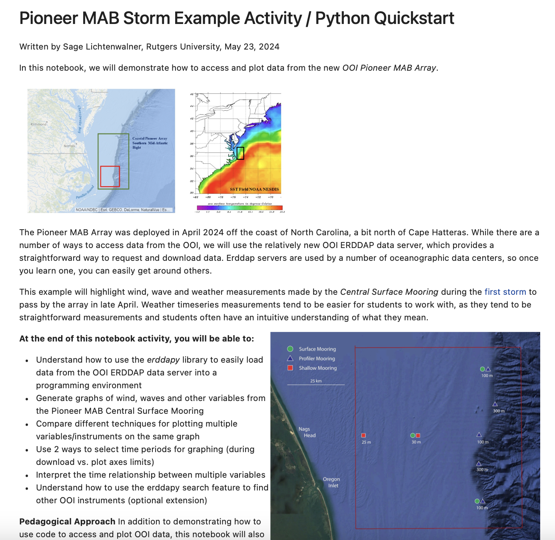
Pioneer MAB Storm Example
Key Features
Demonstrates loading and plotting data (via erddapy)
Scaffolded activity (adds instruments in stages)
Example orientation & interpretation data questions
Also demonstrates multiple plot times and zooming in on time
https://github.com/ooi-data-lab/mab-workshop-2024/blob/main/Pioneer%20MAB%20Storm%20-%20Quick%20Start.ipynb

Slide 62
Lab manual design teams
Geography, bathymetric charts, plate tectonics lab (Lab 2 + 3 revision)
Density, stratification, water masses (Lab 5 revision + new lab)
Ocean acidification
Harmful algal blooms
Python design team members needed!

Slide 63
Topic Selection
Extend a Lab Manual Chapter (existing or new)
Build your own Topic
Help with Preamble Activities

Slide 64
Topic | Lab Manual 3.0 Chapter
Ocean technology | Lab 1: Introduction to the OOI, the collection of oceanographic data Add: people and careers, more on technology
Geography and | Charts and Mapping – MAB setting, General geography, Lat/Long, Bathymetry, ocean floor features
Data skills for oce | Lab 2: Building data skills – add graph types
Marine Geology Tsunami | Lab 3: Plate tectonics and the seafloor – improve scaffolding
Volcanic eruptions | Lab 4: Seafloor changes in a volcanically active setting– improve scaffolding
Ocean Chemistry | Lab 5: Investigating density stratification
Physical Oce | Lab 6: Waves generated by large storms
Physical Oce- Fronts, Eddys, water masses | Compare SST spatial data with OOI sensors – use eddies/satellite Water mass TS characteristics (e.g., slope, shelf, estuarine water masses near MAB Pioneer)
Bio Oce | Lab 7: Primary production – update with new data
Physical/Bio Oce | Lab 8: Anoxic events– update with new data
Natural Hazards | Hurricanes – storm surge vs tide/ Coastal Tides vs. shelf Tsunamis, Coastal flooding,
Climate change | Ocean Acidification - CO2 air-sea flux and ocean acidification, Impacts to organisms, HAB’s Temperature trends

Slide 65
New topics suggested by needs assessment
Natural hazards
Storm events/impacts (e.g., Hurricane Debby passage near Pioneer array)
Wind, waves, temperature, precipitation
Detect land runoff at MAB Pioneer (estuarine plumes)
Coastal tide gauge data for storm surge detection
Fronts, eddies, water masses
Compare SST spatial data with OOI sensors
Water mass T-S characteristics (e.g., slope, shelf, and estuarine water masses near MAB Pioneer)
Tides
Shelf vs. NOAA coastal tide gauges (inshore estuaries, outer coast, offshore)
Interesting impacts of tides? (e.g., earthquake frequency, hydrothermal fluid flux at Axial Seamount)
Climate change - temperature
Long-term temperature trends at Station Papa
Compare OOI temperature data to climatologies (surface and subsurface)
Climate change - carbon
CO₂ air-sea flux and ocean acidification
Impacts on organisms and ecosystems
Other topics mentioned: Subduction zone processes, rip currents, tsunamis, rogue waves
Aiming for 2-3 new topics at most
Notes:
Mention that we are open to additional ideas! But we need some idea of the topics before the workshop so that we can start thinking about data sources

