Slide 1
Thursday PM
Welcome to Data Labs!
Introduction of team members
Goal: Cultivate communities of professors that use Data Labs to improve student learning.

Slide 2
Workshop Goals
Review OOI Data Lab Manual pedagogy, design, structure and scaffolding.
Design 2-3 new Lab Manual chapters and update selected existing Lab Manual activities based on community needs assessment feedback.
Outline a framework and target audience for classroom activities using Python notebooks to access OOI data.
Develop a collection of Python-based data analysis activities appropriate for novice programmers.
Ensure that activities and data widgets are properly scaffolded to be accessible to instructors and students from a variety of backgrounds.

Slide 3
Empathy Exercise
Why should our students engage with Data Labs?

Slide 4
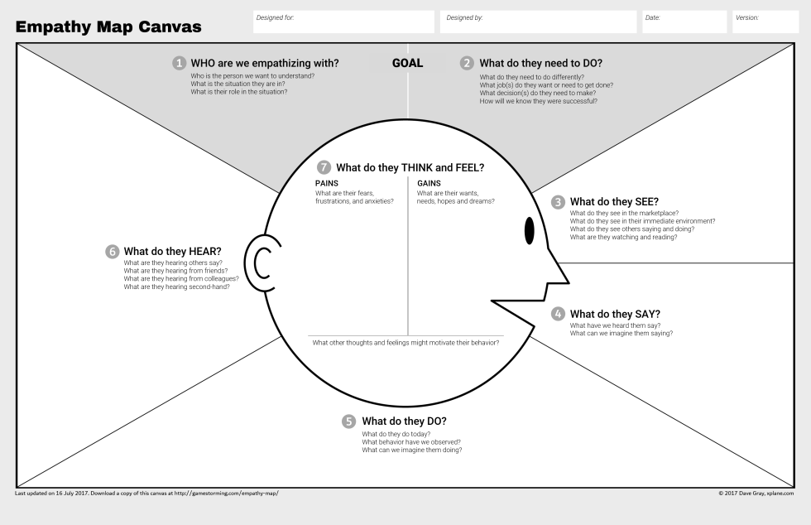

Slide 5
Data Labs Pedagogy
Janice McDonnell

Slide 6
Thought Swap
Friday AM Pedagogy
What do you like about teaching science in your university or college?
Recall an occasion when you thought you were at your best, teaching—or saw someone else teaching in a way that excited or inspired you. What was especially effective about it?
Describe any experiences you’ve had learning with or teaching using data. What are some reasons it might be important for students and the public to gain expertise in using data?

Slide 7
3-2-1 Bridge
How do people learn?
3 words that come to mind
2 questions you have
I analogy or metaphor

Slide 8
Analogy
Metaphor
a comparison in which an idea or a thing is compared to another thing that is quite different from it.
“explains” that idea or thing by comparing it to something that is familiar.
Example: How a doctor diagnoses diseases is like how a detective investigates crimes.
a figure of speech that makes an implicit, implied, or hidden comparison between two things that are unrelated but share some common characteristics.
a resemblance between two contradictory or different objects is made based on one or more common characteristics.
Example: It’s going to be clear skies from now on. (This implies that clear skies are not a threat and life is going to be without hardships.)
Notes:
Three words that come to mind- how people learn
Two questions they have about how people learn

Slide 9
Learning Beliefs and Behaviors
What are the observable characteristics (signs) that learning is happening?
What are the conditions that encourage and support learning? Especially when thinking about data literacy.

Slide 10
Hands-on
Provide a shared experience for everyone to think about learning and teaching.
Engage fully as a learner.
Give space for your friends to mess with the ideas.
Go deeper into your own understanding & bring your friends along.
Inquiry-learning may lead students to question and to share solutions, to extract valid conclusions from hands-on experiments, to formulate questions, to work with peers and to apply the usual research techniques (Lederman & Lederman, 2012; Scharfenberg & Bogner, 2013).

Slide 11
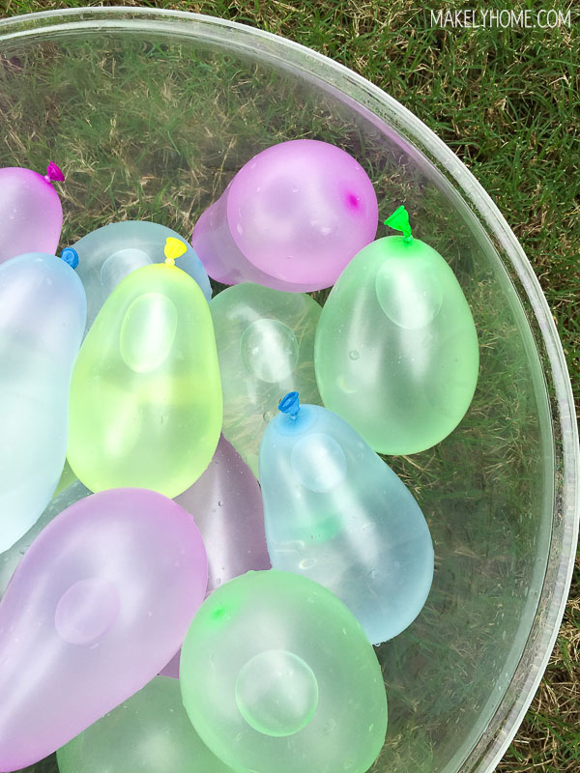
Mystery Balloons
What kind of water is in the mystery balloons?
Make a prediction and then collect evidence.
4 people to each table
Notes:
Table 1- Blue Balloon (hot fresh)
Table 2- Yellow Balloon (cold saltwater)
Table 3- Green Balloon (room temp fresh)
Table 4- Red Balloon (cold freshwater – frozen in advance)
Table 5- Purple Balloon (hot freshwater)

Slide 12
Instructions
Place your assigned balloon in the test tank (1-5).
After 30 seconds, record where the balloon ends up and draw it on the tank diagram.
Write why you think the balloon is responded in that way.
Indicate with arrows the how the position of the balloon changes as you you doing the investigation.

Slide 13
Ponder this…
What did you discover?
What kinds of balloons sank, and what kinds of balloons floated?
How could you explain what happened?

Slide 14
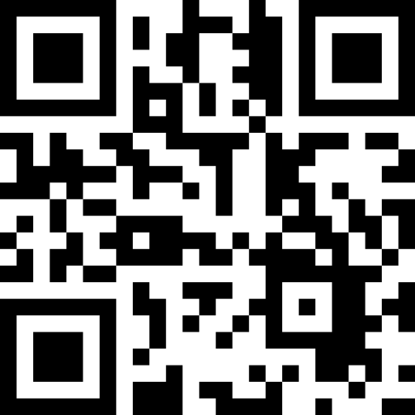
Ellaborate
https://go.rutgers.edu/58v3cevd
Notes:
https://mare.lawrencehallofscience.org/guiding-question-why-are-some-liquids-denser-than-others/

Slide 15
Results
Hot fresh water
Room temp fresh
Cold fresh water
Room temp salt water
Cold salt water

Slide 16
Data Exploration

Slide 17
Denser substances sink below substance that are less dense.
Density is mass/volume and plays a crucial role in driving ocean currents
The density of seawater is influenced by two main factors: temperature (thermo) and salinity (haline). Cold water is denser than warm water, and salty water is denser than fresh water.
When water at the surface becomes cold (e.g., near the poles) or when it gains salinity (e.g., due to evaporation), it becomes denser and sinks. This creates a downward movement of water.
The sinking cold, salty water is replaced by warmer water from lower latitudes, which then moves along the surface. This movement creates a global movement of ocean currents that helps distribute heat around the planet.

Slide 20
Five Foundational Ideas on Learning
Learning is an active process.
Learning builds on prior knowledge.
Learning that is authentic to the learner is more memorable.
Learning occurs in a complex social environment.
Learning requires motivation and cognitive engagement.

Slide 21
5 E’s explained
Learning Cycle (Akins and Karplus 1962)
Tanner (1987) Using the 5 E’s to Align Teaching with How People Learn
Notes:
Educators J. Myron Atkin and Robert Karplus argued in 1962 that effective learning cycles involve three key elements: exploration, term introduction, and concept application. “In their scheme, exploration allowed the learners to become interested in the subject at hand, raise questions, and identify points of dissatisfaction with their current understanding. Introduction of new ideas and terms, primarily by the instructor, but negotiated by both instructor and students, followed. Finally, concept application provided learners with opportunities within the classroom to apply their new ideas, try out their new understandings in novel contexts, and evaluate the completeness of their understanding,” according to Kimberly D. Tanner in the article “Order Matters: Using the 5E Model to Align Teaching With How People Learn.”

Slide 22
Engage
What
Work to gain an understanding of the students’ prior knowledge and identify any knowledge gaps.
It is also important to foster an interest in the upcoming concepts so students will be ready to learn (AKA the HOOK).
How
Teachers might task students with asking opening questions or writing down what they already know about the topic. This is also when the concept is introduced to students for the first time.
Notes:
Constructivism – no one comes to you as a blank slate – they have prior experience and knowledge (not always correct)

Slide 23
Explore
What
Students actively explore the new concept through concrete learning experiences. They might be asked to go through the scientific method and communicate with their peers to make observations.
How
Students learn in a hands-on way.

Slide 24
Explain
Explain + Elaborate + Evaluate = Making Meaning
What
This is a teacher-led phase that helps students synthesize new knowledge and ask questions if they need further clarification.
How
Teachers should ask students to share what they learned during the Explore phase.
Teachers can utilize video, computer software, or other aides to boost understanding.

Slide 25
Elaborate
What
Give students space to apply what they’ve learned. This helps them to develop a deeper understanding.
How
Teachers may ask students to create presentations or conduct additional investigations to reinforce new skills. This phase allows students to cement their knowledge before evaluation.

Slide 26
Evaluate
What
Teachers can observe their students and see whether they have a complete grasp of the core concepts. It is also helpful to note whether students approach problems in a different way based on what they learned.
How
Self-assessment, peer-assessment, writing assignments, and exams.

Slide 27
Synthesis
What themes emerged?
Were there common issues and reactions across the groups?
What questions surprised us?

