Slide 1
Introduction to
OOI Data Explorer
and Data Access
Stace Beaulieu, OOI CGSN Data Team
2024 OOI Data Labs Design Workshop
18 October 2024
Notes:
https://datalab.marine.rutgers.edu/workshops/2024-design-workshop/
18 October 2024
1-2 pm
“Review how to discover instruments and interesting datasets, bookmarking datasets via Data Views, Erddap download links, time series and profile graphs, notable “raw” datasets, etc.”
This material is based upon work supported by the Ocean Observatories Initiative (OOI), which is a major facility fully funded by the National Science Foundation under Cooperative Agreement No. 2244833.

Slide 2
Goals for this demo:
Use Data Explorer to discover and plot datasets
Compare datasets and share links via Data Views
Download from (or link to) Data Explorer ERDDAP
Additional data access points
Notes:
Use Data Explorer to discover and plot datasets including time series at fixed depths and profiles
Bookmark and compare datasets via Data Views
Download from (or link to) Data Explorer ERDDAP
Additional data access points for notable “raw” datasets
Resources;
https://oceanobservatories.org/2023/09/four-part-series-on-using-data-explorer/

Slide 3
Live demo, then hands-on:
30 min presentation with live demonstration:
You’ll learn about OOI Infrastructure while I explore with the Data Explorer.
30 min hands-on:
I will explore with you, for data of your interest.

Slide 4
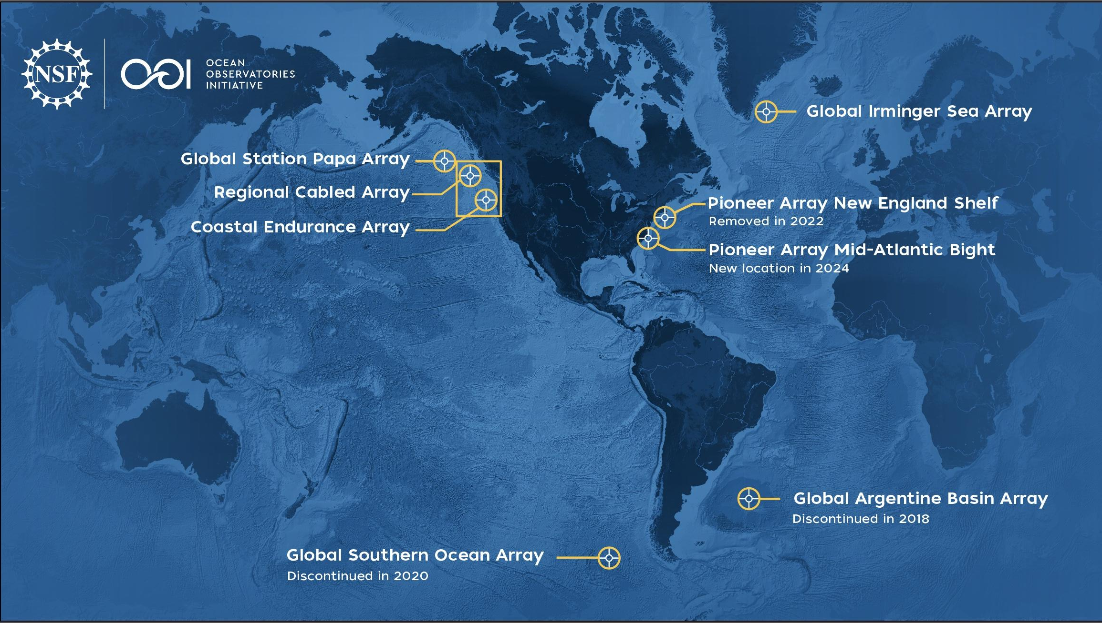
The NSF Ocean Observatories Initiative (OOI) delivers (near-)real-time data from a wide variety of instruments deployed at several ocean arrays
Notes:
NSF is U.S. National Science Foundation
https://oceanobservatories.org/
https://oceanobservatories.org/about-ooi/
I added the (near-) for the telemetered data

Slide 5
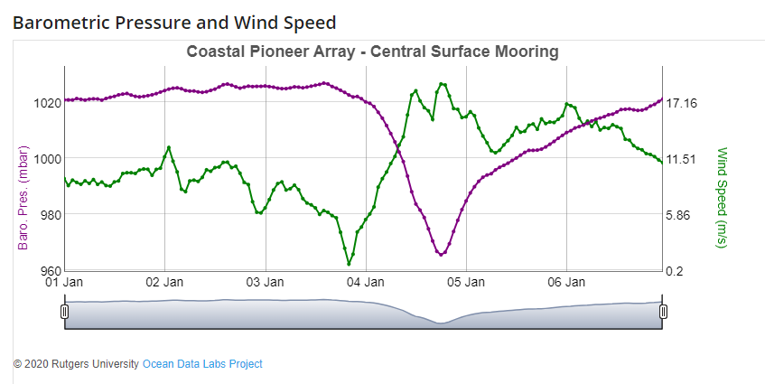
Let’s update Data Lab 6.1 which is presently using data from the Pioneer New England Shelf (NES)
https://datalab.marine.rutgers.edu/ooi-lab-exercises/lab-6-ocean-waves-linking-the-marine-atmosphere-and-the-ocean-surface/lab-6-1/
Notes:
[this Data Lab] https://datalab.marine.rutgers.edu/ooi-lab-exercises/lab-6-ocean-waves-linking-the-marine-atmosphere-and-the-ocean-surface/lab-6-1/ was made for Pioneer NES. note MAB Science Theme Extreme events: Hurricanes, freshwater outflows
“Barometric Pressure and Wind Speed”

Slide 6
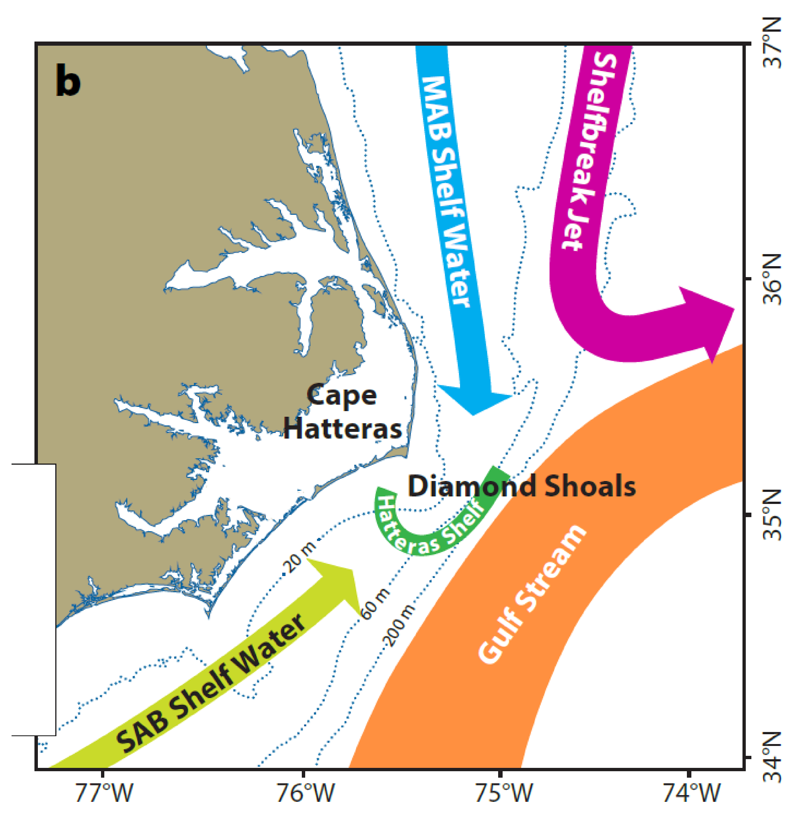
MAB science themes
Dynamics of shelf/slope exchange
Wind forcing, frontal instability, Gulf Stream influence
BGC cycling and transport
Carbon, nutrients, particulates
Ecosystem response
Extreme events
Hurricanes, freshwater outflows
Approximate location
Southern Surface and Profiler Moorings
Seim et al. (2022)
Notes:
MAB science themes as context for today’s data story
https://oceanobservatories.org/2024/04/pioneer-array-operational-at-mab/
slide from Al Plueddemann, slightly modified
Complex region with multiple processes of interest (schematic of circulation from PEACH).
PEACH = Processes driving Exchange At Cape Hatteras
Extreme events: Hurricanes, freshwater outflows

Slide 7
https://oceanobservatories.org/data-access/
Notes:
Today’s focus on these subheaders on Data Access webpage but we are happy to answer questions about all other listings on this webpage

Slide 8
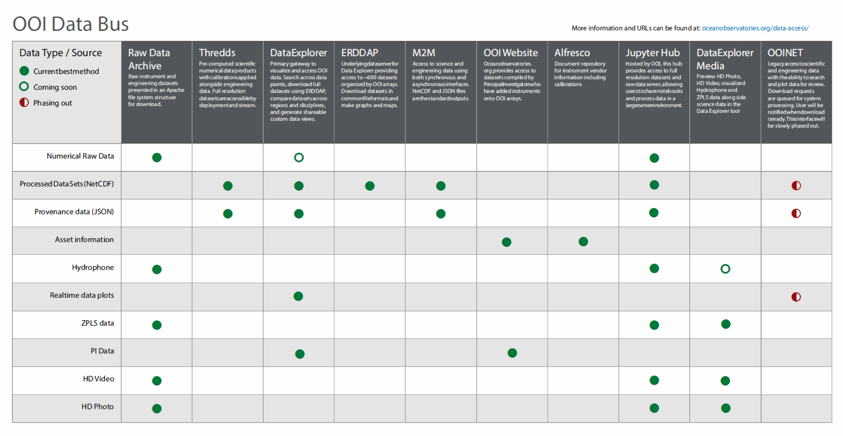
+ NEW: IFCB Dashboard
Notes:
Data Bus shows 10 User Interfaces
Plus:
https://ifcb-data.oceanobservatories.org/dashboard

Slide 9
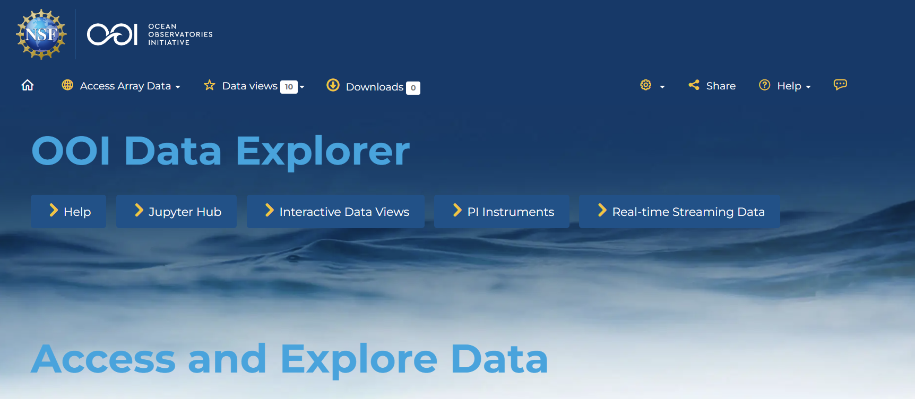
OOI Data Explorer:
Primary gateway to visualize and access OOI data
https://dataexplorer.oceanobservatories.org/
* for best results use Chrome or Firefox web browser
Notes:
You can access OOI data in many ways, with the Data Explorer as primary gateway
(don’t open yet bc next slide)

Slide 10
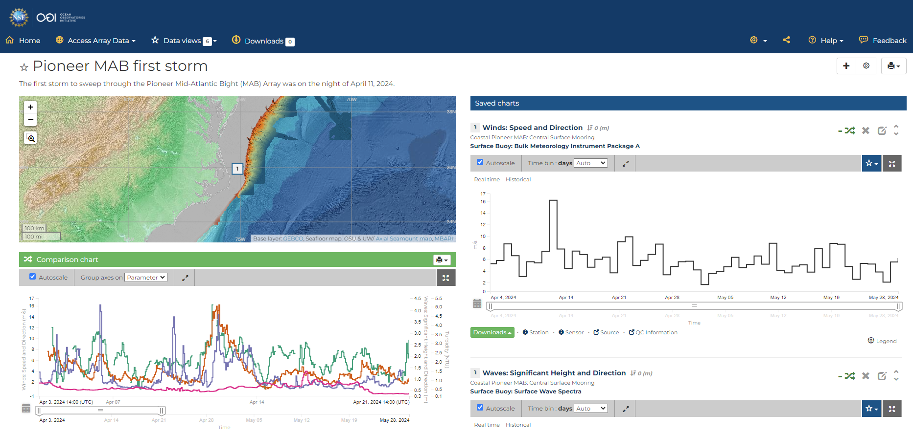
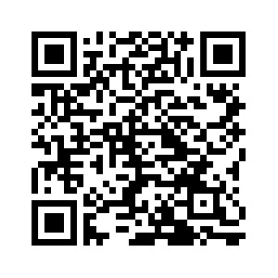
The first storm to sweep through the Pioneer MAB Array
https://dataexplorer.oceanobservatories.org/?ls=xKnA_DDf#data/default
Notes:
This was the Data View created for the June 2024 Data Labs MAB Workshop, slides available at https://datalab.marine.rutgers.edu/workshops/2024-mid-atlantic-workshop/#tab-id-2
This would fulfill the 1st 2 goals of today’s demo (except does not include profiler data)
Target 'data story' for wind, waves, and turbidity at OOI Pioneer MAB Central Site (30-m water depth), about 25 miles offshore the Outer Banks:
Here's Data View showing Apr 11 wind, max sig wave height, and MFN turbidity highest so far at CN, followed a couple days later by highest so far NSIF turbidity. (I don't know how to explain the NSIF turbidity, but I am curious...)
new: https://dataexplorer.oceanobservatories.org/?ls=xKnA_DDf#data/default
[old, also shares other data views: https://dataexplorer.oceanobservatories.org/?ls=OsGoQAe8#data/5.1]
zoom in, on the comparison chart, to about 2 weeks (Apr 7-21).
Anna Pfeiffer-Herbert “storms/coastal hazards is one of the areas we are hoping to further develop in the Data Lab manual with new Pioneer data”
Dax mentioned “event detection” - note in longer time series at other Arrays one can use the min/max or seasonal stats or QARTOD to identify events of interest, but in this case the Array is too new

Slide 11
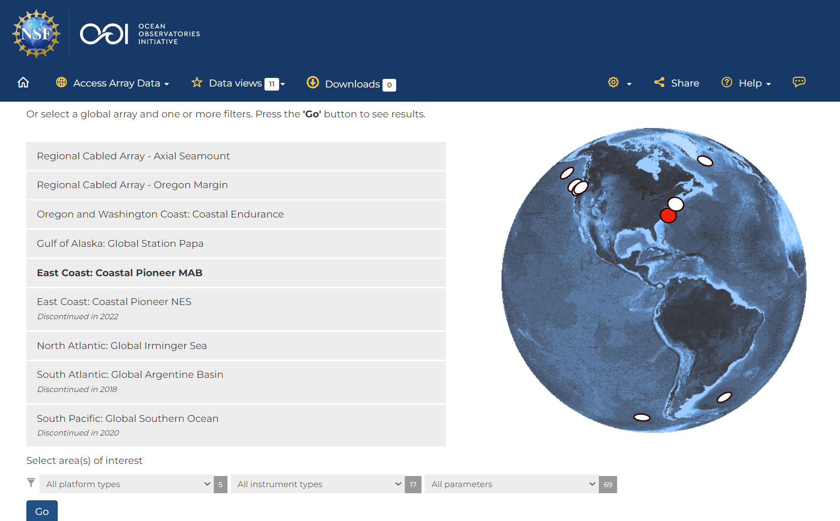
Let’s start by selecting the Pioneer MAB Array and the parameter for barometric pressure
https://dataexplorer.oceanobservatories.org/
Notes:
https://dataexplorer.oceanobservatories.org/
open it up here, it may take a few seconds
stop for a moment to orient participants to the interface
I want the data to “tell me” when there is a significant storm event. I want to see all the barometric pressure available to me at the MAB Array, and then eyeball a dataset to dive into.

Slide 12
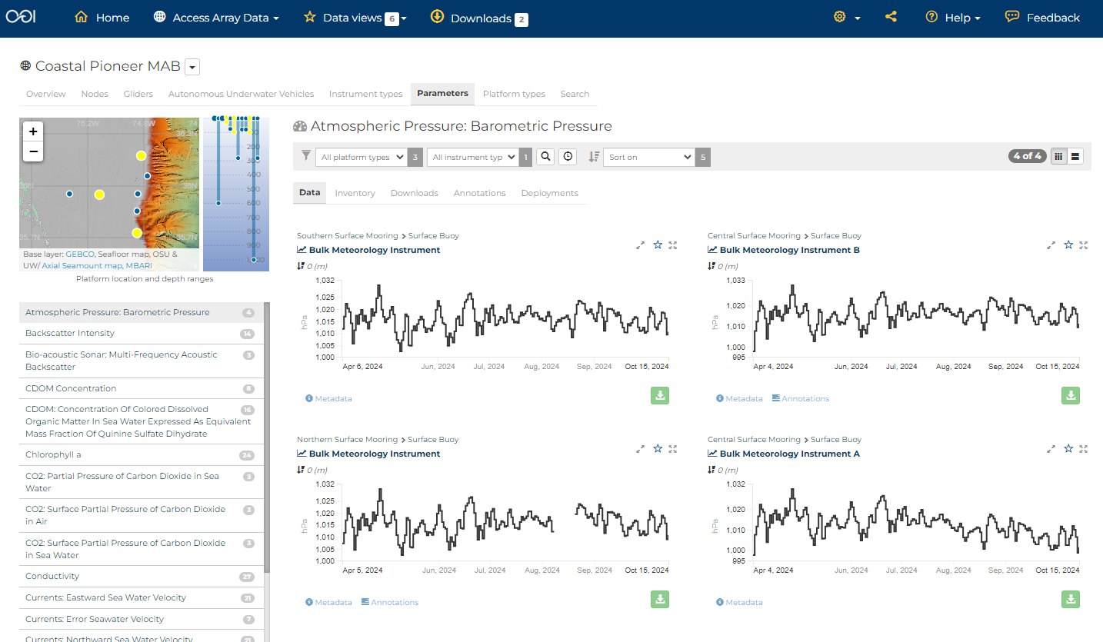
https://dataexplorer.oceanobservatories.org/#ooi/array/CP1/parameter/9/data
Notes:
story in the MAB data for Data Labs demo. Here's the progression:
want to update [this Data Lab] that was made for Pioneer NES. note MAB Science Theme Extreme events: Hurricanes, freshwater outflows
could use the Pioneer MAB 1st storm example that we developed for previous workshops, but instead let's use the data to find a storm event. look for the lowest barometric pressure, find it on May 9. [note this could've been the storm: https://www.charlotteobserver.com/news/weather-news/article288433915.html]

Slide 13
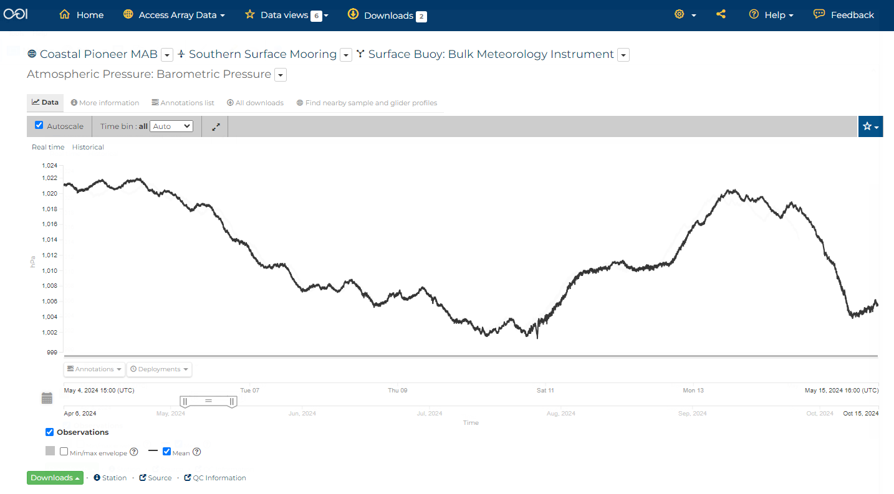
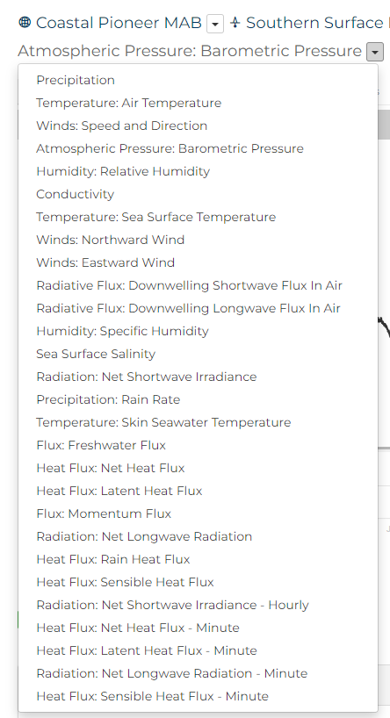
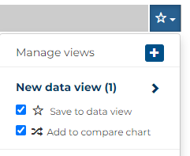
https://dataexplorer.oceanobservatories.org/#metadata/110968/station/9/sensor/data?start=2024-05-04T15:39:34Z&end=2024-05-15T16:09:28Z&leg_clim_max=false&leg_clim_min=false&leg_minmax=false
Notes:
Zoom in to approx 10 days centered on May 9
Create and add to new data view and comparison chart
The METBK has many parameters, use drop-down to select wind speed
story in the MAB data for Data Labs demo. Here's the progression:
want to update [this Data Lab] that was made for Pioneer NES. note MAB Science Theme Extreme events: Hurricanes, freshwater outflows
could use the Pioneer MAB 1st storm example that we developed for previous workshops, but instead let's use the data to find a storm event. look for the lowest barometric pressure, find it on May 9. [note this could've been the storm: https://www.charlotteobserver.com/news/weather-news/article288433915.html]
compare to wind speed to generate comparison plot for updated Data Lab

Slide 14
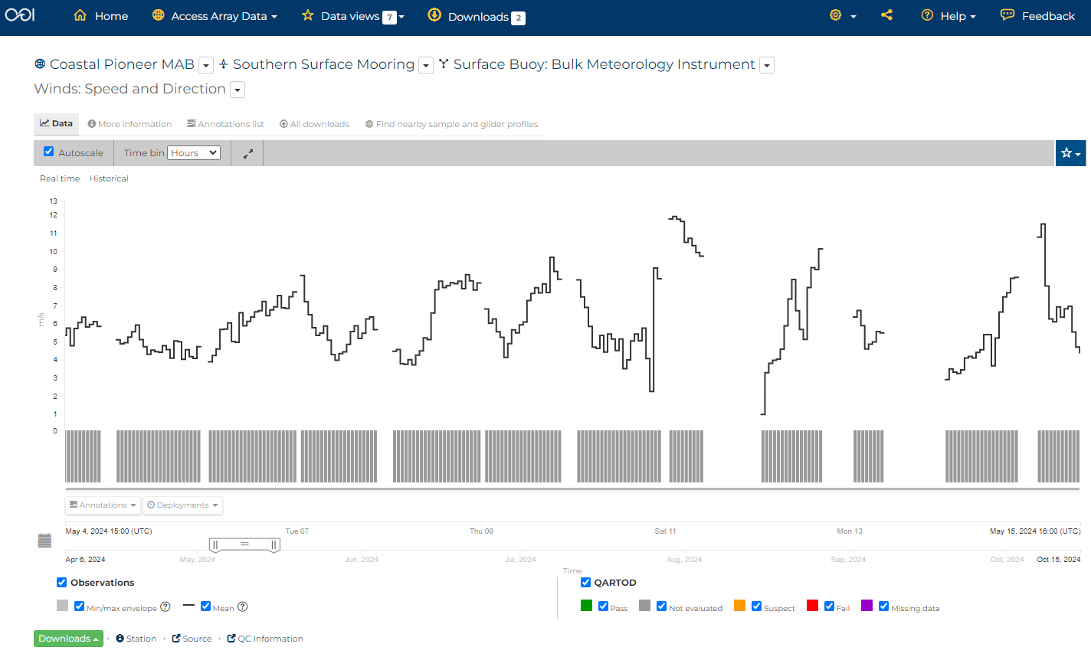
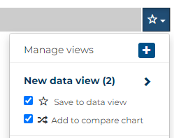
Note gaps in telemetered data
Recovered data will be available in ~December
https://dataexplorer.oceanobservatories.org/#metadata/110968/station/8/sensor/data?start=2024-05-04T15:39:34Z&end=2024-05-15T16:09:28Z&bin=hours&leg_clim_max=false&leg_clim_min=false&leg_minmax=false
Notes:
Change from Auto time bin to hours
add to new data view and comparison chart
Note QARTOD Sensor fail ranges will be available in a few weeks; the others after we've collected one-years worth of data
story in the MAB data for Data Labs demo. Here's the progression:
want to update [this Data Lab] that was made for Pioneer NES. note MAB Science Theme Extreme events: Hurricanes, freshwater outflows
could use the Pioneer MAB 1st storm example that we developed for previous workshops, but instead let's use the data to find a storm event. look for the lowest barometric pressure, find it on May 9. [note this could've been the storm: https://www.charlotteobserver.com/news/weather-news/article288433915.html]
compare to wind speed to generate comparison plot for updated Data Lab

Slide 15
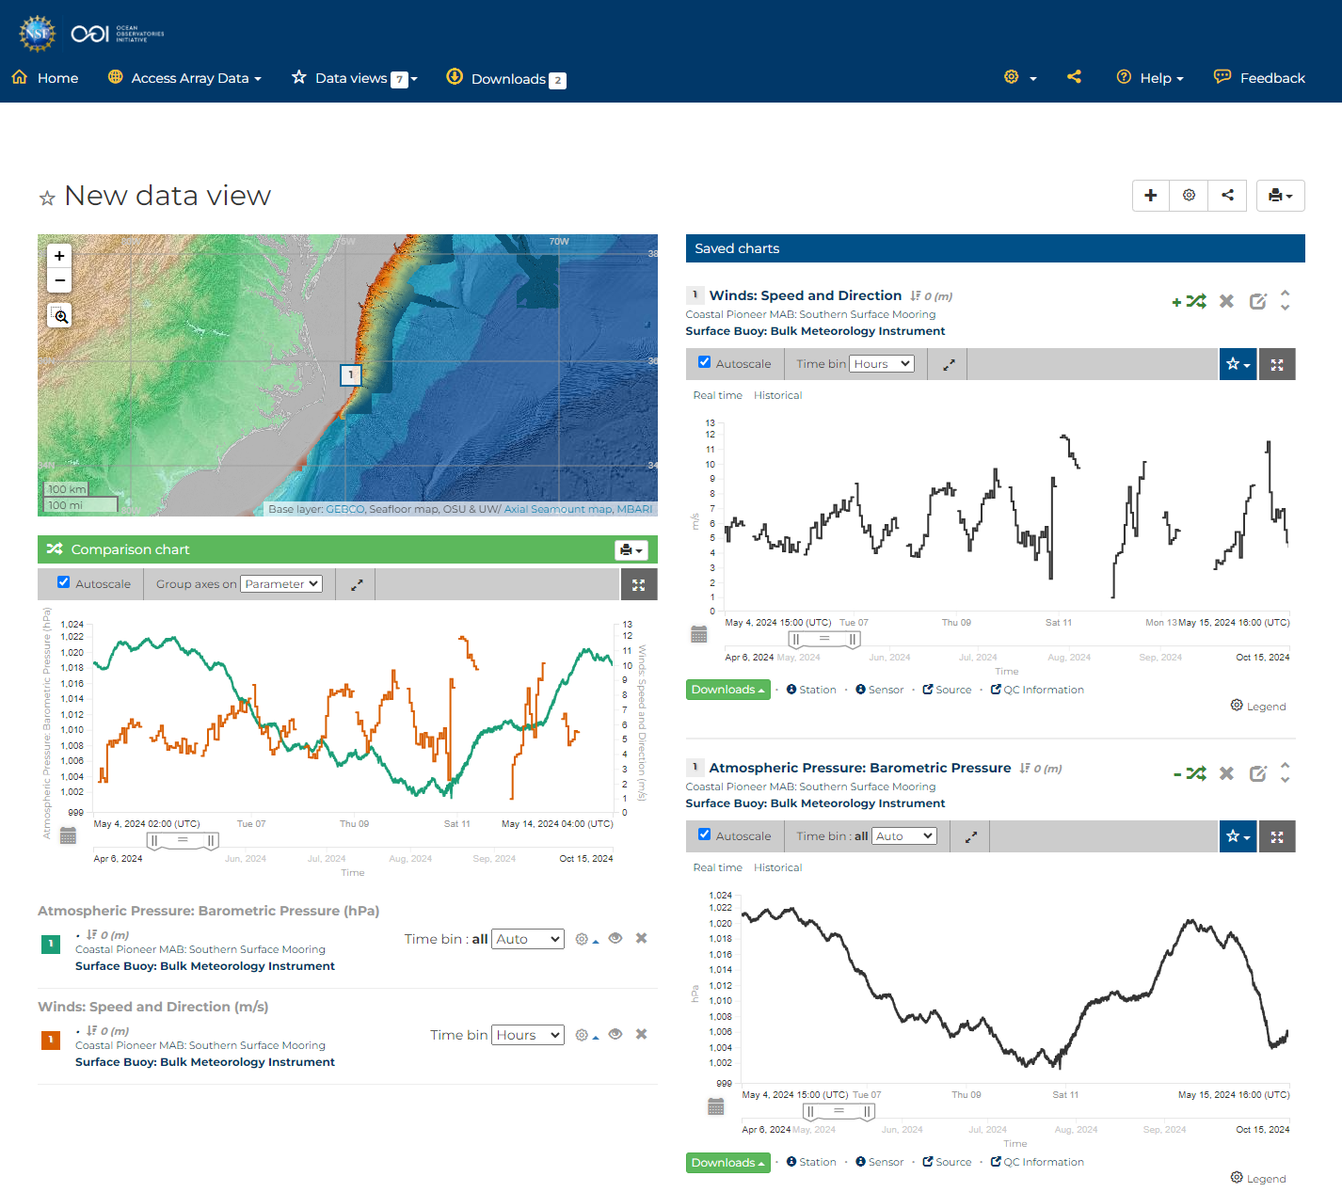
Create share link:
https://dataexplorer.oceanobservatories.org/#add-data-view/o0Km_08S/1
Notes:
New data view comparison chart opens to most recent week by default
Change the time range in the comparison chart
https://dataexplorer.oceanobservatories.org/#add-data-view/o0Km_08S/1
story in the MAB data for Data Labs demo. Here's the progression:
want to update [this Data Lab] that was made for Pioneer NES. note MAB Science Theme Extreme events: Hurricanes, freshwater outflows
could use the Pioneer MAB 1st storm example that we developed for previous workshops, but instead let's use the data to find a storm event. look for the lowest barometric pressure, find it on May 9. [note this could've been the storm: https://www.charlotteobserver.com/news/weather-news/article288433915.html]
compare to wind speed to generate comparison plot for updated Data Lab

Slide 16
Note gaps in telemetered data
Recovered data will be available in ~December
https://dataexplorer.oceanobservatories.org/#add-data-view/o0Km_08S/1
Notes:
https://dataexplorer.oceanobservatories.org/#add-data-view/o0Km_08S/1
Winds are a bit gappy during the low-pressure event. Could look at other array location (e.g., CNSM) winds as an option… storm system is likely large enough to show up at both locations.
story in the MAB data for Data Labs demo. Here's the progression:
want to update [this Data Lab] that was made for Pioneer NES. note MAB Science Theme Extreme events: Hurricanes, freshwater outflows
could use the Pioneer MAB 1st storm example that we developed for previous workshops, but instead let's use the data to find a storm event. look for the lowest barometric pressure, find it on May 9. [note this could've been the storm: https://www.charlotteobserver.com/news/weather-news/article288433915.html]
compare to wind speed to generate comparison plot for updated Data Lab

Slide 17
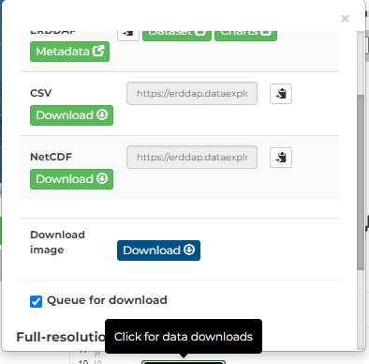
Queue for Download
https://dataexplorer.oceanobservatories.org/#add-data-view/o0Km_08S/1
Notes:
Add to download queue
End this example with Download data: queue these 2, note they are from same instrument so same ERDDAP link,
Show how to change the time range in ERDDAP to create the URL table, then csv output (or other)

Slide 18
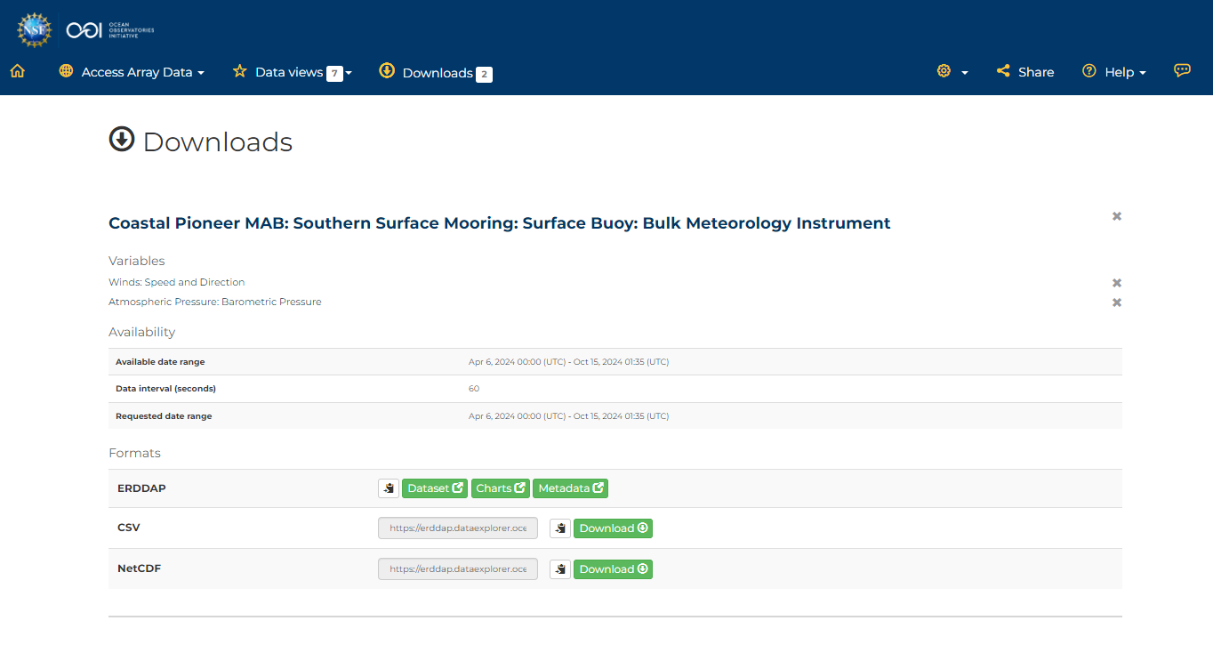
Notes:
Show the ERDDAP Data Access Form with the 2 parameters selected: https://erddap.dataexplorer.oceanobservatories.org/erddap/tabledap/ooi-cp11sosm-sbd11-06-metbka000.html?time%2Cwind_speed%2Cair_pressure%2Cz
Show the file types (csv and NetCDF)
Then back to the Queue to show the URLs for csv and NetCDF

Slide 19
Let’s look for Hurricane Debby ~August 8
https://dataexplorer.oceanobservatories.org/#add-data-view/o0Km_08S/1
Notes:
Next look for Hurricane Debby ~August 8 https://en.wikipedia.org/wiki/Hurricane_Debby_(2024)
but wind speed not available (yet in Data Explorer. I see the data in OOINet with high wind speed on Aug 9. use this as a learning/teaching moment at the workshop Friday, to help people understand that Data Explorer is downstream of the "Source" OOINet.).
we know there was tons of rain on land [https://www.scientificamerican.com/article/former-hurricane-debby-stalls-causing-heavy-rains-and-flooding-along-east/] [https://climate.ncsu.edu/blog/2024/08/rapid-reaction-debby-drenches-nc-in-multi-day-rain-event/]. We could look for rain data (Precipitation) – but – the way that instrument fills up then dumps means you have to do some calculations to use the data https://dataexplorer.oceanobservatories.org/#metadata/110968/station/4/sensor/data?start=2024-08-04T13:27:44Z&end=2024-08-15T06:40:12Z&bin=hours&leg_clim_max=false&leg_clim_min=false&leg_minmax=false
could we look for indicator of freshwater outflow?

Slide 20
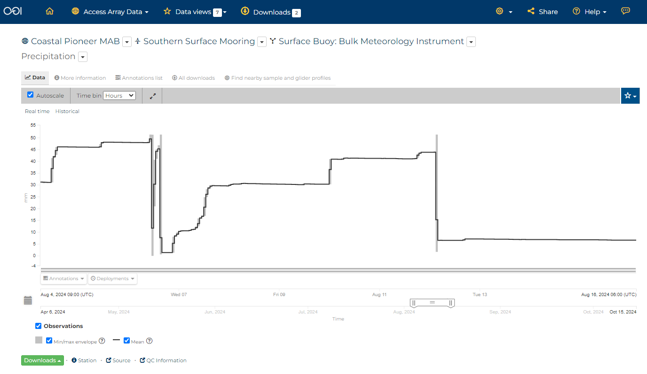
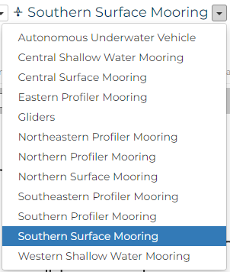
https://dataexplorer.oceanobservatories.org/#metadata/110968/station/4/sensor/data?start=2024-08-04T13:27:44Z&end=2024-08-15T06:40:12Z&bin=hours&leg_clim_max=false&leg_clim_min=false&leg_minmax=false
Notes:
Next look for Hurricane Debby ~August 8 https://en.wikipedia.org/wiki/Hurricane_Debby_(2024)
but wind speed not available (yet in Data Explorer. I see the data in OOINet with high wind speed on Aug 9. use this as a learning/teaching moment at the workshop Friday, to help people understand that Data Explorer is downstream of the "Source" OOINet.).
we know there was tons of rain on land [https://www.scientificamerican.com/article/former-hurricane-debby-stalls-causing-heavy-rains-and-flooding-along-east/] [https://climate.ncsu.edu/blog/2024/08/rapid-reaction-debby-drenches-nc-in-multi-day-rain-event/]. We could look for rain data (Precipitation) – but – the way that instrument fills up then dumps means you have to do some calculations to use the data https://dataexplorer.oceanobservatories.org/#metadata/110968/station/4/sensor/data?start=2024-08-04T13:27:44Z&end=2024-08-15T06:40:12Z&bin=hours&leg_clim_max=false&leg_clim_min=false&leg_minmax=false
could we look for indicator of freshwater outflow?
What parameters do we have for Southern Profiler Mooring? Navigate into Southern Profiler Mooring > WFP > CDOM really changed after 1st week August

Slide 21
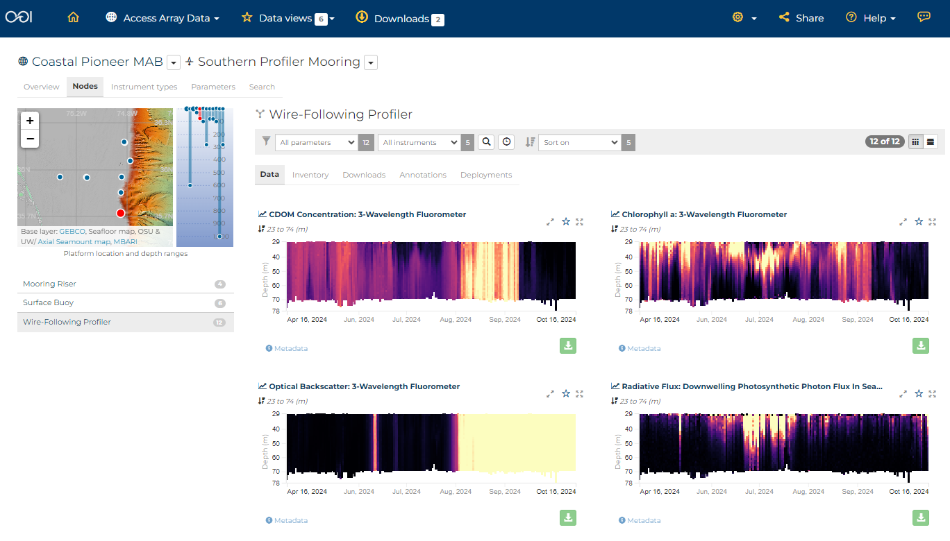
https://dataexplorer.oceanobservatories.org/#ooi/array/CP1/subsite/CP13SOPM/node/CP13SOPM-WF/data
Notes:
story in the MAB data for Data Labs demo.
From Al: “if it is a water column mixing event the optical backscatter might also show something. If it’s fresh water, the salinity signal from the buoy and NSIF might have a signal”
could we look for indicator of freshwater outflow? What parameters do we have for Southern Profiler Mooring? Navigate into Southern Profiler Mooring > WFP > CDOM really changed after 1st week August
We could explore the salinity although around august 8 appears influenced by Gulf Stream because values near surface are 36
find indications in CDOM profiles. line up CDOM with barometric pressure on August 8.

Slide 22
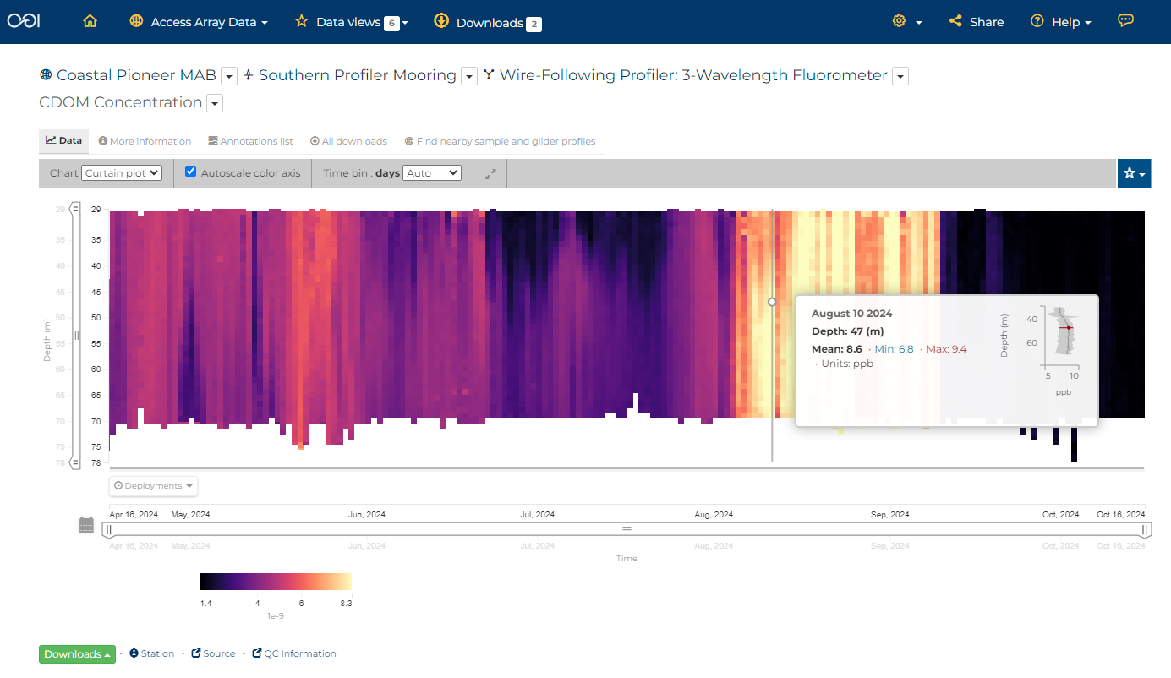
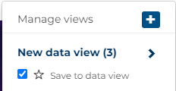
https://dataexplorer.oceanobservatories.org/#metadata/111005/station/2000/sensor/data?start=2024-04-16T22:02:00Z&end=2024-10-16T00:06:00Z&leg_clim_max=false&leg_clim_min=false&leg_minmax=false&fr=subsite.node
Notes:
story in the MAB data for Data Labs demo.
From Al: “if it is a water column mixing event the optical backscatter might also show something. If it’s fresh water, the salinity signal from the buoy and NSIF might have a signal”
could we look for indicator of freshwater outflow? What parameters do we have for Southern Profiler Mooring? Navigate into Southern Profiler Mooring > WFP > CDOM really changed after 1st week August
We could explore the salinity although around august 8 appears influenced by Gulf Stream because values near surface are 36
find indications in CDOM profiles. Hover to show how the mean values increased and profile changed
Add to Data View but can’t add to Compare.
line up CDOM with barometric pressure on August 8.

Slide 23
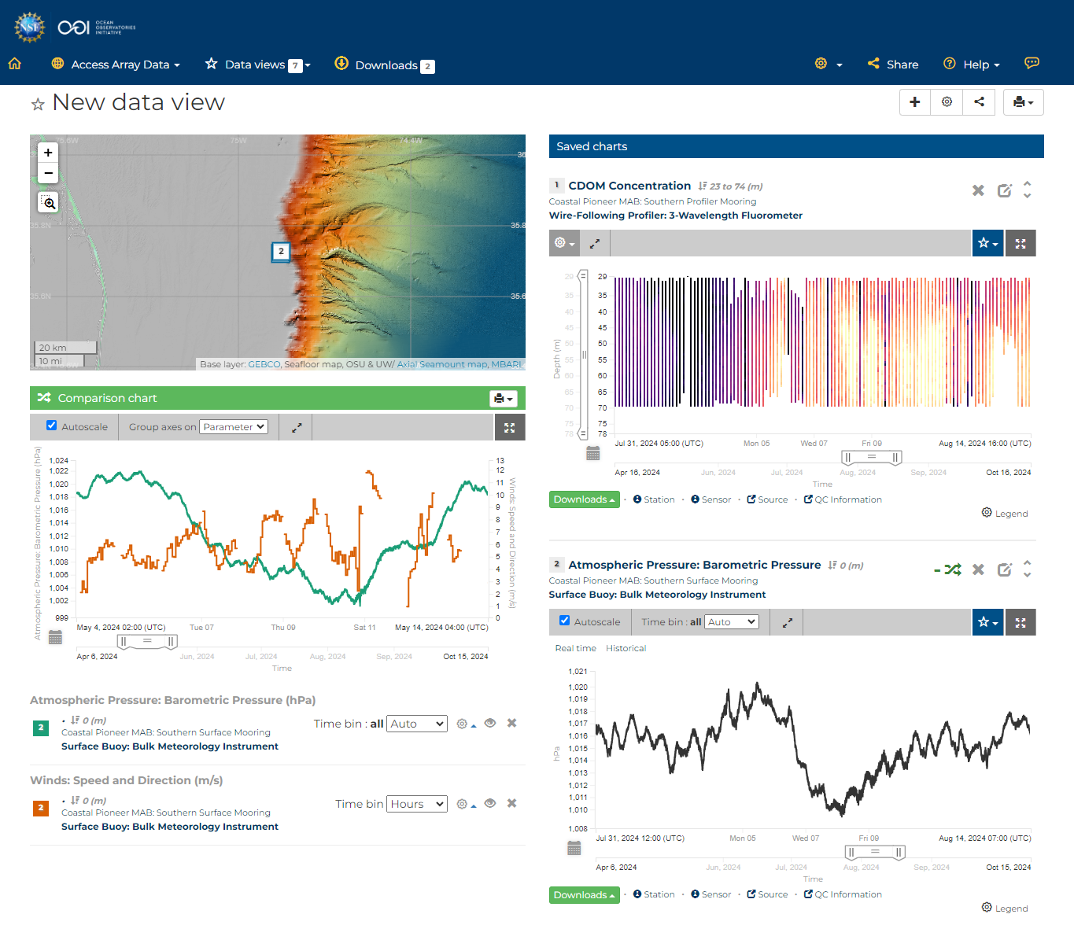
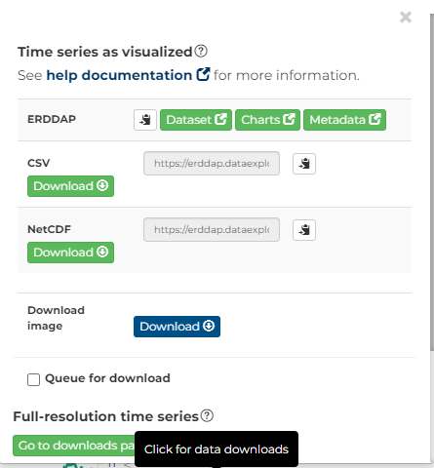
https://dataexplorer.oceanobservatories.org/#add-data-view/EQ1XYmNd/1
Notes:
In the new data view bump up the barometric pressure Data Chart, so that it is underneath the CDOM profiles
Change the time periods to a week b4 and after Aug 8 https://dataexplorer.oceanobservatories.org/#add-data-view/EQ1XYmNd/1
here’s initial version Data View that we'll end with: https://dataexplorer.oceanobservatories.org/#add-data-view/b4mwFbq8/1
End with Download data to show ERDDAP

Slide 24
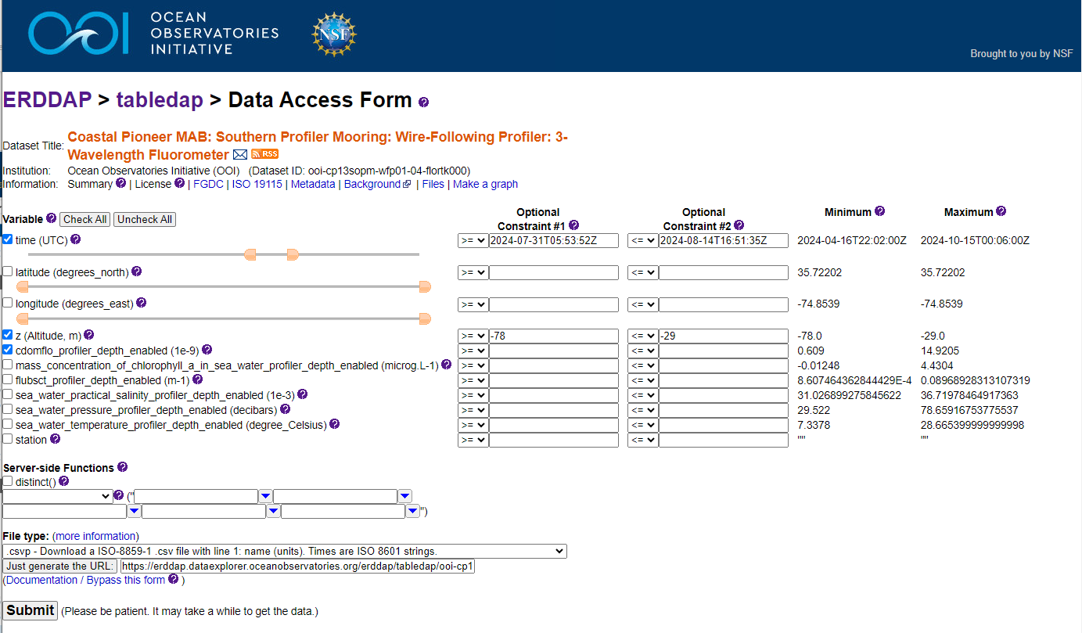
https://erddap.dataexplorer.oceanobservatories.org/erddap/tabledap/ooi-cp13sopm-wfp01-04-flortk000.html?time%2Ccdomflo_profiler_depth_enabled%2Cz&time%3E%3D2024-07-31T05%3A53%3A52Z&time%3C%3D2024-08-14T16%3A51%3A35Z&z%3E%3D-78&z%3C%3D-29
Notes:
Show how to generate URL

Slide 25
+ NEW: IFCB Dashboard
Notes:
Additional data access points
End with the entry points for other data types:
Ask if anyone interested in quick demo of any other access points depending on data type.
I will be available tomorrow morning as well for questions/share screen over Zoom.

Slide 26
Let’s explore for data of your interest

Slide 27
Questions?
Stace Beaulieu (stace@whoi.edu)
Feel free to use the Feedback button on Data Explorer
OOI Discourse HelpDesk https://discourse.oceanobservatories.org/
Notes:
This material is based upon work supported by the Ocean Observatories Initiative (OOI), which is a major facility fully funded by the National Science Foundation under Cooperative Agreement No. 2244833.

Slide 30
Infrastructure…
More than 900 instruments of almost 50 different types mounted onto moored or mobile platforms
Collecting physical, chemical, geological, and biological data from the air-sea interface to the seafloor
https://oceanobservatories.org/ooi-infrastructure/
Notes:
From infrastructure webpage: A variety of infrastructure — platforms, nodes, instruments, and sensors — comprise the arrays designed to provide a continuous stream of ocean data to the user community.

Slide 31
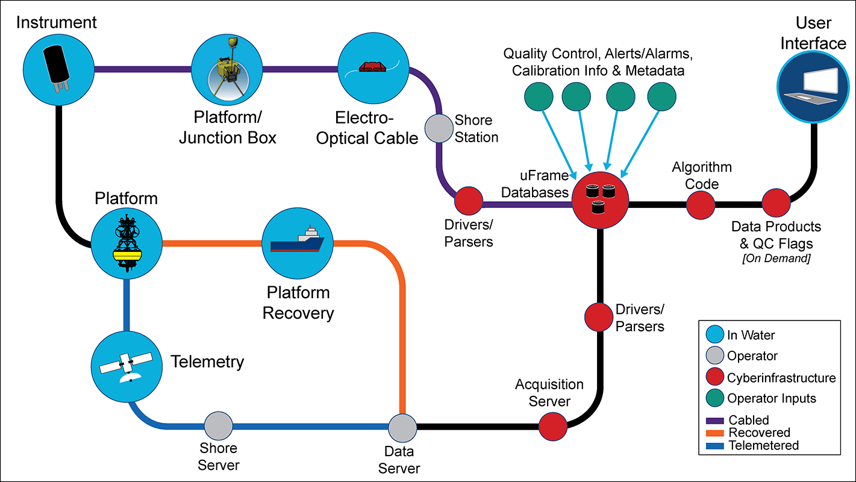
Infrastructure… includes cyberinfrastructure!
https://oceanobservatories.org/cyberinfrastructure/
Notes:
https://oceanobservatories.org/ooi-infrastructure/
“Relaying the data captured by this complex network of infrastructure is accomplished by an equally complex integrated cyberinfrastructure that receives, stores, and transmits ocean data to all those who request it.”
OOI is comprised of four entities: three Marine-Implementing Organizations (WHOI, Oregon State, University of Washington) and the Program Management Office (PMO) which oversees the three MIOs and the CyberInfrastructure (CI) which is responsible for the data delivery/web UI/etc).

Slide 32
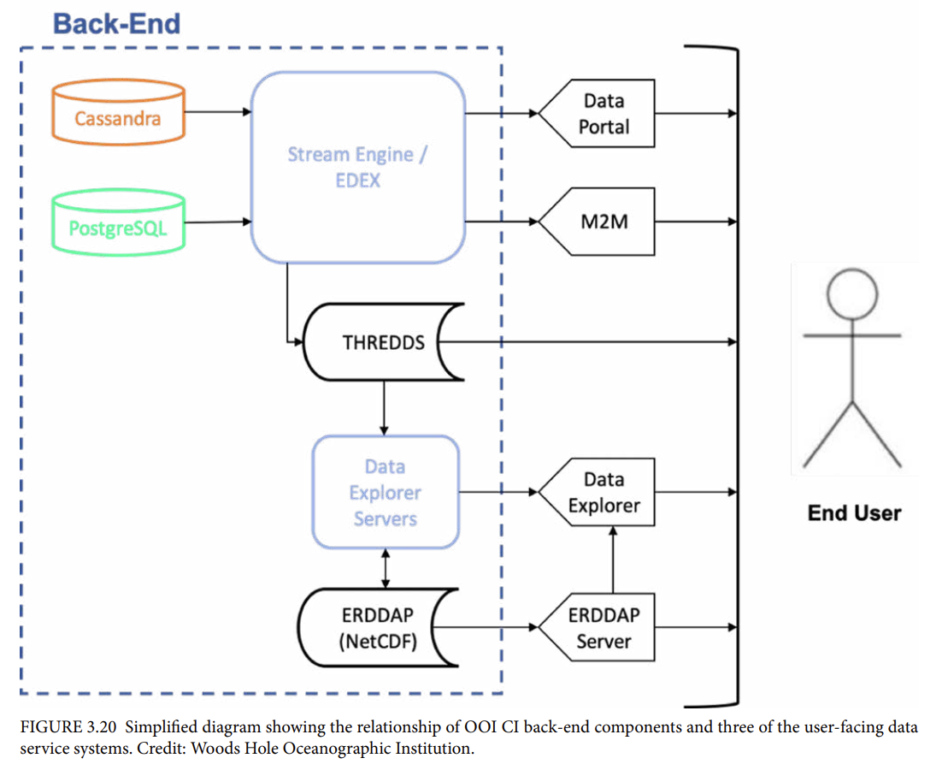
OOI Science Plan
Section 3.C.
OOI Data Delivery System
Notes:
This figure indicates 5 of the User Interfaces

Slide 33
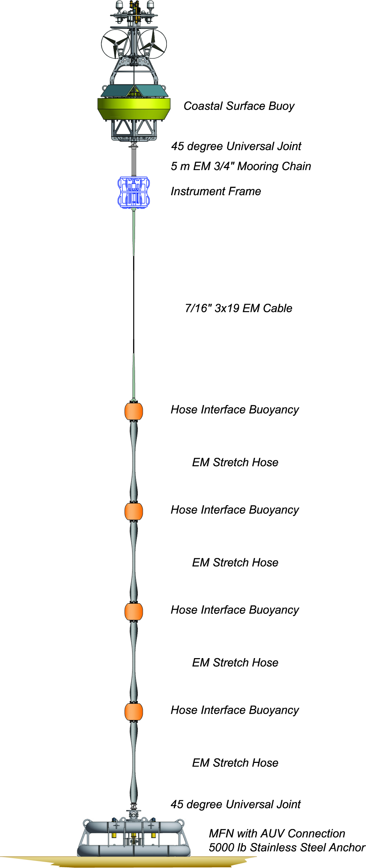
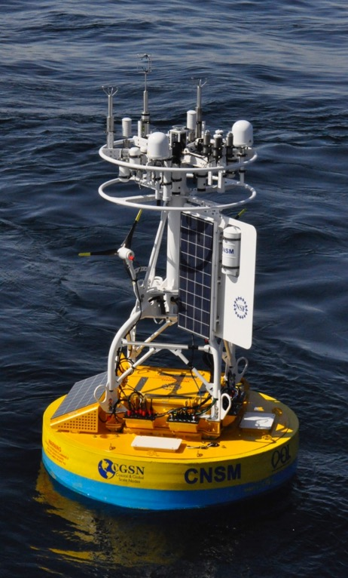
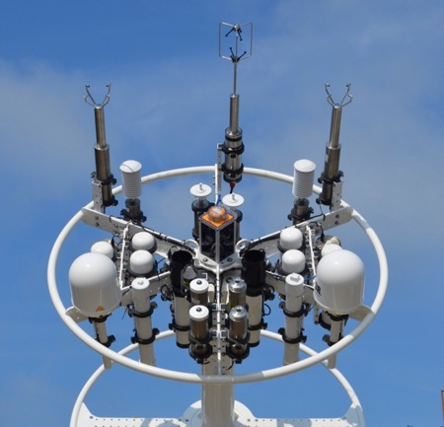
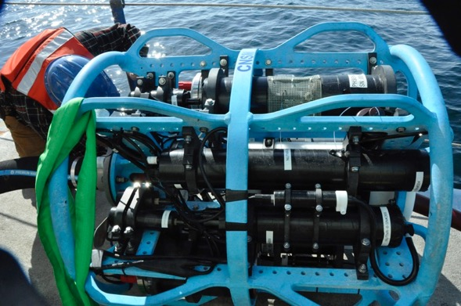
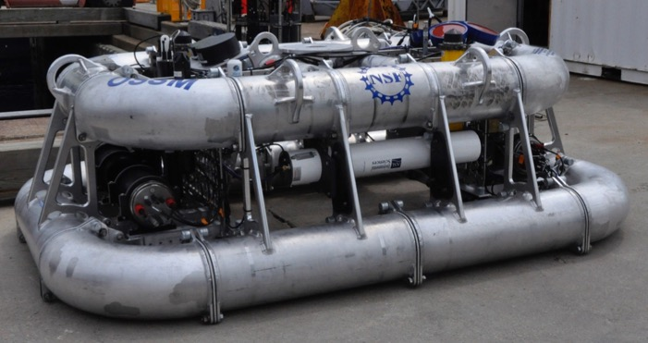
Coastal Surface Moorings
Notes:
Slide from Andrew Reed’s JP class presentation
Power Generation
Near-real-time communications
Instruments from buoy (Meteorology) to seafloor
33

Slide 34
What is a Data View? (in Data Explorer)
Click here for example Data Views
A Data View is a collection of datasets that can be visualized together for comparison
https://dataexplorer.oceanobservatories.org/help/overview.html#data-views-overview

Slide 35
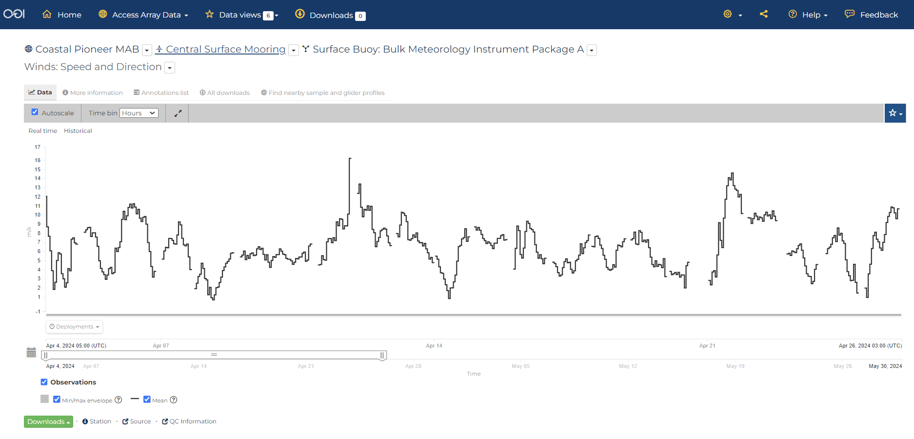
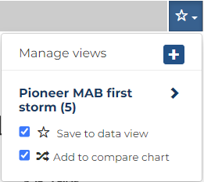
Let’s save this chart into a new Data View
Add new label
Notes:
save into Data View and Comparison Chart
show how it increments the number in the top menu Data views, mention the other available default Data views have Data stories they could use for different subjects

