Slide 1
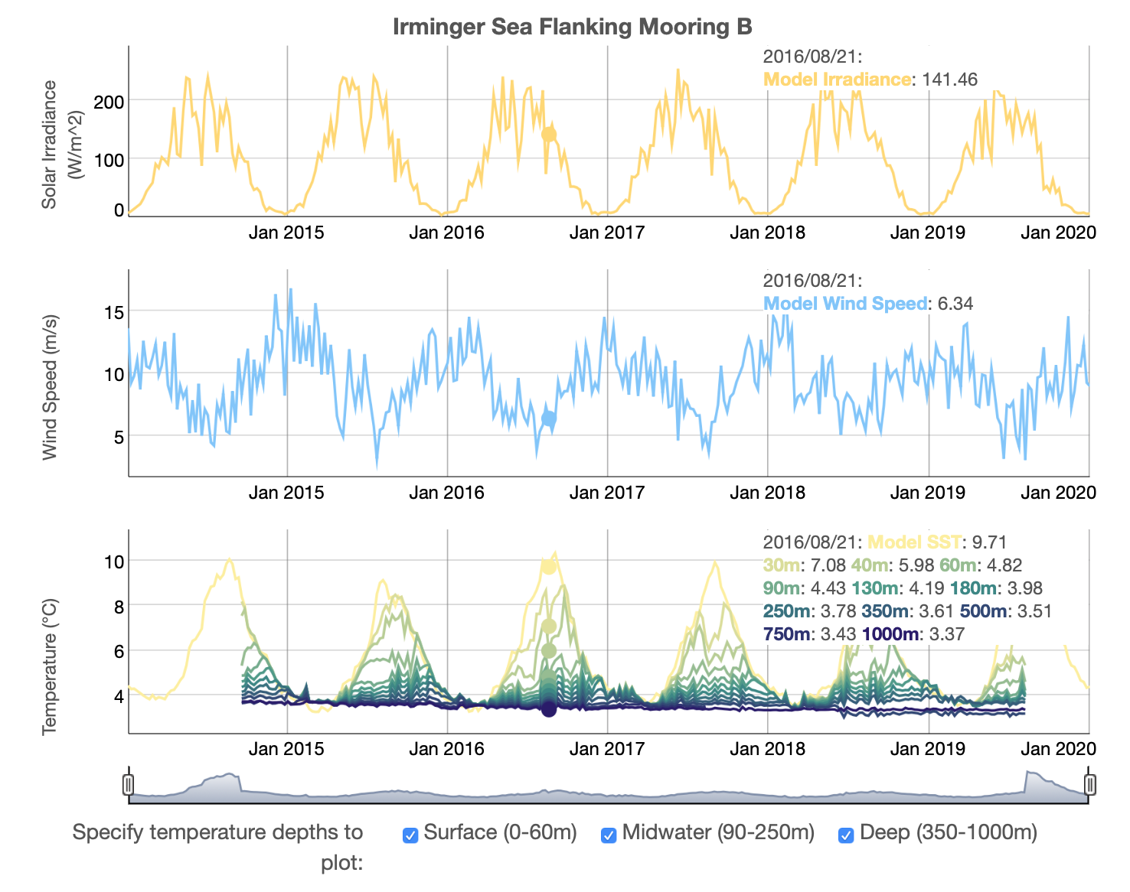
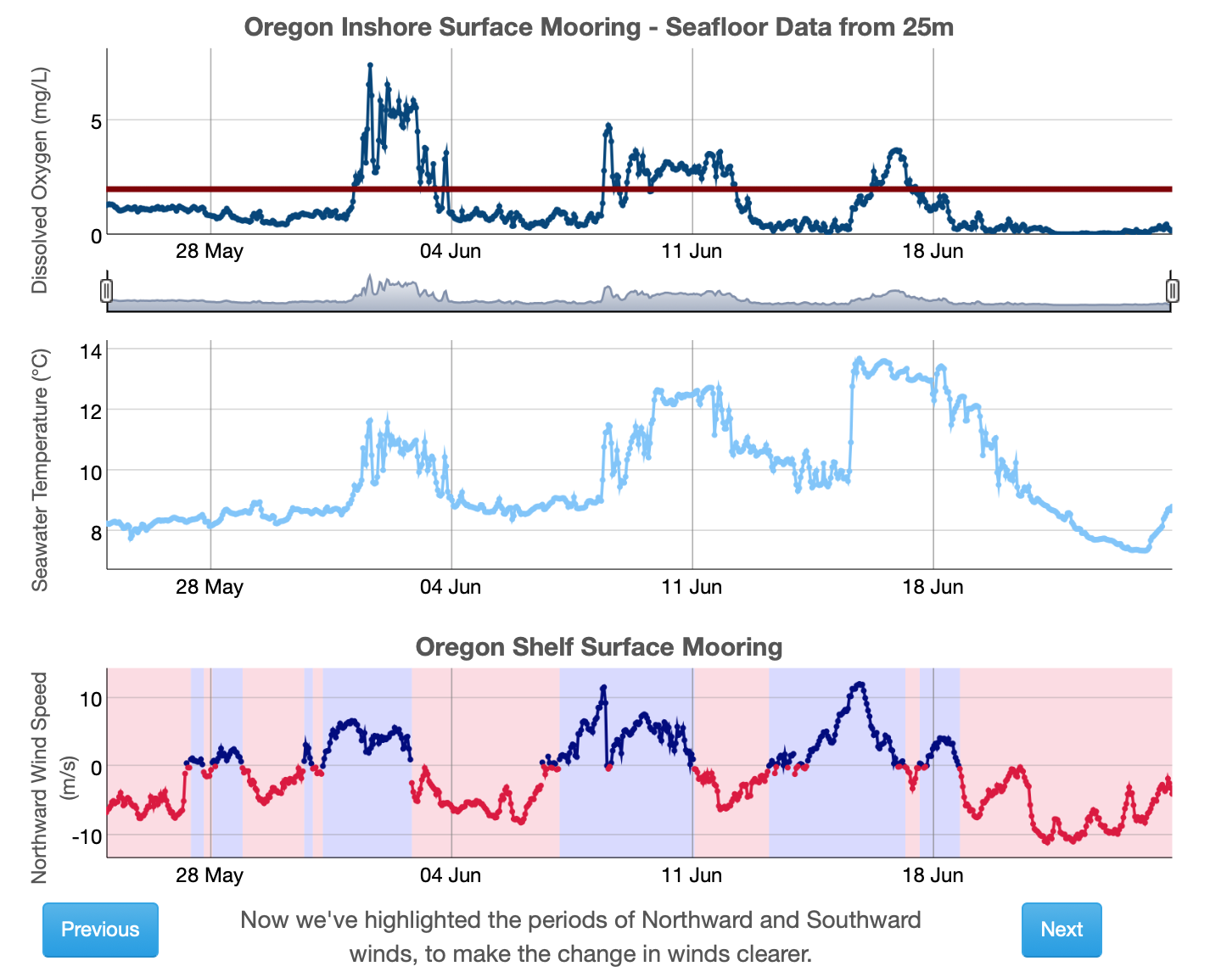
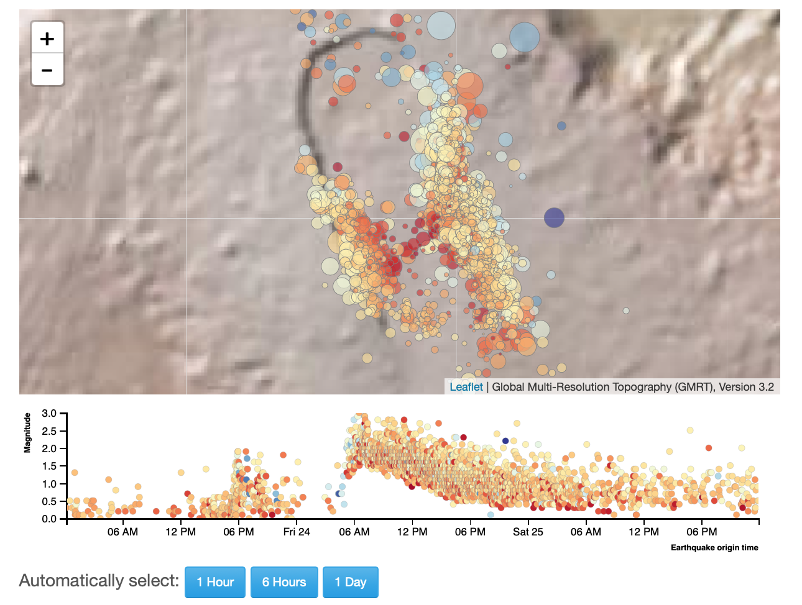
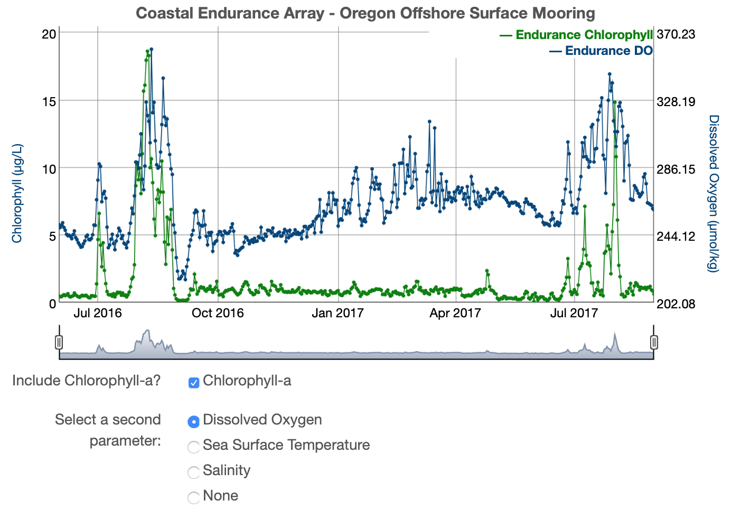
OOI Data Labs 2.0
2023 Fall OOIFB
Data Services Committee Meeting
Sage Lichtenwalner, Rutgers University
This project is supported by NSF Grant OCE-2316075
datalab.marine.rutgers.edu

Slide 2
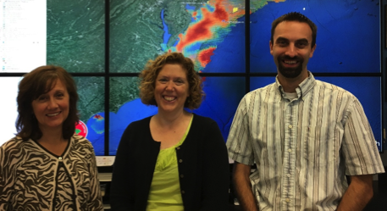
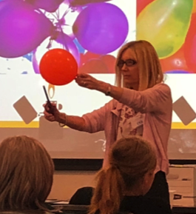
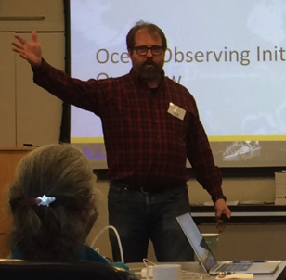
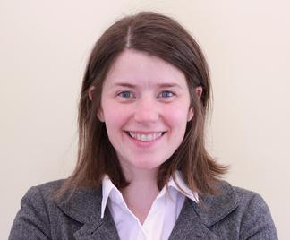
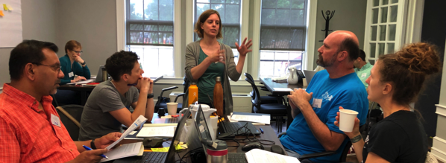
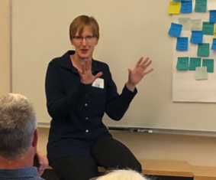
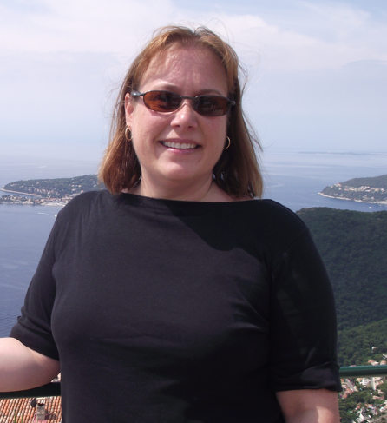
OOI Data Labs Team
* Member of 1.0 team only
Christine Bean*, Janice McDonnell,
Sage Lichtenwalner
Rutgers University
Catherine Halversen*
UC Berkeley
Dax Soule
Queens College CUNY
Kristin O’Connell
SERC
Anna Pfeiffer-Herbert
Stockton University
Brooke Love*
Western Washington Univ
Denise Bristol
Hillsborough CC

Slide 3
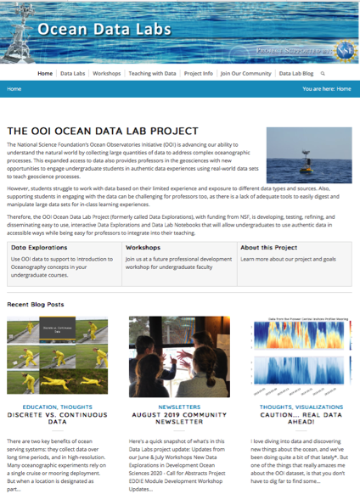
OOI Data Labs Project Goals
Address the challenges of teaching with data & support opportunities for professors and undergraduates to become more expert users of OOI data.
Increase undergraduates’ engagement in and understanding of core concepts through use of OOI data.
http://datalab.marine.rutgers.edu

Slide 4
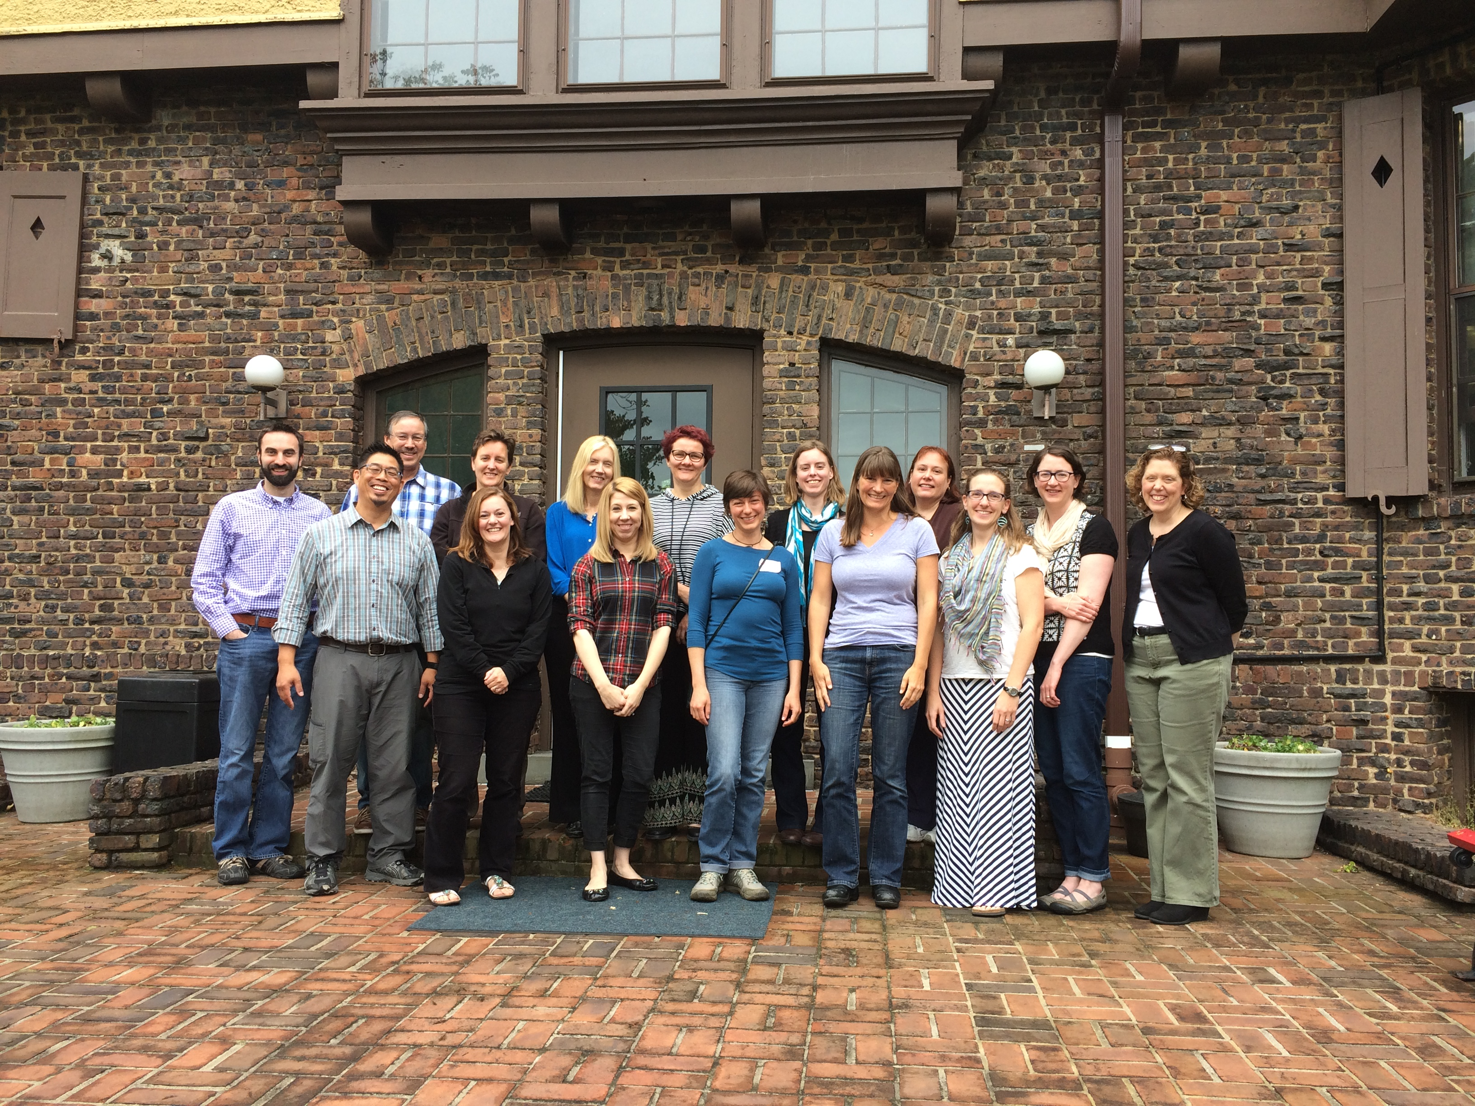
Early Pilot Projects (2016-2017)
Objectives
Crosswalk OOI Science themes with introductory oceanography textbooks
Review sample activities using OOI data/data viz tools
Discuss strategies to incorporate into curriculum
Build long-term working relationships and collaborations on data investigation development
Productivity Workshop 2016

Slide 5
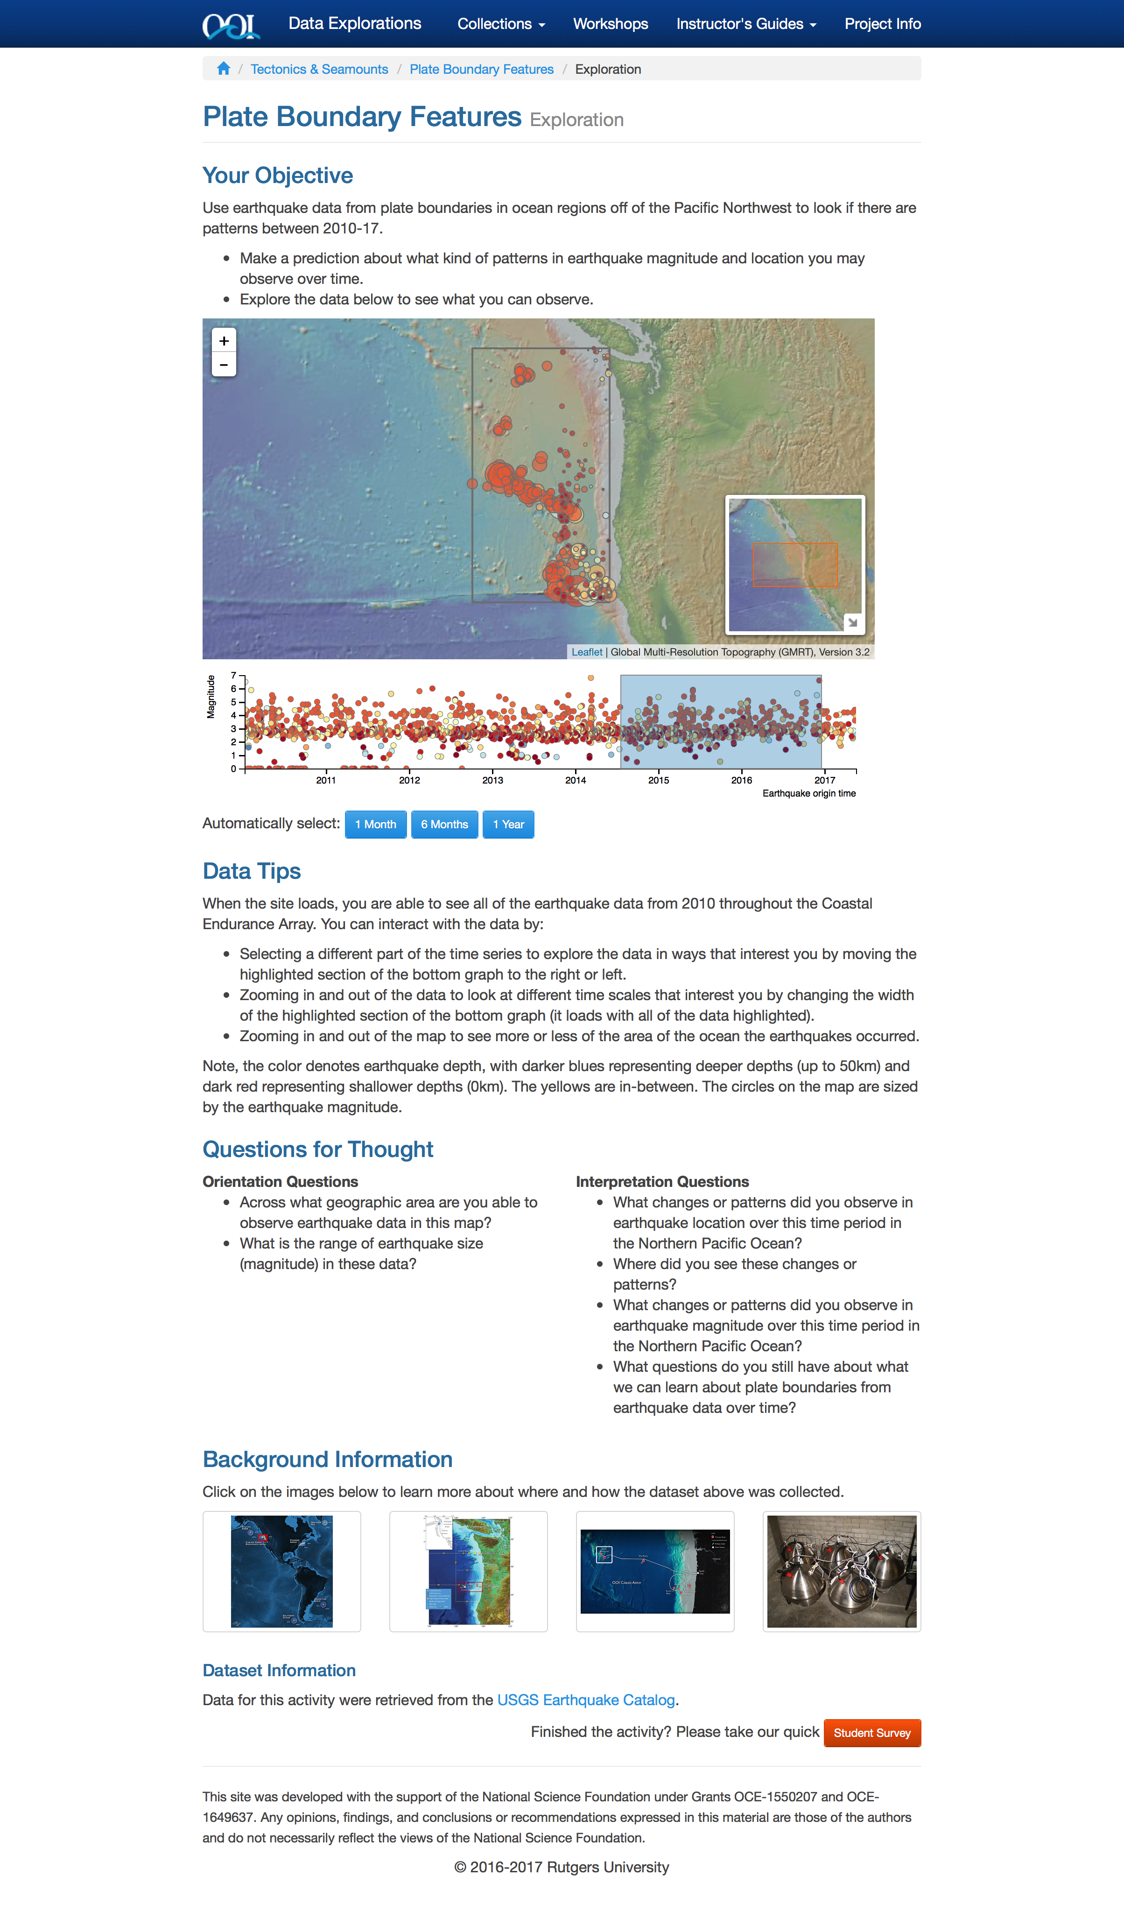
What is a Data Exploration?

Slide 6
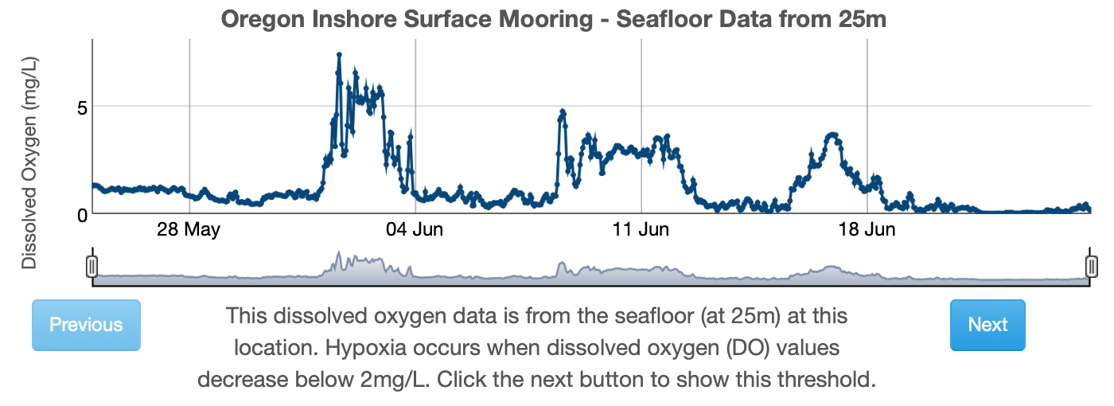
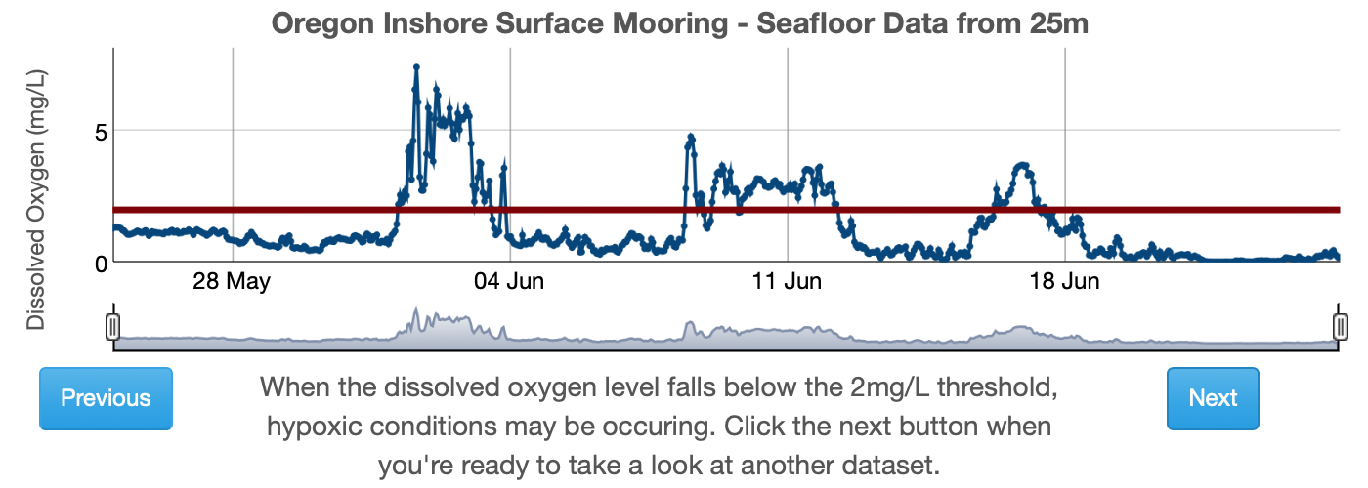
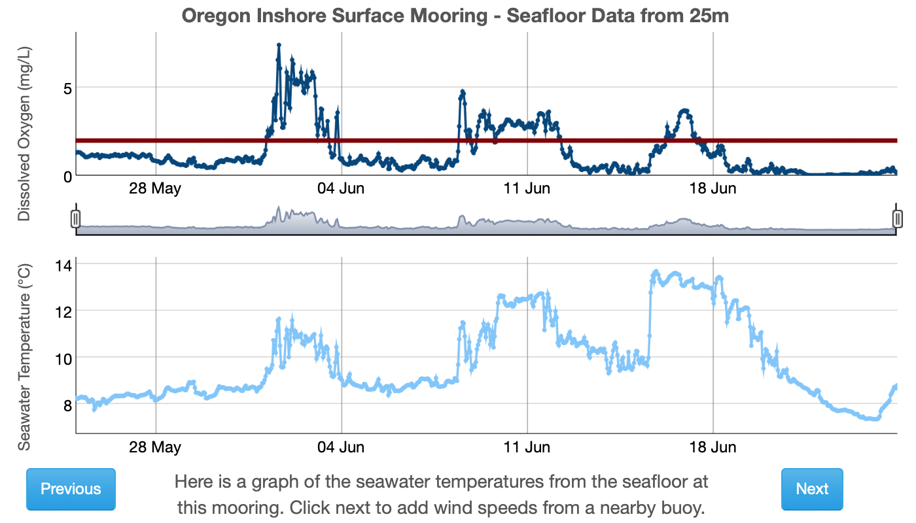
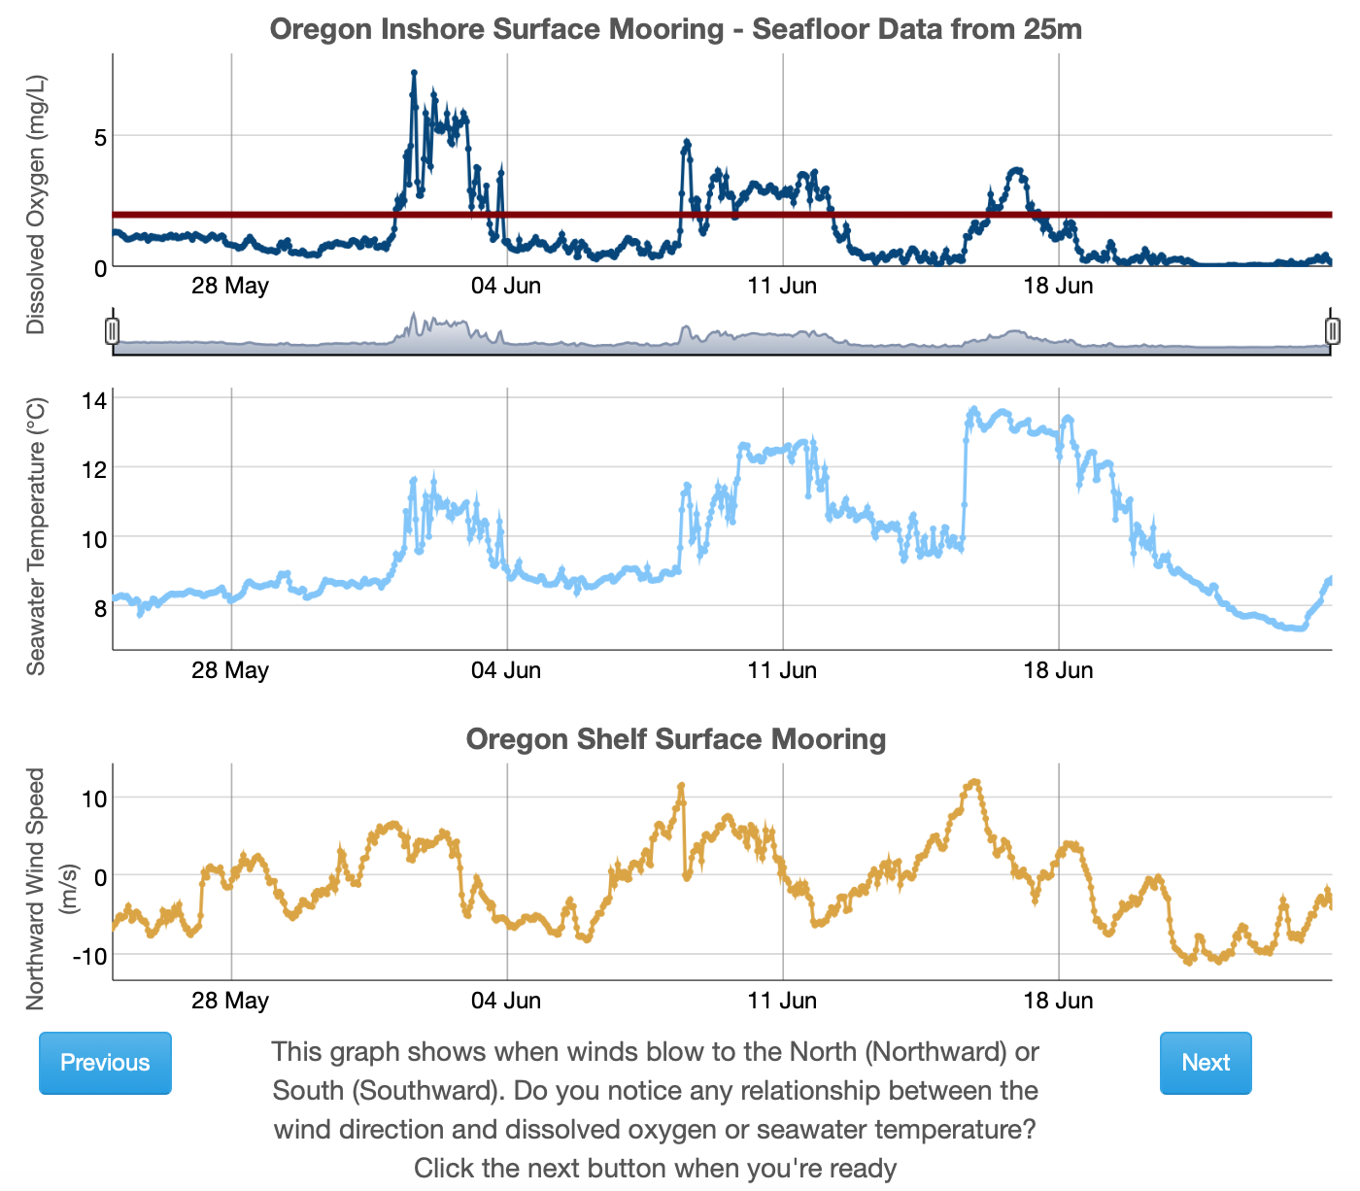
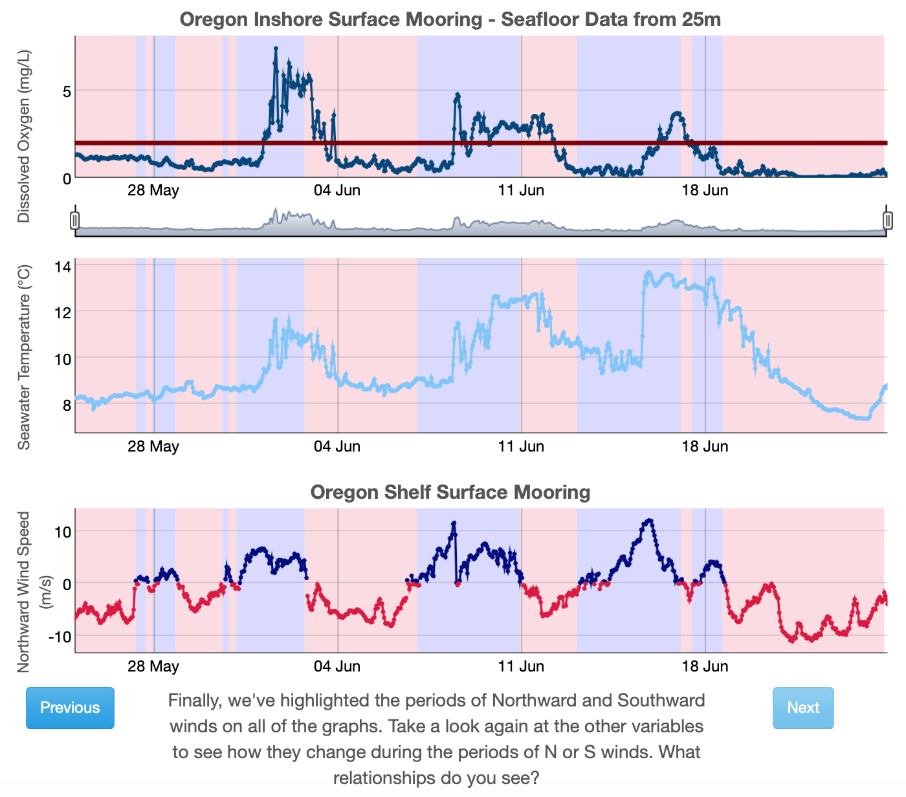
Guided Learning
Anoxic Events (2019)
Kathy Browne, Rider University
Lauren Sahl, Maine Maritime Academy
Rebecca Freeman, University of Kentucky
Gabriella Smalley, Rider University
Carol White, Southern Maine Community College

Slide 7
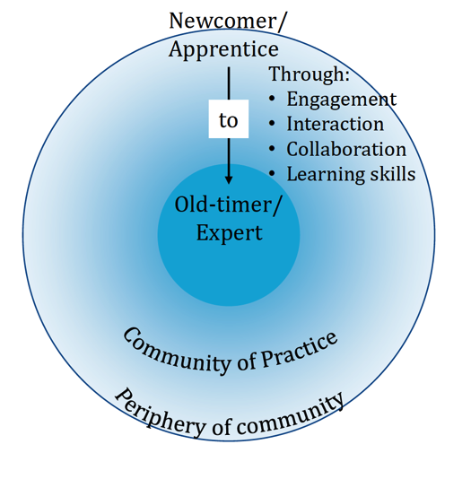
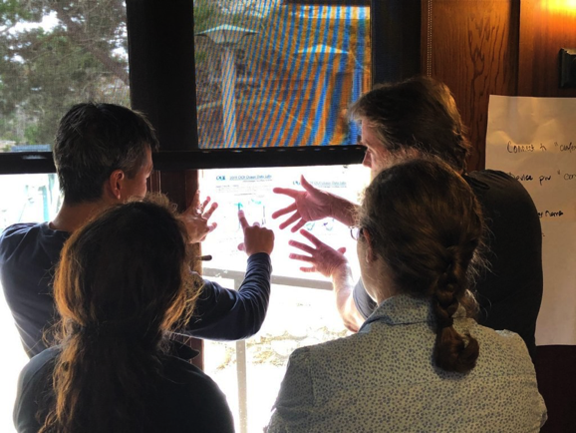
OOI Data Labs Project (2018-2021)
Key Goals
Build a Community of Practice of undergraduate educators, interested in using OOI data with their students
Create and pool tools to make OOI data more accessible to educators and students

Slide 8
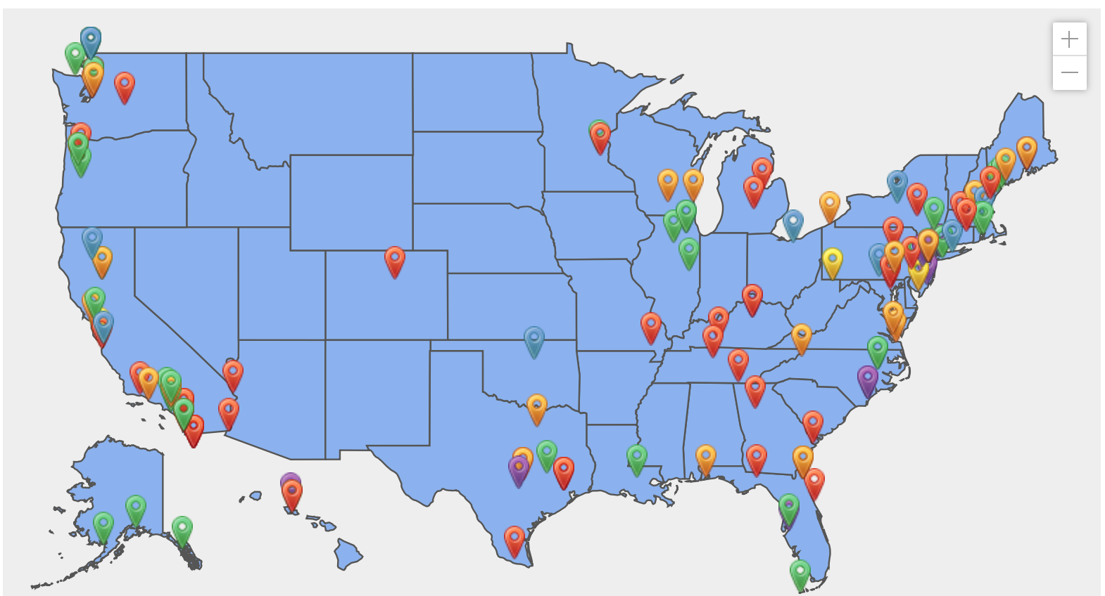
The growing Ocean Data Labs community!
Developers –participated in one of our 2019 weeklong development workshops
Piloters – attended one of our weekend pilot workshops in 2016-2017, or who have pilot tested our OOI Lab Manual
Fellows – 2020 cohort
REU Mentors – Faculty who helped mentor our 2020 Virtual REU students
Leaders & Staff – Members of the core project team
https://datalab.marine.rutgers.edu/community-map/

Slide 10
Data Labs Resource Collection
Want a ready-made lesson plan incorporating OOI datasets?
Want a series of lab activities with built-in student assessments?
Want a modular set of activities that you can adapt?
Want to start from scratch using curated OOI datasets?
Lesson Plans
Online Lab Manual
Data Explorations
OOI Nuggets
Ideal for introductory undergraduate majors or non-majors
Ideal for intermediate undergraduate majors or non-majors
Ideal for upper-level undergraduate majors or graduate level
More guided
More open-ended
Explore the collection: datalab.marine.rutgers.edu/data-labs/

Slide 11
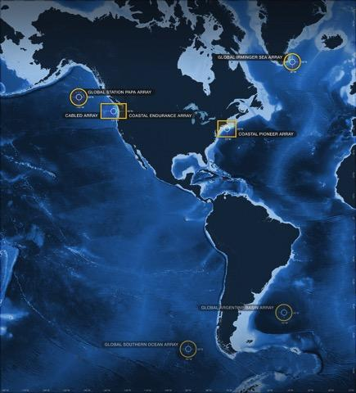
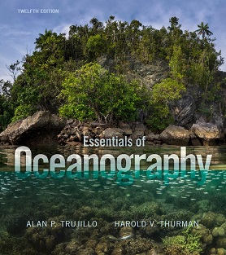
Alignment to Intro Oceanography curriculum
Lab Manual chapters
OOI Science Themes
and Data Availability
Common Oceanography Textbooks
Topic | Chapter
Ocean geography | Lab 1: Introduction to the OOI, the collection of oceanographic data
Ocean technology | Lab 1: Introduction to the OOI, the collection of oceanographic data
Data skills for oceanography | Lab 2: Building data skills
Marine Geology | Lab 3: Plate tectonics and the seafloor Lab 4: Seafloor changes in a volcanically active setting
Ocean Chemistry | Lab 5: Investigating density stratification
Physical Oceanography | Lab 6: Waves generated by large storms
Biological Oceanography | Lab 7: Primary production Lab 8: Anoxic events

Slide 12
Goals of the OOI Lab Manual
Build data literacy and critical thinking skills in undergraduate students using authentic (“messy”) scientific data
Visualize data in a user-friendly, interactive and authentic way
Engage students with data activities that reinforce student confidence in scientific questioning, data analysis, and synthesis
Provide a real-world context for key concepts in oceanography

Slide 13
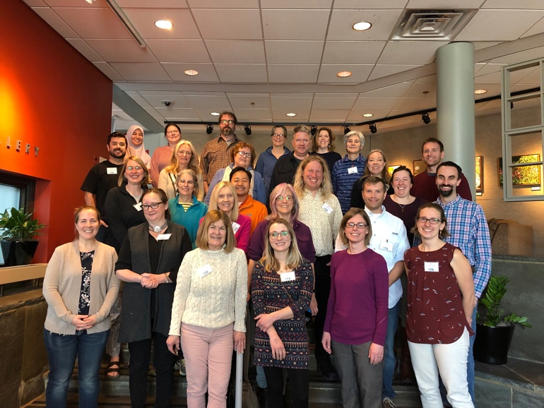
OOI Data Labs 2.0 (2023-2025)
Project Goals
Continue to build and support the OOI educator community
  Especially MSI, 2YC, PUI and R2
  Special focus on the Mid Atlantic
Develop “next level” activities
  Fill in gaps in the existing OOI Data Labs manual
  Domain-specific and level-appropriate programming notebook-based activities (?)

Slide 14
Design Process – Lessons Learned
Lichtenwalner, 2021
Identify Target Scientific Concepts & Skills
Match Educational Goals with Instrumentation
Find Available Instrument Data
Cleanup the Dataset
Add Context & Educational Surrounds
Build Interactive Visualizations
Community Building – Defined process helps divide tasks and keep everyone on track
Takes time and effort – Development is highly iterative (esp. 3&5)
Educators can spearhead content selection and lesson development
  Training is essential for new faculty to lean about the tools and instruments to find appropriate datasets, esp. those not familiar with OOI or using OOS.
  With better data portals, they might also help with data and visualizations

Slide 15
What will OOI Data Labs 2.0 try to accomplish?
OOI
Data + Science
Data Science
Coding/Python
Education
Data
Explorations
Data
Workshops
?
Data Sci
Bootcamps

Slide 16
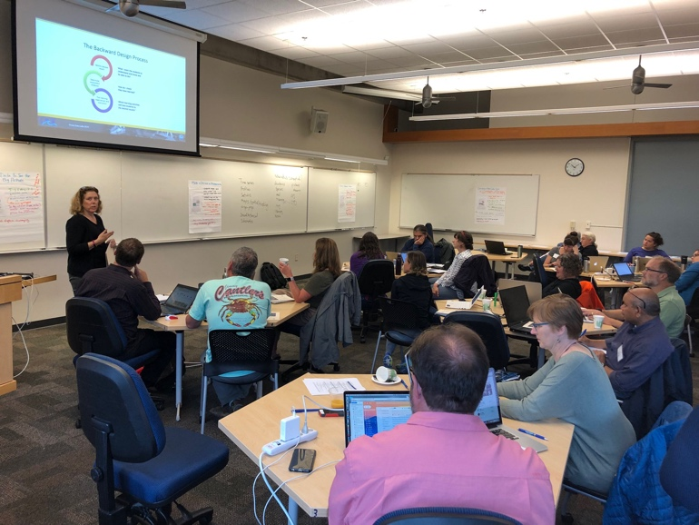
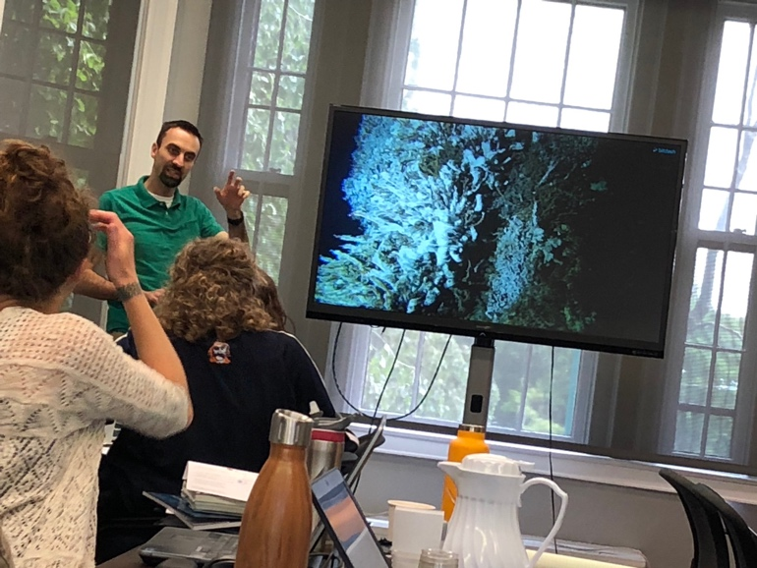
OOI Data Labs 2.0 – Key Tasks
Engage a new community of faculty capitalizing on the Pioneer Array relocation
  Refresh our database of potential faculty
  ”Regional” workshop focused on Pioneer’s potential
Expand the collection of OOI education resources
  “Development” workshop
Continue to support the community
  Two 1-day introductory workshops (e.g. OSM24)
  Collecting and sharing resources
Evaluation
  Needs Assessment to identify community needs
  Reach Survey to measure long-term impact

Slide 17
FIN

