Slide 1
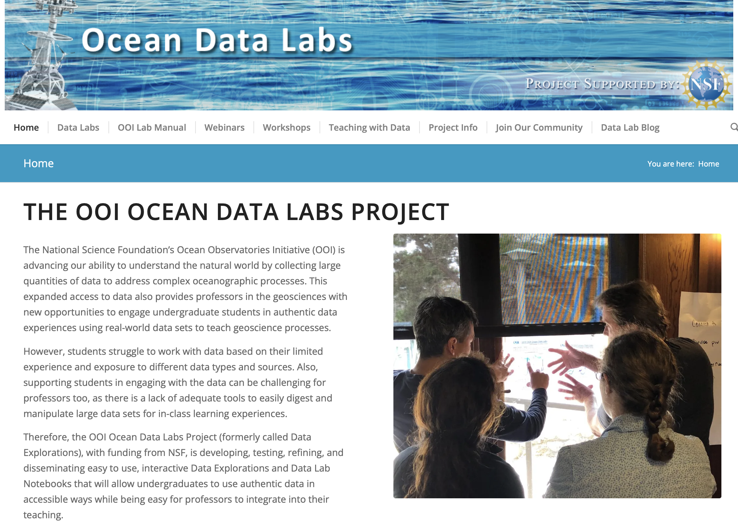
An Update on the OOI Data Labs Project
October 13, 2023
Janice McDonnell, Sage Lichtenwalner, Dr. Anna Pfeiffer-Herbert, Denise Bristol, and Dr. Dax Soule
datalab.marine.rutgers.edu
Notes:
Thank you for invitation
So glad to be back involved in OOI
Here to present an update on our Data Labs project

Slide 2
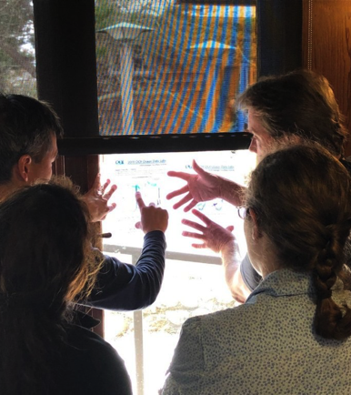
‘To do’ list for today
Background: Data Labs
2023 project goals & objectives
Timeline
Notes:
My to do list for today is to do a refresher on the Data Labs project (highlighting some of our previous work 2018-2022); give you a thumb nail review of our current/updated newly funded work – starting about 2 weeks ago! And a rough timeline for what we think we will do and when.

Slide 3
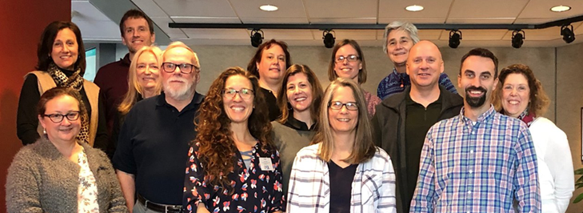
OOI
Data Labs
Project
Key Goals
Build a Community of Practice (CoP) of professors, interested in using OOI data with their undergraduate students:
Make OOI data more accessible to educators and students
Notes:
The data labs project was funded in 2018 -
Our key goals were to build a Community of Practice for professors teaching undergraduate students – our focus was on exploring how we can use OOI data to teaching to improve data literacy skills and understanding of basic oceanographic themes and concepts. Our objective was to make OOI data more accessible to professors and students. It can be thought of a pilot study to explore data skills building through the use of real world data from the OOI.

Slide 4
Notes:
This diagram represents our project journey

Slide 5
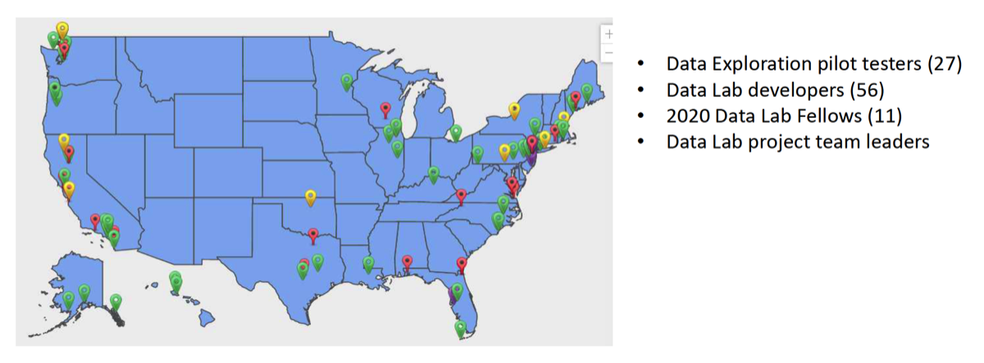
Community of Practice ~182 members
70% (n=133) involved in one or more Data Lab initiatives
** 60 Implementation workshop attendees (not pictured on map)
Notes:
Overall, 70.7% of 133 survey respondents indicated that they had been involved in one or more OOI Data Lab initiatives. 1/3 to 1/4 indicated that they had used an activity that someone else had created.

Slide 6
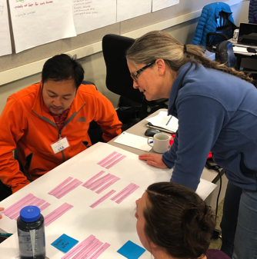
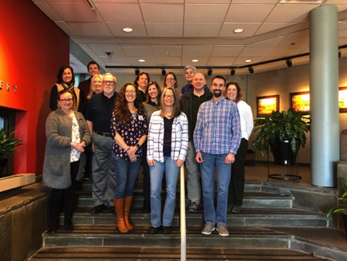
OOI Data Lab Manual
Community-generated from the idea to the authorship
Notes:
One of the un- intended project activities was our Data Lab Manual the idea came from a participant – Sid Mitra from at the time, Eastern Carolina University – now the Associate Dean of Academic Affairs at VIMS. We empowered a team pictured here to develop an open source lab manual that features the data explorations developed as part of the Data Labs project.

Slide 7
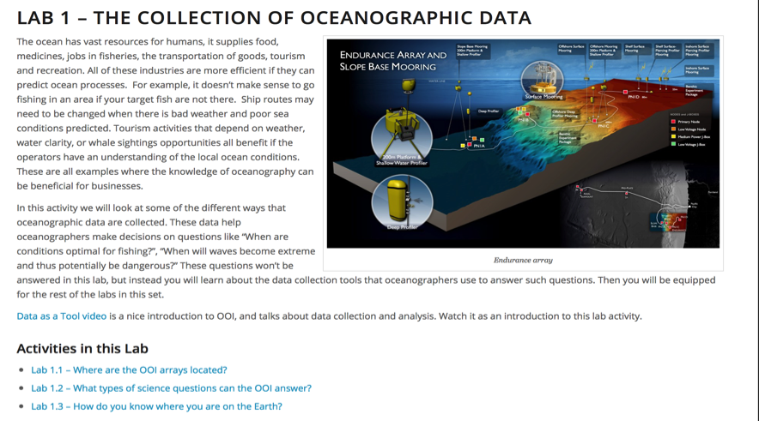
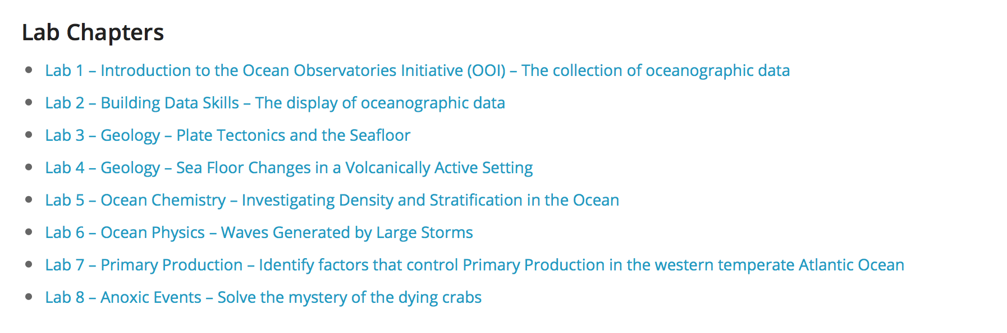
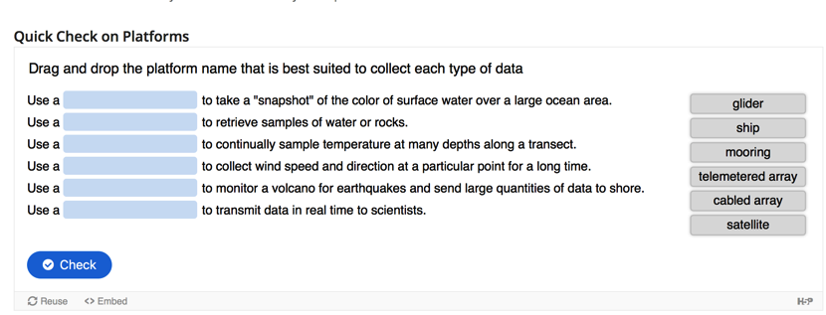
OOI Data Lab Manual
Full lessons
Interactive quizzes
Instructors guide
Notes:
These are full developed lessons and interactive quizzes that help engage undergraduate students in oceanographic concepts with data sets from the OOI.

Slide 8
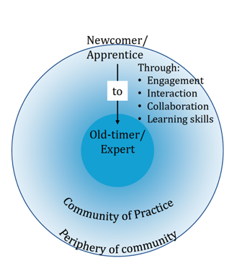
Building a Community of Practice
Of the 116 we worked intensively with in workshops:
19 delivered OOI DL webinars, presenting the DL they had developed during workshop
11 became DL Fellows
11 are designing and building the DL Notebook
9 became peer presenters at mini workshops
10 presented on OOI at Ocean Sciences Meeting in San Diego, CA
13 volunteered to be an OOI Virtual REU mentor
20 participated as Lab Manual testers
The community is growing!
Notes:
The Lab Manual became a boundary object that everyone could feel like they helped to create collectively and for the greater good of the community. From that work – we truly started to build a COP. Those who started as newcomers on the periphery of the community are now CoPIs on the new project!

Slide 9
Evaluation & Impacts
Conducted by Dr. Ellen Altermatt, SERC at Carleton College
The purpose was to:
better understand current perceptions of and practices in using large, real-world oceanographic datasets in undergraduate classrooms,
assess levels of involvement in past and current OOI Ocean Data Labs initiatives,
examine the impact of participation in these initiatives on faculty teaching and perceptions of community belongingness, and
assess planned levels of future involvement and to understand how current resources might better meet community needs.
Notes:
Don’t have time to review all these results But wanted to share some of them – because scientists like data and this is our data. SERC evaluated the project with a reach survey to all of our participants. The purpose was to (1-4) we can focus today on 3

Slide 10
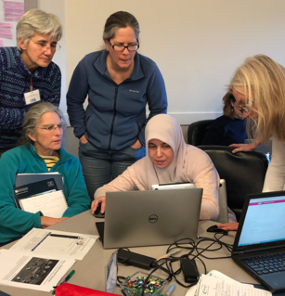
Survey Facts
Sent to updated database of 590 professors
Completed by 145 individuals (22.8% response rate).
Analysis focused on n=133
  130 who indicated that they had taught an undergraduate-level oceanography course (or a related course with substantial oceanographic content) in the past two years.
  An additional 3 respondents indicated that, although they had not recently taught this type of course, they planned to do so in the next two years.
Notes:
A little more about the survey instrument

Slide 11
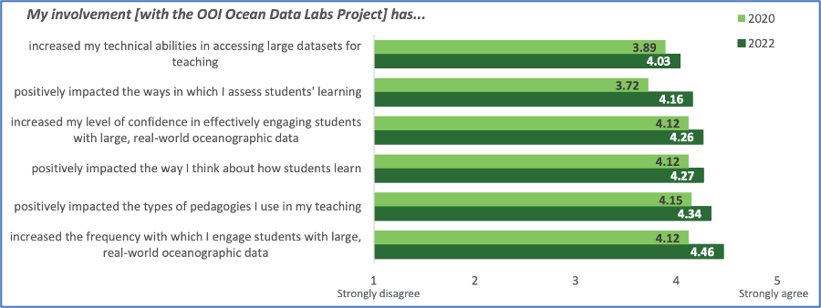
Mean ratings for the degree to which participants’ involvement with the OOI Data Labs Project has influenced their teaching. (1- strongly disagree 5= strongly agree)
Notes:
Comparison between 2020 and 2022 mean ratings of the degree to which participants’ involvement with the OOI Ocean Data Labs Project has influenced their teaching. When asked to report the degree to which their involvement in the Data Labs project influenced their teaching and perception of themselves as instructors, participants reported positive impacts in engagement and confidence in using authentic datasets as well as other areas including teaching, thinking about how students learn. Means for all items > 4 on a scale of 1 (strongly disagree) to 5 (strongly agree).
Respondents, as a group, reported that involvement with the OOI Data Labs project had positive impacts on engagement and confidence in using authentic datasets as well as on other areas teaching (e.g., thinking about how students learn) with means for all items > 3.70. The highest means emerged for two items tapping the degree to which respondents felt part of a community of educators interested in using OOI data in their teaching (mean = 4.20) and interested in changing how they teach to improve student outcomes (mean = 4.24).

Slide 12
OOI Data Labs in a Pandemic
“I will increase the use of real data sets into lab environments. The involvement is depending on how labs are taught. The more labs are taught in a distance learning environment, the more I am relying on real data sets. Using real time data sets has multiple objectives: a) help students learn to analyze data, b) help students to deal with data messiness, c) help students to visualize data using software.”
“I am grateful that these resources are available, especially as I try to convert my class to a hybrid model with less access to field trips and collecting our own data (and potentially being fully remote)”.
“Thank goodness for Data labs! They have really been a remote learning life jacket!"

Slide 13
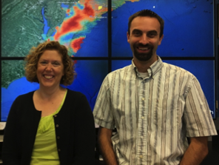
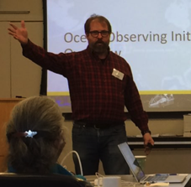
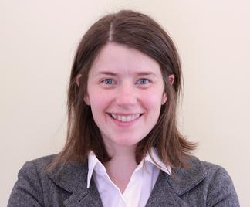


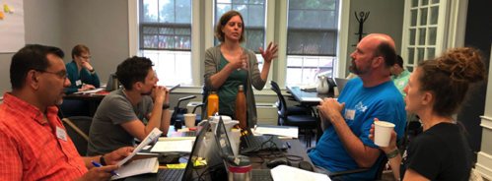
Project Team
NSF Grant #1831625
and # 2316075
Kristin O’Connell
SERC
Janice McDonnell, Sage Lichtenwalner
Rutgers University
Dax Soule
Queens College CUNY
Anna Pfeiffer-Herbert
Stockton University
Denise Bristol
Hillsborough CC

Slide 14
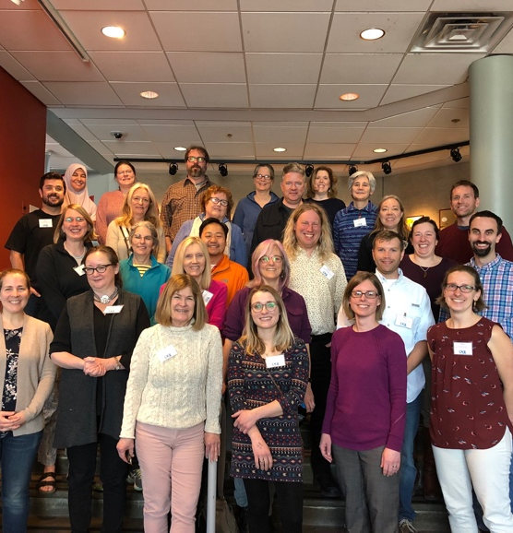
OOI Data Labs 2.0
Project Goals
Continue to build and support the OOI educator community
  MSI, 2YC and R2
  Special focus on the Mid Atlantic
Develop “next level” activities
  Fill in gaps in the existing OOI Data Labs manual
  Domain-specific and level-appropriate programming notebook-based activities

Slide 15
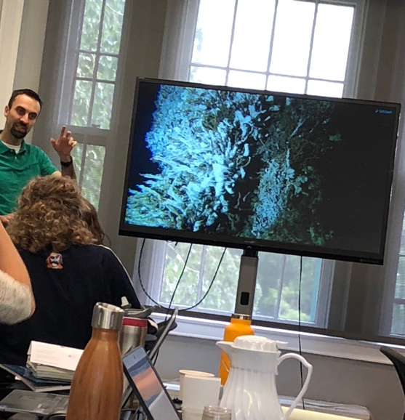
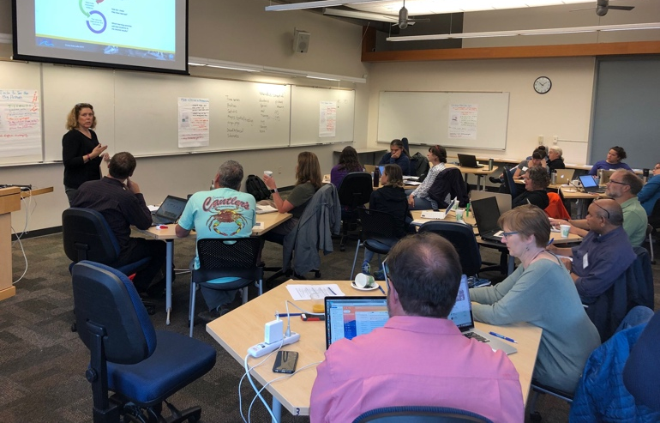
OOI Data Labs 2.0
Tasks
Engage a new community of faculty capitalizing on the Pioneer Array relocation
  Refresh our database of potential faculty
  ”Regional” workshop focused on Pioneer
Expand the collection of OOI education resources
  Development Workshop
Continue to support the community
  Two 1-day introductory workshops (e.g. OSM24)
  Sharing resources
Evaluation
  Needs Assessment to identify community needs
  Reach Survey to measure long-term impact

Slide 16
Timeline
Refresh and Build Database (now!)
Ocean Sciences Meeting (workshop and session)
Feb 2024
Needs assessment and development workshop
Spring 2024
Development workshop (python applications)
Spring 2025
Mini One Day workshops at strategic conferences and meetings (on-going)

Slide 17
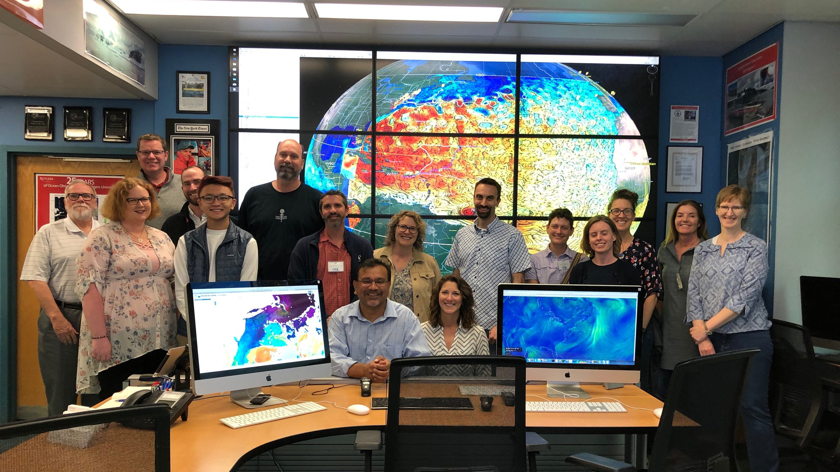
Thank you! mcdonnel@marine.rutgers.edu

Slide 18
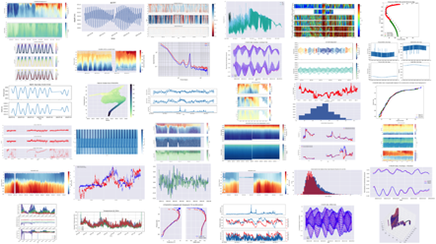
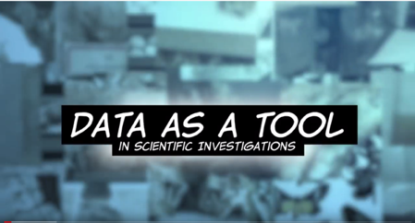
Summary
Building a promising CoP
Positive results of Reach Survey
Active Blog and mailing list
Webinar series Fall 2020, Spring 2021
Video on Teaching with Data
DL Online Manual for Oceanography 101
Cohort I testing (Fall 2020) Cohort II (Spring 2021)

Slide 19
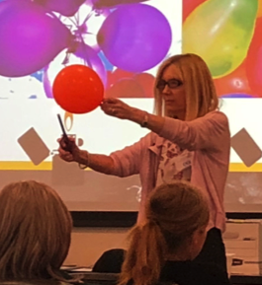



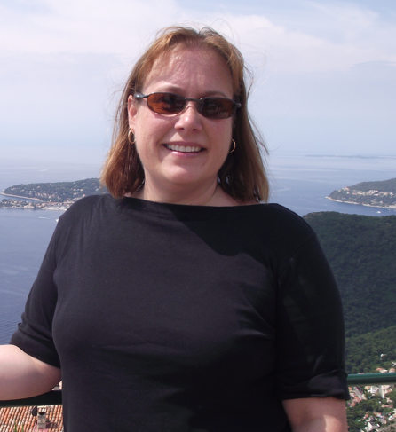
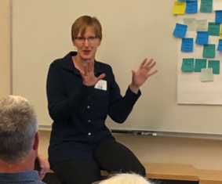
OOI Data Labs Team 1.0
Christine Bean, Janice McDonnell,
Sage Lichtenwalner
Rutgers University
Catherine Halversen
UC Berkeley
Dax Soule
Queens College CUNY
Anna Pfeiffer-Herbert
Stockton University
Brooke Love
Western Washington Univ
Denise Bristol
Hillsborough CC

Slide 20
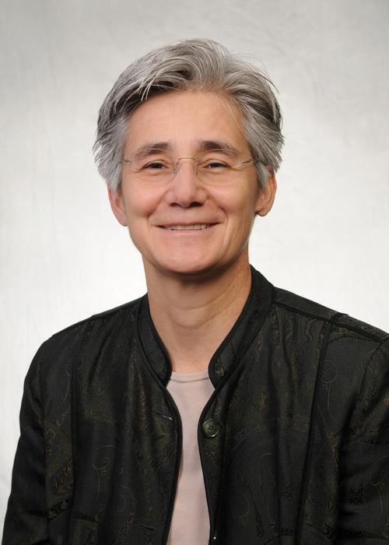
Case Study #1 Kathy Browne, Rider University
Participated in March Development Workshop (2019)
Peer mentor in EER Implementation Workshop (July 2020)
Lab Notebook Designer (January 2020)
PI IUSE grant studying OOI data and learning

Slide 21
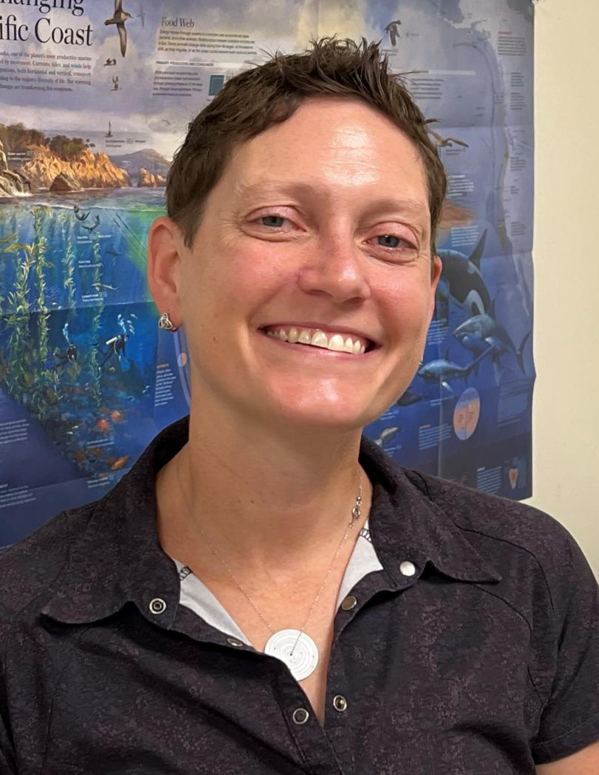
Case Study #2 Melissa Hicks, SUNY Onondaga
Development workshop (June 2019)
Peer trainer/leader in a webinar (2020)
Data Lab Fellow (2020)

Slide 22
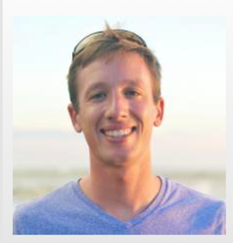
Case Study #3: Sean Crosby, Western Washington University
Not on any of our original lists!
Networked into project by WWU faculty
Attended webinars as a participant
Became a Data Lab Fellow (2020)

Slide 23
Case Study #4: Anna Pfeiffer-Herbert, Stockton University
2016-17 - attended 2.5 day workshop
Regional Facilitator and project team
Co-facilitated OSM mini workshop
Presented at OSM
Co-editor and Co-leader of DL Notebook cohort
Volunteered to be a mentor
Peer presenter at 3 of 4 development workshops

Slide 24
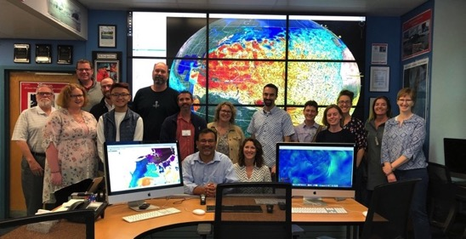
Notable Professor Quotes
“When I asked the students if they wanted to continue this; they overwhelmingly said ‘yes.’”
“I was so excited about the data portal and the new data labs that my students and I look at either OOI data or some other data portal every single day in class.”
“The data set is fantastic. One thing I would like to tell [project leaders] is that this gives the oceanography students the kind of skills which they can take even if they don't want to continue in the oceanography field”
“We had some really good discussions. It was one of the best weeks of the semester where students were engaged, they put the work in, and they really thought about the questions I was asking them.”

Slide 25
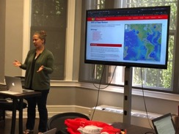
The Data Explorations – Design Process
Identify Target Scientific Concepts & Skills
Match with Research Results
Find Available Instrument Data
Cleanup the Dataset
Add Educational Surrounds (Context)
Make Interactives & Visualizations
Faculty Development Workshops
Science Papers
e.g. OOI Special Issue
“Nuggets” from
OOI 1.0 Data Review
https://datareview.marine.rutgers.edu/nuggets
Guidance from the Lawrence Hall of Science
Active Learning
The Learning Cycle

