Slide 1
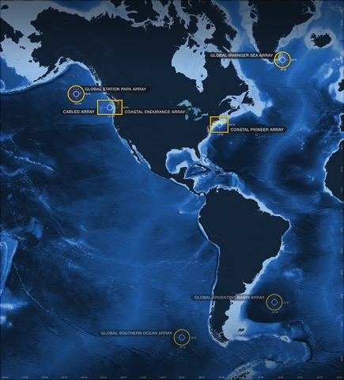
Ocean Data Labs
And an introduction to plotting OOI Profiler data in Python
Sage Lichtenwalner @visualocean
Rutgers University
Presented to the WHOI Ocean Informatics Working Group
August 4, 2020
datalab.marine.rutgers.edu
@ooidatalab

Slide 2
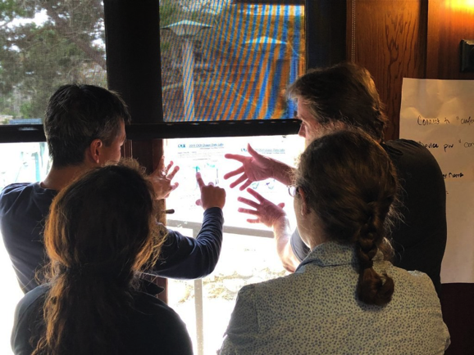
Today’s Agenda
The Data Labs Project
Reproducible Research
  Why should we use programming notebooks?
A nickel tour of the OOI
OOI Profiler Python Tutorial

Slide 3
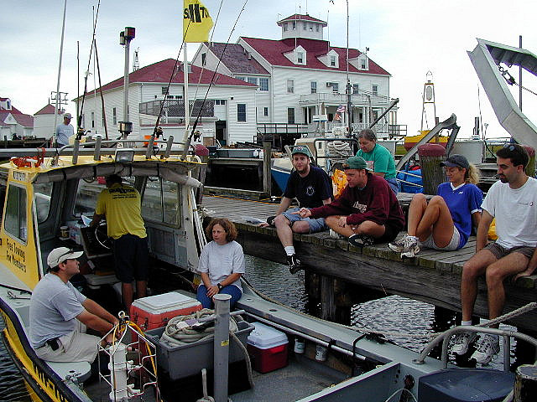
My Background
Science
Data Collection
Visualization
Data Analysis
Education
Pedagogy
Curriculum Design
User Experience Design (UXD)

Slide 4
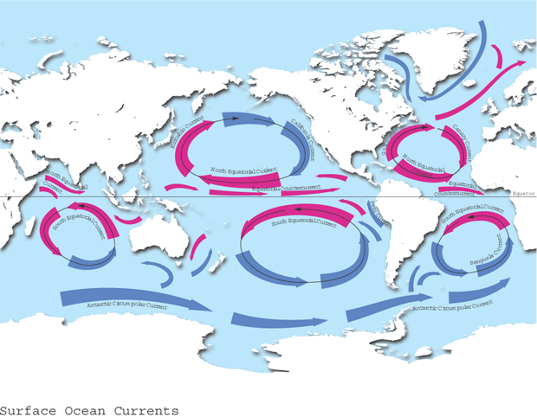
What We Teach
6ish Ocean Gyres
+ Thermohaline Circulation

Slide 5
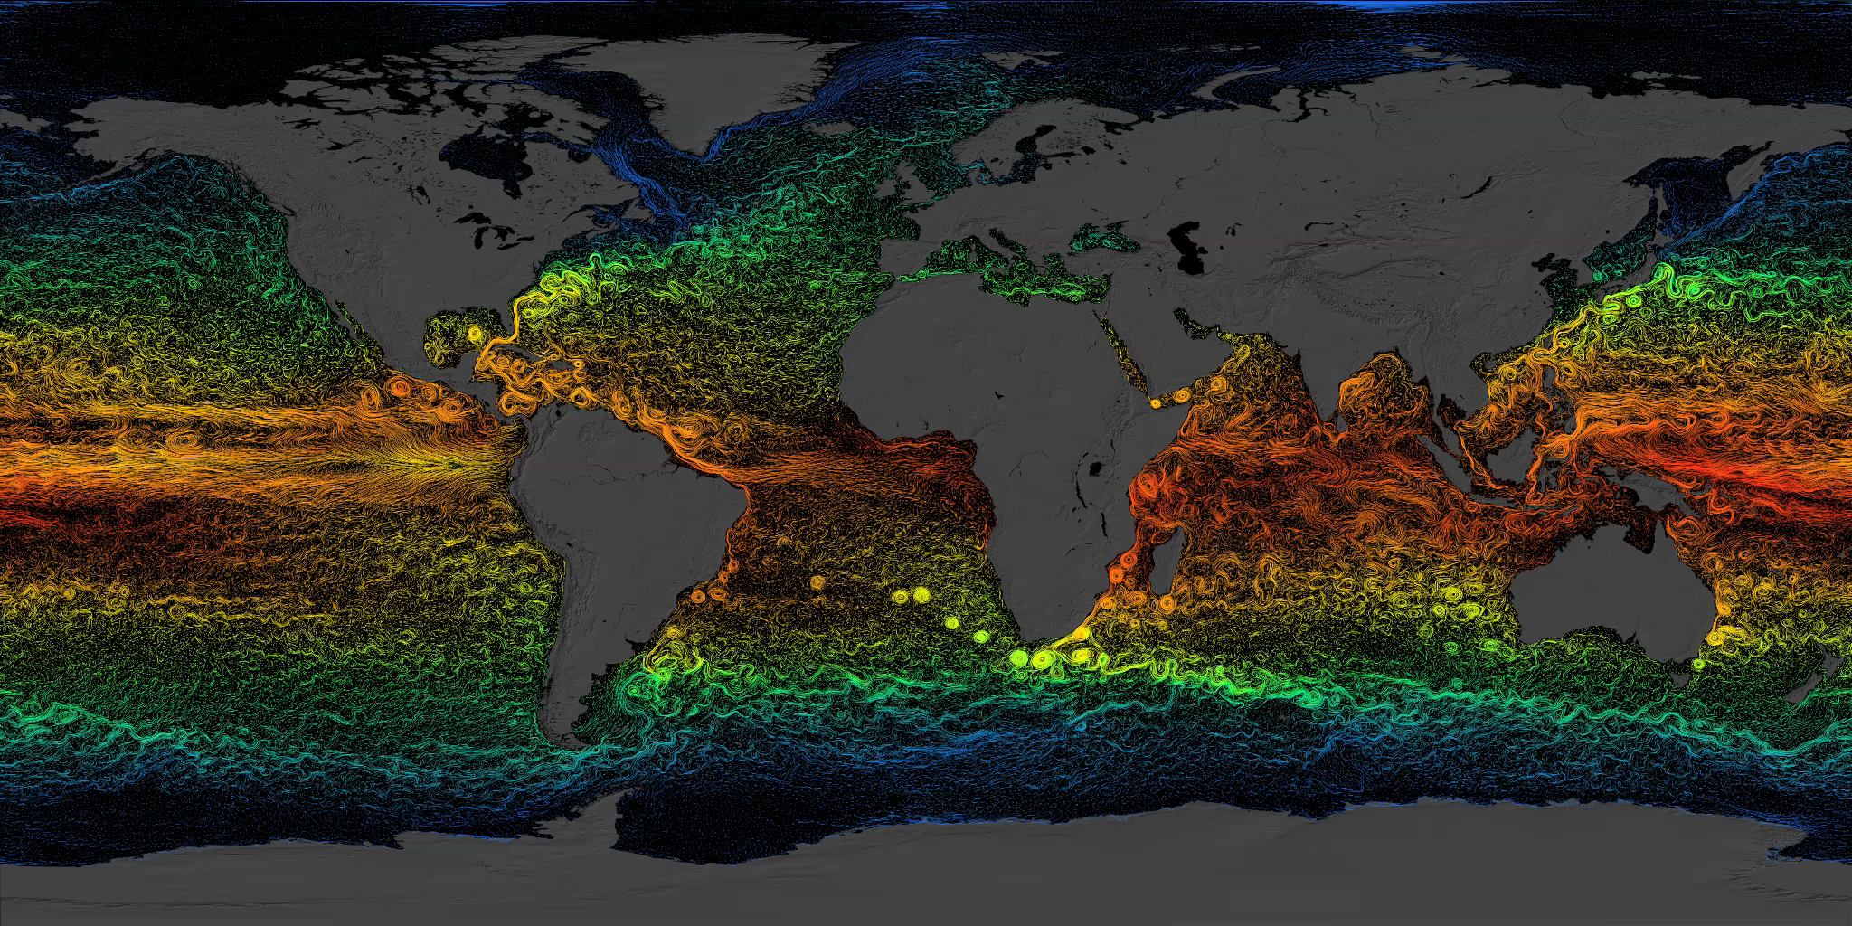
What the World Ocean really looks like (sort of)
Complex circulation defines the Ocean Gyres

Slide 6
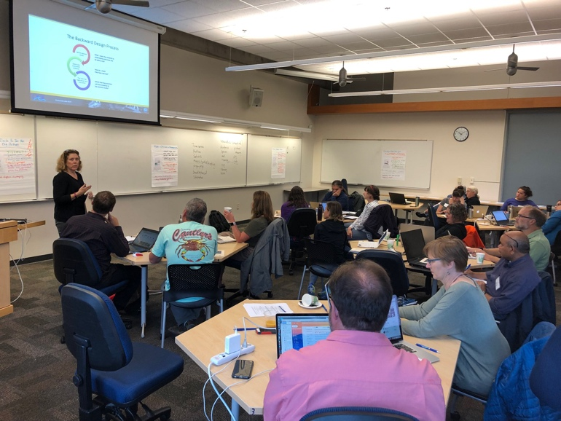
OOI Data Labs Project
Key Goals
Build a Community of Practice (CoP) of undergraduate educators, interested in using OOI data with their students
Create and compile tools to make OOI data more accessible to educators and students

Slide 7
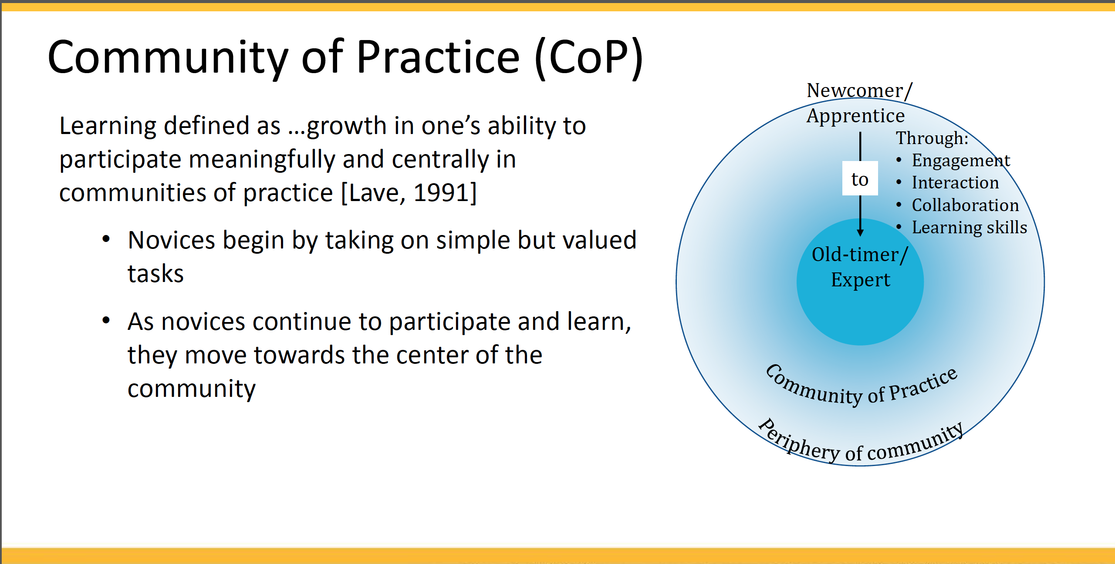
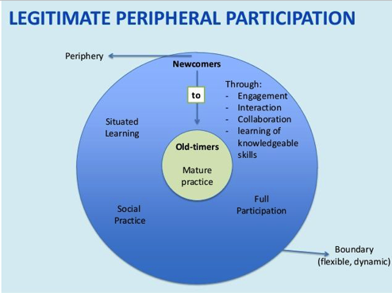
Notes:
. Developing expertise is thus a movement from the periphery to the center and is a very fitting description of how scientists move through doctoral training and beyond, taking on greater responsibility for inquiry and knowledge building in their field. Concomitant with the development of knowledge and skills of participation (i.e. learning the theories and methods of a field), learners also develop an identity as a member of the community (and are seen as such by other members).

Slide 8
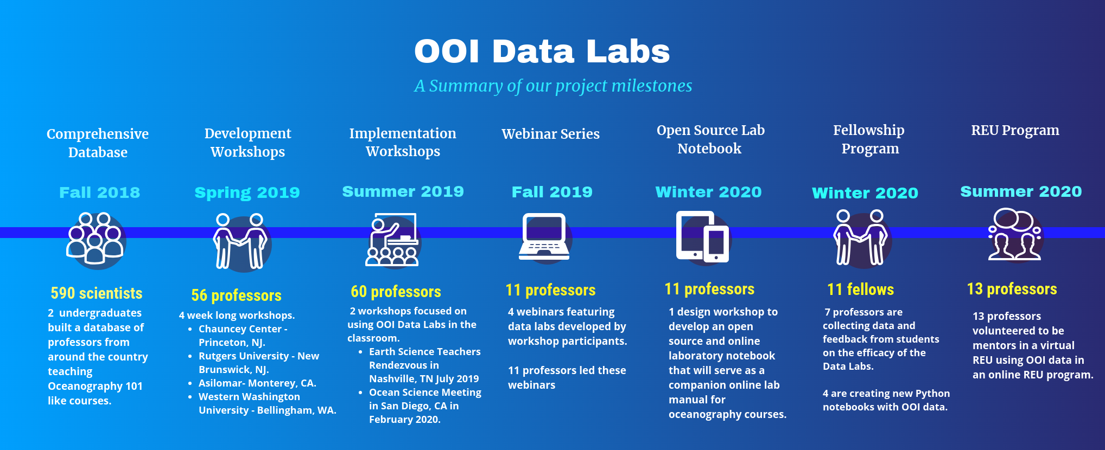

Slide 9
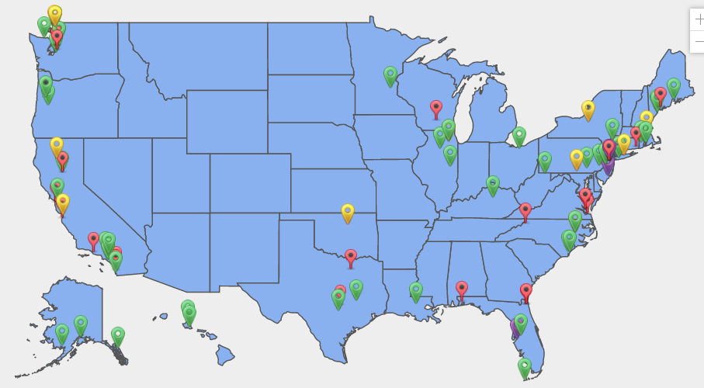
The growing Ocean Data Labs community
Data Exploration pilot testers (24)
Data Lab developers (50)
2020 Data Lab Fellows (11)
Data Lab project team leaders
https://datalab.marine.rutgers.edu/community-map/

Slide 10
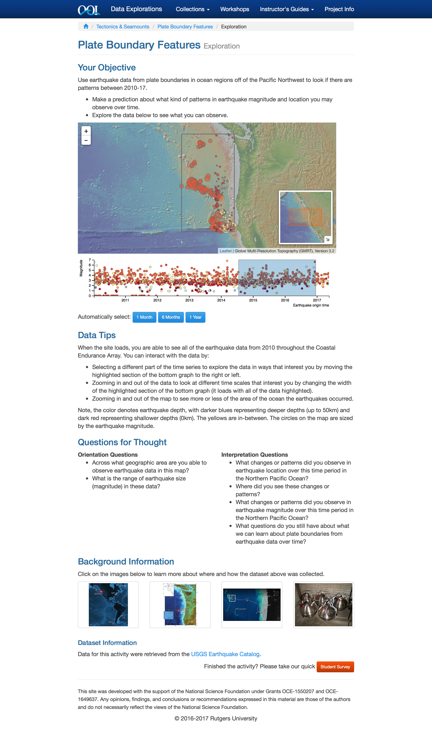
What is a Data Exploration?

Slide 11
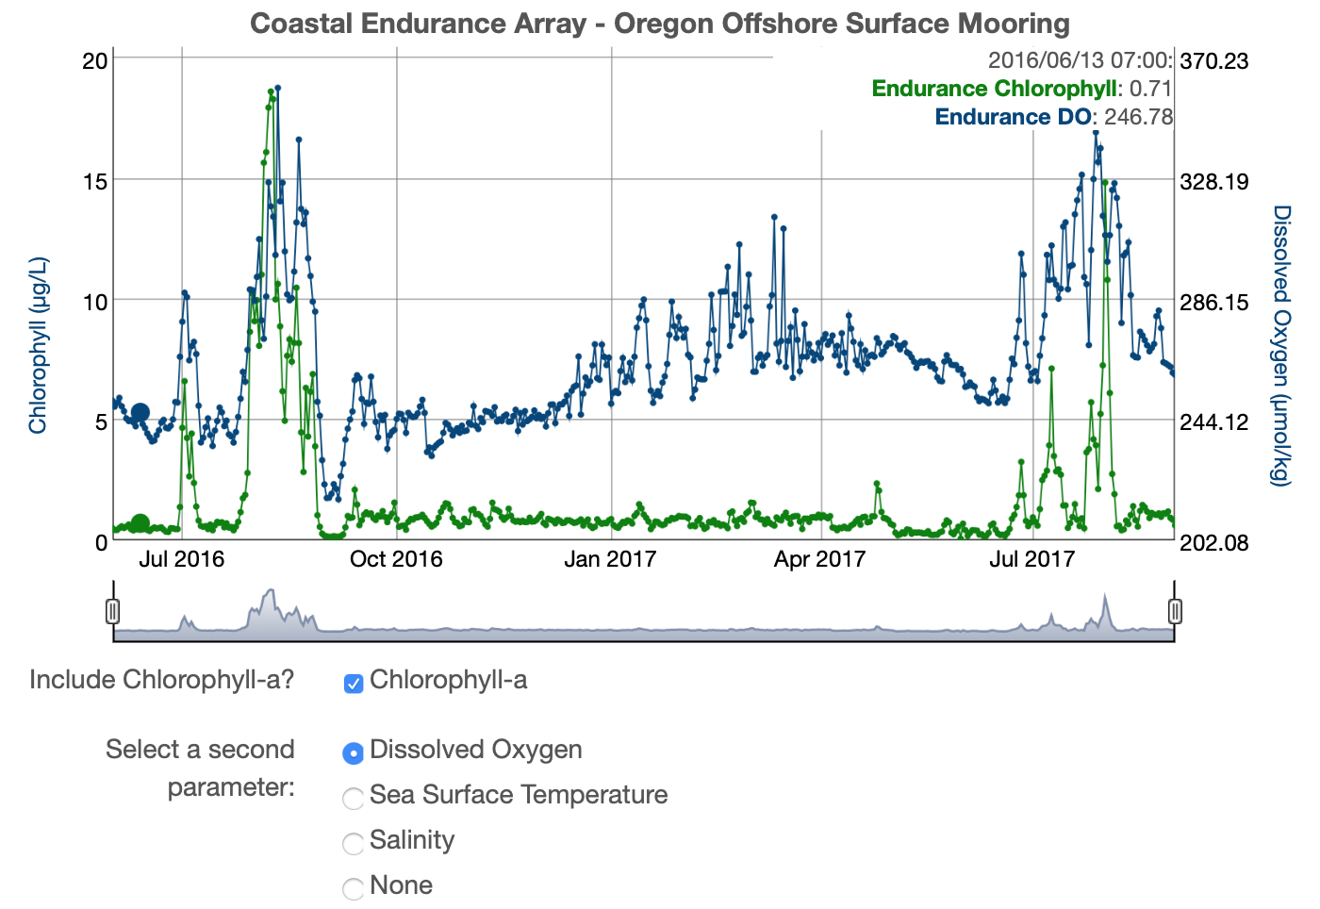
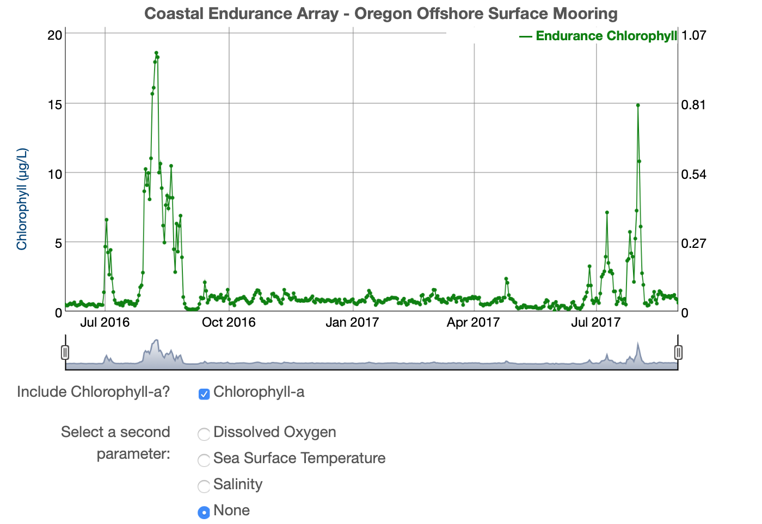
Exploring Data
Chlorophyll-a in
Upwelling and
Stratified Temperate
Regions
Karen Baker, Orange Coast College
Claire Condie, Middlesex County College
Robert Ellis, Orange Coast College
Colleen Petrik, Texas A&M University

Slide 12
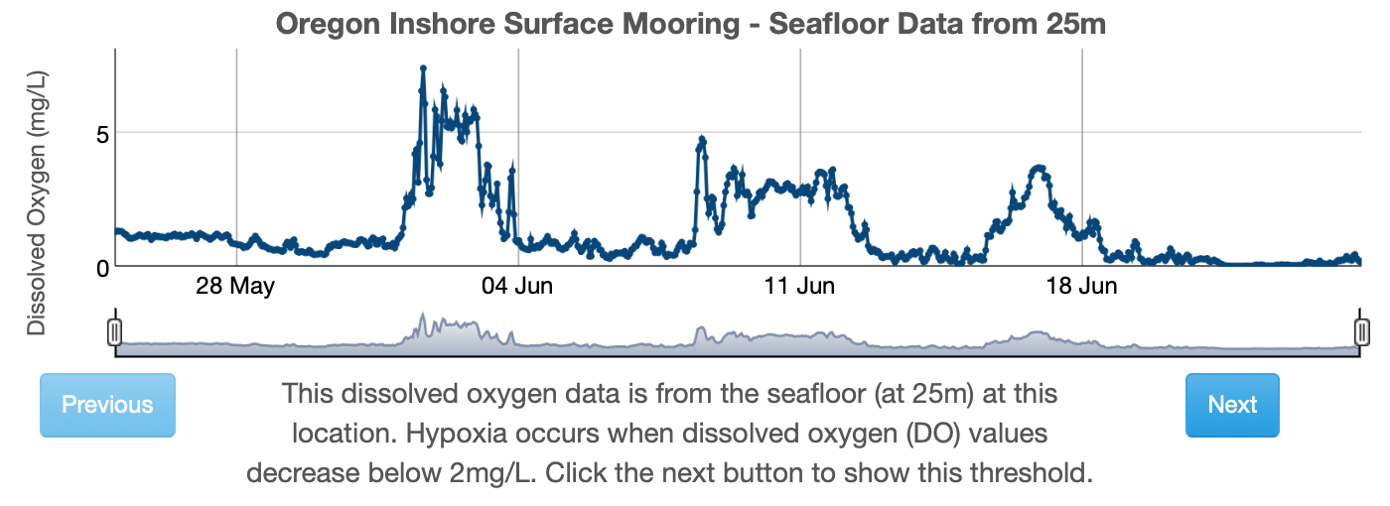
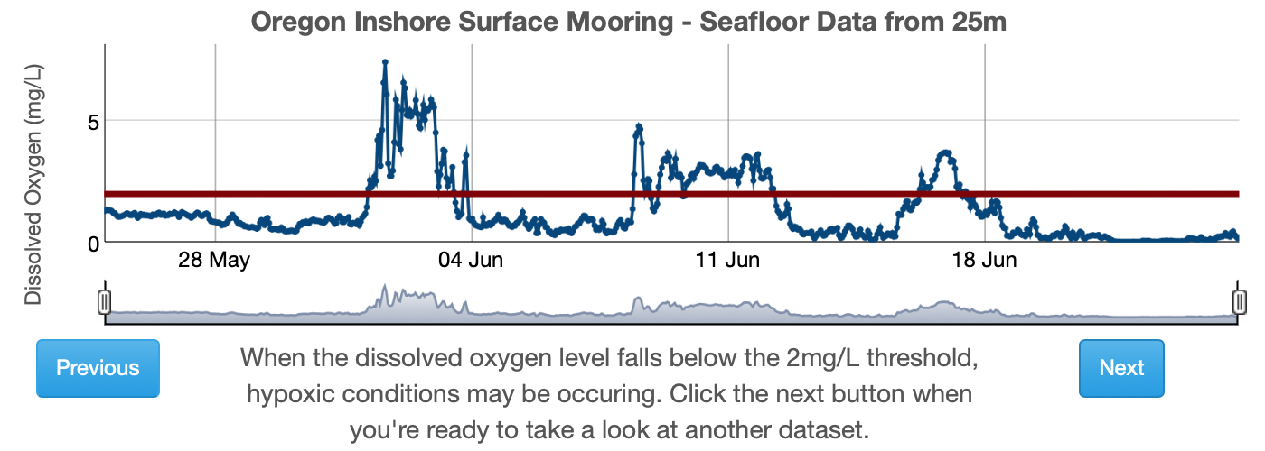
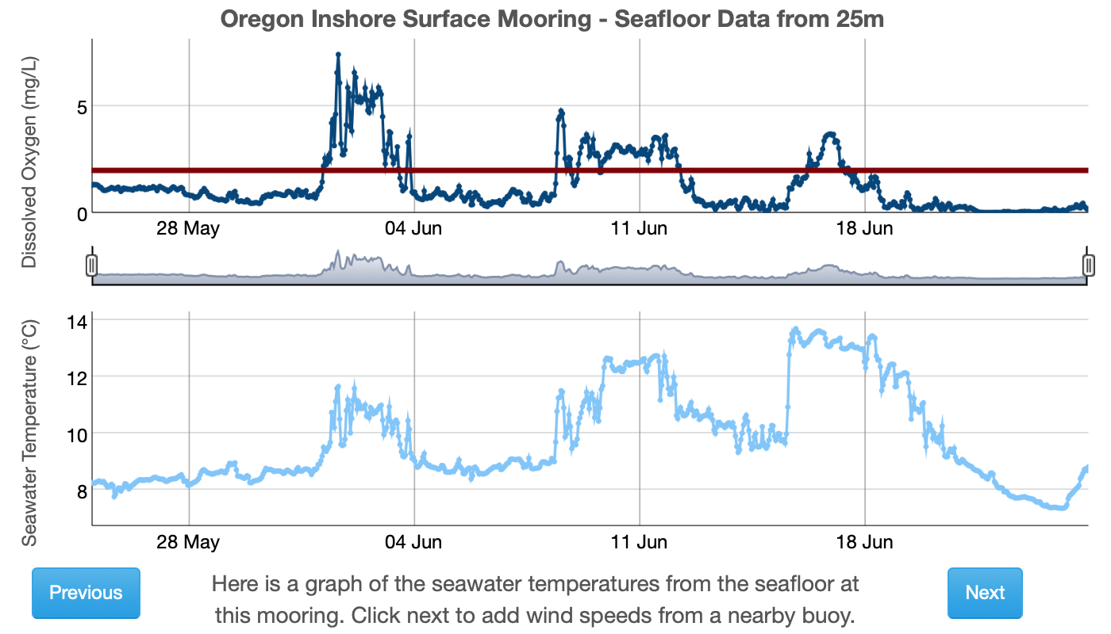
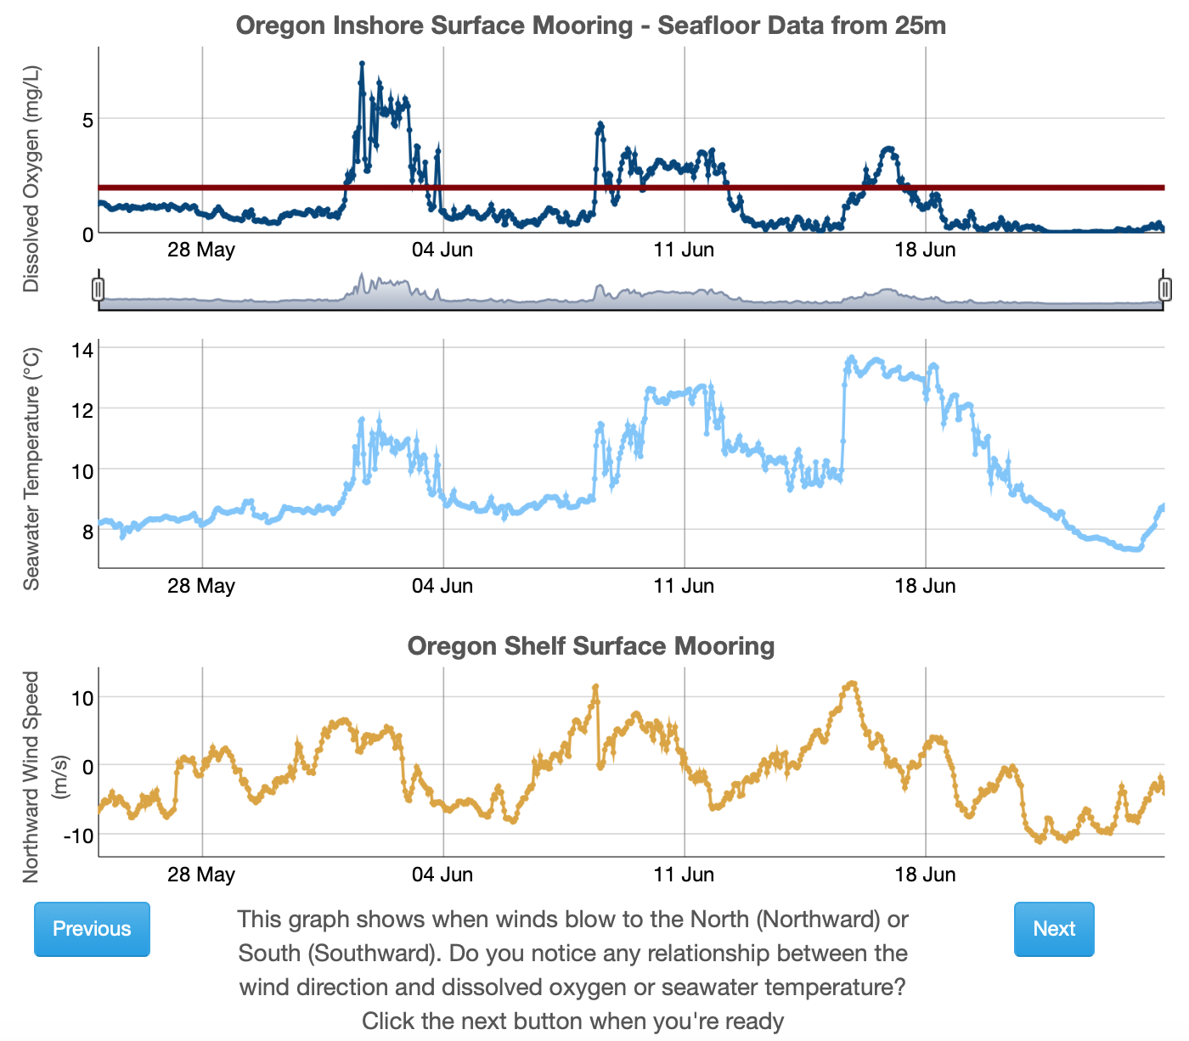
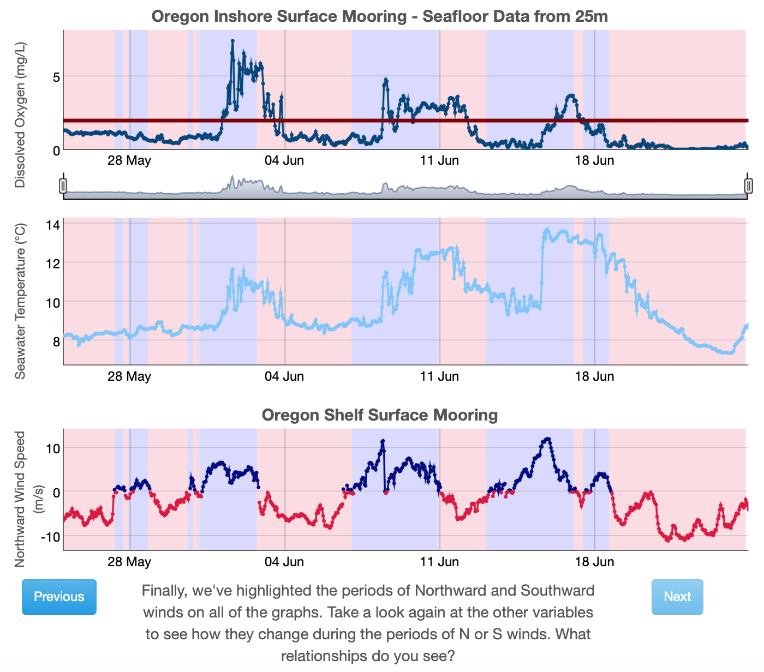
Guided Learning
Anoxic Events
Kathy Browne, Rider University
Lauren Sahl, Maine Maritime Academy
Rebecca Freeman, University of Kentucky
Gabriella Smalley, Rider University
Carol White, Southern Maine Community College

Slide 13
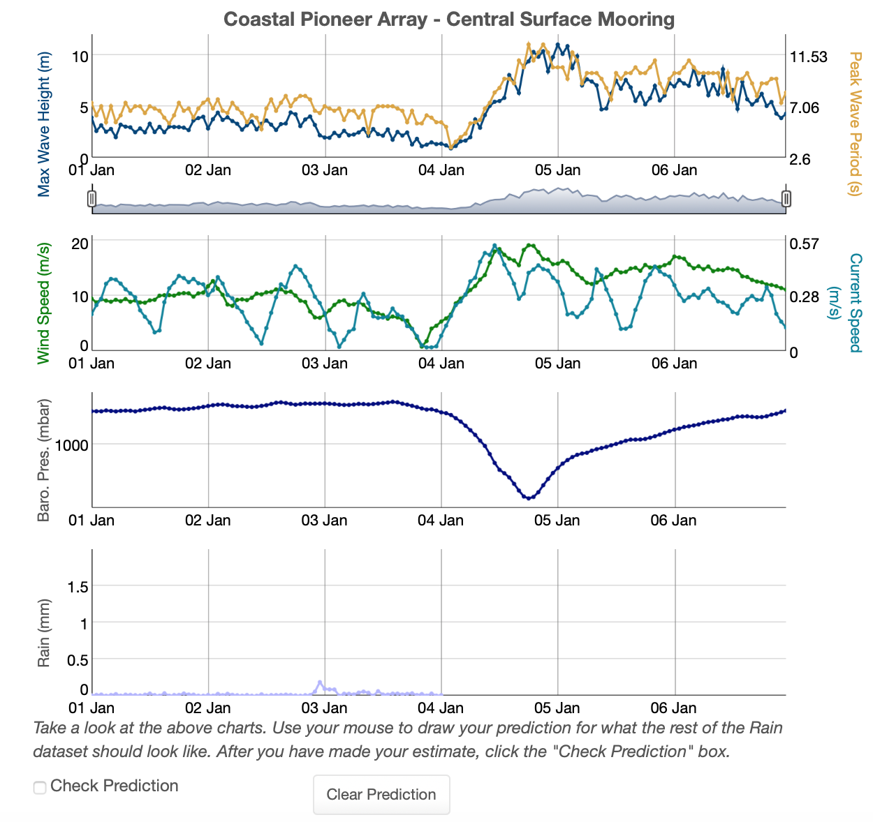
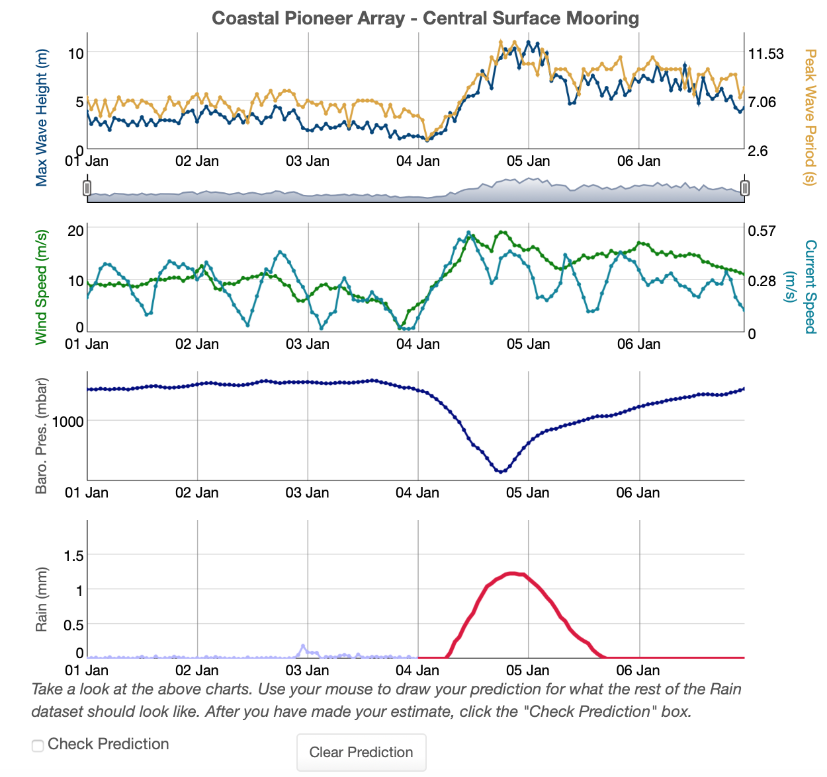
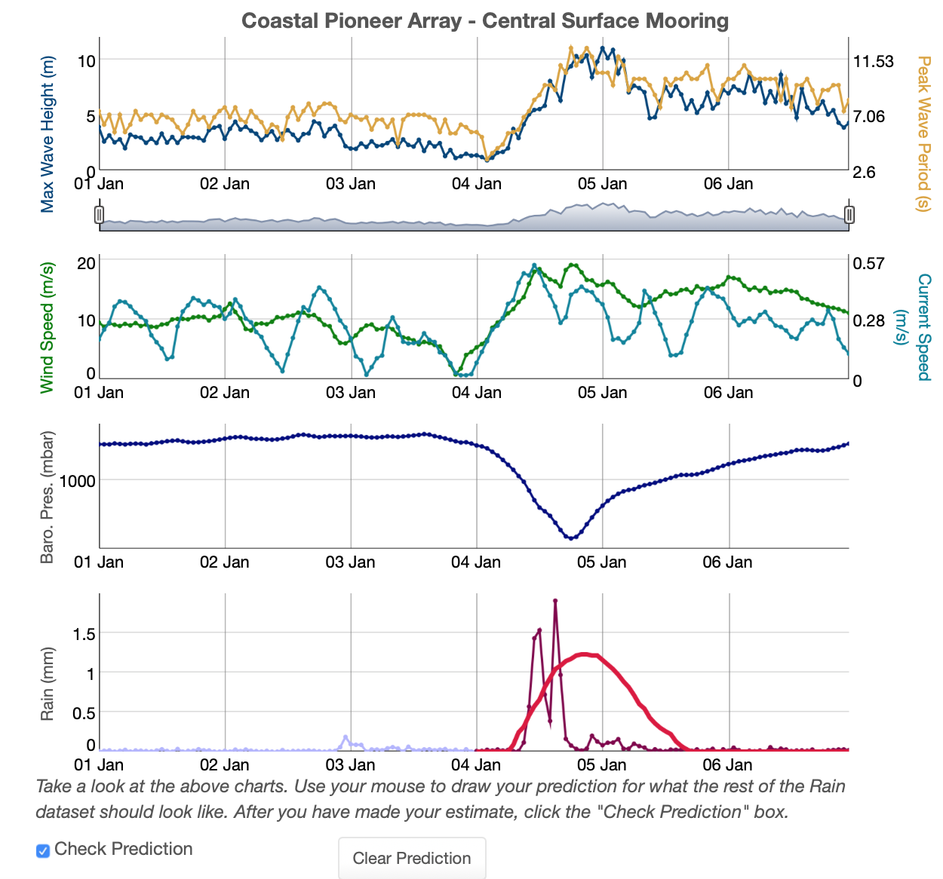
Student Predictions
Dynamic Air-Sea Interactions
Jacqui Degan, Cape Fear Community College
Melissa Hicks, Onondaga Community College
Siddhartha Mitra, East Carolina University
Paul Webb, Roger Wiliams University

Slide 14
What is Data Labs trying to accomplish?
OOI
Data + Science
Data Science
Coding/Python
Education
Data
Explorations
Data
Workshops
?
Data Sci
Bootcamps

Slide 15
Development Workshop– Python/Matlab/R Notebooks
Notebooks can be used for:
Tutorials
Exercises/practice (in-class or out)
Guided discovery
Self-directed inquiry (aka research projects)
Enables Community Driven interactive datasets, lessons and research
31 Example OOI Data Processing Notebooks to date
  https://github.com/ooi-data-lab/data-lab-workshops
4 “Data Labs Fellows” working on Educational notebooks
New visualization libraries enable interactive exploration
  Altair
  HoloViz

Slide 16
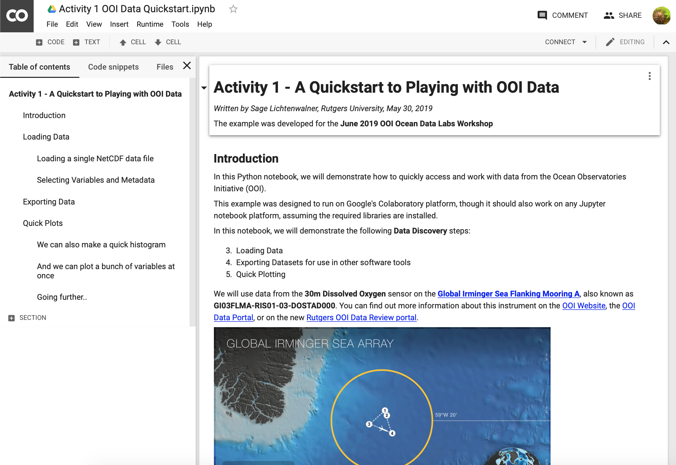
The Power of Notebooks & Google Colab
A streamlined “linear” development approach
  Code blocks are independent
  With an IDE you would have to use debug breakpoints
No need to download files
  Files can be accessed and concatenated on the fly
  Thanks to xarray we can easily perform multi-dimensional analysis
Notebooks are Sharable
  via GitHub
  In real-time with Colab
Easy to share examples
  Data and Metadata Access
  Requesting, loading, concatenating data
  Various plot types
  Color scales
  Filtering and Splicing datasets

Slide 17
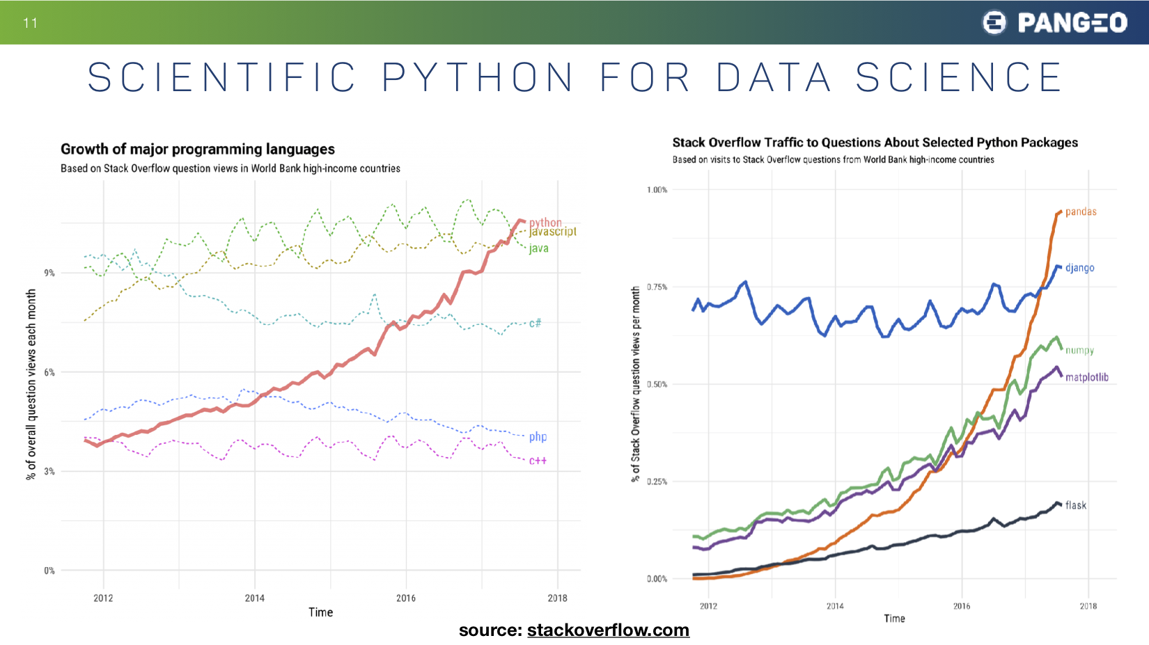
https://stackoverflow.blog/2017/09/06/incredible-growth-python/

Slide 18
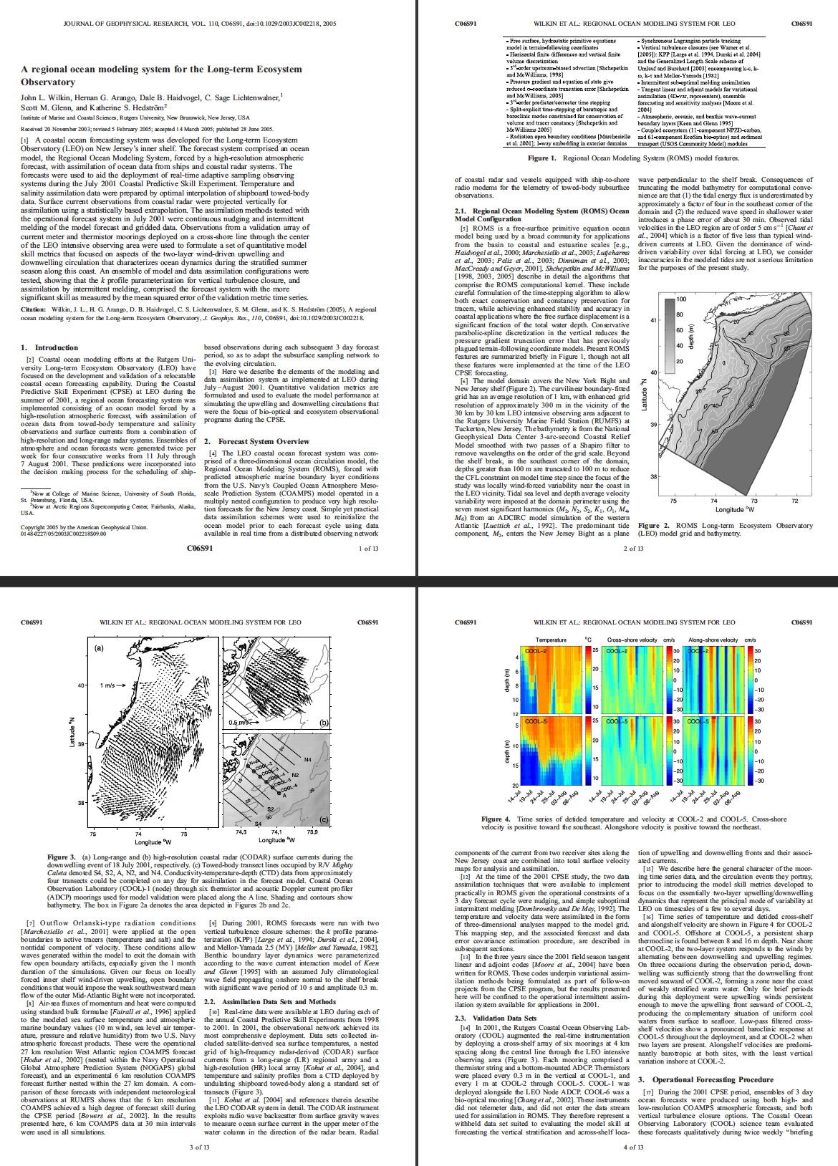
The Scientific Paper Is Obsolete.
Here’s what’s next.
https://www.theatlantic.com/science/archive/2018/04/the-scientific-paper-is-obsolete/556676/

Slide 19
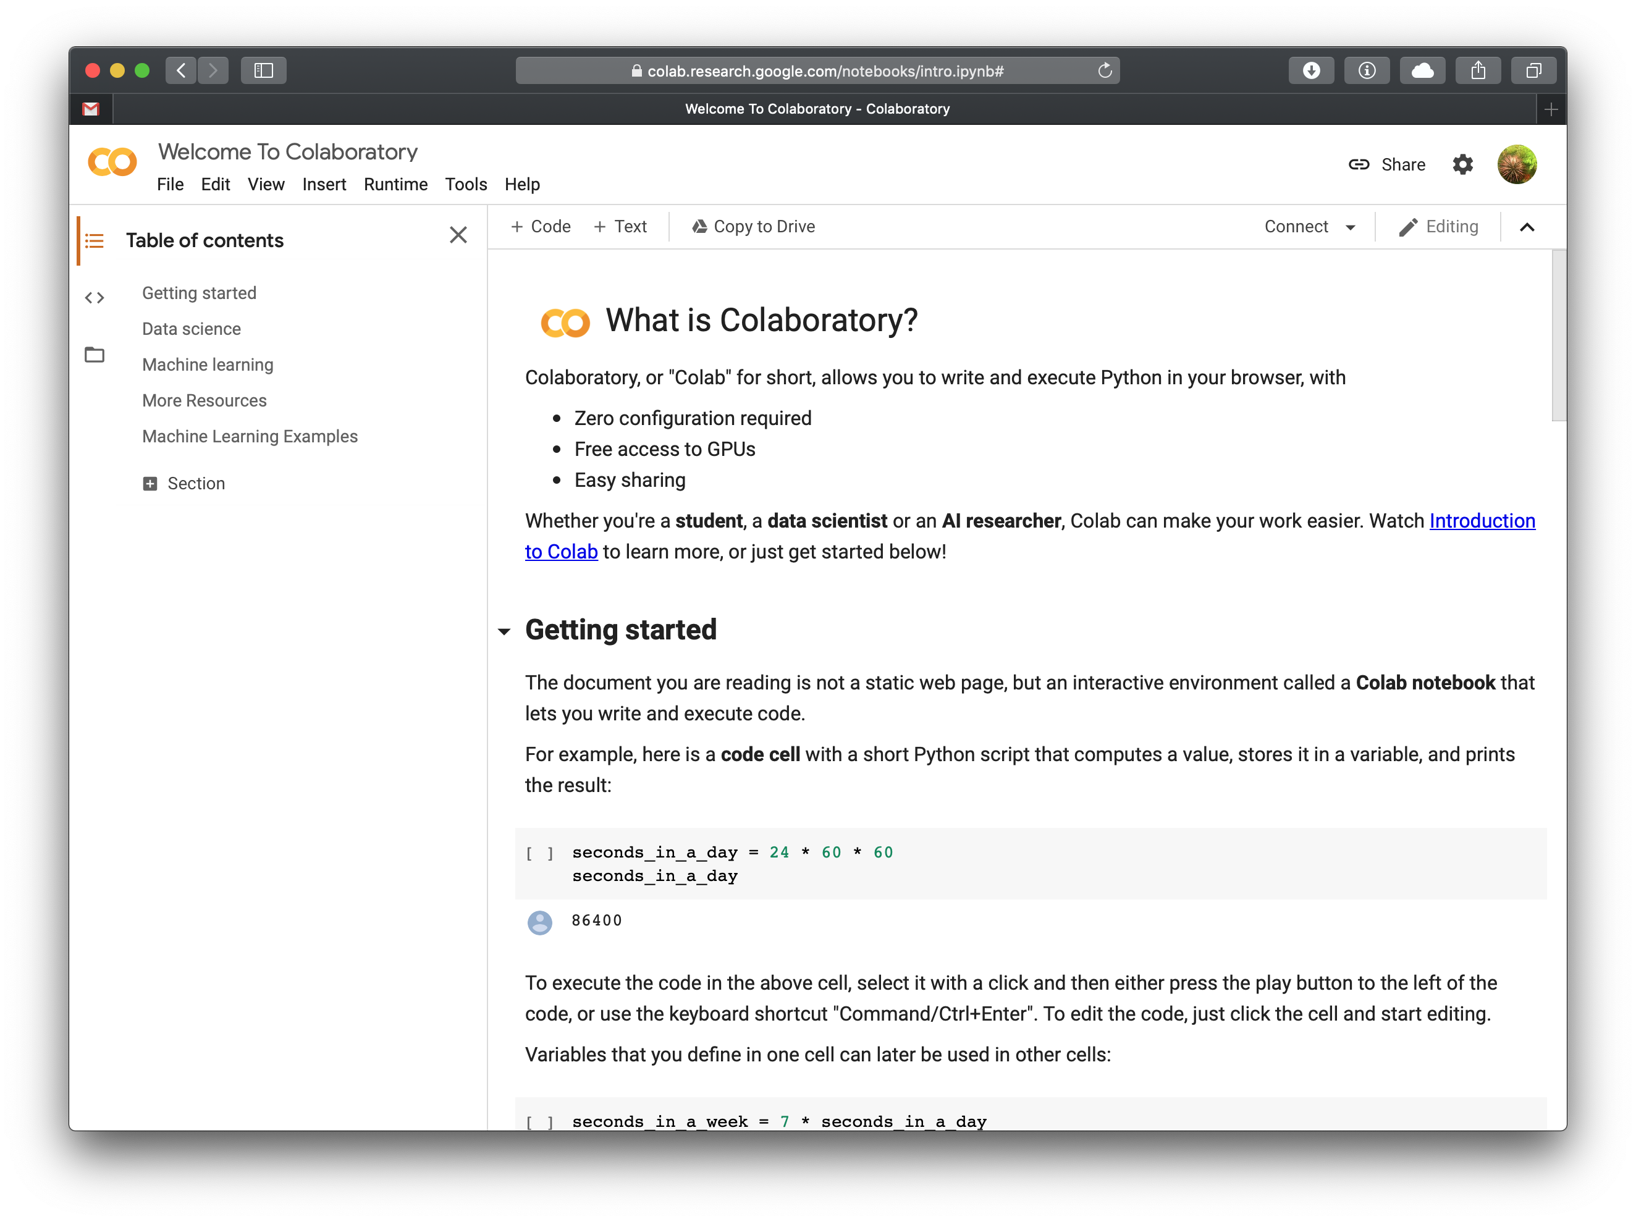
Google Colab
To start your own Colab Notebook, simply go to your Google Drive and click New!
Or go to https://colab.research.google.com

Slide 20
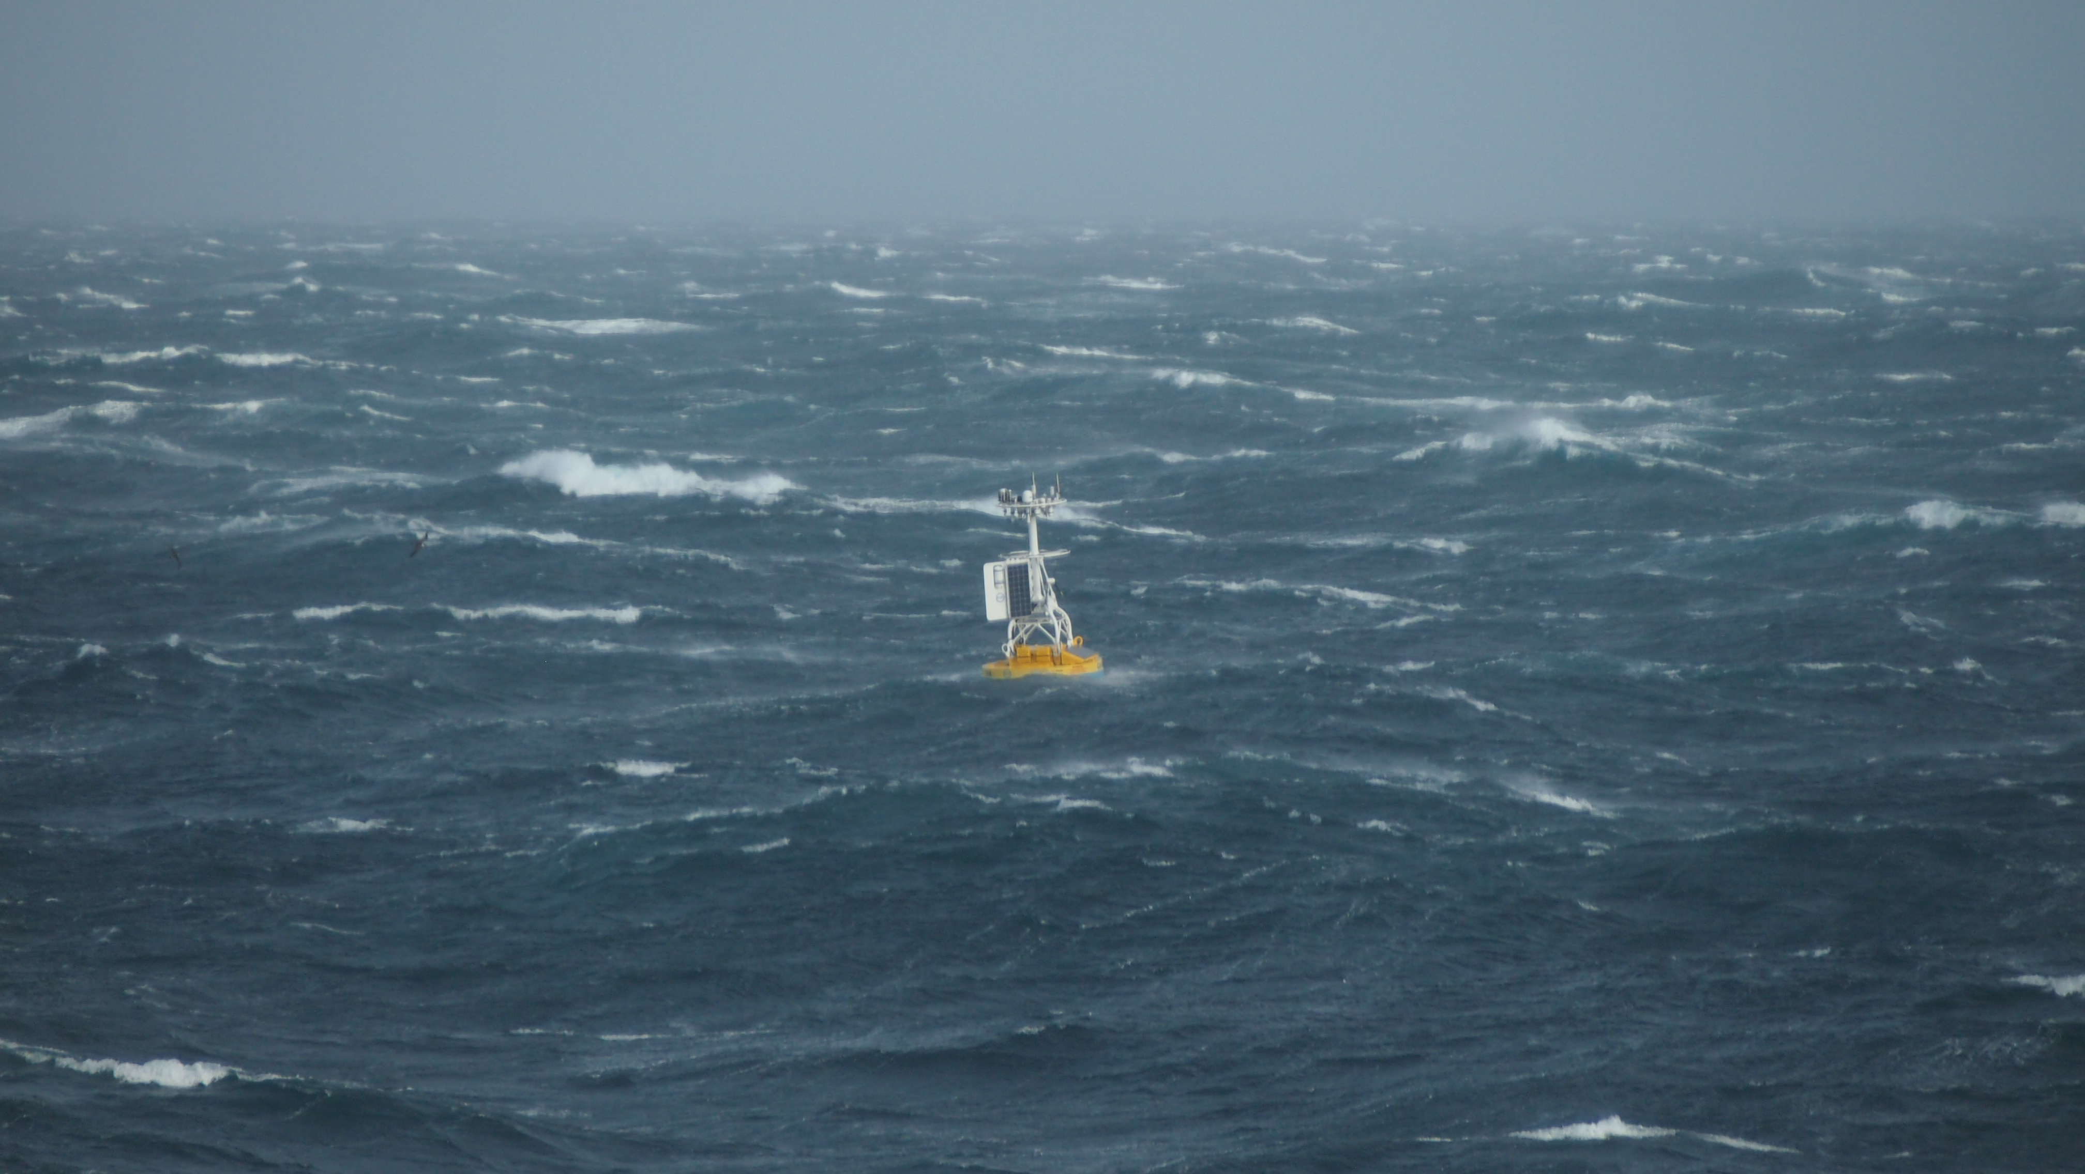
Figuring out the Ocean:
A Big Data Problem

Slide 21
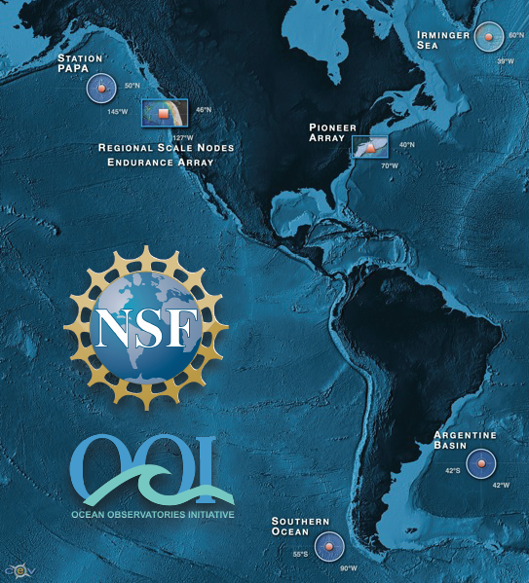
NSF’s Ocean Observing Initiative
Integrated Components
4 High Latitude Global Sites
Regional Plate-scale Cable
2 Coastal Dynamics Arrays
Data Management System

Slide 22
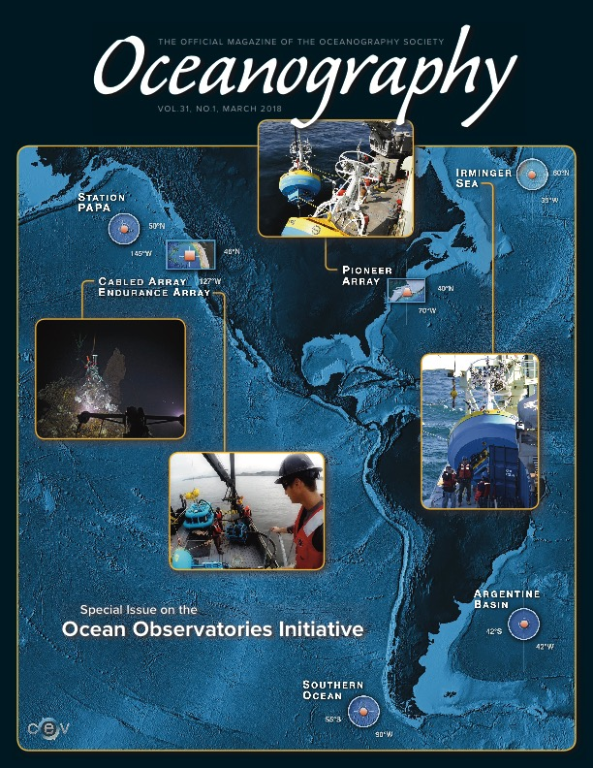
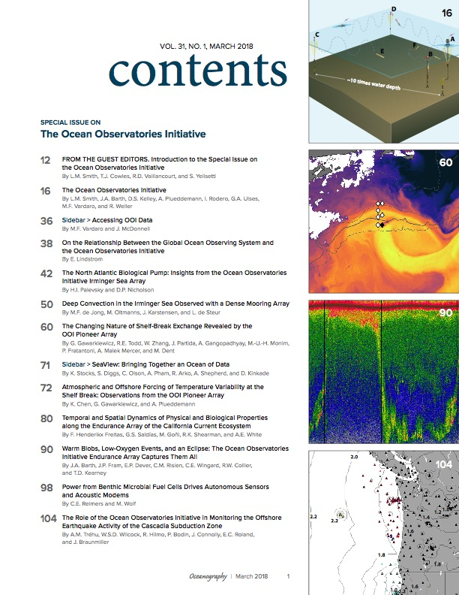
Interested in OOI Science?
Check out the March 2018 Oceanography Special Issue!

Slide 23
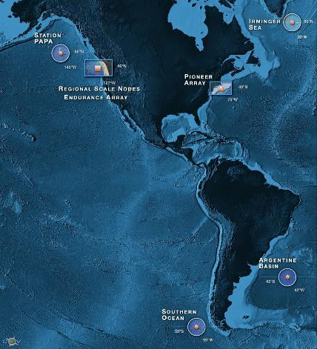
OOI by the Numbers
7
58
34
56
1,313
9,557
153,589
Arrays
(2 suspended)
Stable Platforms
Moorings, Profilers, Nodes
Regularly Planned Mobile Assets
Gliders, AUVs
Instrument Types
Instruments (~850 deployed)
Science Data Products
Science/Engineering Data Products
As of 2/9/18
Notes:
Greater than 2500 data products
Some stream in from the cable
Some are telemetered….things like gliders will dump periodic data when it comes to the surface.
Different latencies with the different data types.
If you include the engineering streams you have over 100K separate data streams at anyone time. The scale of this is a huge data problem.
It is especially difficult because of the diversity of the data streams. If you use the national weather service as a comparison, they deal with a similar amount of data,,, but they are only measuring a few key parameters, so you can build a driver once and it will be usable by a third of the network. With OOI they had to build individual drivers for each sensor. This has been a process… not everything worked the first time, but at every step we have tried to seek and be responsive to community feedback.
We are the goal… NSF and the OOI wants this system to work for you.

Slide 24
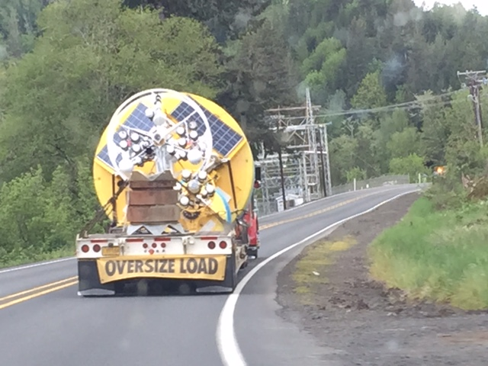
These are not like your typical coastal buoy.

Slide 25
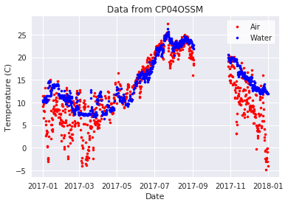
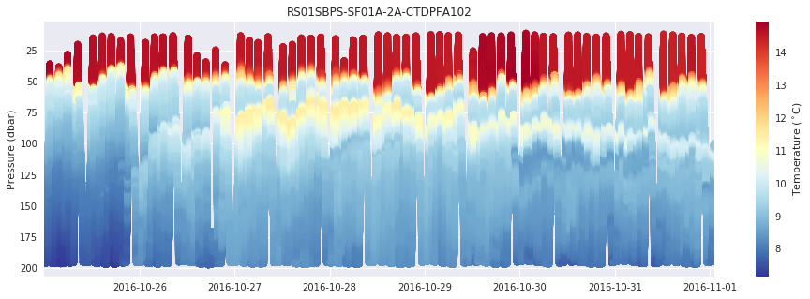
Available Datasets
What types of data are available?
Point Timeseries
Profiles
  Wire Following
  Glider
  ADCP
Multi-point Timeseries Profiles
And others…
  Seismic/Earthquake
  Hydrophones
  Sonar
  Camera
  Optical OPTAA/SPIKR

Slide 26
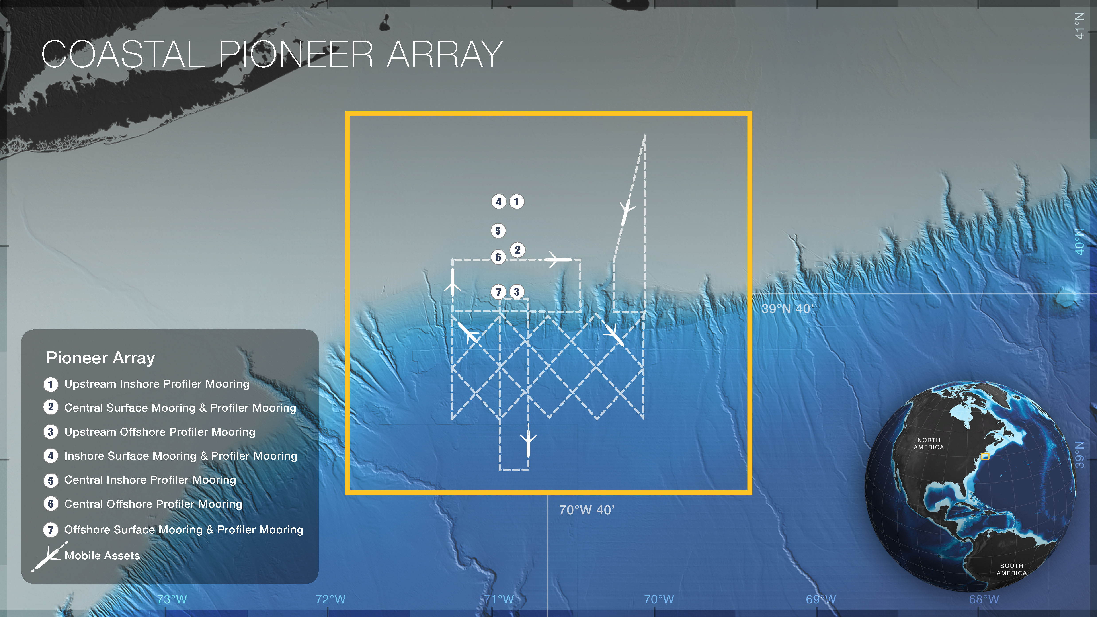
Located over the continental shelf and slope in the NW Atlantic, the Pioneer Array is centered near the shelf-break front. It’s data enable scientists to examine how exchange processes structure physical, chemical, and biological properties.

Slide 27
“Data Discovery” Process
Discovering OOI Data to Use
Requesting OOI Data
Loading Data
Exporting Data for Use in Other Software
Quick Plots
Basic Statistics and Analysis
Discover
Request
Load
Export
Plot
Statistics

Slide 28
Let’s go to the notebook…
GitHub: https://github.com/ooi-data-lab/data-lab-workshops/blob/master/Other_Examples/Profile_Examples_for_WHOI.ipynb
Colab: https://colab.research.google.com/github/ooi-data-lab/data-lab-workshops/blob/master/Other_Examples/Profile_Examples_for_WHOI.ipynb

Slide 29
GI03FLMA-RIS01-03-DOSTAD000
  Array: Global Irminger Sea
  Instrument Type:
  Dissolved Oxygen
  Site: Flanking Mooring A
  Node: Mooring Riser
Notes:
Reference Designators effectively denote a physical deployment location in the OOI.
Asset IDs represent the individual serial-numbered instruments that are swapped in and out at each spot.

Slide 30
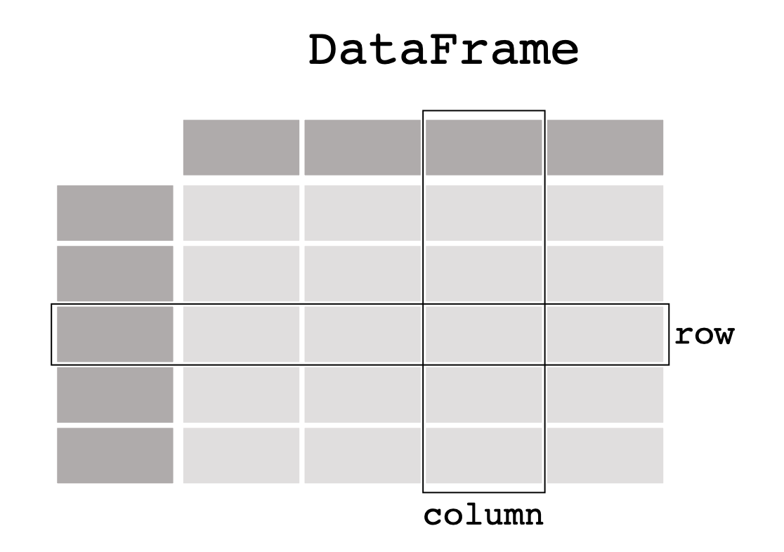
Pandas can handle “spreadsheet” like data
https://pandas.pydata.org/docs/getting_started/intro_tutorials/01_table_oriented.html

Slide 31
Xarray can handle complex Data Structures
http://xarray.pydata.org/en/stable/data-structures.html

Slide 32
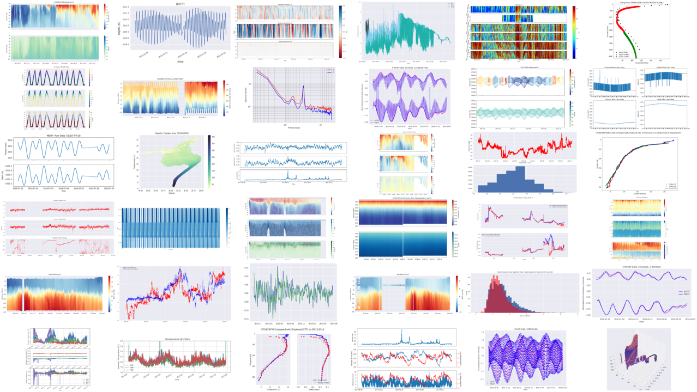
Start your Data Exploration!
Data Explorations
Python Notebooks
Blog / Tutorials
Webinar recordings
Join our mailing list
https://datalab.marine.rutgers.edu
sage@marine.rutgers.edu
@visualocean

Slide 33
FIN

