Slide 1
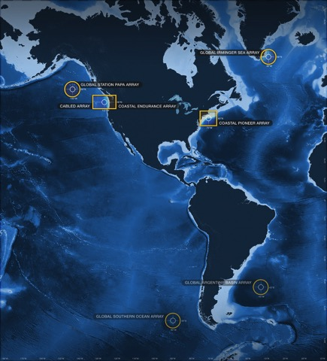
A (quick) Introduction to Using Python Notebooks for Ocean Science Research Day 2
Sage Lichtenwalner
2020 Data Labs Virtual REU
June 2020
datalab.marine.rutgers.edu

Slide 2
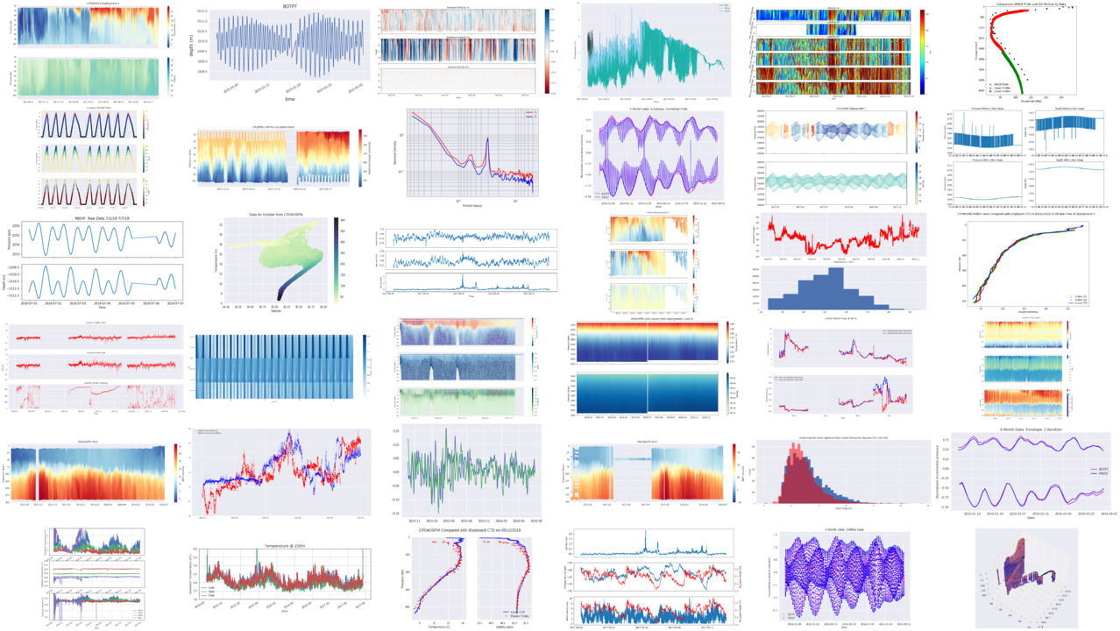
Today’s Agenda
Quick Intro to Data Visualization
Data Visualization in Python
Customizing Plots
More visualization types
Bonus Activity 4 – More plots
A new dataset – Argo Floats
Profile plots
T-S Diagrams
Maps

Slide 3
What is “Visualization”?
Visual Analysis
Data Visualization
Info Aesthetics
Information Design
Explorative Visualization
Visual Analytics
Visualization
Infographics
Information Visualization
(InfoVis)
Information Art
Charting
Data Art
Infoporn
Bioinformatics
Cartography
Mapping
Chart Junk
Pragmatic Visualization
Graphing
Scientific Illustration
Artistic Visualization
“Visual analysis is not primarily about the pictures, but about finding ways to use our powerful visual systems to analyze data. It's analysis done in a visual way. It's visual exploration, visual data analysis, and visual presentation of results.”
Robert Kosara, eagereyes.org

Slide 4
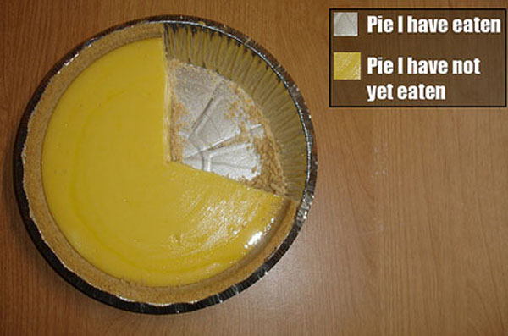
The World’s Greatest Chart?

Slide 5
Reference: https://xkcd.com/388/
Lots more xkcd charts:
https://www.explainxkcd.com/wiki/index.php/Category:Charts

Slide 6
Mount St. Helens
“It’s a good mountain, but it really peaked in the 80s.”
https://xkcd.com/2308/
https://www.explainxkcd.com/wiki/index.php/2308:_Mount_St._Helens

Slide 7
Sea Surface Temp
https://marine.rutgers.edu/cool/sat_data/?product=sst_comp&region=bigbight&nothumbs=0

Slide 8
Global Biosphere 2008
https://earthobservatory.nasa.gov/world-of-change/Biosphere

Slide 9
Data Wrangling
A “linear” process?
Kandel, S., et al (2011), Research directions in data wrangling: Visualizations and transformations for usable and credible data, Inf. Vis., 10(4), 271–288.

Slide 10
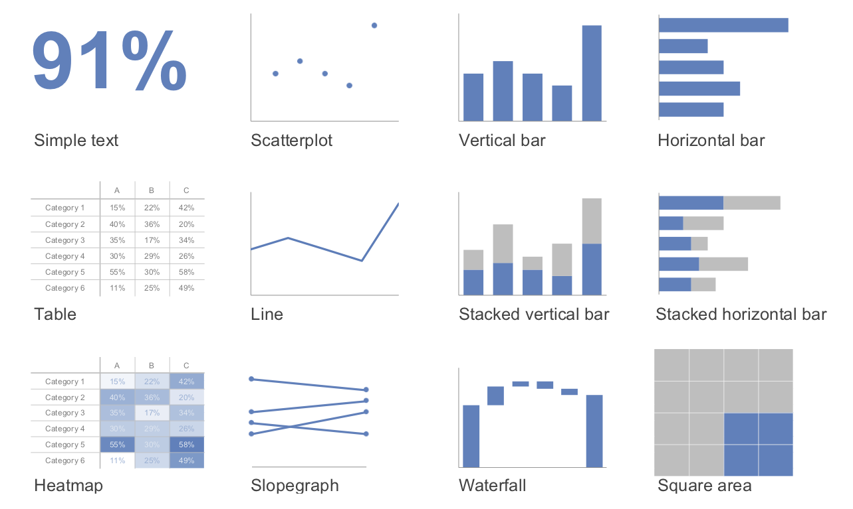
Common Data Visualizations
http://www.storytellingwithdata.com/books

Slide 11
Data Visualization Taxonomy
Data to Viz Poster
https://www.data-to-viz.com
Python Gallery
https://python-graph-gallery.com

Slide 12
Visual Encodings
https://blog.qlik.com/visual-encoding

Slide 13
Visual Encoding & Cognitive Research
https://www.oreilly.com/library/view/designing-data-visualizations/9781449314774/ch04.html

Slide 14
Pre-attentive Attributes
https://help.tableau.com/current/blueprint/en-us/bp_why_visual_analytics.htm

Slide 15
Choose Appropriate Colors & Colormaps
https://agilescientific.com/blog/2017/12/14/no-more-rainbows

Slide 16
New Research: Color Scaling
Feature identification
Pinpointing outliers
Determining relationships
Exploration
Communication
https://eos.org/features/visualizing-science-how-color-determines-what-we-see

Slide 17
Key Chart Elements
Chart Title(s)
X & Y Labels
X & Y Tickmarks
Often automatic
Grid lines
Line/Marker color
Line/Marker style, width
Legend
Subplots
https://matplotlib.org/gallery/subplots_axes_and_figures/figure_title.html#sphx-glr-gallery-subplots-axes-and-figures-figure-title-py

Slide 18
Mini-Project Expectations
Work in your group of 3
Choose one or more NDBC stations
You can try either “stmet” or “ocean” station types
Find some events (e.g. storm), processes (e.g. daily, seasonal, long-term) or other comparisons (e.g. geographic) that interest you
Create figures to tell a story of what you found
If helpful, search the web or literature for more background
Explain your analysis and conclusions
Create a ~10 min presentation where each of you can contribute

Slide 19
Mid-workshop Group Report
Here are a few topics your group should think about for our report out on Monday to the full team. Feel free to use this slide as a template.
Group members (name?)
What is your question? Is it testable or more descriptive?
What dataset(s) will you use?
What analysis will you do?
What is your expectation of what you hope to find after analyzing the data?
Other things to discuss, but not needed for the report:
What are the tasks for each group member?
What challenges do you have you may need help with?

Slide 20
FIN

Slide 21
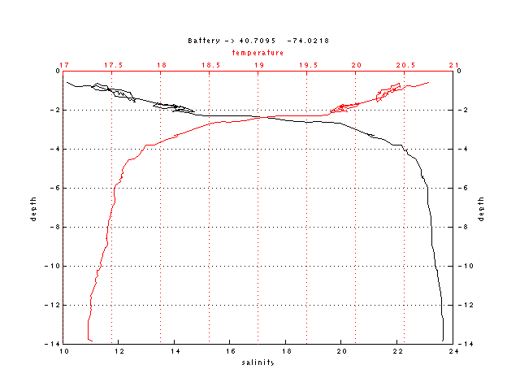
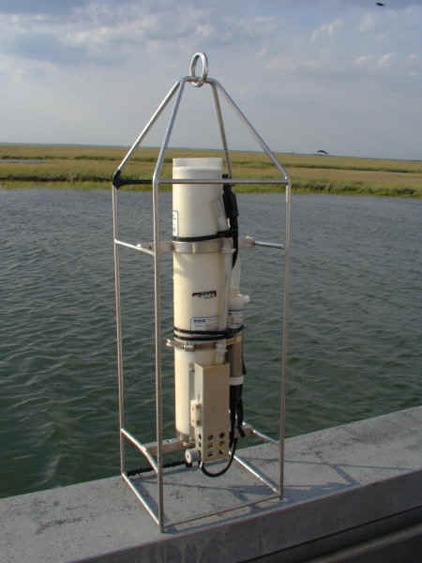
Conductivity Temperature Depth (CTD) Profiles

Slide 22
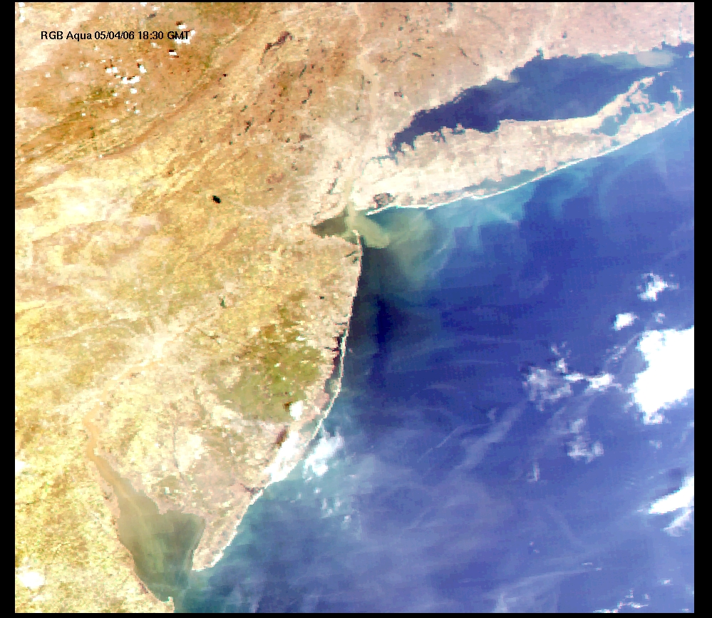
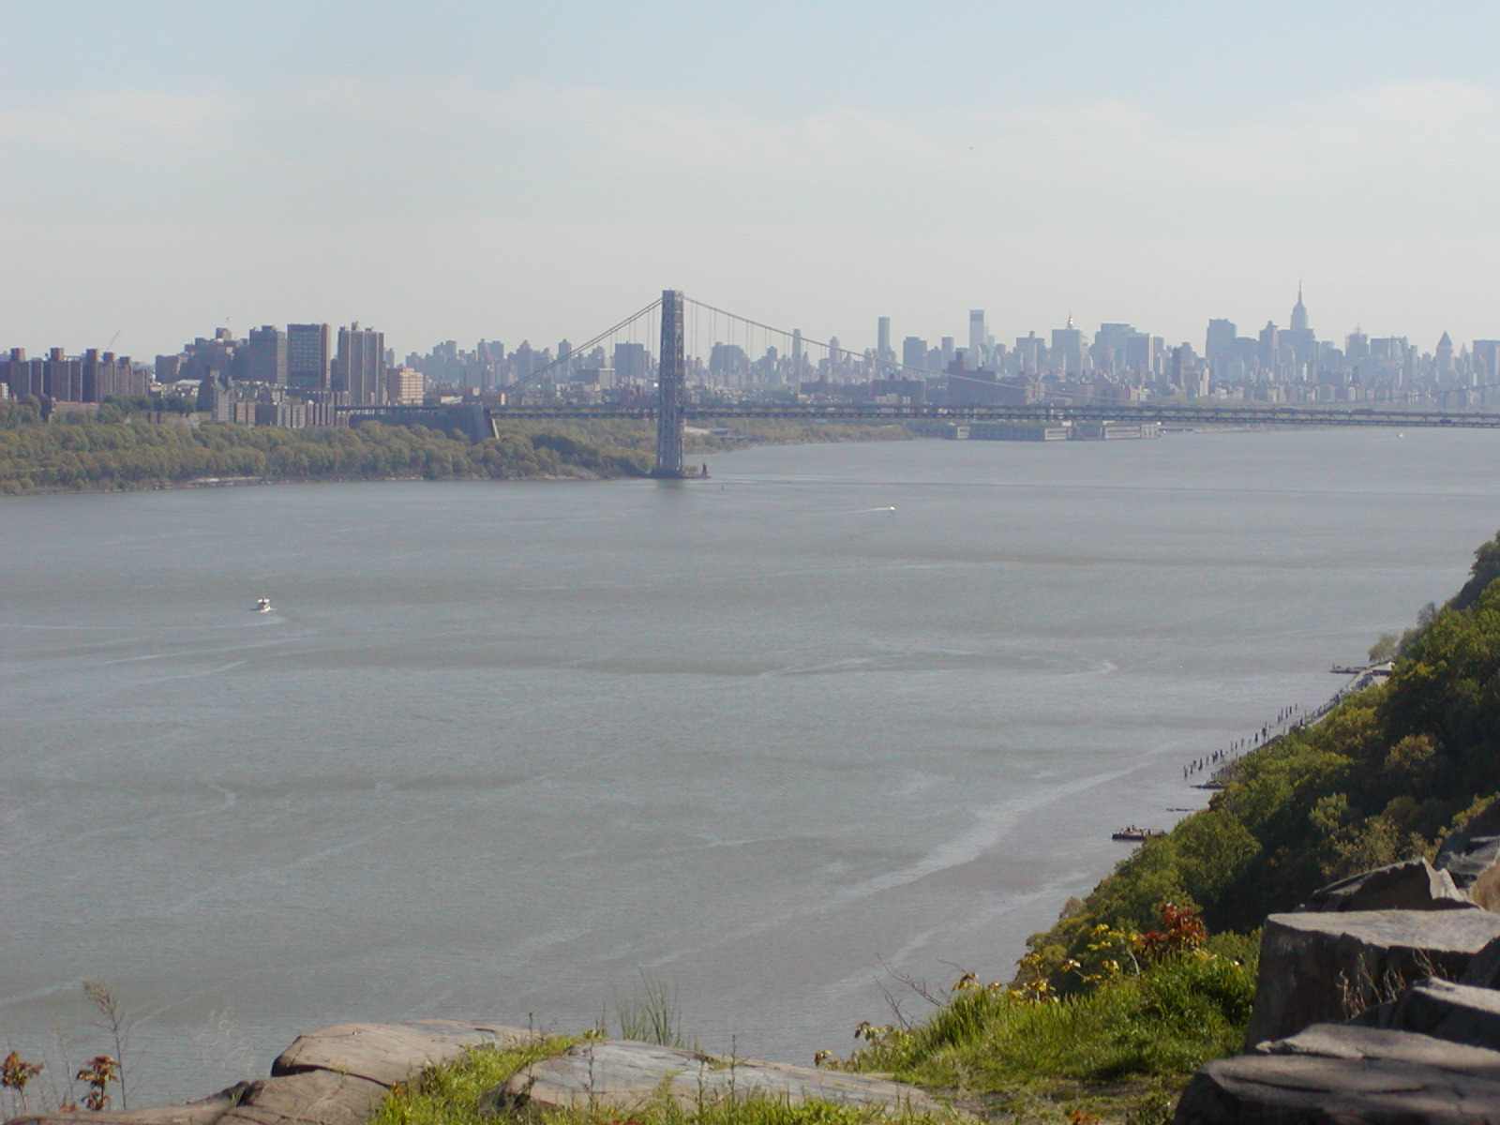
NY Harbor Estuary

Slide 23
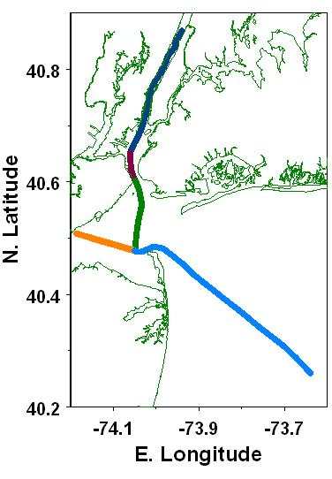
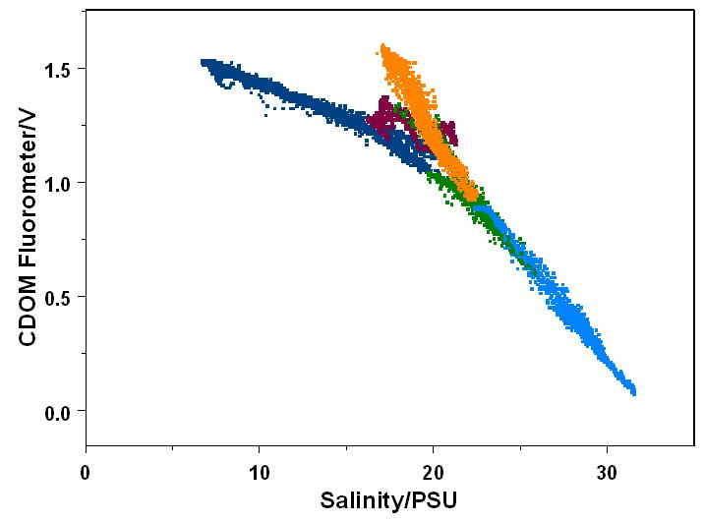
CDOM is conservative which allows for water mass discrimination
Raritan
Hudson
Schmutz?
Thanks Bob Chen

